Slide 1
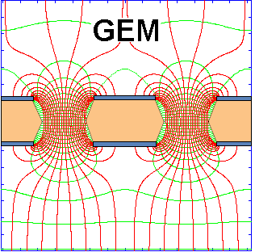
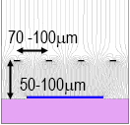
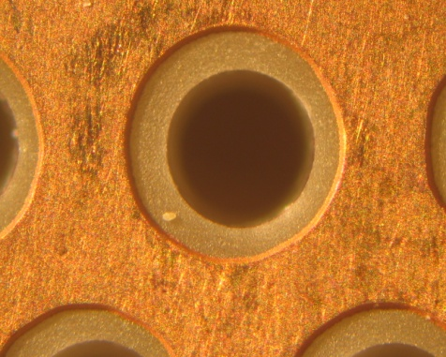

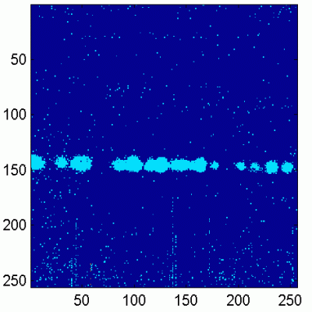
50 μm
140 μm
The RD51 Collaboration: Development of
Micro-Pattern Gas Detector Technologies
Micromegas:
Leszek Ropelewski, CERN
Maxim Titov, CEA Saclay, France
OUTLINE:
News
RD51 Collaboration
MPGD Industrialization
RD51 Events in 2012
RD51 Future
Thick GEM +
(THGEM)
GEM +
CMOS ASIC
Industry-Academia Matching Event
on Micro-Pattern Gaseous Detectors,
April 26-27, 2012

Slide 2
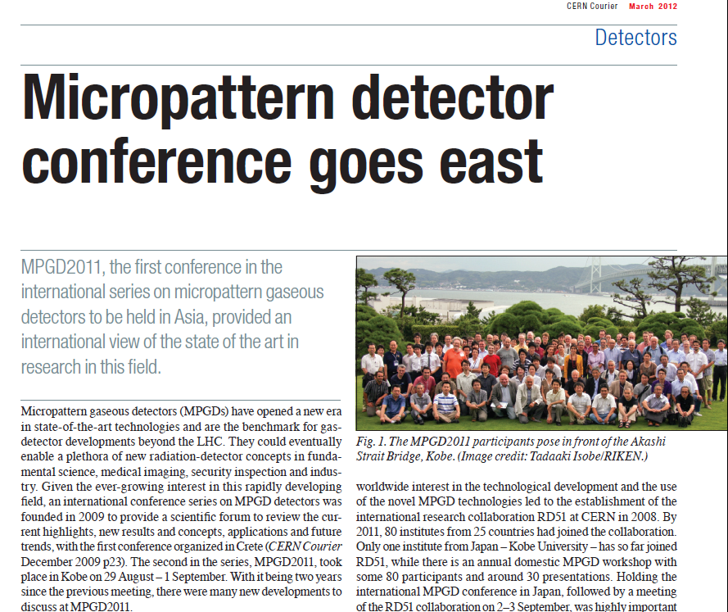
CERN Courier, March 2012
http://cerncourier.com/cws/article/cern/48624

Slide 3
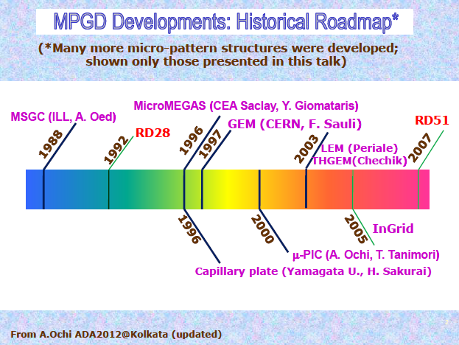
April 13, 2002: CERN Detector Seminar
“Trends and Perspectives in Gaseous Detectors: Linking MPGD Technology for Future Physics Projects”
http://indico.cern.ch/conferenceDisplay.py?confId=184972

Slide 4
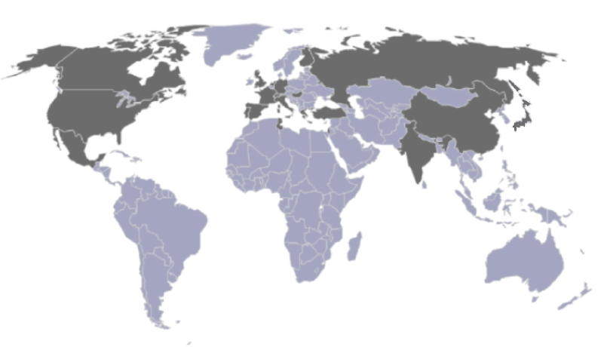
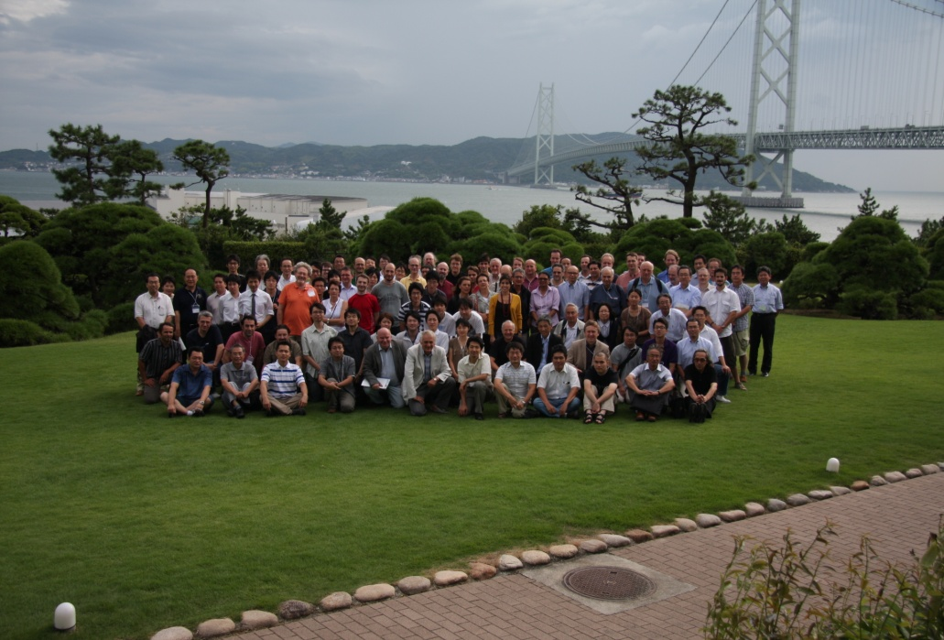
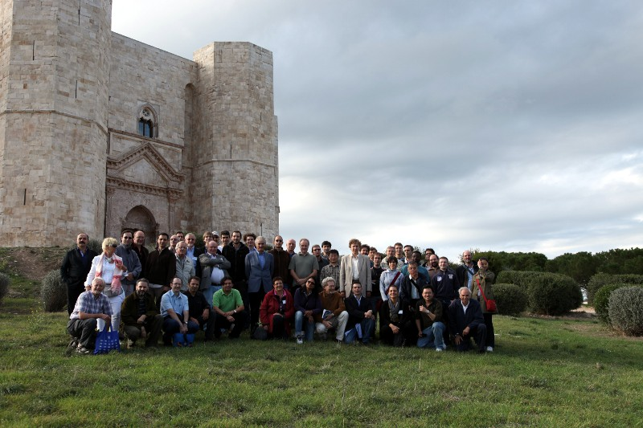
2007: RD51Collaboration “Development of Micro-Pattern
Gas Detector Technologies”
GEM
THGEM
80 institutes worldwide
~ 450 people involved
Representation (Europe, Asia
North/South America, Africa)
Kobe, Japan, September 2011
“RD51 aims at facilitating the development of advanced gas-avalanche detector technologies and associated electronic-readout systems, for applications in basic and applied research”
RD51 contributes to the sLHC upgrades, BUT, the most important is:
RD51 Serves as an access point to
MPGD “know-how” for the world-wide community
Bari, Italy, October 2010

Slide 5
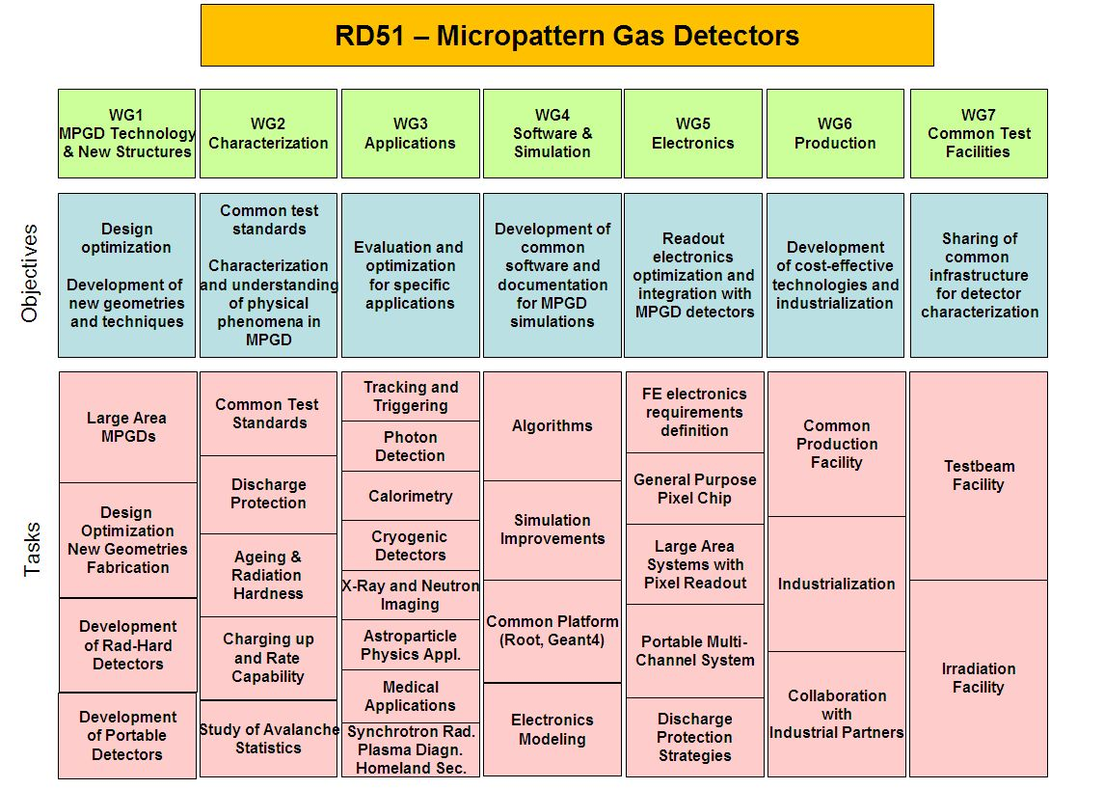
RD 51 Collaboration – Transverse Organization of MPGD Activities in 7 WG
Consolidation around common projects: large area Micromegas, GEM, THGEM R&D; Software Tools; Common Electronics Developments (SRS), CERN/MPGD production facility, Industrialization, RD51 test beam facility
http://rd51-public.web.cern.ch/RD51-Public

Slide 6
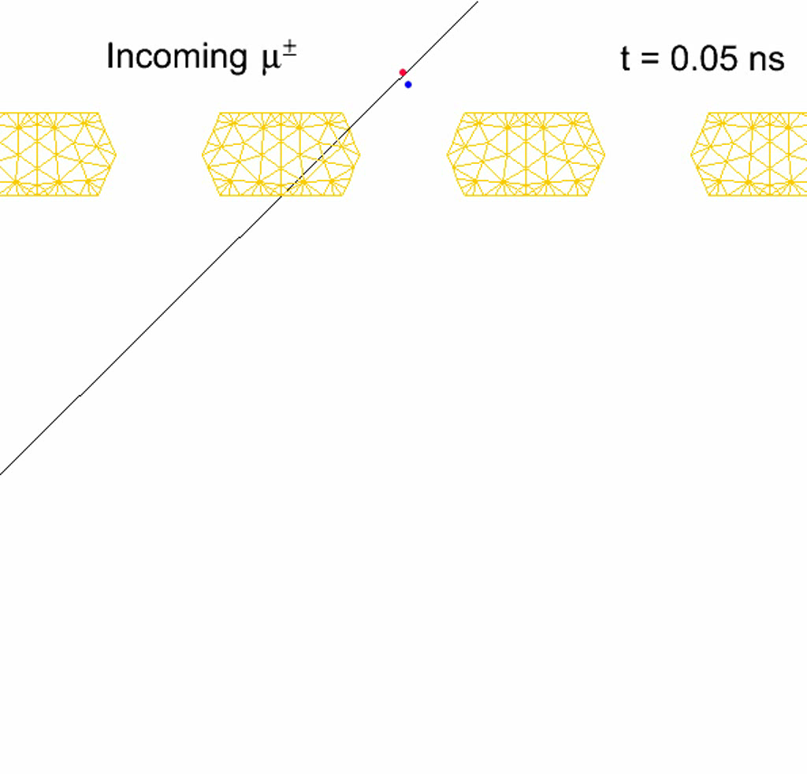
RD51 WG4 - Avalanche Simulation in Single GEM
Animation of the avalanche process (electrons are blue, ions are red, the mesh is orange)
Simulation → monitor (in real-time) ion drifting and ion losses at the upper metal
Developed within the framework
of the RD51 WG Software Activities:
Objectives: understanding
the gain in standard GEM
ANSYS: model & mesh the GEM
Magboltz 8.9.6: relevant cross sections
of electron-matter interactions
Garfeld++: simulate electron avalanches
Courtesy: Sven Dildick,
Heinrich Schindler,
Rob Veenhof
http://garfieldpp.web.cern.ch/garfieldpp/examples/gemgain

Slide 7
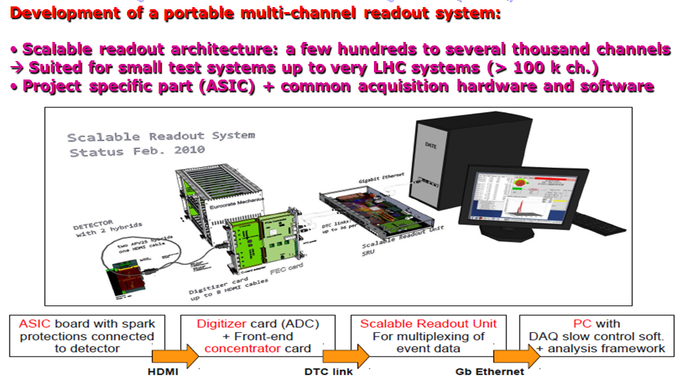
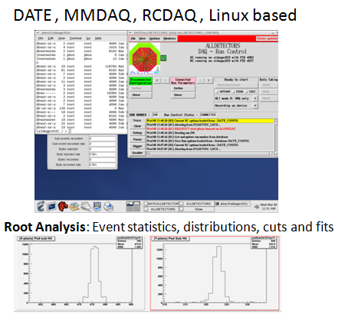
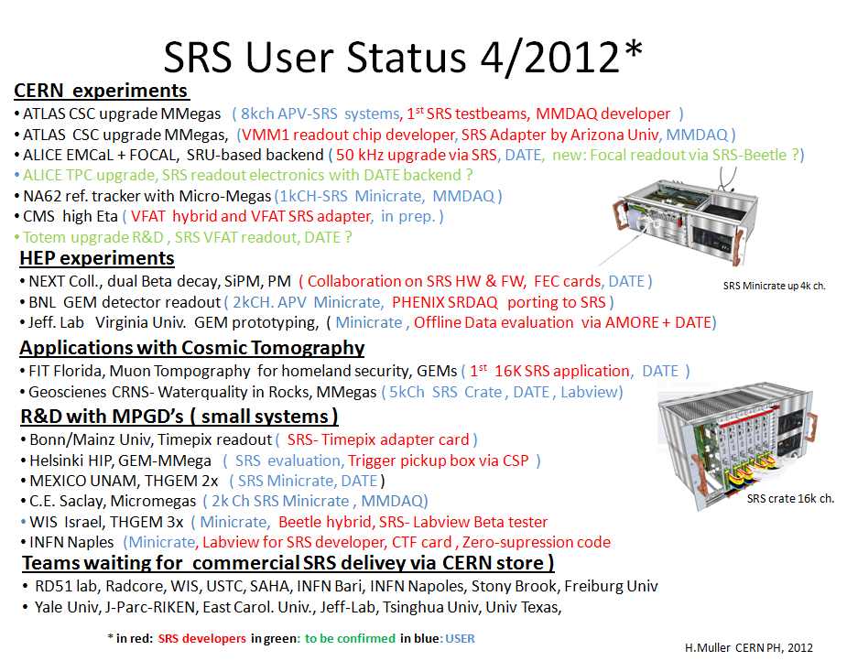
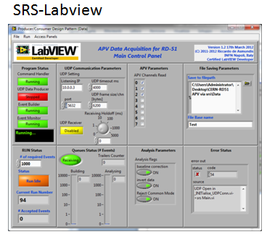
RD51 WG5 – Scalable Readout Systems
Software for event analysis:
SRS Presentation and demonstration
→ Hans Muller (April 26)
Software for event analysis:

Slide 8
WG6 – MPGD Technology & Industrial Partners
THGEM Technology – ELTOS S.p.A. (Italy)
PRINT ELECTRONICS (Israel)
GEM Technology
New Flex (Korea, Seoul)
Tech-ETCH (USA, Boston)
Techtra (Wroclaw, Poland)
Scienergy (Japan, Tokyo)
Keerthi Industries (India)
MicroMetal GmbN (Germany, Muellheim)
Micromegas Technology
TRIANGLE LABS (USA, Nevada)
ELTOS S.p.A. (Italy)
SOMACIS (Italy, Castelfidarco)
CIREA (France, CHOLET)
Tomorrow, presentations on:
MPGD Industrialization/CERN Workshop
Recent Contacts with CIREA, NewFlex, ELTOS, Techtra, Cirea, Tech Etch
Status of License Agreements/Technology Transfer (CERN/CEA)
Prepare Draft of MPGD Industrialization Plan
(CERN Wksh & RD51 with LHC Exp. Inputs)
→ Discussion during the RD51 Mini-week in June

Slide 9
RD51 Common Projects in 2011 and 2012
2011: 4 proposals approved under the call for Project Funding from the RD51 CF
Thin and high-pitch laser-etched mesh manufacturing and bulking (Saclay / CERN / Bari)
Development of innovative resistive GEM alpha detectors for earthquakes prediction
and homeland security (INFN Bari / UNAM, Mexico / INFN Padova / INFN Frascati)
MPGDs technology laboratory for training, development, fabrication, applications
and innovation (Universidad Antonio Nariño, Columbia / Brookhaven National Laboratory/
Helsinki Institute of Physics / HEPTech / GSI Helmholtzzentrum)
A low mass microbulk with real XY strips structure (NCSR Demokritos / Saclay/ Laboratorio
de Física Nuclear y Astropartículas, Universidad de Zaragoza / CERN )
2012: New Call for 2012 Common Project Proposals → deadline June 15, 2012
→ Selection/decision by the time of the RD51 Collaboration Meeting in October

Slide 10
RD51 Collaboration Meetings and Events in 2012:
20 – 22 February: RD51 Collaboration Meeting (CERN)
26 – 27 April: Industrial Applications of Micro-Pattern Gaseous
Detectors – Annecy
13 June: RD51 Presentation to LHCC
13 - 15 June: RD51 Mini-Week (CERN)
1 – 4 October: RD51 Collaboration Meeting (Stony Brook)
November – December: RD51 Mini-Week (CERN)
Submission of the document to the LHCC by the end of 2012 →
initiate prolongation of the RD51 Collaboration beyond 2013

Slide 11
RD51 Future (beyond 2013):
The initial validity of the present RD51 MoU covers the period
until the 31st of December 2013
If RD51 would like to continue beyond 2013 → need to ask for
extension LHCC and CERN Research Board (RB);
If RD51 CB makes a positive decision → ask LHCC for extension for
another 3-5 years term (to avoid prolongation on the yearly basis);
Preliminary discussions with LHCC → will not need to write new
RD51 proposal →prepare executive summary (5-10 pages) to
describe future RD51 program
Document to be submitted to the LHCC by the end of 2012 →
extension discussed/(approved) by LHCC/RB in March/June 2013;

Slide 12
RD51 Future (beyond 2013):
Draft List of Topics for continuation of RD51 Collaboration Activities beyond 2013:
MPGD Industrialization (GEM, Microgemas, Thick GEM)
Further Support of the LHC Upgrade Projects (ATLAS MAMMA, CMS GEM, ALICE TPC, …)
Generic R&D (new structures, ideas, detector physics ) and R & D Developments for Future Projects:
Software Support
RD51 Common Projects
Maintenance of the RD51 Test-Beam Infrastructure
→ Please send your inputs by June 1, 2012

Slide 13
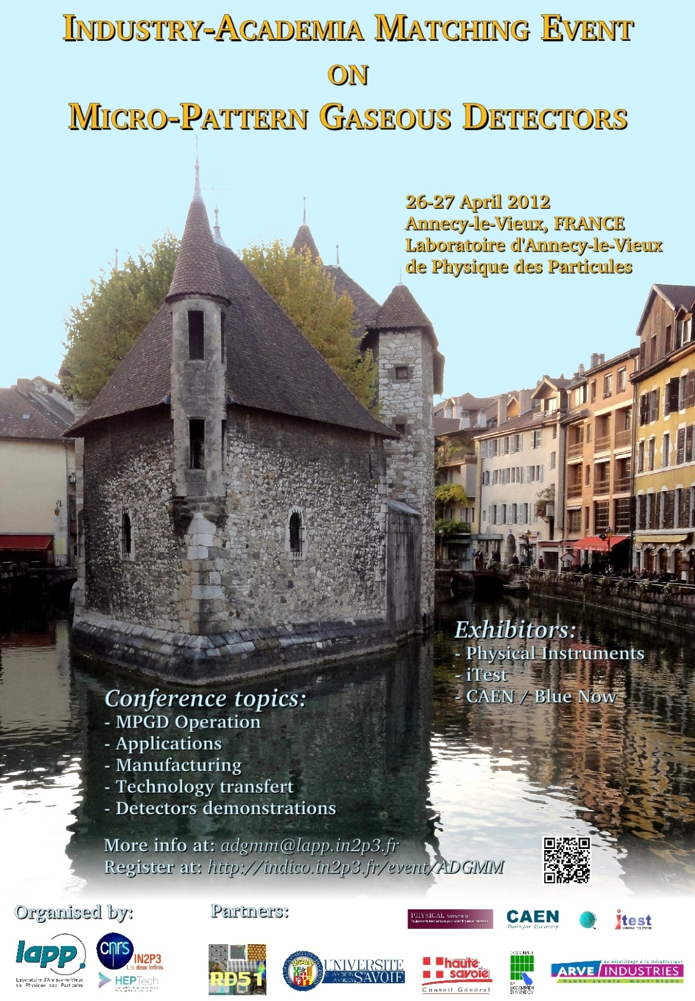
First
industry-academia
matching
event in
MPGD Field:
RD51 Research
Groups & Industrial
Partners
Thank you,
LAPP Annecy,
for organizing it

