Slide 1


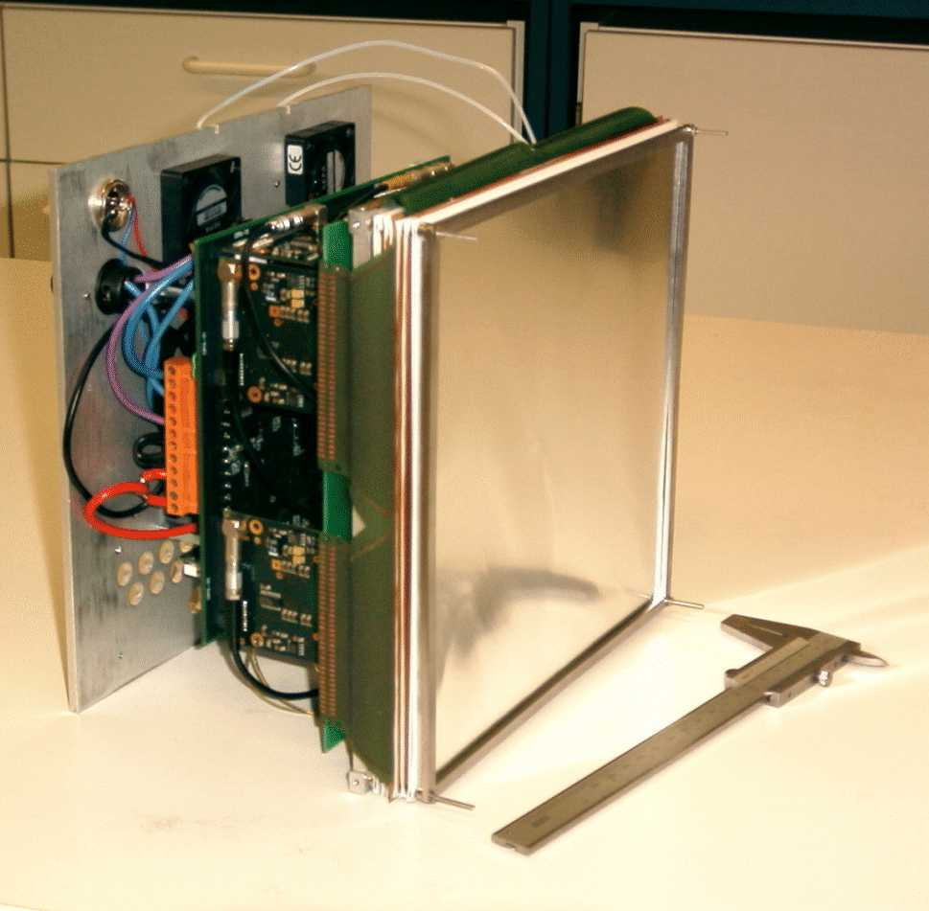
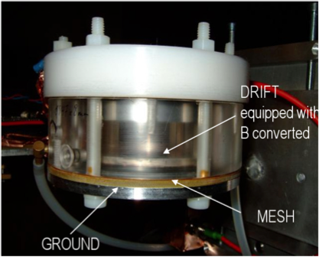



MPGDs for neutron detection applications
n-TOF 2D X-Y neutron
micromegas beam profiler
2D-200 GEM CASCADE
A. Delbart,
CEA/DSM-IRFU,
CE-Saclay, 91191 Gif-Yvette, France

Slide 2
Outline
Neutron detection : applications, principles, commonly used detectors
The « ³He crisis » and the need for new & innovative high efficiency, large area ³He free neutron detectors
Some examples of neutron detectors using MPGDs :
  for neutron radiography
  for neutron beam profile & flux measurement
  for Time Of Flight neutron spectroscopy
  for nuclear reactor in-core neutron flux measurements
Conclusions & perspectives

Slide 3
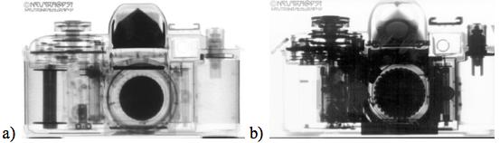
Neutron detection applications
Fundamental research
Industrial applications
The science which can be made with the use of neutron beams is, in many cases, unbeatable or even inaccessible to any other methods thanks to the neutron unique properties. Use to investigate structure & dynamics of mater.
oil and gas exploration : use in conjunction with a neutron source to locate hydrogenous materials, severe 320°C temperature and vibrations environment
neutron scattering experiments for material science, food and medical research
For experiments on high intensity neutron sources (SNS, ESS, …), the high counting rate is one of the key issues for small-angle neutron scattering experiments and neutron reflectometry for instance.
Neutron radiography : Non destructive survey of materials
Homeland security
Neutrons can penetrate high density materials, which are opaque to X-rays, thus allowing the inspection of objects obstructed by a dense material
Neutron radiography
X-ray radiography
Detection of radioactive materials, explosives, chemical and biological warfare agents, narcotics for air and ground and sea transportations (cargo screening, airport security, …)
Nuclear reactor instrumentation
Control (neutron flux) & safety
Out core (in measurement pits) : > 10¹⁰ n.cm⁻².s⁻¹, 10³ à 10⁴ Gy.h⁻¹of γ, 80 to 100°C.
In core (in guide tubes in the center of the fuel elements assembly) :
> 10¹⁴ n.cm⁻².s⁻¹, 10⁷ Gy.h⁻¹ of γ, 320°C.
Nuclear safeguards
safeguards systems are installed at facilities that process, handle, use and store Pu, U, nuclear fuel, spent fuel or nuclear waste

Slide 4
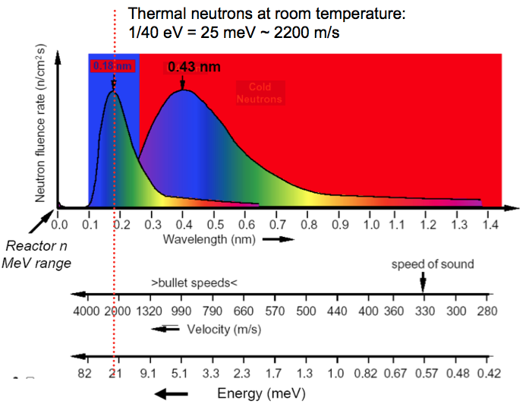
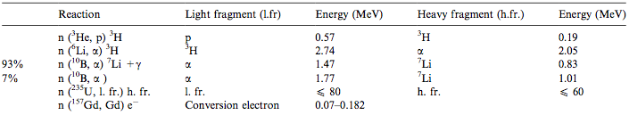
Detecting neutrons
As charge-neutral particles, neutrons can only interact via strong interactions and ionize via secondary reactions
=1.8 Å
~ 1/v ~ E^{-1/2}
1.8 Å
2 ways to detect fast neutrons
– Thermalize → only provide neutron flux (lose position)
– Elastic scattering from protons at high energy : proton detection & reconstruction of recoils for time-of-flight (ToF)
Commonly Used thermal Neutron Reactions
25,3 meV
Cross
Section (b)
Natural
abundance
1,4 10⁻⁴ %
5320
gas
7,4%
942
19.8%
3842
0,7%
solid
+ γs
16%
255k
n(¹¹³Cd, Cd) e- Conversion electrons 0,558 20,7k
Ref: A. Oed, NIM A 525 (2004) 62–68

Slide 5
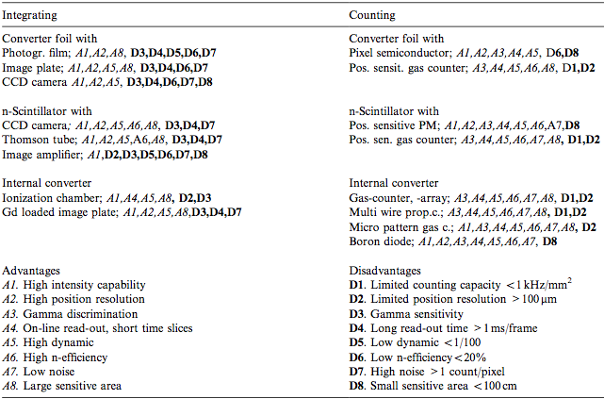
Position sensitive detectors for thermal neutrons
³He
Ref: A. Oed, NIM A 525 (2004) 62–68

Slide 6
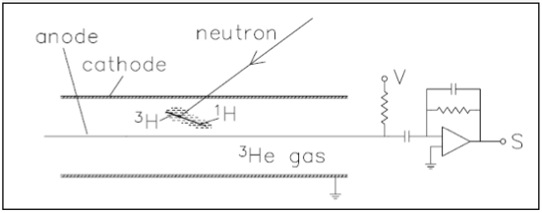
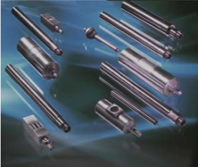
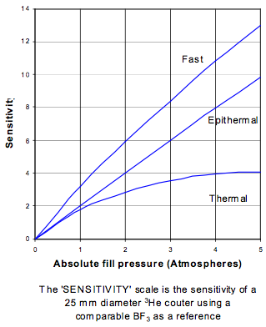
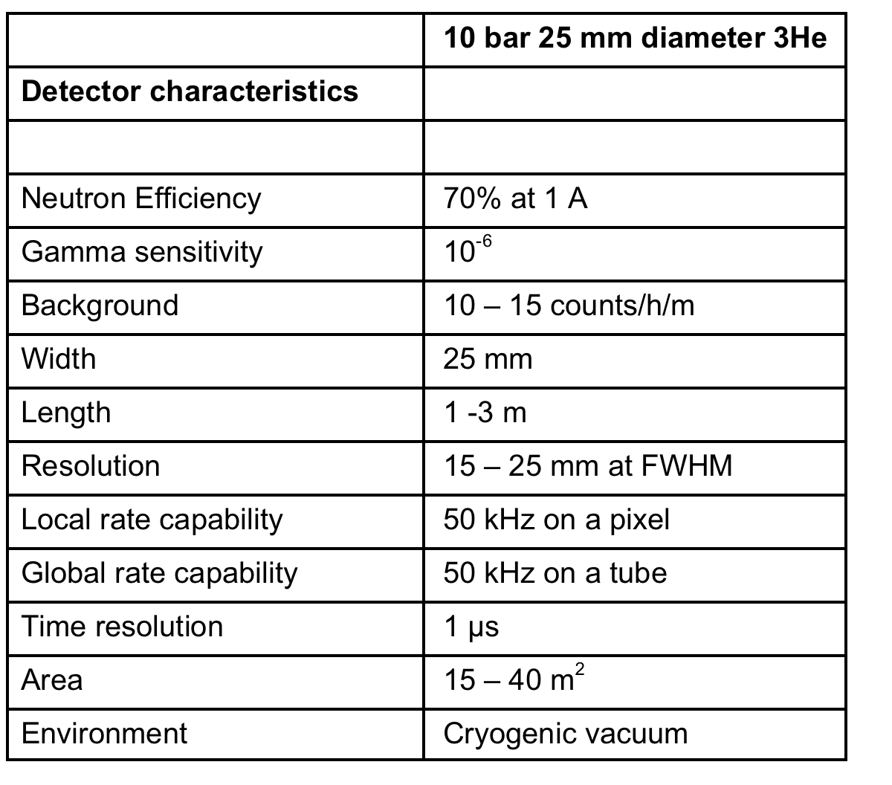
Commonly and worldwide used thermal neutron detectors
Gas proportional counters
γ lab. St Gobain (Fr)
¹⁰B layer for Boron-lined
proportional counters
BF₃ or
Typical 25 mm diameter tube, 50 μm anode
centronics (UK)
C ~ 20 pF / T_{collection} > 10 μs (!)
Referenced to BF₃
@0,68 bar
90% 10B enriched
³He gas counters
P=5-10 bar (!)
V >850V (2 bar)
1.75 kV (10 bar)
Gain~ >20
BF₃ gas counters
Toxic & corrosive
P ~ 0.5 – 1 atm
reV~ 2000 – 3000 V
Gain ~ 100-500
… and Boron-lined proportional counters (¹⁰B conversion layer, Ar+CO₂ …)

Slide 7
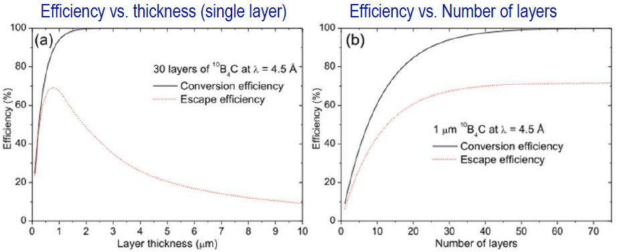

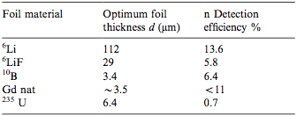
Optimum converter layer thickness and detection efficiency
Ref: C. Höglund, J. Birch, et al. “B4C thin films for neutron detection”, JVST, submitted (2011)
30 layers for 64% efficiency
≈ 1 μm ¹⁰B₄C for max
73% escape efficiency
Other foil materials @1.8 Å
Ref: A. Oed, NIM A 525 (2004) 62–68

Slide 8
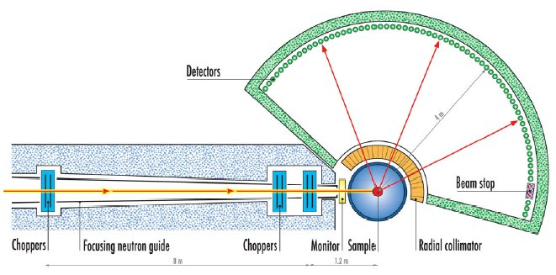
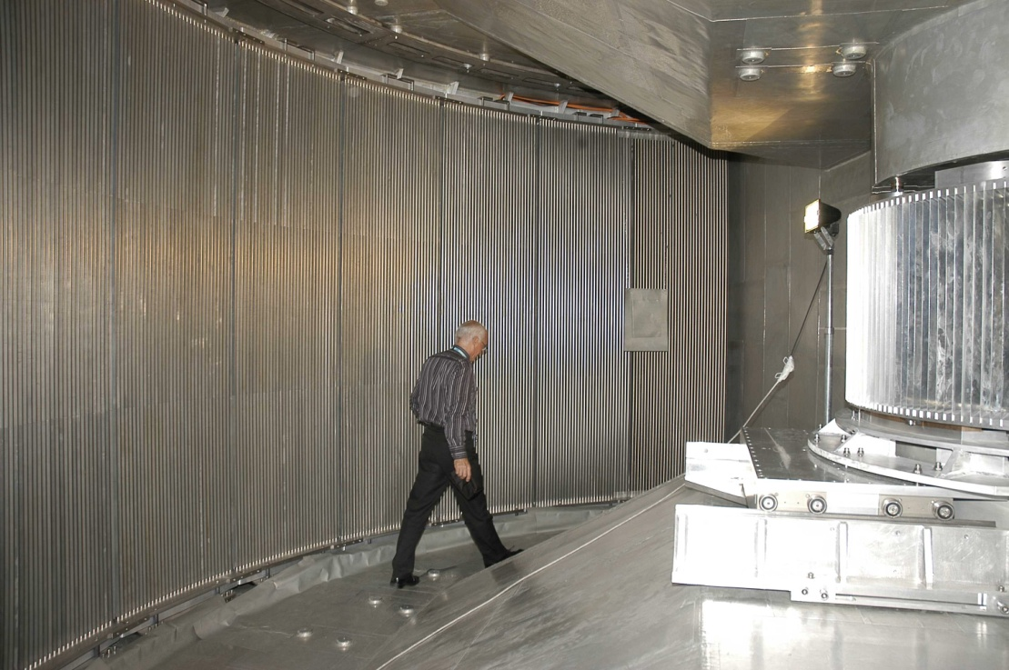
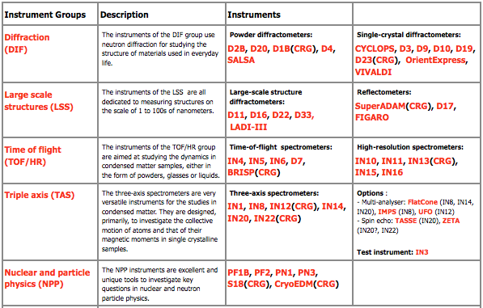
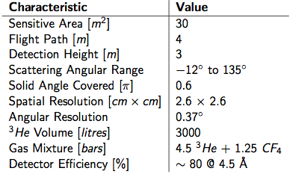
Beam-line IN5@ILL: a time-of-flight spectrometer for quasi-elastic and inelastic scattering
Position sensitive proportional
Counter tubes
http://www.ill.eu/fileadmin/users_files/multimedia/IN5/ill_in5.swf
3m long position-sensitive proportional counters

Slide 9
The ³He crisis
³He is a by product of Tritium production for use in nuclear weapons by Titium ß-decay into ³He with a half life of 12.3 years.
End of the Cold War the ³He : production from Tritium decay has been reduced and since September 2001 the demand of ³He has increased drastically due to security programs
severe depletion of the existing ³He stockpile and shortage.
Cost increase by a factor of 25 , from 80 €/l up to 2000 €/l.
The cost for the ILL/IN5 30 m² ³He detector (3000 l @ 4.5 bars) was 1.5 M€
(incl. 240 k€ for ³He). It would cost 7.2 M€ (incl. 6 M€ for ³He) today !!!
³He demand for neutron scattering in 2009 – 2015 is estimated to 125 kl and the projected demand for US security applications is 100 kl for a ≈20 kl/year available (US+Russia)
Needs for hundreds of m² for ESS : 140 m² in 2019 for 7 detectors (22 detectors in 2024)
Need for alternatives !! (with close performances to a 10 bar 1 inch ³He tube)
→ The NMI3-II/JRA FP7 program started in february 2012 …
« Neutron Scattering and Muon Spectroscopy Integrated Initiative »
… and includes work packages to support R&D for ³He alternatives

Slide 10
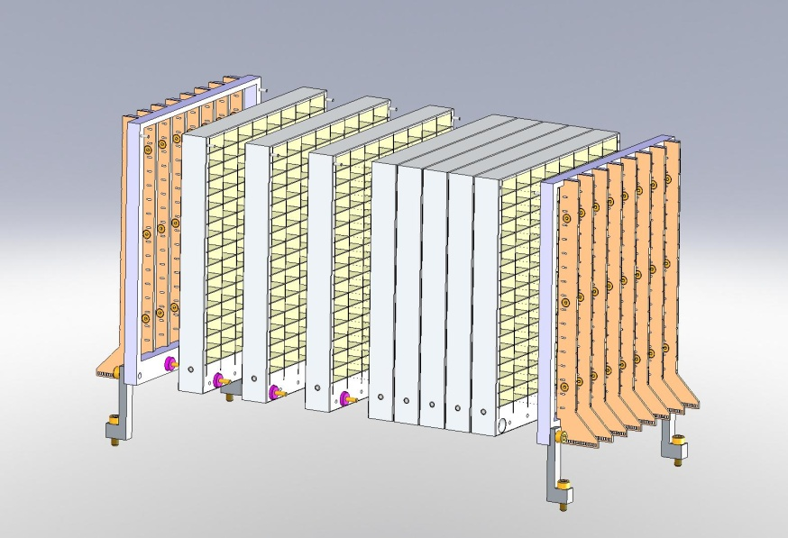


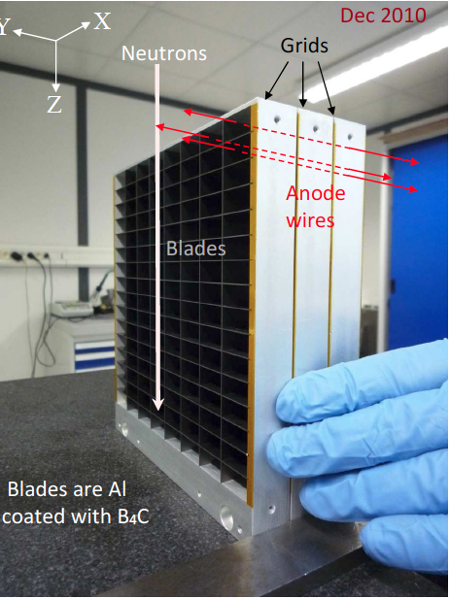
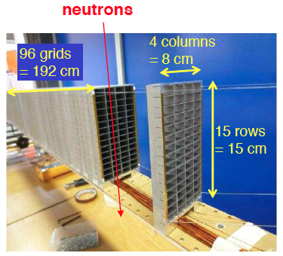
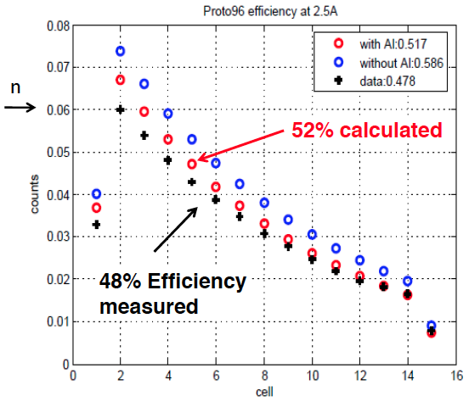
The ILL multi-grid area detector (ILL-Patent appl. #: 20110215251)
A grid is made of Boron-coated aluminum blades forming sections of square tubes
Stacking of several grids to make Boron coated tubes
The grids are electrically insulated
Anode wires are mounted in the middle of each tube
neutrons
X
(wire readout)
Y
(grid readout)
Proto #2, spring 2011
Ref: B. Guerard et al. ECNS-conference, July 2011, Prague

Slide 11
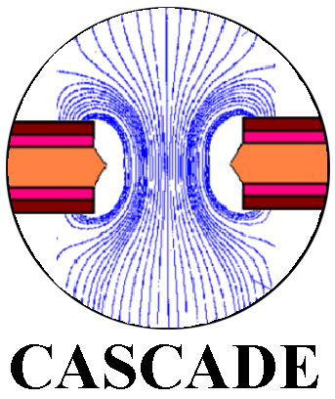
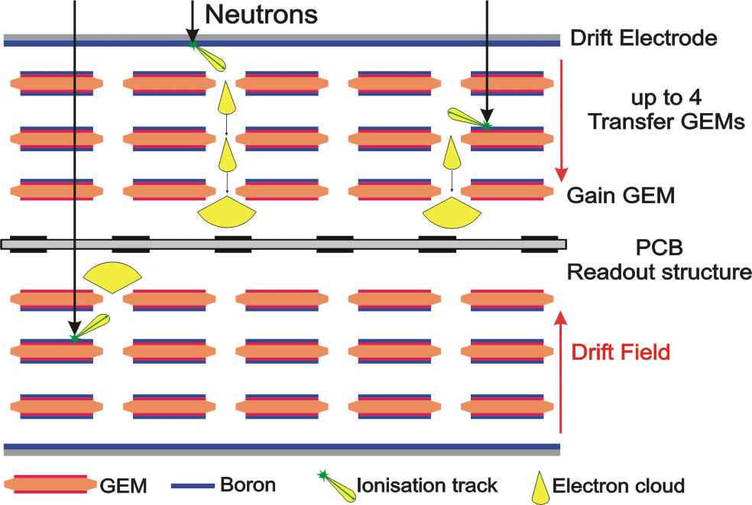
The CACADE GEM detector
Christian J. Schmidt et al (GSI, Darmstadt)
2D-200 CASCADE Detector (200x200 mm²)
Power supply and thermal management
Detector entrance window (100 µm Al)
FPGA based readout board
GEM-foils coated with ¹⁰B and 2D readout structure
Each GEM has two ¹⁰B layers
Last GEM operated as amplifier
10 GEM foils for ~50% efficiency
ASIC frontend-electronic
^{INFM - Perugia}
^{Forschungszentrum Jülich}
^{Hahn Meitner Institut - Berlin}
Ruprecht Karls Universität - Heidelberg
AGH University of Sci. and Tech. - Krakow
Other solutions based on Boron-coated straw tubes
→ room for innovative ideas to maximize conversion efficiency

Slide 12
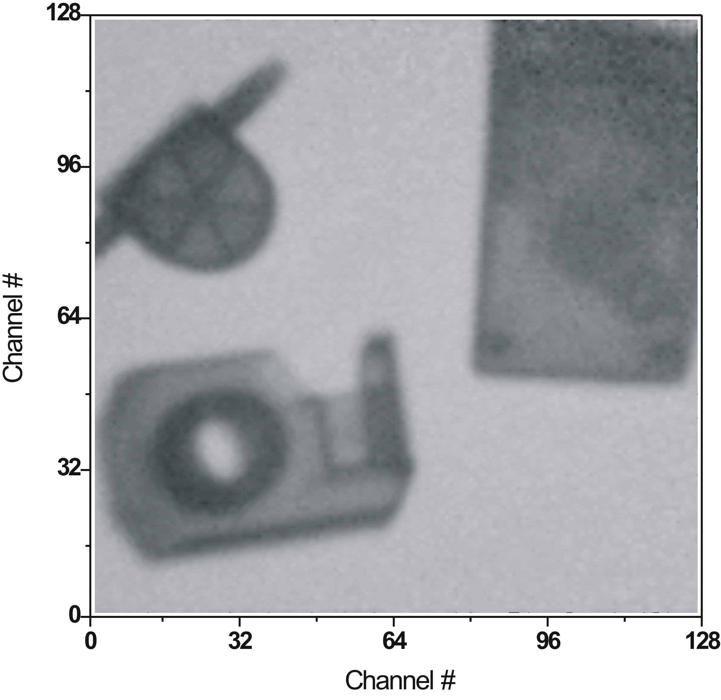
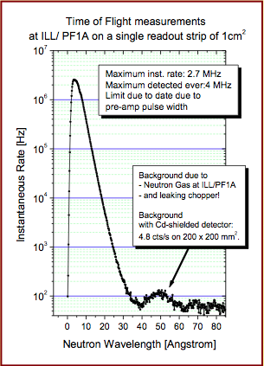
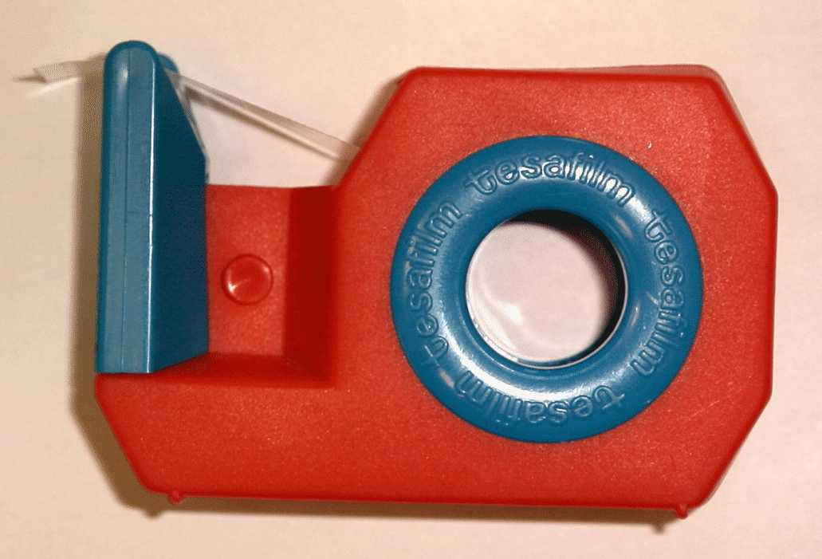
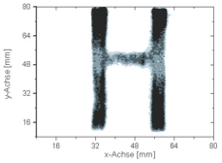
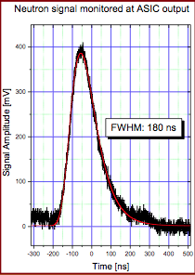
2D-200 CACADE GEM detector performances
A radiography with the CACADE GEM detector
TOF Dynamics Achieved with CASCADE
Water
Flow-Indicator
Old PC
Mouse
old PC-Mouse
Tesa-Tape
Dispenser
~ 1-3 mm spatial resolution
with 1.56 mm pixel size
10 MHz/cm² counting rate capability
Ref:Christian J. Schmidt et al. (GSI Darmstadt)

Slide 13
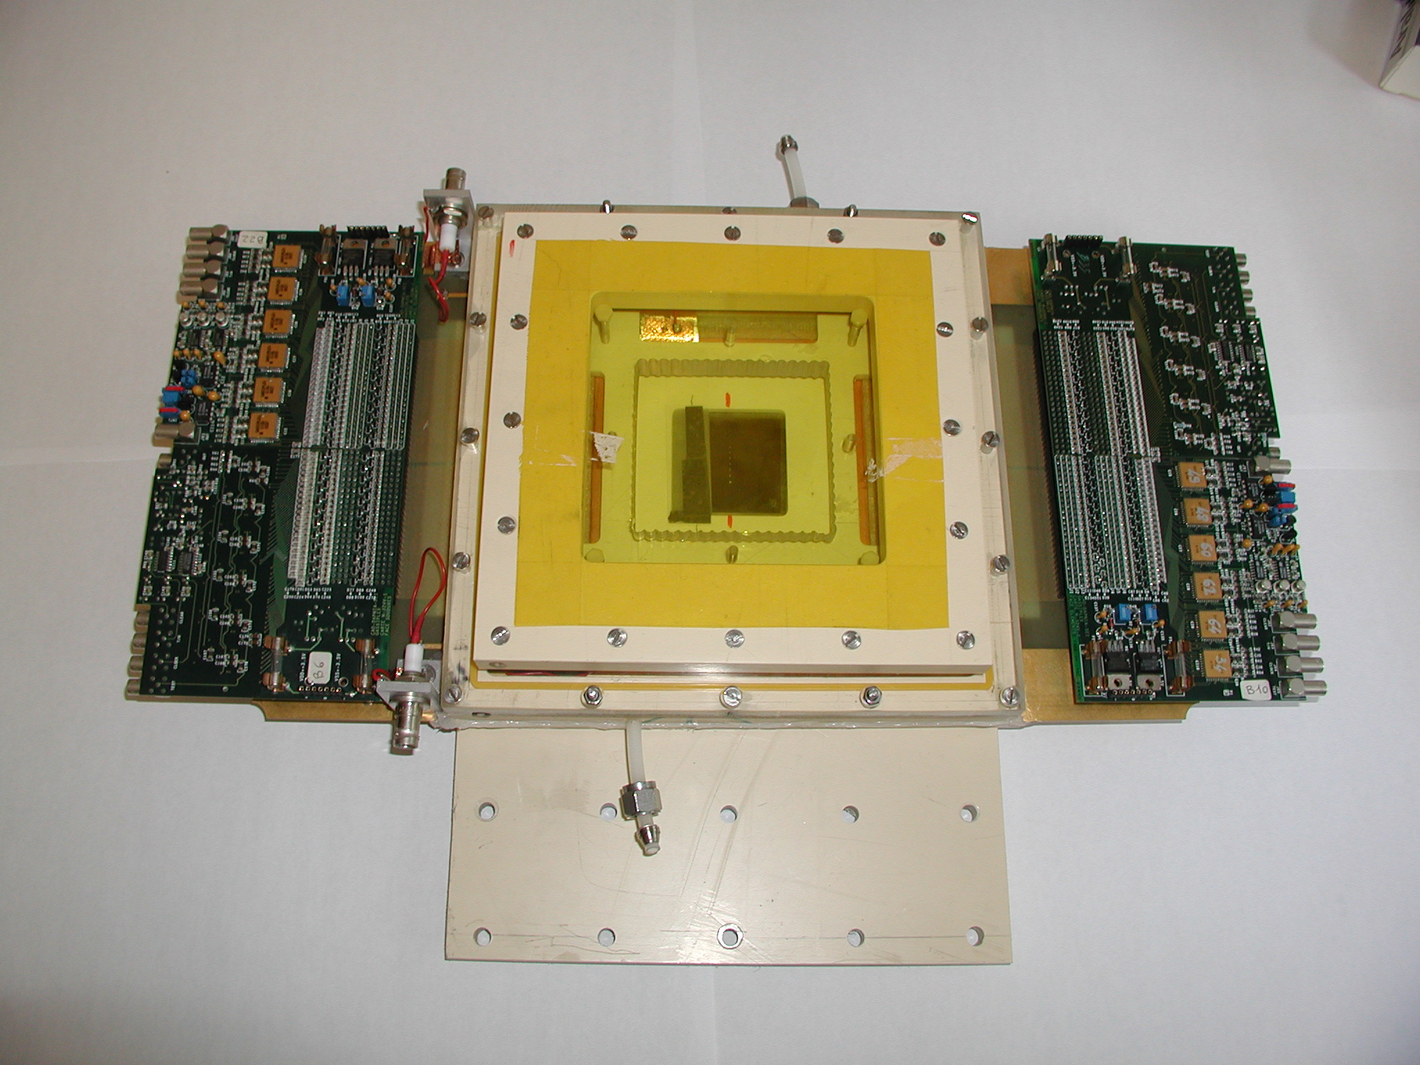
Micromegas for neutron radiography
CEA/DSM-IRFU + CEA/DRT-LIST-DETECS collab.
« classical » micromegas prototype
proof of principle (1D 2002, 2D 2004)
⁶Li converter : 50 µm
Conversion gap : 400 µm
Amplification gap : 50 µm
Self-supported 50 μm micromesh
Gassiplex cards readout
Imaging Mask: Gadolinium foil (5x5 cm², 25 µm thin) holes from 75 to 500 µm
Gadolinium
object
neutron
Holes
HV1
Li6 converter
conversion
(400-700 μm)
E1 ~ 1kV/cm
e-
Micromesh
HV2
amplification (50 μm)
E2 ~ 40kV/cm
Charged
particle
100 µm

Slide 14
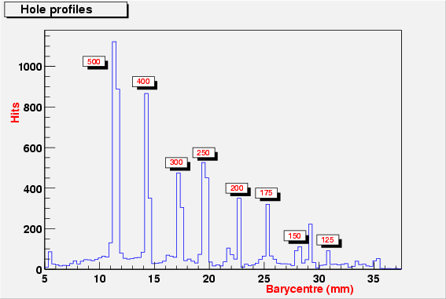
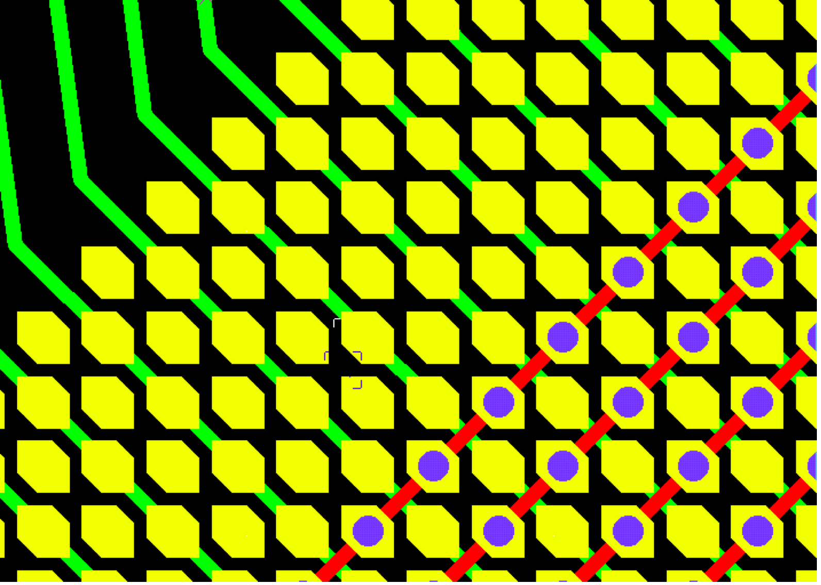
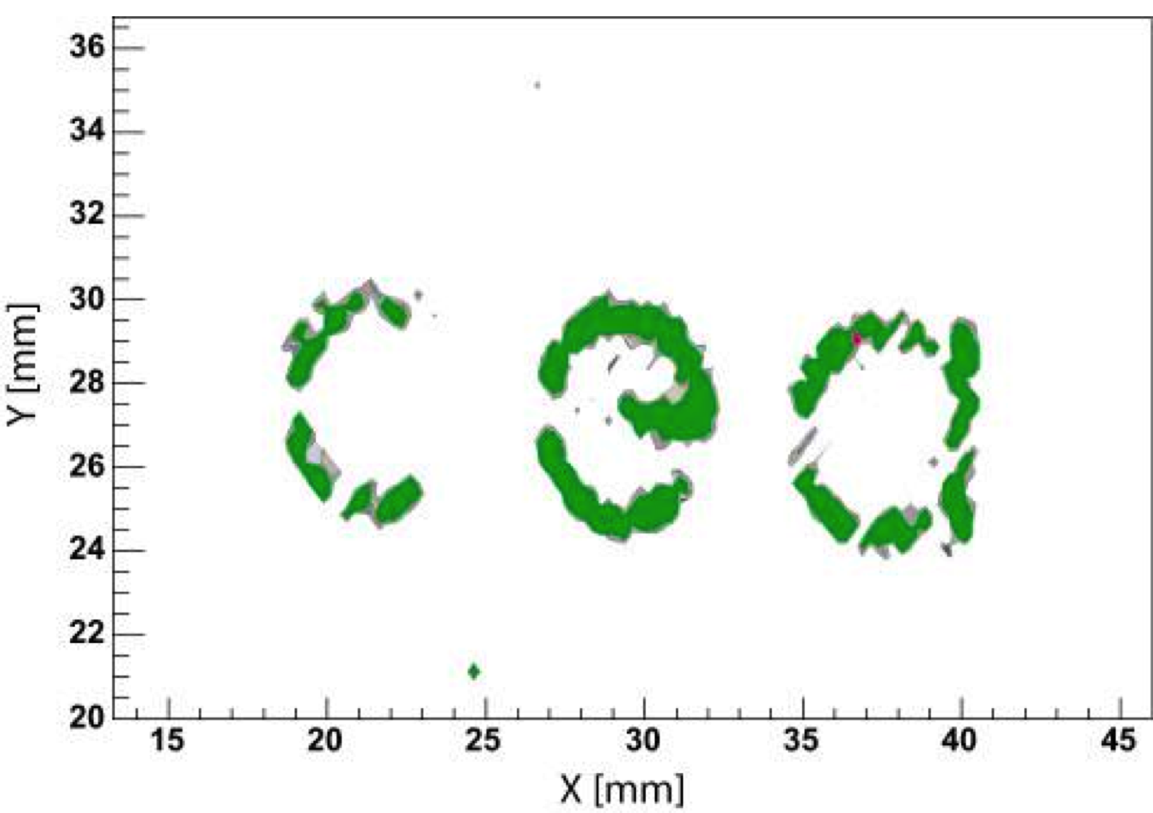
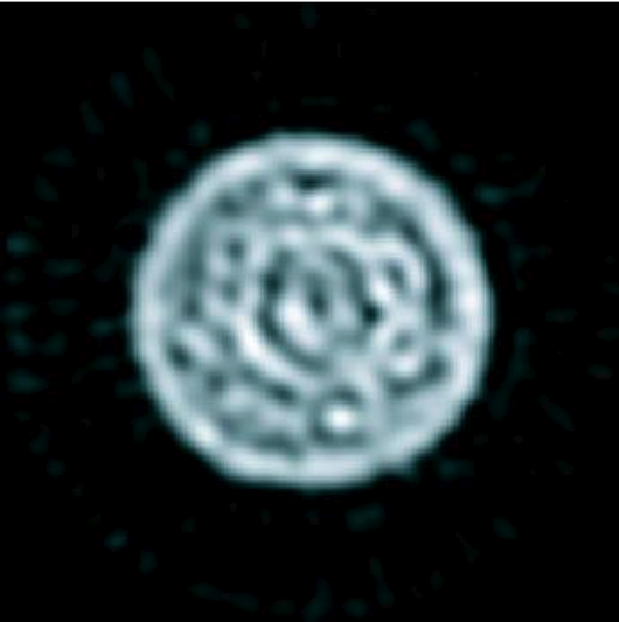
Imaging capabilities of the prototypes
F. Jeanneau, IEEE TRANSACTIONS ON NUCLEAR SCIENCE, VOL. 53, NO. 2, APRIL 2006
3 10⁸ thermal neutrons/cm²/s
350 μm
Image of the Gd mask
Beam tests at the Orphee Nuclear plant
Tomographic image of a multi-wires cable
(∅ 6 mm, 12 wires, ∅ 0.5 mm each)
Distorted tomograhy reconstruction with ~160 μm resolution because of the pillars supporting the “classical” micromegas mesh
Should be greatly improved today by use of the 2D micro-bulk
To be continued …

Slide 15
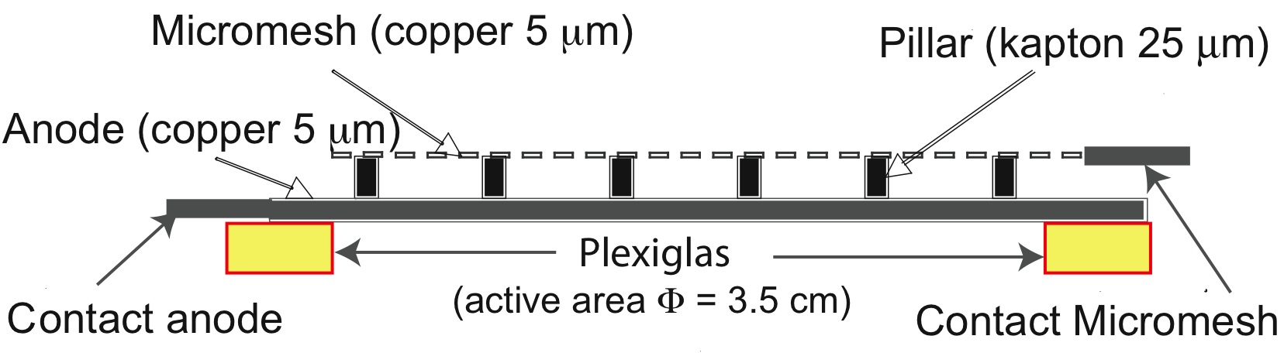
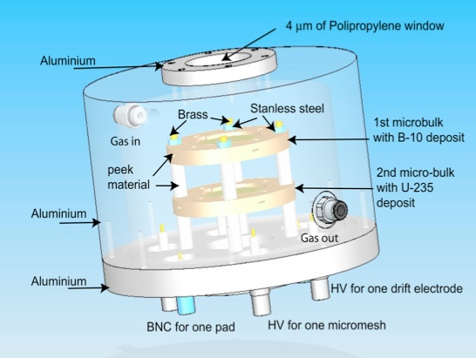
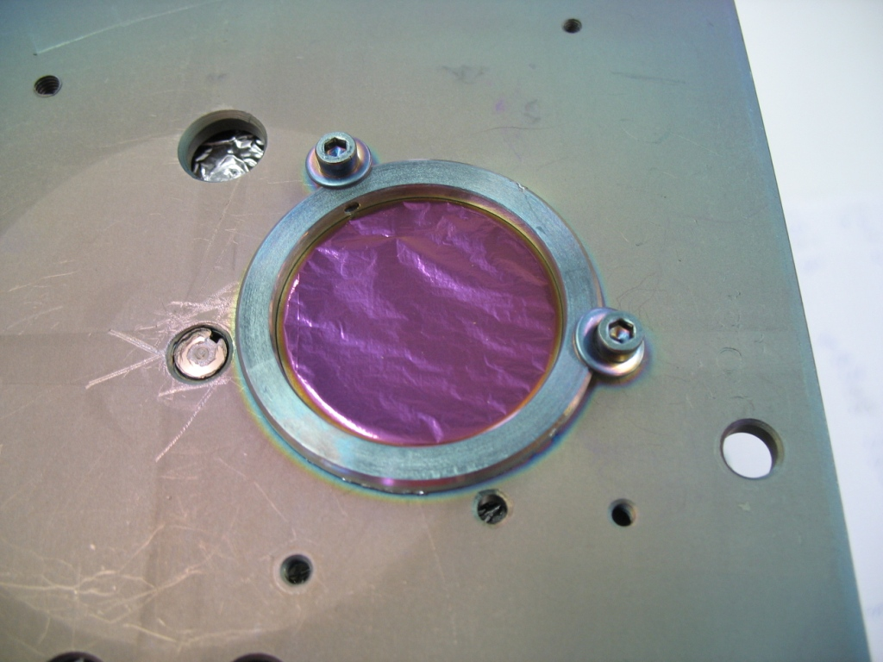
n-TOF transparent neutron beam flux monitor
Micro-bulk technology for very low budget material detector
Use of 2 converters : ¹⁰B(n,a)⁷Li for up to 100 eV neutrons and ²³⁵U(n,f) for 100 eV-1 MeV
Specifications
Ar+2%iC₄H₁₀+10%CF₄
35 mm diameter active area
1 plane Anode
1 channel : on-shelf fast current preamp. + 1GHz flash ADC
500 μm
¹⁰B Converter
Sputtering from B₄C at CERN (0,6 μm)
on 1 μm copper coated 12,5 μm Kapton foil
~1 μm on a Φ 35 mm
²³⁵U Converter
Vaccuum Evaporation (1 mg ²³⁵U @ 99,94%) at JRC-IRMM (Geel)
on 1,5 μm aluminized mylar foil
1 mg on a Φ 20 mm
Ref: S. Andriamonge et.al., proceedings of ND2010, International Conference on Nuclear Data for Science and Technology

Slide 16
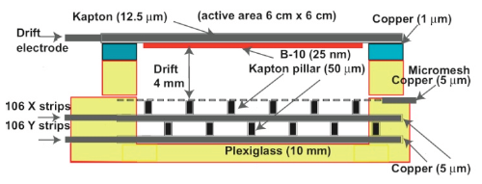
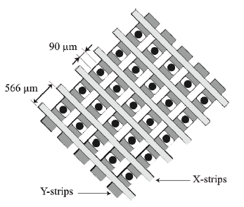
CERN/n-TOF 2D X-Y neutron beam profiler
128 μm Bulk-micromegas technology with 2D X-Y readout (CAST-like)
Use of ¹⁰B(n,a)⁷Li for up to 1 MeV neutron conversion
Woven mesh (30 um)
X & Y strips
+ Y vias
Pyralux pillar (128 μm)
X readout
Y readout
50 μm kapton
Specifications
Ar+2%iC₄H₁₀+10%CF₄
6x6 cm² active area
Φ 60 mm, 24 nm ¹⁰B₄C layer on a 1 μm copper coated 12,5 μm Kapton foil
212 channels : readout with 2 x 96 ch. Gassiplex cards
Ref: S. Andriamonge et.al., proceedings of ND2010, International Conference on Nuclear Data for Science and Technology

Slide 17
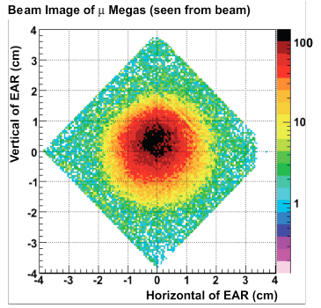
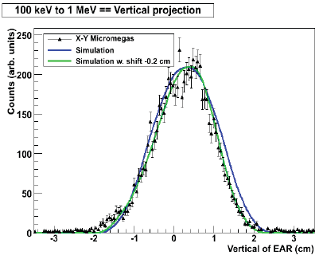
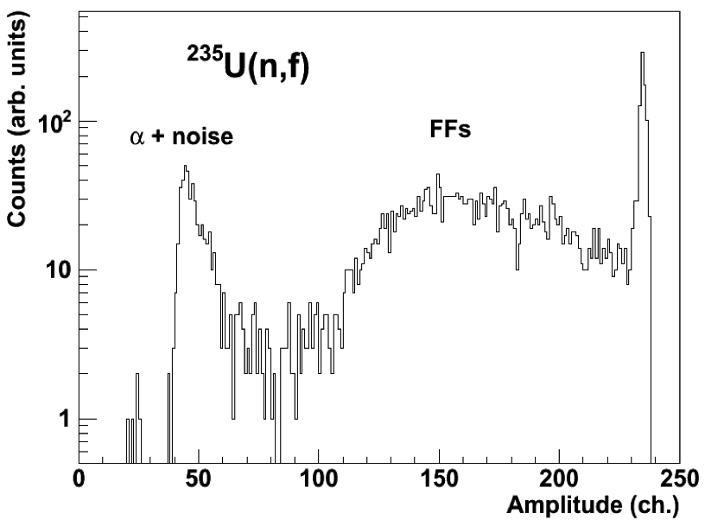
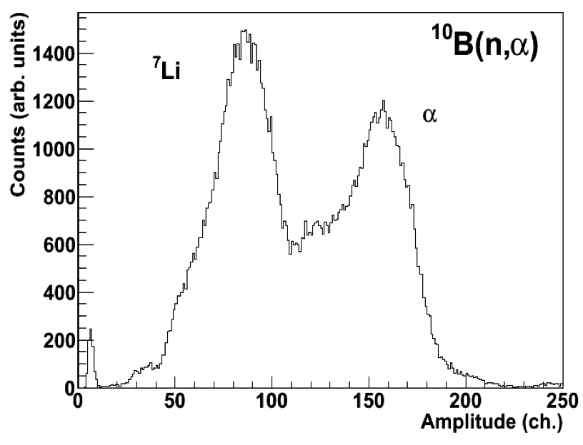
n-TOF beam profile and flux monitor
n-TOF beam flux monitoring (2008)
n-TOF beam profile (2009)
@ 185 m from spallation target
Ref: S. Andriamonge et.al., proceedings of ND2010, International Conference on Nuclear Data for Science and Technology

Slide 18
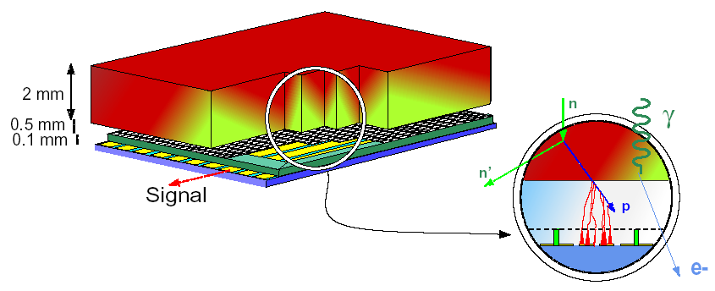
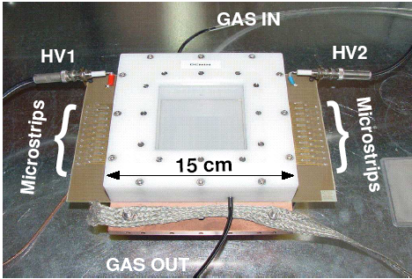
DEMIN : Micromegas Detector for Neutron spectroscopy for MégaJoules Laser and ICF experiments
Up to 30 MeV neutron spectrum diagnostics for inertial confinment DD and DT fusion
Prototype specifications
80x80 mm² « classical » micromegas with 40 x 1 mm width strips
500 μm thick drift volume, filled with He+10%C₄H₁₀+10%CF₄
CH₂ converter
Front-end electronics
Fast current preamp + MATACQ readout (SEDI)
40 electronic channels
Ref: M. Houry et.al., NIM A 557 p648 (2006)

Slide 19

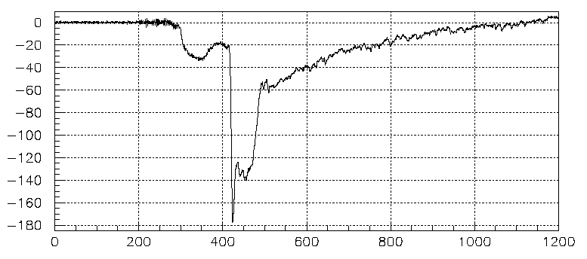
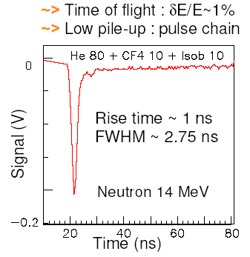
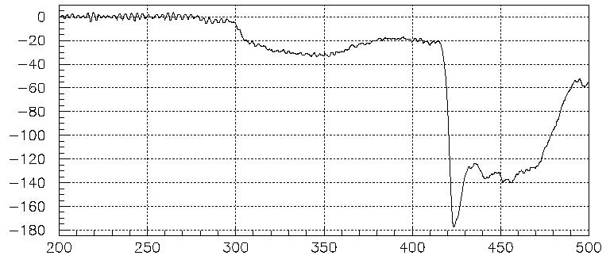

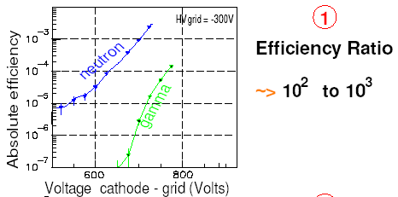
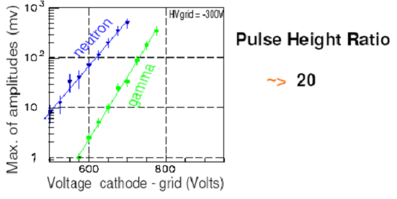
DEMIN : performances @ OMEGA (Rochester, USA)
DT SHOT, 31769; 4.10¹³ n_{14MeV}
T₀
Scattered
Neutrons in
the target bay
Signal (mV)
γ induced
by neutrons
Primary
neutrons
Tertiary neutrons
time window
Time (ns)
30 eV/mm stopping power of 1 MeV e- in gas
→ the thinner drift gap, the better the γ rejection
Ref: M. Houry et.al., NIM A 557 p648 (2006)
DEMIN group (CEA/DIF/DCRE and IRFU)

Slide 20
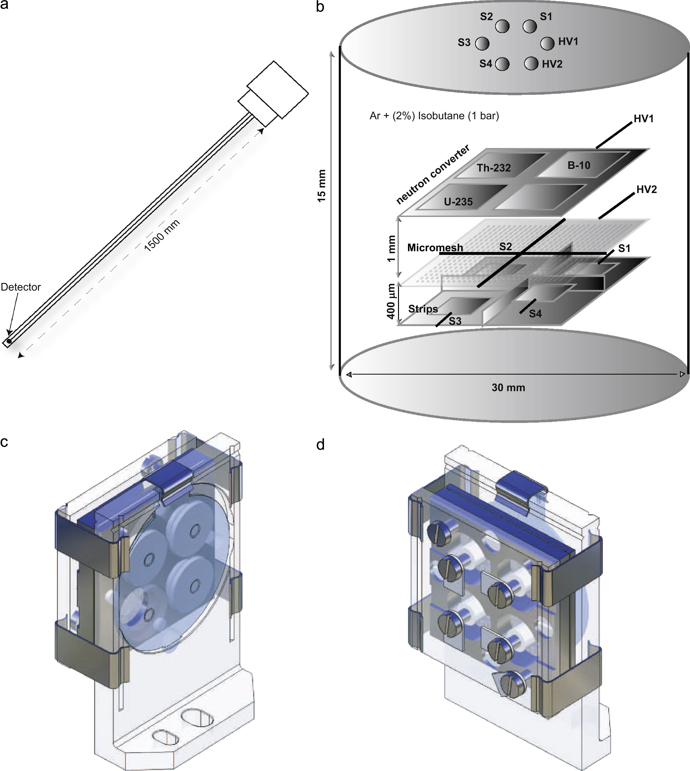
The Piccolo micromegas
In-core Nuclear plant integrated neutron flux measurement
Piccolo collaboration (TRADE WG) : IRFU / CEA-DEN
Specifications
Small sealed 10 cm³ micromegas (160 μm)
Standard design, with woven bulk type mesh
Non-flammable Ar+2%iC₄H₁₀
Wide neutron energy sensitivity with :
  ²³⁵U et 10B, thermal to several MeV
  ²³²Th , En > 1 MeV
  H recoils , thermal to several MeV
Designed for use in the extreme conditions of a reactor core (heated water 300°C, radiation)
Use of stainless steel & ceramic materials
4 individually polarized anode channels
2 readout modes :
  counting mode with fast current preamp. + 1GHz flash ADC + MATACQ (SEDI)
  current mode by mesh current reading for high reactor power
Ref: J. Pancin et al., Nuclear Instruments and Methods in Physics Research A 592 (2008) 104–113

Slide 21
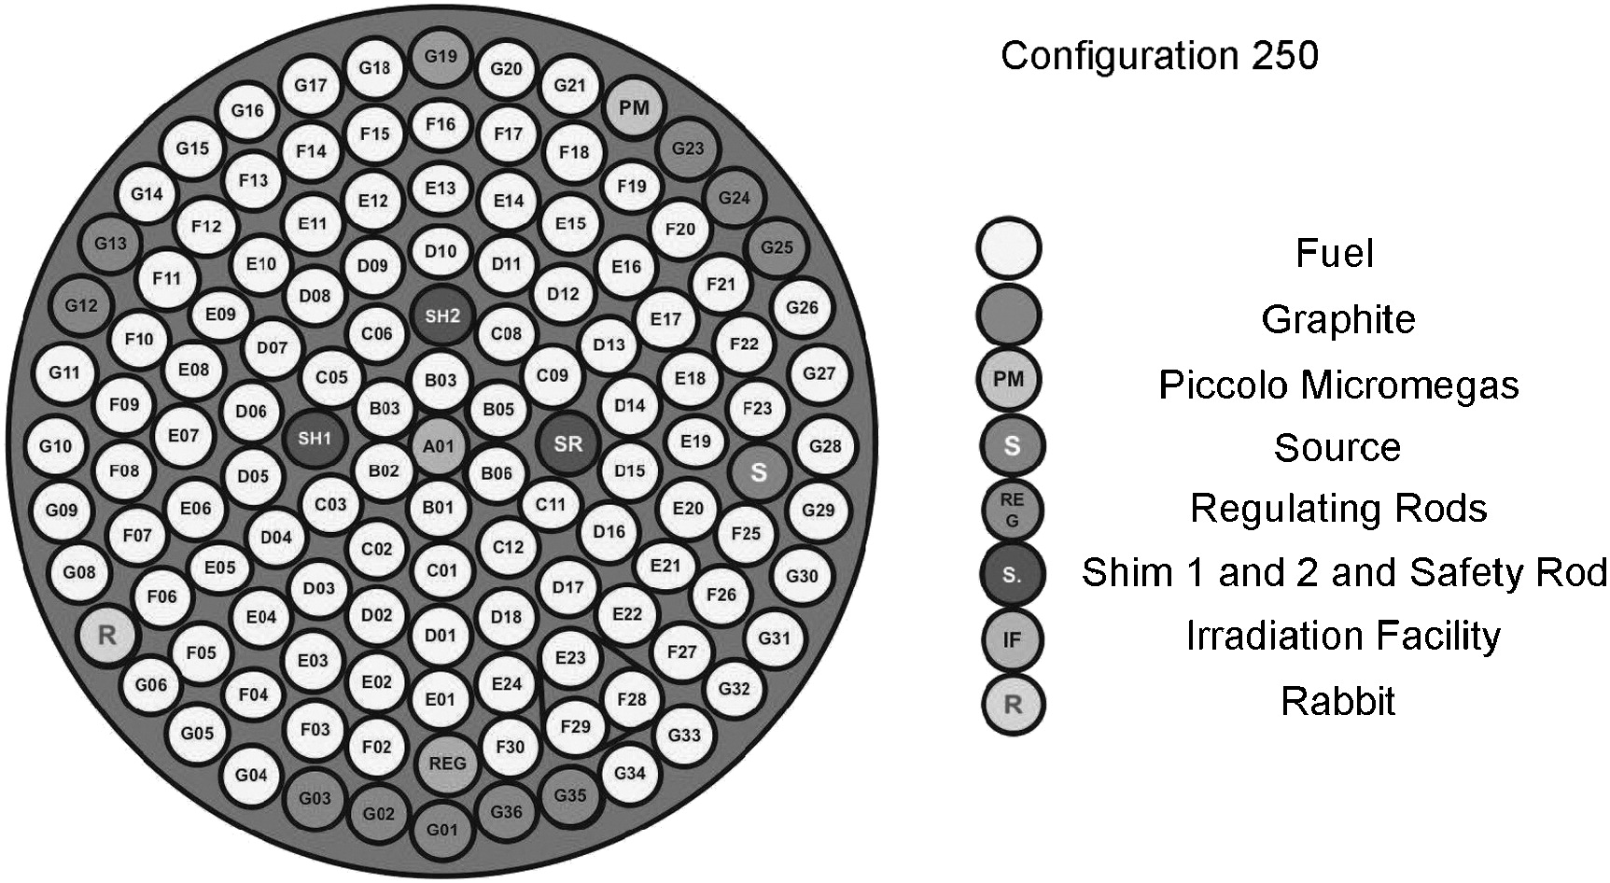


Piccolo micromegas : performances
Piccolo inside a 1 MW TRIGA reactor (Gasaccia)
Counting rate Vs Vmesh @ P=0 kW
~10¹¹ n (10⁹ γ ) /cm²/s @ P=10 kW
Current Vs reactor P in center
Current Vs reactor P in edges
- Good linearity and n/γ discrimination
- Space charge effects & ageing needs to be studied at high flux
good I=f(P[kW]) linearity
Ref: J. Pancin et al., Nuclear Instruments and Methods in Physics Research A 592 (2008) 104–113

Slide 22
Conclusions and perspectives
  More & more developments of neutron detectors using MPGDs for neutron beam flux and profile measurements, neutron spectroscopy (TOF measurements) and neutronography (Germany, Italy, France, Japan …)
MPGDs benefits for neutron detection
  Sub-mm spatial resolution for neutron thomography
  Sub-μs time resolution for TOF measurement (see DEMIN, CASCADE)
  High MHz (and more) counting rate intrinsic capability
  Radiation hardness and
Prospectives
Novel transparent micro-bulk structure for X-Y 2D neutron beam profile and flux monitoring detector (new 2D readout thin micro-Bulk)
TPC for fission fragments, n-alpha reactions, or neutron elastic scattering….. (micro-Bulk, Bulk, GEMs)
High precision neutron radiography
(new 2D readout micro-Bulk with hidden pillars, GEMs )
Large detectors for spallation source (neutron diffraction….) and for alternative to ³He based detectors (Large, low cost, Bulk detectors, multi-stage CASCADE GEMs)

Slide 23
Backup slides

Slide 24




Other limitations of gaseous proportional counters
Limited position resolution on the neutron interaction localisation
The so-called « wall effect »
The spectrum reflects detector response
rather than neutron energy ….
Example of BF₃
Same effect in BF₃
Ref: A. Oed, NIM A 525 (2004) 62–68

Slide 25

B₄C thin film deposition @ Thin Film Lab, Linköping Univ.
¹⁰B₄C-Coatings Patent appl. #: PCT/SE2011/050891
Ref: J. Birch, Development of Thin-film 10B-based neutron detectors, Saclay 2011-11-30

Slide 26

2D readout Micro-bulk manufacturing process

Slide 27

Comparison of bulk & micro-bulk technologies
r.m.s
- Large size
- Large scale production
- Low-budget material
- Excellent energy resolution
Ref: A. Delbart et.al., GLA2010, proceedings of 1st International Workshop towards the Giant Liquid Argon Charge Imaging Experiment

Slide 28




The micro-bulk micromegas
Same manufacturing techniques as GEM :
Copper & Kapton etching of a copper cladded Kapton
1
Micromesh
5 µm copper
1
25 or 50 µm
Kapton
2
Readout anode
CEA-CERN Patent 09 290 285.0 (2009)
Lower capacitance
Under development
2
“All-in one” structure mesh+anode
Excellent Energy resolution
11% FWHM @ 5,9 keV, 6 % @ 22 keV, 1,5 % @ 5 MeV)
Good uniformity
Low materiel budget detector
Flexible structure
Low intrinsic radioactivity
Fabrication process still improving
Fragile
Limited sizes (<100 cm²)
11% FWHM at 5.9 keV
Ar + 5% Iso at 1 bar
1 mm
Better mesh transparency &
12 μm gap under development
Ref: S. Aune et al. NIM A 604, 15-19, 2009
S. Andriamonje et al. JINST 4, MPGD2009 conf. proceedings

Slide 29


The bulk-micromegas
Top 500 μm pillar
First prototypes in 2004. CERN-TS-DEM/Irfu collaboration
A woven micro-mesh is embeded between 2 layers of photo-imageable material. Amplification gap of 128 μm is standard, 104 μm should be ok, 64 μm is tricky
No farme, no mechanics → % level dead zones
Up to 40x40 cm² is standard
Robust, Industrial process
63 μm pitch, 18 μm wires
Base Material
Copper segmented anode
FR4
Lamination of Vacrel
Photo-imageable
polyamide film
Positioning of Mesh
Stainless steel
woven mesh
Encapsulation
Border frame
Development
Spacer
Contact to Mesh
Ref: I. Giomataris et.al., NIM A560 (2006) 405

Slide 30


The T2K/TPC bulk-micromegas
final cutting
MICROMEGAS
NIM A574 (2007) 425-432
NIM A602 (2009) 415-420
  1 year production of 10 m²
  - bulk-MM produced @ CERN-TS-DEM
  - 115 PCBs produced
  - 86 modules produced (6 rejected)
  Finalement, 72 détecteurs + 8 spares
  - 10 faulty pads / 124000 !
Bulk-micromegas detector cost : ~10 k€ /m² ( 80% of the cost in the 4 layers PCB ! )
Ref: A. Delbart et.al., TIPP2009 conference proceedings NIM A preprint doi:10.1016

Slide 31




T2K/TPC Module calibration : a uniform production
1726 pads scan @ -350 V
1 FEC dead ch.
⁵⁵Fe spectra
σ(Ε)/Ε=8.8%
20.6% FWHM
HV connection.
Gain=1500
@ -350 V
Gain
Uniformity
2.1%
Energy
Resol.
Uniformity
5.6%
Gain vs HV curve
8% performance uniformity over the 86 modules

