Slide 1

Meeting MPGD April the 26 2012
© 2010 Eltos S.p.A. | Strada E, 44 - San Zeno - 52100 Arezzo, Italy | tel. +39.0575.94821 | fax +39.0575.959020 | e-mail: eltos@eltos.it | P.IVA 00870080512

Slide 2

Company Profile
Key Figures
Established 1980
Town Arezzo, Tuscany (ITALY)
Production 2 sites, 5.000 sqm
Ownership Management 76%
Private Investors 24%
Staff over 90 employees
© 2010 Eltos S.p.A. | Strada E, 44 - San Zeno - 52100 Arezzo, Italy | tel. +39.0575.94821 | fax +39.0575.959020 | e-mail: eltos@eltos.it | P.IVA 00870080512

Slide 3
Company Profile
© 2010 Eltos S.p.A. | Strada E, 44 - San Zeno - 52100 Arezzo, Italy | tel. +39.0575.94821 | fax +39.0575.959020 | e-mail: eltos@eltos.it | P.IVA 00870080512

Slide 4
Company Profile
© 2010 Eltos S.p.A. | Strada E, 44 - San Zeno - 52100 Arezzo, Italy | tel. +39.0575.94821 | fax +39.0575.959020 | e-mail: eltos@eltos.it | P.IVA 00870080512

Slide 5
Company Profile
© 2010 Eltos S.p.A. | Strada E, 44 - San Zeno - 52100 Arezzo, Italy | tel. +39.0575.94821 | fax +39.0575.959020 | e-mail: eltos@eltos.it | P.IVA 00870080512

Slide 6
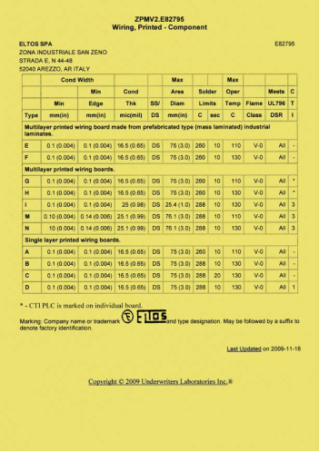



Company Profile
Qualifications
IPC Membership
UL Certification for USA and Canada
UL File E82795
UNI EN ISO 9001:2008
Quality Management System
UNI EN ISO 14001:2004
Environmental Management System
© 2010 Eltos S.p.A. | Strada E, 44 - San Zeno - 52100 Arezzo, Italy | tel. +39.0575.94821 | fax +39.0575.959020 | e-mail: eltos@eltos.it | P.IVA 00870080512

Slide 7
Company Profile
ELTOS Specialties
Type Rigid PCBs
Layers up to 24 layers
Materials FR4, Mid-, High-Tg and Halogen Free, special materials (Isola FR-408, Arlon, Panasonic, Rogers)
PCB thickness up to 6 mm
Big sized boards > 600 mm long
Cu thickness > 210 micron (external layers)
Aspect ratio 1:12 (TH), 1:1 for blind holes
Microvias, Via in pad, Blind vias, Buried vias / HDI boards
(through Sequential-Build-Up, SBU )
Impedance-controlled boards
(through Polar Instruments system)
Blue-mask, Via plugging & filling, Carbon print
© 2010 Eltos S.p.A. | Strada E, 44 - San Zeno - 52100 Arezzo, Italy | tel. +39.0575.94821 | fax +39.0575.959020 | e-mail: eltos@eltos.it | P.IVA 00870080512

Slide 8
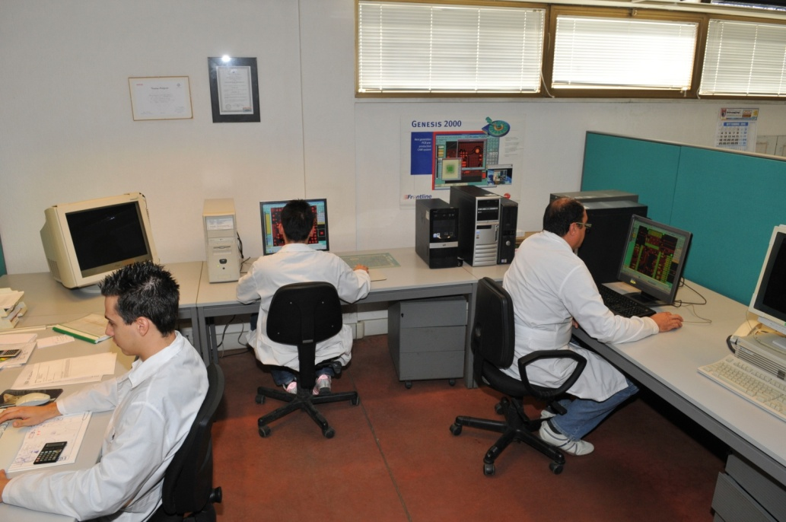
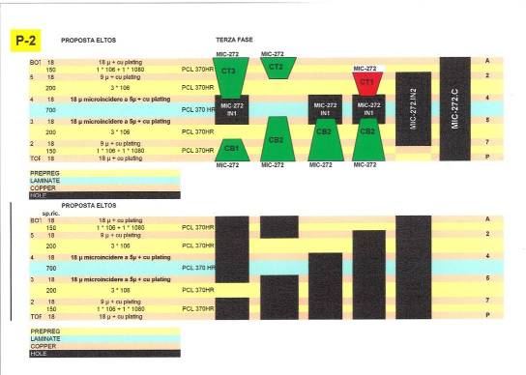
Our Production _ Home
A visit in our production:
CAM
- A professional team checks all the data, prepares the production cycle and the programs for every machine.
- Feedback to customer about every significant change
- Service to customer: special build-up studies
© 2010 Eltos S.p.A. | Strada E, 44 - San Zeno - 52100 Arezzo, Italy | tel. +39.0575.94821 | fax +39.0575.959020 | e-mail: eltos@eltos.it | P.IVA 00870080512

Slide 9
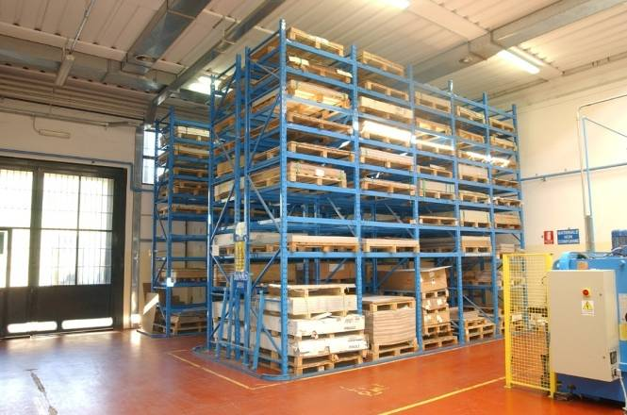
Our Production
A visit in our production:
BASE MATERIAL STOCK
ELTOS has a wide range of base material on stock
End of Presentation
© 2010 Eltos S.p.A. | Strada E, 44 - San Zeno - 52100 Arezzo, Italy | tel. +39.0575.94821 | fax +39.0575.959020 | e-mail: eltos@eltos.it | P.IVA 00870080512

Slide 10
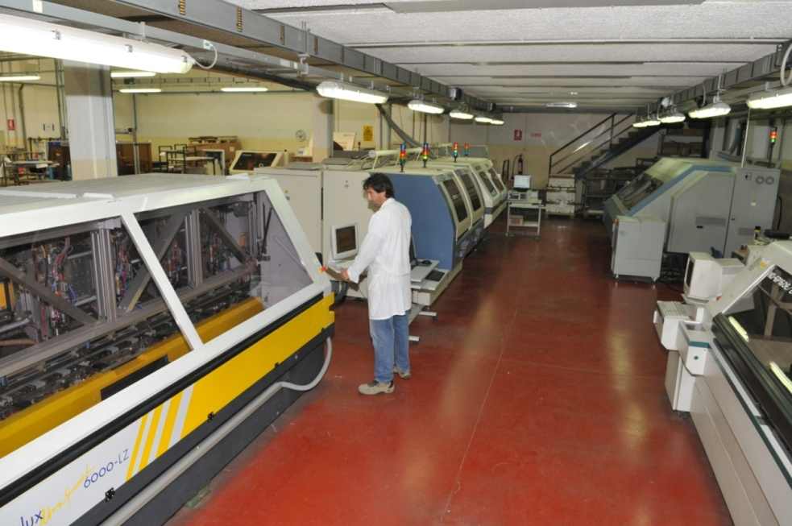
Our Production
A visit in our production:
DRILLING
Drilling machines of HITACHI, POSALUX , PLURITEC and SCHMOLL
- 26 drilling spindles
- 10 of them with high-speed and Z-axis control
© 2010 Eltos S.p.A. | Strada E, 44 - San Zeno - 52100 Arezzo, Italy | tel. +39.0575.94821 | fax +39.0575.959020 | e-mail: eltos@eltos.it | P.IVA 00870080512

Slide 11
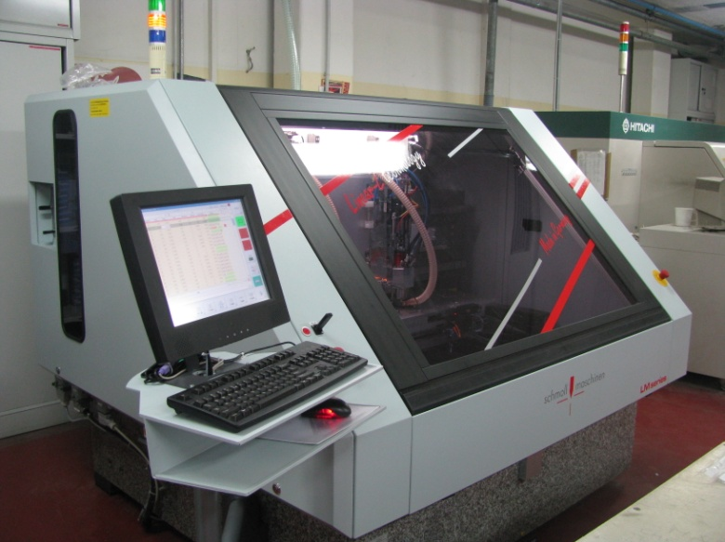
Our Production
A visit in our production:
DRILLING
New Investment end of 2010
LM2, Schmoll CNC Drilling machine
High-speed drilling spindle SM 220 (15-220krpm)
Linear drives in X,Y and Z-axis
Performs also micro- and blind vias
© 2010 Eltos S.p.A. | Strada E, 44 - San Zeno - 52100 Arezzo, Italy | tel. +39.0575.94821 | fax +39.0575.959020 | e-mail: eltos@eltos.it | P.IVA 00870080512

Slide 12
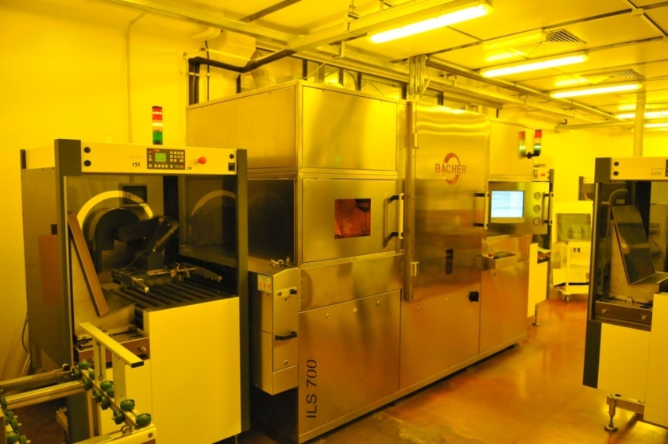
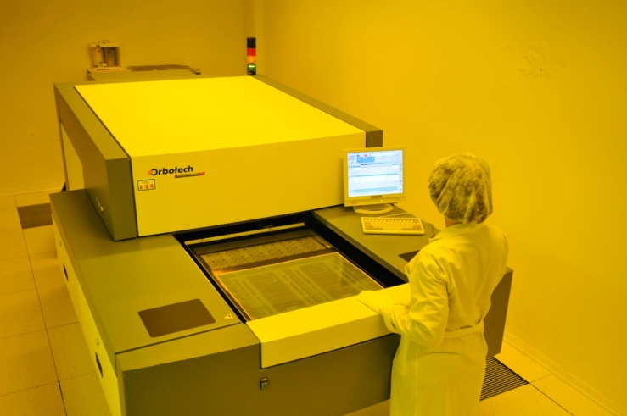
Our Production
A visit in our production:
INNER LAYERS IMAGING and LDI
BACHER
Imaging Line
Orbotech
L.D.I. Machine
© 2010 Eltos S.p.A. | Strada E, 44 - San Zeno - 52100 Arezzo, Italy | tel. +39.0575.94821 | fax +39.0575.959020 | e-mail: eltos@eltos.it | P.IVA 00870080512

Slide 13
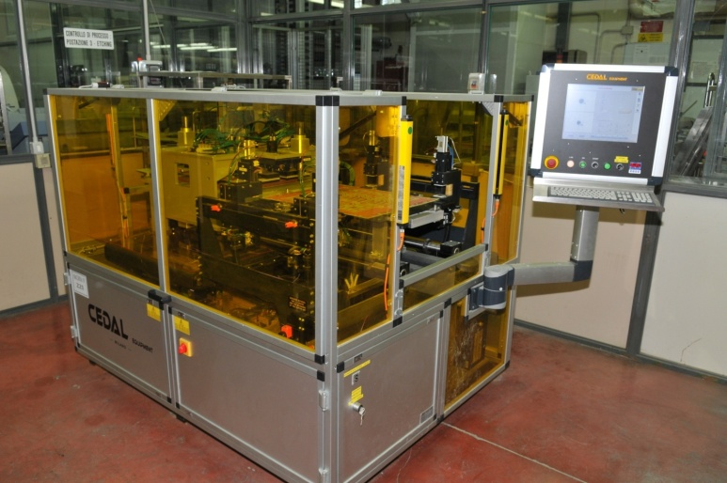
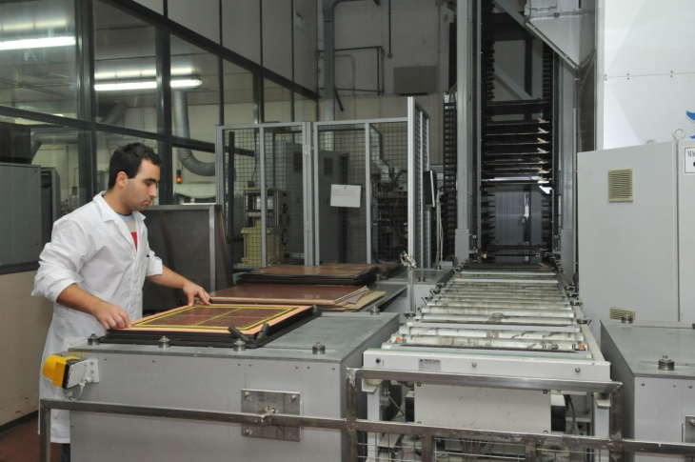
Our Production
A visit in our production:
PINLESS BONDING AND LAMINATION
Investment 2010
Cedal Equipment
Pinless Bonding 211
Multilayer Lamination
© 2010 Eltos S.p.A. | Strada E, 44 - San Zeno - 52100 Arezzo, Italy | tel. +39.0575.94821 | fax +39.0575.959020 | e-mail: eltos@eltos.it | P.IVA 00870080512

Slide 14
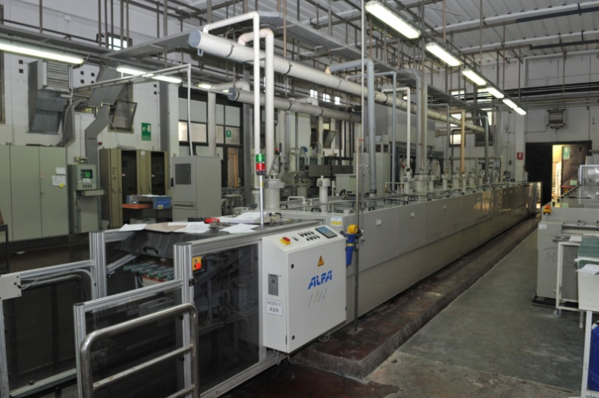
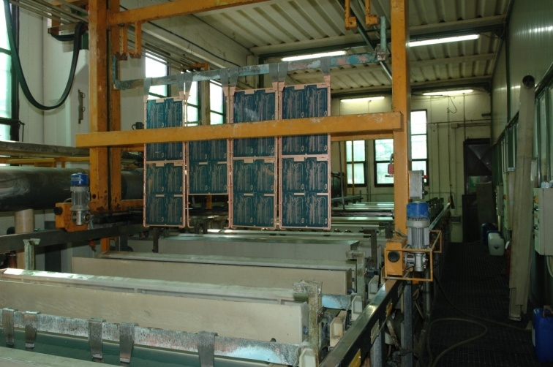
Our Production
A visit in our production:
PLATING LINES
Atotech
Horizontal Line
Asmega
Vertical Line
© 2010 Eltos S.p.A. | Strada E, 44 - San Zeno - 52100 Arezzo, Italy | tel. +39.0575.94821 | fax +39.0575.959020 | e-mail: eltos@eltos.it | P.IVA 00870080512

Slide 15
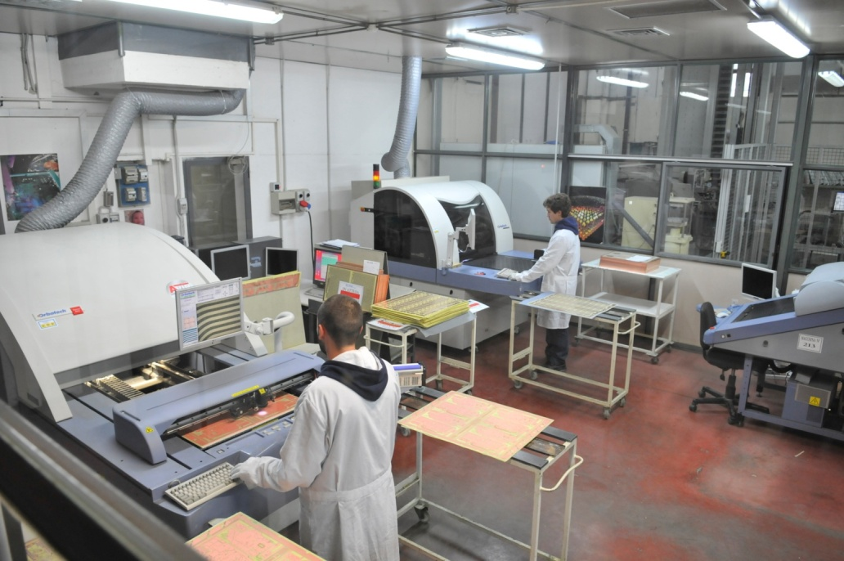
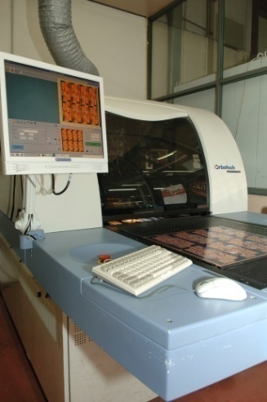
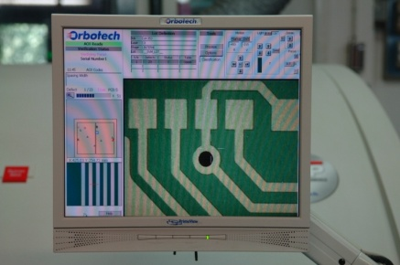
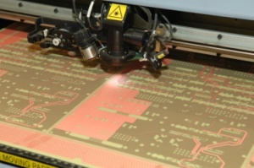
Our Production
A visit in our production:
AOI
Orbotech
AOI Machines
© 2010 Eltos S.p.A. | Strada E, 44 - San Zeno - 52100 Arezzo, Italy | tel. +39.0575.94821 | fax +39.0575.959020 | e-mail: eltos@eltos.it | P.IVA 00870080512

Slide 16
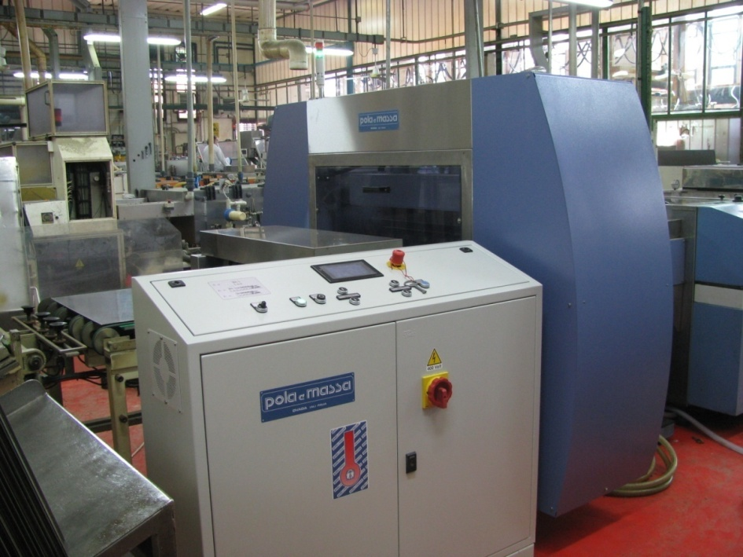

Our Production
A visit in our production:
HOLE PLUGGING
Investment 2010
PEM Planarizer
System for via hole resin removal and planarization after hole plugging process
© 2010 Eltos S.p.A. | Strada E, 44 - San Zeno - 52100 Arezzo, Italy | tel. +39.0575.94821 | fax +39.0575.959020 | e-mail: eltos@eltos.it | P.IVA 00870080512

Slide 17
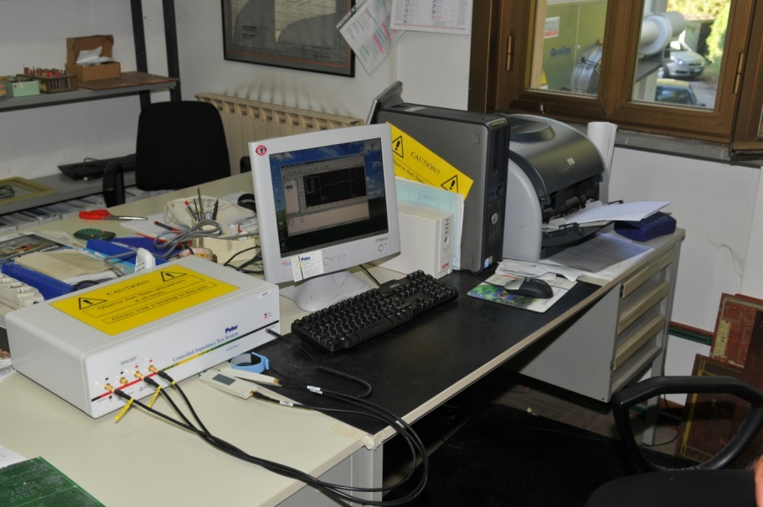
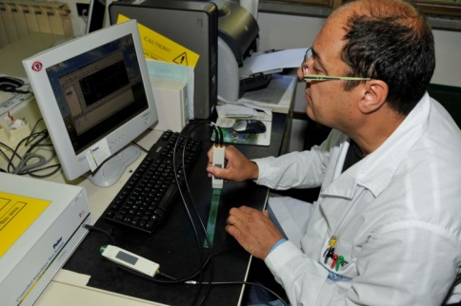
Our Production
A visit in our production:
CONTROLLED IMPEDANCE
Polar Instruments CITS900-S4 System
Stackup design, Coupon generator, Impedance Prediction and Measurement
© 2010 Eltos S.p.A. | Strada E, 44 - San Zeno - 52100 Arezzo, Italy | tel. +39.0575.94821 | fax +39.0575.959020 | e-mail: eltos@eltos.it | P.IVA 00870080512

Slide 18
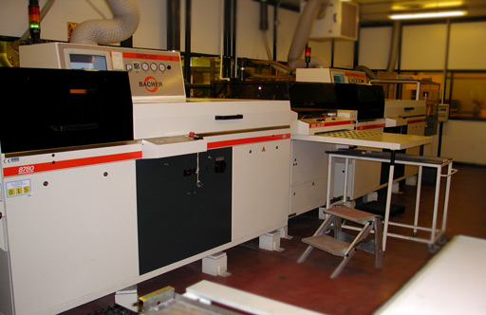
Our Production
A visit in our production:
SOLDER MASK IMAGING
BACHER
Imaging Line
© 2010 Eltos S.p.A. | Strada E, 44 - San Zeno - 52100 Arezzo, Italy | tel. +39.0575.94821 | fax +39.0575.959020 | e-mail: eltos@eltos.it | P.IVA 00870080512

Slide 19
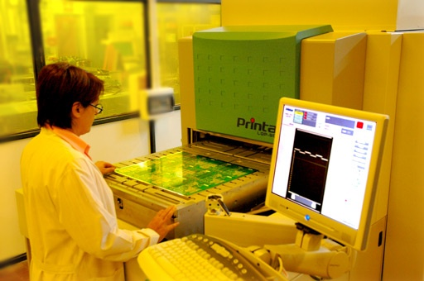
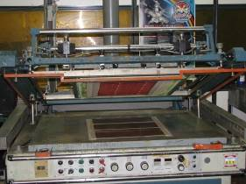
Our Production
A visit in our production:
LEGEND PRINT
PRINTAR
Digital Inkjet Printing
SCREEN PRINTING
© 2010 Eltos S.p.A. | Strada E, 44 - San Zeno - 52100 Arezzo, Italy | tel. +39.0575.94821 | fax +39.0575.959020 | e-mail: eltos@eltos.it | P.IVA 00870080512

Slide 20
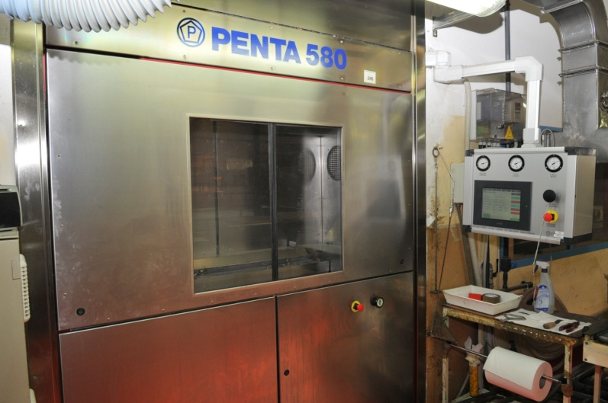
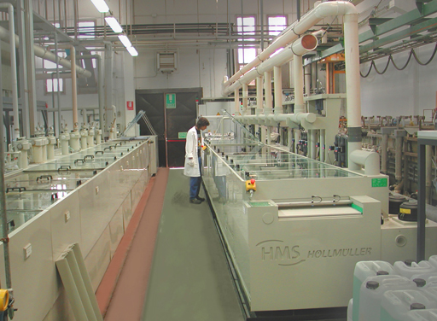
Our Production
A visit in our production:
SURFACE FINISHING
PENTA 580
HAL Lead Free
and SnPb
HOELLMUELLER
Immersion Silver
© 2010 Eltos S.p.A. | Strada E, 44 - San Zeno - 52100 Arezzo, Italy | tel. +39.0575.94821 | fax +39.0575.959020 | e-mail: eltos@eltos.it | P.IVA 00870080512

Slide 21
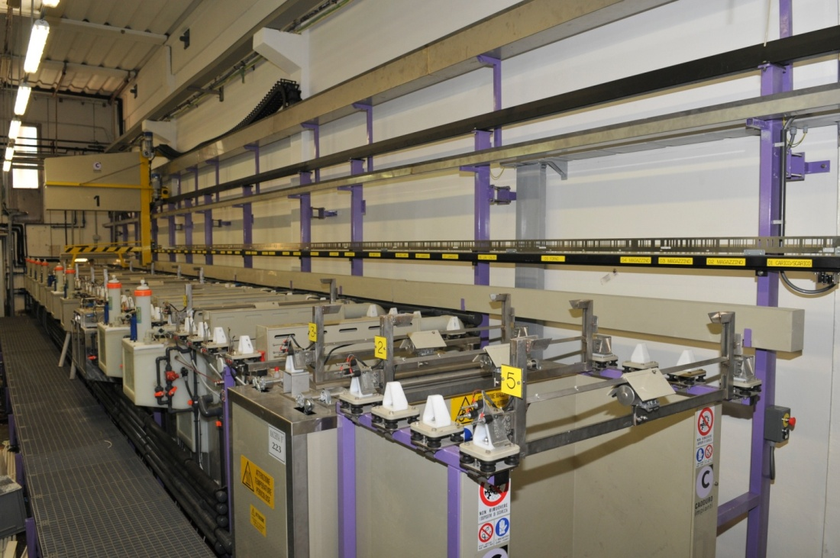
Our Production
A visit in our production:
SURFACE FINISHING
Investment 2010
ENIG / ENEPIG Finishing Line
© 2010 Eltos S.p.A. | Strada E, 44 - San Zeno - 52100 Arezzo, Italy | tel. +39.0575.94821 | fax +39.0575.959020 | e-mail: eltos@eltos.it | P.IVA 00870080512

Slide 22
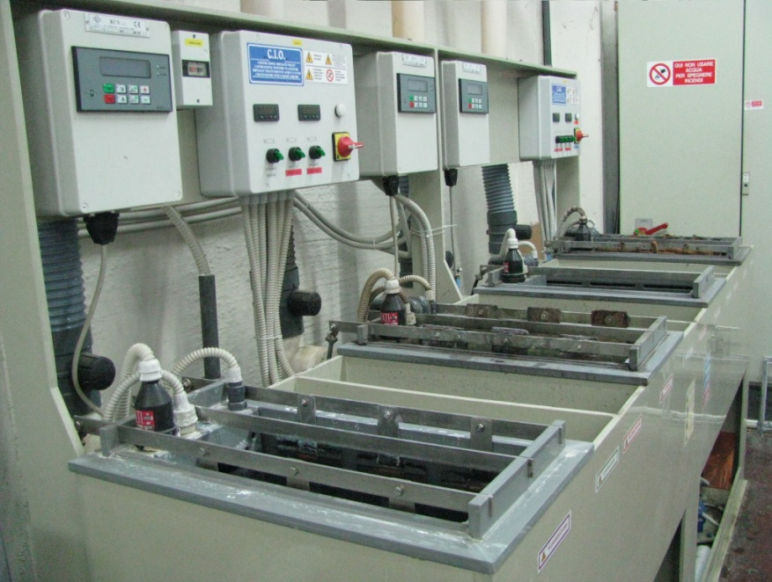
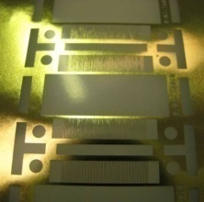
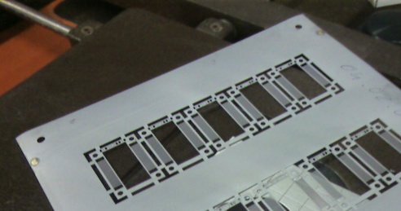
Our Production
A visit in our production:
SURFACE FINISHING
Investment 2010
Tin/Indium Special Finishing
Tin+Indium or Tin-Indium Alloy galvanic deposition,
for very low melting temperature (117° C)
© 2010 Eltos S.p.A. | Strada E, 44 - San Zeno - 52100 Arezzo, Italy | tel. +39.0575.94821 | fax +39.0575.959020 | e-mail: eltos@eltos.it | P.IVA 00870080512

Slide 23
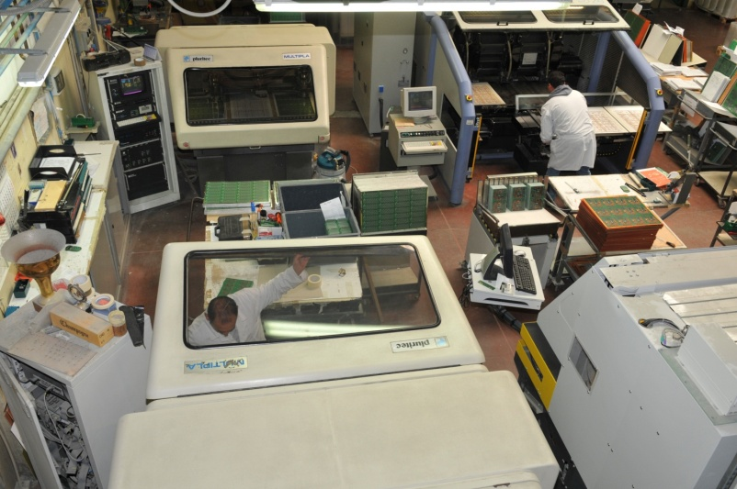
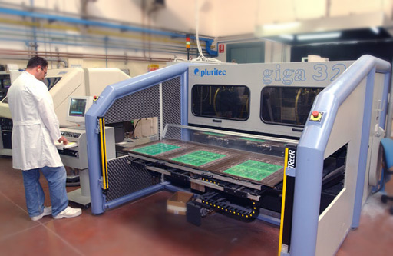
Our Production
A visit in our production:
ROUTING and SCORING
PLURITEC and TELMEC machines
© 2010 Eltos S.p.A. | Strada E, 44 - San Zeno - 52100 Arezzo, Italy | tel. +39.0575.94821 | fax +39.0575.959020 | e-mail: eltos@eltos.it | P.IVA 00870080512

Slide 24
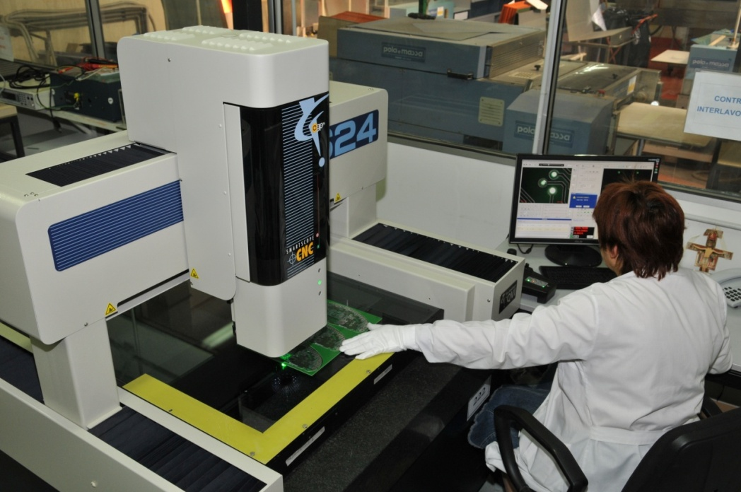
Our Production
A visit in our production:
OPTICAL MEASUREMENT
BACHER
Imaging Line
Investment 2010
OGP SmartScope CNC 640
Automatic control of holes’ position and dimensions and PCB’s mechanical measures
auto-calibrating, high quality 12:1 zoom lens
LED backlight system
© 2010 Eltos S.p.A. | Strada E, 44 - San Zeno - 52100 Arezzo, Italy | tel. +39.0575.94821 | fax +39.0575.959020 | e-mail: eltos@eltos.it | P.IVA 00870080512

Slide 25
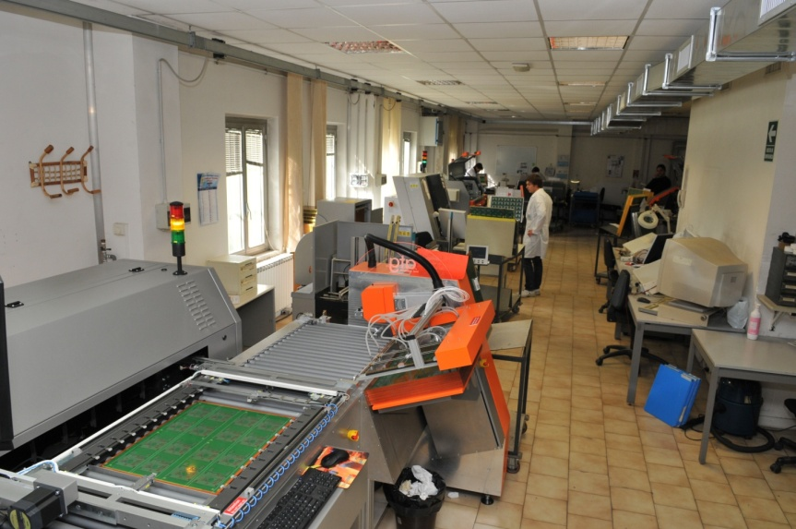
Our Production
A visit in our production:
ELECTRICAL TEST
OUR RANGE OF MACHINES
Model/Test system | A5 Flying Probe | A5-a Flying Probe | A6 Flying Probe | LM100 Parallel Test
min. test point | 50 μm | 50 μm | 35 μm | 150 μm
max. test area | 610mm x 460mm | 610mm x 460mm | 620mm x 600mm | 325mmx 244mm
production batch size | small | medium | small/medium | big
© 2010 Eltos S.p.A. | Strada E, 44 - San Zeno - 52100 Arezzo, Italy | tel. +39.0575.94821 | fax +39.0575.959020 | e-mail: eltos@eltos.it | P.IVA 00870080512

Slide 26
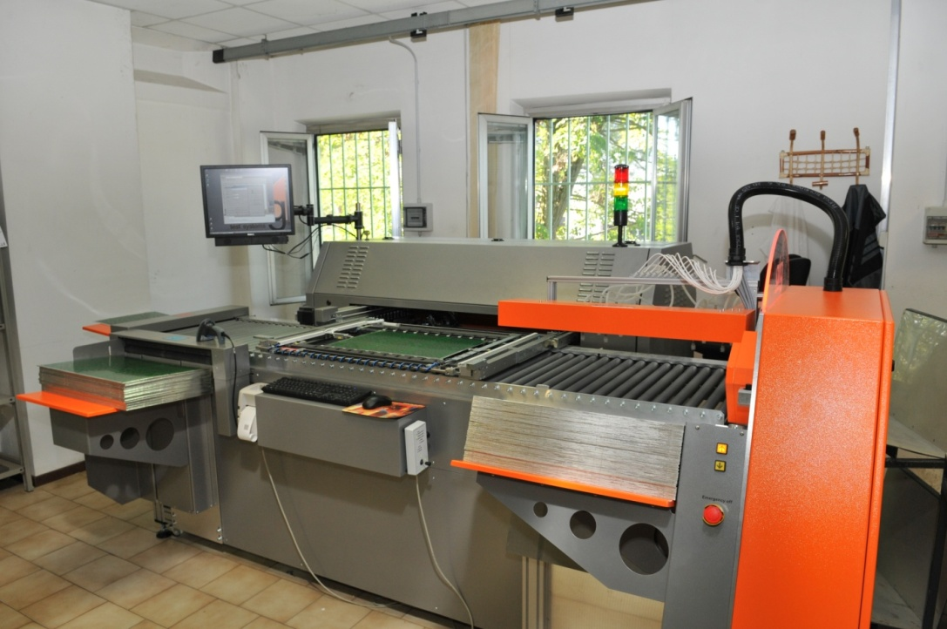
Our Production
A visit in our production:
Inner layers imaging, LDI
Investment 2010
ATG A5-a with full automation
automatic loader and un-loader
connected with the data network of the department
© 2010 Eltos S.p.A. | Strada E, 44 - San Zeno - 52100 Arezzo, Italy | tel. +39.0575.94821 | fax +39.0575.959020 | e-mail: eltos@eltos.it | P.IVA 00870080512

Slide 27
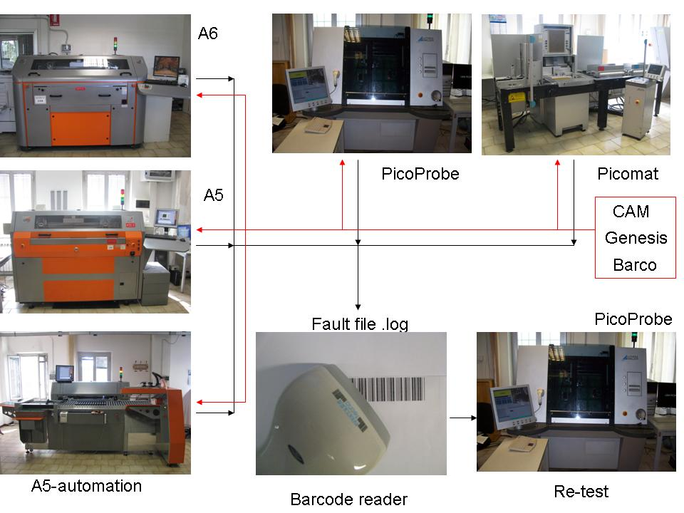
Our Production
A visit in our production:
ELECTRICAL TEST
The networked E-Test
© 2010 Eltos S.p.A. | Strada E, 44 - San Zeno - 52100 Arezzo, Italy | tel. +39.0575.94821 | fax +39.0575.959020 | e-mail: eltos@eltos.it | P.IVA 00870080512

Slide 28
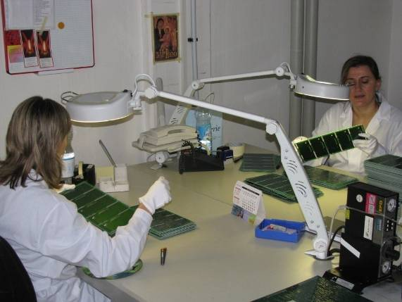

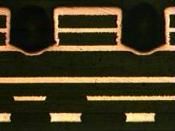
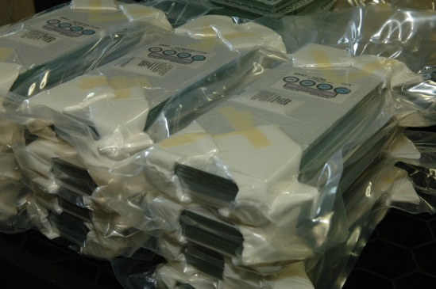
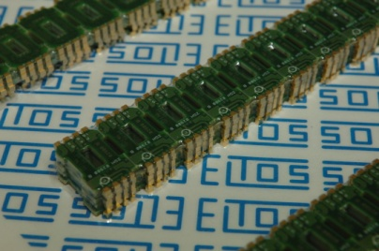
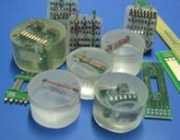
Our Production
A visit in our production:
FINAL INSPECTION and PACKAGING
FINAL INSPECTION, MICROSECTION and F.A.I.R.
PACKAGING
End of Presentation
© 2010 Eltos S.p.A. | Strada E, 44 - San Zeno - 52100 Arezzo, Italy | tel. +39.0575.94821 | fax +39.0575.959020 | e-mail: eltos@eltos.it | P.IVA 00870080512

Slide 29
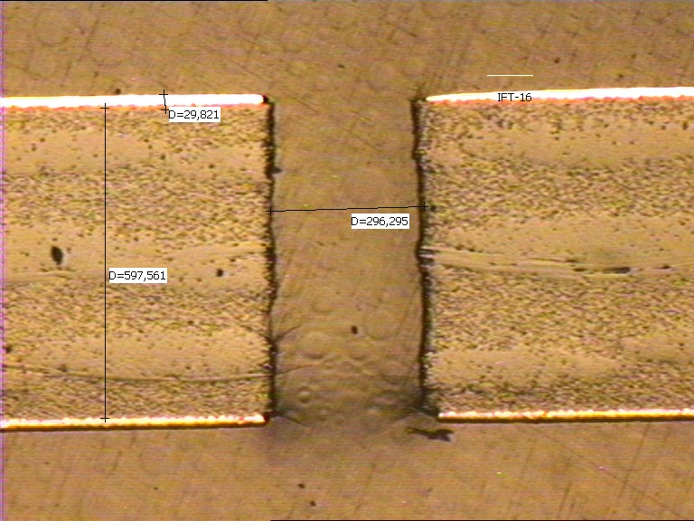
Production of THGEM at ELTOS S.p.A.
Fulvio Tessarotto
Company profile
Production procedures
Small size THGEM prototypes
Large area THGEM photon detector
The production of the first set of
600 x 600 mm² THGEM prototypes

Slide 30
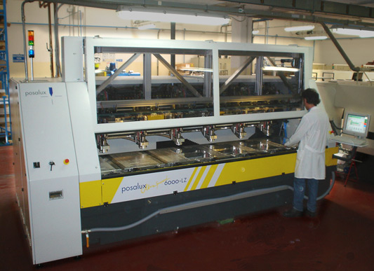
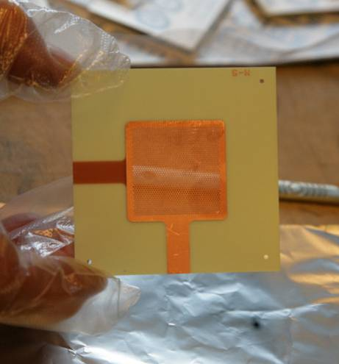
Production of small size THGEM prototypes
At the beginning of 2008 we ordered to the ELTOS Company 13 groups of THGEM prototypes with 30 x 30 mm² of active area.
common prototype parameters:
thickness: 0.4 mm,
Cu thickness: 35 μm,
holes diameter: 0.4 mm,
pitch: 0.8 mm;
material: R-1566 Panasonic (halogen free, anti CAF)
POSALUX ULTRASPEED 6000LZ
6-spindle-roboter
180,000 turns/min, Ø down to 0.15 mm
Nominal CNC drilling tolerance: +- 10 μm
10 samples per type

Slide 31
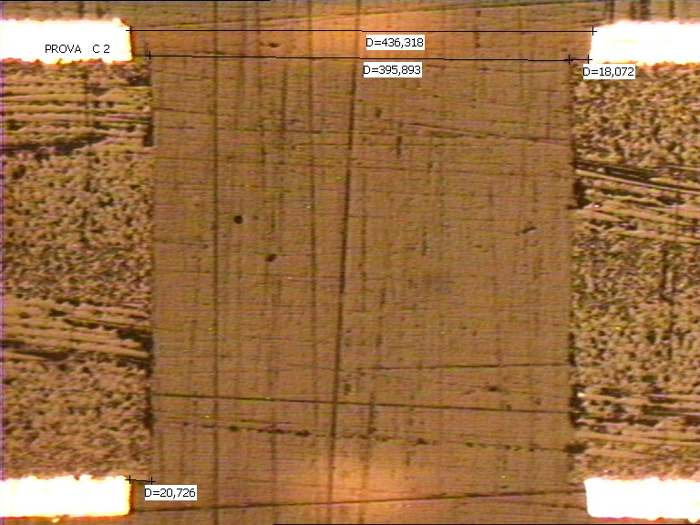
example of “small rim” (25μm) production

Slide 32
example of “small rim” (25μm) production

Slide 33
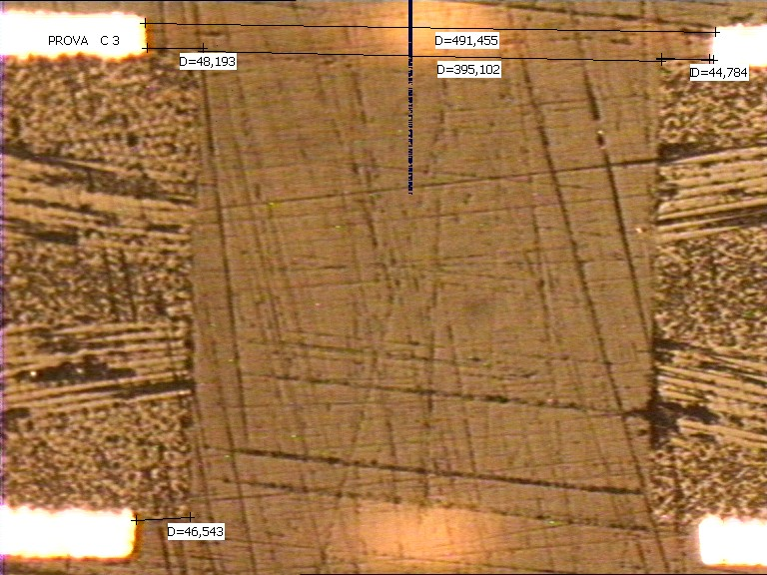
example of “large rim” etching production

Slide 34
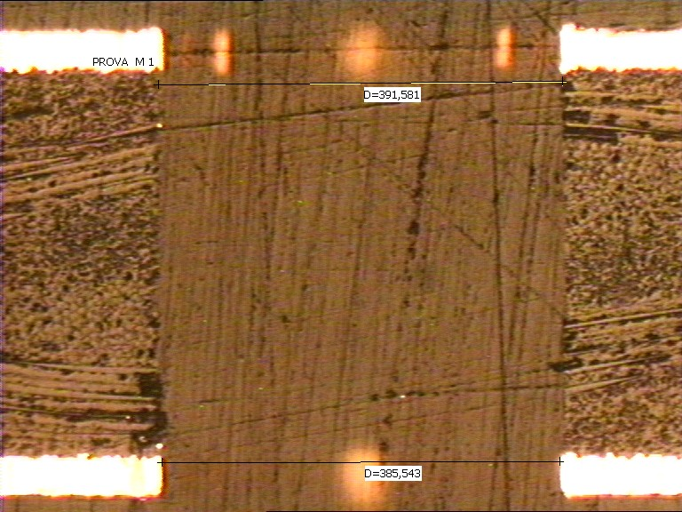
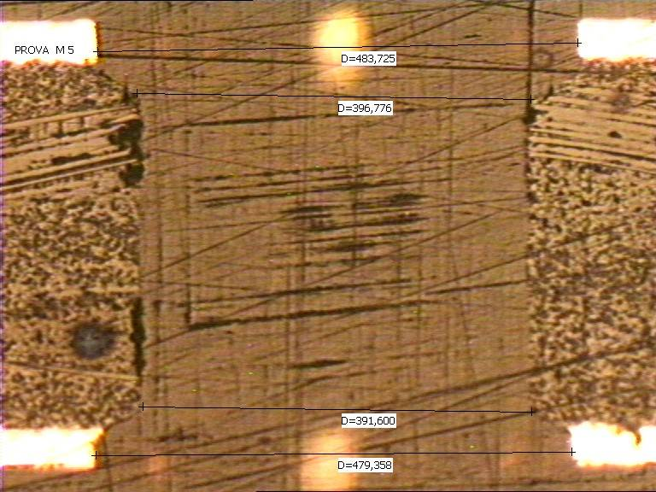
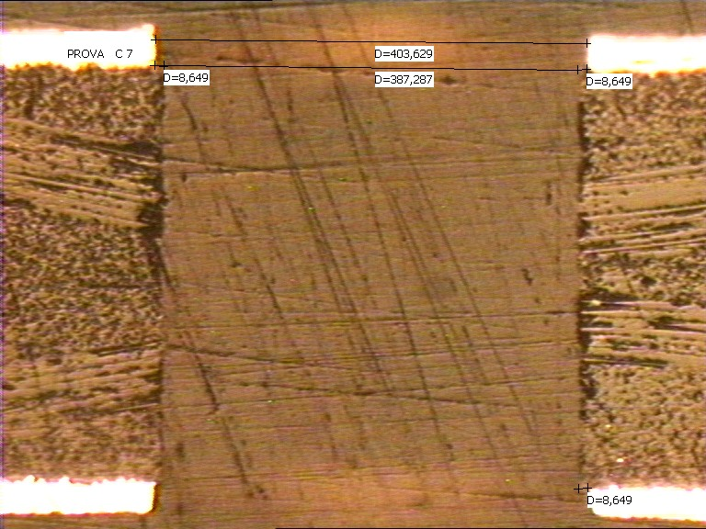
example of 10 μm “global etching” production

Slide 35
pure drilling production process

Slide 36
double drilling production process

Slide 37
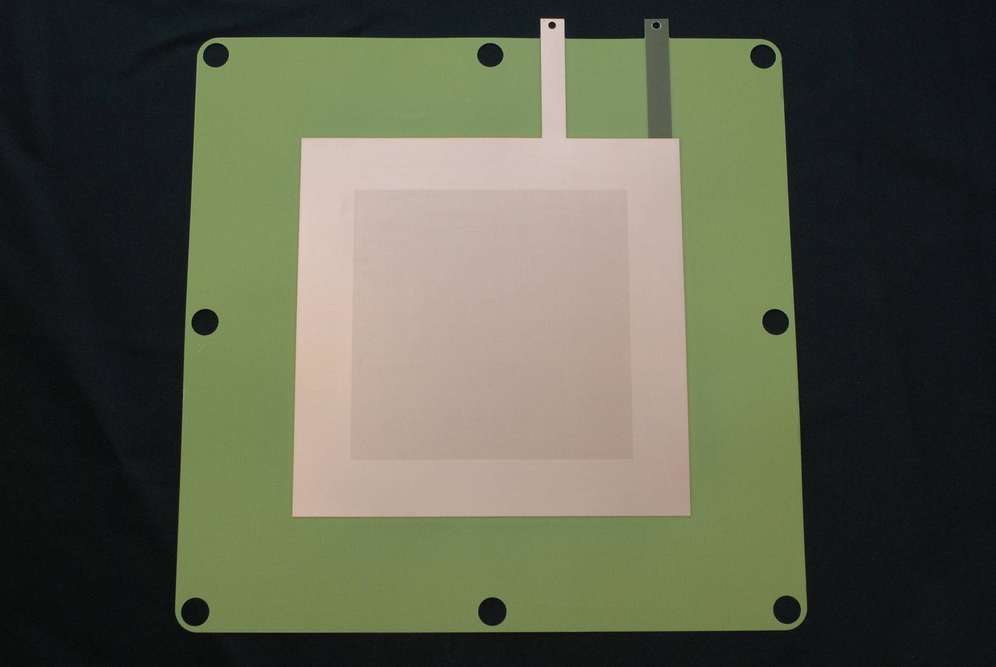
CERN produced 100 x 100 mm² THGEM
thickness: 0.2 mm diameter: 0.2 mm pitch: 0.5 mm rim: ~ 10 μm

Slide 38
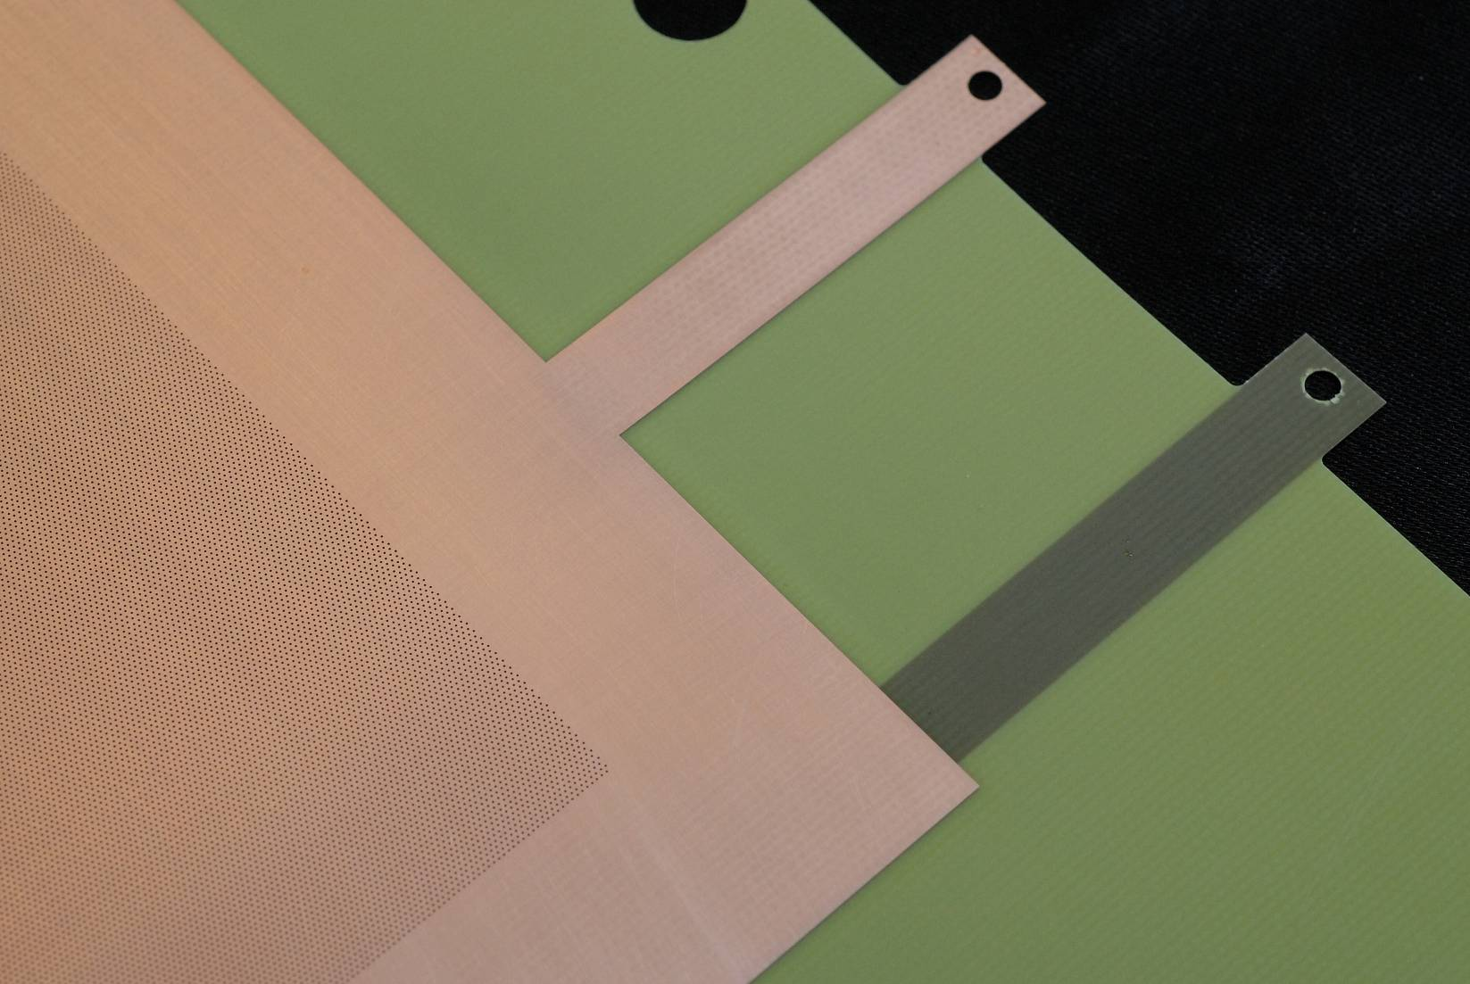

Slide 39
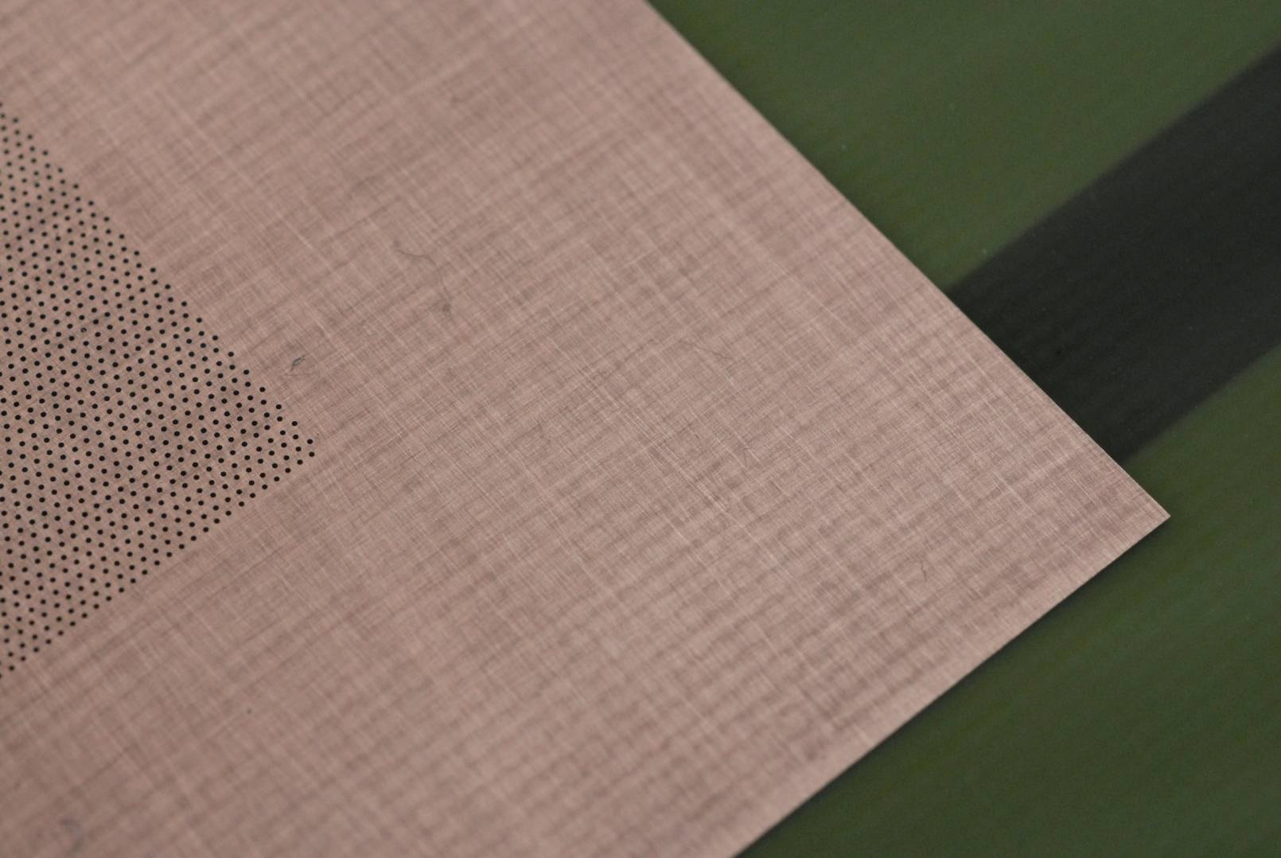

Slide 40


Slide 41


Slide 42

0.5 mm
0.2 mm

Slide 43

anode pcb

Slide 44





anode pcb pads

Slide 45

Pluritec Multistation Evolution at ELTOS
Working area:
630 x 765 mm²
180,000 turns/min
20,000 holes/hour
Storage: 840 tools
Controlled diam.,
depth and run-out

Slide 46

600 x 600 mm2 THGEM protoypes
~600,000 holes/piece
(very large gerber file)
Ø: 0.4, p.: 0.8, th.: 0.6 mm
rim: 5 μm (micro-etching)
Ni-Au coating

Slide 47

THGEM

Slide 48





600 x 600 mm² THGEMs

Slide 49


For the development and production of the large-size high precision printed circuit boards for the Muon chambers
ELTOS Arezzo, Italy

Slide 50
The LHCb Muon System is composed of 1368 Multi-Wire- Proportional-Chambers plus 100 spare chambers
The chamber construction required nearly 6000m² of PCBs → a soccer field
  4500m² of single sided copper cladded PCBs
  1150m² of single sided gold plated PCBs
  215m² of double sided gold plated PCBs
  in total 13500 PCBs of about 0.45m² size.
The PCBs had to be very uniform in thickness (Δth >50μm) and uniform in the finishing (quality of the gold plating).
10% of PCBs have feed-through holes which had to be sealed.

Slide 51



Slide 52
Company Profile
Contacts
Sales
Fabrizio Landi Sales Manager Italy
Marco Attardo Area Sales Manager
Giorgio Pinamonti Sales & Marketing Manager
Silvia Cotoloni Customer Service
Sales Agents
Roberto Granata Central Italy
Luigi Ballarin NE Italy
Pascal Lequerré NW Italy, France, South-Europe
Klaus Kern Germany
Quality
Maria Elena Cruccolini Quality Manager
Go to End
Go to our Production
Go to Microsections
Go to our BOOK
© 2010 Eltos S.p.A. | Strada E, 44 - San Zeno - 52100 Arezzo, Italy | tel. +39.0575.94821 | fax +39.0575.959020 | e-mail: eltos@eltos.it | P.IVA 00870080512

Slide 53



Company Profile _ end
Location
ELTOS is located in Arezzo,
a town in Tuscany with Etruskian origins
© 2010 Eltos S.p.A. | Strada E, 44 - San Zeno - 52100 Arezzo, Italy | tel. +39.0575.94821 | fax +39.0575.959020 | e-mail: eltos@eltos.it | P.IVA 00870080512

Slide 54
Company Profile
Thanks for your attention
Visit us in Arezzo,
You are welcome!
© 2010 Eltos S.p.A. | Strada E, 44 - San Zeno - 52100 Arezzo, Italy | tel. +39.0575.94821 | fax +39.0575.959020 | e-mail: eltos@eltos.it | P.IVA 00870080512

