Slide 1
elvia PCB Group presentation
Bulk implementation at Cirea
27 April 2012
Michel Billant - Annecy

Slide 2
PCB Group
PCB Business : 750 people
2012 expected Turnover : 72 M€
Top 5 of the pcb’s manufacturers in Europe
Main plants in France, one in Tunisia

Slide 3


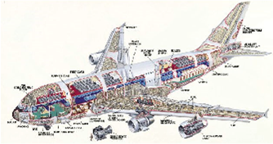

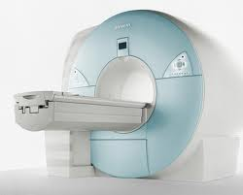




elvia PCB group: « covering all Business areas »
Spatial
Avionic
Defense
Medical
Automotive
Transport
Telecom
Industrial
Power
Lighting
3

Slide 4
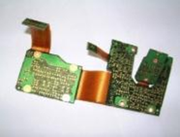
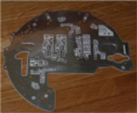
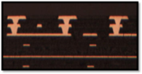
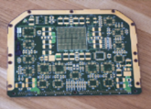
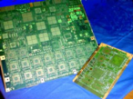
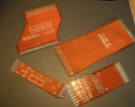
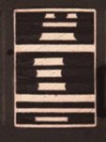

elvia PCB group 2011 split per technology

Slide 5
elvia PCB group : the strategy
  elvia PCB group is striving to become a European leader
  2 strategic directions
  1- INNOVATION and DEDICATED TECHNOLOGIES
  We already propose a “UNIQUE” one stop shop PCB solution,
  (all technologies and services available) supported with a strong R & T team
  Our goal is to be your partner for any
  “New requirement / Specific / High tech”
  2 – DEVELOP OVERSEA BUSINESS
  Our customers reference list includes already most the Key European OEM
  - the group has a European scale,
  - we are operating in every sector of activity
  Our strategy is to support our customers,
  “anywhere in the world”

Slide 6

elvia PCB group - 4 Clusters
Mil & Aero
TIC & industrial
Aero
Medical
Industrial
Space
Mil
Telecom
Consumers
Transport
Power & Lighting
Automotive
Power Management
Thermal Management
Gear Box
Detection
Lighting
Xenon /LED
Lighting
Electric & Hybrid
Security / RFID
Electroluminescence

Slide 7

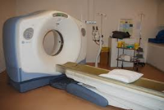

The Mil & Aero Cluster
HDI Pcb µvia stacked 2.5+n+2.5 Stagered SBU
Embedded Resistors Embedded Capacitance
ML/ DS/SS Thick Copper to 210µm Large size to 700mm
Flex PCB Ziff connectors
Flex Rigid PCB To 4 Flex layers
Microwaves PCB SBU PTFE materials Antennas
Power Management Busbar Planar technology
Thermal Management IMS Internal & external drain
Aviflex Sculptured PCB
MIL
SPACE
MEDICAL
Transport

Slide 8
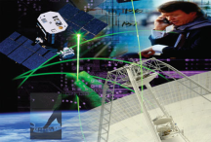
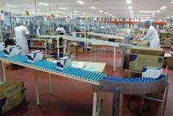
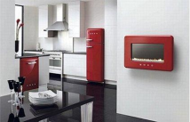
The TIC & Industrial Cluster
HDI Pcb µvia stacked 2.5+n+2.5 Stagered SBU
Embedded Resistors Embedded Capacitance
ML/ DS/SS Thick Copper to 210µm Large size to 700mm
Flex PCB Ziff connectors
Flex Rigid PCB To 4 Flex layers
Microwaves PCB SBU PTFE materials Antennas
Power Management Busbar Planar technology
Thermal Management IMS Internal & external drain
Aviflex Sculptured PCB
TIC
Industrial
Consumers

Slide 9

The Automotives Cluster
HDI Pcb µvia stacked 2.5+n+2.5 Stagered SBU
Embedded Resistors Embedded Capacitance
ML/ DS/SS Thick Copper to 210µm Large size to 700mm
Flex PCB Ziff connectors
Flex Rigid PCB To 4 Flex layers
Microwaves PCB SBU PTFE materials Antennas
Power Management Busbar Planar technology
Thermal Management IMS Internal & external drain
Aviflex Sculptured PCB
Multifunction Display
Transmission
Smart Key
Batteries / Hybrid Vehicle
Detection
Invertor / Convertor
Engine Management
Multifunction Gateway

Slide 10
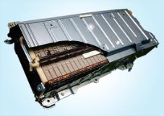
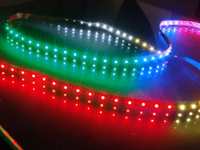
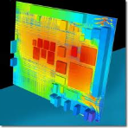
The Power & Lightning Cluster
SS – DS - ML Thick Copper to 210 µm Large size to 700 mm
Flex PCB Ziff connectors
Flex Rigid PCB To 4 Flex layers
Power Management Busbar Planar technology
Thermal Management IMS Internal & external drain
Aviflex Sculptured PCB
Electroluminescence
Power
Lighting
Thermal Management

Slide 11
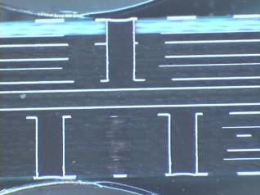
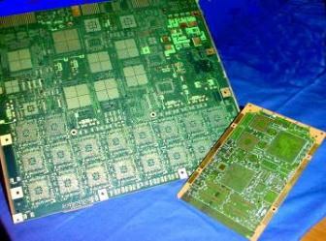
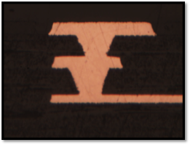
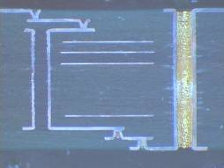
HDI Pcb
SBU
µvias PCB
Stacked & Filled µvias
2+n+2 PCB

Slide 12
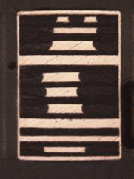
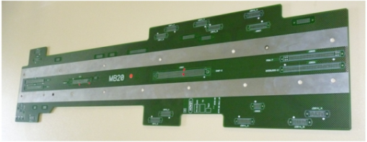
Rigid
*Single Side
*Double side
*Multilayers: 4 to 24 layers
Back Panel – Thickness 2 to 4.5mm
Controlled impedance –
simulation / Measurment
Thick copper to 210µm
Planar technology

Slide 13
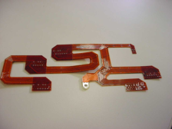
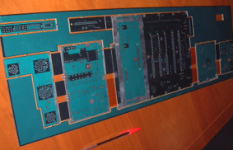
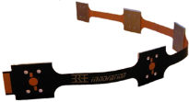
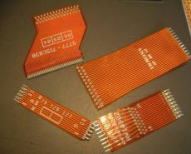
Flex rigid / Flex
Flex :
SS to ML
Zif connector +/-50µm
Flex Rigid :
1 to 9 flex layers
Polyimide – LCP
IMS Flex rigid
HDI
Sculpted Flex :
Cu thickness 100 to 250µm
Terminaisons adapted
Sn & Snpb finishing

Slide 14
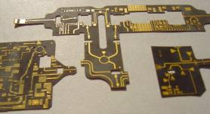
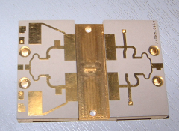
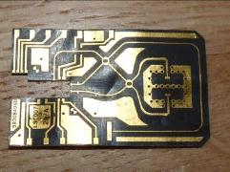
Microwaves
* All Kind of material available:
PTFE
Taconic
Duroid
Neltec
Rogers
Single Layer to Multilayers
Mix build up and full HF material
High accuracy on image and line edge( laser cutting,LDI)
Colaminated PCB

Slide 15
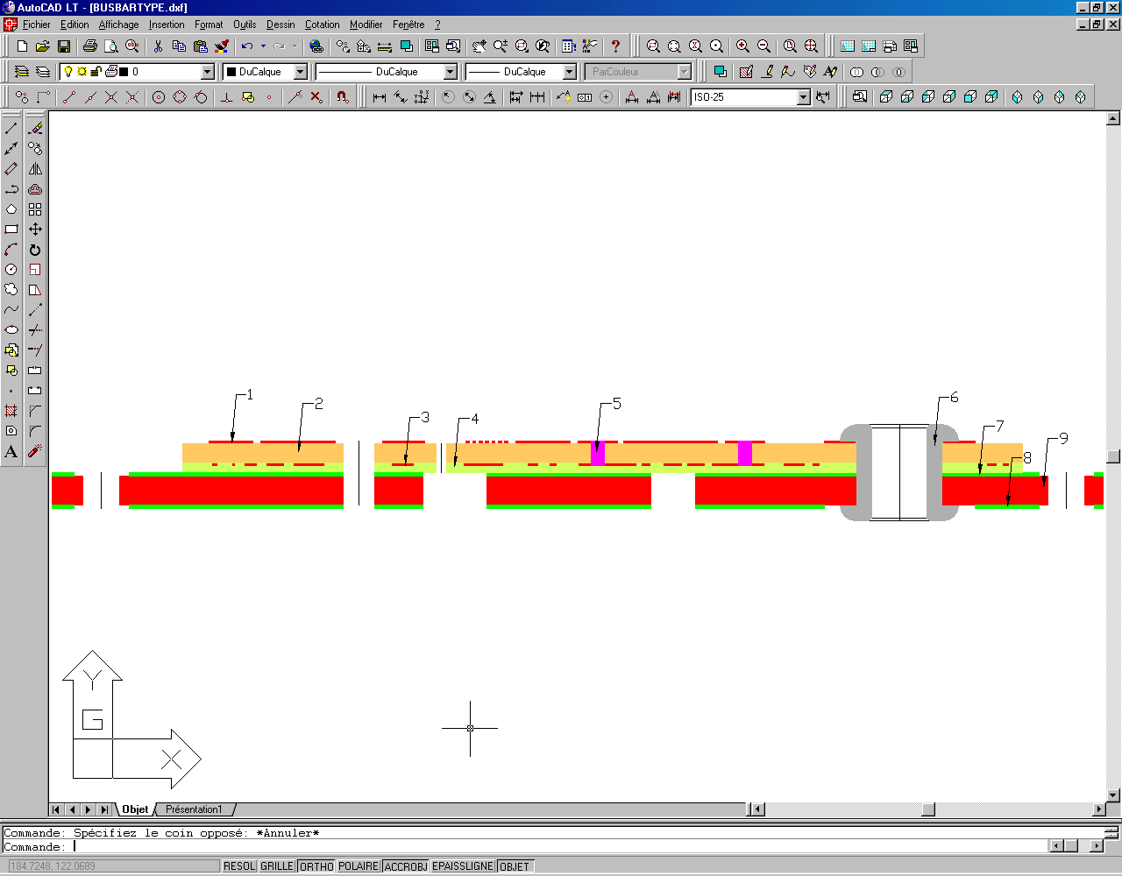
Busbar
1 : Data layer
2 : FR4
3 : Data layer
4 : FR4
5 : Plated through hole
6 : Rivet
7 : Soldermask
8 : Soldermask
9 : Power layer with copper or aluminium (1 to 2mm)

Slide 16
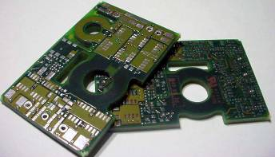
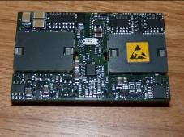
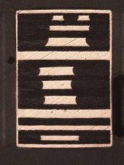
Planar Technology
Power converters :
Planars , Modules
Characteristics:
- High count of layers : 8 to 24
- High copper thickness :
70 to 210 µm
- Plating edges : ½ plating holes
- µvia / Thin dielectrics
New solution :
Embedded Ferrite
Coils created by holes and tracks

Slide 17

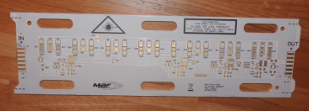
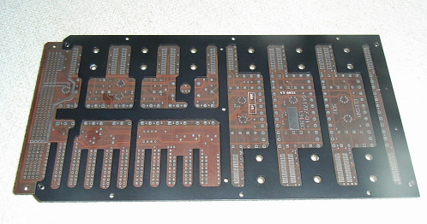
Thermal Management
IMS
Al or Cu foil
Dielectric 0.5 to 2.2W/m°K
ENIG , OSP
Led applications :
ENEPIG – Bonding
Internal & External Drain

Slide 18
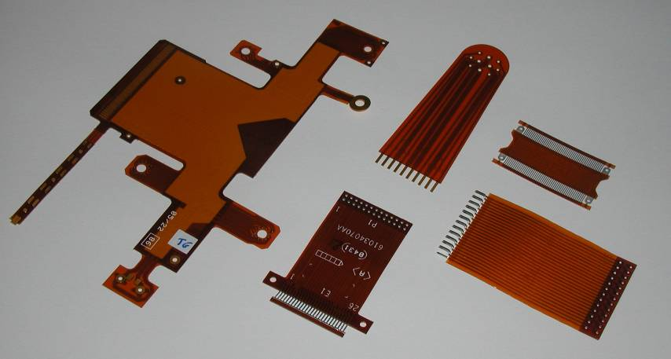
Aviflex & Cireflex PCB’s

Slide 19
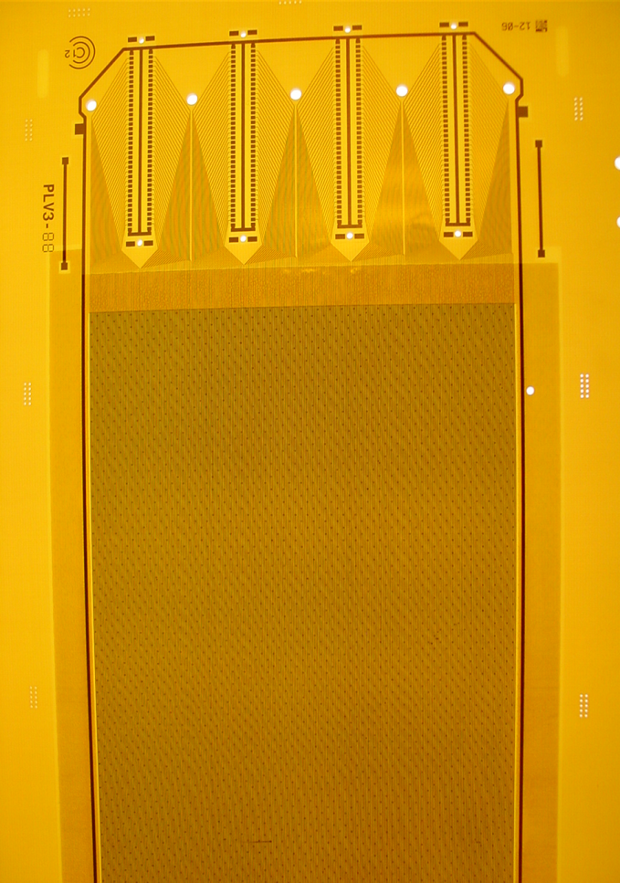
Cirea
Dedicated area for Bulk production

Slide 20
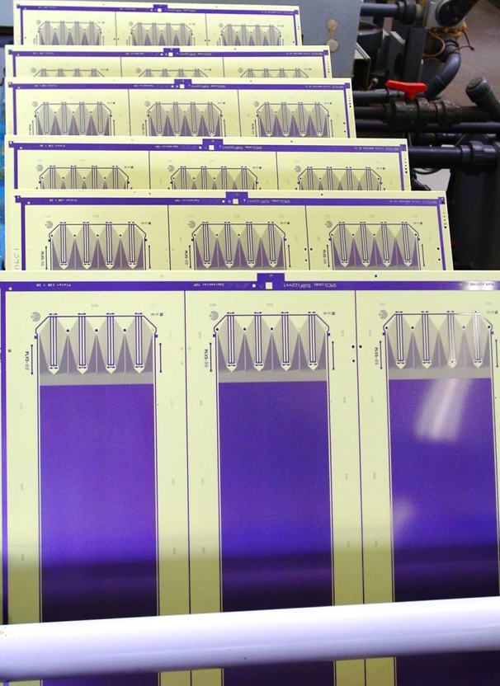
PLV 3 PCB
Production x 3
Panel size : 620 x 576

Slide 21
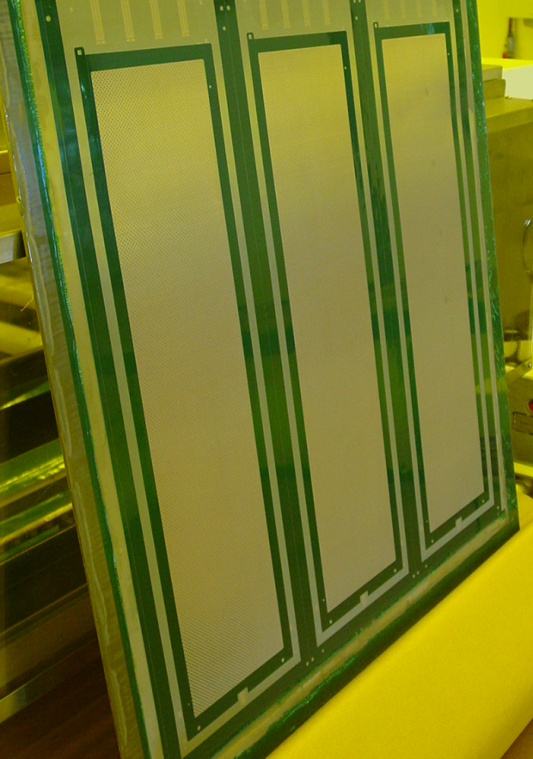
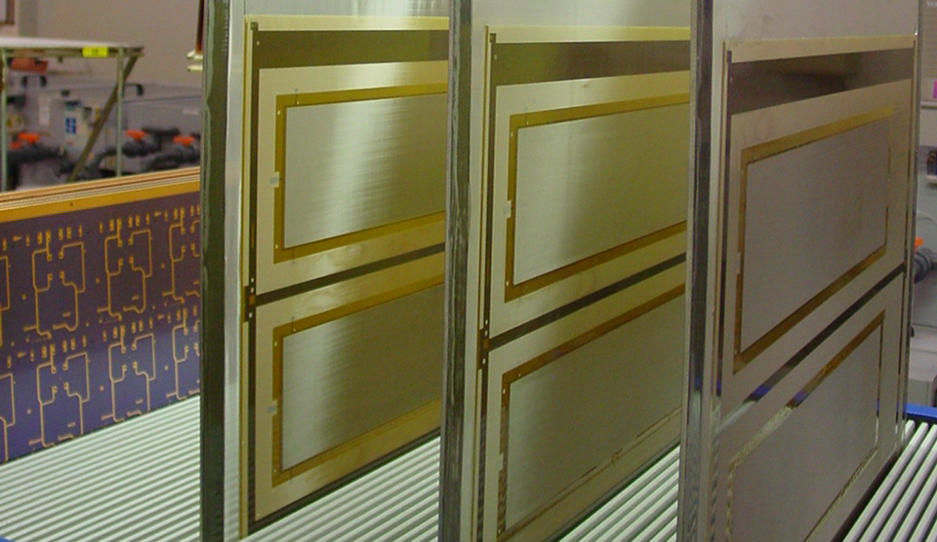
Q1-2012 production
Bulk @ CIREA:

Slide 22
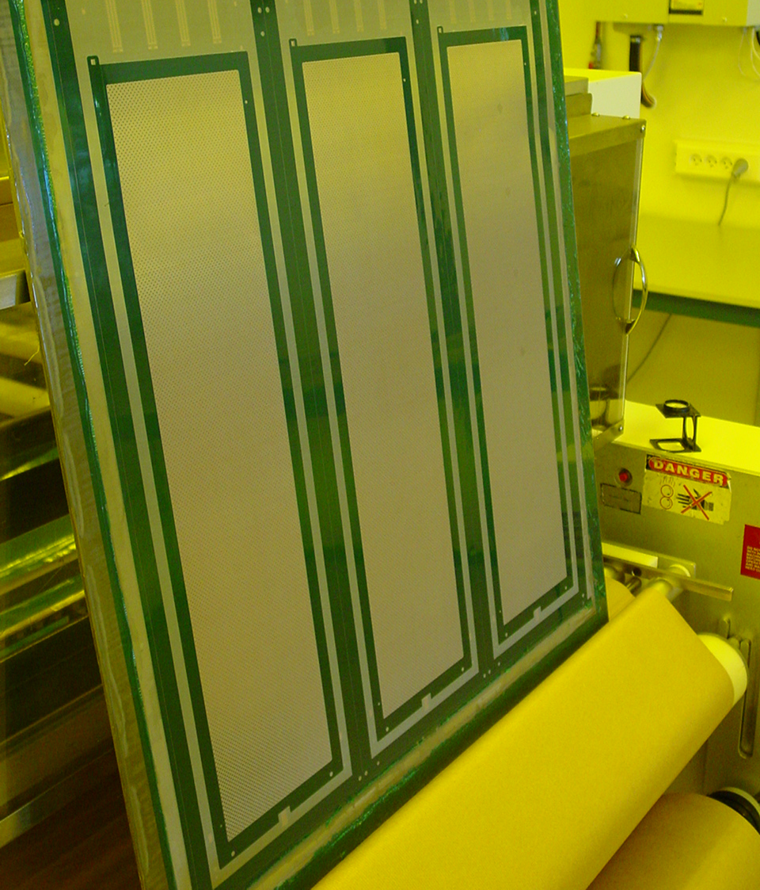
Process
Statut
Coverlay Lamination
Development
Curing
Aspect
Rohacell
Gap PCB & Mesh

Slide 23
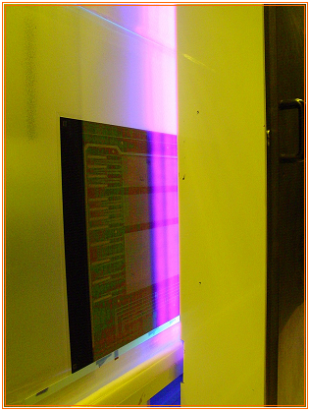
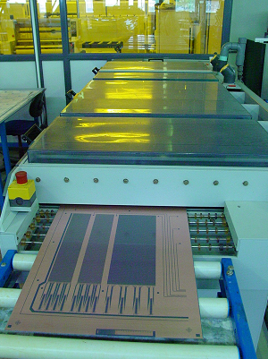
PCB Exposure - Dev

Slide 24
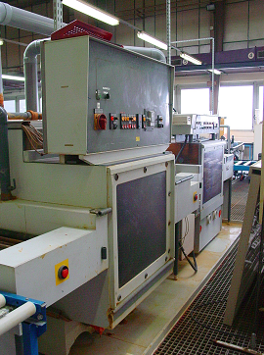
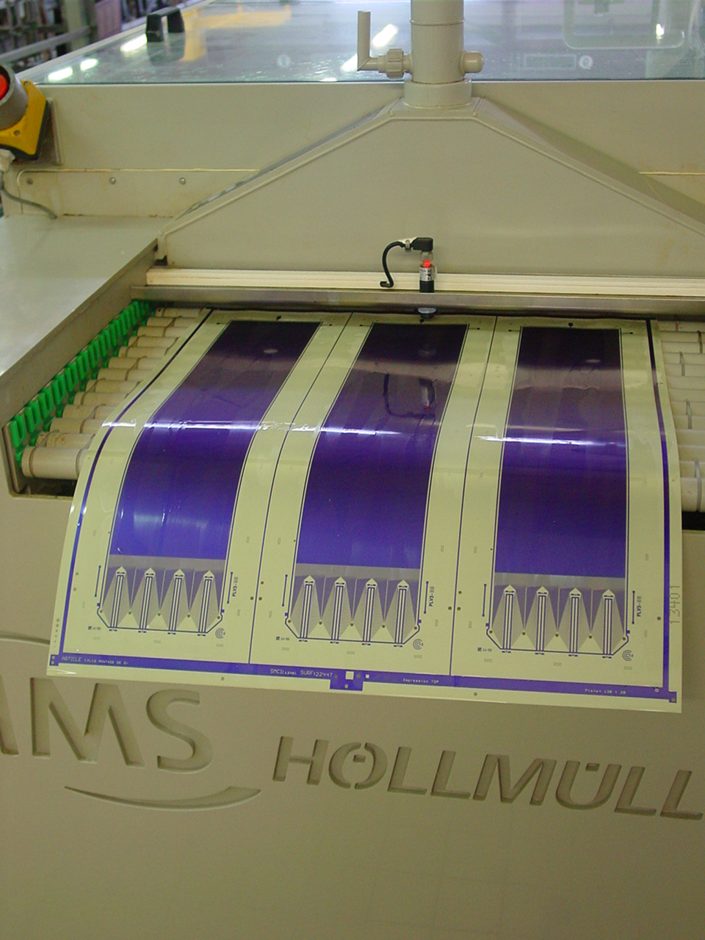
PCB Etching

Slide 25
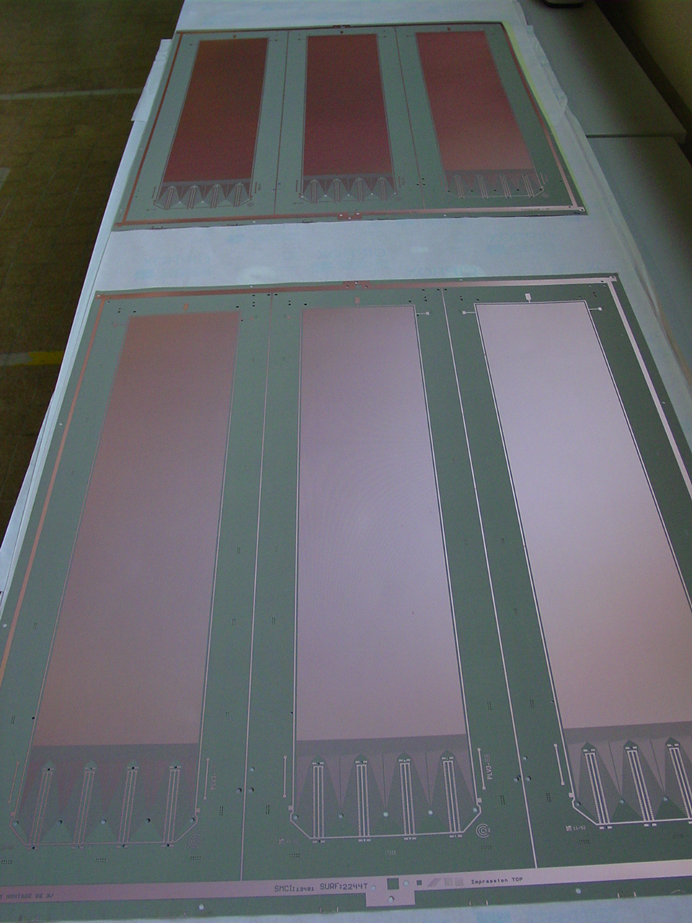
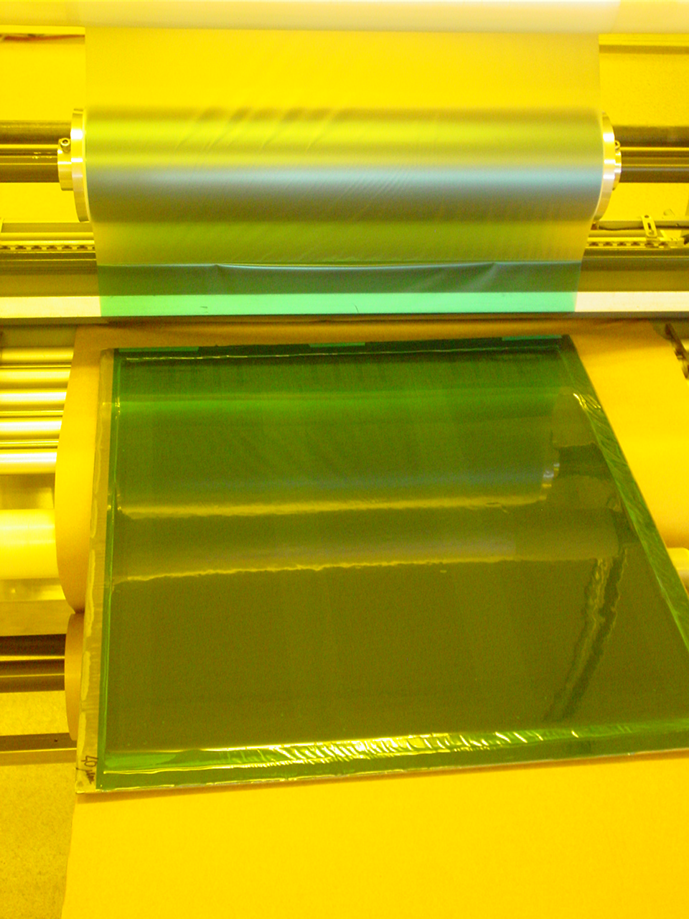
Coverlay Lamination

Slide 26
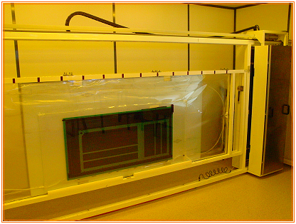
Coverlay Exposure

Slide 27

Coverlay development

Slide 28
Q2-2012
In process for CEA :
Increase panel size
- 680 x 600 (active area 400 x 400 mm )
Design : space at 50µm
Thin material : 0,20 mm
Laminated on rohacell

Slide 29
Q2-2012
In process for CERN :
BXY with resistive layer
  Training done by Rui end of March 2012
  Production of 5 units 100 x 100 delivery in June
  Production of 5 units 600 x 400 delivery in September
  Production of 5 units 600 x 1500 delivery beginning of 2013

Slide 30
Conclusion
Cirea has improved his capability of Micromegas production since this year.
Our target is to be completely ready for this summer for a 680 x 600 panel size without resistive layer
Resistive layer could be available Q3/2012

Slide 31
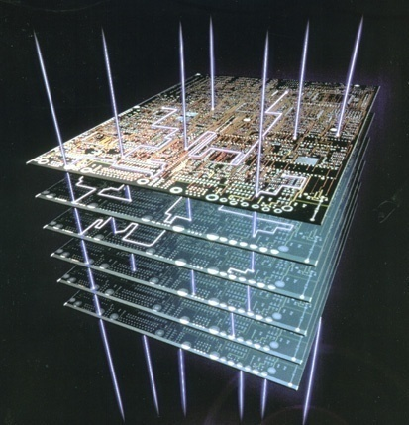
Thanks for
Your attention
Contacts :
Cirea : Yann Duigou yann.duigou@gepcb.com
Sales : Jean-Pol Thiebaut jean-pol.thiebaut@gepcb.com

