Slide 1
The Technology Transfer Network HEPTech and the MPGD Pilot Initiative
Industry Academia Matching Event on MPGD Technologies
LAPP, Annecy, France
27 April 2012
Hartmut Hillemanns, CERN

Slide 2
The Technology Transfer Network (TTN)
Background
17 TTN Members*
  Approved by Council in March 2008
  Cooperation of PP institutions in MS on Knowledge and Technology Transfer matters
  Objectives
    Develop a framework and tools to facilitate TT activities within the PP community
    Launch join technology transfer actions to:
      Foster R&D collaborations with industry and
      Enhance the dissemination of PP technologies to industry
      Raise awareness of researchers on the strategic importance of synergies between research and industry
  Three-year project to meet the above objectives
    Nodes are financing their participation in the TTN
    In-kind contributions of individuals to perform the community tasks
CEA/DSM | France
CPAN | Spain
CERN
CHALMERS | Sweden
Copenhagen University | Denmark
CNRS/IN2P3 | France
DESY | Germany
EPFL | Switzerland
GSI | Germany
ILL | France
INFN | Italy
LIP | Portugal
IJS | Slovenia
PSI | Switzerland
NTU Athens | Greece
STFC | United Kingdom
University of Sofia | Bulgaria
(*) KFKI, Hungary has an observer status

Slide 3
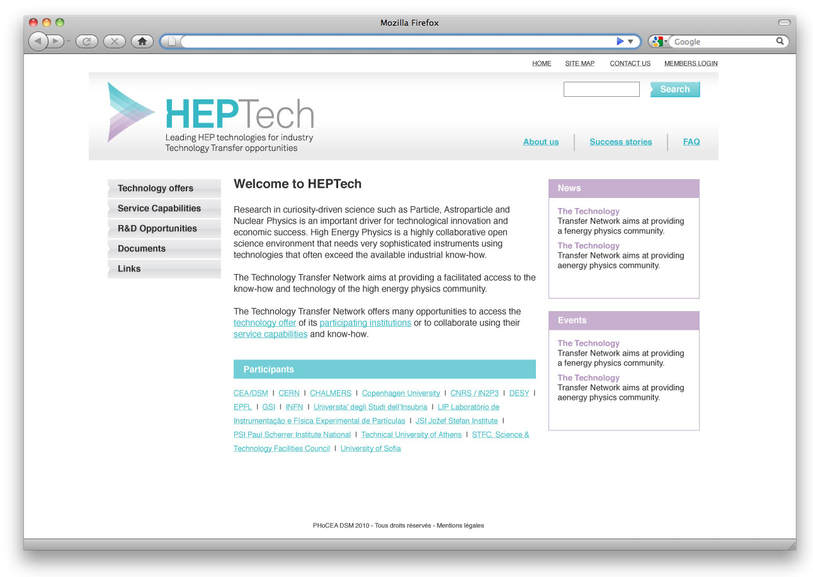
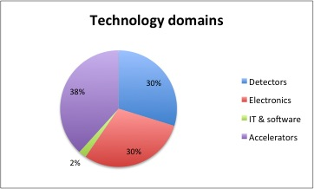
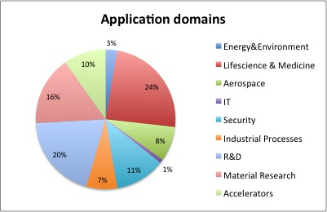
Tools & infrastructure
Intellectual Property Charter
  A framework to streamline principles for conducting joint technology transfer actions
  Following the guidelines from the EC
  Constituting the basis for an IP and TT implementation policy
    Such policy is now in place at CERN;
    Other Nodes are preparing similar ones
  Charter has now been adopted by the Nodes
TTN Website (HEPTech.org)
  48 technology and services offerings
  12 success stories
  Documentations
  Events

Slide 4
Joint Technology Transfer Actions
A study on technology transfer activities during the LHC construction presented at the 12th European Strategy session of Council on June 24 2011 indicates that:
  A large fraction of the CERN know-how and technologies is not patentable
    Patents are not the most suited protection for know-how and electronics
    Complex joint-ownership of developments reduces the chances of filing patents
    Results of R&D partnerships with industry are an additional source of patents (co-ownership)
=>Joint academia-industry development efforts with a view to building demonstrators are more likely to yield to a more effective transfer in which patenting comes as a results and is better focused on exploitation
The TTN has put in place joint technology transfer actions adapted to the particular features of particle physics:
  Strategy for each case:
    Careful review of the intellectual property situation
    Establish a good estimate of application prospects
    Select the most suitable action or set of actions

Slide 5
Joint Technology Transfer Actions (2)
Three main lines of actions can be pursued and eventually combined for key technologies involving many PP laboratories
  Technology pooling
    For technology ready to be used and showing complementarity
    Ex: Ultra-vacuum technologies for accelerators
  Fostering R&D collaborations on the development of pre-industrial prototypes
    For technologies requiring further applied R&D to increase their market readiness
    Concerted offerings addressing the development of pre-industrial prototypes
    Ex: Micro Pattern Gaseous Detectors
    Ex: Mini-cyclotron for producing medical isotopes
  Academia-industry matching events
    For technologies manufactured by industry that are considered as strategic for the R&D programme and for which the community holds significant system expertise
    Increased prospects of partnering with industry
    Ex: MPGD event

Slide 6
Why a MPGD-Pilot Proposal ?
First pilot case: Micro Pattern Gaseous Detectors
  Large collaborative R&D efforts from PP community (RD-51, more than 70 institutions involved, not only PP institutes, important interest from industry);
    Good case to define a collaborative scouting model
  Evidence for patent pooling (GEM, MicroMegas, front-end readout, software, etc.)
    Very good case for the development of a collaborative push and pull model
    First data to test community building tools; specify value and meaning of a PP brand
    Test of concerted communication strategy
  Important and very visible case currently addressed by members of the TT Network individually with a limited collaboration at the TTO level
  TT Network member institutes participating in RD-51
    CEA, CERN, CNRS, DESY, INFN, GSI, LIP
    NTU, KFKI (TT Network Observer)

Slide 7
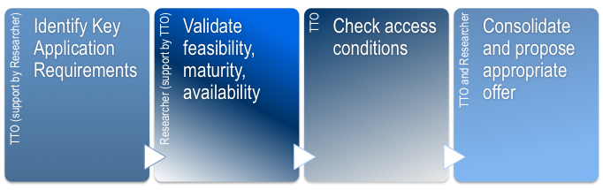
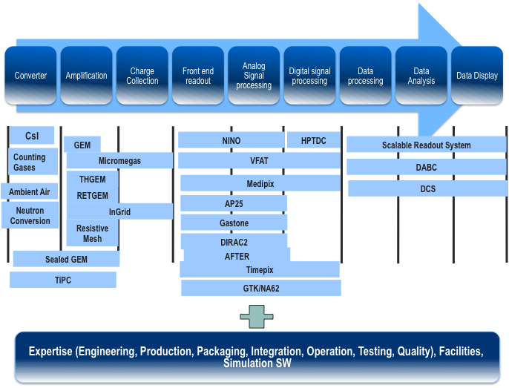
Pilot Technology Offer for MPGD (RD-51)
TT Network Nodes in RD51:
CEA, CERN, CNRS-IN2P3, DESY, INFN, NTUA, LIP (KFKI: Observer)
  RD-51 technology inventory consisting of information on the main technologies, expertise, production methods, test facilities and patents
  Classification of entries according to a conceptual gaseous detector
  User requirements elicitations for application devices in key domains
  Elaboration in collaboration with researcher of application device offers meeting user requirements and according to the conceptual gaseous detector layers

Slide 8
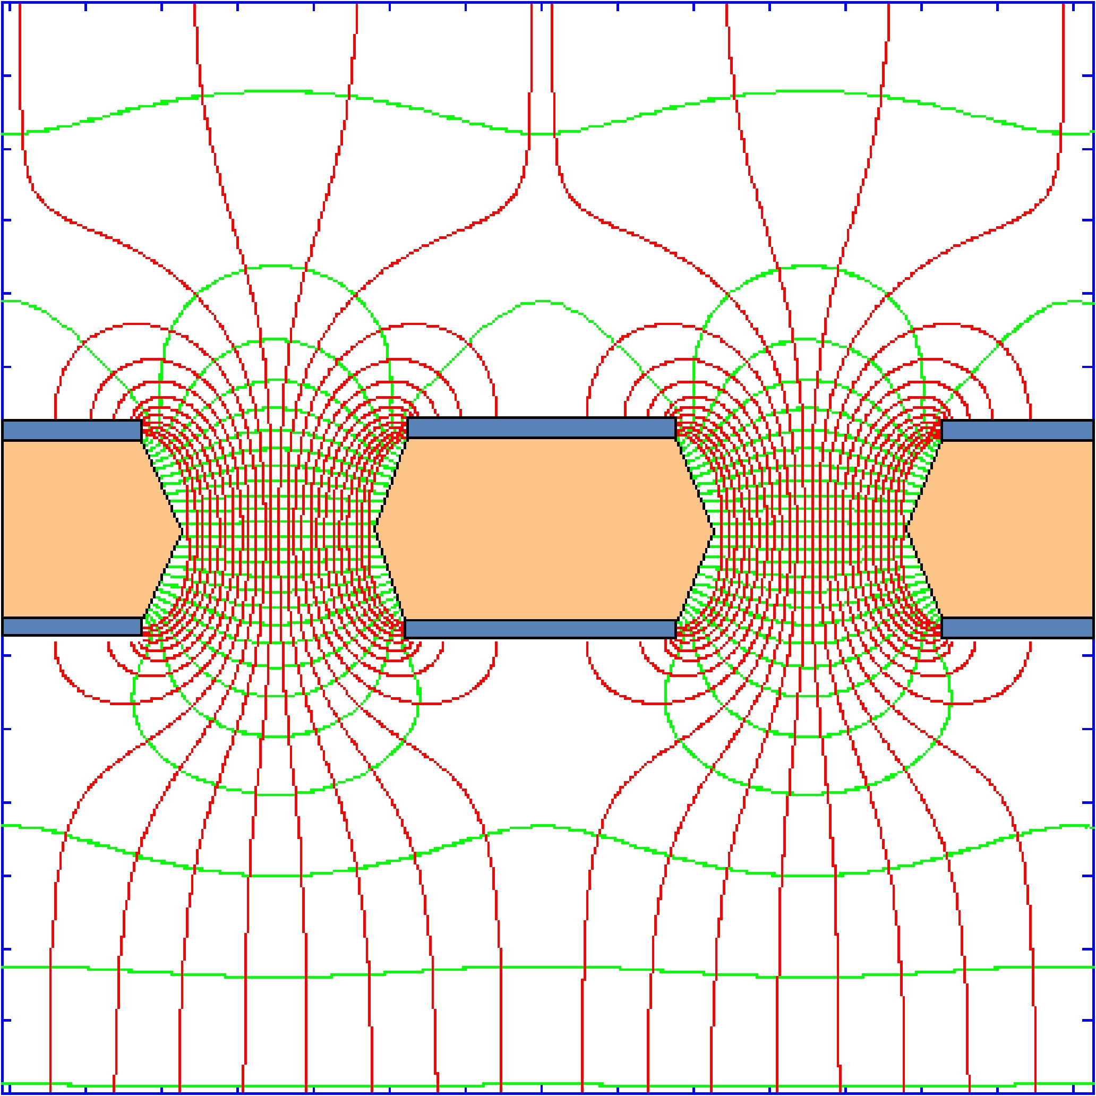
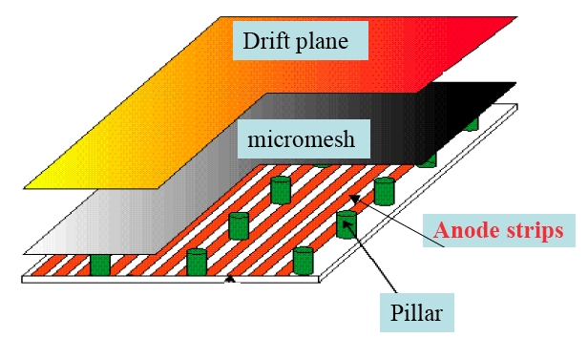
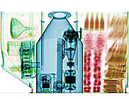
Micro Pattern Gaseous Detectors
R&D collaboration (RD-51, 75 labs) to develop advanced gas-avalanche detector technologies and associated electronic-readout systems, for applications in basic and applied research
  Inventory of RD-51 technologies and know-how
  Selection of competitive market segments for MPGD technologies:
    Large area portal monitors with γ and neutron detections for homeland security
    Muon tomography for high-Z material detection in containers
    Burning plasma diagnostic
    Neutron flux measurements
    And many others (as seen at this MPGD even)
  In-depth literature review and interviews with end users and experts
  Market study conducted in collaboration with the University of Vienna
    Good market prospects for combined γ and neutron scanners
    Recommendation: Air cargo scanner prototypes with R&D institutions specialised in security matters and manufacturers
©CSIRO

Slide 9
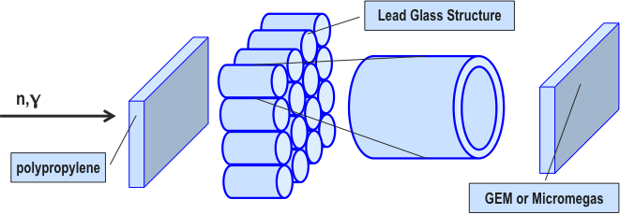
  Progress on technical issues
Activities:
  Many presentations and discussions during MPGD2011 in Kobe (JP)
  Significant progress in the production and test of large area MPGD (both GEM and MicroMegas)
  Technical discussions with INFN Bari (V.Berardi, G.Catanesi)
  Main findings:
    Simulations for gamma detection: 1-2% possible (R.Veenhof)
    Preliminary simulations for neutron detection (Berardi): >0.5% will be difficult for 1-layer system
      Imaging relatively easy for many applications (e.g. beam monitoring, where efficiency is not an issue)
      Simulation of multilayer system planned
    Alternative solution based on a less costly liquid scintillator matrix readout by photosensitive ThickGEM detectors (A.Breskin)
      Unfortunately there is a dramatic mismatch between emission wavelength and quantum efficiency
      Solutions based on LXe work better but are difficult to operate under harsh conditions
    There is a “closed” community of groups working on homeland security detectors
    Being part of this community requires credibility and experience (thus a lot of R&D)

Slide 10
Proposed projects
Various project proposals resulting from this initiative:
  Proposal submitted to the STFC Challenge Led Applied Systems Program (acronym CLASP Proposal )
    Demonstrator prototype of a cargo scanner using Micro-Patterned Gas Detectors
    In collaboration with University of Glasgow- School of Physics and Astronomy
    Proto-collaboration in view of an FP submission: FP7-SEC-2012-1 security
  Topic SEC-2012.3.4-4 Innovative, cost-efficient, and reliable technology to detect humans hidden in vehicles/closed compartments - Capability Project
    Detection of human hidden in vehicles/closed compartments
    In collaboration with JRC and Georgia Tech in US + 1 partner in security (SECURITAS) probably.
  CERN KT fund project: “Development of GEM detectors for environmental applications”
  CTI project on the improvement of ⁴He based detectors for SNM detection
Rejected
Abandoned
Approved
Submitted

Slide 11
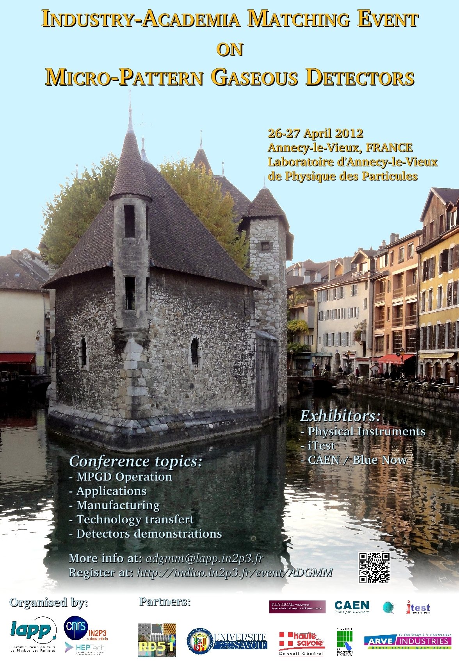
  Lessons learned in this initiative
  Building full commercial systems is unrealistic for HEP laboratories
  Seek public funding for demonstrator prototypes that “solve issues” in and match needs of application domains in a cost effective and reliable manner:
    Small and manageable projects (be aware of resource needs !!!)
    Synergies with ongoing HEP R&D activities
    Synergies with more experienced partners in the field
    Gain expertise and credibility
    Concentrate on the core competencies of HEPTech nodes
    Network building
  Demonstrate production capabilities of key MPGD technologies at industrial scale (GEM, THGEM, MicroMegas, SRS)
  Enhance visibility and brand of MPGD technologies and expertise and its community through dedicated events:
Academia Industry Matching Event (AIME):

Slide 12
A model for setting up R&D collaborations with industry?
Analysis of the situation
  PP laboratories with important experimental facilities
    Have expertise and technology that can significantly benefit a large variety of applications
    Lack resources (Human and Financial) and time to take care of the construction of the pre-industrial demonstrator
      Same experts to work on too many projects
      Compensations
  Multi disciplinary Institutions
    Active in applied R&D
      Have expertise on aspects that are complementary to PP
      Have pertinent industrial contacts
      Have access to dedicated national funds to support the construction of pre-industrial demonstrators
    Interest in building in-house expertise on PP high-tech matters
      To position itself better with respect to the PP Community
    Interested in enhancing their visibility
      At the national level
      With the PP community

Slide 13
A model for setting up R&D collaborations with industry? (2)
What can be done more in the future ?
  Maintain and enhance the MPGD inventory (both in terms of technologies and applications)
  Advertise available technologies, know how, expertise and infrastructure
    GEM’s, MicroMegas, THGEM’s, etc.
    Various readout ASIC’s and SRS
    Integration and characterisation
    Test facilities
  Define terms and conditions of access to such technologies (patents, licenses, etc.)
  Keep your eyes open regarding potential use of MPGD technologies in various application domains
  Seek synergies with on-going R&D for high energy physics purposes (LHC upgrade, other experiments)
  Identify appropriate project partners (both from academia and industry)
  Ask experts for support regarding funding schemes and project management
HEPTech is a pool of expertise and contacts and acts as a facilitator and catalyst

