Slide 1



Scientific thinking, Business thinking
THE CIFRE SCHEME
Industrial contracts for training through research
LAPP-IN2P3 CNRS-HEPTECH
Annecy, 27th april 2012
Carole MIRANDA – ANRT, Paris
In charge of Cifre promotion actions

Slide 2
THE PURPOSE OF THE CIFRE
To enable PhDs student to progress in the best scientific working conditions
To enhance public/private research partnerships between companies and academic research laboratories

Slide 3
WHAT IS THE CIFRE SCHEME ?
ANRT runs the CIFRE scheme on behalf of the French Ministry
of Higher Education and Research
Scientific expertise means :
Evaluation of the quality of the research
project and how appropriate it is to the
doctoral training and the business sectors
Economic expertise means : Evaluation of the company ‘s commitment, the company’s financial health and its capacity to support the PhD ‘s scientific training
Partnership research project
FRENCH
COMPANY
ACADEMIC
LABORATORY
CIFRE
Gives the PhD
a research project
Supervises the thesis
from an academic point of view
PhD STUDENT

Slide 4
WHAT IS THE CIFRE PROCESS ?
ANRT signs the CIFRE with the company
14,000 € per year
during 3 years
+ Research tax Credit (CIR)
For at least 10,595 €
Collaborative contract
FRENCH
COMPANY
ACADEMIC
LABORATORY
CIFRE
Fixed-term contract of 3 years
or permanent contract
23,484 € /an mini
Annual registration
in the doctoral school attached to the academic laboratory
PhD STUDENT

Slide 5
Companies appreciate the CIFRE scheme to…
Create a team of talents regardless of nationality
Access to the best public research in all fields of science and technology
Work with a French and foreign laboratory
Benefit from an annual grant of 14,000 €
Benefit from the French Tax Research Credit (CIR) for at least 10,595 €
Resquests can be filled all year !

Slide 6
Co-tutorial agreement with a foreign laboratory…
Phd Student
Foreign academic laboratory
Co-tutorial
agreement
CIFRE
French
company
French
academic laboratory

Slide 7
Breakdown of results identified by companies
(Results for 11,808 CIFREs since 1981)
Notes:
7

Slide 8
Scientific production (1/2)

Slide 9
Scientific production (2/2)

Slide 10
Business activities involved in 2010
Notes:
10

Slide 11
Companies involved in CIFRE in 2011

Slide 12
Interests for the PhD Student
A professional research-linked experience performed in academic and business contexts
The acquisition of a bicultural minded
Transferable skills, job opportunities
The benefit of a double supervision :
  The thesis ‘ supervisor
  The expert in the company
A minimum gross annual salary of € 23,484
Thesis defence rates (all fields): 85% for the CIFRE completed in 2010
Short job-seeking period (>90% within 6 months and >96% within 12 months

Slide 13
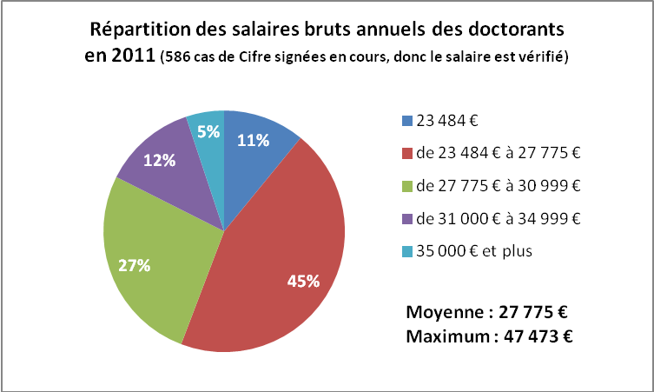
Salary of the PhD students
In 2011, the average salary for PhD students was € 27 775

Slide 14
How doctors are employed after completing a CIFRE ?
(figures of 2010)

Slide 15
A pool of international PhD Students

Slide 16
Academic Laboratory appreciate the CIFRE Scheme to…
Do business-oriented research in collaboration with companies
Enhance their research results
Extend their network and reputation
A doctoral fellowship
Position the PhD student in scientific employment conditions
Notes:
16

Slide 17
Scientific Fields involved in 2011
Notes:
17

Slide 18
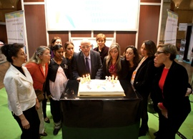
The CIFRE Scheme is 30 years’old !
Progress Report
14,000 PhD awarded since 1981
7 000 companies
4 000 academic laboratory
More than 2,000 patents
Today
3 850 CIFRE are in progress
1747 application forms received in 2011
1 300 CIFRE funded in 2011
1350 CIFRE open in 2012

Slide 19
Criteria for awarding a CIFRE
  COMPANY
  You must be a socio-economic outfit (company, association, territorial authority, etc…) under French Law
  PhD STUDENT
  Not hold a Master’s degree or equivalent diploma from an engineering or business school for more than 3 years when applying for a CIFRE
  Not have been enrolled in a doctoral school for more than 9 months when applying for a CIFRE
  Not have been employed in the company for more than 9 months when applying for a CIFRE
  Be of any nationality
  Specialize in any field
  ACADEMIC RESEARCH LABORATORY
  You must be a research laboratory that is part of a university, a school or a public research body

Slide 20
Tools to find partners
➲ A platform linking partners
➲ A directory of skills research units

Slide 21
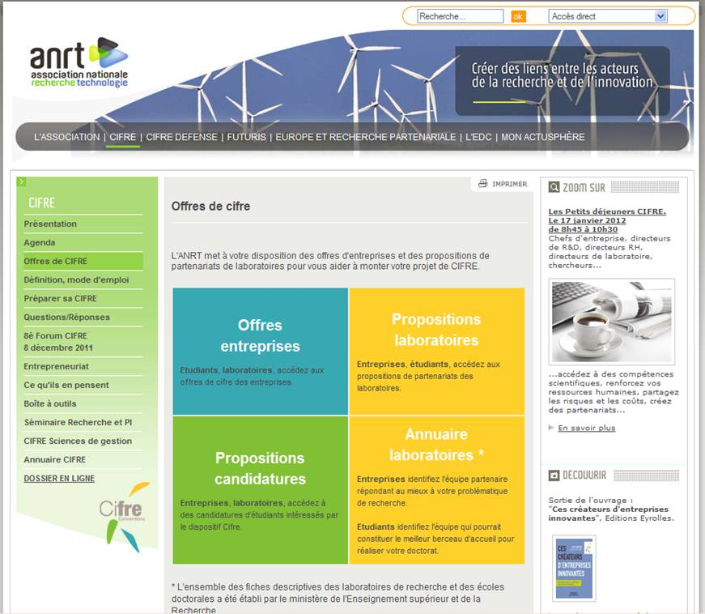

Slide 22
Content of the application forms (1/2)
Summary that covers the main points
1. Identity card of the company, conditions of employment of the PhD Student
➲ We need a letter signed by the person with authority to implement the project and supervise the PhD student
➲ A presentation of the company
2. Presentation of the PhD Student
A detailed chronological CV
A cover letter
Certificate + Marks

Slide 23
Content of the application forms (2/2)
3. R&D Project ‘s description
Description of the intended R&D project in 3 or 4 pages : context and needs, scientific goals of the research, progress beyond the state of the art (scientific obstacles to overcome), methodology and work plan for achieving the scientific objectives, economic impact and exploitation potential, bibliography
4. Presentation of the academic research laboratory
➲ A letter from the director of the laboratory confirming its agreement to supervise the thesis + a presentation of the academic research laboratory
➲ A letter from the director of the doctoral school who agrees to register the PhD student

Slide 24
Evaluation guidelines
The quality of the research project
  The scientific quality, the originality and degree of innovation and progress beyond the state of the art
  Technico-economic impact
The company’s commitment and the adequacy of the project and the chosen approach in the industrial context
  Relevance of the research project for the company
  Commitment and host conditions of the PhD Student
The adequacy of the laboratory and its relevance in the partnership
  Can they provide the expected training through research ?
  Are they competent in the chosen field ?
  Are they known to be open to collaborations with enterprise ?
  4. The quality and adequacy of the curriculum of the PhD Student
  Is the training suitable for the research project ?
  Quality of the curriculum ?
  Date of the master’s degree ?

Slide 25
Registration & statement of an application
Requests can be filled all year
Each month, projects are ranked by the Committee for Evaluation and Monitoring
Response to applications within 3 months
Start of the CIFRE within 4 months
No annual limit to applications per enterprise
Getting ahead in advance !!
www.anrt.asso.fr
Notes:
25

Slide 26
Management of the CIFRE process
Billing/
Report/
Payment
Quaterly
payment
Liquidation/
Follow-up
1 month before
the end
Validation
of the CIFRE
1 month
Registration
Day by day
Evaluation
3 months
Starting date :
date of the work
contract
Eligibility check
Rating allocation
Per criteria
Final payement if questionnaire is back
Collaborative contract to be signed within 6 months after starting the CIFRE
Opinion of the
Committee
Instruction
Acknowledgement
of receipt
Answer : yes or no
Follow-up 6 months after the end if the PhD is unemployed
Annual progress report
Notes:
26

Slide 27
Other companies and laboratories have succeeded ...!
You can do it !
Notes:
27
13

Slide 28
For more information :
www.anrt.asso.fr
cifre@anrt.asso.fr
CIFRE are funded by the French Ministry
of higher education and research

