Slide 1





Toward a new gamma medical imaging technique: the XEMIS project
Presented by Samuel DUVAL
On behalf of the Xénon group
Industry-Academia Matching Event on Micro-Pattern Gaseous Detectors
26-27 April 2012, Annecy-le-Vieux

Slide 2
Compton interactions could be also helpful for γ-rays imaging
With instrument containing
dense liquid (LXe) as detection medium
θ
E₀
Incident MeV γ-rays
E₁, x₁, y₁, z₁
E₂, x₂, y₂, z₂
Good angular resolution (~ 1°) : good energy resolution ( ~ a few %)
good spatial resolution (< 0.5 mm in 3D)
Enough sensitive for γ-rays imaging ? if depth of the detector is sufficient

Slide 3

The XEMIS project
R&D focusing on MeV γ-rays imaging with liquid xenon
and new radioisotopes produced by the ARRONAX cyclotron
The « gold » new prospect: 3γ imaging with ⁴⁴Sc
⁴⁴Sc : detection of the 3rd 1.154 MeV γ
in coincidence with the β⁺ decay
~1 cm resolution along the LOR achievable ?
C. Grignon et al., NIM A 571 (2007)

Slide 4
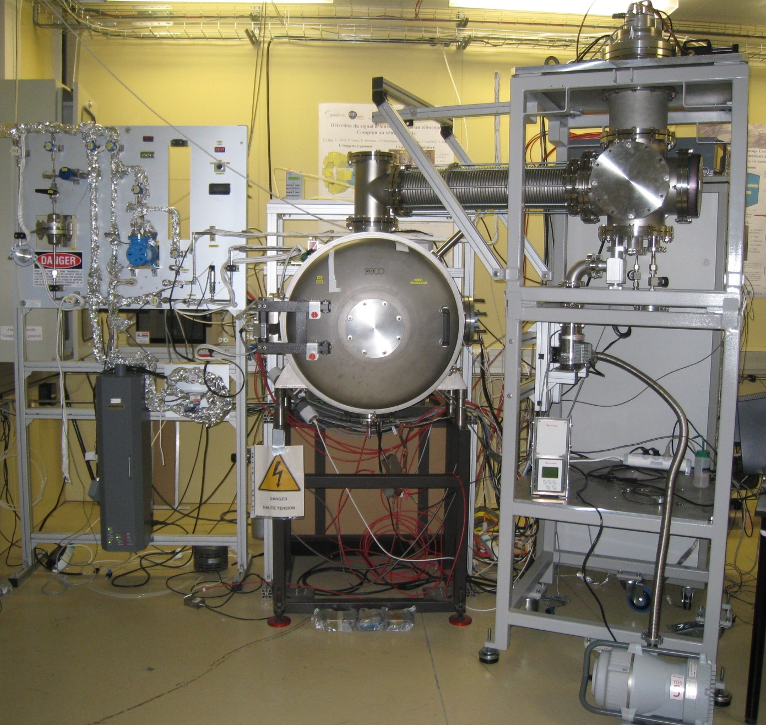

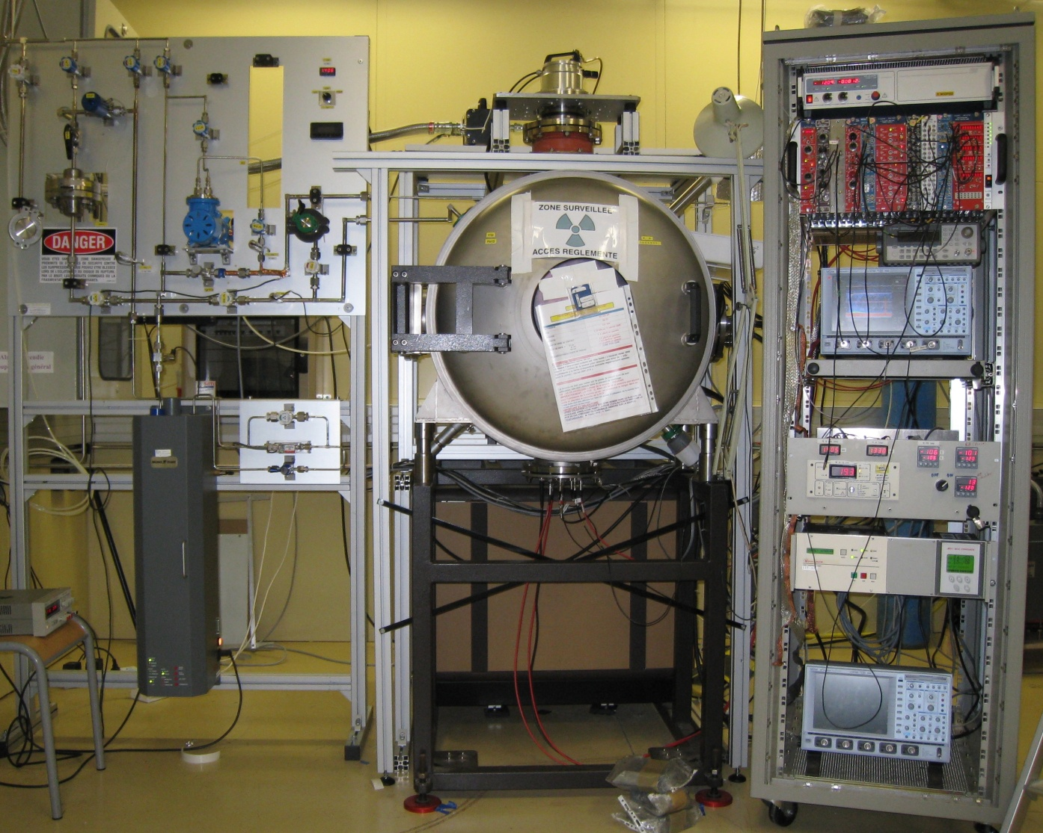
XEMIS 1
“technical” proof of feasibility
PTR
T. Haruyama team
Liquefaction
tower
Cryostat
Closed gaseous purification circuit

Slide 5
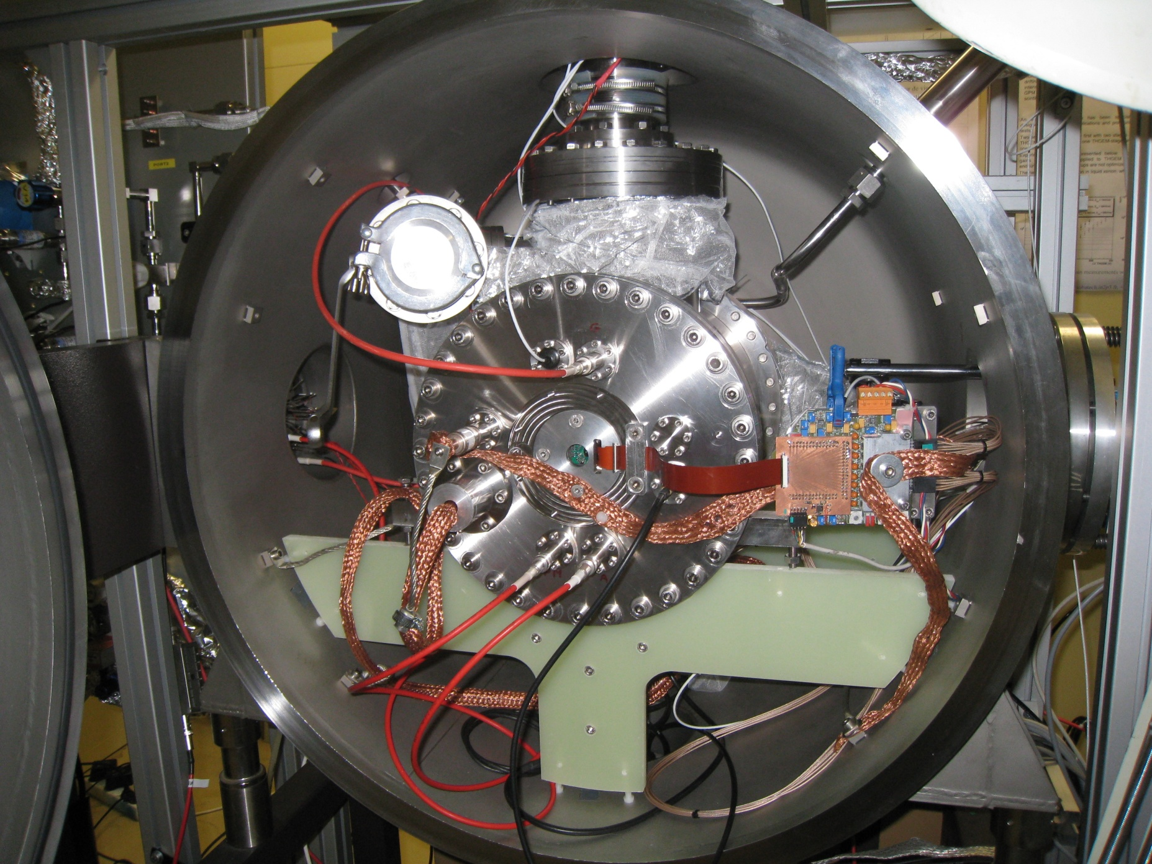
XEMIS 1 cryostat
Xenon inlet
MLI
Xenon outlet
High Volatge
Front-End Electronics
Insulating vacuum

Slide 6
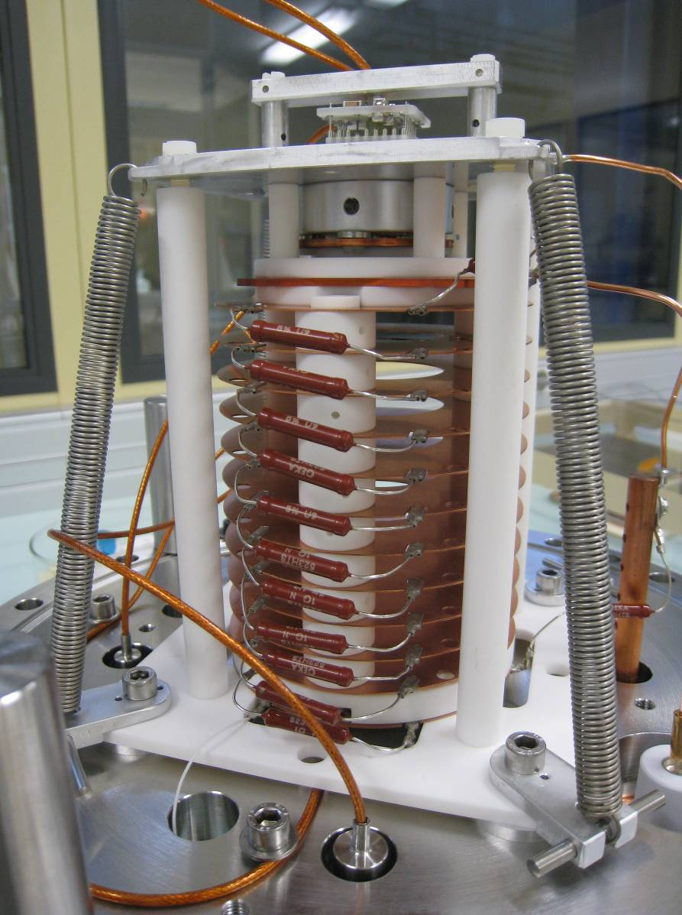
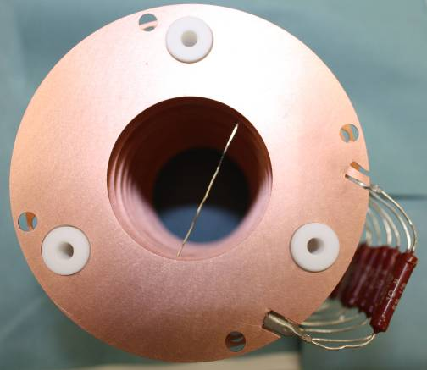
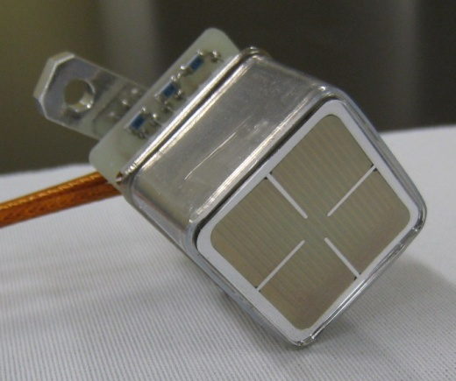
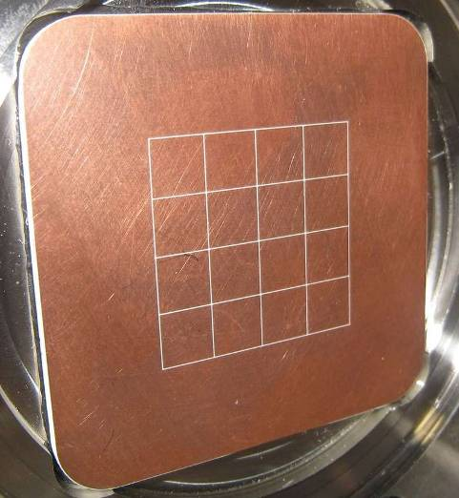
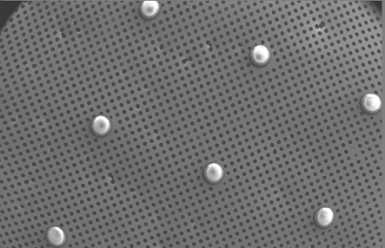
A LXe TPC with MICROMEGAS readout
Shaping rings
PMT
12 cm
2.54 cm
Micromegas Grid
Segmented anode
6.35 x 6.35 mm² pitch

Slide 7

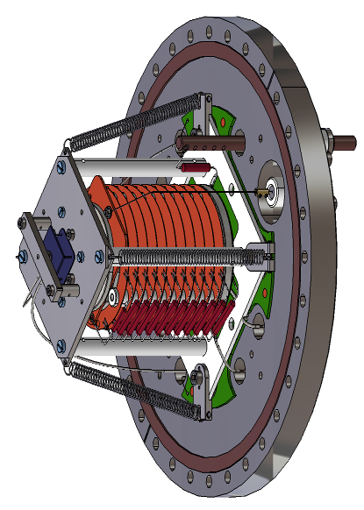

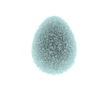
TPC principle
Recoil electrons create both scintillation and ionization in liquid xenon
PMT
Active volume
Time of interaction:
Scintillation light (PMT)
T₀ measurement
12 cm
Energy and position:
Ionization with Micromegas and FEE
Drift time T₁, E, x et y
300 μm
Field rings
Depth inferred from T₀, T₁ and the electron drift velocity :
z = (T₁ – T₀)·v_{drift}

Slide 8
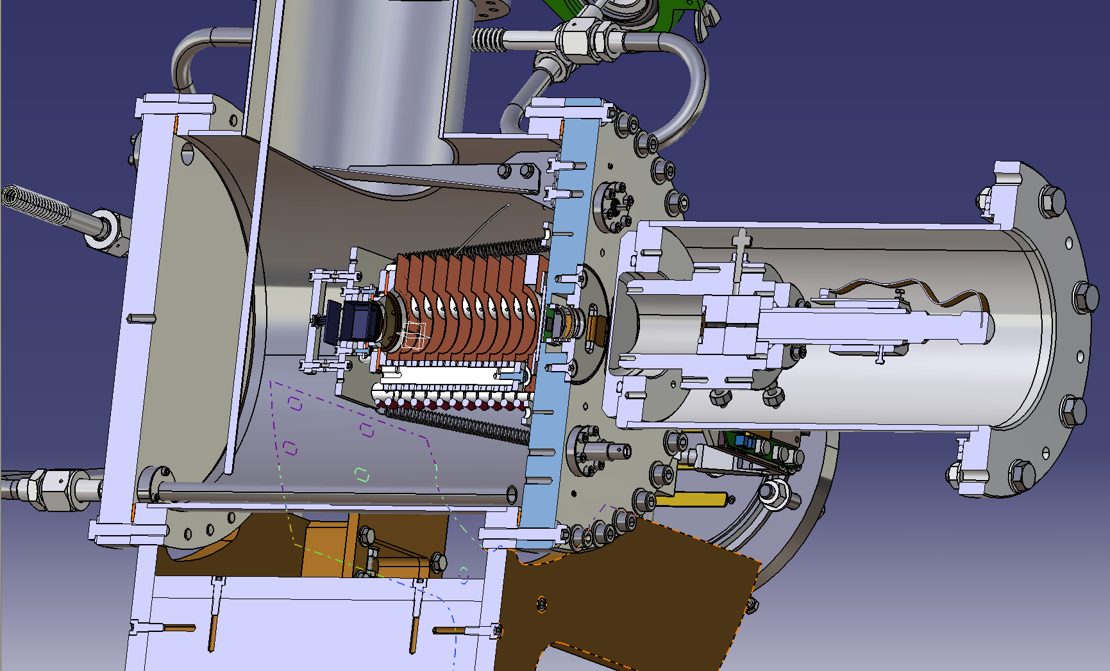
511 keV coincidence setup
CsI Cristal
²²Na source
PMT
TPC
FEE
Collimator

Slide 9
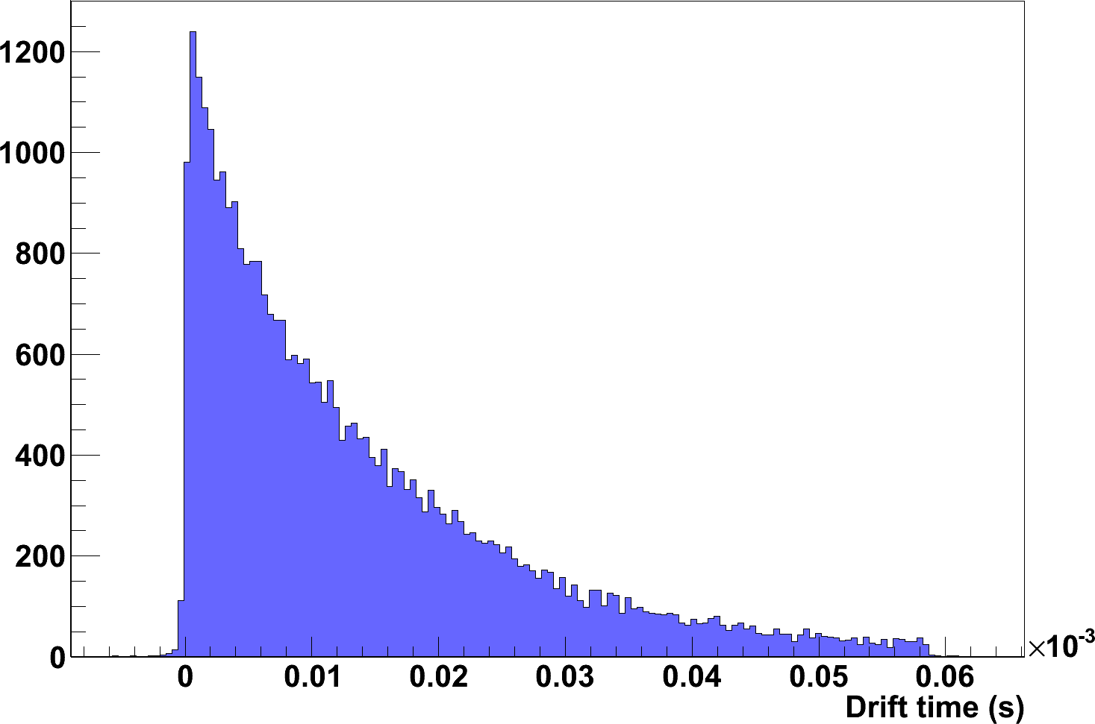
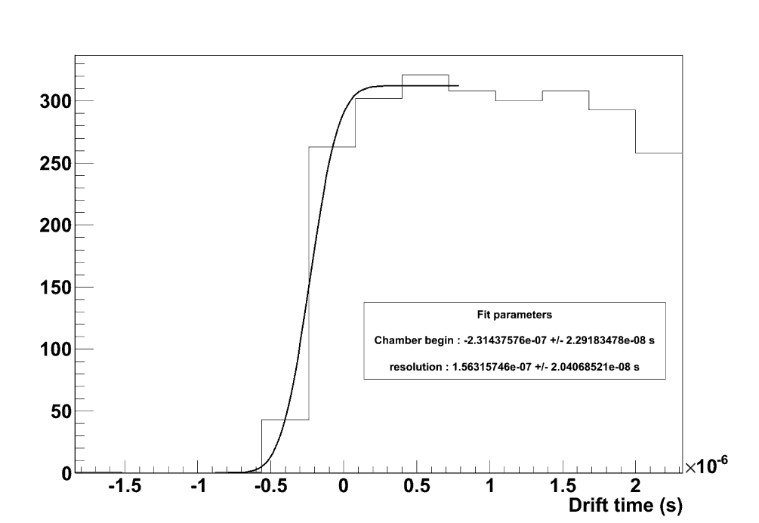
Resolution of interaction depth (@ 511 keV)
Anode side
PMT side
12 cm
Same method to measure the electron
drift velocity
Profile of photoelectric interactions in the TPC
300 µm measured
156 ns x 2 mm/µs
T. Oger et al. NIM A (2011)

Slide 10



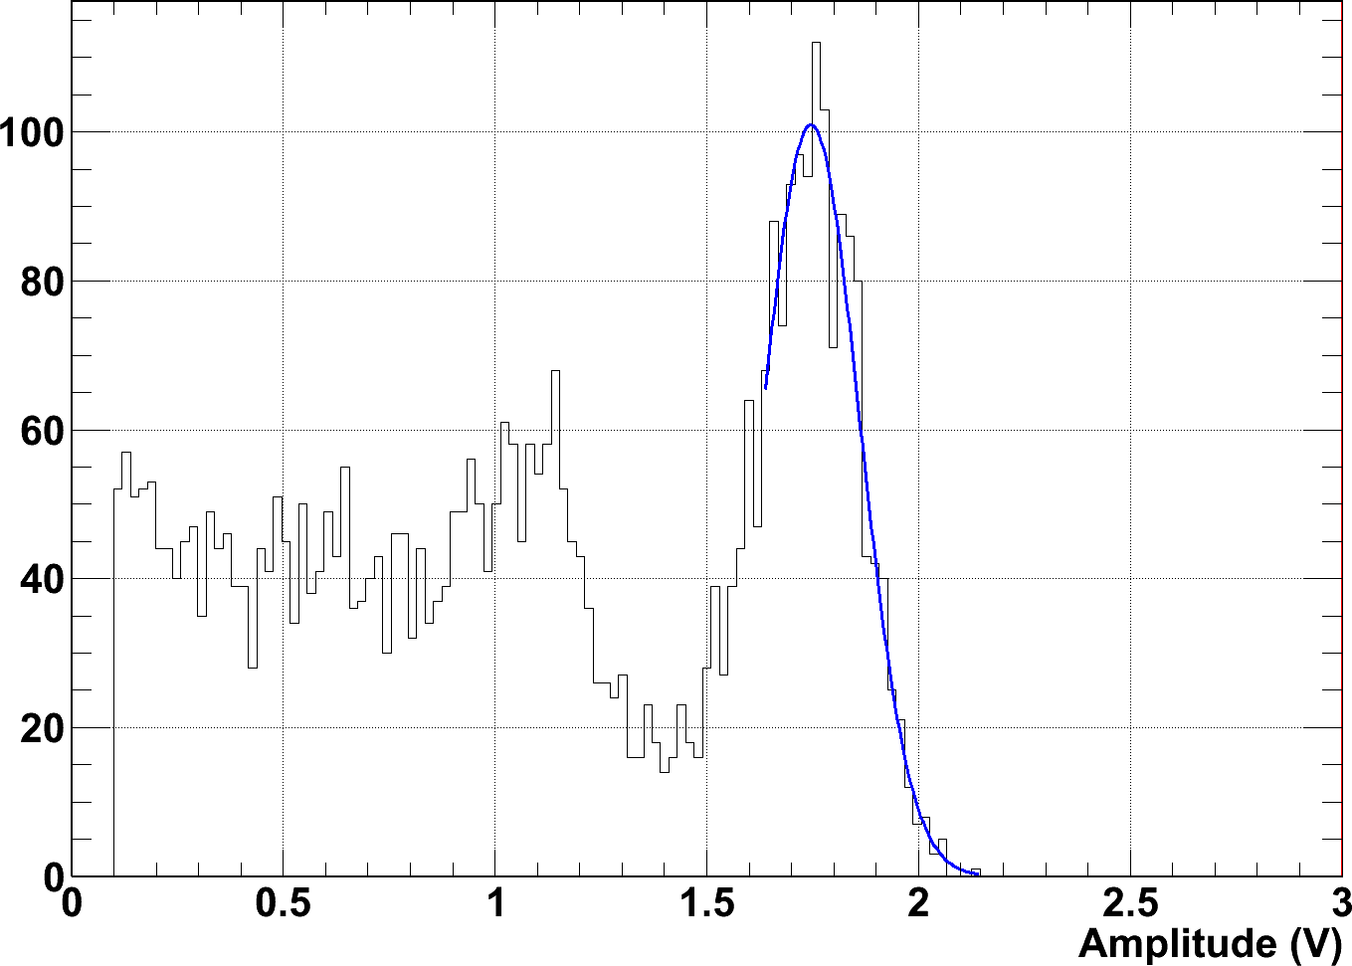
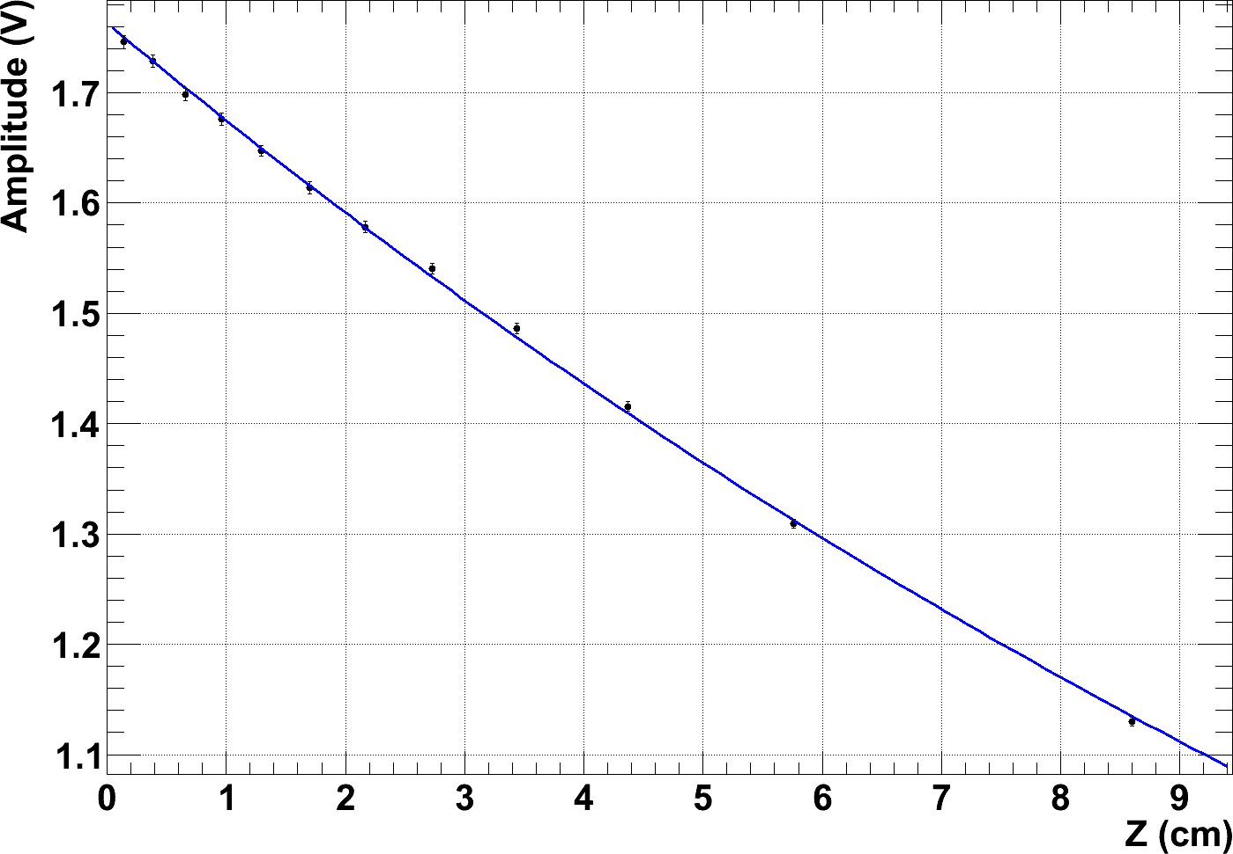
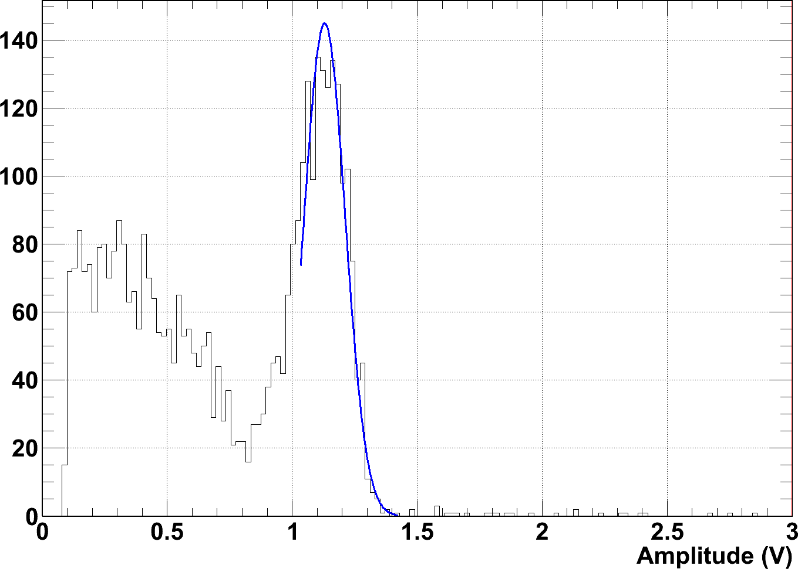
Monitoring of liquid xenon purity
Electronegative impurities absorbe drifting electrons
Z
S = 1.746 ± 0.006 V
S₀ = 1.7623 ± 0.0015 V @511 keV
λ = 19.52 ± 0.16 cm
S = 1.130 ± 0.004 V

Slide 11
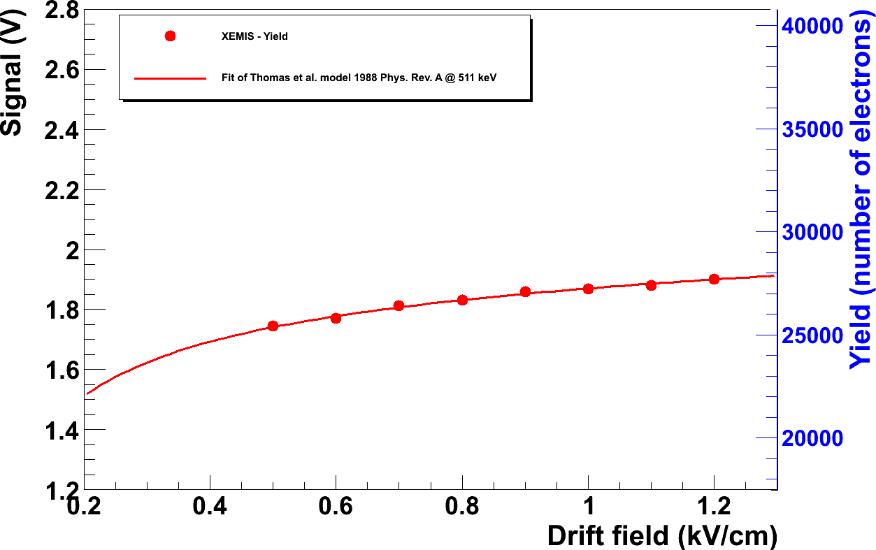
Ionisation yield @ 511 keV
Good agreement with the Thomas model

Slide 12
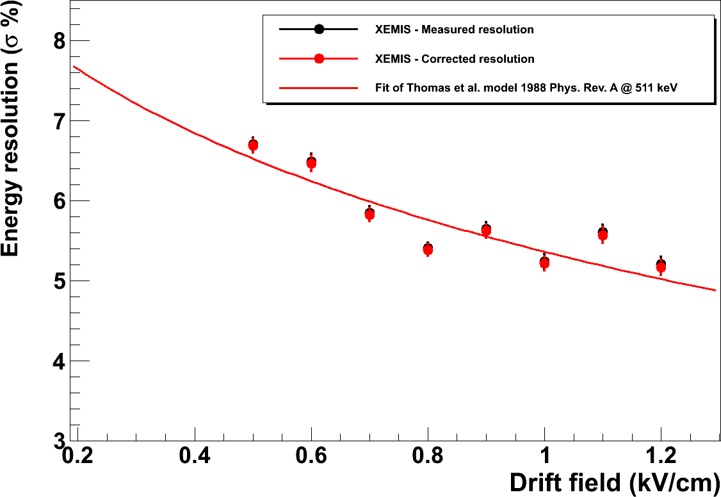
Measured and corrected energy resolution (511 keV)
Very promising measured energy resolution
T. Oger et al. NIM A (2011)

Slide 13
XEMIS1 : what have we learned until now ?
“Technical” proof of concept:
    Intrinsic ionization energy resolution of liquid xenon is achievable with the low noise front-end electronics we developed
    Required spatial resolution for Compton reconstruction is achievable with Micromegas and liquid xenon
    Purification of an important liquid xenon volume is achievable by reproducing the methods used in fundamental researches (XENON100, ...)
What is missing to finish the phase I?
    Higher anode granularity in order to record the whole Compton sequence without unknown corners effect (2012 program)
What is missing to start the phase II?
    Industrial competences to extend the use of cryogenic liquids
    A wise choice of camera design
Toward XEMIS2

Slide 14
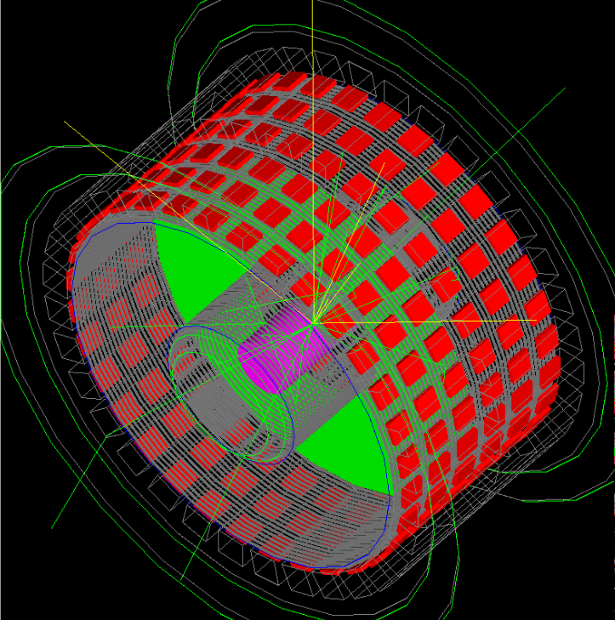
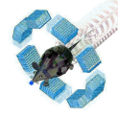
XEMIS2 pre-design study for small animal imaging
with GATE¹
XEMIS2 LXe TPC
PMTs
Cylindrical camera XEMIS2 (~ 100 kg LXe)
Radius 8 < r < 20 cm
Length = 2×12 cm
Electric Field in z direction 2 kV/cm
192 PMTs (also for local trigger)
Micromegas ionization read-out
FEE Idef-X, pixels 3.175x3.175 mm² (~25k channels)
⁴⁴Sc
Anode
TPC characteristics
Intrinsic energy resolution: 5% @ 511 keV
Spatial resolution: 0.5 mm (X, Y and Z)
Cathode
Rat Phantom
Anode
Performances (simulation in progress, PhD student: A.F. Mohamad Hadi)
Efficiency to measure LOR: 30%
Efficiency to measure 1.157 MeV γ-rays: 43%
3 photons efficiency (after selection): ~5%
Precision on localization along LOR ~ 1 cm (FWHM)
Simulation status:
LXe Compton Telescope already implemented in GATE
Future => Simulation with test phantoms (NEMA, Derenzo…) with XEMIS2
¹OpenGATE collaboration: http://www.opengatecollaboration.org/

Slide 15
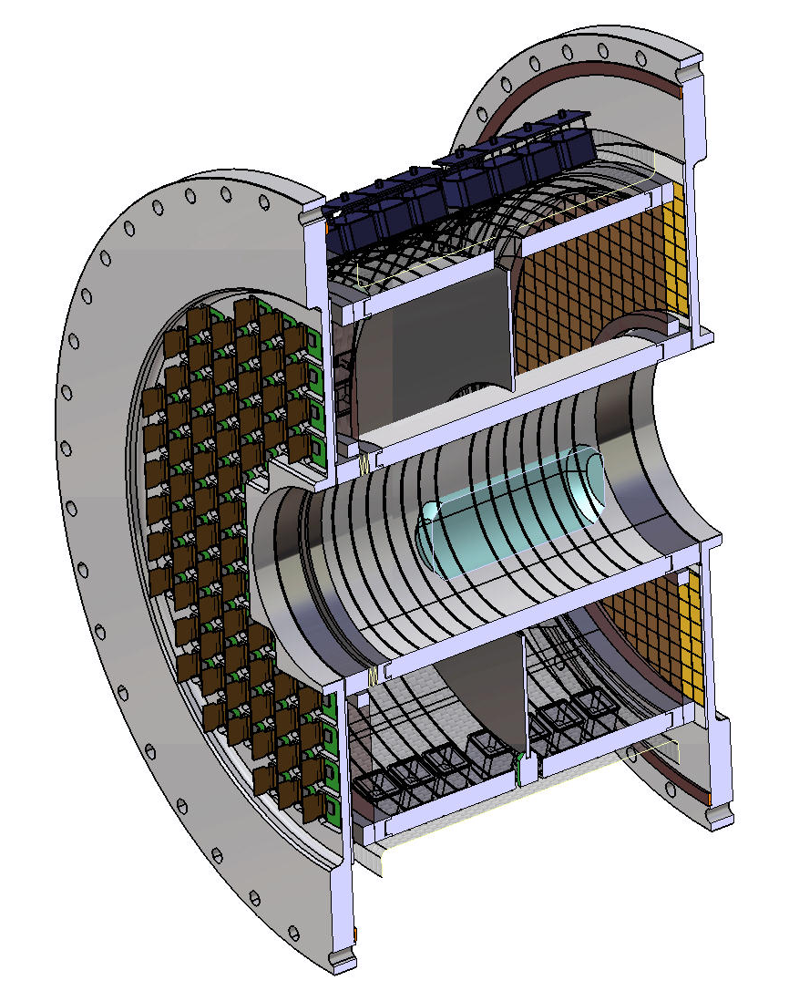

Funding issues almost adressed
with the ARRONAXPLUS EQUIPEX
PMTs
Improved reliability and safety :
ReStoX (liquid xenon station)
E
E
Rat phantom
But some unknowns to solve :
- DAQ cost
- PMTs cost
3rd γ
511 keV LOR
Expected to run at Subatech in 2014-15
Nantes Hospital in 2015-16
R&D on photodetection as an alternative of vacuum PMTs
FEE for ionisation
read-out

Slide 16
Gaseous Photomultiplier principle
Liquid xenon
Energy loss
Entrance window (MgF₂ ou SiO₂)
UV photons
Cathode
E_{coll} ~ 0
Ne mixtures
Photoelectric effect
Reflective CsI
photocathode
THGEM
Collection (THGEM)
E_{ampl}
E_{trans}
Transfer gap
500 lpi
Amplification (PIM)
E_{ampl}
670 lpi
E_{ind}
Transfer gap
CERN grid
Induction
(MICROMEGAS)
E_{ampl}
Anode
THGEM: Efficient photoelectron collection + low gain
PIM/MICROMEGAS: ion blocking (prevents CsI damage) & gain
S. Duval et al., 2009 JINST 4 P12008 & S. Duval et al., 2011 JINST 6 P04007

Slide 17
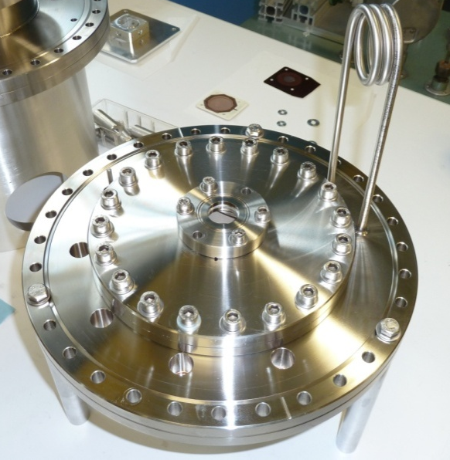
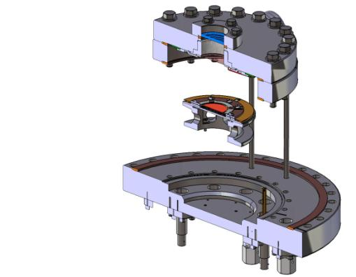
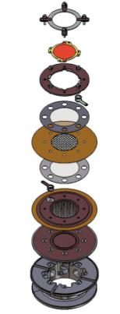
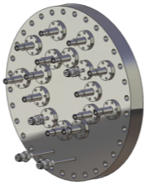
GPM detector
Viewport (MgF₂)
THGEM/PIM/MICROMEGAS
Internal structure
THGEM + supports
LXe GPM prototype (LXe side)
500 lpi grid*
Kapton spacer (125 microns)
670 lpi grid*
SHV
MICROMEGAS (50 microns)
Anode (ROGERS)
Base (stainless steel)
Gas
Vacuum side

Slide 18
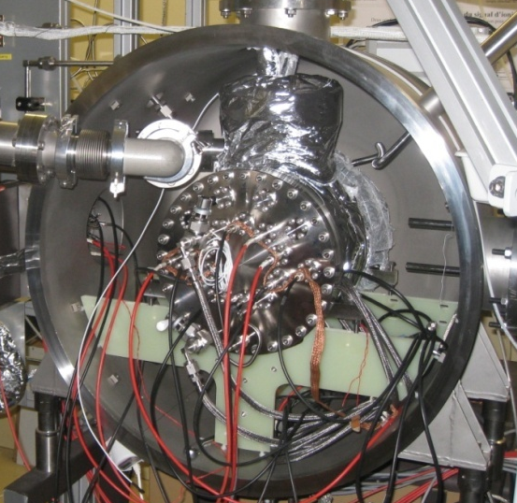
Experiments in single-phase liquid-xenon
GPM
PTR
Pump
Getter
Liquid xenon
Gas outlet
Gas flow
meters
Pressure regulator
CF₄
Ne
Getter
P_{GPM} = 1100 mbar, T = 171 K, P_{Xe} = 1200 mbar, flow rate < 2 ln/h, ΔT_{in/out} ~ 2K

Slide 19
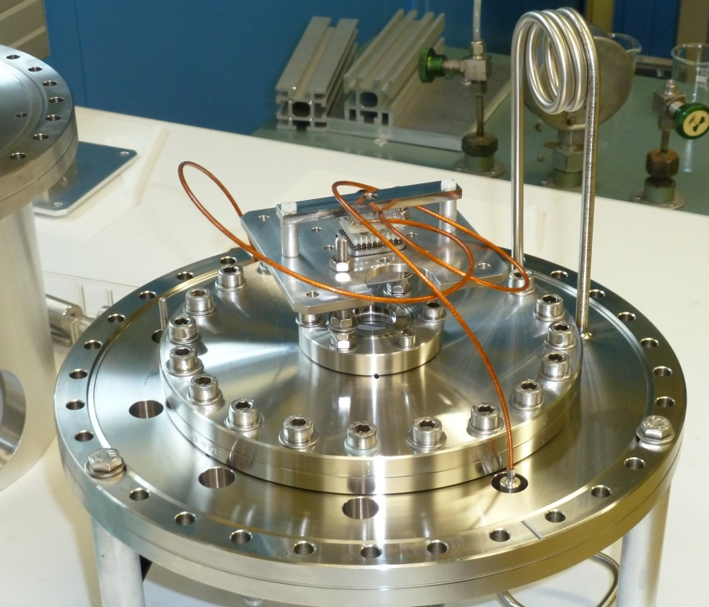
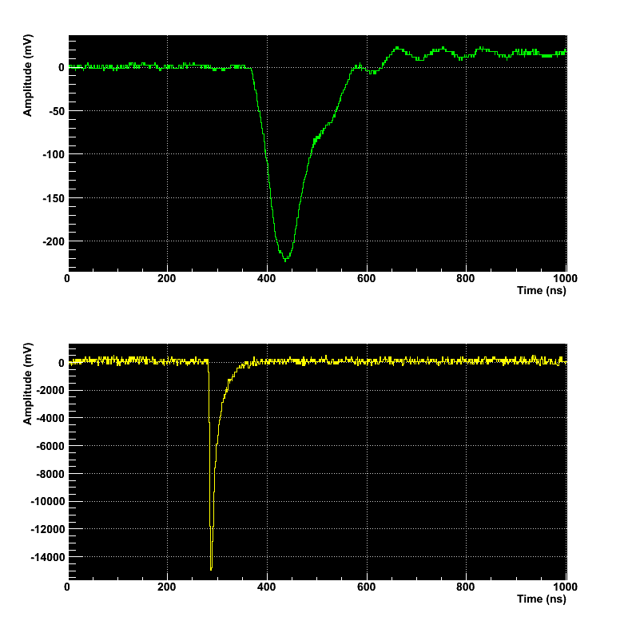
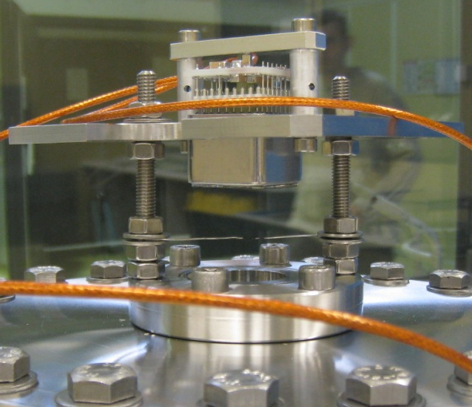
LXe Scintillation pulses recording
First pulse of a GPM in LXe !
Coincidence assembly
PMT
Vacuum PMT pulse
GPM
GPM viewport
PMT Hamamatsu
(R7600-06MOD-ASSY)
Ne/CF₄ (90:10)
T = 173K
P = 1100mbar
GPM pulse
Source ²³⁸Pu
GPM
S. Duval et al., 2011 JINST 6 P04007

Slide 20
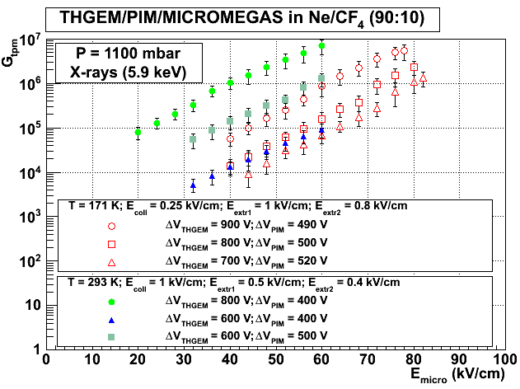
Gain measurements with ⁵⁵Fe
Total gain above 10⁶!
⁵⁵Fe source
E_{coll}
E_{extr1}
E_{extr2}
S. Duval et al, NIM A (2011), doi: 10.1016/j.nima.2011.11.018

Slide 21
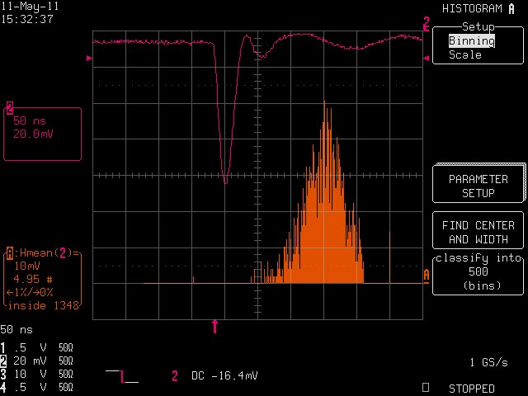
Fast signal direct readout
⁵⁵Fe Hybrid GPM pulse
GPM
25ns
50 Ohms
Really like a PMT!
S. Duval et al., NIM A (2011), doi: 10.1016/j.nima.2011.11.018

Slide 22
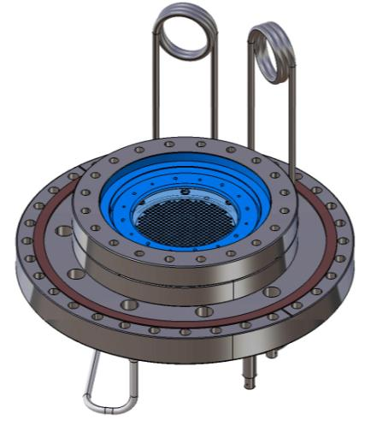
Conclusion & Prospects
Proof of concept (2010)
High gains at LXe T ~10⁶ (2011)
Efficient ion blocking expected also in Ne-mixtures
CsI photocathode studies in progress*
Large-size prototype is designed and ready for being assembled
Bulk-MICROMEGAS will be tested for future large-size cryogenic applications : SPLAM ANR
5” window
Toward 20 inches diameter window or cylindrical one …
*A. Breskin et al., NIMA 639 (2011) 117-120 & S. Duval et al, NIM A (2011), doi: 10.1016/j.nima.2011.11.018

