Slide 1
Efforts for industrialization of GEMs and Micromegas at CERN
Outline:
WG6 in the RD51 context
CERN common infrastructure improvements
Future requirements in LHC experiments
(CMS, Atlas, Alice, LHCb)
Technology transfer: potential partners
(Newflex, Eltos, Cirea, Techtra, TechEtch)
CERN workshop resources on MPGDs
Micromegas resistive training at CERN
Conclusions

Slide 2
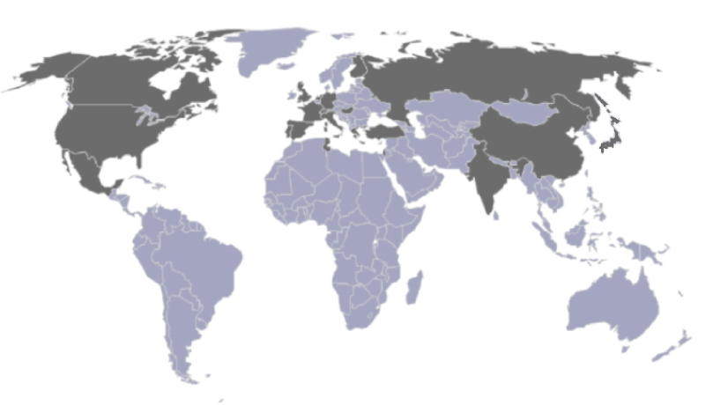
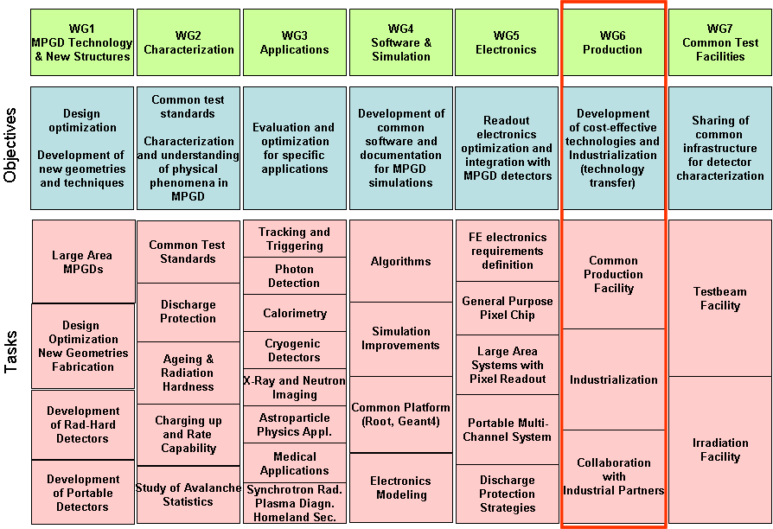
WG6 in the RD51 context
Efforts for industrialization are coordinated within RD51
RD51 is world-wide coordination group for MPGD R&D
(not only for the particle physics community)
~ 80 institutes
~ 450 people involved
Representation (Europe, North America, Asia, South America, Africa)
WG6 offers an open framework for technology transfer and industrialization activities
Coordinators: R. de Oliveira (CERN), I. Giomataris (CEA Saclay), F. Formenti (CERN),
CERN TE-MPE-EM fine pitch photolithography workshop is part of WG6 (R. de Oliveira)
- Provides common infrastructure for R&D and development of MPGDs
- Train own personnel and maintain competences in the domain
- Collaborate w/ industrial partners to define compatible processes and QC procedures

Slide 3
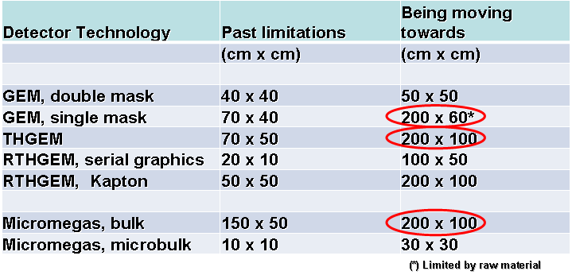
CERN common infrastructure improvements
Some collaborations indicate tendency towards increasing detector sizes
Motivations: improved active area, better integration modularity, lower costs @ same yield, …
The table below shows some indicative numbers
Indicative table
Consequence: new infrastructures are needed to face large size detector fabrication
CERN has upgraded nine process machines (last three planned installation in May)
  and presently is performing large size prototype development
Not yet all fixed, but wise keeping an eye on these possible future needs

Slide 4
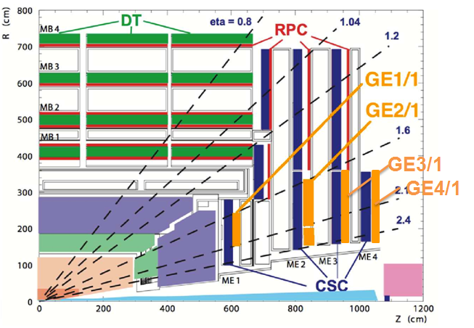
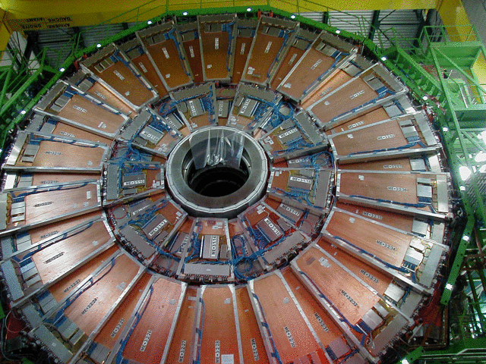
Future requirements: CMS muon upgrade
GEM proposed as technology to withstand the high rate requirement for eta>1.6
Priority for integration stations 1 and 2
Installation (full/partial) during LS2 (2018)
TP has been submitted on February 10th
TDR by end 2012 for approval spring 2013 ?
Time
Scenario for two full inner stations - Dates reflect preliminary plan
Station | Nbr of modules | Module area (containing rectangle) | Total Nbr of modules (w/o spares) | Total GEM foil area (3ple GEMs) | Manufacturing plan
GE1/1 | 18x2x2=72 | ~0.43m² (440x990) | 72 | 0.43x72x3 =93m² | Yrs 2014+2015
GE2/1 | 36x2=72 (long) 36x2=72 (short) | ~2.4m² (1251x1911) ~1.6m² (1251x1281) | 144 | (2.4+1.6)x72x3=864m² | Yrs 2015+1016
CSC detector
About 1000m² of GEM foils in total
216 triple GEM detectors

Slide 5
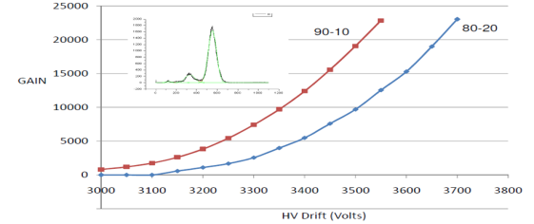
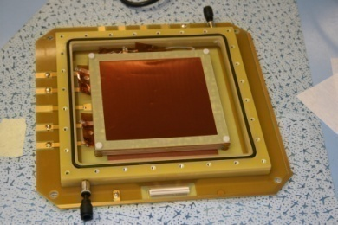
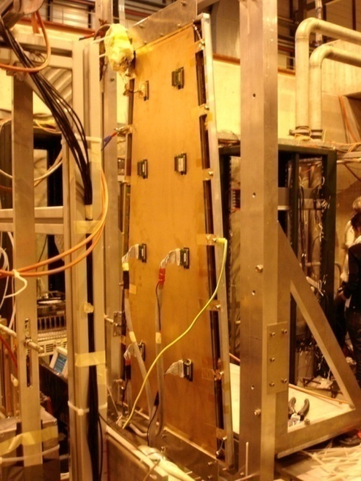

CMS GEM Collaboration: prototypes 2010-11
Small prototypes
CMS_timing_GEM: Standard double mask 10x10cm² 1D readout (3/2/2/2); 256 channels
SingleMaskGEM: Single Mask 10x10cm² 2D readout (3/2/2/2) 512 channels
Honeycomb: Standard double mask 10x10cm² 1D readout (3/2/2/2); 256 channels
CMS_Proto_III Single Mask 10x10cm² [N2] (3/1/2/1); 256 channels
Korean_I Double Mask 7x7cm² (3/2/2/2); 256 channels
(Courtesy of Archana Sharma)
Full-size prototypes 2010/11
CMS_Proto_I: Single mask FULL_SIZE 1D readout (3/2/2/2); 1024 channels
CMS_Proto_II: Single mask FULL_SIZE 1D readout (3/1/2/1); 3072 channels
CMS_Proto_IV Single Mask 30x30cm² [NS2] (3/1/2/1); 256 channels
4 Production Prototypes (NS2) on the way 2012
Measured in RD51 lab
with x-rays
CMS_Proto_V: Single Mask FULL_SIZE 1D [NS2] (3/1/2/1) ~3840 channels
It’s a long way to get the final device all right
R&D is one of the main responsibilities of the MPE-EM workshop
Industry has to follow standard learning steps before achieving final expertise

Slide 6
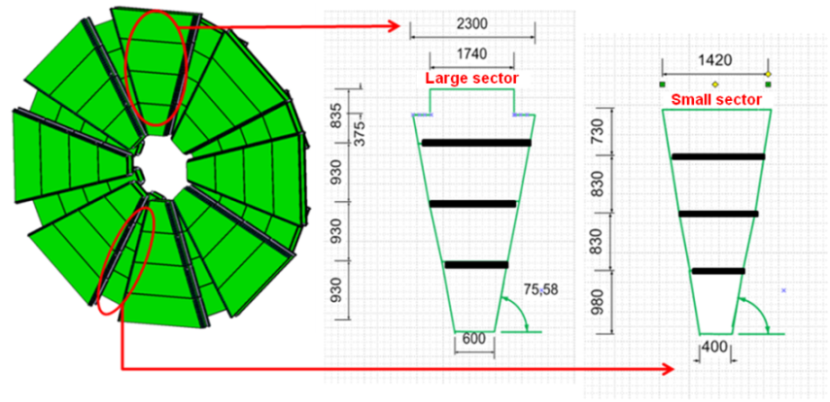
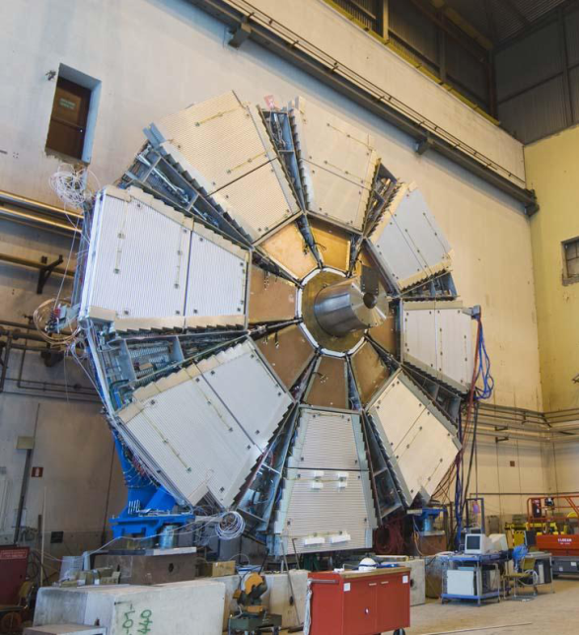
Future requirements: Atlas nSW upgrade project
Micromegas proposed as competitive technology w.r.t. MDT+TGC and CSC
Substitute small wheel muon stations
Commissioning/installation during LS2 (2017/2018)
Pre production 1st complete sector 0 (32 MM layers in 2014)
MoU in 2012 ? and TDR during 2013 ?
Time
CSC detector
Scenario for full nSW - Dates reflect preliminary plan
Sector | Nbr sectors Nbr chambers/sector MM layers/chambers | MM layer area (containing rectangle) | Total Nbr MM layers (w/o spares) | Total MM PCB area | Manufacturing plan
Small | 8x2=16 4 4x2=8 | From ~0.68m² (696x980) To ~1m² (1420x730) | 512 | 0.88x512=450m² | Yrs 2015+2016
Large | 8x2=16 4 4x2=8 | From ~0.96m² (1036X930) To ~1.9m² (2300x835) | 512 | 1.5x512 =768m² | Yrs 2015+2016
MDT detector (TGC behind)
About 1200m² of resistive bulk
1024 MM layers

Slide 7
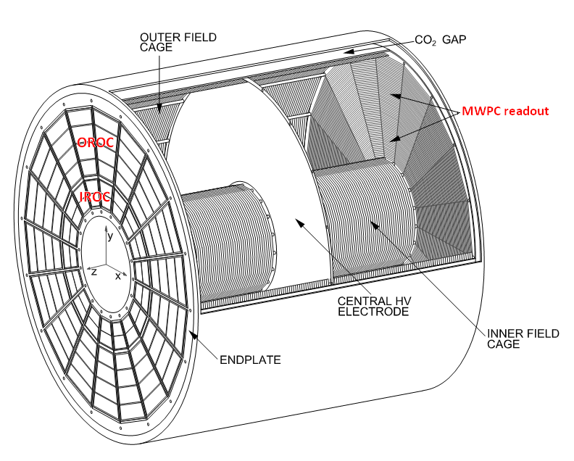
Future requirements: Alice TPC upgrade
GEM proposed as technology for high rate capability upgrade w.r.t. MWPC readout
Installation during LS2 (2018)
Commissioning 2017
MoU in 2012 and TDR during 2013 ?
2012 production 1 IROC prototype for tests
2012 build collaboration and validate concepts
Time
Dates reflect preliminary plan
Module | Nbr of modules | Module area (containing rectangle) | Total Nbr of modules (w/o spares) | Total GEM foil area (3ple GEMs) | Manufacturing plan
IROC | 18x2=36 | ~0.23m² (460x500) | 36 | 0.23x36x3 =25m² | Yr 2016
OROC | 18x2=36 | ~1m² (880x1120) | 36 | 1x36x3 =108m² | Yr 2016
TPC detector
About 130m² of GEM foils in total
72 triple GEM detectors

Slide 8
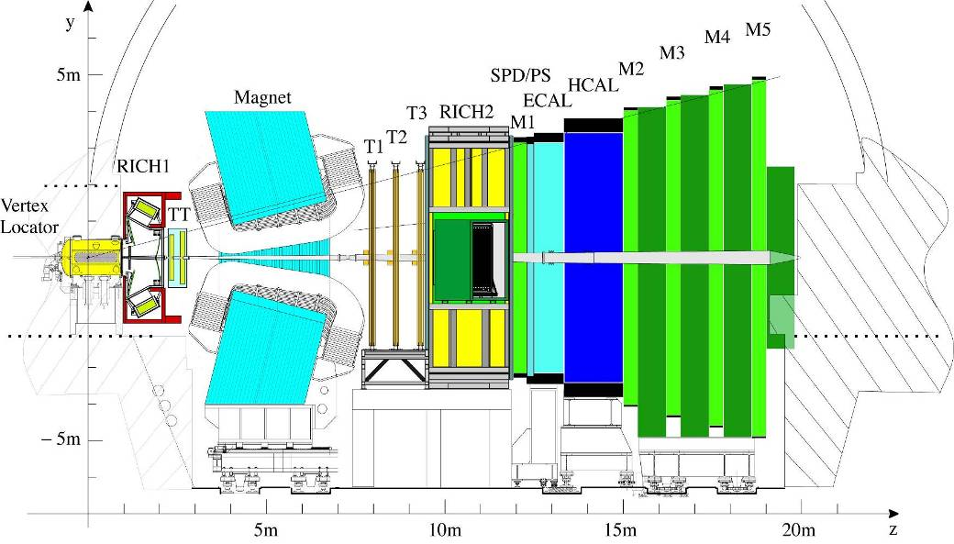
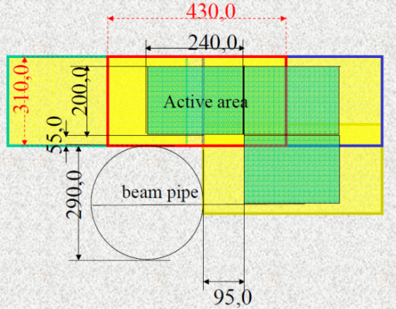
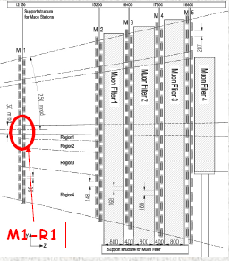
Future requirements: LHCb ?
TODAY:
GEMs are installed in M1 muon detector at the innermost region R1
12 double stations of triple GEMs
Size 310x430 (active 200x240)
Total GEM foil area ≈ 10m²
IN FUTURE:
Till now not yet any known plans to instrument more inner regions of muon detectors with GEMs
But if …
Estimated additional total surface ≈ 100m² ?
For LS2 (2018) ?
???

Slide 9
Technology transfer : potential partners
A few industrial contact were established in the past
GEM Technology
New Flex (Korea, Asan City) Proved 10cm GEMs
Tech-ETCH (USA, Plymouth MA) Fabricated <40cm GEMs
SciEnergy (Japan, Sagamihara) Fabricated <30cm GEMs
Keerthi Industries (India, Hyderabad) Only contact
MicroMETAL GmbH (Germany, Mulheim) Only contact
Techtra (Poland, Wroclaw) Fabricated <30cm GEMs
Micromegas Technology
ELTOS S.p.A. (Italy, Arezzo) Trained on Met. and Res. MMs
CIREA (France, Cholet) Fabricated Met. MMs, trained on Res. MMs
TRIANGLE LABS (USA, Carson city NV) Fabricated Met. MMs
SOMACIS (Italy, Castelfidardo) Only preliminary trials
THGEM Technology
ELTOS S.p.A. (Italy, Arezzo) Fabricated THGEMs <100cm
Print Electronics (Israel, Rishon Le-Zion) Fabricated THGEMs
(Underlined most recent active contacts)

Slide 10
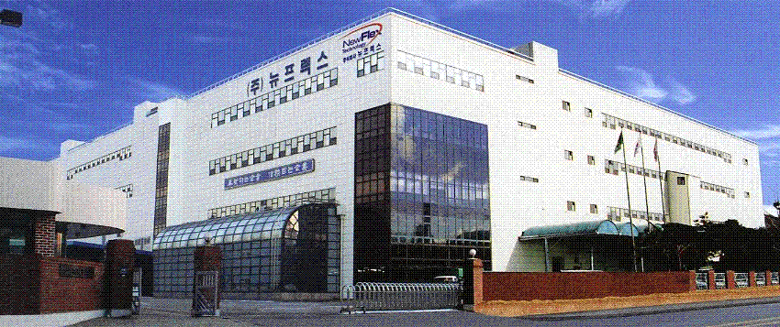
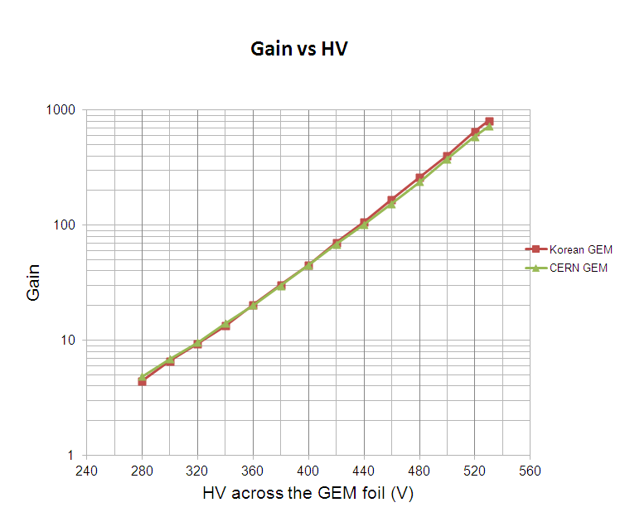
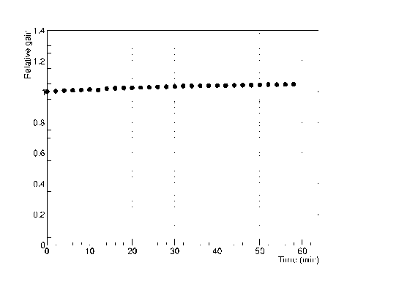
NewFlex (-> GEM)
Main company located nearby Seoul (South Korea)
Two subsidiaries : NewCretec (“next door”) and Qingdao NewFlex China
Specialized in flex circuits, huge production capability of 60000m² / month altogether
Fully automated line machines (reel to reel)
Successfully produced first 7x7 GEM foil
  => tested at CERN OK, June 2011
Successfully produced 20 foils of 10x10
  => tested at CERN OK, January 2012
Being released production of 10 foils 30x30 GEMs
  => including foil qualification test
Planned large samples for later

Slide 11
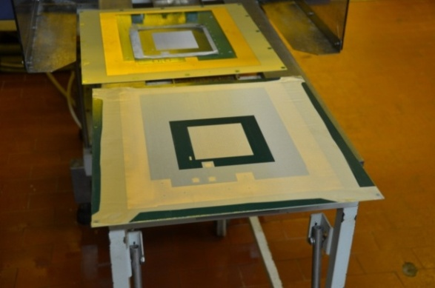
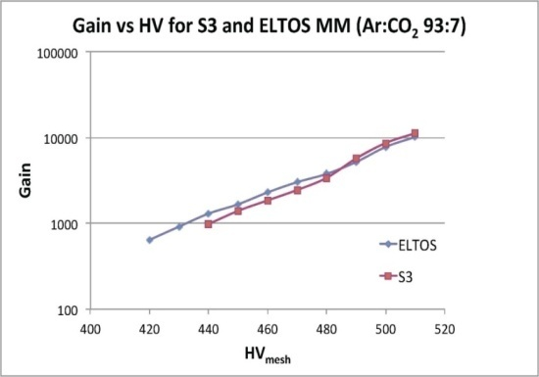
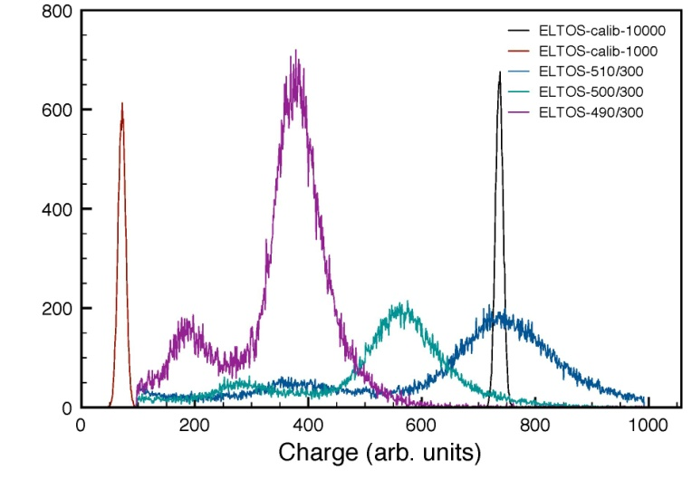
Eltos (-> Micromegas)
Company located in Arezzo (Italy), ~100 employees
Full fine pitch rigid process technology in house and surface finishing with large board capability up to 650x1200
Several type of materials (FR4, Halo free, High/Mid Tg , specials)
Performed first time knowledge transfer for Met. MMs
=> November 2011
Two 10x10 MMs “bulked” with local supervision of CERN expert (PCB and mesh stretching done by them, in-house cleaning)
One detector has high spark rate (reason not explored) other is usable and performs similarly to CERN reference
Planned samples on Res. MM technology

Slide 12
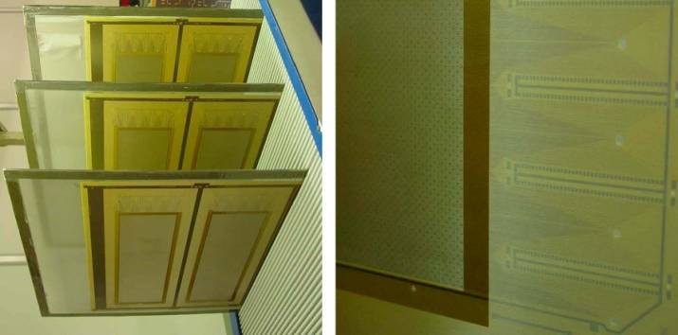
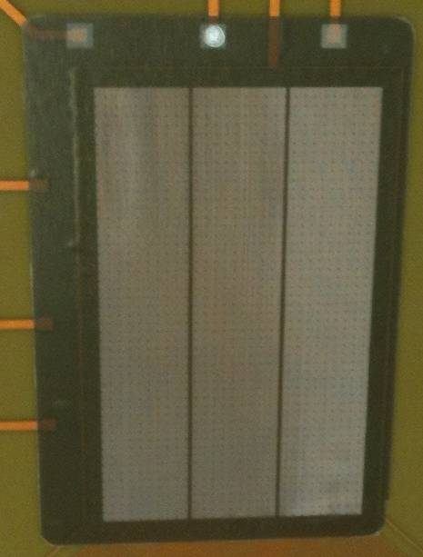
Cirea (-> Micromegas)
Member of CIRE group (CIRETEC, SGCI, BREE, PLANTIN, CIREA and SIFELMET)
Became part of ELVIA PCB as from September 2011.
Very large group with 750 employees offering a complete range of PCB technologies from low cost to high end applications
Known in the domain of Micromegas
Reference company for CEA Saclay for Micromegas R&D
Produced small and mid size (600x500) bulks (different flavors)
Claims still some problems with process steps and stability
Declares willingness to contribute to MM industrialization
Wish to acquire full knowledge for reference MM models
Planned samples on Res. MM technology

Slide 13
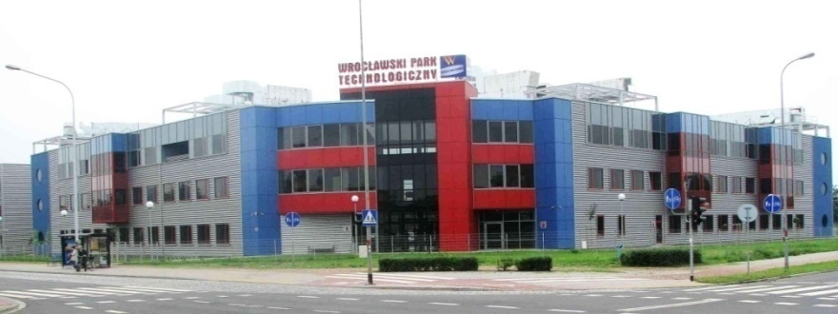
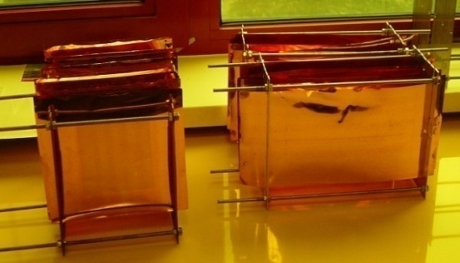
Techtra (-> GEMs)
Company hosted at Wroclaw Technology Park (Poland)
Small facility “laboratory style” with manual equipments
Benefits of special spinoff support program
Focused on GEM foils production, incl. framing and QC
Present status
Produced GEMs w/double mask process for local institutes (mainly for R&D)
Max possible size 30x30
Today getting experience on single mask process 10x10
Future upgrades
Being tendering to upgrade full machine set for sizeable production flow and larger size (650x2200)
Getting larger locations in WTP for installing new machines
CERN has provided technical consultation for new equipments
Techtra could fit cost attractive limited series and fast prototype turn around
Ready to be operative in upgraded configuration: probably ~end 2012

Slide 14
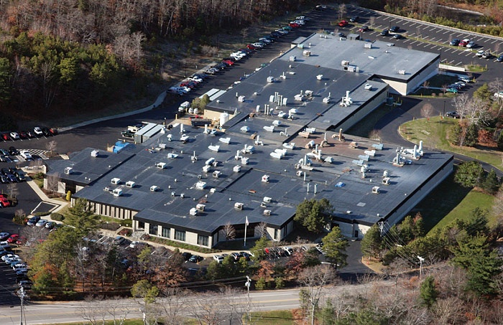
TechEtch (-> GEMs)
US company located in three manufacture plants
Flex circuits are fabricated next to Boston MA
14000m² and 350 employees
Known to CERN from the past
Already producing GEM foils
Contact refreshed by Rui in 2012
Declared interest to upgrade to GEM single mask process -> CERN to give instructions
Concerning large sizes (0.5x1.2m²) they cannot yet deal with long foils (polyimide etching)
They are seeking collaboration with MIT for R&D money for large single mask project
Waiting for their feedback on status of this project

Slide 15
CERN resources on MPGDs
Workshop production capacity
CERN investments for R&D:
  New equipments for large size GEM & Micromegas manufacturing (+ new bldg. 1000m² 1Q2014)
  Participation of 4 specialized technicians of the workshop (2 GEMs + 2 Micromegas)
  Securing 2 technicians as staffs
Contribution of AIDA WP9 (Advanced EU Infrastructure for Detectors at Accelerators):
  1 fellow for 2 years (started Jan 2012) to:
    Help installing, commissioning and setting up equipments
    Support production of MPGD prototypes
    Define test procedures for fabrication QC
The workshop production capacity depends on manpower devoted to production
Typical rule of thumb figure: 1 large GEM or bulk MM / person / day (~220 pcs / person / year)
  (“prototype handling style”, with knowledgeable technician, basic QC, excl. manpower for detector assembly)
  Saturation depends also from number of large concurrent projects: 2 (3 ?) maximum
Today the EM workshop can offer support to limited mass production
Priority to projects with high R&D content and technology stabilization

Slide 16
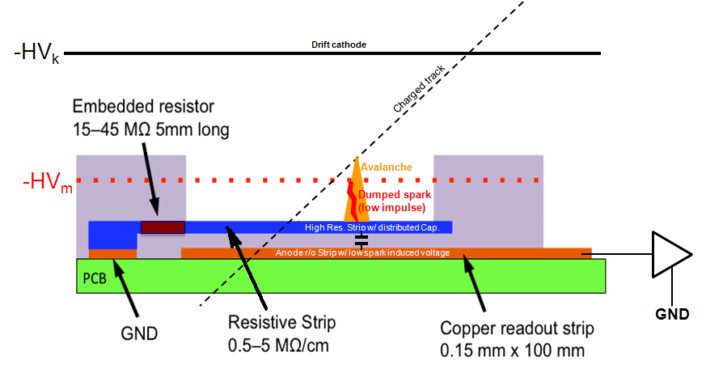
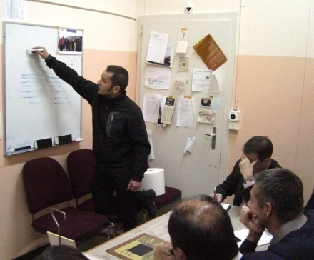
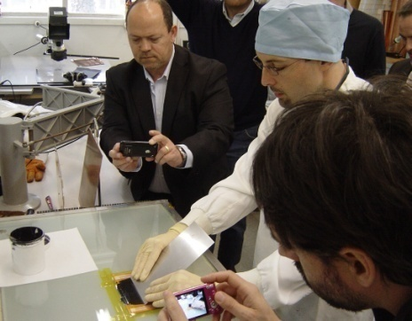
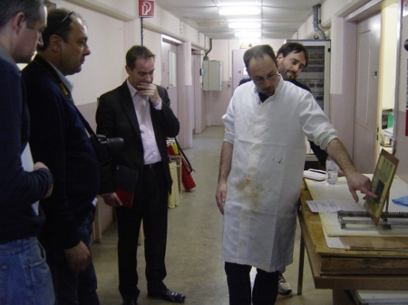
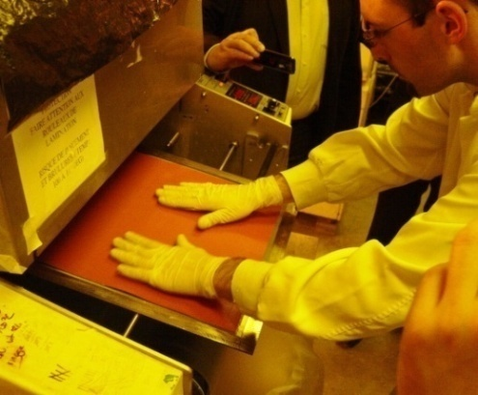
CERN training on Resistive Micromegas
Sparks in MMs create dead time and/or damage to detector and associated electronics
With Res. MMs the spark impulse is highly reduced (technology developed at CERN)
Res. MMs are the present technology for future applications
(also for fewer cases less concerned with spark problem)
CERN organized a 1+½ days training on Res MM technology to Eltos and Cirea (end March)
Course based on theoretical explanations and practical demonstrations
2) Practice
3) Questions
4) Bulking
1) Theory
Remaining home work for Eltos and Cirea : produce samples of Res. MM. 10cm x 10cm size

Slide 17
Conclusions
The work on industrialization has started with a few known companies
It’s well justified by the perspectives of large productions for GEM and Micromegas
Needs from LHC experiment upgrades are being detailed:
Atlas and CMS are the big clients
Alice and LHCb (?) are a factor 10 smaller (but still not negligible)
Plans are still preliminary and will hopefully be approved end 2012/beginning 2013
All experiments indicate LS2 (2018) as target period
The modalities for upgrades are still under discussion
Despite the uncertainty of these preliminary plans, time should not be wasted
Coordination of the industrialization efforts shall be continued
within RD51
in close collaboration with the LHC experiments
and with the support of the other (several) non LHC experiments
(apologies, not mentioned here for time reasons)

