Slide 1
Micromegas for the ATLAS Muon System Upgrade
Jörg Wotschack (CERN)
MAMMA Collaboration
Arizona, Athens (U, NTU, Demokritos), Brandeis, Brookhaven, CERN, Carleton, Istanbul (Bogaziçi, Doğuş), JINR Dubna, LN Frascati, MEPHI Moscow, LMU Munich, Naples, CEA Saclay, USTC Hefei, Roma 1 and 3, South Carolina, Thessaloniki, … (growing community)
Work performed in close collaboration with CERN/TE-MPE PCB workshop (Rui de Oliveira)
Lots of synergy from the RD51 Collaboration

Slide 2
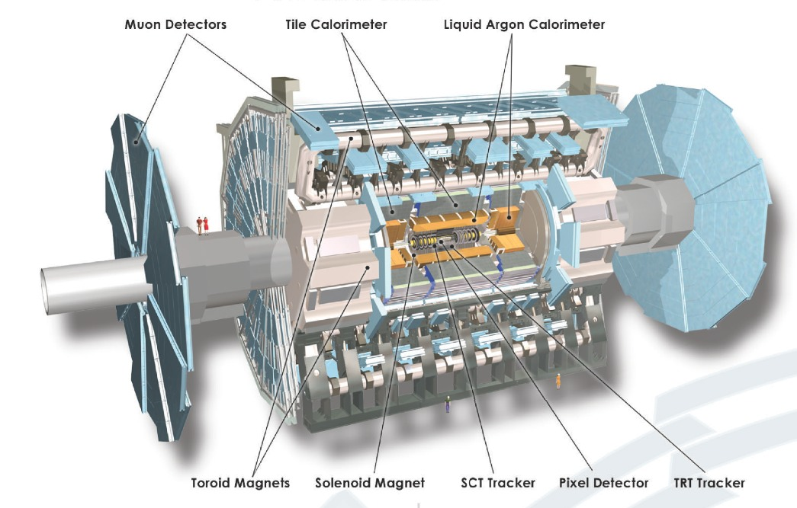
The ATLAS detector
Small Wheels

Slide 3
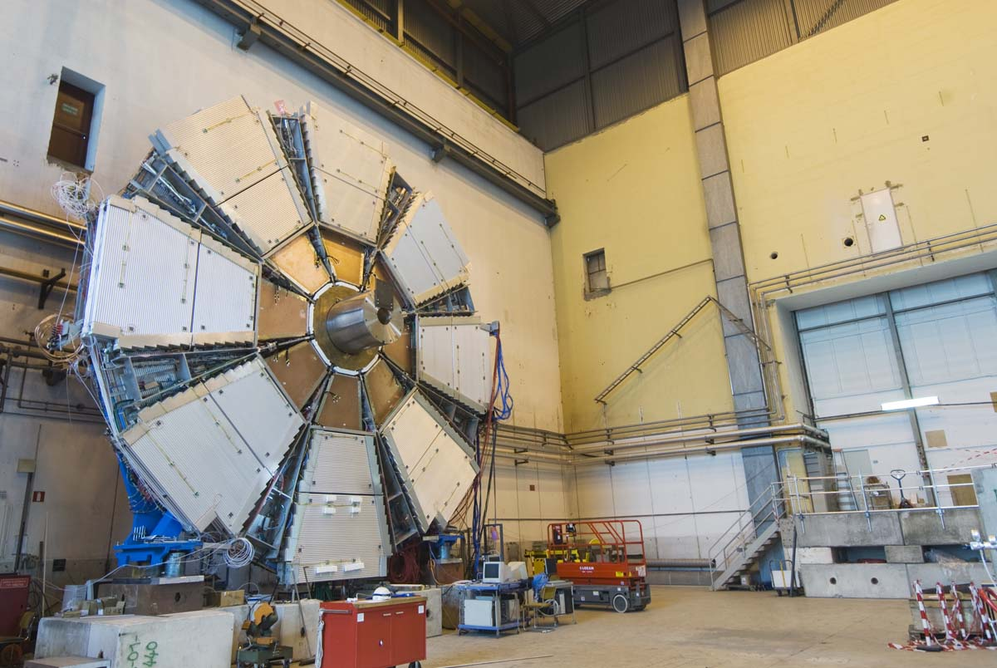
ATLAS Small Wheel upgrade
Today:
MDT chambers (drift tubes) +
TGCs for 2nd coordinate (not visible)
Equip the Small Wheels^{*)} with 128 micromegas chambers (0.5–2.5 m²)
Combine precision and 2nd coord. measurement as well as trigger functionality in a single device
Each chamber comprises eight active layers, arranged in two multilayers
  a total of about 1200 m² of detection layers
  2M readout channels
2.4 m
CSC chambers
  ^{*)} combined systems of MMs and TGCs

Slide 4
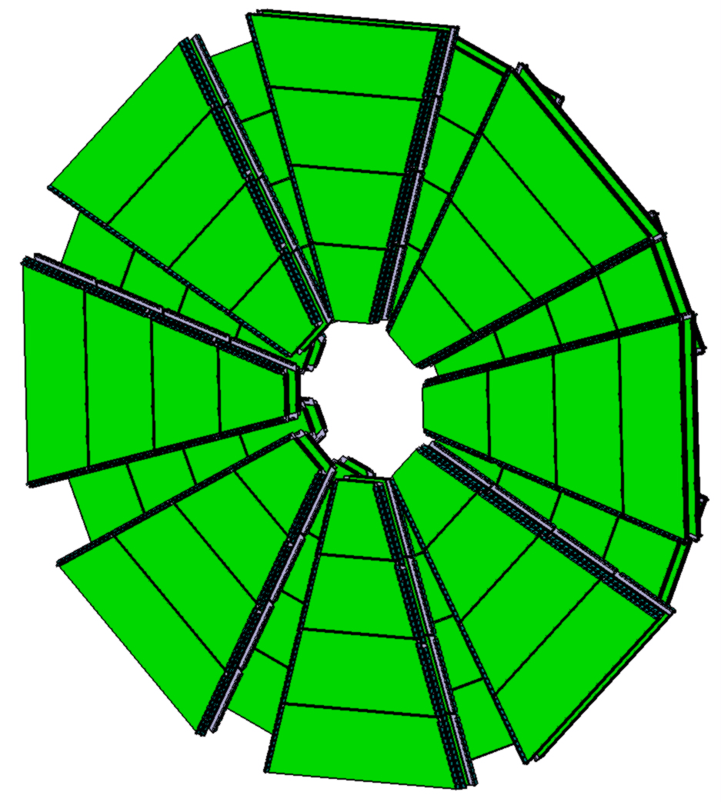
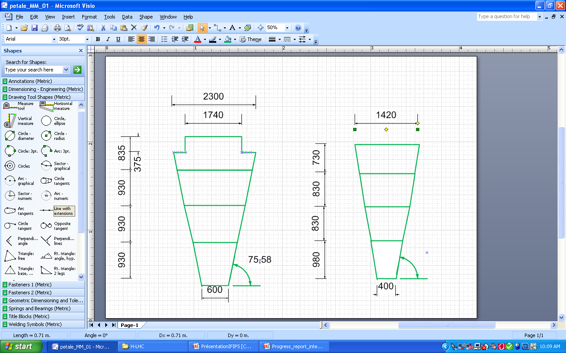
HL-LHC/MAMMA
MICROMEGAS Integration studies
Segmentation of the Small Wheel
Dimensions not final
Large sector
Small sector
Example size of the first layer

Slide 5
Requirements on detectors
High rates (≥ 10 kHz/cm²) => spark protection
  Resistive layer
Spatial resolution ≤ 100 µm
  Strips of 150–400 µm width; strip pitches 0.25–1 mm
  Mechanical precision of patterns (≤ 20 µm)
  Flatness/planarity of boards (≤50 µm)
  Reproducibility
2nd coordinate
  Two readout-strip layers
Radiation environment
  Good ageing properties

Slide 6
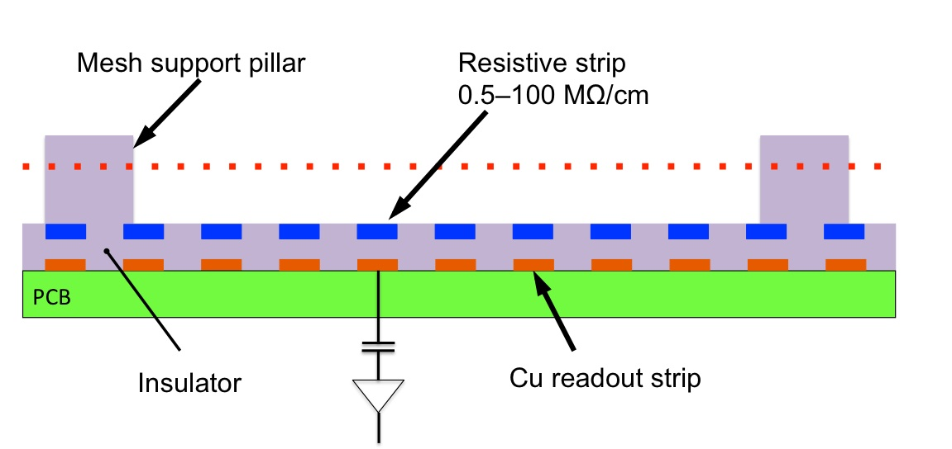
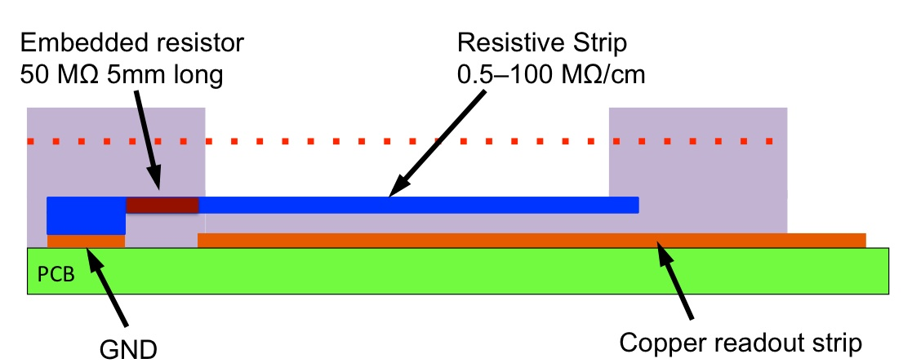
The resistive-strip protection concept

Slide 7
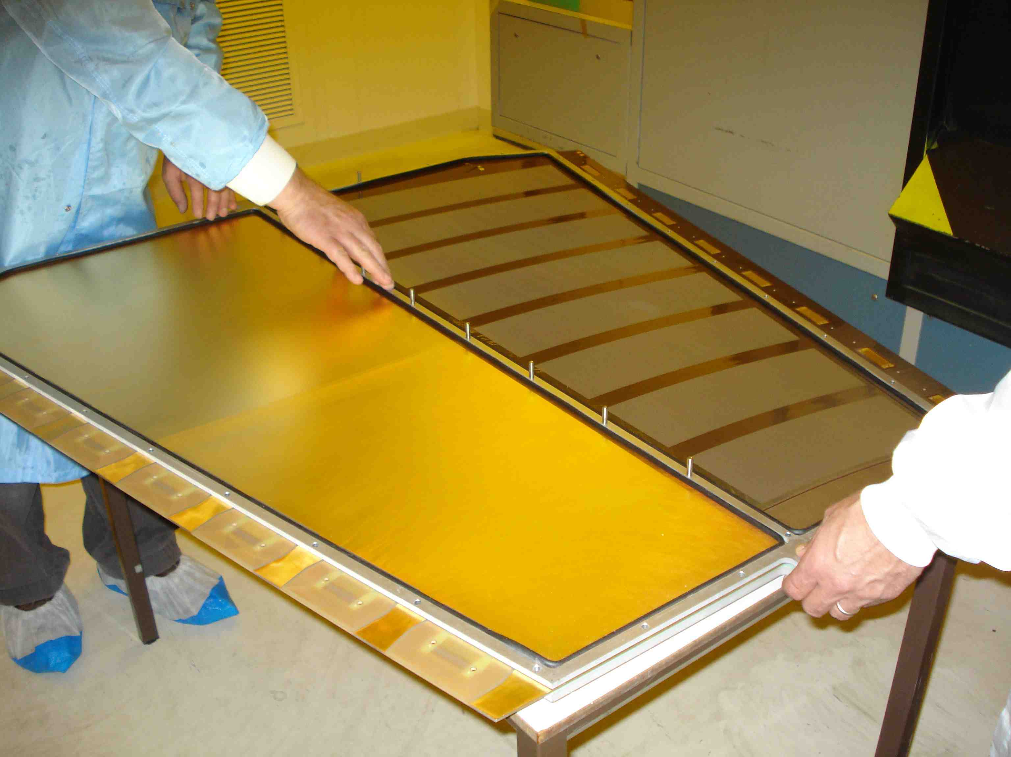
Assembly of 1st large resistive MM in March 2011
Size: 1.2 x 0.6 m²
2048 circular strips
Strip pitch: 0.5 mm
8 connectors with 256 contacts each
Mesh: 400 lines/inch
5 mm high frame defines drift space
O-ring for gas seal
Closed by a 10 mm foam sandwich panel serving at the same time as drift electrode
Dummy PCB

Slide 8
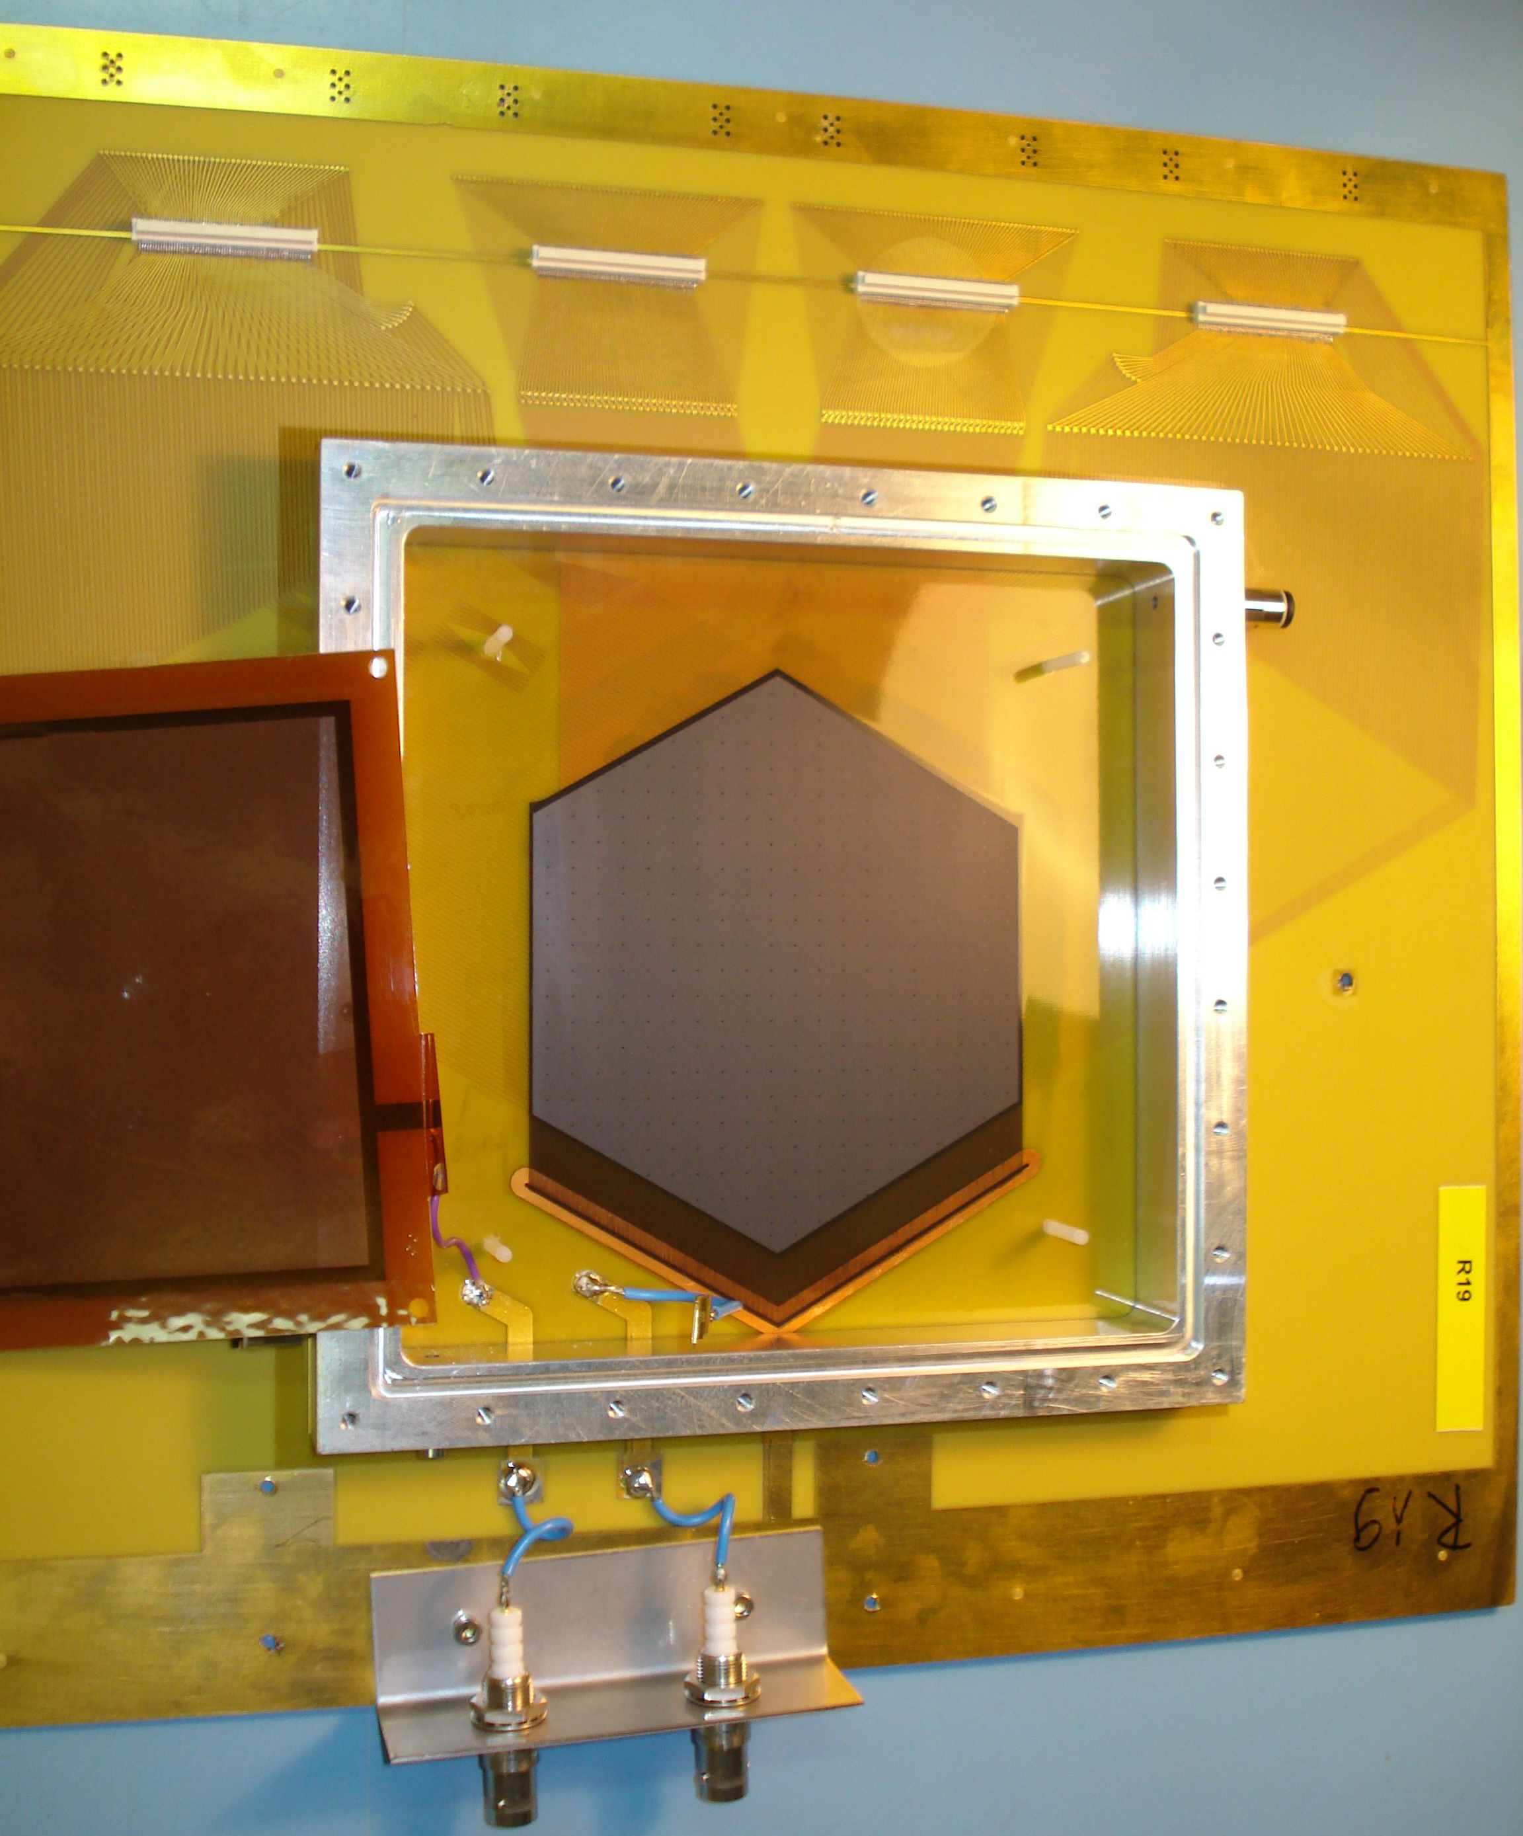
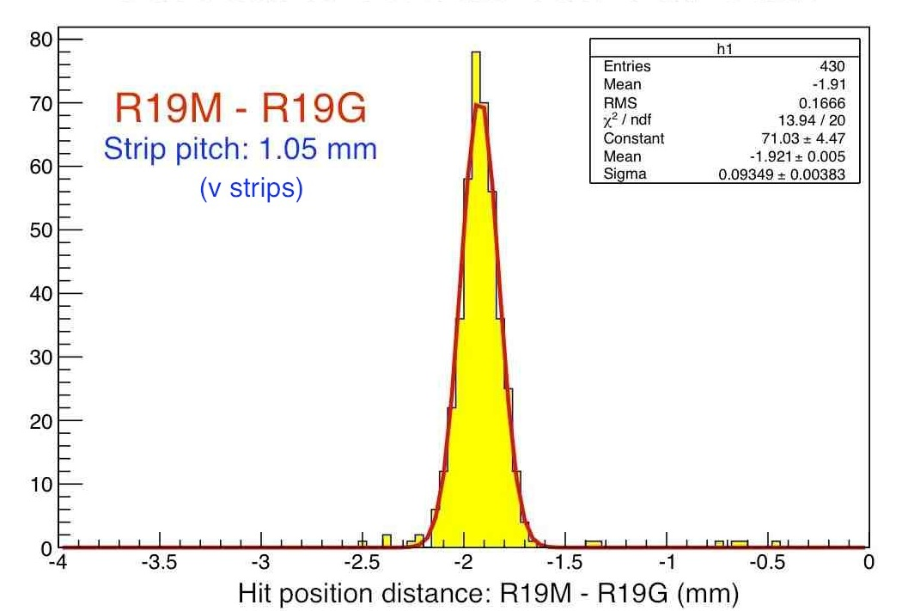
R19 with xuv readout strips
Mesh
Tested two chambers with same readout structure (R19M and R19G) in a pion beam (H6) in July
Clean signals from all three readout coordinates, no cross-talk
Strips of v and x layers well matched, u strips low signal, too narrow
Excellent spatial resolution, even with v and u strips
R strips
v strips
x strips
u strips
x strips parallel to R strips
u,v strips ±60 degree
R19 | R | v | u | x
Depth (µm) | 0 | -50 | -100 | -150
Strip width (mm) | 0.25 | 0.1 | 0.1 | 0.25
Strip pitch (mm) | 0.35 | 0.9 | 0.9 | 0.35
Q collected (rel.) |  | 0.84 | 0.3 | 1
σ = 94/√2 µm

Slide 9
Micromegas structure
Mesh
Resistive strips on prepreg
Support pillars
Second coordinate strips on prepreg
PCB
Precision coordinate strips on prepreg

Slide 10
Time line of Small Wheel project
2012: Large-area prototypes
  1 x 1 m² prototype (July)
  1 x 2 m² prototypes (end of year)
  2013: Technology transfer to industry
  Optimization of production steps in industry
  Development of QA procedures
  Module 0 (1 x 2.4 m²; 2 x 4 planes)
2014: Setup of production & test facilities
2015/16: Production
  Testing, assembly, commissioning
2017: Installation on NSW structure
2018: Installation in ATLAS

Slide 11
Our needs from industry
PCBs of up to 1 x 2.4 m², patterned
Fabrication of MM boards
  Readout strips (possibly two coordinates)
  Resistive strips (0.25 – 0.4 mm pitch, 100 kΩ/☐)
  Mesh deposition (bulk) or support pillar deposition
Quality control & test procedures
Solutions for the connectivity (signal routing, 2M channels)
Front-end electronics boards (≈4000)
Mechanics for detector housing
  Stiffening panels
  Mesh material
  Spacer frames

Slide 12
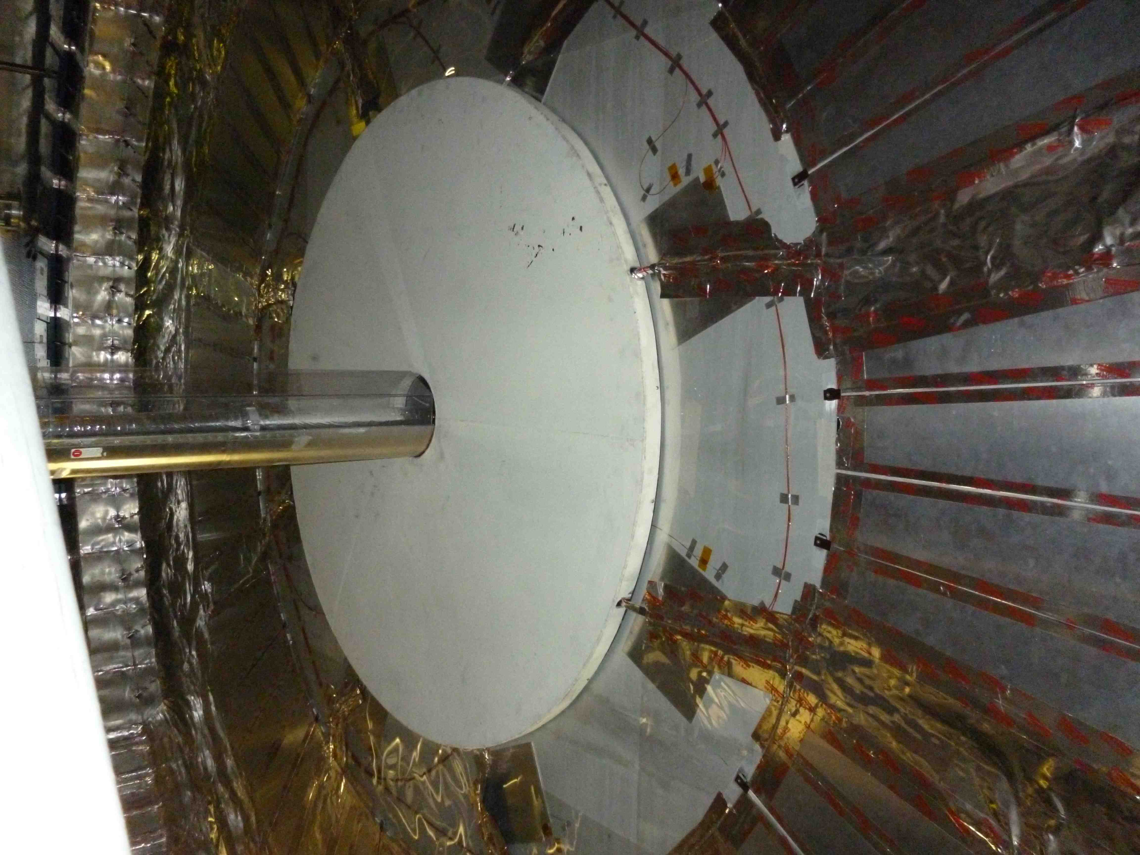
ATLAS minimum-bias trigger (MBT)
(could serve as pre-series production exercise)
Disk of ≈2 m diameter on face of end-cap calorimeter, 60 mm thick
Two disks
Particle rates: ≤ 1 MHz/cm²
3–4 planes of MMs/disk
  8 or 12 sectors
  Segmentation to be defined
  Max. dim. ≤ 0.6 x 0.8 m²
  Total ≈ 100 detector planes
Time scale
  Design & production: 2013
  Installation: early 2014
Project under discussion in ATLAS
Replacement of MBT scintillator disks by micromegas detectors

