Slide 1
ẽL and ν̃e Analysis Status
and
Slepton Note Status
Outline
Motivation
ẽL ,ν̃e and Background cross sections
Lepton Momentum and Boson Mass resolution
Lepton Momentum and angular distributions
Mass fit
Summary
J-J.Blaising

Slide 2
ẽL and ν̃e Analysis motivation
The processes:
e⁻ e⁺-> ν̃e ν̃e -> e¯ e⁺ χ̃¯₁ χ̃⁺₁ -> e¯ e⁺ W¯ W⁺ χ̃⁰₁χ̃⁰₁
e⁻ e⁺-> ẽ⁻L ẽ⁺L -> e¯ e⁺ χ̃₂ χ̃⁰₂ -> e¯ e⁺ h⁰ h⁰ χ̃⁰₁χ̃⁰₁
Allow to assess the physics performances, of 2L + 4 Jets final states, measure the ẽL , ν̃e , cross sections and the ν̃e and χ̃±₁ masses. It is essential to measure the ẽL , ν̃e cross sections which
are irreducible backgrounds for charginos and neutralinos.
The χ̃± masse is measured in other Susy processes, using the W± energy distribution.
In the slepton process the mass is derived from the e¯, e⁺ energy distributions, the hadronic final state is used only to tell apart the W¯W⁺ final state from the h⁰h⁰ final state

Slide 3
S , B Cross Sections
Process | σ fb | σx Br(2L+4J) fb | ε (2l+4J)
e⁻ e⁺-> ν̃e ν̃e -> e¯ e⁺ χ̃¯₁ χ̃⁺₁ -> e¯ e⁺ W¯ W ⁺ χ̃⁰₁χ̃⁰₁ ( S1 | 13.75 | 1.82 | 0.48
e⁻ e⁺-> ẽ⁻ ẽ⁺ (L) -> e¯ e⁺ χ̃₂ χ̃⁰₂ -> e¯ e⁺ h⁰ h⁰ χ̃⁰₁χ̃⁰₁ (S2 | 3.06 | 0.14 | 0.66
e⁻ e⁺-> W W Z (B1 | 40.1 | 0.34 | 0.17
e⁻ e⁺-> ZZZ (B2 | 0.4 | 0.0008 | 0.19
e⁻ e⁺-> χ̃₂⁺ χ̃₂¯ -> W ¯W ⁺ χ̃⁰₂χ̃⁰₂ -> W¯ W⁺ h⁰h⁰ χ̃⁰₁χ̃⁰₁ (B3 | 10.5 | 0.045 | 0.25
e⁻ e⁺-> χ̃⁰₃ χ̃⁰₄ -> W¯W⁺ χ̃̄̄̄¯₁χ̃⁺₁ -> W¯W⁺ W¯W ⁺χ̃⁰₁χ̃⁰₁ (B4 | 4.3 | 0.031 | 0.24
Produced 80K ν̃e, 80K ẽL, 20k WWZ, 10K ZZZ, 80K SUSY.
B1 and B2 rejected by cuts on acoplanarity and Lepton Inv Mass
B3 and B4 rejected by cuts on acolinearity and Lepton Inv Mass
S2/S1 is background of S1/S2

Slide 4
Analysis method
Select pfos with Pt>0,25 GeV.
Use Marco’s Fastjet processor to force events into 6 jets with
Emin>20 GeV
Identify the lepton jets; identify isolated electrons (or e+γ)
Correct the e energy when Eγ>10 Gev && Eγ>3x2.10̄⁻⁵xEe²
Compute the boson masses, pair with minimum mass difference
Compute the event Btag (not yet done)

Slide 5
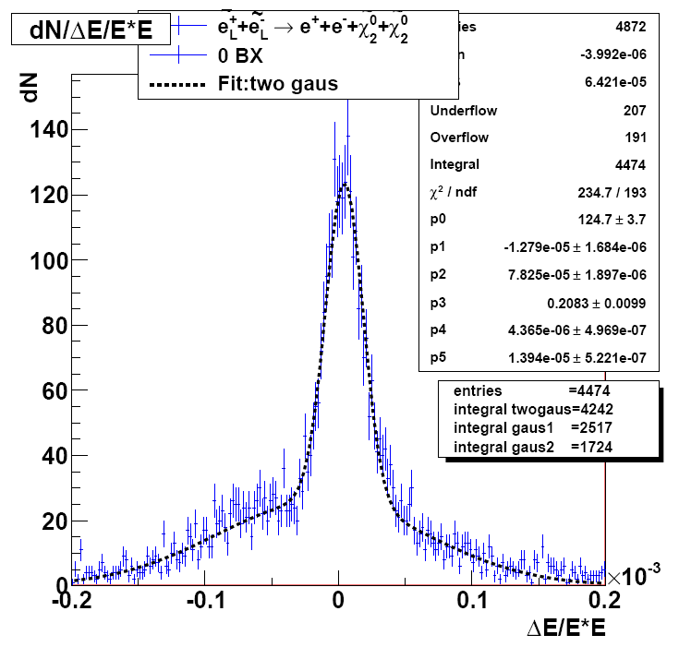
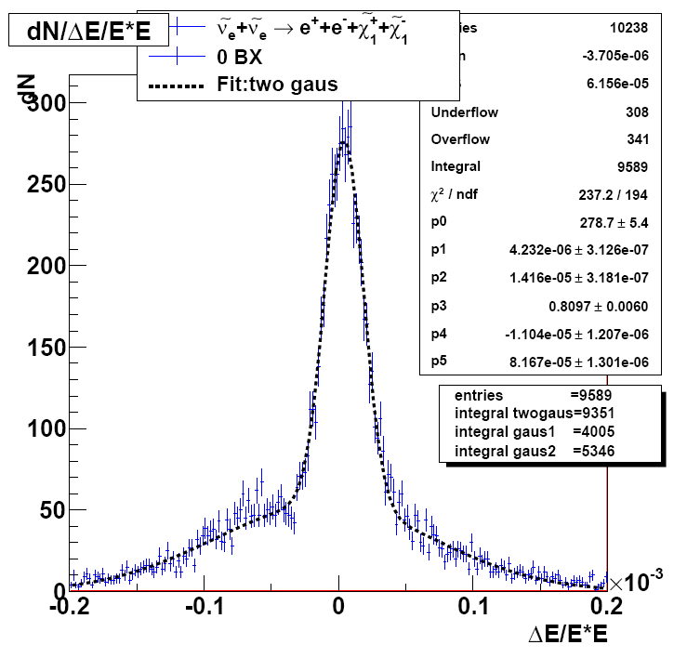
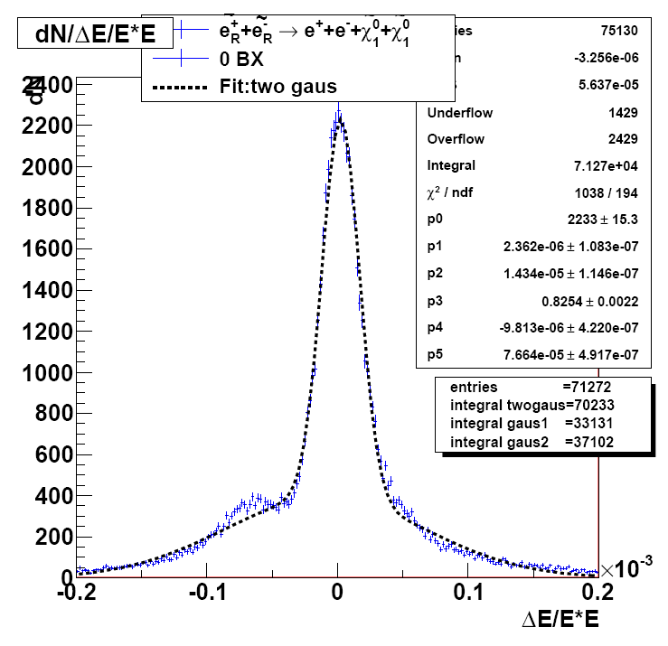
Electron Energy Resolution 2L+4J and 2L without overlay
-The electron energy resolution for ẽL and ν̃e in (2L + 4J) final state is similar to the ẽR (2L) final state

Slide 6
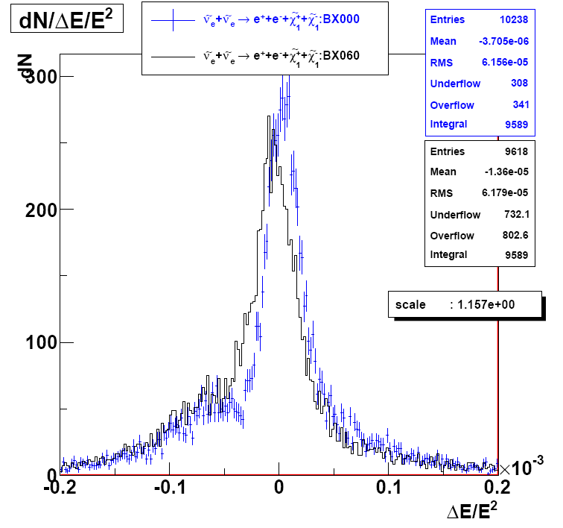
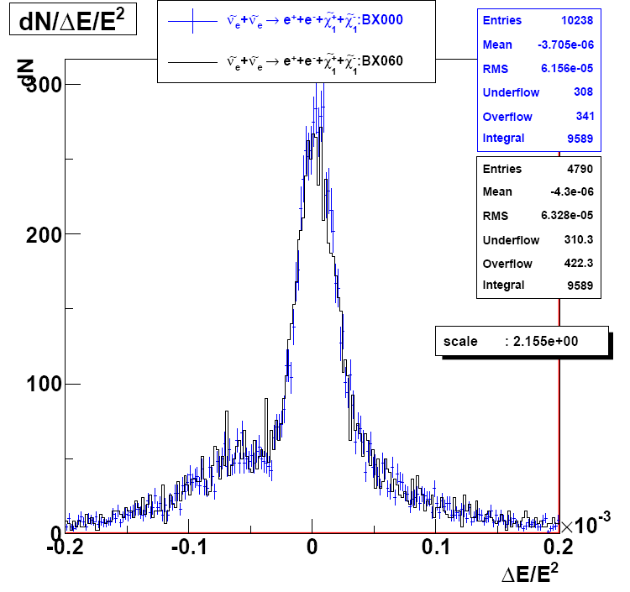
Electron Energy Resolution 2L + 4J, without/with overlay
-The electron energy resolution for ν̃e in (2L + 4J) final state without and with
is similar when the tight timing cut is applied.

Slide 7
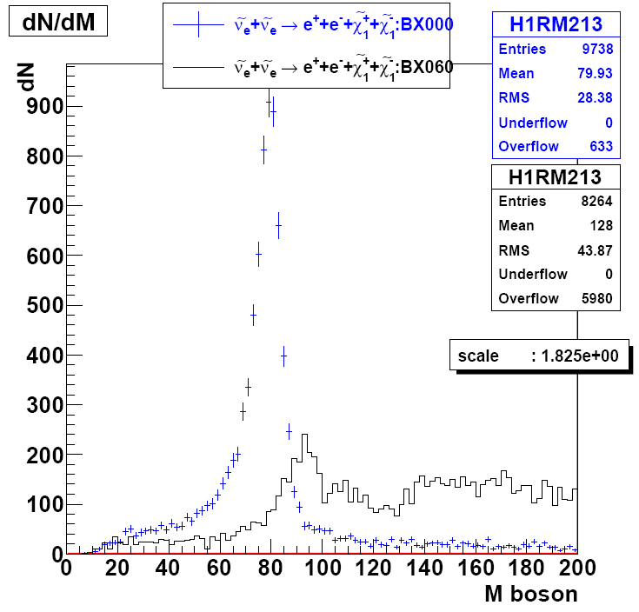
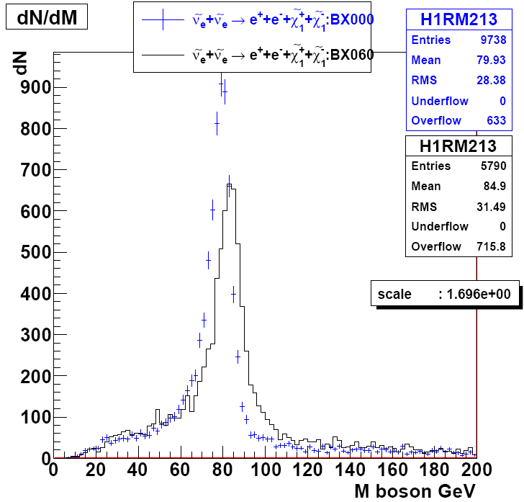
Boson Mass Resolution 2L + 4J, without/with overlay
-Boson mass resolution for ν̃e in (2L + 4J) final state without and with overlay
no time cut (left), loose time cut (right)

Slide 8
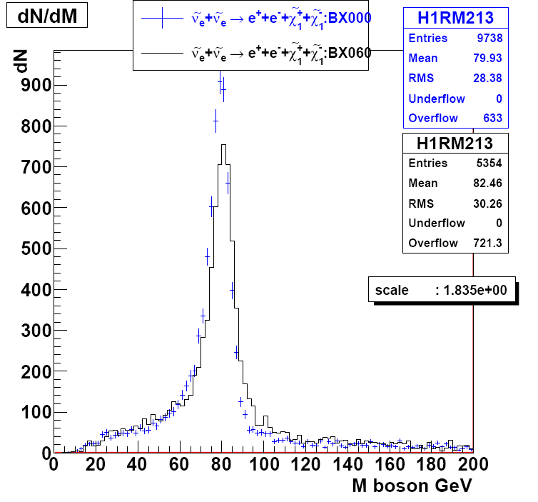
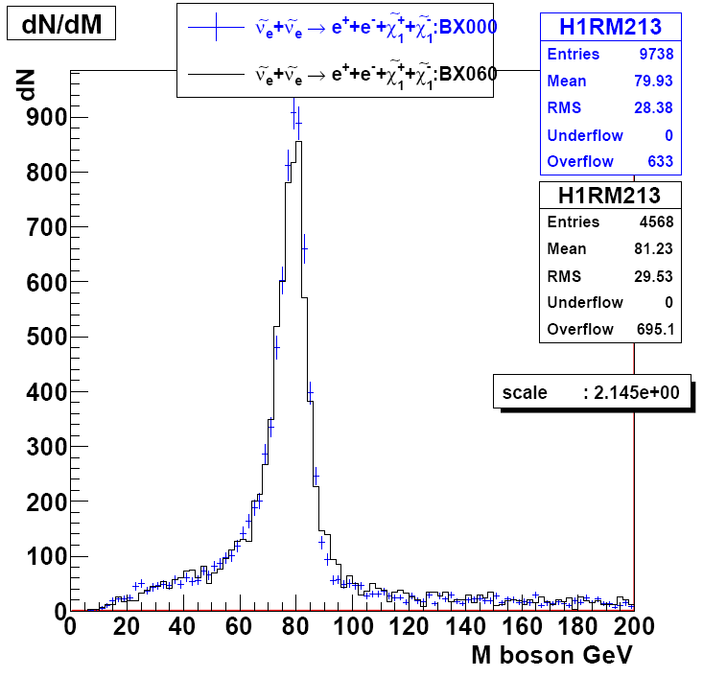
Boson Mass Resolution 2L + 4J, without/with overlay
-Boson mass resolution for ν̃e in (2L + 4J) final state without and with overlay
standard time cut (left), tight time cut (right), the cut inefficiency is 5%.

Slide 9
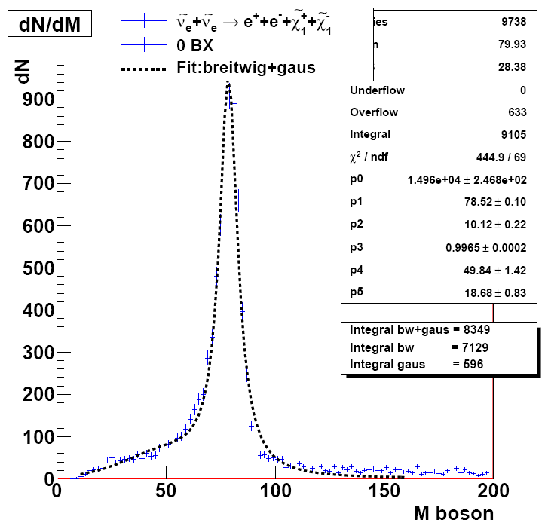
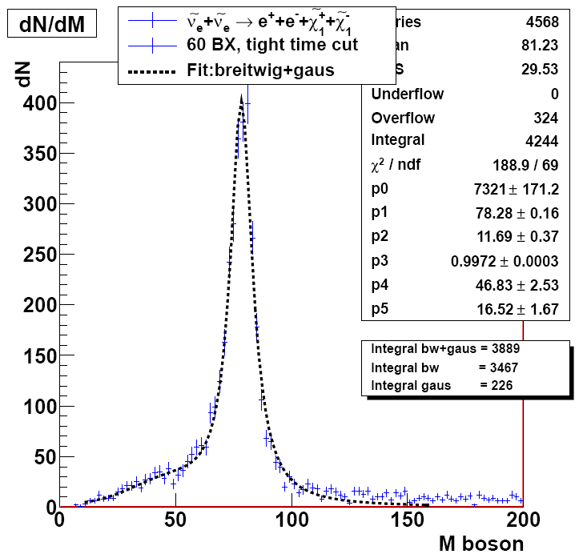
W Boson Mass Resolution Fit without/ with overlay
Boson mass distribution fit : without overlay m(W)= 78.5 GeV, σ(m)=10.1 GeV
with overlay, tight time cut: m(W)=78.3, σ(m)=11.7 GeV.

Slide 10
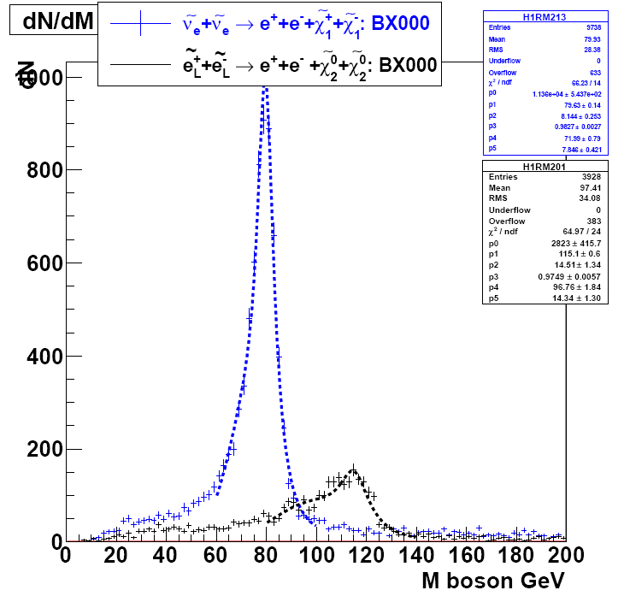
W and h⁰ Boson Mass Resolution Fit without overlay
Boson mass distribution fit : without overlay m(W)= 79.6 GeV, σ(m)=8.1 GeV
m(h⁰)=115.1, σ(m)=14.5 GeV.

Slide 11
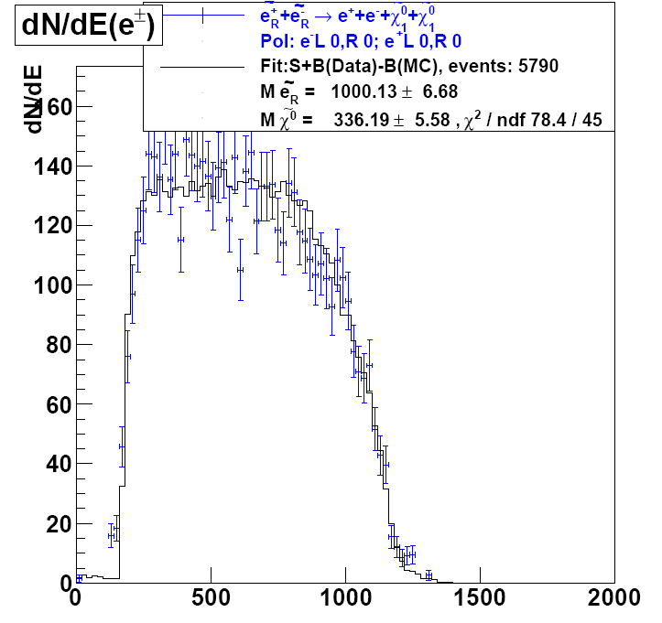
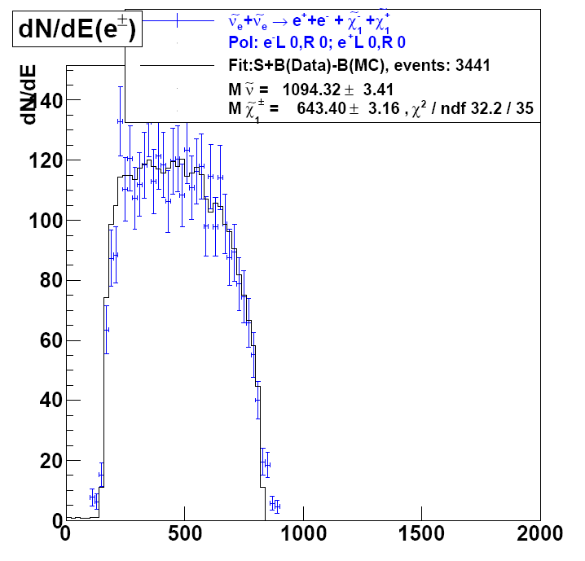
ẽR and ν̃e dN/dE fit
dN/dE (e⁻,e⁺) ; S+B (left); S+B-B fit (right) ; with 2000 fb¯¹ mν̃e and mχ̃±₁ can be measured wit a statistical accuracy of ~0.5% .
Beamstrahlumg impact smaller => sharper edges.

Slide 12
Summary
In processes with final states composed of 2L and 4 jets, the electron energy resolution is similar to the 2L final states resolution.
The lepton energy resolution and boson mass resolution without and with overlay are similar if a tight time cut is applied.
The boson mass resolution and and B tagging should allow to tell apart the W¯W⁺ final state from the h⁰h⁰ final state, offering the possibility to determine the ẽL , ν̃e cross sections and the
the ν̃e ,and the χ̃±₁ masses.
Btag work not yet done

Slide 13
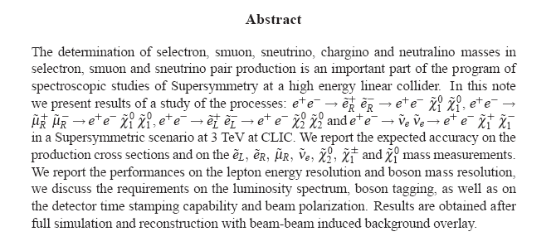
Slepton Note Status
Draft ready

Slide 14
Backup Slides

