Slide 1
StratusLab Marketplace
C. Loomis (CNRS/LAL)
Atelier France Grilles (Lyon)
21 October 2011

Slide 2
StratusLab Project
Goal
Create comprehensive, open-source, IaaS cloud distribution
Demonstrate stability and production quality by supporting grid services
Information
1 June 2010—31 May 2012 (2 years)
6 partners from 5 countries
Budget : 3.3 M€ (2.3 M€ EC)
Contacts
Site web: http://stratuslab.eu/
Twitter: @StratusLab
Support: support@stratuslab.eu
CNRS (FR)
UCM (ES)
GRNET (GR)
SIXSQ (CH)
TID (ES)
TCD (IE)

Slide 3
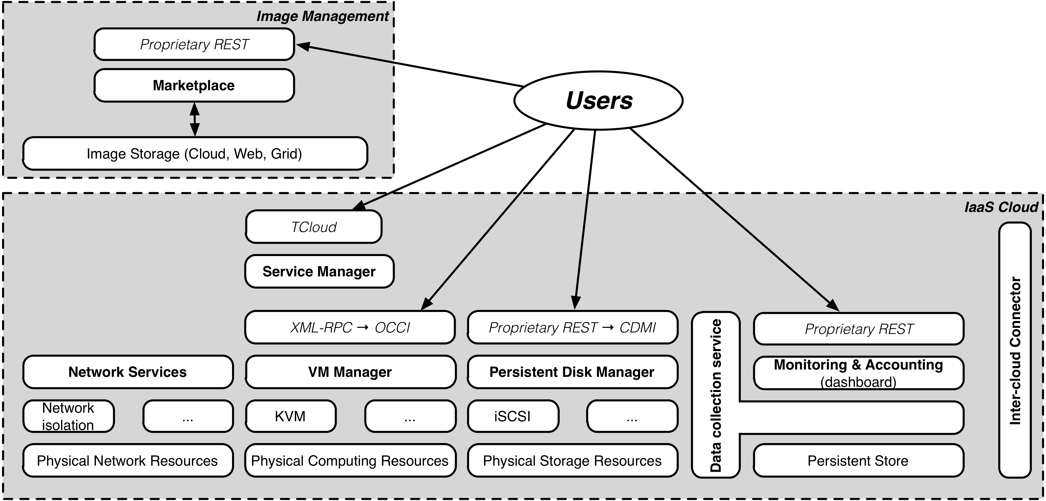
StratusLab Architecture (v1 → v2)
D4.4: Reference Architecture http://stratuslab.eu/doku.php/deliverables

Slide 4
StratusLab Marketplace
Machine image creation is a barrier to cloud adoption
Creating virtual machine images is time-consuming
Ensuring that machines are secure and correct is difficult
Sharing existing machines lowers this barrier
Marketplace facilitates sharing of images
Registry of metadata for machine & disk images
Image contents are kept in cloud, grid, or web storage
Supports trust between creators, users, and administrators
Benefits
End-users: browse and use existing images for their analyses
Creators: publicize their work and attract larger user base
Cloud Admins.: Use metadata to evaluate trustworthiness of images

Slide 5
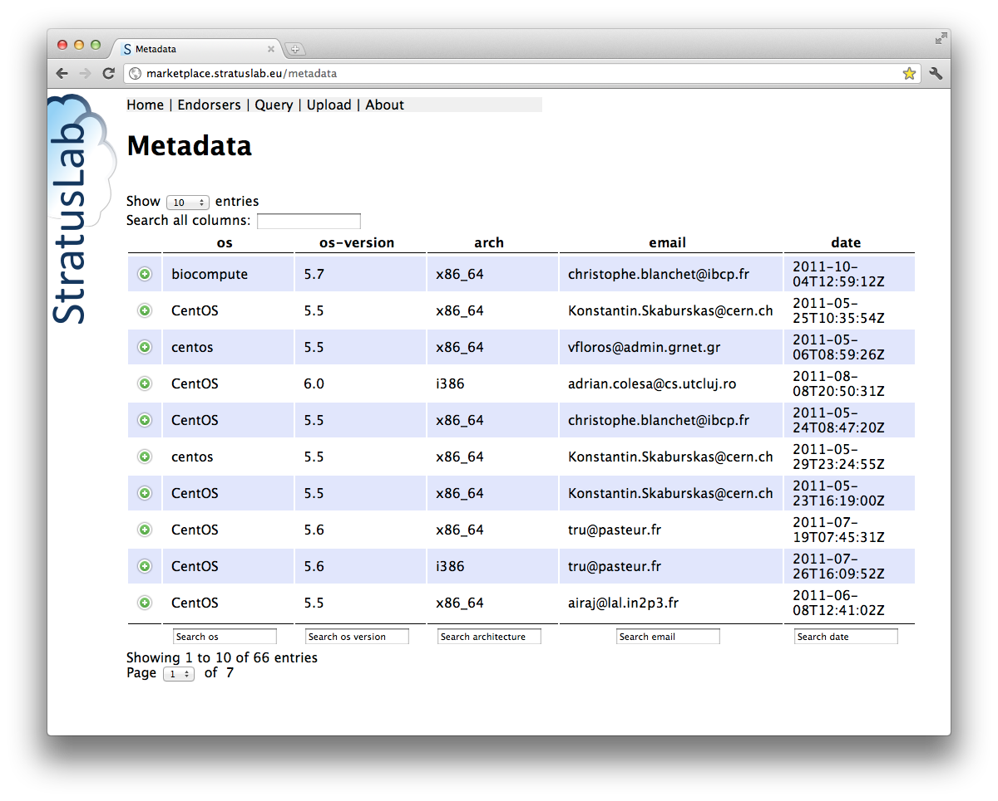
Interfaces
REST interface
Exposes a simple HTTP- based REST interface
Easy to program against in all languages
Web interface
REST interface also allows access via a web browser
Signed entries can also be uploaded via the browser
Endpoint:
Production: http://marketplace.stratuslab.eu/
Soon to be made available via HTTPS.

Slide 6
Metadata
Image metadata
Conform to a defined schema
Cryptographically signed with a (grid) certificate
Contains image ID, size, and checksums
Contains URL(s) to locate content
Standards
XML, XML-Signature, RDF-XML
Dublin Core Metadata
Tools
Create, sign, validate, and deprecate metadata
<rdf:RDF xmlns:rdf=". . .">
<rdf:Description rdf:about="#MMZu9WvwKIro-rtBQfDk4PsKO7_">
<dcterms:identifier>
MMZu9WvwKIro-rtBQfDk4PsKO7_
</dcterms:identifier>
<slreq:bytes>100</slreq:bytes>
<slreq:checksum rdf:parseType="Resource">
<slreq:algorithm>SHA-1</slreq:algorithm>
<slreq:value>c319bbd5afc. . .</slreq:value>
</slreq:checksum>
<slreq:endorsement rdf:parseType="Resource">
. . .
</slreq:endorsement>
<dcterms:type>machine</dcterms:type>
<dcterms:valid>2011-07-23T10:59:42Z</dcterms:valid>
<dcterms:publisher>StratusLab</dcterms:publisher>
. . .
</rdf:Description>
</rdf:RDF>

Slide 7
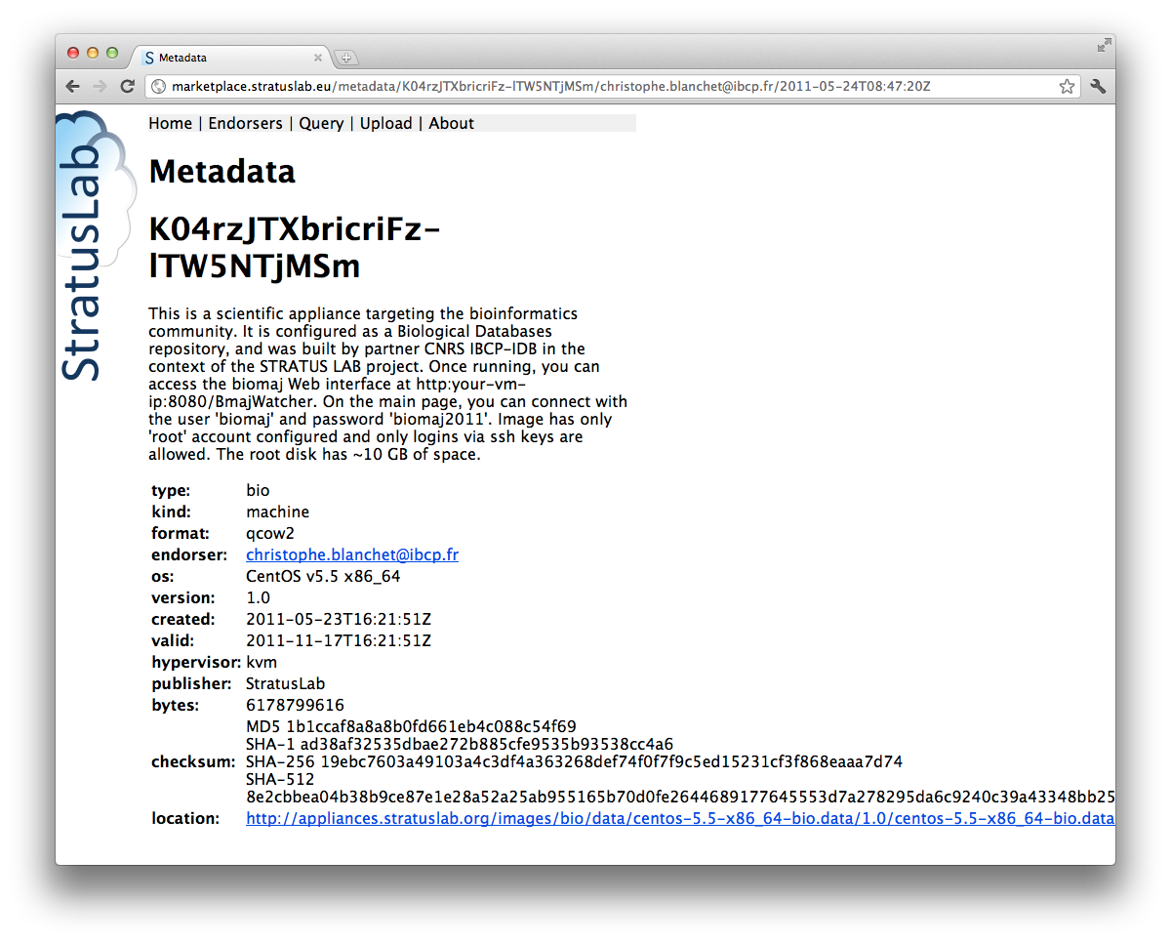
Metadata

Slide 8
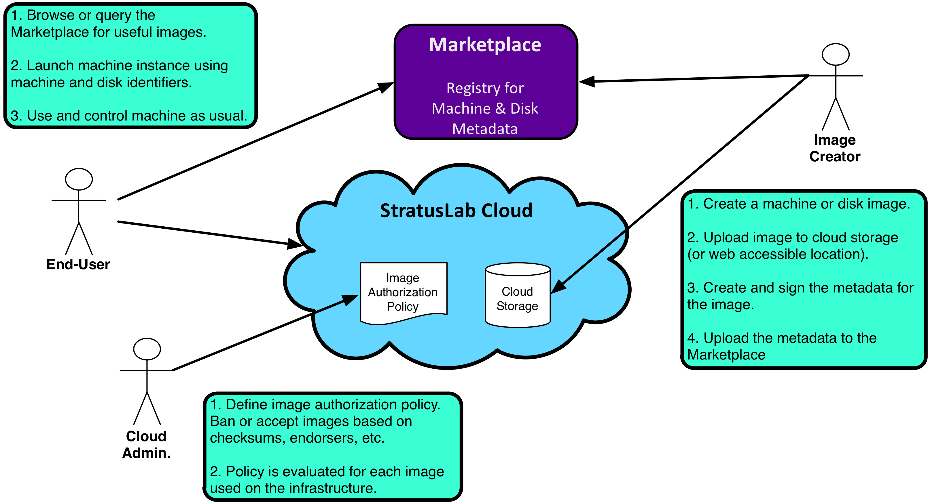
Workflows

Slide 9
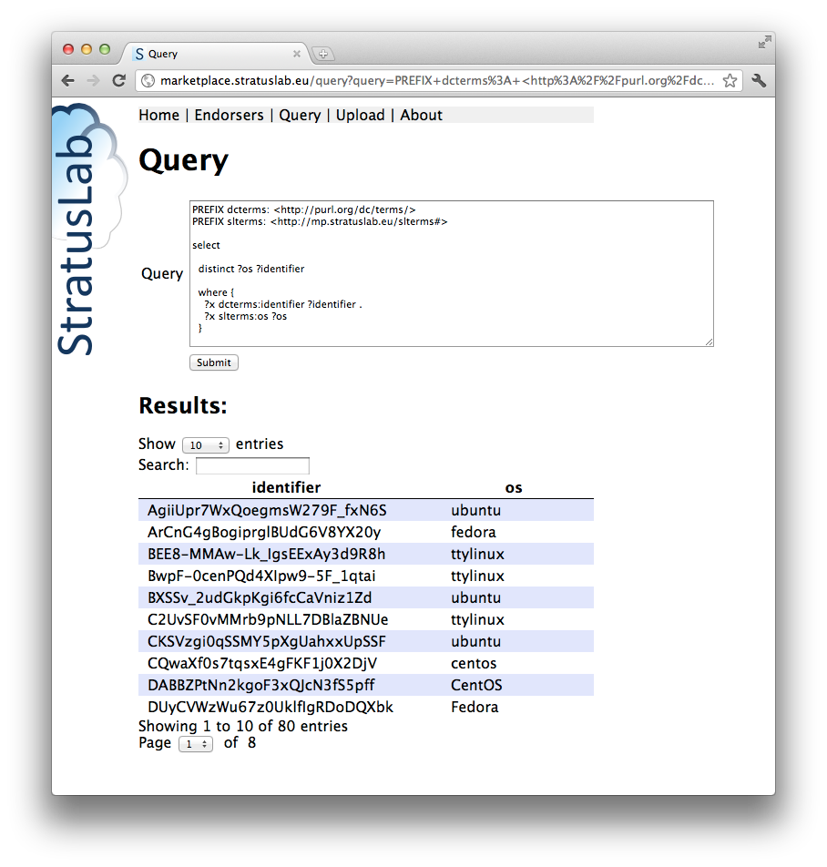
User: Browse or Query Images
Query with SPARQL
Browse via the web

Slide 10
Simple SPARQL Query
PREFIX dcterms: <http://purl.org/dc/terms/>
PREFIX slterms: <http://mp.stratuslab.eu/slterms#>
select
distinct ?os ?identifier
where {
?x dcterms:identifier ?identifier .
?x slterms:os ?os
}

Slide 11
Filtering Results with SPARQL
PREFIX dcterms: <http://purl.org/dc/terms/>
PREFIX slreq: <http://mp.stratuslab.eu/slreq#>
select
distinct ?identifier ?email ?created
where
{
?x dcterms:identifier ?identifier;
slreq:endorsement ?endorsement .
?endorsement slreq:endorser ?endorser;
dcterms:created ?created .
?endorser slreq:email ?email .
FILTER (?email = "me@example.com")
}

Slide 12
User: Run machine instance
Pass the URL for metadata entry when starting instance.
stratus-run-instance … MMZu9WvwKIro-rtBQfDk4PsKO7_
Control the machine with the standard commands
stratus-run-instance <Image ID>
stratus-describe-instance <VM ID>
stratus-kill-instance <VM ID>

Slide 13
Administrator: Define Policy
Create machine image policy
Validate metadata file
White/Blacklist for images
White/Blacklist for endorsers
Blacklist for checksums
Policy evaluation
stratus-policy-image: invokes site policy to determine if the referenced image can be used
stratus-download-image: will download (and cache) a validated image to be used by a VM instance; uses the location URL(s) in the metadata entry
[whitelistendorsers]
group1 = loomis@lal.in2p3.fr
[whitelistimages]
group1 = MMZu9WvwKIro-rtBQfDk4PsKO7_
[blacklistimages]
group1 = XXXy9WvwKIro-rtBQfDk4PsKKzz
[blacklistendorsers]
group1 = hacker@example.org
[blacklistchecksums]
group1 = …
[validatemetadatafile]
activate = true

Slide 14
Creator: Sharing Image
Create an image
Use stratus-create-image or build one from scratch
Upload image to web accessible location (or cloud storage)
Create image metadata
Use stratus-build-metadata to create metadata entry
Add or modify information in entry
Sign the entry with stratus-sign-metadata
Upload metadata
Upload the metadata to Marketplace with stratus-upload-metadata, or
Upload directly via a browser
Server will verify format, signature, and (optionally) endorser’s email

Slide 15
Flexible Certification Schemes
Images may (will) have multiple entries
Evolution in time (e.g. deprecation of image) by same endorser
“External” certification of images by “external” endorser(s)
Complete history available
Entries are never deleted, but…
Only latest entry for each endorser is visible by default
Deprecated entries not shown by default
Supported schemes
Author endorsements
Group (experiment) endorsements
Certification bodies
…

Slide 16
Summary
Marketplace
Registry of metadata for machine and disk images
Works with cloud, grid, and web storage to make images available
Facilitates the trusted sharing of images between sites, users, …
Fully integrated with StratusLab VM deployment
Production service available (http://marketplace.stratuslab.eu/)
Future Work
Federation of independent Marketplace instances
Continued discussions for interoperability and adoption
Developing conventions for additional metadata in entries
Developing image certification conventions

