Slide 1
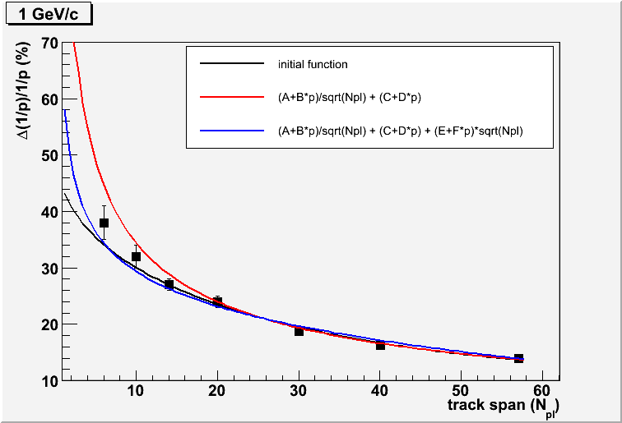
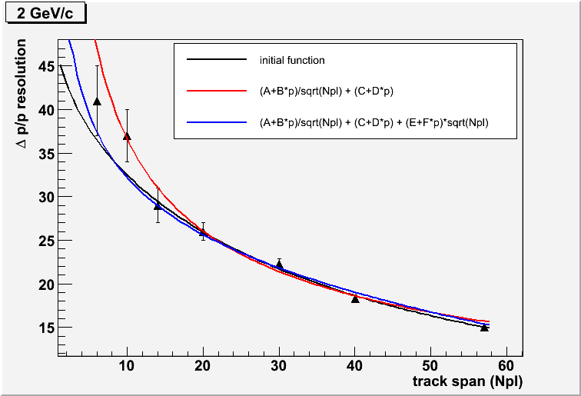
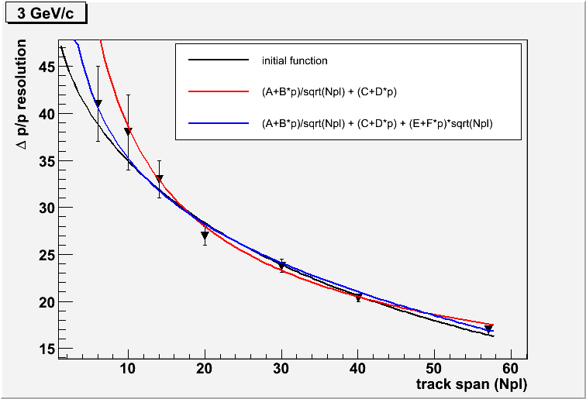
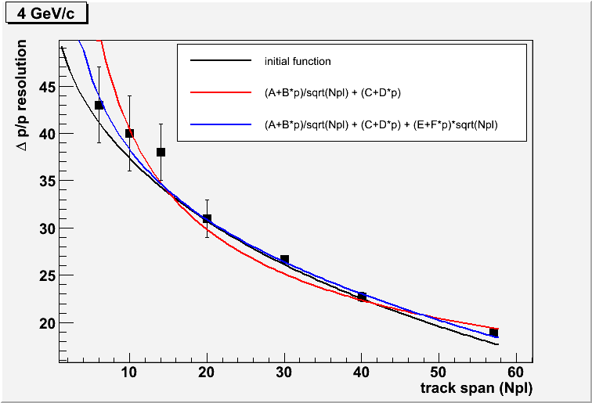
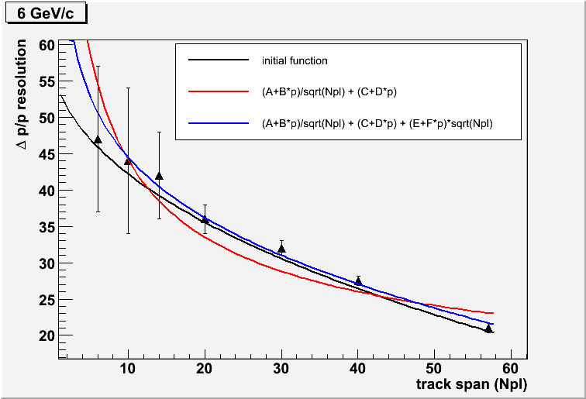
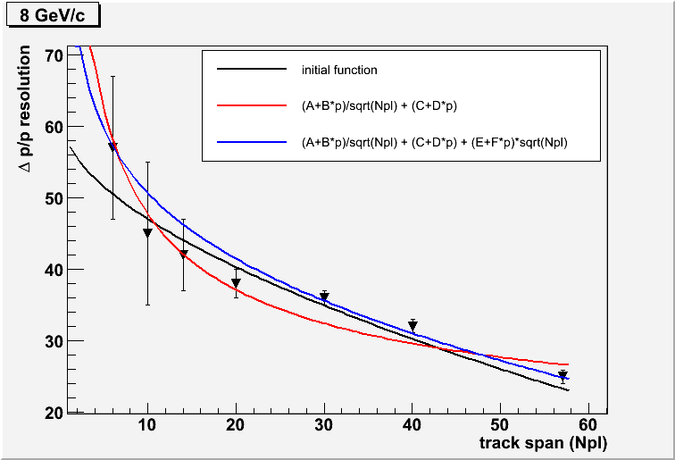
Comparison of 3 functions to fit the MCS resolution from 1 to 8 GeV/c
Red curve: (1.149-0.023*p)/sqrt(Npl) + (-0.030+0.019*p)
Blue curve: (0.397+0.019*p)/sqrt(Npl) + (0.176+0.042*p) + (-0.014-0.003*p)*sqrt(Npl)
Black curve: old parameterization
D. Duchesneau 09/06/2011

Slide 2
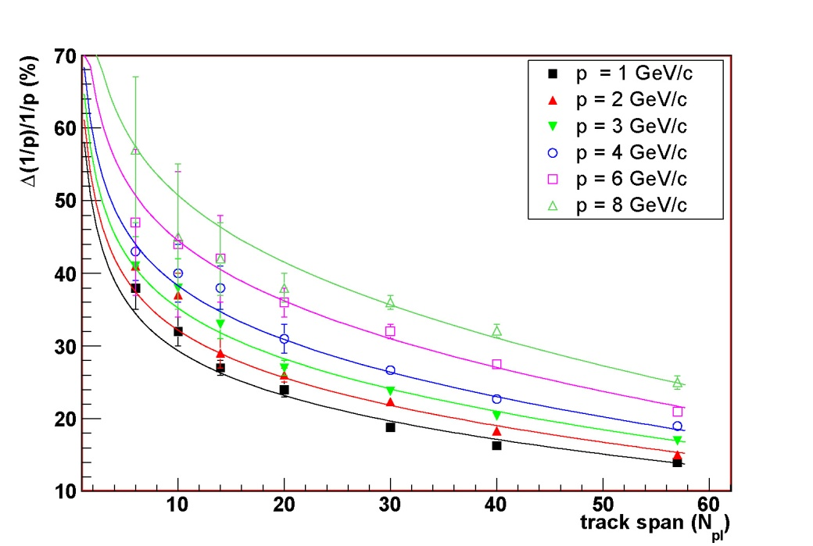
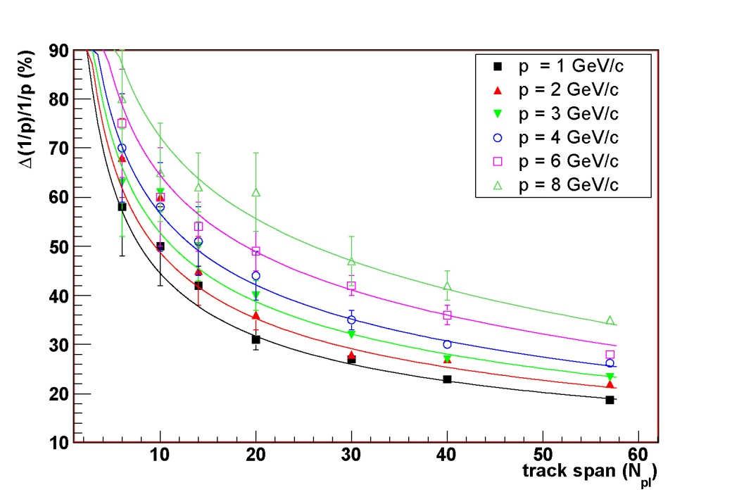
New figures with the new fitted functions:
Fig 7
angle < 0.2 rad
Δ(1/p)/1/p = [(0.397+0.019*p)/sqrt(Npl) + (0.176+0.042*p) + (-0.014-0.003*p)*sqrt(Npl)]
Fig 9
angle >0.2 rad
Δ(1/p)/1/p = [(1.400-0.022*p)/sqrt(Npl) + (-0.040+0.051*p) + (0.003-0.004*p)*sqrt(Npl)]

