Slide 1
Copy on Demand with Internal Xrootd Federation Wei Yang SLAC National Accelerator Laboratory

Slide 2
Why an Internal Federation?
Analysis jobs read directly from Xrootd storage
Need high performance storage to serve the random IO from analysis jobs
Data become cold quickly
Do we really need to keep on buying high performance storage for all data?
Can we divide storage into tiers and federated them?

Slide 3
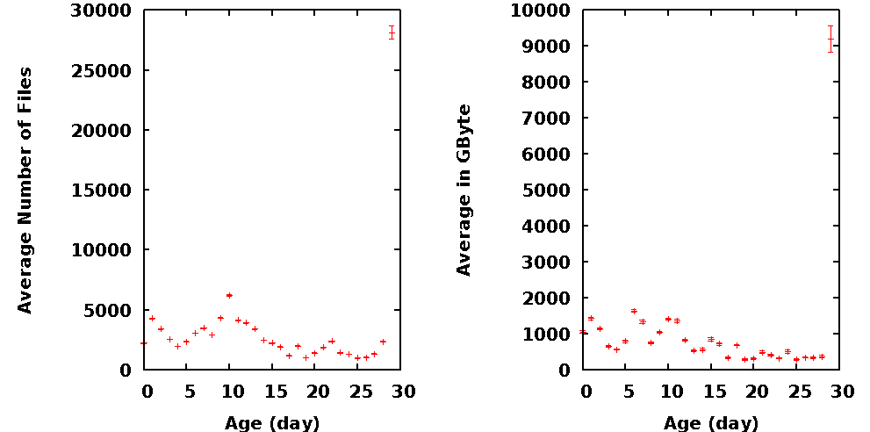
Data is cooling down …
Age: Last access time in days
Average over 17 identical Thumpers/Thors

Slide 4
How an Internal Federation works?
Front tier redirector:
GridFTP Put
Analysis job direct reading
All job outputs
Small Xrootd cluster with high performance configuration
(meta) redirector
sees all storage:
SRM & Data management
Production jobs data stage-in
GridFTP Get
Internal data flow with FRM
Large Xrootd cluster configured toward maximum capacity

Slide 5
Internal Federation
Uniform name space
Data move between tiers/federation automatically
Front tier moves cold data to back tier when space is need
Reading at front tier triggers data stage-in from back tier
Driven by the front tier, using FRM
transparent to jobs
Validate checksum for all data movement

Slide 6
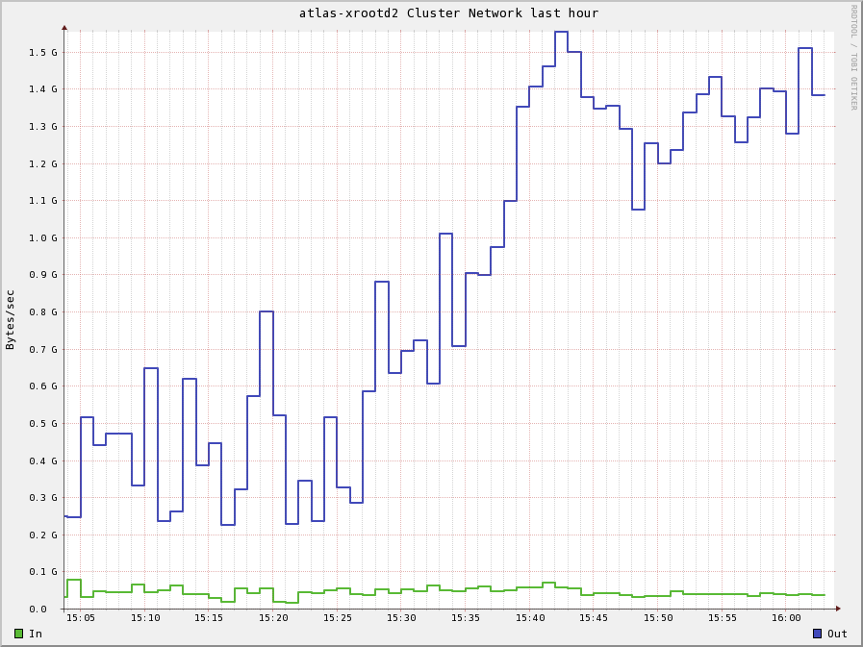
Data Migration
1.5 GB
1.0 GB
15:50 16:00

Slide 7
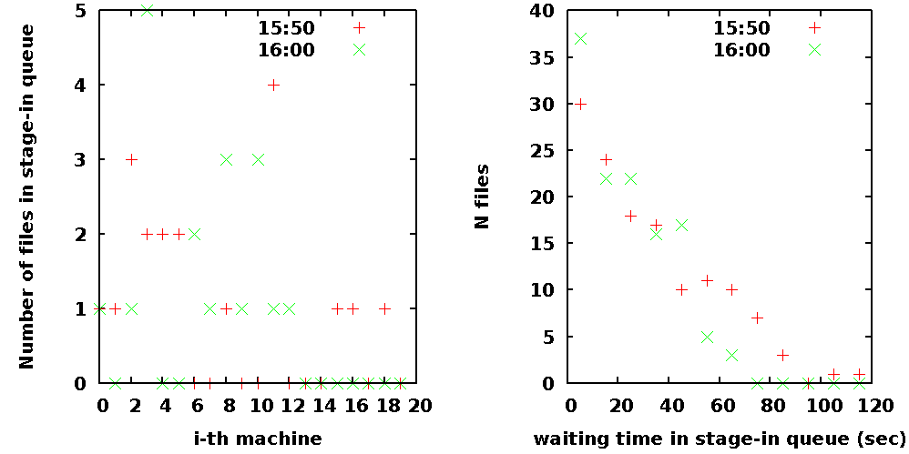
Delays of Copy on Demand

Slide 8
Other benefits of a tiered storage
A node in back tier outage has very little impact to operation
Allow scheduling front tier node outage without down time
Need to vacation the data, could be days
Always spread new data across all front tier nodes. Avoid hot spot
Back tier only needs Xrootd interface.

Slide 9
Issues
Moving small files is inefficient
Bypass back tier redirector to improve performance
Tricky to keep usage info
during stage-in and migration
Complicate operation when vacating a storage node.
Multiple steps, better had a good sleep

