Slide 1
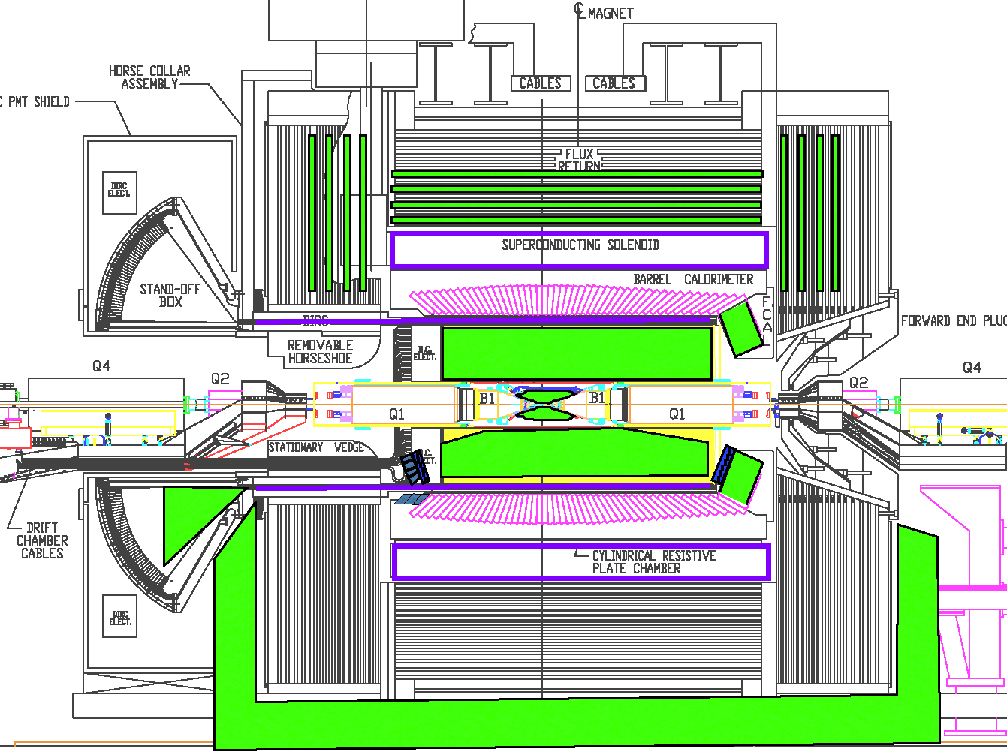


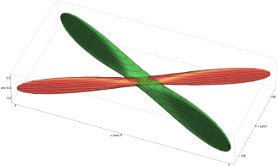
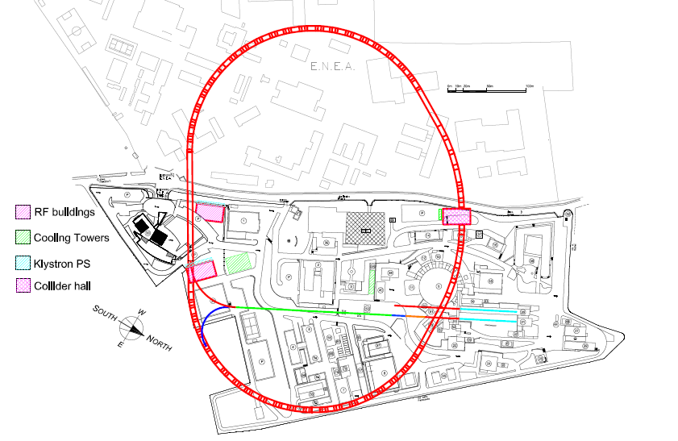
Super-B Projects
mainly the Physics Program and Detector
Aim to form a French Group to participate to SuperB Coll.
Thanks to Nicolas Arnaud in
helping me to prepare these slides
Achille Stocchi - LAL (Université Paris-Sud / IN2P3)

Slide 2
Next generation of Super asymmetric B factory ≡
L= 10³⁶ cm⁻² s⁻¹ , >100 times the one of the present B-factory
Machine is challenging and based on new accelerating
schemes : “crab waist” : luminosity > 10³⁶ possible !
Success of “Frascati tests” has proven that they work !
The « Japanese » machine finally converged to this solution
Two SuperB factories will be built in this decade.
Both projects have been funded.
SuperKEKB
SuperB
I’ll discuss SuperB. Please ask question on SuperKEKB

Slide 3
Milestones
• 2005-2011: 16 SuperB workshops
• 2007: SuperB CDR
• 2010: 3 SuperB progress reports – accelerator, detector, physics
• December 2010 & 1^{rst} quarter 2011: project approbation by Italy
May 2011: site choosen ! Soon start of the civil engineering
May 28th → June 2nd 2011: Kick off SuperB meeting in Elba
• End 2011-beginning of 2012: detector and accelerator Technical Design Reports
▪ Computing TDR ~a year later
• First collisions expected for ~2017

Slide 4
Physics
Program
25’
Why ?
The Machine
How ?
25’
The Detector

Slide 5
PHYSICS : the Physics Program for a machine with
L= 10³⁶ cm⁻² s⁻¹ running >5 years.
KEY WORD : Complementarity to LHC program
MACHINE : the new collision schemes which make
L= 10³⁶ cm⁻² s⁻¹ possible.
KEY WORD : Very ambitious machine. Unique
opportunity to keep expertise
DETECTOR : reuse part of Babar but largely improved
KEY WORD : New and ambitious detector. Possibility
to conceive, construct and use a
detector in a few year time

Slide 6
Physics
Program
(still under construction..)
A discovery machine in the LHC era

Slide 7
Beyond the Standard Model with flavour physics
The indirect searches look for “New Physics”
through virtual effects from new particles in loop corrections
1
~1970 charm quark from FCNC and GIM-mechanism K⁰→ μμ
~1973 3rd generation from CP violation in kaon (ε_{K}) KM-mechanism
~1990 heavy top from B oscillations Δm_{B}
~2000 success of the description of FCNC and CPV in SM
2
3
4
“Discoveries” and construction of the SM Lagrangian
SM FCNCs and CP-violating (CPV) processes occur at the loop level
SM quark Flavour Violation (FV) and CPV are governed by weak interactions
and are suppressed by mixing angles.
SM quark CPV comes from a single sources ( if we neglect θ _{QCD} )
New Physics does not necessarily share the SM behaviour of FV and CPV

Slide 8
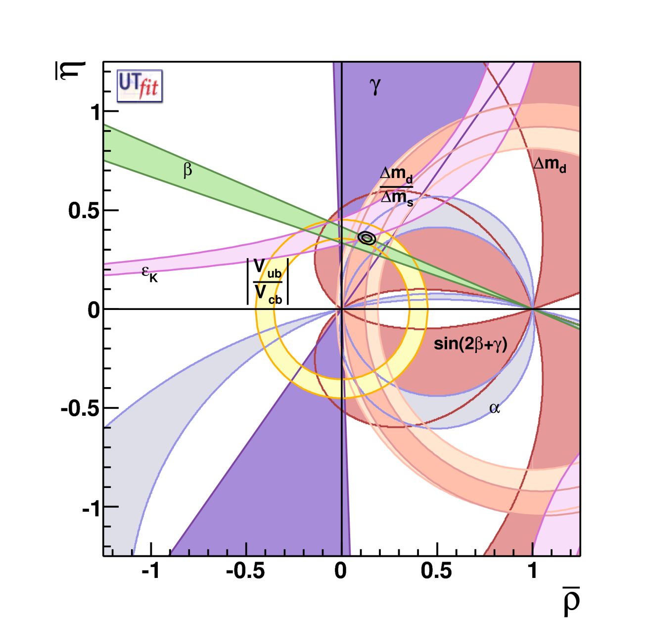
Global Fit within the SM
Coherent picture of FCNC and CPV processes in SM
Consistence on an
over constrained fit
of the CKM parameters
Discovery : absence of
New Particles up to the
~2×Electroweak Scale !
ρ = 0.132 ± 0.020
η = 0.358 ± 0.012
With a precision of
σ(ρ) ∼15% and σ(η) ~4% !
CKM matrix is the dominant source of flavour mixing and CP violation

Slide 9
Is the present picture showing a
Model Standardissimo ?
CKM matrix is the dominant source of flavour mixing and CP violation
σ( ρ)∼15% σ(η) ∼4%
Nevertheless there are tensions here and there that should
be continuously and quantitatively monitored :
sin2β (+2.2σ), ε_{K} (−1.7σ) , Br(B→τ ν) −(3.2σ)
[CP asymmetry in Bs sector (3.1σ)]
To render these tests more effective we need to improve the measurements but also (in same case) the predictions
Other measurements are interesting, not yet stringent tests :
α,γ, β from Penguins, A_{CP} (and Br) in radiative and dileptonic decays…

Slide 10
The problem of particle physics today is :
where is the NP scale Λ ~ 0.5, 1…10¹⁶ TeV
LHC will search
on this range
The quantum stabilization of the Electroweak Scale
suggests that Λ~ 1TeV
t
H
H
t
t
H
t
H
Those are arguments of fine tuning…if the NP scale is at 2-3..10 TeV
…naturalness is not at loss yet…

Slide 11
Present and future goals of Flavour Physics
It is a game of couplings and scales
if NP particles are discovered at LHC we have to
be able to study the flavour structure of the NP
(“reconstructing” the NP Lagrangian)
→to have the capability to explore NP scale beyond
the LHC reach
Coupling δ | PRECISION 20% today | PRECISION 10% Tomorrow (2010-2015) (LHCb,MEG,NA62…) | PRECISION 1% after tomorrow (>2015)
Order 1 | Λ_{eff} ~ 20 TeV | Λ_{eff} ~ 30 TeV | Λ_{eff} ~ 100 TeV
MFV | Λ_{eff} ~ 180 GeV | Λ_{eff} ~ 250 GeV | Λ_{eff} ~ 800 GeV

Slide 12
Which NP
will be ??
Which NP
will be ??
Which NP
will be ??
Which NP
will be ??
Which NP
will be ??
Which NP
will be ??
Which NP
will be ??
The actors in the
next decade
Which NP
will be ??
The actors in the
next decade
The actors in the
next decade
The actors in the
next decade
Which NP
will be ??
The actors in the
next decade
The actors in the
next decade
The actors in the
next decade
The actors in the
next decade
The actors in the
next decade
Br (B_{s}→ μμ)
Br (B_{s}→ μμ)
Br (B_{s}→ μμ)
Br (B_{s}→ μμ)
Br (B_{s}→ μμ)
Br (B_{s}→ μμ)
Br (B_{s}→ μμ)
Br (B_{s}→ μμ)
Br,ACP (B→ X_{s} l l)
Br (B_{s}→ μμ)
Br,ACP (B→ X_{s} l l)
Br,ACP (B→ X_{s} l l)
Br,ACP (B→ X_{s} l l)
Br,ACP (B→ X_{s} l l)
Br,ACP (B→ X_{s} l l)
Br,ACP (B→ X_{s} l l)
Br,ACP (B→ X_{s} l l)
Br (B→ X_{s} γ)
Br,ACP (B→ X_{s} l l)
Br (B→ X_{s} γ)
Br (B→ X_{s} γ)
Br (B→ X_{s} γ)
Br (B→ X_{s} γ)
Br (B→ X_{s} γ)
Br (B→ X_{s} γ)
Br (B→ X_{s} γ)
Br (B→ X_{s} γ)
NMFV (1-3)
NMFV (1-3)
NMFV (1-3)
NMFV (1-3)
NMFV (1-3)
NMFV (1-3)
NMFV (1-3)
NMFV (1-3)
NMFV (1-3)
MFV
MFV
MFV
MFV
MFV
MFV
MFV
MFV
Br (K⁰→ π⁰νν)
MFV
Br (K⁰→ π⁰νν)
Br (K⁰→ π⁰νν)
Br (K⁰→ π⁰νν)
Br (K⁰→ π⁰νν)
Br (K⁰→ π⁰νν)
Br (K⁰→ π⁰νν)
Br (K⁰→ π⁰νν)
Br (K⁰→ π⁰νν)
β
β
β
β
β
β
β
β
β
MFV-GUT
MFV-GUT
MFV-GUT
MFV-GUT
MFV-GUT
MFV-GUT
MFV-GUT
MFV-GUT
MFV-GUT
Br (μ◊ e γ)
Br (μ◊ e γ)
Br (μ◊ e γ)
Br (μ◊ e γ)
Br (μ◊ e γ)
Br (μ◊ e γ)
Br (μ◊ e γ)
Br (μ◊ e γ)
Br (B→ τν , μυ)
Br (μ◊ e γ)
Br (B→ τν , μυ)
Br (B→ τν , μυ)
Br (B→ τν , μυ)
Br (B→ τν , μυ)
Br (B→ τν , μυ)
Br (B→ τν , μυ)
Br (B→ τν , μυ)
Br (B→ τν , μυ)
RH-currents
RH-currents
RH-currents
RH-currents
RH-currents
RH-currents
RH-currents
RH-currents
RH-currents
NMFV (2-3)
NMFV (2-3)
NMFV (2-3)
NMFV (2-3)
NMFV (2-3)
NMFV (2-3)
NMFV (2-3)
NMFV (2-3)
NMFV (2-3)
(g - 2)_{μ}
(g - 2)_{μ}
(g - 2)_{μ}
(g - 2)_{μ}
(g - 2)_{μ}
(g - 2)_{μ}
(g - 2)_{μ}
(g - 2)_{μ}
(g - 2)_{μ}
Br (K⁺→ π⁺νν)
Br (K⁺→ π⁺νν)
Br (K⁺→ π⁺νν)
Br (K⁺→ π⁺νν)
Br (K⁺→ π⁺νν)
Br (K⁺→ π⁺νν)
Br (K⁺→ π⁺νν)
Br (K⁺→ π⁺νν)
Br (K⁺→ π⁺νν)
H⁺ - high tanβ
H⁺ - high tanβ
H⁺ - high tanβ
H⁺ - high tanβ
H⁺ - high tanβ
H⁺ - high tanβ
H⁺ - high tanβ
H⁺ - high tanβ
H⁺ - high tanβ
Br (τ ◊ μμμ)
Br (τ ◊ μμμ)
Br (τ ◊ μμμ)
Br (τ ◊ μμμ)
Br (τ ◊ μμμ)
Br (τ ◊ μμμ)
Br (τ ◊ μμμ)
Br (τ ◊ μμμ)
Br (τ ◊ μμμ)
Br (B→ K νν)
Br (B→ K νν)
Br (B→ K νν)
Br (B→ K νν)
Br (B→ K νν)
Br (B→ K νν)
Br (B→ K νν)
Br (B→ K νν)
Br (B→ K νν)
A_{CP} (B→ X_{s} γ)
A_{CP} (B→ X_{s} γ)
A_{CP} (B→ X_{s} γ)
A_{CP} (B→ X_{s} γ)
A_{CP} (B→ X_{s} γ)
A_{CP} (B→ X_{s} γ)
A_{CP} (B→ X_{s} γ)
A_{CP} (B→ X_{s} γ)
A_{CP} (B→ X_{s} γ)
Z penguins
Z penguins
Z penguins
Z penguins
Z penguins
Z penguins
Z penguins
Z penguins
Z penguins
LHT Models
LHT Models
LHT Models
Br (B→ K_{S}π⁰γ)
LHT Models
Br (B→ K_{S}π⁰γ)
Br (B→ K_{S}π⁰γ)
Br (B→ K_{S}π⁰γ)
LHT Models
LHT Models
LHT Models
LHT Models
Br (B→ K_{S}π⁰γ)
LHT Models
Br (B→ K_{S}π⁰γ)
Br (B→ K_{S}π⁰γ)
Br (B→ K_{S}π⁰γ)
Br (B→ K_{S}π⁰γ)
Br (τ ◊ μγ)
Br (τ ◊ μγ)
Br (τ ◊ μγ)
Br (τ ◊ μγ)
Br (τ ◊ μγ)
Br (τ ◊ μγ)
Br (τ ◊ μγ)
Br (τ ◊ μγ)
Br (τ ◊ μγ)
ACP(B_{s}→J/ ψ φ)
ACP(B_{s}→J/ ψ φ)
ACP(B_{s}→J/ ψ φ)
ACP(B_{s}→J/ ψ φ)
ACP(B_{s}→J/ ψ φ)
ACP(B_{s}→J/ ψ φ)
ACP(B_{s}→J/ ψ φ)
ACP(B_{s}→J/ ψ φ)
ACP(B_{s}→J/ ψ φ)
Many of these channels could be studied by SuperB

Slide 13
L= 10³⁴ cm⁻² s⁻¹ → 150 fb⁻¹ → 1.5 × 10⁸ Υ(4s) produced by year
L= 10³⁶ cm⁻² s⁻¹ → 15 ab⁻¹ → 1.5 × 10¹⁰ Υ(4s) produced by year
B factories have shown that a variety of
measurements can be performed in the clean environment.
Asymmetric
B factory
The systematic errors are very rarely irreducible and can almost on all cases be controlled with control samples. (up to..50-100ab⁻¹)
High luminosity
Many and interesting measurements at different energies (charm/τ threshold, U(5S), other Upsilons.. )
and with polarised beam
Flavour factories
SuperB factory potential discovery evaluated with 75ab⁻¹

Slide 14
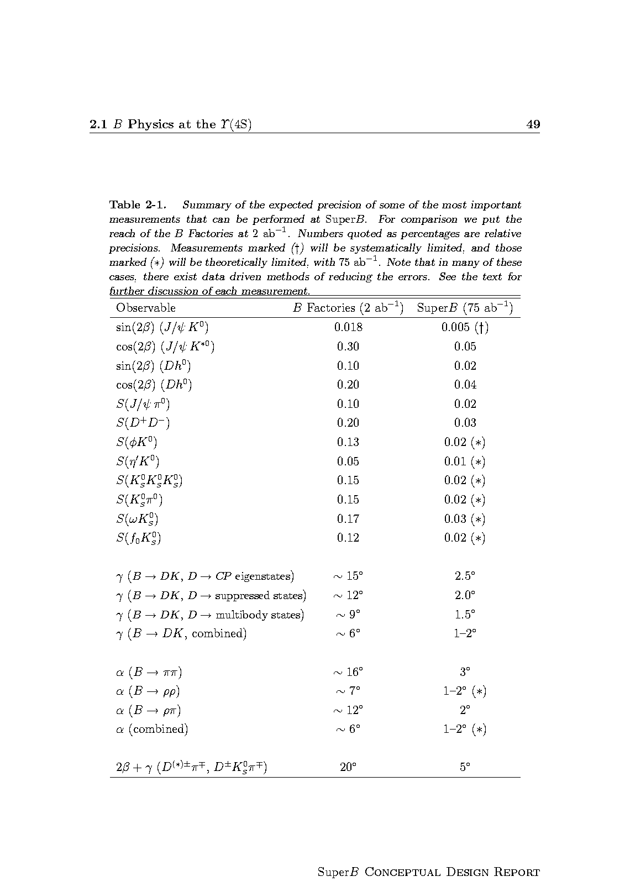
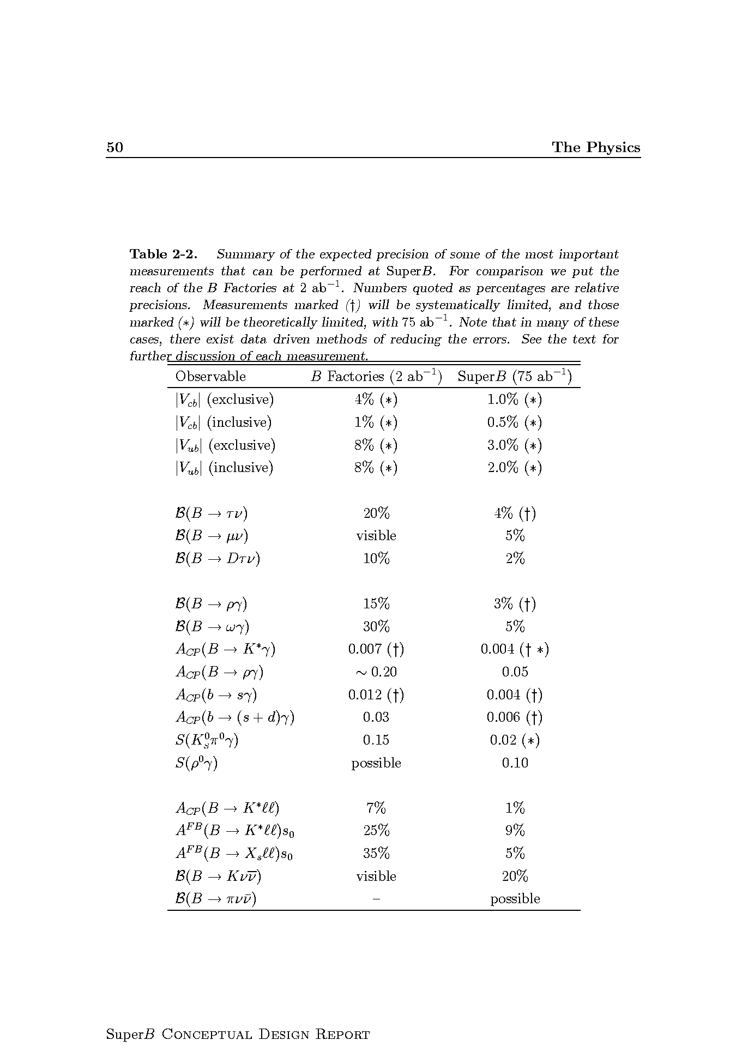
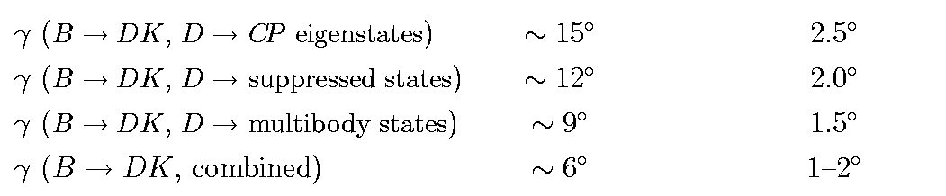
B physics @ Y(4S)
Variety of measurements for any observable
Possible also at LHCb
Similar precision at LHCb
Example of « SuperB specifics »
inclusive in addition to exclusive analyses
channels with π⁰, γ’s, ν, many Ks…

Slide 15
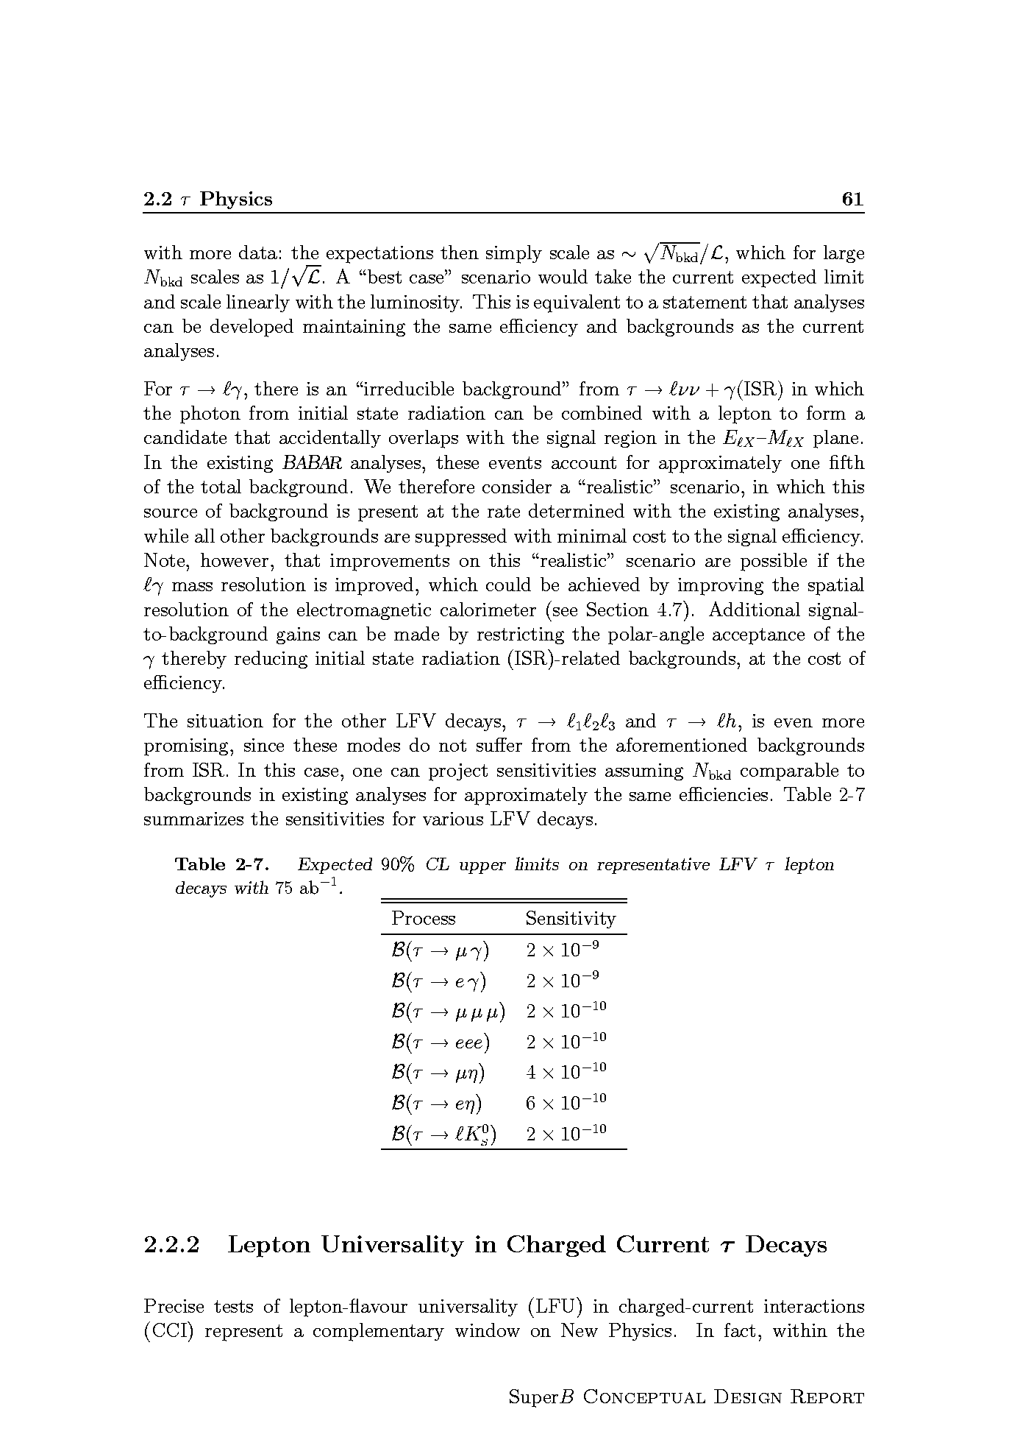
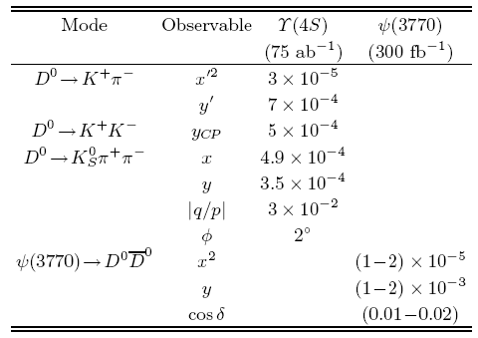
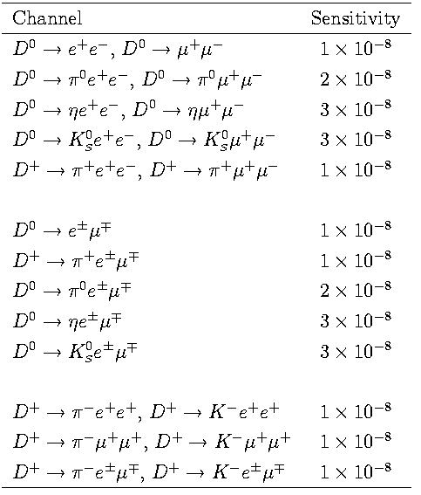
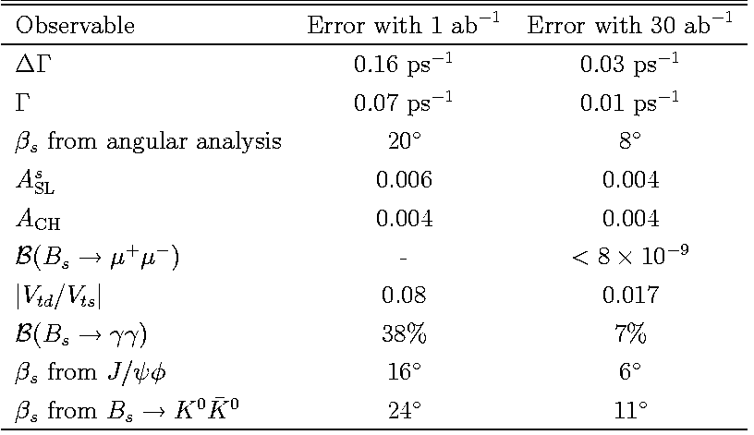
τ physics (polarized beams)
Charm at Y(4S) and threshold
To be evaluated
at LHCb
B_{s} at Y(5S)
Bs : Definitively better at LHCb

Slide 16
The Quantum path
The indirect searches
look for “New Physics”
through virtual effects from new particles in loop corrections
I’ll show
Examples of
golden measurements
for
possible discoveries
Key words :
Precise measurements
→ Luminosity
5

Slide 17
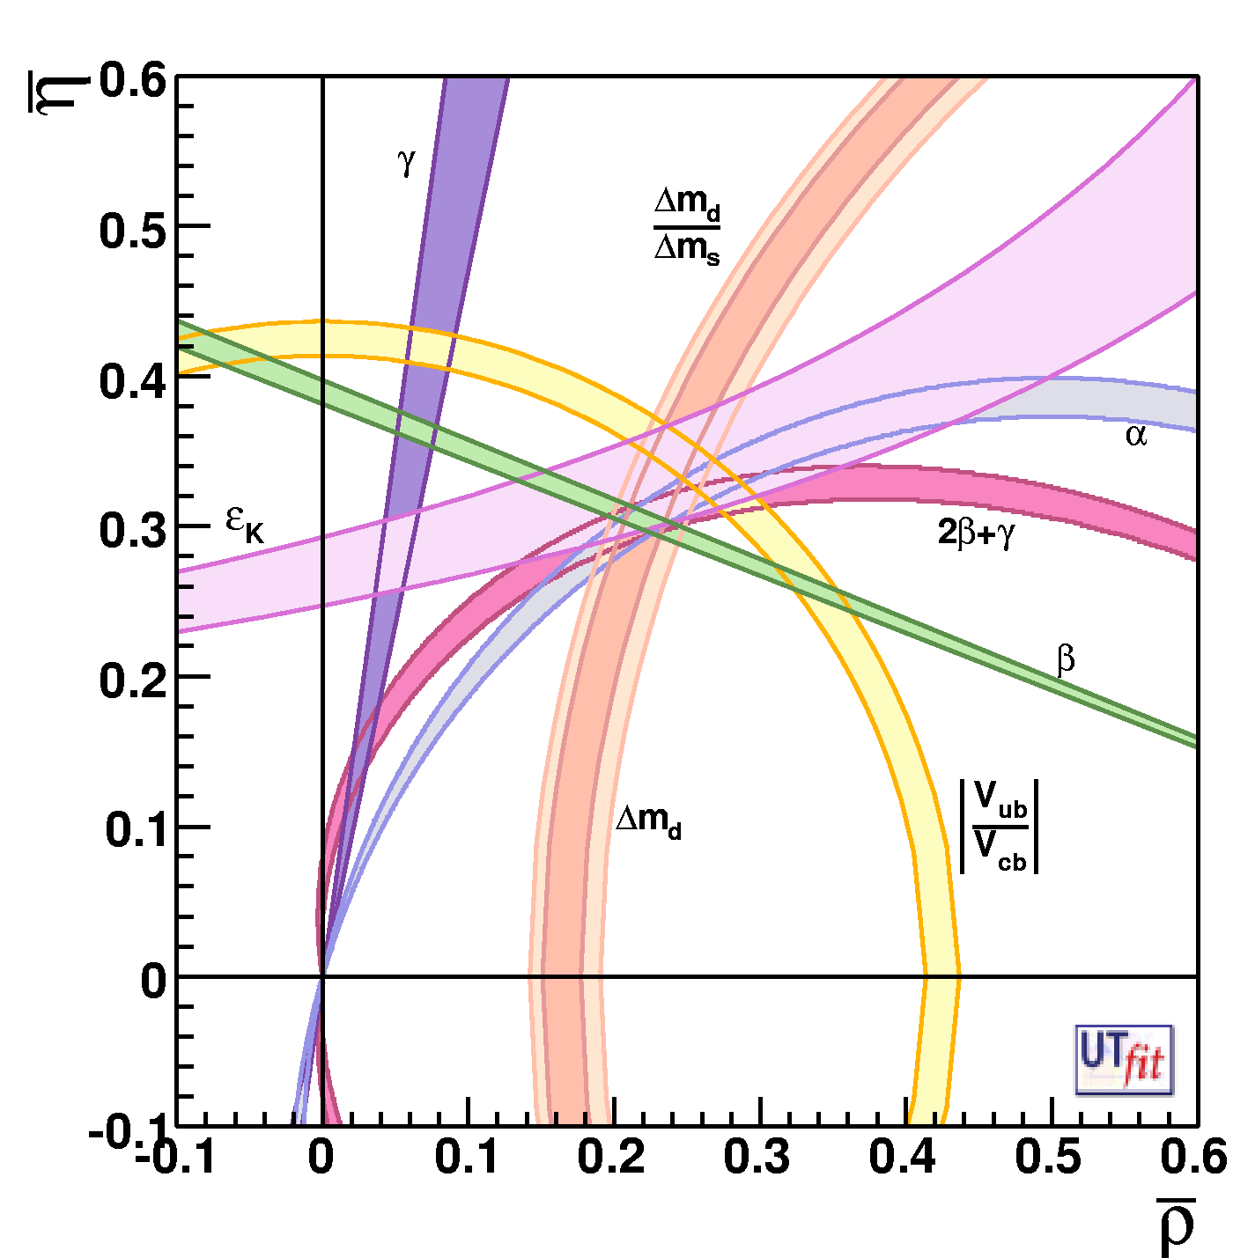
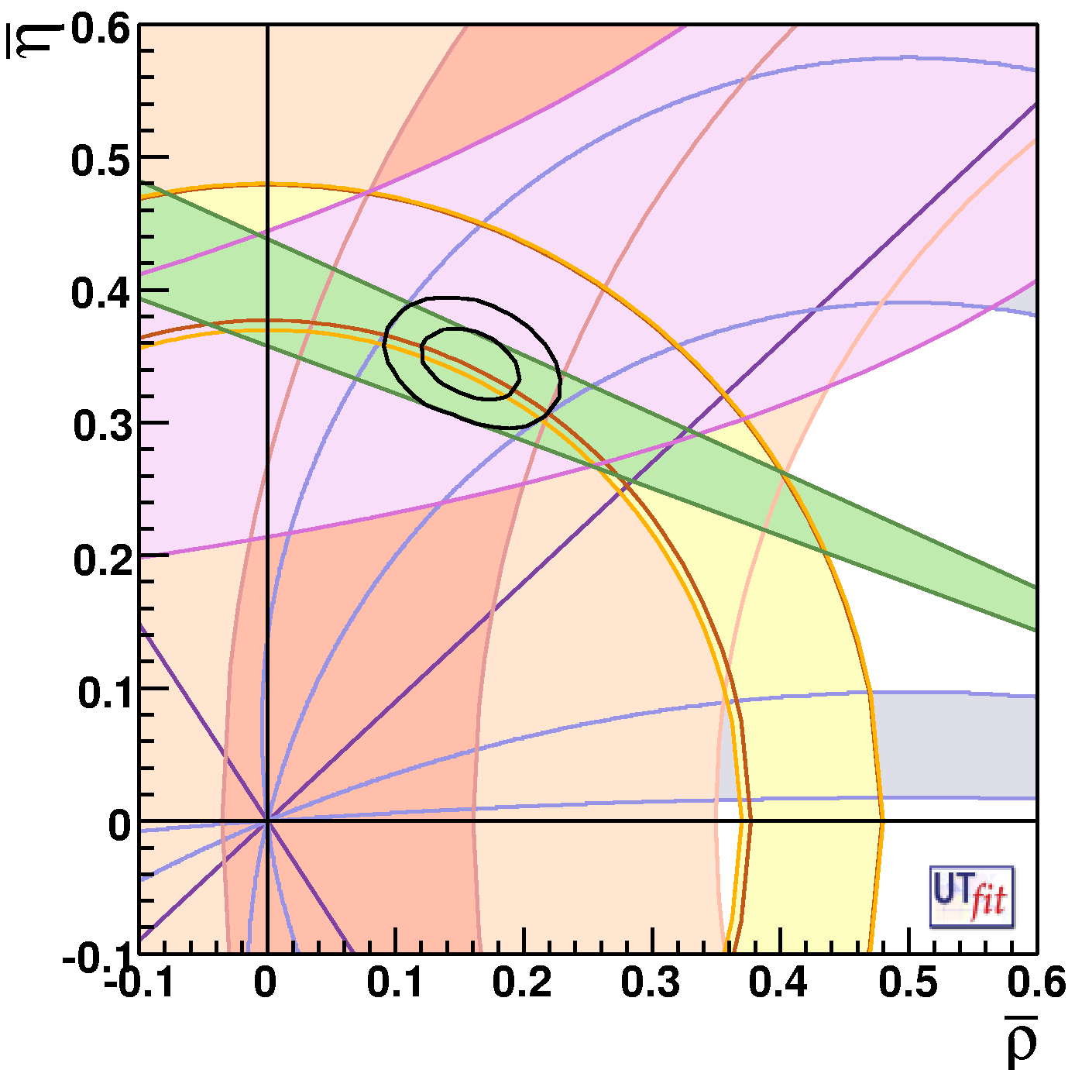
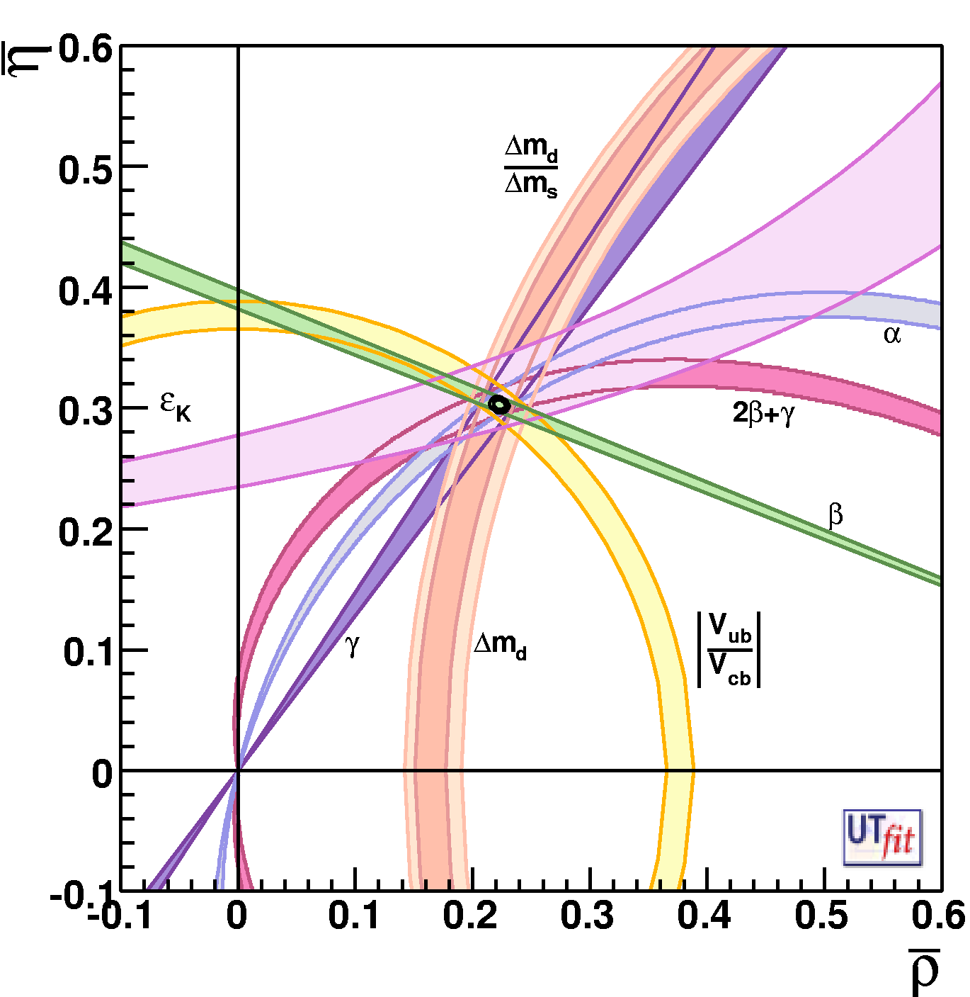
1
Determination of CKM parameters and New Physics
Today
Future (SuperB) + Lattice improvements
This situation will be different @2015 thanks to LHCb
players are :
γ,α,β..,V_{ub}
and Lattice !
ρ = 0.163 ± 0.028
η = 0.344± 0.016
ρ = ± 0.0028
η = ± 0.0024
Improving CKM is
crucial to look for NP
Important also in K physics :
K→ π ν ν , CKM errors dominated
the error budget

Slide 18
Part of the program could be accomplished if SM theoretical predictions are @ 1%
Shown by Vittorio Lubicz at the SuperB Workshop LNF Dec2009
Hadronic matrix element | Lattice error in 2006 | Lattice error in 2009 | 6 TFlop Year | 60 TFlop Year | 1-10 PFlop Year
 | 0.9% | 0.5% | 0.7% | 0.4% | < 0.1%
 | 11% | 5% | 5% | 3% | 1%
f_{B} | 14% | 5% | 3.5 - 4.5% | 2.5 - 4.0% | 1 – 1.5%
 | 13% | 5% | 4 - 5% | 3 - 4% | 1 – 1.5%
ξ | 5% | 2% | 3% | 1.5 - 2 % | 0.5 – 0.8 %
☞ _{B → D/D*lν} | 4% | 2% | 2% | 1.2% | 0.5%
 | 11% | 11% | 5.5 - 6.5% | 4 - 5% | 2 – 3%
 | 13% | 13% | ---- | ---- | 3 – 4%
[2009]
[2011 LHCb]
[2015 SuperB]
18
18
The expected accuracy has been reached! (except for Vub)

Slide 19
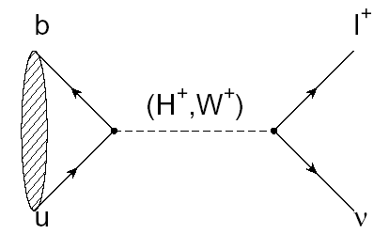
2
Leptonic decay B → l ν
SuperB
SuperB -75ab⁻¹
M_{H}~1.2-2.5 TeV
for tanβ~30-60
2HDM-II
MSSM
75ab⁻¹
2ab⁻¹
LEP m_{H}>79.3 GeV
SuperB
ATLAS 30fb⁻¹
SuperB excludes
SuperB excludes
ATLAS 30fb⁻¹
B-factories exclude
B-factories exclude
ATLAS 30fb⁻¹

Slide 20
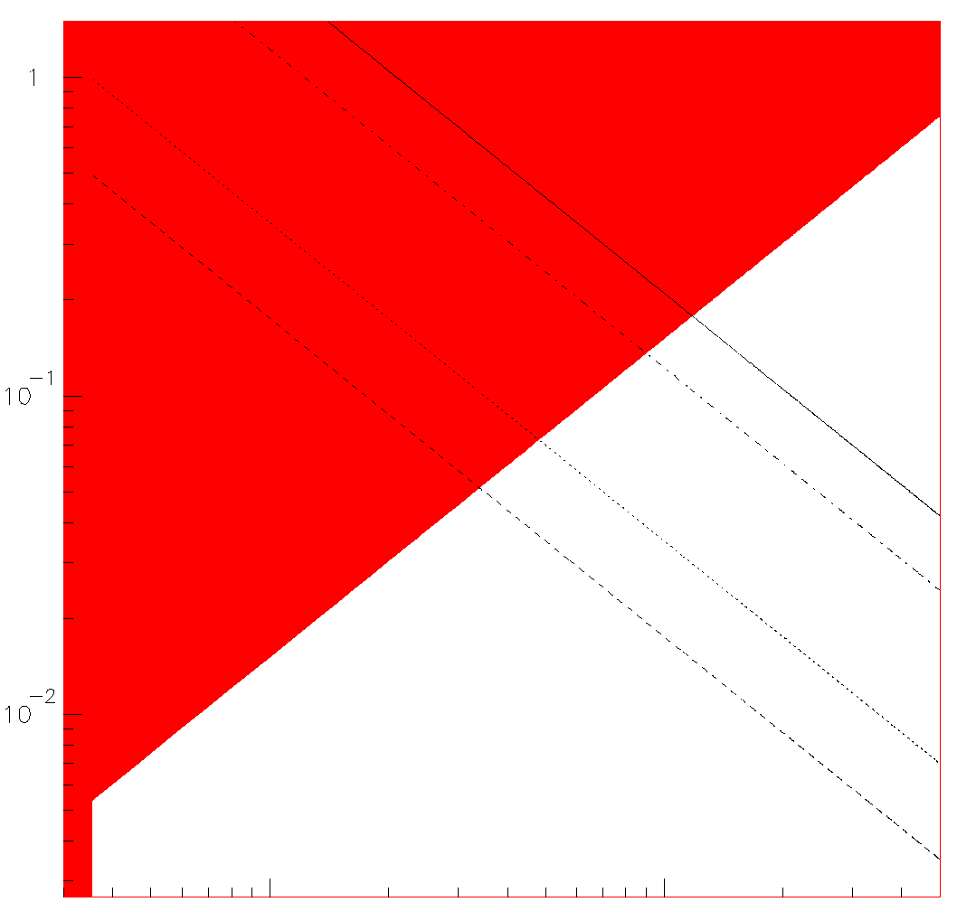
3
MSSM+generic soft SUSY breaking terms
New Physics contribution
(2-3 families)
Flavour-changing NP effects in the squark propagator
NP scale SUSY mass
flavour-violating coupling
~
g
b
~
~
s
b
s
1
10⁻¹
10⁻²
In the red regions the δ
are measured with a
significance >3σ away
from zero
Here the players are :
= (0.026 ± 0.005)
(B→X_{s} γ)
(B→X_{s} l⁺l⁻)
A_{CP}(B→X_{s} γ)
Arg(δ₂₃)_{LR}=(44.5± 2.6)º
1 10
1 TeV

Slide 21
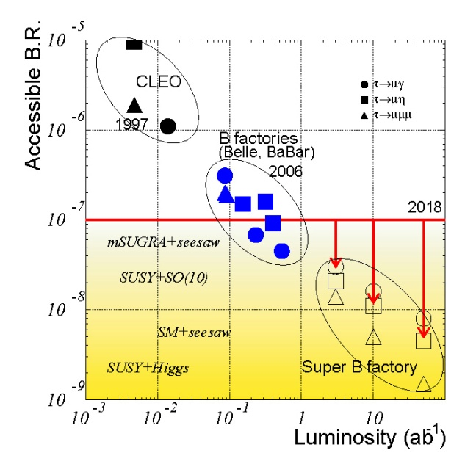
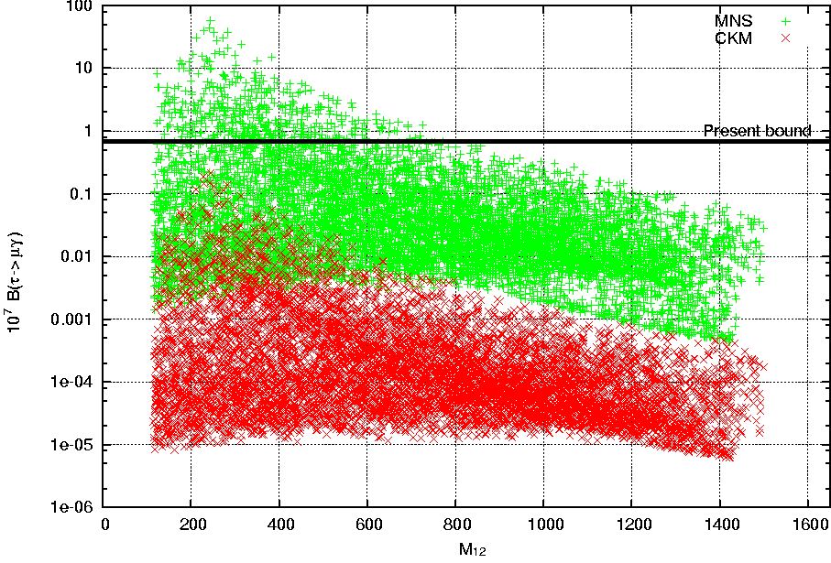
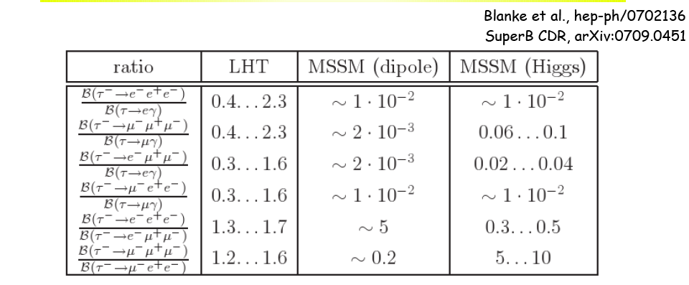
4
Lepton Flavour Violation in τ decays
ν mixing leads to a low level of
charged LFV (B~10⁻⁵⁴)
Enhancements to observable levels
are possible with new physics
MEG sensitivity μ→eγ ~10⁻¹³
Preliminary results < 3 10⁻¹¹
Masurements and origin of LFV
Discrimination between SUSY and LHT
SO(10) MSSM
10⁷ BR (τ→μγ)
LFV from PMNS
SuperB
LFV from CKM
The ratio τ→ lll / τ◊ μγ is not suppressed in
LHT by α_{e} as in MSSM
M_{1/2}

Slide 22
5
CP Violation in charm
NOW
To be evaluated
at LHCb
CPV in D system negligible in SM
SuperB
CPV in D sector is a
clear indication of New Physics !

Slide 23
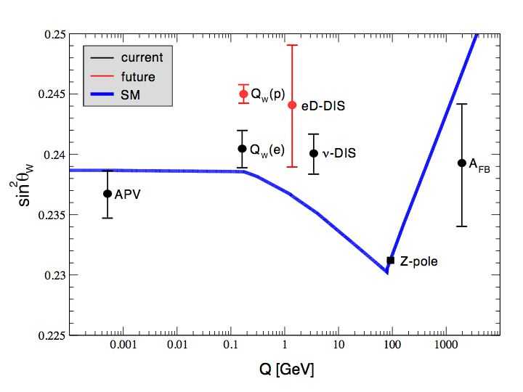
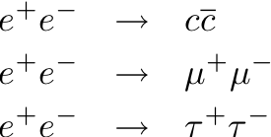
Other opportunities : Precision Electroweak
• sin²θ_{W} can be measured with polarised e− beam
→ √s=ϒ(4S) is theoretically clean, c.f. b-fragmentation at Z pole
• Measure LR asymmetry in at the ϒ(4S) to same precision as
LEP/SLC at the Z-pole
• Can also perform crosscheck at ψ(3770)
SuperB

Slide 24
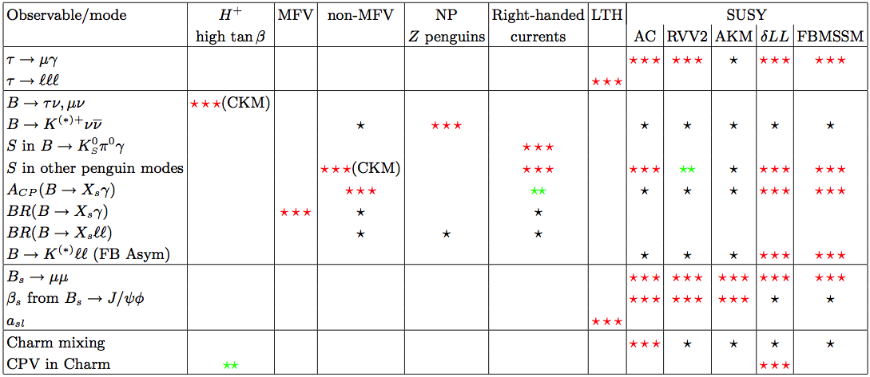
Interplay
• More information on the golden matrix can be found in
arXiv:1008.1541, arXiv:0909.1333, and arXiv:0810.1312.
• Combine measurements to elucidate
structure of new physics
SuperB
scope
✓
✓
✓
✓
✓
✓
✓
✓
✓
✓
✓
, Bs→φγ
✓
✓
NP enhancement:
⬇ Observable effect
⬇ ⬇ Moderately large effect
⬇ ⬇ ⬇ Very large effect

Slide 25
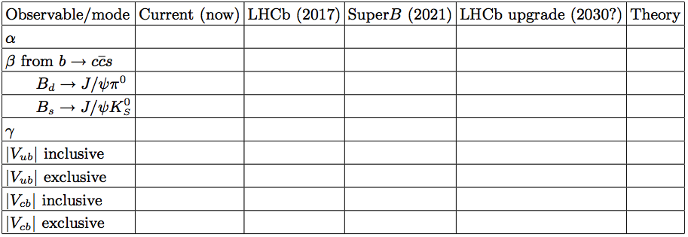
Golden measurements: CKM
• Comparison of relative benefits of SuperB (75ab⁻¹)
existing measurements
vs. LHCb (5fb⁻¹)
LHCb upgrade (50fb⁻¹)
LHCb can only use ρπ
β theory error B_{d}
β theory error B_{s}
Need an e⁺e⁻ environment to do a precision measurement using semi-leptonic B decays.
Experiment: No Result Moderate Precision Precise Very Precise
Theory: Moderately clean Clean Need lattice Clean

Slide 26
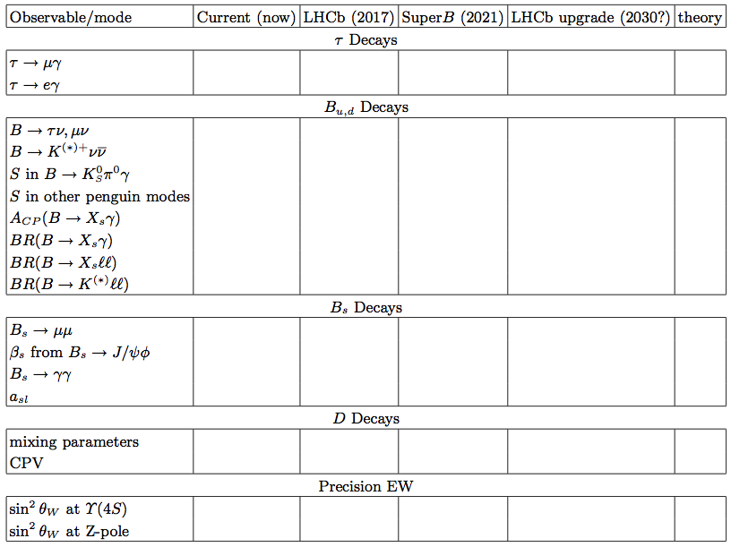
Golden measurements: General
Experiment: No Result Moderate Precision Precise Very Precise
Theory: Moderately clean Clean Need lattice Clean
Benefit from polarised e⁻ beam
very precise with improved detector
Statistically limited: Angular analysis with >75ab⁻¹
Right handed currents
SuperB measures many more modes
systematic error is main challenge
control systematic error with data
SuperB measures e mode well, LHCb does μ
Clean NP search
Theoretically clean
b fragmentation limits interpretation

Slide 27
L= 10³⁶cm⁻² sec⁻¹ → 15ab⁻¹ per year / regime
We need at least 75 ab⁻¹ → L= 10³⁶cm⁻² sec⁻¹ is the baseline option
That’s is the factory we need !
Unprecented precision
SuperB can perform many measurements at <1% level of precision
Precision on CKM parameters will be improved by more than a factor 10
… and do not forget… SuperB could also a Super-Super τ-charm factory,
If we run at threshold.
Unique opportunity of LFV measurements, better if beam polarized.
SuperB Discovery Potential and Complementary to LHC
NP will be studied (measuring the couplings) if discovered at LHC
if NP is not (or “partially”) seen at TeV, SuperB is the way of exploring
NP scales of several TeV (in some scenario several (>10 )TeV..)

Slide 28
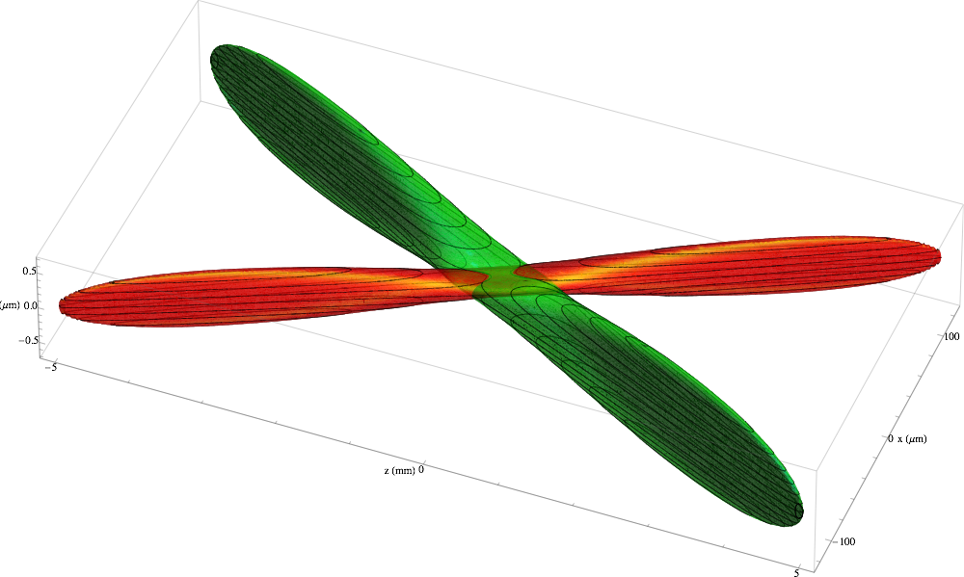
The Machine
How it is possible to gain a factor 100 in the luminosity ..?
10³⁴ cm²sec⁻¹ → 10³⁶ cm²sec⁻¹

Slide 29
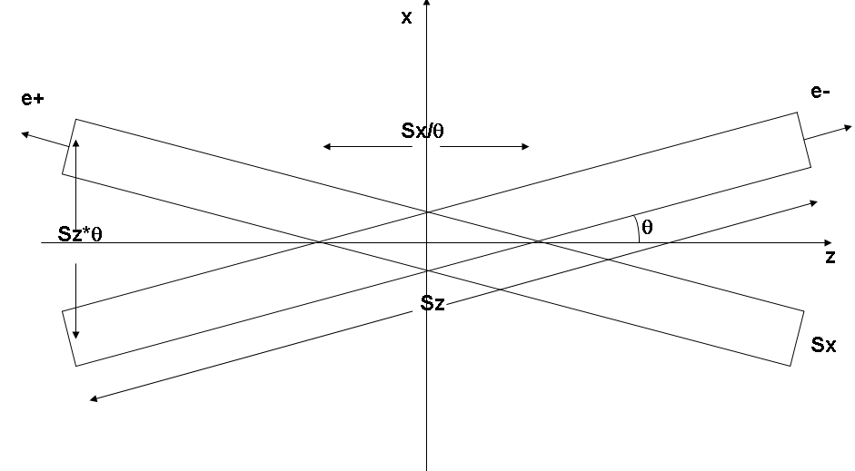
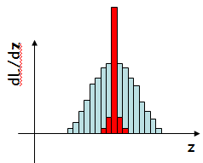
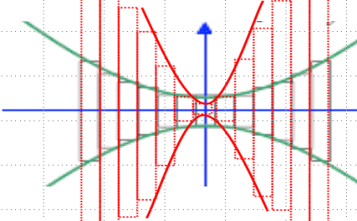
“The Crab waist scheme”
To have large luminosity
1) Single passage : D (disruption) high [profit of beam-beam effects (pinch)] small σ_{x},σ_{y}
2) The beam has to be re-utilized in an accumulation ring → to maxime f_{r} →D “small”
3)To keep D small and small σ_{x},σ_{y} we also need small σ_{z}
Crossing angle interaction
Doing that we also meet another condition
“Hourglass
effect”
σ_{y}(z)
Focalizations with
σ_{y} < σ_{y}
z
Lumi_{y} < Lumi_{y}
The stronger the focalization,
the quicker the de-focalzation !
If σ_{y} too small w.r.t σ_{z} : particle density drops
so fast, away from the IP, that Luminosity is in
fact reduced.

Slide 30
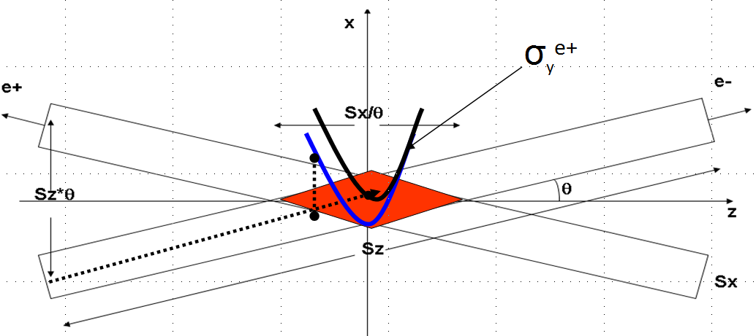
And now we need to… Crab the Waist
Crossing angle between e⁺ and e⁻ : bunch overlap length no longer σ_{z}, but σ_{x}/θ << σ_{z} !
But: Charge density, thus the forces, felt by e⁺/e⁻ in the crossing region
depends on x, y & z simultaneously !
Waist (focalisation) on y
z₂: another e+ vertical focalisation
→ another density → another Force
z₁: one e+ vertical focalisation → a charge density → a force
Force depends
on x & z or y & z
-Coupling between the x, y and z components of the e+/e- trajectories
→oscillations around the collider
In the machine language : Additional betatron-betatron / synchro-betatron resonances

Slide 31
x
…and (finally) to crab the waist:
σ_{Y}
e+
e-
2Sx/θ
2Sz*θ
θ
z
2Sz
2Sx
Vertical waist has to be a function of x:
Crabbed waist realized with a sextupole
(in phase with the IP in X and at π/2 in Y slight luminosity increase)
Conceptually simple : restore the B-B effects
to those we have quadrupoles focalizing in 2D
(compensate the effects of the crossing angle)

Slide 32
Example of resonance suppression
Much higher luminosity!
Typical case (KEKB, DAΦNE):
1. low Piwinski angle Φ < 1
2. β_{y} comparable with σ_{z}
Crab Waist On:
1. large Piwinski angle Φ >> 1
2. β_{y} comparable with σ_{x}/θ

Slide 33
Beam-beam tune scan
The success phase space is increasing…
D.Shatilov
CDR, ξ_{y} = 0.17
CDR2, ξ_{y} = 0.097
■
■
present
■
■
L (red) = 1. ∙10³⁶

Slide 34
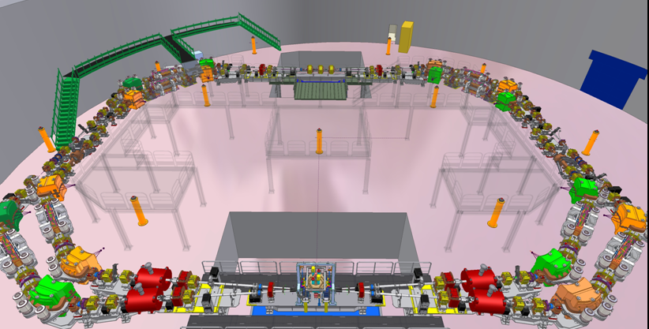
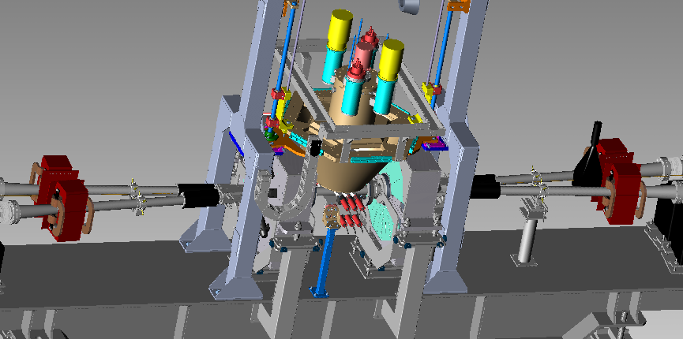
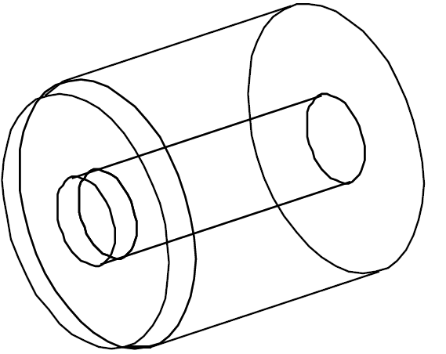
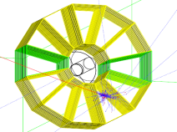
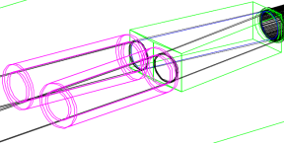
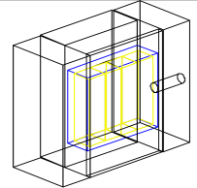
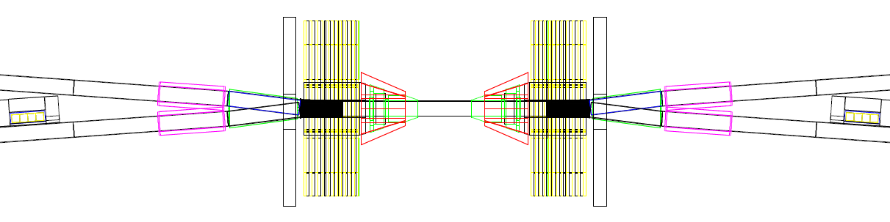
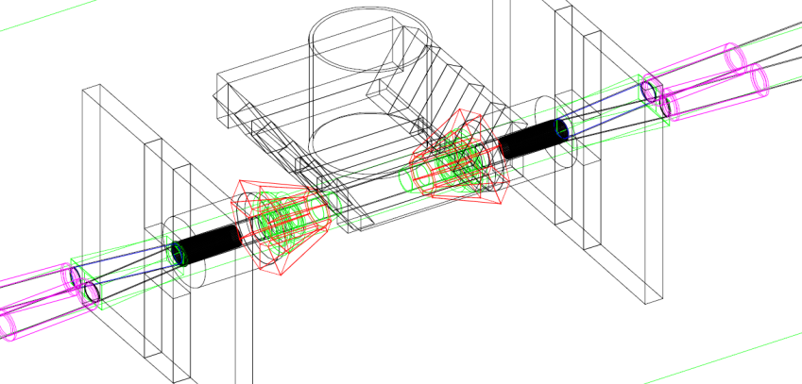
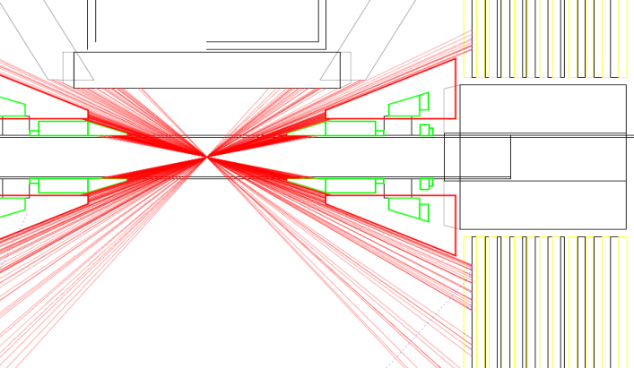
Test of these new colliding schemes in Frascati
From design….
to simulation…
gamma monitor
Bhabha Calorimeters
QD0 Quadrupole
Quadrupoles
Y-tube
Sputnik
Soyuz
MIR
MIR
MIR
Sputnik
Soyuz
QD0
Siddharta Detector and MIR shields
Calorimeters Shields

Slide 35
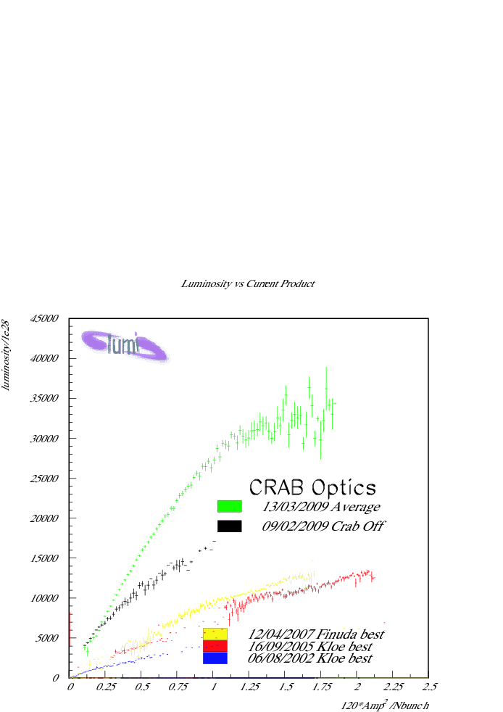
DAFNE Luminosity results
Data averaged on a full day
βy=9mm, Pw_angle=1.9
Luminosity [10²⁸ cm⁻² s⁻¹]
βy=18mm, Pw_angle=0.6
βy=25mm, Pw_angle=0.3
Results match the simulation expectations

Slide 36
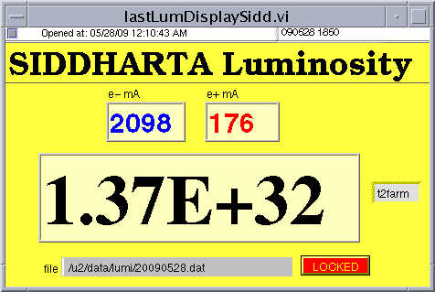
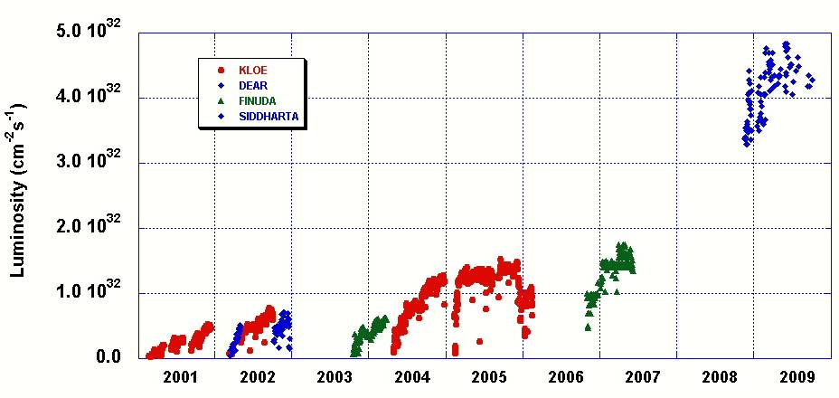
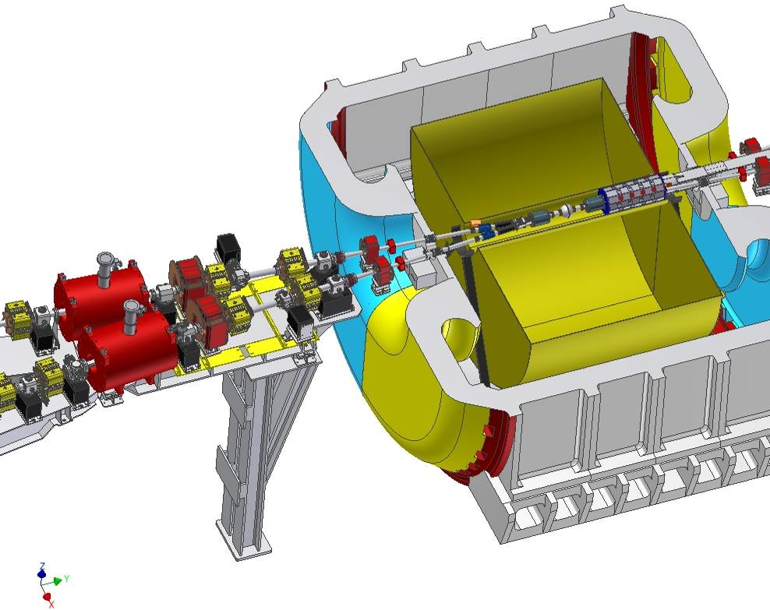
1523
1002
4.53E+32
Results of these tests :
new 3 years run @ Phi-factory
(from May/June)
L_{peak} expected at about 5.5∙10³² cm⁻²s⁻¹
L_{int} (0.5 fb⁻¹/month)

Slide 37
How to extrapolate the Dafne results to SuperB ?
Synergy with ILC
RINGS
LER SR
IP
66 mrad
LER SR
IP
LER
arc
LER
arc
HER
arc
HER
arc
Rings
crossing
e+
e-
RF

Slide 38
SuperB machine parameters
 | Units | HER | LER | HER | LER | HER | LER
Machine |  | Super B |  | PEP II |  | Super KEKB
Circumference | m | 1258.4 |  | 2200 |  | 3016.3
Frequency turn | Hz | 2.38E+05 |  | 1.36E+05 |  | 9.95E+04
# bunch |  | 978 |  | 1732 |  | 2500
Frequency collision | MHz | 233 |  | 236 |  | 249
Full crossing angle | Rad | 0.066 |  | 0.000 |  | 0.083
Energy | GeV | 6.7 | 4.18 | 9.0 | 3.1 | 7 | 4
Energy ratio |  | 1.60 |  | 2.90 |  | 1.75
βx | cm | 2.6 | 3.2 | 35 | 40 | 2.4 | 3.2
βy | μm | 253 | 205 | 9000 | 10800 | 410 | 270
Coupling | % | 0.25 | 0.25 | 0.24 | 0.45 | 0.35 | 0.40
Radial emittance εx | nm | 2.07 | 2.37 | 55 | 33 | 2.4 | 3.1
Vertical emittance εy | pm | 5.18 | 5.93 | 1300 | 1500 | 8.4 | 12.4
Bunch length | cm | 0.5 | 0.5 | 1.15 | 1.25 | 0.5 | 0.6
Current | A | 1.89 | 2.44 | 2.07 | 3.21 | 2.6 | 3.62
# particles/bunch | 10¹⁰ | 5.08 | 6.56 | 5.49 | 8.52 | 6.55 | 9.13
Hor. size @ IP σx | μm | 7.34 | 8.71 | 43.87 | 36.33 | 7.75 | 10.62
Ver. size @ IP σy | nm | 36.2 | 34.9 | 3421 | 4025 | 59.0 | 59.0
Piwinsky angle |  | 22.50 | 18.95 | 0.00 | 0.00 | 26.79 | 23.46
Horizontal tune shift | % | 0.21 | 0.33 | 5 |  | 0.28 | 0.28
Vertical tune shift | % | 9.89 | 9.55 | 5 |  | 8.75 | 9.00
Luminosity | 10³⁶ Hz/cm² | 1.02 |  | 0.012 |  | 0.80

Slide 39
SuperB accelerator crew
→ Accelerator organisation chart still very preliminary
→ Many opportunities for individuals/groups interested in joining the machine crew
▪ Innovative machine; importance of the Machine-Detector Interface
• D. Alesini, M. E. Biagini, R. Boni, M. Boscolo, T. Demma, A. Drago, M. Esposito, S. Guiducci,
G. Mazzitelli, L. Pellegrino, M. Preger, P. Raimondi, R. Ricci, C. Sanelli, G. Sensolini, M. Serio,
F. Sgamma, A. Stecchi, A. Stella, S. Tomassini, M. Zobov (INFN/LNF, Italy)
• K. Bertsche, A. Brachmann, Y. Cai, A. Chao, A. DeLira, M. Donald, A. Fisher, D. Kharakh, A. Krasnykh,
N. Li, Y. Nosochkov, A. Novokhatski, M. Pivi, J. Seeman, M. Sullivan, U. Wienands, J. Weisend,
W. Wittmer, G. Yocky (SLAC, USA)
• A. Bogomiagkov, S.Karnaev, I. Koop, E. Levichev, S. Nikitin, I. Nikolaev, I. Okunev, P. Piminov,
S. Siniatkin, D. Shatilov, V. Smaluk, P. Vobly (BINP, Russia)
• G. Bassi, A. Wolski (Cockroft Institute, UK)
• S. Bettoni (CERN, Switzerland, )
• M. Baylac, J. Bonis, R. Chehab, J. DeConto, Gomez, A. Jeremie, G. Lemeur, B. Mercier, F. Poirier,
C. Prevost, C. Rimbault, Tourres, F. Touze, A. Variola (IN2P3/CNRS, France)
• A. Chance, O. Napoly (CEA Saclay, France)
• F. Meot, N. Monseu (Grenoble, France)
• F. Bosi, E. Paoloni (INFN & Università di Pisa)

Slide 40
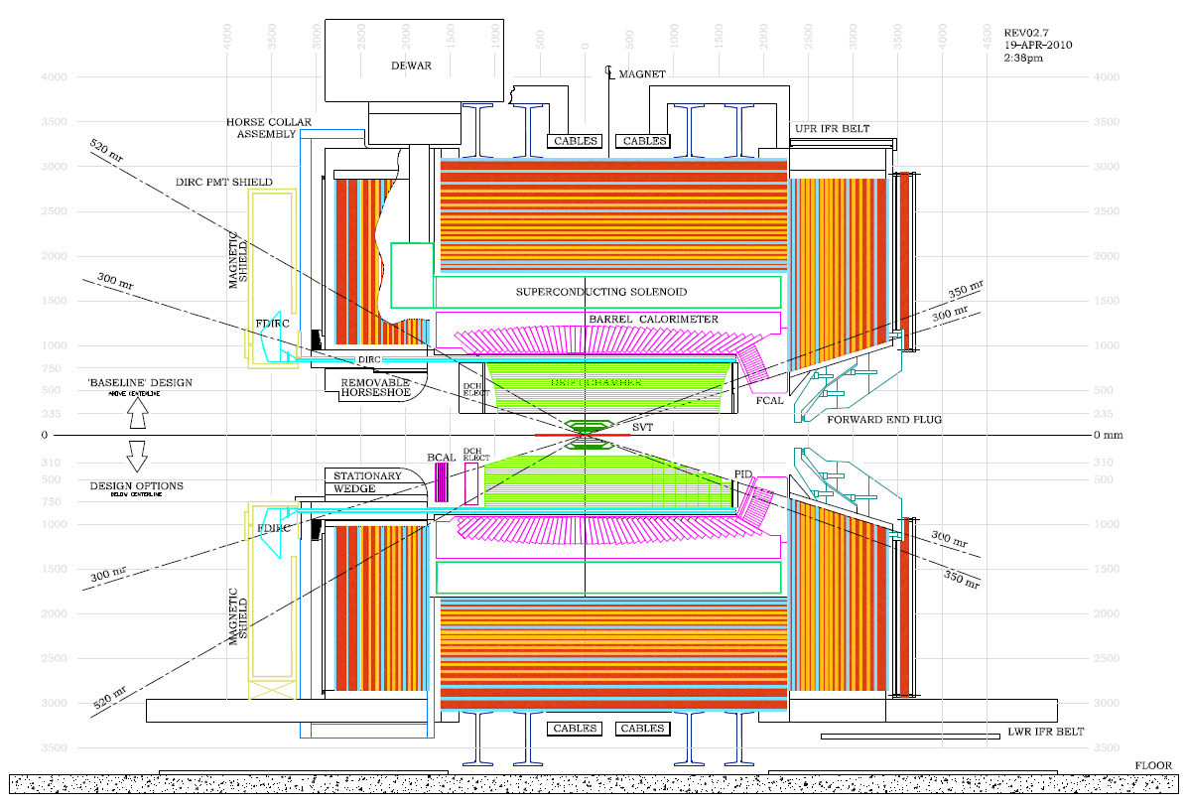
The Detector

Slide 41
Consider that the
boost is βγ=0.24
(instead of 0.56 [BaBar])
Detector become more symmetric
SuperB Detector
Hadron calorimeter
EM calorimeter
200-300 (mrad)
Silicon vertex
Drift Chamber
Cherenkov detector

Slide 42
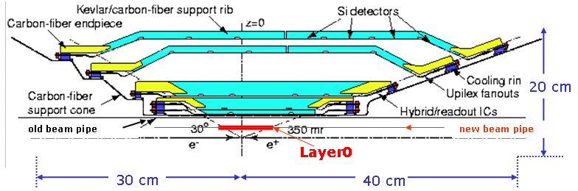

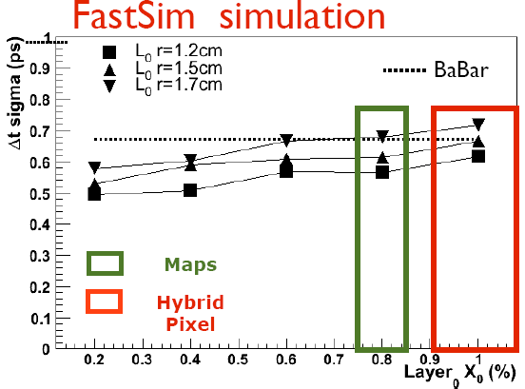
SVT (Silicon Detector)
Layer 0 very close
To the beam pine ADDED
Layer Radius
0 1.2-1.5 cm
1 3.3 cm
2 4.0 cm
3 5.9 cm
4 9.1 to 12.7 cm
5 11.4 to 14.6 cm
15 cm
BaBar SVT
Based on BaBar SVT: 5 layers silicon strip modules + Layer0 at small radius to improve vertex resolution and compensate the reduced SuperB boost w.r.t. PEPII
B→π π, βγ=0.28, hit resolution =10 μm
Be Beam pipe
Δt resolution (ps)
• Physics performance and background levels set
stringent requirements on Layer0:
  ▪ R~1.5 cm, material budget < 1% X_{0,, ,}
  ▪ Hit resolution 10-15 μm in both coordinates
  ▪ Track rate > 5MHz/cm² (with large cluster
  too!), TID > 3MRad/yr
• Several options under study for Layer0
42

Slide 43
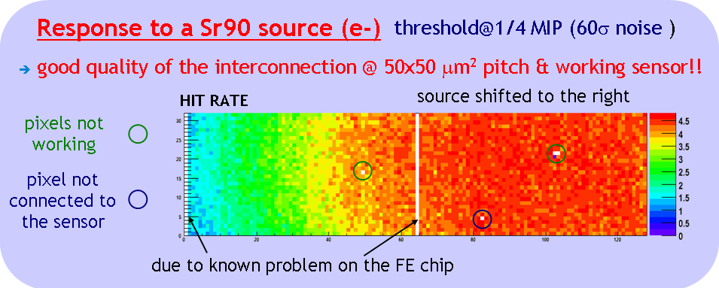
SuperB SVT Layer 0 technology options
CMOS MAPS with
in pixel sparsification
• Ordered by increasing complexity:
▪ Striplets
→ Mature technology, not so robust
against bkg occupancy
▪ Hybrid pixels
→ Viable, although marginal in
term of material budget
▪ CMOS MAPS
→ New & challenging technology:
fast readout needed (high rate)
▪ Thin pixels with vertical integration
→ Reduction of material and improved performance
• Several pixel R&D activities ongoing
▪ Performances: efficiency,
hit resolution
▪ Radiation hardness
▪ Readout architecture
▪ Power, cooling
Test of a hybrid
pixel matrix with
50×50 μm² pitch

Slide 44
Future activities
• Present plan
▪ Start data taking with striplets in Layer0: baseline option for TDR
→ Better perf. due to lower material w.r.t. pixel: thin options not yet mature!
▪ Upgrade Layer0 to pixel (thin hybrid or CMOS MAPS), more robust against
background, for the full luminosity (1-2 years after start)
• Activities
▪ Development of readout chip(s) for strip(lets) modules
→ Very different requirements among layers
▪ Engineering design of Layer0 striplets & Layer1-5 modules
▪ SVT mechanical support structure design
▪ Peripheral electronics & DAQ design
▪ Continue the R&D on thin pixel for Layer0
→ Design to be finalized for the TDR; then move to construction phase
• A lot of activities: new groups are welcome!
▪ Potential contributions in several areas: development of readout chips,
detector design, fabrication and tests, simulation & reconstruction
▪ Now: Bologna, Milano, Pavia, Pisa, Roma3, Torino, Trento, Trieste, QM, RAL
→ Expression of interest from Strasbourg (IPHC) & other UK groups

Slide 45
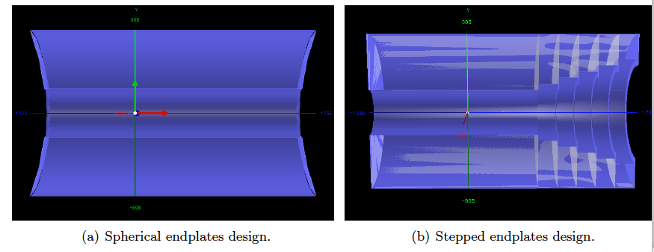
The SuperB Drift CHamber (DCH)
• Large volume gas (BaBar: He 80% / Isobutane 20%) tracking system providing meas. of charged particle mom. and ionization energy loss for particle identification
• Primary device to measure speed of particles having momenta below ~700 MeV/c
• About 40 layers of centimetre-sized cells strung approximately parallel to the
beamline with subset of layers strung at a small stereo angle in order to provide
measurements along the beam axis
• Momentum resolution of ~0.4% for tracks with p_{t} = 1 GeV/c
• Overall geometry
▪ Outer radius constrained to 809 mm by the DIRC quartz bars
▪ Nominal BaBar inner radius (236 mm) used until Final Focus cooling finalized
▪ Chamber length of 2764 mm (will depend on forward PID and backward EMC)

Slide 46
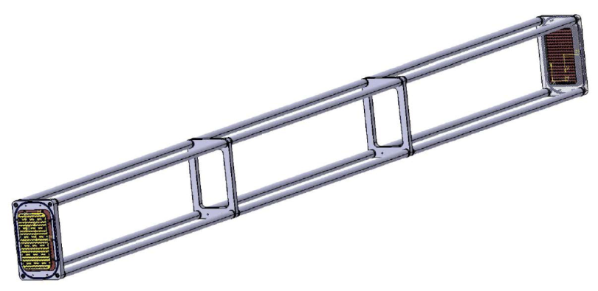
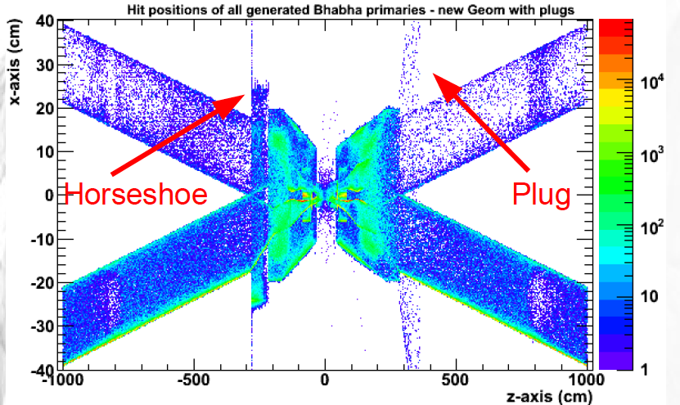
Recent activities
• 2.5m long prototype with 28 sense wires arranged in 8 layers
• Cluster counting: detection of the single primary ionization acts
• Simulations to understand the impact of Bhabha and 2-photon pair backgrounds
▪ Lumi. bkg dominates occupancy – beam background similar than in BaBar
→ Nature and spatial distributions dictate the overall geometry
▪ Dominant bkg: Bhabha scattering at low angle
• Gas aging studies

Slide 47
Future activities
• Current SuperB DCH groups
▪ LNF, Roma3/INFN group, McGill University, TRIUMF, University of British
Columbia, Université de Montréal, University of Victoria
▪ LAPP technical support for re-commissioning the BaBar gas system
• Open R&D and engineering issues
▪ Backgrounds: effects of iteration with IR shielding; Touschek, validation
→ Cell/structure/gas/etc.
▪ Dimensions (inner radius, length, z-position) to be finalized
▪ Tests (cluster counting and aging) needed to converge on FEE, gas, wire, etc.
▪ Engineering of endplates, inner and outer cylinders
▪ Assembly and stringing (including stringing robots)
▪ DCH trigger
▪ Gas system recommissioning – Annecy
▪ Monitoring systems

Slide 48
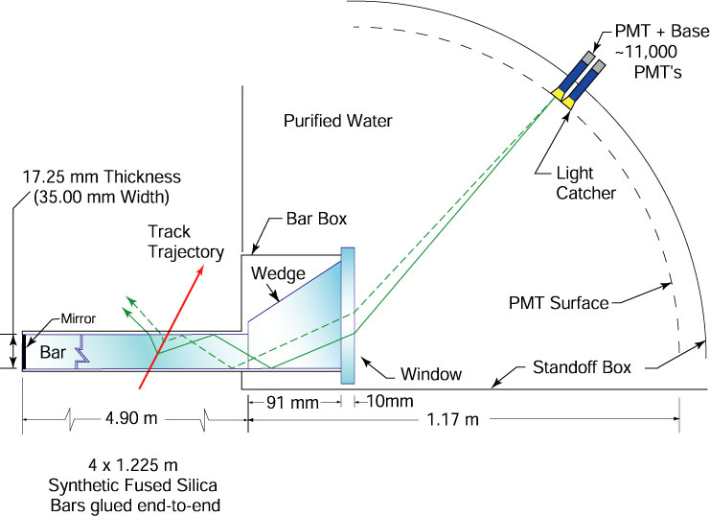
The Focusing DIRC (FDIRC)
• Based on the successful BaBar DIRC:
▪ Detector of Internally Reflected Cherenkov light
[SLAC-PUB-5946]
• Main PID detector for the SuperB barrel
▪ K/π separation up to 3-4 GeV/c
▪ Performance close to that of the BaBar DIRC
• To cope with high luminosity (10³⁶ cm⁻²s⁻¹) & high background
▪ Complete redesign of the photon camera [SLAC-PUB-14282]
▪ A true 3D imaging using:
▪ 25× smaller volume of the photon camera
▪ 10× better timing resolution to detect single photons
▪ Optical design is based entirely on Fused Silica glass
→ Avoid water or oil as optical media
DIRC NIM paper
[A583 (2007) 281-357]

Slide 49





FDIRC concept
Re-use BaBar DIRC quartz bar radiators
  New photon camera
Geant4
simulation
Photon cameras at the end of bar boxes
Current
mechanical
design
FBLOCK

Slide 50
FDIRC photon camera (12 in total)
• Photon camera design (FBLOCK)
▪ Initial design by ray-tracing
[SLAC-PUB-13763]
▪ Experience from the 1^{rst} FDIRC prototype
[SLAC-PUB-12236]
▪ Geant4 model now
[SLAC-PUB-14282]
• Main optical components
▪ New wedge
→ Old bar box wedge not long enough
▪ Cylindrical mirror to remove bar thickness
▪ Double-folded mirror optics to provide access to detectors
• Photon detectors: highly pixilated H-8500 MaPMTs
▪ Total number of detectors per FBLOCK: 48
▪ Total number of detectors: 576 (12 FBLOCKs)
▪ Total number of pixels: 576 × 32 = 18,432

Slide 51
FDIRC Status
• FDIRC prototype to be tested this summer in the SLAC Cosmic Ray Telescope
• Ongoing activities
▪ Validation of the optics design
▪ Mechanical design & integration
▪ Front-end electronics
▪ Simulation: background, reconstruction...
• FDIRC goals
▪ Resolution per photon: ~200 ps
▪ Cherenkov resolution per photon: 9-10 mrad
▪ Cherenkov angle resolution per track: 2.5-3.0 mrad
• Design frozen for TDR; next: R&D → construction
• Groups: SLAC, Maryland, Cincinnati, LAL, LPNHE, Bari, Padova, Novosibirsk
• A wide range of potential contributions for new groups
▪ Detector design, fabrication and tests
▪ MaPMT characterization
▪ Simulation & reconstruction
▪ Impact of the design on the SuperB physics potential

Slide 52

R&D on a forward PID detector
• Goal: to improve charged particle identification in forward region
→ In BaBar: only dE/dx information from drift chamber
• Challenges
▪ Limited space available
→ Small X₀
→ And cheap
→ Gain limited by small solid angle
  [θ_{polar}~15÷25 degrees]
  → The new detector must be efficient
• Different technologies being studied
▪ Time-Of-Flight (TOF): ~50ps resolution needed
▪ RICH: great performances but thick and expensive
Forward
side
Zoom
Forward PID location
Several proposals in the last two years. Examined by the Collaboration.

Slide 53

Our proposal :

Slide 54

15 ps [ 6mm/c]

Slide 55

Tested with the Babar quarkz bars
successfull
Decision taken ! Our detector is the baseline
for the PID in the forward region.
We soon start the first prototype
Building an innovative forward PID detector
require additional manpower & abilities
Dedicated seminar needed.
In October Leonid Burmistrov thesis

Slide 56



The SuperB ElectroMagnetic Calorimeter (EMC)
• System to measure electrons and photons, assist in particle identification
• Three components
▪ Barrel EMC: CsI(Tl) crystals with PiN diode readout
▪ Forward EMC: LYSO(Ce) crystals with APD readout
▪ Backward EMC: Pb scintillator with WLS fiber to SiPM/MPPC readout [option]
• Groups: Bergen, Caltech, Perugia, Rome
→ New groups welcome to join!
CsI(Tl) barrel
calorimeter
(5760 crystals)
Sketch of backward Pb-scintillator
calorimeter, showing both radial and
logarithmic spiral strips
(24 Pb-scint layers, 48 strips/layer,
total 1152 scintillator strips)
Design for forward
LYSO(Ce) calorimeter
(4500 crystals)\

Slide 57


Recent activities and open issues
• Beam test at CERN (next at LNF)
→ Measurement of MIP width on LYSO
→ Electron resolution: work in progress
• LYSO crystal uniformization
▪ Used ink band in beam test
▪ Studying roughening a surface
→ Promising results from simulation
• Forward EMC mechanical design
→ Prototype + CAD/finite elements analysis
• Backward EMC
→ Prototype + MPPC irradiation by neutrons
• Open issues
▪ Forward mechanical structure; cooling; calibration
▪ Backward mechanical design
▪ Optimization of barrel and forward shaping times; TDC readout
▪ Use of SiPM/MPPCs for backward EMC; radiation hardness; use for TOF!?
▪ Cost of LYSO

Slide 58



Instrumented Flux Return (IFR): the μ and K_{L} detector
• Built in the magnet flux return
→ One hexagonal barrel and two endcaps
• Scintillator as active material to cope with high flux
of particles: hottest region up to few 100 Hz/cm²
• 82 cm or 92 cm of Iron interleaved by 8-9 active layers
→ Under study with simulations/testbeam
• Fine longitudinal segmentation in front of
the stack for K_{L} ID (together with the EMC)
• Plan to reuse BaBar flux return
→ Add some mechanical constraints:
gap dimensions, amount of iron, accessibility
• 4-meter long extruded scintillator bars readout
through 3 WLS fibers and SiPM
• Two readout options under study
▪ Time readout for the barrel (two coordinates read by the same bar)
▪ Binary readout for the endcaps (two layers of orthogonal bars)
Scintillator bar
+ WLS fibers

Slide 59



Detector simulation
• Detailed description of hadronic interaction needed
for detector optimization and background studies
• Full GEANT4 simulation developed for that purpose
• Complete event
reconstruction
implemented to evaluate
μ detection performance
Iron absorber thickness:
▪ 920 mm
▪ 820 mm
▪ 620 mm
• A selector based on BDT algorithm is used to
discriminate muons and pions
• PID performance are evaluated for
different iron configurations
• Machine background rates on the detector
are evaluated to study
  ▪ the impact on detection efficiency and muon ID
  ▪ the damage on the Silicon Photo-Multipliers
Pion rejection vs muon efficiency
Neutron flux on the forward endcap

Slide 60




Beam test of a prototype
• Prototype built to test the technology on large scale and validate simulation results
• Up to 9 active layers readout together
→ ~230 independent electronic channels
• Active modules housed in light-tightened boxes
▪ 4 Time Readout modules
▪ 4 Binary Readout modules
▪ 4 special modules
→ Study different fibers or SiPM geometry
• Preliminary results confirm the R&D performances
▪ Low occupancy due to SiPM single counts even at low threshold
▪ Detection efficiency >95%
▪ Time resolution about 1 ns
• Data analysis still ongoing
▪ Refine reconstruction code
▪ Study hadronic showers
▪ Evaluate muon ID performance
▪ Tune the Monte Carlo simulation
▪ Study different detector configurations
Iron: 60×60×92 cm³,
3cm gaps for the active layers
Tested in Dec. 2010 at the
Fermilab Test
Beam Facility with
muon/pion (4-8GeV)
Beam profile
Noise level:
15 counts / 1000 events
Threshold
(# of photoelectrons)

Slide 61
Open issues and next activities
• Define the Iron structure
→ Various options currently under study to evaluate the most cost effective
  ▪ Use the existing Babar Structure, only adding Iron or brass
  ▪ BaBar structure + 10 cm ⇒ Modify the BaBar structure
  ▪ Build a brand new structure optimized for SuperB
• SiPM radiation damage
→ Understand the effects of neutrons and how to shield the devices
  ▪ An irradiation test has just been performed at LNL
  ▪ More tests with absorbers are foreseen
• TDC Readout: meet the required specs
• Beam test at Fermilab in July to extend the studies al lower momentum (2-4 GeV/c)
• Start the construction-related activities
  • A lot of activities: new groups are welcome!
→ Groups working at present on the IFR: Ferrara, Padova

Slide 62



Electronics, Trigger and
Data Acquisition (ETD)
Computing
Fast Simulation
Full Simulation

Slide 63


Distributed computing
• Based on the HEP grid worldwide computing infrastructure
▪ Central site: CNAF (Bologna)
→ Job submission management, bookeeping DB, data repository
▪ Several (currently 18) other sites in Europe (CC-IN2P3, GRIF, etc.) and USA
• Several productions already completed
▪ Example: FastSim Summer 2010
→ 15 sites, 160 kJobs (10% failures), 8.6 BEvents, 25 TB

Slide 64

STATUS
Tor
Vergata
STATUS
LNF

Slide 65

SuperB approval in Italy
• SuperB inserted in April 2010 among the Italian
National Research Program (PNR) Flagship Projects
▪ Cooperation of INFN and IIT (Italian Institute of Technology)
→ HEP experiment and light source
• In December 2010, funding of 19 M€ as first part of a pluriennal funding plan
▪ Internal to Ministry of Research
• In April 2011 approval of the PNR, including 250M€ for SuperB
▪ Press release
▪ PNR info
http://www.interactions.org/cms/?pid=1030662

Slide 66
SuperB Funding in INFN 3-year plan
• Funding for accelerator
and infrastructure
• Computing funding from
special funds for south
development
• Detector funding inside
ordinary funding agency
budget
• In addition, we reuse
parts of PEP-II and Babar
for a value of about
135M€
• IIT contribution (100M€?) in addition, mainly for synchrotron light lines construction
→ Brightness of light produced by bending magnets/ondulators competitive
w.r.t. existing machines on a wide range of photon energy
256M

Slide 67


Funding and management
• MoUs for TDR work in place with Canada, France, UK, Russia and SLAC
• Negotiation with partner countries for construction MoUs started
• Expect that
▪ Important in-kind contribute by the re-use of parts of PEP-II
and Babar, for a value of about 135M€
▪ For the accelerator and infrastructure, most funding will be Italian
▪ For the detector only half of the needed funding will come from Italy
→ About 25M€
• The project and the machine construction will be managed through an
European Research Infrastructure Consortium (ERIC) [see slides from R. Petronzio]
Front faces of DIRC quartz
bars shining in the dark
EMC barrel
before installation
in BaBar

Slide 68
governance
[see slides from R. Petronzio]
Three phases
  INFN: the past and present starting phase
  Consortium: as soon as possible (less than a year) as an independent legal entity
    Following main European infrastructures
    More flexibility in the organisation
    Can directly associate foreign partners (EGO like)
    An “intermediate solution”
  European consortium (ERIC): the final structure

Slide 69
governance
[see slides from R. Petronzio]
A Cern like organisation
  A director general and a directorate
    Departments under director’s supervision
  A scientific evaluation committee
    Science
    Machine
  A finance evaluation committee
A known and working scheme

Slide 70
[see slides from R. Petronzio]
We are proposing a name for the Consortium
  Cabibbo Lab

Slide 71
team
[see slides from R. Petronzio]
Preliminary WBS
Top responsibilities first
The team recruitment
  INFN
  Foreign partners
  University
  New contracts ( about 40 starting within less than a year period)

Slide 72
Accelerator WBS (Draft)
[see slides from R. Petronzio]

Slide 73
Accelerator WBS (Draft)
[see slides from R. Petronzio]

Slide 74
Next steps and timeline
• Complete the detector and accelerator Technical Design Reports
→ End of 2011/Mid 2012
▪ Computing TDR about a year later
• Prepare the transition from TDR Phase to Construction
→ Collaboration started formally forming in Elba meeting, May 2011
• Start recruitment for the construction
→ Mainly Accelerator Physicists and Engineers
• Completion of construction foreseen end of ~2017
→ First collisions mid 2017

Slide 75
Presentation to the IN2P3 Scientific Council next Fall
Request to have the IN2P3 involved in SuperB experiment
(Sofar we have been approved for Frascati test, CDR, TDR)
IN2P3 actually involved in the TDR phase
LAL (Detector PID, MDI, Accelerator)
LAPP (Accelerator – Stability)
LPNHE (Detector PID)
LPSC (Accelerator)
CC-IN2P3 (Support for production)
IPHC now join (Detector – SVT)
A lot of opportunities in various fields for groups/people willing to join the
experiment, for groups/people which want to construct detectors and/or
participate to the initial phase of a new experiment.
Express your interest for joining now, in a near/close future (after the completion of your current experiment)…when SuperB will start to take data.

Slide 76
Outlook
PHYSICS A discovery machine with a program complementary
to LHC
MACHINE ambitious and innovative. Renew and keep
expertise in lepton machine.
DETECTOR will be constructed in few year time with new
ideas and technologies
• SuperB support by Italy is now confirmed – and firmly established
→ Funding coming from a pluri-annual plan for the accelerator
→ ~50 M€ to be found for the detector on a 5 years period (50% covered by INFN)
• Site is choosen
→ Next step will be to start the civil engineering
• Collaboration formation process started
• SuperB communities (detector, accelerator, computing, physics) are growing
→ Yet: many opportunies at all levels for groups willing to join

Slide 77
BACKUP
MATERIAL

Slide 78
Backup
Physics

Slide 79
Let’s consider (reductively) the GOLDEN MATRIX for B physics
X
X
X- CKM
X
X
X- CKM
X
X
The GOLDEN channel for the given scenario
Not the GOLDEN channel for the given scenario,
but can show experimentally measurable deviations from SM.
X
« SuperB specifics »
inclusive analyses
channels with π⁰, γ, ν, many Ks…
In the following some examples of

Slide 80
Br(B → K ν ν) – Z penguins and Right-Handed currents
N+1
today
η
SM
Only theo. errors
ε
If these quantities are measured @ <~10%
deviations from the SM can be observed
~[20-40] ab⁻¹ are needed for observation
>>50ab⁻¹ for precise measurement

Slide 81
Example of need of large statistics
10ab⁻¹
75ab⁻¹
Determination of Susy mass insertion parameter (δ₁₃)_{LL}
with 10 ab⁻¹ and 75 ab⁻¹
Importance of having very large sample >75ab⁻¹

Slide 82






Another example of sensitivity to NP :
sin2β from “s Penguins”…
W⁻
b
s
φ
t
s
B⁰_{d}
s
d
d
K⁰
~
g
≥ 5 σ discovery possible
(extrapolating from today)
b
~
~
s
b
s
Many channels can be measured with ΔS~(0.01-0.04)
SuperB
b→s penguin processes b→d
(*) theoretical limited

Slide 83
Charm Physics
Charm physics using the charm produced at Υ(4S)
Charm physics at threshold
0.3 ab⁻¹
Consider that running 2 month at threshold
we will collect 500 times the stat. of CLEO-C
Strong dynamics and CKM measurements
@threshold(4GeV)
ξ~1%,
exclusive V_{ub} ~ few %
syst. error on γ from Dalitz Model <1º
D decay form factor and decay constant @ 1%
Dalitz structure useful for γ measurement
Rare decays FCNC down to 10⁻⁸
D mixing
Better studied using
the high statistics
collected at Υ(4S)
@threshold(4GeV)
CP Violation in mixing could now addressed

Slide 84

τ→μγ upper limit can be correlated to θ₁₃ (neutrino mixing/CPV, T2K etc.) and also to μ→eγ.
Complementary to flavour
mixing in quarks.
Golden modes:
  τ→μγ and 3μ.
e⁻ beam polarization:
  Lower background
  Better sensitivity than
  competition!
Bonus:
  Can also measure τ g-2
  (polarization is crucial).
  σ(g-2) ~2.4 ×10⁻⁶ (statistically
  dominated error).
~
SUSY seasaw = CMSSM + 3ν_{R} + ν
Herreo et al. 2006

Slide 85
Polarized beams
Polarized beam is
(SuperB specific)
LFV analyses :
novel additional handle on backgrounds
τ anomalous moment (g-2)
The anomalous tau momentum influence both
the angular distribution and the τ polarization.
Measure the Re(F2) and Im(F2) of the (g-2) from factor
NP effects
~ 10⁻⁶
<
Polarisation is
-an important issue for LFV
-opens the possibility of measuring (g-2)
-electroweak physics (neutral current)
Under study

Slide 86



Electroweak physics at SuperB
SuperB could add
a measurement here

Slide 87
New excitement on spectroscopy
→to complete the picture
→ to better studying the recently discovered particle
(quantum numbers, branching fractions…)
More data are needed :

Slide 88
Backup
Machine

Slide 89
DAFNE Luminosity and Tune Shifts
 | KLOE | FINUDA | SIDDHARTA
Date | Sept. 2005 | Apr. 2007 | June 2009
Luminosity, cm⁻² s⁻¹ | 1.53x10³² | 1.60x10³² | 4.53x10³²
e- current, A | 1.38 | 1.50 | 1.52
e+ current, A | 1.18 | 1.10 | 1.00
Number of bunches | 111 | 106 | 105
ε_{x}, mm mrad | 0.34 | 0.34 | 0.25
β_{x}, m | 1.5 | 2.0 | 0.25
β_{y}, cm | 1.8 | 1.9 | 0.93
ξ | 0.0245 | 0.0291 | 0.0443(0.074)

Slide 90
Baseline IR Design
Stable since October

Slide 91
For the baseline QD0 and QF1
magnets we need to keep the ratio of
the magnetic field strengths constant
in order to maintain good field quality
We want the β* values to remain
constant to maintain luminosity
How do we change
the beam energies?
Resonance | Upsilon 4S | Upsilon 3S | Upsilon 2S | Upsilon 1S
Ecm (GeV) | 10.5794 | 10.3554 | 10.0236 | 9.4609
HER
E (GeV) | 6.694 | 6.553 | 6.343 | 5.988
QD0 (T/cm) | -0.97584 | -0.95329 | -0.91969 | -0.86285
QF1 (T/cm) | 0.60408 | 0.59132 | 0.57232 | 0.54019
LER
E (GeV) | 4.18 | 4.091 | 3.96 | 3.737
QD0 (T/cm) | -0.63941 | -0.62522 | -0.60435 | -0.56882
QF1 (T/cm) | 0.37412 | 0.36616 | 0.35445 | 0.33450
QD0 ratio | 1.52617 | 1.52472 | 1.52179 | 1.51693
QF1 ratio | 1.61466 | 1.61491 | 1.61469 | 1.61490
γ | 1.02785 | 1.02787 | 1.02787 | 1.02791
Boost (γβ) | 0.23763 | 0.23773 | 0.23775 | 0.23793
It should be straightforward
to develop a procedure to
perform an energy scan
→ To go to the Tau-charm
region (Ecm ~4 GeV) we
will need to remove most if
not all of the permanent
magnets

Slide 92
Polarisation
In a storage ring, particle spins naturally precess around the vertical fields of the arc dipoles, at a rate determined by the particle energy.
  This means that vertical polarisation is naturally preserved, but longitudinal polarisation can be lost without preventive measures.
For SuperB, there are two options to maintain longitudinal polarisation in the beam at the IP:
  Use solenoids opposite the IP, to rotate the
  spin by π around the longitudinal axis.
  Use solenoids or vertical bends to
  rotate between vertical and longitudinal
  spin before and after the IP.
Option 2 will probably work best
for the multi-GeV SuperB rings,
but more studies are needed.
With a source providing ~ 90%
polarisation, it is expected that an average polarisation of 80% can be achieved for the e⁻ beam. e⁺ polarisation would be an upgrade…

Slide 93








Colliding bunches
e- 2.6 A
New Superconducting / permanent final focusing quads near the IP
Nano-Beam
SuperKEKB
e+ 3.6 A
Replace long dipoles with shorter ones (HER).
Add / modify rf systems
for higher currents.
Redesign the HER arcs to reduce the emittance.
Low emittance positrons to inject
Low emittance gun
Low emittance electrons to inject
New positron target / capture section
~40 times gain in luminosity
TiN coated beam pipe with antechambers

Slide 94

QC1 magnets
closer to IP
Superconducting & permanent magnets
83 mrad
Full crossing

Slide 95
SuperKEKB Parameters as of Feb.15, 2010
 | KEKB Design | KEKB Achieved : with crab | SuperKEKB
Energy (GeV) (LER/HER) | 3.5/8.0 | 3.5/8.0 | 4.0/7.0
Crossing angle (mrad) | 22 | 0 (crab) | 83
β_{y}* (mm) | 10/10 | 5.9/5.9 | 0.27/0.41
ε_{x} (nm) | 18/18 | 18/24 | 3.2/2.4
σ_{y}(μm) | 1.9 | 0.94 | 0.059
ξ_{y} | 0.052 | 0.129/0.090 | 0.09/0.09
σ_{z} (mm) | 4 | ~ 6 | 6/5
I_{beam} (A) | 2.6/1.1 | 1.64/1.19 | 3.6/2.62
Number of bunches | 5000 | 1584 | 2503
Luminosity (10³⁴ cm⁻² s⁻¹) | 1 | 2.11 | 80
Parameters presented at KEKB MAC Review Feb.15-17, 2010

Slide 96


Comparison of SuperB to Super-KEKB
(old solution)
IP beam distributions for KEKB
Parameter | Units | SuperB | Super-KEKB
Energy | GeV | 4x7 | 3.5x8
Luminosity | 10³⁶/ cm²/s | 1.0 to 2.0 | 0.5 to 0.8
Beam currents | A | 1.9x1.9 | 9.4x4.1
β_{y}* | mm | 0.22 | 3.
β_{x}* | cm | 3.5x2.0 | 20.
Crossing angle (full) | mrad | 48. | 30. to 0.
RF power (AC line) | MW | 20 to 25 | 80 to 90
Tune shifts | (x/y) | 0.0004/0.2 | 0.27/0.3
luminosity
10³⁶
5×10³⁵
100 times more luminosity obtained just with
100 times smaller vertical beam
IP beam distributions for SuperB

Slide 97
Backup
Detector
The Detector

Slide 98
Consider that the
boost is βγ=0.28
(instead of 0.56 [BaBar])
Detector become more symmetric
SuperB Detector
Hadron calorimeter
EM calorimeter
200-300 (mrad)
Silicon vertex
Drift Chamber
Cherenkov detector

Slide 99
Online system design principles
• Apply lessons learned from BaBar and LHC experiments
• Keep it simple
  ▪ Synchronous design
  ▪ No “untriggered” readouts
  → Except for trigger data streams from FEE to trigger processors
  ▪ Use off-the-shelf components where applicable
  ▪ Links, networks, computers, other components
  ▪ Software: what can we reuse from other experiments?
• Modularize the design across the system
▪ Common building blocks and modules for common functions
▪ Implement subdetector-specific functions on specific modules
▪ Carriers, daughter boards, mezzanines
• Design with radiation-hardness in mind where necessary
• Design for high-efficiency and high-reliability “factory mode”
▪ Where affordable – BaBar experience will help with the tradeoffs
▪ Minimal intrinsic dead time – current goal: 1% + trickle injection blanking
▪ Minimize manual intervention. Minimize physical hardware access requirements.

Slide 100
SuperB ETD system overview

Slide 101
Projected trigger rates and event sizes
• Estimates extrapolated assuming BaBar-like acceptance and BaBar-like open trigger
• Level-1 trigger rates (conservative scaling from BaBar)
▪ At 10³⁶ cm⁻² s⁻¹: 50 kHz Bhabhas, 25 kHz beam backgrounds,
25 kHz “irreducible” (physics + backgrounds)
→ 100 kHz Level-1-accept rate ( without Bhabha veto)
    → 75 kHz with a Bhabha veto at Level-1 rejecting 50%
    ▪ Safe Bhabha veto at Level-1 difficult due to temporal overlap in slow detectors.
    → Baseline: better done in High-Level Trigger
    ▪ 50% headroom desirable (from BaBar experience) for efficient operation
    → Baseline: 150 kHz Level-1-accept rate capability
• Event size: 75-100 kByte (estimated from BaBar)
    ▪ Pre-ROM event size: 400-500 kByte
    ▪ Still some uncertainties for post-ROM event size
• High-Level Trigger (HLT) and Logging
  ▪ Expected logging cross-section: 25nb with a safe real-time high-level trigger
  → Logging rate: 25kHz x 75kByte = 1.8 Gbyte/s
  ▪ Logging cross section could be improved by 5-10 nb by using a more aggressive
  filter in the HLT (cost vs. risk tradeoff!)
ReadOut
Module
(ROM)

Slide 102
Deadtime goal
• Target: 1% event loss due to DAQ system dead time
→ Not including trigger blanking for trickle injection
• Assume “continuous beams”
▪ 2.1 ns between bunch crossings
▪ No point in hard synchronization of L1 with RF
• 1% event loss at 150 kHz requires 70 ns maximum per-event dead time
→ Exponential distribution of event inter-arrival time
• Challenging demands on
▪ Intrinsic detector dead time and time constants
▪ L1 trigger event separation
▪ Command distribution and command length (1 Gbit/s)
• Ambitious
→ May need to relax goal somewhat

Slide 103
Synchronous, pipelined, fixed-latency design
• Global clock to synchronize FEE, Fast Control and Timing System (FCTS), Trigger
• Analog signals sampled with global clock (or multiples/integer fractions of clock)
→ Samples shifted into latency buffer (fixed depth pipeline)
• Synchronous reduced-data streams derived from some sub-detectors
(DCH, EMC, …) sent to the pipelined Level-1 trigger processors
→ Trigger decision after a fixed latency referenced to global clock
• L1-accept ⇒ readout command sent to the FCTS and
broadcast to FEE over synchronous, fixed-latency links
• FEE transfer data over optical links to the Readout Modules (ROMs)
→ no fixed latency requirement here
• All ROMs apply zero suppression
plus feature extraction and
combine event fragments
• Resulting partially event-built
fragments are then sent via the
network event builder into
the HLT farm

Slide 104
Level-1 Trigger

Slide 105
Level-1 Trigger
• Baseline: “BaBar-like L1 Trigger”
▪ Calorimeter trigger:
cluster counts and energy thresholds
▪ Drift chamber trigger:
track counts, p_{T}, z-origin of tracks
▪ Highly efficient, orthogonal
▪ To be validated for high-lumi
▪ Challenges: time resolution,
trigger jitter and pile-up
• To be studied
▪ SVT used in trigger?
→ Tight interaction with SVT and
SVT FEE design
▪ Bhabha veto
→ Baseline: Best done in HLT
• Fully pipelined
• Input running at 7(?) MHz
▪ Continuous reduced-data streams from
sub-detectors over fixed latency links
    □ DCH hit patterns (1 bit/wire/sample)
    □ EMC crystal sums, properly encoded
• Total latency goal: 6 μs
▪ Includes detectors, trigger readout,
FCTS, propagation
→ Leaves 3-4μs for the trigger logic
• Trigger jitter goal ≤ 50 ns to accommodate short sub-detector readout windows

Slide 106
Fast Control and Timing System (FCTS)

Slide 107
Fast Control and Timing System (FCTS)
• Clock distribution
• System synchronization
• Command distribution
→ L1-Accept
• Receive L1 trigger decisions
• Participate in pile-up and
overlapping event handling
• Dead time management
• System partition
→ 1 partition / subdetector
• Event management
→ Determine event destination
in event builder / high level
trigger farm
• Links carrying trigger data, clocks and commands
need to be synchronous & fixed latency:
≈ 1GBit/s
• Readout data links can be asynchronous,
variable latency and even packetized:
≈ 2 Gbit/s but may improve

Slide 108
Common Front-End Electronics
• Digitize
• Maintain latency buffer
• Maintain derandomizer
buffers, output mux and data
link transmitter
• Generate reduced-data
streams for L1 trigger
• Interface to FCTS
  ▪ Receive clock
  ▪ Receive commands
  • Interface to ECS
  ▪ Configure
  ▪ Calibrate
  ▪ Spy
  ▪Test
  ▪ etc.
• Provide standardized building blocks
to all sub-detectors, such as:
  ▪ Schematics and FPGA “IP”
  ▪ Daughter boards
  ▪ Interface & protocol descriptions
  ▪ Recommendations
  ▪ Performance specifications
  ▪ Software

Slide 109
Readout MOdules (ROMs)

Slide 110

Readout MOdules (ROMs)
• Receive data from the sub-detectors
over optical links
• 8 links per ROM (?)
• Reconstitute linked/pointer events
• Process data
→ feature extraction, data reduction
• Send event fragments into HLT farm
via the network
• We would like to use off-the shelf commodity hardware as much as possible
→ R&D in progress to combine off-the shelf computers
with PCI-Express cards for the optical link interfaces

Slide 111
Event builder and network
Combines event fragments from ROMs into complete events in the HLT farm
  • In principle a solved problem ☺
  • Prefer the fragment routing to be determined by FCTS
  • FCTS decides to which HLT node all fragments of a given events are sent
  (enforces global synchronization), distribute as node number via FCTS
    ▪ Event-to-event decisions taken by FCTS firmware (using table of node numbers)
    ▪ Node availability / capacity communicated to FCTS via a slow feedback protocol
    (over network in software)
  • Choice of network technology
    ▪ Prime candidate: combination of 10 Gbit/s and 1 GBit/s Ethernet
    ▪ User Datagram Protocol vs. Transmission Control Protocol
      → Pros and cons to both. What about Remote Direct Memory Access?
    ▪ Can we use DCB/Converged Ethernet for layer-2 end-to-end flow
    control in the EB network?
  • Can SuperB re-use some other experiment’s event builder?
      → Interaction with protocol choices

Slide 112
High-level trigger farm and logging
• Standard off-the shelf rack-mount servers
• Receivers in the network event builder
→ Receive event fragments from ROMs, build complete events
• HLT trigger (aka Level-3 in BaBar)
▪ Fast tracking (using L1 info as seeds), fast clustering
▪ Baseline assumption: 10 ms/event
→ 5-10 × what the BaBar L3 needed on 2005-vintage CPUs: plenty of headroom
→ 1500 cores needed on contemporary hardware:
~150 16-core servers;10 cores/server usable for HLT purposes
• Data logging & buffering
▪ Few TByte/node
▪ Local disk (e.g. BaBar RAID1) or storage servers accessed via back-end network?
▪ Probably 2 days’ worth of local storage (2TByte/node?)
→ Depends on SLD/SLA for data archive facility
▪ No file aggregation into “runs”
→ bookkeeping
▪ Back-end network to archive facility

Slide 113
Data quality monitoring, control systems
• Data Quality Monitoring based on the same concepts as in BaBar
▪ Collect histograms from HLT and data from ETD monitoring
▪ Run fast and/or full reconstruction on sub-sample of events and collect histograms
→ May include specialized reconstruction for e.g. beam spot position monitoring
▪ Could run on same machines as HLT processes (in virtual machines?)
or on a separate small farm (“event server clients”)
▪ Present to operators via GUI
▪ Automated histogram comparison with reference histograms and alerting
• Control Systems
▪ Run Control provides a coherent management of the ETD and Online systems
→ User interface, managing system-wide configuration, reporting,
error handling, start and stop data taking
▪ Detector/Slow Control: monitor and steer the detector and its environment
▪ Maximize automation across these systems
→ Goal: 2-person shifts like in BaBar
▪ “Auto-pilot” mode in which detector operations is controlled by the machine
▪ Automatic error detection and recovery when possible
▪ Assume we can benefit from systems developed for the LHC,
the SuperB accelerator control system and commercial systems

Slide 114
Opens questions and areas for R&D
• Upgrade paths to 4×10³⁶ cm⁻² s⁻¹
→ What to design upfront, what to upgrade later, what is the cost?
• Data link details: jitter, clock recovery, coding patterns, radiation qualification,
performance of embedded SERDES
• ROM: 10 GBit/s networking technology, I/O sub-system, using a COTS
motherboard as carrier with links on PCIe cards, FEX & processing in software
• Trigger: latency, time resolution and jitter, physics performance, details of event
handling, time resolution and intrinsic dead time, L1 Bhabha veto, use of SVT in
trigger, HLT trigger, safety vs. logging rate
• ETD performance and dead time: trigger distribution through FCTS, intrinsic dead
time, pile-up handling/overlapping events, depth of de-randomizer buffers
• Event builder: anything re-usable out there? Network and network protocols, UDP
vs. TCP, applicability of emerging standards and protocols (e.g. DCB, Cisco DCE),
HLT framework vs. Offline framework (any common grounds?)
• Software Infrastructure: sharing with Offline, reliability engineering and tradeoffs,
configuration management (“provenance light”), efficient use of multi-core CPUs

Slide 115
Computing
• Silicon Vertex Tracker (SVT)
• Drift CHamber (DCH)
• Particle IDentification (PID)
• ElectroMagnetic Calorimeter (EMC)
• Instrumented Flux Return (IFR)
• Electronics, Trigger and Data Acquisition (ETD)
• Computing Contact: Fabrizio Bianchi (Torino)

Slide 116
SuperB computing activities
• Development and support of
▪ Software simulation tools: Bruno & FastSim
▪ Computing production infrastructure
→ Goals: help detector design and
allow performance evaluation studies
• Computing model
→ Very similar to BaBar’s computing model
▪ Raw & reconstructed data permanently stored
▪ 2-step reconstruction process
□ prompt calibration (subset of events)
□ Full event reconstruction
▪ Data quality checks during the whole processing
▪ Monte-Carlo simulation produced in parallel
▪ Mini (tracks, clusters, detector info.) &
Micro (info. essential for physics) formats
▪ Skimming: production of selected subsets of data
▪ Reprocessing following each major code improvement

Slide 117
Bruno
• Full Geant4-based C++ simulation
▪ Detector + beamline (currently up to ± 16 m)
▪ Rewritten from scratch
→ Benefit from BaBar legacy
and LHC experience
▪ Code development ongoing
• Main features
▪ Use of the Geometry Description Markup Langage
▪ Event generators run either inside the executable
or as separate process
▪ Outputs in ROOT format
→ Particle snapshots can be reused as
Bruno inputs in staged simulations
• Interplay with the fast simulation (FastSim)
▪ Production of background frames @ CNAF
→ Luminosity-scaling (Bhabha) and
intensity-scaling (Touschek) backgrounds
▪ Tracking of neutrons

Slide 118


Fast Sim
• Goals
▪ Optimize detector design in terms of physics performances
▪ Realistic comparison of detector configurations
▪ Compute physics sensitivity for rare processes
• Requirements
▪ Easy configuration
▪ Fast (> 1 Hz including analysis)
▪ Compatible with BaBar software
• Features
▪ Overall cylindrical symmetry; detector elements modelized as surfaces
▪ Parameterized material cross-sections and detector responses
▪ Reconstruction of tracks, clusters and particle ID

Slide 119


Fast Sim
• C++ Software
▪ XML-based configuration langage (EDML)
▪ SL and MacOS platforms
▪ Various dependencies: ROOT, BaBar, etc.
• Not used only by SuperB
→ Plan to separate generic FastSim code
from BaBar/SuperB specific code
• Project lead by Dave Brown (LBL)
▪ ~20 contributors
mu2e FNAL
experiment

Slide 120
Distributed computing
• Based on the HEP grid worldwide computing infrastructure
▪ Central site: CNAF (Bologna)
→ Job submission management, bookeeping DB, data repository
▪ Several (currently 18) other sites in Europe (CC-IN2P3, GRIF, etc.) and USA
• Several productions already completed
▪ Example: FastSim Summer 2010
→ 15 sites, 160 kJobs (10% failures), 8.6 BEvents, 25 TB

Slide 121
Collaborative tools
• Directory service based on LDAP application protocol
→ Unique authentification
• Website based on Joomla
• Wiki for easy documentation
• Alfresco for internal content management
• SVN used as source code management
• Primary platform: SL5 64-bits
• Use of CMake as alternative building system
→ Works in parallel with the SRT system used in BaBar

Slide 122
Computing R&D
• New CPU architecture, new software architecture and new framework
• Code development: languages, tools, standards and QA
• Persistence, data handling models and DBs
• User tools and interfaces
• Distributed computing, GRID
• Performance and efficiency of large storage systems
→ Yearly SuperB computing workshops
▪ Ferrara in 2010
→ R&D program

Slide 123
Simulation:
  FastSim (validated on using geometry for BaBar)
    Reproduces BaBar resolutions etc.
    Change to SuperB geometry and boost for development of benchmark studies.
    Then move to GEANT 4 for more detailed work.
  GEANT 4 model of
  SuperB shown.
  Using BaBar framework.
  Draw on a decade of analysis
  experience from BaBar and
  Belle to optimize an already
  good design.

Slide 124

Baseline interaction region defined
  300 mrad line separating
  detector from accelerator,
  backward and forward
  No support tube
    although magnet support still needs to be fleshed out
  1 cm inner radius of the beam pipe
Energy asymmetry
  4x7 ok if we can use a 1cm
  beam pipe and get enough
  vertex resolution.
Δt sigma (ps)
Babar today
Boost = βγ
4+7
In the following just few example of sub-detectors

Slide 125
SVT (Silicon Detector)
Physics studies shows that we
have the following constraints:
  R beampipe ~ 1-1.2 cm
  Beampipe ~ 0.5% X₀
  Layer_0 radius ~ 1.2-1.5 cm
Be Beam pipe
Layer 0 very close
To the beam pine ADDED
Layer Radius
0 1.2-1.5 cm
1 3.3 cm
2 4.0 cm
3 5.9 cm
4 9.1 to 12.7 cm
5 11.4 to 14.6 cm
15 cm
BaBar SVT

Slide 126



Particle ID (Cherenkov detector) - barrel

Slide 127
PID in the forward region
Very little space between the Drift Chamber and the Electomagnetic Calorimeter.
The principle of time of flight (TOF)
Two particles m1, m2, with same momentum flying a distance L, have a Δt
time flight difference given by
Master formula 1
Dependence on 1/p²
Same example π/K separation for p=1GeV/c and L=2m → Δt=~760ps
p=3GeV/c “ → Δt=~80ps
So if we want 4σ separation of π/K up to 3 GeV/c
we need a time resolution σ(t)~20ps

Slide 128

TOF performances
Need : σ(t) ~20ps
Same with sigma 30 ps
π/k separation - Number of sigma
Same with sigma 40 ps
σ(t) ~ 20ps
σ_{sci} = contribution of the light flash
→ Test bench for photodiodes
(MCP-PMT, SiPM)
σ_{l} = variation of the travel time due to
i) different point impact
ii) emission angle of the photons
detector
→ Test the system PMs+electronics
σ_{TTS} = photoelectron transit time spread (TTS)
PM
In future
detector + PMs + electronics
N_{eff} = number of primary photoelectrons
PM+detector
σ_{elec} = spread time due to the electronics
electronics

Slide 129

First results

Slide 130

EMC – forward
We need
→A crystal with a smaller Molière radius
→A crystal that is more radiation hard
A crystal with a faster decay time
(occupancy at lower angle)
Why not, you ask, use PbWO4?
Because we need a crystal that produces
more light than a lead brick
See
S. Barsuk
lecture
We have an excellent candidate in LSO/LYSO,

