Slide 1
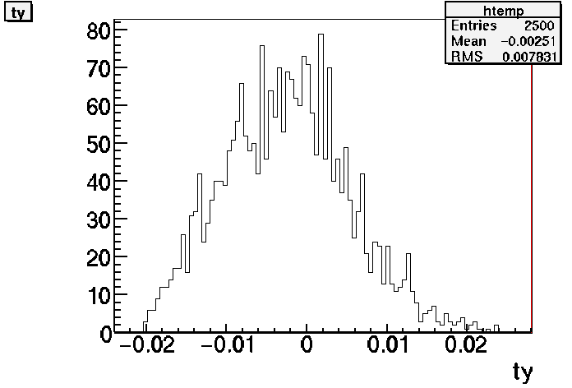
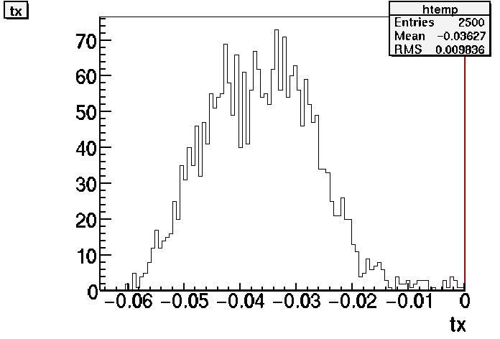
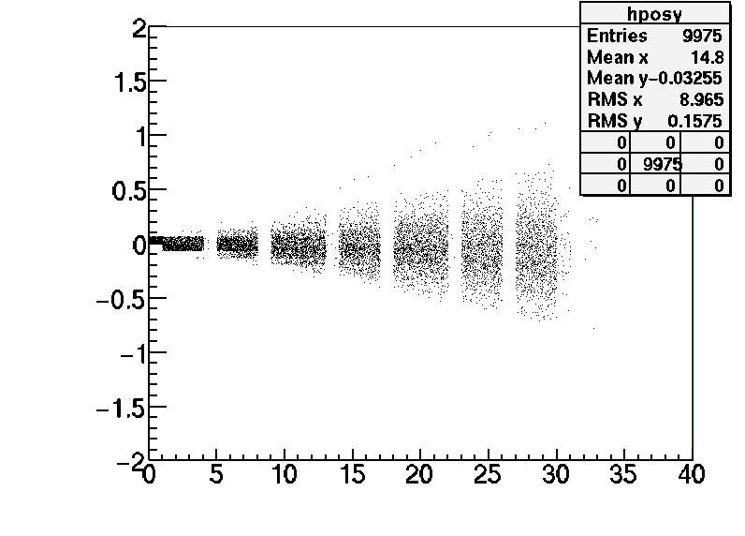
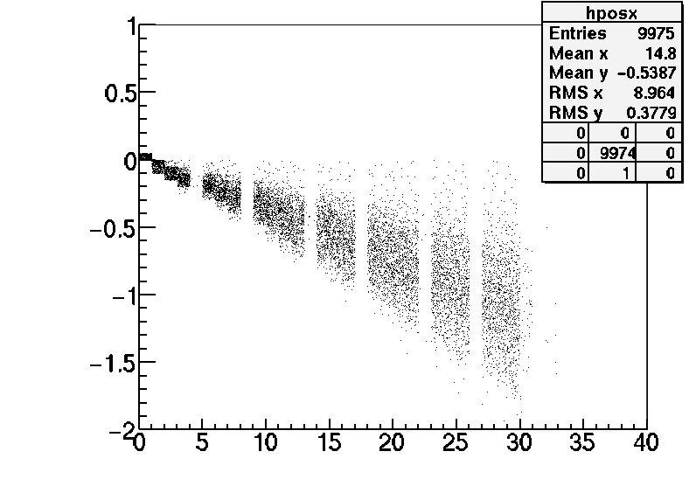
Pion test beam from KEK: momentum studies
Data provided by Toho group:
2512 beam tracks
Track θy
Track θx
Base track positions
Base track positions
Relative X (mm)
Relative Y (mm)
Relative Z (mm)
Relative Z (mm)
D. Duchesneau April 27th 2011

Slide 2
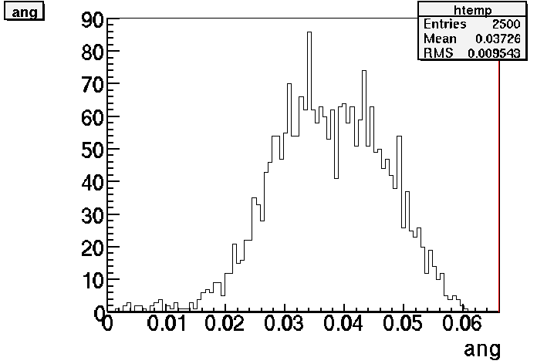
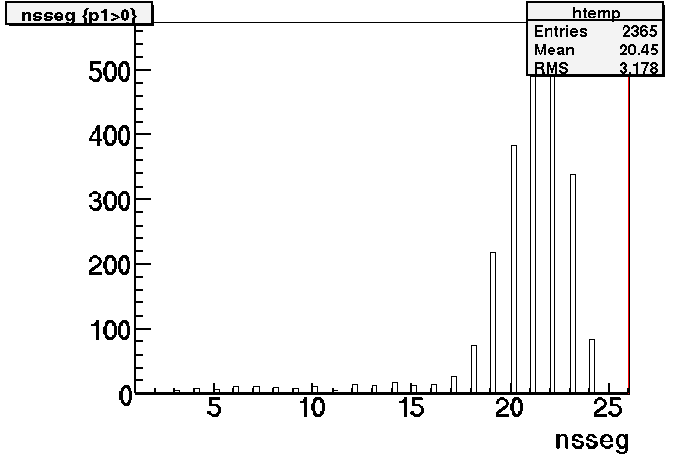
For the momentum measurement the number of segments per track is chosen > 15
Assumption: the base tracks are already corrected for plate alignment.
Number of segments/track
3 D angle
Angle (rad)

Slide 3
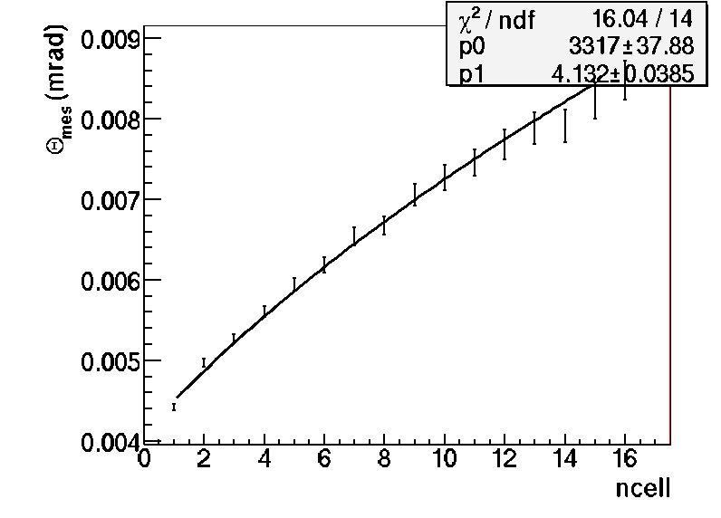
From the sigma of the previous distribution we usually fit the Ncell dependence with the MCS formula with the base track resolution and the global momentum as free parameters
calculating BT resolution ...
P=3317 MeV/c (this momentum is lower than expected for a 4 GeV/c pion beam)
double base track resolution= 4.13 mrad
Observation of a different resolution in XZ and YZ projection planes. Also some geometrical shifts of the plates=> very good and efficient discussion with Toho group ; it has been studied in deeper details.

Slide 4
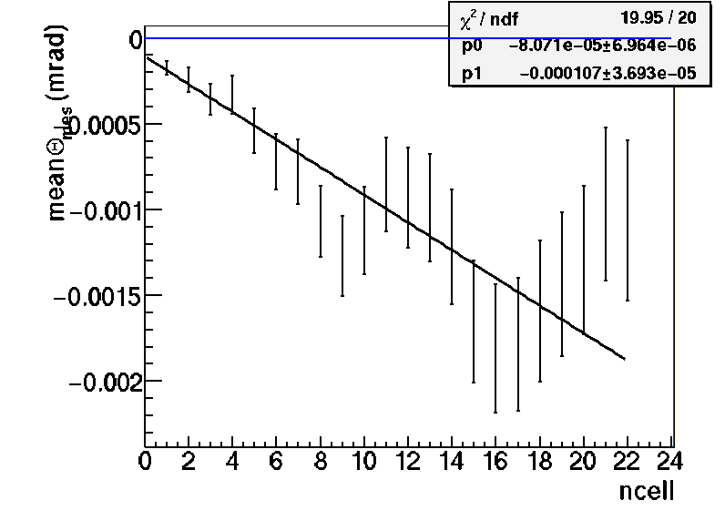
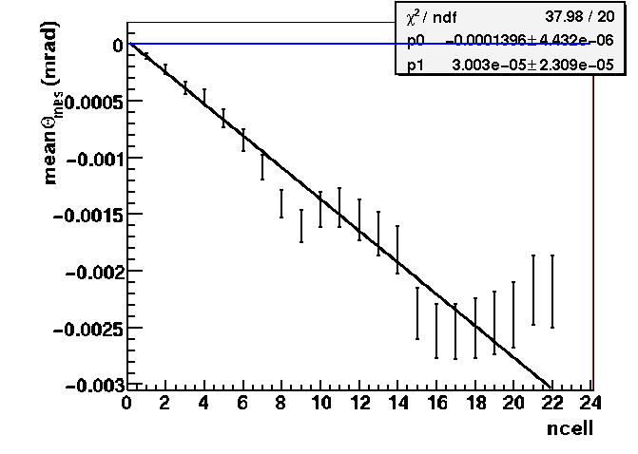
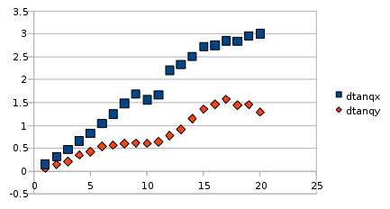
Control of the mean angle shifts to understand the difference
Using only the angle differences measured in XZ plane
rad
Using only the first 400 tracks from the file
XZ
data
Using the first 1000 tracks from the file
Very similar to Toho measurement even the shape
rad
XZ
We have the same values if we use the full data set

Slide 5
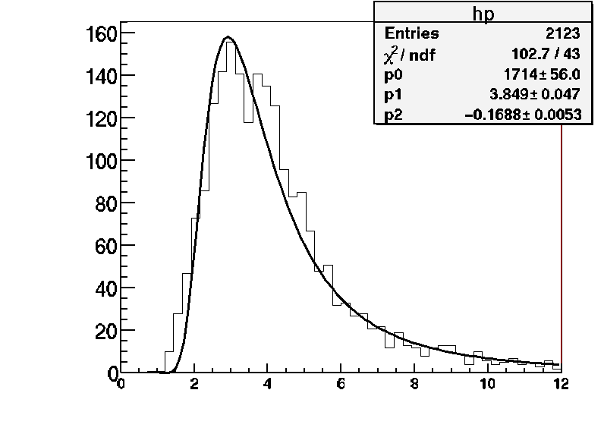
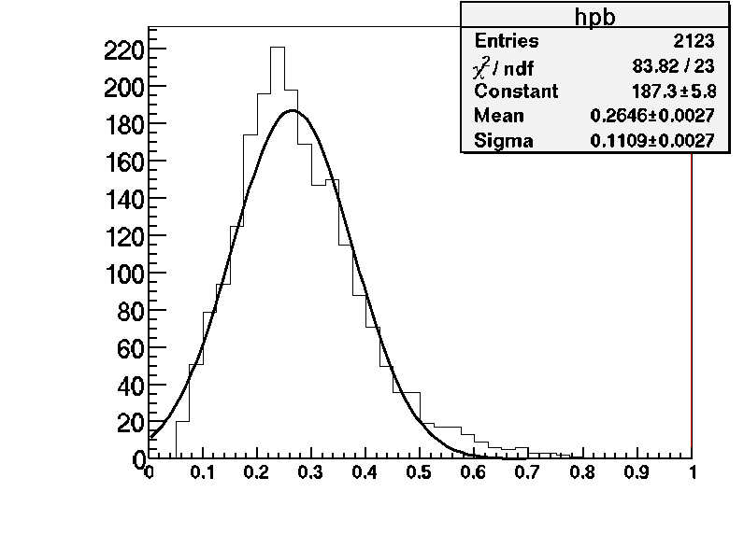
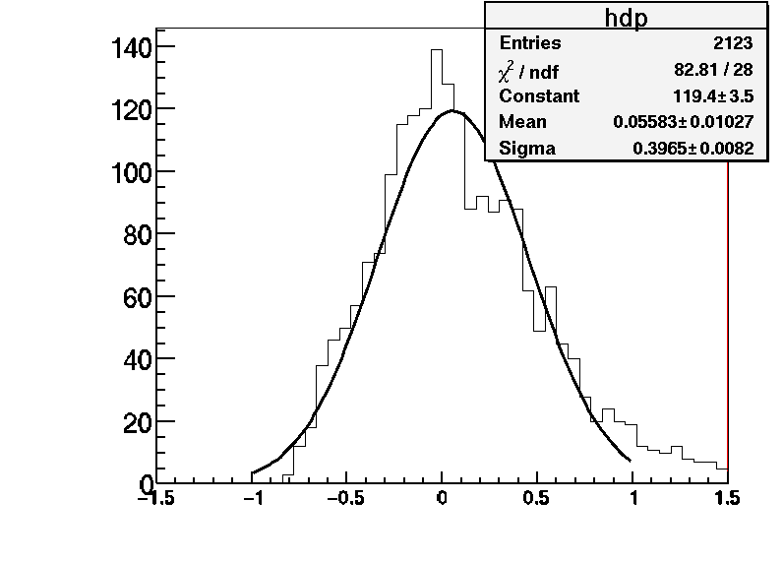
Test beam data
Applying track by track the PMCS algorithm with the double base track resolution= 4.13 mrad
Momentum obtained from p and 1/p distribution =3.81 GeV/c
Data
Data
p
1/p
Resolution Δ(1/p)/(1/p)=[39.6+-6.1] %
Data
This resolution is less than expected (30%) from this algorithm but this is due to the double base track resolution of 4.1 mrad instead of 2.1 mrad.
1- <p>/p

Slide 6
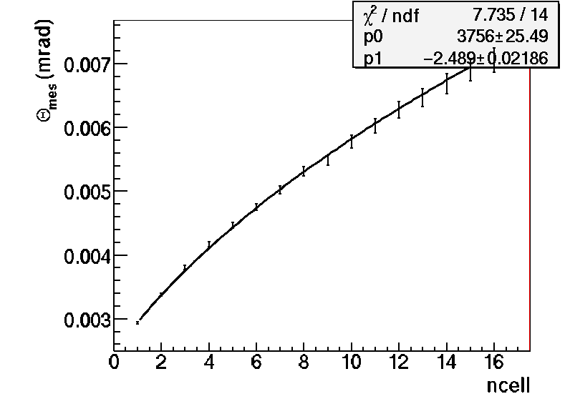
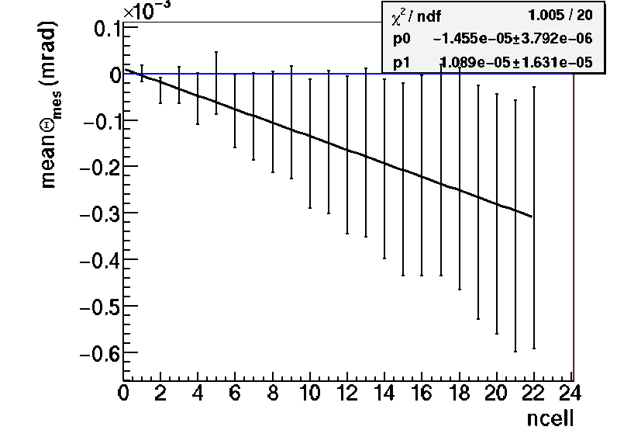
Monte Carlo Studies (double base track angular resolution of 2.4 mrad)
Choose only portion of tracks to match the number of segments in the KEK data (about 20)
Use a sample of 4 GeV pion tracks simulated in a brick
Note the Y axis scale
rad
rad
XZ + YZ
MC
calculating BT resolution ...
P=3.8 GeV/c
double base track resolution= 2.5 mrad

Slide 7
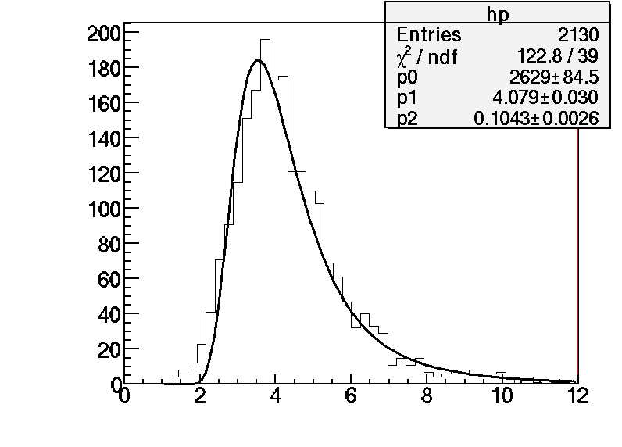
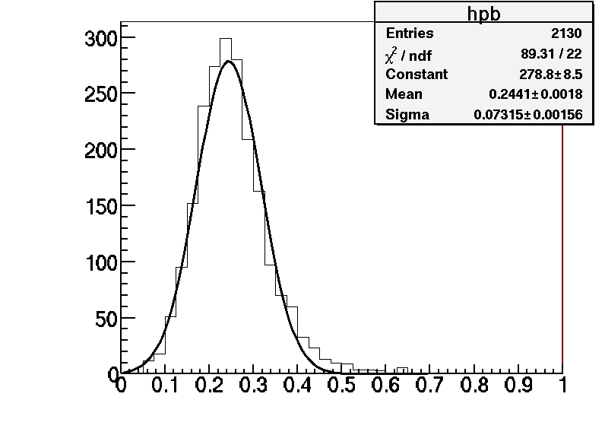
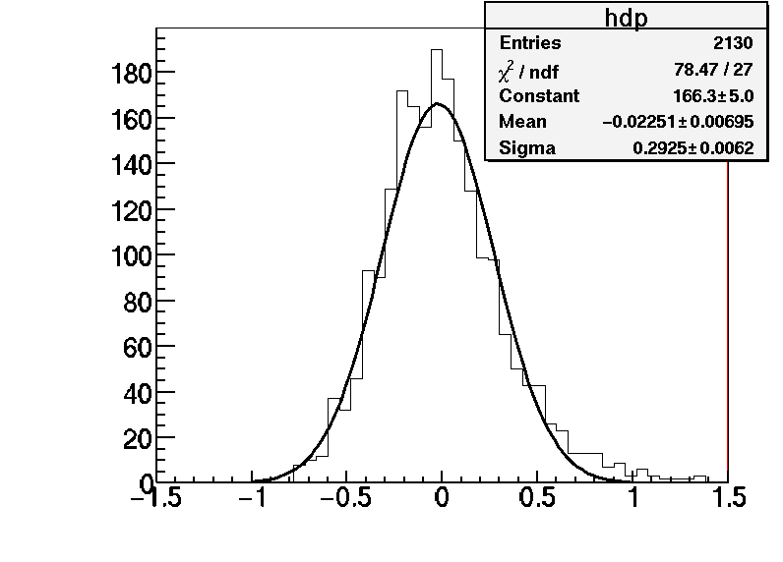
Monte Carle events (double base tracks angular resolution of 2.4 mrad)
Applying track by track the PMCS algorithm with the double base track resolution= 2.4 mrad
Momentum obtained from p and 1/p distribution =4.09 GeV/c
MC
MC
p
1/p
Resolution Δ(1/p)/(1/p)=[29.2+-2.6] %
MC
1- <p>/p

Slide 8
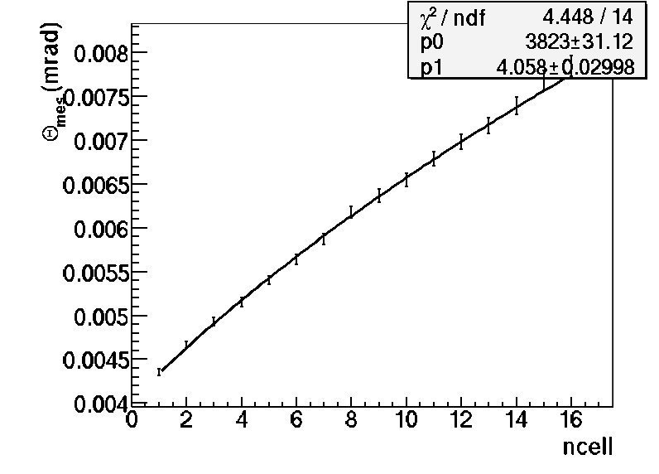
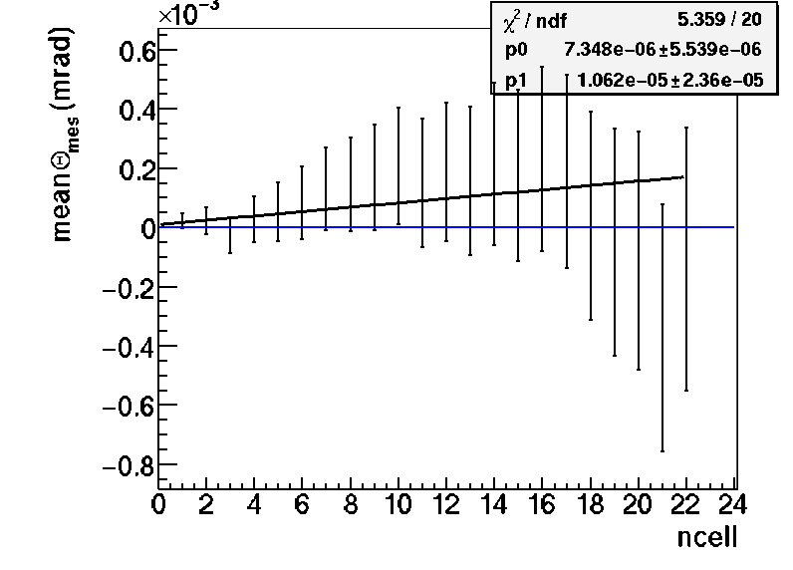
Monte Carlo Studies (double base track angular resolution of 4.1 mrad)
Choose only portion of tracks to match the number of segments in the KEK data (about 20)
Use a sample of 4 GeV pion tracks simulated in a brick
Note the Y axis scale
rad
rad
XZ + YZ
MC
calculating BT resolution ...
P=3.8 GeV/c
double base track resolution= 4.06 mrad

Slide 9
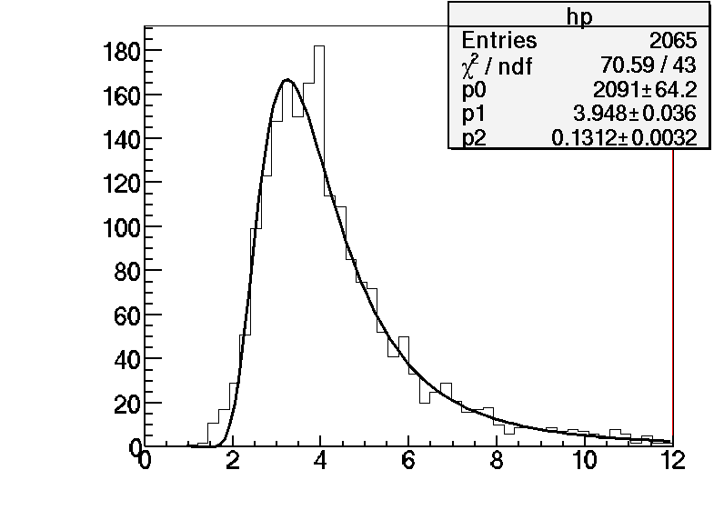
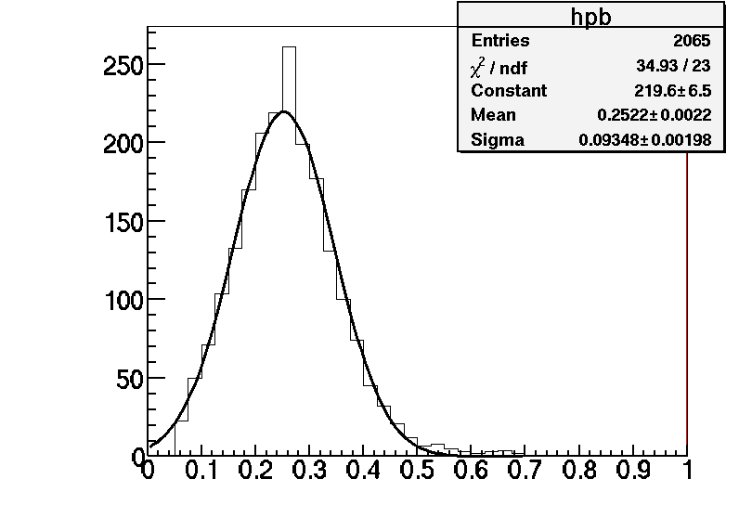
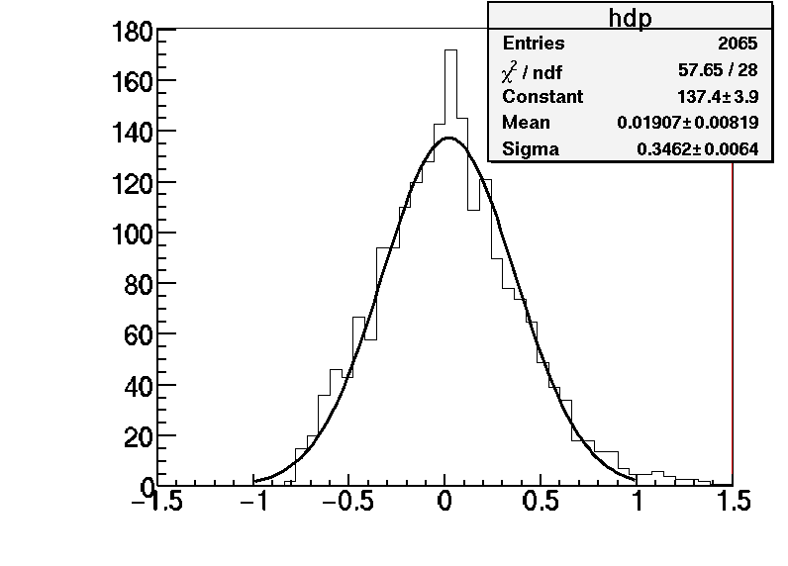
Monte Carle events (double base track angular resolution of 4.1 mrad)
Applying track by track the PMCS algorithm with the double base track resolution= 4.06 mrad
Momentum obtained from p and 1/p distribution =3.96 GeV/c
MC
MC
p
1/p
Resolution Δ(1/p)/(1/p)=[34.6+-2.8] %
MC
1- <p>/p

Slide 10
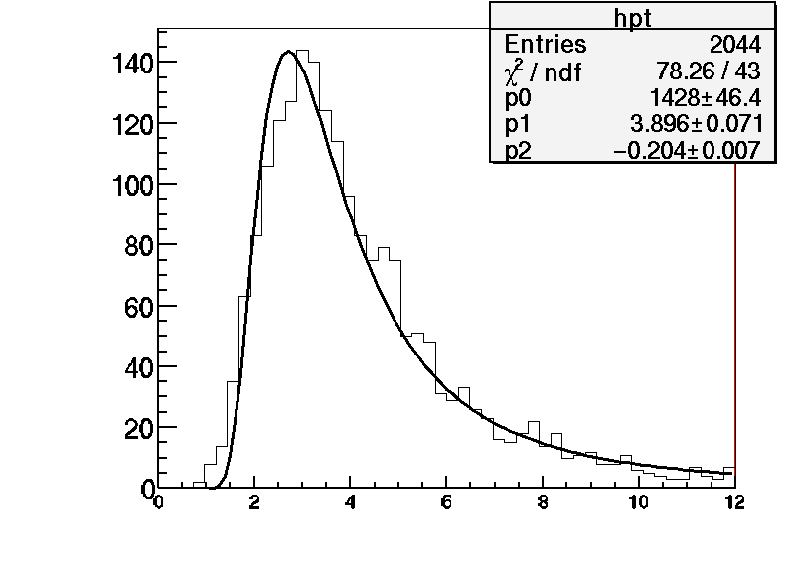
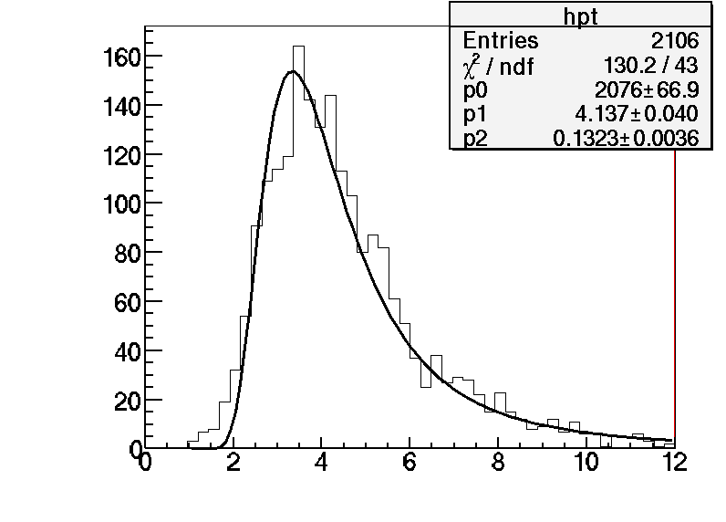
Summary in 3D and in transverse and longitudinal projections
KEK data
P3D=3.81373[0.0347992] GeV - DP/P=39.6496[6.07086] %
PL=3.79157[0.0212307] GeV - DP/P=43.0014[5.00714] %
PT=3.85968[0.0366781] GeV - DP/P=43.6257[6.51717] %
Data
Transverse coord.
Note: the sensitivity to BT resolution is very high with 4 mrad at 4 GeV
P (GeV/c)
MC
2.4 mrad in both projections
P3D=4.0879[0.00929236] GeV - DP/P=29.2465[2.65249] %
PL=4.08167[0.0168638] GeV - DP/P=34.1401[3.81461] %
PT=4.15084[0.0139606] GeV - DP/P=33.8707[3.4425] %
4.06 mrad in both projections
P3D=3.95652[0.00884724] GeV - DP/P=34.622[2.85425] %
PL=3.98682[0.036938] GeV - DP/P=42.0231[6.31024] %
PT=4.22465[0.000709772] GeV - DP/P=42.4319[1.29759] %
MC
Transverse coord.
P (GeV/c)

Slide 11
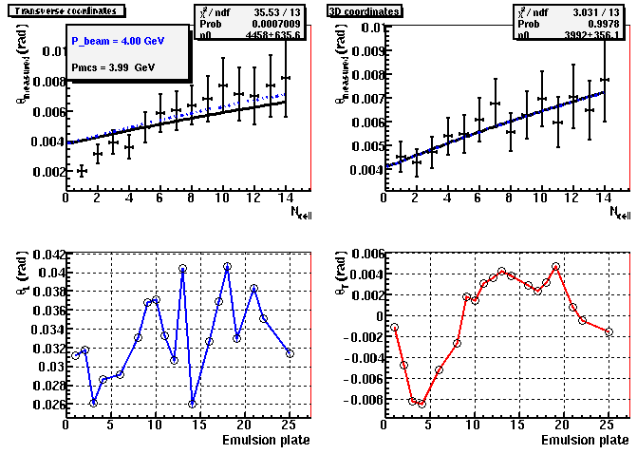
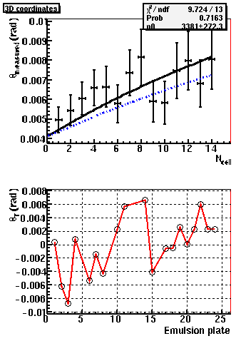
Test beam data
Some examples of a few tracks;
the blue line corresponds to a 4 GeV/c beam track and the black line is the MCS fit result:
Track 1
Track 5
Pmcs=3.38 GeV/c
Pmcs=3.99 GeV/c

Slide 12
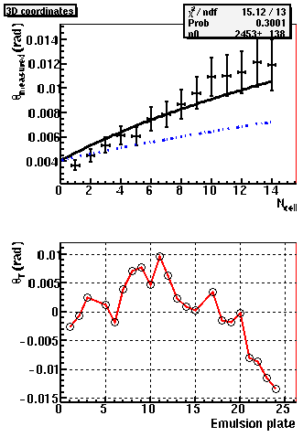
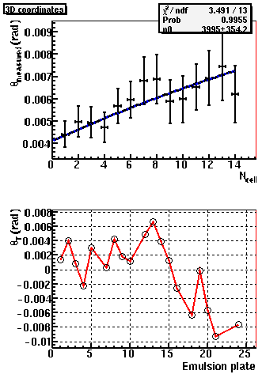
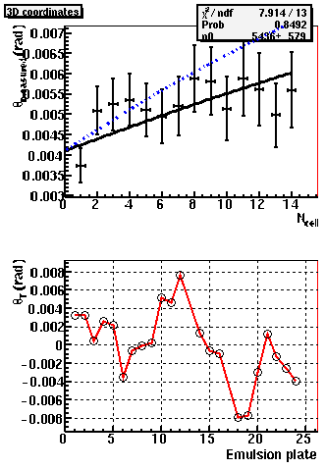
Test beam data
Track 8
Track 7
Pmcs=5.44 GeV/c
Pmcs=3.99 GeV/c

Slide 13
Conclusions:
The momentum measured with the test beam data provided by Toho is:
3.8 GeV/c with an uncertainty on the absolute scale of about 7%.
This uncertainty is mainly dominated by the angular resolution knowledge
The resolution is estimated to be 39% when using both projections and 43% in the transverse projection only
MC studies of 4 GeV/c pions gives (with the same algorithm) 4.1 GeV/c with a systematic uncertainty of about 5% which has been estimated by changing the fit range, varying the angular resolution, changing the track length etc…
We continue detailed comparison with Toho measurements and we track the differences in the momentum estimates knowing that the angular measurements are the same.

Slide 14
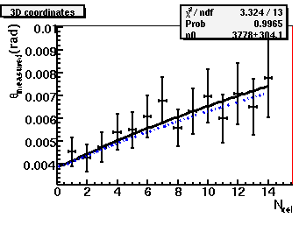
Understanding of the difference in fit result between Toho an DD for the track 1
D. Duchesneau, May 6th 2011
Double BT resolution = 4.1 mrad
Double BT resolution = 3.9 mrad
Pmcs=3.99 GeV/c
Pmcs=3.78 GeV/c
Going from 4.1 mrad to 3.9 mrad the momentum decreases by about 6%
=> 3.99 GeV/c becomes 3.78 GeV/c and the fitted line should now match Toho fit
Note that a resolution of the order of 4 mrad makes the momentum measurement sensitivity of 3 or 4 GeV particles more critical than the sensitivity one can get with a smaller resolution of 2 mrad where a 5% change would not make a 6% effect. It should be taken as a systematic probably.
The remaining difference in the P value comes from a different scaling factor used in the MCS formula. In our MCS study we are using 14.64 instead of the usual 13.6. This was estimated with MC data and test beam data with the OPERA brick structure composed of lead+emulsion. The net effect is to scale up the momentum by 7.6%.
=> 3.78 GeV/c becomes 3.51 GeV/c

Slide 15
Summary:
The difference of 13% on the momentum of track 1 can be explained by the different MCS formula factor and the different double base track resolution (4.1 vs 3.9 mrad)
Now if we apply 3.9 mrad instead of 4.1 mrad to the whole pion data set, the beam momentum measurement goes from 3.78 GeV/c to 3.58 GeV/c.
Concerning these plots:
The reason why it is not at 0 for the first emulsion plate is that the phi angle used to transform the reference frame to TL planes is not calculated using the first base track slopes.
The phi is obtained from the direction of an average track fitted to all the base tracks. This avoids some possible or too strong deviation of the first base tracks.
This can also explain the very little difference seen in the position of the data points shown on the plots of the previous slides.

Slide 16
// correlation matrix (long tracks more than 50 plates)
{
1.0000000 , 0.7019440 , 0.6305600 , 0.5719876 , 0.5257840 , 0.4969909 , 0.4632392 , 0.4348128 , 0.4113047 , 0.3895742 , 0.3672101 , 0.3548928 , 0.3354470 ,
0.7019440 , 1.0000000 , 0.8324922 , 0.7697662 , 0.7219567 , 0.6786730 , 0.6373476 , 0.6047858 , 0.5727320 , 0.5476525 , 0.5177510 , 0.5037926 , 0.4806298 ,
0.6305600 , 0.8324922 , 1.0000000 , 0.8787227 , 0.8373768 , 0.8019863 , 0.7648694 , 0.7319199 , 0.6988111 , 0.6742211 , 0.6417400 , 0.6229187 , 0.5976337 ,
0.5719876 , 0.7697662 , 0.8787227 , 1.0000000 , 0.9139644 , 0.8816085 , 0.8511400 , 0.8181283 , 0.7891668 , 0.7613313 , 0.7320850 , 0.7089916 , 0.6870035 ,
0.5257840 , 0.7219567 , 0.8373768 , 0.9139644 , 1.0000000 , 0.9336929 , 0.9063070 , 0.8758149 , 0.8474949 , 0.8213611 , 0.7904972 , 0.7679949 , 0.7429309 ,
0.4969909 , 0.6786730 , 0.8019863 , 0.8816085 , 0.9336929 , 1.0000000 , 0.9484023 , 0.9238797 , 0.8982391 , 0.8724679 , 0.8444602 , 0.8190991 , 0.7949968 ,
0.4632392 , 0.6373476 , 0.7648694 , 0.8511400 , 0.9063070 , 0.9484023 , 1.0000000 , 0.9588344 , 0.9382656 , 0.9170466 , 0.8911247 , 0.8704507 , 0.8463998 ,
0.4348128 , 0.6047858 , 0.7319199 , 0.8181283 , 0.8758149 , 0.9238797 , 0.9588344 , 1.0000000 , 0.9644410 , 0.9475883 , 0.9269939 , 0.9063236 , 0.8852876 ,
0.4113047 , 0.5727320 , 0.6988111 , 0.7891668 , 0.8474949 , 0.8982391 , 0.9382656 , 0.9644410 , 1.0000000 , 0.9683985 , 0.9525011 , 0.9346613 , 0.9158600 ,
0.3895742 , 0.5476525 , 0.6742211 , 0.7613313 , 0.8213611 , 0.8724679 , 0.9170466 , 0.9475883 , 0.9683985 , 1.0000000 , 0.9728346 , 0.9600545 , 0.9437444 ,
0.3672101 , 0.5177510 , 0.6417400 , 0.7320850 , 0.7904972 , 0.8444602 , 0.8911247 , 0.9269939 , 0.9525011 , 0.9728346 , 1.0000000 , 0.9763121 , 0.9641387 ,
0.3548928 , 0.5037926 , 0.6229187 , 0.7089916 , 0.7679949 , 0.8190991 , 0.8704507 , 0.9063236 , 0.9346613 , 0.9600545 , 0.9763121 , 1.0000000 , 0.9780779 ,
0.3354470 , 0.4806298 , 0.5976337 , 0.6870035 , 0.7429309 , 0.7949968 , 0.8463998 , 0.8852876 , 0.9158600 , 0.9437444 , 0.9641387 , 0.9780779 , 1.0000000
} ;
// covariance matrix (x 3249 tracks)
Double_t cc[169]=
{
0.0002831 , 0.0002555 , 0.0002742 , 0.0002952 , 0.0003151 , 0.0003400 , 0.0003537 , 0.0003689 , 0.0003801 , 0.0003929 , 0.0004017 , 0.0004237 , 0.0004286 ,
0.0002555 , 0.0004679 , 0.0004653 , 0.0005108 , 0.0005561 , 0.0005968 , 0.0006257 , 0.0006596 , 0.0006803 , 0.0007100 , 0.0007280 , 0.0007733 , 0.0007895 ,
0.0002742 , 0.0004653 , 0.0006678 , 0.0006966 , 0.0007706 , 0.0008425 , 0.0008970 , 0.0009536 , 0.0009917 , 0.0010443 , 0.0010780 , 0.0011422 , 0.0011728 ,
0.0002952 , 0.0005108 , 0.0006966 , 0.0009410 , 0.0009984 , 0.0010994 , 0.0011849 , 0.0012653 , 0.0013294 , 0.0013999 , 0.0014598 , 0.0015433 , 0.0016004 ,
0.0003151 , 0.0005561 , 0.0007706 , 0.0009984 , 0.0012682 , 0.0013517 , 0.0014647 , 0.0015725 , 0.0016574 , 0.0017532 , 0.0018299 , 0.0019407 , 0.0020092 ,
0.0003400 , 0.0005968 , 0.0008425 , 0.0010994 , 0.0013517 , 0.0016527 , 0.0017497 , 0.0018936 , 0.0020053 , 0.0021260 , 0.0022316 , 0.0023629 , 0.0024544 ,
0.0003537 , 0.0006257 , 0.0008970 , 0.0011849 , 0.0014647 , 0.0017497 , 0.0020596 , 0.0021939 , 0.0023384 , 0.0024946 , 0.0026289 , 0.0028032 , 0.0029171 ,
0.0003689 , 0.0006596 , 0.0009536 , 0.0012653 , 0.0015725 , 0.0018936 , 0.0021939 , 0.0025420 , 0.0026703 , 0.0028637 , 0.0030382 , 0.0032425 , 0.0033896 ,
0.0003801 , 0.0006803 , 0.0009917 , 0.0013294 , 0.0016574 , 0.0020053 , 0.0023384 , 0.0026703 , 0.0030157 , 0.0031876 , 0.0034002 , 0.0036422 , 0.0038195 ,
0.0003929 , 0.0007100 , 0.0010443 , 0.0013999 , 0.0017532 , 0.0021260 , 0.0024946 , 0.0028637 , 0.0031876 , 0.0035928 , 0.0037906 , 0.0040834 , 0.0042959 ,
0.0004017 , 0.0007280 , 0.0010780 , 0.0014598 , 0.0018299 , 0.0022316 , 0.0026289 , 0.0030382 , 0.0034002 , 0.0037906 , 0.0042257 , 0.0045035 , 0.0047596 ,
0.0004237 , 0.0007733 , 0.0011422 , 0.0015433 , 0.0019407 , 0.0023629 , 0.0028032 , 0.0032425 , 0.0036422 , 0.0040834 , 0.0045035 , 0.0050353 , 0.0052707 ,
0.0004286 , 0.0007895 , 0.0011728 , 0.0016004 , 0.0020092 , 0.0024544 , 0.0029171 , 0.0033896 , 0.0038195 , 0.0042959 , 0.0047596 , 0.0052707 , 0.0057672
};

Slide 17
Use the modified the Minimization function for Graphs
eG=new TGraphErrors(vind3d,da,errvind3d,errda);
TVirtualFitter::Fitter(eG)->SetFCN(GraphFitChisquareDD);
eG->Fit("eF1","QRU");
// printf(" we are in GraphFit of EdbMomentum \n");
f1->InitArgs(x,u);
f = 0;
for (bin=0;bin<n;bin++) {
x[0] = gx[bin];
if (!f1->IsInside(x)) continue;
cu = gy[bin];
TF1::RejectPoint(kFALSE);
fu = f1->EvalPar(x,u);
if (TF1::RejectedPoint()) continue;
fsum = (cu-fu);
npfits++;
if (Foption.W1) {
f += fsum*fsum;
continue;
}
ex = gr->GetErrorX(bin);
ey = gr->GetErrorY(bin);
if (ex < 0) ex = 0;
if (ey < 0) ey = 0;
if (ex > 0) {
xm = x[0] - ex; if (xm < fxmin) xm = fxmin;
xp = x[0] + ex; if (xp > fxmax) xp = fxmax;
xx[0] = xm; fm = f1->EvalPar(xx,u);
xx[0] = xp; fp = f1->EvalPar(xx,u);
eux = 0.5*(fp-fm);
} else
eux = 0.;
eu = ey*ey+eux*eux;
if (eu <= 0) eu = 1;
f += fsum*fsum/eu;
if (bin<13) v[bin] = fsum; // fill with residual
}
// perform residual^T COV^-1 residual vector matrix vector operation
v2 = v;
v *= hinv;
f = v*v2; minimise this value
f1->SetNumberFitPoints(npfits);
}
Modify the Minimization function for Graphs
//______________________________________________________________________________
void GraphFitChisquareDD(Int_t &npar, Double_t * /*gin*/, Double_t &f,
Double_t *u, Int_t /*flag*/)
{
//*-*-*-*-*-*Minimization function for Graphs using a Chisquare method*-*-*-*-*
//*-* =========================================================
//
// In case of a TGraphErrors object, ex, the error along x, is projected
// along the y-direction by calculating the function at the points x-ex and
// x+ex.
//
// The chisquare is computed as the sum of the quantity below at each point:
//
// (y - f(x))**2
// -----------------------------------
// ey**2 + ((f(x+ex) - f(x-ex))/2)**2
//
// where x and y are the point coordinates
Put covariance Matrices etc…. here
TVirtualFitter *grFitter = TVirtualFitter::GetFitter();
TGraph *gr = (TGraph*)grFitter->GetObjectFit();
TF1 *f1 = (TF1*)grFitter->GetUserFunc();
Foption_t Foption = grFitter->GetFitOption();
Int_t n = gr->GetN();
Double_t *gx = gr->GetX();
Double_t *gy = gr->GetY();
Double_t fxmin = f1->GetXmin();
Double_t fxmax = f1->GetXmax();
npar = f1->GetNpar();

Slide 18
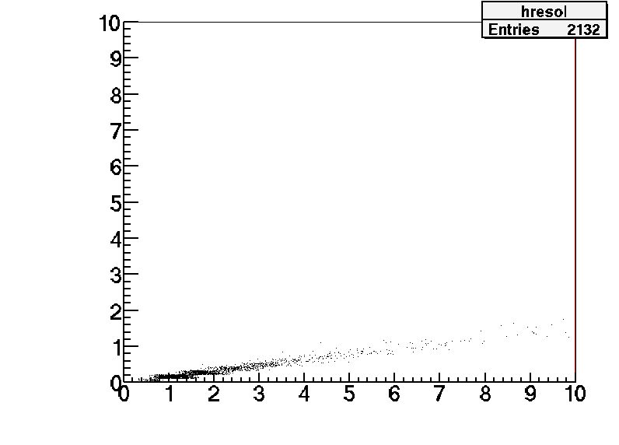
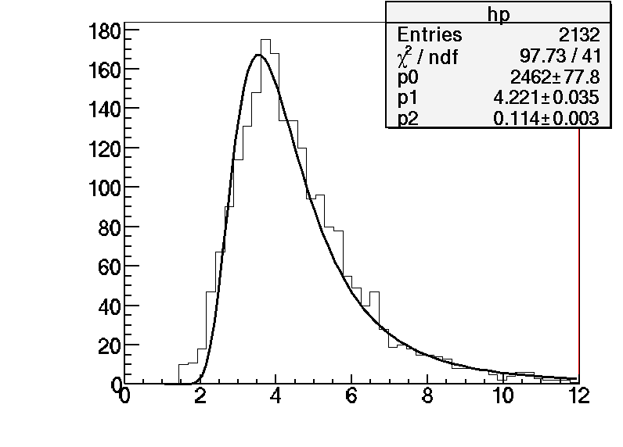
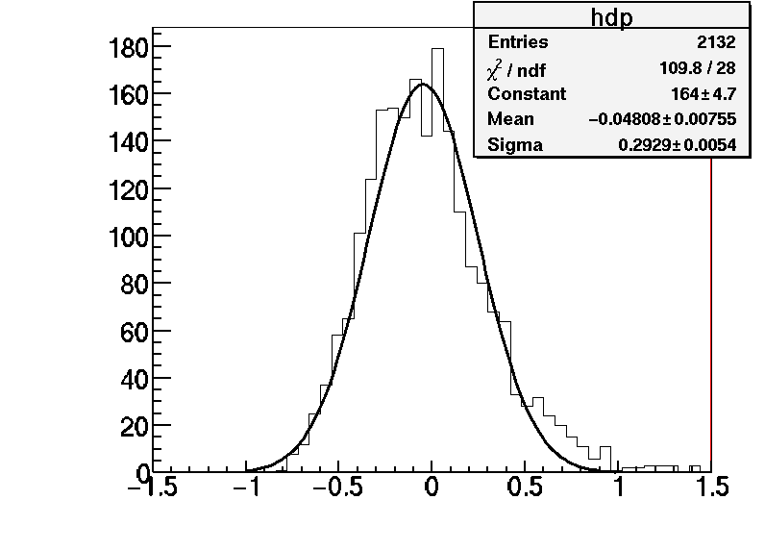
MC 4 GeV pions:
No covariance matrix for the fit
Error from fit (GeV)
Error from parametrisation (GeV)
D. Duchesneau 16/05/2011

Slide 19
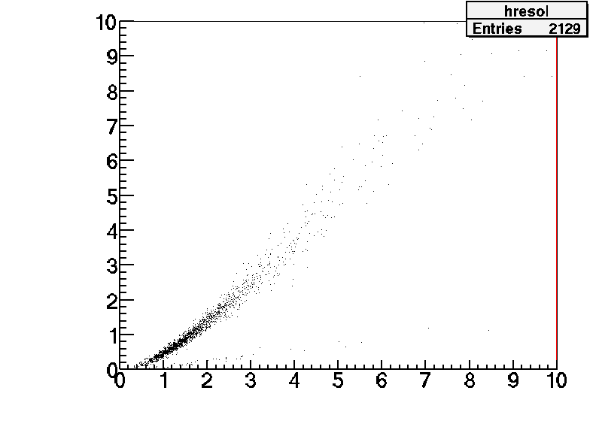
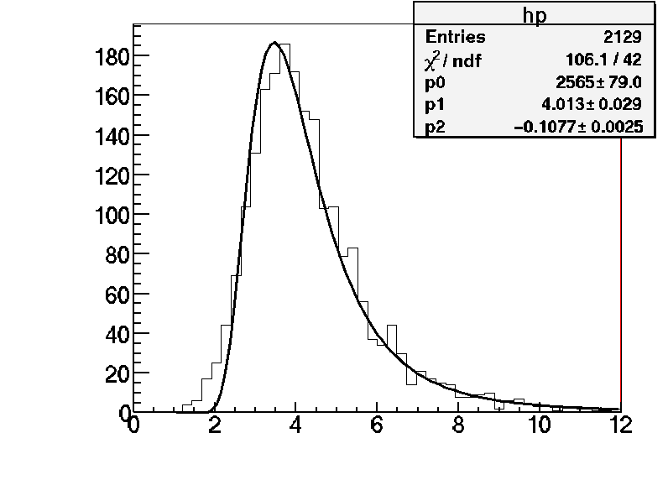

MC 4 GeV pions:
With covariance matrix for the fit
Error from fit (GeV)
Error from parametrisation (GeV)
Conclusion: taking into account the correlations makes a 5% systematic effect
And the error from the fit matches well the parametrisation used,

Slide 20
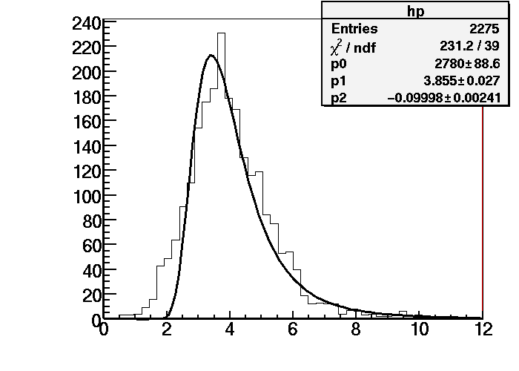
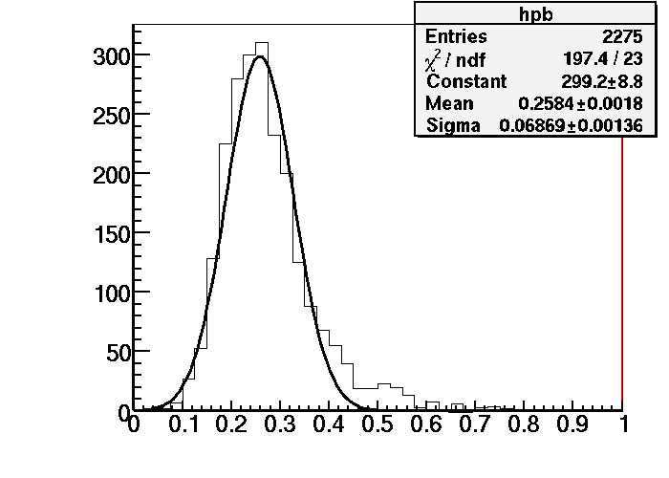
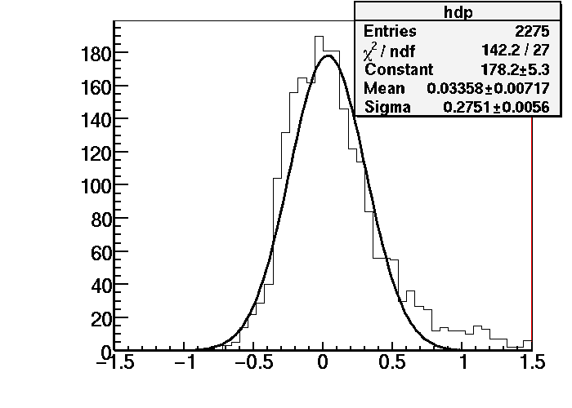
Test beam data from Napoli
Applying track by track the PMCS algorithm with the double base track resolution= 2.1 mrad
Momentum obtained from p and 1/p distribution =3.9 GeV/c
Data
Data
p
1/p
Resolution Δ(1/p)/(1/p)=[27.5+-2.3] %
Data
1- <p>/p

Slide 21
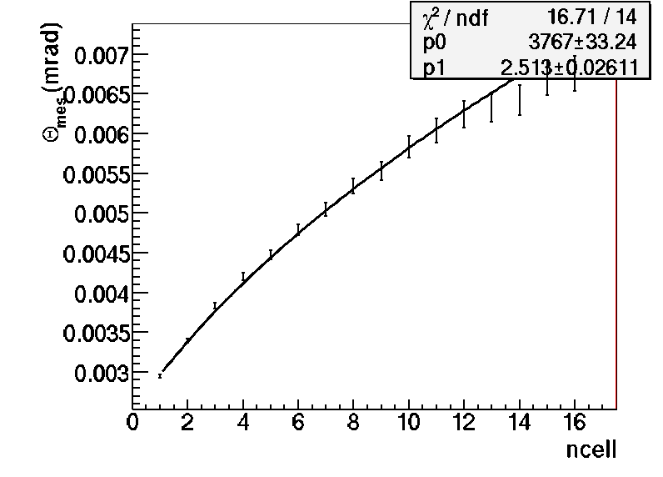
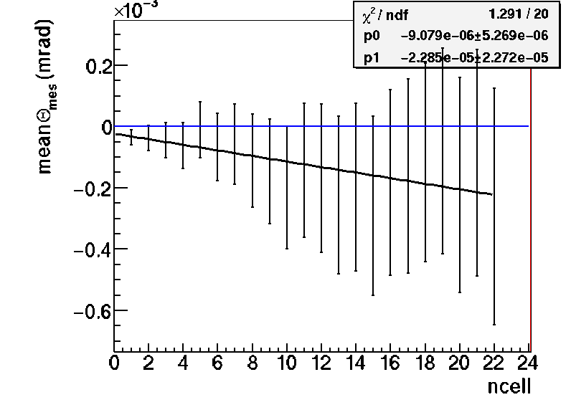

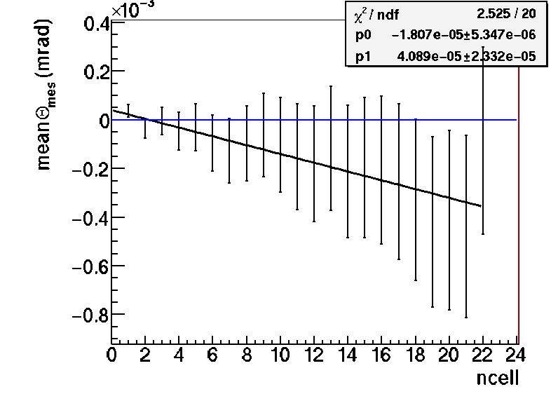
Monte Carlo Studies (4 GeV pions)
rad
XZ
rad
XZ
MC
MC
calculating BT resolution ...
P(XZ)=3.8 GeV/c
double base track resolution= 2.5 mrad
rad
rad
YZ
YZ
MC
MC
calculating BT resolution ...
P(YZ)=3.8 GeV/c
double base track resolution= 2.5 mrad
In the MC all the values are in full agreement between (XZ+YZ) and XZ and YZ

