Slide 1
Heavy particles in π- brick interactions
Frame: GEANT3.2 with one brick as geometry. Option FLUKA
This is the Geant part of GENIMA
5000: 4 and 8 GeV/c, π-, Ѳ = 0 mrad
Inelastic interaction: a π- < 3.8 (7.8) GeV/c observed in one of the 56 emulsions

Slide 2
Results 4 GeV/c
With a beam of 5000 4 GeV/c pions:
1494 interaction ( 30 %) :
1231 protons ( 82.4 % )
104 deuton ( 7 % )
48 triton ( 3.2 % )
105 alpha ( 7 % )
0 heavier nuclei ( 0 %)
in 1494 interactions, 119 show either d,t,α present in the emulsions :
= 8 %

Slide 3
Results 8 GeV/c
1463 interaction 29 % : (Geisha 30%)
1223 protons 83.6 % (89%)
136 deuton 9.3 % (43%)
57 triton 3.9 % (25%)
131 alpha 9 % (6%)
0 heavier nuclei 0 % 0
in 1463 interactions, 263 show either d,t,α present in the emulsions :
= 18 % (56 %)

Slide 4
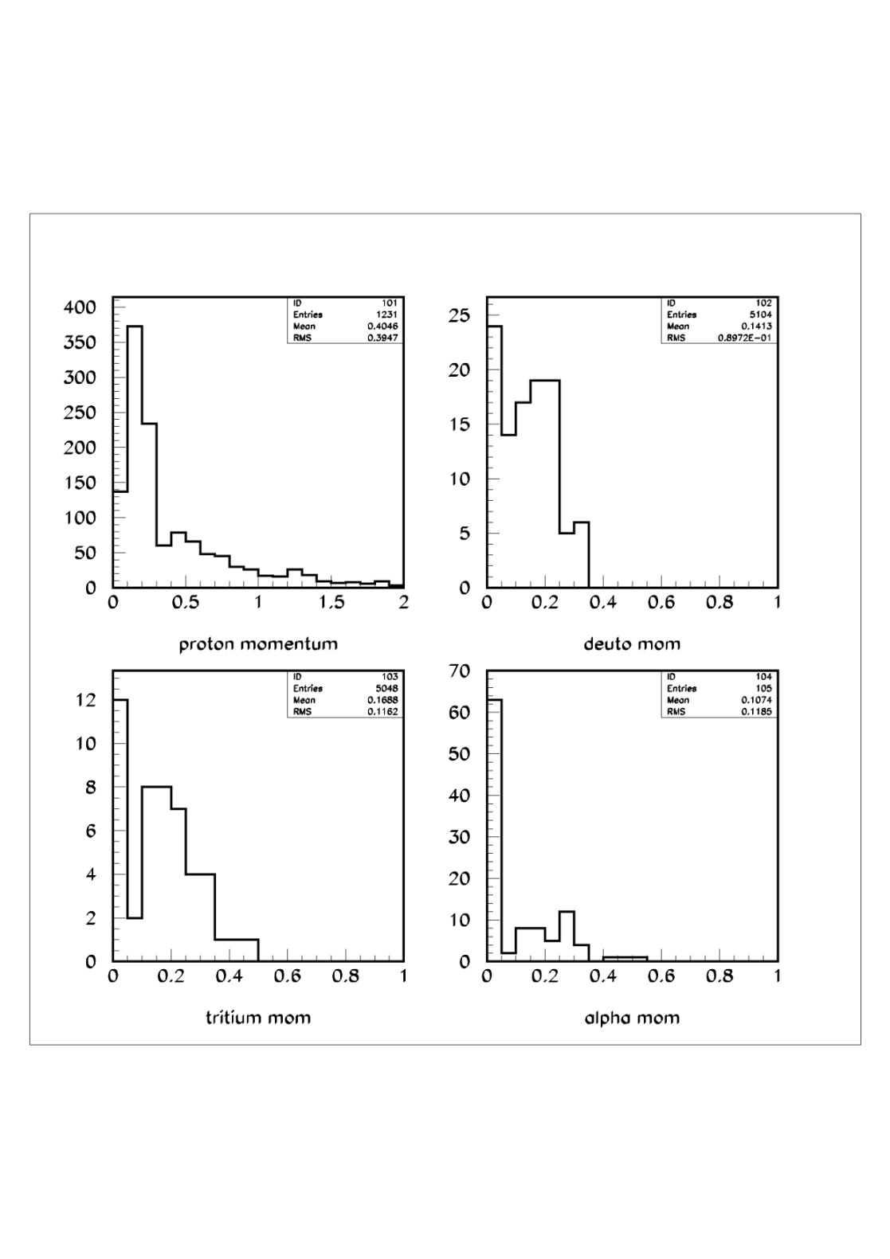
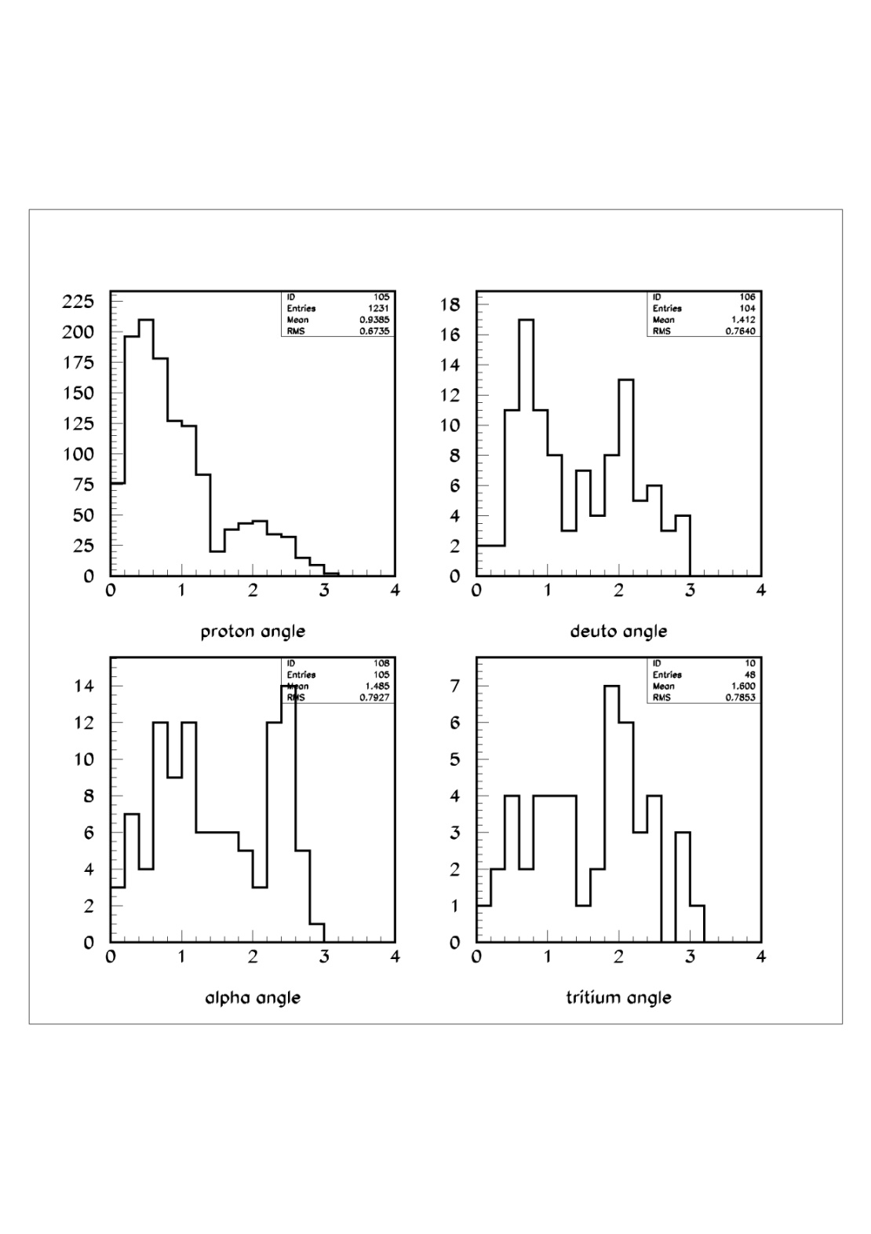
Momentum and angle distributions
4 GeV/c

Slide 5
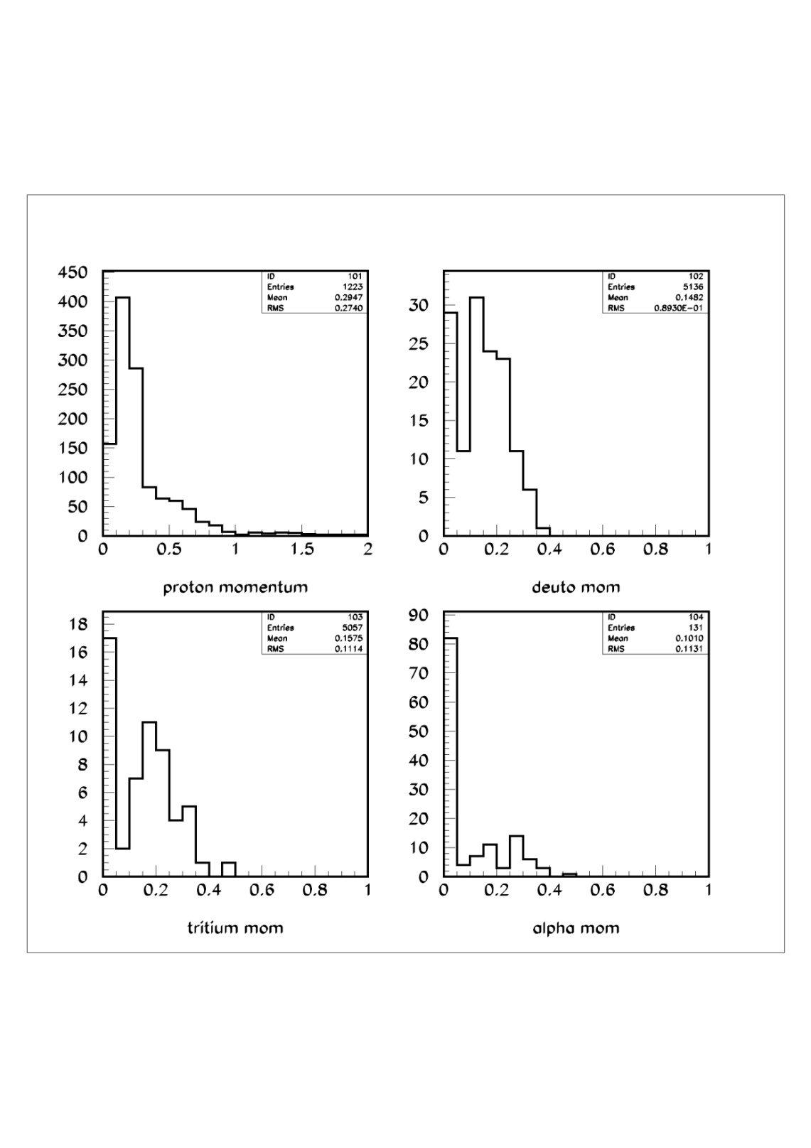
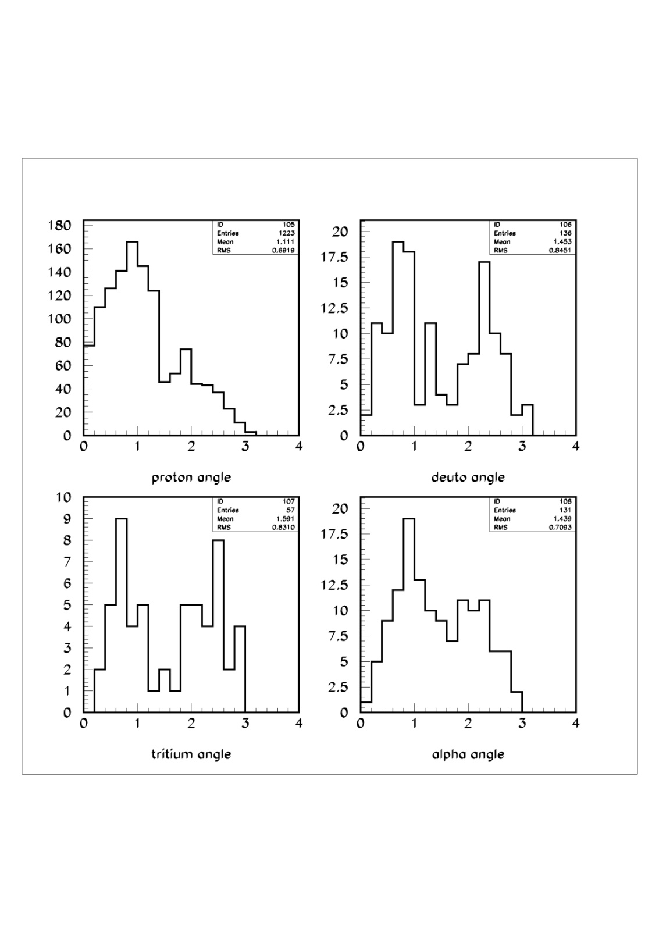
8 GeV/c

Slide 6
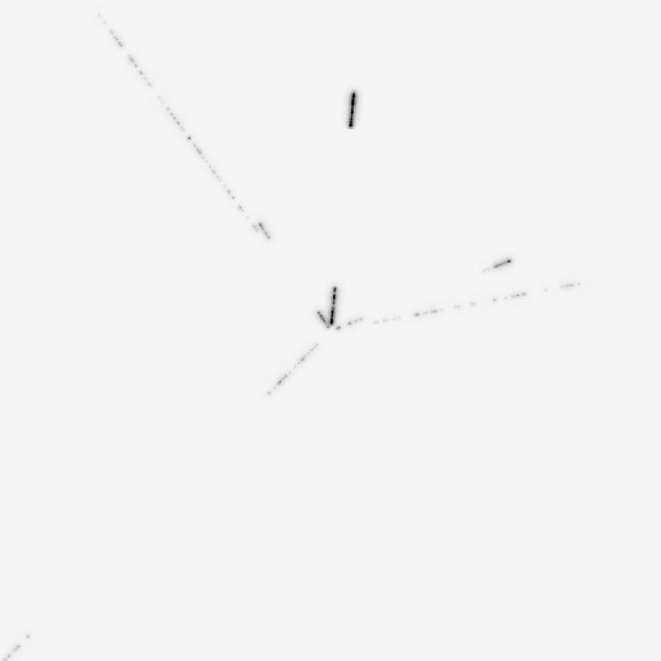
Ev 10 No Fog

Slide 7
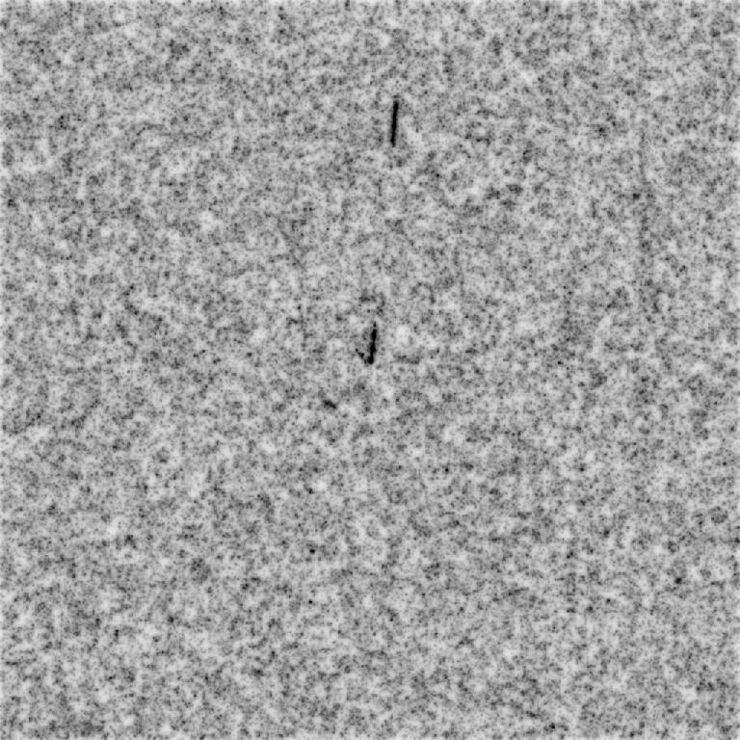
Ev 10 fog=8

Slide 8
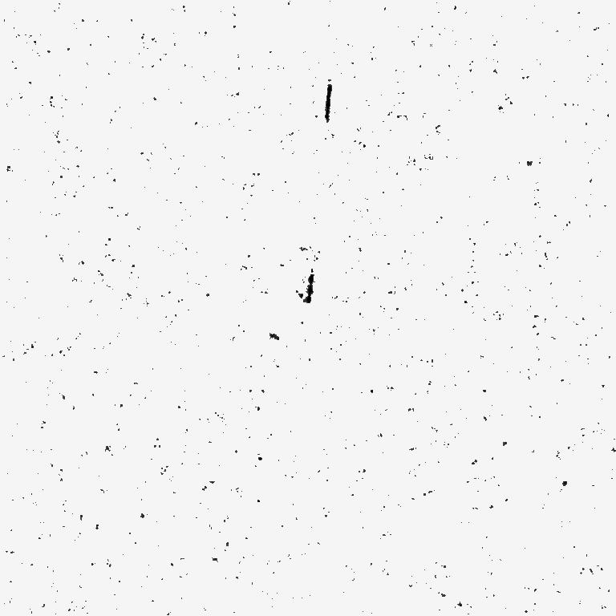
Ev 10 Fog=8 Filtre

Slide 9
Conclusions
In nearly all interactions presence of at least one proton (82-84 %)
Accompanied in 8-18 % of interactions by d,or t, or α

