Slide 1
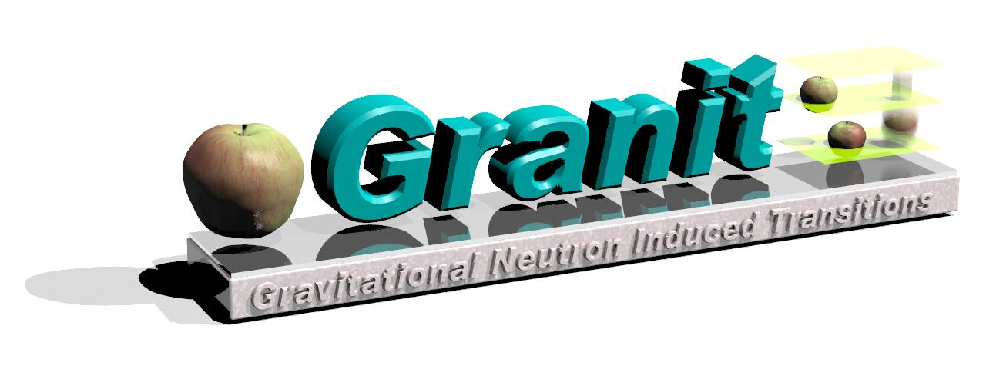
Gravitational and centrifugal quantum states of neutrons and anti-hydrogen atoms
Gravitational and centrifugal quantum states of matter and anti-matter: verification of the weak equivalence principle for an object in a quantum state
Recent first measurement of the gravitational quantum states of neutrons and the centrifugal quantum states of neutrons (the « neutron whispering gallery effect », or the « neutron rainbow »)
Long lifetimes of neutrons in the whispering gallery states allow us to use this phenomenon for precision studies of surface potentials and probably for constraining fundamental short-range potentials
Co-authors of all results included in this talk are indicated on respective transparencies
11.10.11
V.V. Nesvizhevsky

Slide 2

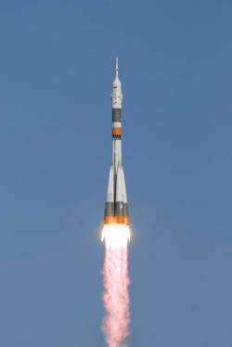

Comparison of gravitational and centrifugal quantum states
Gravity / Acceleration
V.V. N. « Near-surface quantum states of neutrons in the gravitational and centrifugal potentials », Phys.-Uspekhi 53 (2010) 645.
Height above mirror
40μm
30μm
20μm
10μm
Illustration for the quantum motion of an object above a mirror in a gravitational field and that in an accelerating frame. Positions of the ball correspond to the most probable heights of a neutron, or an anti-hydrogen atom, in the 5th quantum state.
11.10.11
V.V. Nesvizhevsky
Notes:
2

Slide 3
Comparison of neutron and antihydrogen quantum states
Matter / Anti-matter
Gravitational properties of matter have never been directly measured!!
GBAR, AEGIS projects…
?
?
?...
Illustration for the quantum motion of a matter object and an anti-matter object above a mirror in a gravitational field.
11.10.11
V.V. Nesvizhevsky
Notes:
3

Slide 4
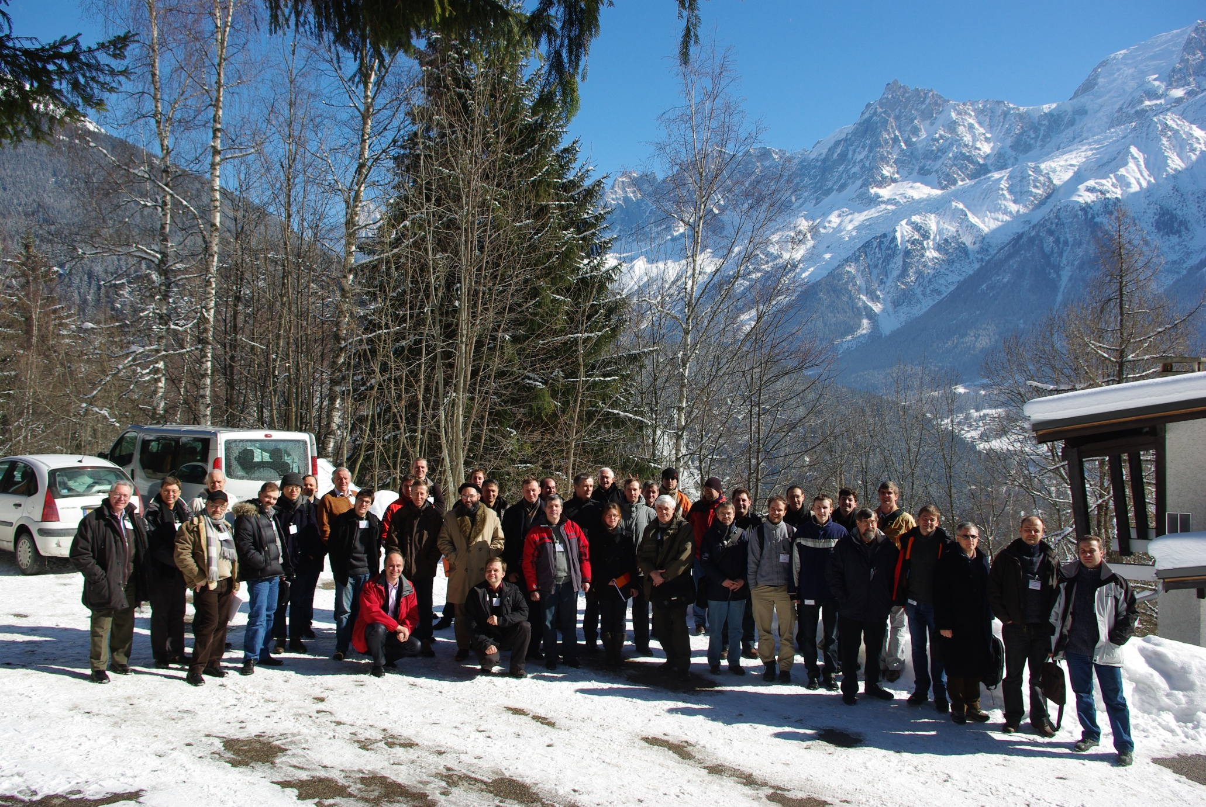
GRANIT-2010 Workshop 14-19 February 2010, Les Houches, France
Countries ~12
Europe, Asia, USA, Australia
Proceedings to appear soon in Les Comptes Rendus Academie des Science
Participants ~80
Countries ~12
Europe, Asia, USA, Australia
11.10.11
11.10.11
V.V. Nesvizhevsky

Slide 5
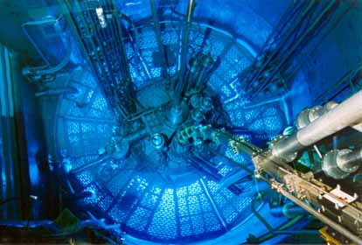
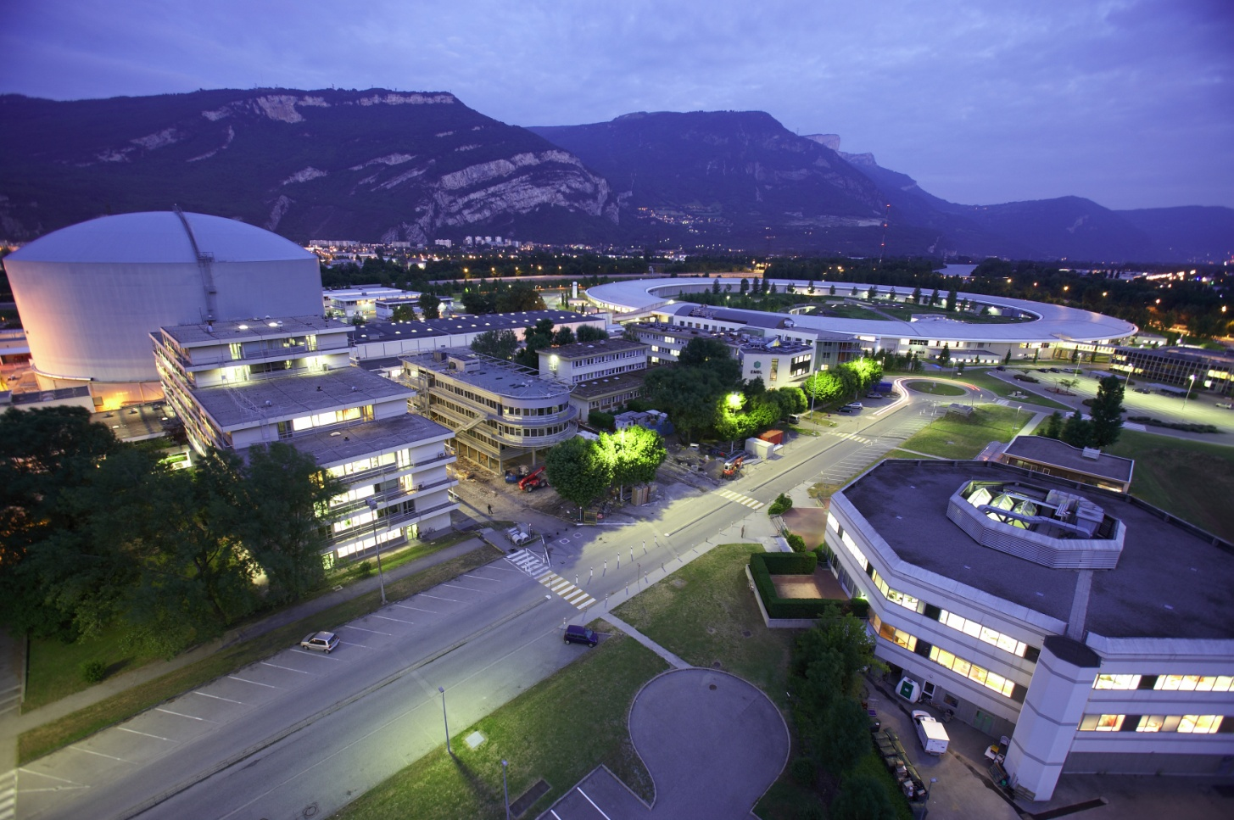
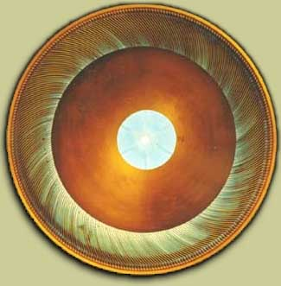
Neutron: The European Center for Neutron Research, Grenoble. The largest worldwide research reactor
ESRF
ILL
EMBL
11.10.11
11.10.11
V.V.Nesvizhevsky

Slide 6
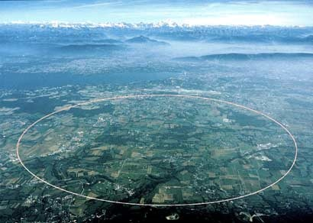
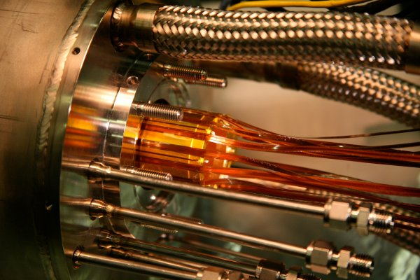
Anti-hydrogen: The European Organization for Nuclear Research, Geneve. The largest worldwide particle accelerator
11.10.11
11.10.11
V.V.Nesvizhevsky

Slide 7
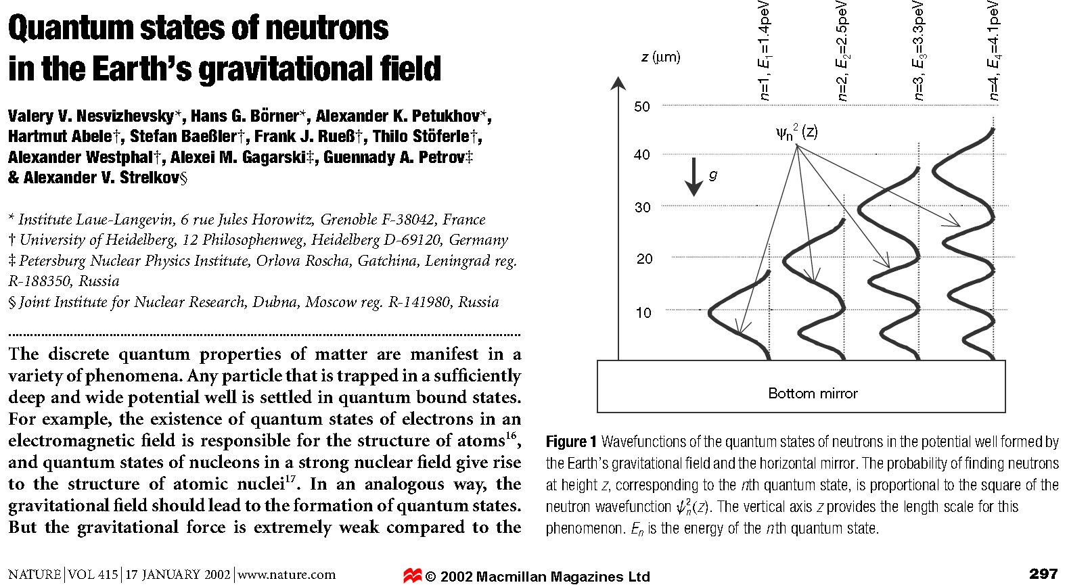

Gravitational quantum states of ultracold neutrons (UCN)
11.10.11
V.V. Nesvizhevsky

Slide 8
Choosing a quantum system
Electrical neutrality (usually gravitational interaction of an object with a surface is much weaker than other interactions)
Long life-time
Small mass
Energy (effective temperature) of UCN, or an atom, is extremely low; it is not equal to the surface temperature (the effective temperature of a particle in gravitational quantum states is ~10⁻⁸K)
A particle avobe a mirror in the gravity field: An ultracold neutron (V.I. Luschikov, A.I. Frank « Quantum effects occuring when ultracold neutrons are stored on a plane », JETP Lett. 28 (1978) 759) and … an anti-hydrogen atom (A.Yu. Voronin, P. Froelich, V.V. N. « Gravitational quantum states of antihydrogen », Phys. Rev. A 83 (2011) 032903) (a mirror represents a nearly infinitely-high and sharp potetial step)
Energy of quantum states, in the Bohr-Zommerfeld approximation, equals :
11.10.11
V.V. Nesvizhevsky

Slide 9
Choosing a quantum system
A neutron is reflected from the effective nuclear-optical potential of matter due to averaging of its interaction with a huge number of nuclei in matter
An anti-matter (matter) atom is reflected from the van der Waals/ Casimir-Polder (vdW/CP) potential appearing due to polarization of the anti-hydrogen atom and the surface atoms
A(n) (anti)-particle avobe a mirror in the gravity field
11.10.11
V.V. Nesvizhevsky

Slide 10
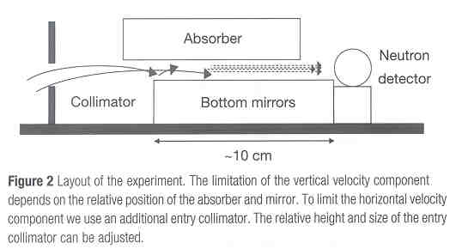
The experimental installation and the method used in the first neutron experiment
V.V. N., H.G. Borner, A.K. Petukhov, H. Abele, S. Baessler, F.J. Ruess, Th. Stoferle, A. Westphal, A.M. Gagarski, G.A. Petrov, A.V. Strelkov « Quantum states of neutrons in the Earth’s gravitational field », Nature 415 (2002) 297; V.V. N., H.G. Boerner, A.M. Gagarski, A.K. Petukhov, G.A. Petrov, H. Abele, S. Baessler, G. Divcovic, F.J. Ruess, Th. Stoeferle, A. Westphal, A.V. Strelkov, K.V. Protasov, A.Yu. Voronin, « Measurement of quantum states of neutrons in the Earth’s gravitational field », Phys. Rev. D 67 (2003) 102002.
V_{vert}~2 cm/s
V_{horiz}~4-15 m/s
Selection and measurement of the vertical and horizontal velocity components:
The maximum vertical velocity is defined by the scatterer/absorber height above the mirror
The range of horizontal velocities is defined by the relative position of plates in the entrance collimator and the slit between the mirror and the scatterer
11.10.11
V.V. Nesvizhevsky

Slide 11
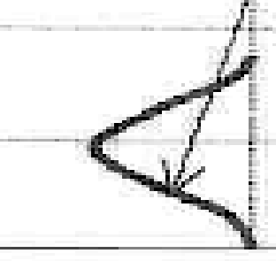
The experimental installation and the method Model of tunneling through a gravitational barrier
V.V. N., A.K. Petukhov, H.G. Boerner, T.A. Baranova, A.M. Gagarski, G.A. Petrov, K.V. Protasov, A.Yu. Voronin, S. Baessler, H. Abele, A. Westphal, L. Lucovac, « Study of the neutron quantum states in the gravity field », Europ. Phys. J. C 40 (2005) 479; A. Yu. Voronin, H. Abele, S. Baessler, V.V. Nesvizhevsky, A.K. Petukhov, K.V. Protasov, A. Westphal, « Quantum motion of a neutron in a waveguide in the gravitational field », Phys. Rev. D 73 (2006) 044029.
11.10.11
V.V. Nesvizhevsky

Slide 12
« Integral » method; soft spectrum
V.V. N., A.K. Petukhov, H.G. Boerner, T.A. Baranova, A.M. Gagarski, G.A. Petrov, K.V. Protasov, A.Yu. Voronin, S. Baessler, H. Abele, A. Westphal, L. Lucovac, « Study of the neutron quantum states in the gravity field », Europ. Phys. J. C 40 (2005) 479.
Detector count rate, 1/s
Slit size, microns
μm
11.10.11
V.V. Nesvizhevsky

Slide 13

« Differential » method, position-sensitive detectors
A method to increase the spatial variation of the density probability
3
4
1
2
11.10.11
V.V. Nesvizhevsky

Slide 14
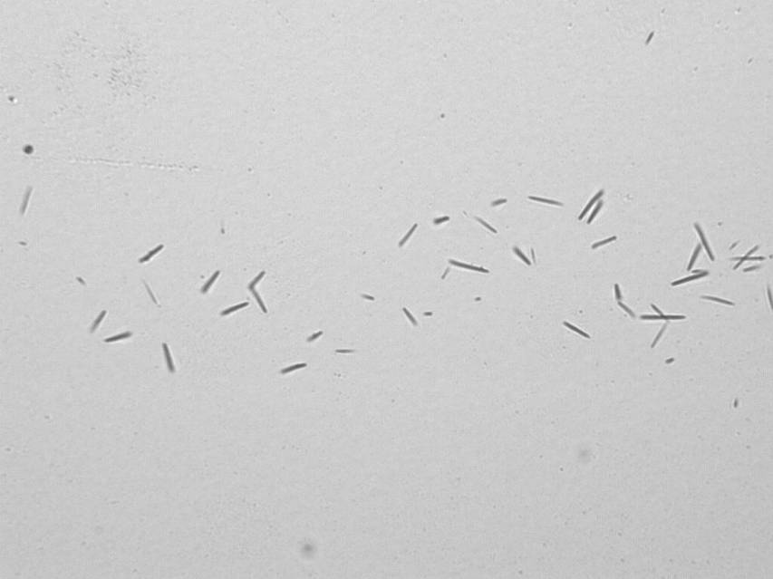
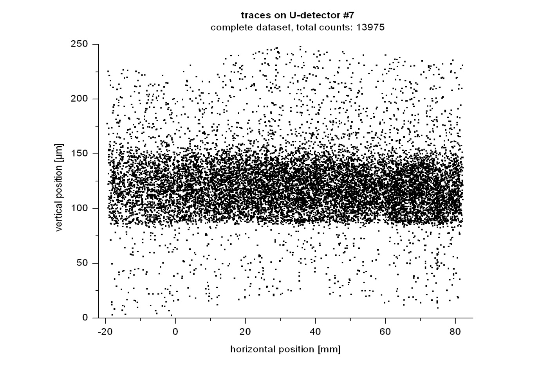
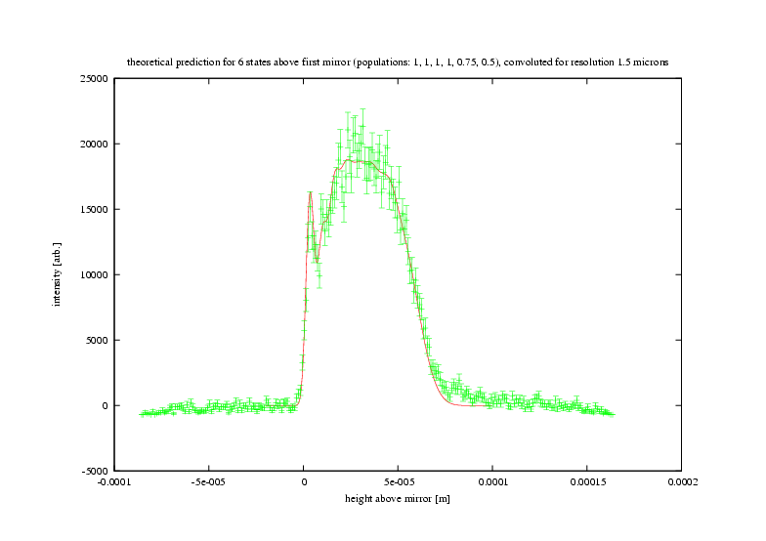
« Differential » method, position-sensitive detectors
A method to increase the spatial variation of the density probability
11.10.11
V.V. Nesvizhevsky

Slide 15
Transitions between gravitational quantum states
Remember: flow-through mode; modest energy resolution
Transitions could be excited, for instance:
- By periodically varying magnetic field gradient;
By periodically varying local gravitational field;
By oscillating mechanically the mirror
V.V. N., K.V. Protasov, « Quantum states of neutrons in the Earth’s gravitational field : state of the art, applications, perspectives », Ed. Book on Trends in Quantum Gravity Research (NOVA science publishers, New York, 2006).
Now: storage mode, long observation time and high energy resolution
Probability of transition
Perturbation frequency, Hz
11.10.11
V.V. Nesvizhevsky

Slide 16
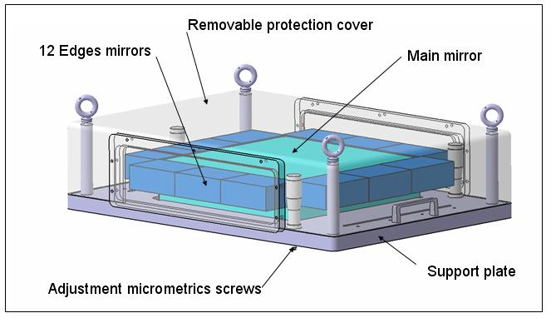
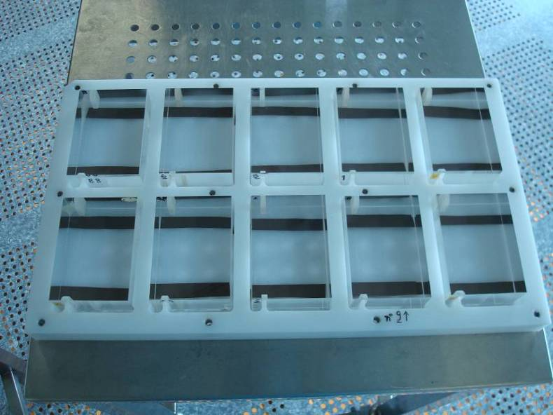
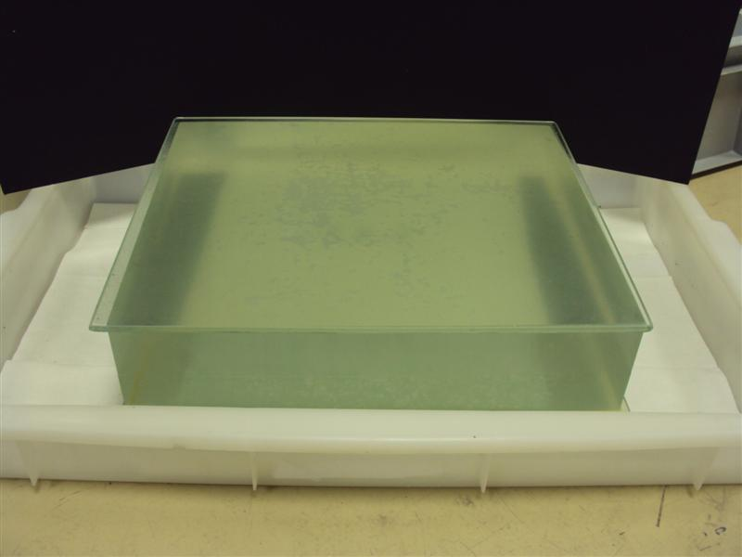
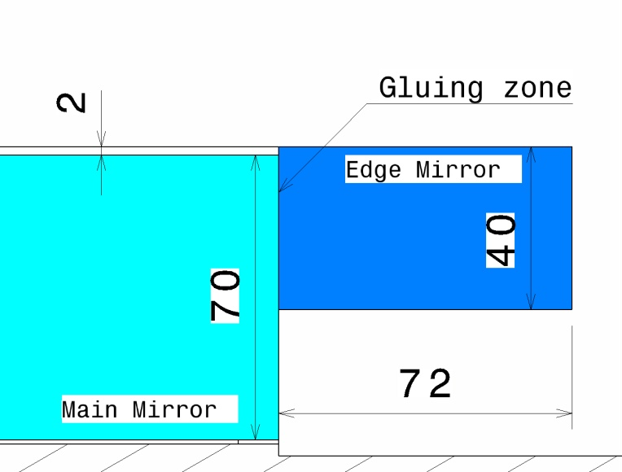
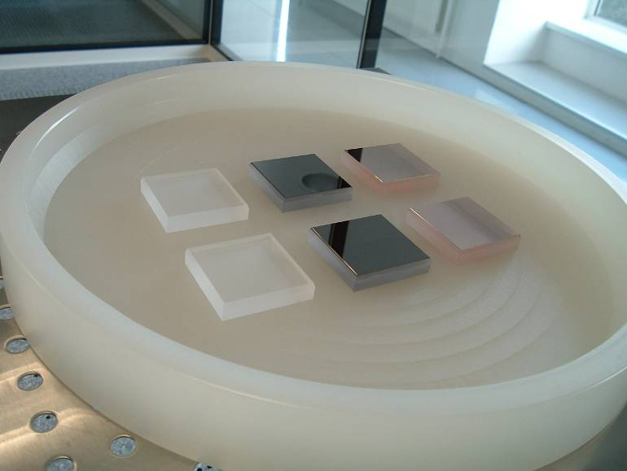
Transitions between gravitational quantum states Quantum trap 30cm by 30cm; Height of edges 0.5mm
Main Mirror-Edges
Main Mirror
11.10.11
V.V. Nesvizhevsky

Slide 17
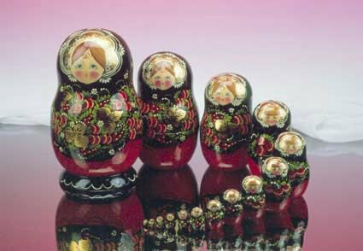
GRANIT Assembling the spectrometer
11.10.11
V.V. Nesvizhevsky
Notes:
17

Slide 18
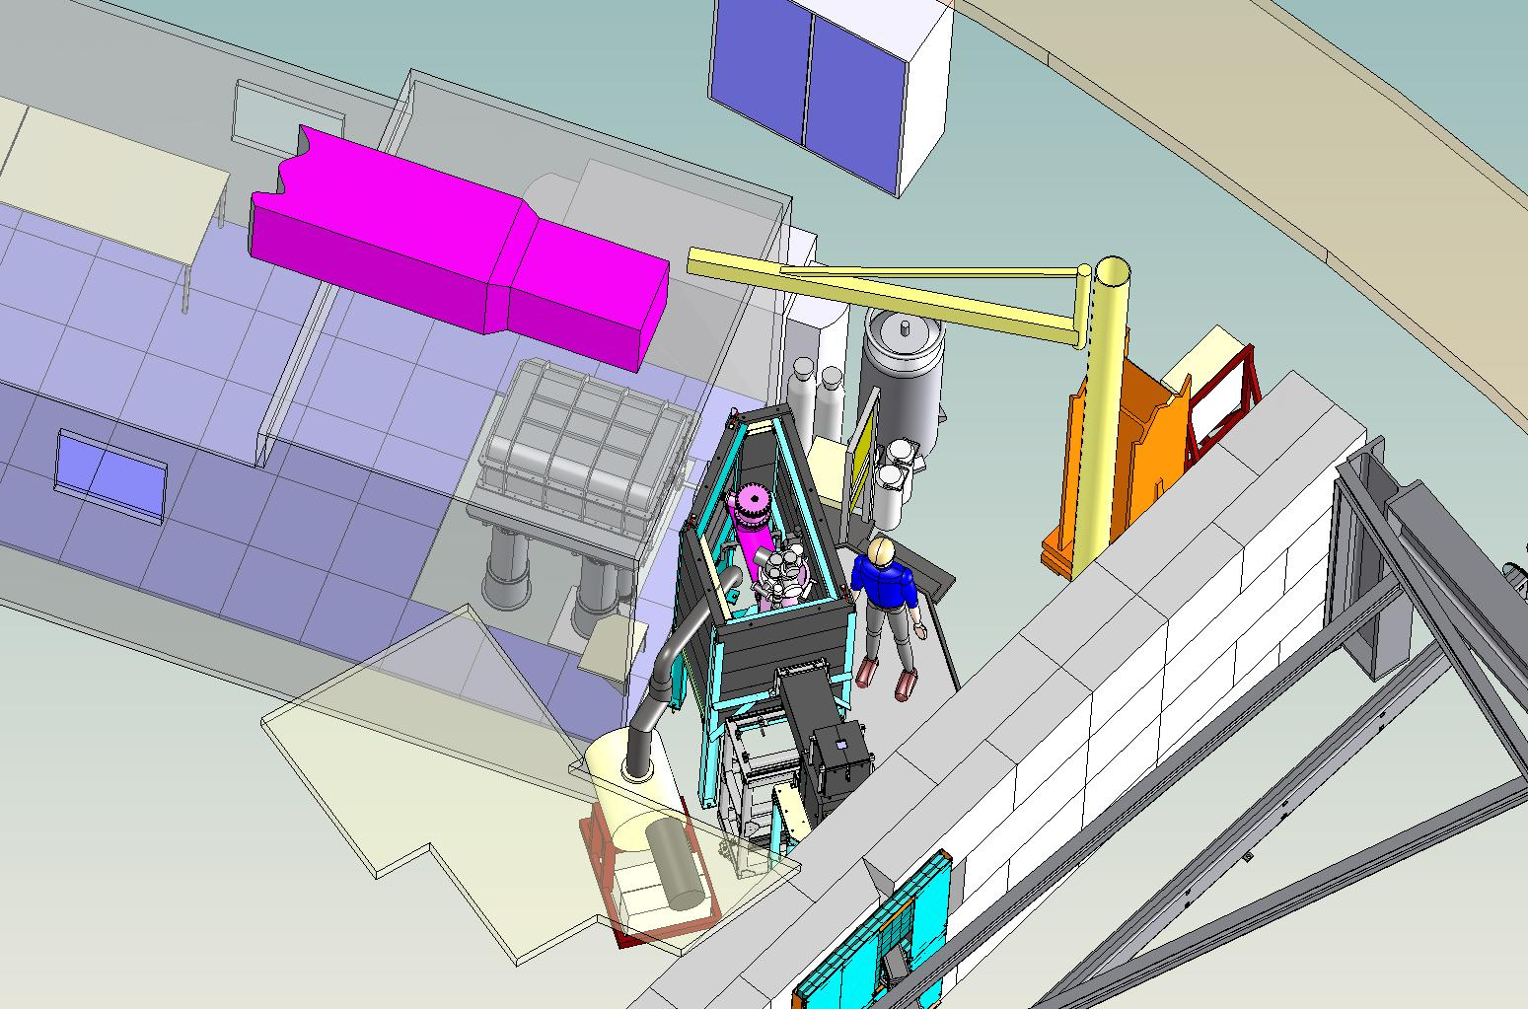
Installation of GRANIT spectrometer at the level C at ILL
11.10.11
V.V. Nesvizhevsky
Notes:
18

Slide 19
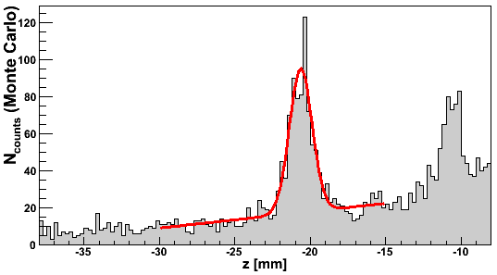
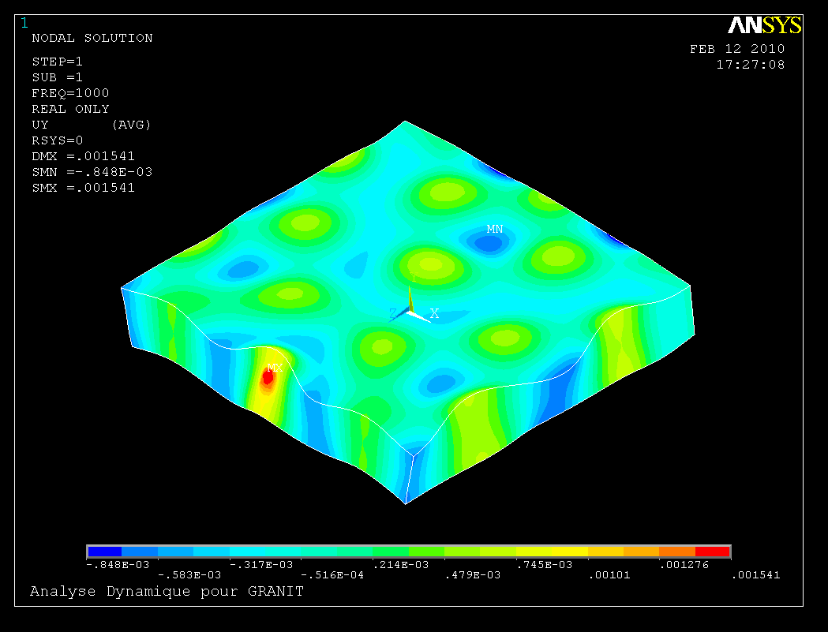
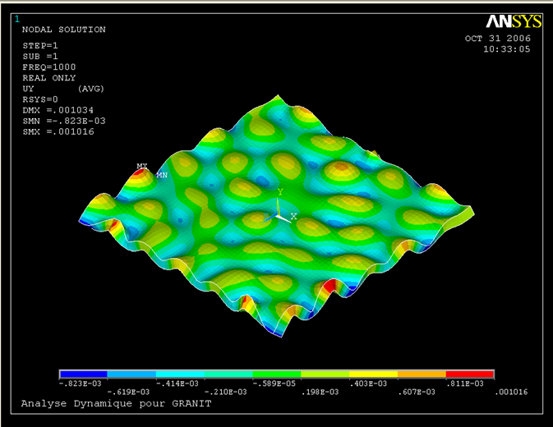
GRANIT on methods of excitation the transitions
Magnetic holding field B₀
2. Induce transitions in periodic magnetic field gradient
4. Measure horizontal velocity in position-sensitive detector
1. Prepare initial state,
ground state suppressed
3. Filter ground state
1 cm
New UCN
Source
1 mm
Position-sensitive Detector
Bottom mirror
11.10.11
V.V. Nesvizhevsky
Notes:
19

Slide 20
Applications
The phenomenon of gravitational quantum states of neutrons could be used in various applications, as apriory it provides a very « clean » system with well-defined quantum states.
Contraints for short-range forces;
Constrains for axion-like forces;
Constrains for neutron electric charge;
Neutron quantum optics;
UCN reflectometry;
Quantum revivals;
Constrains for a logarithmic term in the Schrödinger equation;
Loss of quantum coherence;
UCN extraction, transport, tight valves;
-Study of thin surface layers;
etc....
11.10.11
V.V. Nesvizhevsky

Slide 21
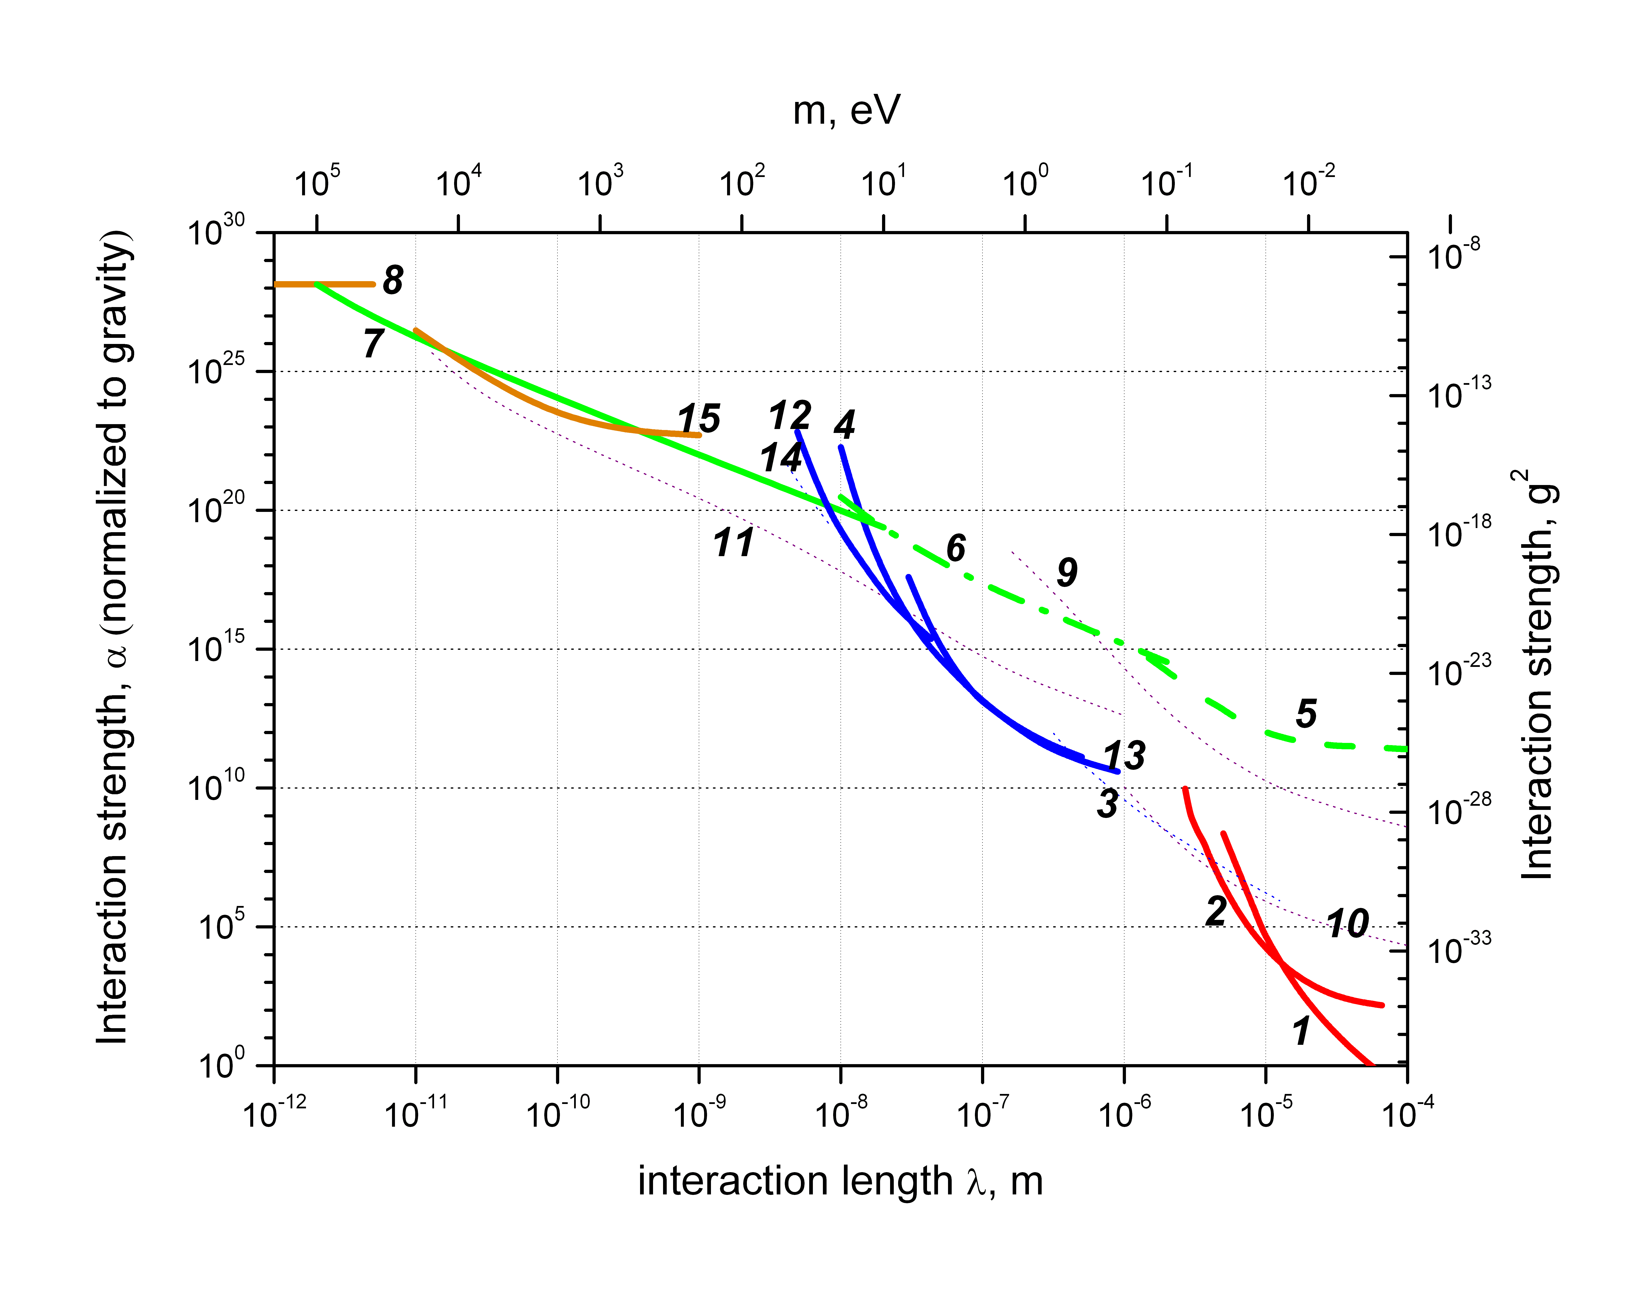
Constrains for short-range forces
I. Antoniadis, S. Baessler, M. Buchner, V.V. Fedorov, S. Hoedl, V.V. N., G. Pignol, K.V. Protasov, S. Reynaud, Yu. Sobolev, « Short-range fundamental forces », Compt. Rendu Acad. Sci (2011) accepted.
11.10.11
V.V. Nesvizhevsky

Slide 22
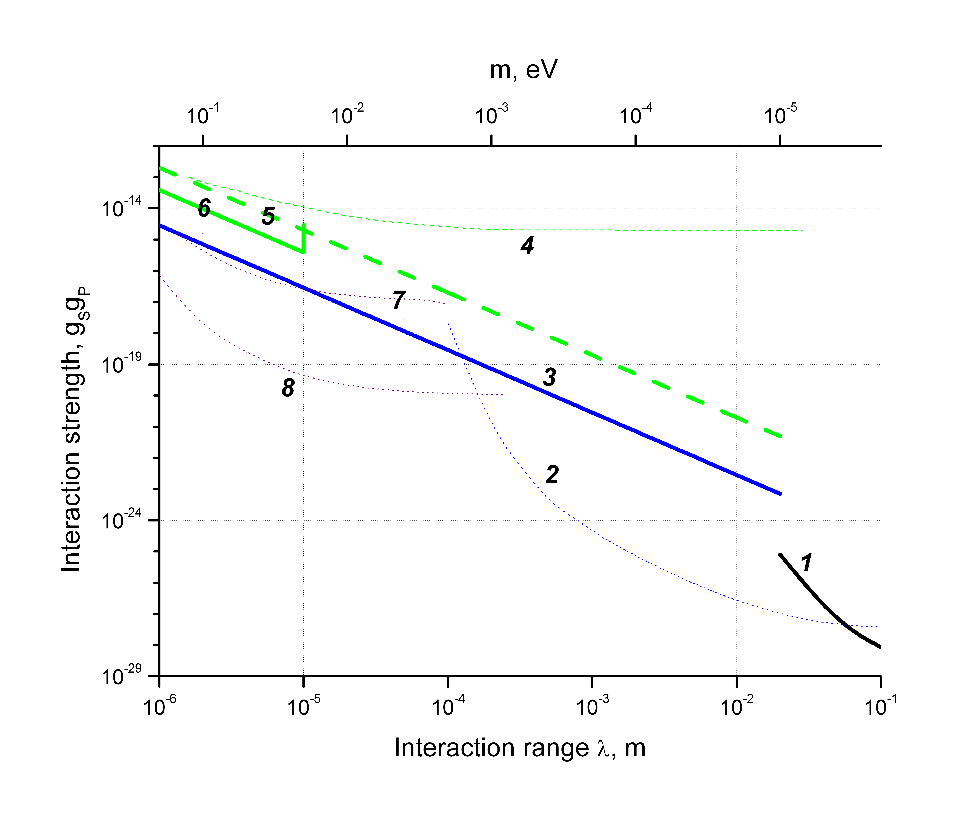
Constrains for short-range forces
I. Antoniadis, S. Baessler, M. Buchner, V.V. Fedorov, S. Hoedl, V.V. N., G. Pignol, K.V. Protasov, S. Reynaud, Yu. Sobolev, « Short-range fundamental forces », Compt. Rendu Acad. Sci (2011) accepted.
11.10.11
V.V. Nesvizhevsky

Slide 23
Numerous follow-up projects and technical developments to study gravitational quantum states of neutrons
T. Sanuki, S. Komamiya, S. Kawasaki, S. Sonoda, « Proposal for measuring the quantum states of neutrons in the gravitational field with a CCD-based pixel sensor », NIM A 600 (2009) 657.
J. Jakubek, Ph. Schmidt-Wellenburg, P. Geltenbort, M. Platkevic, Ch. Plonka-Spehr, J. Solc, T. Soldner, « A coated pixel device TimPix with micron spatial resolution for UCN detection », NIM A 600 (2009) 651.
J. Jakubek, M. Platkevic, Ph. Schmidt-Wellenburg, P. Geltenbort, Ch. Plonka-Spehr, M. Daum, « Position-sensitive spectroscopy of ultra-cold neutrons with Timepix pixel detector », NIM A 607 (2009) 45.
H. Abele, T. Jenke, D. Stadler, P. Geltenbort, « QuBounce: the dynamics of ultracold neutrons falling in the gravity potential of the Earth », Nucl. Phys. A 827 (2009) 593.
T. Jenke, T. Stadler, H. Abele, P. Geltenbort, « Q-Bounce-experiments with quantum bouncing ultracold neutrons », NIM A 611 (2009) 318.
S. Kawasaki, G. Ichikawa, M. Hino, Y. Kamiya, M. Kitaguchi, S. Komamiya, T. Sanuki, S. Sonoda, « Development of a pixel detector for ultracold neutrons », NIM A 615 (2010) 42.
T. Jenke, P. Geltenbort, H. Lemmel, H. Abele, « Realization of a gravity-resonance-spectroscopy technique », Nature Phys. 7 (2011) 468.
11.10.11
V.V. Nesvizhevsky

Slide 24
Feasibility of analogous experiments with anti-hydrogen
A.Yu. Voronin, P. Froelich, V.V. N. « Gravitational quantum states of antihydrogen », Phys. Rev. A 83 (2011) 032903
Similarities:
1. The anti-hydrogen mass is about equal to the neutron mass
2. Modifications, due to vdW/CP potential, of the anti-hydrogen quantum states energies and wave-functions are negigible
3. Lifetimes of anti-hydrogen in quantum states are of the order of 0.1 s that is even longer than the time of UCN passage through the setup used for the first neutron experiment
4. Projected anti-hydrogen velocities are even smaller than typical UCN velocities.
5. Projected anti-hydrogen phase-space densities are even larger than the highest UCN densities available.
6. But: effects of parasitic electromagnetic fields to anti-hydrogen atoms are much larger than those to neutrons! Should not be overlooked, but looks very promissing.
11.10.11
V.V. Nesvizhevsky

Slide 25
Conclusion (on gravitational quantum states)
First observation of quantum states of UCN in the gravitational field above a mirror; first demonstration (and still the only one!) of quantum states of matter in a gravitational field
Applications in fundamental and surface physics
New gravitational spectrometer GRANIT, with all parameters improved by many orders of magnitude compared to the first setup, is going to become operational this year
Such an experiment is feasible with anti-hydrogen
The GRANIT spectrometer could be used for one-to-one prototyping of an experiment measuring quantum states of anti-hydrogen atoms
,
11.10.11
V.V. Nesvizhevsky

Slide 26
Comparison of centrifugal and gravitational quantum states
Gravity / Acceleration
g
Effective acceleration could be varied by varying the particle velocity and the mirror radius
A particle above a mirror in the gravity field
The energy of quantum states in the Bohr-Zommerfeld approximation :
11.10.11
V.V. Nesvizhevsky
Notes:
26

Slide 27
Neutron whispering gallery
V.V. N., A.K. Petukhov, K.V. Protasov, A.Yu. Voronin, «Centrifugal quantum states of neutrons », Phys. Rev. A 78 (2008) 033616;
R. Cubitt, V.V. N., A.K. Petukhov, A.Yu. Voronin, G. Pignol, K.V. Protasov, « Methods of observation of the centrifugal quantum states of neutrons », NIM A 611 (2009) 322;
V.V. N., A.Yu. Voronin, R. Cubitt, K.V. Protasov, « Neutron whispering gallery », Nature Physi. 6 (2010) 114;
V.V. N., R. Cubitt, K.V. Protasov, A.Yu. Voronin, « The whispering gallery effect in neutron scattering », New J. Phys. 6 (2010) 113050.
11.10.11
V.V. Nesvizhevsky

Slide 28
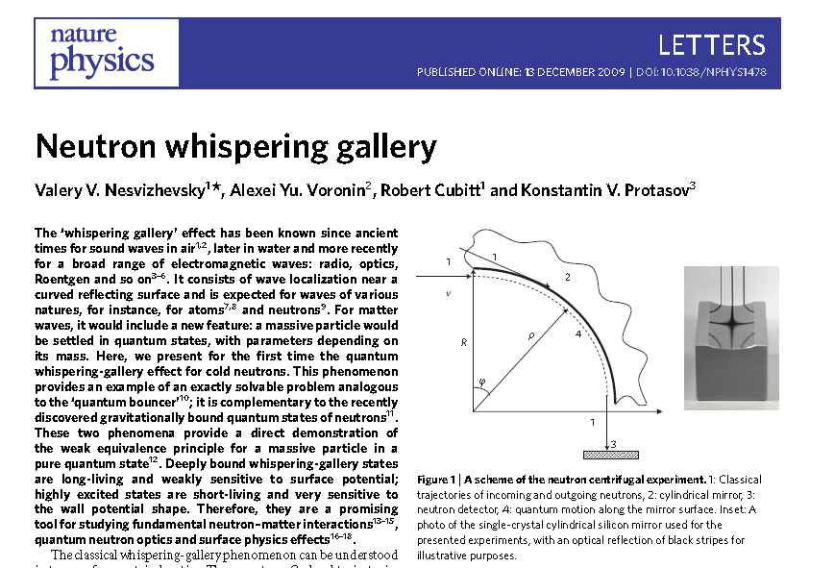
Neutron whispering gallery
Nature Physics, 6, 114-117 (2010)
11.10.11
V.V. Nesvizhevsky

Slide 29
Neutron whispering gallery
Massive particle, sliding along a curved mirror surface is settled, under certain conditions, in quasi-stationarry quantum states
Such a phenomenon has been considered (but not yet observed) for ultracold atoms:
- Mabuchi H. & Kimble H.J. Atom galleries for whispering atoms – binding atoms in stable orbits around an optical resonator. Opt. Lett. 19, 749-751 (1994).
- Vernooy D. M. & Kimble H.J. Quantum structure and dynamics for atom galleries. Phys. Rev. A 55, 1239-1261 (1997).
Characteristic parameters
Cold neutrons with a velocity of ~10³ m/s, sliding along a cylindrical mirror with a radius of a few cm
11.10.11
V.V. Nesvizhevsky
Notes:
29

Slide 30
Neutron whispering gallery
Two « independent » velocity components
If the characteristic size of quantum states and the quasi-classical distance between two collisions are much smaller than the mirror radius then tangential and longitudal motions could be separated
Effective centrifugal acceleration
11.10.11
V.V. Nesvizhevsky
Notes:
30

Slide 31
Methods of observation
Life-times of quasi-stationary states due to tunneling change rapidly as a function of the neutron energy
60
45
60
45
U, (neV)
U, (neV)
30
15
30
15
N=2
N=1
-200 -100 0 100 200
-200 -100 0 100 200
Tunneling
R-ρ, (nm)
λc
R-ρ, (nm)
λ>λc
11.10.11
V.V. Nesvizhevsky
Notes:
31

Slide 32
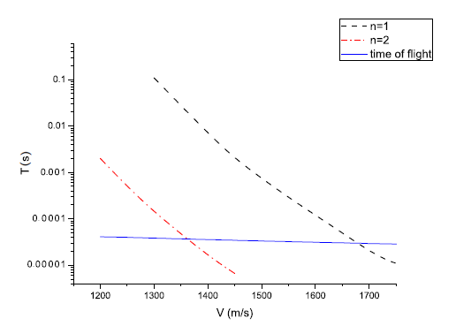
Methods of observation
Life-times of quasi-stationary states due to tunneling change rapidly as a function of the neutron energy
11.10.11
V.V. Nesvizhevsky
Notes:
32

Slide 33

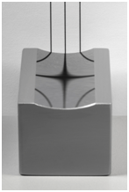
Methods of observation
1
2
V
4
R
ρ
5
ϕ
3
D17 instrument at the ILL
The tangential neutron velocity is defined by the time-of-flight method;
The scattering angle (the radial velocity) is measured in a position-sensitive neutron detector.
1
3
Neutrons entering from edge of a truncated cylindrical mirror
11.10.11
V.V. Nesvizhevsky
Notes:
33

Slide 34
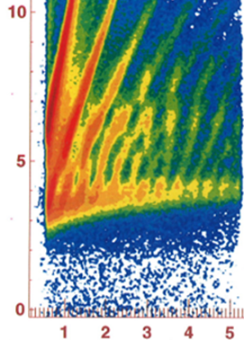
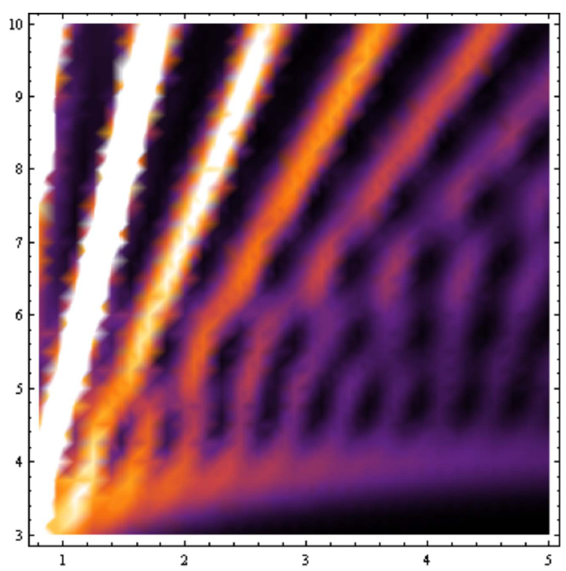
Results: NEUTRON RAINBOW
Neutrons tunneling OUT of quantum states
Neutrons populate quantum states states through the entrance edge of a truccated cylinder and tunnel out through the triangular potential barrier
11.10.11
V.V. Nesvizhevsky
Notes:
34

Slide 35
Results: NEUTRON RAINBOW
Neutrons entering from the mirror edge
b=0
Experiment
Theory
The interference pattern is very sensitive to surface potential shapes even for small angular size of the mirrors; 3.95 degrees in this case
b=4nm

Slide 36
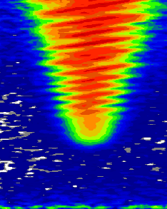


Results: NEUTRON RAINBOW
Experiment
Theory
Neutrons populate quantum states states through the entrance edge of a truccated cylinder and are counted behind the exit edge
Neutrons entering from the mirror edge
Experiment
11.10.11
V.V. Nesvizhevsky
Notes:
36

Slide 37
Results: NEUTRON RAINBOW
1
2
V
4
R
ρ
5
ϕ
3
1
3
Constrain for fundamental short-range forces from the neutron whispering gallery experiment
11.10.11
V.V. Nesvizhevsky
Notes:
37

Slide 38
Conclusion (on centrifugal quantum states)
First observation of quasi-stationary quantum states of cold neutrons in vicinity of curved mirror surface: neutron whispering gallery
First direct demonstration of the weak equivalence for an object in a quantum state.
Long lifetimes of neutrons in the quantum states allow us to use this phenomenon for precision studies of surface potentials and probably for constraining fundamental short-range potentials
Such an experiment is feasible with anti-hydrogen
The GRANIT spectrometer could be used for one-to-one prototyping of an experiment measuring quantum states of anti-hydrogen atoms
11.10.11
V.V. Nesvizhevsky
Notes:
38

Slide 39
Conclusion
The first observation of quasi-stationary quantum states of cold neutrons in vicinity of a curved mirror surface: neutron whispering gallery
The first direct demonstration of the Weak equivalence of the General Relativity for an object in a quantum state.
Long lifetimes of neutrons in the quantum states allow us to use this phenomenon for precision studies of surface potentials and for constraining fundamental short-range potentials
11.10.11
V.V. Nesvizhevsky
Notes:
39

