Slide 1
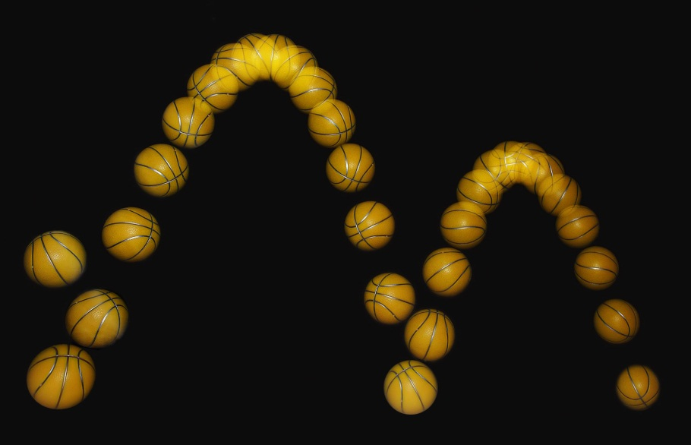
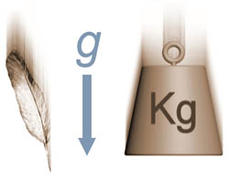
ANTIHYDROGEN
Gravitational States above material surface
A. Voronin P.Froelich V.Nesvizhevsky

Slide 2
Antihydrogen Gravitational Quantum states =
Quantization of antiatom motion in the superposition of Earth gravity and material plane potential
Almost similar to neutron gravitational states
V.V. Nesvizhevsky et al., Nature 415, 297 (2002)

Slide 3
Motivation
Access to high precision measurement of Gravitational Properties of Antimatter
Antimatter confined in quantum states near material surface = access to “extra” forces between matter and antimatter at the scale of gravitational quantum states ( micrometers)

Slide 4
Gravitational states of AntiHydrogen
What happens to AntiHydrogen when it is dropped on the floor?
Bouncing!

Slide 6
Quantum reflection=
J. E. Lennard-Jones, Trans. Faraday Soc. 28, 333 1932.
Reflection from the fast changing attractive potential

Slide 7
Casimir-Polder potential

Slide 9
Full absorption & Reflection

Slide 10
On-Wall Annihilation Probability
1.0
0.8
0.6
0.4
0.2
0.0
-16
-14
-12
-10
-8
Ln E/eV

Slide 11
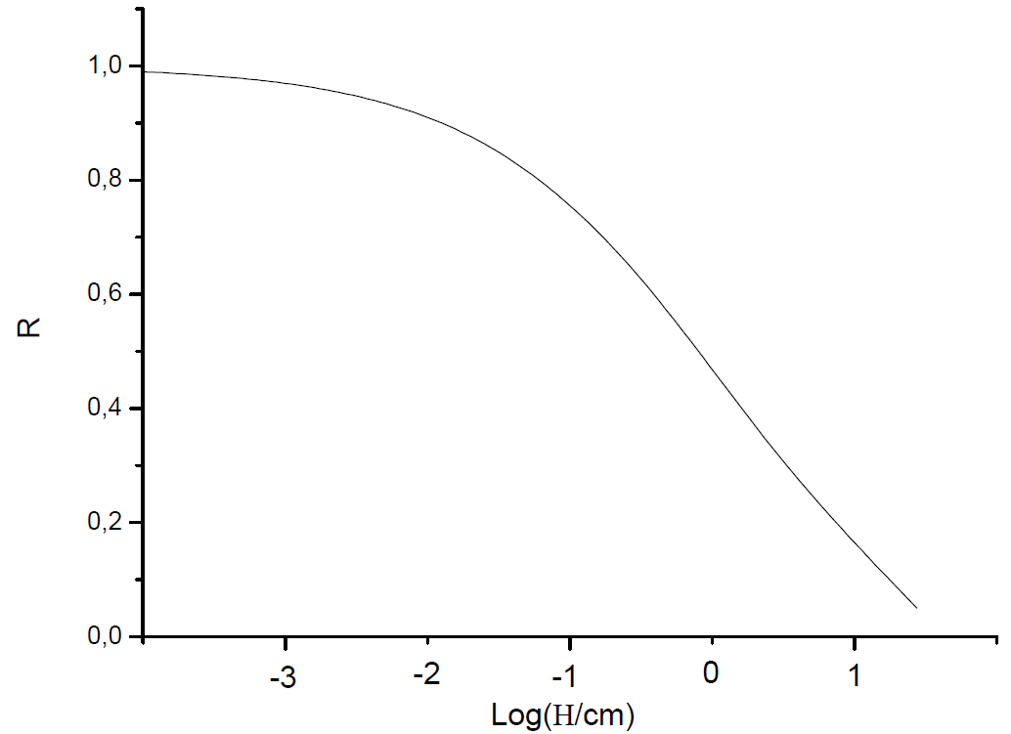
From which height can we drop antihydrogen?
10μm = 97%
Silica-by S.Reynaud et al.
0.1cm = 89%
0.1cm = 77%
1cm = 73%
1cm = 45%
10cm = 32%
10cm = 14%

Slide 12
Ultracold Antihydrogen between conducting walls
Ψ(z)
van der Waals-Casimir potential
Annihilation

Slide 13
Quantum reflection
Over-barrier Reflection from the fast changing attractive potential

Slide 14
Antihydrogen:
quantum reflection + absorption core

Slide 15
Where reflection takes place

Slide 16
On-Wall Annihilation Probability
T=3 10⁻⁶ K
Quantum reflection states
Ψ(z)
van der Waals-Casimir potential
Annihilation

Slide 17
Ultracold Antihydrogen between conducting walls
Quantum reflection states
One-dimensional cavity

Slide 18
Antihydrogen in a wave-guide
Detector
S
v
τ=S/V
L

Slide 19
Quantum states in the gravitational field of Earth
Nesvizhevsky V.V. et. al. Nature 415, 297 (2002)

Slide 20
Gravitational Neutron states – The experiment
Nesvizhevski et al. Nature 415, 297 (2002)
Slit Height Measurement
Inclinometers
Collimator
Absorber/Scatterer
Neutron
detector
UCN
Bottom mirrors
~10-12 cm
Anti-Vibrational Feet
Count rates at ILL turbine: ~1/s to 1/h
Effective (vertical) temperature of neutrons is ~20 nK
Background suppression is a factor of ~10⁸-10⁹
Parallelism of the bottom mirror and the absorber/scatterer is ~10⁻⁶

Slide 21
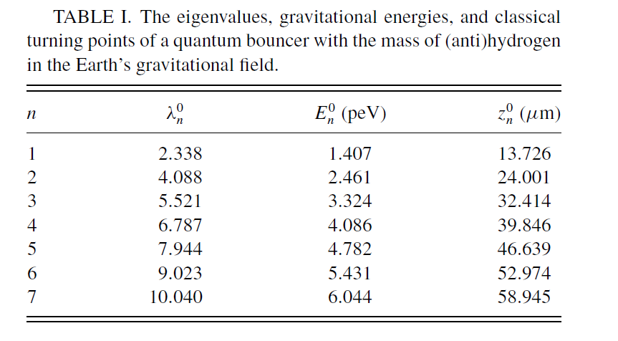
Gravitational states
Antihydrogen bouncing on a surface
ε₂
Mgz
ε₁
V(z)
z

Slide 22
Quantum states in the gravitational field of Earth

Slide 23
Correction by Casimir-Polder potential + annihilation
ε₂
Mgz
ε₁
V(z)
z

Slide 24
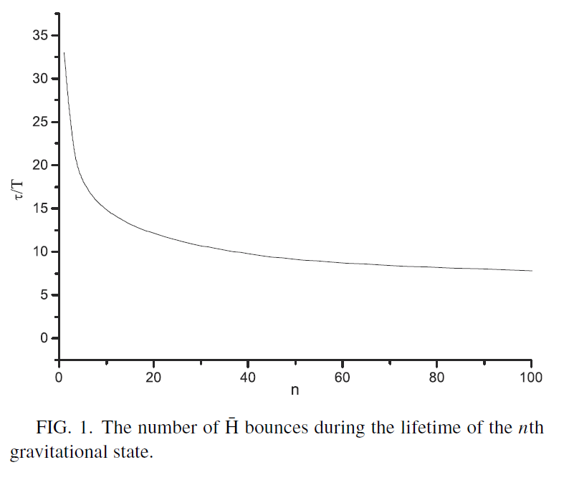


When gravitational states are still defined?
$${ τ/T_{n}}\text{>1}$$
$R=\exp\left(−\frac{T_{n}}{τ}\right) τ/T_{n}$>1
Ln(R(n))<1
n<30 000

Slide 25
EP in Classical Mechanics

Slide 26
Quantum EP

Slide 27
Results with the Position-Sensitive Detector
´300
Neutron counts
´200
Position-sensitive detector
Absorber
´100
Bottom mirrors
0
0
10
20
30
40
50
60
70
Height above the mirror [μm ]

Slide 28

Antihydrogen “clock”

Slide 29
Antihydrogen “clock” temporal-energy properties of gravitational states
V
S

Slide 30
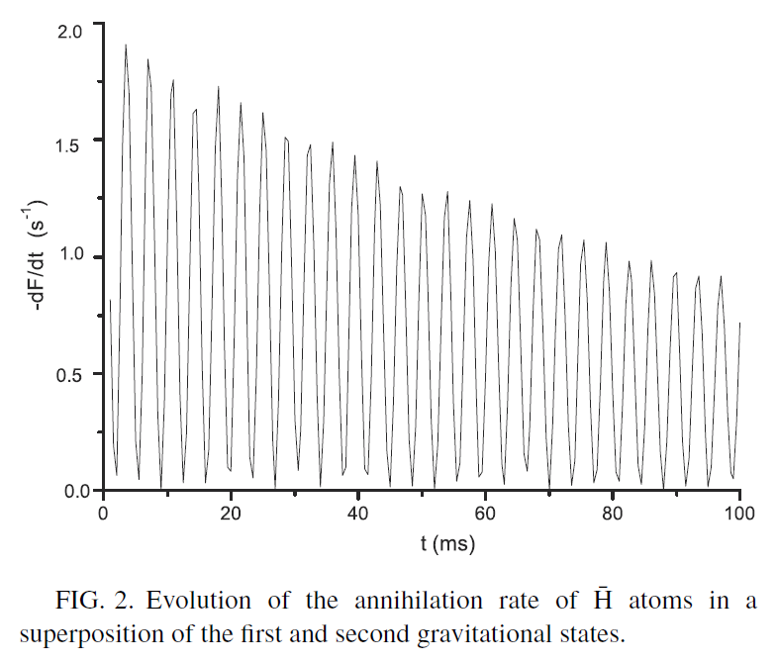

Bouncing Antihydrogen 2 states
$ω_{12}$= ${(λ}_{2}$-$λ_{1}$) $ε_{0}$=254.54 Hz

Slide 31
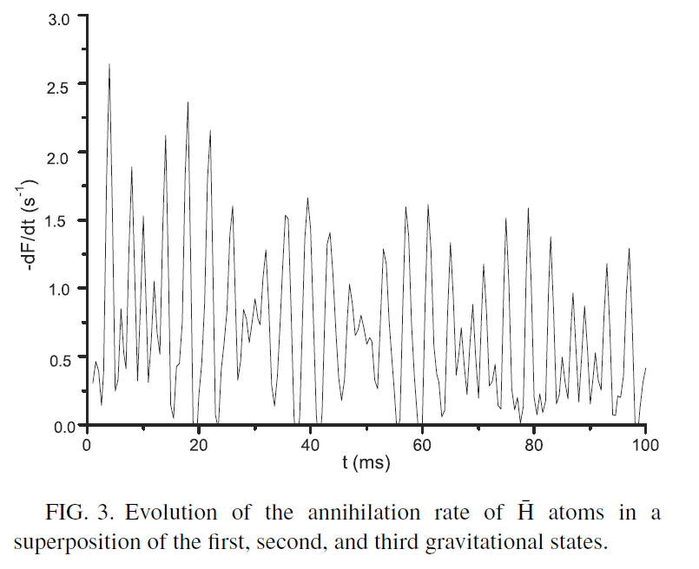
Bouncing antihydrogen 3 states
3-level system “feels” the gradient of gravitational field

Slide 32
Bouncing antihydrogen semiclassical case
Superposition of states with 8<n<12. Semiclassical period T=7.2 ms

Slide 33
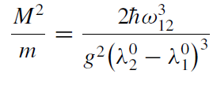
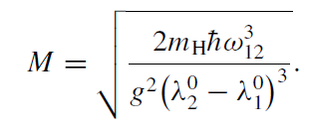
Quantum EP

Slide 34
RESONANCE SPECTROSCOPY of Gravitational States
Studied by V.Nesvizhevsky et. al in connection with neutron gravitational states
Induced resonance transitions :
Gradient magnetic field
Oscillating bottom mirror
h₃
h₂
h₁

Slide 35
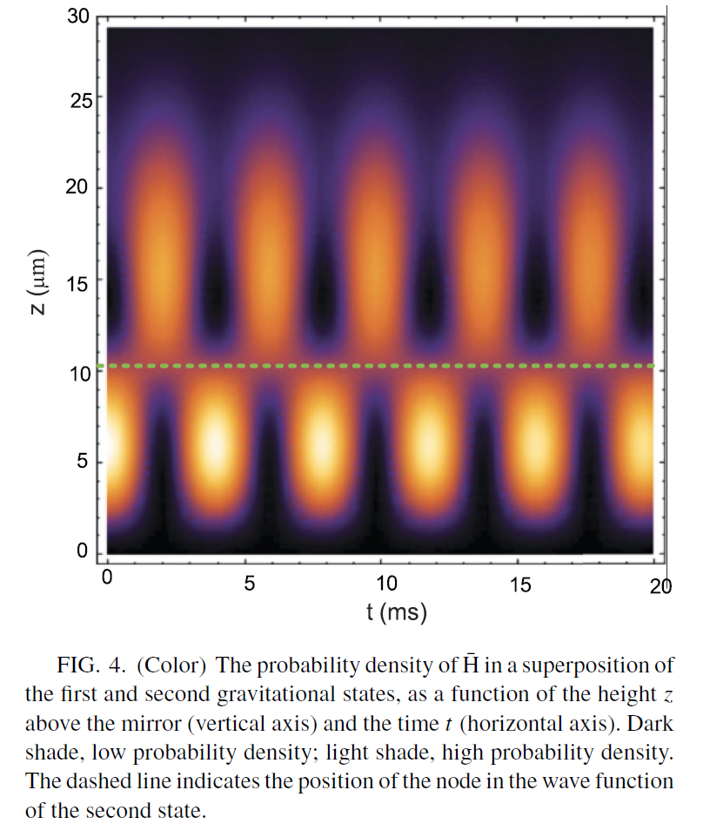

Quantum ballistic experiment spatial properties of gravitational states
V
S
$z_{1,2}$= ${(λ}_{2}$-$λ_{1}$) $l_{0}$=10.27 μm

Slide 36
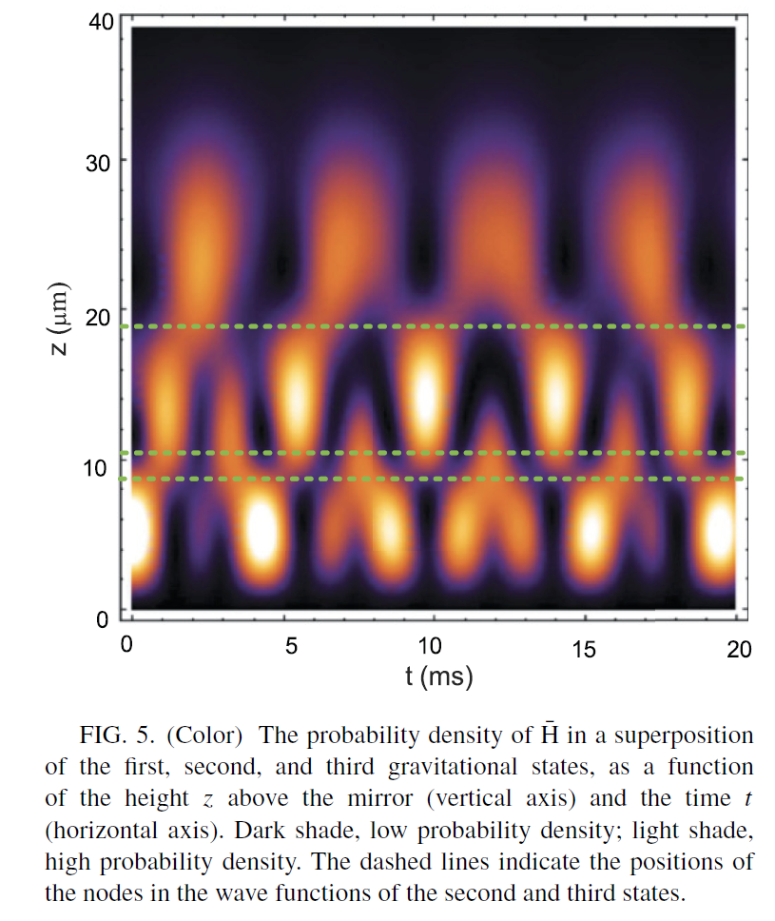

Slide 37
Gravitational Force Measurement
V
S

Slide 38
Extra-short-range forces, mediated by light bosons?
Non-newtonian gravitation
Axion and others
Induce Yukawa –type interaction between fermion and media

Slide 39
Atom-Wall States
Casimir-Polder potential
Short-range repulsion

Slide 40
Axion-mediated macroscopic force

Slide 41
Exclusion Plot
1
0
-
1
2
Ni et al., 1999:
Hammond et al., 2007
1
0
-
1
5
Our limit
-
1
8
Ni et al., 1999
1
0
|g_{S}g_{P}|/ħc
-
2
1
S. Hoedl et al.,
prospect
1
0
1
0
-
2
4
Youdin et al., 1996
-
2
7
Heckel et al., 2006:
1
0
1
0
-
3
0
PVLAS
Heckel et al., 2006
1
0
-
6
1
0
-
4
1
0
-
2
1
0
0
λ [m]
Polarized Particle is an electron
Polarized Particle is a neutron

Slide 42
Atom-wall Resonances

Slide 43
Atom-wall Resonances

Slide 44
Conclusions
Ultracold Antihydrogen can be stored in traps with material walls
Quantum reflection+annihilation = method of Antiatoms Gravitational properties measurement
Antiatom localized at micrometer range near material surface in quantum states= access to extra forces

