Slide 1
One-day Meeting: fixed-target projects at CERN, 7 Juillet 2011
Chic @ SPS: Physics case
Elena G. Ferreiro
Universidade de Santiago de Compostela, Spain
E. G. Ferreiro USC Chic @SPS: Physics case IPN, 7 July 2011

Slide 2
Some definitions…
Charmonium: heavy quark bound states made of charm
J/Ψ meson: bound state of a charm quark and its antiquark
QGP: deconfined matter made of quarks and gluons, supposed
to exist in the first instants after Big Bang
The goal: search of a QGP in heavy-ions collisions (high T and density)
Looking for QGP signals:
unambiguous” signature of QGP Onset of quarkonia melting above a certain temperature / energy density threshold
Matsui & Satz, PLB178 (1986) 416
E. G. Ferreiro USC Chic @SPS: Physics case IPN, 7 July 2011
Notes:
the idea to use high energy nuclear collisions to
form small and short-lived bubbles of the quark-gluon plasma in the laboratory,

Slide 3
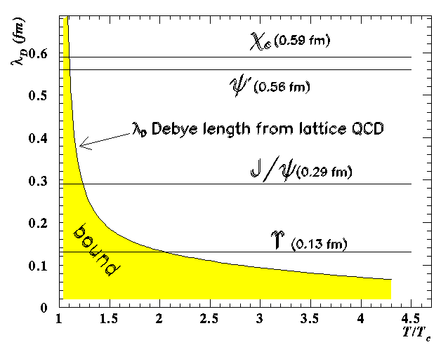
Motivation: the intringuing story of J/ψ production
Potential between q-anti-q pair
grows linearly at large distances
V(r)
Screening of long range confining potential at high enough temperature or density.
r
What happens when the range of the binding force becomes smaller than the radius of the state?
V(r)
different states “melting” at different temperatures due to different binding energies.
Matsui and Satz:
J/ψ destruction in a QGP by Debye screening
J/Ψ suppression = QGP signature
E. G. Ferreiro USC Chic @SPS: Physics case IPN, 7 July 2011

Slide 4
...but the story is not so simple
•Are there any other effects, not related to colour screening, that may induce a
suppression of quarkonium states ?
•Is it possible to define a “reference”(i.e. unsuppressed) process in order to properly
define quarkonium suppression ?
•Which elements should be taken into account in the design of an experiment looking
for quarkonium suppression?
•Do we understand charmonium production in elementary collisions?
•Can the melting temperature(s) be uniquely determined ?
•Do experimental observations fit in a coherent picture ?
Let’s start by the end….
E. G. Ferreiro USC Chic @SPS: Physics case IPN, 7 July 2011

Slide 5
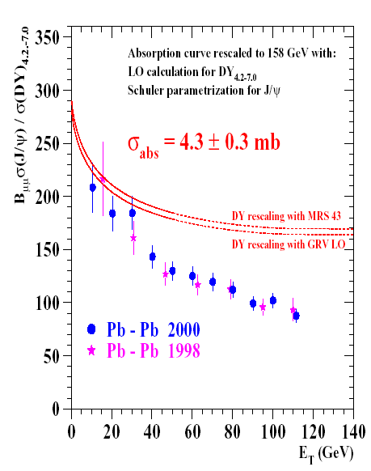
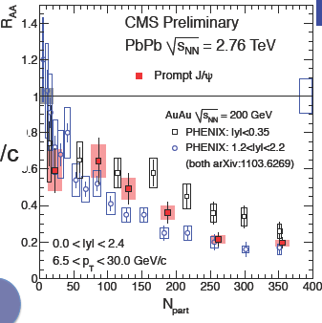
Experimental situation : the strange J/ψ behaviour
• J/Ψ suppression at SPS
Suppression beyond nuclear absorption
observed in central Pb+Pb at √s ~ 17 GeV
CERN communicate: SPS results presented a compelling evidence for the existence of a new state of matter in which quarks, instead of being bound up into more complex particles such as protons and neutrons are liberated to roam freely.
• J/Ψ suppression at RHIC
J/Ψ are suppressed, but not as much as
expected if we have complete color screening
Puzzle at RHIC:
Same amount of suppression at RHIC and SPS
√s≈200 GeV
√s≈20GeV
At LHC the situation is still not clear but…
amount of suppression similar to RHIC¿?
E. G. Ferreiro USC Chic @SPS: Physics case IPN, 7 July 2011

Slide 6
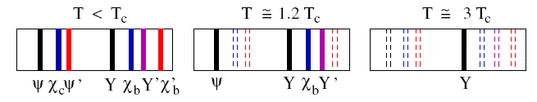
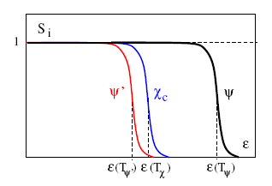
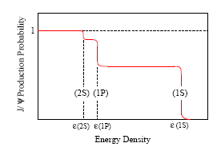
Quarkonium suppression: The sequential picture
• QGP consists of deconfined colour charges ⇒ colour charge screening for QQ probe
• screening radius r_{D}(T) decreases with temperature T
• when r_{D}(T) falls below binding radius r_{i} of QQ state i ⇒
Q and Q cannot bind, quarkonium i cannot exist
• quarkonium dissociation points T_{i}, through r_{D}(T_{i}) = r_{i}, specify temperature of QGP
⇒
E. G. Ferreiro USC Chic @SPS: Physics case IPN, 7 July 2011

Slide 7
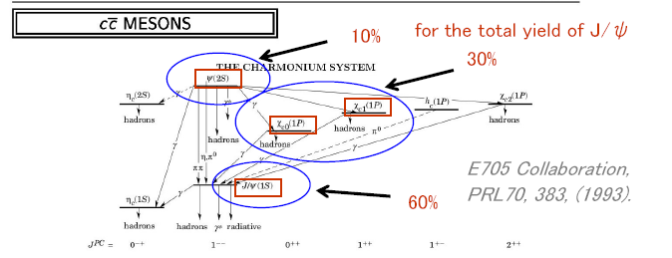
Quarkonium feed-downs
The interpretation of the J/ψ suppression as a signature of the QGP requires knowing which fractions of the measured J/ψ yields are due to decays of heavier charmonium states
• The production rates of the various charmonium states are predicted to be
proportional to each other and independent of the projectile, target and energy
• The assumption of the universality of charmonium hadronisation implies that
values of feed-downs should be independent of the kinematic variables x_{F} and p_{T}
• Usually, one assumes that the observed J/ψ production contains:
60% directly produced 1S states
30% decay products from χc(1P)
10% decay products from ψ′(2S)
E. G. Ferreiro USC Chic @SPS: Physics case IPN, 7 July 2011

Slide 8
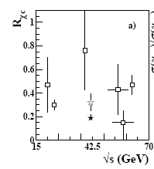
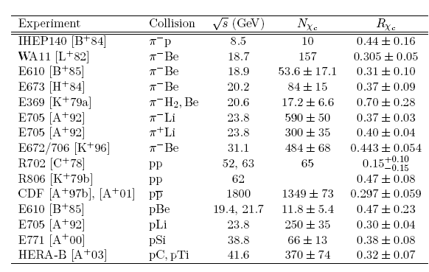
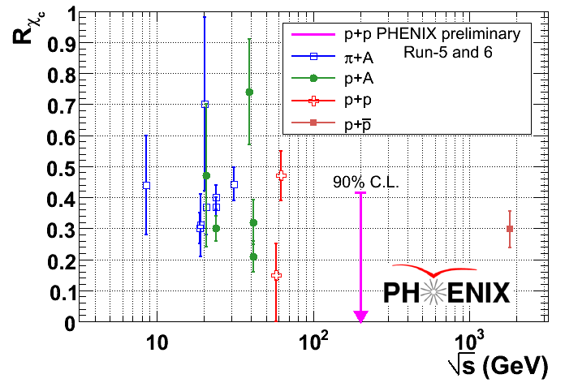
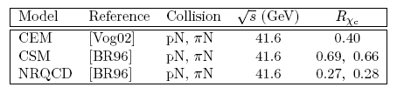
Incertainties: Quarkonium feed-downs
• The J/ψ feed-down fraction from ψ’ decays can be rather precisely determined, from data collected by SPS and Fermilab experiments.
•The χ_{c} case has been much less investigated:
• Experimental uncertainties
World average is about 0.3.
But it has large fluctuations and
uncertainties
• Theoretical uncertainties
E. G. Ferreiro USC Chic @SPS: Physics case IPN, 7 July 2011

Slide 9

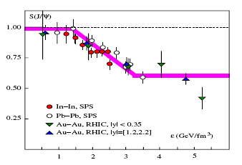
Incertainties: Quarkonium dissociation temperatures
• By determine heavy quark potential V(r,T) in finite T QCD and solving Schrodinger eq:
Dissociation temperatures T_{diss}/T_{c}
Energy densities:
0.5-1.5 GeV/fm³ = 1.0 T_{c}
10 GeV/fm³= 1.5 T_{c}
30 GeV/fm³= 2.0 T_{c}
J/ψ could survive up to T ≥ 2 Tc ⇒ ε_{J/ψ} ≥ 25 GeV/fm³
χ_{c} and ψ′ melt near Tc ⇒ ε _{ψ′,χ} ≃ 0.5 − 2 GeV/fm³
If J/ψ(1S) survives up to 2 Tc ∼ ε ≥ 25 GeV/fm³:
• all anomalous suppression observed at SPS and
RHIC due to dissociation of excited states χc and ψ′
• onset of anomalous suppression at ε(Tc) ≃ 1 GeV/fm³
• J/ψ survival probability for central Au +Au collisions
at RHIC same as for central Pb+Pb collisions at SPS
E. G. Ferreiro USC Chic @SPS: Physics case IPN, 7 July 2011

Slide 10
Quarkonium supression in A+A collisions
• While a rather rich sample of data on J/ψ production exists, the available data
on fractional production rates of the other charmonium states suffer from
imprecision.
• Moreover very little experimental information is available on the possible
polarisation of the produced charmonium states.
• In order to characterize the QGP formation @ SPS energies we need precission
measusurement of different quarkonium species.
• In particular,
we need to directly measure the production yields of the χ_{c} state
in heavy-ion collisions.
• This will also clarify the present data @ LHC and RHIC energies
We need to correctly calibrate our QGP thermometer
χ_{c} golden QGP signal?
E. G. Ferreiro USC Chic @SPS: Physics case IPN, 7 July 2011

Slide 11
Quarkonium supression in A+A and p+A collisions
Quarkonium production is suppressed in nuclear collisions
...but for a variety of reasons
QGP effects
A+A collisions
• dissociation by screening (“melting”) and/or collisions in hot QGP
• nuclear modification (“shadowing”) of parton distribution functions
• pre-resonance dissociation (“absorption”) in cold nuclear matter
• parton energy loss in cold nuclear matter
CNM effects
p+A and A+A collisions
The so-called “anomalous” suppression proposed as an indicator of the formation of a QGP has been reported by several experiments from SPS and RHIC energies
Nevertheless the conclusion that the reported suppression is indeed anomalous is contingent on the full understanding of normal suppression mechanisms, i. e. those existing in the absence of a QGP as is expected to be the case in p+A reactions
E. G. Ferreiro USC Chic @SPS: Physics case IPN, 7 July 2011

Slide 12
CNM effects: nuclear absorption
• Description of particle production in p+A interactions: factorization theorem
scaling of the p+p production cross section with nuclear mass number A
σ_{pA} = σ_{pp} A^{α}
In absence of nuclear effects: α=1
In presence of nuclear effects: α < 1
• First attempt:
to parametrize all the nuclear depence through an effective absorption cross section
σ_{pA} /σ_{pp} = exp(- σ_{abs} ρ L)
• This parametrization represents a rather simplified description of the nuclear
absorption process.
• It convolutes in a single effective absorption cross section a multitude of physical
effects:
interaction of pre-resonant charmonium states with the nuclear matter
the nuclear modifications of the parton distribution functions
possible energy loss mechanisms,
formation time effects, etc.
E. G. Ferreiro USC Chic @SPS: Physics case IPN, 7 July 2011

Slide 13
CNM effects: nuclear absorption and feed-downs
• Moreover, the known A dependence of J/ψ production has been used to determine
the strength of the “anomalous” J/ψ suppression in Pb+Pb interactions at the SPS
• There is no reason to assume that the χ_{c} and J/ψ mesons have the same “nuclear
dependence”
• A stronger χ_{c} “normal nuclear absorption” would decrease the yield of J/ψ mesons
produced from χ_{c} decays and, hence, would account for part of the “anomalous J/ψ
suppression” seen in heavy-ion collisions.
• How much of that “anomaly” might be due to the normal nuclear absorption of the
ψ’ and χ_{c} mesons depends on the fractions of J/ψ mesons produced by ψ’ and χ_{c}
decays.
These considerations underline the importance of knowing these fractions, in
elementary collisions, as accurately as possible.
E. G. Ferreiro USC Chic @SPS: Physics case IPN, 7 July 2011

Slide 14
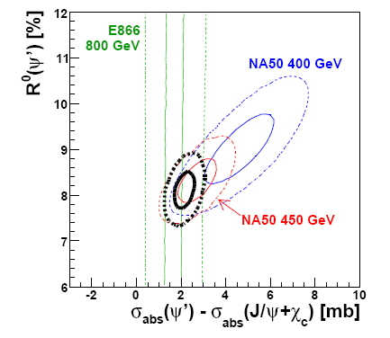
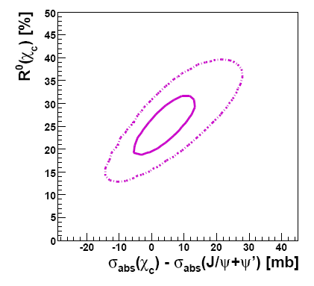
Incertainties: nuclear absorption and feed-downs
Some attemps
P. Faccioli, C. Lourenco, J. Seixas, H.K. Woehri, JHEP 0810:004 (2008)
Here σ_{abs} has been assumed to be a “universal quantity”, independent of the collision energy
and of the kinematical properties of the produced charmonium states.
E. G. Ferreiro USC Chic @SPS: Physics case IPN, 7 July 2011

Slide 15
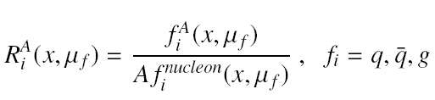
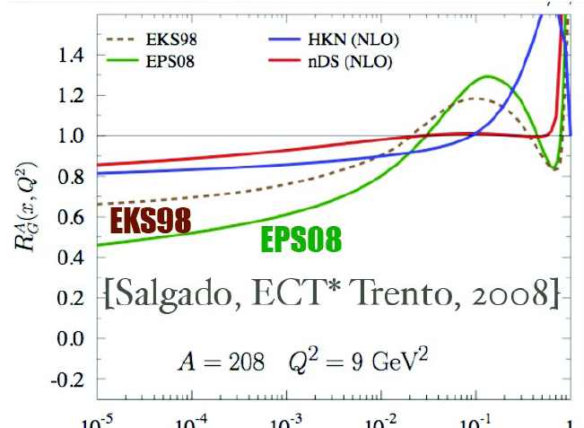
Shadowing: an initial cold nuclear matter effect
• Nuclear shadowing is an initial-state effect on the partons distributions
• Gluon distribution functions are modified by the nuclear environment
• PDFs in nuclei different from the superposition of PDFs of their nucleons
Shadowing effects increases with energy (1/x) and decrease with Q² (m_{T})
antishadowing
shadowing
Shadowing depend only on either the projectile or target momentum fractions and not on the identity of the final charmonium state and thus should affect J/ψ, ψ’ and χc production identically
E. G. Ferreiro USC CNM effects on quarkonium @ RHIC and LHC BNL 6-18 June 2011

Slide 16
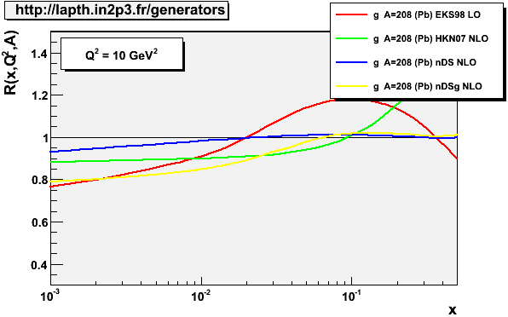
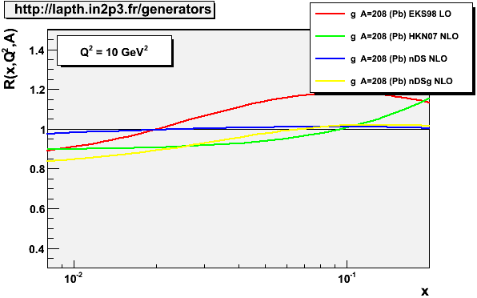
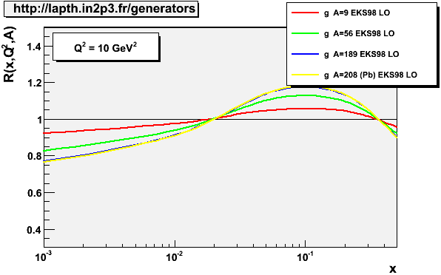
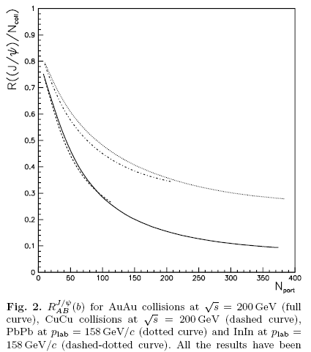


Incertainties: shadowing
Model dependent
In+In @ SPS
Pb+Pb @ SPS
Nucleus dependent,
but, for the same energy,
the same at fixed
centrality
Cu+Cu @ RHIC
Au+Au @ RHIC
For J/ψ, ψ’, χ_{c}
independent of
final charmonium
state
E. G. Ferreiro USC CNM effects on quarkonium @ RHIC and LHC BNL 6-18 June 2011

Slide 17
CNM effects: disentangle shadowing vs nuclear absorption
• p+A measurements for different species: J/ψ, ψ’,χ_{c}, DY vs centrality
Assumption:
shadowing J/ψ ≈ shadowing ψ’ ≈ shadowing χ_{c} =>
σabs J/ψ / σabs ψ’,
σabs J/ψ / σabs χ_{c}
extraction of σabs
• p+A measurements for different species: J/ψ, ψ’,χ_{c}, DY vs rapidity
Assumption:
shadowing J/ψ ≈ shadowing ψ’ ≈ shadowing χ_{c} =>
check of σabs J/ψ / σabs ψ’,
check σabs J/ψ / σabs χ_{c}
σabs = σabs (y) ?
• p+A measurements for different species and different A vs N_{part} and y
extraction of the shadowing
• Comparation of p+A measurements for fixed A @ different energies
E. G. Ferreiro USC Three days of quarkonium Ecole Polytechnique July 2010

Slide 18
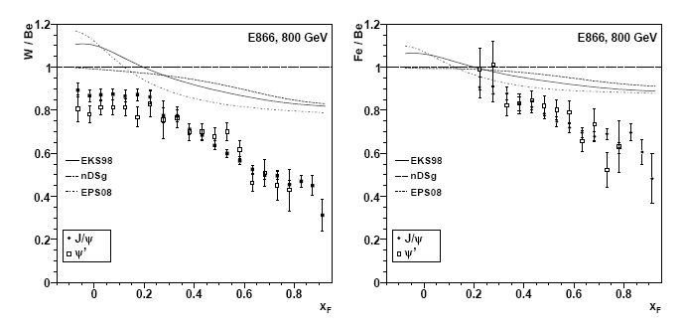
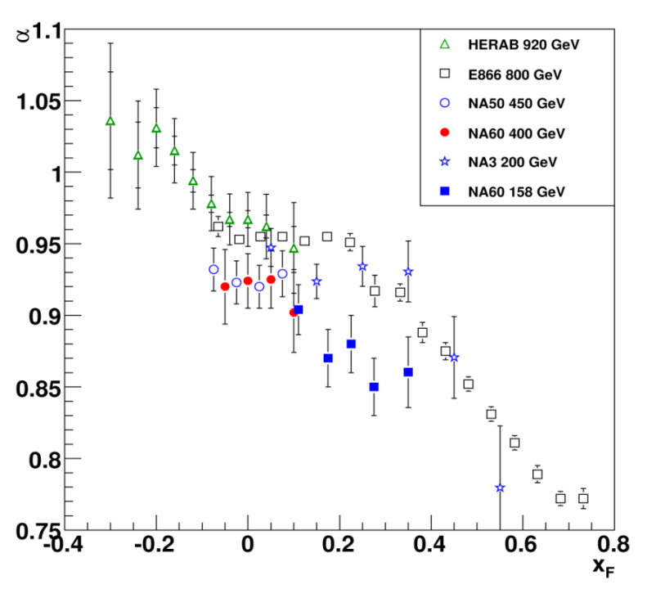
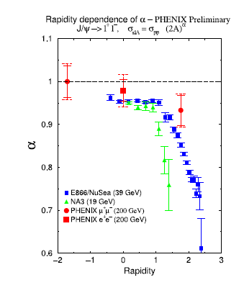
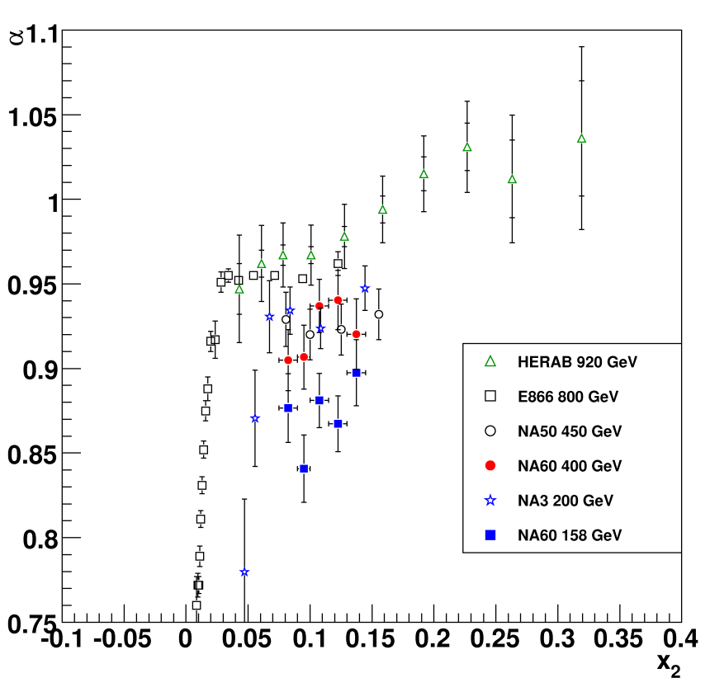
Proposed measurements
vs x_{F}
vs x₂
vs y
J/ψ, ψ’ and χc
E. G. Ferreiro USC CNM effects on quarkonium @ RHIC and LHC BNL 6-18 June 2011

Slide 19
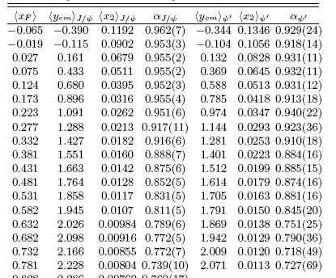
Proposed measurements
E866: Plab=800 GeV, A=Be, Fe, W
J/ψ, ψ’, χ_{c} for
-0.5 < y_{cm} < 2
-0.12< x_{F} < 0.9
0.2> x₂ > 0.015
in pp, pA and AA
E. G. Ferreiro USC CNM effects on quarkonium @ RHIC and LHC BNL 6-18 June 2011

Slide 20
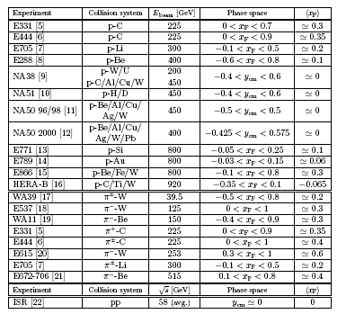
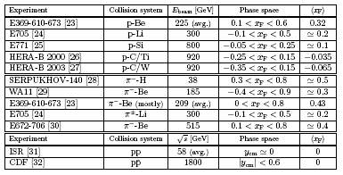
Proposed measurements and comments
• By now, the A dependence of J/ψ production at x_{F} > 0 is known to rather high precision at
several different energies (NOTE: without corrections from feed down contribution)
• While the ψ′ A dependence is not as accurately known, its statistics were sufficient for the
E866 collaboration to determine the ψ′ α and the J/ψ α for -0.1 <x_{F} < 0.8
• On the contrary, few experiments have presented differential distributions of χ_{c} production,
and we have very few measurement of the χ_{c} A dependence.
We need precission measurements of
J/ψ, ψ’, χ (directly produced when possible)
E. G. Ferreiro USC CNM effects on quarkonium @ RHIC and LHC BNL 6-18 June 2011

Slide 21
Final comments
The known A dependence of J/psi production has been used to determine the strength of the “anomalous” J/psi suppression in Pb+Pb interactions at the CERN SPS
However, an important assumption in this interpretation is that all charmonium states interact with the nucleus while in “pre-resonant” states in the same way
There is no reason to assume that the χ_{c} and J/ψ mesons have the same “nuclear dependence”
Since a significant fraction, ∼ 40%, of the observed J/ψ comes from ψ’ and χ_{c} decays, a measurement of the χ_{c} A dependence is crucial for the understanding of J/ψ suppression in nucleus-nucleus collisions because in a quark-gluon plasma, J/psi suppression is expected to occur in steps, the first of which is the dissociation of the χ_{c}
Moreover, since Tdiss /T_{c} for χ_{c}= 1, the measurement of anomalous suppression for χ_{c} in A+A compared to p+A would be sufficient to probe the QGP at SPS!
The measurement of χ_{c} golden signal?
Also, elementary collisions can give us information about the
production mechanism of charmonium
E. G. Ferreiro USC CNM effects on quarkonium @ RHIC and LHC BNL 6-18 June 2011

