Slide 1
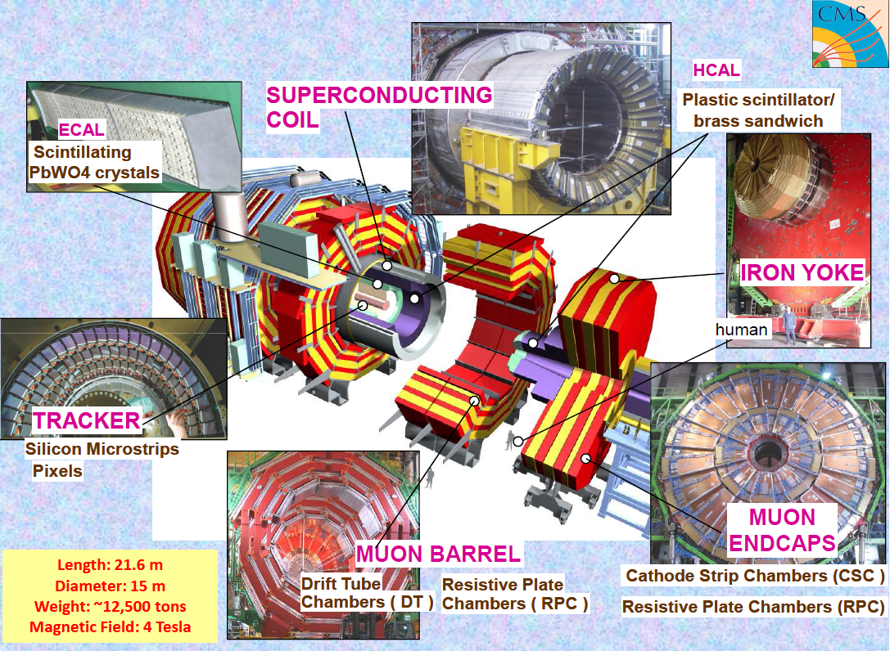
CMS Detector Upgrades for High Luminosity LHC
Maxim Titov (IRFU/SPP)
Journée LHC à Haute Luminosité,
CEA Saclay, May 31, 2011

Slide 2
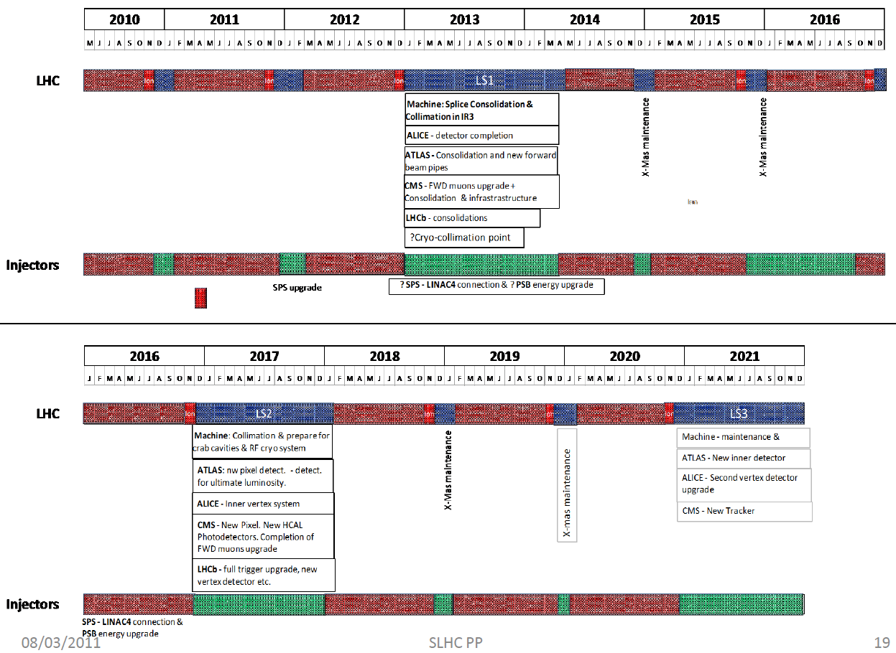
LHC 10 years plan (Outcome Chamonix, 2011)
The 2013/14 shutdown is
determined by the machine →
experiments – consolidation &
partial detector upgrades possible
LHC Phase I: until 2020
LHC Phase II > 2021
The 2017 shutdown is mostly
determined by the experiments:
→ Detector upgrades are to be
justified by physics case
R&D for HL-LHC era (after 2021)
D. Pitzl, LHCC Upgrade Meeting, 22.03.2011

Slide 3
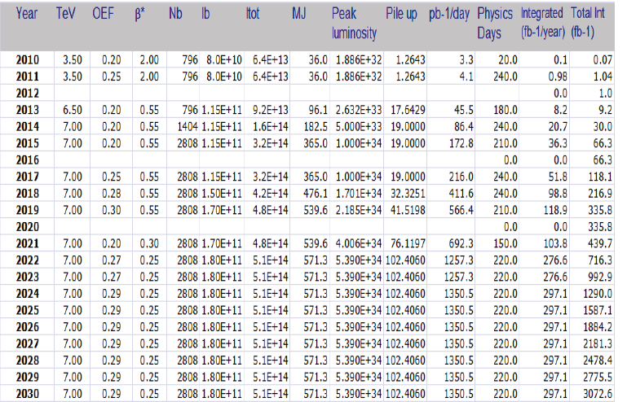
LHC Progression in Luminosity
*
LHC
Phase I:
~ 300 fb⁻¹
*
LHC
Phase II
(HL-LHC):
~ 3000 fb⁻¹
* Outdated Tables from Nov. 2011 (shutdowns now planned for 2013 and later in 2017 (?) )

Slide 4
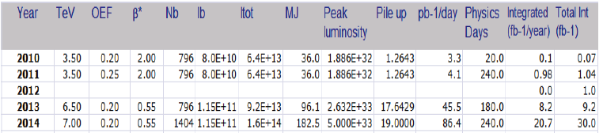
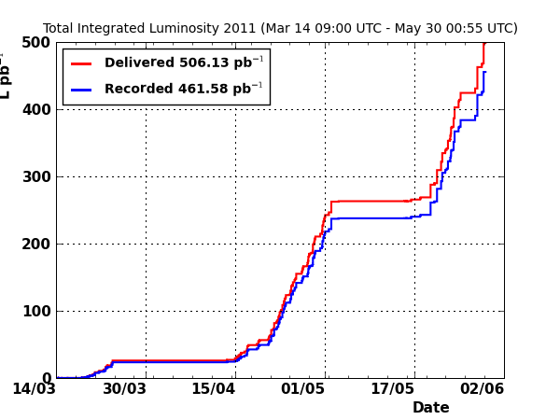
LHC & CMS: Excellent Performance
Recent LHC Performance: Saturday, May 28 (LHC Fill 1812) and Sunday, May 29 (LHC Fill 1815)
β* = 1.5
Nb = 912-1092
I tot ~ 1.2e+14
Peak Lumi
~ 1.3 e+33
pb-1/day
~ 32-38 pb
LHC Fill 1812
(May, 28 - 08:00-19:00)
LHC delivered lumi ~ 32 pb
CMS recorded lumi ~ 31 pb
During 2 days,
CMS recorded
~ 2 times the 2010
dataset (36pb-1)
LHC Fill 1815
(May, 29 - 11:00-21:00)
LHC delivered lumi ~ 38 pb
CMS recorded lumi ~ 35 pb

Slide 5
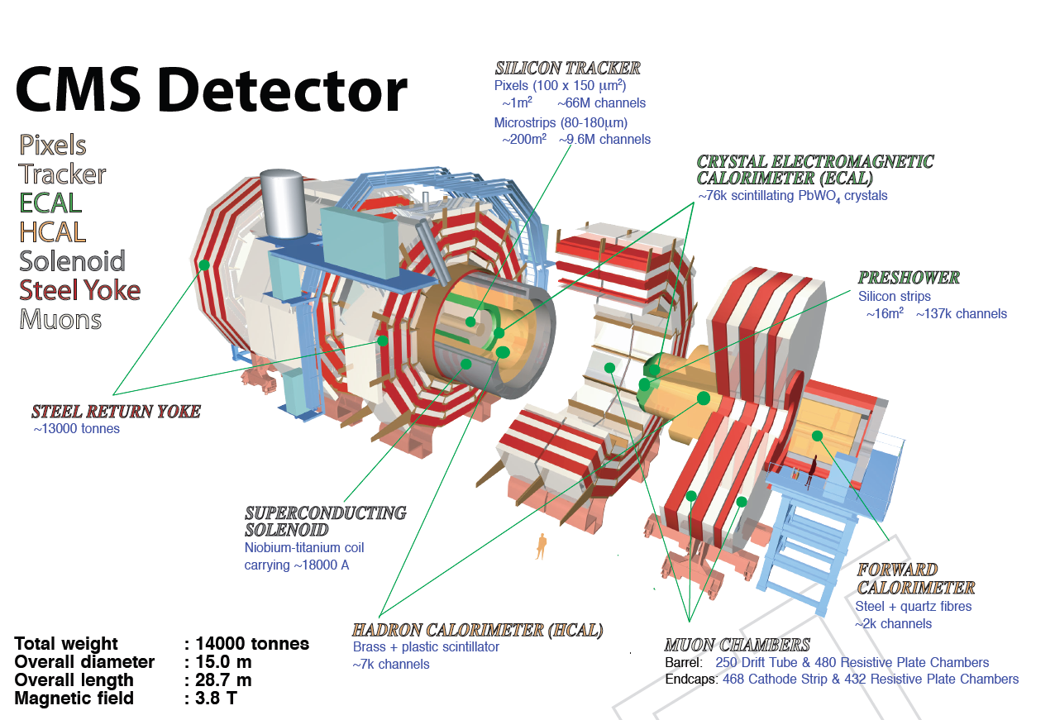


Slide 6
CMS Upgrade Plans & Scope
BASED ON THE TECHNICAL PROPOSAL FOR THE UPGRADE OF THE CMS DETECTOR
THROUGH 2020: https://cms-docdb.cern.ch/cgi-bin/DocDB/ShowDocument?docid=2717
System
2010-2020
2020-2030
Tracker
New Tracking System (incl Pixel)
HCAL
HPD replacement with SiPM
+ Electronics
HF/HE?
Pixel
ECAL
Muons
Trigger
New Pixel Detector
Trigger Primitives (Off Detector Electronics) ?
EE ?
HCAL/RCT/GCT to mTCA
Complete replacement
ME4/2, ME1/1 ,RPC endcap, some CSC Electronics
Electronics replacement
2017
2013
2017
Saclay
2013
/2017
2017
J. Nash, LHCC Upgrade Meeting (Updated Slides), 16.11.2010

Slide 7
Planned CMS Detectors Upgrades and Improvements
2013 Shutdown
  Start Completion of Forward Muon System (ME 4/2 CSC, RPC)
  HO (Hadronic Calorimeter Tail Catcher) replacement of HPD with SiPMs
  HF thin-window PMTs & segmented anodes (Forward Hadron Calorimeter: η ~ 3-5)
  Pixel Luminosity Telescope (diamond) for luminosity measurement
2017 (?) Shutdown
  Install new smaller radius (r=23-25 mm) Be-beampipe;
  Install new low-mass pixel detector (4 barrel layers);
  HB/HE replacement of HPD with SiPMs and modified FEE/trigger electronics
  Install new trigger system (calorimeter, muon track finder, global trigger)
2021 (?) Shutdown
  Install new full tracker (pixel + strips); Tracker in Level-1 Trigger
  Major consolidation/replacement of electronics systems
    Including potentially ECAL electronics
  ECAL Endcaps (subject of a task force)
  DAQ system upgrade
J. Nash, LHCC Upgrade Meeting (Updated Slides), 16.11.2010

Slide 8
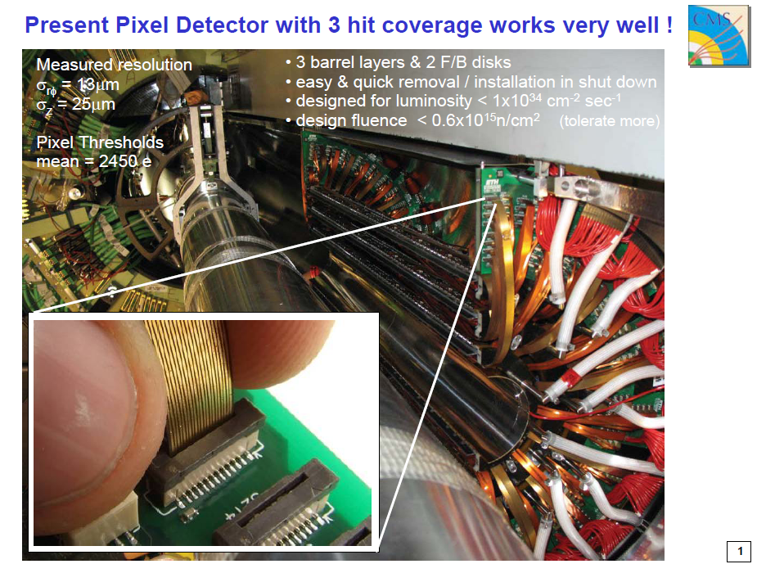
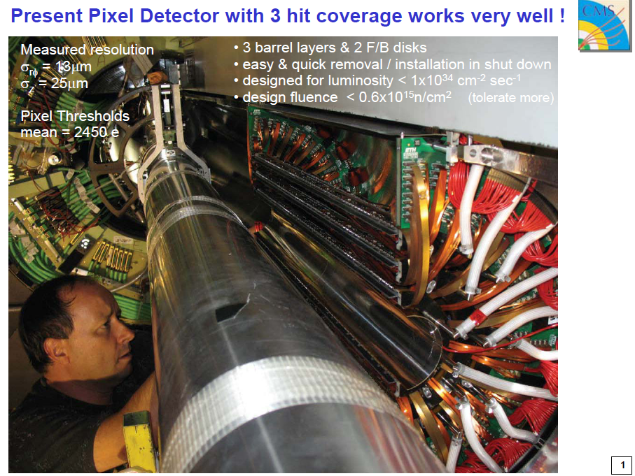
R. Horisberger, LHCC Upgrade Meeting, 16.11.2010

Slide 9
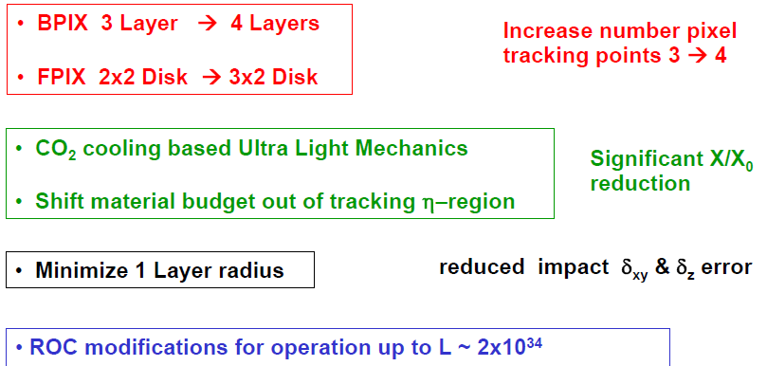
Pixel Detector Upgrade for 2016
Motivation: maintain high tracking efficiency at luminosities up to 2 * 10³⁴
New readout chips (ROC) to reduce trigger latency related data losses
Pixel upgrade to 4 hit system significantly improves and robustifies pixel track
seeding and vertexing
Reduced and displaced material budget significantly improves impact parameter
resolution and therefore vertexing and b-tagging
Pixel standalone tracking crucial in HLT → particularly useful for electron and tau triggers

Slide 10
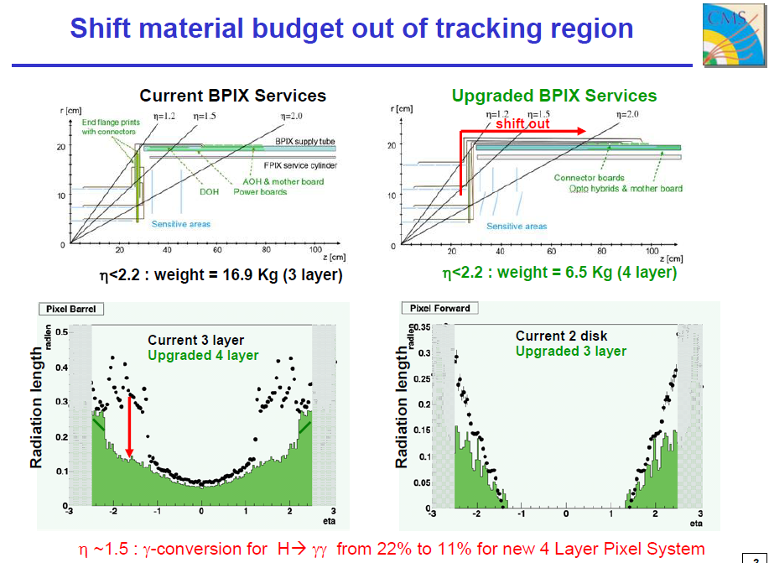
R. Horisberger, LHCC Upgrade Meeting, 16.11.2010

Slide 11
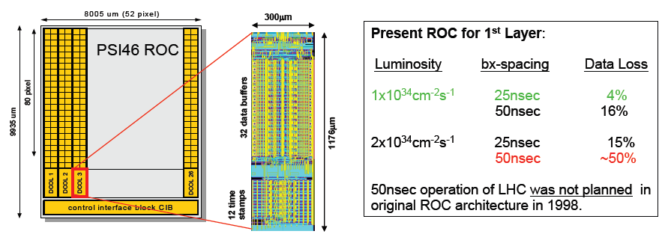
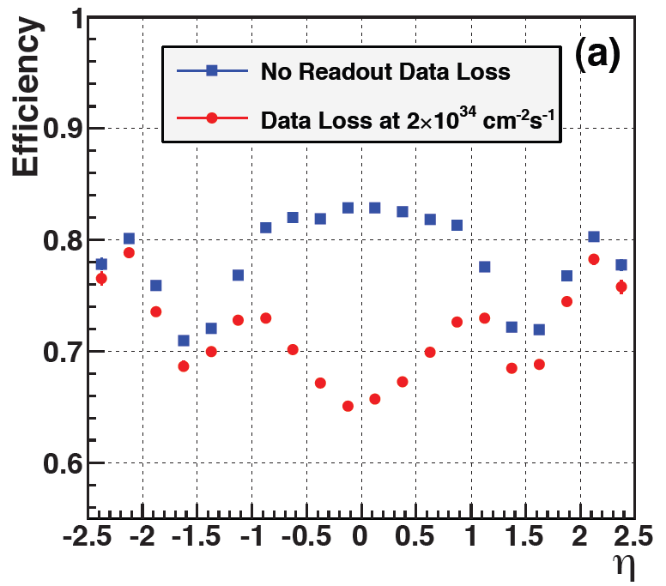
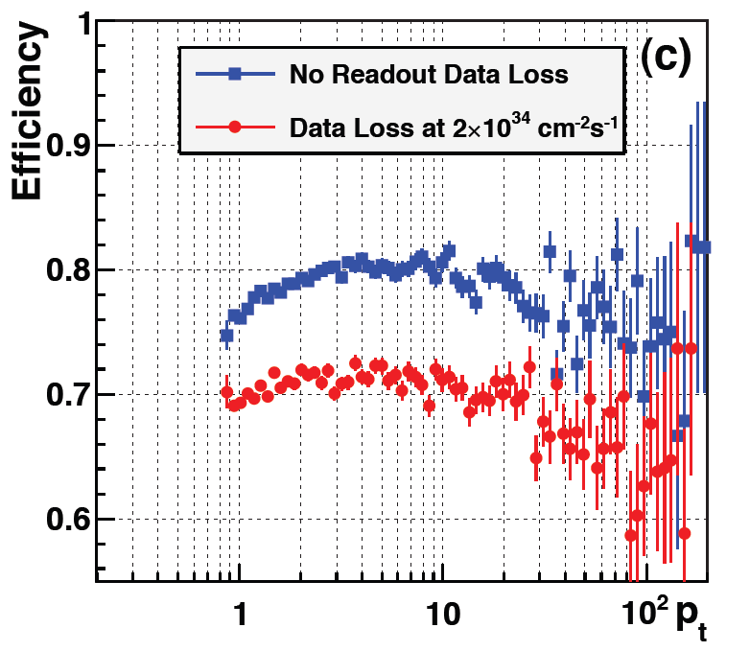
Upgrade of Pixel Readout Chain
Latency
related
Pixel detector performance for ttbar events and 25 ns bunch spacing
R. Horisberger, LHCC Upgrade Meeting, 16.11.2010

Slide 12
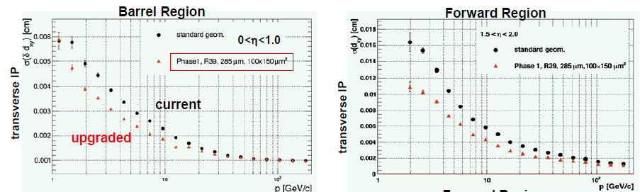
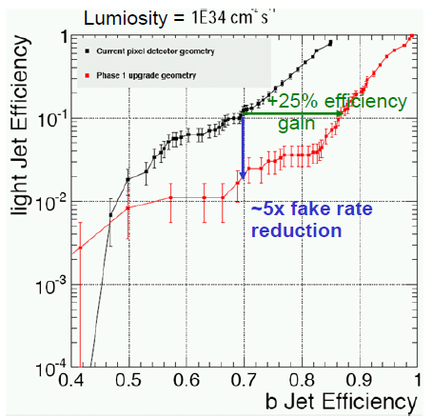
Physics Performance of Upgraded Pixel Detector
Impact Parameter of Current/Upgraded Pixel System
Reduced material in tracking volume → smaller MS;
Moving innermost layer closer to the beam pipe;
Adding extra layers in BPIX/FPIX →improved track “lever arm”;
Decreased pixel pitch & improved geometry
B-tagging of Current/Upgraded
Pixel System:
Efficient b-tagging crucial to many analysis →
e.g. 4-b jet channel → fake-rate reduction
by factor of 600 or ~2.4x signal gain
R. Horisberger, LHCC Upgrade Meeting, 16.11.2010

Slide 13
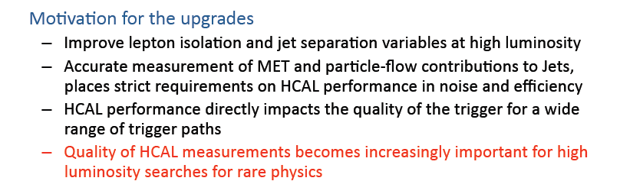
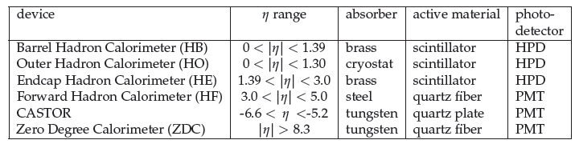
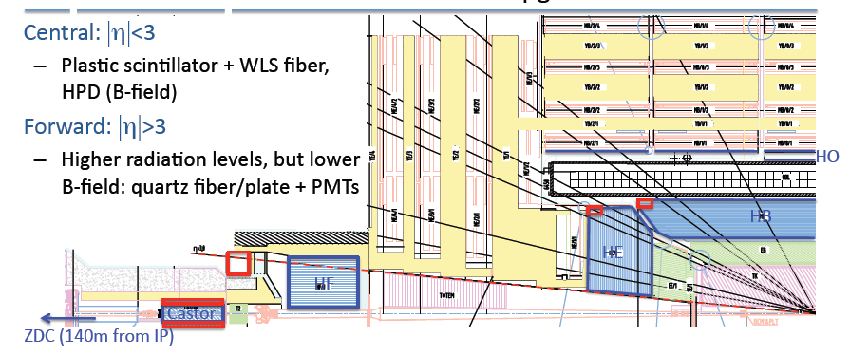
HCAL Calorimeter Upgrades
J. Spalding, LHCC Upgrade Meeting, 16.11.2010

Slide 14
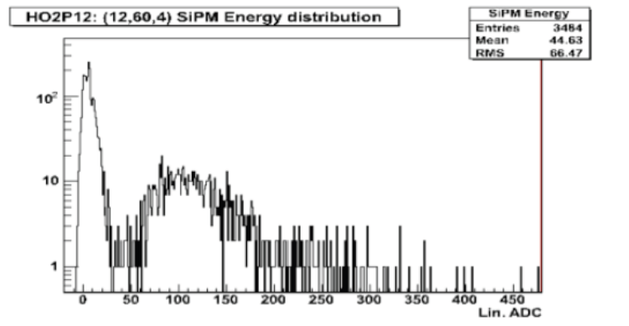
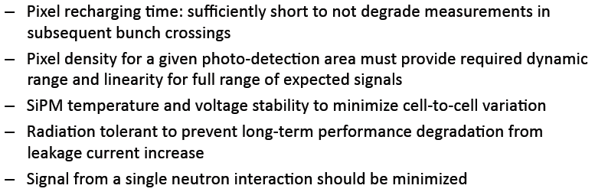
Outer Hadron Calorimeter (HO) Upgrade for 2013
Problem: hybrid photomultipliers (HPD) are susceptible to discharge at intermediate B-fields
(~0.2 – ~3.5 T) → about 15% fail at 3.8T (HB/HE), and about 50% at 0.2‐0.3T (HO R1/2)
HO (R1/R2) are not able to operate at nominal gain (and remain a source of spurious noise
when HPD E-field is not well aligned with local B-field) → unable to identify muons, reduced
contribution to jet measurement
Replace HO (R0/R1/R2) HPD with Silicon
PhotoMultipliers (SiPM) (new technology to HEP):
SiPM photon detection efficiencies >2x HPDs and
gain a factor of 50 to 500 larger;
SiPMs are compact and operate at ~100V
compared to ~10KV for HPDs;
SiPMs are not affected by magnetic fields
pedestal
SiPM:
MIP
Key SiPM
R&D
Issues:

Slide 15
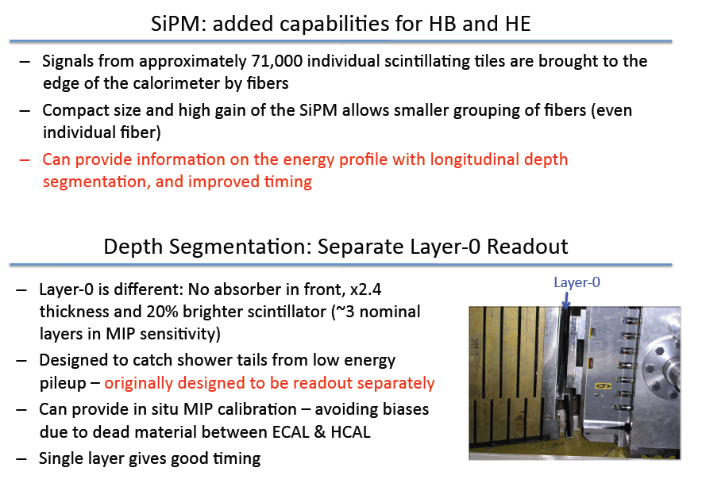
HB/HE Calorimeter Upgrades
Motivation: Replacement of HPD with SiPMs to eliminate the sources of anomalous signals
and to improve the front-end signal-to-noise by an order of magnitude
J. Spalding, LHCC Upgrade Meeting, 16.11.2010

Slide 16
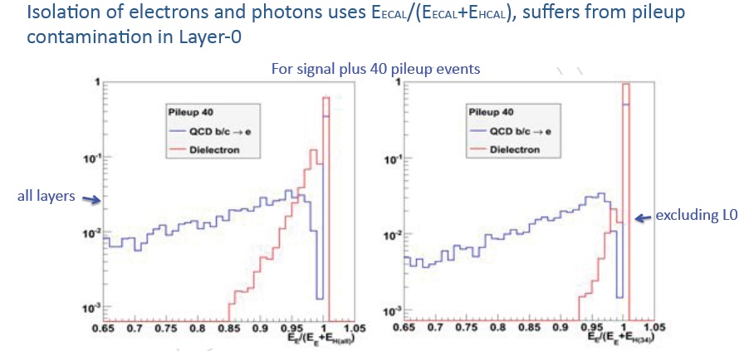
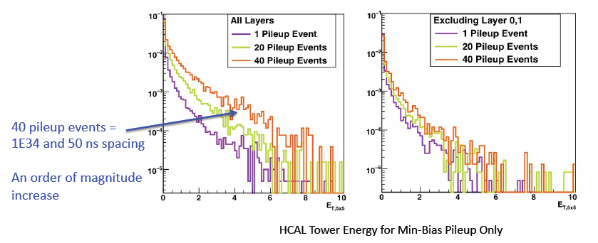
Improved HB/HE with Depth Segmentation and Separate Layer -0 Readout
The full signal of layer-0 can provide a powerful tagging mechanism for non-interacting pions entering the HCAL barrel and allows to make H/E variable more sensitive
→ Separate hadronic energy measurements for the jet & electron paths of the CAL triggers
J. Spalding, LHCC Upgrade Meeting, 16.11.2010

Slide 17
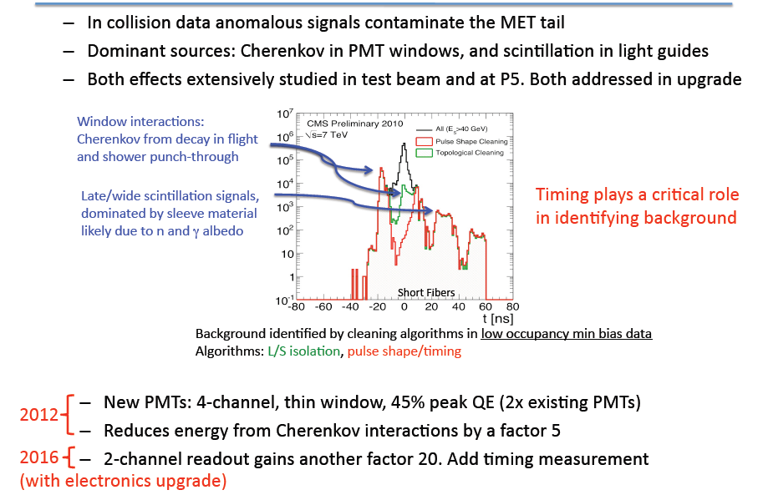
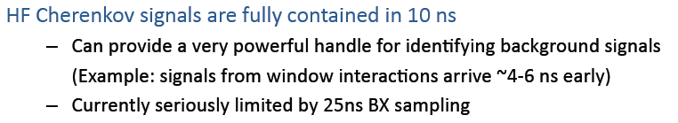
HF Calorimeter Upgrade
J. Spalding, LHCC Upgrade Meeting, 16.11.2010

Slide 18
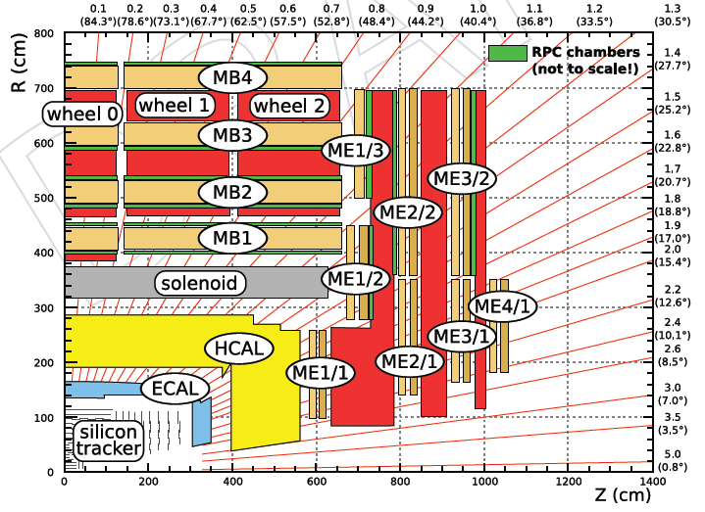
Muon System Upgrades
Motivation: Complete Muon Detector (4th layer) to achieve redundancy for muon trigger rates
3 types: Drift Tubes (DT), Cathode Strip Chambers (CSC), Resistive Plate Chambers (RPC)
CSC: only part (ME 4/1) of the 4th endcap station installed → complete 4th station (ME 4/2)
RPC: construct & install the 4th RPC station (RE4)
MPGD/GEM (?): add redundancy in the region 1.6 < h < 2.4 not covered of the RPC

Slide 19
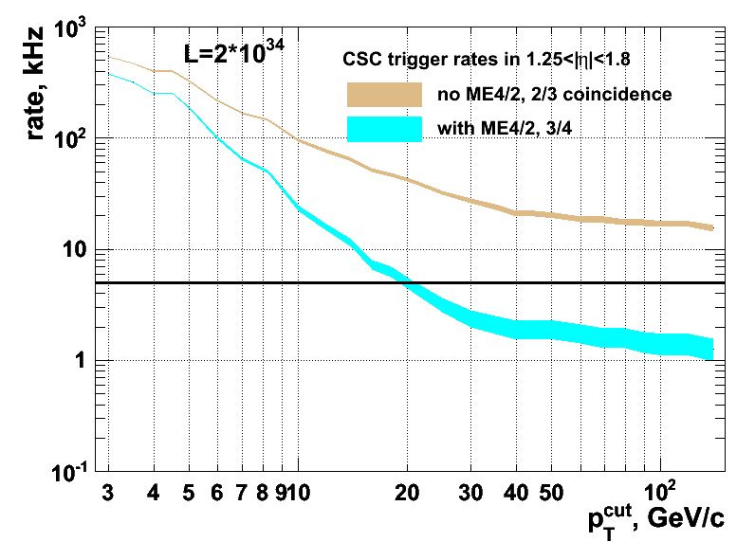
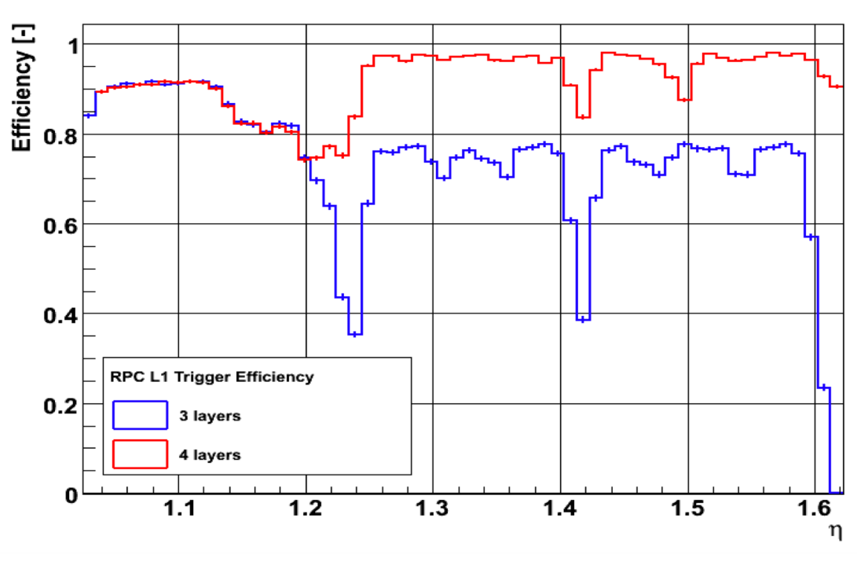
Trigger Performance of Upgraded Muon Detector
Problem: Muon trigger requires segments
in 2 out of 3 stations (avoid efficiency
loss due to gaps in the coverage)
High flux of (poorly measured)
low-momentum muons dominate the
trigger rate making it unacceptably high
Trigger rates and system robustness
depends crucially on the 4th layer of
the Muon Detector
CSC Trigger Rate
RPC L1 Efficirncy

Slide 20
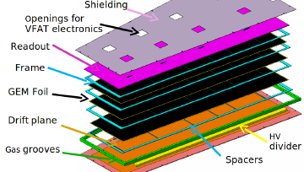
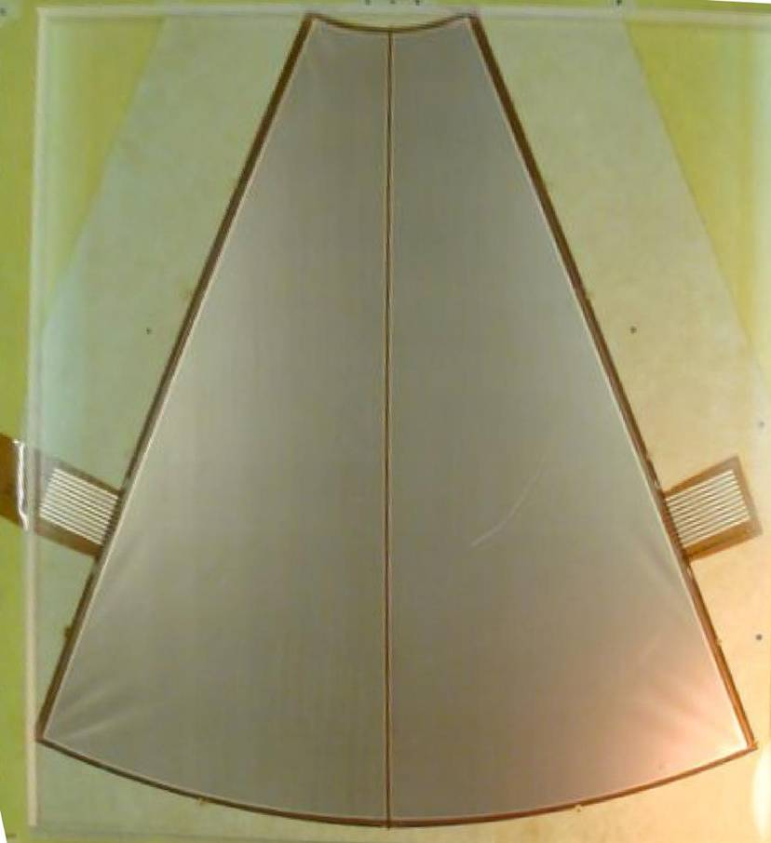
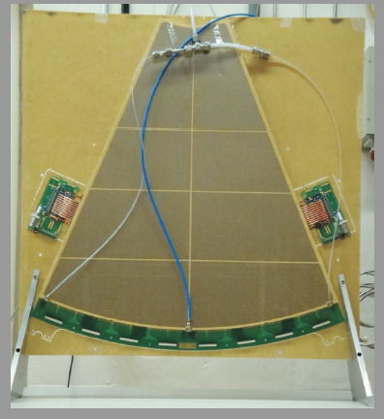
Large-Area GEM Detectors for CMS Muon System
GEM/CMS Collaboration (15 institutes, 80 people)
GEM feasibility studies for
extension of CMS Muon System:
high-eta (h > 1.6) upgrade
TWO-SECTORS TRIPLE-GEM PROTOTYPE FOR
TOTEM T1 UPGRADE
(60x60 cm²)
60 cm

Slide 21
Estimated Particle Rates in CMS Muon System
RPC Region | Rates Hz/cm² LHC (10³⁴ cm²/s) | High Luminosity LHC | SLHC ?? (10³⁵cm²/s)?
RB | 30 | Few 100 | kHz
RE 1, 2, 3,4 η < 1.6 | 30 | Few 100 | kHz
Expected Charge in 10 years | 0.05 C/cm² | 0.15 C/cm² | ~ C/cm²
RE 1,2,3,4 η > 1.6 | 500Hz ~ kHz | Few kHz | Few 10s kHz
Total Expected Charge in 10 years | (0.05-1) C/cm² | few C/cm² | Few 10s C/cm²
Personal remark : MPGD can “enter” anytime if particle fluxes in HL-HLC are higher
that can be tolerated by the current Muon Detector technologies (e.g. for RPC < 1 KHz)

Slide 22
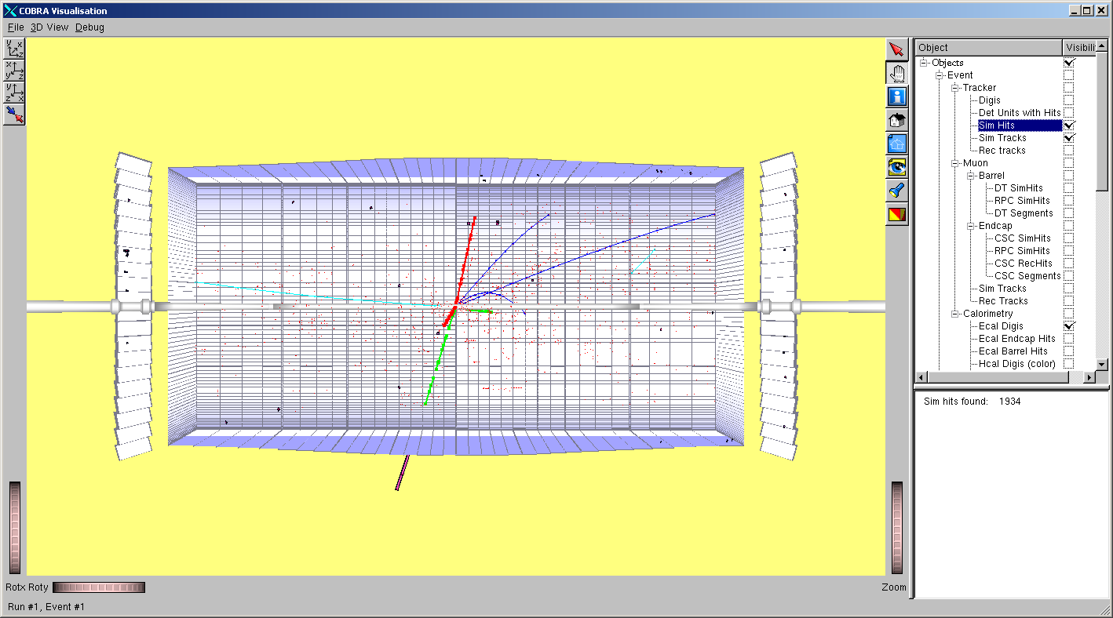
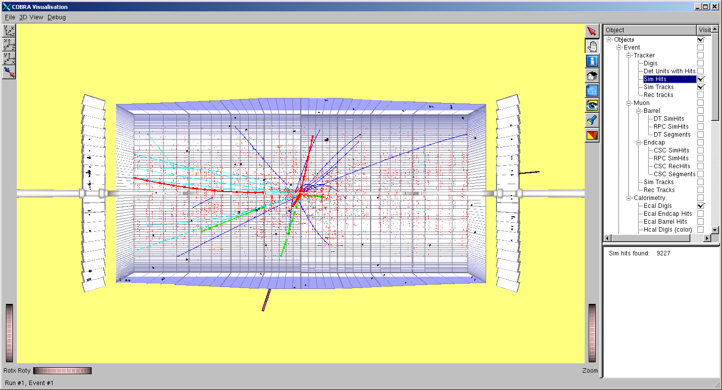
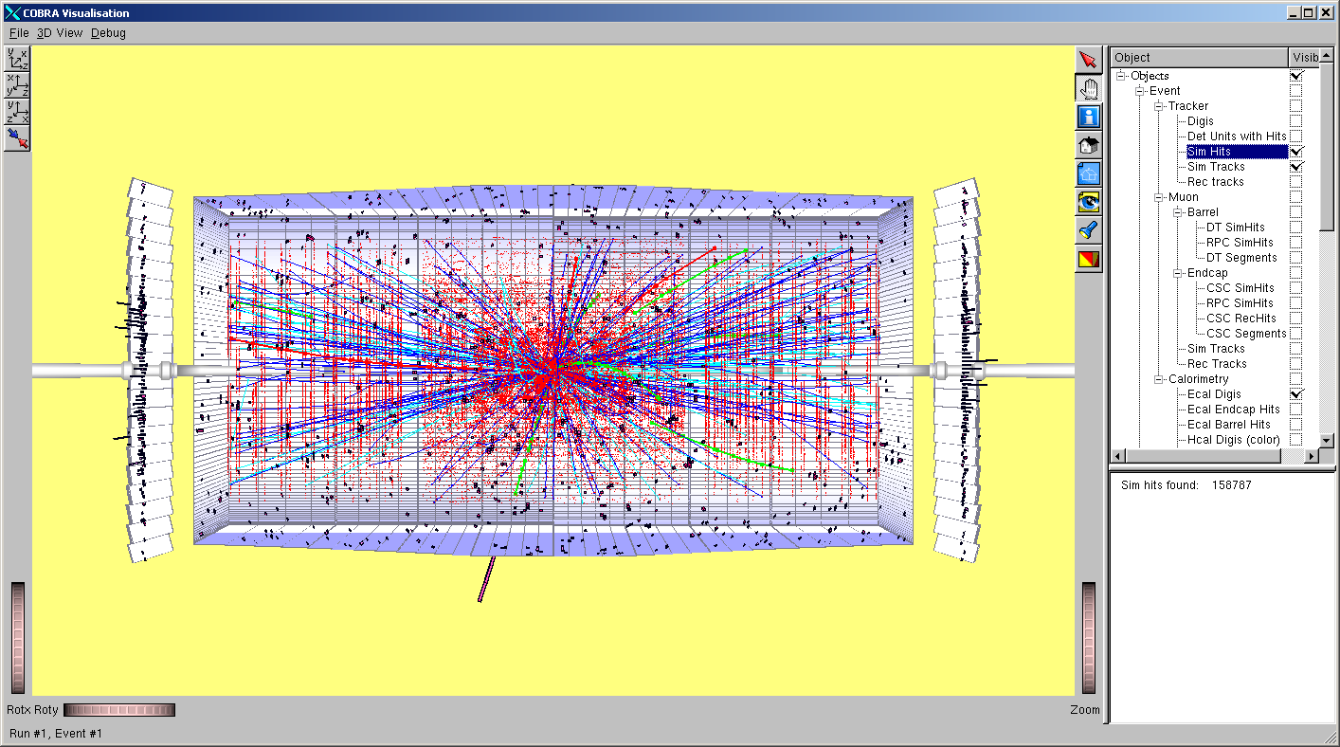
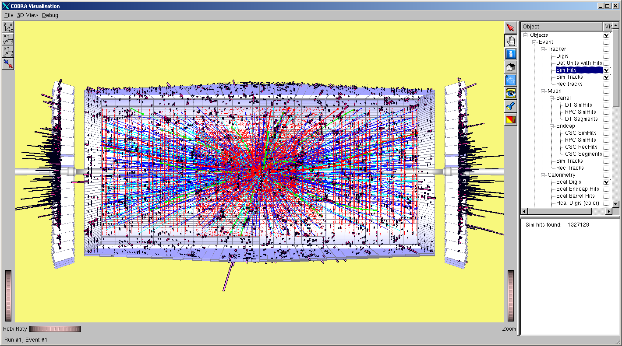
LHC Operation: From Phase I to Phase II (> 2021)
Motivation for L1 Tracking Trigger:
10³² cm⁻² s⁻¹
10³³
There is now a consolidated expectation for
Sustained Operation at Luminosity > 5.4 * 10³⁴
(nb. Luminosity Leveled)
Baseline is 25ns => Pile-up ~ 100
However,
50ns provides more margin to meet luminosity target
50ns => Pile-up ~ 200
=>must make allowance also for this scenario
The need for a Track Trigger has motivated the introduction of new concepts
for Tracking at very high luminosities
Pt Module:
Measure Locally both track position and direction
Local Pt Determination & Discrimination
A Hierarchical Scheme for Localizing Pattern Recognition & Data Reduction
10³⁴
10³⁵
At LH-LHC (Phase II) faces new challenges, in particular for both Tracking and Triggering
M. Manelli, D. Contardo, CMS Upgrade Week, May 2011

Slide 23
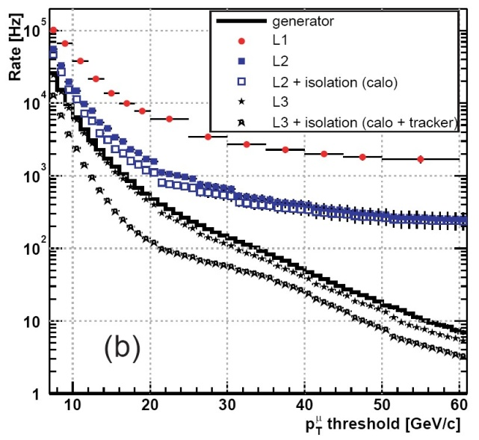
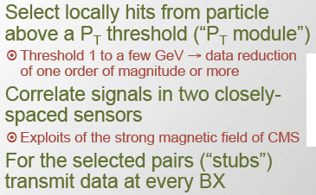
L1 Tracking-Trigger Concept
  There may be not be enough rejection power using e/μ triggers to handle sLHC high luminosity
L1 muon trigger rate has
no discrimination power
for p_{T} ≥ 30GeV/c
Topic requiring substantial R&D:
→ Requires a lot of processing on the chip
Challenge is to develop new chips in time,
without increasing the material budget too
much (power as well as chip material)
Pixellated pT modules based on 3D
electronics is an attractive concept !

Slide 24
CMS Upgrade Plans & Outlook
System
2010-2020
2020-2030
Tracker
FEDs?
New Tracking System (incl Pixel)
HCAL
HPD replacement with SiPM
+ Electronics
HF/HE?
Pixel
ECAL
Muons
Trigger
New Pixel Detector
Trigger Primitives (Off Detector Electronics) ?
EE ?
HCAL/RCT/GCT to mTCA
Complete replacement
ME4/2, ME1/1 ,RPC endcap, some CSC Electronics
Electronics replacement
2017
2013
2017
2013
/2017
2017
NO PLANS for significant UPGRADE of ECAL for LHC Phase I & II (degraded ECAL
performance should be sufficient for Phase II; concern - lifetime of FEE (?) )
Upgrade opportunities may “open-up” depending from CMS Performance

