Slide 1
The High Luminosity
Large Hadron Collider
Reyes Alemany
CERN BE/OP
Engineer In Charge of LHC
Journée HL-LHC à Saclay (31.05.2011)

Slide 2
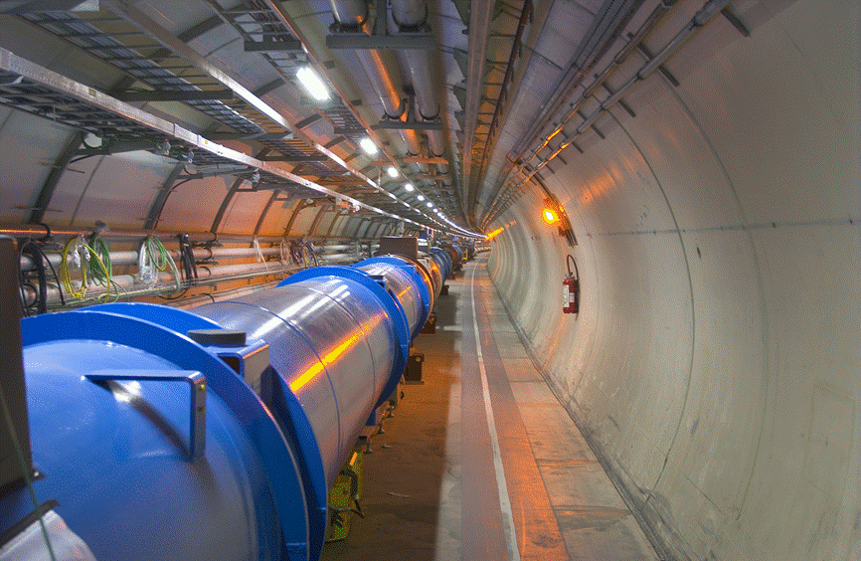
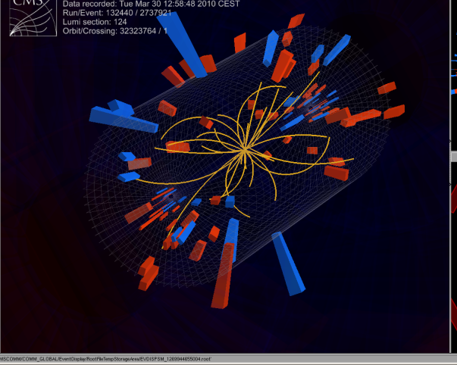
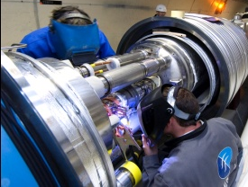
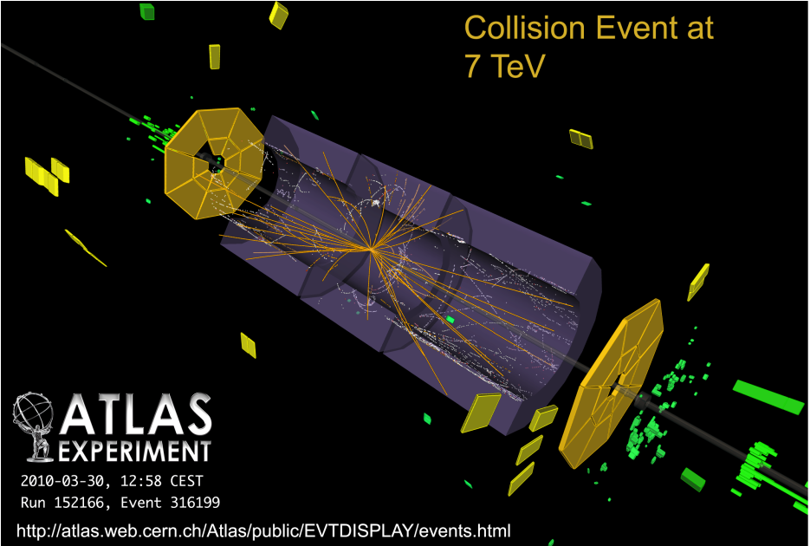
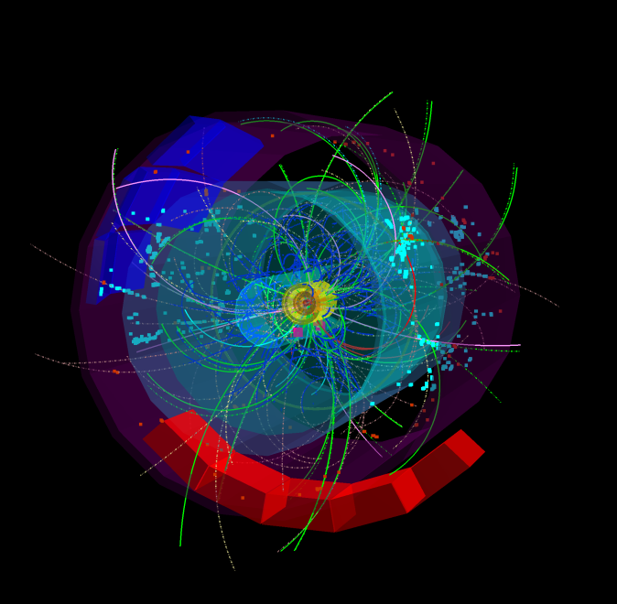
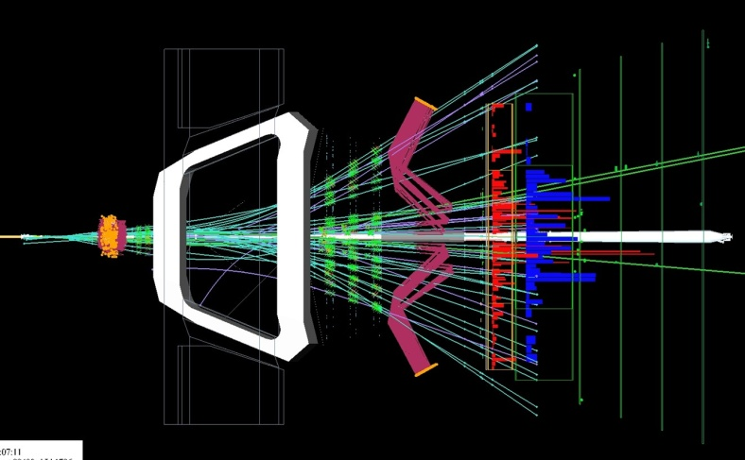
Next Years
2012
MD will tell us about the real potential of LHC ➔ beam beam, aperture, emittance, intensity (pile-up) ➔ may be we can do better than foreseen!!
Following measurements of the copper stabilizers during the Christmas stop we will re-evaluate the maximum energy for 2012 (Chamonix 2012)
2013
Repair/upgrade the magnet interconnects for operation at 6.5-7 TeV/beam
2014- 2017
2018
Install new collimation system in Dispersion Suppression zone ➔ needed to reach NOMINAL LHC
2019-2030
Hardware upgrades for High Luminosity LHC ➔ next slides
High Luminosity LHC ➔ PEAK LUMI: 5×10³⁴ cm⁻²s⁻¹ with levelling, 250 fb⁻¹ per year, 3000 fb⁻¹ twelve years after the upgrade
2031-XX
High Energy LHC
ALICE
LHCb
CMS
ATLAS
This luminosity is more than ten times the luminosity reach of the first 10 years of the LHC lifetime.
MD: Machine Development

Slide 3
The goal ➔ 5x10³⁴ cm⁻²s⁻¹
5×10³⁴ cm⁻²s⁻¹
1×10³⁴ cm⁻²s⁻¹ ⬅ Nominal LHC
Leveling
limit proton burning and consequent lumi fast decay rate (∝peak lumi)
less pile-up
less radiation to the detectors
less heat load in IRs
L integrated = 250 fb⁻¹ per year
L integrated = 1 fb⁻¹ per day

Slide 4
How ➔ There is no magic … but the golden formula
... increase number of protons per bunch
N₁,N₂ = 1.7*10¹¹
... decrease the beam size at IP
β_{x}= β_{y}= 0.22 m
... reduce the geometric loss factor ➔ F
crab cavities
Goal
β*↓↓
*
↑↑
↑↑
Φ
↑↑
F
↓↓
L
↓↓
*
F is a pure crossing angle (Φ) contribution:
FLHC = 0.836
x
Φ
Φ
s
ρ₁(x,y,s,-s₀)
ρ₂(x,y,s,-s₀)

Slide 5
The Main Ingredients
stronger focusing / larger aperture at the mini beta triplet quadrupoles. Goal: β∗ as small as 22 cm with a
          ➔ factor ∼2.5 in luminosity.
→ High Gradient Quadruples, Nb₃ Sn technology
combined with a mechanism to compensate the geometrical reduction → Crab Cavities
combined with higher single bunch currents
→ new Pre-Accelerator

Slide 6
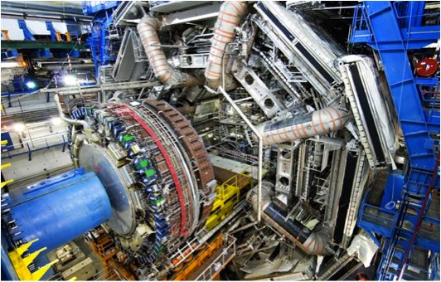
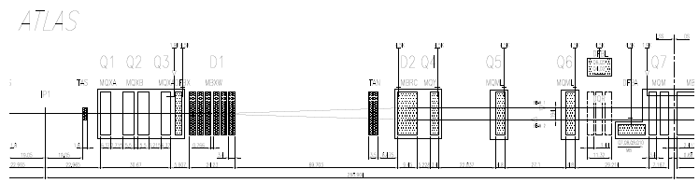
Luminosity Upgrade:
Stronger Focusing & Larger Aperture
Inner Triplet
Separation/ Recombination
Matching Quadrupoles
Q1 Q2 Q3
D1
(1.38 T)
Tertiary collimators
D2 Q4
(3.8 T)
Q5
Q6
Q7
TAS*
TAN*
IP1
188 mm
1.9 K
Warm
1.9 K
4.5 K
4.5 K
4.5 K

Slide 7
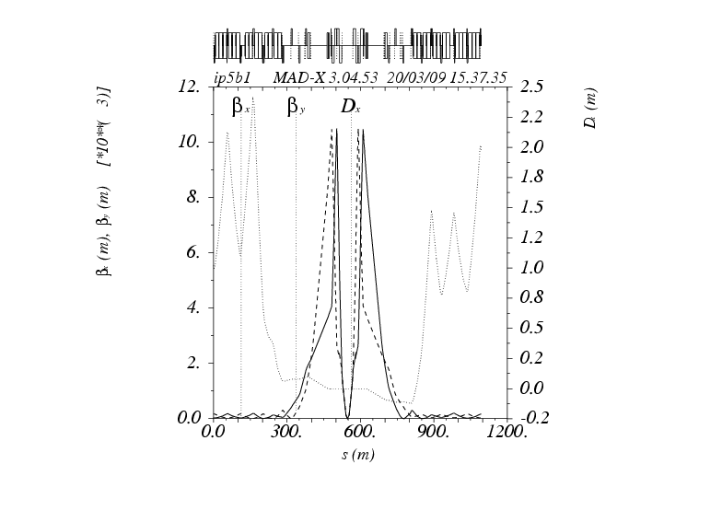
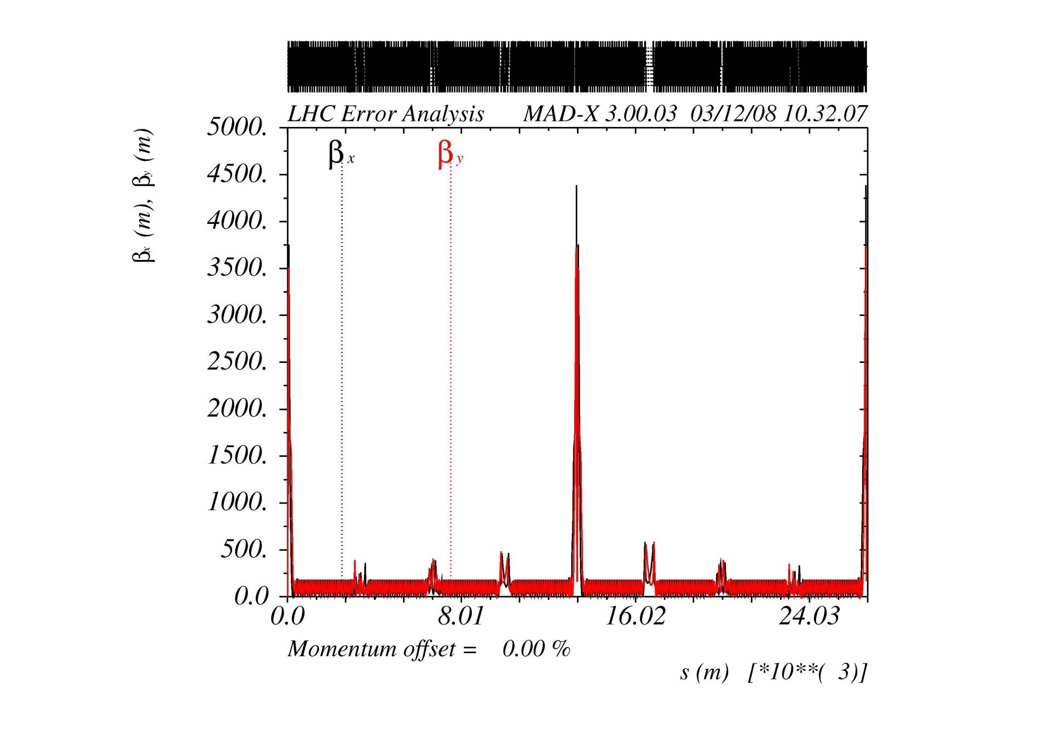
Stronger Focusing & Larger Aperture
Stronger focusing → smaller beam size at the IP
  High Gradient/Large Aperture Insertion Quadupole Magnets
    possibly: l = 8 m, G= 175 T/m, Φ=120 mm
    β* ≤ 22 cm are possible with a factor ~ 2.5 in luminosity by itself
~11 km
β*=35cm
new sc. technology Nb₃Sn
IR1
IR5
β* = 55 cm
IR2
IR3
IR4
IR6
IR7
IR8

Slide 8
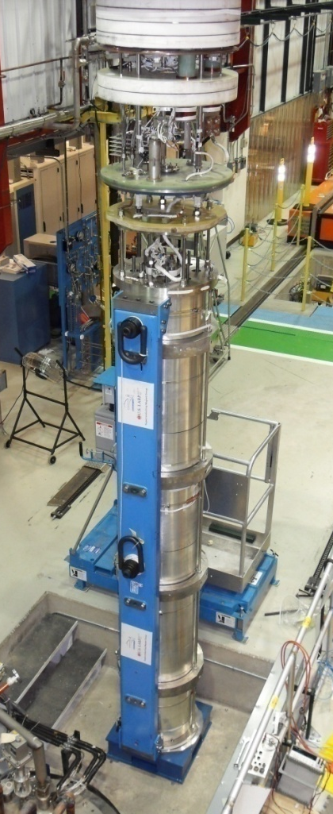
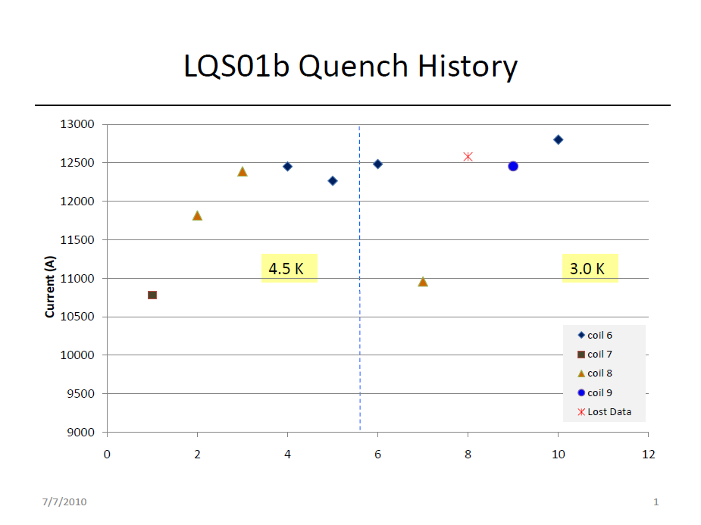
High Field Nb₃ Sn Quad
reminder: LHC standard inner triplet NbTi: GLHC=215 T/m, ΦLHC=66 mm
G (for a given current) = f(1/ρ²) (ρ is the aperture radius)
So for 2xΦLHC ➔ G = ¼ x GLHC if standard NbTi technology
Clearly NbTi technology cannot be used
Nb₃Sn is becoming a reality (first LQ l = 3.6 m – Φ = 90 mm)
This year we expect a second LQ: l = 1 m long – Φ =120 mm
In 3 years: l = 4-6 m – Φ = 120 mm - G = 180-200 T/m
G= 200 T/m
160 T/m G_{equiv} LHC

Slide 9
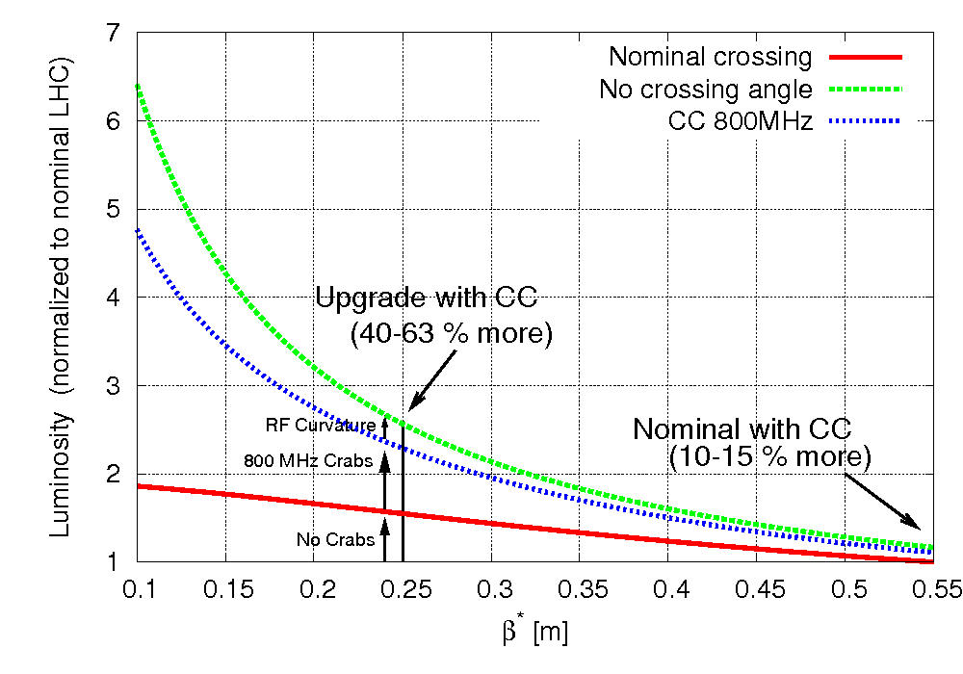
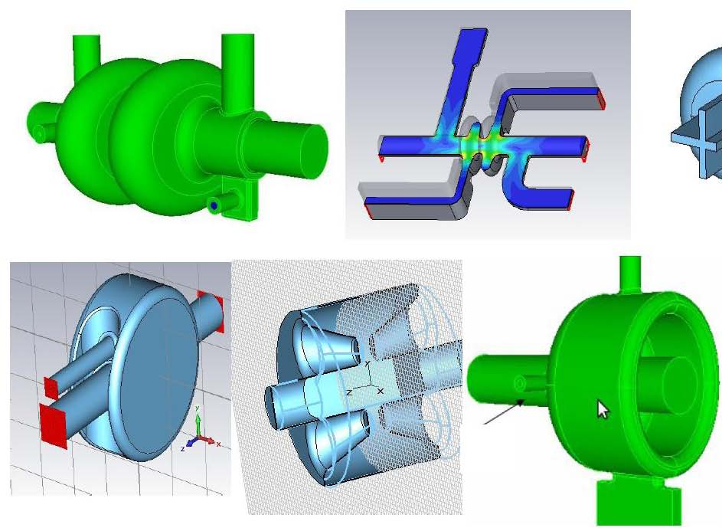
Crab Cavities
x
x
s
s
ρ₁(x,y,s,-s₀)
ρ₁(x,y,s,-s₀)
ρ₂(x,y,s,-s₀)
ρ₂(x,y,s,-s₀)
1st proposed in 1988, in operation at KEKB since 2007
Elliptical 800 MHz not far from being designed.
400 MHz small cavity under conceptual study, they can (?) fit in 194 mm beam-beam. Required for final solution
Technical challenge: fast, precise, compact
court. F. Zimmermann, Ed Ciapala

Slide 10
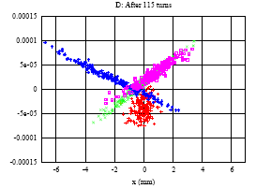
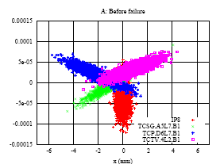
Problem: Crab Cavities have to be fast ➔Machine Protection & Safety
Machine Protection:
beam loss & possible
machine damage
Phase space deformation in case of failure of RQ4.LR7 (A. Gómez)
Short Summary of the studies:
- quench in sc. arc dipoles: τ _{loss} =20 - 30 ms
BLM system reacts in time, QPS is not fast enough
- failure of nc. quadrupoles: τ _{det} = 6 ms
τ _{damage} = 6.4 ms
- failure of nc. dipole: τ _{damage} = 2 ms
crab cavities: instantenous ( τ ≈ ns ) → a true technical challenge
→ FMCM installed

Slide 11
Single bunch intensity
Luminosity depends directly upon beam brightness N/ε* (i.e. particle density)
Brightness is limited by space charge at low energy in the injectors
Tune shift
Need to increase the injection energy in the pre-accelerator chain

Slide 12
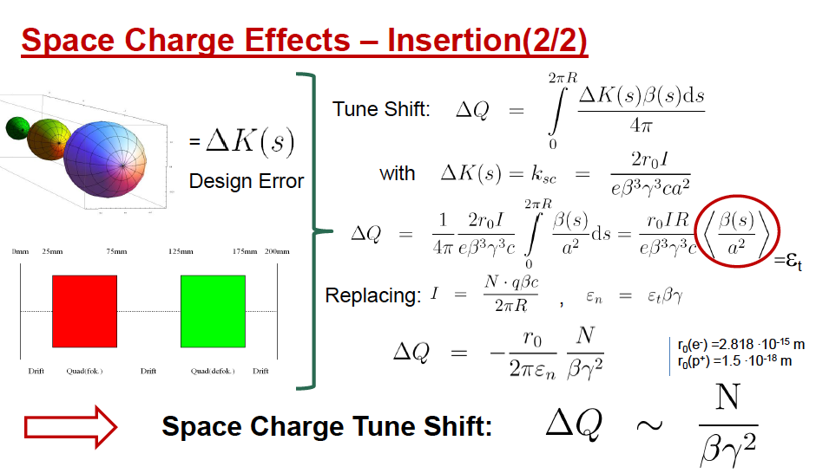
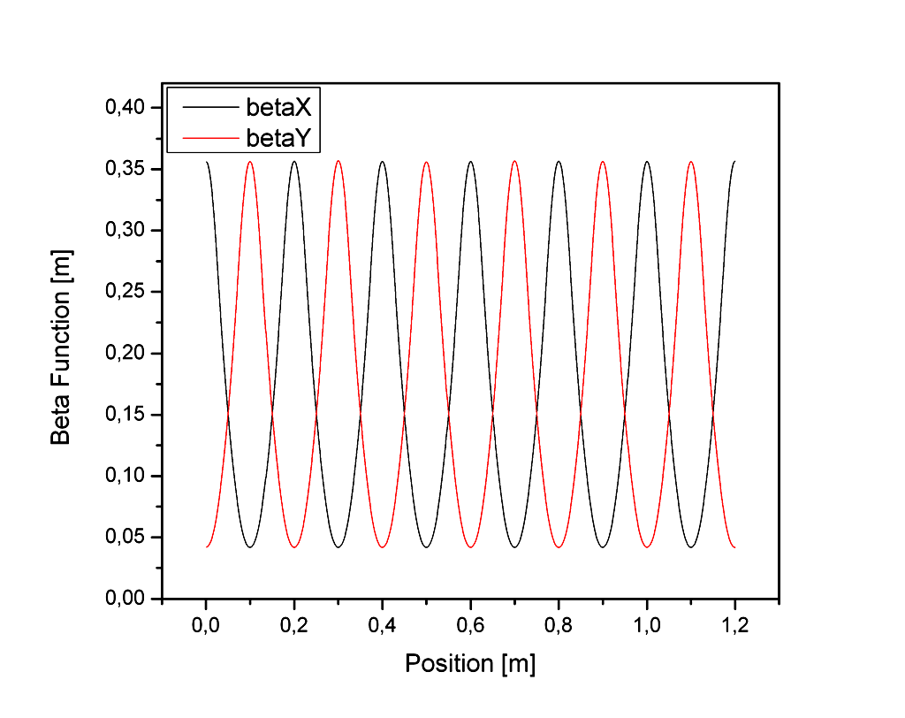
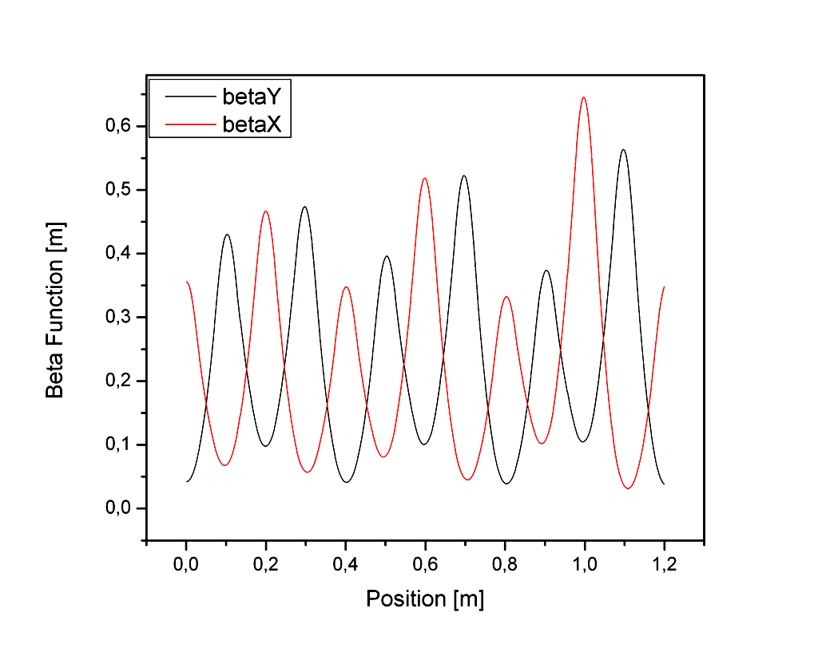
Space Charge problem
t1
t2
t3
Defocusing force
court. L. Hein

Slide 13
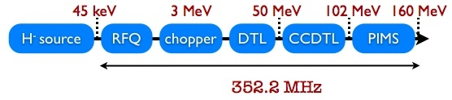
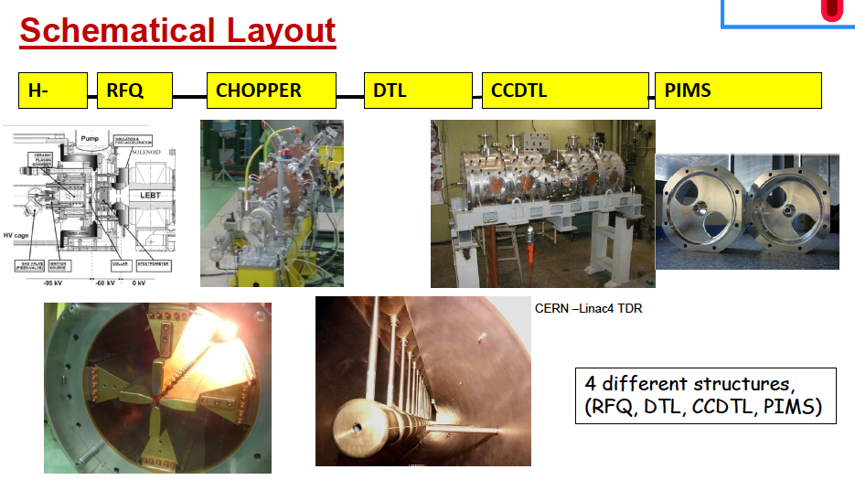
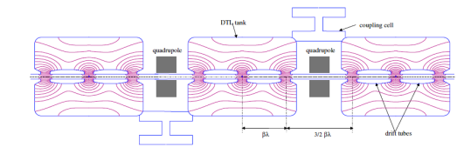
LINAC4
H⁻
p⁺
Stripoff foil
p⁺
PSB
N_{p}=1.15 → 1.7 * 10¹¹ p+/bunch
(Linac2 50 MeV)
New tech, never used before in linacs
RFQ: Radio Frequency Quadrupole
DTL: Drift Tube Linac
CCTL: Coupled Cells DTL
PIMS: πMode Linac

Slide 14

More Lumi ➔ More cooling power
L. Tavian,
2005
H. Maury Cuna,
2009
Cooling & e- heat for 25 ns spacing
nominal
“ultimate”
spare
cooling
capacity
at zero
luminosity
(=total-SR
-impedance)
e-cloud
heat
load for
SEY=1.3
spare cooling capacity
for 0.55 m β*
going above N_{b}=1.7x10¹¹ & ultimate luminosity requires
dedicated IR cryo plants; limit then becomes N_{b}~2.3x10¹¹

Slide 15
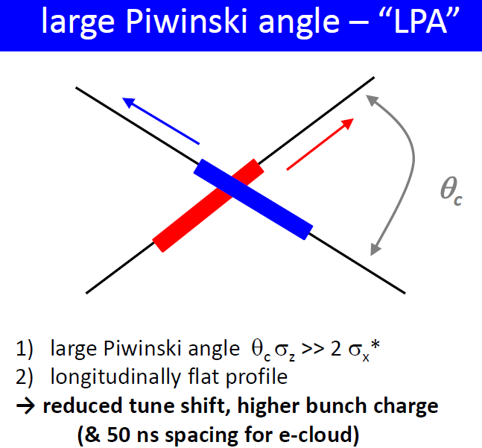
cooling & e- heat for 50 ns spacing
L. Tavian,
2005
H. Maury Cuna,
2009
(longer flat bunches)
spare cooling capacity
for 0.25 m β*
e-cloud
heat
load for
SEY=1.5!
Spare cooling
Capacity at zero
Luminosity (=total-SR-impedance)
going above N_{b}=2.3x10¹¹ & ultimate luminosity requires
dedicated IR cryo plants; limit then becomes N_{b}~5.0x10¹¹

Slide 16
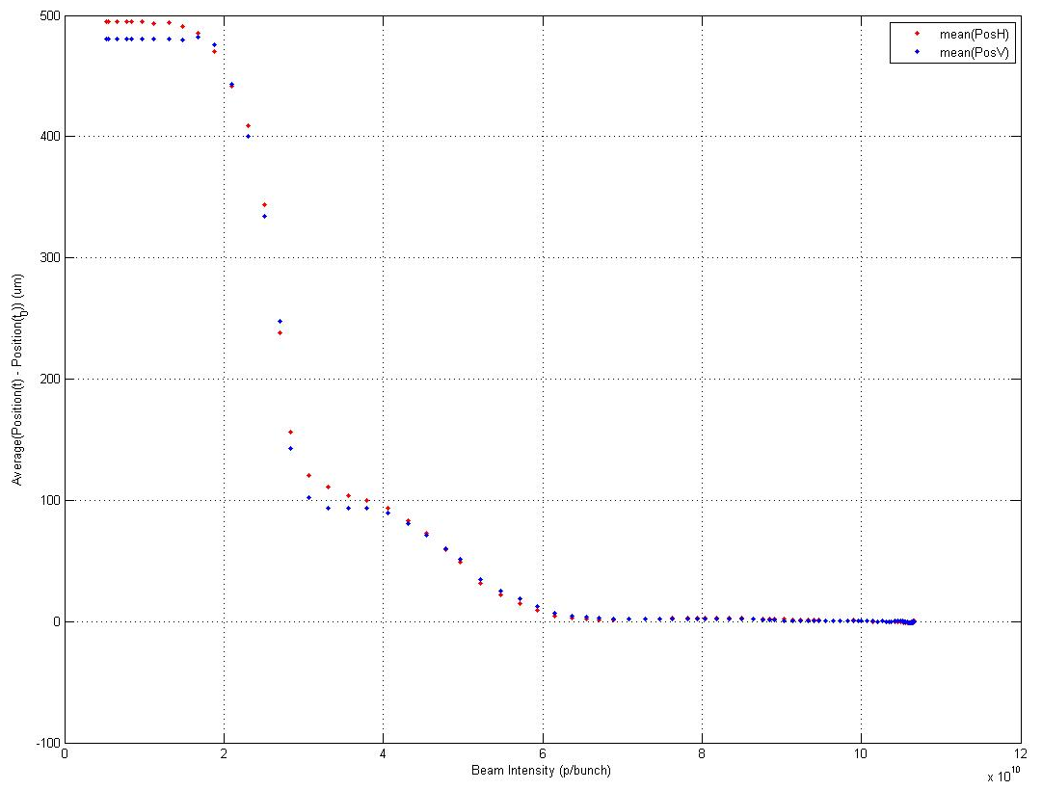
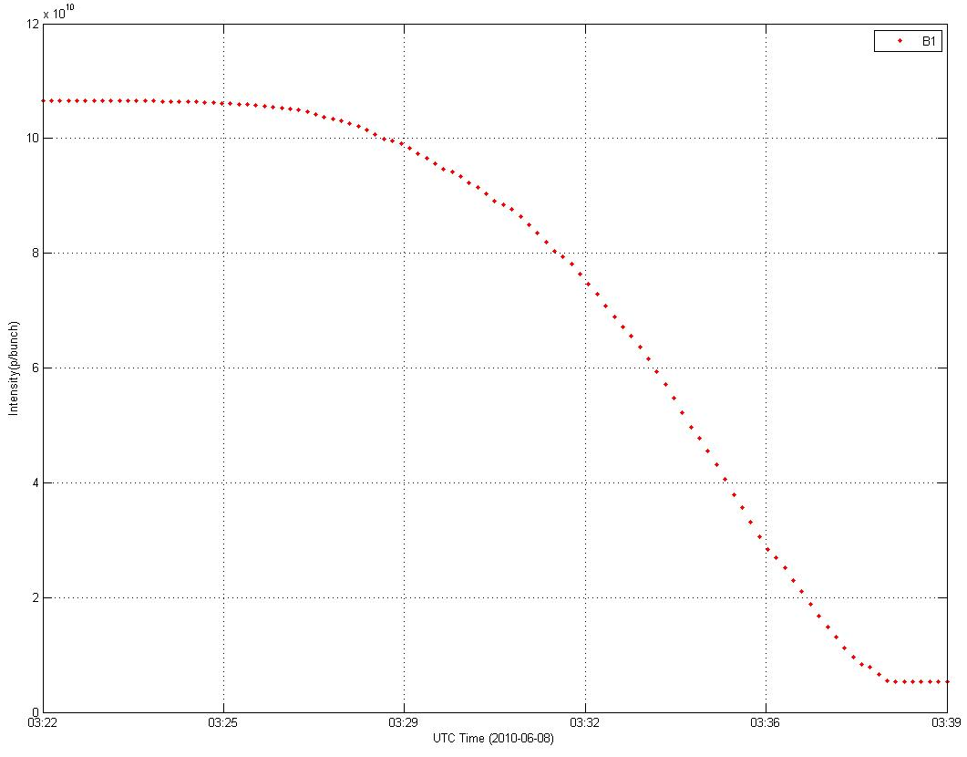
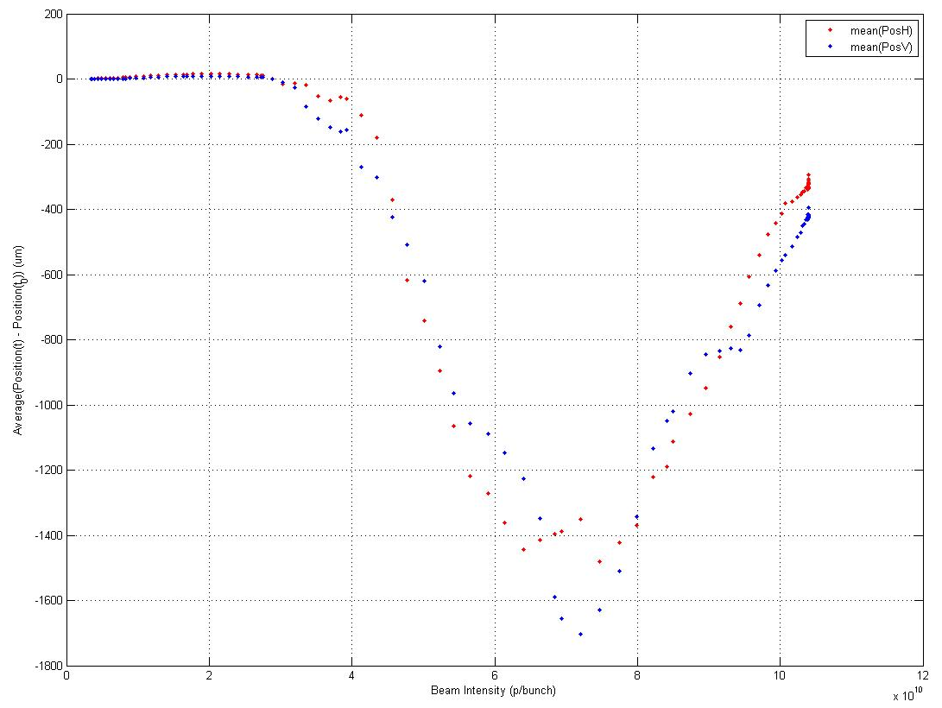
Are there any other challenges ? ... sure there are
Intensity dependence of Electronics:
  e.g. BPM signals
One nominal bunch of 1×10¹¹
slowly scraped away using a primary collimator
Low Sensitivity
Dead zone where neither setting works well
Average (position(t)-position(to)) (µm)
10¹⁰
10
Intensity (p+/bunch)
×10¹⁰
8
6
High Sensitivity
Intensity (p+/bunch)
4
2
Average (position(t)-position(to)) (µm)
time
Intensity (p+/bunch)
×10¹⁰

Slide 17
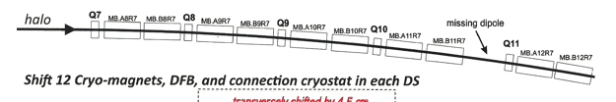
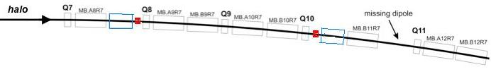
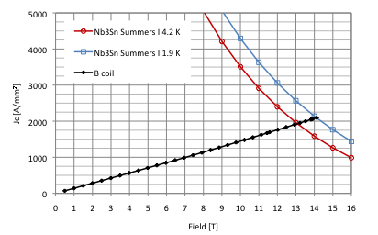
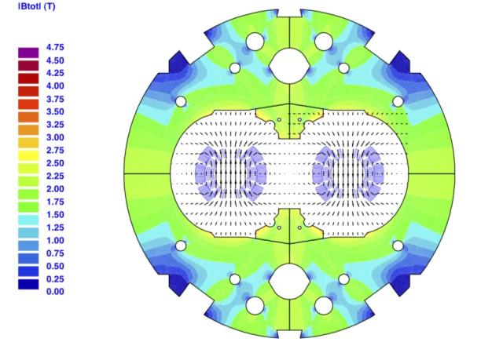
Problem: Collimation Efficiency
  Collimation limits luminosity to 2*10³³ cm⁻²s⁻¹
  → additional collimators needed in the cold section
Option: stronger and shorter dipole magnets
... again: Nb₃ Sn technology
Nb3Sn 4.2 K
Nb3Sn 1.9 K
B coil
Jc (A/mm²)
Field (T)
2
4
6
8
10
12
14
16

Slide 18
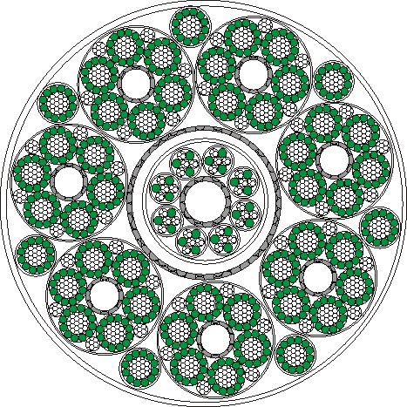
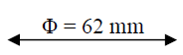
Problem: Radiation Background
Displacement of Power Converters & DFBs of Inner Triplets and other equipment on surface by means of SC links.
1.1 mm
MgB₂ wire
MgB₂ T_{c}=39K
or even Bi-2223 / Y-123

Slide 19
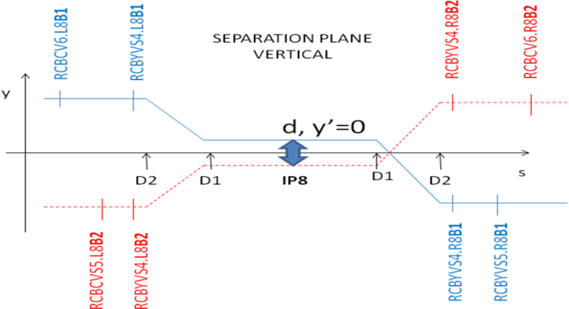
How can we level?
1. Via crossing angle
F is a pure crossing angle (Φ) contribution:
FLHC = 0.836
x
Φ
Φ
s
2. Via the β*
ρ₁(x,y,s,-s₀)
ρ₂(x,y,s,-s₀)
3. Via beam separation
Leveling by separation used today at LHCb

Slide 20
What happens to the pile-up?
#events per bunch crossing:
bunch collision rate
µ_NOMINAL LHC= 10³⁴ cm⁻²s⁻¹ 6x10⁻²⁶ cm² / (32 x10⁶ s⁻¹) ~ 20
inelastic cross section
e.g. 10 times higher luminosity at same #bunches
→ ~200 events per crossing
Detector upgrade!

Slide 21
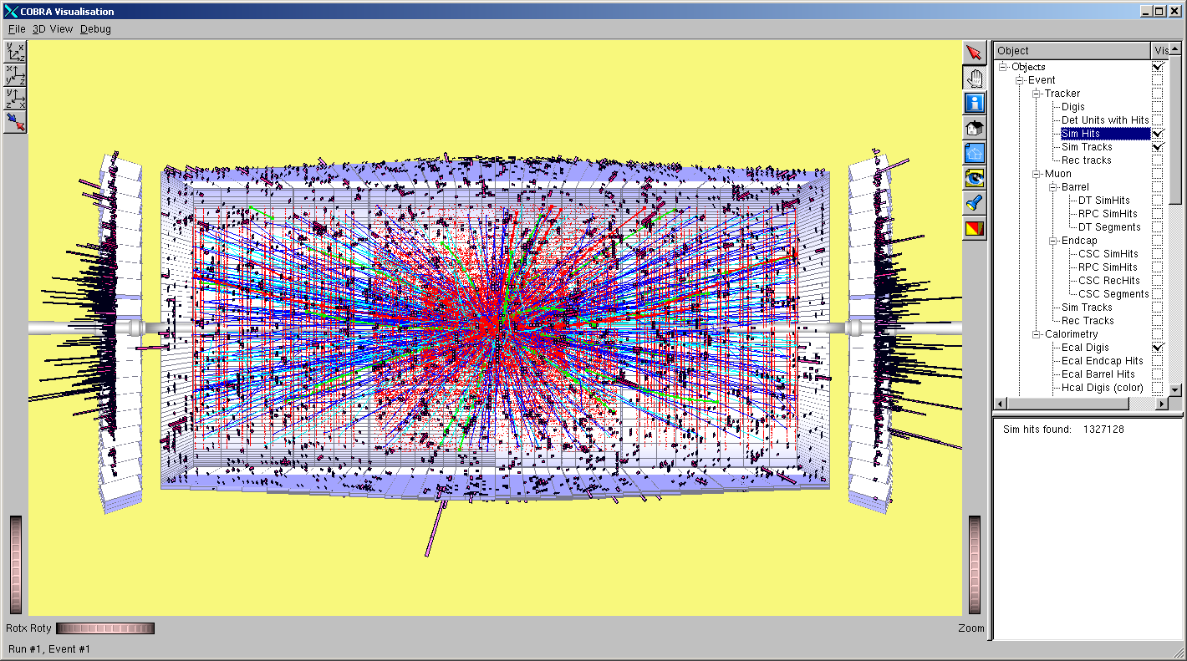
thank you for your attention!
I. Osborne
5x10³⁴ cm⁻²s⁻¹
generated tracks per crossing,
p_{t} > 1 GeV/c cut, i.e. all soft tracks removed!

Slide 22
LHC Performance Estimates
Performance reach for existing machines @ 7 TeV:
nominal emittance
small emittance
Parameter | nominal | 25ns | 50ns | 50ns
N | 1.15E+11 | 1.2E+11 | 1.7E+11 | 1.7E+11
n_{b} | 2808 | 2808 | 1404 | 1404
beam current [A] | 0.58 | 0.61 | 0.43 | 0.43
x-ing angle [μrad] | 300 | 320 | 320 | 270
beam separation [σ] | 10 | 10 | 10 | 10
β* [m] | 0.55 | 0.5 | 0.5 | 0.5
ε_{n} [μm] | 3.75 | 3.75 | 3.75 | 2.5
ε_{L} [eVs] | 2.51 | 2.5 | 2.5 | 2.5
energy spread | 1.00E-04 | 1.00E-04 | 1.00E-04 | 1.00E-04
bunch length [m] | 7.50E-02 | 7.50E-02 | 7.50E-02 | 7.50E-02
IBS horizontal [h] | 80 -> 106 | 101 | 71 | 29
IBS longitudinal [h] | 61 -> 60 | 58 | 41 | 25
Piwinski parameter | 0.68 | 0.76 | 0.76 | 0.78
geom. reduction | 0.83 | 0.80 | 0.80 | 0.79
beam-beam / IP | 3.10E-03 | 3.1E-03 | 4.4E-03 | 6.6E-03
Peak Luminosity | 1 10³⁴ | 1.0 10³⁴ | 1.2 10³⁴ | 1.7 10³⁴
Radiation
damping:
hor: 26h
ver: 13h
Chamonix, January 2011 Oliver Brüning BE-ABP
22
Notes:
Smaller than nominal beam current for small emittance beam; aperture margin due to smaller required crossing angle; potential for smaller beta*, less e-cloud effect due to larger bunch spacing; Transverse damping time = 26 h and longitudinal damping time = 13 h; RF noise seems to be small

Slide 23
LHC Performance Estimates
Performance reach for existing machines + LINAC4:
nominal emittance
Parameter | nominal | 25ns | 50ns
N | 1.15E+11 | 1.4E+11 | 2.5E+11
n_{b} | 2808 | 2808 | 1404
beam current [A] | 0.58 | 0.71 | 0.64
x-ing angle [μrad] | 300 | 320 | 320
beam separation [σ] | 10 | 10 | 10
β* [m] | 0.55 | 0.5 | 0.5
ε_{n} [μm] | 3.75 | 3.75 | 3.75
ε_{L} [eVs] | 2.51 | 2.2 | 2.5
energy spread | 1.00E-04 | 1.00E-04 | 1.00E-04
bunch length [m] | 7.50E-02 | 7.50E-02 | 7.50E-02
IBS horizontal [h] | 80 -> 106 | 80 | 45
IBS longitudinal [h] | 61 -> 60 | 41 | 23
Piwinski parameter | 0.68 | 0.76 | 0.76
geom. reduction | 0.83 | 0.80 | 0.80
beam-beam / IP | 3.10E-03 | 3.64E-03 | 6.5E-03
Peak Luminosity | 1 10³⁴ | 1.6 10³⁴ | 2.5 10³⁴
Chamonix, January 2011 Oliver Brüning BE-ABP
23
Notes:
50ns beam option provides possibility of more than twice the nominal performance at approximately nominal total beam current; reduced e-cloud due to larger bunch spacing

Slide 24
LHC Performance Estimates
Performance reach for LINAC4 + LIU + HL triplet: long bunch
small β*
‘large’ β*
Parameter | nominal | 25ns | 50ns | 25ns | 50ns
N | 1.15E+11 | 2.0E+11 | 3.3E+11 | 2.0E+11 | 3.3 E+11
n_{b} | 2808 | 2808 | 1404 | 2808 | 1404
beam current [A] | 0.58 | 1.02 | 0.84 | 1.02 | 0.84
x-ing angle [μrad] | 300 | 420 | 520 | 270 | 320
beam separation [σ] | 10 | 10 | 10 | 10 | 10
β* [m] | 0.55 | 0.2 | 0.2 | 0.5 | 0.5
ε_{n} [μm] | 3.75 | 2.5 | 3.75 | 2.5 | 3.75
ε_{L} [eVs] | 2.51 | 3.0 | 3.0 | 3.0 | 3.0
energy spread | 1.00E-04 | 1.00E-04 | 1.00E-04 | 1.00E-04 | 1.00E-04
bunch length [m] | 7.50E-02 | 0.1 | 0.1 | 0.1 | 0.1
IBS horizontal [h] | 80 -> 106 | >40 | 56 | >40 | 56
IBS longitudinal [h] | 61 -> 60 | >40 | 56 | >40 | 56
Piwinski parameter | 0.68 | 2.57 | 2.59 | 1.04 | 1.00
geom. reduction | 0.83 | 0.36 | 0.36 | 0.69 | 0.70
beam-beam / IP | 3.10E-03 | 3.6E-03 | 4.9E-03 | 6.8E-3 | 7.6E-3
Peak Luminosity | 1 10³⁴ | 5.5 10³⁴ | 4.9 10³⁴ | 4.2 10³⁴ | 3.9 10³⁴
Beam current well beyond ultimate design is needed
Chamonix, January 2011 Oliver Brüning BE-ABP
24
Notes:
Gain from lower beta* becomes smaller if bunch length is increased

Slide 25
Beam parameters (nominal)
 |  | Injection | Collision
Proton energy | GeV | 450 | 7000
Particles/bunch |  | 1.15 x 10¹¹
Num. bunches |  | 2808
Longitudinal emittance (4σ) | eVs | 1.0 | 2.5
Transverse normalized emittance | µm rad | 3.5 | 3.75
Beam current | A | 0.582
Stored energy/beam | MJ | 23.3 | 362
Peak luminosity related data
RMS bunch length | cm | 11.24 | 7.55
RMS beam size @IP1 & IP5 ➔ σx,y = √εβ | µm | 375.2 | 16.7
RMS beam size @IP2 & IP8 ➔ σx,y = √εβ | µm | 279.6 | 70.9
Geometric luminosity reduction factor (F) |  |  | 0.836
Instantaneous lumi @IP1 & IP5 (IP2Pb-Pb, IP8) | cm⁻²s⁻¹ |  | 10³⁴(10²⁷ , 10³²)
Instantaneous lumi/bunch crossing @IP1 & IP5 | cm⁻²s⁻¹ |  | 3.56 x 10³⁰
= 10 m
ε = 0.5 nm rad
= 0.55 m
ε = 0.5 nm rad

Slide 26
approaches to boost LHC luminosity
low β* & crab cavities (80 MV)
low β* & higher harmonic RF (7.5 MV @800 MHz) + LR compensation
large Piwinski angle (& “flat” bunch shape) + LR-BB compensation
always pushing intensity to “limit”
θ_{c}
θ_{c}
θ_{c}

