Slide 1
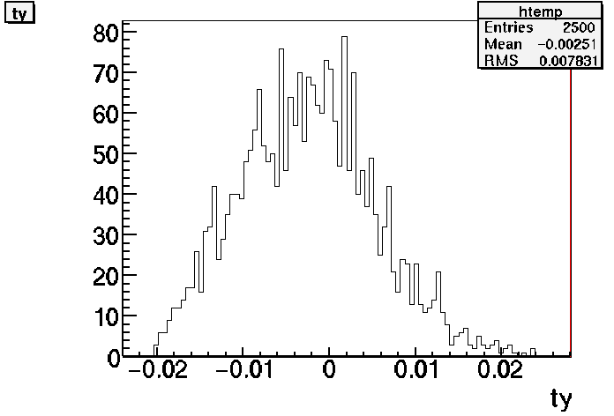
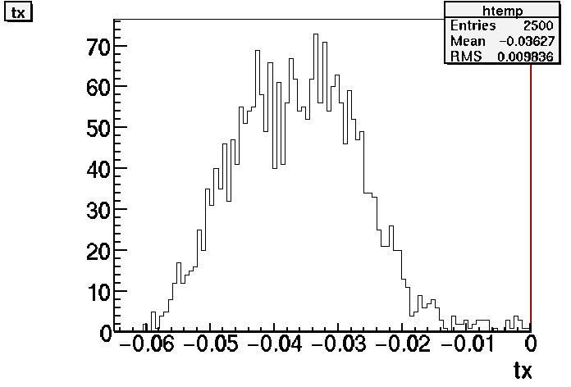
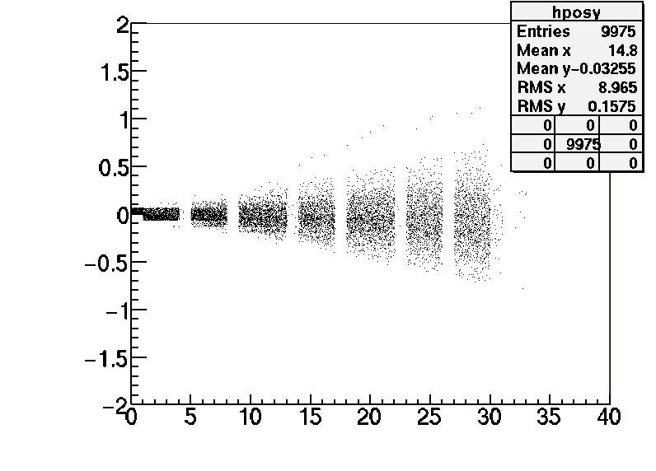
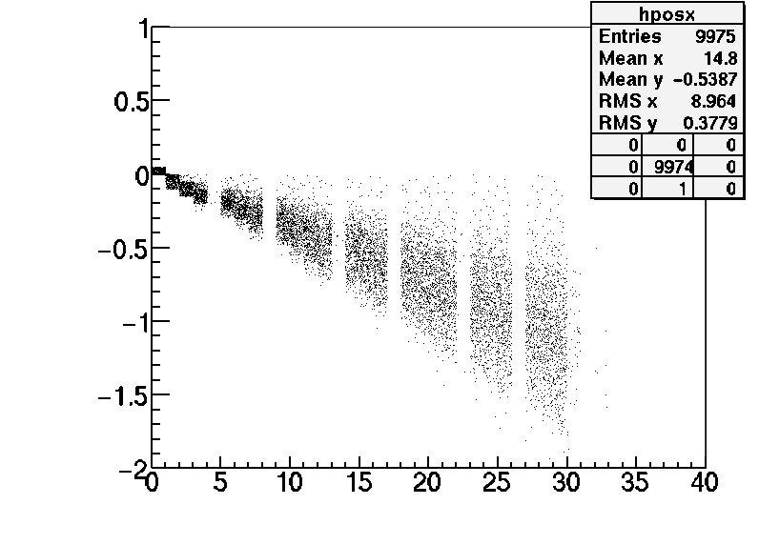
Pion test beam from KEK: momentum studies
Data provided by Toho group:
2512 beam tracks
Track θy
Track θx
Base track positions
Base track positions
Relative X (mm)
Relative Y (mm)
Relative Z (mm)
Relative Z (mm)
D. Duchesneau April 27th 2011

Slide 2
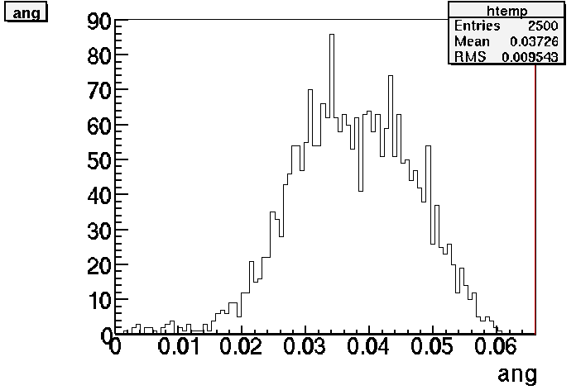
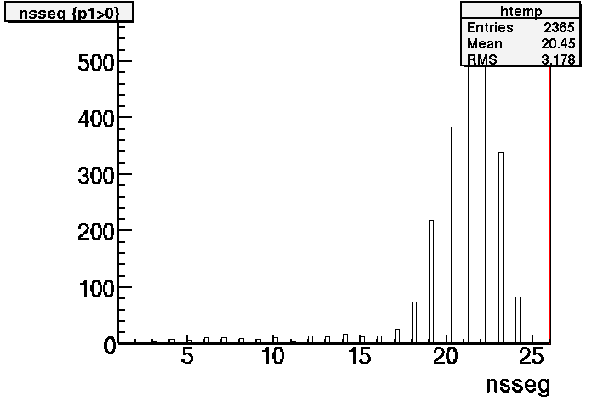
For the momentum measurement the number of segments per track is chosen > 15
Assumption: the base tracks are already corrected for plate alignment.
Number of segments/track
3 D angle
Angle (rad)

Slide 3
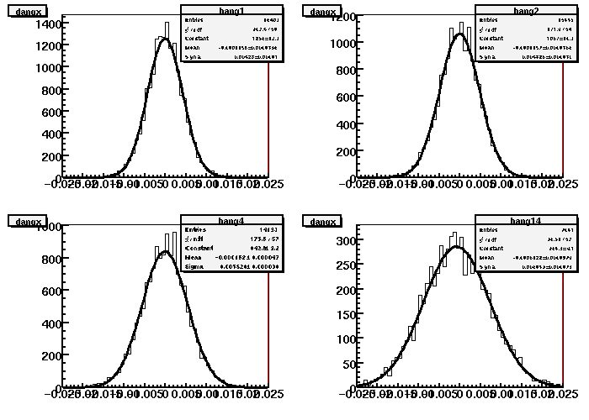
Difference of base track angle distributions for 4 different values of Ncell combining XZ and YZ projections
Ncell = 1
Ncell = 2
Δangle between 2 base tracks
Ncell = 4
Ncell = 14
Observe a shift in the mean value of these distribution as a function of lead thickness => to analyse because they should be centered around 0.

Slide 4
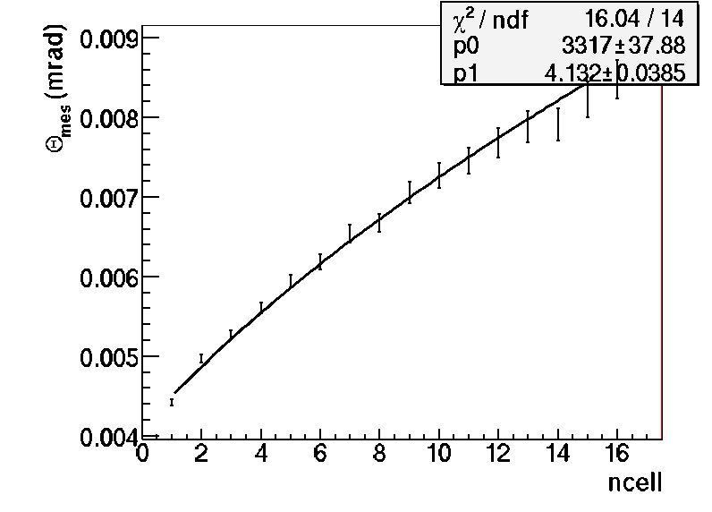
From the sigma of the previous distribution we usually fit the Ncell dependence with the MCS formula with the base track resolution and the global momentum as free parameters
calculating BT resolution ...
P=3317 MeV/c (this momentum is lower than expected for a 4 GeV/c pion beam)
double base track resolution= 4.13 mrad

Slide 5
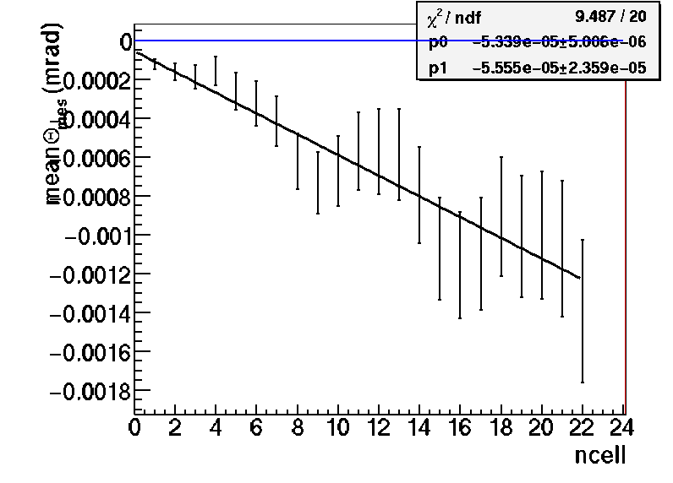
In order to understand the normal behaviour we should look into more details the difference of angle distributions of all tracks.
First: the mean value of the previous gaussian distributions as a function of Ncell.
There is a clear bias corresponding to an average constant angular deviation of
0.053 mrad every mm
Reasons: for example could be a systematic piling error of the plates which spoils the parallelism. This is a alignement correction if this is the case.
data
Both XZ + YZ projections
However this is an effect which usually is not impacting the variance of the distributions if the effect is identical for all angle measurements, especially between the 2 projection planes. And should not affect the momentum measurements but criteria to verify.

Slide 6
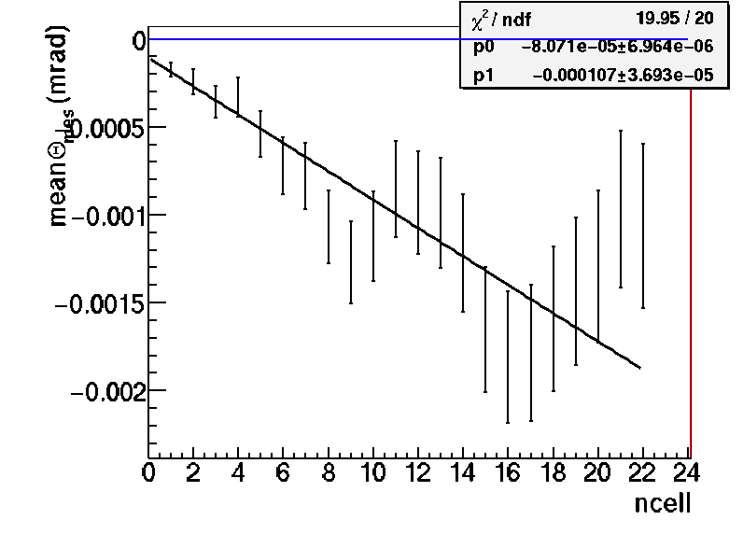
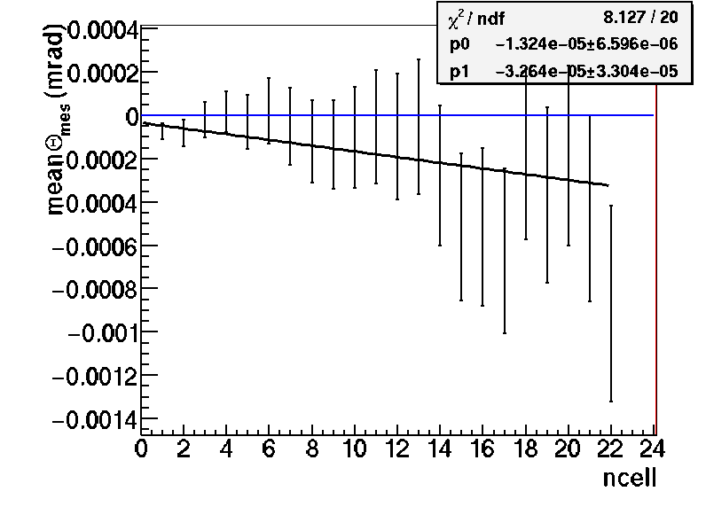
Analyse the bias independently for the 2 different projection planes:
Using only the angle differences measured in XZ plane
rad
Most of the bias comes from this plane
corresponding to an average constant angular deviation of
0.081 mrad every lead cell
data
Using only the angle differences measured in YZ plane
rad
No bias measurable for ncell <15.
This means that we cannot combine the XZ and YZ angular differences in the same distribution. This would increase artificially the variance and subsequently would pull the momentum of the fit shown in slide 4 to low values
data

Slide 7
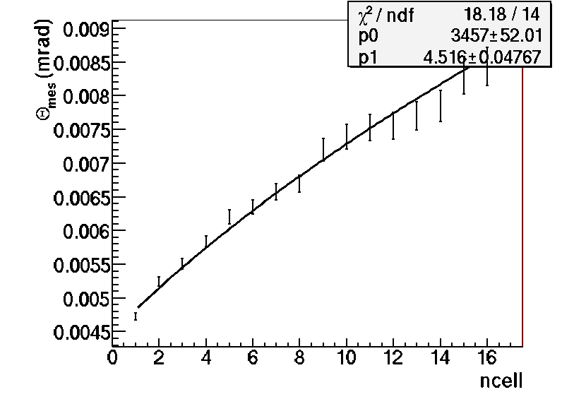
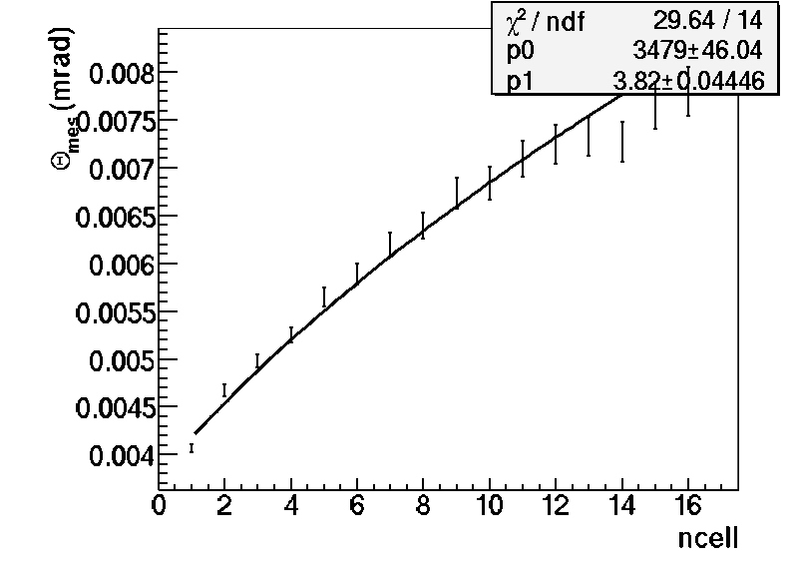
Analyse the angle differences in XZ and YZ separately:
From the mean variance of the difference of angle distributions
rad
XZ
calculating BT resolution ...
P(XZ)=3.5 GeV/c
double base track resolution= 4.5 mrad
data
calculating BT resolution ...
P(XZ)=3.5 GeV/c
double base track resolution= 3.8 mrad
rad
YZ
data
Remarks: the global momentum fitted is now 3.5 GeV/c
The angular resolution is very different and relatively large in both projection planes.

Slide 8
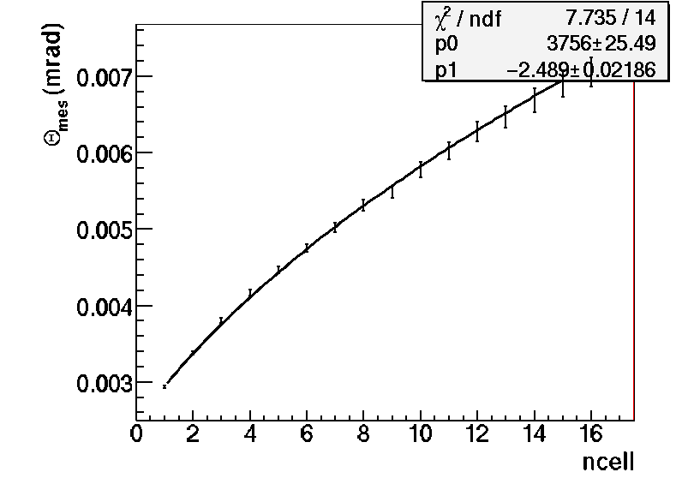
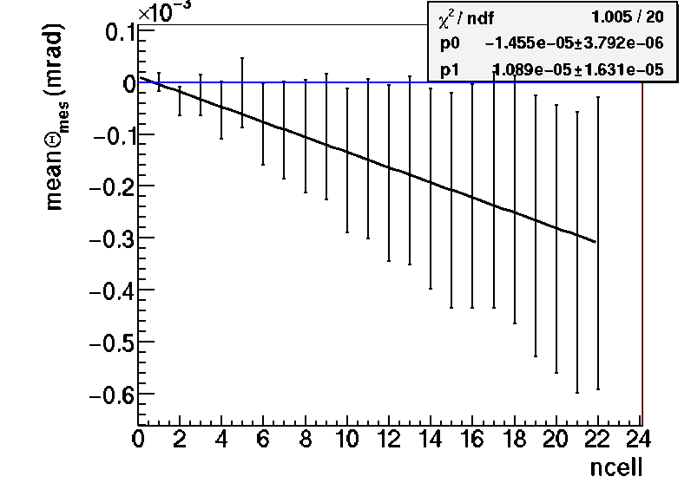
Monte Carlo Studies
Choose only portion of tracks to match the number of segments in the KEK data (about 20)
Use a sample of 4 GeV pion tracks simulated in a brick
Note the Y axis scale
rad
rad
XZ + YZ
MC
calculating BT resolution ...
P=3.8 GeV/c
double base track resolution= 2.5 mrad

Slide 9
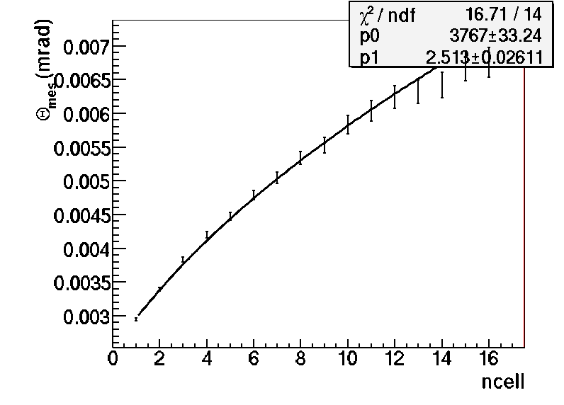
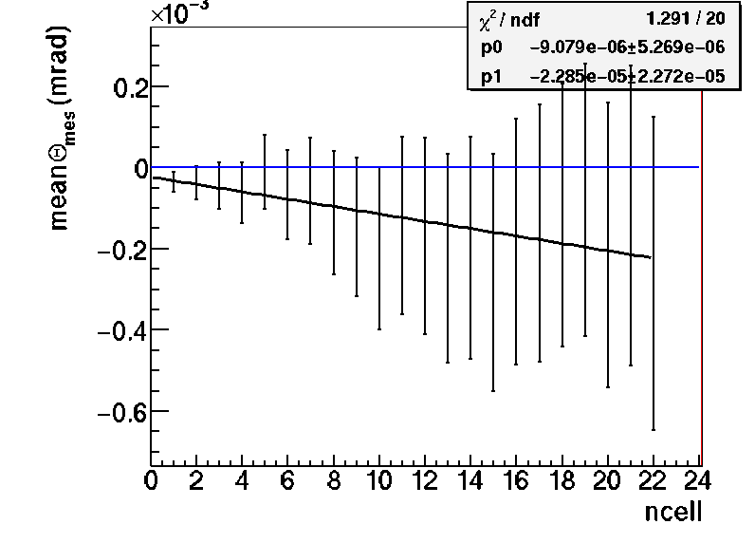

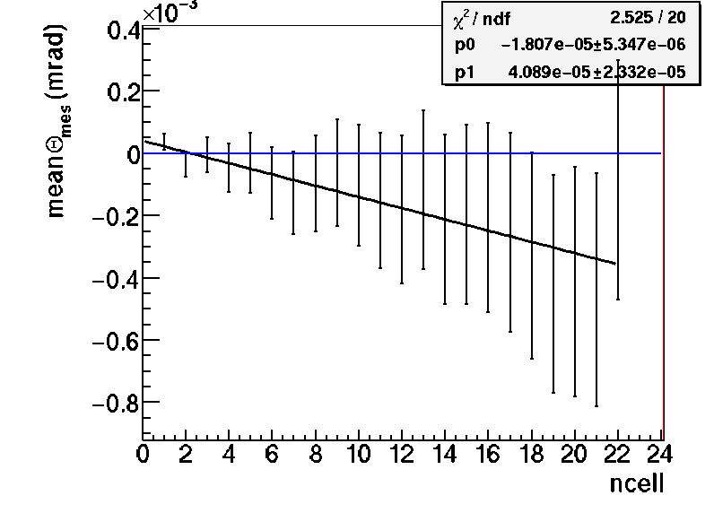
Monte Carlo Studies (4 GeV pions)
rad
XZ
rad
XZ
MC
MC
calculating BT resolution ...
P(XZ)=3.8 GeV/c
double base track resolution= 2.5 mrad
rad
rad
YZ
YZ
MC
MC
calculating BT resolution ...
P(YZ)=3.8 GeV/c
double base track resolution= 2.5 mrad
In the MC all the values are in full agreement between (XZ+YZ) and XZ and YZ

Slide 10
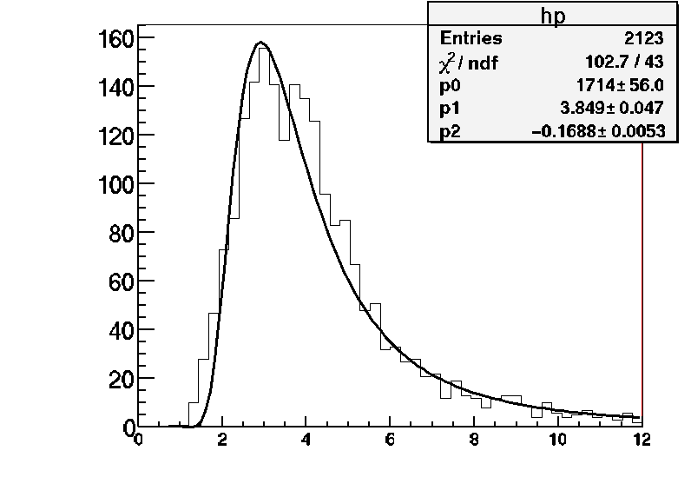
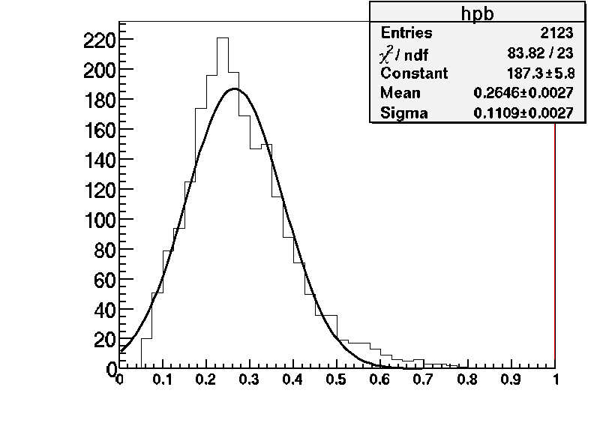
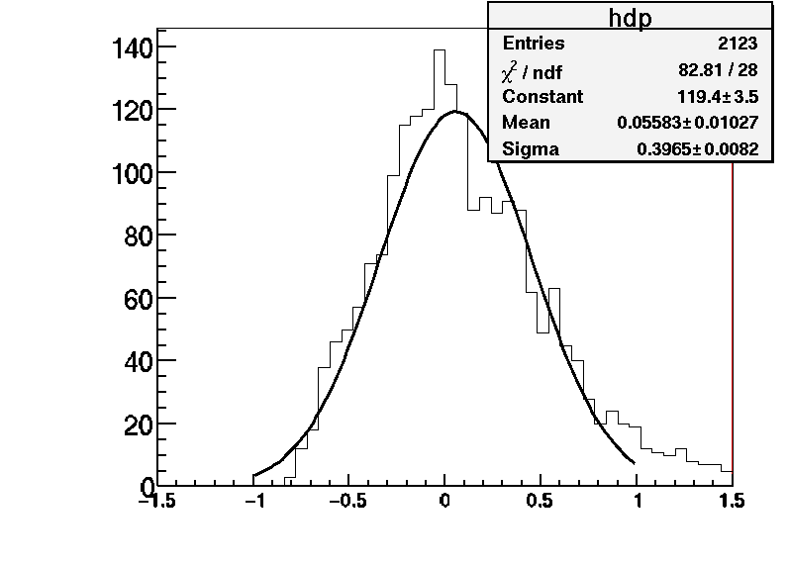
Test beam data
Applying track by track the PMCS algorithm with the double base track resolution= 4.13 mrad
Momentum obtained from p and 1/p distribution =3.81 GeV/c
Data
Data
p
1/p
Resolution Δ(1/p)/(1/p)=[39.6+-6.1] %
Data
This resolution is less than expected (30%) from this algorithm but this is due to the double base track resolution of 4.1 mrad instead of 2.1 mrad.
1- <p>/p

Slide 11
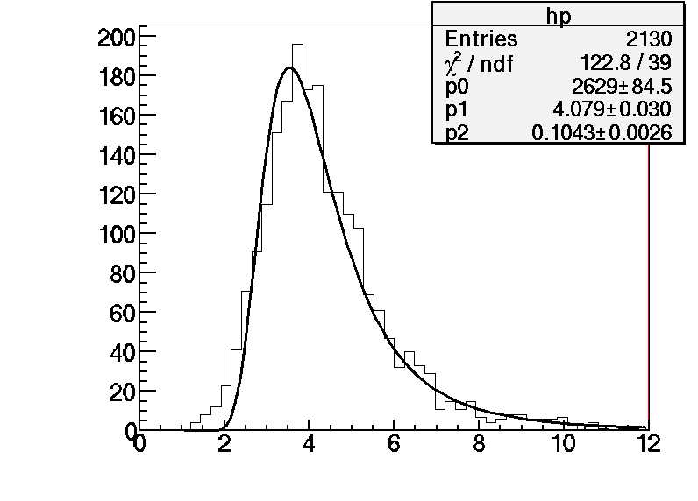
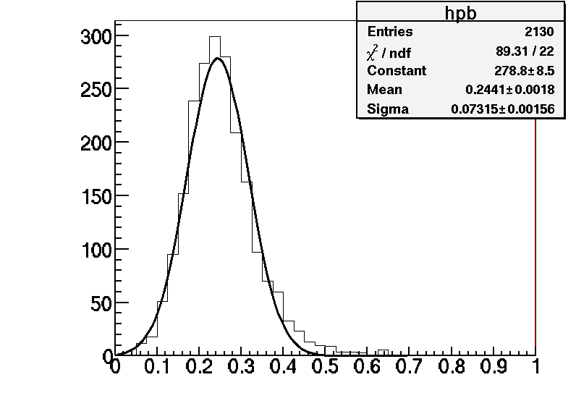
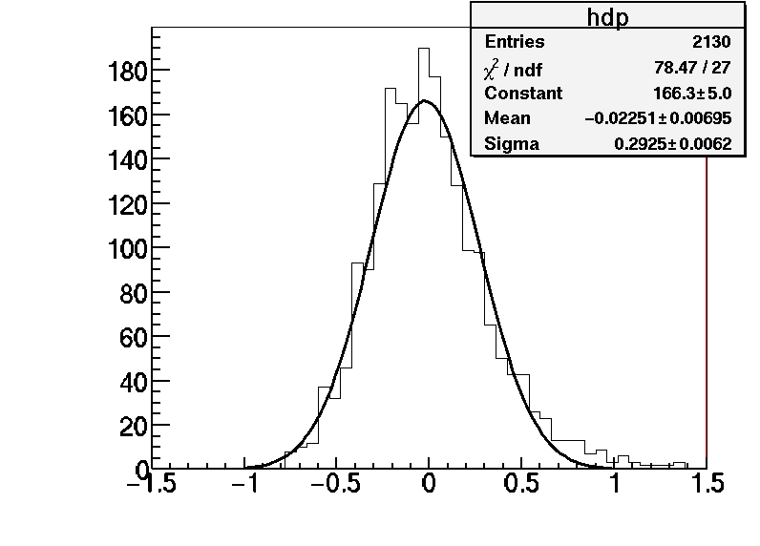
Monte Carle events
Applying track by track the PMCS algorithm with the double base track resolution= 2.5 mrad
Momentum obtained from p and 1/p distribution =4.09 GeV/c
MC
MC
p
1/p
Resolution Δ(1/p)/(1/p)=[29.2+-2.6] %
MC
This resolution is less than expected (35%) from this algorithm but this is due to the double base track resolution of 4.1 mrad instead of 2.1 mrad.
1- <p>/p

Slide 12
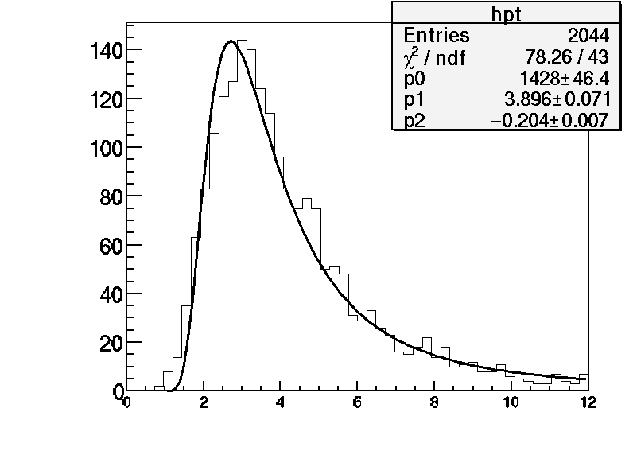
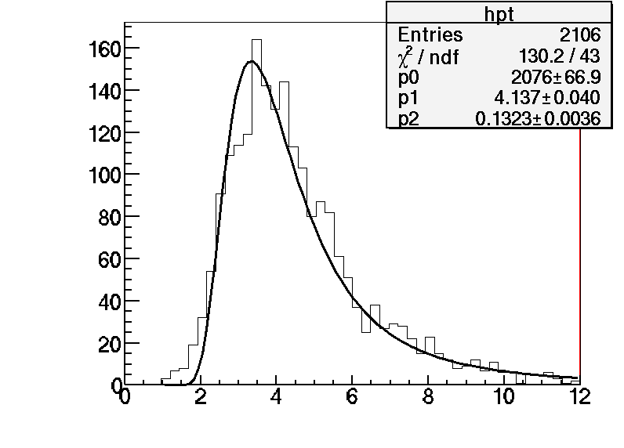
Summary in 3D and in transverse and longitudinal projections
KEK data
P3D=3.81373[0.0347992] GeV - DP/P=39.6496[6.07086] %
PL=3.79157[0.0212307] GeV - DP/P=43.0014[5.00714] %
PT=3.85968[0.0366781] GeV - DP/P=43.6257[6.51717] %
Data
Transverse coord.
P (GeV/c)
MC
P3D=4.0879[0.00929236] GeV - DP/P=29.2465[2.65249] %
PL=4.08167[0.0168638] GeV - DP/P=34.1401[3.81461] %
PT=4.15084[0.0139606] GeV - DP/P=33.8707[3.4425] %
MC
Transverse coord.
P (GeV/c)

Slide 13
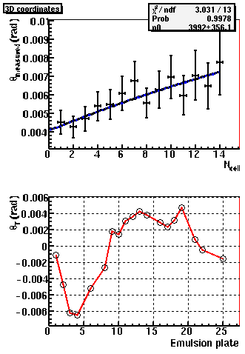
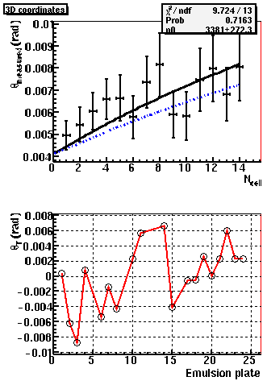
Test beam data
Some examples of a few tracks;
the blue line corresponds to a 4 GeV/c beam track and the black line is the MCS fit result:
Track 1
Track 5
Pmcs=3.38 GeV/c
Pmcs=3.99 GeV/c

Slide 14
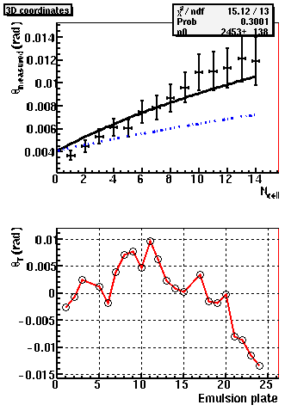
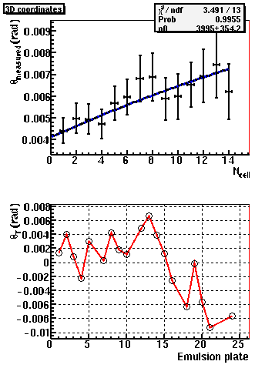
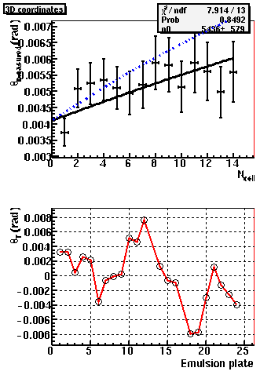
Test beam data
Track 8
Track 7
Pmcs=5.44 GeV/c
Pmcs=3.99 GeV/c

Slide 15
Conclusionw:
The momentum measured with the test beam data provided by Toho and assuming the base track quantities have been corrected for alignment etc… is:
3.8 GeV/c with an uncertainty on the absolute scale of about 7%.
This uncertainty is mainly dominated by the angular resolution knowledge
The resolution is estimated to be 39% when using both projections and 43% in the transverse projection only
MC studies of 4 GeV/c pions gives (with the same algorithm) 4.1 GeV/c with a systematic uncertainty of about 5% which has been estimated by changing the fit range, varying the angular resolution, changing the track length etc…
The global fit of the Ncell dependence of the RMS of the angle difference is systematically giving a reduced momentum of a few hundreds of MeV in both MC and data. Concerning this point see remark on next slide.
An observed angle variation along the tracks is seen in the XZ projection planes. (see the last slide) The origin should be clarified: is it due to some misalignment, or systematic plate piling effects or unrelated field effect?

Slide 16
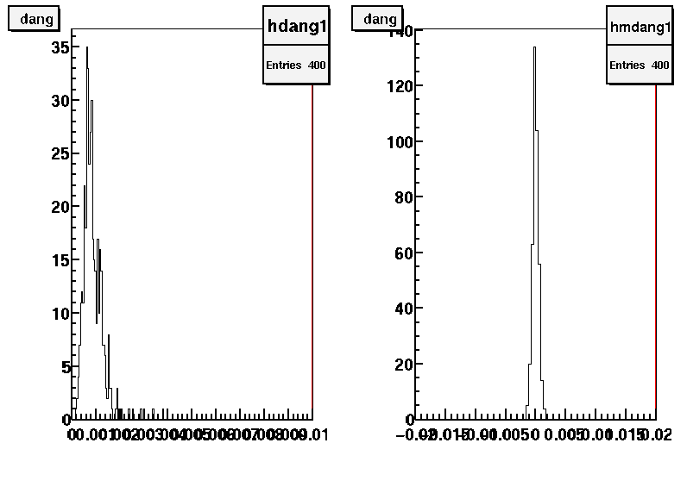
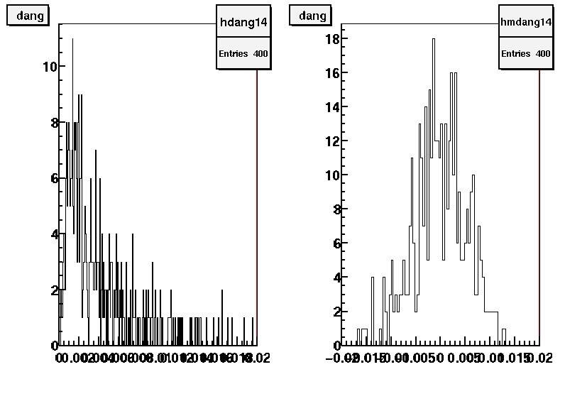
Remark:
The global momentum value obtained at the same time as the BT resolution is usually biased towards a lower value due to the combination of all the tracks together. This assumes that the mean Δθ of each track is about 0. In fact there is large fluctuation from track to track which increases with the lead depth as can be seen in the figures for 1mm and 14 mm for the MC
MC
Mean of Δθ per track
Variance of Δθ per track
1mm
1mm
This smears the variance which affects directly the average momentum but without affecting the resolution which is constrained mostly by the values at small values of Ncell.
Mean of Δθ per track
Variance of Δθ per track
14mm
14mm

Slide 17
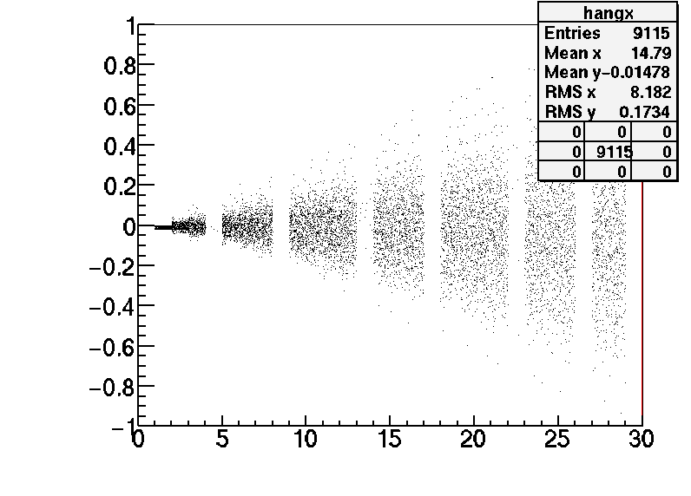
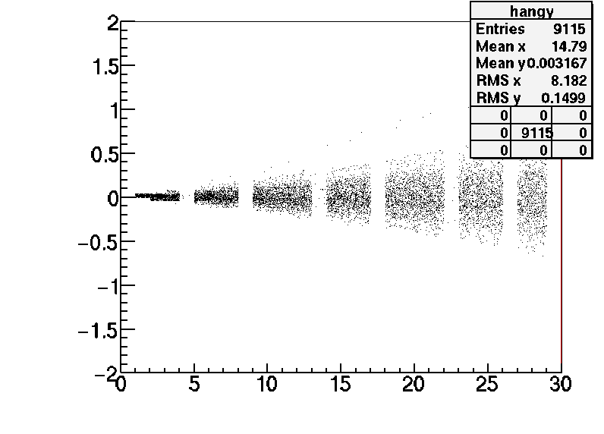
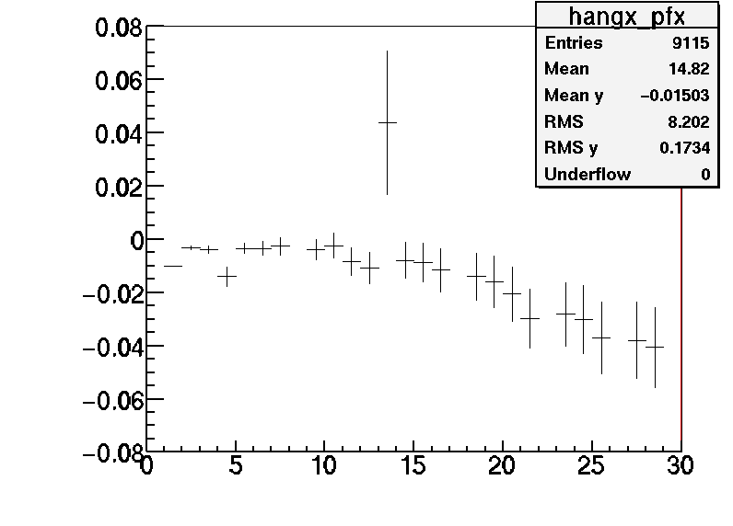
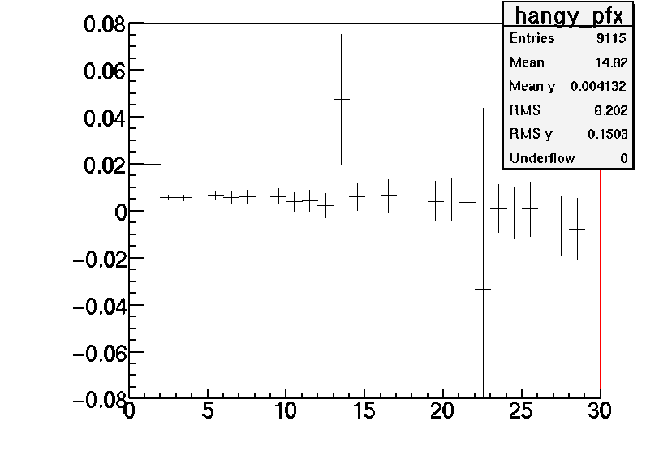
Test beam data
First glance to the bias observed in the angle variation in the XZ plane
Scatter plots represents extrapolated positions of base tracks by using the measured angles from the previous one and starting from the first plate. This should remove effect from plate misalignment . The bottom plots are just profile histograms of the top ones
Relative X position (mm)
Relative Y position (mm)
Corrected for the average beam angle
Relative Z position (mm)
Relative Z position (mm)
Relative X position (mm)
Relative Y position (mm)
Effect of about 30 μm which is close to an angle change of 1 mrad/mm as already quoted ?
Relative Z position (mm)
Relative Z position (mm)

