Slide 1
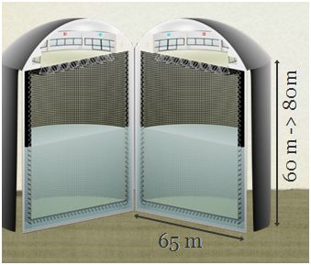
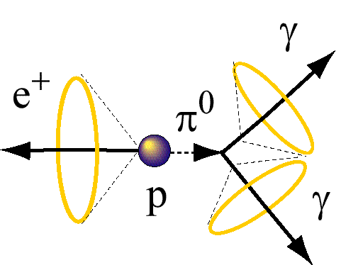
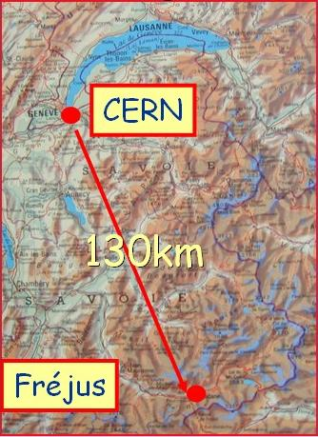
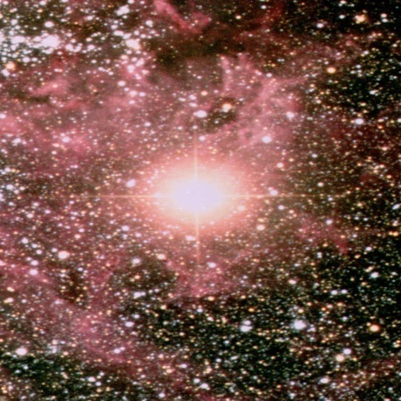
MEMPHYS Simulation & Performance A. Tonazzo, N. Vassilopoulos* / APC for MEMPHYS
* now at IPHC, Strasbourg

Slide 2
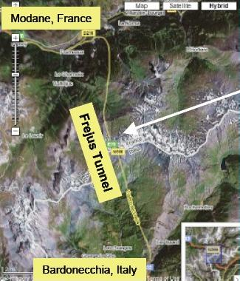
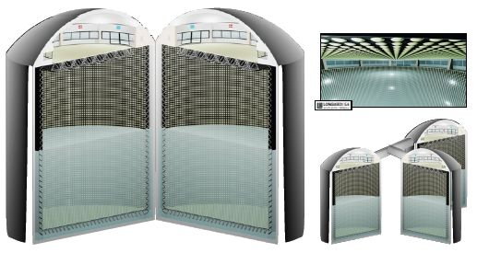
MEMPHYS: Underground Laboratory and Detector
underground water Cherenkov at Laboratoire Souterrain de Modane Fréjus at 4800 m.w.e.
total fiducial volume: up to 400 kton: 3 x 65mX60 modules could be designed up to 572kton: 3 x 65mX80m
size, shape limited by light attenuation length (λ~80m) and pressure on PMTs
readout : ~3 x 81k 12″ (alternatively 8″, 10″) PMTs, 30% cover
PMT R&D + detailed study on excavation existing & ongoing + prototype Cherenkov detector MEMPHYNO
one possible design at LSM
(by Lombardi SA Inagenieurs – Conseils)

Slide 3
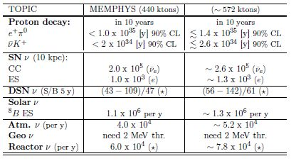
MEMPHYS physics goals
Proton decay sensitivity:
up to 10³⁵yrs in 10y from the "golden" channel: p → e⁺ π⁰
up to 2x10³⁴yrs in 10y from p → K⁺ + anti-ν
SuperNova core collapse:
huge statistics from galactic SN => spectral analysis in E,t, flavour -> access SN collapse mechanism / neutrino oscillation parameters
sensitivity up to ~1 Mpc
possibility of early SN trigger (from event coincidence) up to ~5 Mpc
SuperNova relic neutrinos:
observable in few years with significant statistics, according to most of existing models
direct measurement of ν emission parameters possible
and, of course... NEUTRINO BEAMS (EUROnu WP2, WP4)

Slide 4
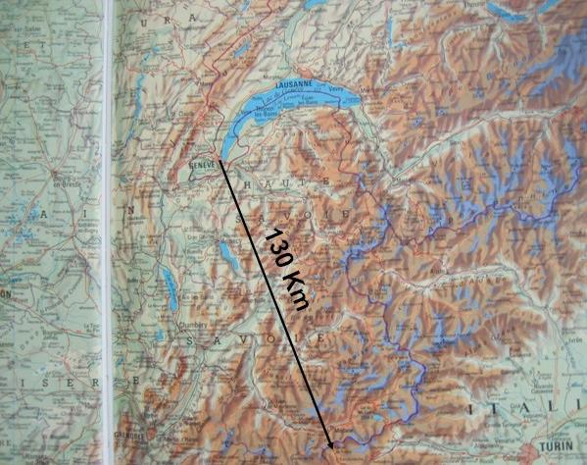
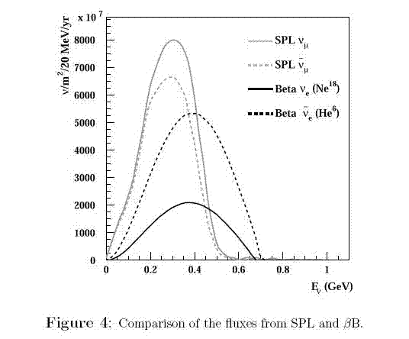
CERN-MEMPHYS: Oscillation measurements with ν beams
Campagne, Maltoni, Mezzeto, Schwertz
hep-ph/0603172
CERN
θ₁₃ discovery reach and sensitivity to CP Violation
Fréjus

Slide 5
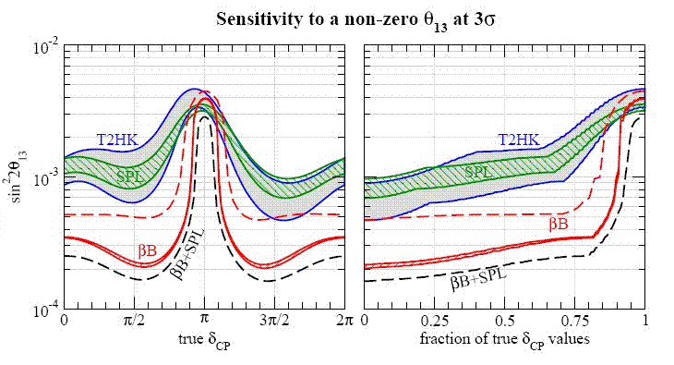
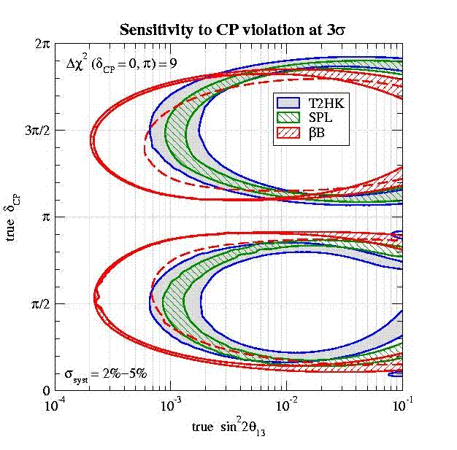
CERN-MEMPHYS: Oscillation measurements Studies with ν beams
βB beam’s ions/year reduced by 2:
performance is strongly depended on ion
production
good sensitivity of θ₁₃ and δ_{CP} for super- beams (ν_{μ}→ν_{e}) & beta-beams (ν_{e}→ν_{μ})
improved performance with the 2 beams combined
Campagne, Maltoni, Mezzeto, Schwertz
hep-ph/0603172

Slide 6
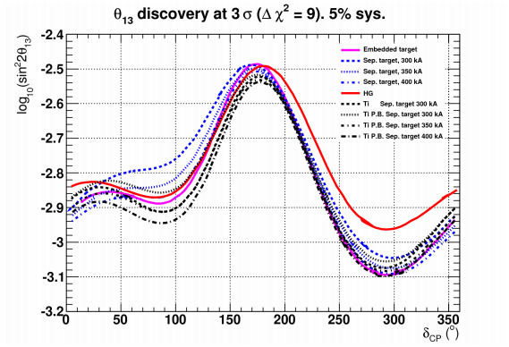
Latest Results from WP2 SuperBeam Studies
Graphite Solid target, 2λ_{I}
Hg, 2λ_{I}
Integrated target, 2λ_{I}
excellent performance of packed bed Ti, d= 74%d_{Ti}
any density reduction of packed could be recuperated increasing the horn current by 50, 100 kA
6

Slide 7
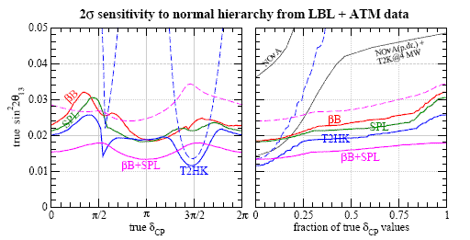
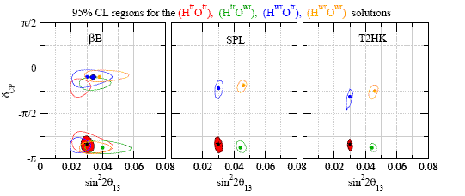
CERN-MEMPHYS: mass hierarchy and degeneracies
without ATM data
for large sin ²2θ₁₃ degeneracies and mass hierarchy is possible to be resolved:
addition of ATM data leads to a sensitivity to the neutrino mass hierarchy at 2σ CL for sin ²2θ₁₃≥ 0.025 for βB and SPL
the optimal hierarchy sensitivity is obtained from combining βB + SPL + atmospheric data
beta beam + ATM can not solve degeneracies (no ν_{μ} and insufficient spectral info)
super beam + ATM: degeneracies lifted
Campagne, Maltoni, Mezzeto, Schwertz
hep-ph/0603172

Slide 8
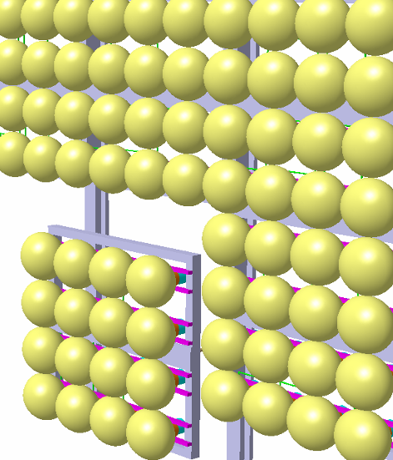
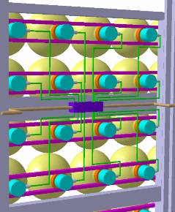
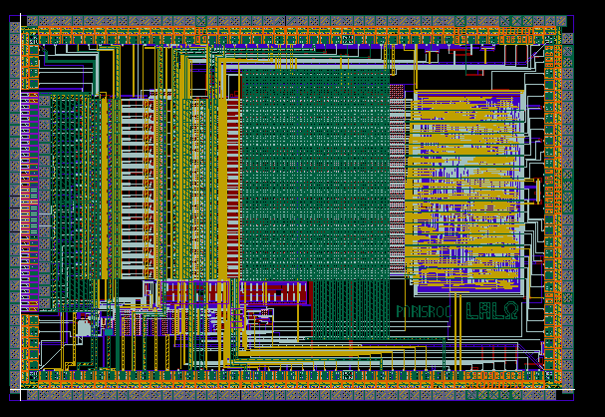
R&D towards MEMPHYS : PMm2:
installed at APC, Paris
“Innovative electronics for array of photodetectors used in High Energy Physics and Astroparticles”.
R&D program funded by French national agency for research
(LAL, IPNO, LAPP and Photonis) (2007-2010)
Basic concept: very large photodetection surface → macropixels of PMTs connected to an autonomous front-end electronics.
Replace large PMTs (20”) by groups of 16 smaller ones (12”, 8”) with central ASIC :
Independent channels
charge and time measurement
water-tight, common High Voltage
Only one wire out (DATA + VCC)
detailed description of the R&D: pmm2.in2p3.fr
studies on 12" 8" PMTs design
parameter correlation
potting
pressure resistance
(collaboration with BNL since NNN07)
PArISROC readout chip
complete front-end chip with 16 channels
testboard now in layout, soon available

Slide 9
MEMPHYNO at APC & Demonstrator
M. Marafini’s talk at NNN10

Slide 10
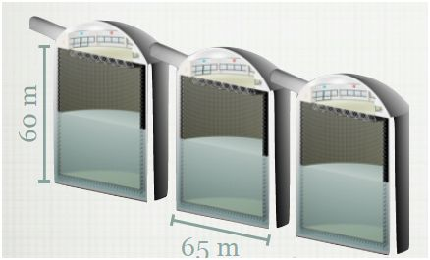
MEMPHYS: Full Simulation Present Status
Event Generator:
GENIE for ν beam new
MEMPHYS Full Simulation (M. Fechner , J.E. Campagne, N. Vassilopoulos) :
Interface with the OpenScientist v16r0 framework (G. Barrand/LAL) using distribution kits as Geant4 & CLHEP & AIDA-IO implementation to Rio (also HDF5, XML)
3 modes of running in the same framework:
Interactive Viewing, Batch processing, AIDA_ROOT analysis
primary + secondary + Optical Photon info, modular detector geometry, ntuples’ storage, etc...
MEMPHYS Event Reconstruction, Analyses (N. Vassilopoulos, A. Tonazzo, M. Marafini):
interactive ROOT- cint
Solo C++ for complex/high stats using ROOT + AIDA libraries

Slide 11
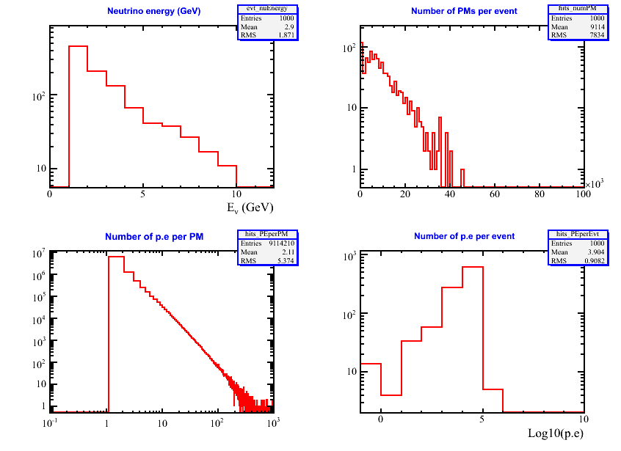
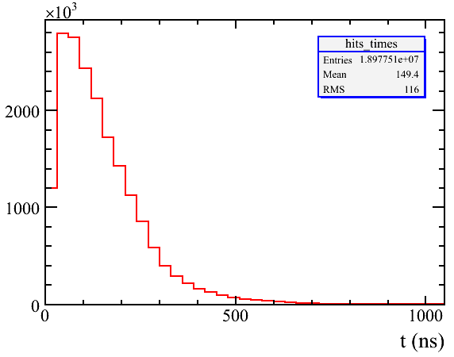
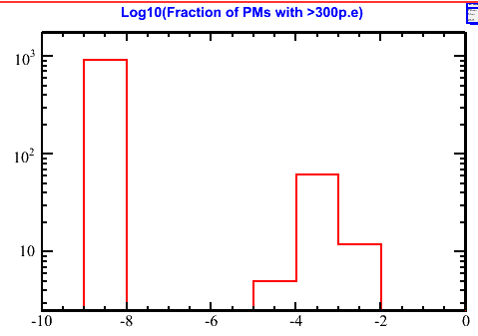
ν atmospheric (1-10GeV)
transparency by J. E. Campagne
MEMPHYS v7

Slide 12
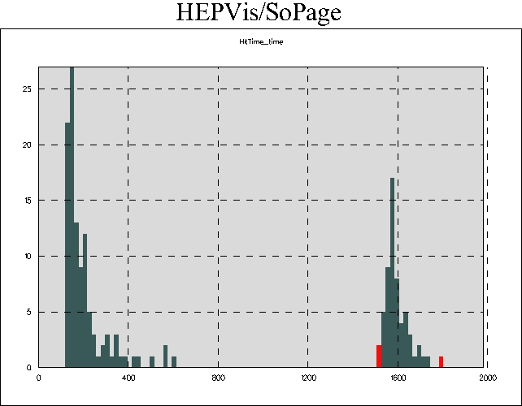
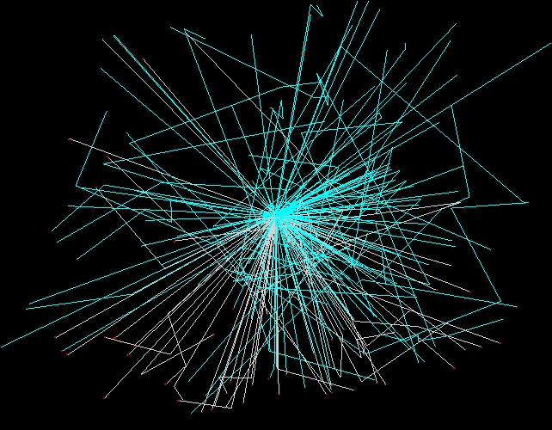
ν_{μ}→μ⁻→e⁻
Only detected op. photons
1600ns
Interactive histogram to identify the e Michel optical photons…
transparency by J. E. Campagne
MEMPHYS v7

Slide 13
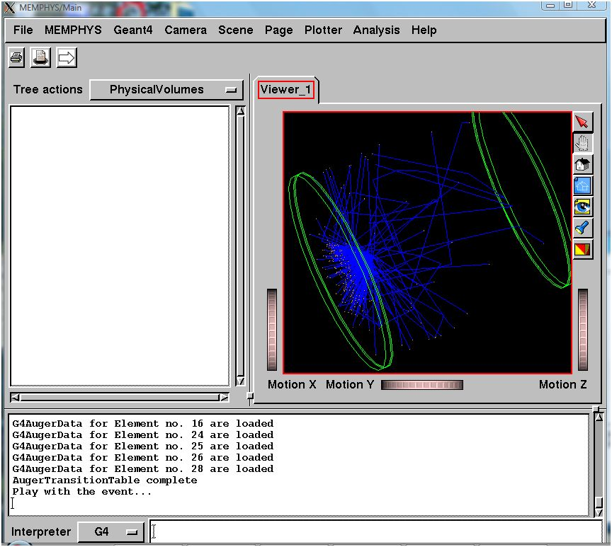
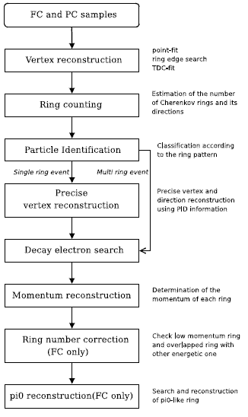
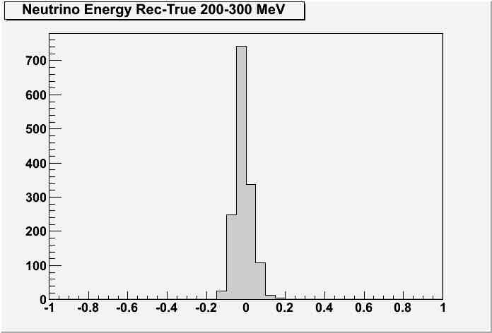
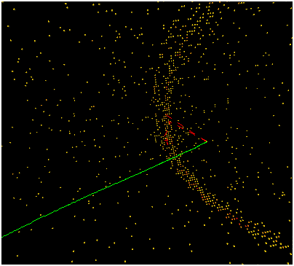
MEMPHYS: GUI / Event Reconstruction
MEMPHYS GUI
MEMPHYS: interactive μ⁺500 MeV
main task using all the available tools
evaluate detector performance
extract energy resolutions and lepton efficiencies migration matrices

Slide 14
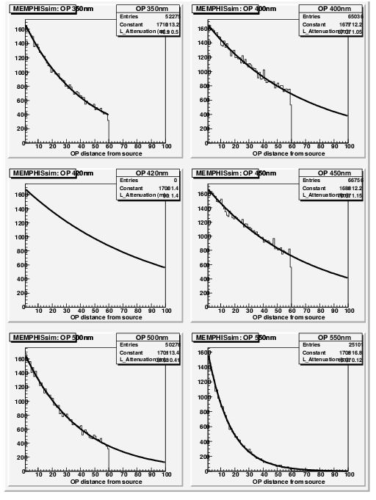
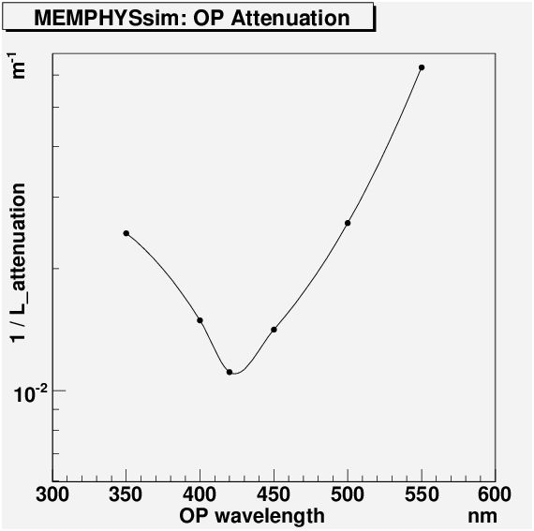
Attenuation length studies
correct modelling of light propagation
attenuation length in water as a function of the wavelength in MEMPHYS simulation
looks comparable to SK data

Slide 15
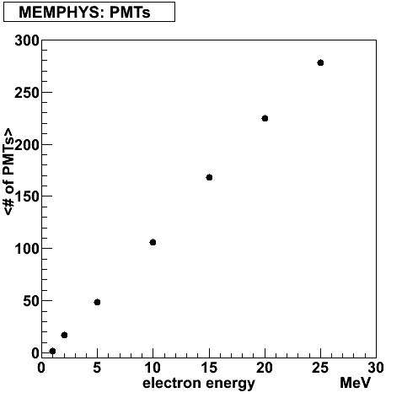
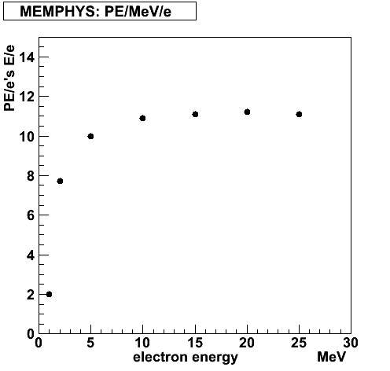
MEMPHYS Single ring studies, electrons
27% more FV without light reduction
single e- events from 1 to 25 MeV (FC): PMTs and PE infos
65mX60m
* 65mX80m
*
*
*
65mX60m
* 65mX80m
*
*
*
*
*
Number of PMTs with at least one photoelectron as a function of electron energy

Slide 16
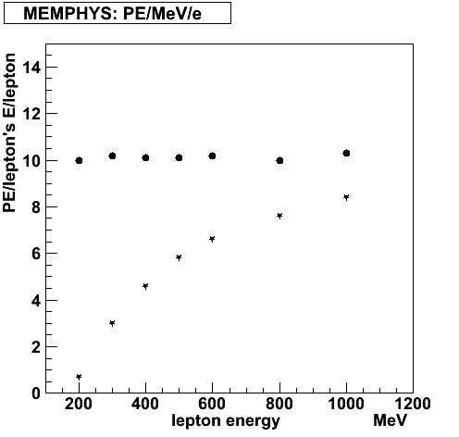
MEMPHYS Single ring studies electrons, muons
single e- , μ+ (no decays) events from 200 to 1000 MeV: PMTs and PE infos
e-
e-
μ+
μ+
Number of PMTs with at least one photoelectron as a function of lepton energy
Number of detected photoelectrons per MeV as a function of lepton energy

Slide 17
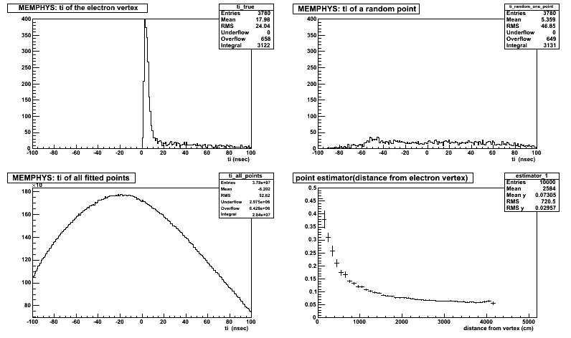
Single rings: electrons primary vertex fit
pick up a 400 MeV electron (FC), assume point like track length
primary vertex fit based only on each PMT’s timing info: t_{i PMT} = t_{i} + TOF_{i} => t_{i} = t_{i PMT} – TOF_{i} , where TOF_{i} = (n / c) x D, D = distance between each PMT and grid’s coordinates
maximize estimator E a la SK to find the true vertex of electron :
e- vertex
random point
fit estimator

Slide 18
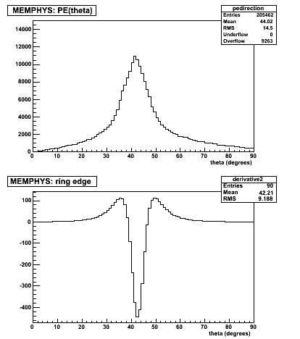
Single rings: particle direction, outer ring edge
keep the 400 MeV e-
calculate roughly the direction: t
θ_{edge}
θ_{edge} > θ_{peak}
d²PE(θ) / d² (θ) = 0
θ_{peak =} 42⁰
θ_{edge}
θ_{edge} > θ_{peak}
d²PE(θ) / d² (θ) = 0

Slide 19
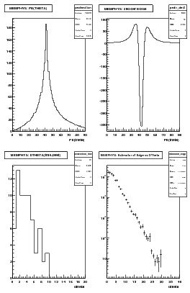
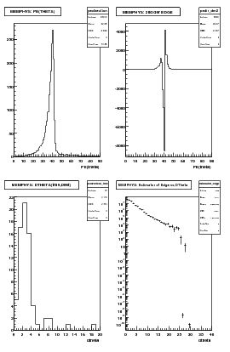
Single rings (FC): e-, μ+ 200MeV to 1000MeV ring direction
find the best direction maximizing :
PEs angular distribution seen at best vertex and with respect to true direction.
Different shapes
θ_{peak}= 42⁰
θ_{mean}= 44⁰
θ_{edge}
θ_{peak}= 42⁰
θ_{mean}= 38⁰
θ_{edge}
e-
μ+
spread e’ s rings
sharper μ’ s rings
Q(θ_{edge})
Q(θ_{edge})

Slide 20
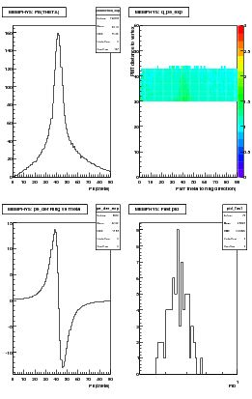
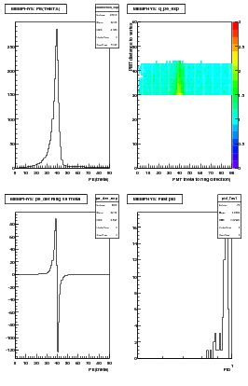
Single rings: e-, μ+ 200MeV to 1000MeV pid
use PEs (PMT) angular distribution from best reconstructed vertex and best direction as fast pid variable
full detector simulation
PEs angular distribution seen at best vertex and with respect to best direction.
Different shapes
θ_{peak}= 42⁰
θ_{mean}= 44⁰
θ_{peak}= 40⁰
θ_{mean}= 37⁰
e-
μ+
number of PEs as a function of the PMT distance to the best vertex and with respect to best direction
pid
dPE(θ) / d (θ)
dPE(θ) / d (θ)
pid
spread e’ s rings
sharper μ’ s rings

Slide 21
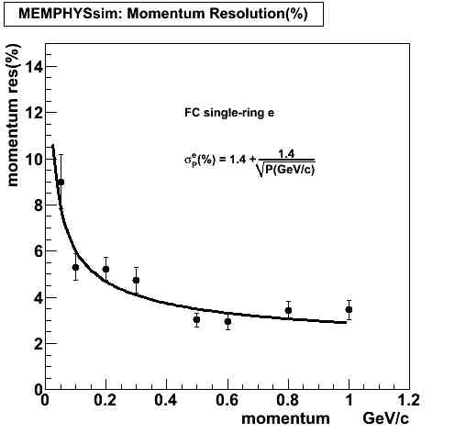
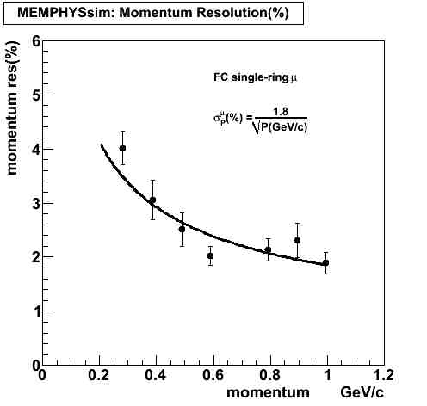
Single rings: e-, μ+ up to 1 GeV/c momentum resolution (magnitude)
R_{tot} , to correlate momentum with measured charged
full detector simulation but low statistics
e-
μ+
resolutions in between to SK-I, SK-II:
higher energies higher statistics of collected charge
lower energies small degradation due to detector size

Slide 22
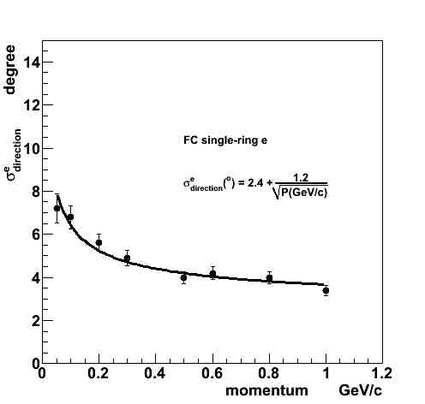
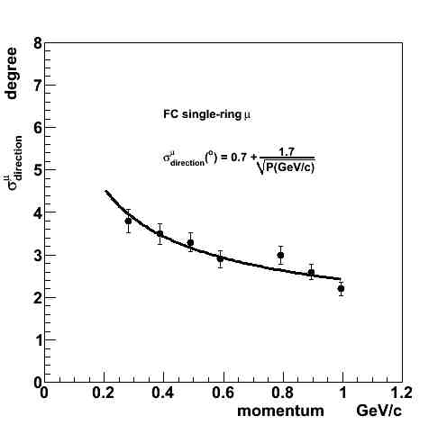
Single rings: e-, μ+ up to 1 GeV/c momentum resolution (direction)
make the difference of true and reconstructed: resolution in degrees at 68% of events
full detector simulation but low statistics
e-
μ+
comparable to SK

Slide 23
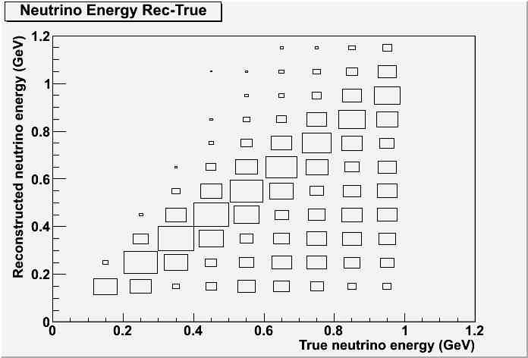
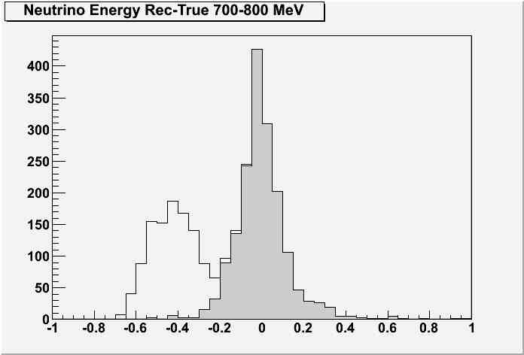
MEMPHYS energy reconstruction
momentum resolution could be be applied to any beam design to derive efficiencies, bdg. contamination and migration matrices
e.g. true versus reconstructed
uniform neutrino, antinuetrino samples up to 1 GeV, interactions in water simulated with GENIE
ν_{μ}
ν_{μ}
ν_{μ}
tail due to no-QE events, increasing with ν ‘s energy
gaussian peak due to QE’s smearing of Fermi motion and experimental resolution

Slide 24
conclusions, next steps
conclusions so far:
MEMPHYS detector performance:
primary vertex reconstruction, ring direction
excellent single-ring identification as e or μ (low stats)
single-ring momentum and direction resolution: energy reconstruction
detector optimisation: no light reduction when moving from 65mx60m to 65mx80m detector (+27% FV): similar results are expected in event reconstruction.
next steps:
optimisation of vertex reconstruction, ring counting
background: π⁰ for SB and single π⁺⁻ for βB analyses
high statistical neutrino samples to extract migration matrices (in progress)
volume vs. performance studies: more detailed
THANKS

