Slide 1
EUROnu Target and Horn Studies
Nikolaos Vassilopoulos/IPHC-CNRS on behalf of WP2

Slide 2
Talk layout
Horn/Physics performance optimization
Target Studies
Energy Deposition Studies for different elements of the Super Beam cooling
Horn Studies
Preliminary Radiation Studies

Slide 3
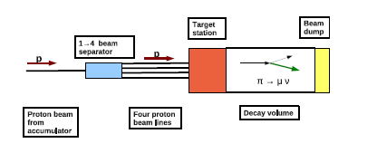
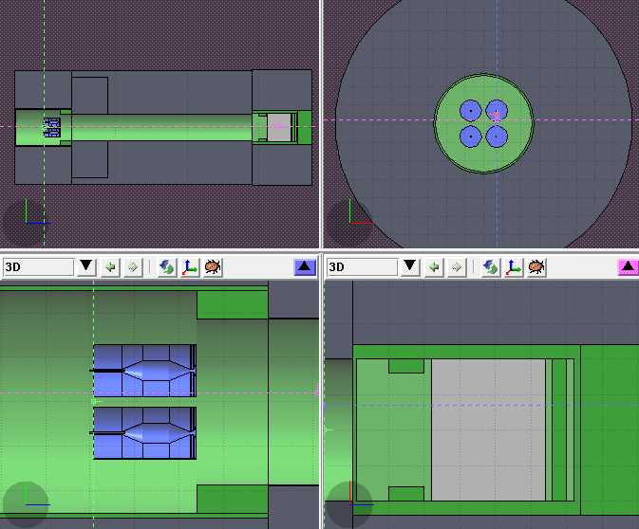
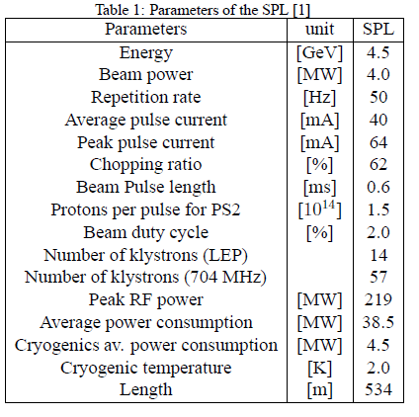
SuperBeam Layout
decay channel
L=25m
R=2m
target horn station
use 4 horn system
split the 4MW beam power
increase reliability for the target and horn
achieve an adequate cooling
beam dump
L=3.2
H,W=4m
target horn station

Slide 4
Horn optimization
details in WP2 notes @ http://www.euronu.org/
evolution of the horn shape after many studies:
triangle shape (van der Meer) with target inside the horn : in general best configuration for low energy beam
triangle with target integrated to the inner conductor : very good physics results due to high energy deposition and stresses on the conductors
miniboone shape with target integrated to the inner conductor : best physics results, best rejection of wrong sign mesons but high energy deposition and stresses
miniboone shape with target around the horn: best compromise between physics and reliability

Slide 5
Horn’s Shape Optimization I

Slide 6
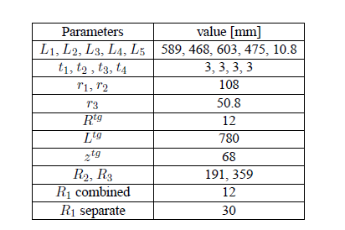
Horn’s Shape Optimization II
restrict & re-iterate for best horn parameters
similar logic for Decay Tunnel dimensions

Slide 7
from Liquid Targets to Static Packed one
goal: to achieve reliable target operation with 4 MW beam
favourable baseline for WP2

Slide 15
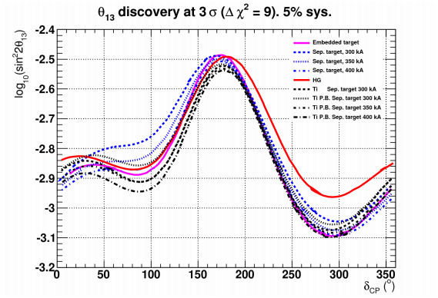
Physics Performance for different Targets I
Graphite Solid target, 2λ_{I}
Hg, 2λ_{I}
Integrated target, 2λ_{I}
excellent performance of packed bed Ti, d= 74%d_{Ti}
CERN to Frejus/MEMPHYS neutrino beam
any density reduction of packed could be recuperated increasing the horn current by 50, 100 kA

Slide 16
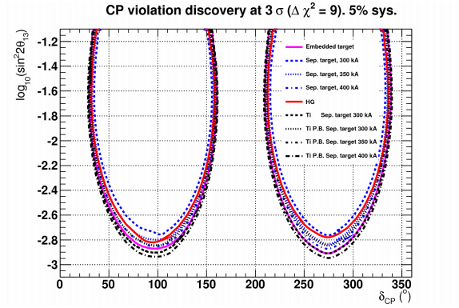
Physics Performance for different Targets II
Graphite Solid target, 2λ_{I}
Hg, 2λ_{I}
Integrated target, 2λ_{I}
excellent performance of packed bed Ti, d= 77%d_{Ti}
CERN to Frejus/MEMPHYS neutrino beam
any density reduction of packed could be recuperated increasing the horn current by 50, 100 kA

Slide 17
alternative target solution:

Slide 18
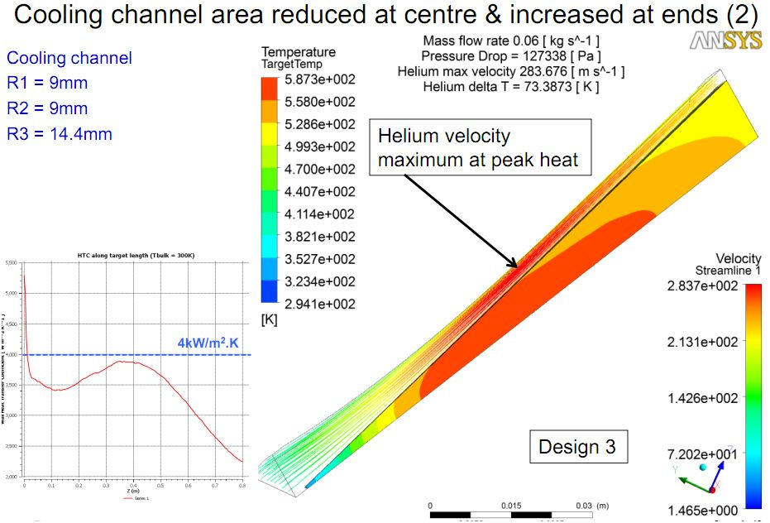
pen like target: cooling
looks feasible

Slide 19
considerations:

Slide 20
Comments on Packed-bed & Pencil like Target
Pencil like Geometry merits further investigation
Steady-state thermal stress within acceptable range
Pressurized helium cooling appears feasible
Off centre beam effects could be problematic?
Needs further thermo-mechanical studies
Packed-bed target:
Large surface area for heat transfer
Coolant able to access areas with highest energy deposition
Minimal stresses
Potential heat removal rates at the hundreds of kiloWatt level
Pressurised cooling gas required at high power levels
Bulk density lower than solid density
From a thermal and engineering point of view seems a reasonable concept where stress levels in a traditional solid target design look concerningly high

Slide 21
favourable method

Slide 22
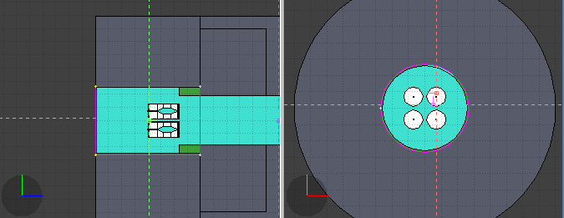
Energy Deposition Studies in different elements of SuperBeam
aim safety:
use T2K as guideline as shielding designed for 4MW
design the shielding of the layout to confine all the energy
calculate the energy deposition on Horn, Target , ..., Decay Tunnel Vessel, ..., Beam Dump
define
any shielding to protect the equipment
the cooling methods

Slide 23
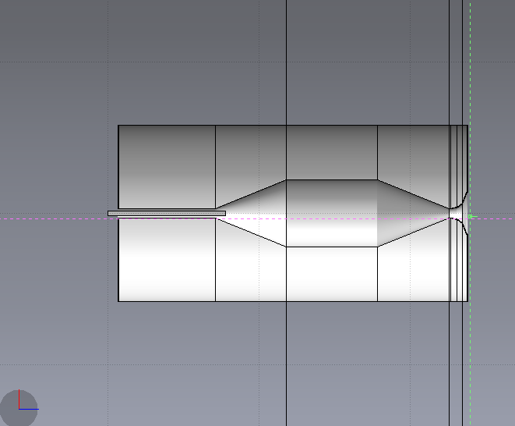
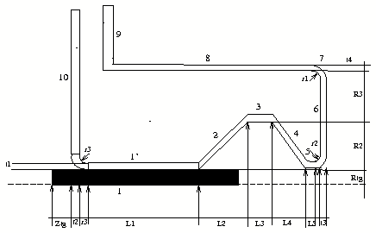
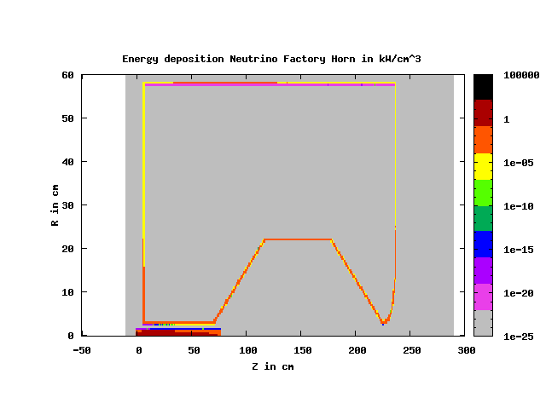
Power distribution for 4horn System, 350kA, 1.3MW, Ti packed bed target studies done with flair 0.9.1 with geoviewer 0.9, fluka 2008.3d
for 1horn, 1.3 MW beam, 350kA
total power for different parts:
d_{packed} = 74% d_{Ti}
(Graphite target in parenthesis)
1.28
(0.6)kW
2.3
(1.9)kW
1.7 (1.3)kW
1.2 (1)kW
0.38
(0.3)kW
9.8 (6)kW
P_{t} =113 (64)kW
0.58
(0.5)kW
P^{tot}_{h}= 21.2 (14.4)kW
3.9 (2.6)kW
stats: 10⁶ protons

Slide 24
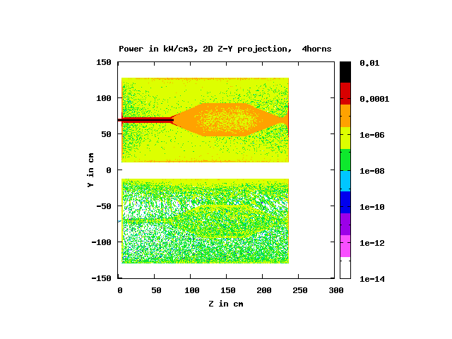
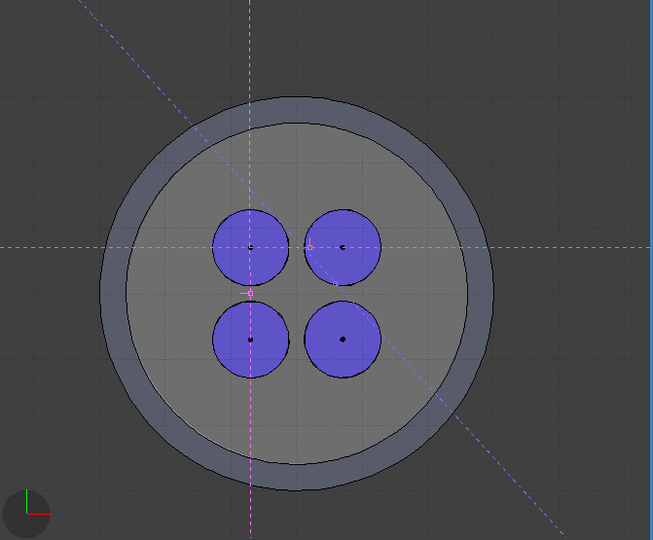
Power on horn # 2,4 (next to the active one)
active horn is # 1, 1.3MW beam, 350kA, Gr target
shown upstream plates
E^{tot}_{h}= 14.4kW
2nd
1st
1st
3rd
4th
E^{tot}_{h}= 0.8kW
2nd or 4th
Power in kW for the horn next to the active one
total | inner | outer | plates
0.8 (5.5% of active horn) | 0.1 | 0.6 (50% of outer next to 1st) | 0.1

Slide 25
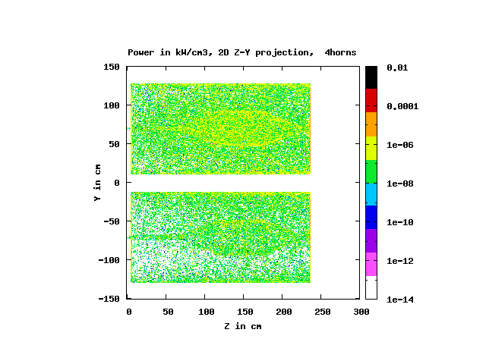
Power on horn # 3 (diagonal to the active one)
active horn is # 1, 1.3MW beam, 350kA, Gr target
shown upstream plates
E^{tot}_{h}= 0.8kW
2nd
1st
2st or 4th
3rd
4th
E^{tot}_{h}= 0.4kW
3rd
Power in kW for the horn diagonal to the active one
total | inner | outer | plates
0.4 (2.8% of active horn) | 0.06 | 0.28 (50% next to 1st) | 0.06

Slide 26
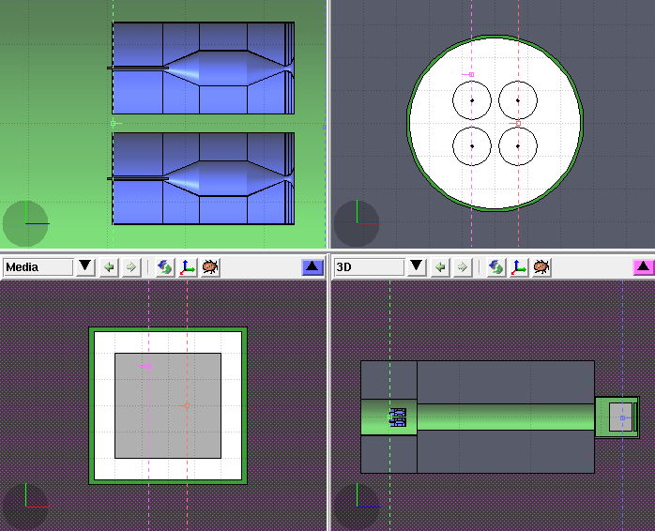
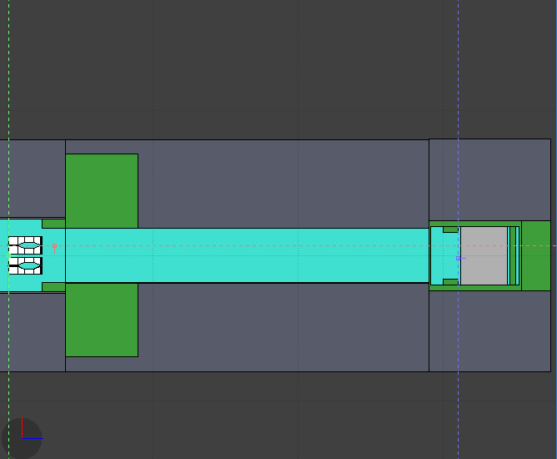
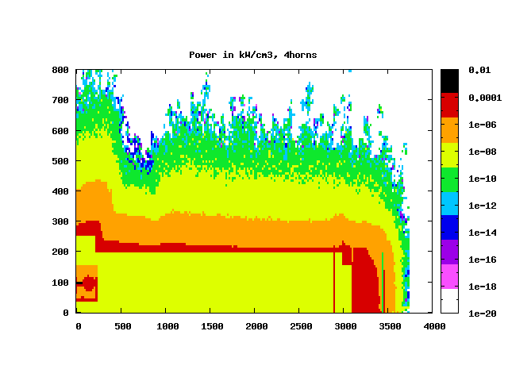
Power for SB Layout, 4MW
FLUKA schematics for SB layout, service gallery not studied yet
stats: 4x10⁵ protons
He, Fe, Concrete, Gr
to scale: D_{dt}= 4m
P_{tot} = 3.25MW
example model based on info from T2K talks at NBIs

Slide 27
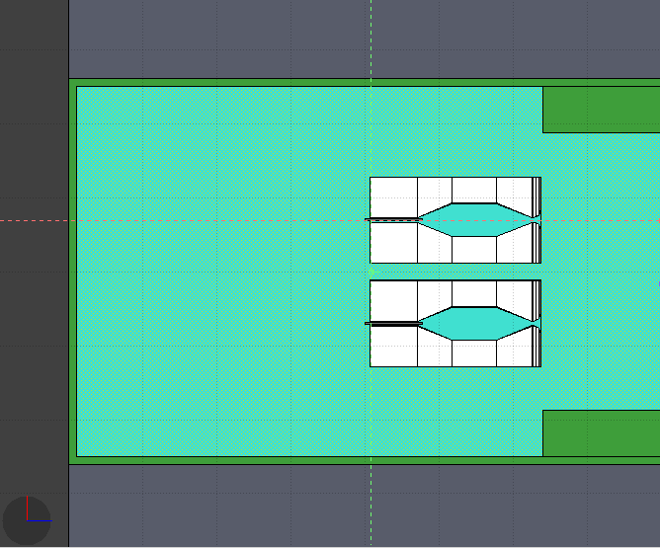
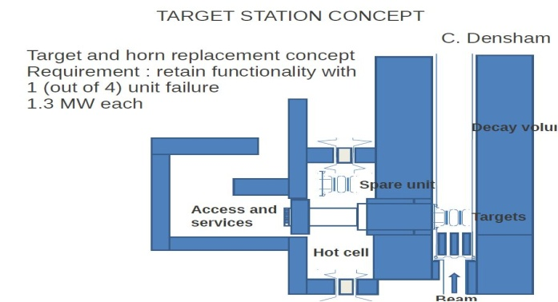
Power in Target Horn Station, 4MW
Power scoring parameters:
concrete:
t = 5.7m
L = 4m
P = 128kW
collimator, water cooled (in T2K):
t_{Fe} = 60cm
L_{Fe} =160cm
P_{Fe} = 420kW
He vessel, water cooled:
t_{Fe} = 10cm
L_{Fe}= 4m
P_{Fe} = 243kW
L = 4m,
to be shorten
shielding will be re-defined for the protection
of the service gallery and equipment

Slide 28
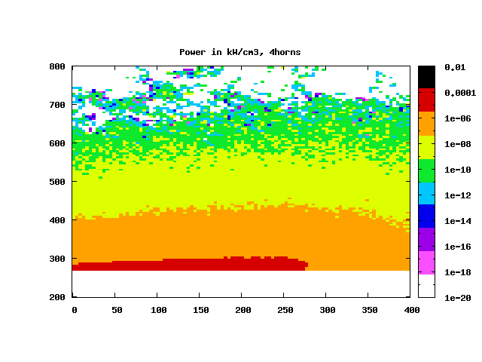
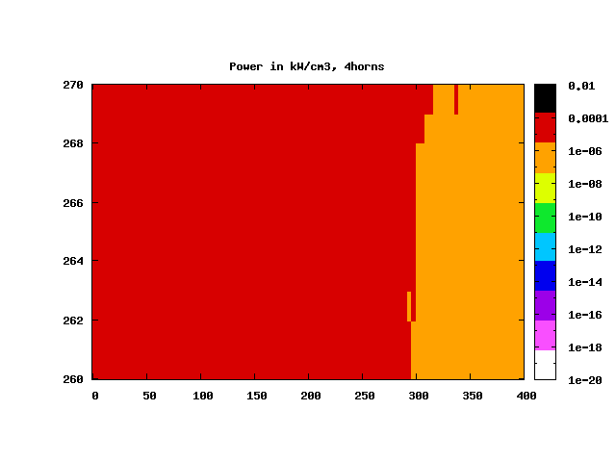
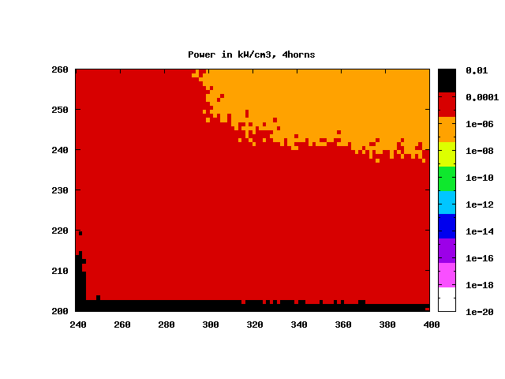
Power in Target Horn Station, 4MW
R-Z
Power density distribution in kW/cm³
P concrete : 128kW
P vessel = 243kW
P collimator = 420kW

Slide 29
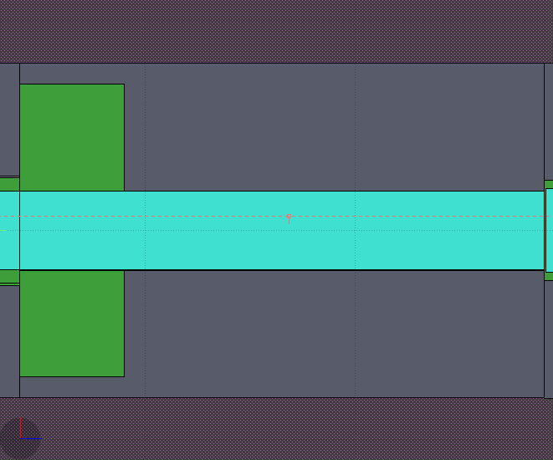
Power in Decay tunnel
Power scoring parameters:
concrete:
t = 6m
L = 20m
P = 452kW
upstream collimator (will be re-defined accordingly) :
t_{Fe} = 5m
L_{Fe} = 5m
P_{Fe} = 420kW
He vessel, water cooled
t_{Fe} = 1.6cm
L_{Fe}= 25m
P_{Fe} = 362kW
He decay tunnel:
R = 2m
L = 25m
P_{He} = 1.5kW

Slide 30
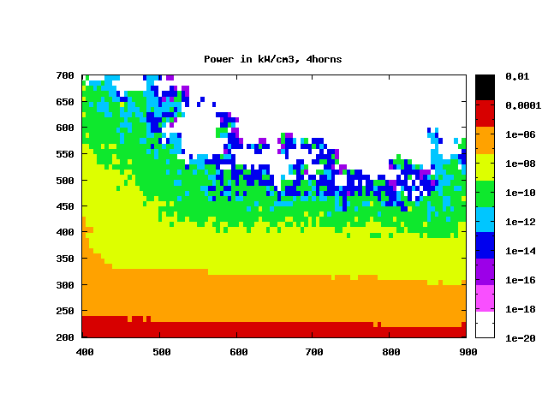
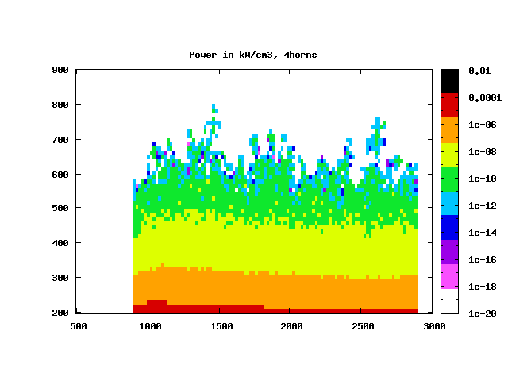
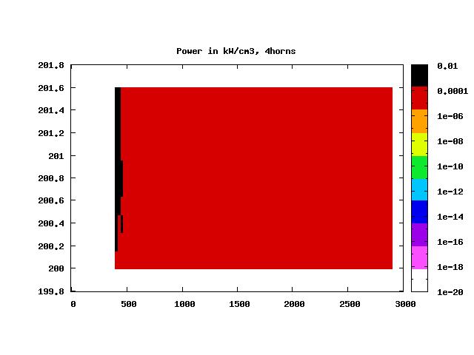
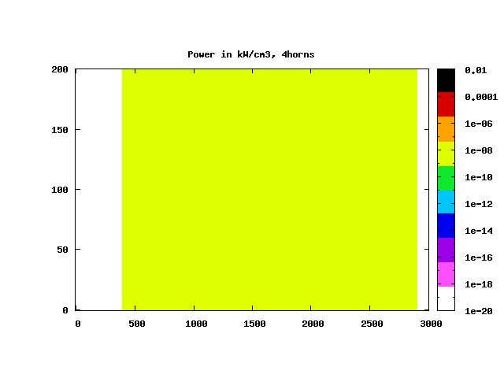
Power in Decay Tunnel Elements
R-Z
Power density distribution in kW/cm³
end tunnel
P collimator = 420kW
P concrete = 452kW
P vessel = 362 kW
P He = 1.5kW

Slide 31
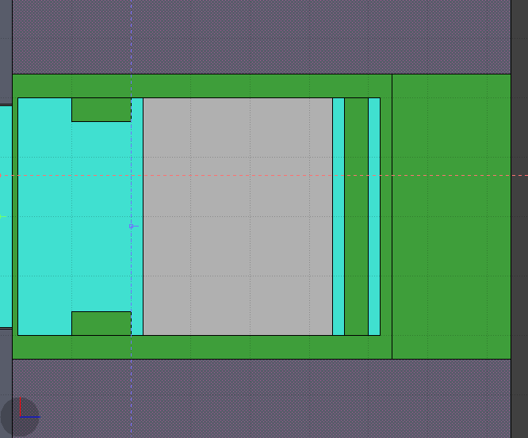
Power in Beam Dump
Power scoring parameters:
concrete:
t = 5.6m
L = 8.4m
He vessel + iron plates, water cooled
t_{Fe} = 10-40cm
L_{Fe}= 4m
upstream shield (iron plates), water cooled
t_{Fe} = 40cm
L_{Fe} = 1m
Graphite beam dump:
L = 3.2m, W = 4m, H = 4m
P= 473kW
downstream iron shield (iron plates), water cooled:
L_{Fe} = 40cm, W_{Fe} = 4m, H_{Fe} = 4m
P_{Fe} = 9.2kW
outer iron shields (iron plates), water cooled
L _{Fe}= 2m, W_{Fe} = 4.8m, H_{Fe} = 4.8m
P_{Fe} = 1kW

Slide 32
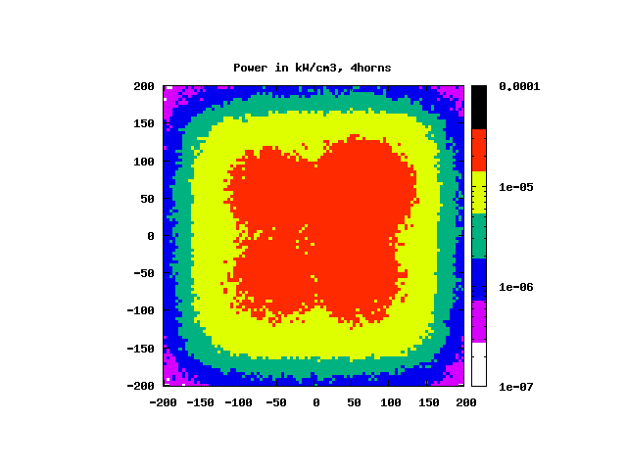
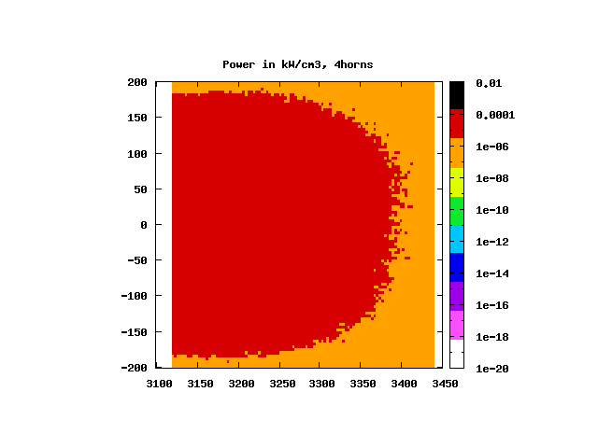
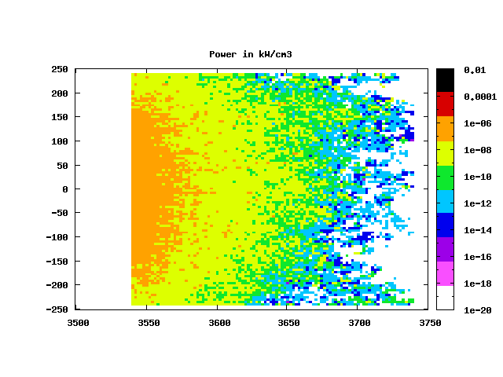
Power in Beam Dump
X-Y
Power density distribution in kW/cm³
R-Z
Power density distribution in kW/cm³
P graphite = 473kW
P outer shield= 1kW
end of beam dump structure:
Power Density minimum along the direction of secondary beam

Slide 33
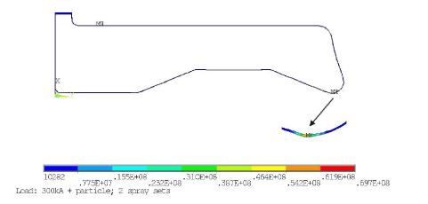
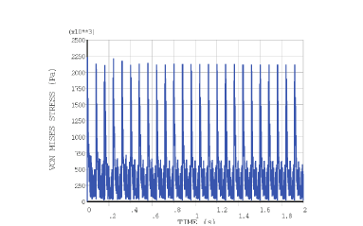
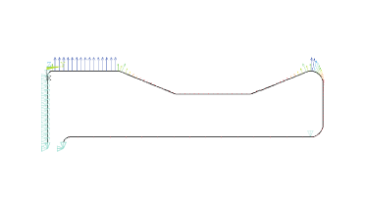
Horn: Dynamic Stress Analyses due to Thermal and Magnetic pulses
Dynamic stresses are due to
Transient Joule heating due to the current passing through the horn’s skin
Secondary Particles
Magnetic Pulses/forces
deformation
von Mises stresses due to thermal loads
stress vs time in the horn, 25pulses
Pulse: 100μs
T=1/50/4s=0.08s
magnetic pressure on the horn
static stress

Slide 34
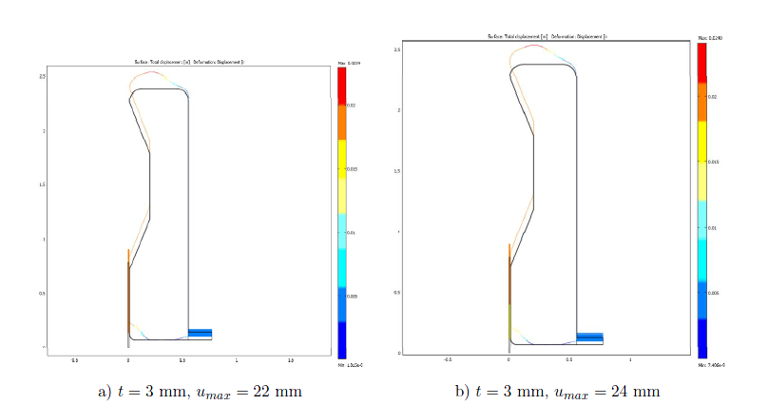
Horn: Static stress, deformation
in order to assess the horn deformation and horn life time, the calculation of the stress inside the horn is necessary. The stress level in the structure should be low enough in comparison with the fatigue limit of the materials. Loads coming from the magnetic pressure and the thermal dilatation of the material
dynamic stress superimposed on the quasi-static stress are the basis of the fatigue life time estimate of the horn – work ongoing
horn with integrated target: highly stress domain exists on the inner conductor and in the right angles connection domains + high energy deposition on the inner conductor
displacement due to magnetic pressure and thermal dilatation
displacement due to magnetic pressure
Horn with separated target and rounded back-plate, corners
Horn without integrated target
9.9mm
10.5mm

Slide 35
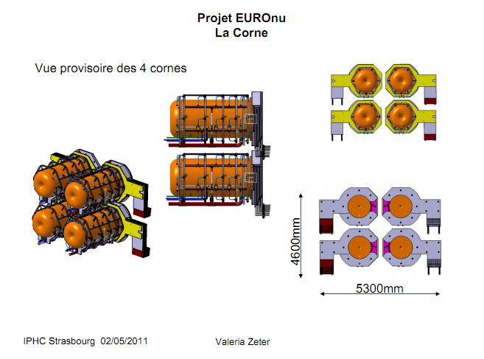
baseline horn shape for EUROnu

Slide 36
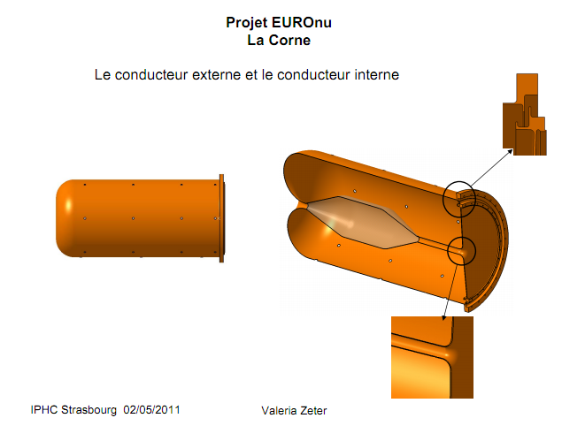
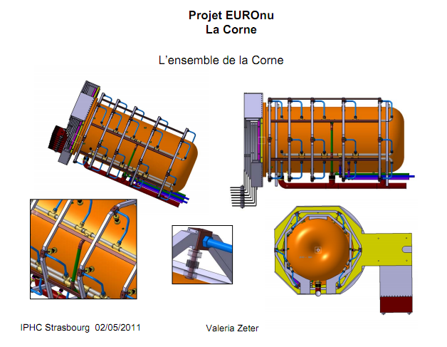
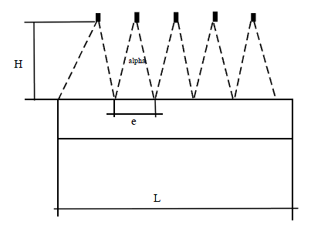
Horn Drawings & cooling scenario
cooling (EUROnu WP2 Note 10-06)
power distribution due to Joule losses & secondary particles
energy balance, to maintain working temperature
flow rate
jet distribution along the outer conductor
h correlation for jets’ geometry

Slide 37
4-Horn System Drawings with strip Lines

Slide 38
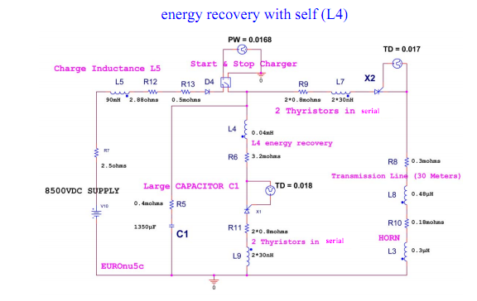
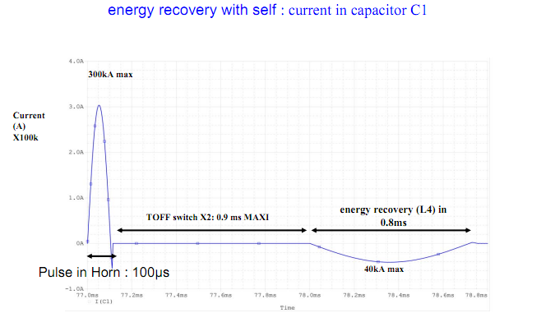
Horn: Power Supply Studies
Requirements: 350kA, ½ sinusoid, 100μs length, 50 pulses/s
critical lifetime 13x10⁹ pulses, 200d
modularity
Studied two solutions:
Energy recovery with a self (L4): good energy recuperation 60% but needs to further investigate the large constraints on the switch X2 and capacitor
Energy recovery with diode and resistor: less constraints on the capacitor but less energy recuperation
needs to estimate the cost for both cases
horn focusing plateau

Slide 39
Radiation Studies
for a given part of the SB layout e.g. target, horn, cable, tunnel ...
specify the level radioactivity and its synthesis after irradiation of 200days and different cooling times ...
calculate effective doses at the different distances from the radiated material
benchmark the results with CNGS studies:
CNGS http://proj-cngs.web.cern.ch/proj-cngs/
Safety

Slide 40
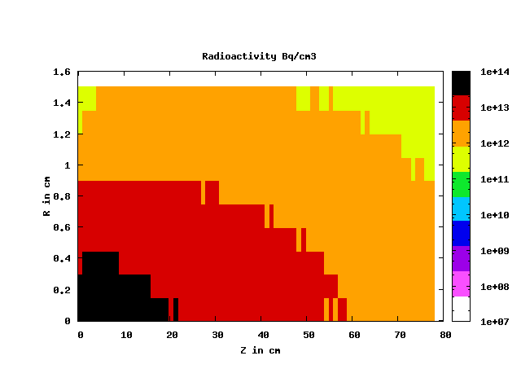
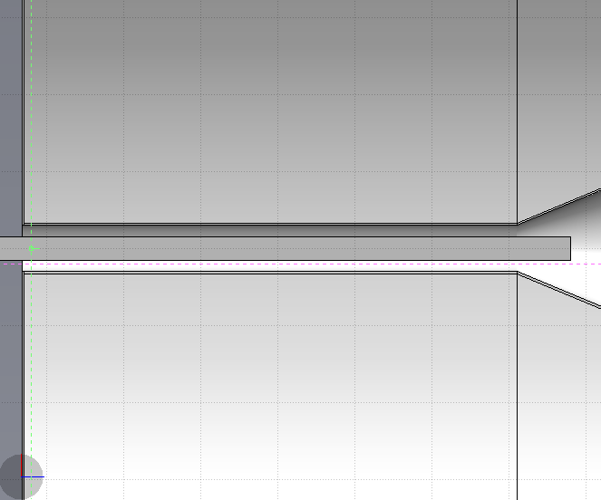
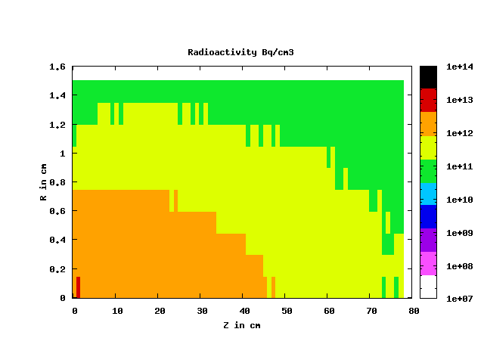
Ti packed target's radioactivity, 4MW : irradiation=200days, cooling times= 1d, 10y
cooling: 1d
stats: 10⁶ protons
cooling: 10y
target activity in Bq
1d | 10y
1.7E15 | 3.9E13

Slide 41
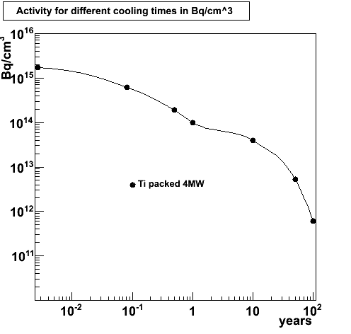
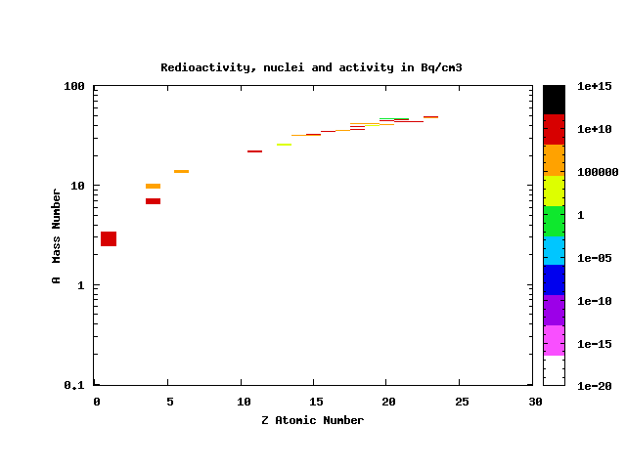
Ti packed target's radioactivity, 4MW : irradiation=200days cooling times= 1d, 1m, 1/2y, 1y, 10y, 50y, 100y
1m
1/2y
1y
10y
50y
stats: 10⁶ protons
from those calculations:
dose rates for different locations and cooling times to define accessibility time-table
work ongoing

Slide 42
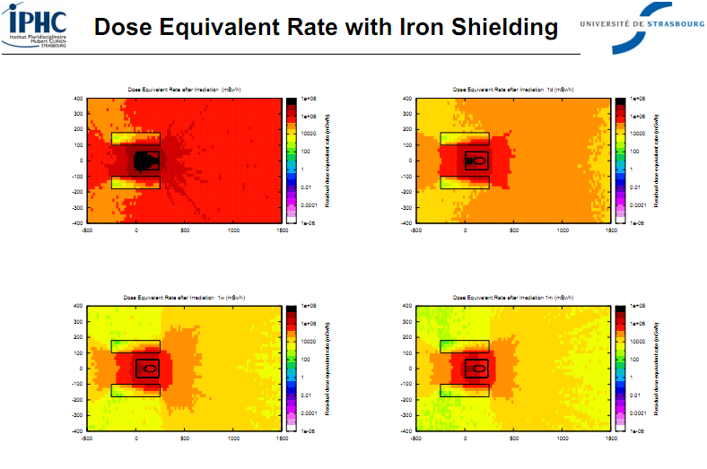
Towards the benchmarking:
effective dose rates in mS/h for different cooling times

Slide 43
for Experimental Hall (Target/Horns, DT, Beam Dump), Safety Gallery, Maintenance Room, Waste Area

Slide 44
Safety II
Proton driver
to be done by CERN
beam lines by WP2
Target/horn station
Shielding around
Air recycling
Cooling system
Tritium production
Lifetime
target
horn (+pulser)
Decay tunnel
Shielding
Cooling
System repairing/exchange
Retreatment
shielding
decay tunnel
spare area
target/horn station
hot cell
Power supply
gallery
beam

Slide 45
Conclusions
Horn with separated target baseline as result of dynamic and static stress analyses
4-horn system to reduce the 4MW power effects
Horn shape defined as miniboone-like due to best physics results and reliability issues
Horn cooling/power supply studies ongoing
Packed-bed Target is preferable in multi-Watt beam environment due to minimum stresses and high heat rate removal due to transverse cooling among others
Safety Studies ongoing for the design of the layout and radiation
Thanks

