Slide 1
BTagging Performance Study in ATLAS
Bai Yu
Supervisor : Emmanuel Monnier
Laurent Vacavant

Slide 2
Outline
Introduction
LHC
ATLAS Experiment
BTagging in ATLAS
ATLAS BTagging Performance Study
Tuning SV Finder
Pileup Cuts Study
Other work in Doctor Stage

Slide 3
Introduction LHC
Size : 27km in circumference
Location: 175m beneth the ground, cross the boarder of France and Switzerland
Energy: proton beam to 3.5TeV per nuclei(will upto 7TeV finally)
Luminosity: can be up to 10³⁴cm⁻²s⁻¹
To answer the basic questions in particle physics

Slide 4
Introduction ATLAS Experiment
Search for Higgs
Search for super symmetry
Search for W’,Z’ or 4th generation particles
Extra dimension?
…
Accumulated 313pb^-1 3.5TeV+3.5TeV collision data so far
3000 collaborators from 38 countries and 174 university or laboratories

Slide 5
Introduction BTag in ATLAS
What is BTag : to select b jet out from light(from u,d,s quark or gluon) or charm jet
Why Btag : Important to a lot of physics analysis channels
B jet as signal : any channel include top production
B jet as background : .i.e WH(H->WW) need b veto
How to do Btag : B quark is heavy(~5GeV) and decay slowly (cτ~1mm), that allows
Btag via secondary vertex : SV0(decay length significance) ,
Track Imapct parameter information : IP2D, TrackCounting, JetProb
Advanced Tagger, combination of jet variables: JetFitter(NN), SV1+IP3D…

Slide 6
Performance Study: Secondary Vertex Reconstruction
SV taggers performance are strongly depend on secondary vertex reconstruction
To improve the sv tagger performance by tuning the secondary vertex finder
The result may applied in next athena release
Many thanks to Vadim Kostyukhin

Slide 7
Secondary Vertex Reconstruction
Jet Pt>20GeV, |η|<2.5,Quality<4.0
Track : ΔR<0.4 .w.r.t Jet
Pt Cut, Chi2 Cut, ID Hit Cut, IP Cut
Track for 2trk Vertex
Chi2 Cut, IP significance Cut, Material Region Removal
2Trk Secondary Vertex
Try to add more tracks
Secondary Vertex

Slide 8
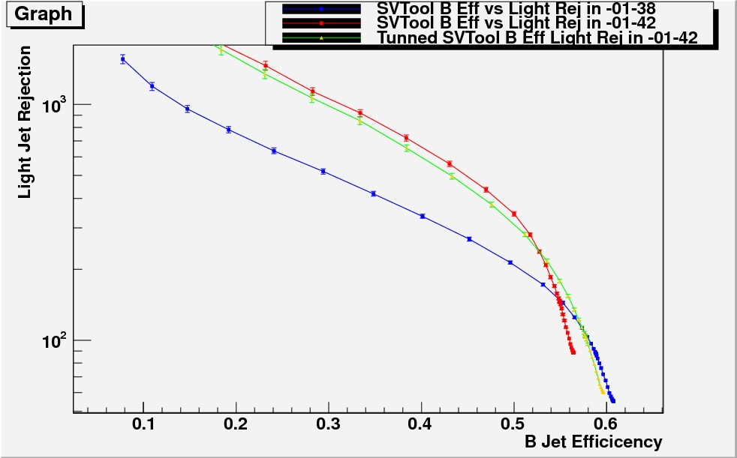
Secondary Vertex Reconstruction Performance Comparison(1)
InDetVKalVxInJetTool-00-01-38
As a benchmark
Default InDetVKalVxInJetTool-00-01-42
Tight AntiFake 2TrkVertex Cut: reject sv far from impact point(tight)
Tunned -00-01-42
tunning on trksig cut, sv chi2 cut
SV0 Performance
Significantly Higher Rejection, but lower sv reconstruction efficiency(make performance worse in high efficiency region). By tuning the cut in -00-01-42, we improve the performance in high efficiency region. Meanwhile the AntiFake2TrkVrt cut may be too tight.

Slide 9
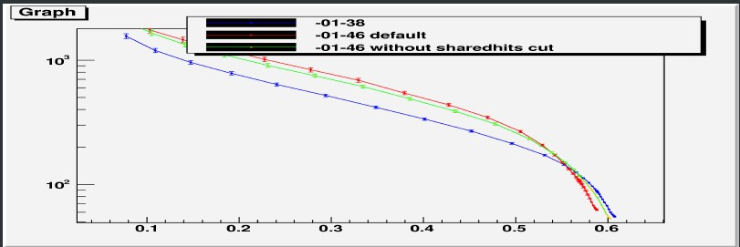
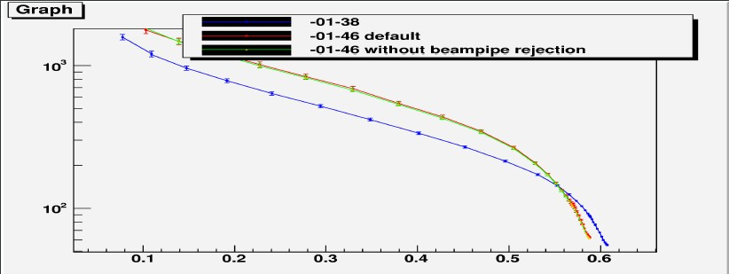
Secondary Vertex Reconstruction Performance Comparison(2)
InDetVKalVxInJetTool-00-01-38
As a benchmark
InDetVKalVxInJetTool-00-01-46
Moderate anti fake 2trk vertex cut
Beam pipe rejection for sv
Shared track rejection
Shared Hits Cut doesn’t help in high efficiency region
We cannot abandon antifake2trk vertex cut
Beam pipe rejection doesn’t hurt performance

Slide 10
Conclusion from SV Tuning
A set of secondary vertex cut configuration (will be applied in future release)
Moderate antifake 2trk vertex cut
No Shared track rejection
Tunned value of track significance and sv chi2 cut
Beam pipe rejection doesn’t have significant effect on the performance

Slide 11
Pileup Cuts Performance Study (in progressing)
More and more Pile-ups (6 currently, will up to 13 later this year)
We want robust cuts against pile up
So:
Data Set: Pile up QCD dijet sample with bunch train
Do the retagging (only IP2D are recalibrated now, un-recalibrated result was in back up) with different pile up cut configuration
Compare the performance between different pile up cuts on track selection

Slide 12
Introduction
To study the impact of pile up cuts on btag performance
Samples:
mc_10a JX sample(mu=8)
Method:
Compare the performance switch on/off z0%d0 antipileup cut
Classify the events by the primary vertex multiplicity
Low (0-6 pile up)
Medium(7-12)
High(>12)
Classify the jets by their pt
Low pt(30-50GeV)
Medium(50-100GeV)
Hight(>100GeV)
It is just a first look at that now. The study on going
Currently Preliminary :
Only IP2D IP3D and sv0 are studied now
Without recalibration for IP2D and IP3D
Only J3 sample considered

Slide 13
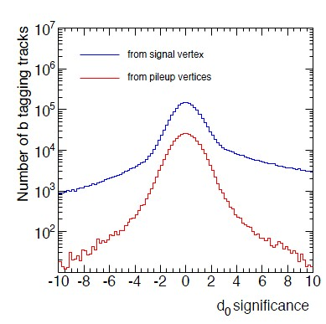
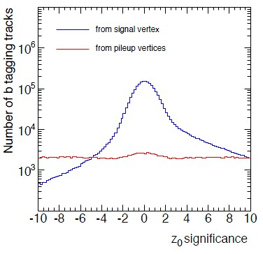
Cuts on Tracks against PU
d0%z0 AntiPU Cuts (inspired from IBL Study by Laurent and Nicolas)
If track D0Sig<3.0 and trackZ0Sig>3.8, reject this track

Slide 14
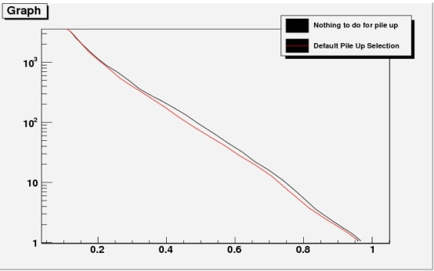
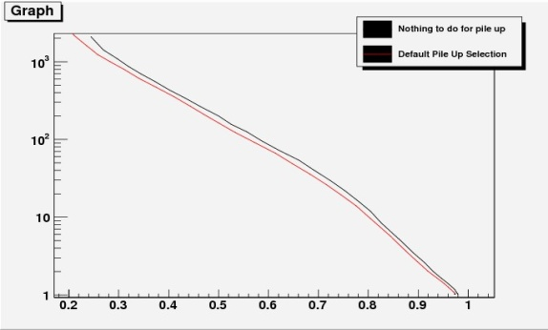
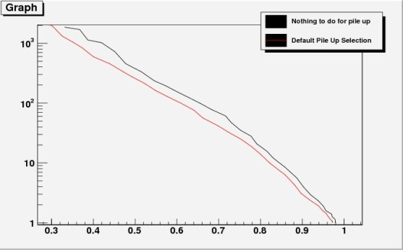
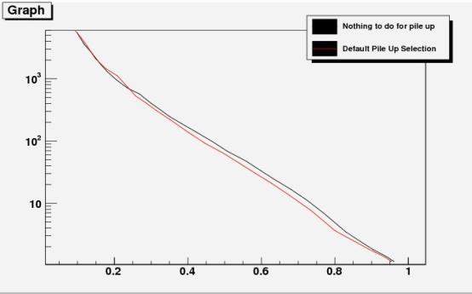
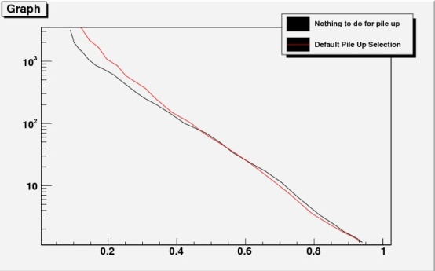
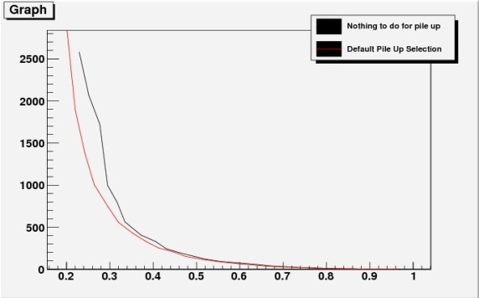
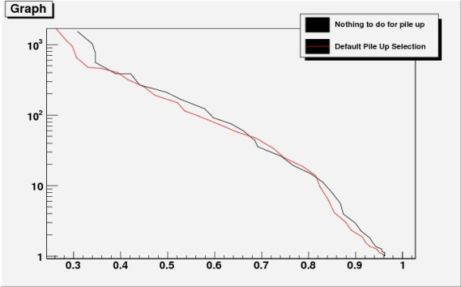
Results of IP3D Performance
Low pt Medium pt high pt
Low PU Medium PU High PU

Slide 15
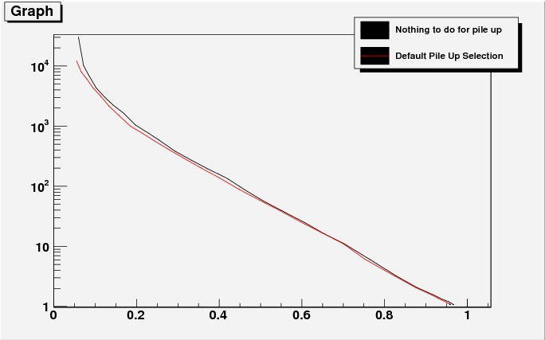
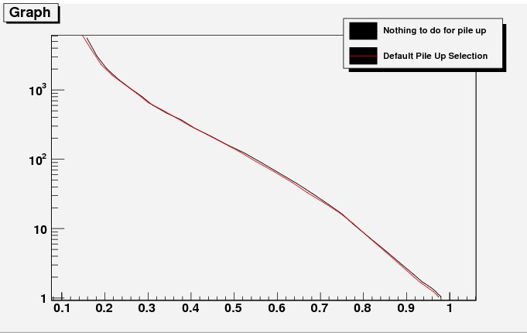
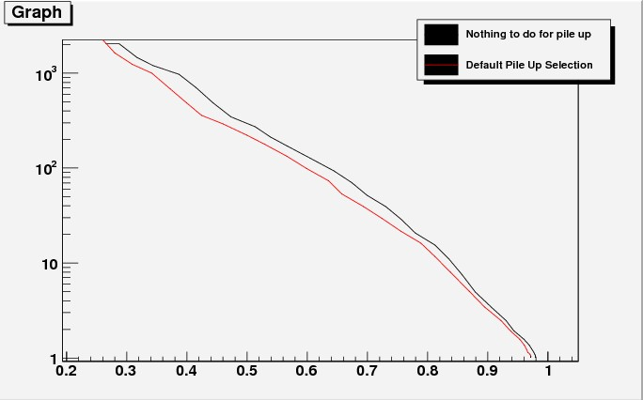
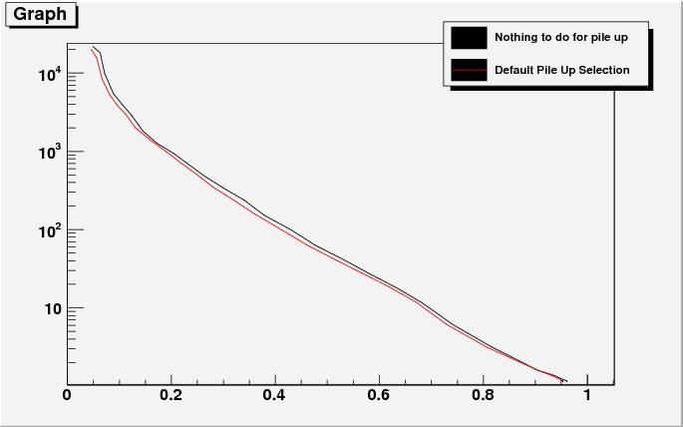
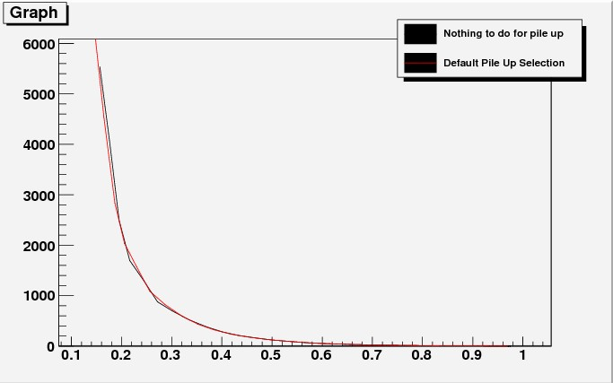
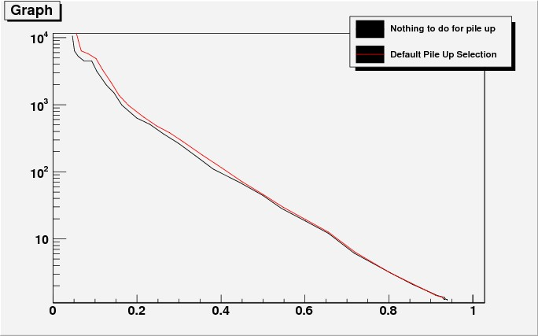
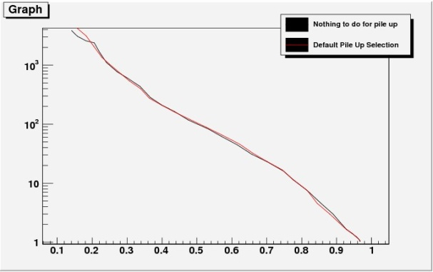
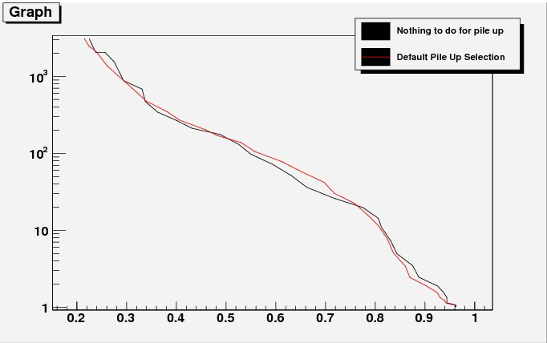
IP2D Results Performance
Low pt Medium pt highPt
Low PU Medium PU High PU

Slide 16
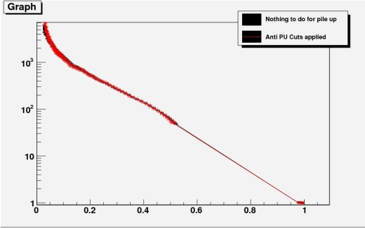
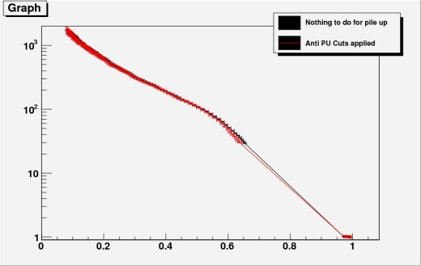
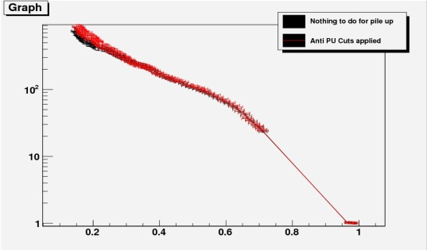
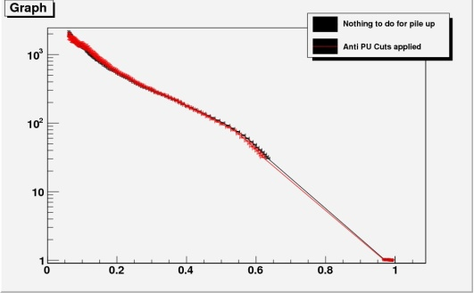
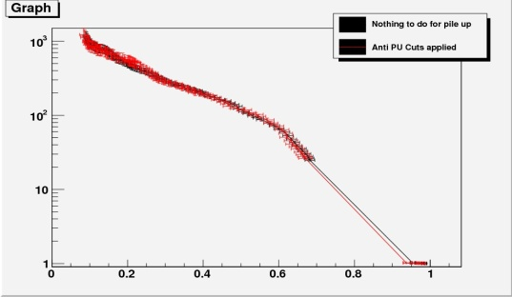
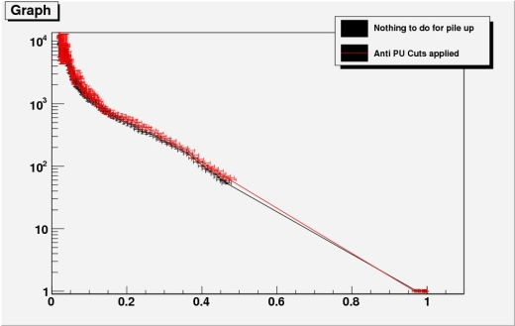
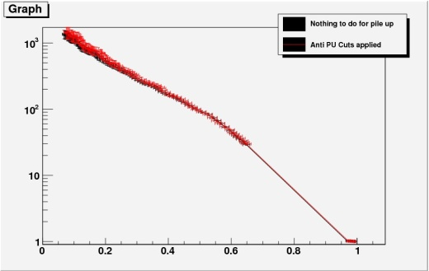
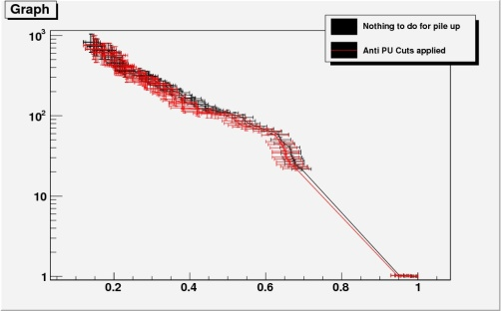
SV Performance Curve
Low Pt Medium Pt High Pt
Low PU Medium PU High PU

Slide 17
Rejection in Eff=0.45 for SV0
 | Low PU Level | Medium PU Level | High PU Level
Low Pt | 96.1/95.0 | 81.6/84.4 | 62.2/74.9
Medium Pt | 143.0/144.1 | 136.8/134.1 | 126.9/132.2
High Pt | 132.4/138.8 | 160.4/155.6 | 121.3/107.3
Without PU Cut
With PU Cut
Low pt jets benefit from antipu cuts while high pt jets doesn’t

Slide 18
Conclusion from PU Cuts Study
For IP2D antiPU improve the performance in some region
For IP3D the performance decreased
For SV0 the improvement of performance depend on Jetpt
These cuts have been put in rel 16.6.x.y but not applied in dataset production yet(determine whether or not apply it asap)

Slide 19
Other Work In Doctor Stage
W higgs(H->WW) analysis with 3 leptons final state(with Lianyou Shan, CSC note)
SV0 positive negative asymmetry study (with Lorenzo Feligioni)
Investigation on the impact of material double counting on taggers(2010 May reprocessing, with Laurent Vacavant)
Participate in BTagging Commissioning work for 2010 Data(within CPPM BTagging group, Laurent Vacant, Nicolas Bousson, Nancy Tannoury and so on,)

