Slide 1
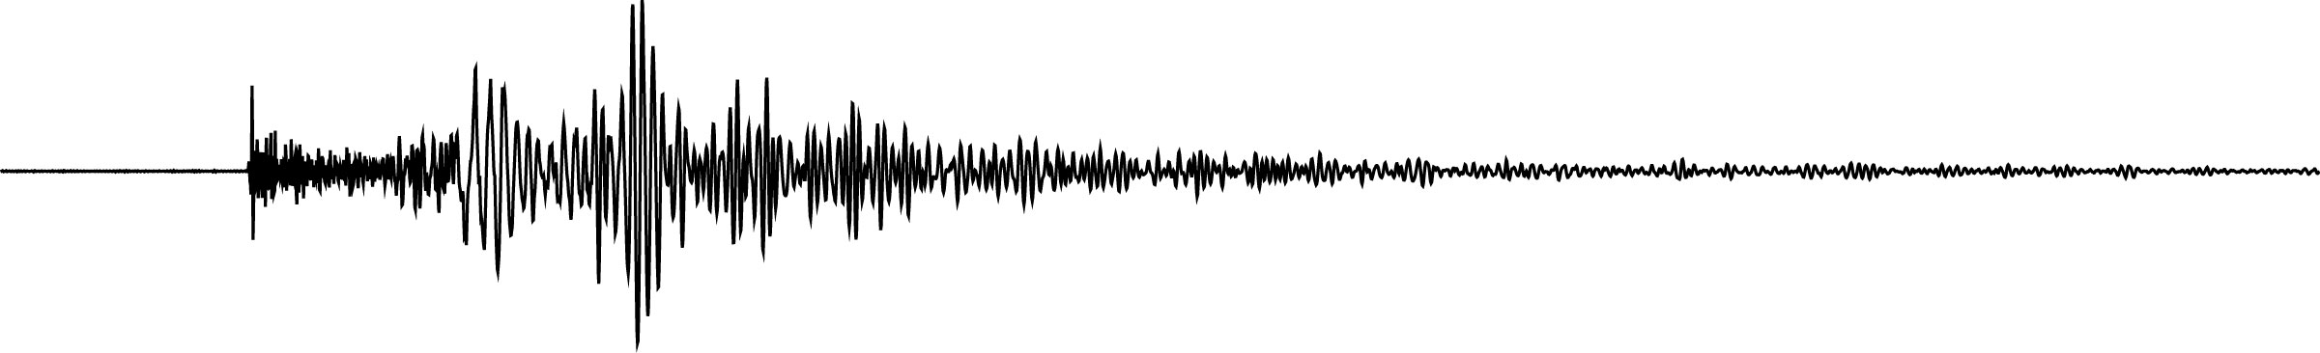









VERCE : Virtual Earthquake and Seismology Research Community in Europe e-science environment
Centre National de la Recherche Scientifique (CNRS-INSU), France
University of Edinburgh (UEDIN), United Kingdom
Royal Netherlands Meteorological Institute (KNMI-ORFEUS), Netherlands
European-Mediterranean Seismological Centre (EMSC), France
Istituto Nazionale di Geofisica e Vulcanologia (INGV), Italy
Ludwig-Maximilians-Universität (LMU), Germany
University of Liverpool (ULIV), United Kingdom
Bayerische Akademie der Wissenschaften (BADW-LRZ), Germany
Fraunhofer-Gesellschaft e.V. (SCAI), Germany
Centro di Calcolo Interuniversitario (CINECA), Italy
Jean-Pierre Vilotte (IPG Paris – CNRS UMR 7154)
IdG, Comité de Pilotage, CNRS Paris (18 Avril 2011)

Slide 2
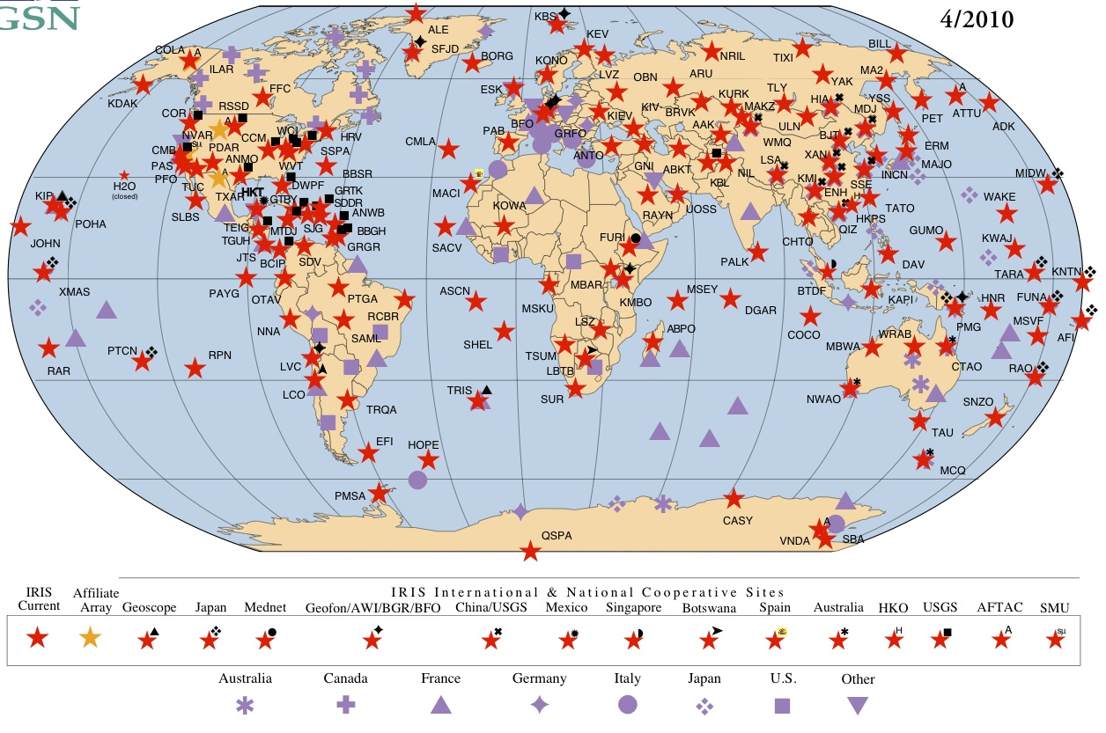
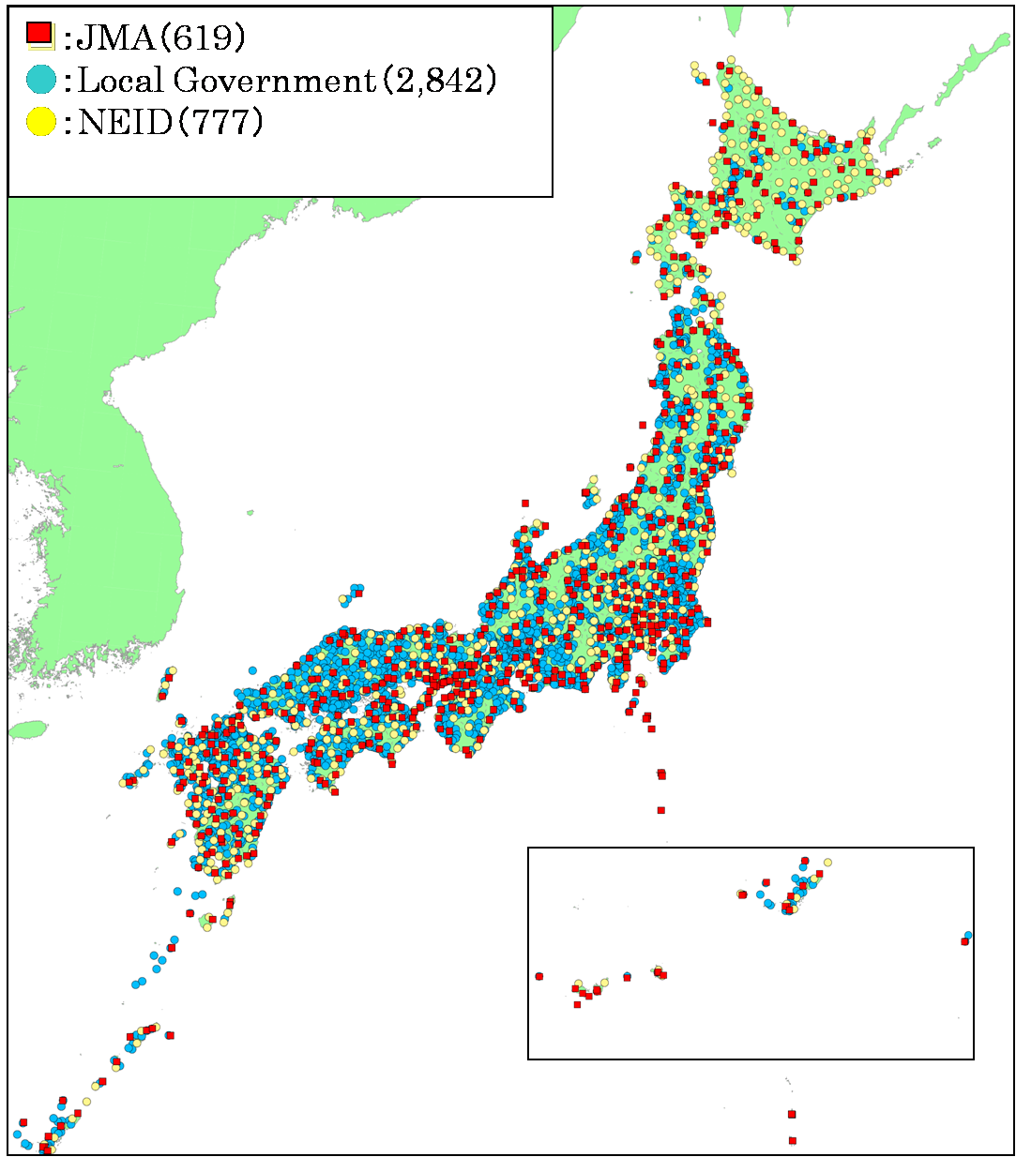
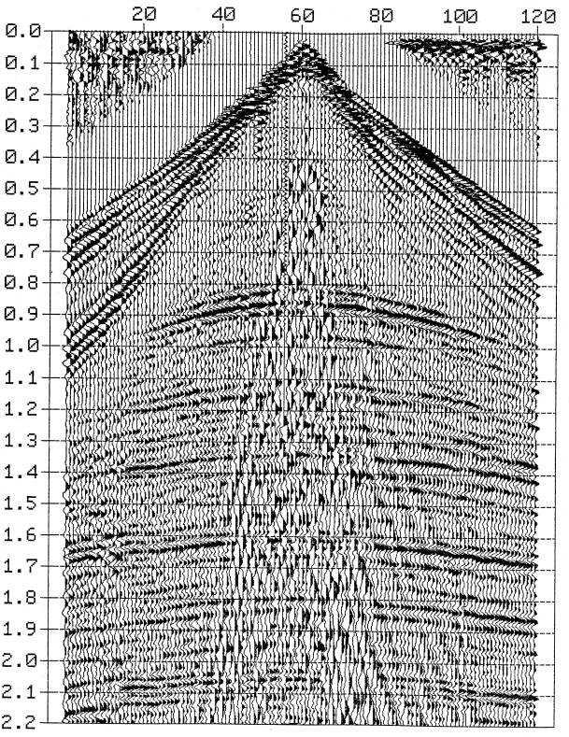
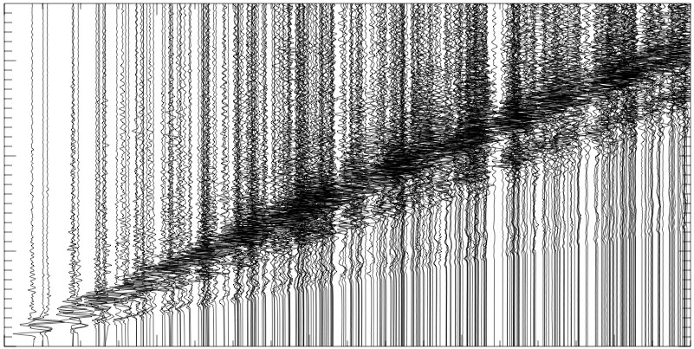
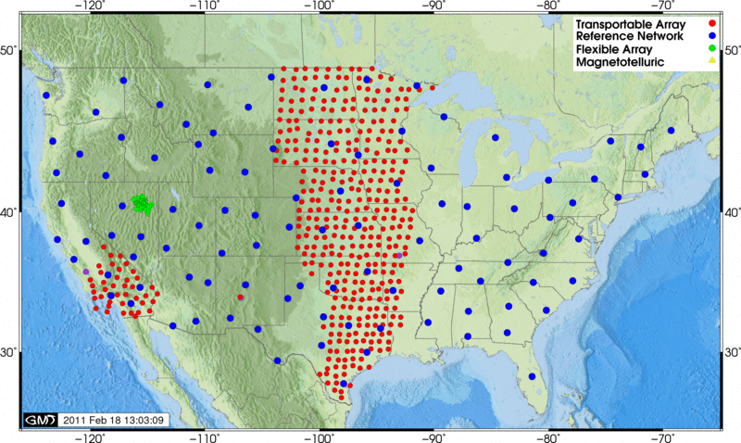
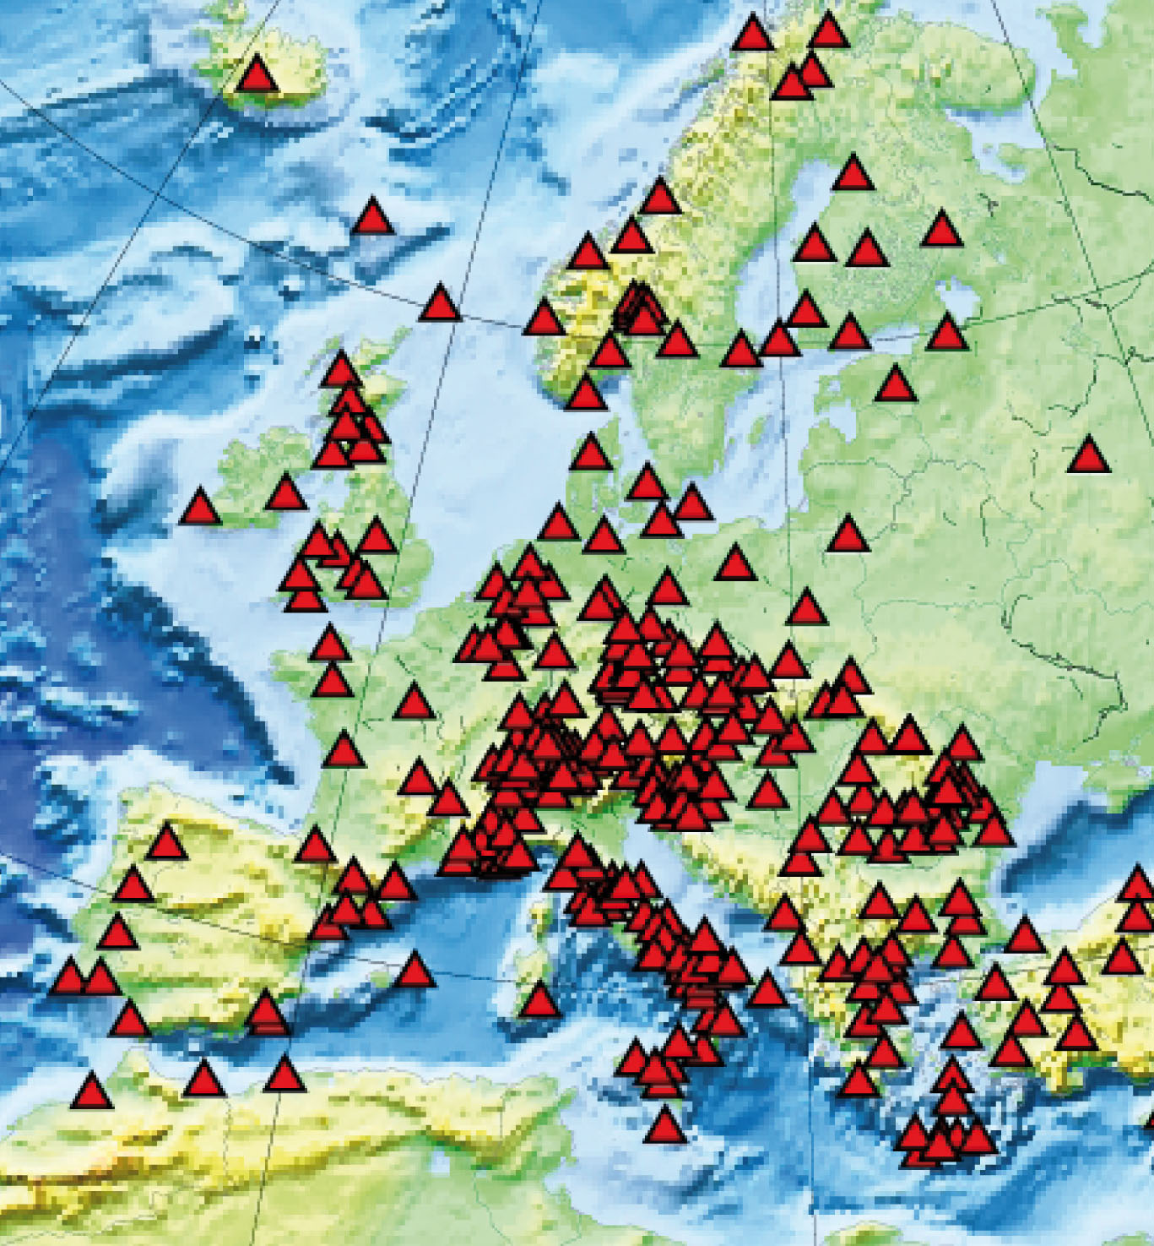



EUROPEAN INTEGRATED DATA INFRASTRUCTURE (EIDA)
SEISMIC RECORDS
ODC
Sync
GFZ
FDSN/JMA
SeedLink/ArcLink Network
FDSN/IRIS
....
INGV
IPGP/RESIF
Data Intensive Research
Visualization
Data analysis /parallel data mining
Simulation, inversion, HR imaging
HPC/GRID
Infrastructures
Earth’s interior imaging and dynamics: noise correlation, waveform analysis | Natural hazards: new tools for monitoring earthquakes, volcanoes, and tsunami | Interaction of solid Earth with Ocean and Atmosphere: environment, climate changes
Notes:
The earthquake and seismology research is an intrinsically Global undertaking that addresses both fundamental understanding of the Earth’s interior structures and evolution, and augmented societal issues concerning natural hazards, energy resources, environmental changes and national security. This community is central in the European Plate Observatory System (EPOS), the ESFRI project of the solid earth community now in the preparatory phase.
Global and regional monitoring networks are continuously transmitting wealth of digital continuous time data from dense seismic arrays to the European Integrated Data Archives (EIDA), part of the International Federation of Digital Seismograph Networks (FDSN) - an international consortum within GEOSS - with well established standards for data exchange formats and data center management systems.
The earthquake and seismology community is facing today a fundamental research paradigm shift: from data and event driven research to data intensive research exploiting the wealth of information provided by dense arrays of continuously recording stations.
Today, innovative analysis methods extracting spatial and time coherent information using correlation-based and mining methods allow to exploit the whole waveform information even in what was previously disregarded as noise.
These new data analysis and inversion methods require seamless access to large volumes (~100 TB – 1 PB) of distributed multi-sets data and extensive computing and storage capabilities across the Grid and HPC infrastructures. Other critical issues are related to curation, sharing and re-use of processed and simulated data (publishing); collaborative sharing of data and methods, together with orchestrated workflows across multiple service components.
To exploit the full potential of the community data environment and of the emerging European e-infrastructures (Grid and HPC), VERCE aims to build, within the ESFRI-PP project EPOS, a data-intensive e-Science environment based upon a service-oriented architecture and a framework of services and tools integrating Data, HPC and Grid infrastructures.
VERCE will provide to the solid earth community in the EU: a scalable data, mining and modeling infrastructure, a entry point to access data, sharing and knowledge-based dissemination tools in the seismology community and beyond in the Earth Sciences community that will benefit to societal problems.

Slide 3
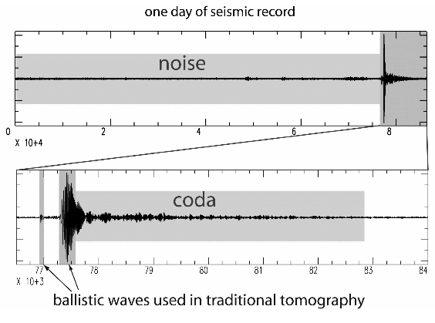
A shift in paradigm
Exploiting the coherence in space and time from dense arrays of continuously recording stations

Slide 4
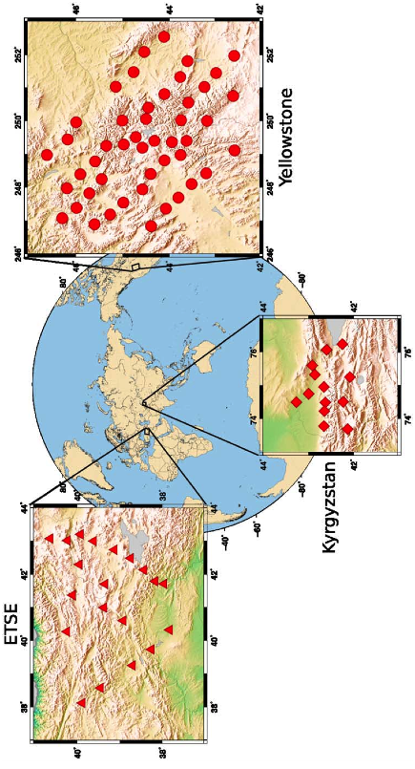
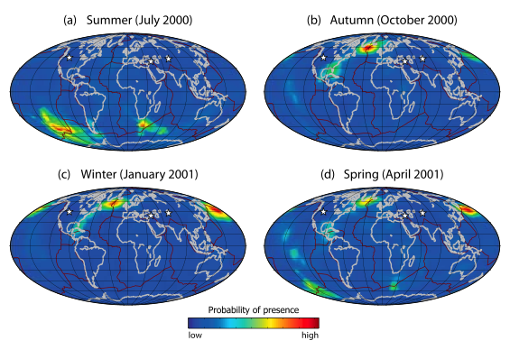
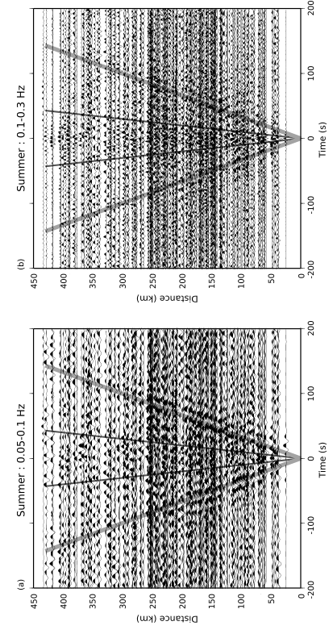
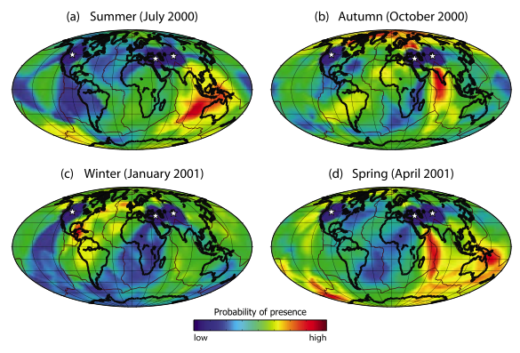
Noise correlation: origin of deep ocean sources
Landes et al (2010)

Slide 5
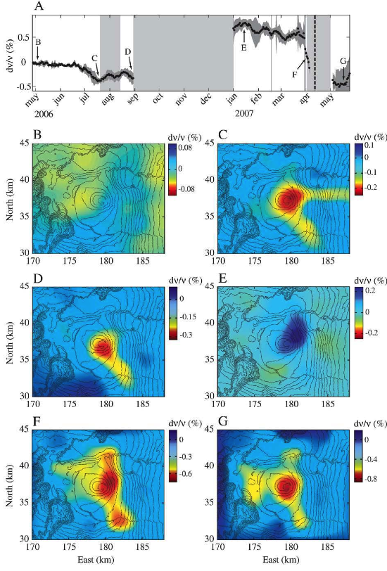
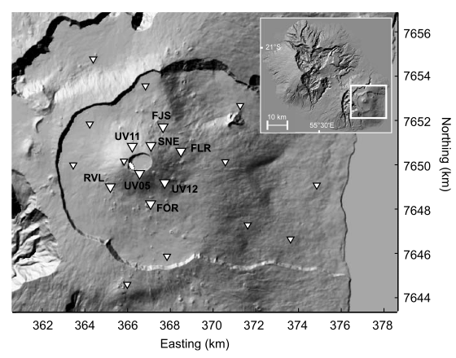
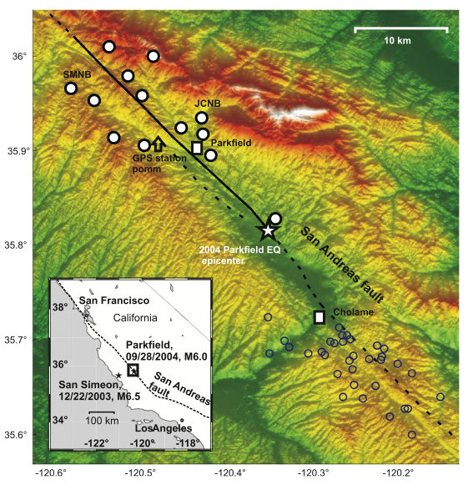
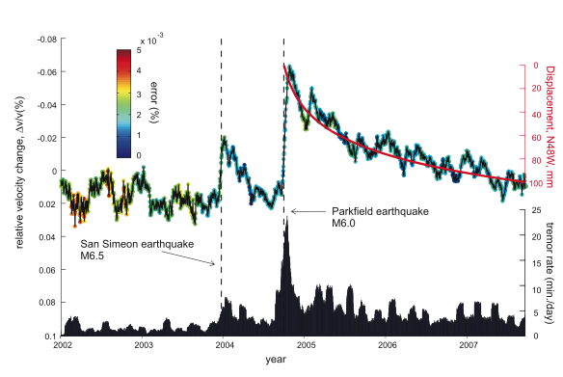
Monitoring physical changes
Frequency band: 0.1-0.9 Hz
Relative travel time shift -> relative seismic velocity
Parkfield
13 short period stations, 5 years, 1 day time window, 194, 740 cross correlations
Réunion
21 short period stations, 18 months, 15 days time window,
Brenguier et al. (2008)

Slide 6
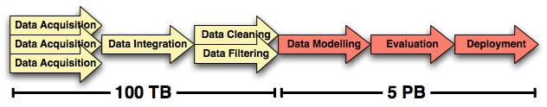
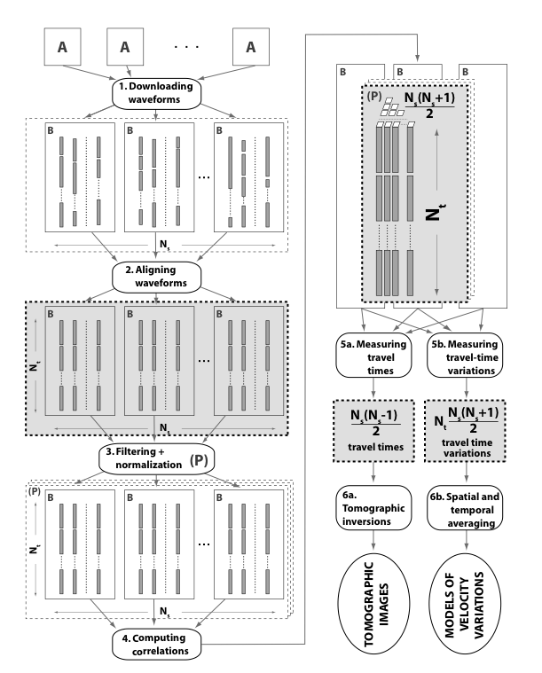
Data Intensive analysis
Distributed Data Mining:
Distributed Mining of Data
Mining of Distributed Data
Data Architecture requirements:
Archiving and distribution (data centers)
Mining large data volumes (distributed)
Mining multi-source data (heterogeneity)
Amdahl’s parallelism law: If a computation has a serial part S and a parallel component P, then the maximum speedup is S/(S+P).
Amdahl’s balanced system law: A system needs a bit of IO per second per instruction per second.
Amdahl’s memory law: The MB/MIPS ratio in a balanced system is 1.
Amdahl’s IO law: Programs do one IO per 50,000 instructions

Slide 7
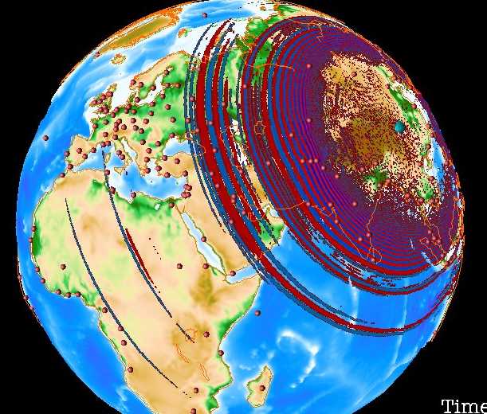
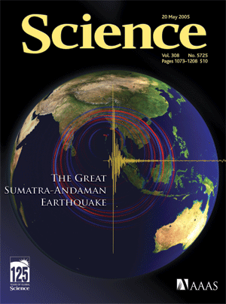
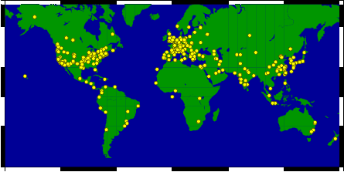
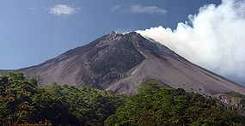
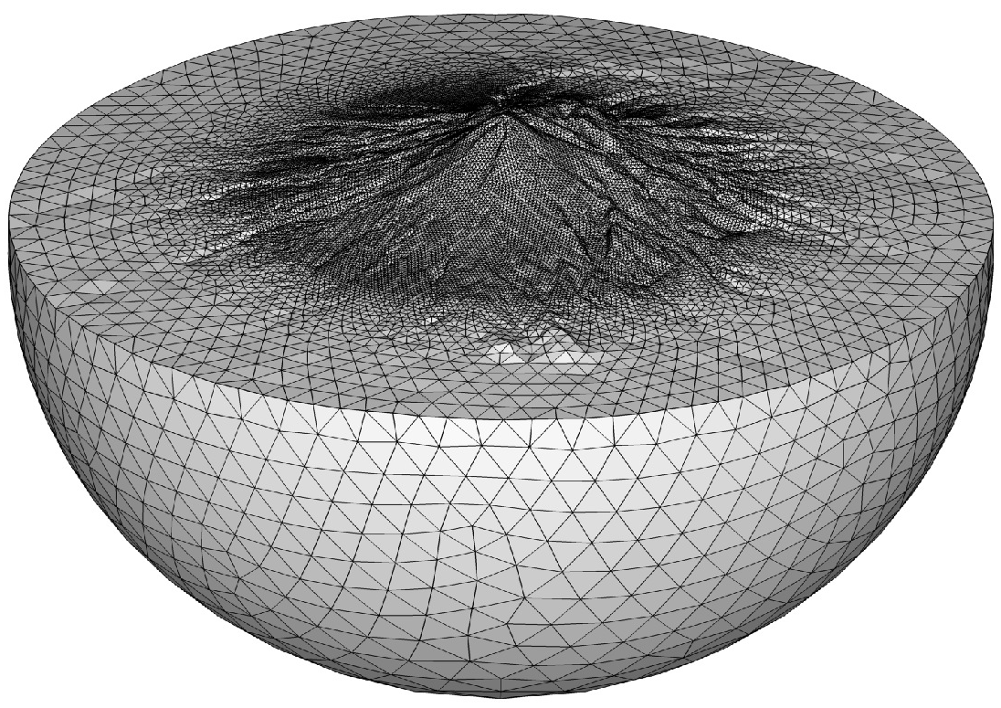
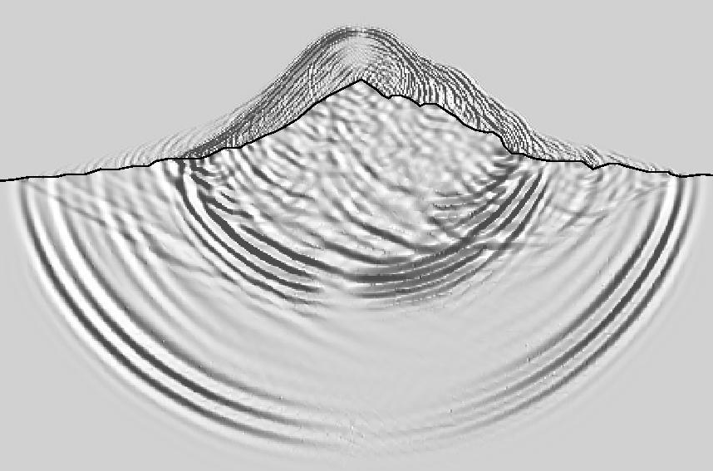
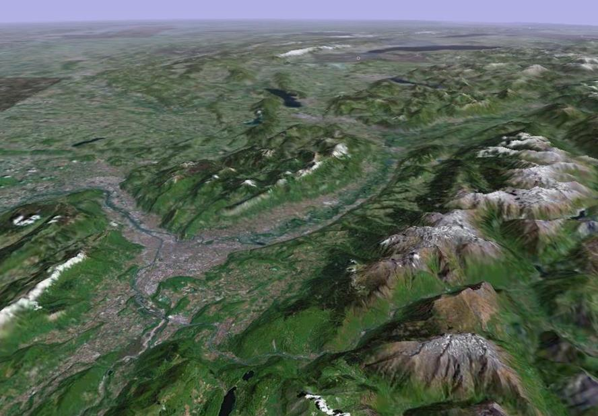
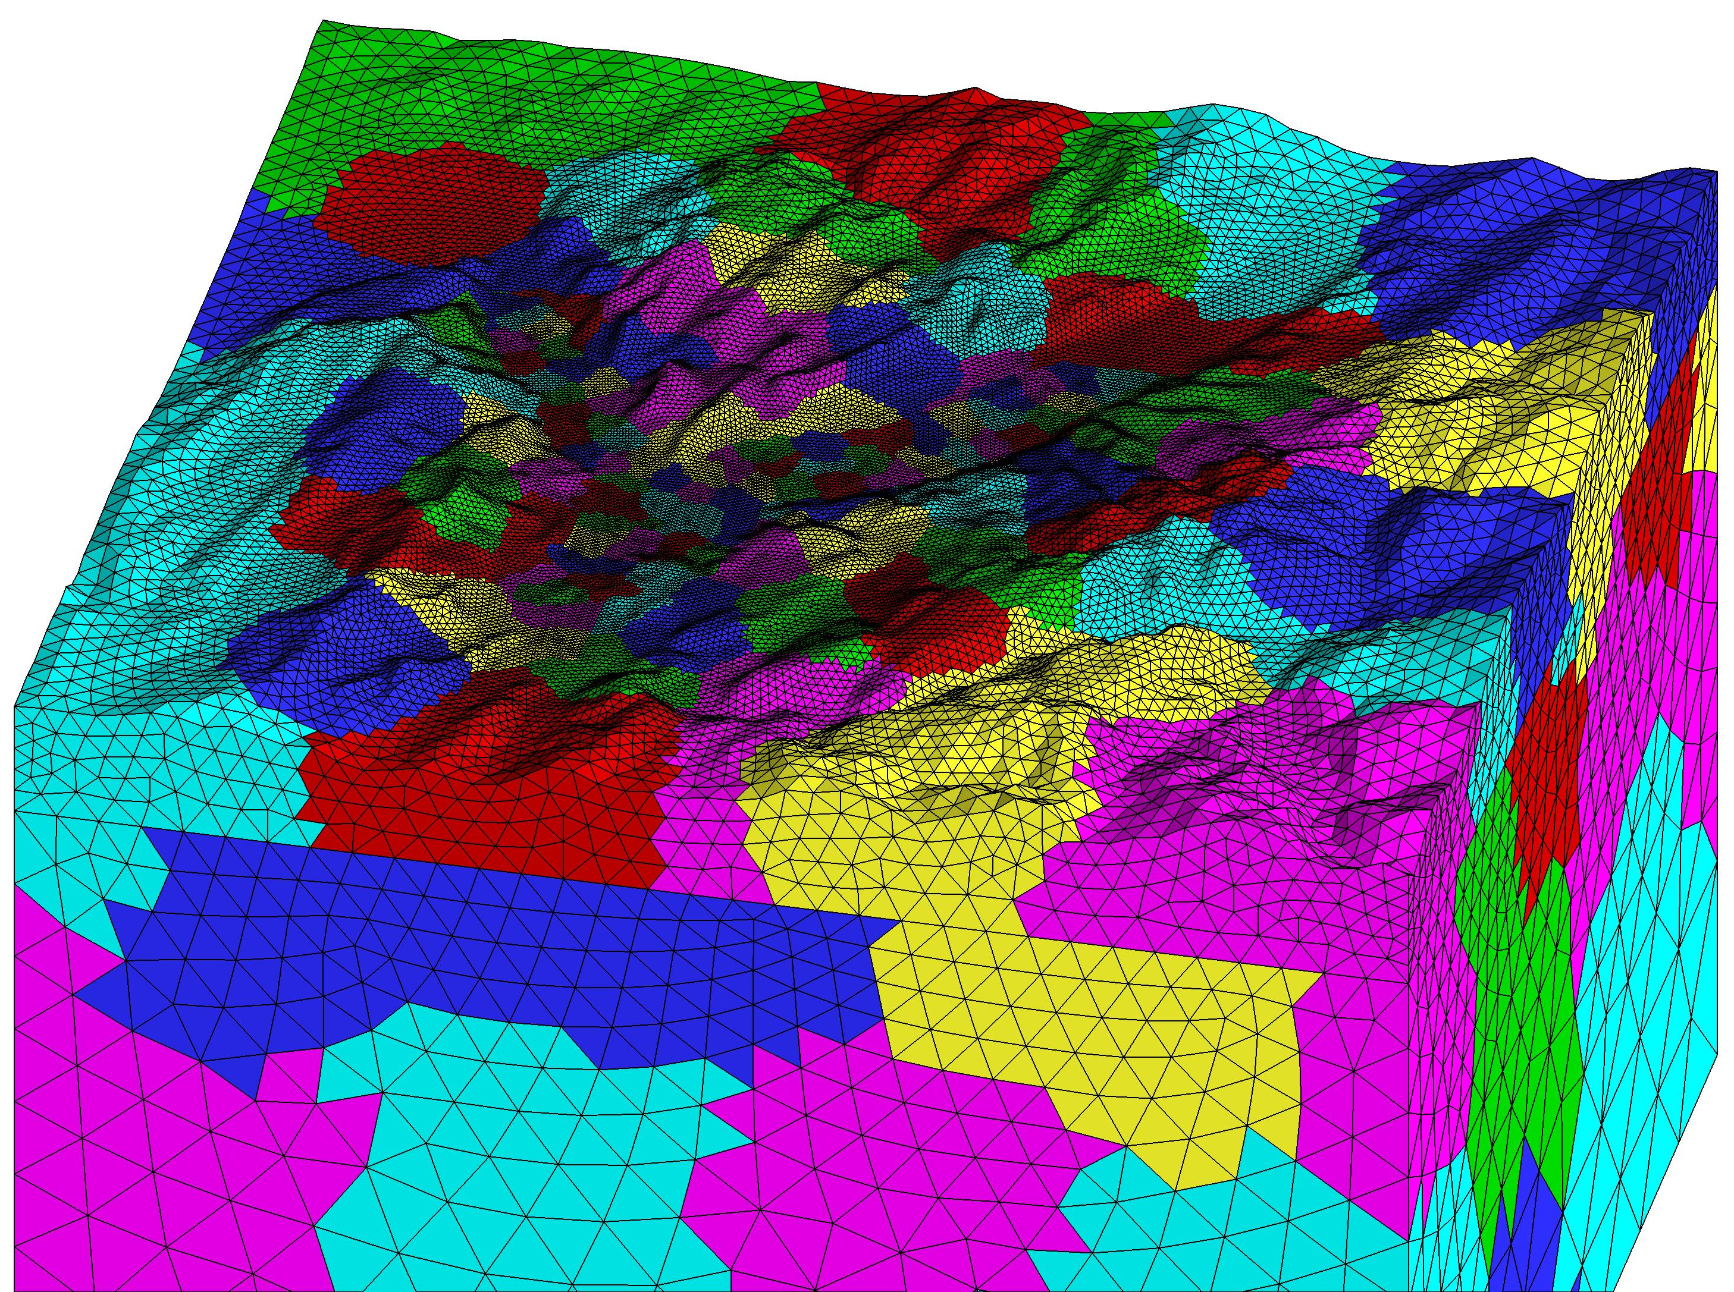
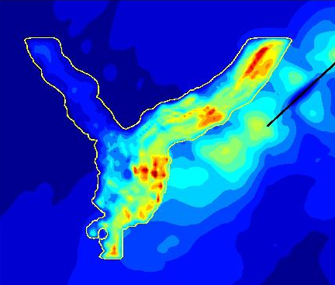
CPU Intensive simulation and inversion
Large earthquake source radiation: Sichuan (Mw 7.9, 2009, China); Sumatra-Andaman (Mw 9.2, 2004, Indonesia)
Global scale:
Synthetics
Full waveform inversion
Earthquake location
Conforming mesh
Research groups using SPECFEM3D
Regional scale:
Complex wave propagation
Aero-acoustic coupling
Non conforming mesh
Full waveform inversion
Aero-acoustic wave simulation in a volcano
Strong motion simulation: Grenoble Valley
Strong motion prediction:
Synthetics waveforms
Geometry+ heterogeneity + sources
Homogeneization
Stochastic simulation

Slide 8
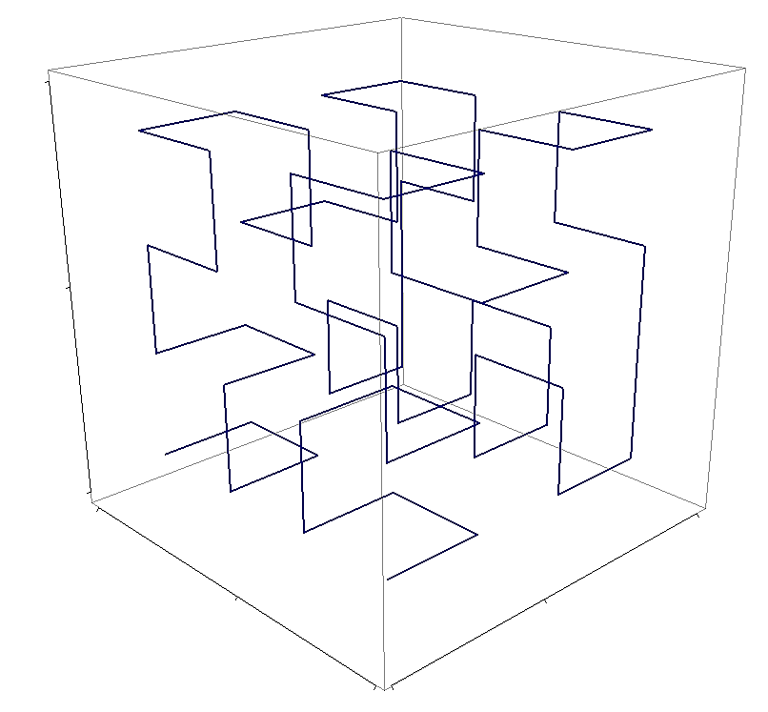
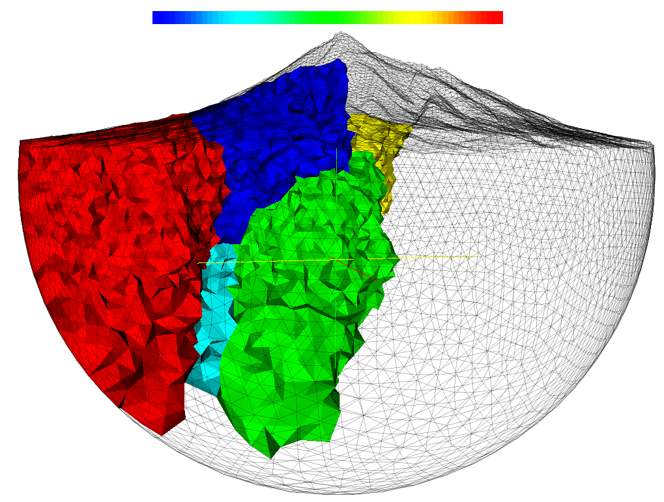
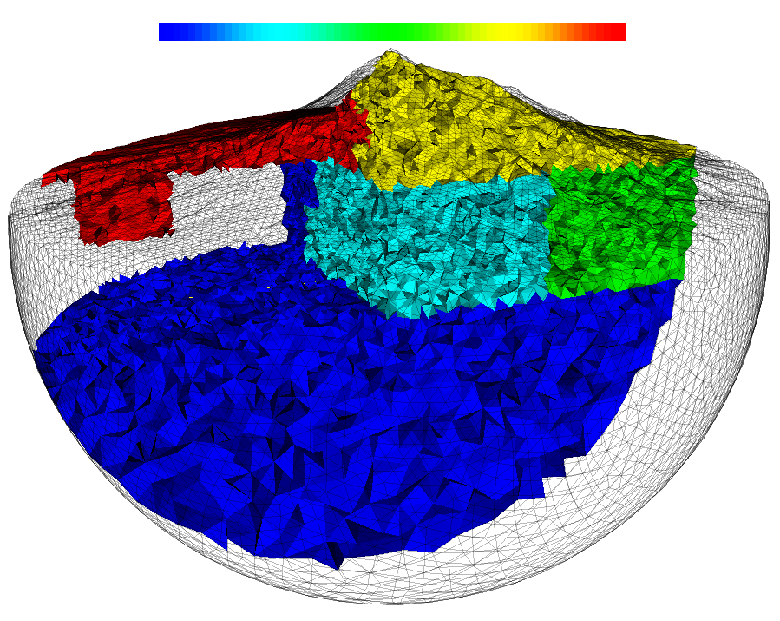
Data intensive computing challenges
Large scale 3D wave simulation:
synthetic seismograms
strong motion prediction
Full waveform inversion:
Adjoin methods
Non linear inversion
Orchestrated data analysis and data simulation
Scalability and Load balancing
  Communication fabrics
  Asynchronous time integration (local time stepping)
SPECFEM3D: up to 149,784 cores on the CRAYXT5 (Jaguar) at ORNL (200 Tflops sustained) ; DG3D-SEISOL: up to 2040 processors
Memory complexity
  Memory hierarchy
  Advanced data-structure
Multicore architectures
  Mixed-hybrid parallel implementation
  Self-scheduling at thread level
  Asynchronous communications
Orchestration workflows and visualization
  Mesh and domain decomposition
  Data management
Community building and software sharing
Hilbert SFC of level 2 and 64 sub-cubes
Domain decomposition by METIS (left) and SFC (right)
16 sub-domains, visible: 0-4

Slide 9
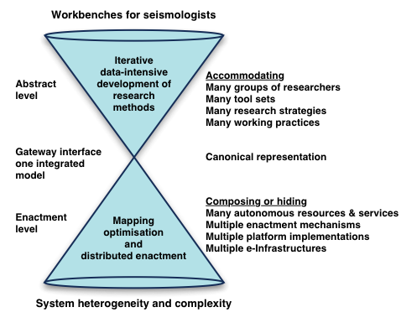
A three layer architecture

Slide 10
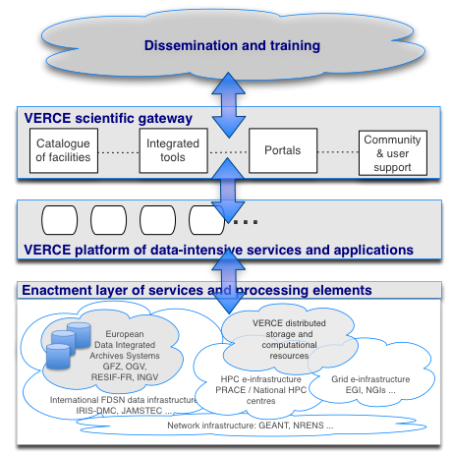
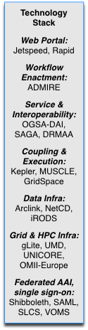
A service oriented platform
Notes:
Technology Stack
Web portal: Jetspeed, Rapid
Workflow enactment: ADMIRE
Coupling and execution environments: Kepler, MUSCLE, GridSpace
Service gateway and interoperability layer: OGSA-DAI, SAGA, DRMAA
Data infrastructures: Arclink, NetCD, iRODS
Grid and HPC infrastructures: gLite, UMD, UNICORE, OMII-Europe
Federated AAI, single sign-on: Shibboleth, SAML, SLCS, VOMS
Coordination and interaction with:
European data integrated archive systems: GFZ, OGV, RESIF-FR, INGV
International FDSN data infrastructures: IRIS-DMC, JAMSTEC
Network infrastructures: GEANT, NRENS
HPC infrastructures: PRACE, National HPC centres
Grid infrastructures: EGI, NGIs
VERCE will work in close synergy with European initiatives such as EUDAT and ENVRI, together with EPOS, to insure that the technology stack remains in line with the evolving standards of the community and of the e-Science community.

Slide 11
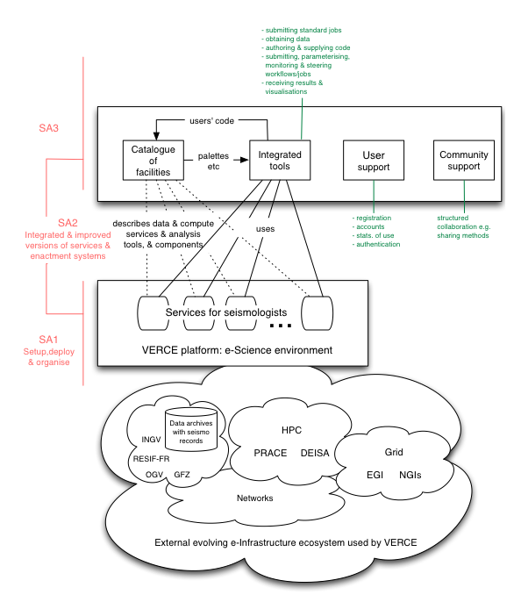
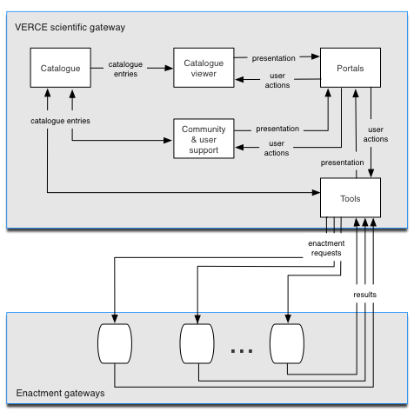
VERCE implementation strategy
A tree layer architecture:
Hide lower level heterogeneity (resilience)
Mapping mechanisms and data-access adapters
Mapping credentials and security protocols
A Platform of tools and services
Production platform through release cycles
Support evolving standards services and interfaces
A collaborative environment:
workbenches, workflow tools
reusable libraries
Provenance, multi-source, publication
OGSA-DAI, WS-DAI, SAGA, OGSA-DMI (GridFTP), Globus Online

Slide 12
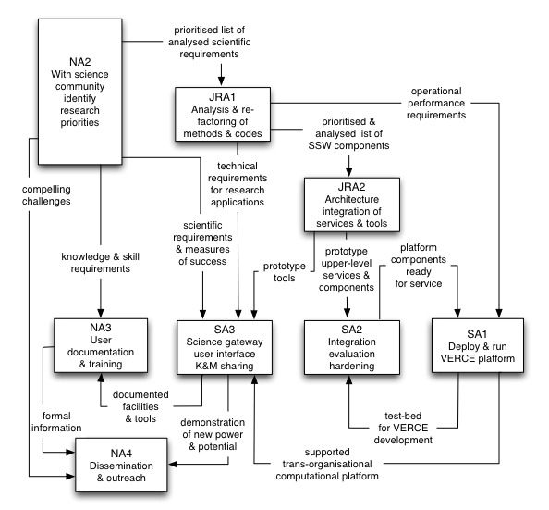

Slide 13
Seismology: research and data infrastructure
VERCE ecosystem and interactions
Ocean and seafloor sciences
EMSO (ESFRI-PP) – ESONET
Technical developments
Engineering seismology: infrastructure
EFAST – SERIES
Outreach
Community interaction
Infrastructure projects: NERA, SHARE…
ORFEUS, EMSC, FDSN
VERCE
Earthquakes, Volcanoes, Earth dynamics, Tectonics
Seismology Research and Training:
ITN project: QUEST… ; ERC project: WHISPER,…
EPOS Preparatory Phase project
Earth Observation: GEOSS, ESA…
Technical developments
Standards
Environment ESFRI initiatives: ENVRI…
E-Infrastructure Initiatives: EUDAT, EarthServer…
EGI/PRACE
NGIs
E-science ecosystems: research and infrastructure

Slide 14
Towards an e-Science environment for seismology and EPOS
Provide a data intensive service-oriented e-Science environment to the EPOS community
Lay the basis for transformative data-intensive research in the solid earth sciences
Build trust and collaborative models for sharing of data , methods and tools
Engage a new generation of researchers and experts in solid earth data intensive research
European and International domain context
Integrated European distributed Data Archives (EIDA), part of the international FDSN
A number of coordinated European projects in seismology: NERA, SHARE, GEM, ERC WHISPER, ITN QUEST…
The European Plate Boundary Observation System (EPOS): the ESFRI-PP project
Active collaborations within the FDSN with US (IRIS-DMC), and Japan (JAMSTEX, NIED)
European e-Science context
Fast evolution of seismology services and applications
RapidSeis Portal for Accessing & Processing FDSN archives
European initiatives: EPOS, ENVRI and EUDAT
Converging e-Infrastructure ecosystem: EGI/NGIs, PRACE/NHPCs, GÉANT
Emerging new data base management system and data centric architecture
Emergent data access and single-sign on protocols
A seismology architecture for data intensive applications: data analysis, mining and modelization
Sharing with other disciplines: Astronomy & Astrophysics, Particle Physics, Biology
Notes:
A joint team from KNMI, ULIV and UEDIN, built on the NERIES project, to deliver a convenient portal for accessing and processing data from seismic archives supporting the FDSN standards.
A joint team from KNMI & UEDIN are working under the auspices of the ADMIRE project on a Seismic Noise Data Processing system drawing data from multiple European seismic archives, including the BGS and ORFEUS.

Slide 15
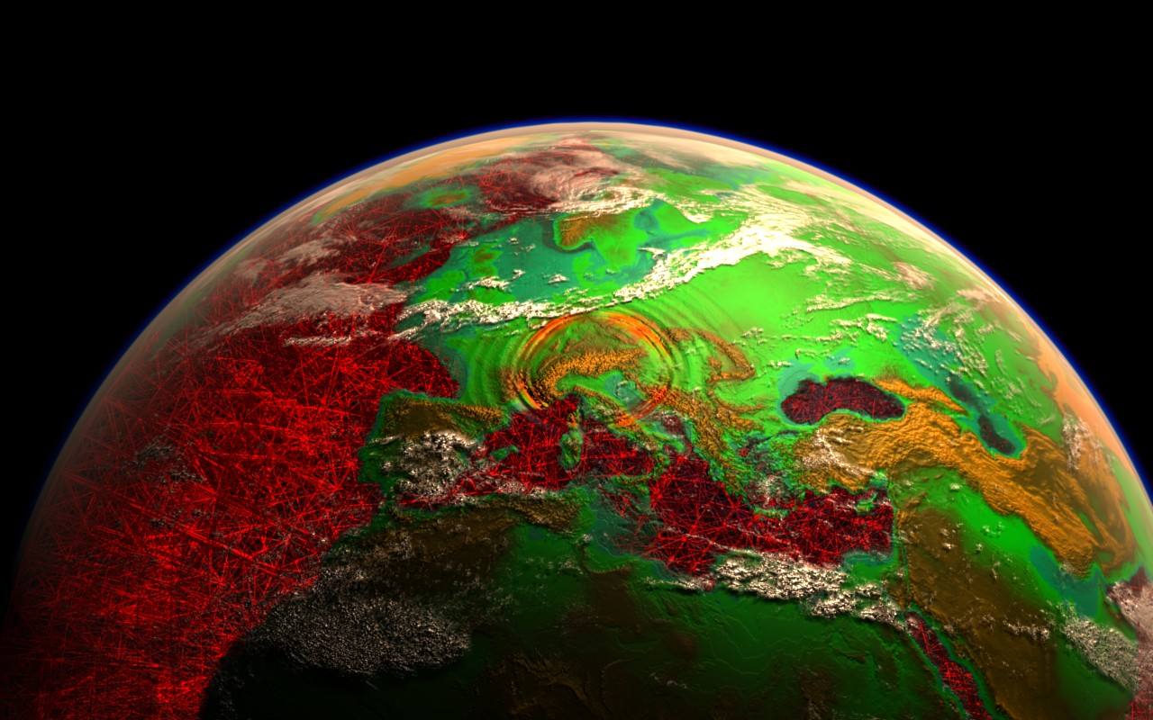
Thank you!

