Slide 1
Age of Universe and cosmological constant

Slide 2
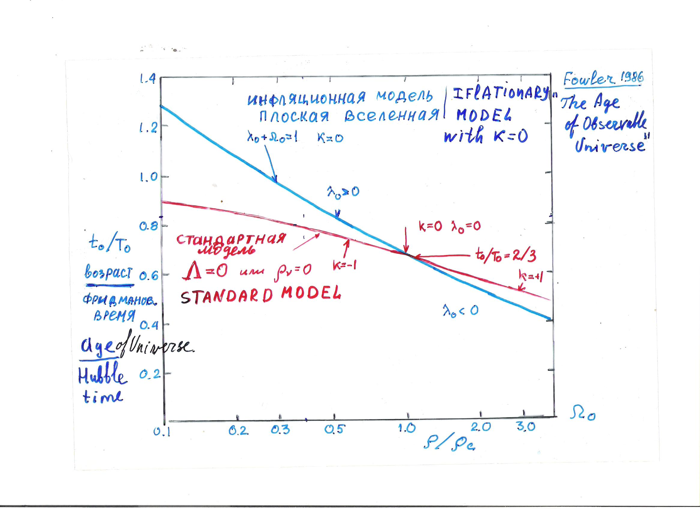

Slide 5
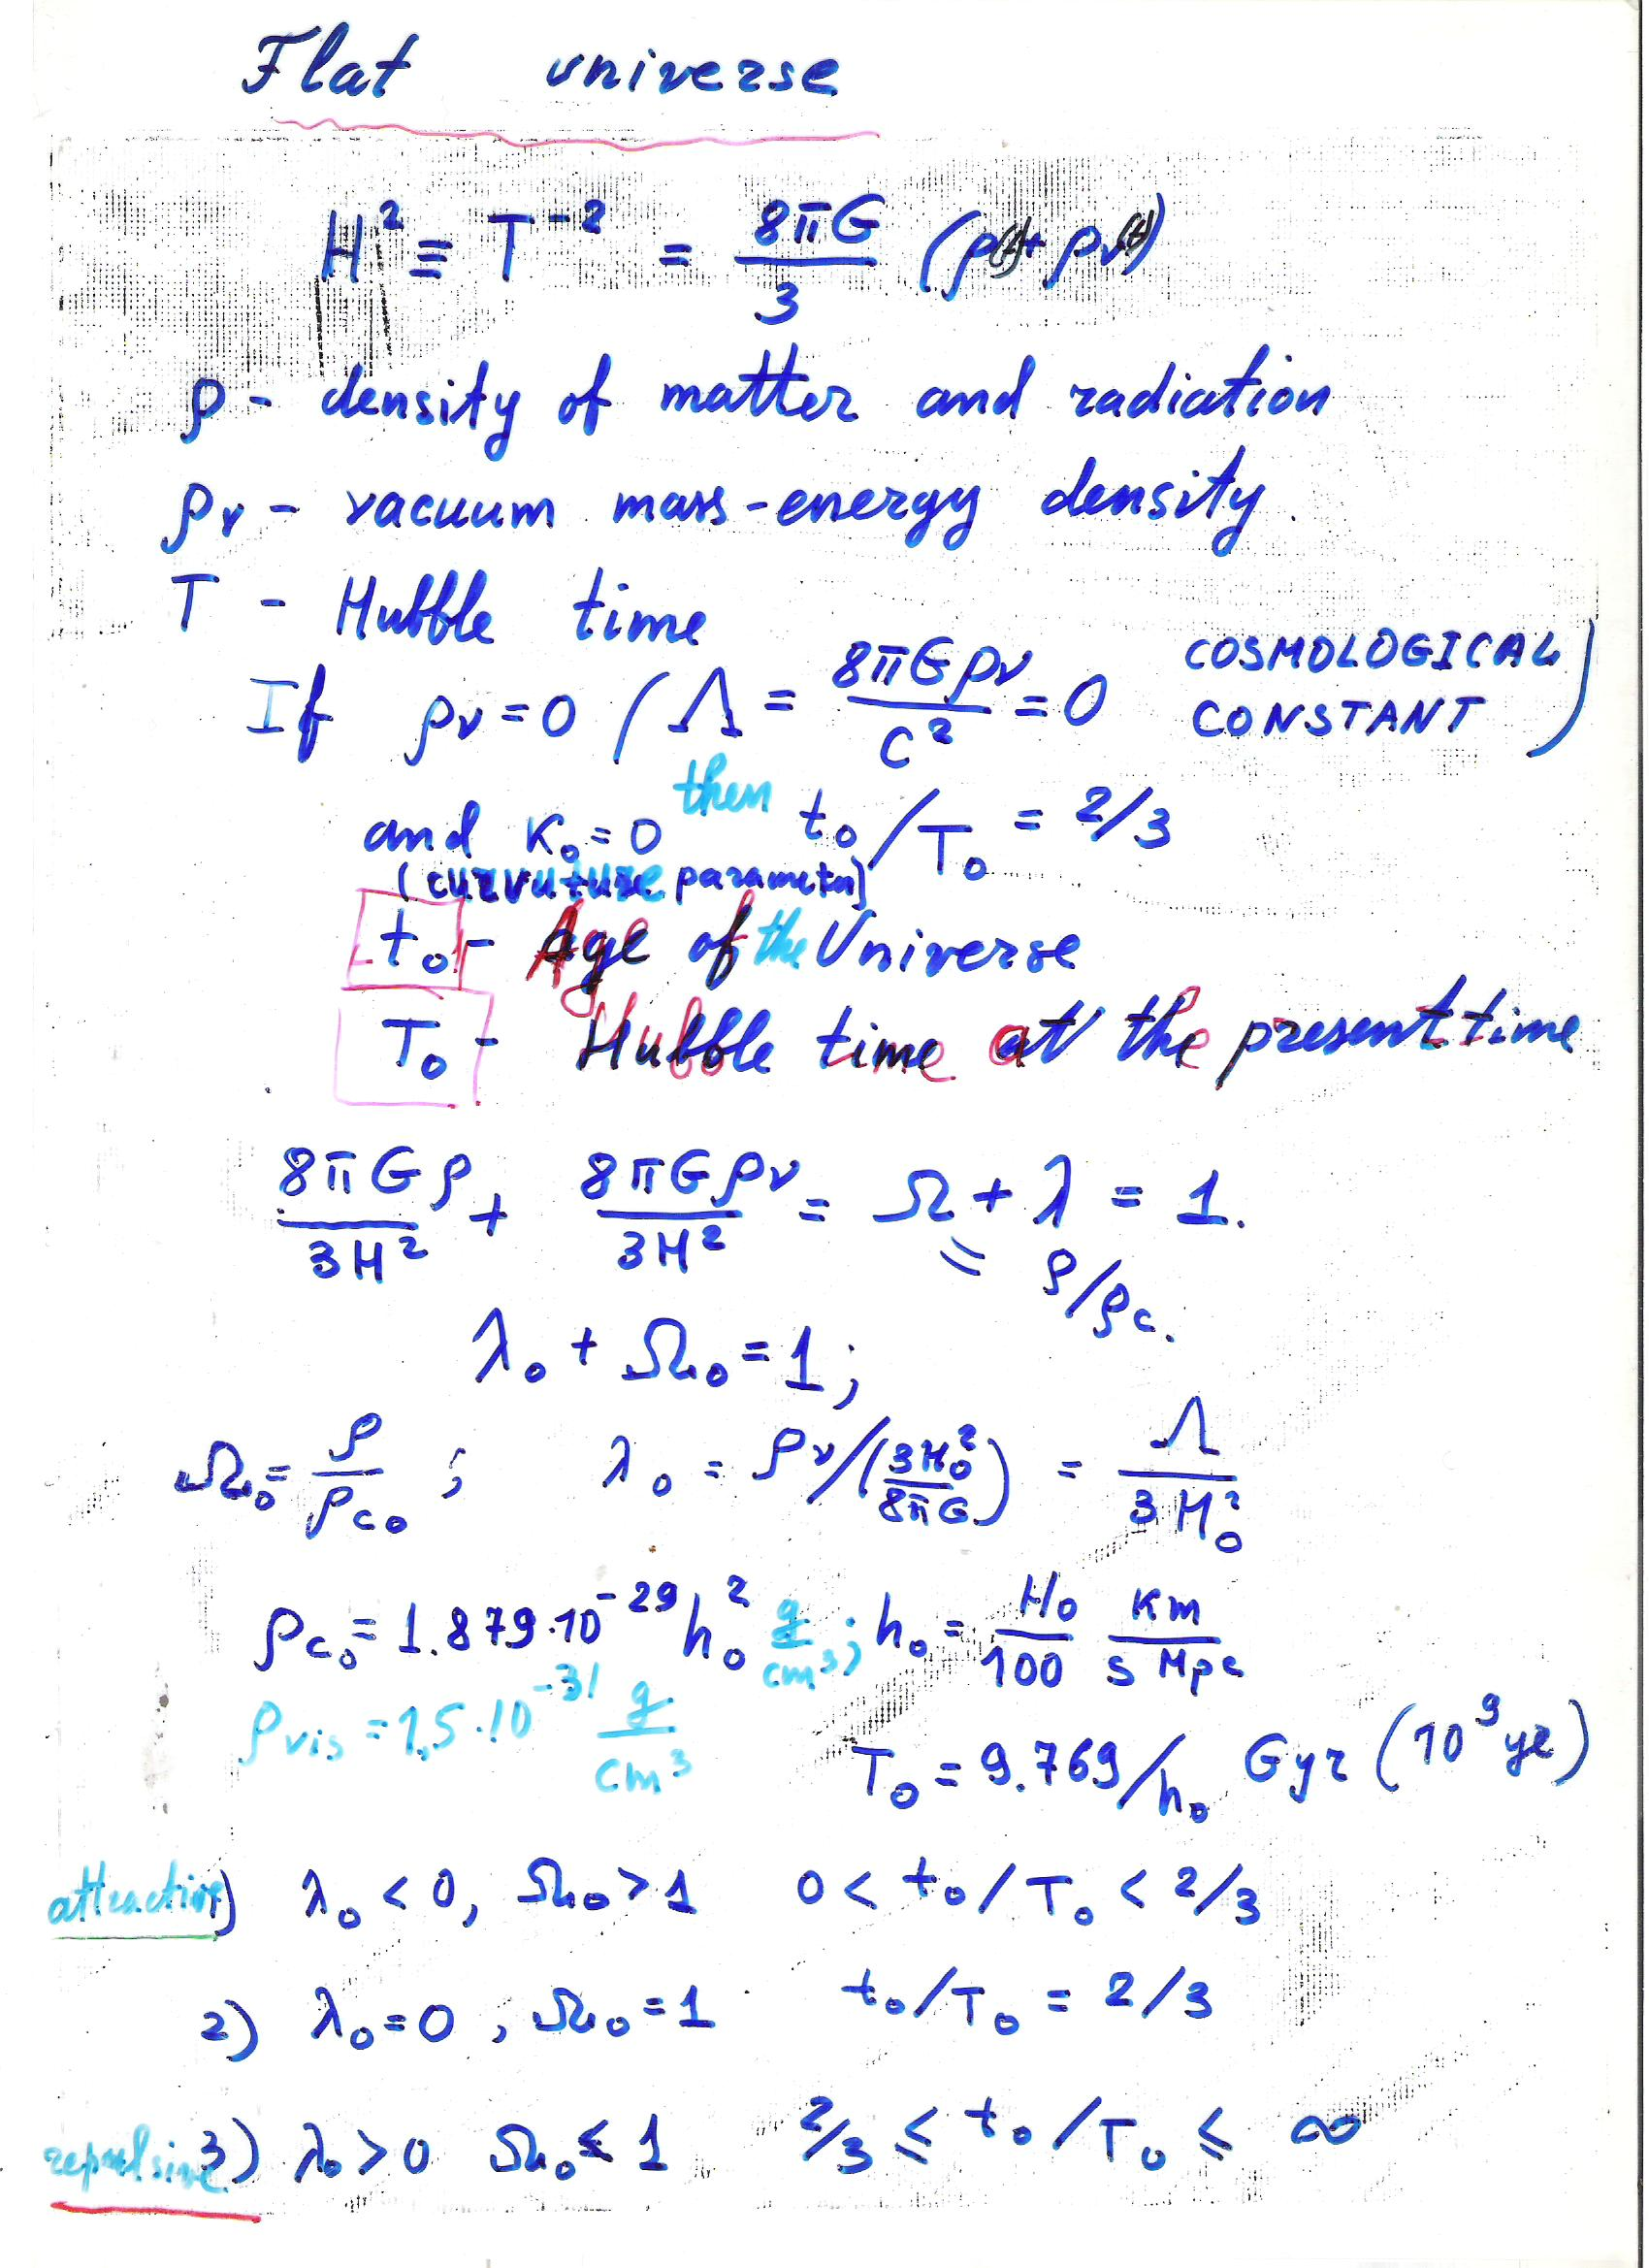

Slide 7
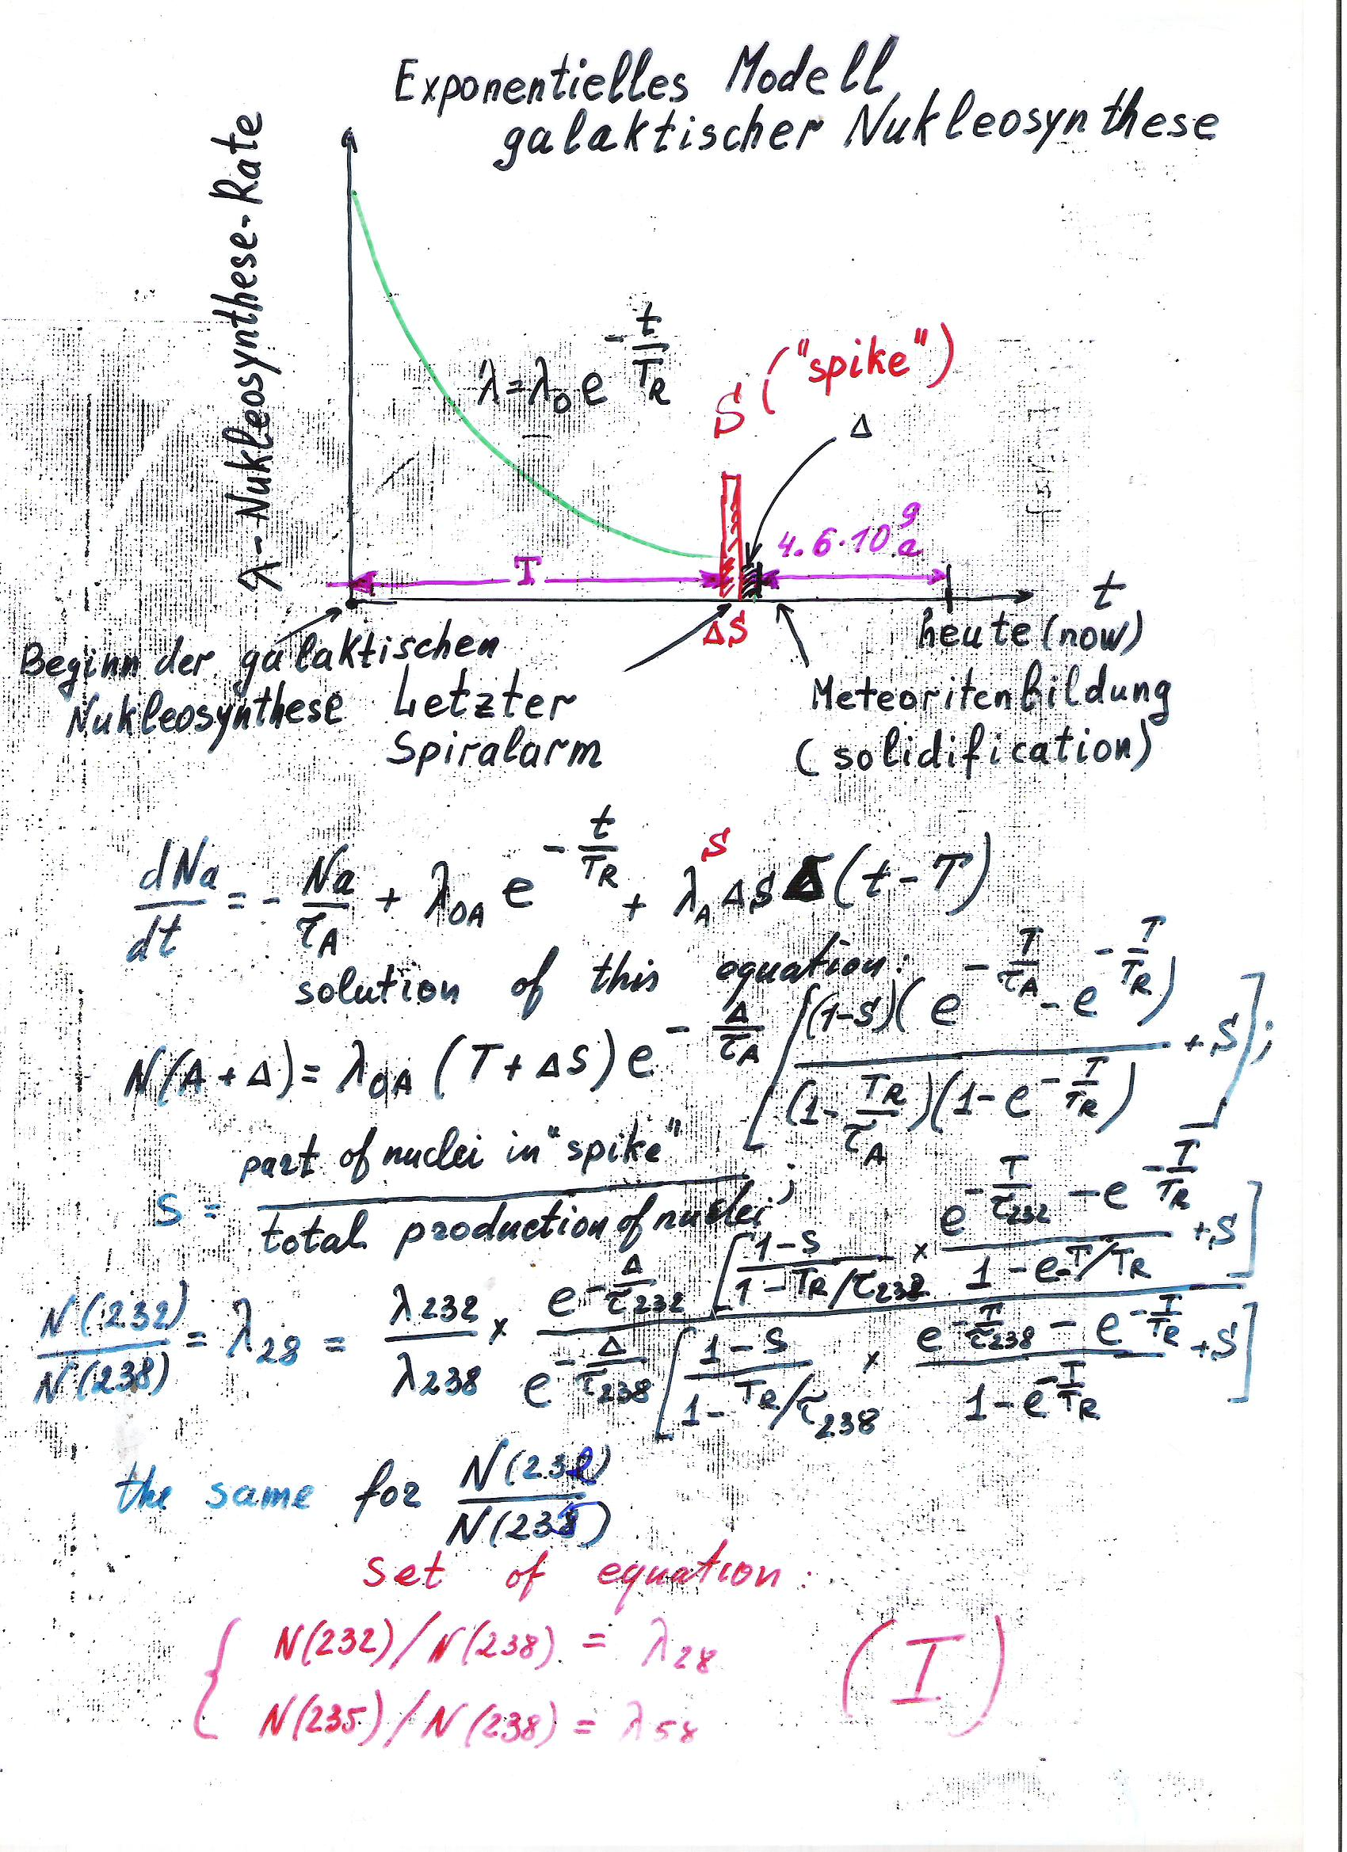

Slide 8
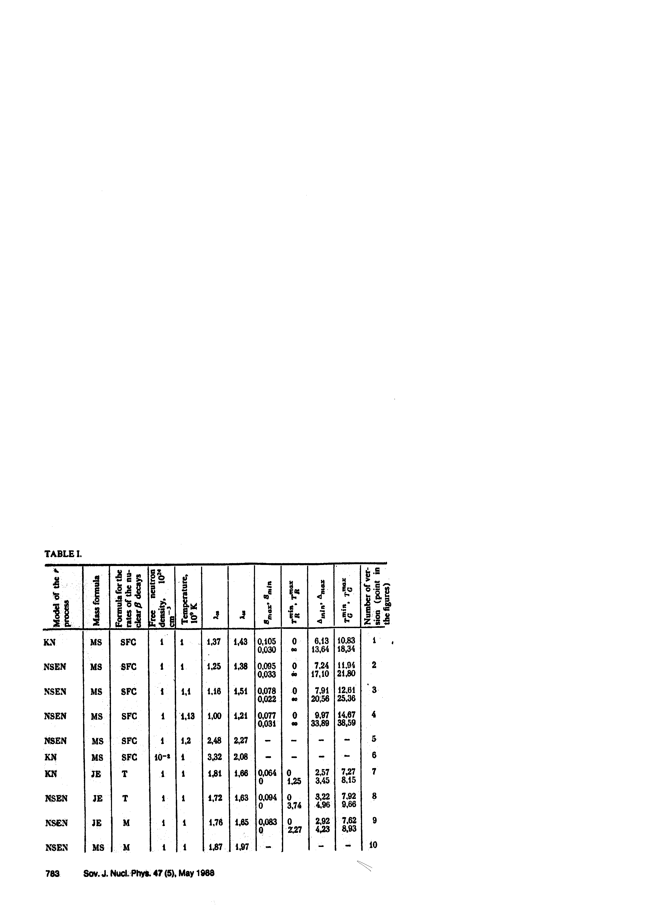

Slide 9
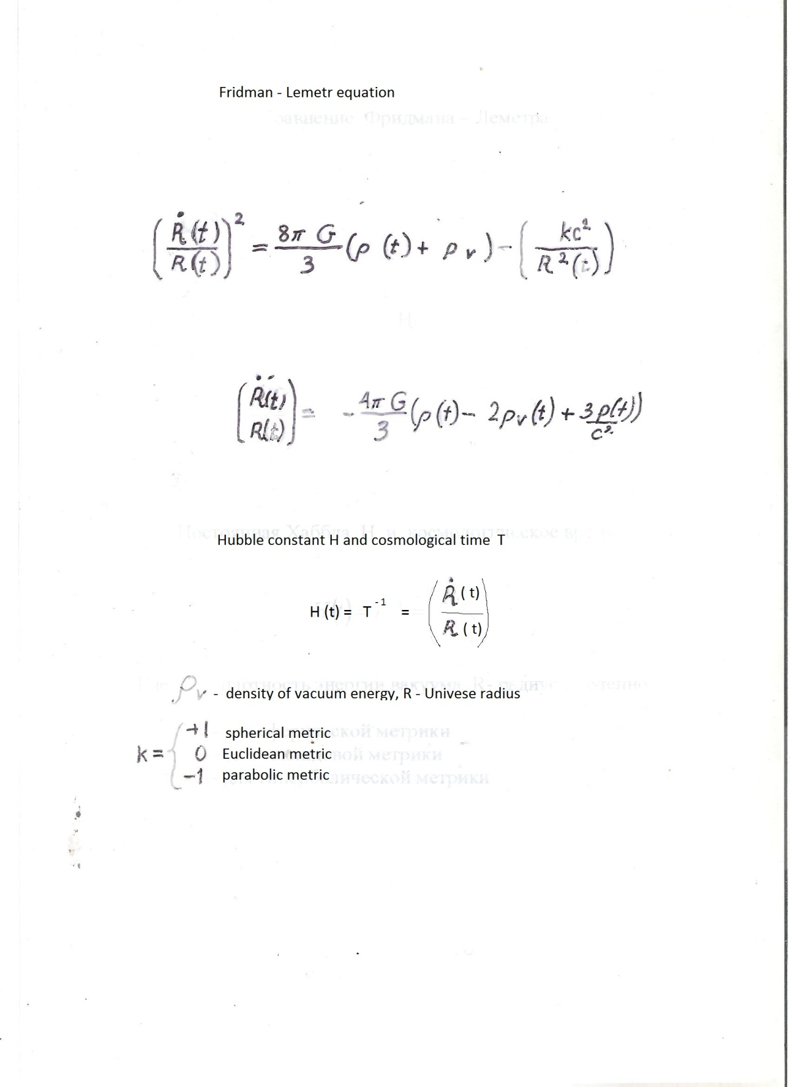

Slide 10
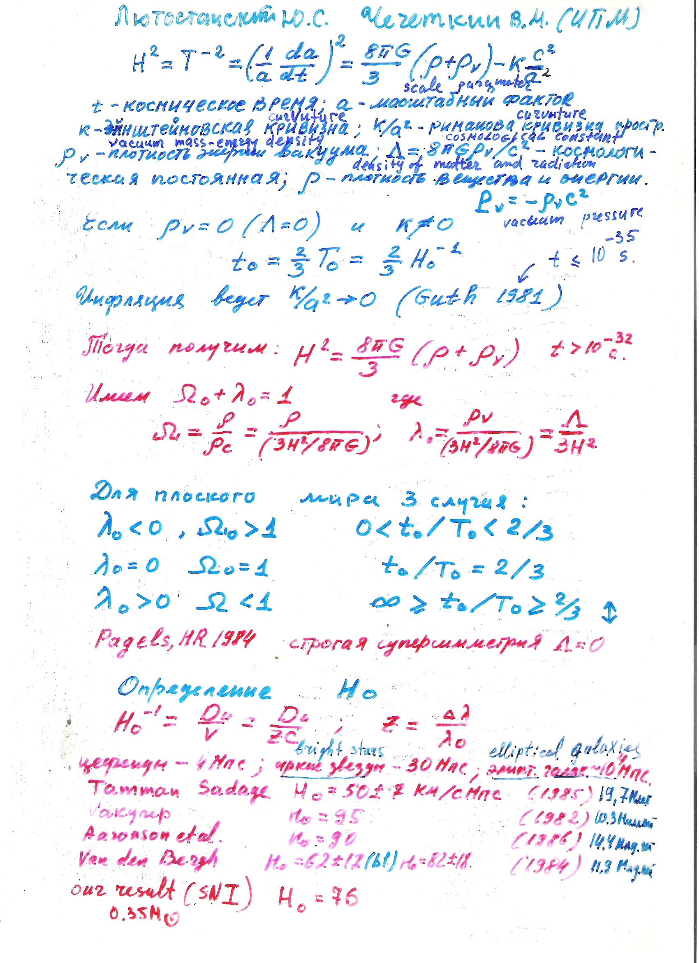

Slide 11
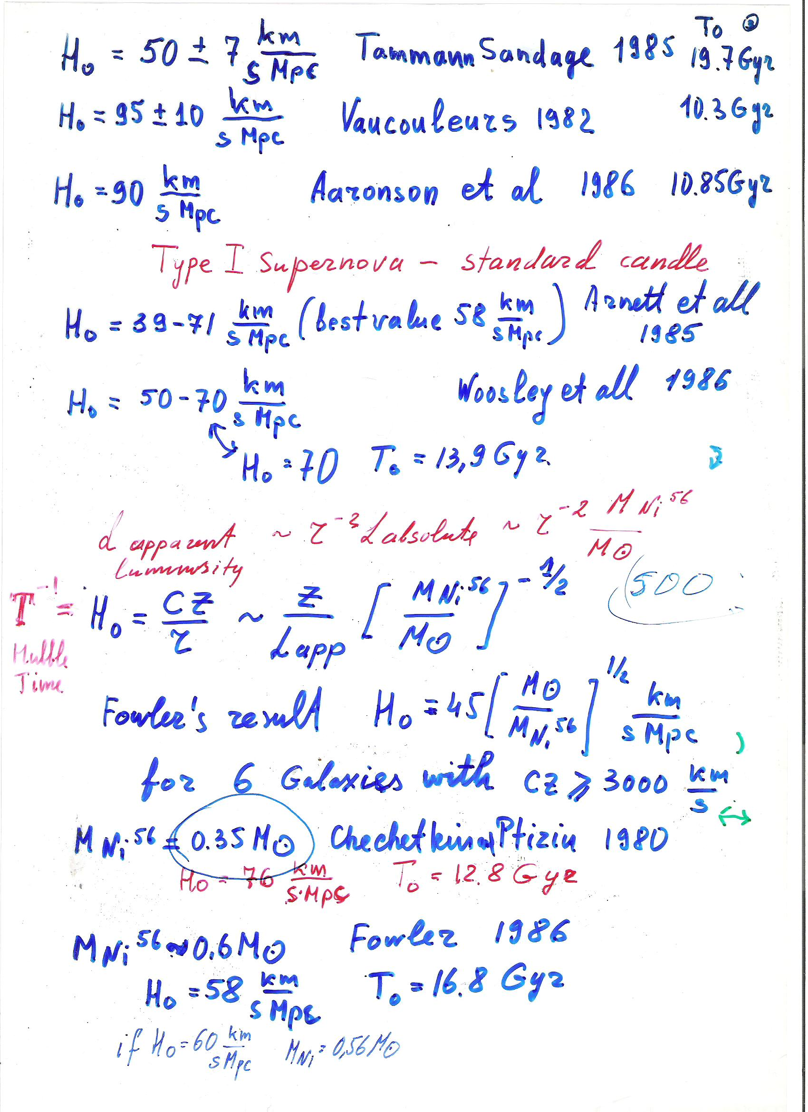

Slide 13
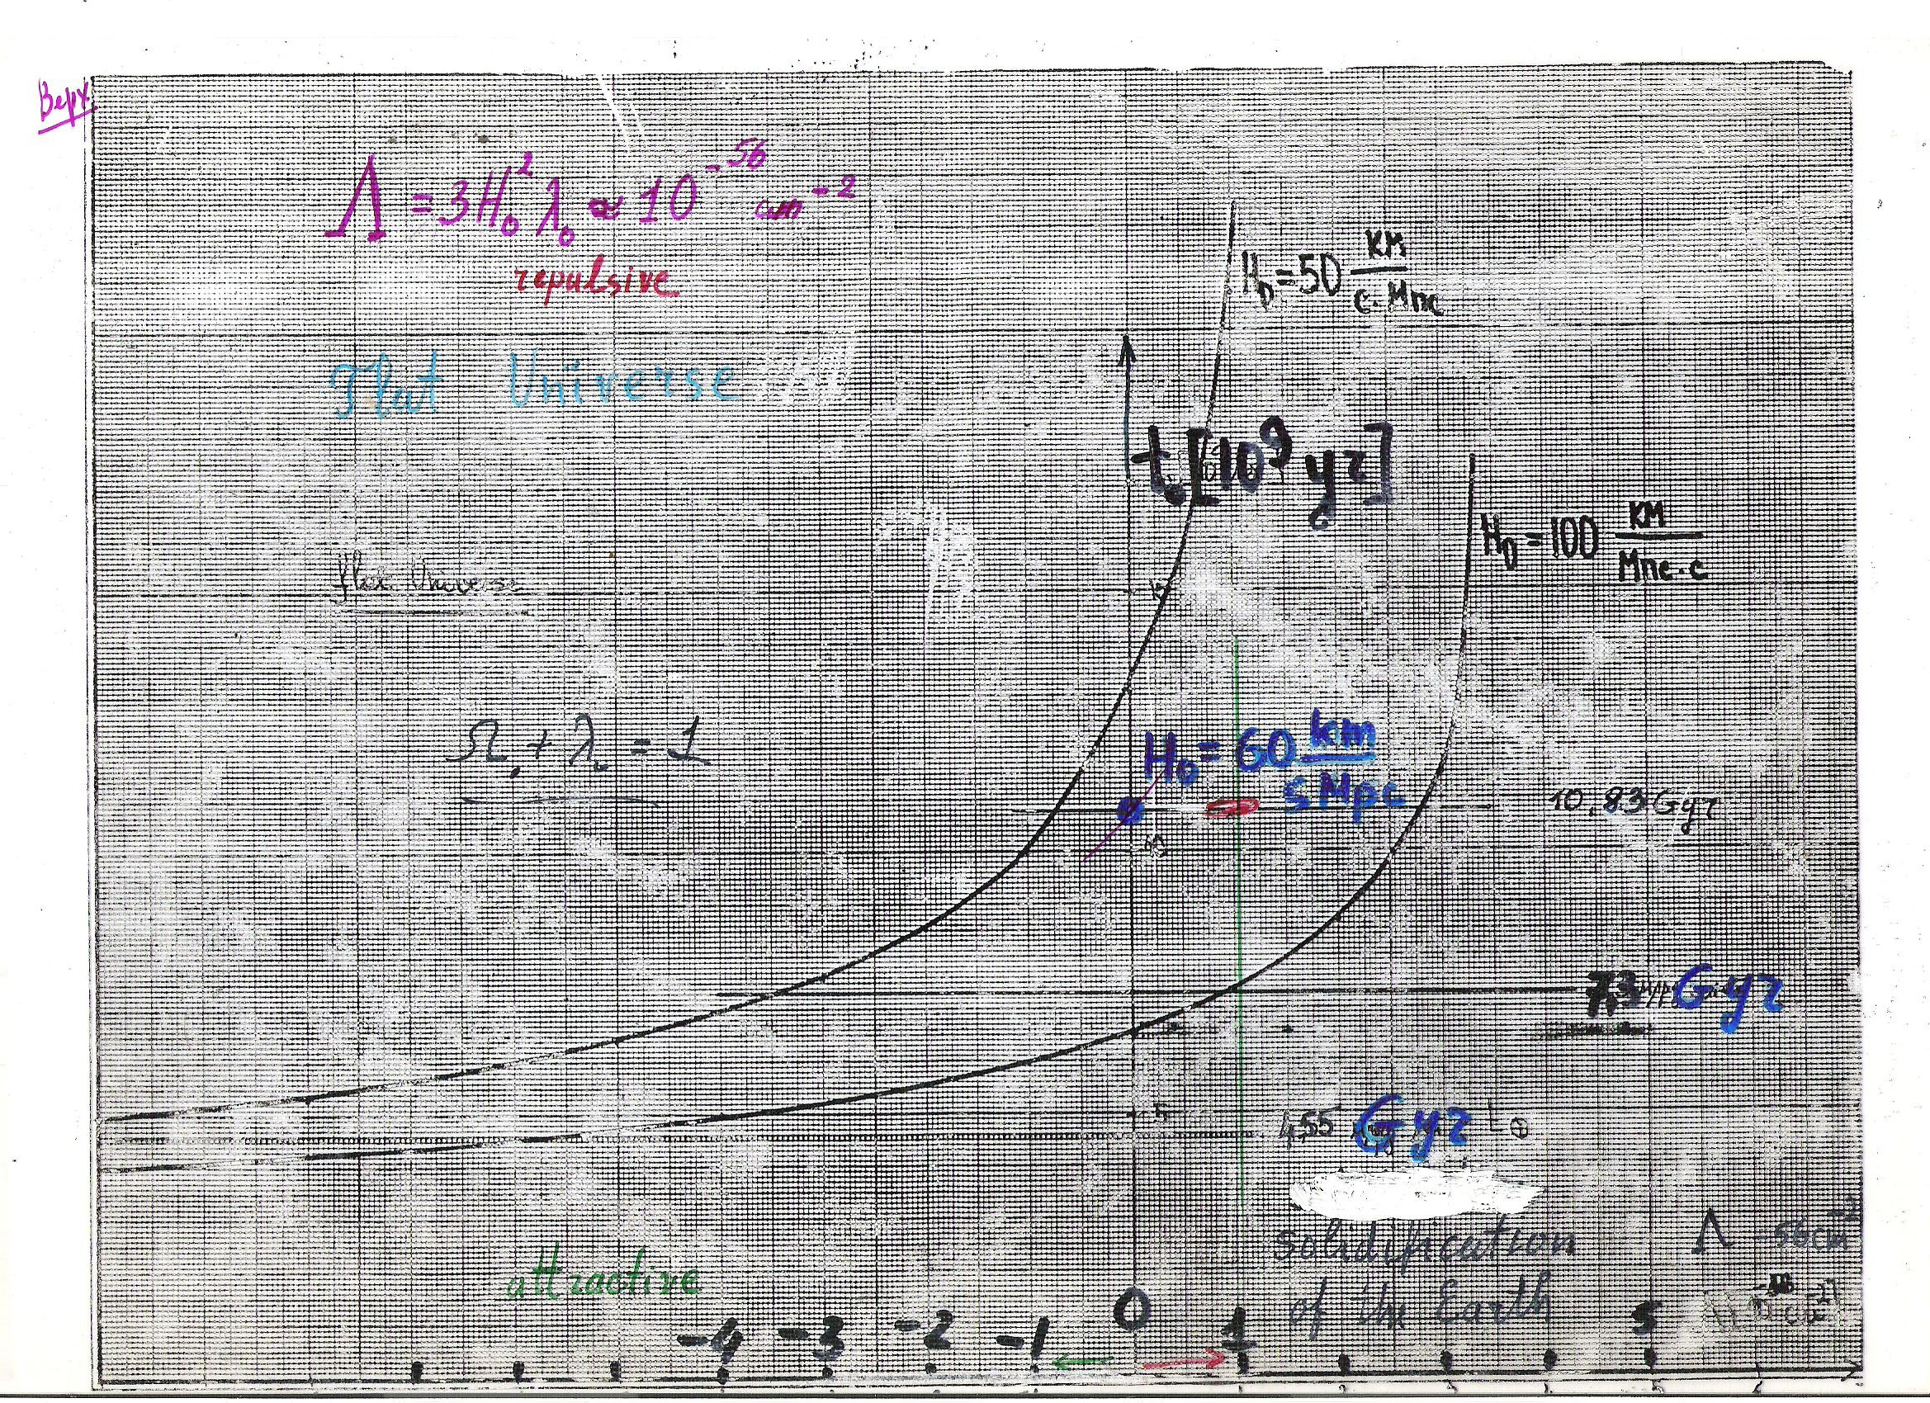

Slide 15
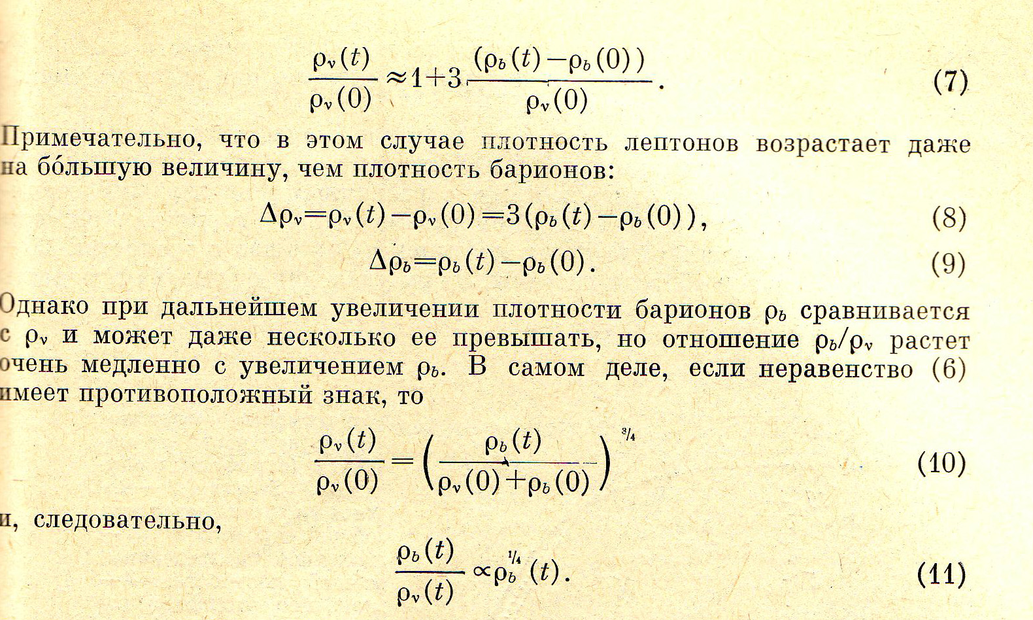

Slide 17
Dependence of surface density from radius in model : 1 initial distribution of total density, 2 final distribution of total density , 3 final distribution of leptons, 4 final distribution of baryons

Slide 18
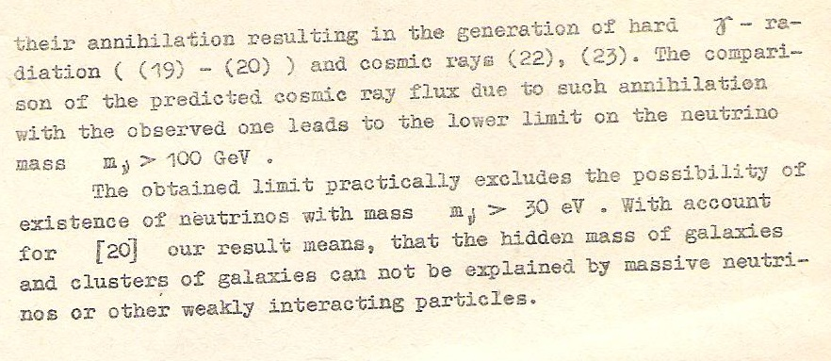

Slide 19
Limits on the Mass of Dark Matter in the Sun from a Model for the Modern Sun and its, Previous Evolution N. S. Kardashev1A. V. Tutukov2, and A. V. Fedorova2 1Astro Space Center, Lebedev Physical Institute, Moscow, Russia 2Institute of Astronomy,Moscow, Russia Received May 20, 2004; in final form, May 27, 2004
Abstract—The influence of dark gravitating matter on the present-day Sun and its evolution is studied. Numerical simulations show that substantial departures of themain model parameters (luminosity, effective temperature, neutrino flux, and age) from the modern solar parameters occur would if the relative mass of dark matter exceeds 2–5% of the solar gravitational mass. The flux of solar neutrinos is relatively insensitive to the presence of uniformly distributed dark matter. However, a strong concentration of dark matter toward the center of the Sun would increase the neutrino flux beyond the observational limits.

