Slide 1
Core & WMS New and planned features
DIRAC Project

Slide 2
Overview
Workload Management System
Current status
Some ideas of where to go
DISET
Multi-VO support

Slide 3
DIRAC’s Workload Management System
The LHCb WMS is handling on average 14k concurrently running jobs
Production and user jobs
Currently we want the WMS to:
Scale better (currently for LHCb we have on average 14k jobs running concurrently)
Be multi-VO aware
Have the notion of group of jobs/DAG and treat it as a single objects
Handle VMs (currently is an extension)

Slide 4
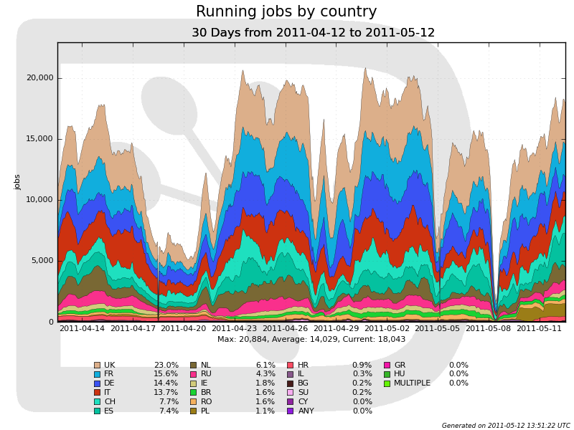
DIRAC Last month running jobs for LHCb

Slide 5
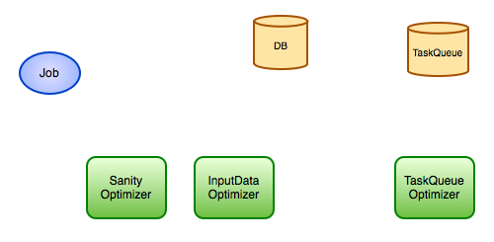
One bottleneck to solve
Current bottleneck is the job submission because of the WMS Optimizers
They check that the job is OK before it enters “ready to run” status
Currently optimizers poll the DB

Slide 6
DISET
DISET: DIRAC Secure Transport
Internal framework used to handle communications
Currently all queries in DIRAC are RPC
Open a connection -> SSL handshake -> execute query -> close connection
Lots of CPU & network invested in SSL handshaking
No possibility of pushing data to client

Slide 7
DISET
Idea! 1 connection -> 1 ssl handshake -> N queries c2s and s2c
Reduces CPU and data transfer
Push to client messages
Better client/server timeout control
Just make sure we don’t DDoS ourselves from the jobs

Slide 8
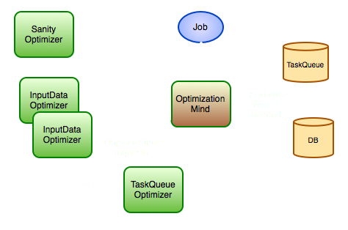
On demand executors!
Push the job optimization request when needed
Much less load on the DB
More than one instance of the same optimizer
Optimization
requests
Read once/write if needed

Slide 9
Added benefits
Not only for WMS but also Request management, Data management…
Connections are kept for a long time, so we now need a keep alive mechanism
Will solve the timeout problem.
Currently RPC calls have a timeout as a protection against stalled services
Same query with different arguments may wildly vary the execution time

Slide 10
Multi-VO
Problem: Several DIRAC installations serve more than one Virtual Organization (VO)
DIRAC was not designed to handle nicely that
Currently it can be done using some nasty tricks
Main issue to solve is configuration data is not aware of multi-VO environments
What entries under /Resources belong to each VO?

Slide 11
Main changes in the CS schema
/Resources will be reorganized a bit
/Resources/Sites/<vo>/… will be introduced
/Registry (definition of users, groups, permissions…) will mostly stay the same
Only a VO property will be added to the groups
The VO a user belongs to is tied to the user he/she belongs to
Other sections will just have a vo level added if necessary
For instance /Operations/vo/…

Slide 12
Minimize CS transition damage
Currently most DIRAC components are directly accessing the CS directly
CS helpers will be coded (some are already there) to access the CS
Helpers will take care of accessing the proper path depending on the VO
Single VO installations (LHCb, Belle, CTA…) will be able to skip all the <vo> levels by defining a special option in the CS

