Slide 1
Code Management Releases
DIRAC Project

Slide 2
Overview
We’re moving!
Code migration
Where and why
Code management
How to make the life of the release manager a bit easier
New release and installation tools

Slide 3
We’re moving!
In the beginning… DIRAC and all the extensions were in a single code repo
We’ve got multiple extensions from different people
Not practical to have a single repo for all
Each extension should be able to have it’s own repo
DIRAC will have it’s own

Slide 4
Where do we move to?
Not just migrating the location of the repository but also the Source Code Management (SCM)
SCM Requirements
Open source
Allow anyone to contribute
Fast operation of the SCM independently of location
Branching has to be fast and easy, but merge has to be flawless

Slide 5
Merging is the key
We need to support multiple releases
Branches are the easiest way to:
Apply a fix to several releases
Develop new features
Branching is usually not a problem, merging is the nightmare

Slide 6
Review of SCM
Has to be an open source VCS
CVS
Allow anyone to contribute
Fast operation of the VCS independently of location
Only distributed SCM remain

Slide 7
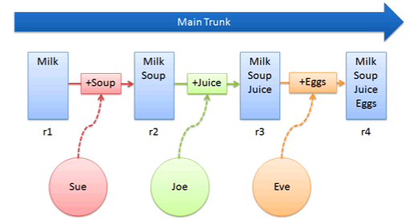
Centralized SCM

Slide 8
What’s a distributed SCM?
Everyone has the full history instead of only one central repository
Network communication is only required when pushing (sending) or pulling (bringing) changes from another peer
Fast because all operations are local
Allows anyone to publish changes that can be integrated into the release repository

Slide 9
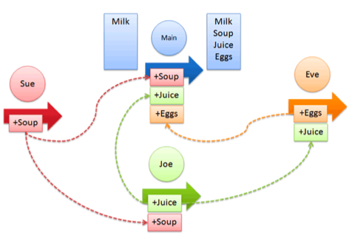
Distributed SCM

Slide 10
We need to decide on one
Mercurial
Cannot delete branches
“Cheap” branches are “cp” of the local repository
Bazaar
Tightly integrated with launchpad
What if launchpad is stopped?

Slide 11
And the winner is…
We’re migrating the code to Git !
Pros
Branches cost essentially nothing to create and delete
Fast (all ops are local)
Merge is nearly omniscient (a conflict still is a conflict)
Not tied to any repository provider
Cons
Steeper learning curve than the alternatives

Slide 12
Release repository will is hosted at
https://github.com/DIRACGrid
Github provides:
Code hosting
Issue tracking
Pull request management
Since everyone can have a copy of the full history, if github closes doors, we can easily migrate somewhere else.

Slide 13
Code management
How to decide what goes into the release?
Since branch/merge is easy in Git, everyone is invited to use branches!
Branch per fix, new feature… encouraged
Why not use the branches to propose what is to go into the next release?

Slide 14
Distributed but centralized
A single repo is agreed to be the “release” repository (github)
Everyone clones (copies) the repository
Developers commit changes to their local repositories
Publish the changes to some public repo
Send a pull request to the release manager telling:
Where to pull (retrieve) the changes from (repo and branch)
What is in that branch

Slide 15
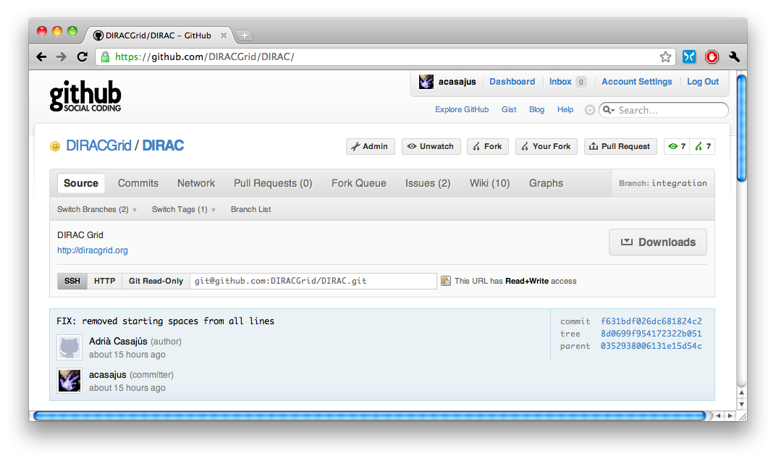
How to work with Git and github?

Slide 23
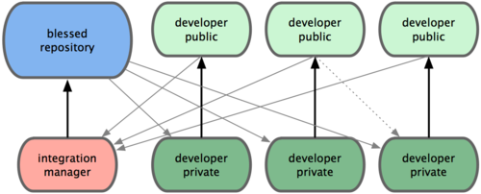
Overall picture

Slide 24
Releases
Problem: To create a release for an extension DIRAC’s releases.cfg had to be modified
We redesigned the release tools to each community can generate it’s own releases for it’s extensions
For instance LHCb has LHCbDIRAC and LHCbWebDIRAC
Each community release can depend on a certain version of DIRAC. For intance, LHCb v2p3 requires DIRAC v5r2 to be installed.

Slide 25
A single project release
Can group multiple extensions
LHCb v3r5 contains LHCbDIRAC v3r2 and LHCbWebDIRAC v1r2
Depend on one version of DIRAC
When creating the release, dirac-distribution will create all the required files
Files have to be uploaded to somewhere accessible to dirac-install
When installing a project release dirac-install will install the dependencies automatically

Slide 26
Example of a releases.cfg

Slide 27
For a full tutorial on how to create releases please check:
http://marwww.in2p3.fr/~atsareg/Docs/DIRAC/build/html/DeveloperGuide/ReleaseProcedure/index.html

