Slide 1
DIRAC on GISELA
Vanessa Hamar
DIRAC User Community Meeting
12th - 13th May 2011
Barcelona (Spain)

Slide 2
Outline
GISELA Project
MPI in DIRAC
DIRAC on GISELA

Slide 3
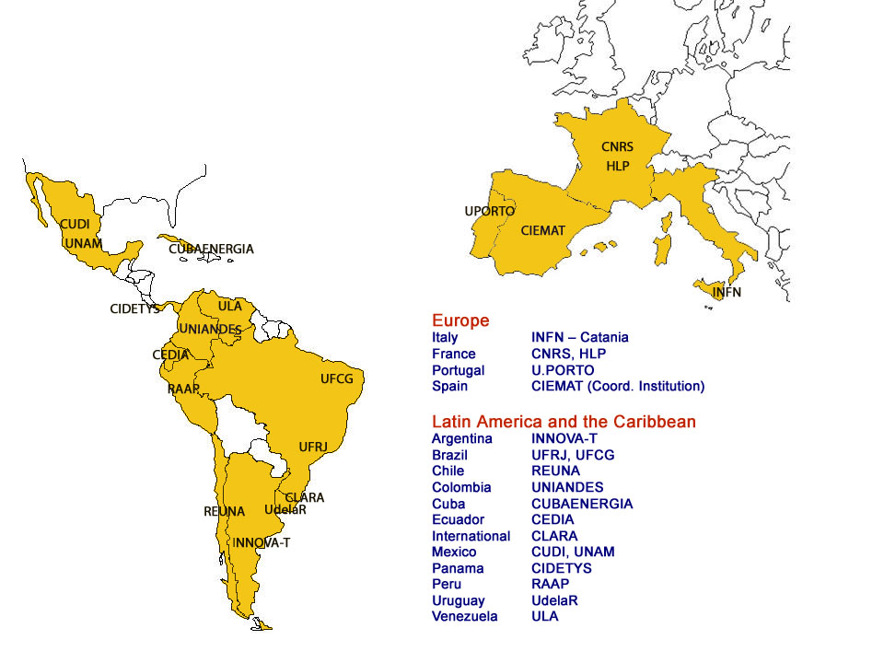
GISELA Project
15 Countries (11 in Latin America)
19 Partners (14 in Latin America)
12 Third Parties (11 in Latin America)
Negotiation with Bolivia & Paraguay for possible collaboration
FP7 INFRA-2010-2 call - Topic INFRA-2010-1.2.3: Virtual Research Communities
Start date: 01/09/2010
Duration: 24 months
Project type: CP-CSA
Grant agreement Nº: 261487
http://www.gisela-grid.eu/

Slide 4
GISELA Project - Objectives
Ensure the long- term sustainability of the e-Infrastructure in the Latin American continent
Provide full support to the Virtual Research Communities spanning Latin America and Europe, using the e-Infrastructure.
Focus on two inter-related goals:
  Implement a sustainability model rooted on National Grid Initiatives (NGI), in association with CLARA, NRENs and collaborating with EGI.
  Provide the communities with the suited e-Infrastructure and Application-related Services required to improve the effectiveness of their research. This will address both:
    The inherit EELA-2 User Communities whose research investigations are carried out at the Institution level or in small collaborations.
    The larger Virtual Research Communities as Life & Earth Sciences, HEP

Slide 5
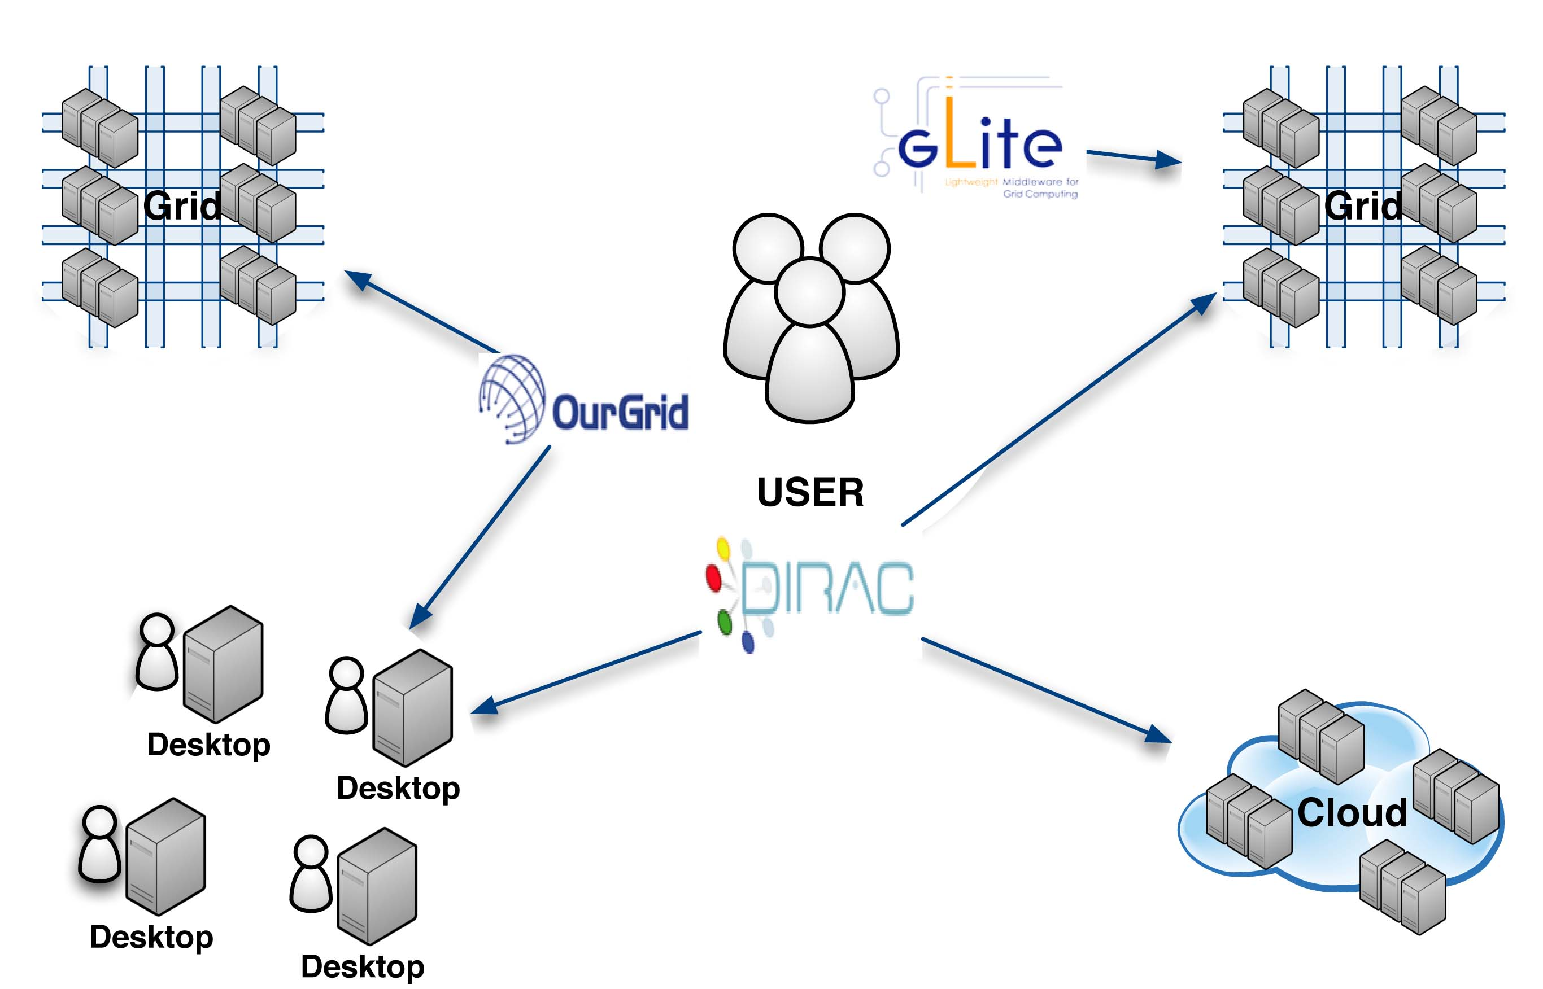
GISELA Project
Broad range of services, covering both Application and Infrastructure support
Examples of services for which support is available are:
  Application-related Services
    Job, Catalogue, File and Data Management
      Digital archives, Secure storage, WatchDog, lcg-rec toolkit
  Infrastructure-related Services
    Support for opportunistic resources (OurGrid middleware)
    Support for infrastructure bridging (OurGrid and gLite)
    Support for Storage Accounting (SAGE)
  Data processing and distributed user analysis services
    DIRAC: workload and data management system
Single VO for all the users
prod.vo.eu-eela.eu
Part of GISELA Infrastructure

Slide 6
MPI in DIRAC
The predecessor project of GISELA was EELA2, in such moment a good fraction of applications ≈ 30% were making parallel computations using MPI.
But, some problems were faced:
  MPI Installation in the sites are different.
    Some has MPI_SHARED_HOME
    Some are providing MPI_START
  Most of the sites are not providing MPI or it is quite limited.
That is why we decided to provide the support of MPI applications entirely in the DIRAC middleware

Slide 7
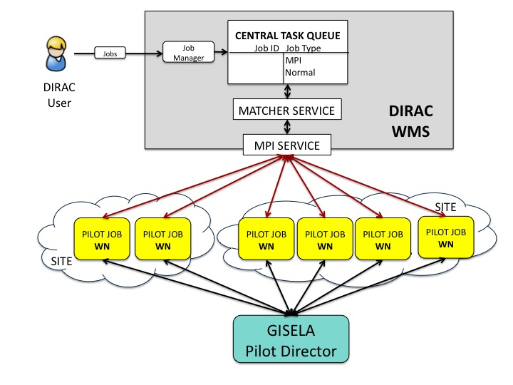
MPI in DIRAC
MPI in DIRAC needed special development and it was done in the framework of the EELA2 Project.
The following functionalities were developed:
  A dedicated MPI Central Service was added to the DIRAC WMS.
  MPI Pilots (Master and Slaves)
Security mode operation is the same used in EGEE project, fully complaint with security standards.
MPI Jobs are not different, we are not adding security holes.

Slide 8
MPI in DIRAC
MPI Pilot jobs take a role of a Master or a Slave.
  Master functionality includes:
    Start mpd master daemon
    Job execution
  Slave Pilots functionality is:
    Start mpd slave daemon
  These roles can change dynamically if pilot lifetime allows to run more than one MPI job.

Slide 9
MPI in DIRAC
MPI RINGS – Life cycle
Master

Slide 10
Advantages MPI in DIRAC
Allows run MPI jobs in sites than are not providing official MPI support.
All the advantages of run pilots jobs are also advantages for MPI pilot jobs.
The use of generic pilots allows to prioritize the user jobs.
The user jobs will be started after:
  environment is checked
  the ring is completely created
Allows to reuse the already reserved resources to create more rings.
Reusing filling mode.
MPI jobs can run also in clusters.

Slide 11
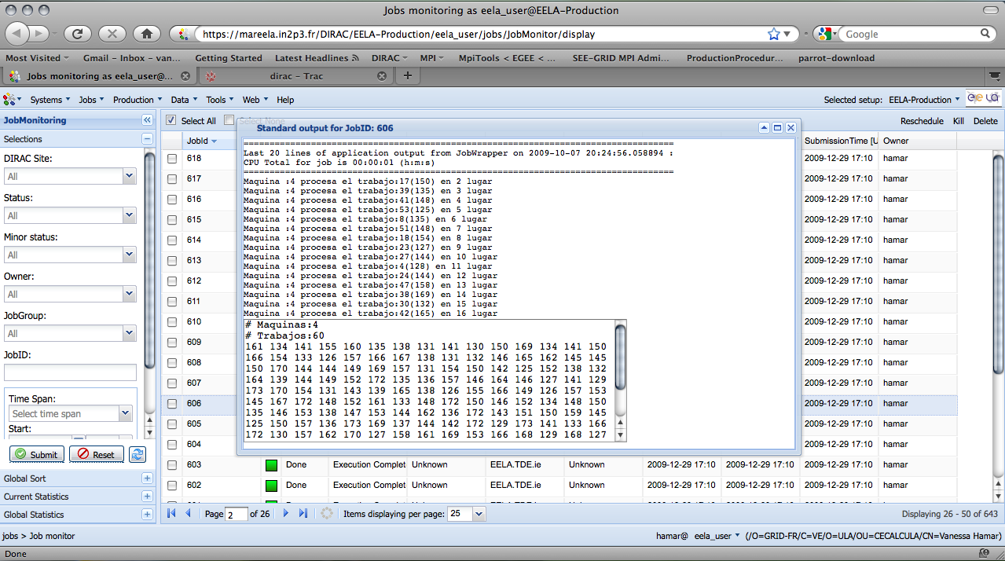
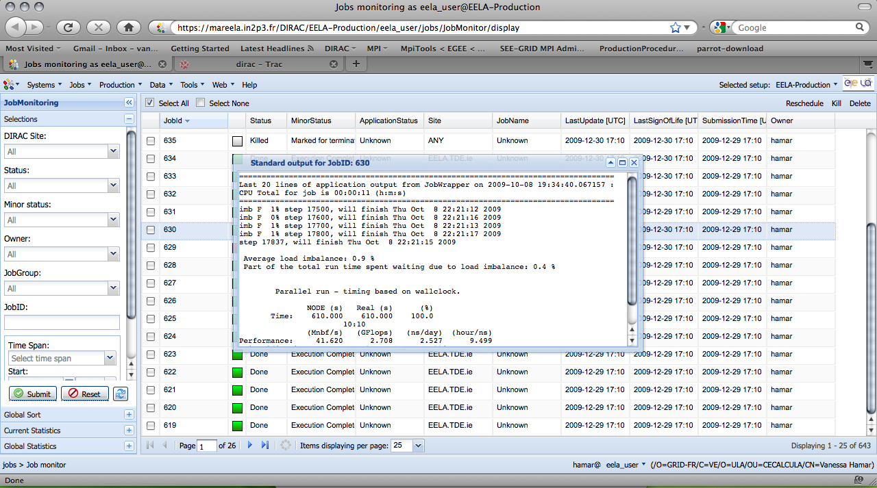
MPI Applications
  PSAUPMP: Parallel Simulated Annealing algoritm for the weighted Unrelated Parallel Machines Problem
  BioMD: Molecular Dynamics Using Grid Environment
Two MPI applications were gridified during E2GRIS2 using DIRAC:

Slide 12
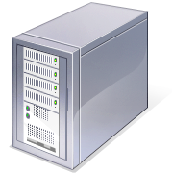
DIRAC on GISELA
DIRAC is offered in GISELA WP6 as a service:
Job Management:
  DIRAC broker: better match making and customized scheduling
Catalogue and file management
  DIRAC FC: DIRAC file catalogue
Support for resource centre deployment
  DIRAC middleware: improved scheduling for service grids
3 DIRAC servers are installed
  2 in LA
  1 in Europe

Slide 13
DIRAC on GISELA
Actually we are porting a chemistry application, as requirements:
  The users will use the same web portal than until now
  A special DIRAC agent is going to be developed to contact their server and pick-up the jobs, make the heaviest calculus in the grid and return the jobs.
  Actually the pilots jobs are submitted with a cron job, and running the user jobs.

Slide 14

DIRAC on GISELA
Lims /Server
Portal/Workflow
FAST.sh
MOLOC
Hardware License
Cluster
Universidad del Valle
Cali - Colombia
User License
DIRAC
Server
Gaussian
SLOW.sh
SLOW.sh
SLOW.sh
SE
PilotJob
WN
SE
PilotJob
WN
SE
PilotJob
WN

Slide 15
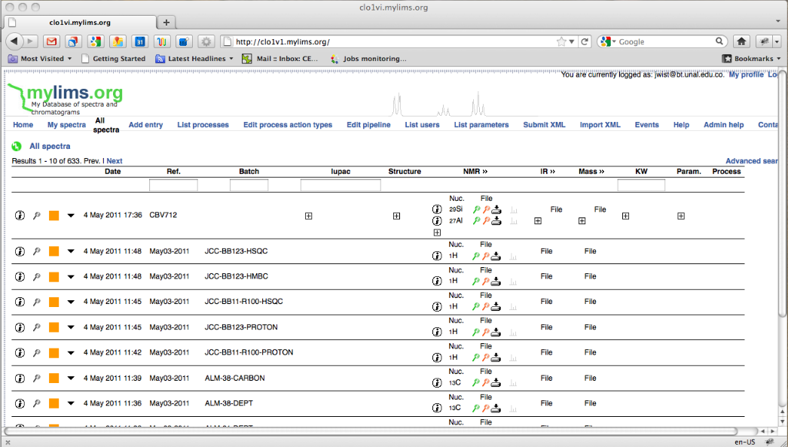
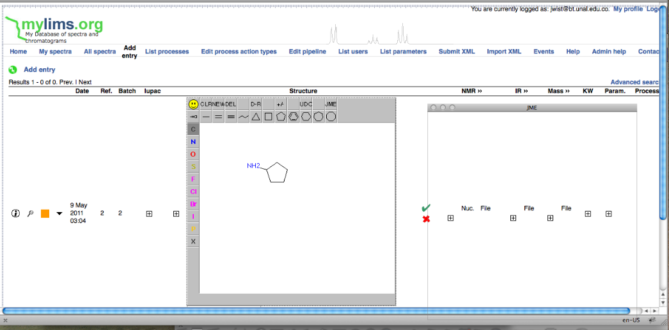
DIRAC on GISELA

Slide 16
Future work
Ensure the DIRAC service as part of GISELA Infrastructure
  Service Maintenance
  Resources (CEs and SEs) monitoring and updates
Incorporating OurGrid desktop resources
Provide user support
  Tutorials, mailing list
Gridify more applications, providing personalized attention during the gridification process.
Continue enhancing the MPI Service:
  add more MPI Flavors
  optimize the service.

Slide 17
Questions
?

