Slide 1
Non exhaustive summary of highlights from OPERA collaboration meeting
Slides are directly extracted from presentations
D.D.
15/03/2011

Slide 2
Next meetings
4 April 2011: meeting at CERN with the SPSC referees
7-8 April 2011: meeting at LNGS to finalize the 2nd oscillation paper CERN
14-15 April: LNGS-SC meeting, Pasquale M. to give the open presentation (a <6 pages written report is due)
14-17 June 2011: Collaboration Meeting at LNGS (note the change of week)
27 June 2011: meeting at CERN with the SPSC referees (annual review, a written report is due)
28 June 2011: SPSC open presentation Giovanni D.L. to give the open presentation

Slide 3
Finalize 2nd oscillation publication
Goal to publish the final data sample 2008-2009 by spring
Successful Task Force meetings held in the last months (5 sessions)
This meeting: review all analyses and define a converging strategy (freeze by end of March)
Use the pre-booked dates of 7-8 April (and 9, if needed) for a meeting at LNGS to finalize the next oscillation publication. Redefine the timing if a new candidate will be found.
Editing Committee (follow the example of the 1st oscillation paper) for “special” papers:
Ex officio members:
AE, Migliozzi, Terranova, De Lellis, Sato, Autiero, Dusini, Komatsu, Wilquet, Pessard, Spinetti
Co-opted members (tentative list):
Ariga, Duchesneau, Shibuya
To report to the Collaboration for the final review and decision
Ask the CB to endorse the above proposal

Slide 4
Shifts OPERA
Shifts 2010: LAPP : 89% de ce qui etait a faire= 61 local + 225 remote
Shifts 2011: LAPP : 68% de ce qui est a faire est deja realise ou prevu: 42 local +225 remote
En 2011: le schema suivant est prevu: a partir de septembre le 2eme shifter BMS sera le shifter ED de 16h00 a 24h00.

Slide 5
2011 Shift organization
F. Terranova
Structure similar as for 2010:
  Electronic detectors: 1 on site shifter + 1 Run Coordinator. All expert on remote except for gas+magnet expert. All in all 3 persons on site for all subdetectors
  Brick Handling: a team of three people working underground 8h/day. One of this gives assistance to BMS operator (new in 2010)
  BMS:
    Jan-Aug: 1 operator from external firm (+ 1 person from BH for assistence). 1 remote expert + 1 local expert giving assistence also to BH facilities (D.Fracasso)
    Sept-Nov: 2 shifts per day with 2 expert operators from external firm (+1 from BH in 8-16 +1 from eledet in 16-23.30) (done on voluntary basis in 2010; mandatory in 2011)

Slide 6
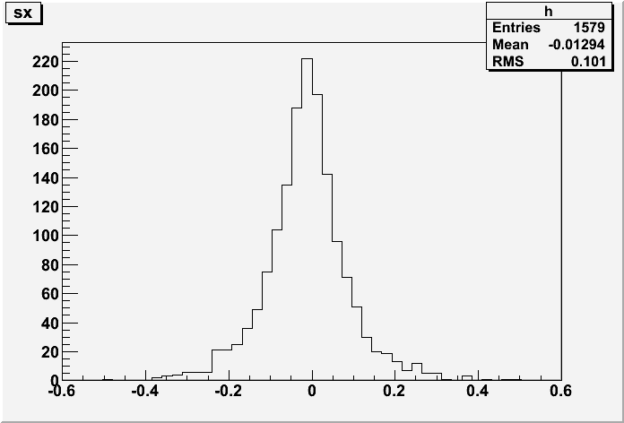
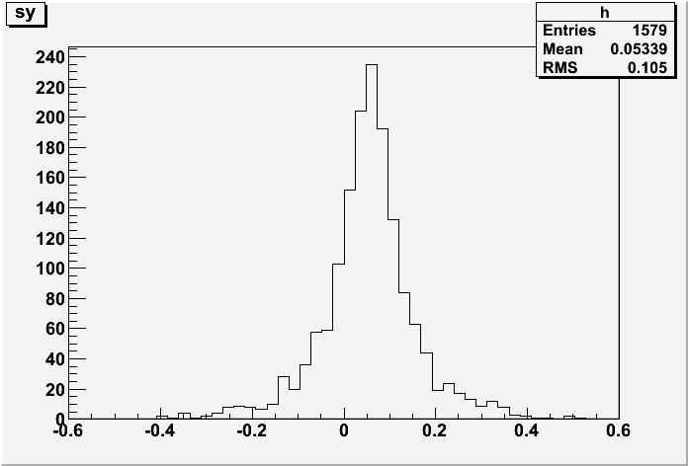
F. Pupilli
Muon slopes in CS
Slopes distribution of muons found in CS related to developed bricks
Where this tilt comes from?
Beam tilt well visible in Y
Tilt in X direction visible also in Japanese data (thanks to Fukuda)

Slide 7
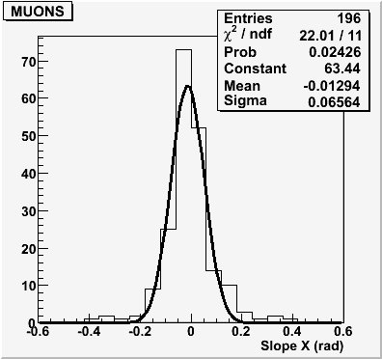
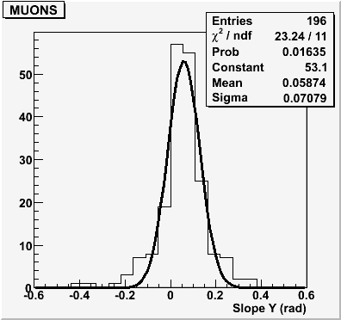
F. Pupilli
Muon slopes in bricks
Slopes distribution of muons found in located interactions in Napoli Lab (thanks to Antonia)
The same tilt is present in muons from CS and bricks; this means that there should be a rotation of at least the whole system CS-brick
To investigate: Hall orientation? Systematic brick positionning etc…?

Slide 8
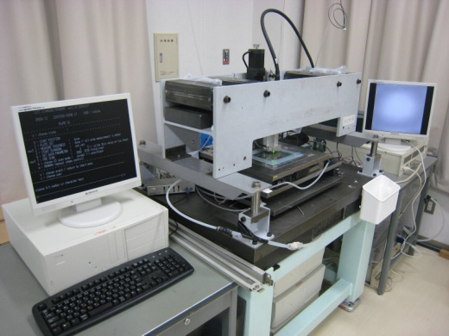
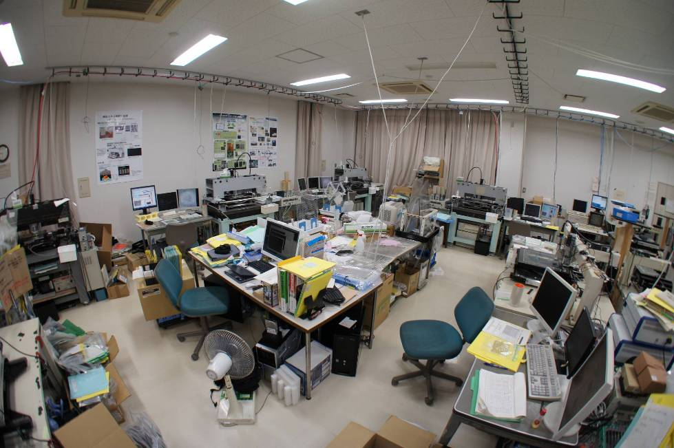
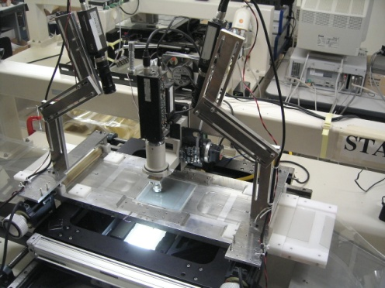
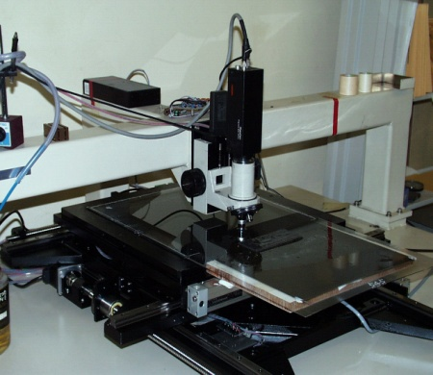
Status
K. Morishima
10 microscopes operative in TONO Scanning Station
5 S-UTS for CS scan and ECC volume scan
2 UTS with Plate Changer for Scanback Location
3 UTS for Manual Check (CS, Decay Search, …)

Slide 9
Move plan of Scanning Station from TONO to NAGOYA
Because the TONO mine is shut down in this year, we must move scanning station
All scanning system usually operative until 2nd April
week1 in April | last normal operation before move
week2 in April | dismantlement, packing
week3 in April | move construction of network, database, PC, vacuum system
week4 in April | S-UTS, UTS and PLCH assembling
week5 in April | S-UTS, UTS and PLCH assembling
week1 in May | restart normal operation
In this plan, the number of CS and ECC that accumulates for the move period corresponds for 1 month
We need to recover the delay of 1 month
It is possible to recover the delay of 1 month by changing the shift organization (6 day/week -> 7days/week) for 8 months*.
*8months from
~ 80CSD/week -> ~92CSD/week => +12CS/week -> 1week recover ~1day

Slide 10
Decay search in Japan:
Located till Jan10 sample processed,
1252 (processed) /1474(Located)
Corresponding 91.7% of 2008+2009 located event
and 56.9% of 2010 located events .
12(’08) + 10(’09) Charm candidates and 2 kinks(’09) in NC .
One gamma off vertex NC event under study .
Decay search in Europe:
decay search (2008) = 98% and (2009) = 70% of located events
Decay search in Bern:
Run | Received | Started | Located in brick | Dead material | Passing through | Decay search
2008 | 244 | 242 | 172 | 20 | 5 | 169 (98 %)
2009 | 437 | 429 | 290 | 13 | 27 | 263 (91 %)
2010 | 183 | 149 | 111 | 1 | 13 | 105 (95 %)
Total | 864 | 820 | 573 | 34 | 45 | 537 (94 %)

Slide 11
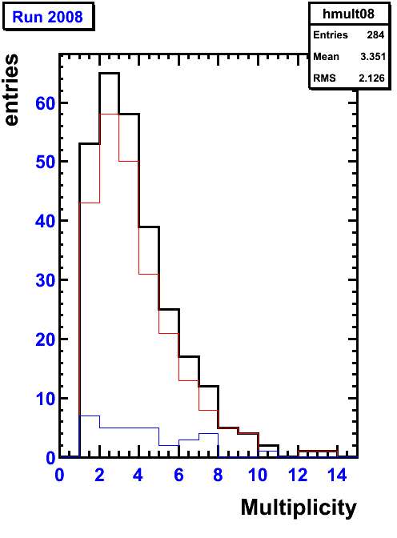
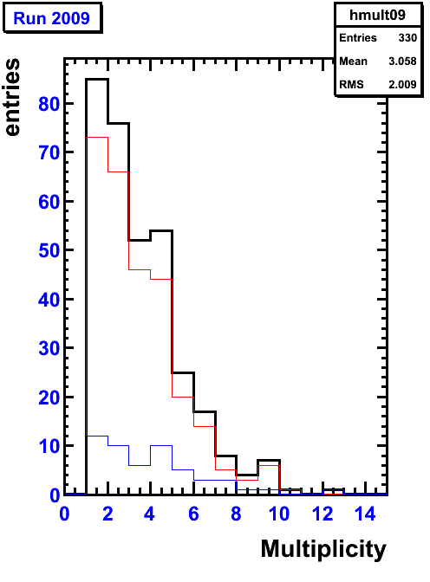
Multiplicity
Europe scanning
Different from Bern
G. Sirri
ALL
CC
NC
ALL
CC
NC

Slide 12
Peculiar topologies
G. De Lellis
Lab | Events located | CC decay searched | Charm candidates | ν_{e} | ν_{τ}
Bari | 180 | 119 | 3 | 0 | 0
Bern | 568 | 427 | 12 | 3 | 0
Bologna | 165 | 110 | 1 | 1 | 0
Frascati | 13 | 10 | 0 | 0 | 0
Napoli | 336 | 216 | 5 | 4 | 1
Padova | 64 | 40 | 3 | 0 | 0
Roma | 33 | 26 | 0 | 0 | 0
Salerno | 297 | 192 | 2 | 0 | 0
Europe | 1657 | 1140 | 26 | 8 | 1
Nagoya | 1451 | 987 | 18 | 5 | 0
Total | 3108 | 2127 | 44 | 13 | 1

Slide 13
Conclusions
OpEmuRec Status (M. Pozzato)
Some bugs visible looking into the details of first 100 events production → fixed
All the chain from CS up to vertex reco fully working (now copy also MC TTree)
A next small production in progress (thanks to Elisabetta) to check again that all the “new fixing” are ok and then ➔ prodution of 1000 events to “make distributions”.
OpEmuRec users can start using available event files: in order to find out all the bugs feedbacks from users are needed!

Slide 14
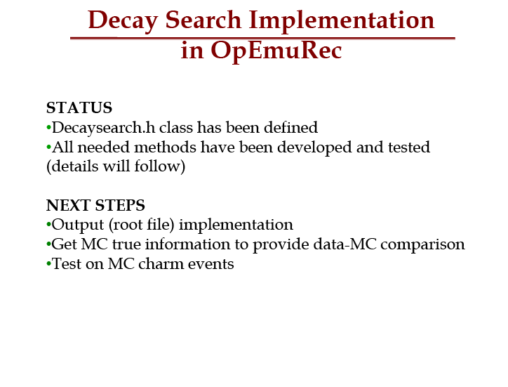
T. Strauss

Slide 15
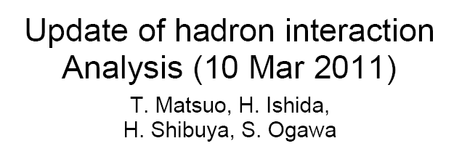
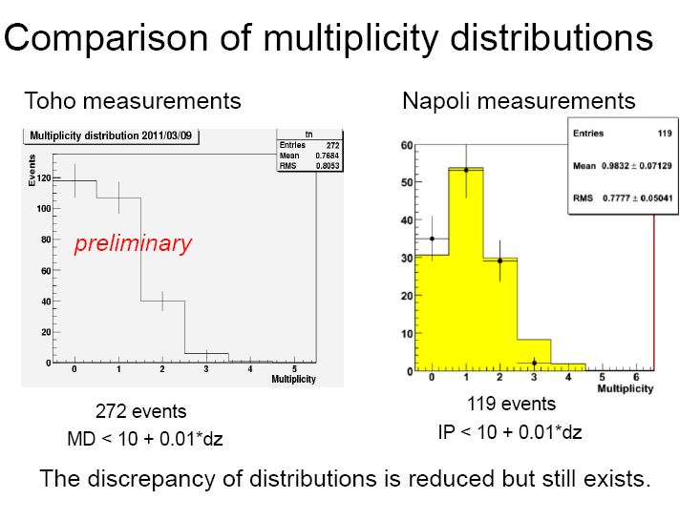
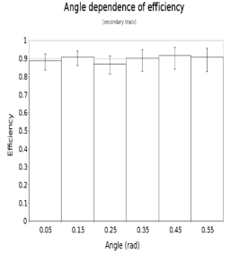
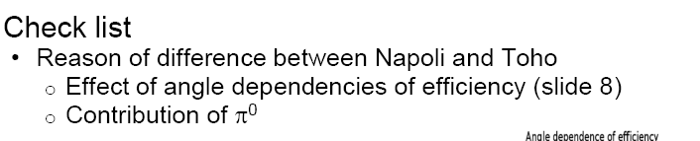

Slide 16
Additional material of interest:
  Location bias studies (G. Sirri; K. Hamada)
  Vertex localization in tau->nue DIS and QE (Umut and Budimir)
  Brick finding MC/Data comparison using GEANT4 and OpSim (Artem)
  Charm summary (Thomas)
  Vertexing with CS tracks (V. Tioukov)

