Slide 1
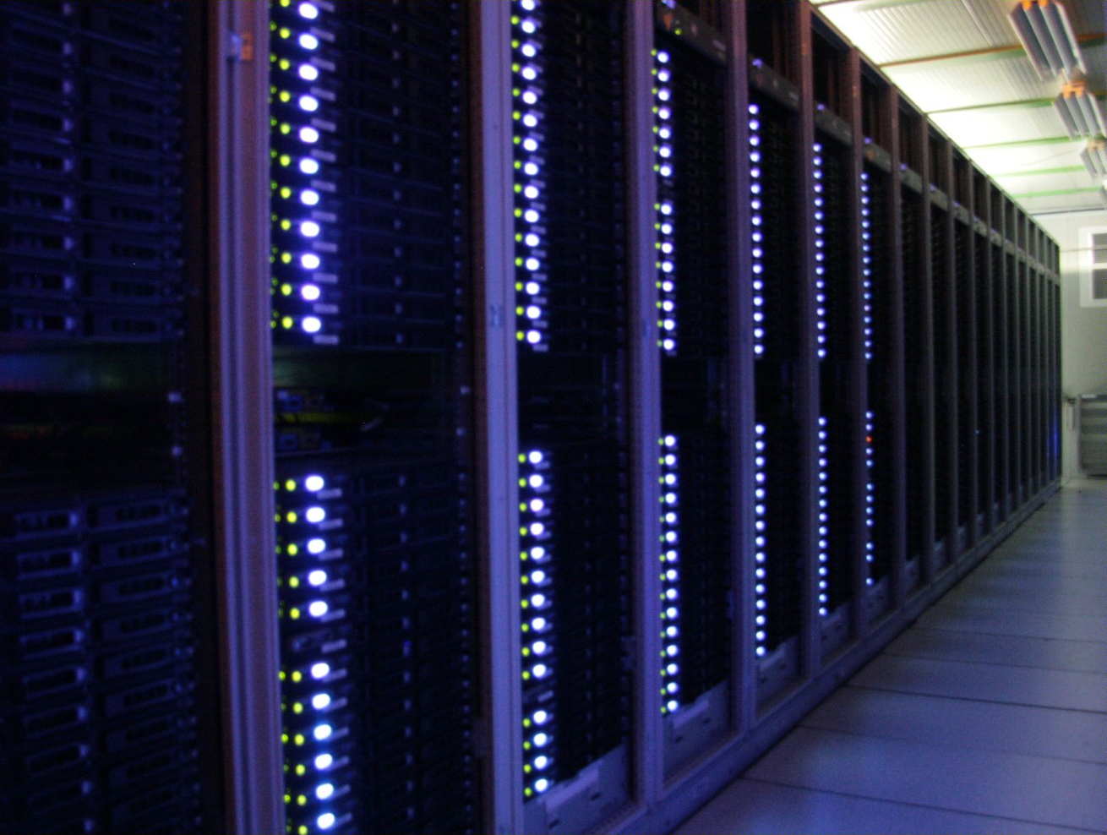


Overview of the
ATLAS Data-Acquisition System operating with proton-proton collisions
Nicoletta Garelli
(CERN)
CPPM, Marseille
Particle Physics Seminar
March, 25th 2011
Notes:
presentazione
Cancellare 100 kHz

Slide 2
Outline
Introduction
  Large Hadron Collider (LHC)
  Physics at LHC
  ATLAS experiment
ATLAS Trigger and Data Acquisition system (TDAQ)
  Network
  Read-Out System (ROS)
  Region of Interest (RoI)
  Event Builder
  High Level Trigger (HLT)
  Local Mass Storage
2010
  TDAQ working point
  Beyond design
  ATLAS Efficiency
Tools to predict and track the system working point
  Network monitoring
  HLT resource monitoring
  TDAQ operational capabilities
2011-2012 Run
Conclusion

Slide 3
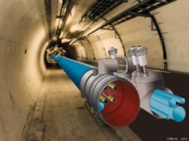
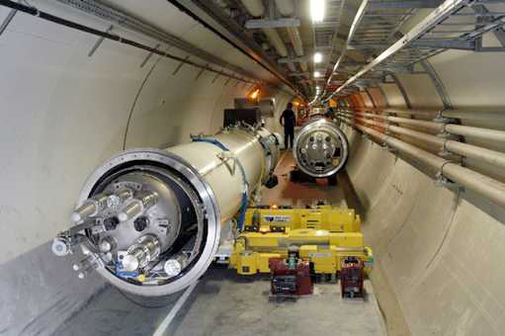
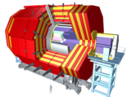
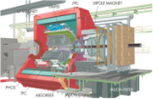
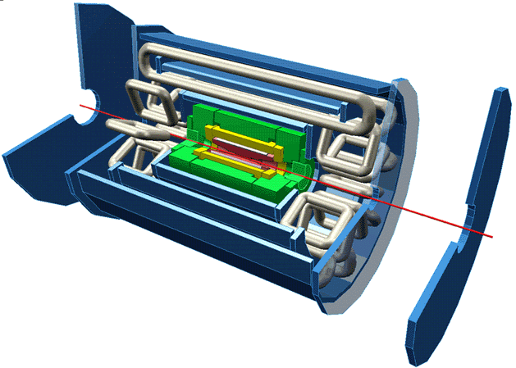
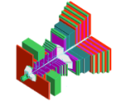
LHC: a Discovery Machine
MOTIVATION: Explore TeV energy scale to find Higgs Boson & New Physics beyond the Standard Model
Hadron collisions → large discovery range
Built at CERN in a circular tunnel of 27 km circumference, ~100 m underground
4 interaction points → 4 big detectors
Machine | Beams | √s | Luminosity
LHC | p p | 14 TeV | 10³⁴ cm⁻²s⁻¹
LHC | Pb Pb | 5.5 TeV | 10²⁷ cm⁻²s⁻¹
Tevatron | p anti-p | 2.0 TeV | 10³² cm⁻²s⁻¹
LEP | e⁺ e⁻ | 200 GeV | 10³² cm⁻²s⁻¹
CMS
Large Hadron Collider (LHC)
Alice
Particles travel in bunches at ~ speed of light
Bunches of O(10¹¹) particles each
Bunch Crossing frequency: 40 MHz (bunch cross every 25 ns)
27 km/7.5 m ~3600 possible bunches, but only 2835 filled (need abort gap to accommodate abort kicker rise time)
SPS
ATLAS
PS
LHCb

Slide 4
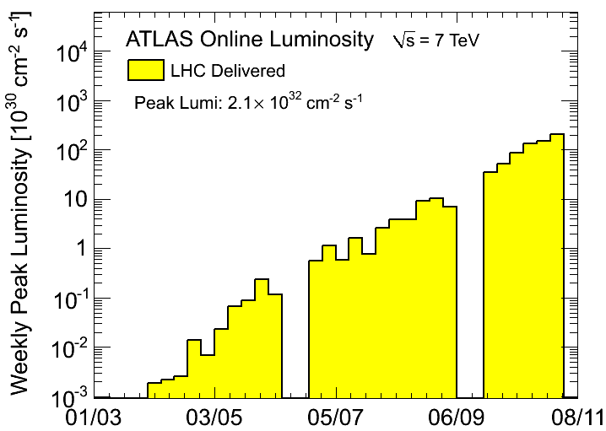
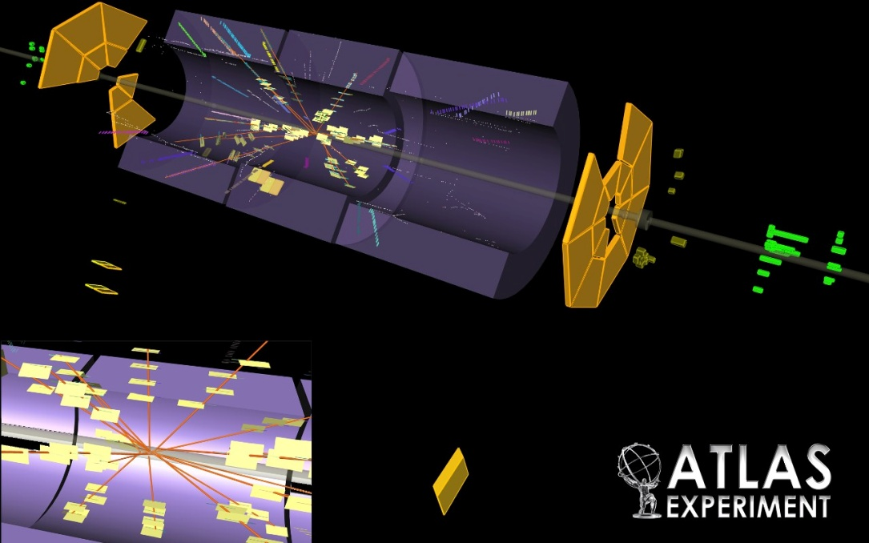
2010: the First Year of Operation
√s = 7 TeV (first collisions on March, 30th 2010) √s = 14 TeV
Commissioning bunch train with 150 ns spacing 25 ns
Up to 348 colliding bunches 2835
Max Peak Luminosity L= 2.1 10³² cm⁻²s⁻¹ 10³⁴ cm⁻²s⁻¹
LHC delivered ~49 pb⁻¹ integrated luminosity 2012: 2fb⁻¹
Notes:
Peak lumi goal was 2 10³²
Plot1. peak lumi increased exponentially with time
Plot 2. first collision seen by ATLAS
Move after 7?

Slide 5
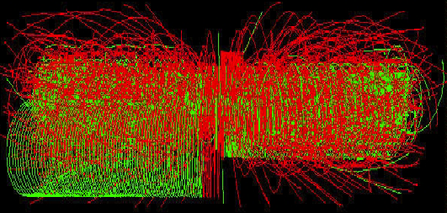
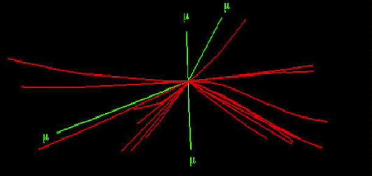
Interesting Physics at LHC
Fluegge, G. 1994, Future Research in High Energy Physics, Tech. rep
Total (elastic, diffractive, inelastic) cross-section of proton-proton collision
Find a needle in the haystack!
Higgs -> 4μ
~22 MinBias
Cross-section of SM Higgs Boson production

Slide 6
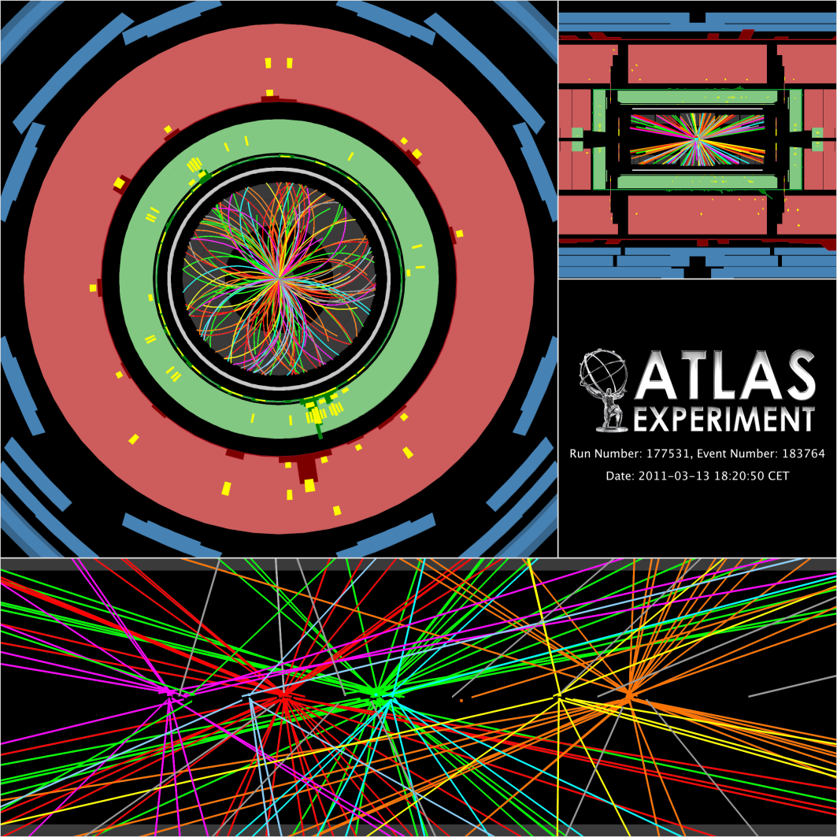
Impact on LHC Detector Design
LHC experimental environment:
  σ_{pp} _{inelastic} ≈ 70 mb
  Luminosity = 10³⁴ cm⁻² s ⁻¹
  Event Rate = Luminosity x σ_{pp} _{inelastic} = 7 10⁸ Hz
  Bunch Cross every 25 ns
  7 10⁸ Hz / 25 ns = 17.5 interactions every bunch crossing
  Not all bunch crossings are filled:
  17.5 x 3600 / 2835 ~ 22 interactions every “active” bunch crossing
  1 interesting collision is rare and always hidden within ~22 “bad” (minimum bias) collisions
Impact on the LHC detectors design
  fast electronics response to resolve individual bunch crossings
  high granularity (= many electronics channels) to avoid that a pile-up event goes in the same detector element as the interesting event
  radiation resistant
Notes:
Simplify!

Slide 7

ATLAS (A Toroidal Lhc ApparatuS)
width: 44 m
diameter: 22 m
weight: 7000 t
@ LHC nominal conditions, the ATLAS detector would produce:
1.5 MB x 40 MHz = 60 TB/s
TDAQ (Trigger & Data Acquisition): sophisticated system (electronics + sw + network) to process the signals generated in the detector storing the interesting information on a permanent storage
~90M channels
~98% fully operational in 2010
Event = snapshot of values of all front-end electronics elements containing particle signals from a single bunch crossing. ATLAS event = 1.5 MB

Slide 8
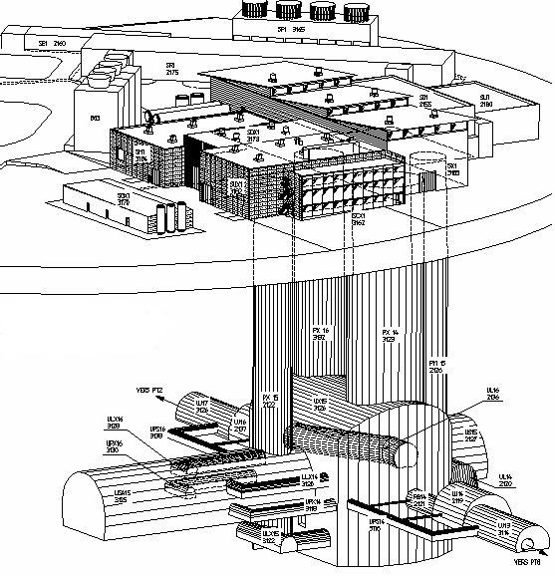


TDAQ System On-Site
CERN
computer
center
[~5 ]
[~1600]
[~100]
[~ 500]
[26]
Local
Storage
SubFarm
Outputs
(SFOs)
Event
Filter
(EF) farm
Event
Builder
SubFarm
Inputs
(SFIs)
Level 2
farm
Control+ Configuration
Data Storage
[48]
[1]
Monitoring
SDX1
DataFlow
Manager
[4]
Network Switches
[70]
Level 2
Super-
visors
File Servers
surface
underground
Event data requests & Delete commands
USA15
Requested event data
ATLAS Data
VME bus
UX15
Trigger Info
[~ 150]
~1600
Read-Out
Links
Read-
Out
Drivers
(RODs)
Read-Out
Subsystems
(ROSes)
[# nodes]
ROI
Builder
Level 1
trigger
Control, Configuration and Monitoring Network not shown
Region Of Interest (ROI)
Timing Trigger Control (TTC)

Slide 9
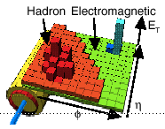
TDAQ Design
ATLAS Data
Trigger Info
Trigger
DAQ
ATLAS Event
1.5 MB/25 ns
Calo/Muon Detectors
<2.5 μs
Other Detectors
Level 1
40 MHz
40 MHz
Detector Read-Out
L1 Accept
75 (100) kHz
FE
FE
FE
75 kHz
Regions Of Interest
ROD
ROD
ROD
High Level Trigger
Data-
Flow
112 GB/s
~40 ms
ReadOut System
Level 2
ROI data
(~2%)
ROI Requests
Event Builder
~ 3 kHz
Data Collection Network
~4.5 GB/s
~4 sec
L2 Accept
~3 kHz
SubFarmInput
Event Filter
Event Filter Network
EF Accept ~200 Hz
SubFarmOutput
~ 300 MB/s
~ 200 Hz
CERN Data Storage

Slide 10
Trigger
ATLAS Data
Trigger Info
Trigger
DAQ
ATLAS Event
1.5 MB/25 ns
Calo/Muon Detectors
<2.5 μs
Other Detectors
Level 1
40 MHz
40 MHz
Detector Read-Out
3-level trigger architecture
to select interesting events
Level 1
  HW based: custom built electronics which analyze information from muon detectors & calorimeters
  Coarse event selection
  Define geographical interesting areas, the Region of Interests (RoI)
Level 2
  SW based: refines LVL1 results with a local analysis inside RoI
  Effective rejection mechanism with only 1-2% of the event
Event Filter
  SW based: access the fully assembled events
L1 Accept
75 (100) kHz
FE
FE
FE
75 kHz
Regions Of Interest
ROD
ROD
ROD
Data-
Flow
112 (150) GB/s
High Level Trigger
~40 ms
ReadOut System
Level 2
ROI data
(~2%)
ROI Requests
Event Builder
~ 3 kHz
Data Collection Network
~4.5 GB/s
~4 sec
L2 Accept
~3 kHz
SubFarmInput
Event Filter
Event Filter Network
EF Accept ~200 Hz
SubFarmOutput
~ 300 MB/s
~ 200 Hz
CERN Data Storage

Slide 11

Data Flow
ATLAS Data
Trigger Info
Trigger
DAQ
ATLAS Event
1.5 MB/25 ns
Calo/Muon Detectors
<2.5 μs
Other Detectors
Level 1
40 MHz
40 MHz
Detector Read-Out
L1 Accept
75 (100) kHz
FE
FE
FE
Collection & conveyance of event data from detector front-end electronics to the mass storage
Farm of ~2000 PCs
Multi-threaded SW, mostly written in C++ and Java and running on a Linux OS
75 kHz
Regions Of Interest
ROD
ROD
ROD
High Level Trigger
Data-
Flow
112 GB/s
~40 ms
ReadOut System
Level 2
ROI data
(~2%)
ROI Requests
Event Builder
~ 3 kHz
Data Collection Network
~4.5 GB/s
~4 sec
L2 Accept
~3 kHz
SubFarmInput
Event Filter
Event Filter Network
EF Accept ~200 Hz
SubFarmOutput
~ 300 MB/s
~ 200 Hz
CERN Data Storage
Notes:
Say where I am working

Slide 12
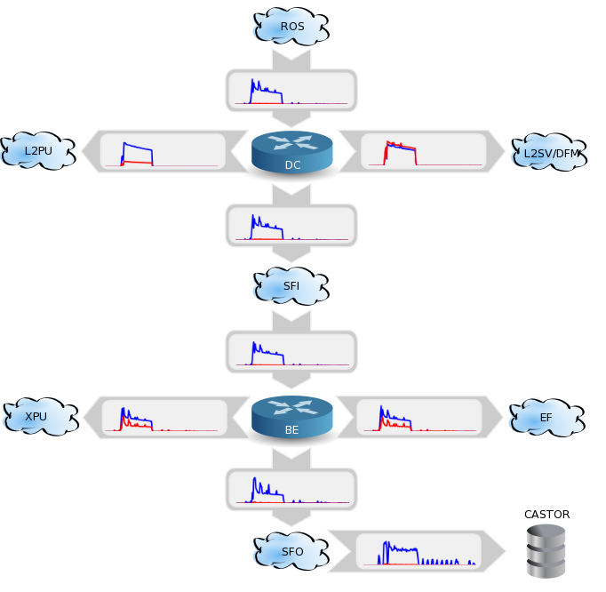
Two Network Domains
ATLAS Data
Trigger Info
Trigger
DAQ
ATLAS Event
1.5 MB/25 ns
TDAQ networking infrastructure = two different networking domains
Calo/Muon Detectors
<2.5 μs
Other Detectors
Level 1
40 MHz
40 MHz
Detector Read-Out
L1 Accept
75 (100) kHz
FE
FE
FE
2x 1 Gb/s
75 kHz
10 Gb/s
Regions Of Interest
1 Gb/s
ROD
ROD
ROD
High Level Trigger
Data-
Flow
112 GB/s
1 Gb/s
ReadOut System
~40 ms
Level 2
ROI data
(~2%)
ROI Requests
Event Builder
~ 3 kHz
1 Gb/s
Data Collection Network
~4.5 GB/s
~4 sec
L2 Accept
~3 kHz
2x 1 Gb/s
10 Gb/s
SubFarmInput
Event Filter
Event Filter Network
2x 1 Gb/s
EF Accept ~200 Hz
10 Gb/s
SubFarmOutput
~ 300 MB/s
~ 200 Hz
CERN Data Storage
Notes:
Correlate more the left schema with the one on the right

Slide 13
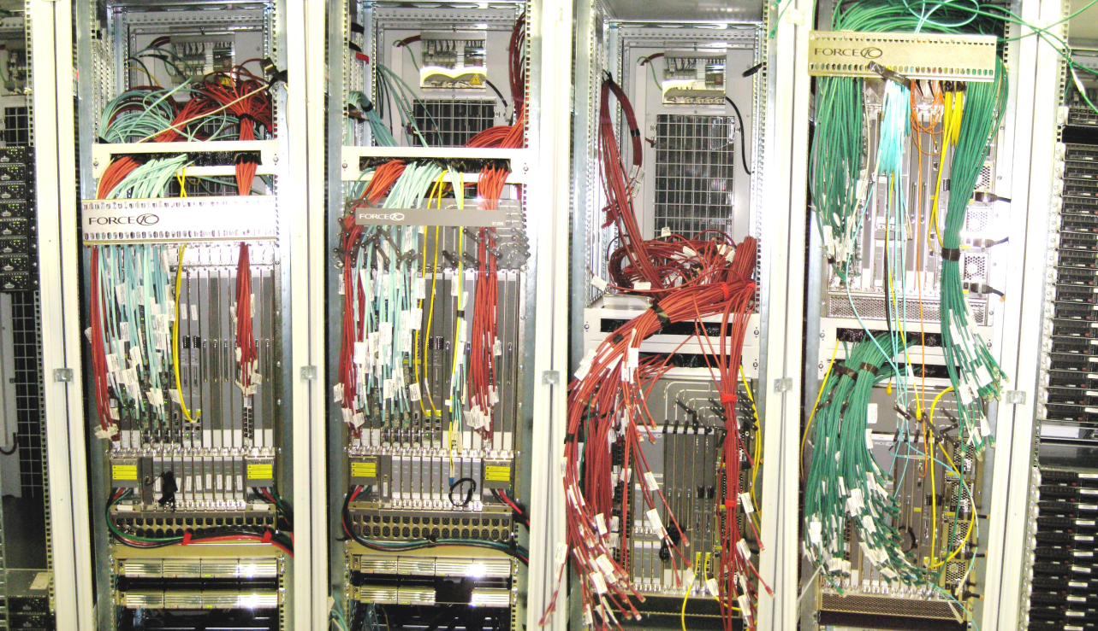
Network
Three networks:
High speed data collection network feeding 100 K event/s to ~600 PCs
Back-end network feeding ~1600 PCs
Control network
Back-end
Control
Data Collection
200 edge switches
5 Core routers
~8500 ports:
O(100) 10 Gb Ethernet +
O(8000) 1 Gb Ethernet
Real time traffic display and fault analysis
Data archival for backwards analysis
Notes:
Control and data network are separated in order to be able to control your system even if it is saturated by data. Back-up?

Slide 14
Read-Out System
ATLAS Data
Trigger Info
Trigger
DAQ
ATLAS Event
1.5 MB/25 ns
Calo/Muon Detectors
<2.5 μs
Other Detectors
Level 1
40 MHz
40 MHz
Detector Read-Out
L1 Accept
75 (100) kHz
FE
FE
FE
75 kHz
Regions Of Interest
ROD
ROD
ROD
High Level Trigger
Data-
Flow
112 GB/s
~40 ms
ReadOut System
Level 2
ROI data
(~2%)
ROI Requests
Event Builder
~ 3 kHz
Data Collection Network
~4.5 GB/s
L2 Accept
~3 kHz
~4 sec
The connection between the detectors and the DAQ system
SubFarmInput
Event Filter
Event Filter Network
EF Accept ~200 Hz
SubFarmOutput
~ 300 MB/s
~ 200 Hz
CERN Data Storage
Notes:
Introdurre 1600 links dal rivelatore

Slide 15
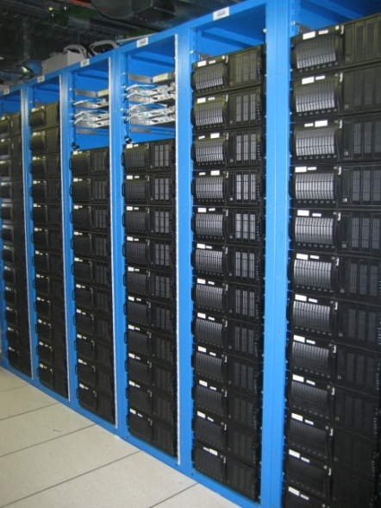
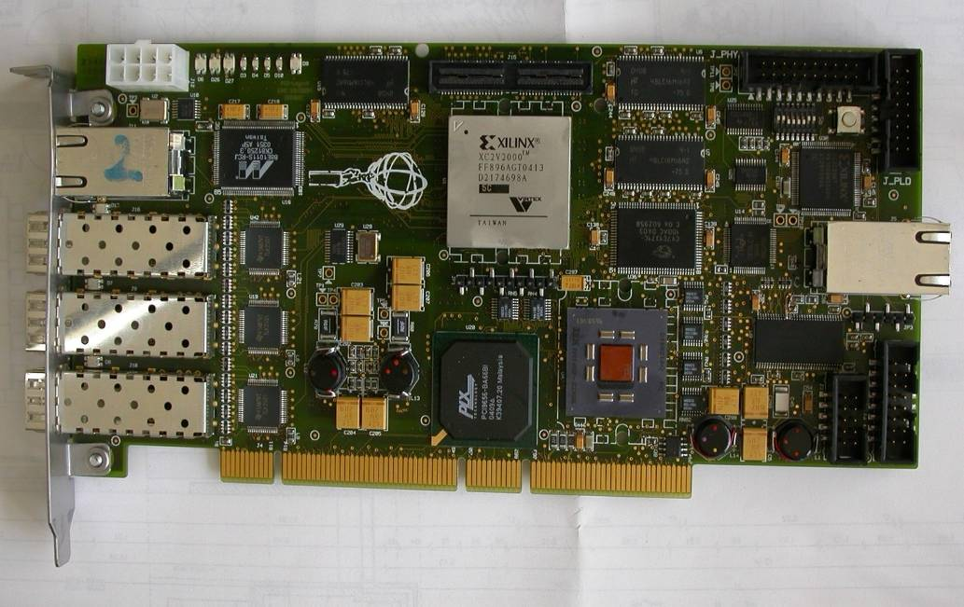
Read-Out System
Read-Out System (ROS) implemented with ~150 PCs
4 PCI custom cards with 3 Read-Out links each, per ROS:
~1600 optical links
Each card corresponds to a Read-Out Buffer (ROB)
Level 1 accepts cause the transfer of the event data to the ROS:
Event Data pushed @ 75kHz
~1600 fragments of ~1 kB each
ROS provides data fragments to Level 2 & Event Builder
ROS buffers events during Level 2 decision time and event building
Notes:
ROBIN in the pic, they are custom made

Slide 16
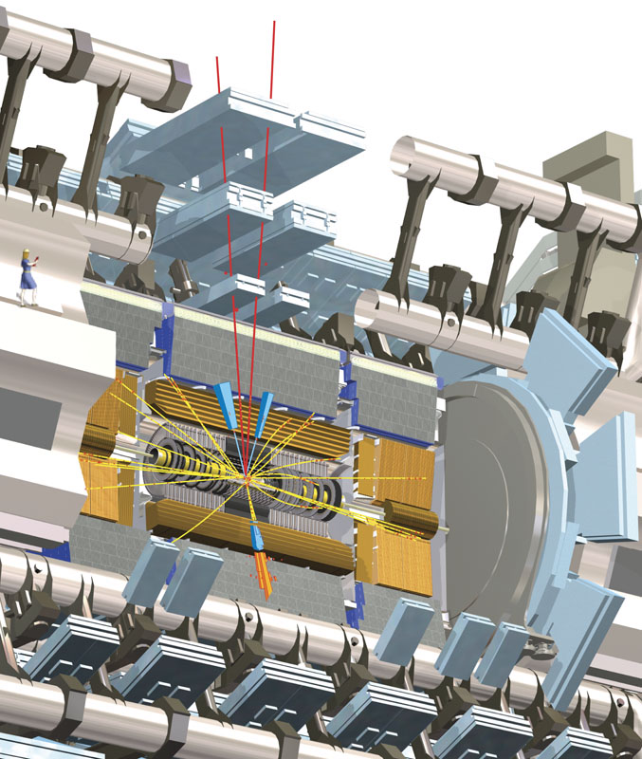
Region of Interest
ATLAS Data
Trigger Info
Trigger
DAQ
ATLAS Event
1.5 MB/25 ns
Calo/Muon Detectors
<2.5 μs
Other Detectors
Level 1
40 MHz
40 MHz
Detector Read-Out
L1 Accept
75 (100) kHz
FE
FE
FE
75 kHz
Regions Of Interest
ROD
ROD
ROD
High Level Trigger
Data-
Flow
112 GB/s
~40 ms
ReadOut System
Level 2
ROI data
(~2%)
ROI Requests
Event Builder
~ 3 kHz
Data Collection Network
~4.5 GB/s
~4 sec
L2 Accept
~3 kHz
SubFarmInput
Event Filter
Event Filter Network
EF Accept ~200 Hz
SubFarmOutput
~ 300 MB/s
~ 200 Hz
CERN Data Storage
Notes:
Cut pictures explanation

Slide 17
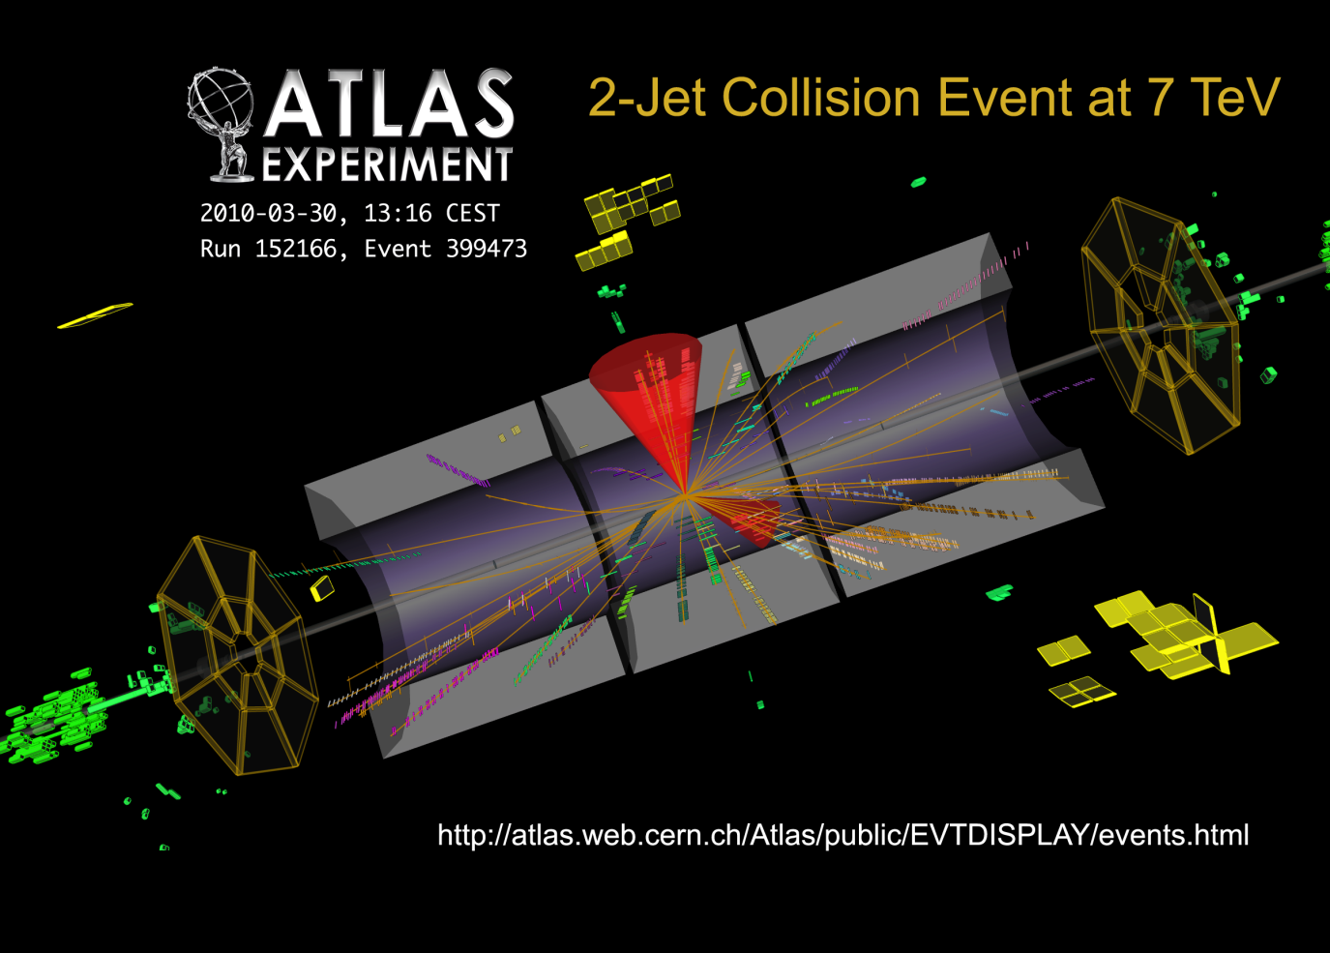
RoI Mechanism
η−φ regions identified by Level 1 selection
for each detector: correspondence between ROB and η−φ region
for each RoI:
list of ROBs with corresponding data from each detector
2 ROIs identified by 2 jets
powerful & economic important rejection factor before event building
reduce requirements on ROS & networking (bandwidth & CPU power)
ROS designed to cope with a max request rate of ~25 kHz
Notes:
Explain the picture

Slide 18
Event Builder
ATLAS Data
Trigger Info
Trigger
DAQ
ATLAS Event
1.5 MB/25 ns
Calo/Muon Detectors
<2.5 μs
Other Detectors
Level 1
40 MHz
40 MHz
Detector Read-Out
L1 Accept
75 (100) kHz
FE
FE
FE
75 kHz
Regions Of Interest
ROD
ROD
ROD
High Level Trigger
Data-
Flow
112 GB/s
~40 ms
ReadOut System
Level 2
ROI data
(~2%)
ROI Requests
~ 3 kHz
Data Collection Network
Event Builder
~4.5 GB/s
~4 sec
L2 Accept
~3 kHz
SubFarmInput
Event Filter
Event Filter Network
EF Accept ~200 Hz
SubFarmOutput
~ 300 MB/s
~ 200 Hz
CERN Data Storage

Slide 19
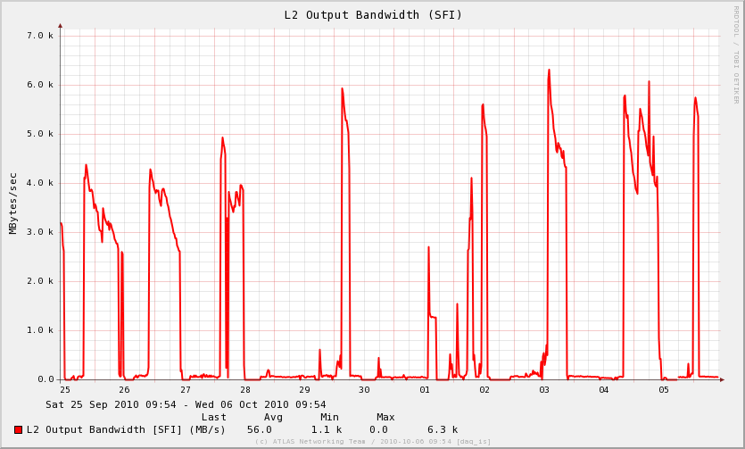
Event Builder
collects Level 2 accepted events into single data structure @ a single place
3 kHz (L2 accept rate) x 1.5 MB (event size)→ 4.5GB/s (EB input)
can handle a wide range of event size from O(100 kB) to O(10 MB)
sends built events to EF farm
EB Input Bandwidth
L2 commissioning = high acceptance
[~150]
ROS
[1]
Dashed line = nominal working point
design spec. for EB input ~4.5 GB/s
DFM
Data Flow Manager (DFM)
Sub-Farm Input (SFI)
SFI
receives trigger from Level 2
assigns events to the SFI
sends clear messages to the ROS
asks all ROS for data fragments
builds a complete event
serves EF
[~100]

Slide 20
High Level Trigger (HLT)
ATLAS Data
Trigger Info
Trigger
DAQ
ATLAS Event
1.5 MB/25 ns
Calo/Muon Detectors
<2.5 μs
Other Detectors
Level 1
40 MHz
40 MHz
Detector Read-Out
L1 Accept
75 (100) kHz
FE
FE
FE
75 kHz
Regions Of Interest
ROD
ROD
ROD
High Level Trigger
Data-
Flow
112 GB/s
~40 ms
ReadOut System
Level 2
ROI data
(~2%)
ROI Requests
Event Builder
~ 3 kHz
Data Collection Network
~4.5 GB/s
~4 sec
L2 Accept
~3 kHz
SubFarmInput
Event Filter
Event Filter Network
EF Accept ~200 Hz
SubFarmOutput
~ 300 MB/s
~ 200 Hz
CERN Data Storage

Slide 21
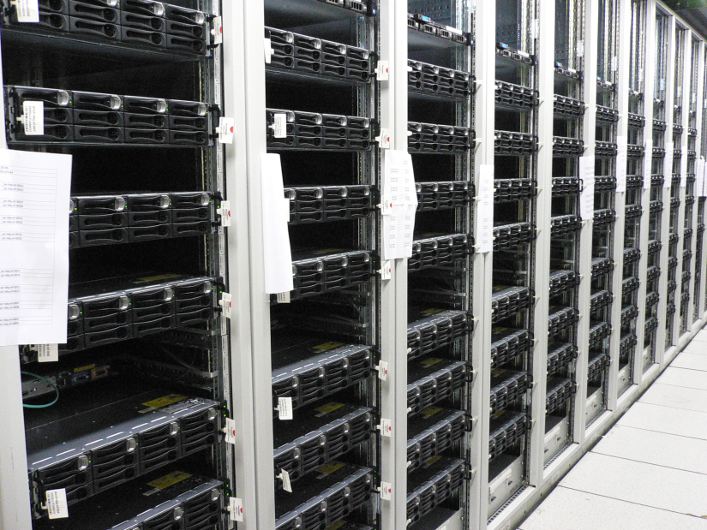
High Level Trigger (HLT)
Same selection infrastructure:
  Level 2: fast algorithms based on RoI
  EF: reconstruction algorithms adapted from offline sw
Part of the farm in common:
27 xpu racks ~800 xpu nodes, connected to Data Collection Network and Event Filter Network
XPU = L2 or EF Processing Unit
  on a “run by run” basis can be configured to run either as Level 2 or EF
  high flexibility to meet the trigger needs
  very good for the early running phase while commissioning the trigger
10 dedicated Event Filter racks (connected only to the Event Filter Network with a 10 Gb/s link) in use since September to accommodate the increase of LHC luminosity (computing power & bandwidth)

Slide 22
Local Mass Storage
ATLAS Data
Trigger Info
Trigger
DAQ
ATLAS Event
1.5 MB/25 ns
Calo/Muon Detectors
<2.5 μs
Other Detectors
Level 1
40 MHz
40 MHz
Detector Read-Out
L1 Accept
75 (100) kHz
FE
FE
FE
75 kHz
Regions Of Interest
ROD
ROD
ROD
Events selected by EF are saved on mass storage, the Sub-Farm Output (SFO)
High Level Trigger
Data-
Flow
112 GB/s
~40 ms
ReadOut System
Level 2
ROI data
(~2%)
ROI Requests
Event Builder
~ 3 kHz
Data Collection Network
~4.5 GB/s
~4 sec
L2 Accept
~3 kHz
SubFarmInput
Event Filter
Event Filter Network
EF Accept ~200 Hz
SubFarmOutput
~ 300 MB/s
~ 200 Hz
CERN Data Storage

Slide 23
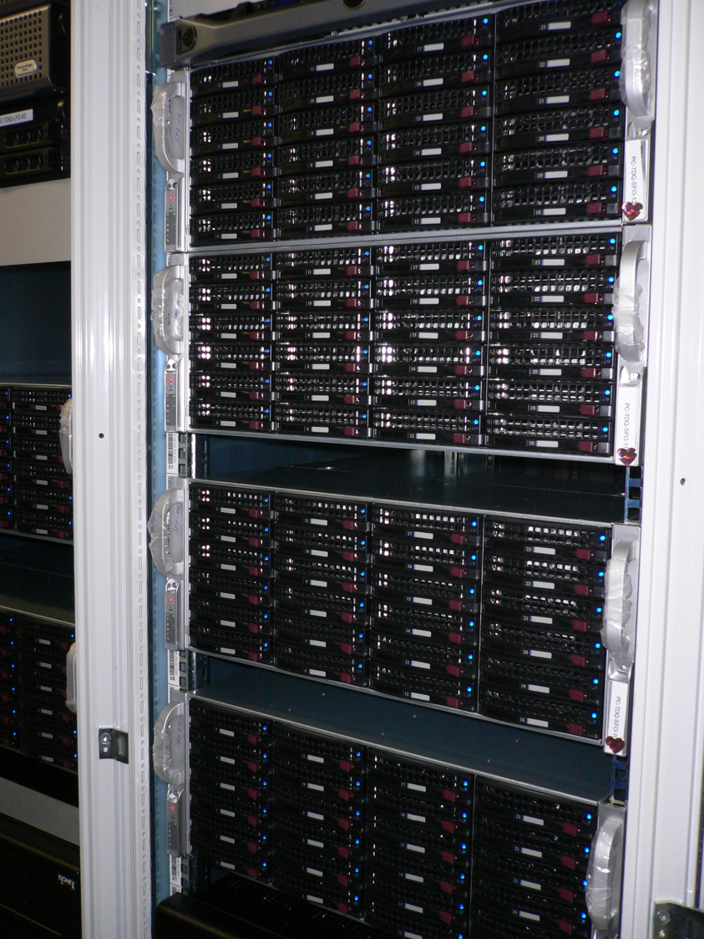
Local Mass Storage
SFO farm:
  6 disk storage server PCs (5 + 1 spare)
  3 HW raid arrays & 24 HD per node, RAID5 scheme
Events distributed into Data Files following data stream assignment done at HLT (express, physics, calibration, debug)
Data files asynchronously transferred to CERN Data Storage
52.5 TB total capacity = 1 day of disk buffer in case of mass storage failure
Scalability

Slide 24
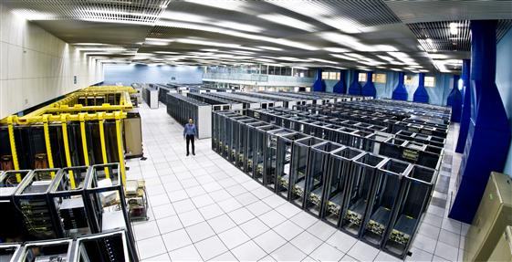
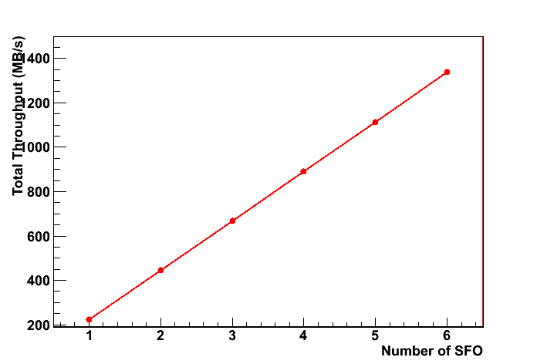
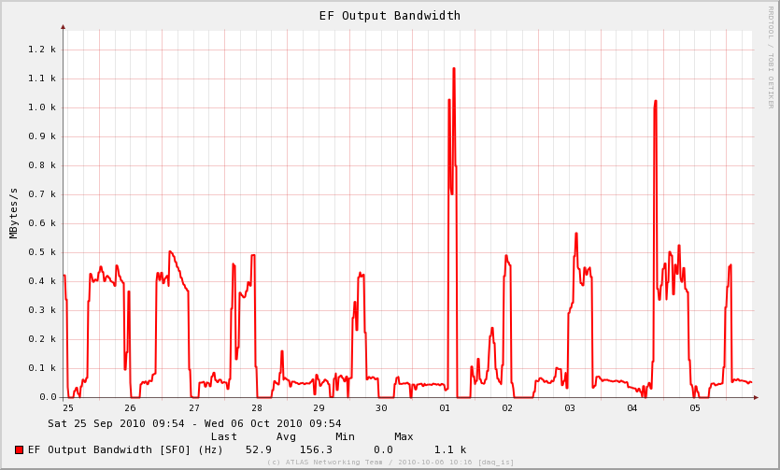
SFO Performance
2x 1 Gbit link
2x 10 Gbit link
CERN Data Storage
[6]
2x 1 Gbit link
SFO
SFO
SFO
SFO effective throughput
(240 MB/s per node): 1.2 GB/s
Dashed line = nominal working point
design spec. for SFO input ~300 MB/s
EF Output Bandwidth
EF commissioning = high acceptance

Slide 25
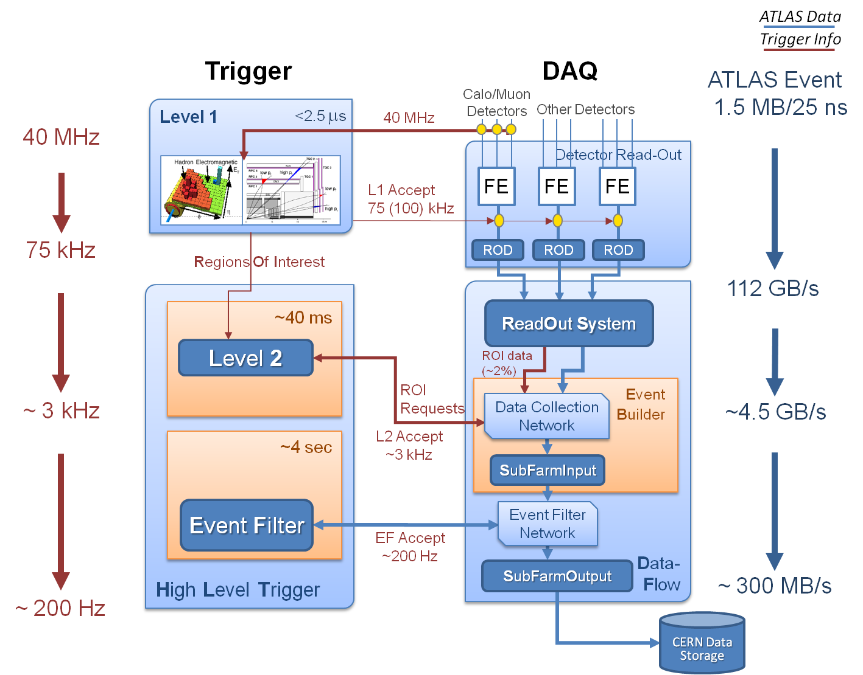
TDAQ
2010
1.5 MB/150 ns
~1 MHz
~1 MHz
20 kHz
~20 kHz
~65 kHz
~30 GB/s
High Rate Test with Random Triggers
~40 ms
~3.5 kHz
~5.5 GB/s
~300 ms
~3.5 kHz
~350 Hz
~550 MB/s
~ 350 Hz

Slide 26
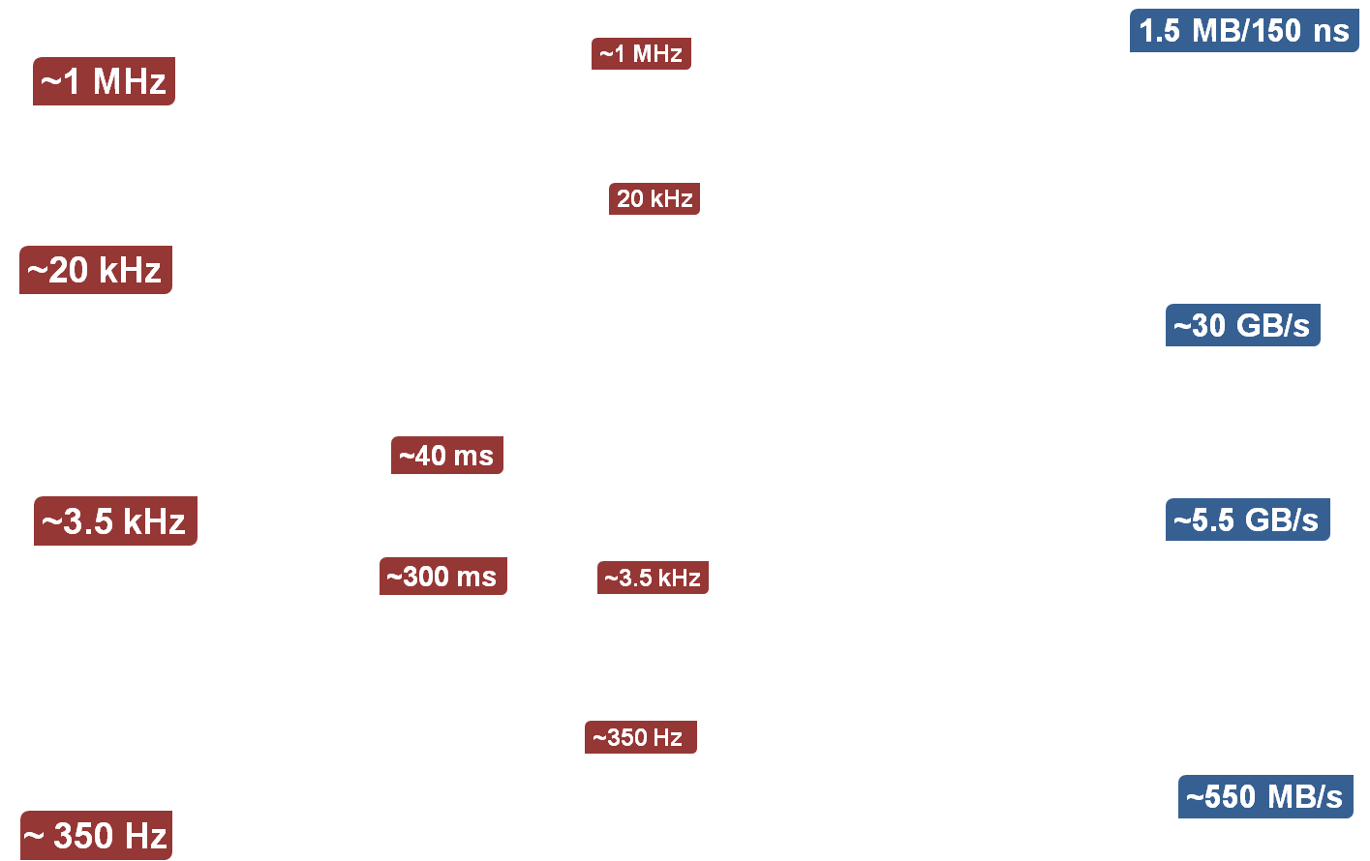
Design
BEYOND
Trigger Commissioning: Balancing L2 and EF
4.5 kHz
7 GB/s

Slide 27
Design
BEYOND
Full Scan for
B-Physics
ReadOut System
Full Scan @20 kHz
(max ~25 kHz)
Data Collection Network

Slide 28
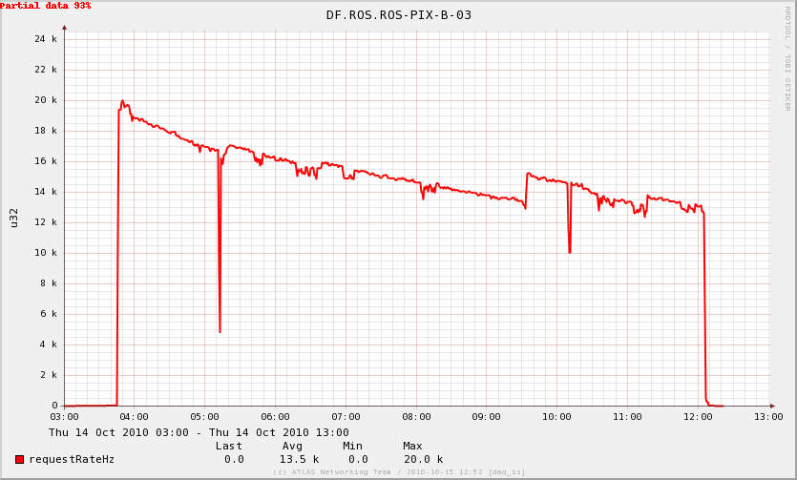
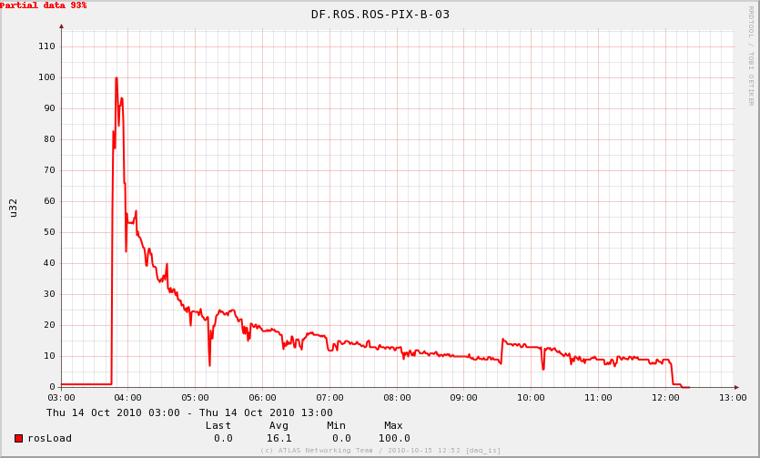
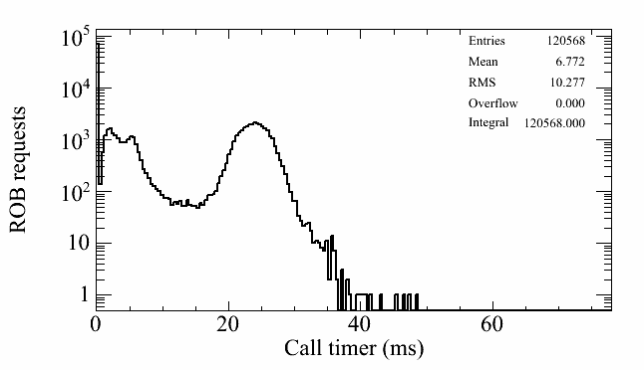
Pixel ROS Problem
During October physics run an unexpected saturation of the Pixel ROS was reached:
  ROS-PIX Request Rate = 20 kHz
  ROS-PIX Load = 100%
  ROS-PIX Request Time > 20 ms
  (nominal: 1 ms)
20 kHz
100%
Investigations showed
  Sub-Optimal Trigger Configuration
  Sub-Optimal Cabling of Pixel ROS

Slide 29
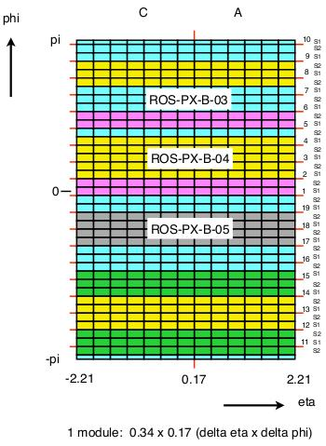
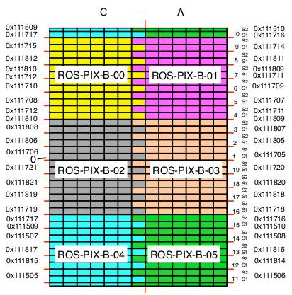
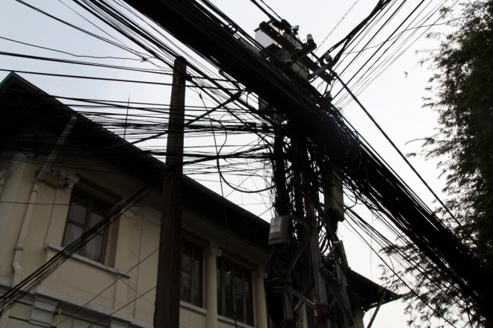
Pixel ROS Re-cabling
Pixel ROS connected to non-contiguous detector regions, fragmented in η−φ → different ROI belong to the same ROS → some ROS overloaded of requests
Pixel Barrel – Layer 1, before and after re-cabling

Slide 30
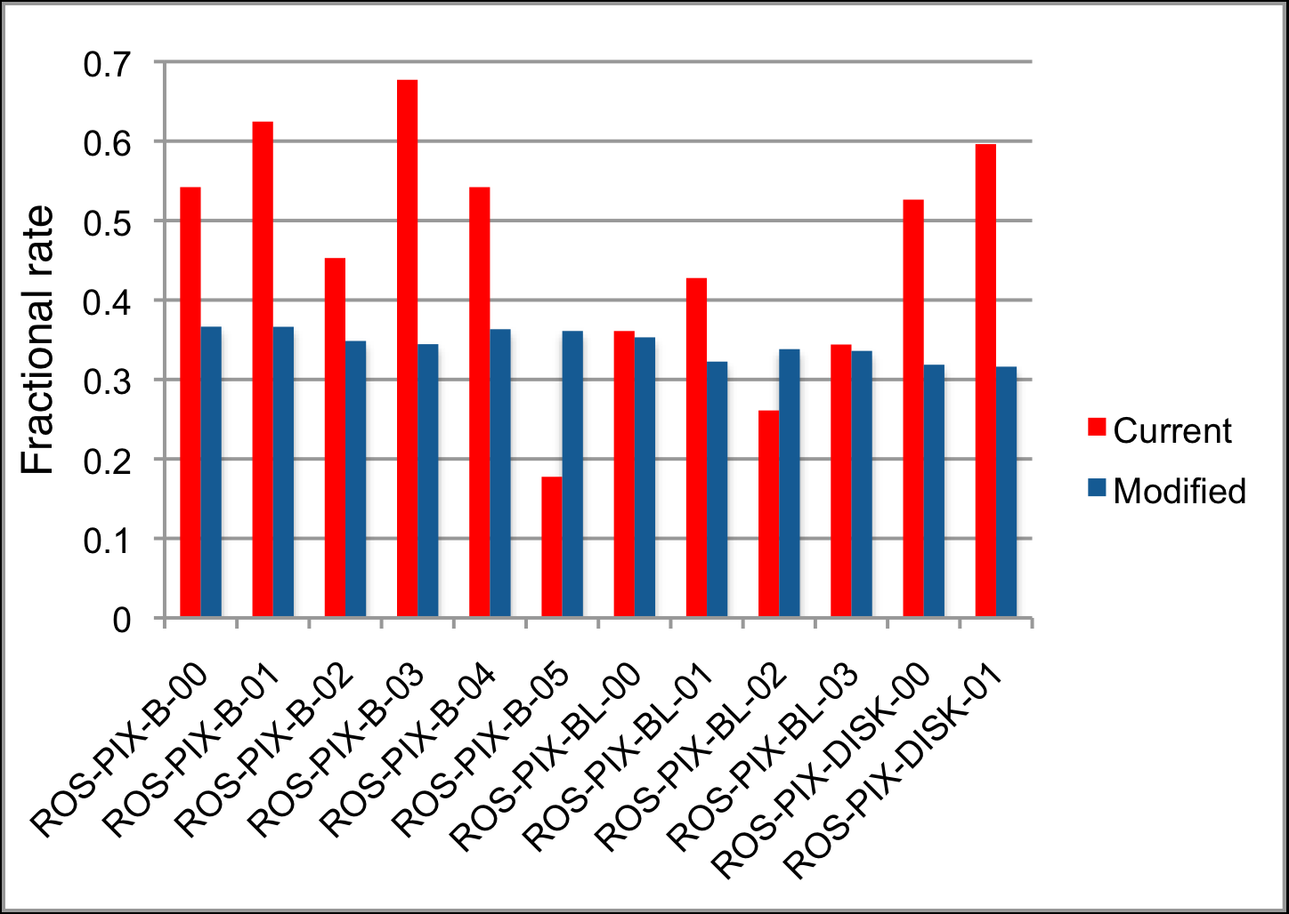
New Pixel-ROS Cabling Performance
Fractional Rate = fraction of total RoI request rate seen by ROS
BEFORE
AFTER
New Mapping: requests homogeneously spread over Pixel ROS

Slide 31
Design
BEYOND
LHC
Van-der-Meer Scans
Up to 1.5 GB/s
Up to 1 kHz

Slide 32
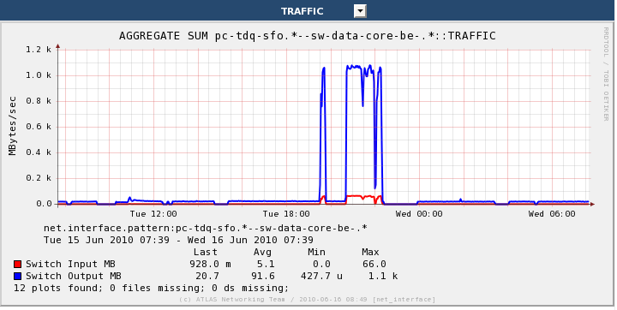
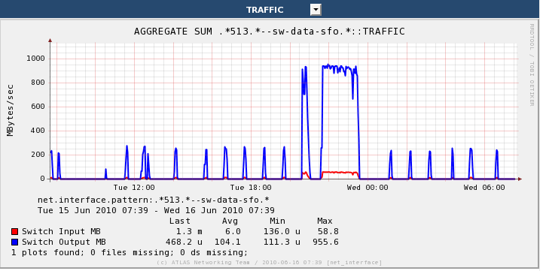
SubFarm Output Beyond Design
LHC Van-der-Meer scan
SFO input rate up to 1.3 GB/s
Data transfer to mass storage ~920 MB/s for about 1 hour
~1 GB/s input throughput sustained during special runs to allow low event rejection
LHC Tertiary Collimator Setup
SFO input rate ~1GB/s
Data transfer to mass storage ~950 MB/s for about 2 hours
TRAFFIC TO SFO
TRAFFIC TO CERN DATA STORAGE

Slide 33
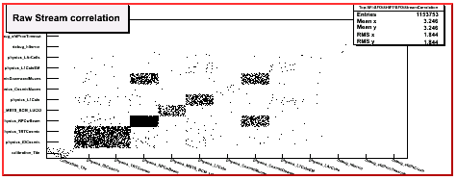
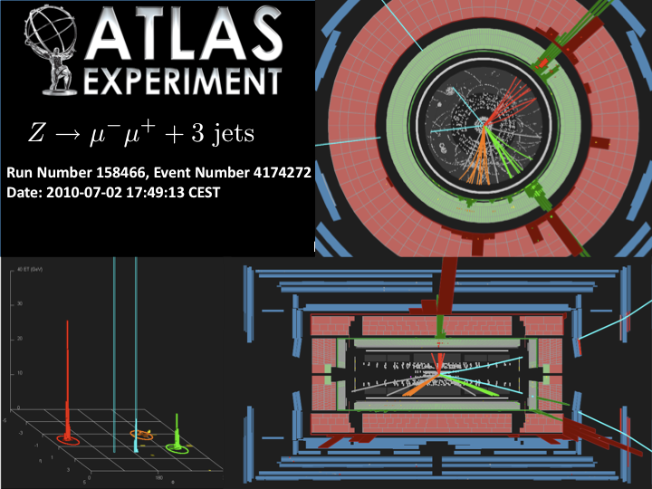
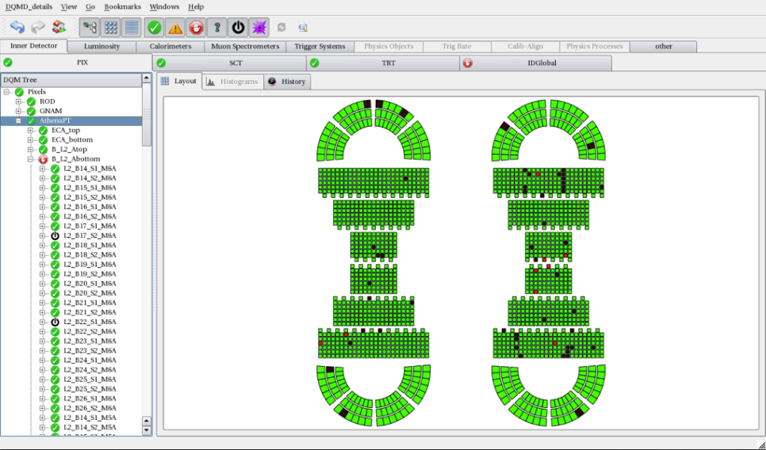
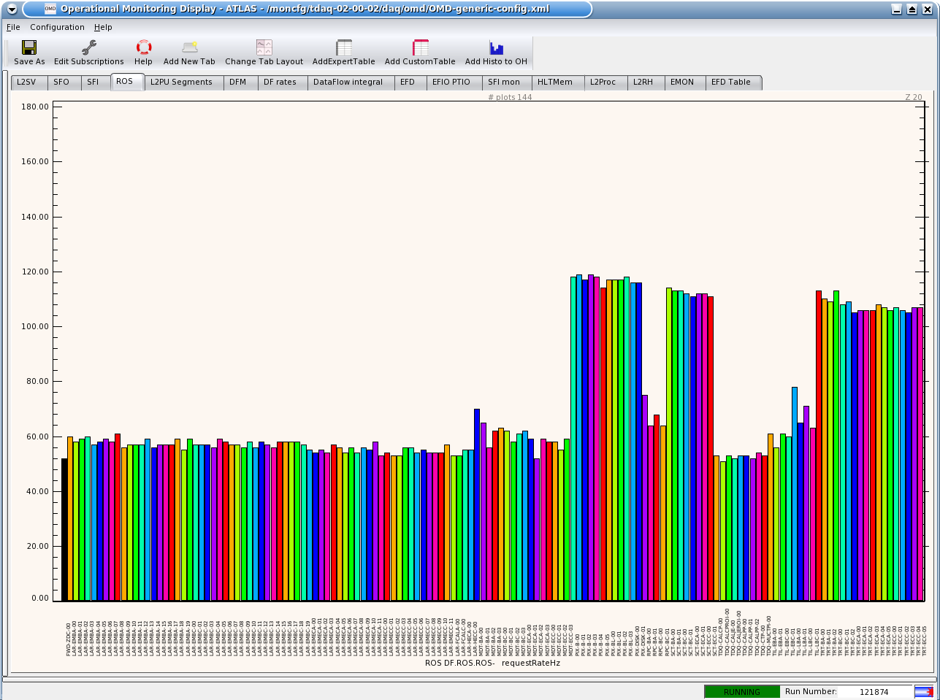
On-line SW
On top of Trigger and Data Flow: additional system allowing for operator control, configuration and monitoring of acquisition runs
Inter-process communication based on CORBA framework, which allows to send data, messages and commands through the whole system
Sub-detectors, trigger, and each data flow level are monitored via:
  operational monitoring (functional parameters)
  event content monitoring (sampled events to ensure good data quality)

Slide 34
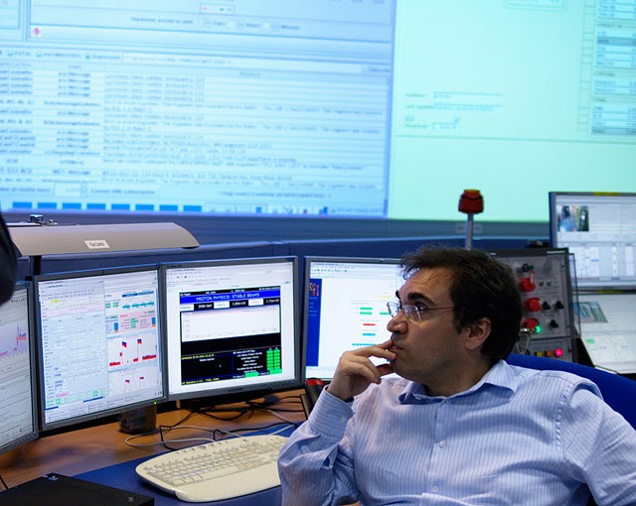
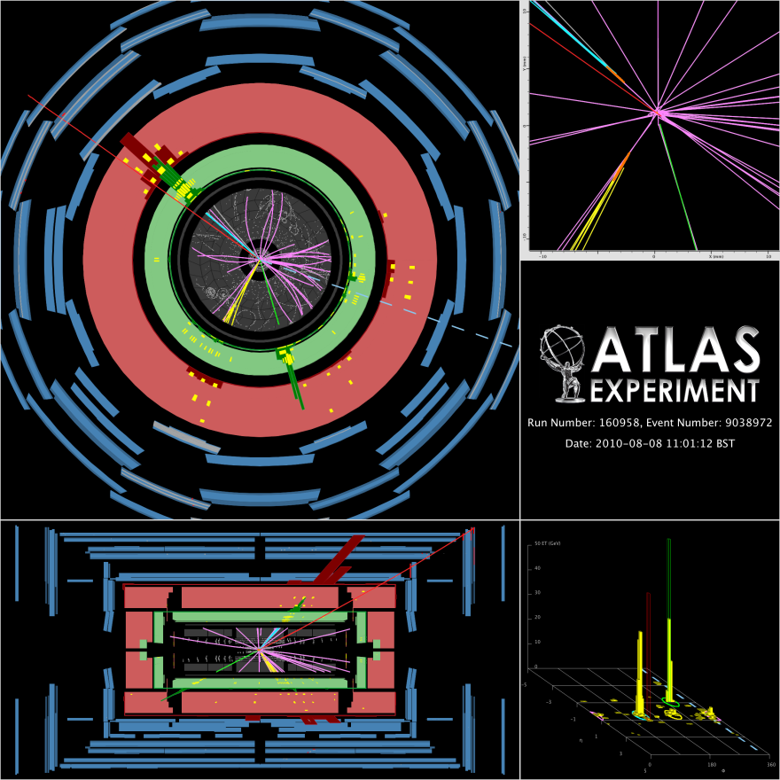
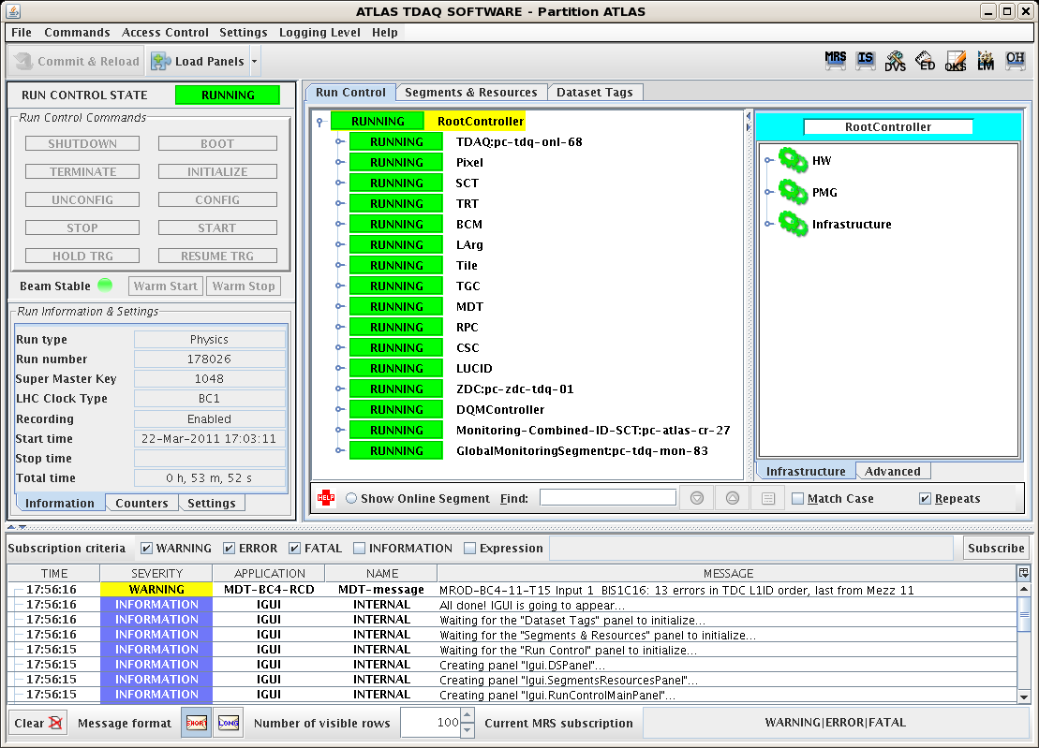
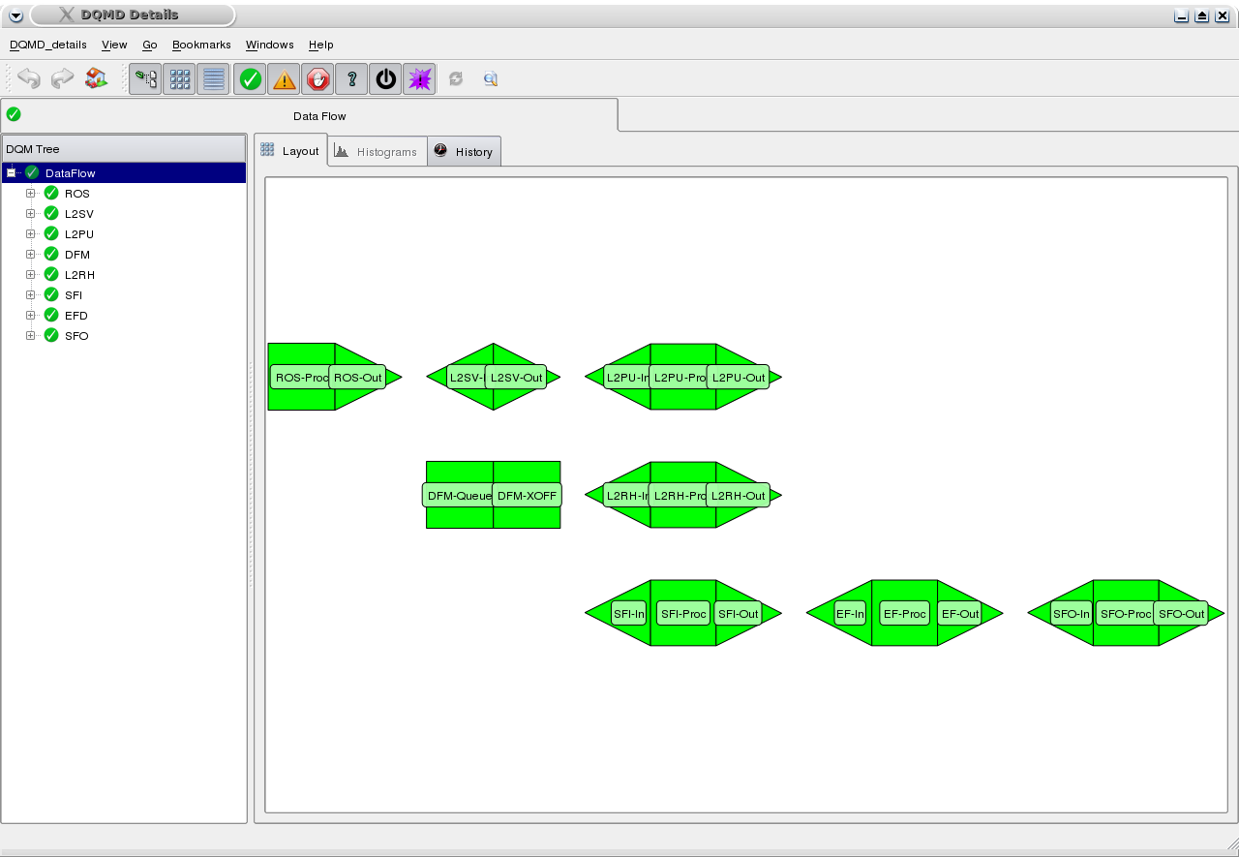
TDAQ Operator
Graphical User Interface
Notes:
IGUI al posto dello start

Slide 35
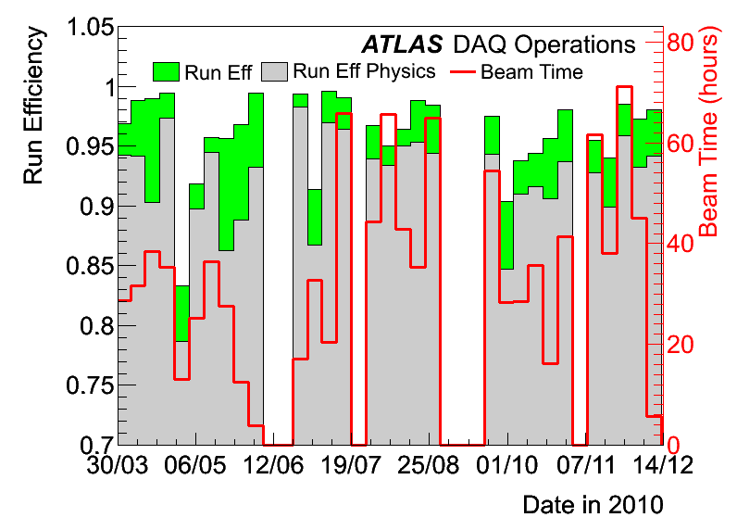
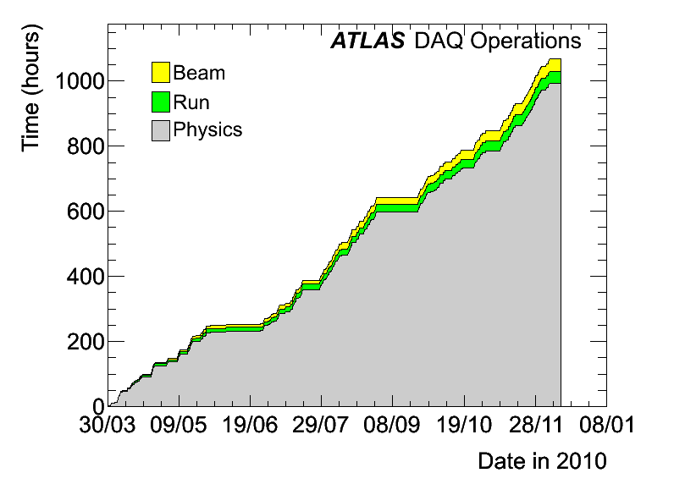
ATLAS Run Efficiency
Run Efficiency 96.5% (green): fraction of time in which ATLAS is recording data, while LHC is delivering stable beams
Run Efficiency for Physics 93% (grey): fraction of time in which ATLAS is recording physics data with innermost detectors at nominal voltages (safety aspect)
Key functionality for maximizing efficiency
Automatic start/stop of physics run
Stop-less removal/recovery: automated removal/ recovery of channels which stopped the trigger
Dynamic resynchronization: automated procedure to resynchronize channels which lost synchronization with LHC clock, w/o stopping the trigger
1068.3 h of stable beams (March, 30th - Dec, 6th)
Notes:
not lumi weighted

Slide 36
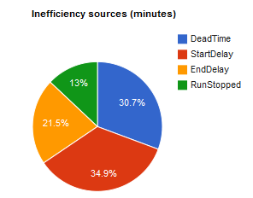
Automated Efficiency Analysis
Automated analysis of down-time causes for 2011 run
Important backwards analysis to improve the system
Analysis results with pie charts available on the web
Dead-Time (blue): the trigger was on-hold, data could not flow
Start Delay (red): the stable beam is delivered, but ATLAS was not yet recording physics data
End Delay (orange): the ATLAS run stops too early, while LHC is still delivering stable beams
Run Stopped (green): the run was stopped while LHC was delivering stable beams
Each slice has associated a further detailed analysis (source & type of problem)
Notes:
change slide as suggested by reiner?

Slide 37
Monitoring the Working Point
Monitoring the TDAQ working point is mandatory to guarantee a successful and efficient data taking and to anticipate possible limits
Dynamically reconfigure the system in response to
  changes of the detector conditions
  beam position
  LHC luminosity
Three tools developed:
  Network Monitoring Tool
  HLT Resources Monitoring Tool
  TDAQ operational capabilities simulation

Slide 38
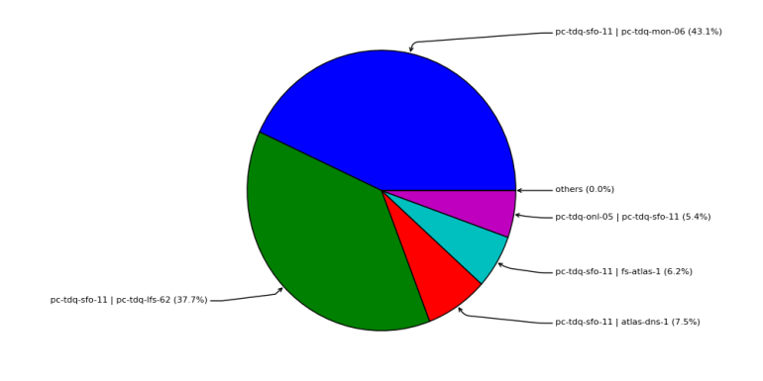
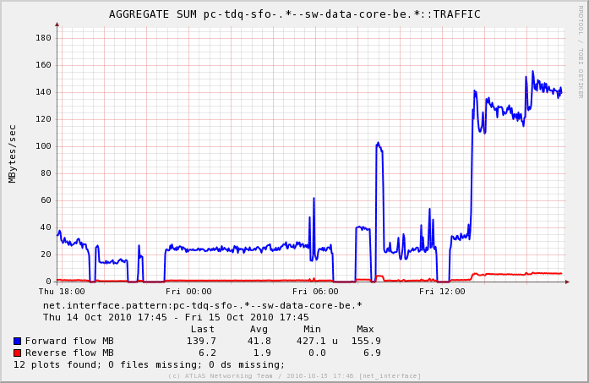


1. Network Monitoring Tool
Scalable, flexible, integrated system for collection and display with same look&feel:
  Network Statistics
  Computer Statistics
  Environmental Conditions
  Data Taking Parameters
Correlate network utilization with TDAQ performance
Constant monitoring of network performance, anticipation of possible limits

Slide 39


2. HLT Resources Monitoring Tool
Record online information about HLT performance (CPU consumption, decision time, rejection factor)
Information elaborated offline to report trigger rate, execution order, processing time, Level-2 access pattern
Example: announced increase of L
    need for CPU power @ HLT (HLT Resources Monitoring Tool)
    need for bandwidth @ EB output (Network Monitoring Tool)
10 EF dedicated racks: high computing performance & 10 Gbps/rack

Slide 40

  3. TDAQ Operational Capabilities Simulation
Curves = maximum EF processing time sustainable with racks used as EF
Variables:
  XPU sharing (Level-2 & EF)
  # of installed specific EF racks
  proc. time
  rejection factor
How to read the plot:
to sustain EB rate of 3.5 kHz (green dashed line) → max EF proc. time = 1.8 s (with fair XPU sharing)
For a EF proc. time longer than 1.8 s (design: 4 s)
  decrease EB rate or
  install more EF computing power
Vertical Dashed Lines = region operating with the indicated EB bandwidth & EF rejection factor, needed to sustain an SFO throughput of 500MB/s
Notes:
shorter, backup?

Slide 41

Run 2011-2012
LHC started delivering stable beams on Sunday, 13th March 2011
After 10 days, LHC delivered ~28 pb^{‐1}. Took several months last year…
Luminosity
L= 2.5 10³² cm⁻²s⁻¹
After 10 days of operations
Notes:
now: 28 pb -1

Slide 42


Beginning of 2011 Run
L1 rate already at 40 kHz
LHC started very well
Delivered luminosity is rapidly increasing and more fills with respect to last year
ATLAS TDAQ: already same working point of the end of last year
Ready to operate in 2011-2012
TDAQ challenges
System ready, but we are exploring unknown
Increase the trigger rejection factor will be mandatory → new commissioning phase with tight schedule
Keep high efficiency
Automate as much as possible to reduce the manpower wrt needs of 2010
EF Output Bandwidth > 300 MB/s

Slide 43
Conclusions
ATLAS TDAQ system
  three-level trigger architecture exploiting the Region of Interest mechanism → keep DAQ system requirements (and costs) down
  computing power can be moved between the two High Level Trigger farms → flexibility
  scalable solution for local mass storage
In 2010 ATLAS TDAQ system operated beyond design requirements to meet changing working conditions, trigger commissioning and understanding of detector, accelerator and physics performance
Tools in place to monitor and predict the working conditions
High Run Efficiency for Physics of 93% in 2010
Ready for steady running in 2011-2012 with further increase of L

Slide 44
Outlook
LHC and ATLAS life time is very long (20 years)
ATLAS collaboration already studying the challenges imposed by the further increase of luminosity after the long shutdown
TDAQ is evaluating:
  merge Level 2 & EF, keeping ROI mechanism, adopting a sequential event rejection → reduce ROS data request & simplify SW framework
  add tracking trigger after Level-1, but before Level-2
Keep HW and SW technologies up-to-date to guarantee smooth operation across decades

Slide 45
Back-up

Slide 46

Event Filter
Each SFI feeding several EF racks
Each EF rack connected to multiple SFIs
In each EF node, decoupling between data flow (EFD) and data processing functionalities (PT)
EFD manages events and makes them available (via read only shared memories) to event selection processes
PTs cannot corrupt the data

Slide 47

Partial Event Building (PEB) & Event Stripping
Calibration events require only part of the full event info → event size ≤ 500 kB
Dedicated triggers for calibration + events selected for physics & calibration
PEB: calibration events are built based on a list of detector identifiers
Event Stripping: events selected by Level 2 for physics and calibration are completely built. The subset of the event useful for the calibration is copied @ EF or SFO, depending on the EF result
Output bandwidth @ EB: calibration bandwidth ~2.5% of physics bandwidth
High rate, using few TDAQ resources for assembling, conveyance, and logging of calibration events
Beyond design feature, extensively used
Continuous calibration complementary to dedicated calibration runs
Notes:
Emphasis on the fact that we take data for calibration and physics at the same time

Slide 48

Event Filter Racks
Increase of LHC luminosity → move towards final configuration
10 dedicated Event Filter racks installed and used
  allows Event Builder rates well beyond 2 kHz (3 GB/s)
  machines with high computing performance
Installed EF BW after Sept 2010
Event Builder operational capability
~8 GB/s
5.5 kHz@1.5MB
Installed EF BW before Sept 2010
Notes:
Backup

Slide 49
A candidate Top Event at √s=7 TeV
Event display of a top pair e-mu dilepton candidate with two b-tagged jets. The electron is shown by the green track pointing to a calorimeter cluster, the muon by the long red track intersecting the muon chambers, and the missing ET direction by the dotted line on the XY view. The secondary vertices of the two b-tagged jets are indicated by the orange ellipses on the zoomed vertex region view.

Slide 50
Van der Meer Scan
Technique to reduce the uncertainties on the width of the beams
Before starting collisions, the physical separation used to avoid collisions during injection and ramp has to be removed
A residual separation can remain after the collapsing of the separation bumps
The so-called Van Der Meer method allows for a minimization of this unwanted separation by transversally scanning one beam through the other
HowTo: scan of number of interactions seen by the detector vs the relative position of the 2 beams. The maximum of the curve is the perfect overlap and the width of the sigma.
The beam sizes at the IP can also be determined by this method and used to give an absolute measurement of the luminosity

