Slide 1
Workshop KEK - CC-IN2P3
27 – 29 Oct. 2007 @ CC-IN2P3, Lyon, France
Day2 14:15 - 14:55 (40min)
KEK new Grid system
Koichi Murakami, KEK/CRC

Slide 2
Outline
Computer system on KEK/CRC
Central Information System
Belle Computing System
Upgrade plans
Strategy for the migration of Grid system
List of items to be configured towards the new Grid system

Slide 3
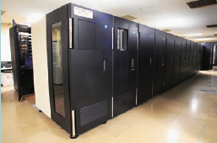
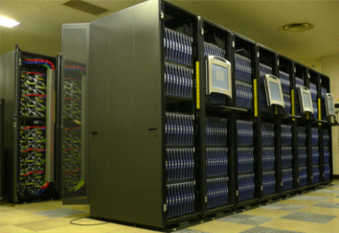
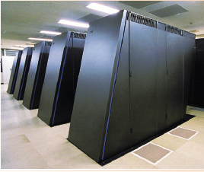
Computer System on KEK/CRC
“Central Computing System” as a part of “Central Information System”
CIS provides general information services on KEK.
mail system, web system, Indico, etc.
CCS provides work servers, batch servers, and storage system.
LCG system is operated.
B Factory Computer System
dedicated to analysis of the Belle experiment
including Grid testing servers
Supercomputer System
Hybrid system of a vector machine (Hitachi SR11000) and a scalar system (IBM Blue Gene)
There are also data grid activities on Lattice QCD

Slide 4
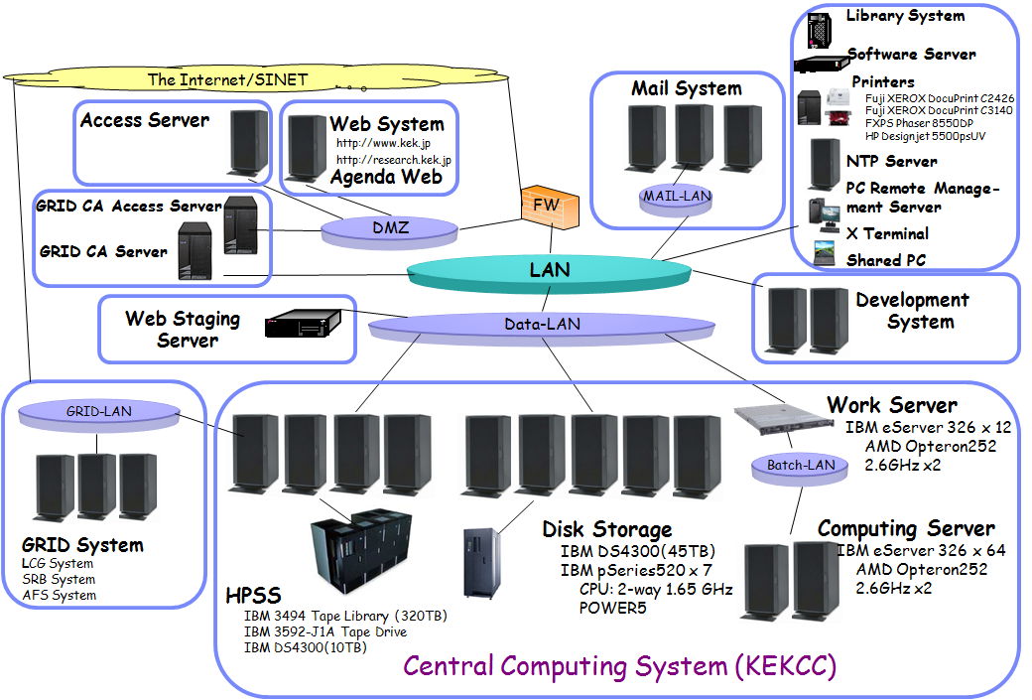
Central Information System
KEK-2 is operated as a part of Central Information System

Slide 5
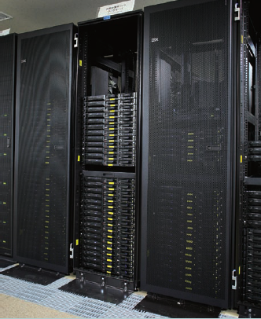
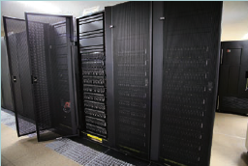
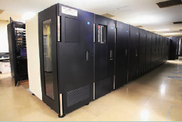
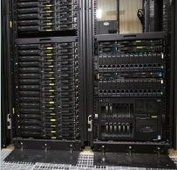
Central Computing System (KEKCC)
Computing Servers
Linux (RedHat ES4) cluster
76 nodes (AMD Opteron 252 x 2), 4GB memory/node
Disk System
45TB disk storage
HPSS Data Storage
HPSS tape library
maximum capacity of 320TB
Grid System
LCG system
KEK-2 is operated
24 WNs, 2TB disk storage
SRB system, AFS servers

Slide 6
System Replacement of CI System
The current Central Information System is rental system of 3 years duration.
2006/Feb. – 2009/Jan.
System replacement (“upgrade”) is scheduled on 2009/Feb.
again, rental for 3 years
We are collecting requirements for system specifications from experimental groups.
HEP exp., Neutron exp. at J-PARC, ATLAS, ILC, Acc., Theory
Estimated amount of computing resources
~2,000 cores of CPU
LSF as batch system
~4PB storage (~500TB as disk)
HPSS or Storage Tek

Slide 7
System Structure of B Computer System

Slide 8
Overview of B Computer Resouces
 | Capability | # of racks | Electrical Power Consumption (kW)
Tape | 3.5 PB | 21 | 6
Disk | 1 PB | 13 | 60
CPU | 2280 CPU | 23 | 475
Login node | 80 node 80 TB | 8 | 70
DAQ | 100 TB | 3 | 22
633 kW in total

Slide 9
Computing Server (CS)
1 Enclosure | = | 10 nodes, 7U space
1 rack | = | 50 nodes
25 racks | = | 4 arrays
CS＋WG servers(80)
= 1208 nodes = 2416CPU
= 45,662 SPEC CINT 2k rate = 5,114 kSI2K base
= 8.7THz
DELL Power Edge 1855
Xeon3.6GHz x2, memory 1GB
Linux
CentOS/CS, REL/WGS

Slide 10
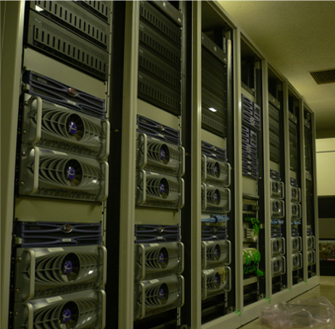
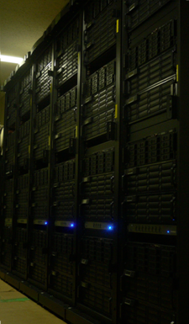
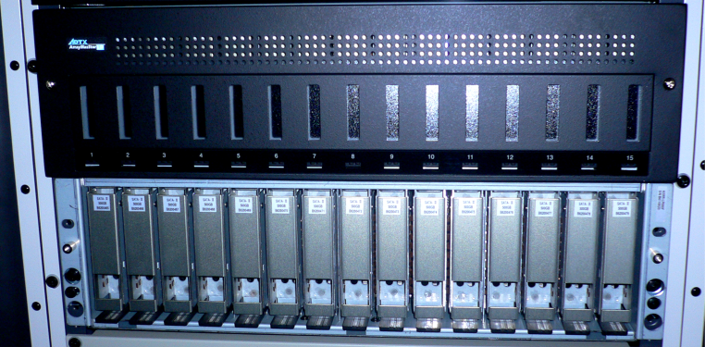
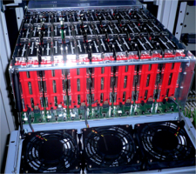
Belle Storage System – disk -
Array Master 15dr/3U/8TB
SATABeast 42dr/4U/21TB
1PB, on 42 File Servers
Nexan + ADTeX + SystemWks
SATAII 500G drive ×~2k
~1.8 f/day
HSM = 370TB non HSM (no backup) = 630TB

Slide 11
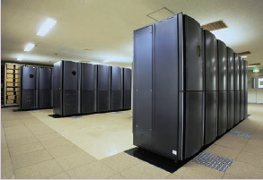
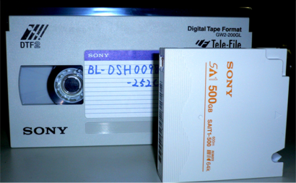
Bell Storage System – tape -
Tape Library
3.5PB + 60 drives + 13 servers
SAIT 500GB/volume
30MB/s drive
SONY SAIT-PetaSite
Work File Server Backup
90TB + 12 drives + 3 servers
LTO3 400GB/volume
NetVault

Slide 12
Upgrade plan for B Computer System
rental for 6 years duration
JFY April - March | 1997 | 1998 | 1999 | 2000 | 2001 | 2002 | 2003 | 2004 | 2005 | 2006 | 2007 | 2008 | 2009 | 2010 | 2011
Computing Server | WS |  |  |  | WS+PC |  |  |  |  | PC |  |  | ?
Throughput SPECint rate2K | 100 |  |  |  | 1,250 |  |  |  |  | 42,500 |  |  | 68,000
Speed (kSI2K) SPECint2K base | 11 |  |  |  | 140 |  |  |  |  | 4,760 |  |  | 7,600
Disk (TB) | 4 |  |  |  | 9 |  |  |  |  | 1,000 |  |  | 1,500
Tape (TB) | 160 |  |  |  | 620 |  |  |  |  | 3,500
Work Group Server # of hosts | 3+(9) |  |  |  | 11 |  |  |  |  | 80+16FS
User Workstation # of hosts | 25WS+68X |  |  |  | 23WS+100PC |  |  |  |  | 128PC

Slide 13
Status of Grid Deployment
Current Grid environments are deployed as a “fragment” of these computer system
R&D for how to utilize Grid environment, trying distributed analysis using Grid technology
mainly focused on applications other than LHC activities
Gradual integration of Grid environment
Co-operation with the current (non-Grid) system is mandatory.
accumulating knowledge for Grid operation

Slide 14
Concerns about Grid deployment
Support for both non-Grid and Grid users
System configuration of such “hybrid” system is a key issue.
resource management of batch servers
job submission using LSF
providing LFC access using SRB-DSI/HPSS-DSI with SE
using virtualization technology (VM) for more robust and performant operation
Interoperability between NAREGI and LCG
choice of GRID middleware
There might be one possibility of migrating two computer system in the next next system replacement (2012) as a further prospect?
more efficient resource management in different aspects

Slide 15
Technical stuffs toward new Grid system
Job submission via LSF on CE/WN
sharing resources with locally submitted jobs and grid jobs
optimization of setting parameters for practical operation
SE integration
LFC accesses to a large scale of storage system (SRB/HPSS)
We can access to both SRB-DSI and HPSS-DSI via GridFTP, but not use LFC.
HSM access by using SRB-DSI and HPSS-DSI on SRM
More robust and flexible operation
system configuration /operation using VMs
Networking/Security
We were suffered from restrictions due to a domestic security policy!
((need for bureaucratic? (not technical) global security assurance mechanism.))

Slide 16
Integration of different components
WAN
DMZ
KEK-2
SRB-DSI
HPSS-DSI
KEK FW
CE
SE
KEK-1
NAREGI
HPSS
Batch
CE
SE
SE
SS
CS
head node
Gfarm
B-Computing System
Central Information System

Slide 17
Summary
Computer system on KEK/CRC
Central Information System
Belle Computing System
Grid environments are deployed as a “fragment” of these computer system
Central Computing System will be replaced on 2009/Feb.
Migration of Grid environment
Support for both non-Grid and Grid access
Technical items and plans towards new Grid system

