Slide 1
Workshop KEK - CC-IN2P3
27 – 29 Oct. 2007 @ CC-IN2P3, Lyon, France
Day1 15:25 - 16:05 (40min)
LCG update and plan at KEK
Go Iwai, KEK/CRC

Slide 2
Agenda
Introduction
  Grid at KEK, its role and stance, etc
  Brief history and summary on Grid
  Ops stats
  Grid related services
  Networking (SINET3)
Particular Activities over the VO
  Belle experiments
  Accelerator Science over the SINET3
  ILC experiments
  Geant4 Medical Application
NAREGI
  Beta-1: Activities at KEK
  Beta-2: Current status
Summary

Slide 3

Introduction
  - Grid at KEK, its role and stance, etc
  - Brief history and summary on Grid
  - Ops stats
  - Grid related services
  - Networking (SINET3)

Slide 4
KEK’s role, stance, etc
KEK-EGEE II Collaboration
  Focusing on operation and management (SA1)
  Many supports by ASGC, Asia-Pacific ROC
Domestic support
  KEK has a role to offer necessary assistance to university groups in Japan
    They are interested in Grid, but most of them are not production site
      They hesitate to participate in EGEE?
      Mostly, graduate students in physics are the main human resource to support IT unfortunately
  Support for their deployment, operation and monitoring is a role instead of ROC
We are T2 center, but not for any LHC exp.
  T2 for ATLAS: ICEPP, Univ. of Tokyo
  T2 for ALICE: Hiroshima University
Currently, our activities on Grid are focused on operation and management, and developing gridified application over the LCG infrastructure, but not for LHC experiments
  Encourage users to use the Grid
  Just circumstance only at KEK, not at other institutions

Slide 5
People on Grid at KEK, CRC
7 persons in total
  Today’s participants are underlined
CA
  T. Sasaki and Y. Iida
VOMS
  Y. Watase and G. Iwai
Site Operation and Security
  KEK-1
    T. Sasaki, Y. Iida, Y. Watase and G. Iwai
  KEK-2
    T. Sasaki, Y. Watase, and G. Iwai
  NAREGI
    Y. Watase, and G. Iwai
Deployment
  Y. Watase, Y. Iida and G. Iwai
Documentation
  Y. Watase
Networking
  S. Suzuki, S. Yashiro and Y. Iida
Application (SRB, Portal and some Gridified applications)
  K. Murakami, Y. Iida and G. Iwai

Slide 6
Brief History on Grid
2005 | Q1 (Jan-Mar)
 | Q2 (Apr-Jun) | Testbed project was started with LCG-2.6 - Federation among a few institutions
 | Q3 (Jul-Sep)
 | Q4 (Oct-Dec) | “HEP Data Grid Workshop” was held at KEK - KEK-1 system were introduced based on experience in workshop
2006 | Q1 | KEK Grid CA: accredited as production JP-KEK-CRC-01: approved as a certified site
 | Q2 | JP-KEK-CRC-02 (LCG-2.7): approved as a certified site NAREGI beta1 released
 | Q3 | 1st KEK-IN2P3 workshop at IN2P3 KEK-1 and KEK-2 was upgraded to gLite-3.0
 | Q4
2007 | Q1 | 2nd KEK-IN2P3 workshop at KEK
 | Q2
 | Q3 | NAREGI beta2 released
 | Q4 | 3rd KEK-IN2P3 workshop at IN2P3

Slide 7

Brief Summary of Grid Deployment
2 sites are in operation
  Deployed in different network logically
JP-KEK-CRC-01
  Since Nov 2005
  Usage: experimental use and R&D, but production in LCG framework
JP-KEK-CRC-02
  Since Jan 2006
  More stable services based on experience at KEK-1
NAREGI
  Using NAREGI beta1 released on May 2006.
  Testing and evaluation, what is lack for our usage?
Accepted VOs are
  belle
  ppj
  ilc, calice
  g4med
  dteam, ops
  apdg, ail (have been gone)
KEK FW
SINET
KEK-LAN
JP-KEK-CRC-02
JP-KEK-CRC-01
NAREGI

Slide 8
KEK-1: JP-KEK-CRC-01
KEK FW
SINET
KEK
LAN
KEK-2
KEK-1
NAREGI
Service Name
SL30X/gLite-3.0
  still not migration to SL4
CPU: 14 x P4
Storage: ~1.5TB
dgXX.cc.kek.jp
130.87.208.xxx
KEK FW
130.87.208.0/22
KEK-LAN
FTS
RB
CE
SE
MON
WMS/LB
UI
BDII/PX
LFC
dg08
168
dg09
169
dg10
170
dg11
171
dg12
172
dg13
173
dg14
174
dg15
175
dg16
176
192.168.1.0/24
dg17
177
dg18
178
dg19
179
dg20
180
WNs
wn001
101
wn001
101
wn001
101
wn001
101
wn001
101
wn001
101
VOBOX
SE
WEB
DB
wn001
101
wn002
102
wn003
104
wn001 - wn015 (192.168.1.xxx)

Slide 9
KEK-2: JP-KEK-CRC-02
KEK FW
SINET
KEK
LAN
KEK-2
KEK-1
NAREGI
Service Name
SL30X/gLite-3.0
  still not migration to SL4
CPU: 48 x Opteron252
Storage: ~2.0TB
  Only disk in use, HPSS exclusive
rlsXX.cc.kek.jp
202.13.197.xxx
L3 SW
202.13.197.0/24
SINET
CE
CE
RB
BDII
LFC
SE
MON
rls01
101
rls02
102
rls03
103
rls04
104
rls05
105
rls06
106
rls07
107
rls08
108
10.32.2.0/24
WNs
wn001
101
wn001
101
wn001
101
wn001
101
wn001
101
wn001
101
wn001
101
wn001
101
wn001
101
wn001
101
rlc01
51
rlc02
52
rlc03
53
rlc04
54
rlc05
55
rlc01 - rlc24 (10.32.2.xxx)
* 2 processors on each

Slide 10
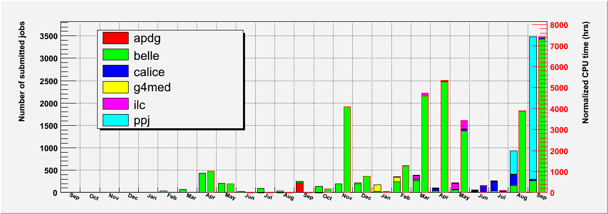
Ops Stats at KEK-1 last 2yrs
JP-KEK-CRC-01
2005
2006
2007
Number of Jobs (w/o ops, dteam): 7,677
33,140 CPU time normalized by 1kSI2K (hrs*kSI2K)

Slide 11
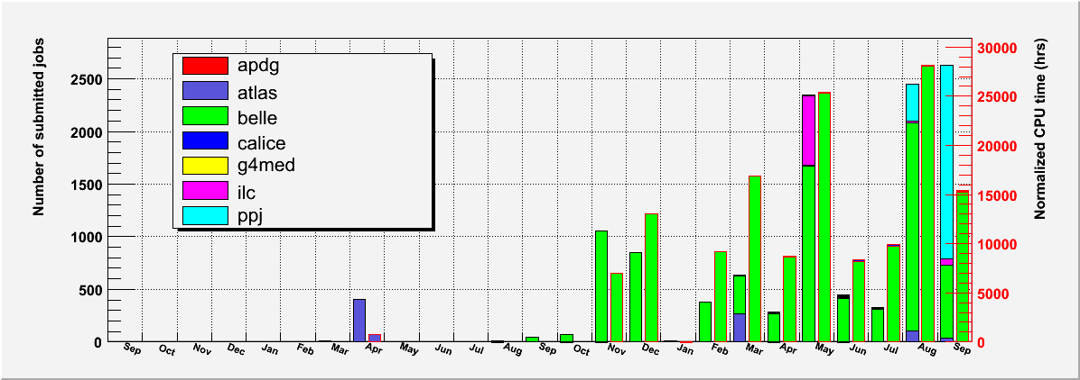
Ops Stats at KEK-2 last 2yrs
JP-KEK-CRC-02
2005
2006
2007
Number of Jobs: (w/o ops, dteam) 11,951
142,960 CPU time normalized by 1kSI2K (hrs*kSI2K)

Slide 12
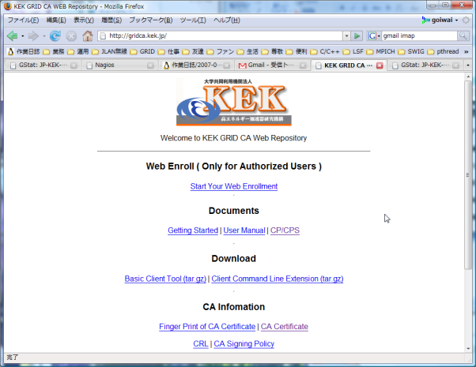
KEK Grid CA
http://gridca.kek.jp
KEK Grid CA has been started since Jan 2006.
  75 CAs are in production all over the world, 3 in Japan.
    AIST, NAREGI, and KEK
  is accredited by IGTF (International Grid Trust Federation)
    The IGTF consists of APGridPMA (AP), EUGridPMA (EU) and TAGPMA (US).
  is recognized by LCG also.
KEK Grid CA has been audited by Yoshio Tanaka (chair of APGridPMA), AIST on May 2007 and passed
  Audited NAREGI CA also for cross checking on July 2007
KEK Grid CA: Statistics of Issued Certificates
 | JFY2006 Apr 2006 - Mar 2007 | JFY2007 Apr 2007 -
Globus Client Certificate (Personal cert.) | 68 | 119
Globus Server Certificate (Host cert.) | 139 | 238
Web Server Certificate | 4 | 0

Slide 13
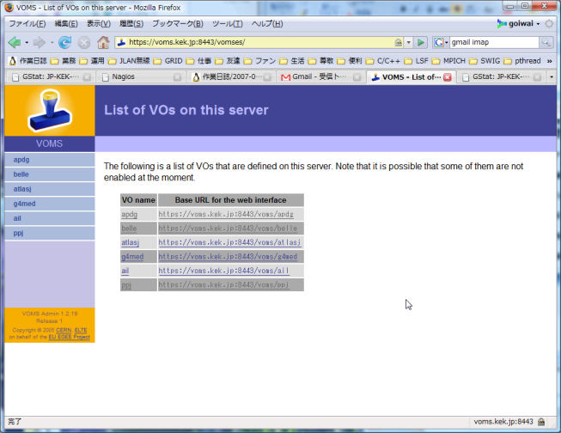
VOMS operated at KEK
VOMS has been serviced in production since Sep 2006.
  Tested from Nov 2005.
VOMS support the VO for
  BELLE: Belle Experiments (belle only registered in CIC)
    The biggest target for us
  PPJ: Accelerator Science in Japan
  G4MED: Geant4 Medical Application for Radiotherapy
  APDG: The R&D of Data Grid among Asia-Pacific region
  ATLASJ: The ATLAS Experiment only for Japanese Group
  AIL: Associated International Laboratory between KEK and France
http://voms.kek.jp

Slide 14
Networking on Grid
: Edge node (w/ edge L1 SW)
: Core node
(w/ core L1 SW + IP router)
: 1G to 10G
: 10G to 40G
The production R&E networks, “SuperSINET/SINET” operated by NII has been upgraded to “SINET3” on April 2007
  Two tier structures with edge and core layers.
    The edge layer consists of edge layer 1 switches with Ethernet interfaces to accommodate users’ equipment.
    The core layer consists of core layer 1 switches and high performance IP routers and constitutes a nationwide reliable backbone network.
  63 edge nodes and 12 core nodes, i.e., 75 L1 switches and 12 IP/MPLS routers
    2x10GbE for KEK
  The line speed between the edge and core nodes is 1 to 20 Gbps, and the backbone line speed between the core nodes is a maximum of 40 Gbps.
Shift to more application oriented rather than the band width
  GRID deployment is an issue
  Virtual Organization for HEP in Japan

Slide 15

Particular Activities over the VO
  - Belle experiments
  - Accelerator Science over the SINET3
  - ILC experiments
  - Geant4 Medical Application

Slide 16
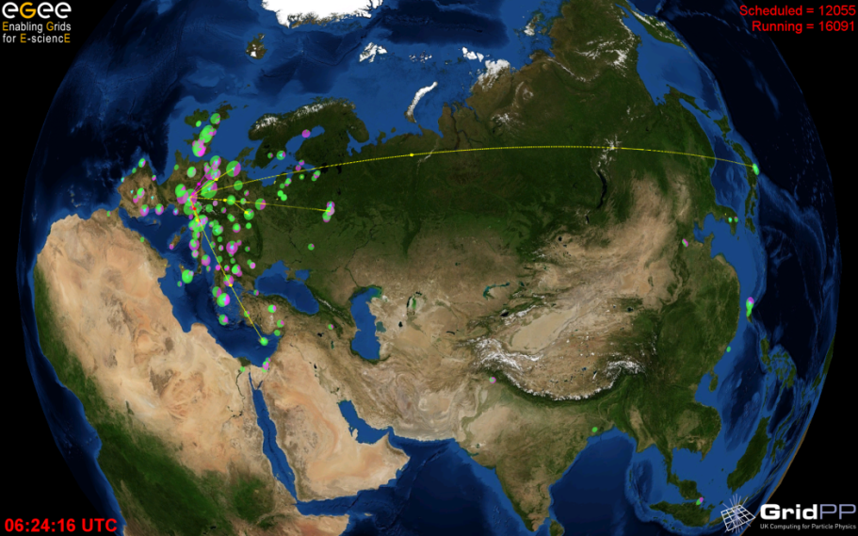
BELLE: The VO for the Belle Exp.
Belle VO is federated among 5 countries, 7 institutes, 10 sites.
  Nagoya University, University of Melbourne, ASGC, NCU, CYFRONET, Korea University
    KEK-1/2 are also
VOMS is supported by KEK
  http://voms.kek.jp/
Past Activities
  Federation among sites
  Library installation
  Submitting MC production job for more realistic use
  Long-term jobs, MC is taken ~1 week usually
  Functional tests and performance tests over the VO
  Finding a way to access existing data
    SRB (next slide)
KEK
Japan
CYFRONET
Poland
Nagoya Univ.
Japan
Korea Univ.
Korea
ASGC
Taiwan
NCU
Taiwan
Univ. of Melbourne
Australia

Slide 17


The choice and design by using SRB-DSI
LCG user
LCG user
Melbourne
KU
APAN
CYFRONET
GEANT2
GridFTP
ASGC
NCU
KEK-DMZ
KEK FW
SINET
SRB
KEK-LAN
KEK-2
Nagoya
SRB-DSI
KEK-1
Enhanced
GridFTP service
SRB server
Belle Net
dedicated inside
Pluggable
Extension
Reference
Registration
NFS
3.5PB
MCAT
HSM
A user can access by just using GridFTP client from out side
  SRB client can access HSM also from inside.
  Benefit for both SRB user and LCG user
  Both user can read and write from/to HSM without considering protocol.
Both protocols are authorized by GSI
SRB client
LSF
Computing Farm
Still not integration with Grid
Belle analysis user

Slide 18
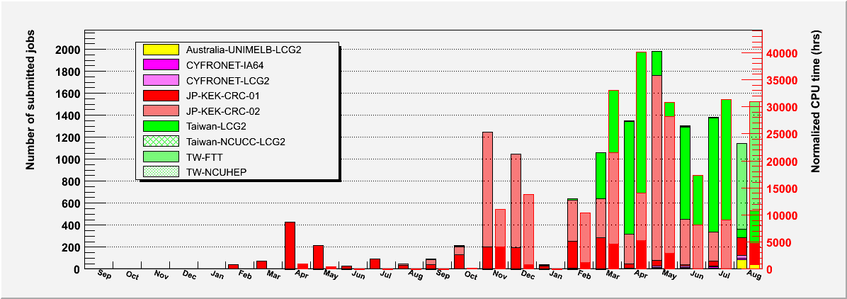
Ops Stats over the Belle VO last 2yrs
Number of Jobs: 12,417
  7,706 of 12,417 has been processed at KEK-1/2
220,809 CPU time normalized by 1kSI2K (hrs*kSI2K)
  122,032 of 220,809 has been used at KEK-1/2
2005
2006
2007

Slide 19
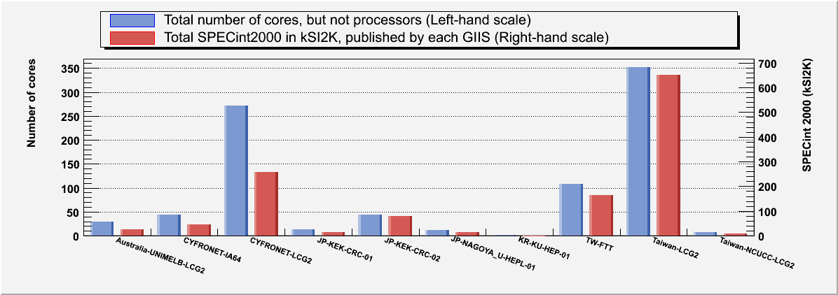
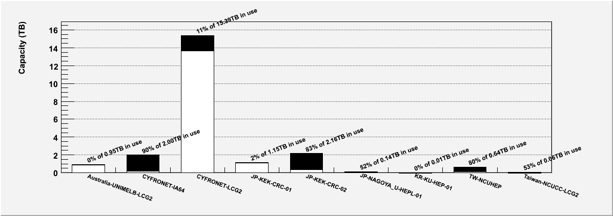
Computing Resources over the Belle VO
CPU resources over the belle VO as a function of sites
883 cores, 1,260kSI2K in total
Storage capacities over the belle VO as a function of sites
■: used
□: available
22.5TB in total
5.94TB in use

Slide 20
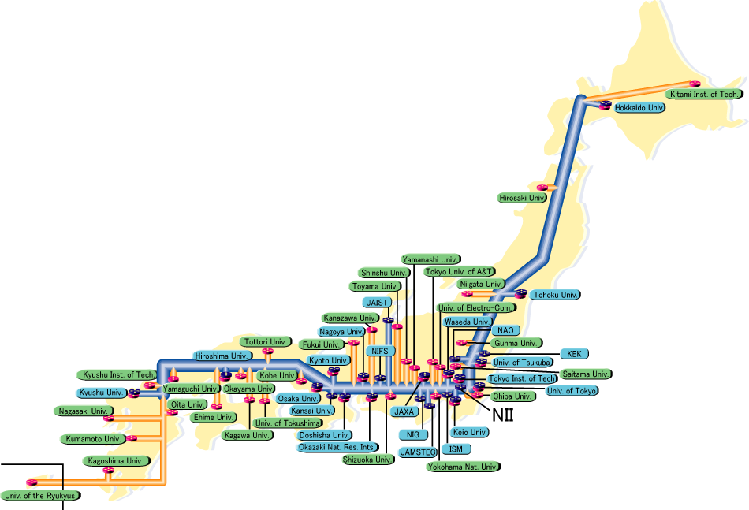
PPJ: The VO for Accelerator Science in Japan
Nagoya Univ.
Tohoku Univ.
Kobe Univ.
Hiroshima IT
KEK
Univ. of Tsukuba
Computing Resources over the PPJ VO
 | Tohoku U | KEK | Tsukuba U | Nagoya U | Kobe U | HIT | Total
CPU (kSI2K) | 0.68 | 91 | 5.1 | 8.3 | 8.5 | 1.2 | 115
SE (GB) | 150 | 2,676 | 65 | 150 | 68 | 36 | 3,145
Federated among major university groups and KEK only in Japan.
  Tohoku-U (KAMLAND, ILC)
  Tsukuba-U (CDF)
  Nagoya-U (BELLE, ATLAS)
  Kobe-U (ILC, ATLAS)
  Hiroshima-IT (ATLAS, Computing Science)
We have a common VO, but do NOT depend on scientific projects.
  To test each site.
KEK assists their operation over the this VO
  same motivation with ops VO

Slide 21
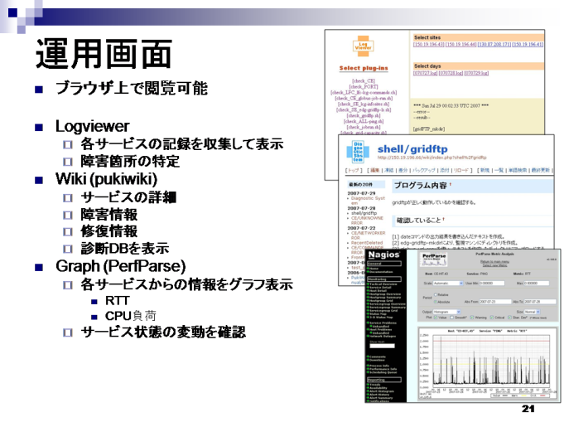
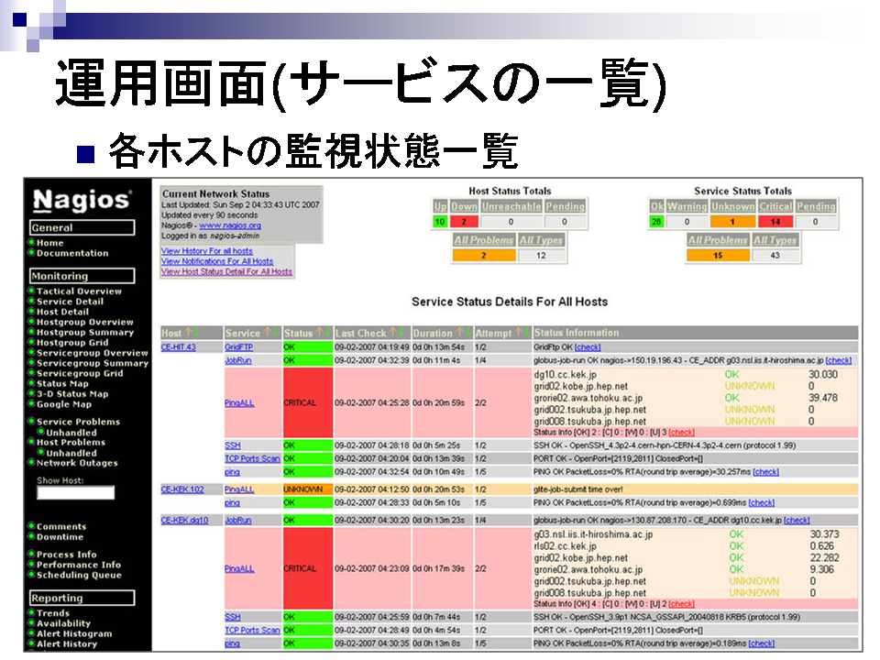
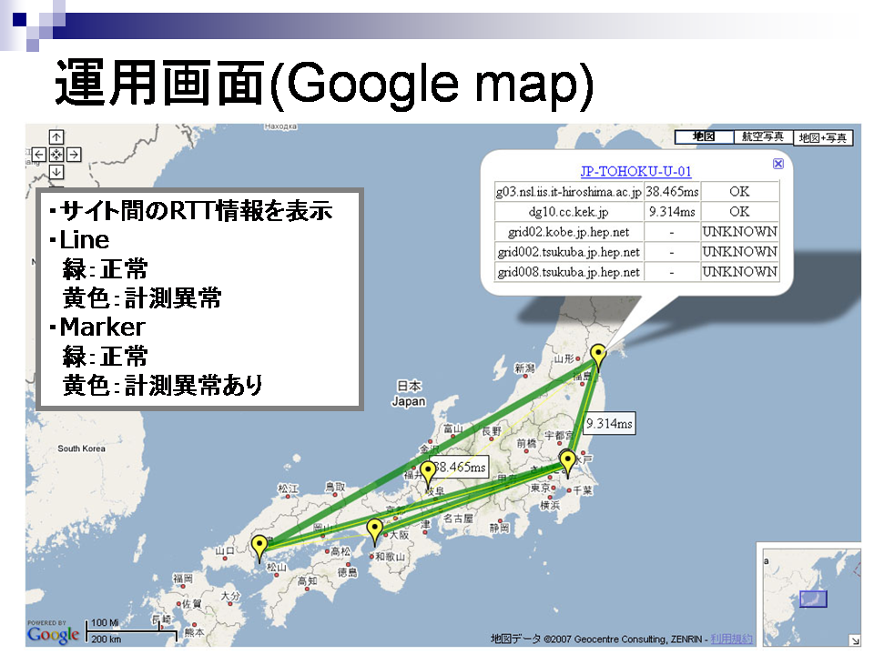
The Supporting System
Mineo Fujii, Hiroshima-IT
A screenshot of summary view: some of results are summarized and shown on the map as a part of monitoring system. Each site is iconified and shown their status as a few color, e.g., yellow show “warning”, red show “error”. The thickness and color of line indicates RTT and network status.
A few screenshots of supporting system: consists of “monitoring system” and “knowledge DB” and “FAQ by wiki”
Monitoring Portal
A screenshots of monitoring system: The site status is checked by a few simple jobs or commands, and is listed here. Link to FAQ is generated as to error description.
The monitoring system based on nagios and wiki has been developed over the PPJ.
  To support their operation at the university.
The monitoring portal creates a link automatically based on knowledgebase and navigates administrators to appropriate troubleshooting page on wiki.

Slide 22
ILC/CALICE: The VO for Linear Collider Exp.
ILC/CALICE supported by DESY has bean ready at KEK
  Since end of 2006
Initial goal is achieved.
  Triangle file sharing/transfer among DESY, IN2P3 and KEK over the VO
ILC
  Number of cores: 32,793
  SPEC: 35,384 kSI2K
  Storage: 68.4TB (12.6TB in use)
  Members: 69 (4 from Japan)
Calice
  Number of cores: 13,469
  SPEC: 15,140 kSI2K
  Storage: 203TB (15.6TB in use)
  Members: 52 (3 from Japan)

Slide 23
Ops Stats Last 2yrs
ILC
CALICE
Number of Jobs: 150,269
  955 of 150,269 has been processed at KEK-1/2
323,251 CPU time normalized by 1kSI2K (hrs*kSI2K)
  569 of 323,251 has been used at KEK-1/2
Number of Jobs: 145,776
  579 of 145,776 has been processed at KEK-1/2
338,531 CPU time normalized by 1kSI2K (hrs*kSI2K)
  1,061 of 338,531 has been used at KEK-1/2

Slide 24
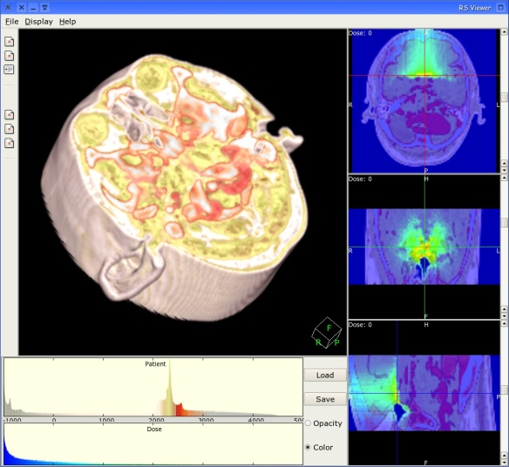
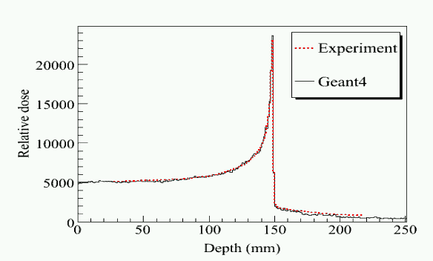
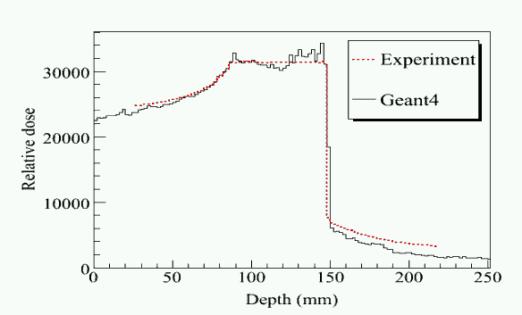
G4MED: Geant4 Medical Application
We provide the framework and software toolkit for simulation in radiotherapy
This software has following functions
  CT/MRI data conversion to the Geant4 simulation
  Simulation load sharing and data sharing with data grid technology
  Visualization
  Interactivity
  Web based interface
    Hospital is strongly protected by FW
  etc
Notes:
24

Slide 25
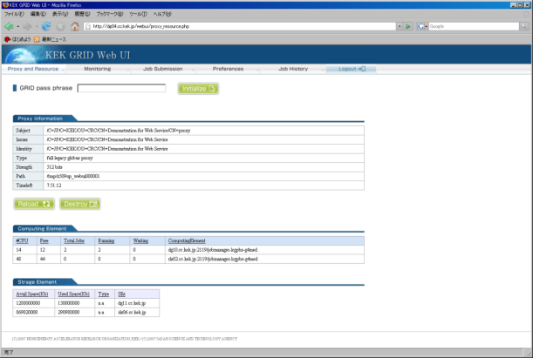
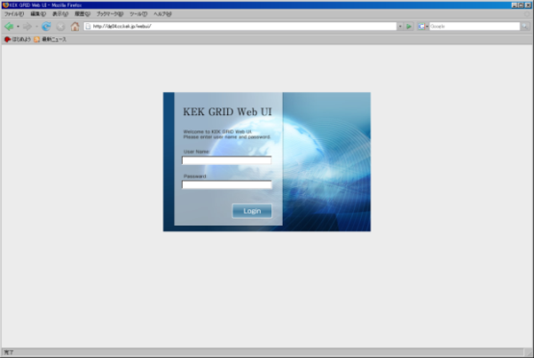
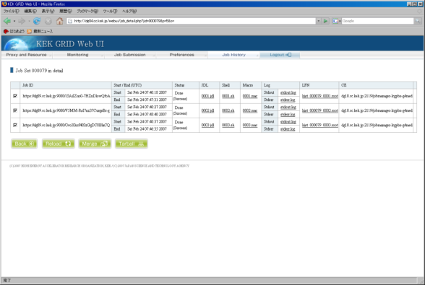
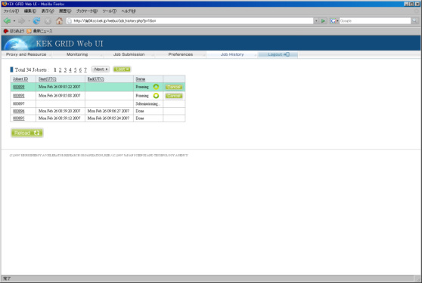
Screenshots of Web Interface
Proxy cert Creation
Login view
Job Status View
Job History View
Web Interface has been developed as the first practical implementation.
Job control and getting/viewing results are available only with web browser without any rich client.
Keep the developing to improve the usability and to integrate into other components.

Slide 26
High priority issues in LCG
CE and WN
  Migration to SL4 (WN, lcg-CE)
    Higher performance for the application
  Queue settings
    Always occupied by jobs, sometime jobs from ops are expired
  Migration to LSF
    Sharing resources with local user and grid user
    Most of batch system at KEK are using LSF
    Most of staffs have many knowhow
    Maui is a bit poor
SE integration
  Currently only disk in use
    A bit poor for us
    We want larger scale storage, e.g. TAPE system
  We are using DPM/SRM as a head node of SE
    Established to access HSM by using SRB-DSI, hopefully HPSS by using HPSS-DSI soon
      We can access to both SRB-DSI and HPSS-DSI via GridFTP, but not use LFC
  Keep the contact with application team at ASGC
Networking/Security
  Always tradeoff relationship between convenience and security
  Always important subject how to manage easily and quickly with security assurance
More robust and higher performance services
  Using VM
  Redundant design
    How? round robin DNS?

Slide 27

NAREGI
  - Beta-1: Activities at KEK
  - Beta-2: Current status

Slide 28
Introduction to NAREGI
NAREGI: NAtional REsearch Grid Initiative
  Foundation: 2003-2007 10 billion Yen for 5 years (Initial plan)
    extended to 2009
  Host institute: National Institute of Informatics (NII)
  Core collaborators:
    IMS(molecular science), AIST (industrial app.), TIT, Osaka, Hitachi, Fujitsu, NEC
Mission:
  R&D of the Grid middleware for research and industrial application toward the advanced infrastructure
  Primary target application is nano technology for innovative and intelligent materials production.
    More focused in the computing grid for linking supercomputer centers for coupled simulation of multi-scale physics
    Support heterogeneous computer architectures (vector & super parallel & clusters)
    Data grid part were integrated in 2005
Notes:
28

Slide 29
NAREGI Architecture
Complete set of Grid middleware
Advanced implementation of the OGF (GGF) standards to contribute for Grid world
OGSA-WSRF(WebServiceResoureFramework) compliant architecture based on Globus ToolKits 4.0 (GT2 in gLite)
  provides Web service interface components for various services
  not only resource brokering. resource reservation, co-allocation, and co-scheduling
  GGF JDSL 1.0 for job submission (JDL in gLite)
  Resource Information based on CIM standard schema (GLUE schema in gLite)
Security
  adopt VOMS/EGEE
Information service
  Service interface: OGSA-DAI (Data Access & Integration)
Adopt many standards
NAREGI beta-1 released in May 2006

Slide 30
NAREGI-beta1 at KEK
Testbed: 9 server nodes & 5 compute nodes
Middleware installation
  NAREGI-beta 1.0.1: Jun. 2006 - Nov. 2006
    Manual installation for all the steps
    Confirmed functionalities of Information Service, PSE (Problem Solving Environment), WFT (GUI Workflow Tool), GVS (Grid Visualization System)
  NAREGI-beta 1.0.2: Feb 2007
    DG comprehensive installation manual was released in Jan. 2007
Site federation test Sep. 2007
  KEK-NAREGI/NII
Job Tests with Application software
  Data analysis of ion scattering experiment
  Geant4 simulation with MPI
  Belle event simulation

Slide 31
Configuration of NAREGI Testbed at KEK
KEK FW
SINET
KEK
LAN
KEK-2
KEK-1
NAREGI
nrg00
nrg02
nrg01
nrg04
nrg09
nrg10
nrg11
nrg06
nrg03
Portal
Portal
Iinfo Serv
SuperSched
GridVM Serv
MetaData Serv
AccessManage
Gfarm
192.168.2.11 gfms
NAT/DNS
UMS/VOMS
Private network( .keknrg.jp)
IS
192.168.2.101~
SINET
SS
192.168.2.4: gvms
192.168.2.6: gwy
GridVM Eng
GridVM Ser
MDS
AMS.
AMS
Gfarm
NAT/DNS
UMS/VOMS
KEK Site

Slide 32
Data storage with Gfarm Test
Data Grid part is consist of Gfarm
  data files are stored in the multiple disk servers under the Gfarm file system
  Input and output data are stage-in and stage-out to the GFarm storage.
  Gfarm client installed in the Engine nodes (Worker nodes) can get access the data file through program read/write directly with no change in the application program (Belle event simulation).

Slide 33
Next Steps for us
NAREGI beta-2 released in Oct. 2007
  Under installation now
    Mostly done, but DG part still not yet
  Features
    “Easy” installation by apt-rpm
      Greatly improved
        Beta-1: 6 months
        Beta-2: 2 hours
        DG part is exclusive
    Interoperation with EGEE/gLite
      Job submission, Data exchange, Information exchange
    Various useful features for application
      GridMPI: MPI jobs linking over sites
      Burst job submission
      GridFTP interface to the Gfarm files
        Perhaps, expect to work with SRM
Release of NAREGI ver1.0 in Apr-May 2008

Slide 34
Summary (1/2)
2 systems are in operation as production.
  Main usage:
    KEK-1: R&D
    KEK-2: high quality services
NAREGI beta1 is installed and tested.
  being replaced with beta-2 very soon (this month)
Other services related on Grid
  KEK Grid CA
  VOMS
19,628 jobs have been processed, 176,100 CPU hours have been used in KEK last 2 years.
SITE | # of cores | SPEC (kSI2K) | Storage (TB) | # of jobs | CPU (kSI2K*hrs)
KEK-1 | 14 | 15 | 0.26/1.41 (18%) | 7,677 | 33,140
KEK-2 | 44 | 80 | 0.57/2.03 (28%) | 11,951 | 142,960
Notes:
34

Slide 35
Summary (2/2)
BELLE VO
  The GridFTP server plugged SRB-DSI is in operation.
    Succeed to establish access method of existing data by using GridFTP client from outside.
  Installation of belle library remotely, MC production is available at each site.
ILC/CALICE VO
  Triangle file sharing/transfer and job submission each among DESY, IN2P3 and KEK over the VO.
  FW
    Shigeo (Yashiro-san) talk about this issue on Thursday
The VO for the Accelerator Science in Japan (ppj)
  Installed and federated among 6 institutes, non-production sites mostly.
  Developing supporting system.
Geant4 Medical Application VO
  Web Interface has been developed.
  Job control and getting/viewing results are available only with web browser.
NAREGI beta-2 has been released
  We are installing and testing now
VO | # of cores | SPEC (kSI2K) | Storage (TB) | # of jobs | CPU (kSI2K*hrs)
BELLE | 883 | 1,260 | 5.94/22.5 (26%) | 12,417 | 220,809
ILC | 32,793 | 35,384 | 12.6/68.4 (18%) | 150,269 | 323,251
CALICE | 13,469 | 15,140 | 15.6/204 (7.6%) | 145,776 | 338,531
Notes:
35

Slide 36
Items to be continued
“KEK new Grid system” given by Koichi Murakami on Wednesday
  CE and WN
    Migration to LSF
      Sharing resources with local user and grid user
      Most of batch system at KEK are using LSF
      Most of staffs have many knowhow
  SE integration
    We are using SRM as head node of SE
      Established to access HSM by using SRB-DSI, hopefully HPSS by using HPSS-DSI soon
        We can access to both SRB-DSI and HPSS-DSI via GridFTP, but not use LFC
  More robust and higher performance services
    Using VM
    Redundant design
“Discussion on security issue on GRID system and network operation” given by Shigeo Yashiro on Thursday
  Networking/Security
    We are planning to change the network configuration logically for more flexible operation

Slide 37
Acknowledge
Daily operation
  All members of APROC (ASGC)
  All of ROCs
  K. Ishikawa, M. Matsui (ISE Co., Ltd)
Belle virtual organization
  K. Inami, M. Kaga (Nagoya Univ.)
  P. Lason (CYFRONET)
  J. Shih, M. Tsai (ASGC)
  M. Rosa, G. Moloney (Univ. of Melbourne)
  S. Lee (Korea University)
ILC/Calice virtual organization
  R. Poeschl (LAL)
  A. Miyamoto (KEK)
  People in DESY-IT
Accelerator Science
  M. Fujii, Y. Nagasaka (Hiroshima-IT)
  J. Ebihara, K. Yamada (Soum Co.,Ltd)
  Y. Takeuchi (Univ. of Tsukuba)
  K. Kawagoe (Kobe University)
  T. Nagamine (Tohoku Univ.)
Many thanks for your attention

