Slide 1
LHC Upgrade Options
Lucio Rossi
CERN
Grenoble 23 July 2011, HEP-EPS

Slide 2
Content
Where we are for LHC ?
Scope of HL-LHC
Main technologies
HL-LHC and the FP7 HiLumi LHC Design Study
  The program
  A global collaboration
HE-LHC
  The aim
  The challenges

Slide 3
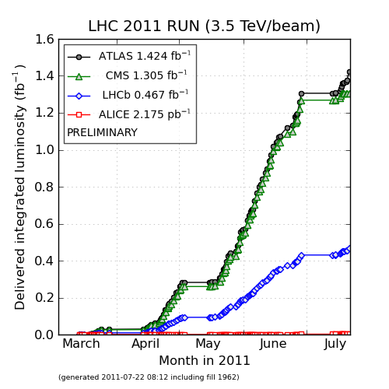
Lumi today
Peak lumi:
50-70 pb⁻¹/fill

Slide 4
How the luminosity might evolve here we assume we saturate at nominal
Data from M. Lamont
Not validated by LMC

Slide 5
How the luminosity might evolve cont.
Data from M. Lamont
NOT validated in LMC
220 inv fb by
end of 2020

Slide 6
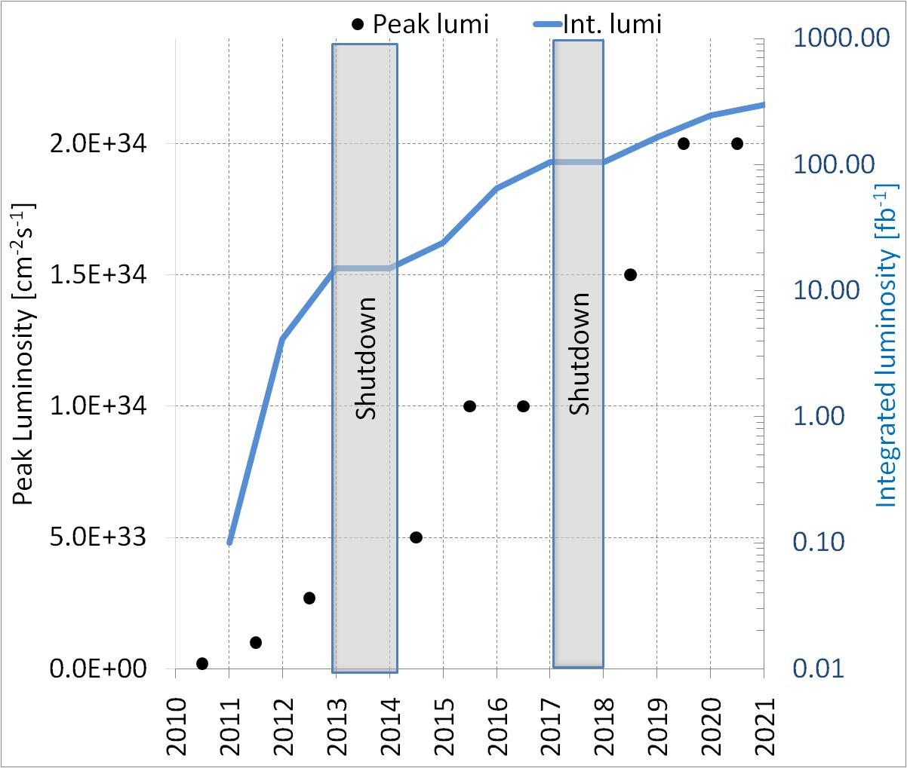
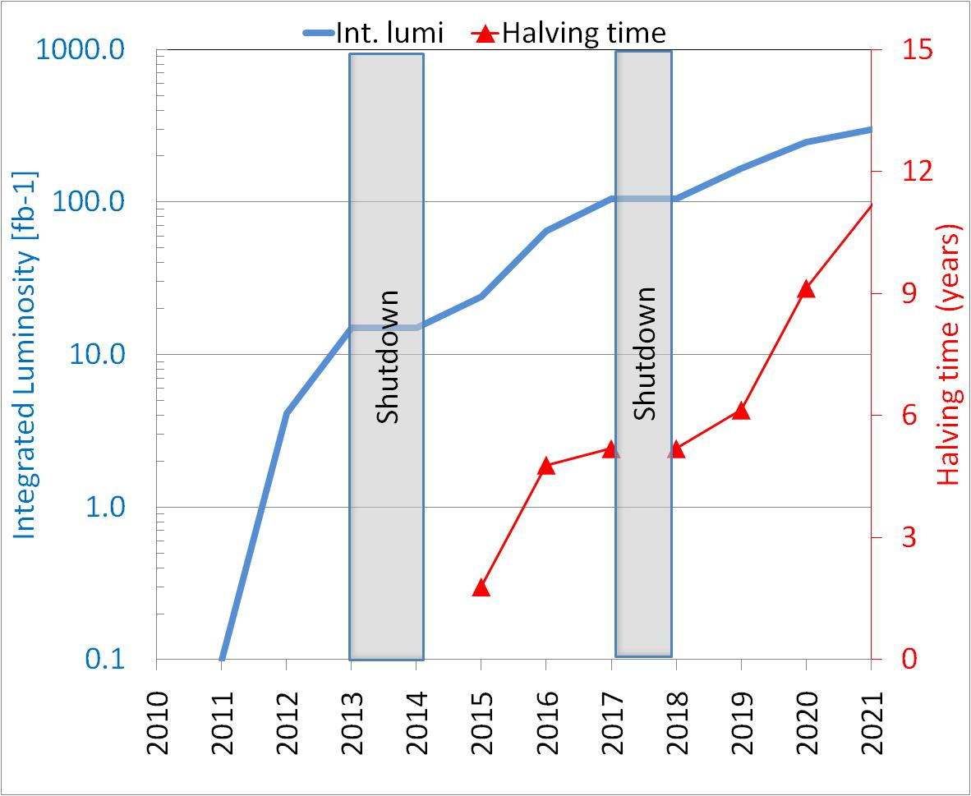
Lumi evolution: more otpimistic
(ultimate=2xnominal) is reached
Data from M. Lamont
NOT validated in LMC
In such case we may reach 320 inv. fb for end of 2020.
If LHC performs « nominal »: the upgrade is required by the saturation
If LHC performs better, saturation is 2 years later, but radiation limits may come in earlier

Slide 7
The goal of HL-LHC
(Installing hardware in 2021-22 in LS3)
The main objective of HL-LHC is to implement a hardware configuration and a set of beam parameters that will allow the LHC to reach the following targets:
A peak luminosity of 5×10³⁴ cm⁻²s⁻¹ with levelling, allowing:
An integrated luminosity of 250 fb⁻¹ per year, enabling the goal of 3000 fb⁻¹ twelve years after the upgrade. This luminosity is more than ten times the luminosity reach of the first 10 years of the LHC lifetime.
allow design for lower peak L, less pile up
less peak heat deposition ( a factor 2 may be critical especially in the quad triplet)

Slide 8
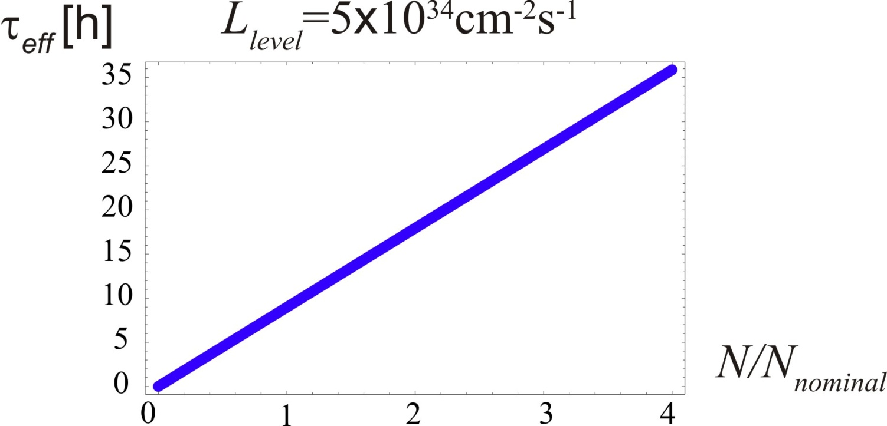
Upgrade Considerations: Beam Lifetime
F. Zimmermann, Chamonix 2011
For given luminosity τ_{eff} scales with total beam current
N(t) = (1-t/τ_{eff}) N_{tot}
(σ=100 mbarn)
argument for HL-LHC scenarios with maximum beam current
τ_{eff} = 13.9 hours for 5 10¹⁴ p/beam
LIU-HL-LHC Brainstorming meeting, CERN, 24 June 2011
Oliver Brüning BE-ABP
8

Slide 9
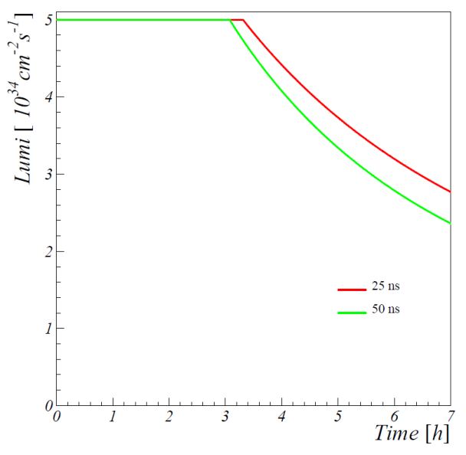
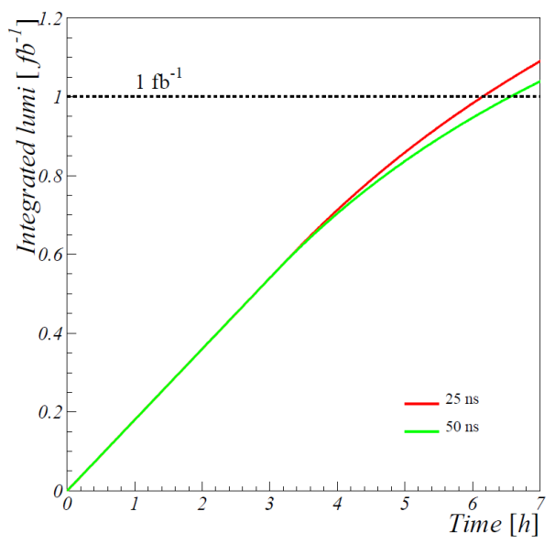
Upgrade Considerations: Integrated Luminosity
Integrated luminosity: run with luminosity decay
[Stephane Fartoukh]
assuming no emittance growth over the fill ➔ the emittance growth due to IBS and beam-beam is compensated by radiation damping
L_{int} = ca 0.4 fb⁻¹ over 3 h for a luminosity decay to 2.5 10³⁴ cm⁻² s⁻¹
LIU-HL-LHC Brainstorming meeting, CERN, 24 June 2011
Oliver Brüning BE-ABP
9

Slide 10
Here the critical zone a lot of magnet change… but not only
Crab cavities
ATLAS
CMS
2. We need to touch deeply also the matching section
1. Changing the interaction region is not enough
3. For collimation we would like (may be) to change also this part, DS in the continous cryostat

Slide 11
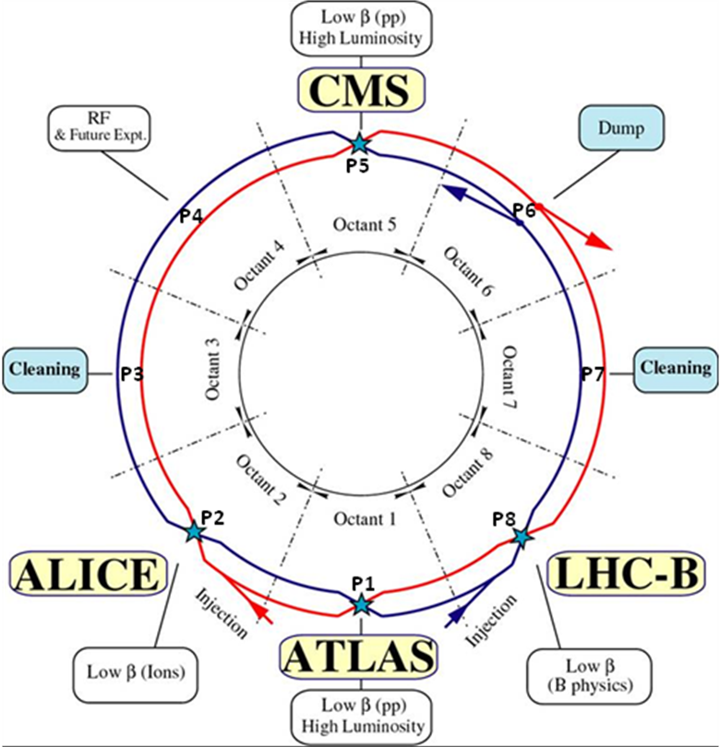
The path toward high lumi
From Chamonix 2011:
Integrate also LHCb and Alice in the upgrade picture (so far they were not)
The shutdown scheme has been shifted of one year : a resource loaded plan under preparation, the length of shutdown(s) is critical
the assessment of what are the LHC bottlenecks is critical
  collimation
  e-clouds
  Beam tune shift due to collision
  R2E real limitation
  Heat deposition and cryogenic limits

Slide 12
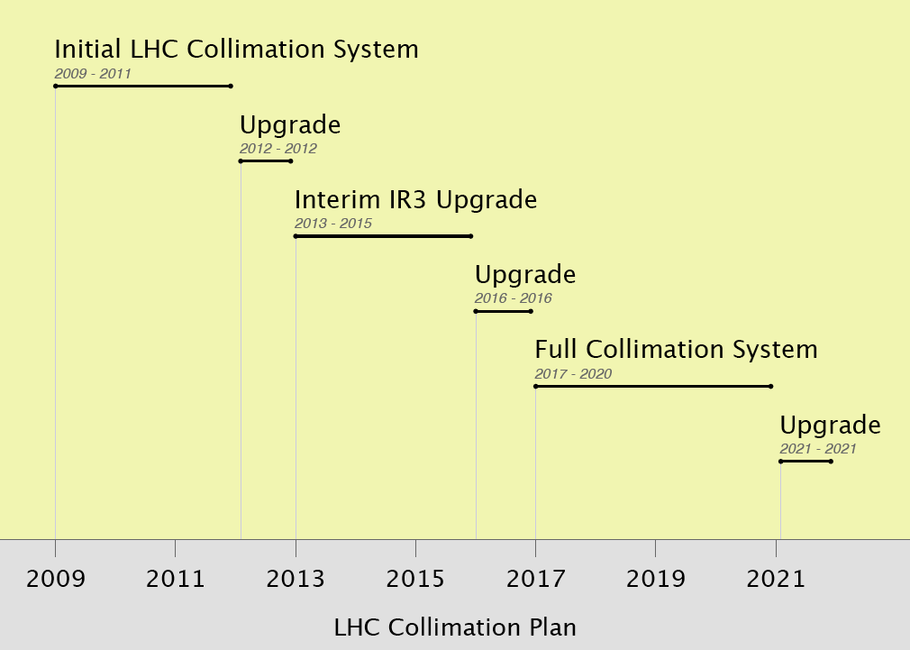
From R. Assman in 2010
≤ 50% I_{nom} @ 3.5 TeV
β* ≈ 2m
HL-LHC WP5:
Upgrades as required for HL-LHC upgrade
But today we are at 1.4 m
Going soon to 1 m
≤ 100% I_{nom} @ 7.0 TeV
β* ≈ 1m
≥ 160% I_{nom} at
7.0 TeV
β* ≈ 55cm

Slide 13
Preparation for upgrade the technologies
In any case, how good or less good could be the performance, changing the machine to reach potentially 10³⁵ and then levelling at
5 10³⁴ takes a lot of time:
10 years wotk is not a luxury: HL-LHC is a jump in hadrton colider technology
  High field magnets
  Sc crab cavities
  Extreme collimation in the collision points (and DS)
  Sc links to remove problem of R2E to power supply

Slide 14
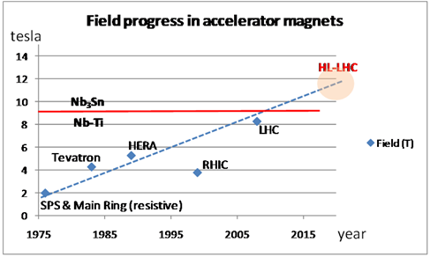
Squeezing the beam
High Field SC Magnets
13 T, 150 mm aperture Quads for the inner triplet
  LHC: 8 T, 70 mm.
  sLHC-PP: 8.5 T 120 mm
More focus strength, β* as low as 15 cm (55 cm in LHC). In some scheme even β* down to 7.5 cm are considered
Dipole separators capable of 6-8 T with 150-180 mm aperture (LHC: 1.8 T, 70 mm)

Slide 15

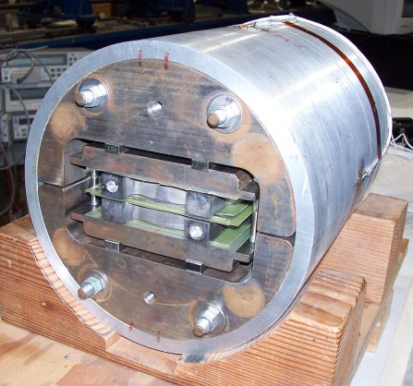
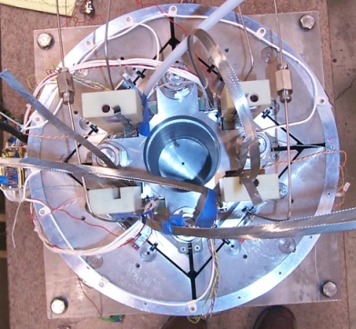
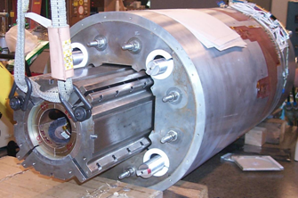
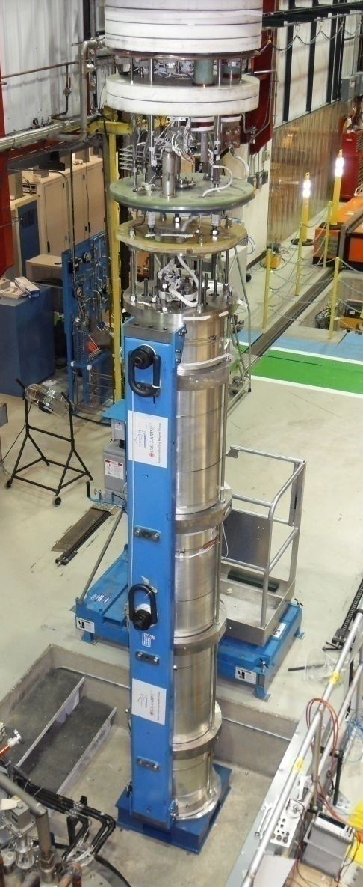
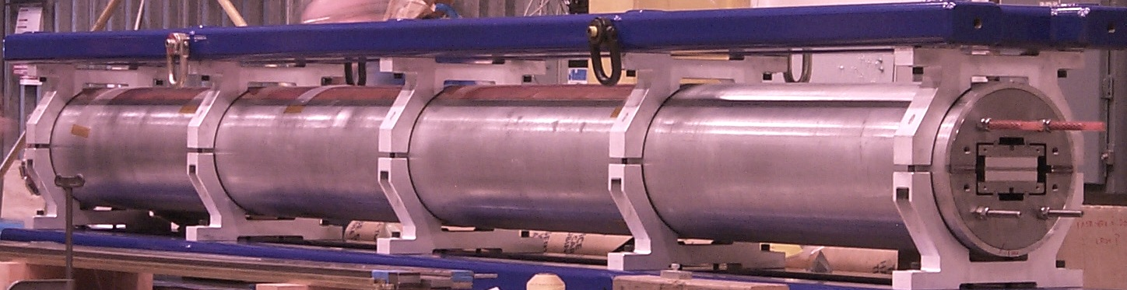
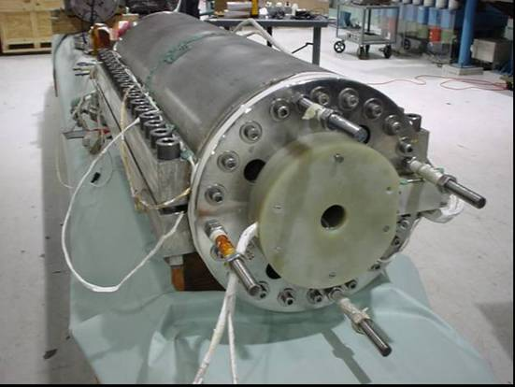
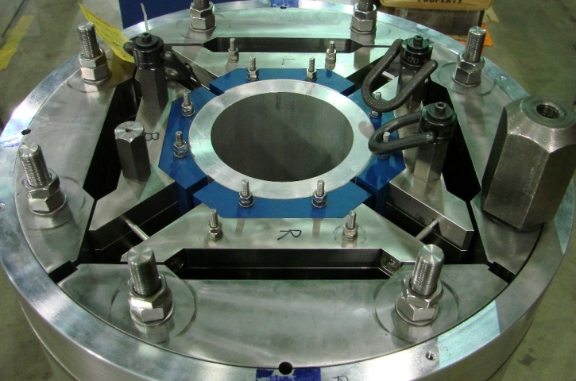
LARP (US LHC program) Magnets
SM
SQ
TQS
LQS-4m
LR
TQC
HQ

Slide 16
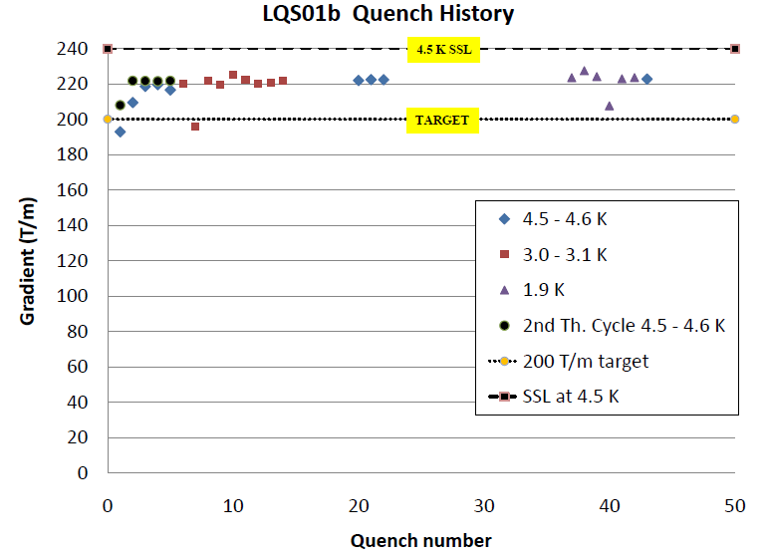
Results LARP LQ (90 mm vs 70 mm LHC)
LHC equivalent today

Slide 17
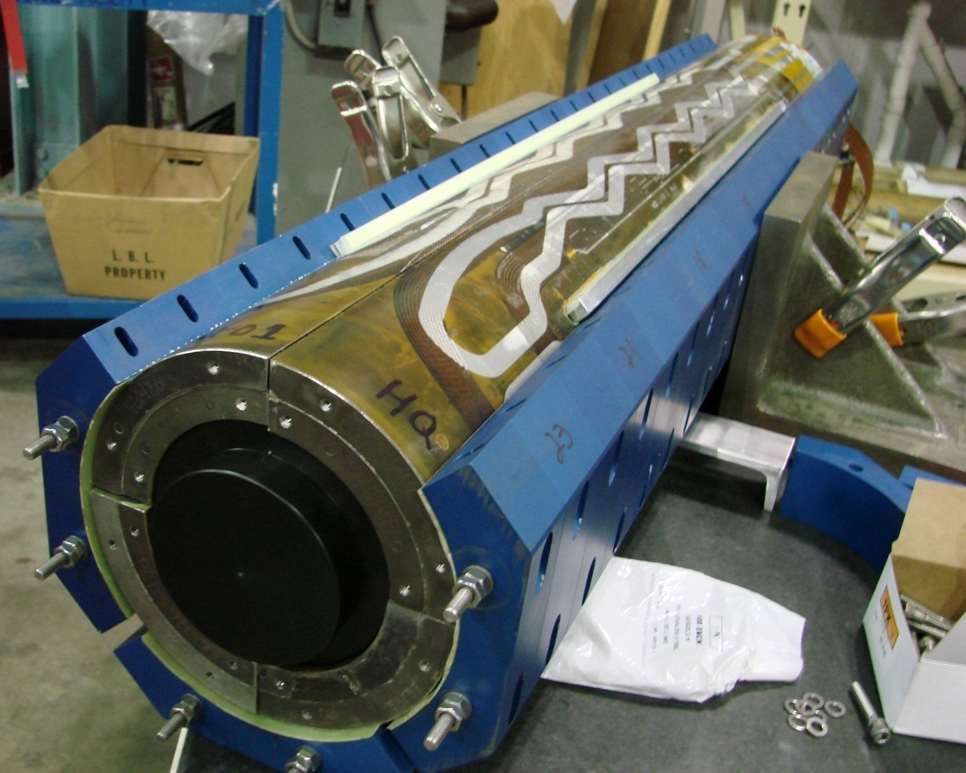
Coils Assembly and Alignment
Alignment Keys
Coil & heater
Collars

Slide 18
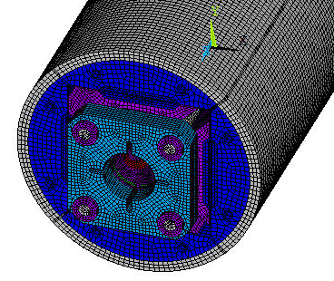
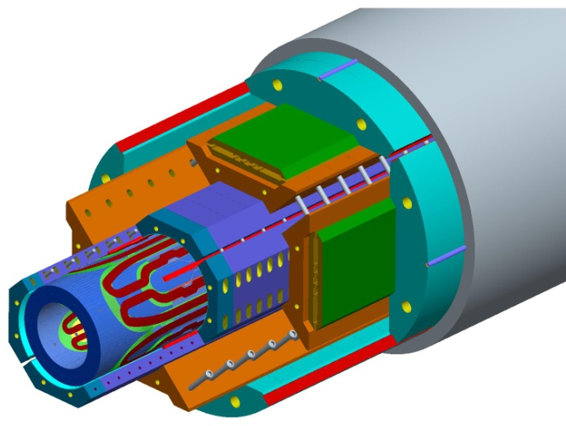
ANSYS 3D Analysis
Axial pre-load
Azimuthal pre-load
Cool-down
Excitation
Low pre-stress during assembly
Cool-down and high pre-stress
No stress overshoot
Reusable structural components

Slide 19
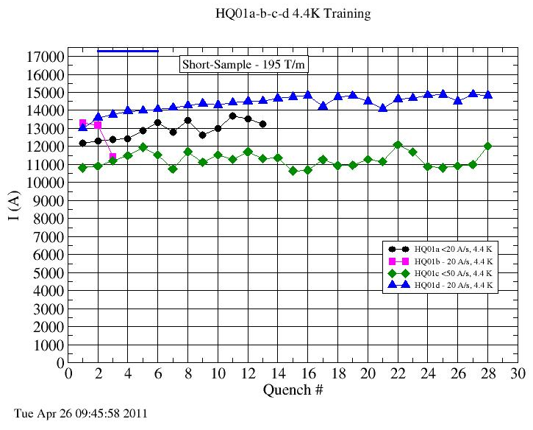
HQ01 Training (4.4K)
HQ01a
13683A (157T/m, 79% of ss)
coils 1,2,3,4
HQ01b
13308A (153T/m, 77% of ss)
coils 1,4,5,6
HQ01c
11953A (138T/m, 70% of ss)
coils 1,5,7,8
HQ01d
14983A (170T/m, 86% of ss)
coils 5,7,8,9
HL-LHC technology 170 T/m – 13 T
LHC technology 120 T/m - 8.5 T

Slide 20
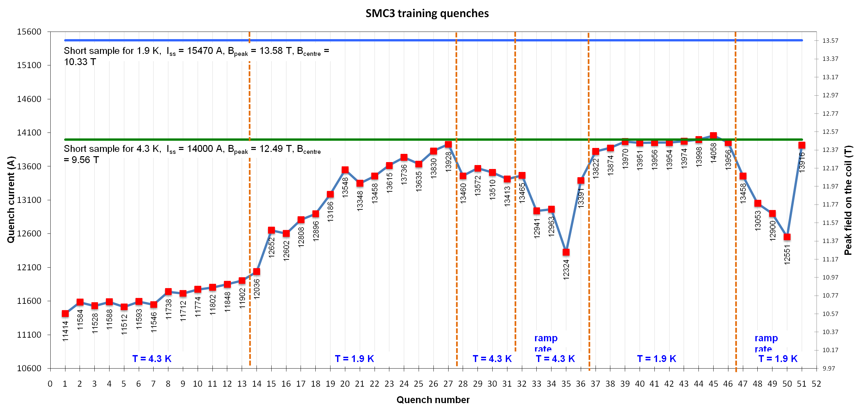
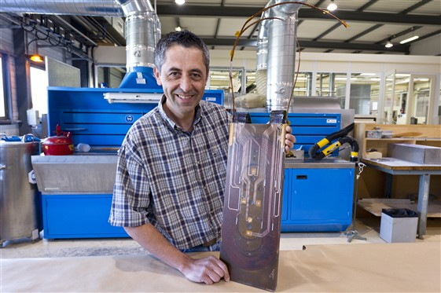
CERN: recent achievement of 12.5 T at 4.2 K in a (first) 400 mm Nb₃Sn coil!
12.5 tesla level
10 tesla level

Slide 21
crossing angle reduces the luminosity
θ_{c}
F. Zimmermann & R. Calaga
_{z}
luminosity loss comes from imperfect geometric overlap
it becomes significant if σ_{z}θ_{c}/2>σ_{x}* or φ_{piw}>1 with φ_{piw}= σ_{z}θ_{c}/(2σ_{x}*) the “Piwinski angle”

Slide 22
crab crossing restores bunch overlap
θ_{c}
F. Zimmermann & R. Calaga
RF crab cavity deflects head and tail in opposite direction so that collision is effectively “head on” for luminosity and tune shift
bunch centroids still cross at an angle (easy separation)
1st proposed in 1988, in operation at KEKB since 2007 → world record luminosity!

Slide 23
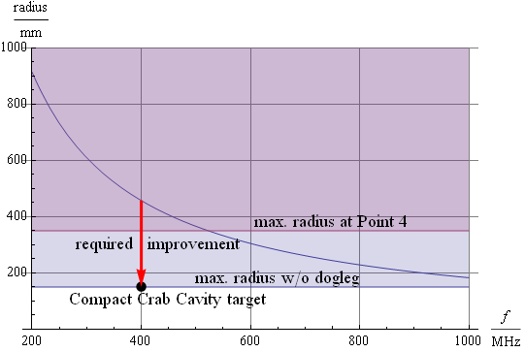
Improve beam overlap
SC RF Crab cavities
Crab cavities to rotate the beam and colliding with good overlap
Providing « easy » way for levelling
Necessary to fully profit of the low β*
Very demanding phase control (better than 0.001°) and protection
Very compact design
40-80 MV (16 MV in LHC)

Slide 24
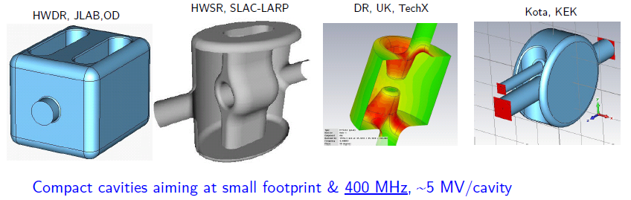
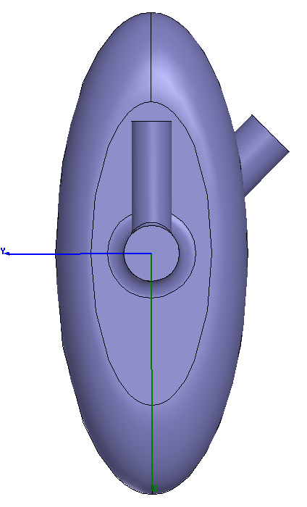
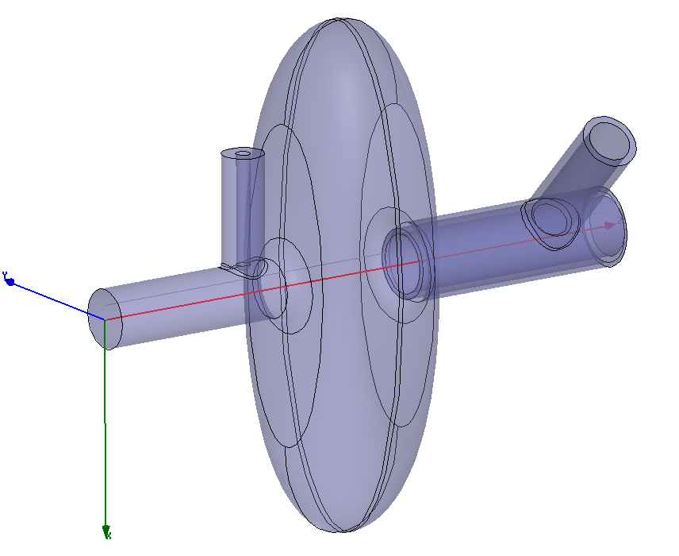
Compact 400 MHz
Completely new domain
Technical space for He tank, etc..
All these 400 MHz can fit into the standard 194 mm LHC beam separation with cavities in a common cryostat (but not easy…)
LHC
pipe1
LHC
pipe2
New idea for a very compact elliptical 800 MHz
194 mm

Slide 25
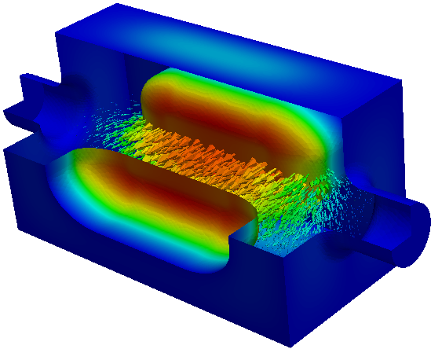
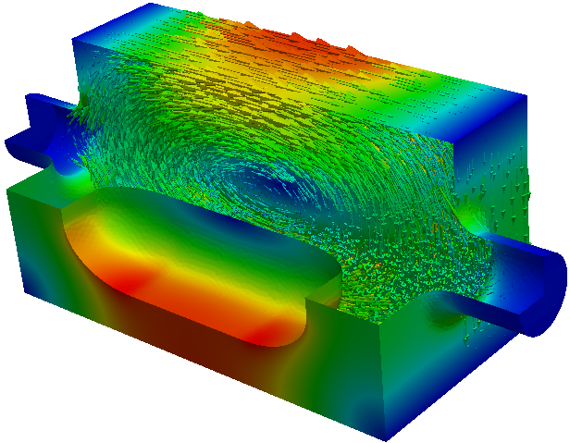
New Ridged waveguide deflector (Z. Li, SLAC)
Operating mode Frequency | 400 MHz
Operating Mode | TE11 like mode
Lowest acc mode Frequency | 671 MHz
Lowest vertical HOM Frequency | 617 MHz
Lowest horizontal HOM Frequency | 698 MHz
Iris aperture (diameter) | 84 mm
Transverse dimension | 250 mm
Vertical dimension | 270 mm
Longitudinal dimension | 525 mm
Transverse Shunt Impedance | 330 ohm/cavity
Required deflecting voltage per cavity | 5 MV
Peak surface magnetic field | 94 mT
Peak surface electric field | 45 MV/m
Transverse dimension: 250mmX270mm
Fit both H and V crabbing schemes

Slide 26
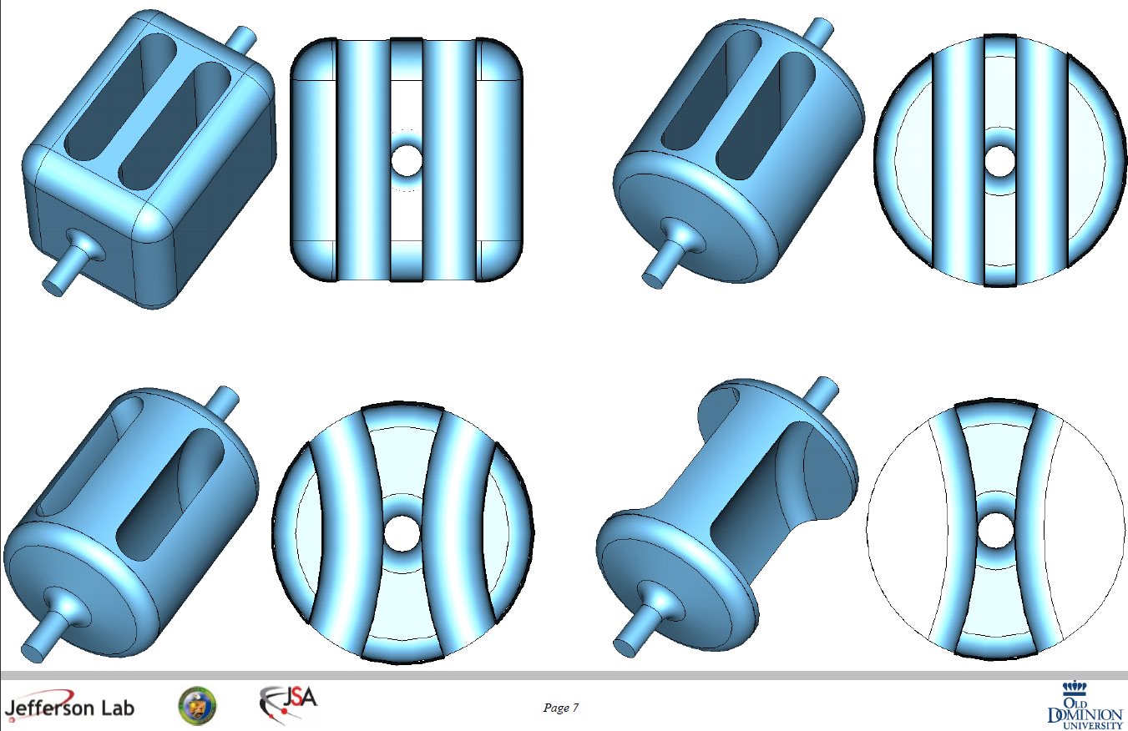
Evolution of the parallel bar design into a ridged deflector (J. Delayen, ODU)

Slide 27
News on Crab Cavities
The two designs by Zenghai Li (SLAC) and Jean Delayen (ODU) are now similar and it was agreed in Montauk (US-LARP meeting, May ‘11) that they will join forces to work on a single design!

Slide 28
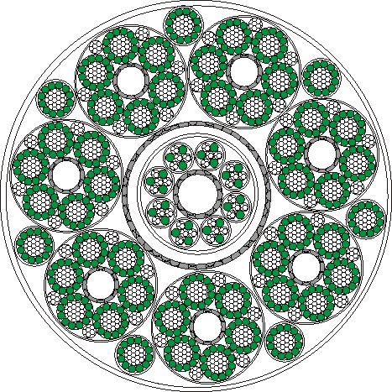
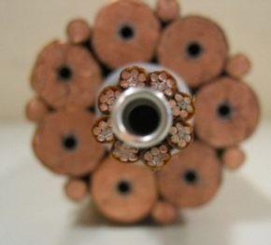
R2E: Removal of Power Converter (200kA-5 kV SC cable, 100 m height)
Φ = 62 mm
MgB2
(or other HTS)
7 × 14 kA, 7 × 3 kA and 8 × 0.6 kA cables – Itot∼120 kA @ 30 K
Also DFBs (current lead boxses) removed to surface
Definitive solution to R2E problem – in some points
Make room for shielding un-movable electronics
Make much easier maintenance and application of ALARA

Slide 29
Technical reasons for the upgrade
(or at least for important improve)
The zone of the triplets will wear out
  Radiation damage limit (300-400 fb⁻¹ ? More?)
  Hardware and shielding that has not been really optimized for very high radiation
    Better and increased shielding of the triplet and other elements
    Better design (absorbers, TAS) also for background
    Removing power supply, longer lines, necessity of a re-layout
  Necessity to increase to heat removal capacity
    Restoring cooling capacity in IR5 Left and decouple RF from Magnets in 2017
    Local removal (inside triplet) and transport away
    Cooling capacity
    Cooling sectorization (complete decoupling of IRs form Arcs: this will allow more budget for e-clouds, 25 ns will may re-favourite)

Slide 30
HL-LHC Performance Estimates
nominal bunch length and minimum β*: ‘HL-LHC Kickoff+’
minimum β*
5.6 10¹⁴ and 4.6 10¹⁴
p/beam
Parameter | nominal | 25ns | 50ns
N | 1.15E+11 | 2.0E+11 | 3.3E+11
n_{b} | 2808 | 2808 | 1404
beam current [A] | 0.58 | 1.02 | 0.84
x-ing angle [μrad] | 300 | 475 | 520
beam separation [σ] | 10 | 10 | 10
β* [m] | 0.55 | 0.15 | 0.15
ε_{n} [μm] | 3.75 | 2.5 | 3.0
ε_{L} [eVs] | 2.51 | 2.5 | 2.5
energy spread | 1.00E-04 | 1.00E-04 | 1.00E-04
bunch length [m] | 7.50E-02 | 7.50E-02 | 7.50E-02
IBS horizontal [h] | 80 -> 106 | 25 | 17
IBS longitudinal [h] | 61 -> 60 | 21 | 16
Piwinski parameter | 0.68 | 2.5 | 2.5
geom. reduction | 0.83 | 0.37 | 0.37
beam-beam / IP | 3.10E-03 | 3.9E-03 | 5.0E-03
Peak Luminosity | 1 10³⁴ | 7.4 10³⁴ | 8.4 10³⁴
sufficient room for leveling
(with Crab Cavities)
Virtual luminosity (25ns) of
L = 7.4 / 0.37 10³⁴ cm⁻² s⁻¹
= 20 10³⁴ cm⁻² s⁻¹ (‘k’ = 4)
Virtual luminosity (25ns) of
L = 8.4 / 0.37 10³⁴ cm⁻² s⁻¹
= 22.7 10³⁴ cm⁻² s⁻¹ (‘k’ = 4.5)
OK for HL goals (‘k’ = 4)
(Even better if emittances can be further reduced:
still a factor 1.2 to 2.5
wrt beam-beam limit)
(Leveled to 5 10³⁴ cm⁻² s⁻¹)
Events / crossing | 19 | 141 | 257 | 95 | 190
LIU-HL-LHC Brainstorming meeting, CERN, 24 June 2011
Oliver Brüning BE-ABP
30
Notes:
50ns beam option provides HL-LHC performance levels at ultimate total beam currents; only the ‘large beta*’ option reaches beam-beam limit; IBS growth rates are a concern!; low beta option has 50% higher performance potential

Slide 31
HL-LHC Performance Estimates
nominal bunch length and LIU estimates for injector complex:
minimum β*
Parameter | nominal | 25ns | 50ns
N | 1.15E+11 | 1.7E+11 | 2.5E+11
n_{b} | 2808 | 2808 | 1404
beam current [A] | 0.58 | 0.86 | 0.64
x-ing angle [μrad] | 300 | 480 | 430
beam separation [σ] | 10 | 10 | 10
β* [m] | 0.55 | 0.15 | 0.15
ε_{n} [μm] | 3.75 | 2.5 | 2.0
ε_{L} [eVs] | 2.51 | 2.5 | 2.5
energy spread | 1.00E-04 | 1.00E-04 | 1.00E-04
bunch length [m] | 7.50E-02 | 7.50E-02 | 7.50E-02
IBS horizontal [h] | 80 -> 106 | 25 | 10
IBS longitudinal [h] | 61 -> 60 | 21 | 13
Piwinski parameter | 0.68 | 2.56 | 2.56
geom. reduction | 0.83 | 0.37 | 0.36
beam-beam / IP | 3.10E-03 | 3.0E-03 | 5.6E-03
Peak Luminosity | 1 10³⁴ | 5.3 10³⁴ | 7.2 10³⁴
4.8 10¹⁴ and 3.5 10¹⁴
p/beam
intensity and leveling room
marginal
Virtual luminosity of
L = 5.3 / 0.36 10³⁴ cm⁻² s⁻¹
= 14 10³⁴ cm⁻² s⁻¹ (‘k’ = 2.8)
L = 7.2 / 0.36 10³⁴ cm⁻² s⁻¹
= 20 10³⁴ cm⁻² s⁻¹ (‘k’ = 4)
IBS growth rates need to be re-evaluated for ATS optics!
25ns slightly short of HL goals (k < 4)
50ns requires > 80% machine efficiency
Events / crossing | 19 | 101 | 274 | 95 | 190
LIU-HL-LHC Brainstorming meeting, CERN, 24 June 2011
Oliver Brüning BE-ABP
31
Notes:
50ns beam option provides HL-LHC performance levels at ultimate total beam currents; only the ‘large beta*’ option reaches beam-beam limit; IBS growth rates are a concern!; low beta option has 50% higher performance potential

Slide 32
Upgrade Considerations: Integrated Luminosity
LIU 25ns goal: 25ns; 4.8 10¹⁴ p/beam k = 2.8
  τ_{eff} = 13.3 h and leveling time: 5.4 h
  Turnaround time: 5.4h + 3h + 5h = 13.4h ➔ 1.8 fills /day
  L_{int} / fill = 1 fb⁻¹ + 0.4 fb⁻¹
  60% efficiency on 150 days ➔ 225 fb⁻¹
LIU 50ns goal: 3.5 10¹⁴ p/beam k = 4
  τ_{eff} = 9.7 h and leveling time: 4.9 h
  Turnaround time: 4.9h + 3h + 5h = 12.9h ➔ 1.9 fills /day
  L_{int} / fill = 0.9 fb⁻¹ + 0.4 fb⁻¹
  60% efficiency on 150 days ➔ 115 fb⁻¹
LIU-HL-LHC Brainstorming meeting, CERN, 24 June 2011
Oliver Brüning BE-ABP
32

Slide 33
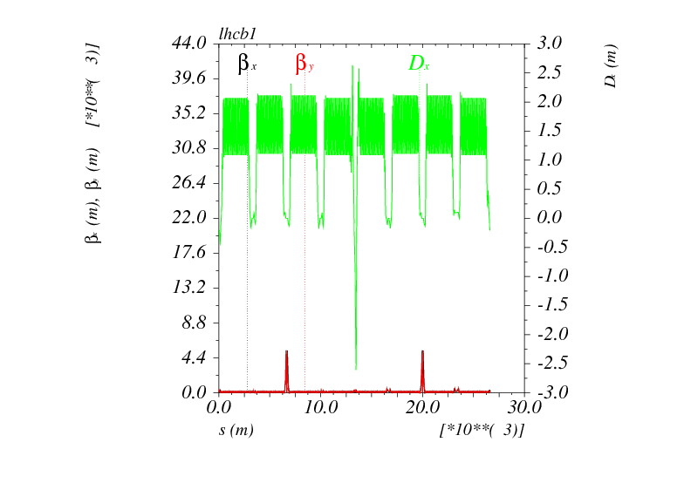
Pre-squeezed optics: β* = 60 cm in IR1 and IR5: “1111”
Similar to the nominal LHC
NEW scheme ATS:
It may improve present LHC
S. Fartoukh, sLHC-PR0049 & LMC 21/07/2010
R. D. Maria, S. Fartoukh, sLHC-PR0050
2011 MD: works excellently
S. Fartouk at IPAC2011 !!
Nominal β_{arc} (180m) in s45/56/81/12

Slide 34
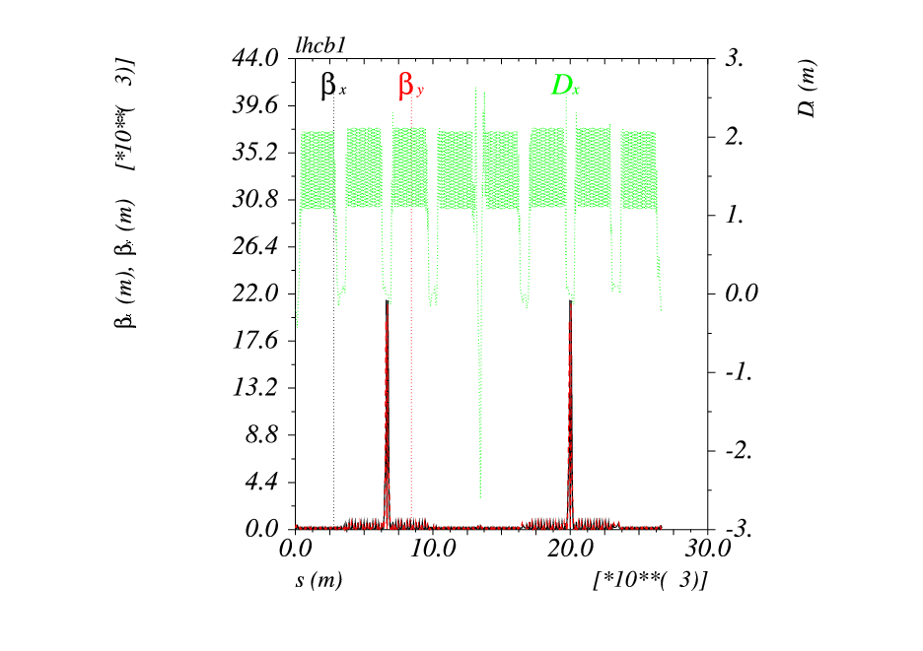
Squeezed optics (round): β* = 15 cm in IR1 and IR5: “4444”
HL-LHC with round optics
(preferable with crabs)
β_{arc} increased by a factor of 4 in s45/56/81/12

Slide 35
HL-LHC composition
Matching section and correctors
Collimation
Project
High Field Magnets R&D
Beam Diagnostics
HE-LHC Studies
Hardware Commissioning

Slide 36
Large participation FP7 HiLumi application 25 Nov 2010

Slide 37
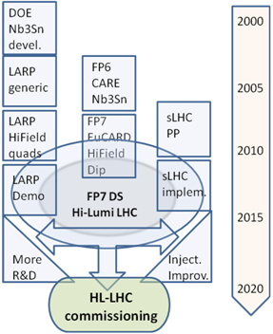
HiLumi is the focal point of 20 years of converging International collaboration
The collaboration wiht US on LHC upgrade started during the construction of LHC
EU programs have been instrumental in federating all EU efforts
With Hi-Lumi the coordination makes a step further: from coordinated R&D to a common project
CERN is not anymore the unique owner, rather is the motor and cathalizer of a wider effort.
Managed like a large detector collaboration (with CERN in special position as operator of LHC)

Slide 38
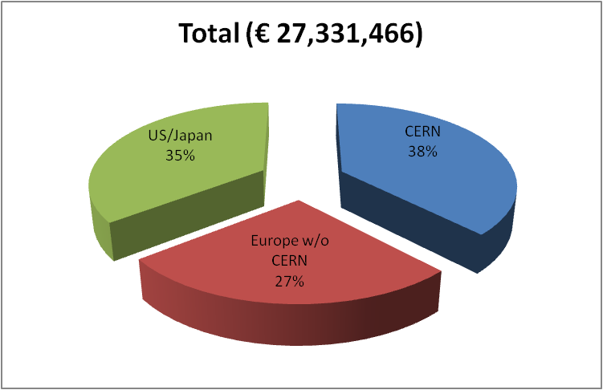
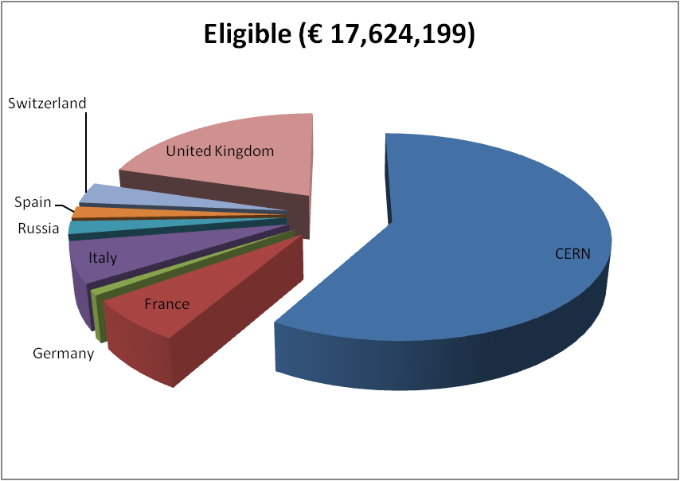
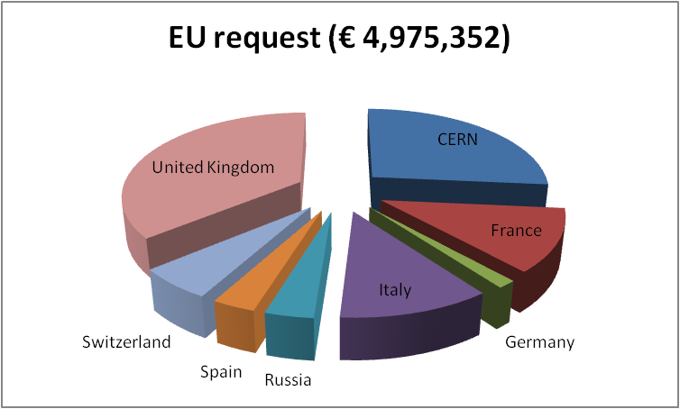
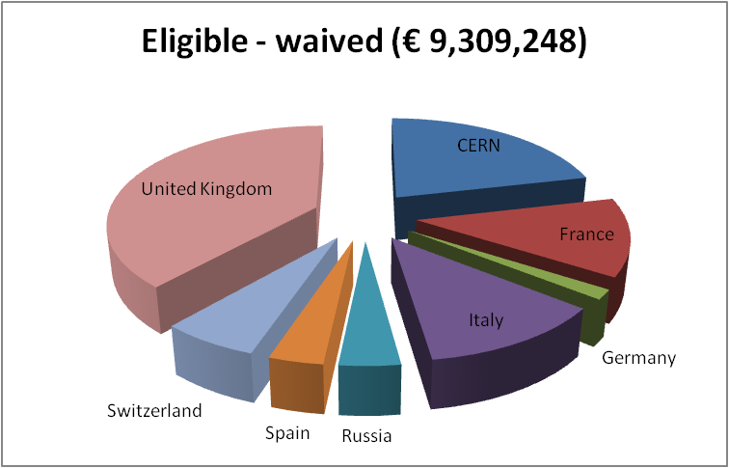
Budget FP7 HiLumi
CERN waives all technical works:
LHC is core program.
Only kept the CERN cost for managem.
Only EU research area
Perfect score 15/15, 100% budget
Waiving effect
50%
85% of CERN gen. mngt

Slide 39
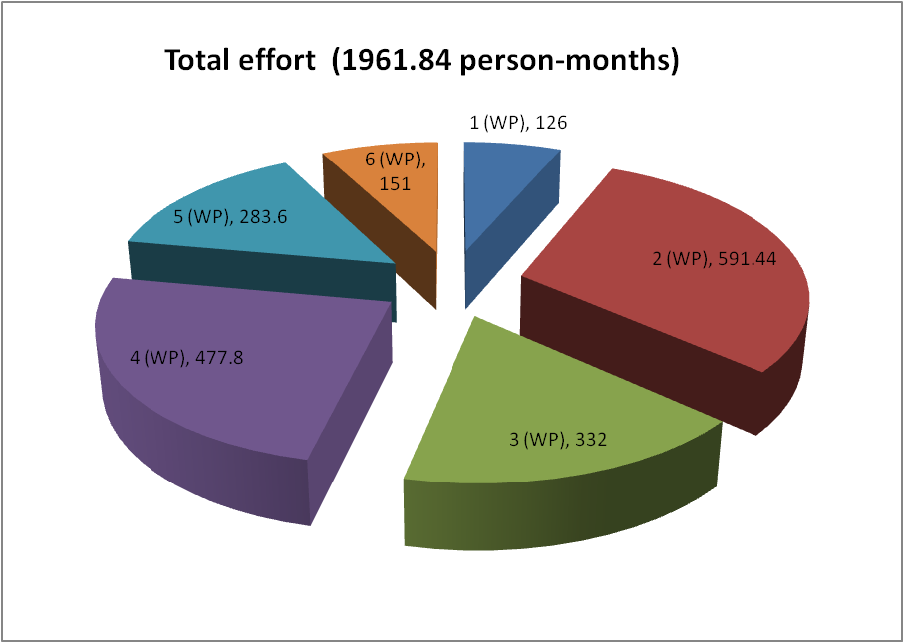
Budgetfor FP7 HiLumi Design Study and for total HL-LHC project
Personnel for HiLumi by WP
Manag and Tech. Coord. (6%)
Acc. Physics and beam
Magnets for IR
Crab Cavities
Collimators
Sc links
Estimated cost for the the whole HL-LHC over 10 years in M€

Slide 40
HL-LHC management

Slide 41
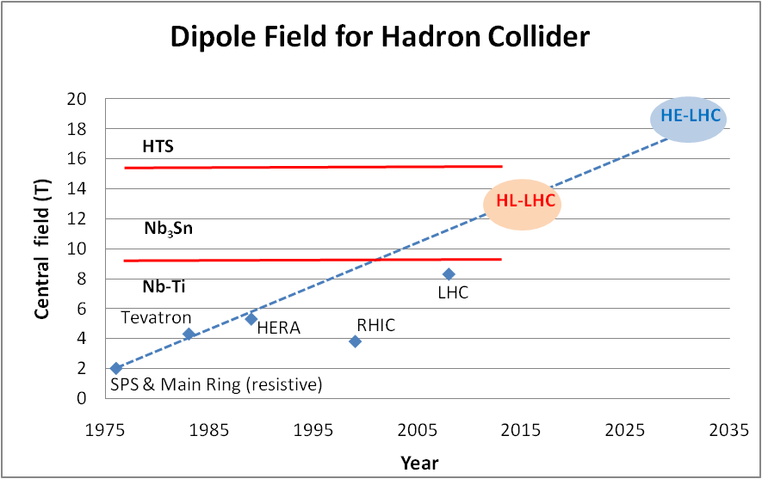
Is there a further exploitation of the LHC tunnel and infrastructure?
We need to go faster than for LHC.
But LHC « suffered » from LEP and LEP II endeavour

Slide 42
Evolution in magnet size
All coils in cosθ shape
J_{overall} is about the same 350 A/mm2 !
Too low J, too big coil
Very high density
⇒ low field (see later)
⇒ low copper for stabilization and protection
All good designs fall within ± 10%
2010s
2000s
1990s
1980s
For a perfect dipole with current J cosϑ, the field scales with the current density and coil thickness Δa : B ∝ J ⋅Δa

Slide 43
The Superconductor « space »
Nb-Ti
Nb₃Sn
HTS

Slide 44
Look back at LHC timeline
(SC magnet dominated)
9 T - 1 m single bore
10 T-1m Nb3Sn dipole
9 T -10 m long protoype
9 T-15 m final protoype
Last LHC dipole
1985 1987 1990 1994 2000 2006 2010
LHC study
Decision for Nb-Ti
Industry contracts Nb-Ti
LHC start-up

Slide 45
What is the possibile for HE-LHC?
US basic programs and LARP R&D
EU FP6-CARE-NED
EuCARD 13 T large dipole+ 18 T small insert
US 13 T Quads FP7-HiLumi
US NbSn-HTS development
US 16 T small dipole
LARP 11 T long quad
EuCARD R&D
15-20 T R&D dipole models and prototypes
15-20 T dip final proto & Industrialization
Final delivery Magnets HE-LHC
2005 2010 2015 2020 2025 2030 2035
EuCARD2 full bore dipole HTS
HE-LHC preliminary study
HTS for HE-LHC: yes.or.no
Industry contracts, start constrution
HE-LHC start-up

Slide 46
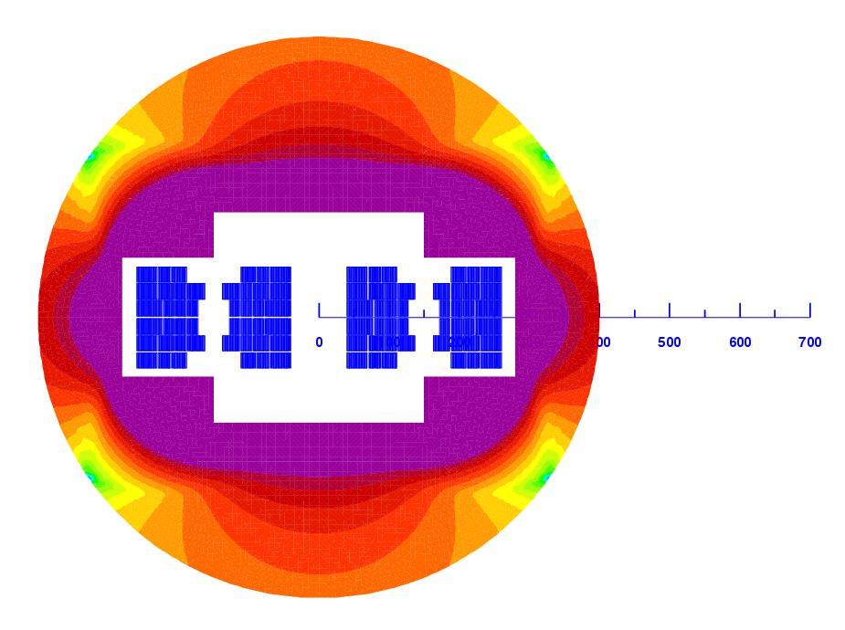
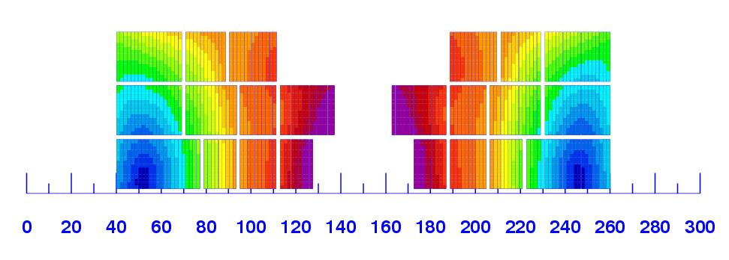
Malta Workshop: HE-LHC @ 33 TeV c.o.m.
14-16 October 2010
Magnet design: very challanging but not impossible. 300 mm
Work with multiple power supply.
Work for 4 years to assess HTS for 2X20T: to open the way to 16.5 T/beam .
Otherwise limit field to 15.5 T for 2x13 TeV
Higher INJ energy is desirable (2xSPS)
The synchrotron light emission is not a stopper: we can deal with it by operating the beam screen at 60 K.
The beam physics may appear even « easier » than LHC thanks to dumping time.
Collimation is amny be not more difficutl than HL-LHC.
The big problem apart magnet technology is beam handling for INJ & beam dump: new kicker technology is needed.

Slide 47
Conclusion
HL-LHC project is starting, forming a large international collaboration
HL-LHC has a flexible 10 year plan: however the development of the main hardware is –almost – traced
HL-LHC builts on the strength and expertise of:
  CERN injectors (that will deliver the needed beam)
  LHC operation and MD (for understanding the real limitation)
  HL-LHC needs a long preparation, because it will use new hardware, beyond state-of-the-art and as such, in addition to the pyhsics goal, it may pave the way toward a high energy LHC.
HE-LHC is may be the ultimate upgrade of the LHC: 26-33 TeV c.o.m
  All project relies on the Very High Field Magnet Development: 16-20 T!
  Injection, Beam Dump, Vacuum and Cryogenics, together with Collimation, are also a big challenge. Beam handling technology must be improved by a factor 1.5 to 2.

