Slide 1


Measurements of single top production in p-pbar collisions at √s=1.96 TeV using data collected with the D0 detector at the Fermilab Tevatron Collider
Shabnam Jabeen
Brown University
s+t channel Cross section
t channel cross section
Top quark decay width measurement
International Europhysics Conference on High Energy Physics
Grenoble, France
21- 27 July 2011

Slide 2
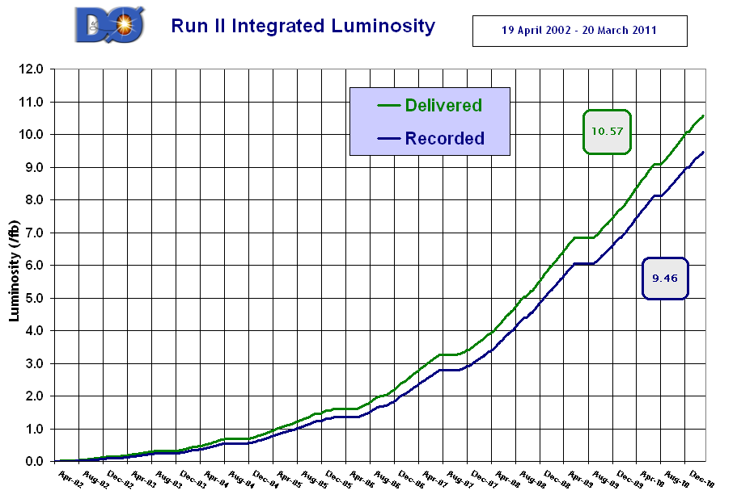
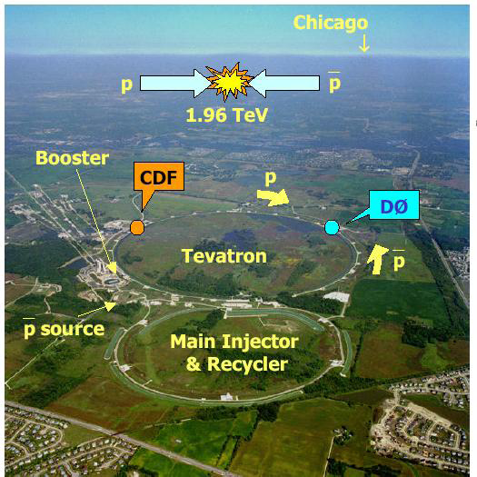
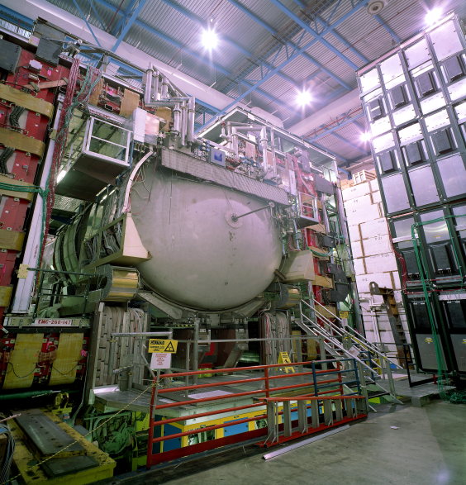
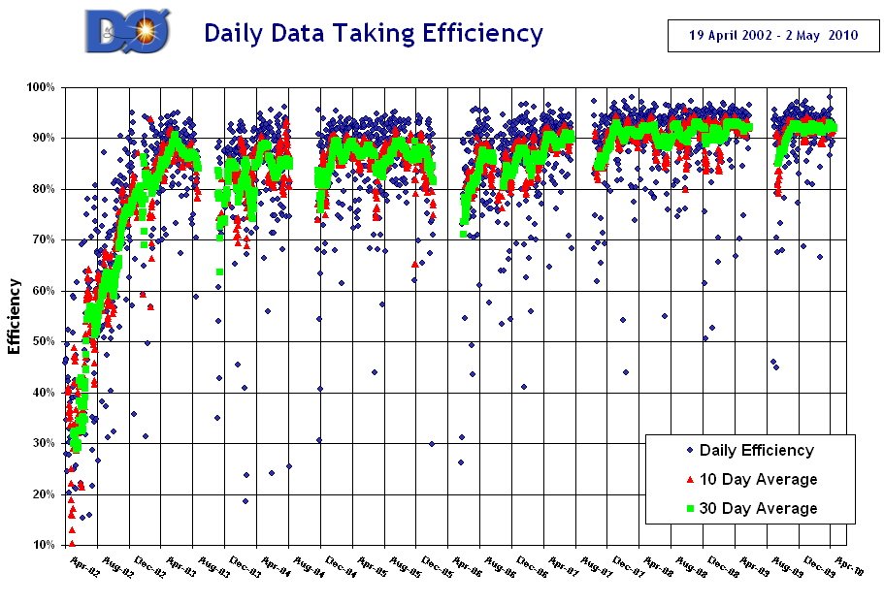
Tevatron and D0
Data delivered ~11fb-1
Today’s analyses
Place where top quarks were first observed and studied
Notes:
Two exeriments CDF and D0, are marvels of technology, and human effort in terms of achieving and then maintaining very high resolutoions for all physics objects. Both try to record as much of the precious data provided by the accelerator and their average efficiencies are 80-95%

Slide 3
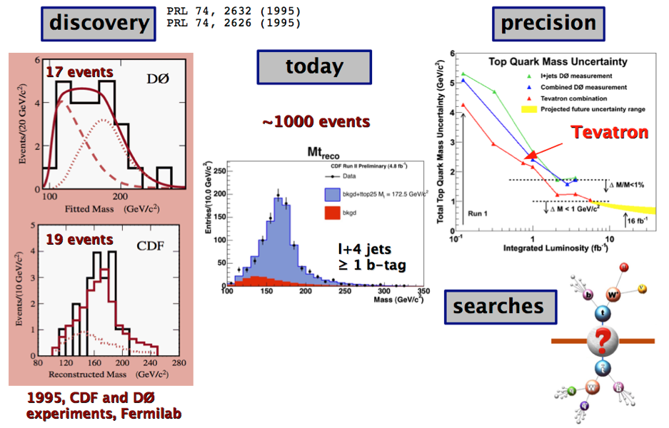
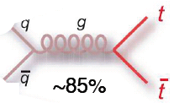
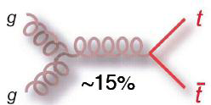
The Beloved Top Quark
Was discovered at Tevatron in 1995
The heaviest known fundamental particle
  m_{t} = 173.3 ±1.1 GeV (<1% precision
τ = 5×10⁻²⁵ s <<Λ_{QCD}⁻¹
Decays before hadronization
- Mass close to scale of electroweak symmetry breaking
- Plays special role in many of the new physics models
Production at Tevatron
Mainly produced in pairs via the strong interaction
σtt= 7.46 + 0.48 -0.67 pb
(Calculated for top mass = 172.5 GeV)
Notes:
Only quark for which coupling to Higgs is significant
May shed light on EWSB mechanism

Slide 4
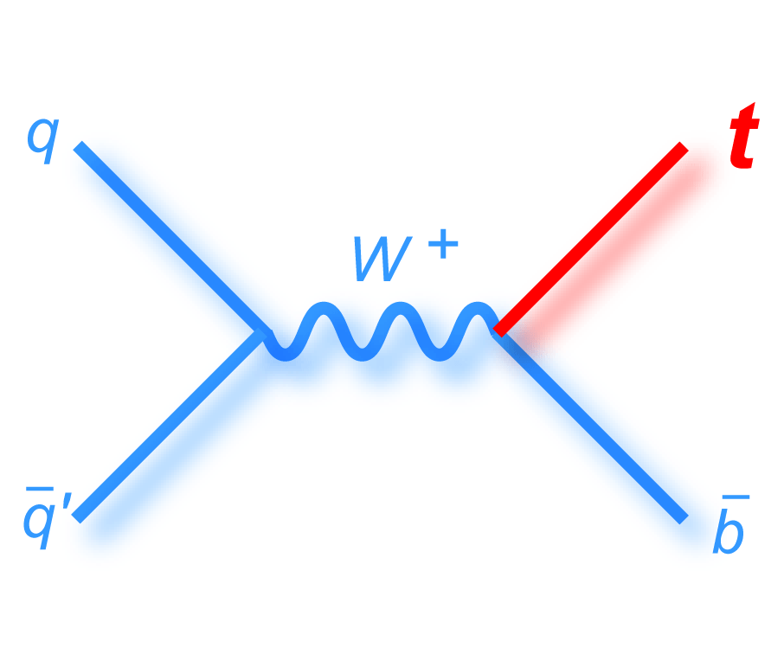
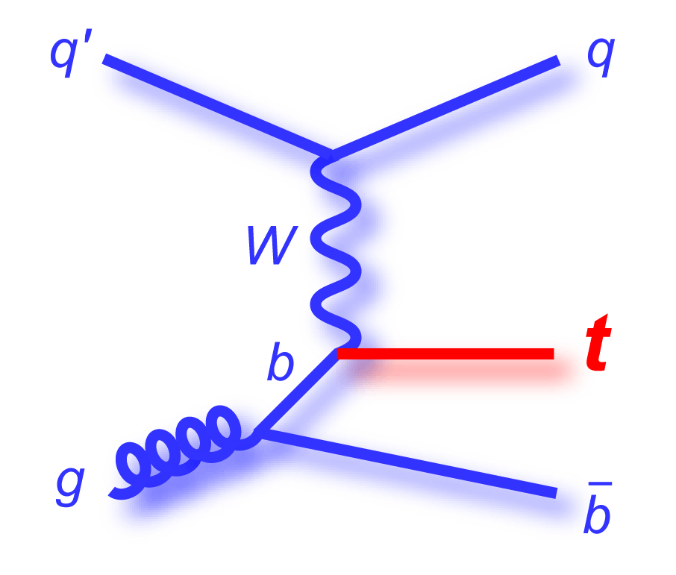
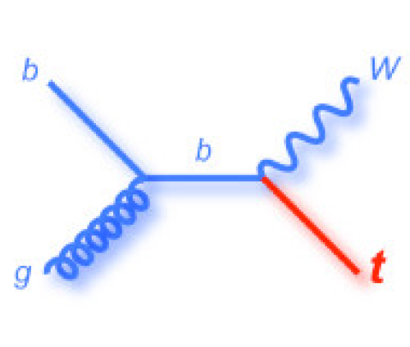
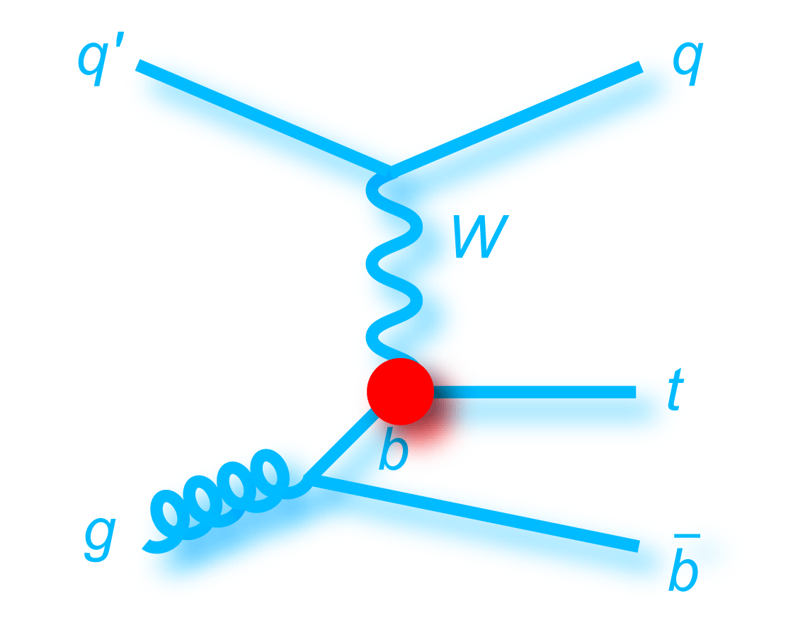
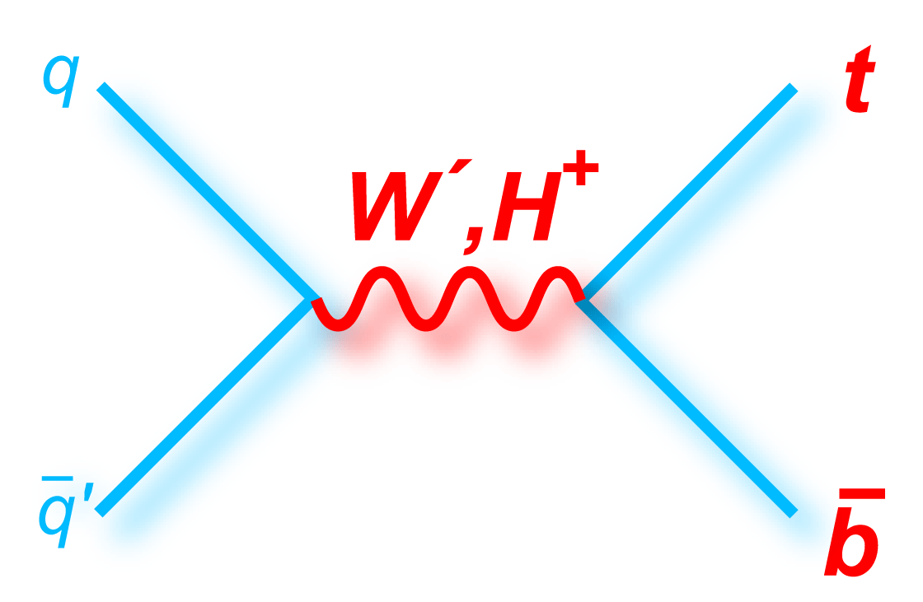
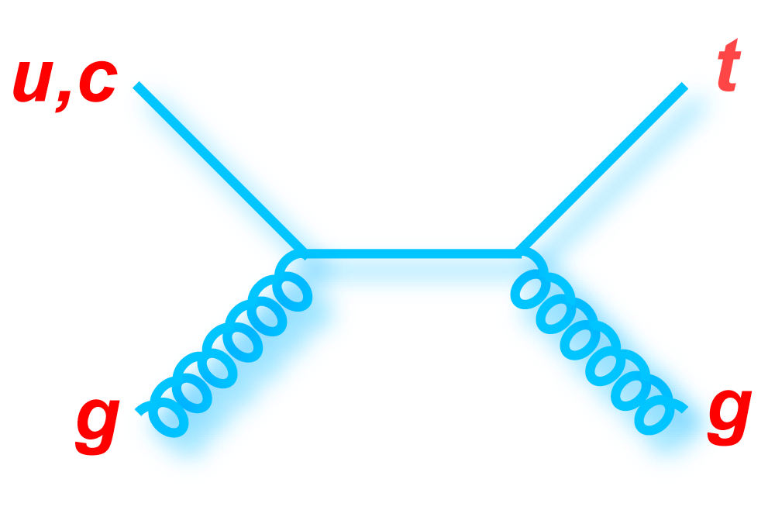
Single Top Quark Production
s-channel(“tb”)
t-channel(“tqb”)
tW production
σ ~1 pb
σ ~ 2pb
σ ~0.25 pb
Motivation:
Study Wtb coupling in top production
  Measure |V_{tb}| directly:
Cross sections sensitive to new physics
  s-channel: resonances (heavy W′ boson, charged Higgs boson, Kaluza-Klein excited W_{KK}, technipion, etc.), t-channel: flavor-changing neutral currents (t – Z / γ / g – c / u couplings), Fourth generation of quarks
Top properties
  Polarized top quarks – spin correlations measurable in decay products, Measure top quark partial decay width and lifetime, CP violation (same rate for top and antitop?)
Similar search for WH associated Higgs production

Slide 5
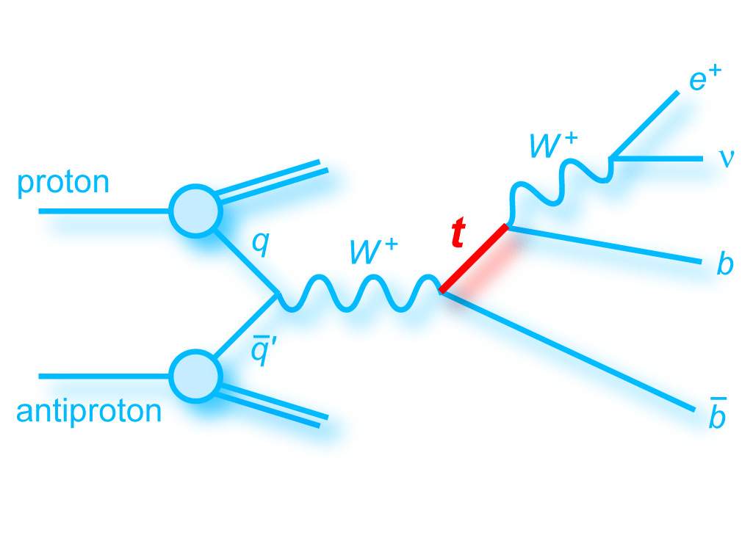
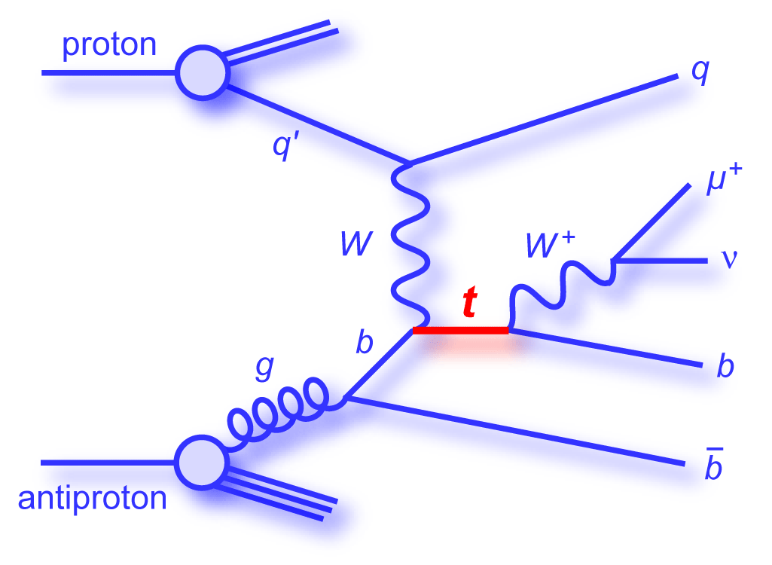
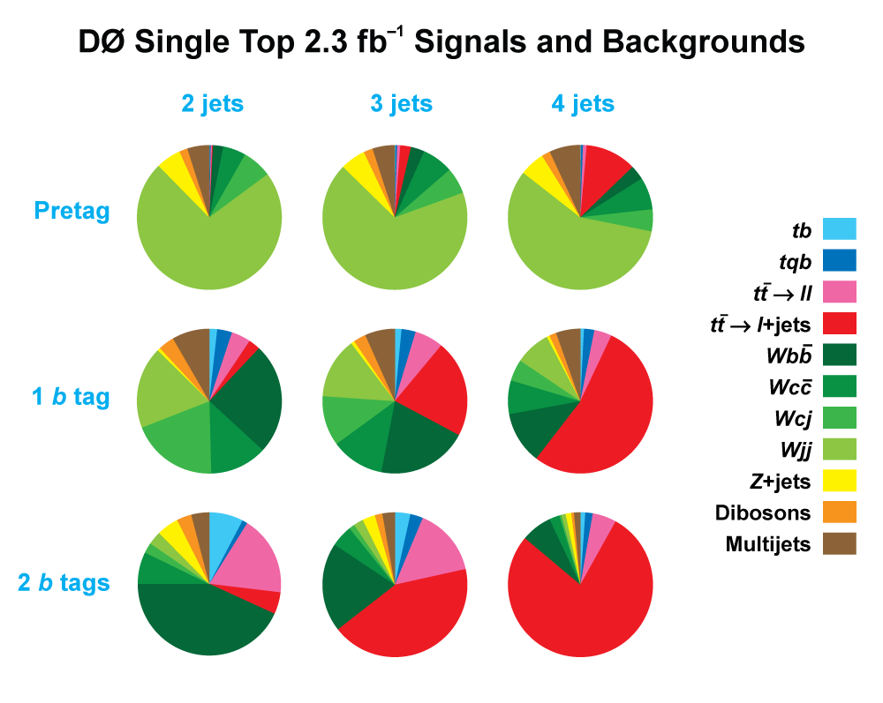
Signatures and Selection
One isolated electron or muon
High missing transverse energy
At least two or more jets with at least one jet identified as a b-jet
Top pairs, W+jets, and Multijets are the main
processes that can mimic these signatures

Slide 6
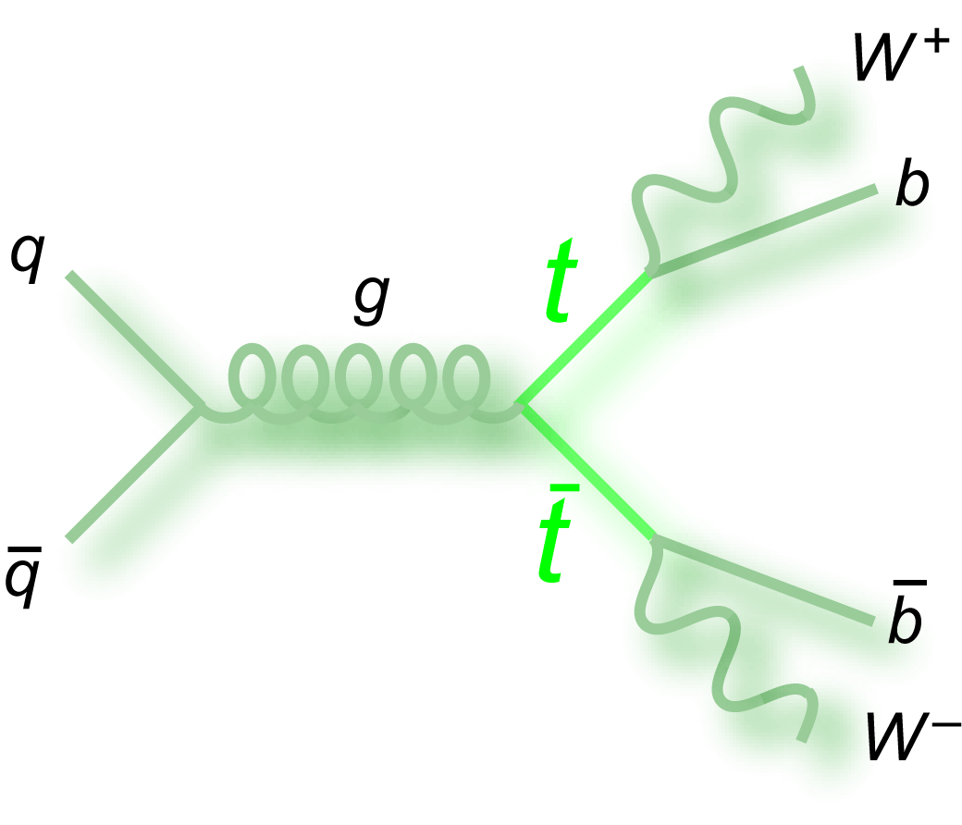
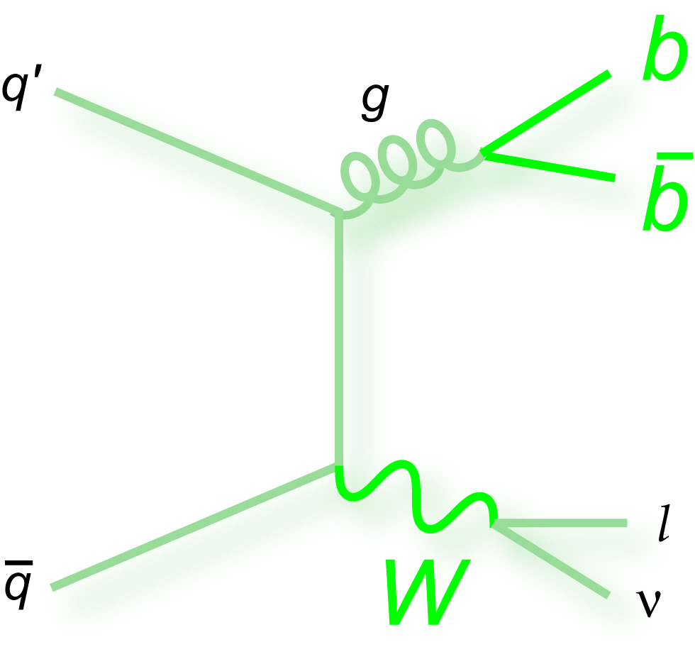
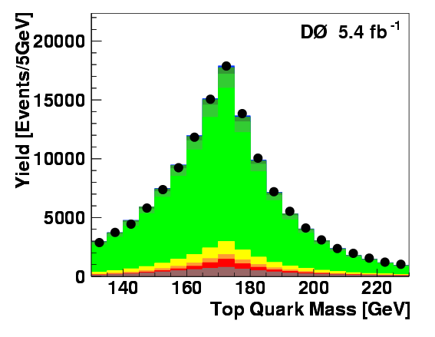
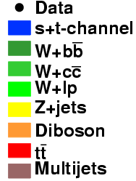
Background Modeling
W+jets background
  - Event kinematics and flavor composition modeled using Alpgen generator
  - Normalized to data before b tagging and after subtracting other backgrounds
  Additional scale factor α~1.5 for Wbb and Wcc
Multijet background
  Modeled using data with a non-isolated lepton and jets
Top pair backgrounds modeled using ALPGEN
  Normalized to NNLO theoretical prediction

Slide 7
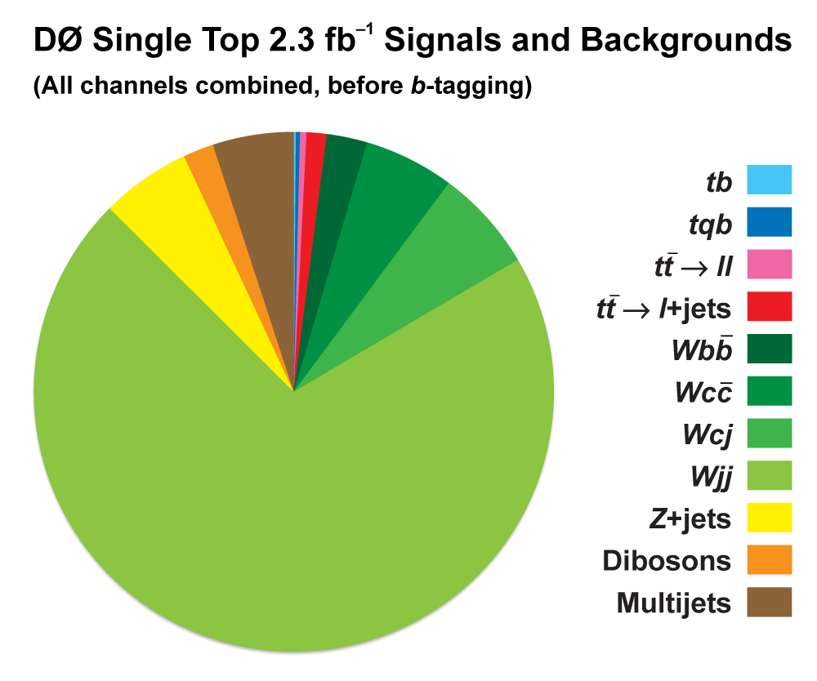
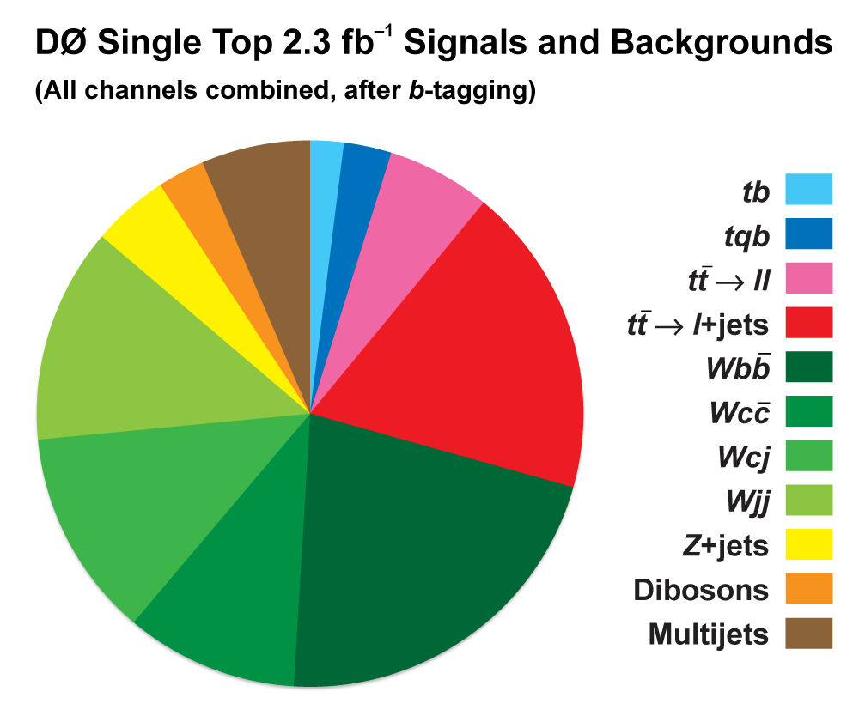
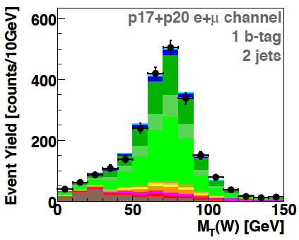
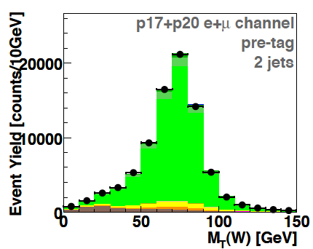
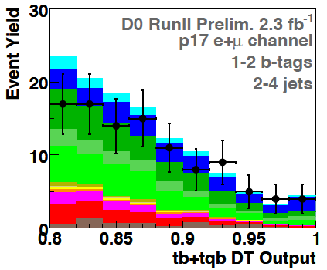
Single Top Observation
After the top quark discovery
it took more than a decade to find single top quarks
Analysis is challenging at the Tevatron
- requires lot of effort and use of many sophisticated analysis tools and techniques

Slide 8

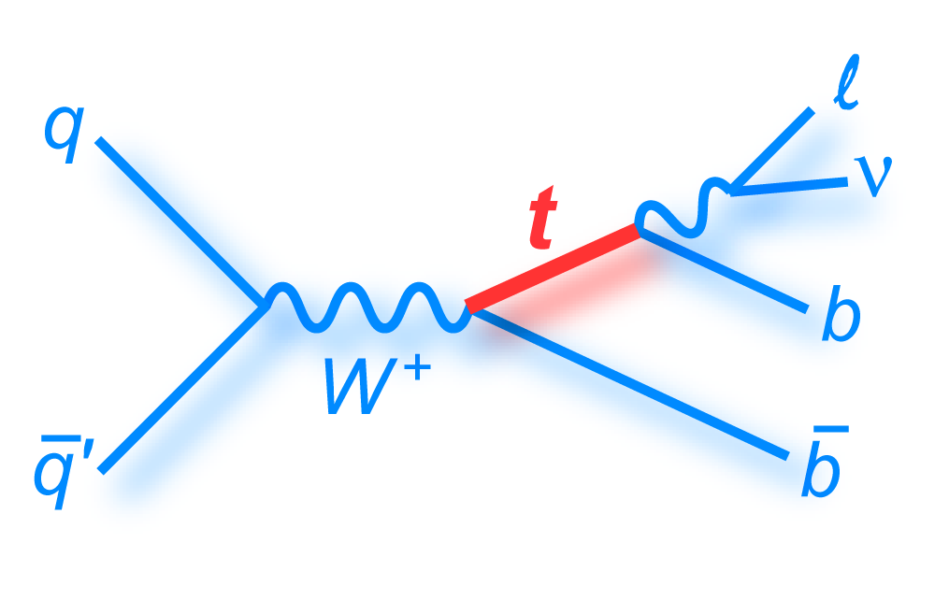
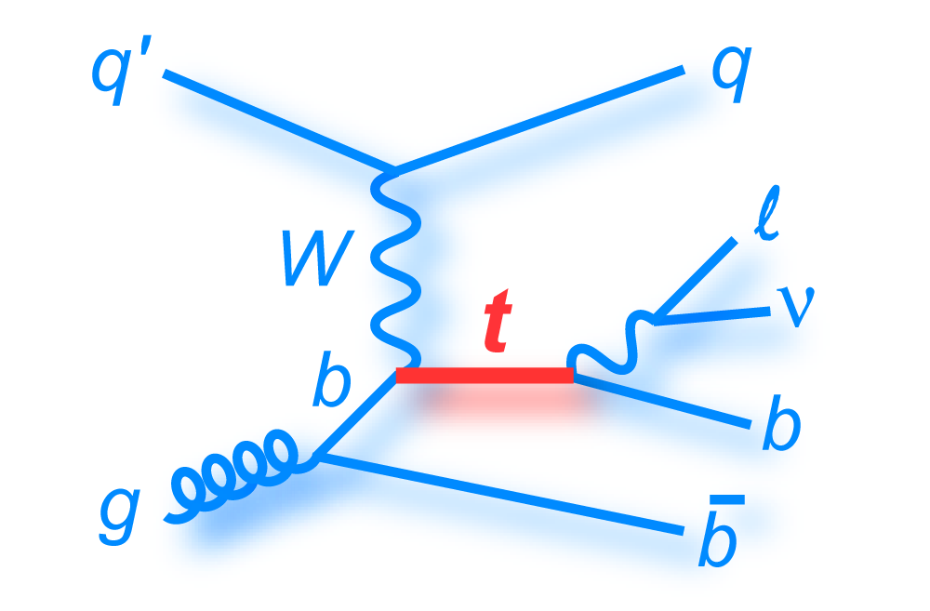
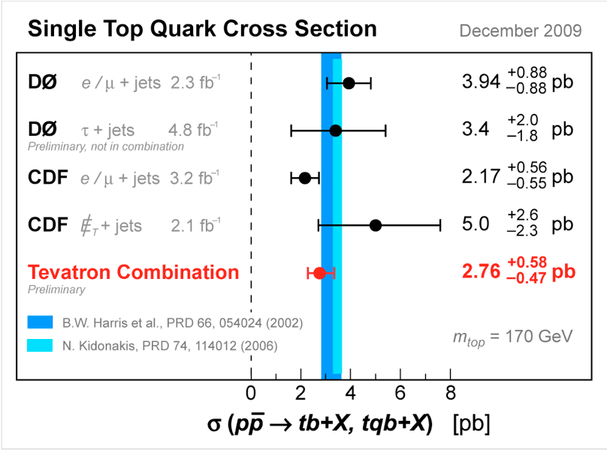
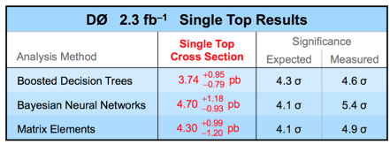
Single Top Observation
Observation in 2009

Slide 9
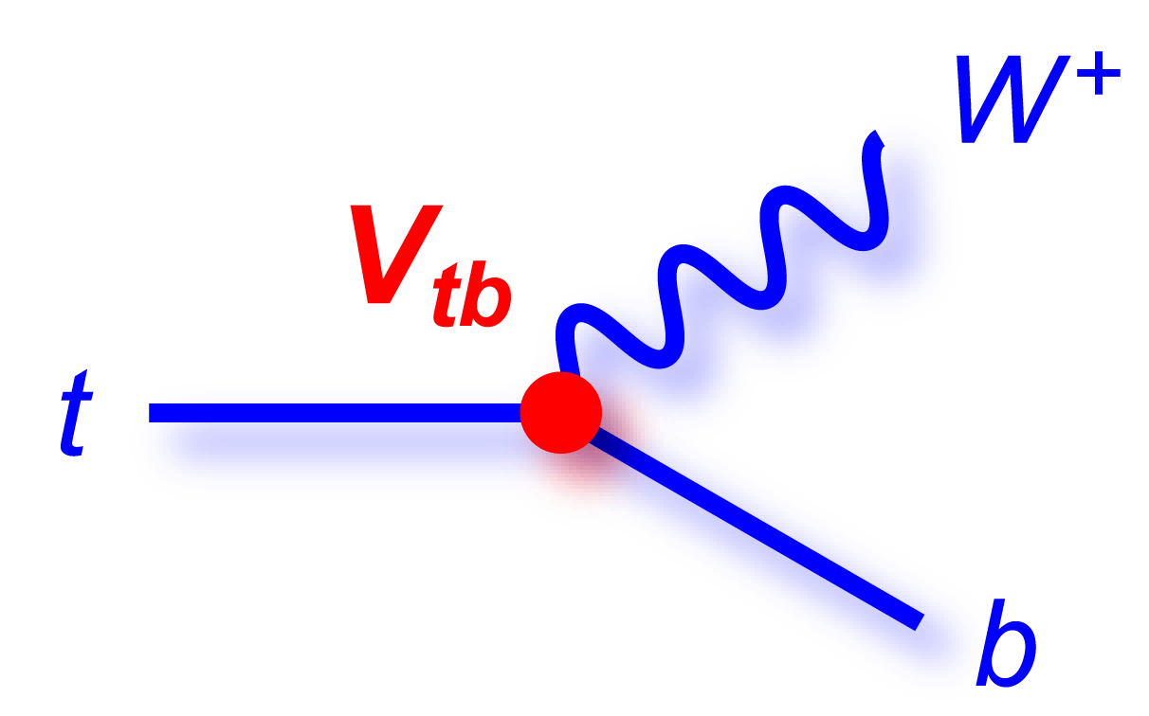
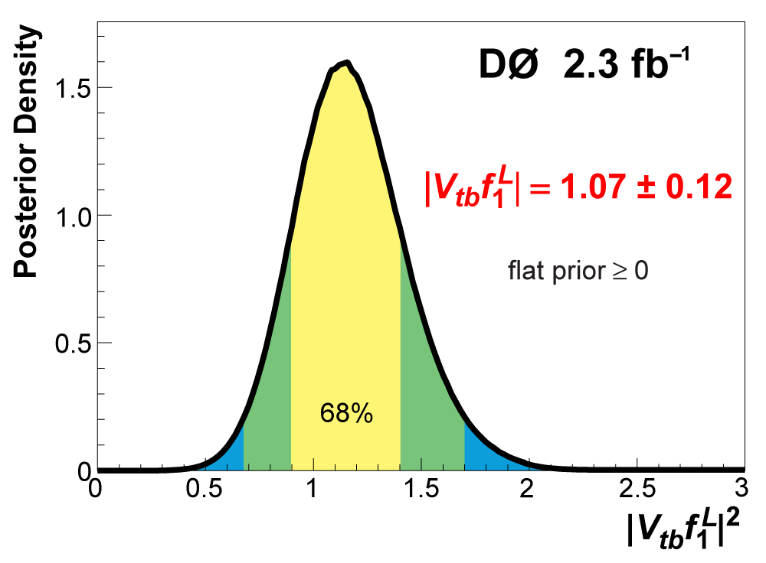
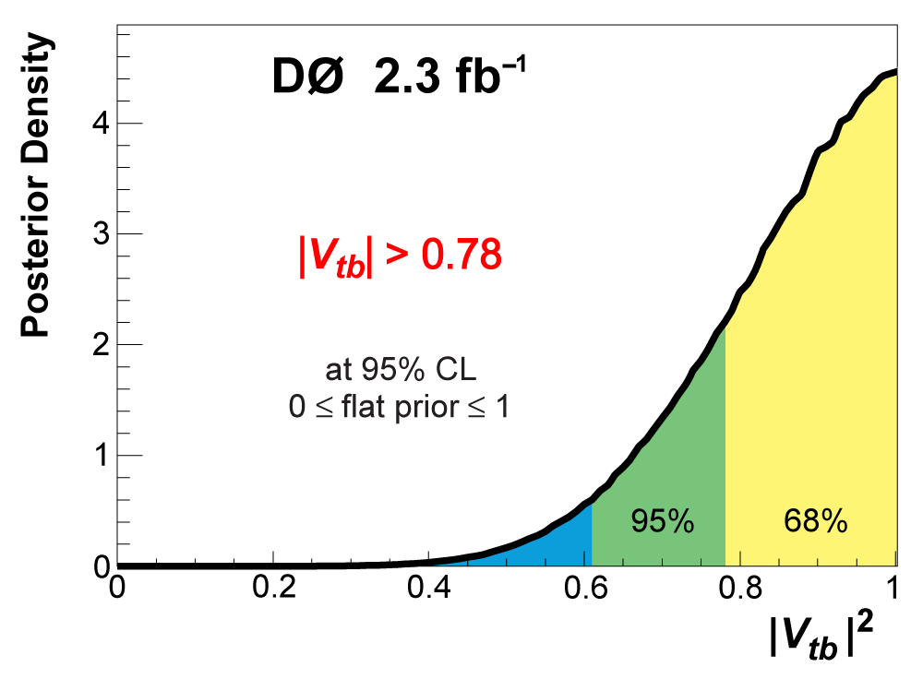
Measurement of Vtb
Most general tbW vertex
Within SM:
3-generation and unitary CKM matrix
CP conserving pure V−A interaction:
Measure assuming:
No constraint on number of generation and unitarity of CKM matrix
CP conserving pure V-A interaction, but not necessarily of SM strength
CDF, D0 combined:
|Vtb| = 0.88 ± 0.07
|Vtb| > 0.77@95%C.L.

Slide 10
What is next?
s-channel(“tb”)
t-channel(“tqb”)
tW production
σ ~1 pb
σ ~ 2pb
σ ~0.25 pb
Motivation:
Study Wtb coupling in top production
  Measure |V_{tb}| directly:
Cross sections sensitive to new physics
  s-channel: resonances (heavy W′ boson, charged Higgs boson, Kaluza-Klein excited W_{KK}, technipion, etc.), t-channel: flavor-changing neutral currents (t – Z / γ / g – c / u couplings), Fourth generation of quarks
Top properties: Polarized top quarks – spin correlations measurable in decay product Measure top quark partial decay width and lifetime, CP violation (same rate for top and antitop?)
Similar search for WH associated Higgs production

Slide 11
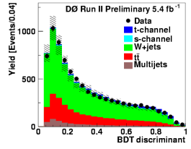
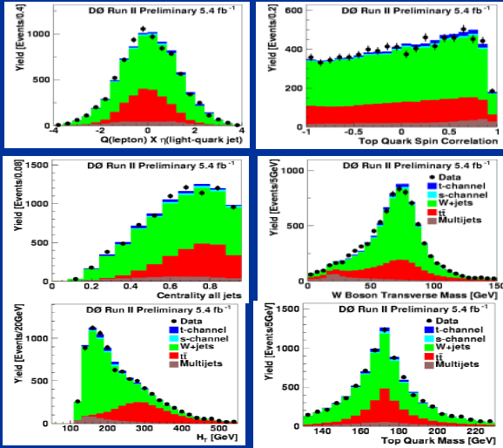
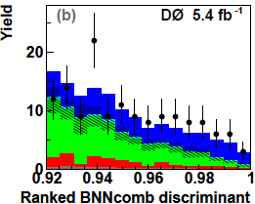
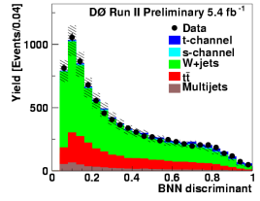
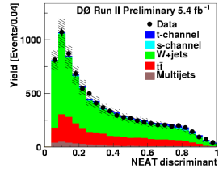
Search Strategy
Optimize for t-channel production (tb treated as background)
Combine three multivariate methods and combine their final decriminanats: Boosted Decision Trees (BDT), Bayesian Neural Networks (BNN), Neuroevolution of Augmented Topologies (NEAT)
Check discriminant performance using data control samples
Use discriminant output to measure cross section and significance
Event Discriminant
Notes:
Search strategy similar to observation analysis:
Combine variables with large discriminating power into discriminant fcunctions that separate signal from background
Correlation between methods ~70%, gain by combining them into CombBNN
Check discriminant performance using data control samples
Use ensembles of pseudo-data to test validity of x-sec extraction method

Slide 12
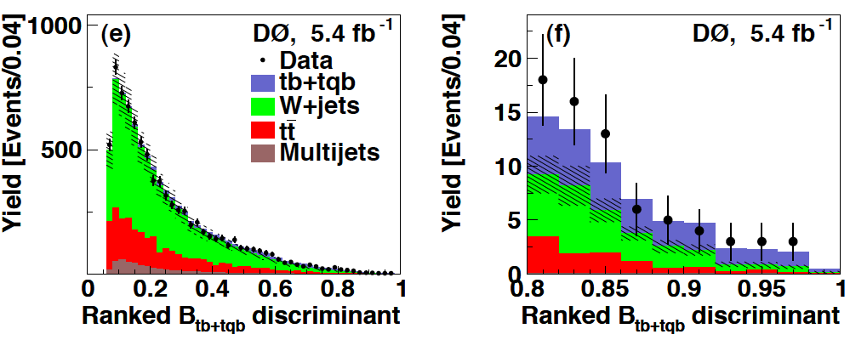
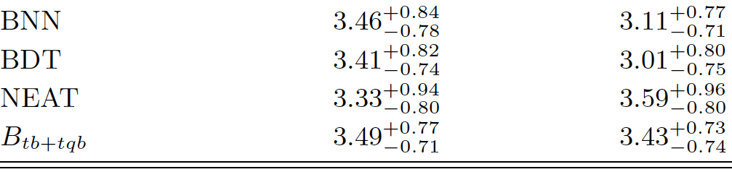
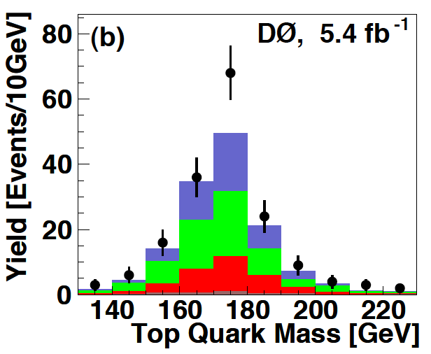
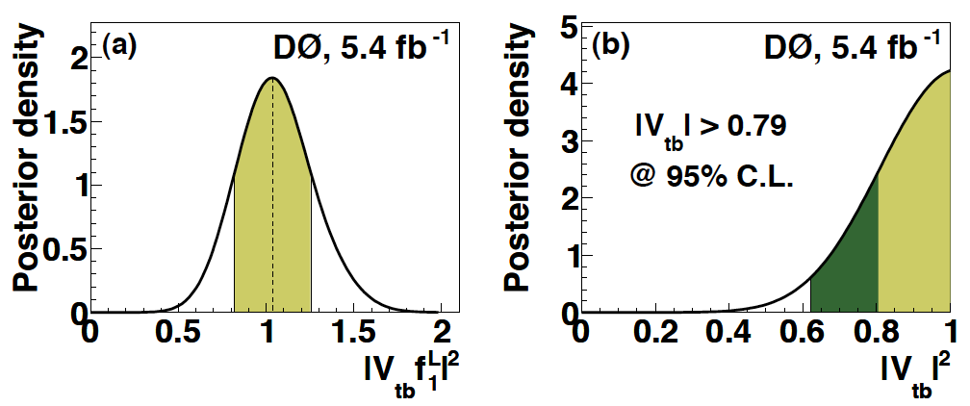


s+t-channel Cross Section
Combine three discriminants
Main systematic uncertainties arise
from jet energy scale and resolution,
b-jet identification

Slide 13
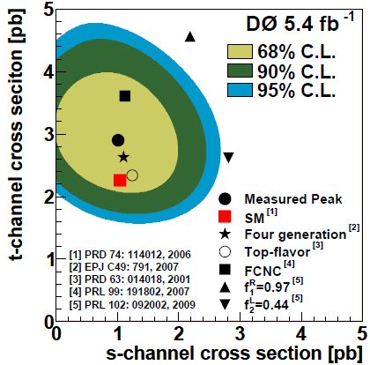
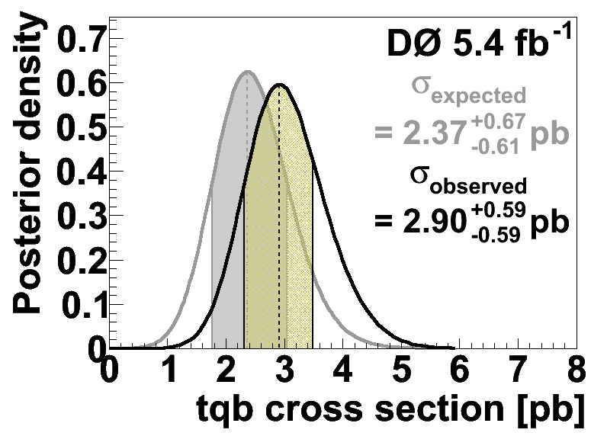
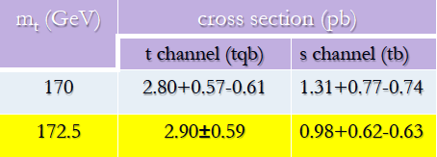
t-channel Cross Section
Uncertainty ~ 20%, 11% systematics
Dominant systematics: JES, JER, b-tagging efficiency and W + heavy jets normalization
Observed significance > 5 SD

Slide 14
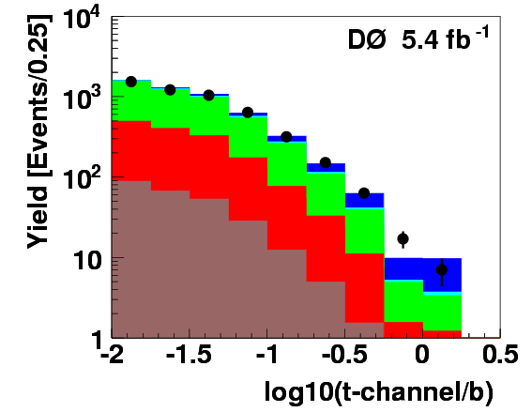
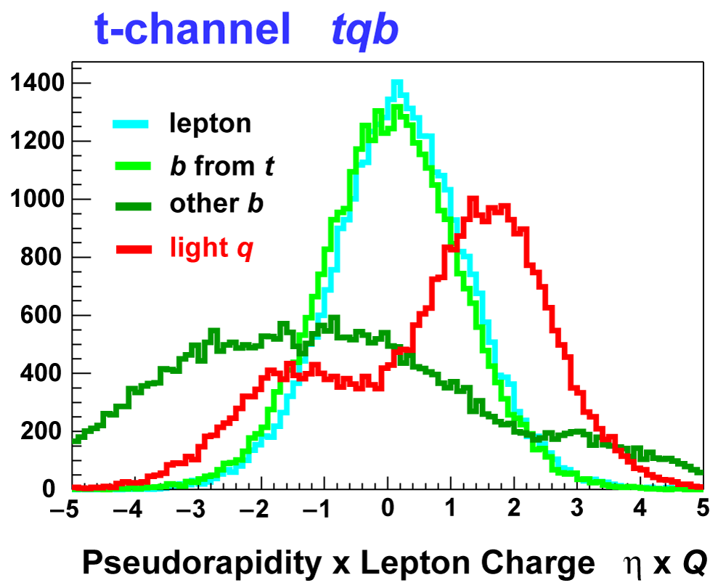
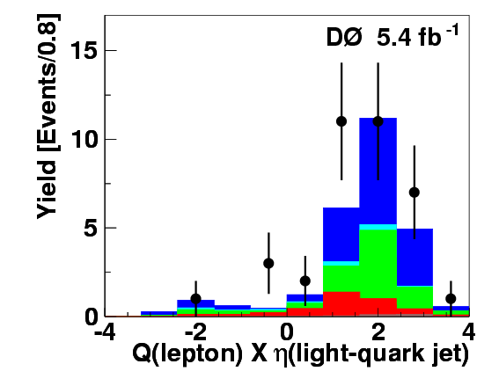
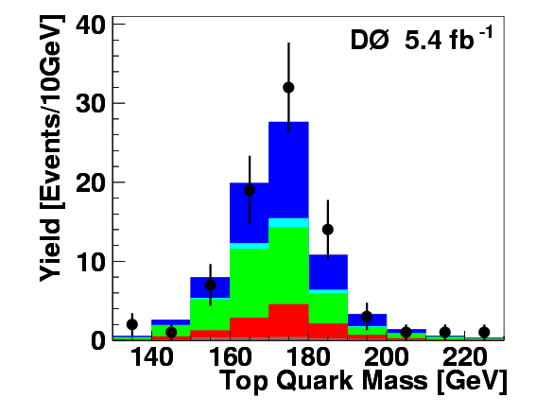
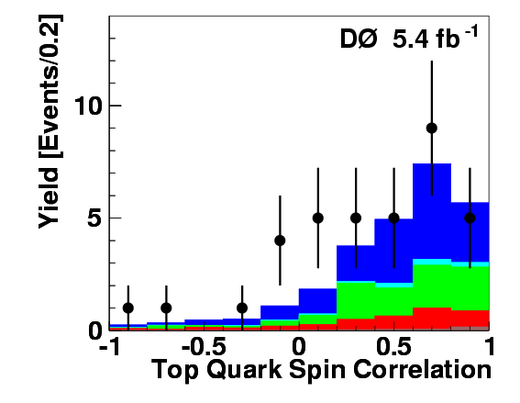
Is it really t-channel production?

Slide 15
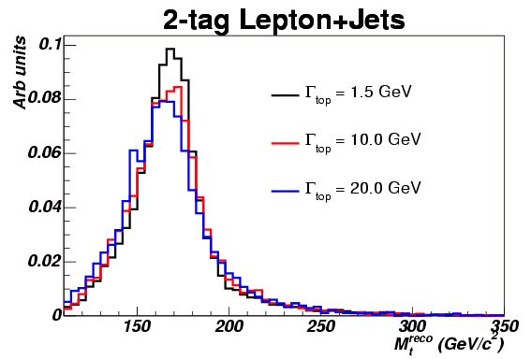


Top Quark Width
SM predicts ~1.5 GeV (Mt = 175 GeV)
Lepton+Jets with 4.3fb⁻¹
CDF Template based top width measurement
  limit placed on top width
0.4 GeV < Γ_{top}< 4.4 GeV @ 68% CL
Γ_{top}< 7.5 GeV @ 95% CL
model independent but not really sensitive
Width is proportional to coupling in SM

Slide 16


Top quark width and t-channel
T-channel top quark production: fusion of real W and b quark
Treat W boson as parton inside proton
  W boson and top and b are on shell
  Same kinematics and virtuality as top decay
⇒ Width is proportional to cross section for any coupling, including new physics
T. M. P. Tait and C. P. Yuan
arXiv:hep-ph/9710372
Combine t-channel cross section measurement
and top quark decay ratio measurement to get total width

Slide 17



Top Quark Width
Assumptions: t-channel production and decay kinematics as in SM, Decay is 100% t→Wb
Measured value of t-channel Cross section with 2.3 fb⁻¹ data:
And branching fraction:
Phys. Lett. B 682, 363 (2010)
Phys. Rev. Lett. 100,192003 (2008)
This analysis will be soon updated with the latest t-channel measurement and the new branching ratio measurement
PRL 106, 022001 (2011)

Slide 18
Summary
Search for single top quark production at the Tevatron is very challenging
D0 has observed s+t channel production and has measured t-channel production cross section
Single top production provides a very unique place to look for new physics effects or measuring top quark properties, e.g top width, cp violation, Wtb couplings, etc.
With double the data available per experiment, there is lot of room for surprises - we are not yet done exploring this very interesting mode of the most interesting quark
Notes:
Δ/~ 7%, close to theoretical uncertainty
Δm/m=0.6% and will improve: below 1 GeV with more data
True legacy measurement: will be hard to surpass
Many properties have been studied
No significant deviation from SM so far
Exciting discrepancy in color charge asymmetry: keep an eye on this
Broad program of searches in top sector
Will soon be improved by LHC reach
Single top observed (s+t and t) and continues to be studied
LHC at current lumis produces ten times more top quarks per
minute than Tevatron!
Will still work on complementary searches: boosted tops, Afb,
s-channel, spin correlations...
Now 10 fb-1 on tape: double the data presented here

Slide 19




Input Variables

Slide 20

Cross Check

