Slide 1
High Energy Accelerators: recent progress and future directions
EPS-HEP Conference,
ECFA-EPS session,
Grenoble, France
SATURDAY 23rd July 2011
Steve Myers with help (slides) from
O. Bruning, R. Calaga, J-P. Delahaye, I. Efthmiopoulos, R. Garoby, M. Klein, R. Palmer, T.Roser, L. Rossi, S. Stapnes, V. Schiltsev, D. Schulte, M. Zisman,

Slide 2
High Energy Frontier (Colliders)
Recent Progress
    Tevatron
    RHIC
    LHC
Future Directions
    Future Ion Colliders
    HL-LHC
    ILC/CLIC
    electron-hadron colliders
    HE-LHC
    Neutrinos (Intensity Frontier)
    Muon collider
11 topics in 25 minutes!!
Operating
About 1 to 2 billion $ per minute!!
Approved, funded?
Not yet approved

Slide 3
TeVatron

Slide 4
Tevatron

Slide 7
Collider Run 2; Weekly/Total Integrated Luminosity

Slide 8
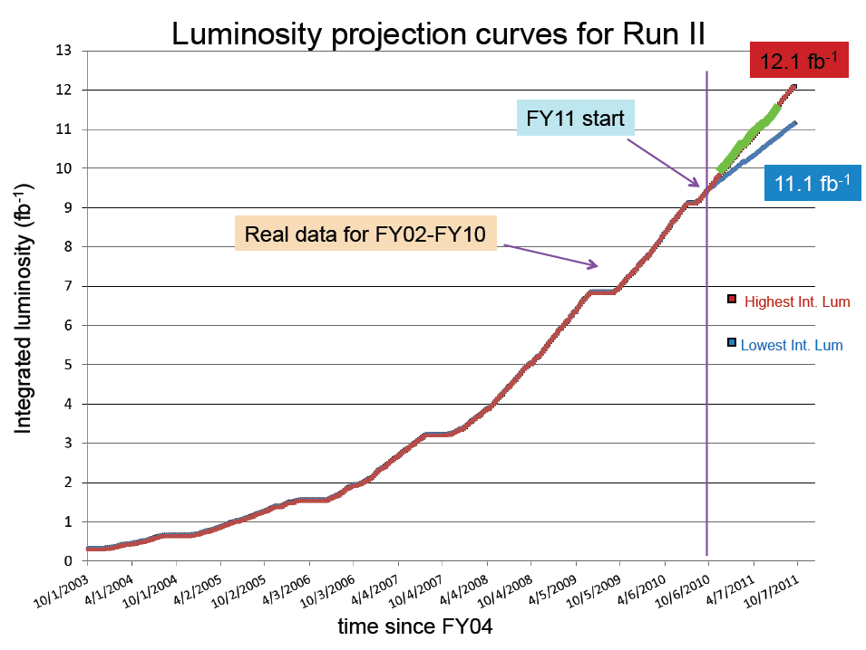

Slide 9
Summary

Slide 10
RHIC

Slide 11
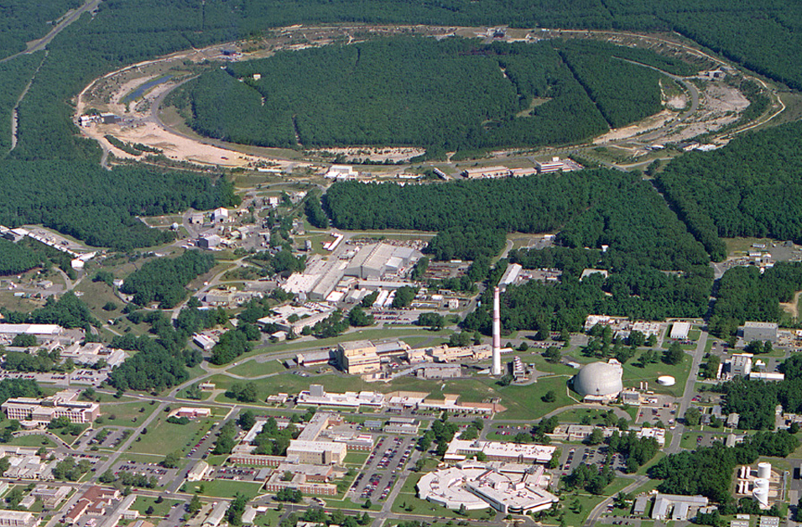
RHIC – a High Luminosity (Polarized) Hadron Collider
Polarized Jet Target
12:00 o’clock
10:00 o’clock
RHIC
2:00 o’clock
PHENIX
8:00 o’clock
4:00 o’clock
STAR
6:00 o’clock
LINAC
NSRL
EBIS
Booster
AGS
Operated modes (beam energies):
Au–Au 3.8/4.6/5.8/10/14/32/65/100 GeV/n
d–Au* 100 GeV/n
Cu–Cu 11/31/100 GeV/n
p↑–p↑ 11/31/100/205/250 GeV
Planned or possible future modes:
Au – Au 2.5 GeV/n (~ SPS cm energy)
U – U 100 GeV/n
p↑ – Au* 100 GeV/n
Cu – Au* 100 GeV/n (*asymmetric rigidity)
Achieved average store luminosities:
Au–Au (100 GeV/n) 30×10²⁶ cm⁻² s ⁻¹
p↑–p↑ (250 GeV) (<P> = 46%) 90×10³⁰ cm⁻² s ⁻¹
Goal with additional luminosity upgrades:
Au–Au (100 GeV/n) 40×10²⁶ cm⁻² s ⁻¹
p↑–p↑ (250 GeV) (<P> = 70%) 300×10³⁰ cm⁻² s ⁻¹
Tandems

Slide 12
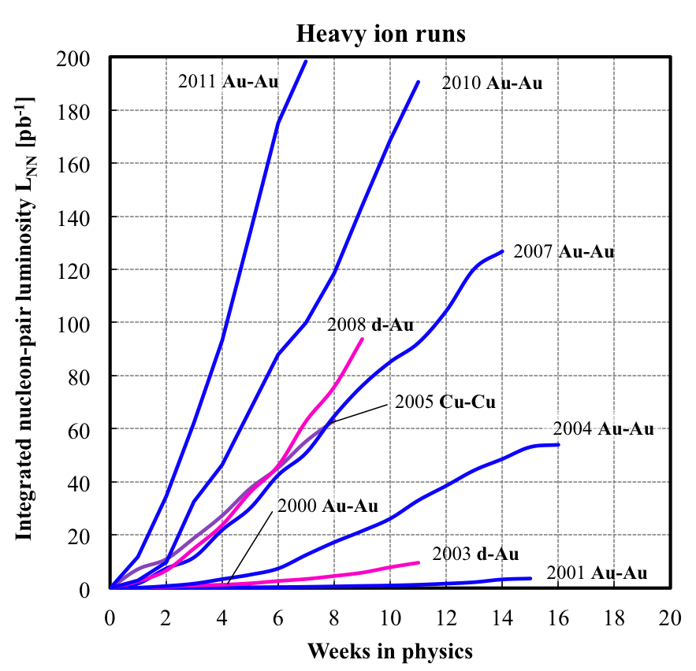
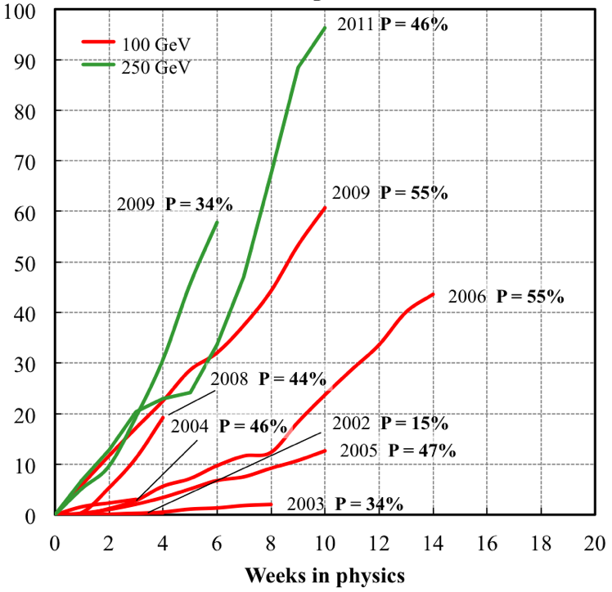
Delivered Integrated Luminosity and Polarization
Heavy ion runs
Polarized proton runs
Integrated nucleon-pair luminosity L_{NN} [pb⁻¹]
Integrated luminosity L [pb⁻¹]
Nucleon-pair luminosity: luminosity calculated with nucleons of nuclei treated independently; allows comparison of luminosities of different species; appropriate quantity for comparing runs with different species.
Notes:
updated

Slide 13
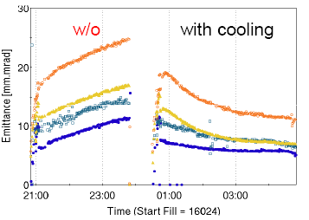
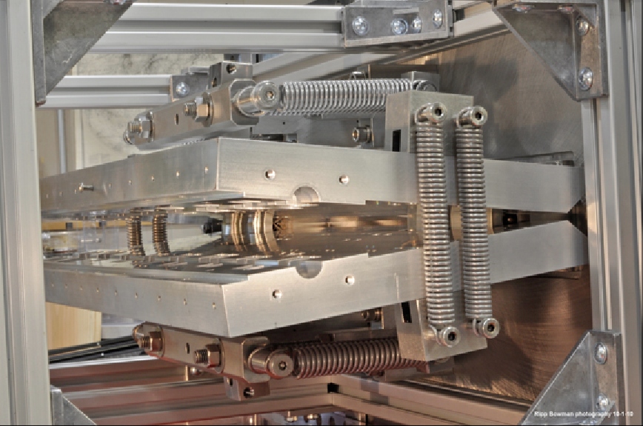
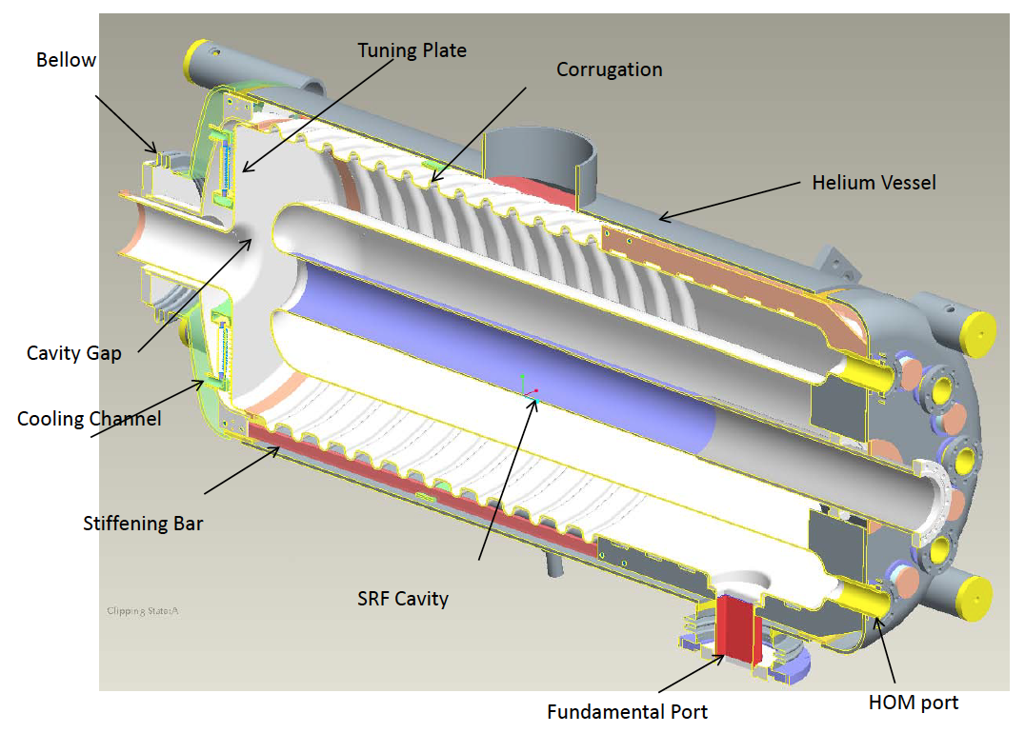
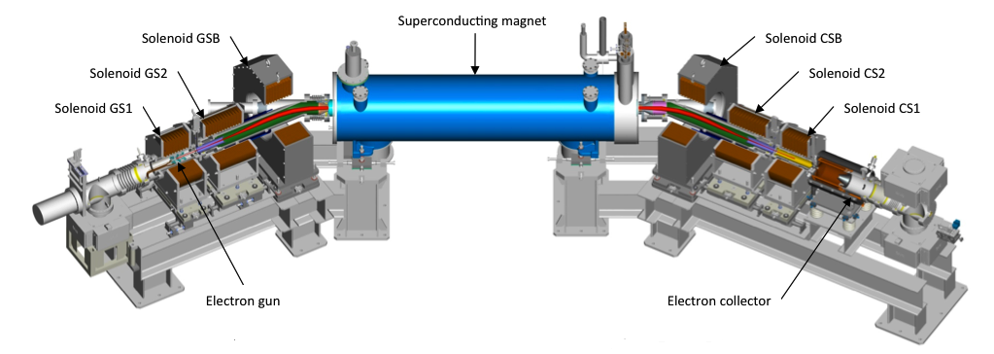
RHIC Luminosity Upgrades Under Way
3-D high-energy bunched-beam stochastic cooling (three planes in each ring) to overcome beam blow-up from intra-beam scattering
56 MHz SRF quarter wave
2 MV storage cavity to reduce vertex length
Head-on beam-beam compensation: Electron beam lenses to partially compensate head-on p-p interactions
horizontal kicker (open)

Slide 14
LHC

Slide 15
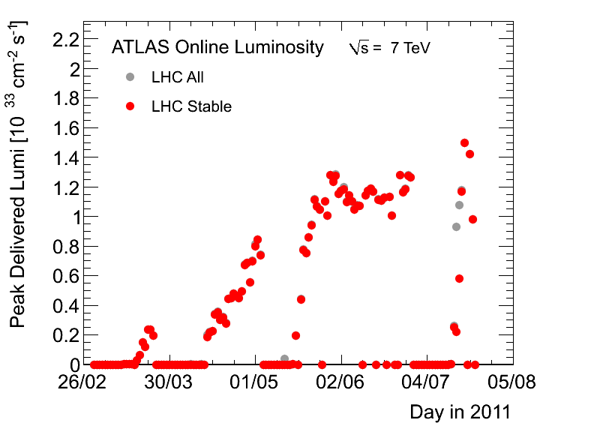
Peak Luminosity (22/7)

Slide 16
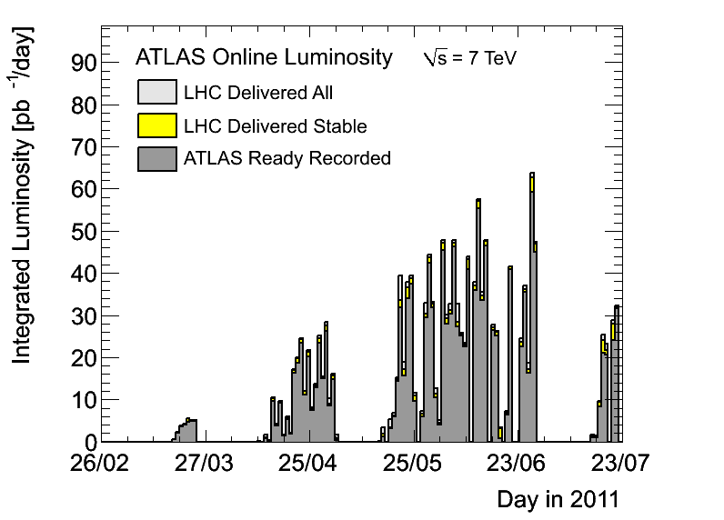
Daily Integrated Luminosity (22/7)
Average 26pb-1 per physics day

Slide 17
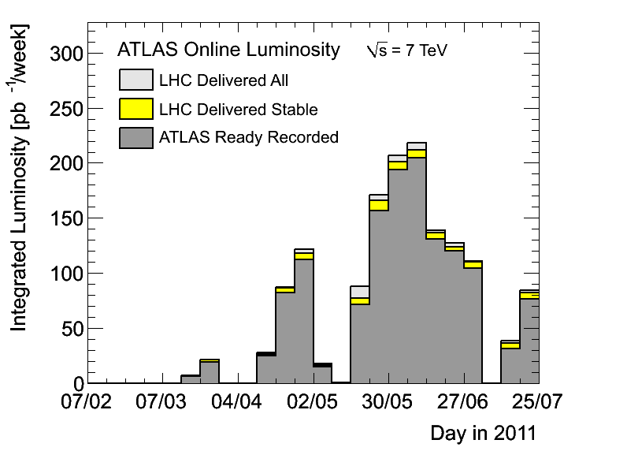
Weekly Integrated Luminosity (22/7)

Slide 18
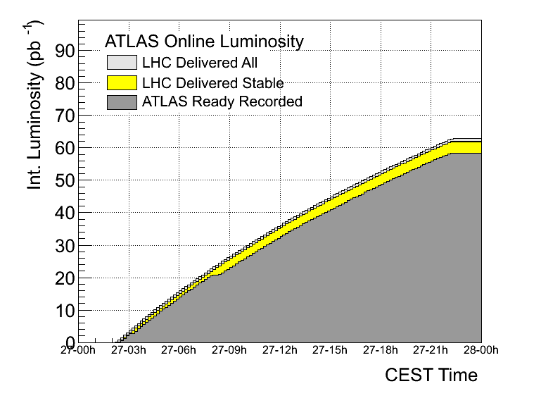
Best Fill as of 22/7

Slide 19
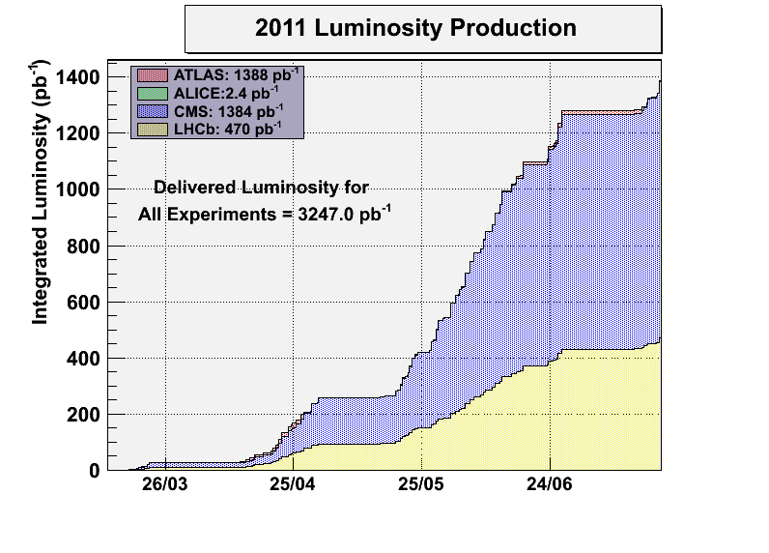
Integrated Luminosity (22/7)

Slide 20
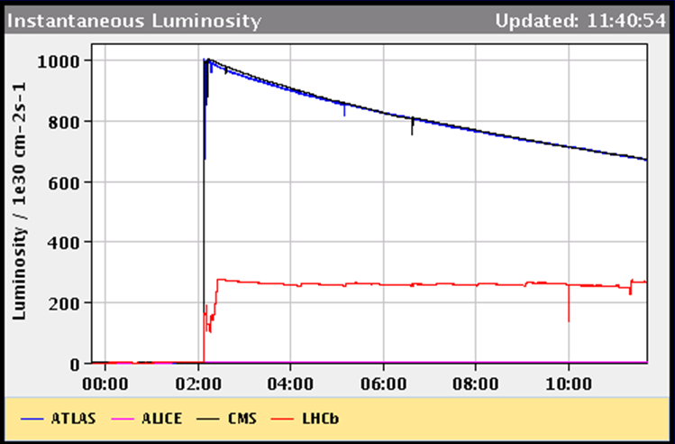
Expected integrated luminosity for LHCb in 2011
Introduced luminosity leveling for LHCb → can run at optimal μ and L_{max}
GPD luminosity falls-off exponentially
Luminosity of LHCb levelled continuously
LHCb design luminosity
→ Since end of May running at constant L ~ 3∙10³² cm⁻²s⁻¹ with μ ~ 1.5

Slide 21
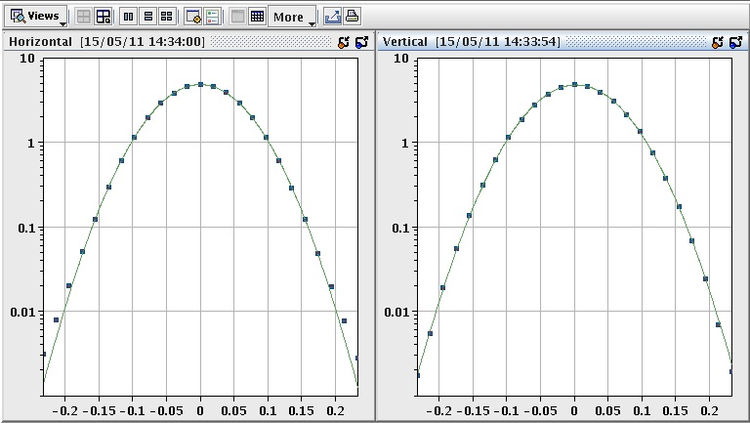
LHC precision front
absolute luminosity normalization
low, well understood backgrounds
precision optics for ATLAS-ALFA and TOTEM
VdM scan
IP1 H
IP1 V
precise measurement of the luminous region +
beam intensity --> absolute luminosity and
cross section calibration
currently ~ 5 % level, already better than Tevatron

Slide 22
Evolution of Peak Performances to date

Slide 23
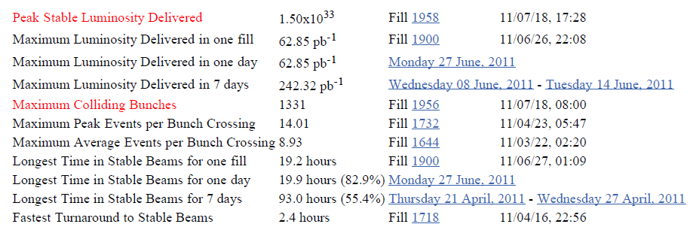
Records (up to 22nd July 2011)

Slide 24
Future Ion Colliders

Slide 28
HL-LHC

Slide 29
HL-LHC Performance Goals
Leveled peak luminosity: L = 5 10³⁴ cm⁻² sec⁻¹
Virtual peak luminosity: L = 10 10³⁴ cm⁻² sec⁻¹
Integrated luminosity: 200 fb⁻¹ to 300 fb⁻¹ per year
(assume 250 fb⁻¹ per year in the following)
Total integrated luminosity: ca. 3000 fb⁻¹

Slide 30
Performance optimization for the LHC
Luminosity (round beams):
1) maximize bunch brightness [N_{bunch}/ε_{n}]
beam-beam limit and injector complex performance
2) minimize beam size [β*] (constant beam power)
3) maximize number of bunches (beam power limit)
4) compensate for ‘R’
Event pileup & e-cloud
30

Slide 31
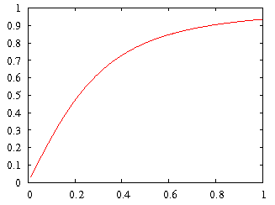

LHC Challenges: R
geometric luminosity
reduction factor:
effective cross section
Piwinski angle
θ_{c}
large crossing angle:
➔ reduction of long range beam-beam interactions
➔ reduction of head-on beam-beam parameter
➔ reduction of the mechanical aperture
➔ synchro-betatron resonances
➔ reduction of instantaneous luminosity
➔ inefficient use of beam current
➔ option for L leveling!

Slide 32
HL-LHC Performance Goals
Operation at performance limit
choose parameters that allow higher than design performance
leveling mechanisms for controlling performance during run
Preferred leveling mechanism: Crab Cavities
Reservations: technology & field quality
➔ Supplementary tools for leveling:
# crossing angle and long-range and
beam-beam wire compensators
# transverse offsets at IP
# dynamic β* squeeze

Slide 33
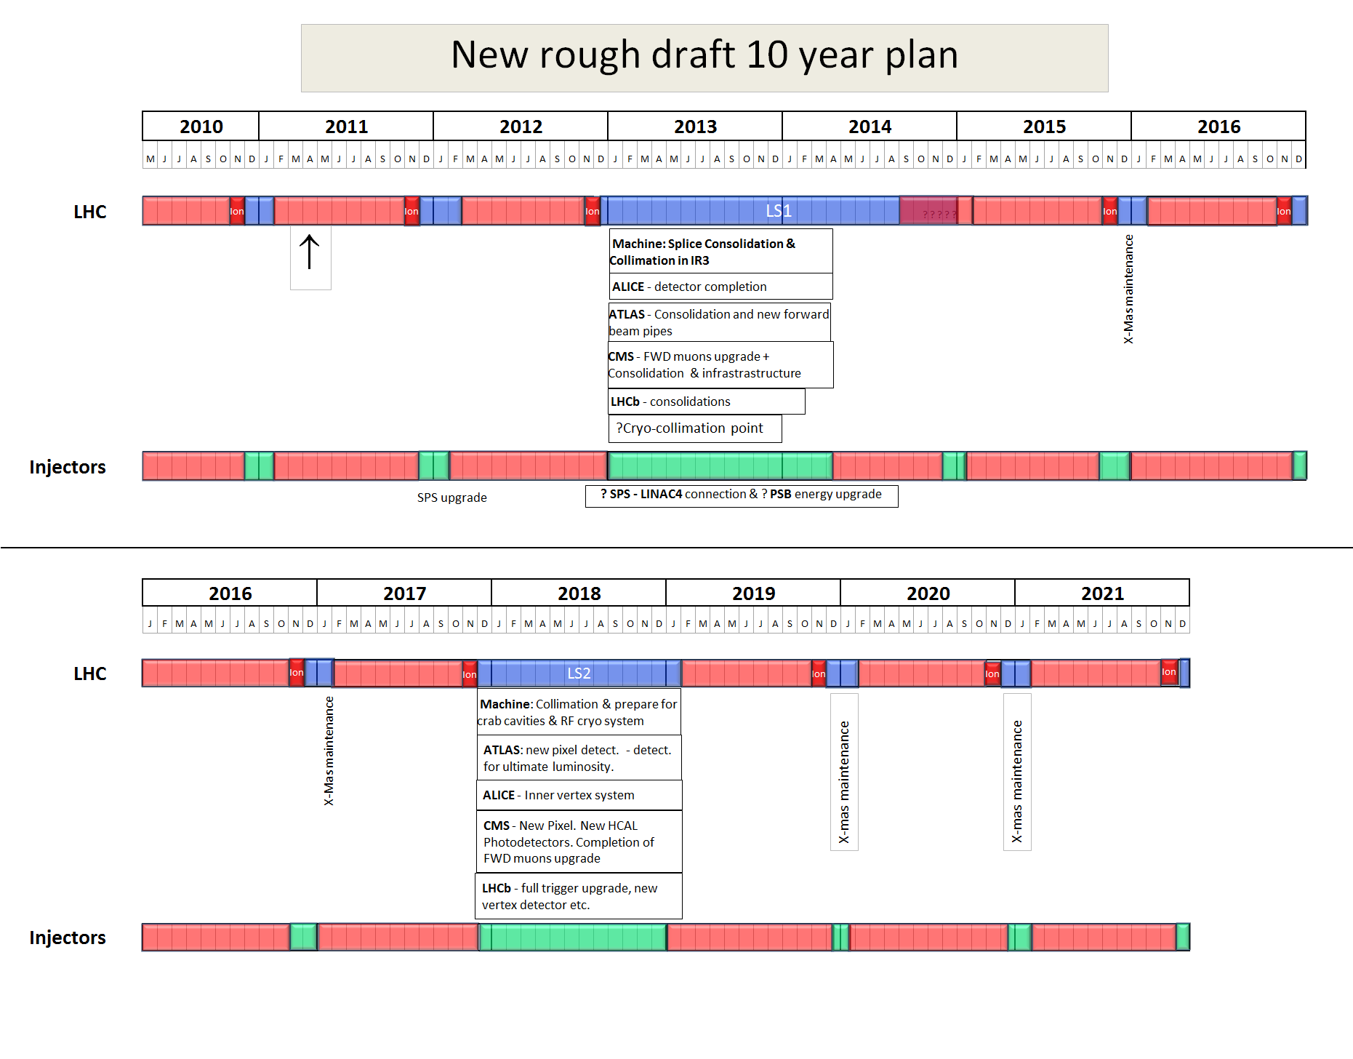
Not yet approved!
2022
LS3
Installation of the HL-LHC hardware

Slide 34
HL-LHC Performance Estimates
nominal bunch length and minimum β*: Chamonix’11 &
‘HL-LHC Kickoff’
minimum β*
Parameter | nominal | 25ns | 50ns
N | 1.15E+11 | 2.0E+11 | 3.3E+11
n_{b} | 2808 | 2808 | 1404
beam current [A] | 0.58 | 1.02 | 0.84
x-ing angle [μrad] | 300 | 475 | 580
beam separation [σ] | 10 | 10 | 10
β* [m] | 0.55 | 0.15 | 0.15
ε_{n} [μm] | 3.75 | 2.5 | 3.75
ε_{L} [eVs] | 2.51 | 2.5 | 2.5
energy spread | 1.00E-04 | 1.00E-04 | 1.00E-04
bunch length [m] | 7.50E-02 | 7.50E-02 | 7.50E-02
IBS horizontal [h] | 80 -> 106 | 25 | 37
IBS longitudinal [h] | 61 -> 60 | 21 | 21
Piwinski parameter | 0.68 | 2.5 | 2.5
geom. reduction | 0.83 | 0.37 | 0.37
beam-beam / IP | 3.10E-03 | 3.9E-03 | 3.9E-03
Peak Luminosity | 1 10³⁴ | 7.4 10³⁴ | 6.8 10³⁴
5.6 10¹⁴ and 4.6 10¹⁴
p/beam
OK for HL goals, if
CRAB cavities are a viable option
(Leveled to 5 10³⁴ cm⁻² s⁻¹)
Events / crossing | 19 | 141 | 257 | 95 | 190
34
Notes:
50ns beam option provides HL-LHC performance levels at ultimate total beam currents; only the ‘large beta*’ option reaches beam-beam limit; IBS growth rates are a concern!; low beta option has 50% higher performance potential

Slide 35
ILC/CLIC

Slide 36

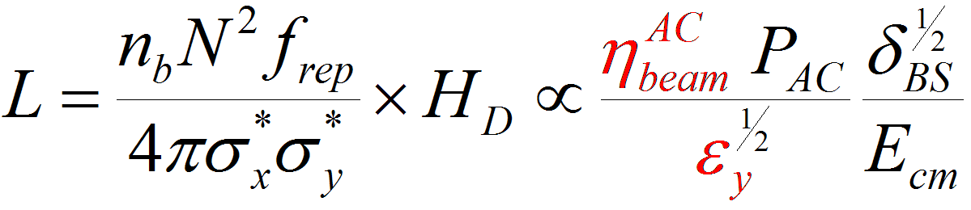
Multi-TeV Linear Colliders challenges
e+
e-
source
main linac
damping ring
beam delivery
Energy reach
Accelerating structures: large accelerating fields with low breakdown rate
RF power source: high peak power with high efficiency
Luminosity
Beam acceleration: MW of beam power with high gradient and high efficiency
Generation of ultra-low emittances: micron rad-m in H, nano rad-m in V
Preservation of low emittances in strong wake field environment
Alignment (micron range)
Stability (nano-meter range)
Small beam sizes at Interaction Point: Focusing to nm beam sizes
Stability to sub nano-meter

Slide 38
ILC/CLIC Parameters
4.1%
5.0%

Slide 39
ILC

Slide 40
Proposed Design changes for TDR
RDR
SB2009
Single Tunnel for main linac
Move positron source to end of linac ***
Reduce number of bunches factor of two (lower power) **
Reduce size of damping rings (3.2km)
Integrate central region
Single stage bunch compressor ????

Slide 41
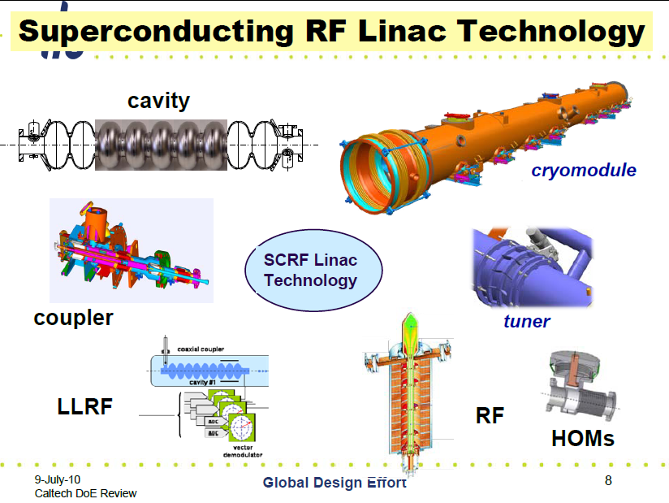

Slide 42
The ILC SCRF Cavity
Achieve high gradient (35MV/m); develop multiple
vendors; make cost effective, etc
Focus is on high gradient; production yields; cryogenic
losses; radiation; system performance

Slide 43
Global Plan for SCRF R&D
Year | 07 | 2008 |  | 2009 |  | 2010 |  | 2011 | 2012
Phase | TDP-1 |  |  |  |  |  | TDP-2
Cavity Gradient in v. test to reach 35 MV/m | → Yield 50% |  |  |  |  |  | → Yield 90%
Cavity-string to reach 31.5 MV/m, with one-cryomodule |  | Global effort for string assembly and test (DESY, FNAL, INFN, KEK)
System Test with beam acceleration |  |  | FLASH (DESY) , NML (FNAL) STF2 (KEK, test start in 2013)
Preparation for Industrialization |  |  |  |  | Production Technology R&D
Communication with industry: | 2009: 1st step: Visit Venders (2009) 2010: 2nd step: Organize Workshop (2010) 2011: 3rd step: Send specification & receive response

Slide 44
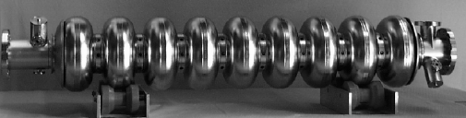
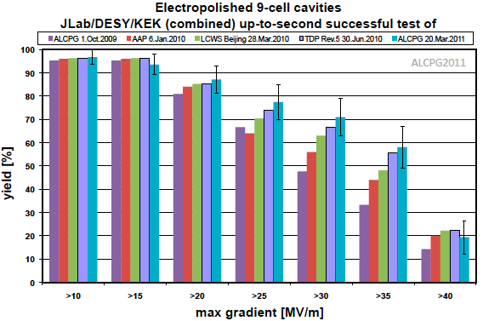
Global ILC Cavity Gradient Yield
Updated at ALCPG2011
Plot courtesy
Camille Ginsburg of FNAL
TDP-2 Goal
TDP-1 Goal
Achieved

Slide 45
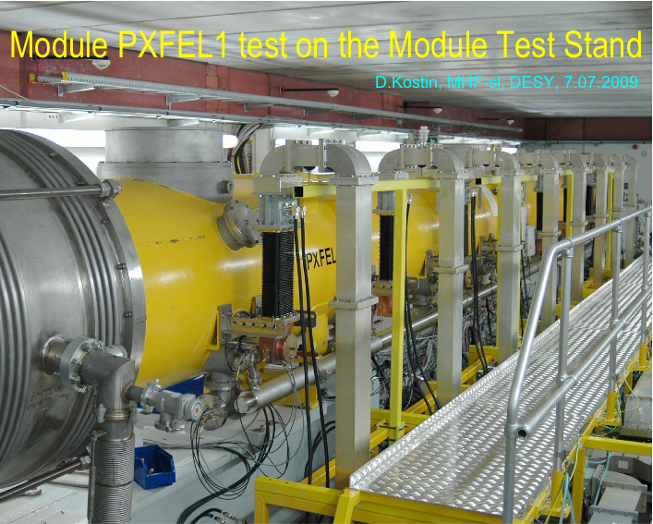
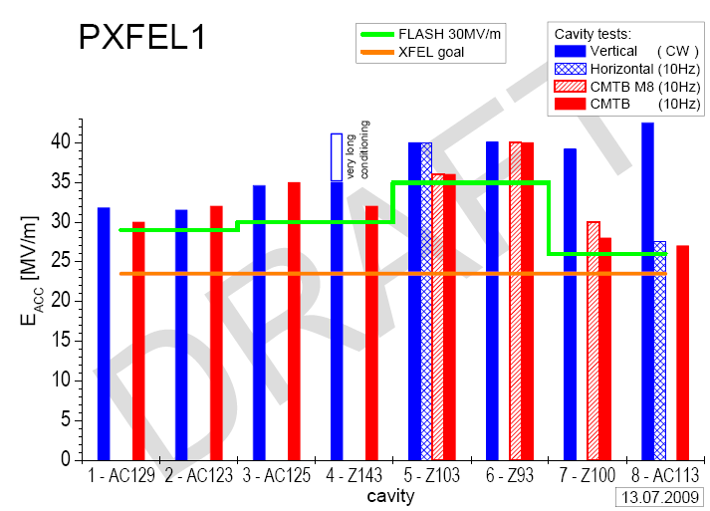
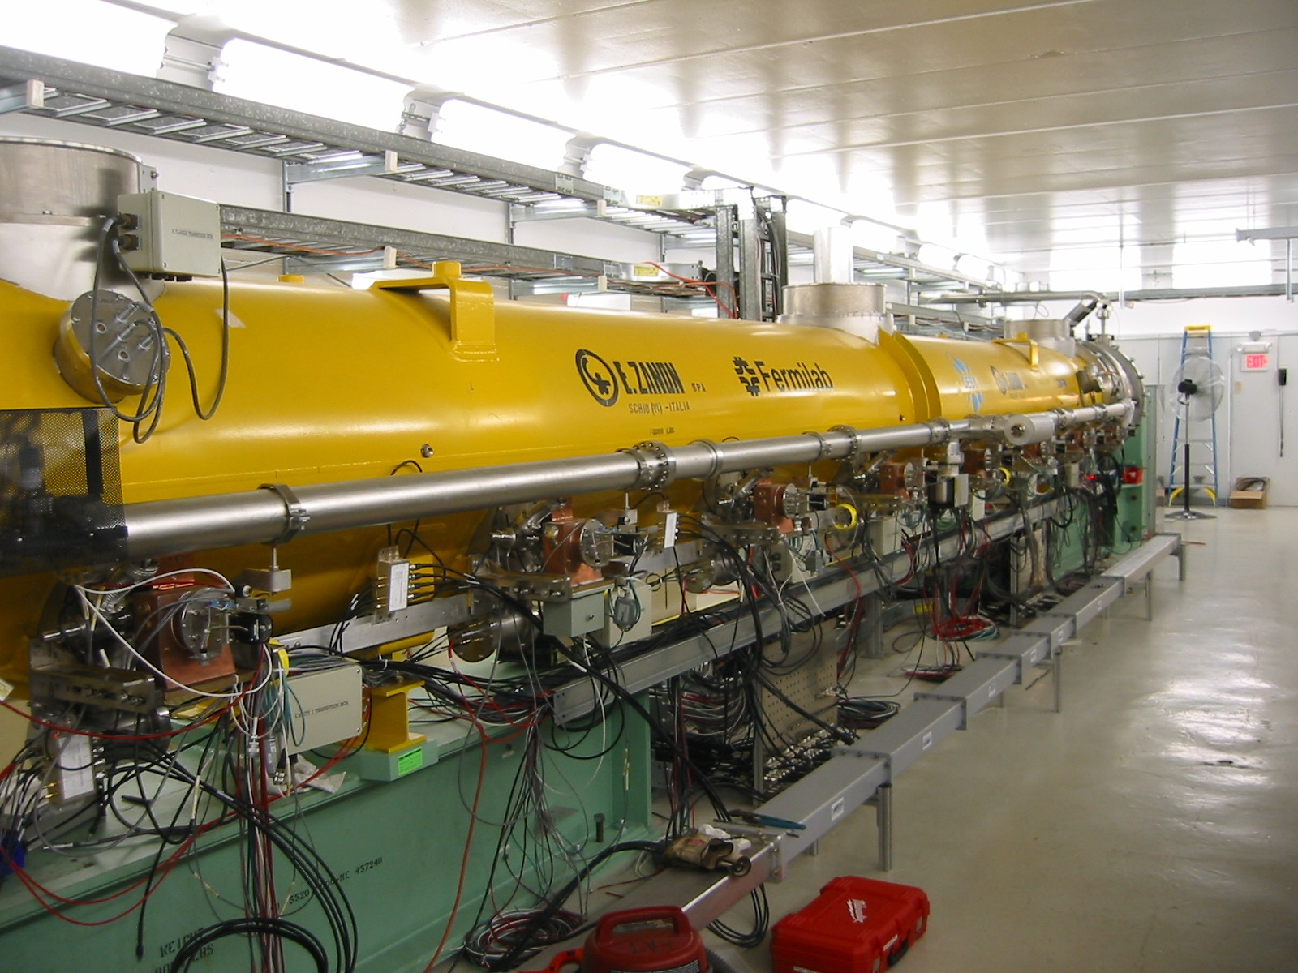
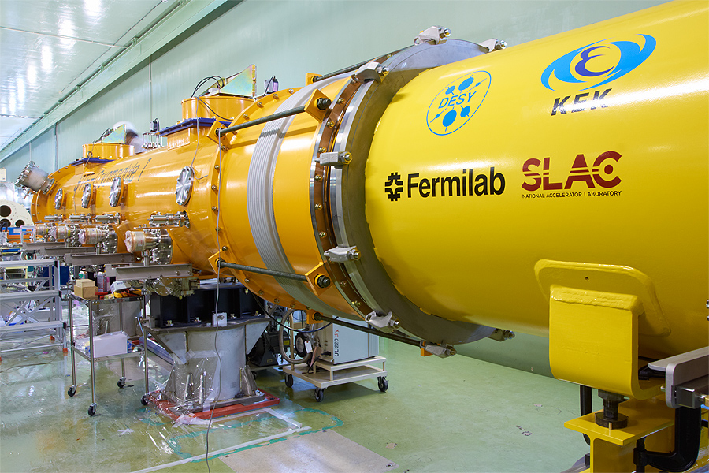
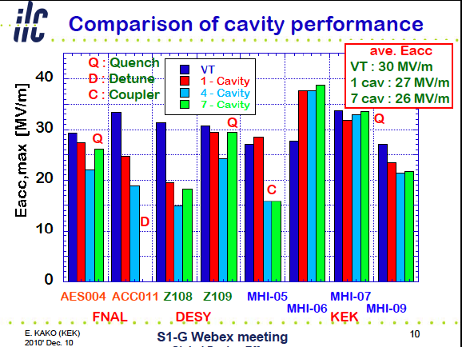
Cryomodule Development & Test
DESY: PXFEL-1
  <32 MV/m> in CM operation as ACC7, FLASH (~30MV/m)
FNAL: CM-1
  In progress
KEK: S1-Global
  <26 MV/m> in CM operation

Slide 46
CLIC

Slide 47
The CLIC Layout

Slide 48
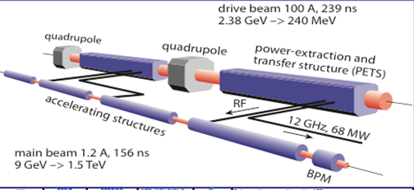
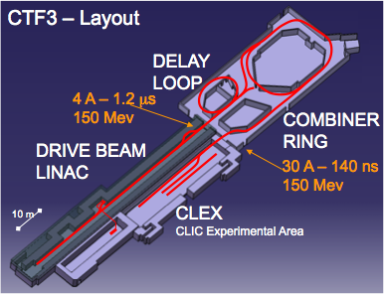
Feasibility studies and the CDR
Feasibility issues:
Drive beam generation
Beam driven RF power generation
Accelerating Structures
Two Beam Acceleration
Ultra low emittances and beam sizes
Alignment
Vertical stabilization
Operation and Machine Protection System
CDRs:
Vol 1: The CLIC accelerator and site facilities (H.Schmickler)
  CLIC concept with exploration over multi-TeV energy range up to 3 TeV
  Feasibility study of CLIC parameters optimized at 3 TeV (most demanding)
  Consider also 500 GeV, and intermediate energy ranges
Vol 2: The CLIC physics and detectors (L.Linssen)
Vol 3: CLIC study summary (S.Stapnes)
  Summary and input to the European Strategy process, including possible implementation stages for a CLIC machine as well as costing and cost-drives
  Proposing objectives and work plan of post CDR phase (2012-16)
Timescales:
  By end 2011: Vol 1 and 2 completed
  Spring/mid 2012: Vol 3 ready for the European Strategy Open Meeting
Notes:
Picture of CTF3 because it remains a key testing ground for the two beam concept
For information: Two options for the costing, 500 GeV and 1000 GeV (to be in line with ILC), or 500 GeV and discuss cost-drivers for the next stages. The value of 500 GeV is chosen to provide comparison to ILC

Slide 49
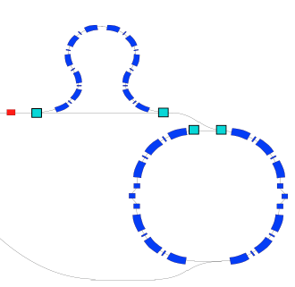
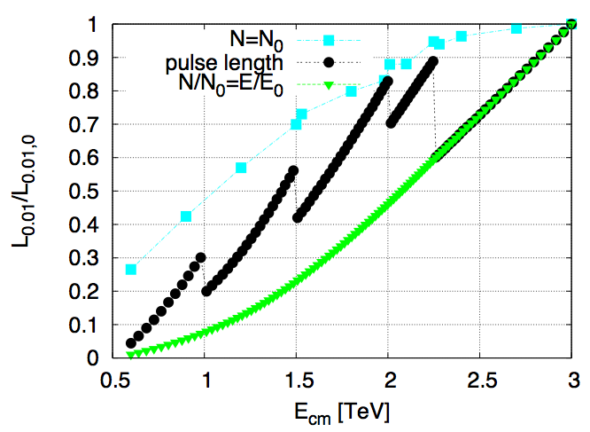
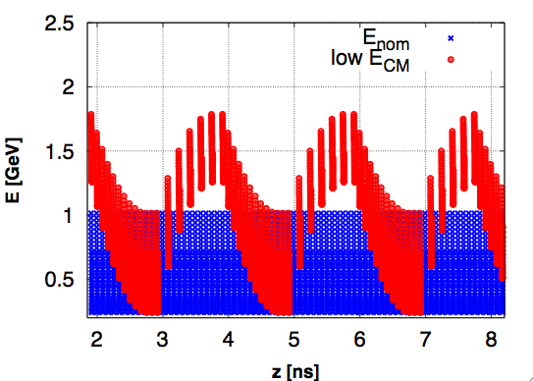
CLIC energy scans (for a single stage)
Requirement from physics : vary the c.m. energy for a given CLIC machine. Main options :
Early extraction lines : expensive, large hardware modifications needed
Reduce gradient : disadvantage: need to scale down bunch charge linearly with gradient for stability, leading to a significant luminosity loss (green)
CLIC drive beam scheme: gradient can be reduced while increasing pulse length. A large fraction of the luminosity loss is recovered (black). Modifications to drive beam generation are minimal.
Lower gradient can be achieved by switching of phase of incoming drive beam bunches :
Drive beam energy after extraction

Slide 50
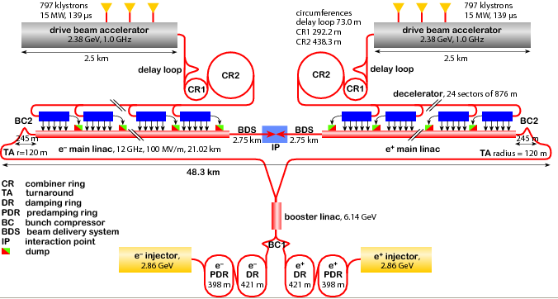
CLIC energy staging
CLIC two-beam scheme with
energy staging to provide the optimal machine for large energy range
Lower energy machine can run most of the time during the construction of the next stage.
Physics results will determine the energies of the stages.
Optimization need to take into many account many others parameters: performance and luminosities (inst. and integr.) at various energies, costs, construction and commissioning times, manufacturing/re-use/move of components, etc
Linac 1
I.P.
Linac 2
0.5 TeV Stage
Injector
Complex
4 km
4 km
~14 km
The drive beam can deal with various stages of the machine
Linac 1
I.P.
Linac 2
1 TeV Stage
Injector
Complex
7.0 km
7.0 km
~20 km
Linac 1
3 TeV Stage
I.P.
Linac 2
Injector
Complex
20.8 km
3 km
3 km
20.8 km
48.2 km

Slide 51
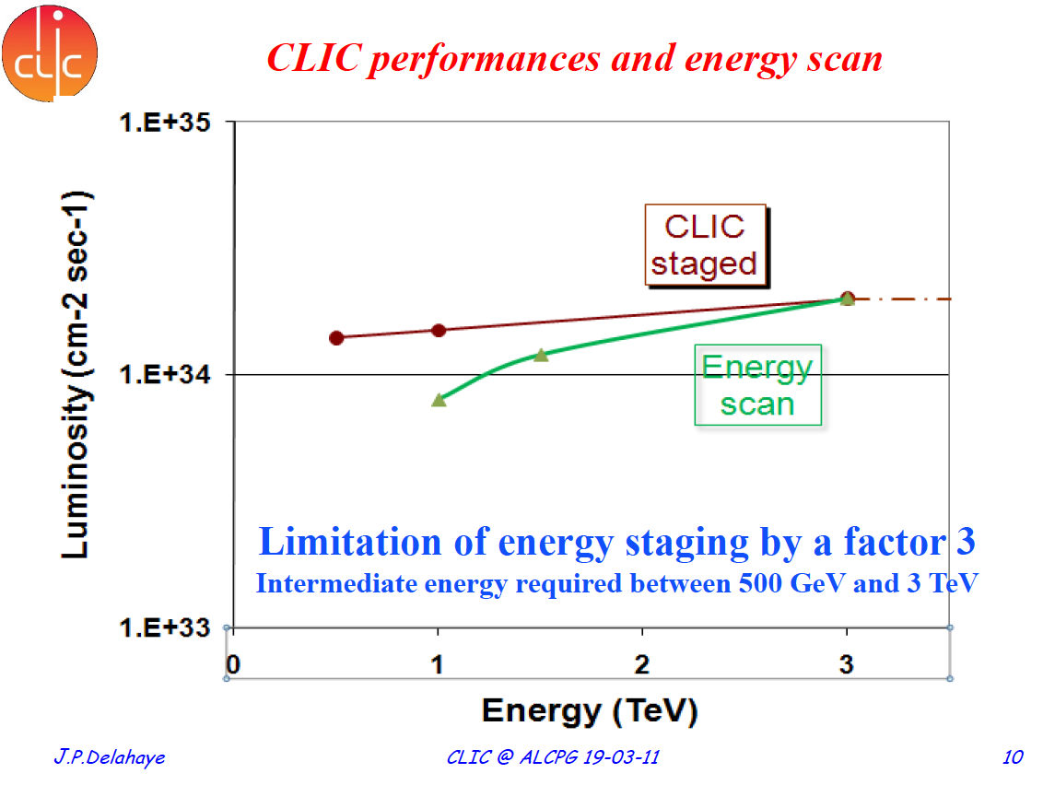

Slide 52
CLIC Tentative Schedule
Final CLIC CDR and
proposal next phase
@ European Strategy
European Strategy
for Particle Physics
@ CERN Council
Project Implementation Plan (PIP) and
proposal for next phase

Slide 54
Electron Hadron Colliders eRHIC, LHeC

Slide 55


eRHIC: 5 – 30 GeV pol. e⁻ on 100 GeV/n Au or 250 GeV pol. protons
High-Resolution, Ultra-Fast Imaging of Gluon-Dominated Matter
High-intensity energy recovery linacs (ERL) and six recirculation passes to accelerate and decelerate the electron beam
Single pass allows for large collision disruption of electron bunch and high luminosity
Major eRHIC R&D items:
  High current (50 mA) polarized electron gun
  Multi-pass high average current ERLs
  Small gap magnets and vacuum chambers
  Coherent electron cooling
L > 10³⁴ cm⁻² s⁻¹
0.6 GeV
New detector
Polarized
e-gun
2.45 GeV Energy Recovery Linac
Coherent e-cooler
3.05 GeV
2.45 GeV Energy Recovery Linac
5.50 GeV
7.95 GeV
Beam
dump
10.4 GeV
0.6 GeV
12.85 GeV
15.3 GeV
17.75 GeV
20.2 GeV
22.65 GeV
25.1 GeV
27.55 GeV
30.0 GeV
ePHENIX
100 m
eSTAR

Slide 56
Coherent electron cooling
Idea proposed by Y. Derbenev in 1980, novel scheme with full evaluation developed by V. Litvinenko
Fast cooling of high energy hadron beams
Made possible by high brightness electron beams and FEL technology
~ 20 minutes cooling time for 250 GeV protons  reduced proton emittance gives high eRHIC luminosity at much reduced electron current
Proof-of-principle demonstration planned with 40 GeV/n Au beam in RHIC.
Pick-up: electrostatic imprint of hadron charge distribution onto co-moving electron beam
Amplifier: Free Electron Laser (FEL) with gain of 100 -1000 amplifies density variations of electron beam, energy dependent delay of hadron beam
Kicker: electron beam corrects energy error of co-moving hadron beam through electrostatic interaction
E < E_{h}
E_{h}
Dispersion section
Hadrons
Modulator
E > E_{h}
Kicker
High gain FEL
Electrons

Slide 57
EIC/eRHIC Realization Imagined
Potential Electron-Ion Collider Timeline Shown by Hugh Montgomery at INT Workshop, Sept. 2010
Activity Name | 2010 | 2011 | 2012 | 2013 | 2014 | 2015 | 2016 | 2017 | 2018 | 2019 | 2020 | 2021 | 2022 | 2023 | 2024 | 2025
12 Gev Upgrade
FRIB
EIC Physics Case
NSAC LRP
CD0
Machine Design/R&D
CD1/D’nselect
CD2/CD3
Construction
Notes:
57

Slide 58

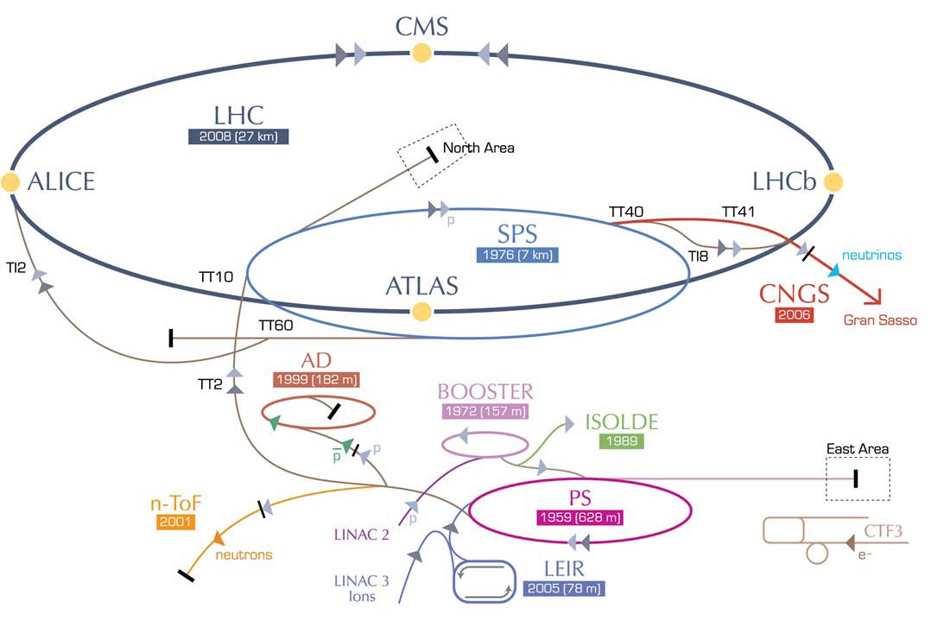
LHeC options: RR and LR
RR LHeC:
new ring in
LHC tunnel,
with bypasses
around
experiments
RR LHeC
e-/e+ injector
10 GeV,
10 min. filling time
LR LHeC:
recirculating
linac with
energy
recovery,
or straight
linac
Frank Zimmermann, UPHUK4 Bodrum 2010

Slide 59
Design Parameters
electron beam | RR | LR | LR*
e- energy at IP[GeV] | 60 | 60 | 140
luminosity [10³² cm⁻²s⁻¹] | 17 | 10 | 0.44
polarization [%] | 40 | 90 | 90
bunch population [10⁹] | 26 | 2.0 | 1.6
e- bunch length [mm] | 10 | 0.3 | 0.3
bunch interval [ns] | 25 | 50 | 50
transv. emit. γε_{x,y} [mm] | 0.58, 0.29 | 0.05 | 0.1
rms IP beam size σ_{x,y} [μm] | 30, 16 | 7 | 7
e- IP beta funct. β*_{x,y} [m] | 0.18, 0.10 | 0.12 | 0.14
full crossing angle [mrad] | 0.93 | 0 | 0
geometric reduction H_{hg} | 0.77 | 0.91 | 0.94
repetition rate [Hz] | N/A | N/A | 10
beam pulse length [ms] | N/A | N/A | 5
ER efficiency | N/A | 94% | N/A
average current [mA] | 131 | 6.6 | 5.4
tot. wall plug power[MW] | 100 | 100 | 100
proton beam | RR | LR
bunch pop. [10¹¹] | 1.7 | 1.7
tr.emit.γε_{x,y} [μm] | 3.75 | 3.75
spot size σ_{x,y} [μm] | 30, 16 | 7
β*_{x,y} [m] | 1.8,0.5 | 0.1
bunch spacing [ns] | 25 | 25
“ultimate p beam”
1.7 probably conservative
Design also for deuterons
(new) and lead (exists)
RR= Ring – Ring
LR =Linac –Ring
Ring uses 1º as baseline : L/2
Linac: clearing gap: L*2/3
*) pulsed, but high energy ERL not impossible
EPS-HEP, 23 July 2011, Grenoble
Oliver Brüning CERN

Slide 60
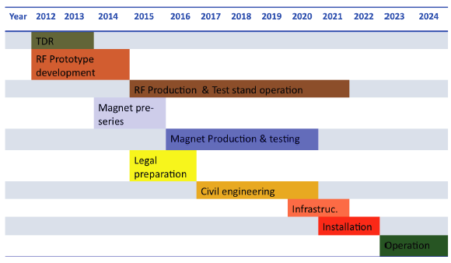
LHeC Tentative Time Schedule
LS3 --- HL LHC
EPS-HEP, 23 July 2011, Grenoble
Oliver Brüning CERN

Slide 61
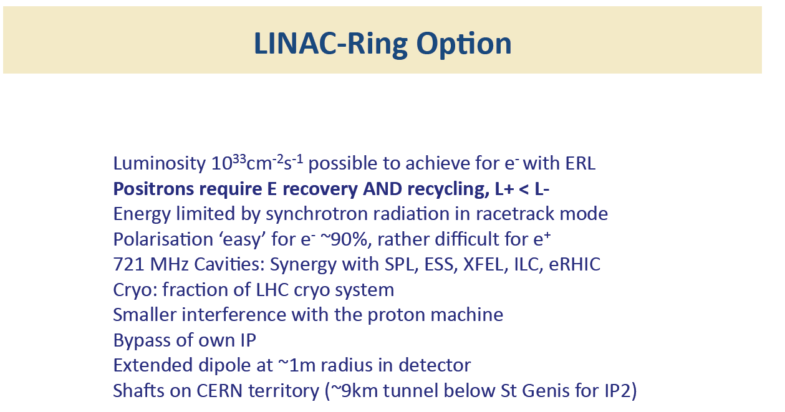

Slide 62
Main accelerator challenges

Slide 63
HE-LHC

Slide 64
HE-LHC – LHC modifications
HE-LHC
2030-33
SPS+,
1.3 TeV, 2030-33
2-GeV Booster
Linac4

Slide 65
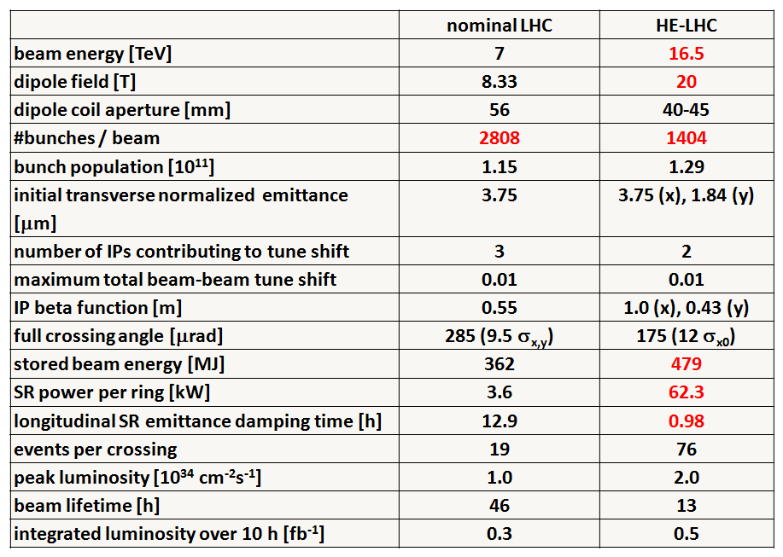
Preliminary HE-LHC - parameters
Very Long Term Objectives: Higher Energy LHC
Very preliminary with large error bars

Slide 66
HE-LHC – main issues and R&D
high-field 20-T dipole magnets based on Nb₃Sn, Nb₃Al, and HTS
high-gradient quadrupole magnets for arc and IR
fast cycling SC magnets for 1-TeV injector
emittance control in regime of strong SR damping and IBS
cryogenic handling of SR heat load (first analysis; looks manageable)
dynamic vacuum

Slide 67
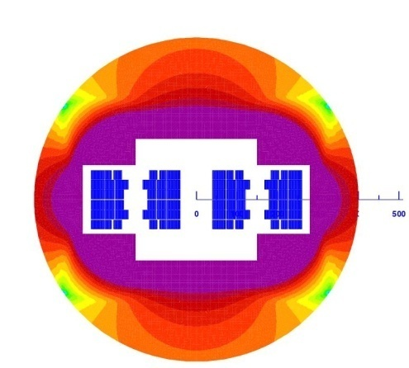
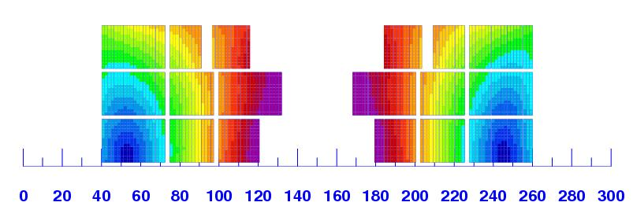
High Energy-LHC (HE-LHC)
CERN working group since April 2010
EuCARD AccNet workshop HE-LHC’10 ,
14-16 October 2010, Proc. CERN-2011-003
key topics
beam energy 16.5 TeV; 20-T magnets
cryogenics: synchrotron-radiation heat
radiation damping & emittance control
vacuum system: synchrotron radiation
new injector: energy > 1 TeV
parameters
E. Todesco
 | LHC | HE-LHC
beam energy [TeV] | 7 | 16.5
dipole field [T] | 8.33 | 20
dipole coil aperture [mm] | 56 | 40
#bunches | 2808 | 1404
IP beta function [m] | 0.55 | 1 (x), 0.43 (y)
number of IPs | 3 | 2
beam current [A] | 0.584 | 0.328
SR power per ring [kW] | 3.6 | 65.7
arc SR heat load dW/ds [W/m/ap] | 0.21 | 2.8
peak luminosity [10³⁴ cm⁻²s⁻¹] | 1.0 | 2.0
events per crossing | 19 | 76
hybrid magnet

Slide 68
Neutrinos

Slide 69
ν-Accelerators : Future possibilities
Long, Very-long baselines
ν-source | Beam | [km] | Proton beam |  | Accelerators
 |  |  | [GeV] | [kW]
CERN | CNGS | 730 | 400 | 510 | SPS
 | Pyhasalmi | 2’300 | 400 30-50 | 510 - 750 2’000 | SPS + upgrade LP-SPL + HPPS
 | Frejus | 130 | 8 | 4’000 | HP-SPL + accumulator
FNAL | MINOS | 735 | 120 | 300 - 700 | Main Injector + upgrade
 | NOνA | 830
 | LBNE | 1’600 | 120 | 700 - 2’300 | MI + upgrade, Project-X
J-PARC | T2K | 250 | 30 | 70 – 1’600 | Main Ring + upgrade
 | Okinoshima | 658 | 30 | 3’800 | Main Ring + upgrade
Technical challenges for accelerators:
  high-power proton drivers, targets, collection systems
R&D Studies with strong EU participation and International Collaboration
  EUROnu[Super Beam, β-beam, Neutrino Factory], LAGUNA[detectors] – LAGUNA_LBNO

Slide 70
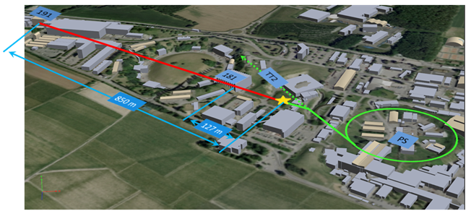
ν-Accelerators : Future possibilities
From the (very)long ⟶(very)short baselines to search for anomalous ν oscillations – sterile ν’s ??
FNAL: Booster beam (8 GeV) to MiniBooNE and upgrades, MicroBooNE
CERN : PS Neutrino Beam
Beam line originally operated in early 80’s for PS169, PS181, PS180(BEBC)
Near (150t) + Far(600t) detector with ICARUS LArgon technology
Expect : 6.13 10¹⁹ ÷ 2.1 10²⁰ pot/y @ 20 GeV, depending on beam sharing

Slide 71
ν-Accelerators : Future possibilities
R&D Studies with strong EU participation and International Collaboration
  EUROnu
  LAGUNA – LAGUNA_LBNO
  International Design Study for a Neutrino Factory (IDS-NF)
Intensity upgrades – Long(Very-Long)-baseline beams
Facilities for precision measurements
Super-beam (Frejus)
Neutrino Factory
Present generation
Beta-beams
NOνA – LBNE
T2K (1.6MW)
CN2PY (Pyhasalmi-FI)
θ₁₃ measurement
θ₁₃ measurement, CP violation, mass hierarchy
2-4 MW
700kW – 1(2) MW
300-400 kW

Slide 72
Muon Collider

Slide 74
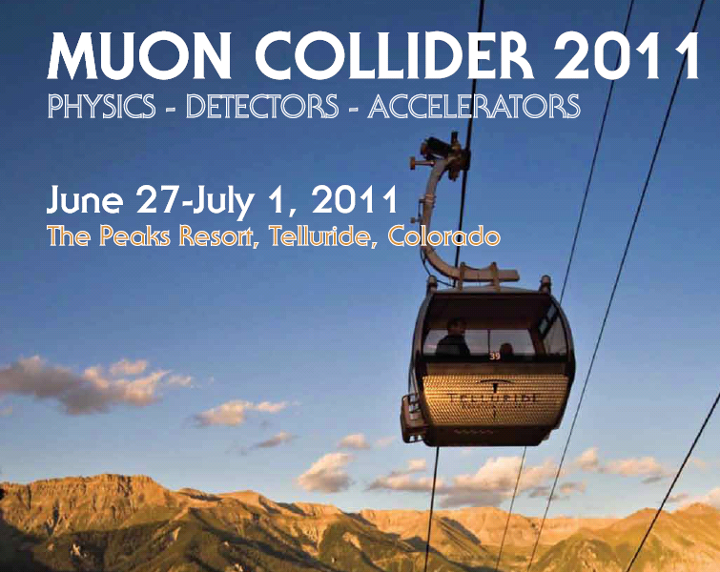
Engaging the Community
“…To review the physics case for a Muon Collider, accelerator R&D progress, the outstanding challenges, future plans, and opportunities for new and existing groups to participate in the R&D. “
http://conferences.fnal.gov/muon11/

Slide 75
Muon Collider Challenges
Need Multi-MW proton target with long lifetime
  Liquid Hg jet MERIT experiment demo up to 8 MW
Need a technology for capture and cooling
  Gas-filled RF cavities operating inside magnetic fields offer a possible solution
  R&D program at Fermilab’s MuCool Test Area
Need demonstration of 6D cooling by a factor of 10⁶
  4D MICE experiment in progress (demonstrate O(10%) by ~2014)
  6D cooling experiment sometime after 2015
Need development of very high field solenoids
  >30T for last stages of cooling, with luminosity proportional to field
  Program started at several labs FNAL, BNL, LBNL

Slide 76
Muon Collider Challenges
Need substantial acceleration length (few km)
  Ideally would use ILC technology
  Major wall plug power consumer (out of perhaps 160 MW total)
Need end-to-end system simulation to understand beam dynamics, ultimate losses, and emittances
  Recent substantial progress with collider ring, optimized cooling channels and proton beam compression ring designs
Need demonstration of LC precision physics capability with realistic detector, MDI, and backgrounds simulation
  Will require detailed simulation and physics performance studies
  Upcoming workshop at Telluride, CO June 27-July 1

Slide 77
High Energy Frontier (Colliders)
Recent Progress
    Tevatron
    RHIC
    LHC
Future Directions
    Future Ion Colliders
    HL-LHC
    ILC/CLIC
    electron-hadron colliders
    HE-LHC
    Neutrinos (Intensity Frontier)
    Muon collider
Operating
Approved, funded?
Degree of feasibility, matureness,
(Likelihood)
Not yet approved

Slide 78
Ad personam Issues (1)
The physics output from the LHC will be decisive
If 500GeV cm is sufficient:
  ILC500; almost ready to go with construction (>200MW of electrical power, capital cost)
  CLIC500; staged version, several years technical development needed (>200MW of electrical power, capital cost)
If 1000GeV is needed and sufficient
  ILC1000; at the upper energy limit of this technology (~400MW Electrical power, serious issue, capital cost, 50km)
  CLIC1000; staged version, several years technical development needed (~400MW Electrical power is a serious issue)
If 3000GeV is needed and sufficient
  CLIC3000; maximum energy imaginable, still some major feasibility issues (560MW of electrical power would make this highly undesirable for the ecologists + operational costs)
If even higher energies are needed
  HE-LHC; aggressive R&D for high field sc magnets needed, SPS upgrade, injection/extraction systems, synchrotron radiation…
  Muon collider; many as yet unsolved technical issues (list too long to record), but very interesting accelerator physics… very long term
Aggressive R&D needed to increase the efficiency wall-plug to beam

Slide 79
Summary (2)
If e-p is interesting as a complimentary project:
    LHeC (RR): certainly technically do-able. Integration presents major challenges, impact on the LHC operation is a major concern. By-passes are not trivial
    LHeC (LR): luminosity (10³³)may be difficult to achieve, ERL a major challenge but is very interesting due to synergy with many other projects.
All these projects need continuing accelerator R&D so that the right decision can be made when the time comes to identify the next energy frontier accelerator (collider). We need to keep our choices open.

Slide 80
Thank you
Acknowledgement
Sincere thanks to all the people from whom I have begged, borrowed or stolen slides

Slide 81
SPARES

Slide 82
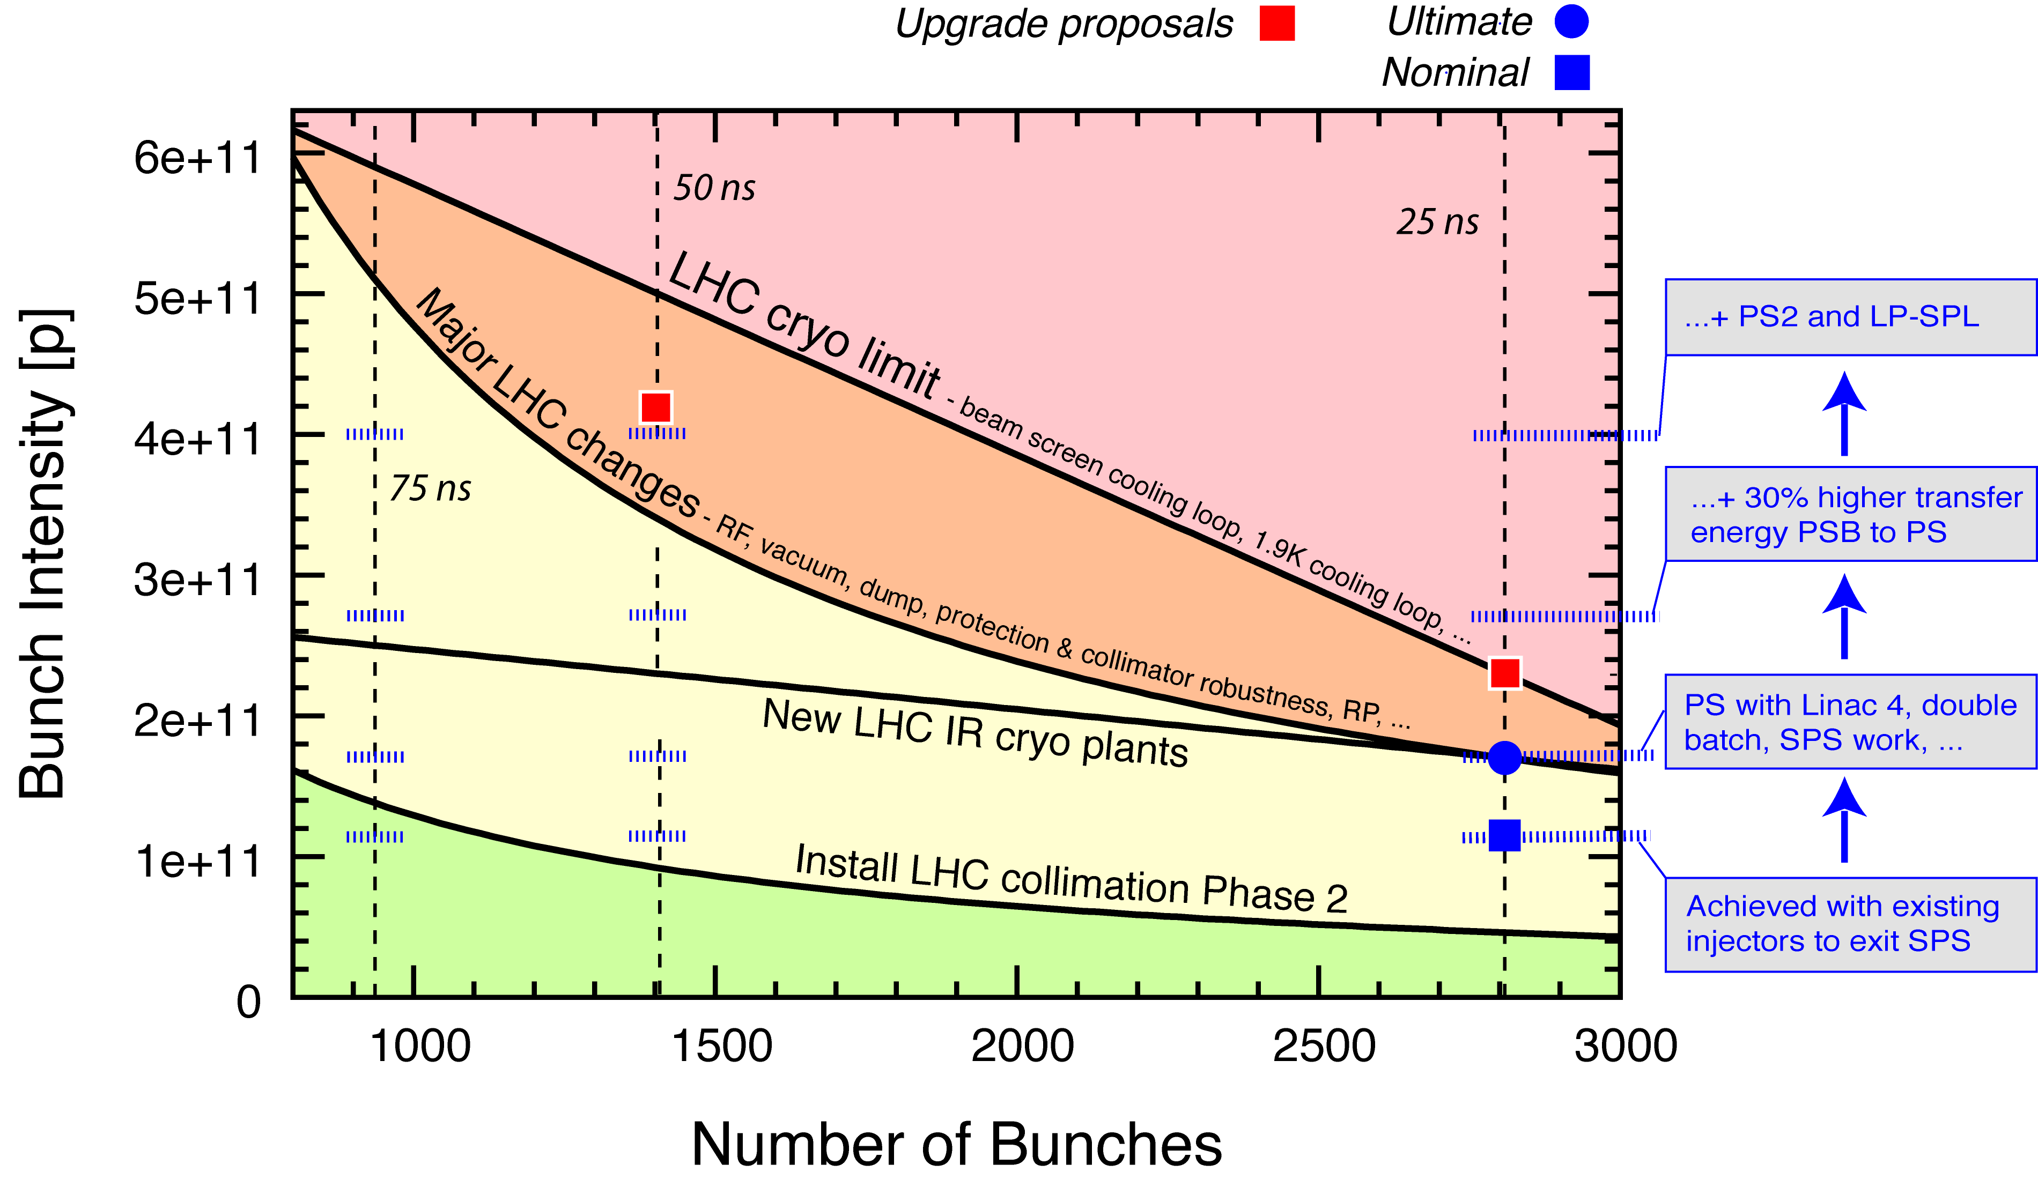
Summary of LHC Intensity Limits (7 TeV)
Chamonix 2011
Beam Current Limit of ca. 1 A / beam!

Slide 83
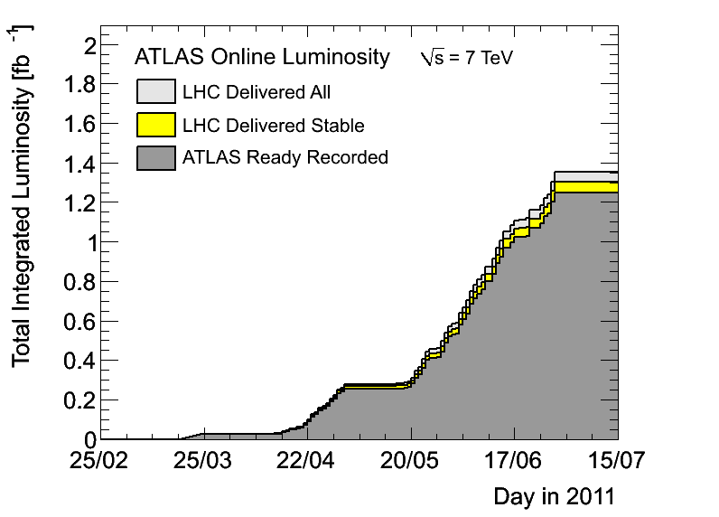
Luminosity
26 pb⁻¹/day

Slide 84
TeVatron

Slide 85
RHIC

Slide 86
LHC

Slide 87
RHIC “Ions”

Slide 88
LIU

Slide 89
LIU

Slide 90
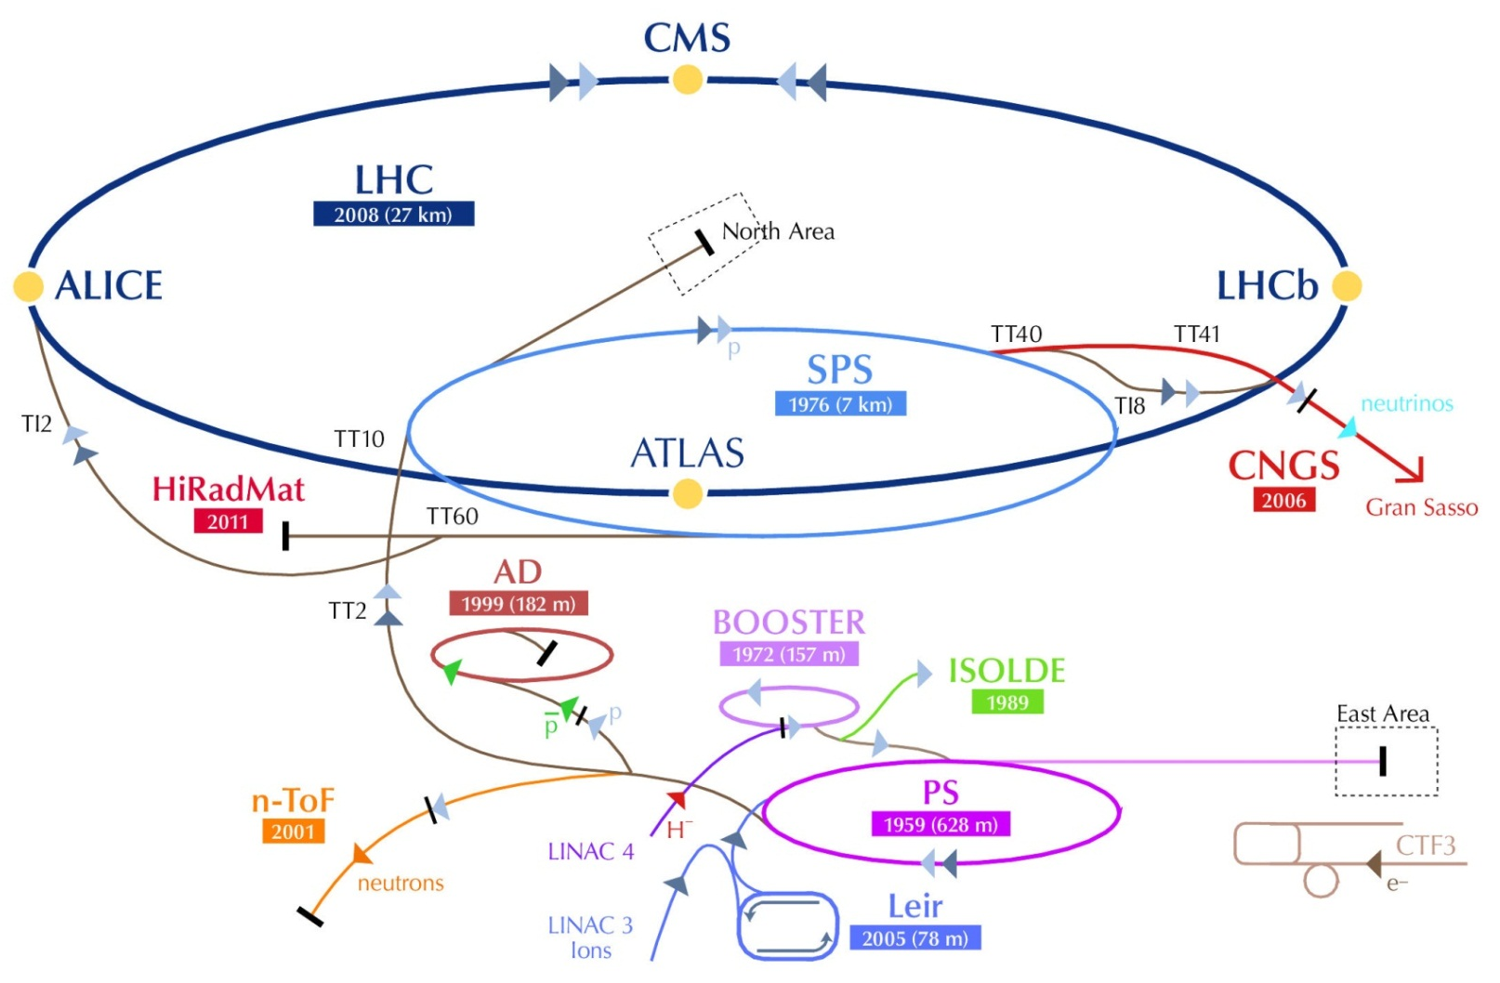
Future directions for the LHC Injectors
R. Garoby
15/07/2011

Slide 91
Beam specifications
(Work in progress...)
HL-LHC / LIU Brainstorming – June 2011 https://indico.cern.ch/conferenceDisplay.py?confId=138437
CERN-ATS-2010-177
[First thoughts on a higher energy LHC]
 | Nominal LHC | HL-LHC | HE-LHC
Beam energy [GeV] | 450 | 450 | > 1000
Distance between bunches [ns] | 25 | 25 (resp. 50) | 50
Bunch population* [10¹¹ p/b] | 1.2 | ~2 (resp. 3.3) | ~1.4
Transverse normalized emittance [μm] | 3.5 | <2.5 (resp.3) | 3.75 (H) 1.84 (V) | 2.59 (H & V)
Longitudinal emittance [eVs] | 1 | 1? | ?

Slide 92
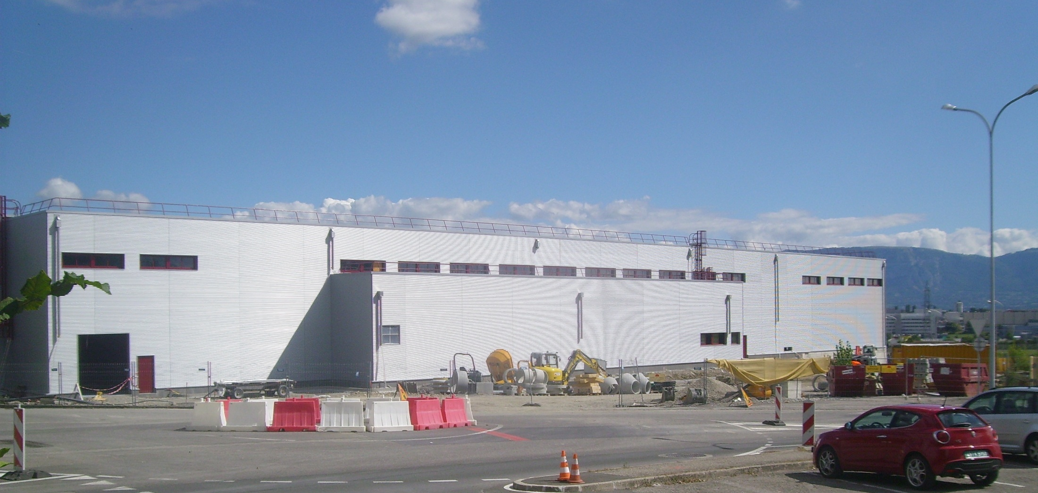
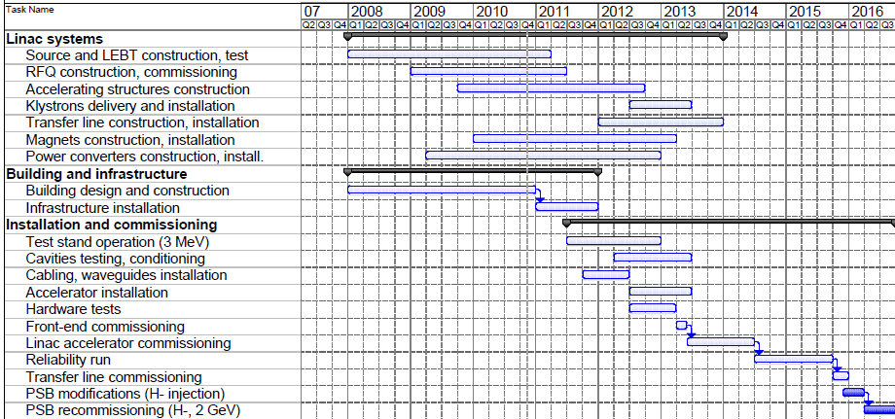
HL-LHC (1/2)
Challenges for the injectors:
Higher brightness:
  Increased injection energy in the PSB from 50 to 160 MeV [Linac4 replacing Linac2]
2011:
Infrastructure installation
2012/13:
Accelerator installation
2013/14:
Commissioning
July 2014:
Linac4 ready

Slide 93
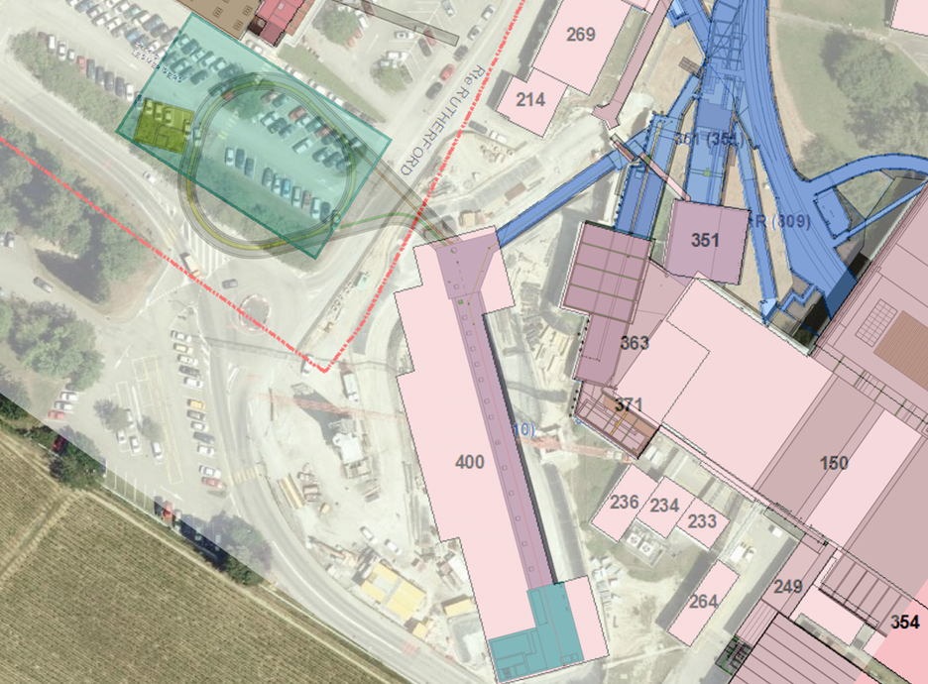
HL-LHC (2/2)
Challenges for the injectors:
Higher brightness:
  Increased injection energy in the PS from 1.4 to 2 GeV [increased PSB energy or new RCS]
  Upgrades in PSB, PS and SPS for handling higher brightness beams (feedbacks, cures against electron clouds, hardware modifications to reduce impedance…)
Reliability during the period 2018-2030:
  Upgrade/replacement of ageing equipment (power supplies, magnets, RF…)
  Procurement of spares
  Improvement of radioprotection measures (shielding, ventilation…)

Slide 94
HE-LHC
Challenges for the injectors:
1.2 TeV beam energy:
  new 1.2 TeV synchrotron either in the LHC tunnel or in the SPS tunnel,
  or use of the LHC itself, if it is economically interesting to locate the HE-LHC in a new and longer tunnel.
Operation during 2030-2050:
  replacement of all or part of the existing synchrotrons (to improve reliability, reduce the cost of maintenance and decrease the environmental impact). The specifications of these new accelerators could also be influenced by the needs of other users (e.g. for neutrinos and/or nuclear physics). Typical example:
Bmax~5 T
Bdotmax~2T/s
Energy range | Machine | Other application
100 GeV – 1.2 TeV | HE-SPS | RIB acceleration?
~8 - 100 GeV | HE-PS | RIB acceleration ?
Up to ~8 GeV | SC linac | (+ 2 fixed energy rings) μ production for ν factory
Bmax~4 T
Bdotmax~3T/s

Slide 95
Potential Proton Drivers at CERN
R. Garoby
15/07/2011

Slide 96
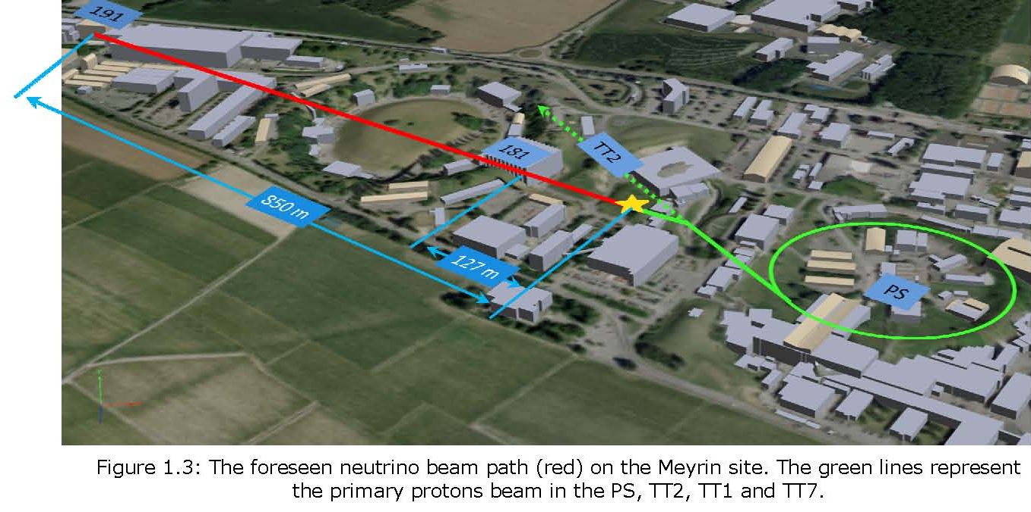
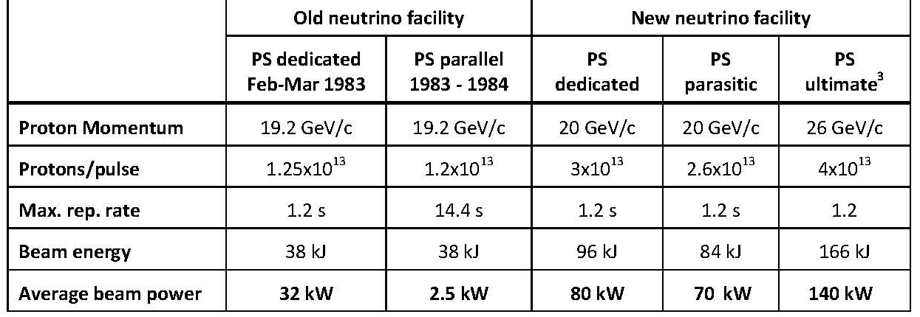
PS-based Proton Driver
[EDMS Document No.1108369 rev 1.1]
Draft layout
Short baseline experiment
Proton beam characteristics

Slide 97

SPS-based Proton Driver
From LAGUNA-LBNO proposal (EU-FP7)
CERN-AB-2007-013 PAF
Long baseline experiment (2300 km)
CERN-Pyhasalmi (Finland)
1.3 x nominal CNGS performance

Slide 98

High Power PS-based Proton Driver
New High Power PS (30-50 GeV, 2MW beam power) using the Low Power SPL (LP-SPL) as injector. Future Feasibility Study based on the work for LP-SPL and PS2 to be supported within the LAGUNA-LBNO DS (EU-FP7)
Long baseline experiment (2300 km)
CERN-Pyhasalmi (Finland)
CN2PY
Near detector
Target
0.75-2MW
HPPS
(LP)-SPL

Slide 99
Linac (SPL)-based Proton Driver (1/4)
High Power SPL and fixed energy accumulator (5 GeV, 4MW beam power). Based on Linac4 and the HP-SPL R § D, to be complemented within the LAGUNA-LBNO DS (EU-FP7)
Medium baseline experiment (150 km)
CERN-Frejus (France)
Main characteristics
Ion species H⁻
Output Energy 5 GeV
Bunch Frequency 352.2 MHz
Repetition Rate 50 Hz
High speed chopper < 2 ns
(rise & fall times)
Required for low loss in accumulator
Required for muon production
Required for flexibility and low loss in accumulator
 | Option 1 | Option 2
Energy (GeV) | 2.5 or 5 | 2.5 and 5
Beam power (MW) | 2.25 MW (2.5 GeV) or 4.5 MW (5 GeV) | 5 MW (2.5 GeV) and 4 MW (5 GeV)
Protons/pulse (x 10¹⁴) | 1.1 | 2 (2.5 GeV) + 1 (5 GeV)
Av. Pulse current (mA) | 20 | 40
Pulse duration (ms) | 0.9 | 1 (2.5 GeV) + 0.4 (5 GeV)
2 × beam current ⇒ 2 × nb. of klystrons etc .

Slide 100

Linac (SPL)-based Proton Driver (2/4)
HP-SPL block diagram
0 m
0.16 GeV
110 m
0.73 GeV
291 m
2.5 GeV
500 m
5 GeV
From Linac4
Medium β cryomodule
High β cryomodules
Ejection
High β cryomodules
Debunchers
To HP-PS and/or Accumulator
9 x 6
β=0.65 cavities
11 x 8
β=1 cavities
to
EURISOL
13 x 8
β=1 cavities
Segmented cryogenics / separate cryo-line / room temperature quadrupoles:
Medium β (0.65) – 3 cavities / cryomodule
High β (1) – 8 cavities / cryomodule
Low energy
Intermediate energy
High energy

Slide 101

Linac (SPL)-based Proton Driver (3/4)
Objective of HP-SPL R § D:
String of 4 “equipped β=1 cavities” with main couplers § tuners to be installed into a short cryo-module by 2013 and tested in 2014.
Cryomodule
(CERN – CNRS)

Slide 102

Linac (SPL)-based Proton Driver (4/4)
SPL β = 1 cavity + helium tank + tuner + main coupler
Bulk niobium cavities (CERN)
HOM coupler
(CERN – Uni Rostock)
Helium tank
(CERN – CEA)
Tuner (CEA)
Main coupler
(CERN)

Slide 103
HL-LHC

Slide 104
Operation Experience in 2010/2011: Pros
Aperture ➔ better than expected (β-beat, dispersion, tolerances)
Emittance ➔ able to operate the LHC with 50% smaller than
nominal beam emittances (aperture & brightness)
beam-beam: ➔ able to collide beams with larger than nominal
beam-beam parameters
Leveling: ➔ successful for LHCb by separation
Collimation ➔ better than expected beam lifetimes
ability to re-optimize beam parameters for higher performance
  smaller beam emittance and larger beam-beam parameter

Slide 105
Operation Experience in 2010/2011: Cons
e-cloud ➔ confirmed to be an issue for the LHC
beam scrubbing is effective
UFOs: ➔ origin not yet understood
➔ proportional to number of bunches (total beam current)
R2E: ➔ first events observed, but not as bad as expected at >10³³
➔ will increase with luminosity and beam intensity
105

Slide 106

HL-LHC paves the way for the future
  SCRF (Crab Cavity), SC link 1 GW rate, HF SC magnets

Slide 107
The goal
The main objective of HL-LHC is to implement a hardware configuration and a set of beam parameters that will allow the LHC to reach the following targets:
A peak luminosity of 5×10³⁴ cm⁻²s⁻¹ with levelling, allowing:
An integrated luminosity of 250 fb⁻¹ per year, enabling the goal of 3000 fb⁻¹ twelve years after the upgrade. This luminosity is more than ten times the luminosity reach of the first 10 years of the LHC lifetime.

Slide 108
Goal – cont.
Levelled lumi of LL_{p} =5⋅10³⁴ s⁻¹ cm⁻² (not Hz cm⁻²)
Annual integrated luminosty: IL =250 fb-1
  More than 1 fb⁻¹ a day
Which is more important? I guess IL . We take L_{p} as guideline, not a barrier, however it is understood that this is the nominal limit.
These goals are already questioning parameter space of Linear Collider: we need to be correct, optimist but not overoptimist

Slide 109
We need to have potential for L_{p} =10-15⋅10³⁴ (before levelling)
  Today the preferred baseline is to reach 5 10³⁴ and then « crabbing ». But may be we put crab at max immediately and then use another parameters.
  We cannot rely only on one scheme: we need to have scheme with very low β and not small β, we need to explore very high beam current and moderate beam current, and having more than on leveling methods.
  Many actions will be needed in addition to the most visible being discussed today to reach integrated :
    Turn around time: will allow « releasing » beam current (protection)
    Stops, Shutdowns, etc…
      Advanced robotics and monitoring?
      Remove on surface of sensible equipments.
    To be worked out with experiments
    The upgrade is « ultimate consolidation », too. I see these actions as a « continuum » with some spike activities , the biggest being the final installation around 2021-22

Slide 110

Cold Powering
Cold powering system: electrical transfer of the current from the room temperature terminal of the current leads to the magnet bus (LHe). It is an active mechanical, electrical and cryogenic system that incorporates superconducting parts - in the LHC High Temperature Superconductor (Bi-2223) in the current leads and Low Temperature Superconductor (Nb-Ti) in the bus.
LHC: DFBs in line
with the magnets
in most of the cases.
Power converters are in the
tunnel in dedicated alcoves
-as near as possible to the
the DFBs.
Current Leads
From A. Ballarino - CERN
SC bus bar
DFB

Slide 111
Current Leads
Powering via remote power converters
requires the use superconducting links
DFB
Electrical transfer at cryogenic temperature
across long lengths
Link
From A. Ballarino - CERN
SC bus bar

Slide 112
Cold Powering via Superconducting Links
Advantages of remote powering:
Safer long-term operation of powering equipment (power converters, current leads
and associate auxiliary devices) located in a radiation-free environment;
Safer access of personnel to equipment for maintenance, repair, diagnostic and
routine tests interventions;
Reduced time of interventions on power converters, current leads and DFBs if the
powering equipment is located outside of the tunnel areas – gain in machine
availability ;
- Free space in the beam areas which becomes available for other equipment.
From A. Ballarino - CERN

Slide 113
example HL-LHC parameters, β*=15 cm
parameter | symbol | nom. | nom.* | HL crab | HL sb + lrc | HL 50+lrc
protons per bunch | N_{b} [10¹¹] | 1.15 | 1.7 | 1.78 | 2.16 | 3.77
bunch spacing | Δt [ns] | 25 | 50 | 25 | 25 | 50
beam current | I [A] | 0.58 | 0.43 | 0.91 | 1.09 | 0.95
longitudinal profile |  | Gauss | Gauss | Gauss | Gauss | Gauss
rms bunch length | σ_{z} [cm] | 7.55 | 7.55 | 7.55 | 5.0 | 7.55
beta* at IP1&5 | β∗ [m] | 0.55 | 0.55 | 0.15 | 0.15 | 0.15
full crossing angle | θ_{c} [μrad] | 285 | 285 | (508-622) | 508 | 508
Piwinski parameter | φ=θ_{c}σ_{z}/(2*σ_{x}*) | 0.65 | 0.65 | 0.0 | 1.42 | 2.14
tune shift | ΔQ_{tot} | 0.009 | 0.0136 | 0.011 | 0.008 | 0.010
potential pk luminosity | L [10³⁴ cm⁻²s⁻¹] | 1 | 1.1 | 10.6 | 9.0 | 10.1
events per #ing |  | 19 | 40 | 95 | 95 | 189
effective lifetime | τ_{eff} [h] | 44.9 | 30 | 13.9 | 16.8 | 14.7
run or level time | t_{run,level} [h] | 15.2 | 12.2 | 4.35 | 4.29 | 4.34
e-c heat SEY=1.2 | P [W/m] | 0.2 | 0.1 | 0.4 | 0.6 | 0.3
SR+IC heat 4.6-20 K | P_{SR+IC} [W/m] | 0.32 | 0.30 | 0.62 | 1.30 | 1.08
IBS ε rise time (z, x) | τ_{IBS,z/x} [h] | 59, 102 | 40, 69 | 38, 66 | 8, 33 | 18, 31
annual luminosity | L_{int}[fb⁻¹] | 57 | 58 | 300 | 300 | 300

Slide 114
ILC/CLIC
Steinar

Slide 115
ILC yamamoto

Slide 116
Major R&D Goals for Technical Design
  SCRF
    High Gradient R&D - globally coordinated program to demonstrate gradient by 2010 with 50%yield; improve yield to 90% by TDR (end 2012)
    Manufacturing: plug compatible design; industrialization, etc
    Future systems tests: NML (FNAL), STF2 (KEK)
  Test Facilities
    ATF2 - Fast Kicker tests and Final Focus design/performance
    CesrTA - Electron Cloud tests to establish damping ring parameters/design and electron cloud mitigation strategy
    FLASH – Study performance using ILC-like beam and cryomodule
Global Design Effort
Notes:
116

Slide 117


Single Tunnel Options (HLRF)
Distributed RF Sources (DRFS)
  800 kW MAK
  Everything in tunnel
Klystron Cluster Scheme (KCS)
  Surface clusters of klystrons (2×32 MBK)
  RF power distributed via over-moded waveguide (350 MW)
    ±1 km
RDR HLRF Technology
  e.g. XFEL-like solution
  (pulsed cables)
  Back-up (risk-mitigation)

Slide 118

Creation of a Global Database for
Better Understanding of “Production Yield” in TDP
Global Data Base Team formed by:
  Camille Ginsburg (Fermilab)
  Rongli Geng (JLab)
  Zack Conway (Cornell University)
  Sebastian Aderhold (DESY)
  Yasuchika Yamamoto (KEK)
Activity
  July 2009:
  - Determine DESY-DB to be viable option,
  Sept., 2009: (ALCPG/GDE)
  - Dataset, web-based, support by FNAL/DESY,
  Dec., 2009: (SB2009) : 1st update
  March, 2010 (IW-ILC) : 2nd update
  June, 2010 (End TDP-1) : 3rd update
  March, 2011 (ILC-ALCPG): 4th update

Slide 119
Cryomodule Gradient Spread Observed at DESY and KEK, as of Nov. 2010
D. Kostin & E. Kako
PXFEL-1 PXFEL-2 PFEL-3
FLASH:
  3 PXFEL cryomodules
ILC-TDP:
  S1-Global cryomodule
S1-Global

Slide 120
RDR Design Parameters
Max. Center-of-mass energy | 500 | GeV
Peak Luminosity | ~2x10³⁴ | 1/cm²s
Beam Current | 9.0 | mA
Repetition rate | 5 | Hz
Average accelerating gradient | 31.5 | MV/m
Beam pulse length | 0.95 | ms
Total Site Length | 31 | km
Total AC Power Consumption | ~230 | MW

Slide 121


Cavity Gradient Milestone Achieved
TDR
Goal
2010
Milestone

Slide 122


Slide 123


Slide 124





Integrated Systems Tests
Full systems integration testing
FLASH (DESY)
NML (FNAL)
STF (KEK)
TDP focus
Under construction
Up to 6 cryomodules
Operation: end 2012
“Quantum Beam” experiment 2011
1 CM with beam 2013
7 CM → 1.2 GeV beam
photon user facility
(2 CM 2015)
(3 CM)
“9mA experiment”
achieved ~1800 bunches at 9mA in 09.2009
ΔE/E_{RMS} ~0.5% (@ 0.8 GeV)
~0.1% within pulse

Slide 125


New Configuration for FLASH@DESY
ACC7 cavity quench limits and gradient spread are approaching ILC spec
Opportunity to study:
Gradient overhead and RF power overhead near ILC gradients
RF distribution setup schemes with cavity powers close to ILC spec
Lorentz-force detuning + piezo compensation near ILC gradients
Two 9mA runs planned for 2011
  January
  Late Autumn (TBC)
40.0
ACC6
ACC7
35.0
31.5 MV/m
30.0
25.0
20.0
15.0
Significant improvements in operability during 2010 (LLRF)

Slide 126

FLASH: Stability
15 consecutive studies shifts (120hrs), and with no downtime
Time to restore 400us bunch-trains after beam-off studies: ~10mins
Energy stability with beam loading over periods of hours: ~0.02%
Individual cavity “tilts” equally stable
Energy stability over 3hrs with 4.5mA
~0.02% pk-pk
9 Feb 2011

Slide 127




Beam Test Facilities (non SCRF)
Two Large Scale Test Facilities for R&D:
  Damping Ring (ATF, CesrTA)
  Beam Delivery System (Final Focus) (ATF2)
strong
ILC-CLIC
synergy
● ATF/ATF-2 (KEK)
● CesrTA (Cornell)

Slide 128

eCloud R&D
Mitigating Electron Cloud
Simulations – electrodes; coating and/or grooving vacuum pipe
Demonstration at CESR critical tests

Slide 129

Mitigation - Simulation Studies

Slide 130
Proposed ILC Mitigation Scheme
Field Region | Baseline Mitigation Recommendation |  | Alternatives for Further Investigation
Drift* | TiN Coating | Solenoid Windings | NEG Coating
Dipole | Grooves with TiN Coating | Antechambers for power loads and photoelectron control | R&D into the use of clearing electrodes.
Quadrupole* | TiN Coating |  | R&D into the use of clearing electrodes or grooves with TiN coating
Wiggler | Clearing Electrodes | Antechambers for power loads and photoelectron control | Grooves with TiN Coating

Slide 131



CesrTA Programme (Collaboration)
Major Reconfiguration of CESR ring
2 Year Programme
  Ending 2010 (i.e. now)
Principal goals
  Measure EC build-up in wigglers / arcs
  Evaluate experimentally mitigating techniques
  Develop (benchmark)models for EC-driven instabilities

Slide 132

ATF2 – Beam size/stability and kicker tests
IP
Shintake Monitor
Final Doublet

Slide 133


ATF / ATF2 After Earthquake?
See first reports in ILC Newsline 17-March-11
Articles by Toshiaki Tauchi and Rika Takahashi

Slide 134
CLIC
Steinar

Slide 135
CLIC Power Source Concept
Delay Loop × 2
gap creation, pulse compression & frequency multiplication
Drive Beam Accelerator
efficient acceleration in fully loaded linac
RF Transverse Deflectors
Combiner Ring × 3
pulse compression &
frequency multiplication
Combiner Ring × 4
pulse compression &
frequency multiplication
CLIC RF POWER SOURCE LAYOUT
Drive Beam Decelerator Section (2 × 24 in total)
Power Extraction
Drive beam time structure - initial
Drive beam time structure - final
240 ns
240 ns
5.8 μs
140 μs train length - 24 × 24 sub-pulses
4.2 A - 2.4 GeV – 60 cm between bunches
24 pulses – 101 A – 2.5 cm between bunches

Slide 136
Tentative CLIC Post-CDR phase(s)
2011-2016 – Project Preparation phase
Goal: preparation of a (staged) Project Implementation Plan (PIP) at reviewed energy and luminosity (taking into account results of CDR and based on Physics requests as soon as available…) :
  - technical developments & test of critical component prototypes in upgraded facilities
  - Machine/Detector interface and Detector developments -
  - Site studies , Organisation and Governance
After 2016 – Project Implementation phase
Goal: Lay the grounds for full approval and preparation of the technical documentation needed for moving into (staged) construction following Physics requests (should be known by the time….)
    - Industrialisation & pre-series production of large series components with validation facilities
  - Detector&physics studies with emphasis on technical coordination issues&integ.
    - Project Implementation Plan (PIP) update, following staging strategy and detailed resource discussion with all partners

Slide 137

ILC/CLIC Parameters
4.1%
5.0%

Slide 138

CLIC Main Parameters
http://cdsweb.cern.ch/record/1132079?ln=fr http://clic-meeting.web.cern.ch/clic-meeting/clictable2007.html
High gradient to reduce cost
Break down of structures at high fields and long pulses
  Pushes to short pulses
  and small iris radii (high wakefields)
High luminosity
Improve wall plug to RF efficiency
Push RF to beam efficiency
  Push single bunch charge to beam dynamics limit
  Reduce bunch distance to beam dynamics limit
Push specific luminosity -> High beam quality
  Beam-based alignment and tuning
  Excellent pre-alignment
  Component stabilisation

Slide 141
CLIC main parameters
Centre-of-mass energy | 500 GeV | 3 TeV
Total (Peak 1%) luminosity | 2.3(1.4)·10³⁴ | 5.9(2.0)·10³⁴
Total site length (km) | 13.0 | 48.3
Loaded accel. gradient (MV/m) | 80 | 100
Main linac RF frequency (GHz) | 12
Beam power/beam (MW) | 4.9 | 14
Bunch charge (10⁹ e+/-) | 6.8 | 3.72
Bunch separation (ns) | 0.5
Beam pulse duration (ns) | 177 | 156
Repetition rate (Hz) | 50
Hor./vert. norm. emitt (10⁻⁶/10⁻⁹) | 4.8/25 | 0.66/20
Hor./vert. IP beam size (nm) | 202 / 2.3 | 40 / 1
Hadronic events/crossing at IP | 0.19 | 2.7
Coherent pairs at IP | 100 | 3.8 10⁸
Wall plug to beam transfer eff | 4.1% | 5.0%
Total power consumption (MW) | 240 | 560
Notes:
Spare slide ?

Slide 142
CLIC Feasibility status

Slide 143


CLIC – layout for 500 GeV
only one DB complex
shorter main linac
Drive Beam Generation Complex
797 klystrons
15 MW, 2x29µs
2.5 km
Drive beam
Main beam
Main Beam Generation Complex

Slide 144

























The CLIC collaboration
CLIC multi-lateral collaboration
41 Institutes from 21 countries
ACAS (Australia)
Aarhus University (Denmark)
Ankara University (Turkey)
Argonne National Laboratory (USA)
Athens University (Greece)
BINP (Russia)
CERN
CIEMAT (Spain)
Cockcroft Institute (UK)
ETHZurich (Switzerland)
FNAL (USA)
Gazi Universities (Turkey)
Helsinki Institute of Physics (Finland)
IAP (Russia)
IAP NASU (Ukraine)
IHEP (China)
INFN / LNF (Italy)
Instituto de Fisica Corpuscular (Spain)
IRFU / Saclay (France)
Jefferson Lab (USA)
John Adams Institute/Oxford (UK)
John Adams Institute/RHUL (UK)
JINR (Russia)
Karlsruhe University (Germany)
KEK (Japan)
LAL / Orsay (France)
LAPP / ESIA (France)
NIKHEF/Amsterdam (Netherland)
NCP (Pakistan)
North-West. Univ. Illinois (USA)
Patras University (Greece)
Polytech. University of Catalonia (Spain)
PSI (Switzerland)
RAL (UK)
RRCAT / Indore (India)
SLAC (USA)
Thrace University (Greece)
Tsinghua University (China)
University of Oslo (Norway)
Uppsala University (Sweden)
UCSC SCIPP (USA)
Notes:
144

Slide 145





Key CTF3 feasibility milestones: drive beam generation
Fully loaded acceleration RF to beam transfer: 95.3 % measured.
No issues found with transverse wakes in structures. Operation is routinely with full loading
Drive beam current stability at the end of the fully loaded linac : better than CLIC specification: 0.75 10⁻³
1.2 us drive beam pulse
Full commissioning of x 4 combiner ring

Slide 146





Accelerating structures:
Achieved < nominal Break down
Scaled @ 100 MV/m (unloaded ) Accelerating Gradient and 180 ns pulse length)
New
TD24
T24 – Higher efficiency
T18 – strong tapering
T24 – Higher efficiency
TD18 – waveguide damping
T18 – strong tapering
T18 – strong tapering
TD18 – waveguide damping
T18 (CERN) – strong tapering
log(BDR/m)
in CTF3
CLIC BDR specification
Interrupted by earthquake in Japan – last estimate available
Notes:
The combination of high gradient, low break-down rate and the correct pulselenght
Maybe next is better

Slide 147
Unloaded gradient at CLIC 4*10⁻⁷ BDR and 180 ns pulse length
T18 – strong tapering
1400
T18 – strong tapering
3900
T18 – strong tapering (now with recirculation)
280
T18 – strong tapering (CERN built)
550
conditioning
time [hr]
TD18 – waveguide damping
1300
TD18 – waveguide damping
3200
T24 – high efficiency
600
T24 – high efficiency
1570
MV/m
Interrupted by earthquake in Japan
Notes:
Maybe this one is better

Slide 148


Slide 149



2010: Two-beam acceleration with a gradient of 106 MV/m
December 14, 2010:
Probe beam accelerated by
23 MV in a TD24 accelerating structure, corresponding to 106 MV/m, in a reproducible way.
Meas. PETS power input to structure ~ 80 MW (~200 MW in the resonant loop)
Drive beam: 12.5 A, 113 MV, 12 GHz in CLEX (1.5 GHz beam combined factor 8), 140 ns pulse length
Probe beam: 0.08 A, 173 MV, 1.5 GHz, 8 ns pulse length

Slide 150




Two-beam Test Stand results 2011
2011 : CTF3 TBTS running for full after winter shut-down. Gradients of 110 – 120 GV/m are routinely reached (20% above CLIC target).
Rf power in PETS routinely reaches 300 MW (two times the CLIC target)
Notes:
Expect better slide

Slide 151




DR: comparison to other projects
CLIC requirements close to new generation synchrotron light sources (Operation- Projects)
CLIC 500 GeV similar as ILC and demonstrated in ATF/KEK (normalized emittance)
CLIC 3 TeV similar as PEPX/SLAC project.
Close collaboration with ATF/KEK (small emittances) and CESRTA/Cornell (electron clouds)
Emittance conservation a challenges:
For example, CLIC main linac design fulfills emittance requirements. Tight, but feasible component specification.
Notes:
Need to be cleaned up but has to info needed to discuss initial emittance and conservation

Slide 152


DR technology and experimental program
Parameters | BINP | CERN/Karlsruhe
B_{peak} [T] | 2.5 | 2.8
λ_{W} [mm] | 50 | 40
Beam aperture full gap [mm] | 13 | 13
Conductor type | NbTi | NbSn₃
Operating temperature [K] | 4.2 | 4.2
Super-conducting wigglers
  Demanding magnet technology combined with cryogenics and high heat load from synchrotron radiation (absorption)
High frequency RF system
  1 or 2 GHz RF system in combination with respect to power and transient beam
Coatings, chamber design and ultra-low vacuum
Electron cloud mitigation, low-impedance, fast-ion instability
Kicker technology
  Extracted beam stability
Diagnostics for low emittance
Experimental program set-up for measurements in storage rings and test facilities:
    ALBA (Spain), ANKA (Germany),
    ATF (Japan), CESRTA (USA),
    Synchrotron (Australia),
    SOLEIL (France)..
Notes:
Spare ?

Slide 153




Tunnel implementations (laser straight)
Central Injector complex
Central MDI & Interaction Region
Notes:
To illustrate siting

Slide 154




Work-plan for the coming years
Before 2011 - CDR (2011-12), CLIC feasibility established
2011(12)-2016 – Project Preparation phase
Goal for 2016: Develop a project implementation plan for a Linear Collider (at CERN):
  addressing the key physics goals as emerging from the LHC data
  with a well-defined scope (i.e. technical implementation and operation model, energy and luminosity), cost and schedule
  with a solid technical basis for the key elements of the machine and detector
  including the necessary preparation for siting the machine at CERN
  within a project governance structure as defined with international partners
After 2016 – Project Implementation phase, possibly including an initial period to lay the grounds for full approval (CLIC 0 – a significant part of the drive beam facility)
Notes:
Pictures illustrate various parts of the activities in this period: rebasellning and staging taking into account physics results, ctf3 and other system tests of key parts of the machine, further site studies, further work on RF components, complete modules and start of industralization of components, a significant build up of testing capacity of RF components (at CERN and with collaborators)

Slide 155
Linear versus Circular Collider
accelerating cavities
N
N
S
S
Circular Collider
many magnets, few cavities, stored beam
higher energy → stronger magnetic field
→ higher synchrotron radiation losses (E⁴/m⁴R)
source
main linac
Linear Collider
few magnets, many cavities, single pass beam, no synchrotron losses
higher energy → higher accelerating gradient
higher luminosity → higher beam power (high bunch repetition)

Slide 156
Cost Linear versus Circular Collider
cost
Circular
Collider
Linear
Collider
energy
200 GeV e⁻
Circular Collider
ΔE ~ (E⁴/m⁴R)
cost ~ aR + b ΔE
optimization: R~E² → cost ~ cE²
Linear Collider
E ~ L
cost ~ aL

Slide 157
LHeC

Slide 159

Physics and Range
New Physics
Physics
eQ states
GUT (δα_{s}=0.1%)
Excited fermions
Hot/cold spots
Single top
Higgs
PDFs
Multi-Jets
DVCS
Unintegrated
partons
Saturation
Vector Mesons
IP - graviton
Odderons
NC couplings
sin²Θ
Beauty
Charm
Partons in nuclei
Shadowing
….
Large x
High precision
partons in plateau
of the LHC
Nuclear
Structure
& dynamics
High Density Matter
Q² = 4momentum transfer² x = Bjorken x: fraction of p’s momentum

Slide 160





















LHeC - Participating Institutes
TOBB ETU
KEK

Slide 161


LHeC Design Considerations
LHC hadron beams: E_{p}=7 TeV E_{A}=E_{e}•Z/A
Luminosity O (10³³) cm⁻²s⁻¹ with Beam Power 100 MW (wall plug)
Integrated e±p : O(100) fb⁻¹ ≈ 100 * L(HERA) → synchronous ep and pp operation
Two solutions
e Ring in the LHC tunnel (Ring-Ring - RR) Superconducting ERL (Linac-Ring -LR)

Slide 162


Bypassing ATLAS
For the CDR the bypass concepts
were decided to be confined to
ATLAS and CMS

Slide 163

LINAC - Ring
Workpackages as formulated in 2008, now in the draft CDR
Baseline Parameters [Designs, Real photon option, ERL]
Sources [Positrons, Polarisation]
Rf Design
Injection and Dump
Beam-beam effects
Lattice/Optics and Impedance
Vacuum, Beam Pipe
Integration and Layout
Interaction Region
Magnets
Cryogenics
IP2
1056 cavities
66 cryo modules per linac
721 MHz, 19 MV/m CW
Similar to SPL, ESS, XFEL, ILC, eRHIC, Jlab
21 MW rf
Cryo 29 MW for 37W/m heat load
Magnets in the 2 * 3 arcs:
600 - 4m long dipoles per arc
240 - 1.2m long quadrupoles per arc
Linac (racetrack)
inside the LHC for
access at CERN
Territory
U=U(LHC)/3=9km

Slide 164

LHeC: Ring-Ring Option
Challenge 1: Bypassing the main LHC detectors
EPS-HEP, 23 July 2011, Grenoble
Oliver Brüning CERN
164

Slide 165


LHeC: Ring-Ring Option
Challenge 2: Integration in the LHC tunnel
EPS-HEP, 23 July 2011, Grenoble
Oliver Brüning CERN
165

Slide 166

LHeC: Ring-Ring Option
Challenge 3: Installation with LHC circumference:
requires:
support
structure
with
efficient
montage
and
compact
magnets
EPS-HEP, 23 July 2011, Grenoble
Oliver Brüning CERN
166

Slide 167
LHeC: Linac-Ring Option ➔
Considdered Various Layout
p-60
erl
1.67 km
LHC p
injector
0.34 km
dump
10-GeV linac
injector
30-GeV linac
IP
dump
2.0 km
“least expensive"
LHC p
1.0 km
high
luminosity
p-140
10-GeV linac
IP
2.0 km
LHC p
3.9 km
injector
70-GeV linac
IP
dump
high
energy
p-140’
7.8 km
IP
injector
140-GeV linac
dump
EPS-HEP, 23 July 2011, Grenoble
Oliver Brüning CERN

Slide 168
LHeC Options: Executive Summary
Ring-Ring option:
-We know we can do it: ➔ LEP 1.5
-Challenge 1: integration in the LHC tunnel and co-existence with
LHC hardware
-Challenge 2: installation within shutdowns of LHC schedule
CDR will be reviewed by Expert Panel
The goal is to identify the best option for the LHeC by the end of the year
Linac-Ring option:
-Installation decoupled from LHC operation and shutdown planning
-Infrastructure investment with potential exploitation beyond LHeC
-Challenging new technology: high current SC ERL
EPS-HEP, 23 July 2011, Grenoble
Oliver Brüning CERN
168

Slide 169
LHeC Planning and Timeline
We assume the LHC will reach end of its lifetime with the end of the HL-LHC project:
-Goal of integrated luminosity of 3000 fb⁻¹ with 200fb⁻¹ to 300fb⁻¹ production per year ➔ ca. 10 years of HL-LHC operation
-Current planning based on HL-LHC start in 2022
➔ end of LHC lifetime by 2032 to 2035
LHeC operation:
-Luminosity goal based on ca. 10 year exploitation time (100fb⁻¹)
-LHeC operation beyond or after HL-LHC operation will imply significant operational cost overhead for LHC consolidation
EPS-HEP, 23 July 2011, Grenoble
Oliver Brüning CERN
169

Slide 170
Not yet approved!
2022
LS3
Installation of the HL-LHC hardware
EPS-HEP, 23 July 2011, Grenoble
Oliver Brüning CERN

Slide 171
LHeC Planning and Timeline
CERN Medium Term Plan:
-Only 2 long shutdowns planned before 2022
-Only 10 years for the LHeC from CDR to project start (other smaller projects like ESS and PSI XFEL plan for 8 to 9 years [TDR to project start] and the EU XFEL plans for 5 years from construction to operation start)
LHeC planning:
-Need to start R&D work as soon as possible
-Need to develop detailed TDR after feedback from review panel
➔ concentrate future effort on only one option
EPS-HEP, 23 July 2011, Grenoble
Oliver Brüning CERN
171

Slide 172




60 GeV Energy Recovery Linac
CERN 1
CERN 2
Jlab
BNL
Two 10 GeV energy recovery Linacs, 3 returns, 720 MHz cavities

Slide 173





CDR draft
LINAC 60 GeV ERL

Slide 174





CDR draft

Slide 175




Magnets
Injector to Ring – similar to Linac design [R+D]
Novosibirsk dipole prototype
measured field reproducible
to the required 2 10⁻⁴
CERN prototype under test
3080 dipoles
336+148 F+D

Slide 176


Bypassing CMS
RF

Slide 177

Accelerator: Ring - Ring
Workpackages as formulated in 2008, now in the draft CDR
Baseline Parameters and Installation Scenarios
Lattice Design [Optics, Magnets, Bypasses]
IR for high Luminosity and large Acceptance
rf Design [Installation in bypasses, Crabs?]
Injector Complex [Sources, Injector]
Injection and Dump
Cryogenics – work in progress
Beam-beam effects
Impedance and Collective Effects
Vacuum and Beam Pipe
Integration into LHC
e Beam Polarization
Deuteron and Ion Beams
LHeC Ring Dipole Magnet
.12-.8T
1.3kA
0.8MW
5.3m long
(35 cm)²
slim + light(er)
3080 magnets
Prototypes:
BINP-CERN

Slide 178



Ring: Dipole + Quadrupole Magnets
BINP &
CERN
prototypes
5m long
(35 cm)²
slim + light
for installation
736 magnets
1.2 m long

Slide 179
HE-LHC

Slide 180
Neutrinos

Slide 181

ν-Accelerators : Future Possibilities
Neutrino Factory
  Neutrinos from accelerated and stored μ⁺ and μ⁻
R&D Experiments
MERIT
  High-Power Target test
  Liquid Mercury inside a 20T capture solenoid
MICE
  Mon front-end ionization cooling experiment
  RF in B-fields
EMMA
  Fast acceleration of muons
  Re-circulating linacs, ns-FFAGs

Slide 182

ν-Accelerators : Future Possibilities
Beta-beam
  Neutrinos from accelerated and stored radioactive ions, pure ν_{e} or anti-ν_{e} beams
  Two pairs under study: ⁶He/¹⁸Ne and ⁸Li/⁸B
Technology challenges
  ion production
  ion collection and bunching
  ion acceleration
    collective effects
    ion decays

Slide 183
ν-Accelerators : Present landscape
Conventional Neutrino Beams
p + C(target) → π⁺, K⁺ → (decay) → μ⁺ + ν_{μ}
CNGS @ CERN
  design: 500kW(beam), 750kW(infra.)
  OPERA/ICARUS experiments
    ν_{τ} appearance
T2K @ J-PARC
  design : up to 1.6MW(beam), 4MW (infra.)
  Near Detector + Super-K
    indication for θ₁₃ non-zero and large
MINOS @ FNAL
  design: 400kW(beam), upgrade
  Near Detector + MINOS
    supports θ₁₃ non-zero hypothesis
    differences in ν anti-ν oscillations
Duty factor:
42s (CNGS)/49.2s (total) = 85%
362 kW average power at SPS
423 kW
Design and operation of high-intensity facilities is always very challenging

Slide 184


ν-Accelerators : Future Possibilities
NOνA Off-Axis Experiment @ FNAL
NuMI beam upgrade: 320→ 700kW
  120 GeV beam from Main Injector, cycle time from 2.2s to 1.5s
  More RF power (1.5s→ 1.33s)
  High-power target
  New extraction/injection lines
  Expect : ~6×10²⁰ pot/yr, starting 2014
Long baseline beams @ CERN (LAGUNA-LBNO)
  Build on CNGS, and extend LAGUNA & EUROnu work
Courtesy : Ryan Patterson - CALTECH
CN2PY (Pyhasalmi)
Initial: beam from SPS (500kW-750kW)
Long term: LP-SPL + HPPS - 2MW
810 km
2300 km
CERN
130km
730 km
CN2FR (Frejus)
HP-SPL + accumulator (5 GeV – 4 MW)
CNGS - Umbria
Beam from SPS (500kW)
Synergy with β-beam for (γ=100)

Slide 185
ν-Accelerators : Future possibilities
R&D Studies with strong EU participation and International Collaboration
  EUROnu
  LAGUNA – LAGUNA_LBNO
  International Design Study for a Neutrino Factory (IDS-NF)
Intensity upgrades
Facilities for precision measurements
Super-beam (Frejus)
Neutrino Factory
Present generation
Beta-beams
NOνA – LBNE
T2K (1.6MW)
CN2PY (Pyhasalmi-FI)
2-4 MW
700kW – 1(2) MW
300-400 kW
Technology challenges for accelerators
  (M)MW proton drivers
  High-power targets and ion production (β-beams)
  Muon cooling and (fast) acceleration

Slide 186


ν-Accelerators : Future Possibilities - FermiLab
NOνA Off-Axis Experiment @ FNAL
  120 GeV beam from main injector like NUMI
NuMI beam upgrade: 320→ 700kW
  convert recycler to p-ring
  Reduce MI cycle time from 2.2s to 1.33s
  High-power target
  New extraction/injection lines
  Expect : ~6×10²⁰ pot/yr, starting 2014
Courtesy : Ryan Patterson - CALTECH
LBNE Very-Long baseline beam to DUSEL
  Initial phase : same beam line as NUMI-NOνA – 120 GeV form MI, 700 kW
  Upgrade to 2.3 MW – Project-X
810 km
2300 km
130km
1300 km
730 km
Courtesy : G. Rameika - FNAL

Slide 187

ν-Accelerators : Future Possibilities - Japan
T2K Beam to Super Kamiokande
  30 GeV beam from main ring
Reached 70kW [1.43e20 pot] before earthquake
Repairs ongoing, hope to restart in 2012, aim to reach ~0.5MW in 2013 [1e21 pot]
Continue approved program: reach ~1 MW in few years, extend to 3.8MW later
  Major upgrades to the accelerators would be required - Target station designed for 4 MW of beam power
Plans for longer baseline (658 km) to Okinoshima island with off-axis detector
Courtesy : T. Kobayashi - KEK

Slide 188
ν-Accelerators : Future Possibilities - CERN
Long-Baseline Options – LAGUNA-LBNO study
CN2PY (Pyhasalmi)
Initial : beam from SPS (500kW - 750kW)
Long term: LP-SPL + HPPS - 2MW
    Build on CNGS experience
    Extend LAGUNA (underground detectors) & EUROnu work
    The beam to Frejus offers good synergy for enhanced physics reach with β-beam at γ=100
2300 km
CERN
130km
730 km
CN2FR (Frejus)
HP-SPL + accumulator (5 GeV – 4 MW)
CNGS - Umbria
Beam from SPS (500kW)
No near detector possibility

Slide 189



ν-Accelerators : Future Possibilities – Neutrino Factory
EMMA – FFAG demonstration
R&D Experiments
MERIT – High-power target
MICE – Muon Cooling

Slide 190



EUROnu – Super-Beam
Neutrinos created from high power proton beam on low Z target.
Pions produced focussed towards detector using magnetic horn.
Design of CERN to Frejus SB based on HP-SPL
Use MEMPHYS as far detector

Slide 191


EUROnu – Super-Beam
Ti pebble bed target.
3mm spheres
4 target + horn system

Slide 192
EUROnu – Beta-Beams, Isotope Production
Present estimations of isotope production

Slide 193



EUROnu – Beta Beams, Some Technological Challenges …
Measurements of X-sections, energies and angles, 8Li and 8B
Puller
electrode
High voltage
ring
Plasma
electrode
28 GHz
waveguide
Extraction
insulator
Plasma
chamber
60 GHz pulsed ion source
Collection of produced ions in an accelerator (production ring)
Also important: accelerator and impedance challenges, RF …

Slide 194
Muon Collider

Slide 197
Muon Accelerator Program (MAP) R&D Plan
Fermilab-led collaboration to deliver a Design Study by ~FY2012, evaluating the feasibility of a multi-TeV Muon Collider:
  An end-to-end simulation of a MC complex based on technologies in-hand or that can be developed with a specified R&D program.
  Hardware R&D and experimental tests to guide & validate the design work.
  Rough cost range.
  R&D plan for longer term activities (e.g. 6D cooling expt)
Deliver on commitments to making MICE and the IDS-NF studies a success.
Annual cost ~10M$ now → ~15 M$ requested after FY11

Slide 200

Muon Collider Concept: Fermilab

Slide 202


Possible Muon Collider advantages
Compact: fits on FNAL site
Multipass acceleration: cost effective
Multipass collisions in a ring (~1000 turns): relaxed emittance requirements & hence relaxed tolerances
Cost
Benefits very narrow resonances (Z too wide)
Narrow energy spread: precision scans, kinematic constraints
Potentially two detectors (2 IPs): lots of time for readout (ΔT_{bunch} ~ 10 μs) & minimal pile up
Higgs possibly visible as s-channel resonance
Physics

Slide 203


Targeting, capturing and cooling

