Slide 1



WLCG:
The 1st year with data & looking to the future
Ian Bird, CERN
WLCG Project Leader
LCG-France;
Strasbourg; 30th May 2011
Accelerating Science and Innovation
Notes:
1

Slide 2
Outline
Status of the WLCG collaboration
  Future of the collaboration
Results from 1st year with data
  Some lessons learned
Evolution of the WLCG distributed computing
  Computing models
  Networks
  Virtualization & clouds
  Job management
  Information service
Relations with EGI & EMI
  Middleware support & etc.

Slide 3
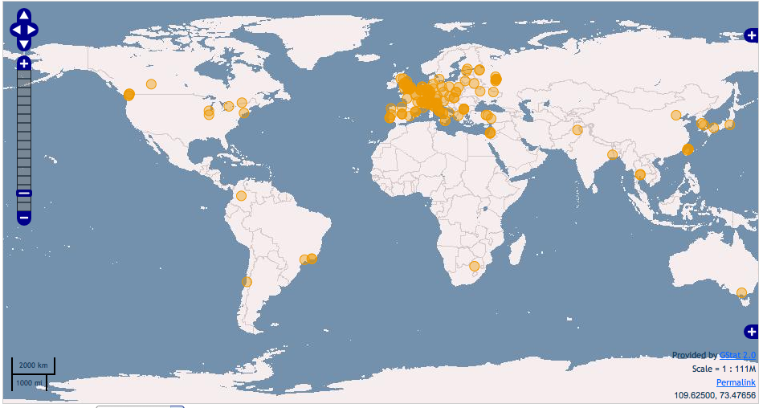
Collaboration: Worldwide resources
WLCG Collaboration Status
Tier 0; 11 Tier 1s; 68 Tier 2 federations
Today we have 49 MoU signatories, representing 34 countries:
  Australia, Austria, Belgium, Brazil, Canada, China, Czech Rep, Denmark, Estonia, Finland, France, Germany, Hungary, Italy, India, Israel, Japan, Rep. Korea, Netherlands, Norway, Pakistan, Poland, Portugal, Romania, Russia, Slovenia, Spain, Sweden, Switzerland, Taipei, Turkey, UK, Ukraine, USA.
Today >140 sites
>250k CPU cores
>150 PB disk
Notes:
This is also a truly worldwide undertaking. WLG has computing sites in almost every continent, and today provides significant levels of resources – computing clusters, storage (today we have close to 100 PB of disk available to the experiments), and networking.

Slide 4
Future of the collaboration
The WLCG collaboration & MoU is the long-term framework for LHC computing
More MoU signatures:
  Several countries in the process of joining
  Several have expressed intentions
  Expect this to continue at a low level: a few / year
This framework will remain (& expand)
However the technical implementation of distributed computing for LHC will change and evolved
  New technologies, new models, lessons learned …

Slide 5
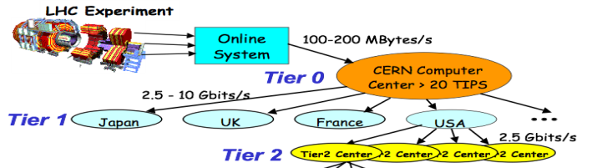
What is WLCG today?
Collaboration
Coordination & management & reporting
Coordinate resources & funding
Coordination with service & technology providers
Common requirements
Memorandum of Understanding
Framework
Service management
Service coordination
Operational security
Support processes & tools
Common tools
Monitoring & Accounting
World-wide trust federation
for CA’s and VO’s
Complete Policy framework
Evolution of implementation and technology
Distributed Computing services
Physical resources: CPU, Disk, Tape, Networks

Slide 6
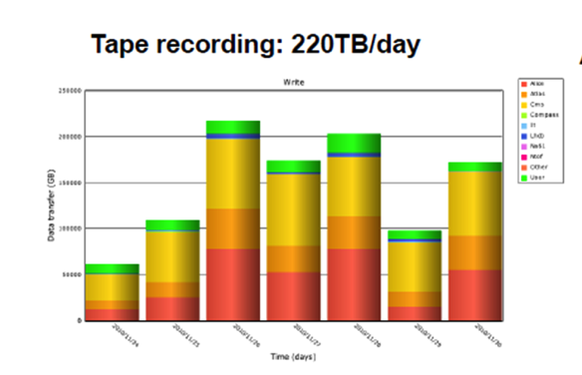
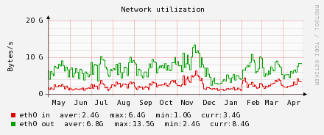
1st year of LHC data: Tier 0
Data written to tape (GB/month): 2010-11
Stored ~ 15 PB in 2010
p-p data to tape at close to 2 PB/month
HI
2010 Reprocessing
Peak rate: 225TB/day
2 PB/month
LHCb
(compass)
CMS
ATLAS
ALICE
>5GB/s to tape during HI
~ 2 PB/month to tape pp
~ 4 PB to tape in HI
Disk Servers (GB/s)
Tier 0 storage:
Accepts data at average of 2.6 GB/s; peaks > 11 GB/s
Serves data at average of 7 GB/s; peaks > 25 GB/s
CERN Tier 0 moves > 1 PB data per day
Notes:
We have now been taking real LHC data for 1 year and the results have been remarkable. All aspects of the grid have really worked for LHC and have enabled physics output incredibly quickly. Here we see the Tier 0 performance, even though this was the 1st year of data taking we nevertheless recorded 15 PB of data on tape as anticipated for a nominal year of running. The Tier 0 write on average 2 PB of data per month to tape in proton running, and double that in the 1 month of heavy ion running – setting some world records for writing data to tape.
The mass storage system supported data rates much higher than those anticipated – the average over the year of data consumed was 2.5 GB/s with peaks up to 11 GB/s, while data was served at an average rate of 7 GB/s with peaks up to 25 GB/s. The CERN facility moves on average much more than 1 PB of data per day.

Slide 7
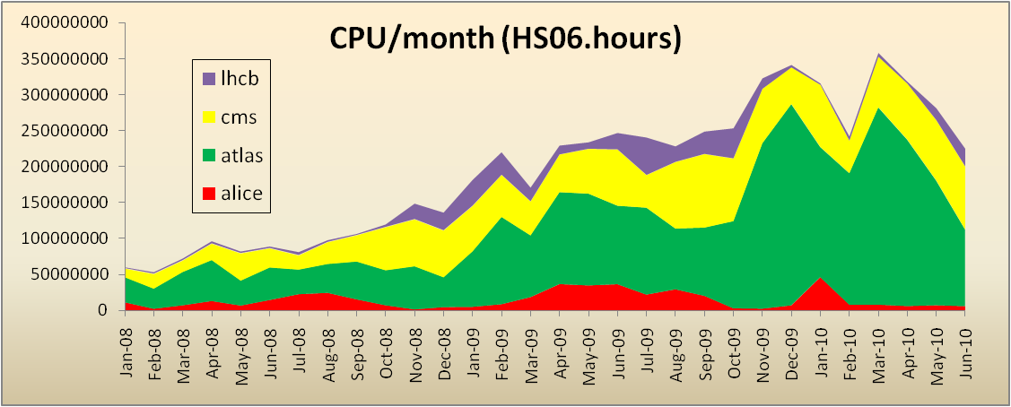
Grid Usage
Use remains consistently high:
  >1 M jobs/day;
  ~150k CPU
1 M jobs/day
CPU used at Tier 1s + Tier 2s (HS06.hrs/month) – last 12 months
100k CPU-days/day
At the end of 2010 we saw all Tier 1 and Tier 2 job slots being filled
CPU usage now >> double that of mid-2010 (inset shows build up over previous years)
As well as LHC data, large simulation productions always ongoing
Large numbers of analysis users:
ATLAS, CMS ~800
LHCb,ALICE ~250
In 2010 WLCG delivered
~ 80-100 CPU-millennia!
Notes:
In terms of the workload on the grid, here we see a load of in excess of 1 million jobs per day being run (and this is still increasing). This is notable since this was the rate anticipated for a nominal year of data taking. This translates into significant amounts of computer time. In fact, towards the end of 2010 we reached the situation where all of the available resources in the Tier 1 and Tier 2 centres were often fully occupied. We anticipate this problem becoming more interesting in 2011 and 2012.
The other notable success in 2010 was the number of individuals actually using the grid to do physics. This had been a point of concern as the usability of grids has always been difficult, but the experiments had really invested a lot of effort to provide a seamless integration with their tools. We see some 800 different individuals per month using the service in the large experiments, and some 250 in each of the smaller collaborations.

Slide 8
CPU – around the Tiers
The grid really works
All sites, large and small can contribute
  And their contributions are needed!
Significant use of Tier 2s for analysis
Tier 0 usage peaks when LHC running – average is much less
Jan 2011 was highest use month ever … so far
Notes:
The distribution of delivered CPU between the various tiers has also been according to the design, with tier 2s providing in excess of 50% of the total. If this is broken down we see that countries deliver close to what they pledged. Thus the grid concept really does work on this scale, and enables institutes worldwide to collaborate, share data, and provide resources to the common goals of the collaboration. Early worries that people would simply ignore the grid and use CERN for analysis were unfounded – Tier 2s are used extensively and exclusively.

Slide 9
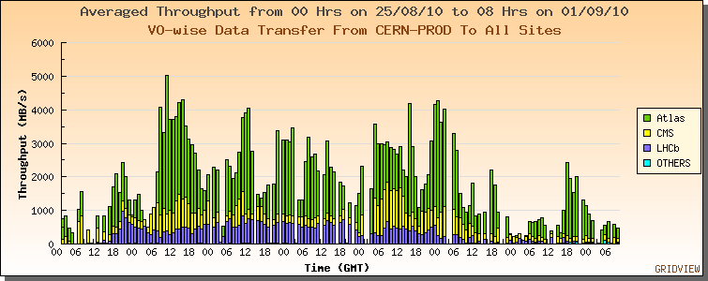
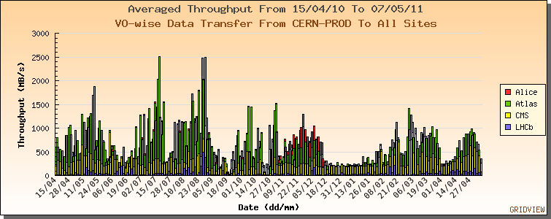
Data transfers
LHC data transfers:
April 2010 – May 2011
Rates >> higher than planned/tested
Nominal: 1.3 GB/s
Achieved: up to 5 GB/s
World-wide: ~10 GB/s per large experiment
2010 pp data → Tier 1s
& re-processing
ALICE HI data → Tier 1s
2011 data → Tier 1s
Re-processing 2010 data
CMS HI data zero suppression & → FNAL

Slide 10
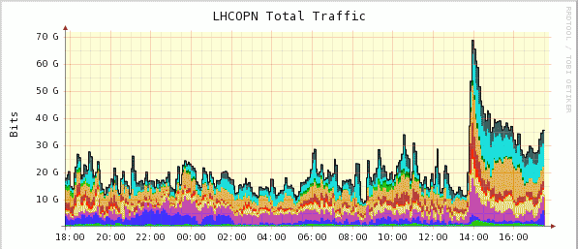
70 / 110 GB/s !
Traffic on OPN up to 70 Gb/s!
- ATLAS reprocessing campaigns
Significant levels of network traffic observed in 2010
Caused no network problems, but:
Reasons understood (mostly ATLAS data management)
Data popularity/on demand placement improve this

Slide 11
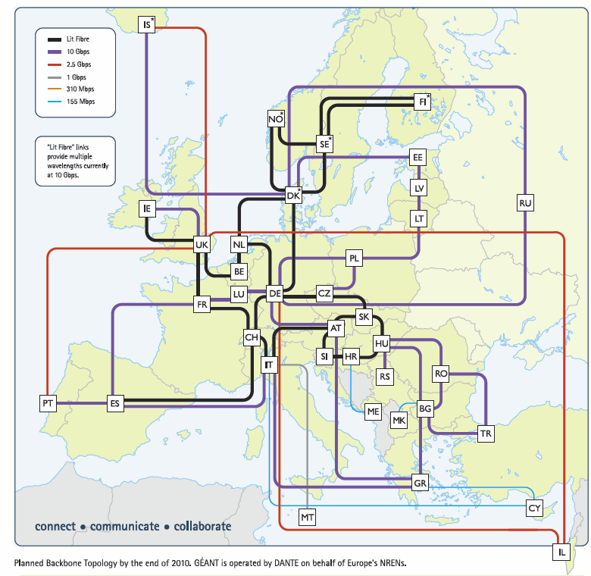
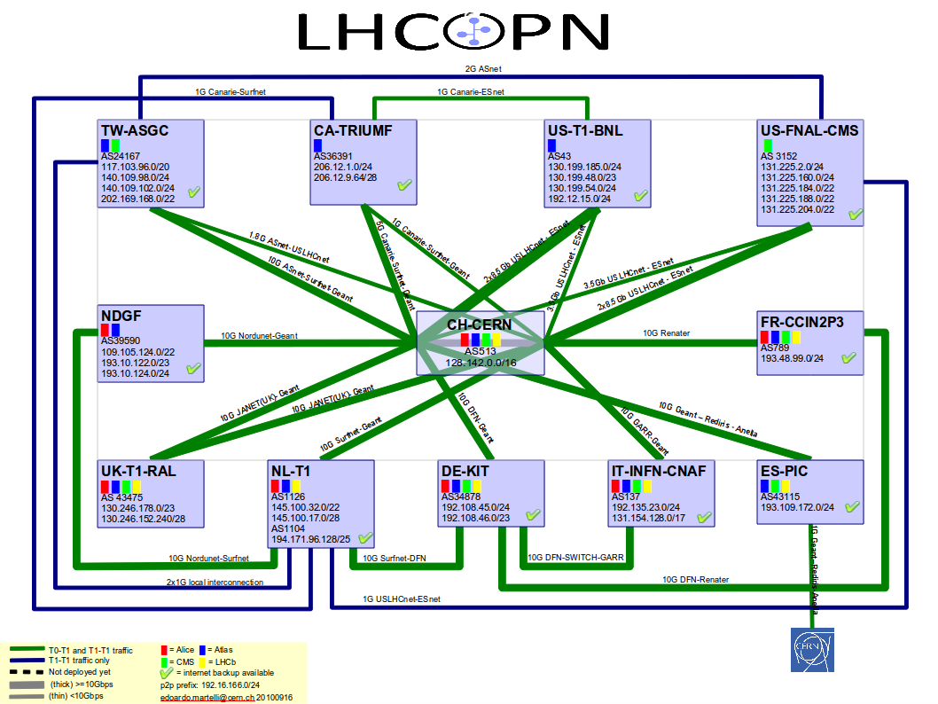
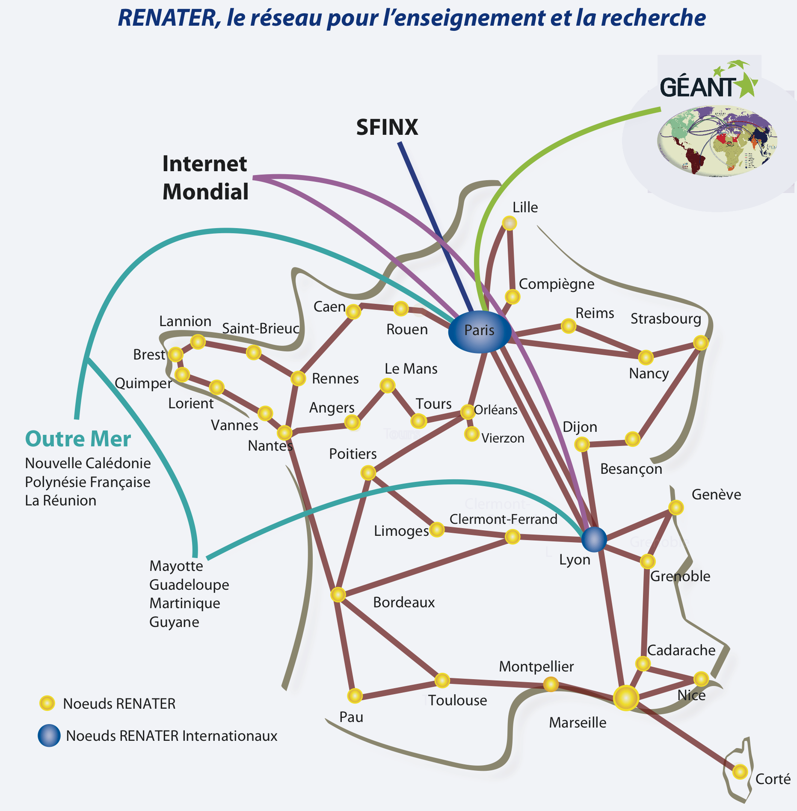
LHC Networking
Relies on
  OPN, GEANT, US-LHCNet
  NRENs & other national & international providers

Slide 12
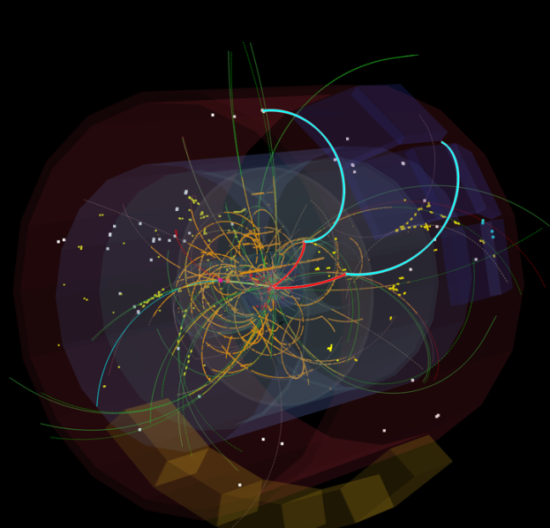
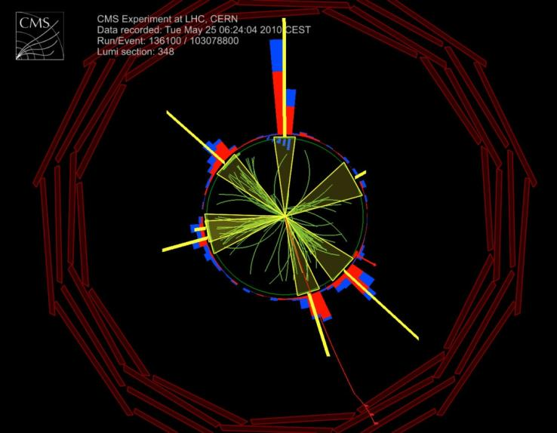
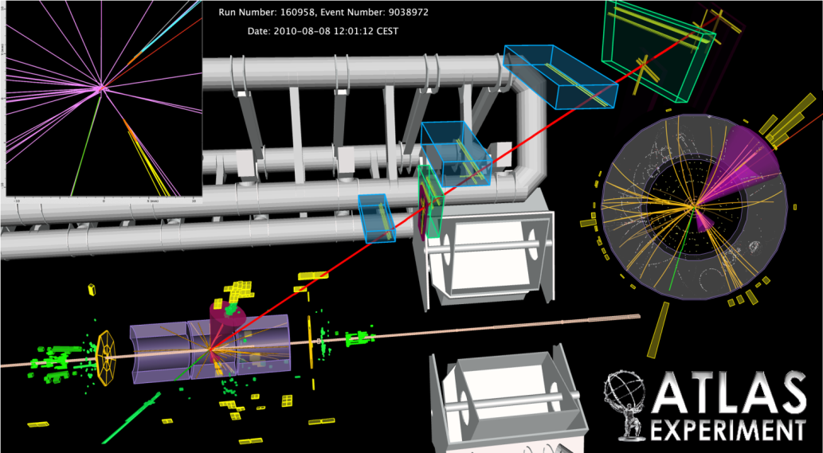
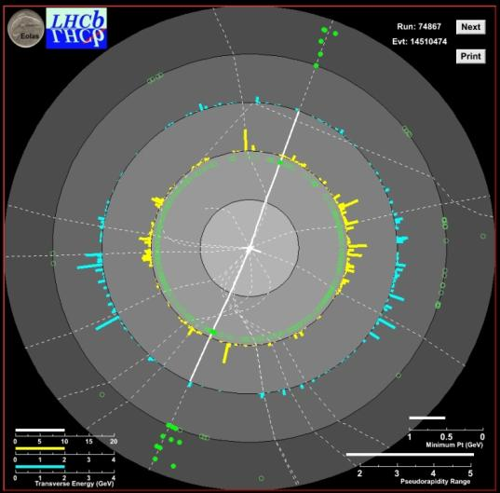
Successes:
We have a working grid infrastructure
Experiments have truly distributed models
Has enabled physics output in a very short time
Network traffic in excess of that planned –
  and the network is extremely reliable
Significant numbers of people doing analysis (at Tier 2s)
In 2010 resources were plentiful, now start to see contention …
Support levels manageable ... just

Slide 13
Lessons learned
Complexity & Sustainability
  Took a lot of effort to get to the level of today
  Ongoing effort for support is probably too high
  Experiments had to invest significant effort to hide grid complexity from users
Distributed nature of the infrastructure
  Was not really understood in the computing models
    Evolution of data distribution and management
    Evolution of networking

Slide 14
Lessons: Data
Computing models based on MONARC model of 2000 – reliance on data placement
  Jobs sent to datasets resident at a site
  Multiple copies of data hosted across the infrastructure
  Concern that the network would be insufficient or unreliable
However:
  A lot of data “placed” at sites was never touched
  Refreshing large disk caches uses a lot of networking
  The network is extremely reliable (…with redundancy)

Slide 15
Lessons: Services
Until now many services have been distributed
  Databases, Data placement, etc.
  Because of lack of trust that networks would be reliable enough
  Increased the complexity of the middleware and applications
Now we see centralization of those services again
  1 failover copy of a db is much simpler than a distributed db schema!

Slide 16
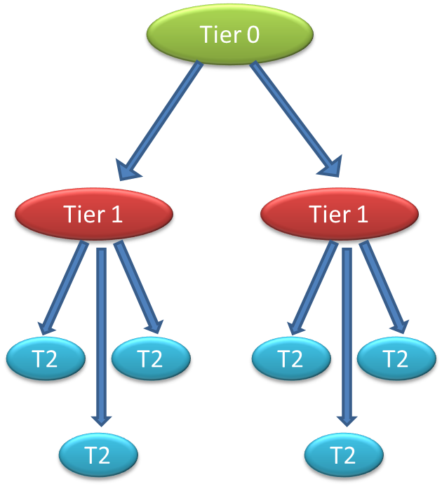
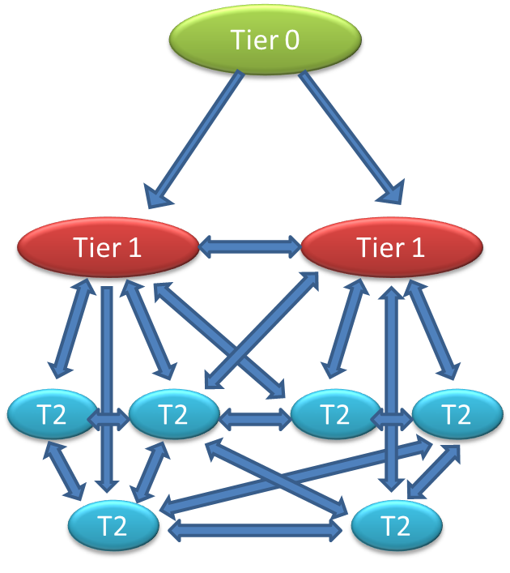
Computing model evolution
Evolution of computing models
Hierarchy
Mesh

Slide 17
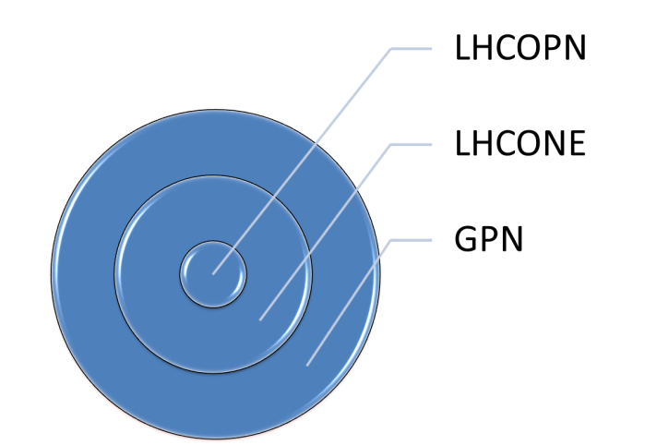


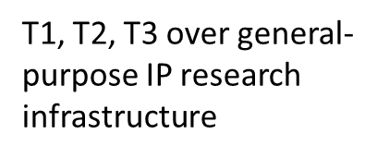
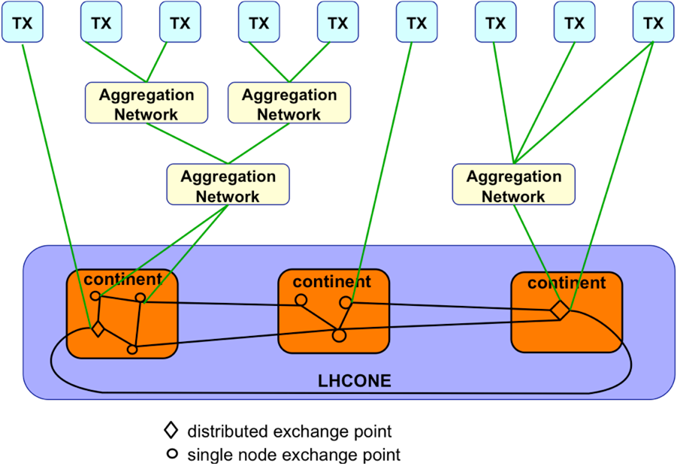
Network evolution - LHCONE
Evolution of computing models also require evolution of network infrastructure
- Enable any Tier 2, 3 to easily connect to any Tier 1 or 2
Use of Open Exchange Points
Do not overload the general R&E IP infrastructure with LHC data
Connectivity to T1s, T2s, and T3s, and to aggregation networks: NRENs, GÉANT, etc.

Slide 18
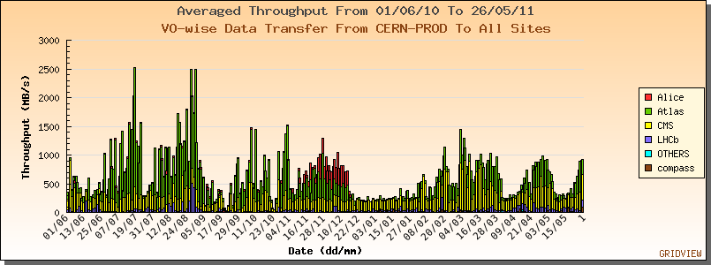
Change of the data model…
Data placement will now be based on
  Dynamic placement when jobs are sent to a site
  Data popularity – popular data is replicated – unused data is removed
Analysis disk becomes a more dynamic cache
Also start to use remote (WAN) I/O:
  Fetch a file missing from a dataset
  Read a file remotely over the network
Can be less network traffic

Slide 19
Other Challenges:
Resource efficiency
  Behaviour with resource contention
  Efficient use – experiments struggle to live within resource expectations, physics is potentially limited by resources now!
Changing models – to more effectively use what we have
  Evolving data management
  Evolving network model
  Integrating other federated identity management schemes
Sustainability
  Grid middleware – has it a future?
  Sustainability of operations
  Is (commodity) hardware reliable enough?
Changing technology
  Using “clouds”
  Other things - NoSQL, etc.
Move away from “special” solutions

Slide 20
Grids → clouds??
We have a grid because:
  We need to collaborate and share resources
  Thus we will always have a “grid”
  Our network of trust is of enormous value for us and for (e-)science in general
We also need distributed data management
  That supports very high data rates and throughputs
  We will continually work on these tools
But, the rest can be more mainstream (open source, commercial, … )
  We use message brokers more and more as inter-process communication
  Virtualisation of our grid sites is happening
    many drivers: power, dependencies, provisioning, …
  Remote job submission … could be cloud-like
  Interest in making use of commercial cloud resources, especially for peak demand

Slide 21
Grid Services
Data Management Services
Security Services
Job Management Services
Storage Element
Certificate Management Service
VO Membership Service
Compute Element
File Catalogue Service
Workload Management Service
Authentication Service
Grid file access tools
VO Agent Service
Authorization Service
File Transfer Service
Application Software Install Service
GridFTP service
Information Services
Database and DB Replication Services
Information System
Messaging Service
Experiments invested considerable effort into integrating their software with grid services; and hiding complexity from users
POOL Object Persistency Service
Accounting Service
Site Availability Monitor
Monitoring tools: experiment dashboards; site monitoring

Slide 22
Relationship to EGI and EMI
MoU between WLCG and EGI in progress
  Has been presented to WLCG OB
  Now with CERN legal dept.
  Initially was too complex, and had no clearly explained benefit for WLCG
Important that NGIs provide the services that WLCG needs
  EGI can help in coordinating that
EGEE/EGI-style grid is only useful for certain sciences (like WLCG)
  Other communities don’t see it as usable
  Pressure for EGI to adapt – how does it affect WLCG?
    Thus we need a good understanding of our future needs

Slide 23
Middleware support
Process is (too?) complex:
  WLCG makes requirements to (asked by):
    EGI
    EMI
  EMI delivers software to EGI (EMI-x)
  EGI includes this in UMD release, and adds more
  WLCG has software not included in EMI or UMD
WLCG has to take software from:
  WLCG, EMI, EGI
This is probably OK in practice
  WLCG specifies minimum versions (as now) and points to relevant repositories

Slide 24
Technical discussions that we need to have:
Data management (ongoing)
Virtualisation (HEPiX, + etc)
Information system
Security – is there a simpler model than glexec etc?
Job management
  Pilot jobs mean less need for WMS-like functions
  Can we simplify the CE?
    Performance/scale?
    Need to describe the batch system?
    Give a throttle to site manager?
    How do batch schedulers evolve in a virtualized infrastructure?

Slide 25
Summary
Conclusions
WLCG has built a true distributed infrastructure
The LHC experiments have used it to rapidly deliver physics results
Experience with data has initiated new models for the future
Additional technical discussions are needed to plan future evolution

