Slide 1
Scales and Universality in Three-Body Systems
Marcelo Takeshi Yamashita
yamashita@ift.unesp.br
Instituto de Física Teórica – IFT / UNESP

Slide 2
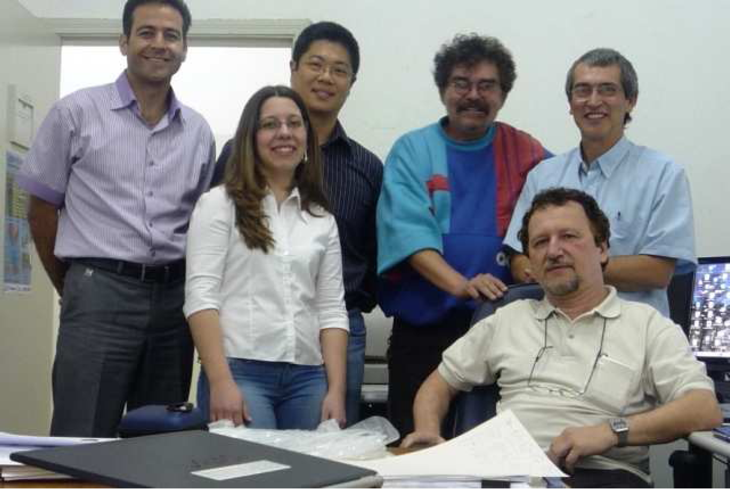
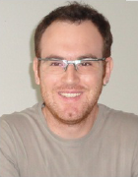
M. R. Hadizadeh
IFT
MTY
IFT
A. Delfino
UFF
T. Frederico
ITA
F. F. Bellotti
ITA
D. S. Ventura
IFT
L. Tomio UFF/IFT

Slide 3


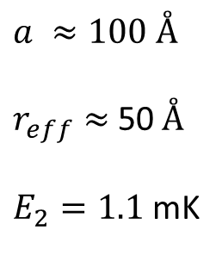
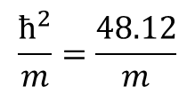
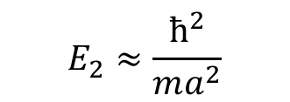

What's Universality?
Independence of the potential
Two-body scattering length >> range of the potential
Some consequences
$$E_{2}≈\frac{ħ^{2}}{ma^{2}}$$
Two-body sector
Ex: Two identical bosons interacting in s-wave
$$a ≈100 Å$$
$r_{eff}≈$50$Å$
$E_{2}=1.1$ mK
$$\frac{ħ^{2}}{m}=\frac{48.12}{m}$$
K $Å$²
Helium-4 dimer
Three-body sector
Ex: Three identical bosons interacting in s-wave
$${|E}_{2}^{\left(1\right)}|$$
Decrease
$${|E}_{2}^{\left(2\right)}|<{|E}_{2}^{\left(1\right)}|$$
Decrease
Three-body
bound states
Three-body
bound states

Slide 4
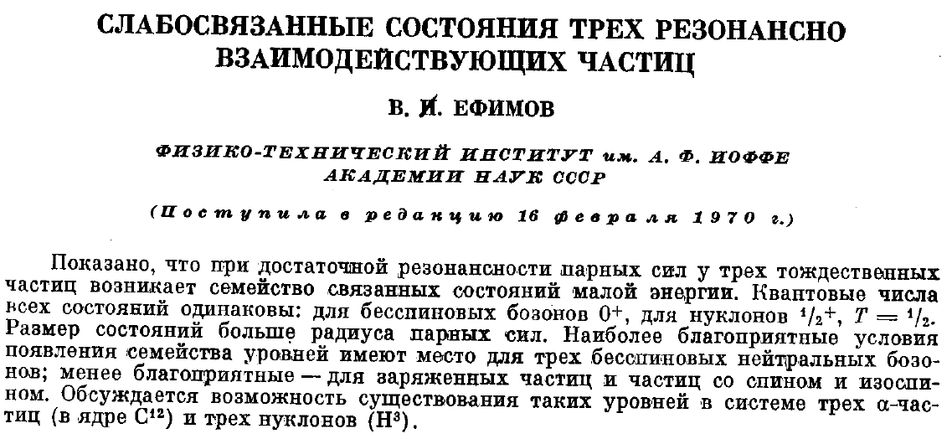
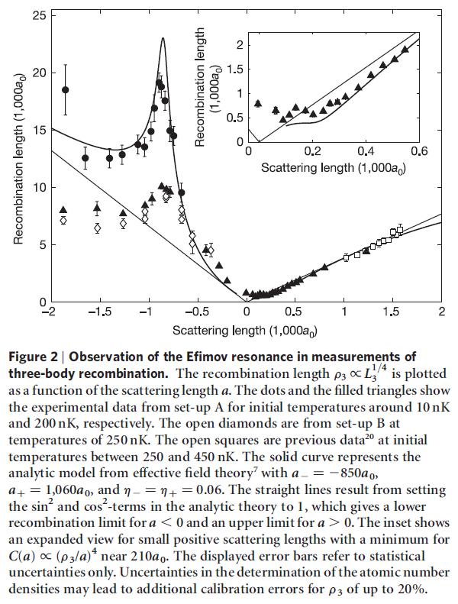
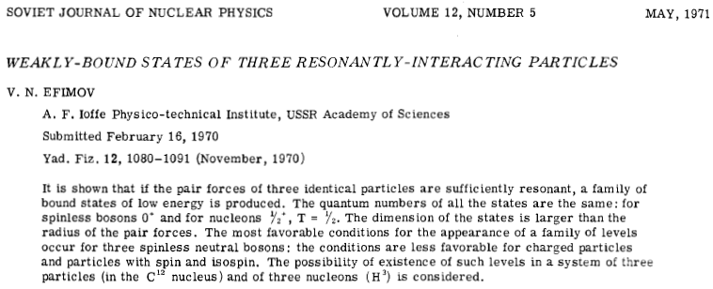
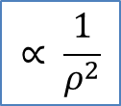
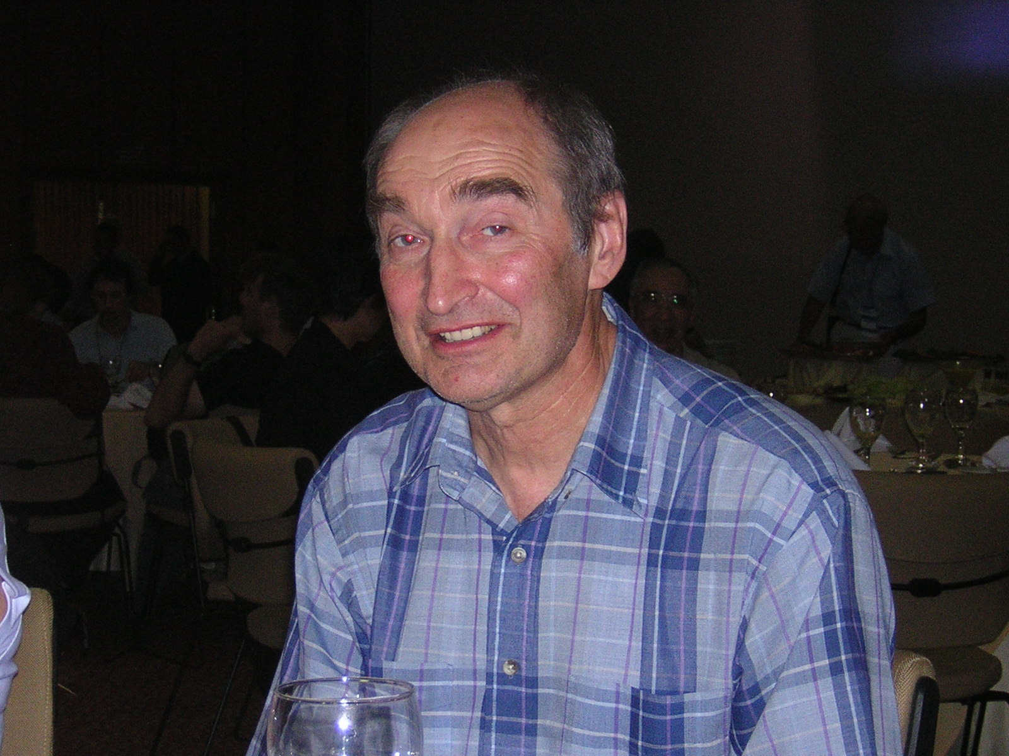

$$∝ \frac{1}{ρ^{2}}$$
Infinite three-body
bound states
$E_{2}^{}=$ 0
Appearance of an effective potential
Efimov states
“Evidence of Efimov quantum states
in an ultracold gas of cesium atoms” !
discovered by Vitaly Efimov in 1970
T. Kraemer et al. Nature 440, 315 (2006)

Slide 5
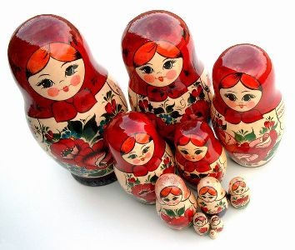
Efimov states
• Energy ratio between two consecutive states 515.03
• rms hyperradius ratio between two consecutive states 22.7
Describing universal systems
2: scattering length (a) / two-body energy
3: two-body energy +
Three-body scale
r₀ → 0
V₀ → ∞
E₂ → fixed
Thomas collapse in 1935
E₃^{deepest} → ∞
Scaling function

Slide 6

Three-body bound state equation with zero-range interaction with momentum cutoff
Skorniakov and Ter-Martirosian equation (1956)
momenta
energies
Λ $=r_{0}^{−1}$
ε₂
0
(N = 0, 1, 2, ...)
Efimov states
1) E₂ tends to zero with Λ fixed – Efimov effect
2) Λ tends to infinity with E₂ fixed – Thomas collapse
S.K. Adhikari, A. Delfino, T. Frederico, I.D. Goldman and L. Tomio, Phys. Rev. A 37, 3666 (1988)
If E2 ≠ 0: what happens to the Efimov states after they disappear?

Slide 7
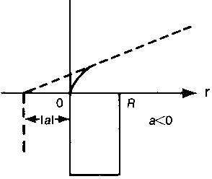
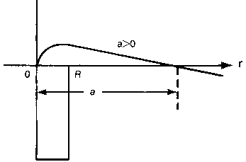
Im E
E₂ bound
E₂ virtual
Im E
E₃
E₃
E₂
Re E
Re E
Increasing |E₂|
Im E
Im E
E₃
E₃
E₂
Re E
Re E
Im E
Im E
E₃ (virtual state)
E₂
Re E
Re E
second Riemann sheet
E₃ (resonance)

Slide 8


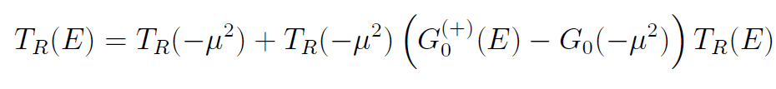
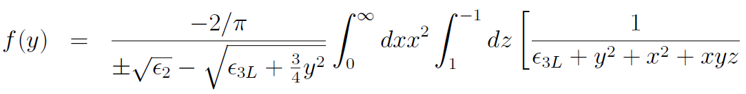
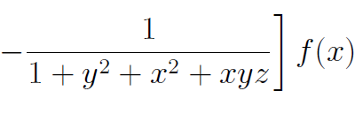
Subtracted T-matrix Equation
S.K. Adhikari, T. Frederico and I.D. Goldman, Phys. Rev. Lett. 74, 487 (1995)
Three-body bound state equation for zero-range interaction with subtraction
M.T. Yamashita, T. Frederico, A. Delfino and L. Tomio, Phys. Rev. A 66, 052702 (2002)

Slide 9
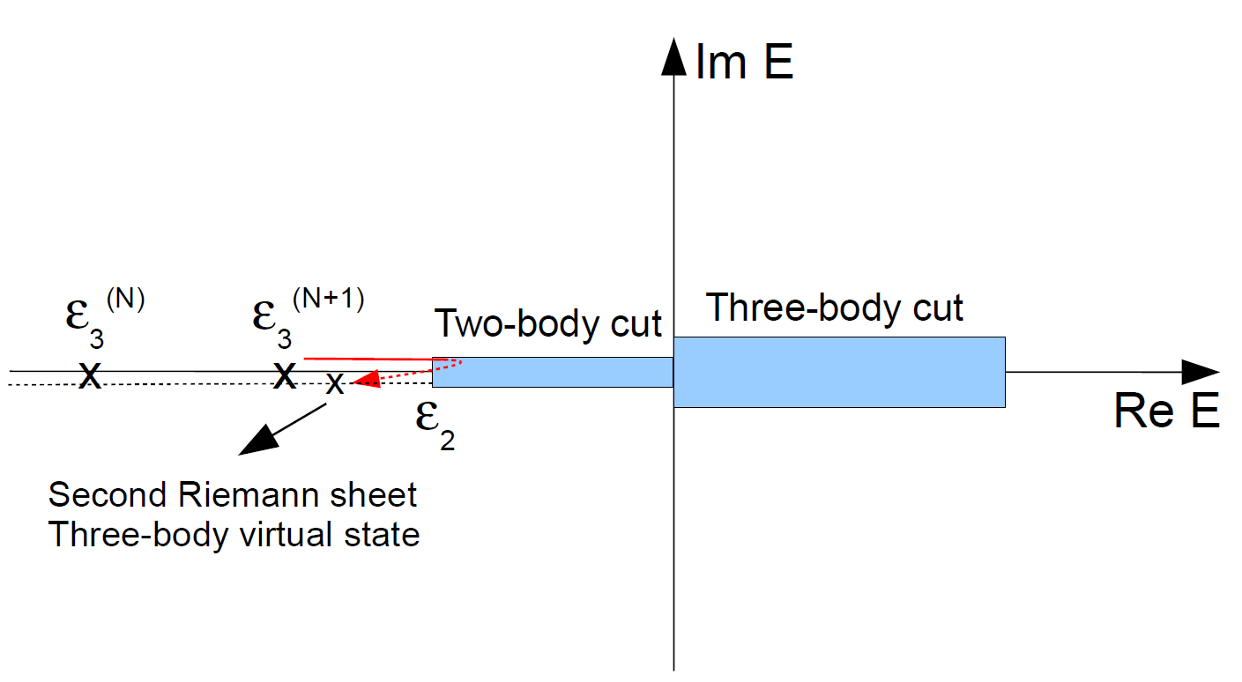

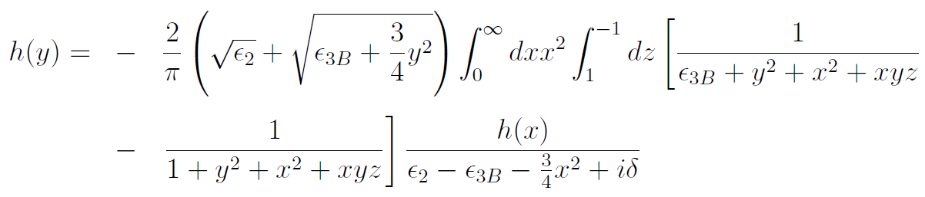
Virtual states – extension to the second Riemann sheet
M.T. Yamashita, T. Frederico, A. Delfino and L. Tomio, Phys. Rev. A 66, 052702 (2002)
Defining
we can write the bound state equation as

Slide 10
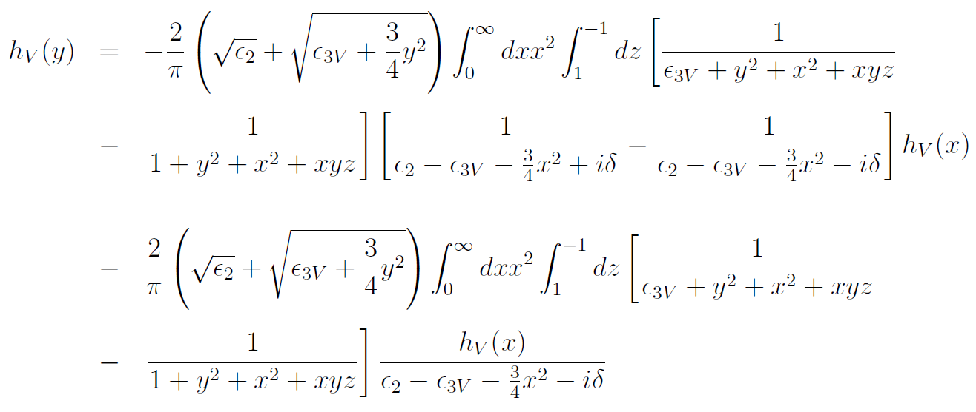


Then we can write the cut explicitly
After integration and defining

Slide 11
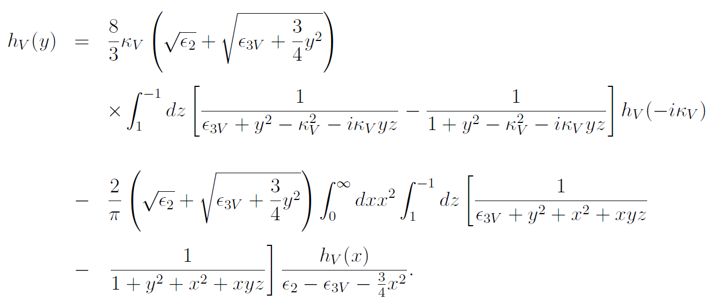



We have finally
should be outside the cut
thus

Slide 12
Efimov states – Bound and virtual states
Lines – Bound states
crosses – ground
squares – first excited
diamonds – second excited
Symbols – Virtual states
circles - refers to the first excited state
triangles – refers to the second excited state
ε₂ bound
Appearance of the virtual state (dotted line)
The virtual state turns into an excited state (solid line)

Slide 13
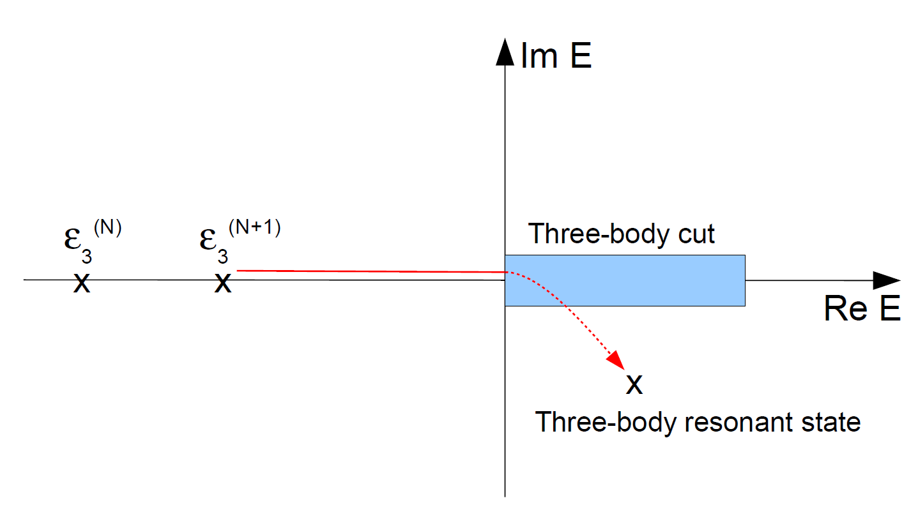
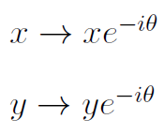

Resonances
F. Bringas, M.T. Yamashita and T. Frederico Phys. Rev. A 69, 040702(R) (2004)
ε₂ unbound
is complex

Slide 14
Efimov states - Resonances
ε₂ virtual

Slide 15
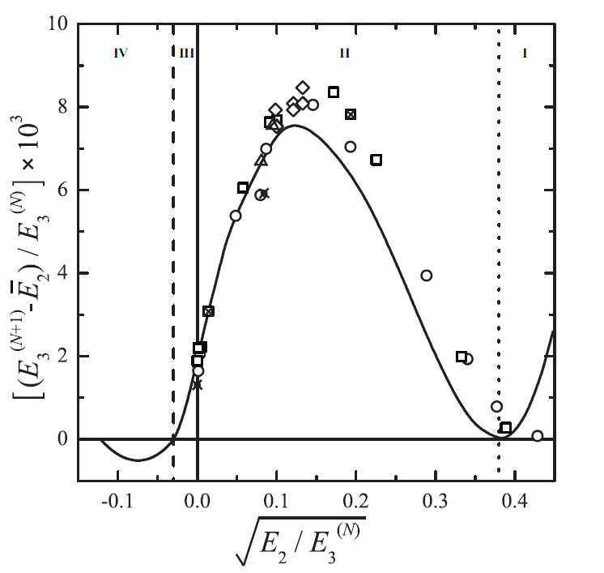
E3 bound
E2 virtual
Full trajectory of Efimov states
E3 bound
E2 bound
E3 resonance
E2 virtual
E3 virtual
E2 bound
T. Frederico, L. Tomio, A. Delfino, M.R. Hadizadeh and M.T. Yamashita, Few Body Syst. (2011) online first
x
s wave (N=0)
s+d waves (N=0)
s wave (N=1)
Th. Cornelius, W. Glöckle. J. Chem. Phys. 85, 1 (1996).
S. Huber. Phys. Rev. A31, 3981 (1985).
x
B. D. Esry, C. D. Lin, C. H. Greene. Phys. Rev. A 54, 394 (1996).
E. A. Kolganova, A. K. Motovilov e S. A. Sofianos. Phys. Rev. A56, R1686 (1997).

Slide 16
Weakly-bound molecules – Helium trimer
M.T. Yamashita, R.S. Marques de Carvalho, L. Tomio and T. Frederico, Phys. Rev. A 68, 012506 (2003)
Ground
First excited
Symbols from
P. Barletta and A. Kievsky
Phys. Rev. A 64, 042514 (2001)
squares - Ground state
circles - First excited state
Potentials: HFDB, LM2M2, TTY, SAPT1, SAPT2

Slide 17
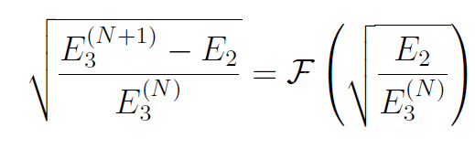
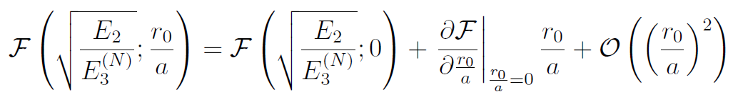
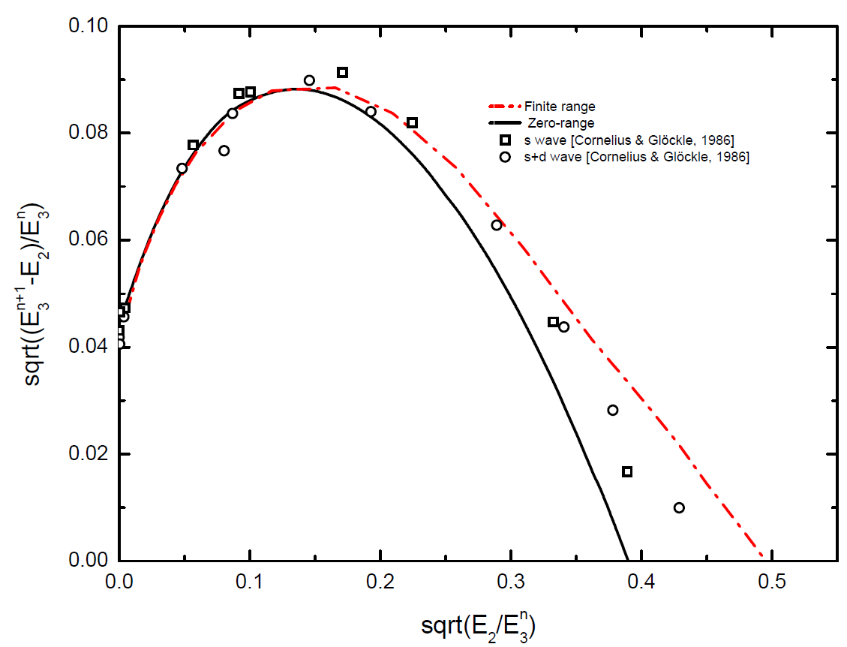
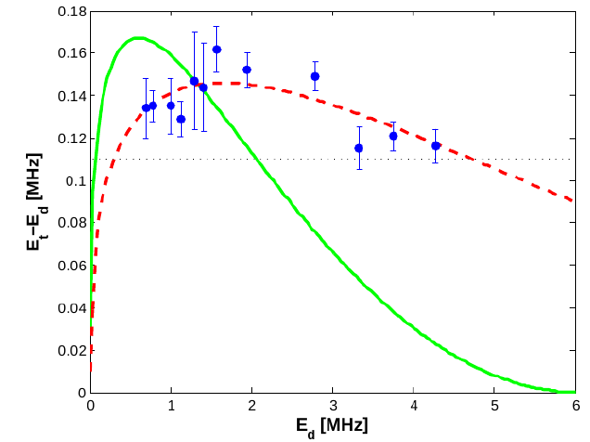
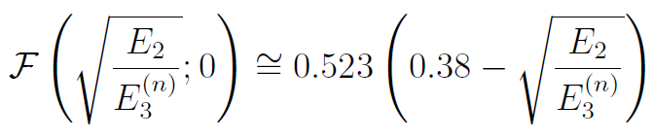
Range correction for bound states
D. S. Ventura, M.T. Yamashita, L. Tomio and T. Frederico, in preparation
From Kokkelmans presentation

Slide 18
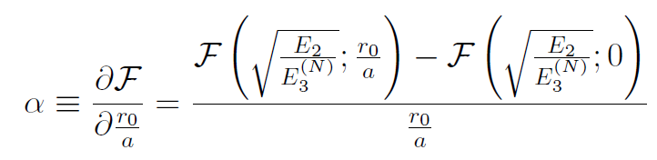
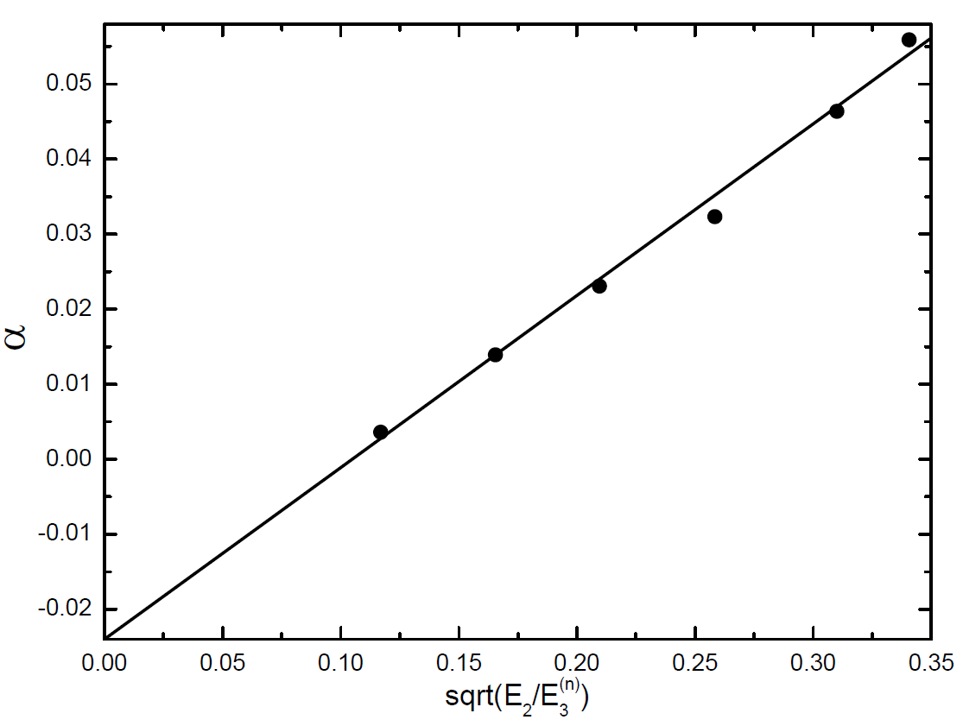
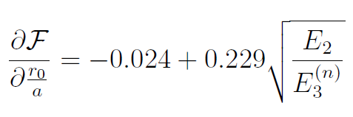
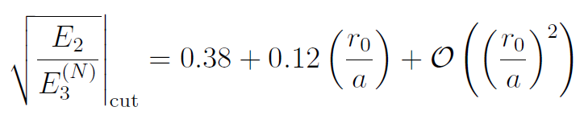
Point where an excited three-body state becomes virtual/bound

Slide 19
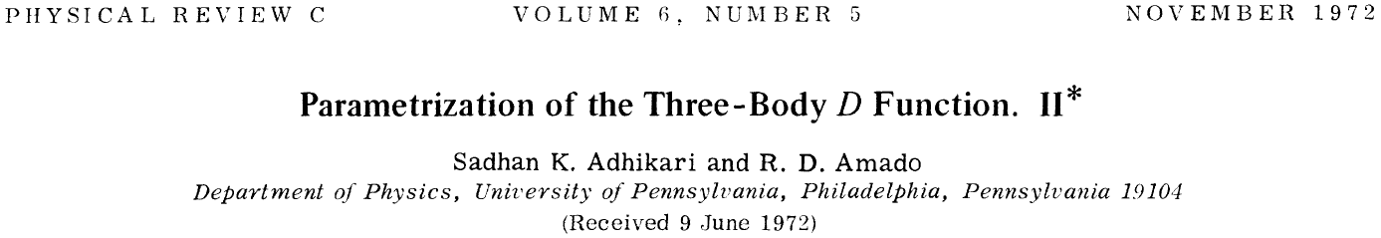
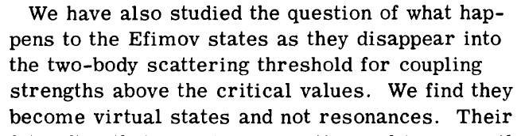
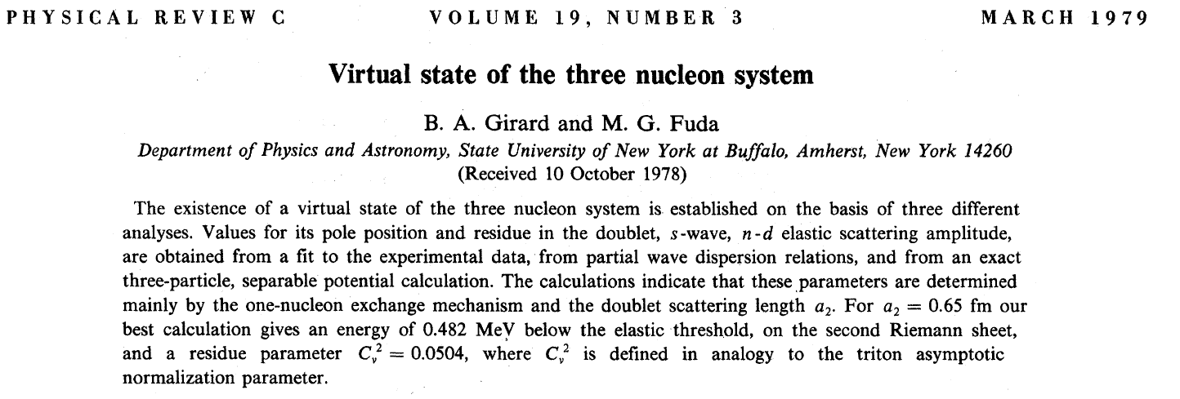
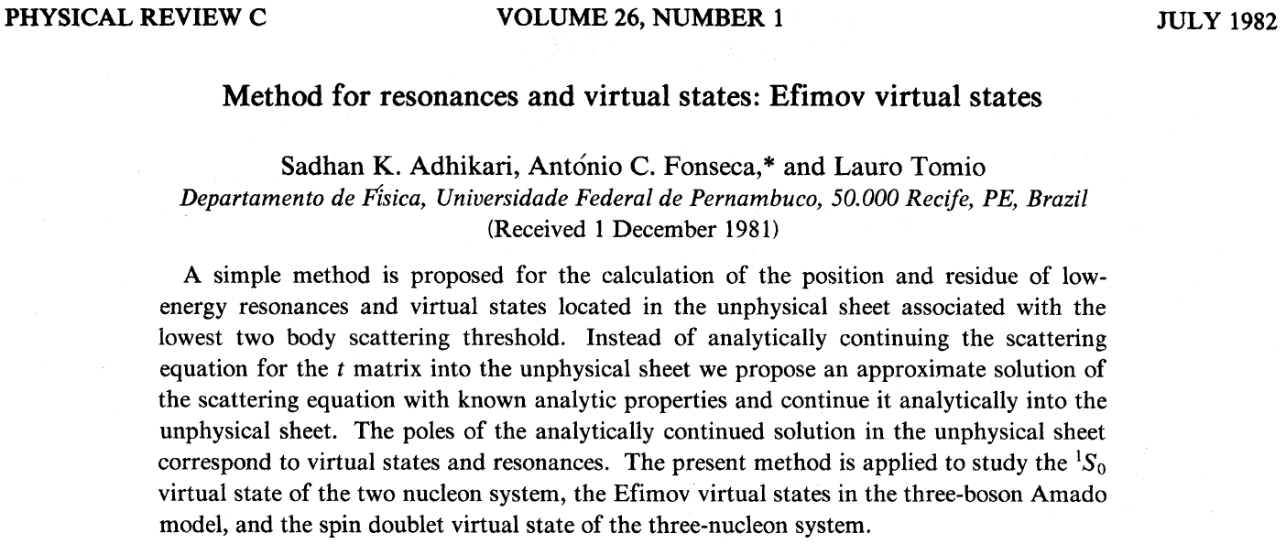

Slide 20
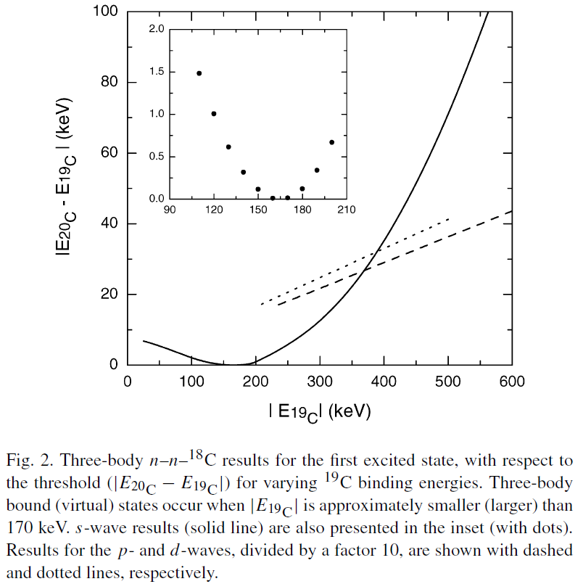
The transition bound-virtual does not depend on the particles mass ratio
M.T. Yamashita, T. Frederico and L. Tomio, Phys. Lett. B 660, 339 (2008); Phys. Rev. Lett. 99, 269201 (2007)
Example:
²⁰C (3.5 MeV)
¹⁸C
bound
virtual
n
n
n-¹⁸C: 160 (110) keV

Slide 21
Root mean square radii
Scaling function for the radii
A
B
B
γ = A or B
+ two-body bound state
- two-body virtual state
bound state
virtual state

Slide 22
Root mean square radii
BB bound
BB virtual
BB bound
BB virtual
>
>
>
M.T. Yamashita, L. Tomio and T. Frederico, Nucl. Phys. A 735, 40 (2004)

Slide 23
Summary
If at least one two-body subsystem is bound:
Efimov state
virtual
All two-body subsystems are virtual (borromean case):
Efimov state
resonance
Range correction for the point where an excited Efimov state disappears
http://www.ift.unesp.br/users/yamashita/publist.html
Thank you!

