Slide 1
Innovation at Intel to address Challenges of
Exascale Computing
Laurent Duhem
Software Application Engineer
EMEA High Performance and Throughput Computing

Slide 2
Legal Disclaimer
Today’s presentations contain forward-looking statements. All statements made that are not historical facts are subject to a number of risks and uncertainties, and actual results may differ materially.
NO LICENSE, EXPRESS OR IMPLIED, BY ESTOPPEL OR OTHERWISE, TO ANY INTELLECTUAL PROPERTY RIGHTS IS GRANTED BY THIS DOCUMENT. EXCEPT AS PROVIDED IN INTEL’S TERMS AND CONDITIONS OF SALE FOR SUCH PRODUCTS, INTEL ASSUMES NO LIABILITY WHATSOEVER, AND INTEL DISCLAIMS ANY EXPRESS OR IMPLIED WARRANTY, RELATING TO SALE AND/OR USE OF INTEL® PRODUCTS INCLUDING LIABILITY OR WARRANTIES RELATING TO FITNESS FOR A PARTICULAR PURPOSE, MERCHANTABILITY, OR INFRINGEMENT OF ANY PATENT, COPYRIGHT OR OTHER INTELLECTUAL PROPERTY RIGHT. INTEL PRODUCTS ARE NOT INTENDED FOR USE IN MEDICAL, LIFE SAVING, OR LIFE SUSTAINING APPLICATIONS.
Intel does not control or audit the design or implementation of third party benchmarks or Web sites referenced in this document. Intel encourages all of its customers to visit the referenced Web sites or others where similar performance benchmarks are reported and confirm whether the referenced benchmarks are accurate and reflect performance of systems available for purchase.
Intel processor numbers are not a measure of performance. Processor numbers differentiate features within each processor family, not across different processor families. See www.intel.com/products/processor_number for details.
Intel, processors, chipsets, and desktop boards may contain design defects or errors known as errata, which may cause the product to deviate from published specifications. Current characterized errata are available on request.
Intel, Intel Xeon, Intel Core microarchitecture, and the Intel logo are trademarks or registered trademarks of Intel Corporation or its subsidiaries in the United States and other countries.
*Other names and brands may be claimed as the property of others
Copyright © 2010, Intel Corporation. All rights reserved.

Slide 3




Intel in France
Meudon: HQ, Sales
& Marketing
Paris La Défense: Sales
& Marketing
Saclay: R&D, HPC and
Data Centers
Toulouse: R&D, Mobility
Vannes: R&D
Software
Montpellier: SW R&D,
Open Source Center Tech.
Les Ulis: Sales
& Marketing
Sophia Antipolis: R&D,
Certification, Mobility
Grenoble: Technical
Support
Sophia Antipolis: iMC
Intel Mobile Communications
500+ employees, 60% Dedicated to R&D

Slide 4
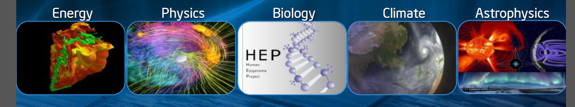
Why Exascale Computing?
Computational methods and HPC are established and will grow in:
  Science (as 3rd pillar in addition to theory and experiments
  industry (virtual product development)
Driving forces for more performance:
  New science, new models require more performance
  New usage models
  New technology

Slide 5
Today’s Exascale Expectation
Projected performance development
EFLOP
10⁸
PFLOP
10⁶
10⁴
TFLOP
GFLOPS
10²
GFLOP
10⁰
10⁻²
MFLOP
10⁻⁴
Notes:
Year GFLOP
1964 0.001
1969 0.01
1976 0.16
1985 2
1993 131
1997 1338
2006 101400
2008 1000000

Slide 6
ExaFlops ???
1 EF (ExaFlops) = 10¹⁸ Flops
How can we achieve this?
It could take:
- A microarchitecture that does 10 ops/cycle
- In a core running at 1GHz
- With 1,000 cores per socket
- On a 100,000 sockets
10¹
10⁹
10³
10⁵
One among many solutions

Slide 7
Business as usual will not work because…
Challenges Need to Be Addressed to Reach Exascale
Energy Per Operation
Associated with Computation, Data Transport, Memory, and other overheads
Extreme Concurrency and Locality
Associated with programming billions of threads
Resiliency
Associated with growth in component count, lower voltages, security, etc
Memory/Storage Capacity, Bandwidth and Power
Associated with inability of current technology trend to meet requirements
Source: Exascale Computing Study: Technology Challenges in achieving Exascale Systems (2008)
Notes:
There are 4 main challenges that need to be addressed in order to get to exascale…Power, Power, Power, and Power
Ok – I made my point, but in addition to power associated with Computation, Data Transport, Memory, and other overheads such as cooling, there are 3 other key areas that we need to focus on to get to exascale.
Power associated with Computation, Data Transport, Memory, and other overheads such as cooling
Concurrency and locality issues associated with programming billions of threads that will be needed for exascale systems
Reliability issues that come up due to the large growth in component count, lower voltages, security issues, etc
And finally memory – both in terms of BW and power.

Slide 8
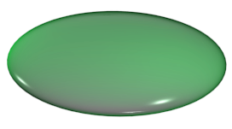
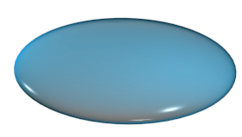
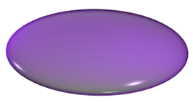
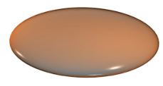
Exascale Systems Design
Power Management
Packaging
Thermal Mgmt
Parallel
Software
Exascale systems will need multiple technology innovations to achieve
1000-fold improvements
Reliability
And
Resiliency
Microprocessor
Memory
Interconnect
Notes:
The “4 pillars” sometimes discussed excludes S/W and power management.

Slide 9
Power Management
Current CMOS process technology may hit its scaling limits in the next decade!
feature size → 5nm
voltage scaling
Leakage power
The energy needed to move data will dominate over the energy needed to transform data!

Slide 10
A 20-40 MW Exa-ops Envelope consensus
20 MW for 1 Exa (1 billion giga-ops) is 20mW per giga-ops (equivalently 20 picoJoules (pJ) per operation)
We can divide this power budget among mathematical operations, local memory accesses, and distant memory accesses
Roughly 1/3 each with a little left over for I/O
All intra-system overheads are included in these budgets: power delivery, resiliency, cooling…
How hard is this?

Slide 11
A “typical” TFLOPS platform today:
3K pJ per Peak FLOP (3W/GFlops)
1000W
Power delivery
Cooling
  1000 pJ per Flop
3KW
I/O & Disk
100W
100 pJ per Flop
Comm
800W
800pJ per Flop
Memory
640W
640pJ per Flop
400W
400pJ per Flop
Compute
Notes:
Scaling up from today…
~5KW Tera
~5MW Peta
~5GW Exa???

Slide 12
Exascale’s Power Challenge
2020 datacenter TFLOPS: 30 pJ per Peak FLOP
1000W
(33%)
Exascale TFLOPS
Machine
4W (15%)
3KW
2W
~30W
8W
100W
8W
Disk
8W
800W
Comm
Compute 50x
Memory 100X
Comms 160x
Disk/Storage 30x
Other 300x
640W
Memory
400W
Compute

Slide 13
Low-power CPU
20-40 pJ total CPU energy budget per peak arithmetic operation
  Cannot have huge ISAs and complex execution engines
    they cost power.
  Minimize data movement: no inessential traffic!
  Feeding the ALU is paramount.
  Computers have one use: mathematically transform data.

Slide 14
Simple Core Scaling Example
65nm Core
w/Local Memory
8nm Core
w/Local Memory
DP FP Add, Multiply
Integer Core, RF
Router
5mm² (50%)
DP FP Add, Multiply
Integer Core, RF
Router
0.17mm² (50%)
Memory 0.35MB
5mm² (50%)
Memory 0.35MB
0.17mm² (50%)
10mm²
3GHz
6GF
1.8W
0.34mm² (30x)
4.6GHz (1.5x)
9.2GF (1.5x)
0.35W (5.1x)
Notes:
Frequency scaling continues to fall
Hitting the limits of voltage scaling
In example, perf went up by 50%, power down by a third

Slide 15
Moore’s Law 2008-2020
Semiconductor Device Scaling Factors
Technology (High Volume) | 45nm (2008) | 32nm (2010) | 22nm (2012) | 16nm (2014) | 11nm (2016) | 8nm (2018) | 5nm (2020)
Transistor density (50) | 1.75 | 1.75 | 1.75 | 1.75 | 1.75 | 1.75 | 1.75
Frequency scaling (1.6) | 15% | 10% | 8% | 5% | 4% | 3% | 2%
Voltage (Vdd) scaling (.75) | -10% | -7.5% | -5% | -2.5% | -1.5% | -1% | -0.5%
Size and C_{dyn} (.1) | 0.75 | 0.75 | 0.75 | 0.75 | 0.75 | 0.75 | 0.75
SD Leakage scaling/micron | 1X Optimistic to 1.43X Pessimistic
Sources: International Technology Roadmap for Semiconductors and Intel
Power = P_{leak} + P_{dyn} = P_{leak} + C_{dyn} ω V²
Notes:
Frequency scaling continues to fall
Hitting the limits of voltage scaling
In example, perf went up by 50%, power down by a third

Slide 16
Terascale Experimental Hardware
Tera-Flops: Polaris Prototype
80 Cores
1 TFLOP at 62 Watts
256 GB/s bisection
ROUTER
22 mm
CORE
13.75 mm

Slide 17
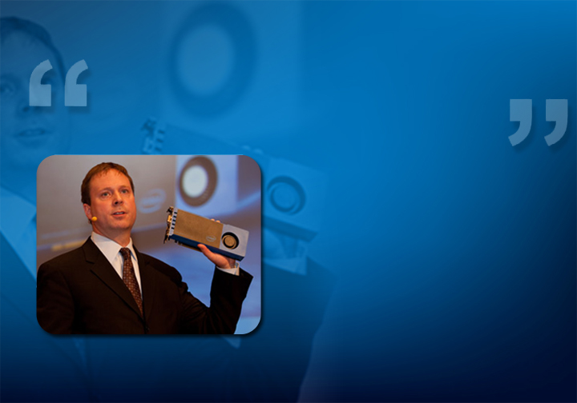
Intel® Many Integrated Core (MIC) Architecture
The CERN openlab team was able to migrate a complex C++ parallel benchmark to the Intel MIC software development platform in just a few days.
Sverre Jarp, CTO of the CERN openlab
Announced at ISC’10 in May
Targeted at highly parallel applications
Common set of Programming Tools for Intel® Xeon® Processors and Intel MIC Architecture
Software Development Program ramps in 2011
First product will be based on Intel’s 22nm process
All trademarks, copy rights, and brands are properties of third party companies.
Notes:
Intel® MIC architecture is a large, multi-year, investment by Intel

Slide 18

The Knights Family
Future Knights Products
Knights Corner
1st Intel® MIC product
22nm process
>50 Intel Architecture cores
Knights Ferry

Slide 19
Exascale Systems Design
Power Management
Packaging
Thermal Mgmt
Parallel
Software
Exascale systems will need multiple technology innovations to achieve
1000-fold improvements
Reliability
And
Resiliency
Microprocessor
Memory
Interconnect
Notes:
The “4 pillars” sometimes discussed excludes S/W and power management.

Slide 20


Our Strategy:
Computing for highly parallel workloads
Common tools suite and programming model
  Tools become architecturally aware
  Ct programming model
Xeon® serves
Most HPC Workloads
  Xeon right for most workloads
  Extending instruction set
  arch (AVX, etc.)
Intel® MIC
Products for highly
parallel applications
  First intercept 22nm process
  Software development platforms available this year
Common Tool Suites insures Application Development
Continuity, and Fast Time to Performance

Slide 21
Programming at Exascale
New languages needed?
First: actually support and use the ones we have
New Runtime Systems and OS approaches are needed
Resiliency cannot be the primary focus of programming
Get rid of Bulk Synchronous Programming
It is wasteful of resources and power
Do algorithms need to inform and be informed by system SW and HW (e.g., resources going south, jitter, …)?
We may be approaching a crossover point where probabilistic methods come into their own

Slide 22
Exascale Systems Design
Power Management
Packaging
Thermal Mgmt
Parallel
Software
Exascale systems will need multiple technology innovations to achieve
1000-fold improvements
Reliability
And
Resiliency
Microprocessor
Memory
Interconnect
Notes:
The “4 pillars” sometimes discussed excludes S/W and power management.

Slide 23
Memory advances
Do we need to keep Memory balance at ½ byte/sec per flops
We do need to keep total memory energy budget below ~5pJ per bit moved to or from memory
Memory must be very close to the processor
greatly reduce signalling power
CPU and Memory controller will blur together
Memory paths must be very simple
The hard problem is not global addressability!
It’s cache coherency– strains resources and power
DRAM architecture must become more power efficient

Slide 24
Revised DRAM Architecture
Today’s energy cost :
~150 pJ/bit
Today’s DRAM
Tomorrow’s DRAM
RAS
Page
Page
Page
Addr
Page
Page
Page
CAS
Addr
Activates many pages
Lots of reads and writes (refresh)
Small amount of read data is used
Requires small number of pins (DIPs)
Activates few pages
Read and write (refresh) what’s needed
All read data is used
Requires large number of IO’s (3D)

Slide 25
Innovative Multi-Chip 3D Packaging Will Address Multiple Challenges
Heat Extraction
CPU with 100s
of cores
DRAM die
DRAM or
NVRAM die
CPU with
100s of cores
Interconnect
substrate
Through
Silicon Via
Through
Silicon Via
Pins required + IO Power limits the use of traditional packaging
Tighter integration between memory and CPU is required
Enables high memory BW and low latency using memory locality
Shorter Distances Allow Improved Latency and BW/Watt
Source: Exascale Computing Study: Technology Challenges in achieving Exascale Systems (2008)
Notes:
Earlier on, we saw the limitations around memory that require large number of pins to be supported to maintain the memory BW and power requirements of exascale systems.
We also saw that interconnect power is going to be the dominating source of system power if technology trend is left to continue as is.
One thing is rather clear – we cannot develop a package to support the 1000’s of pins that will be required and we need to start looking at alternative packaging options first, such as 3D integration of dice using TSVs and taking this a step further and including multiple chips in a 3D package.
As the two pictures show, there are multiple ways this can be addressed based on locality and latency requirements
3D integration allows fewer external pins on the package boundaries - you still need large number of connections between memory and the CPU, but they are done at the die stack level using TSV
It also allows an increase in BW, either though higher SERDES frequencies or via widened IO – with the caveat that software must ensure that memory locality rules are observed.
And finally, decreased distances between memory and CPU means lower power
Advances in 3D system geometries need to be considered
Opportunity to use geometry to reduce power consumption
BW in excess of 100K Tbps/sq.cm can be obtained. In excess of 10K vias per sq mm can be placed

Slide 26


Terascale Experimental Hardware
Tera-Bytes: 3D Stacked Memory
256 KB SRAM per core
4X C4 bump density
3200 thru-silicon vias
Polaris with Cu bump
Polaris
Memory
Thru-Silicon
Via
Package

Slide 27
Exascale Systems Design
Power Management
Packaging
Thermal Mgmt
Parallel
Software
Exascale systems will need multiple technology innovations to achieve
1000-fold improvements
Reliability
And
Resiliency
Microprocessor
Memory
Interconnect
Notes:
The “4 pillars” sometimes discussed excludes S/W and power management.

Slide 28
Interconnect
If the Achilles heel of CPUs is the memory system,
That of the computer is the interconnect:
Scalability is critically dependent on balance between the nodes and the interconnect.
Applications families can pose vastly differing requirements of an interconnect:
One size does not fit all!

Slide 29


Future: A Terabit Optical Chip
Optical Fiber
Multiplexer
25 modulators at 40Gb/s
25 hybrid lasers
A future integrated terabit per second optical link on a single chip

Slide 30
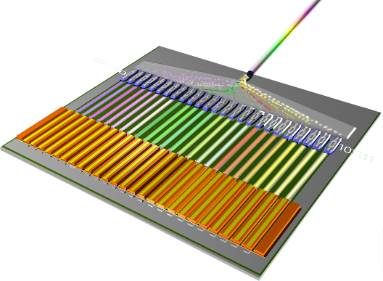
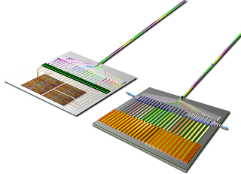
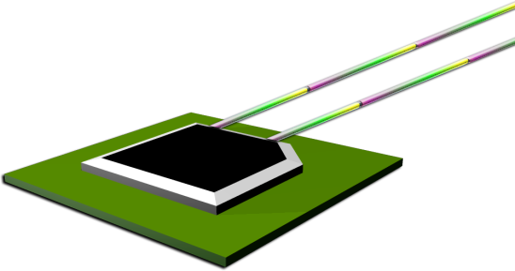
Integrating into a System
This transmitter would be combined with a receiver
Rx
Tx
Which could then be built into an
integrated, silicon photonic chip

Slide 31
HPC: High Performance Computing >>Tb/s
Core-Core: On Die
Interconnect fabric
Memory: Package
3D Stacking
Chip-Chip: Fast Copper
FR4 or Flex cables
Tb/s of I/O
Memory
Memory
Memory
Memory
Integrated Tb/s Optical Chip?

Slide 32
Exascale Systems Design
Power Management
Packaging
Thermal Mgmt
Parallel
Software
Exascale systems will need multiple technology innovations to achieve
1000-fold improvements
Reliability
And
Resiliency
Microprocessor
Memory
Interconnect
Notes:
The “4 pillars” sometimes discussed excludes S/W and power management.

Slide 33
… Reliability and Resiliency
Scaling Peta to Exa | Critical Reliability Issues
>1,000X more parallelism | Up to 1,000X intermittent faults due to soft errors More chips means more hard failures
Aggressive Voltage scaling to reduce power/energy | Gradual faults due to increased variations More susceptible to Vcc droops (noise) More susceptible to dynamic temp variations Exacerbates intermittent faults—soft errors
Deeply-scaled technologies | Aging related faults Lack of burn-in? Variability increases dramatically
Chip Stacking Correlated soft errors?

Slide 34
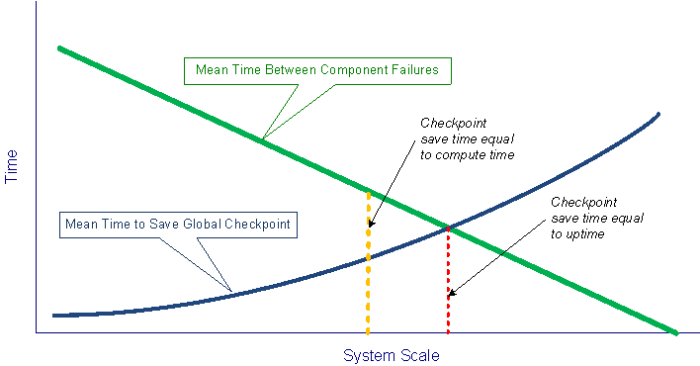
Software and System Resilience
Global checkpoint is primary resilience mechanism in current use
  Implementation can be non-trivial
Global checkpoint save time will dominate system uptime
  Checkpoint save time increases with system scale
  System uptime decreases with system scale
  Checkpoint overhead expected to dominate by exascale
Go to hierarchical SW controlled checkpointing w HW support
Notes:
34

Slide 35
Conclusion: The Path Forward
Extreme voltage scaling to reduce core power
More parallelism 10x – 100x to achieve speed
Re-architecting DRAM to reduce memory power
New interconnect lower power and distance
NVM to reduce disk power and accesses
Resilient design to manage unreliable transistors
New programming tools for extreme parallelism
Applications built for extreme parallelism
Research Needed to Achieve Exascale Performance (3 Labs in EU, 1 in Fr)

Slide 36
Thank you

