Slide 1
The LHCb 2010 Computing
Philippe Charpentier
CERN – LHCb
On behalf of the LHCb Computing Group

Slide 2
Guidelines for the Computing Model
Small processing time, but high trigger rate
24 kHS06 required for reconstruction
Typically 2000 CPU slots
Tier0 could not provide the necessary CPU power
Use Tier1s as well for reconstruction (first pass)
Most problems for analysis jobs are related to Data Management
SE accessibility, scalability, reliability…
Restrict the number of sites with data access
Use Tier1s for analysis
High requirements on simulated data
Background identification, efficiency estimation for signal
Typically 360 HS06.s per event
Use all possible non-Tier1 resources for simulation

Slide 3
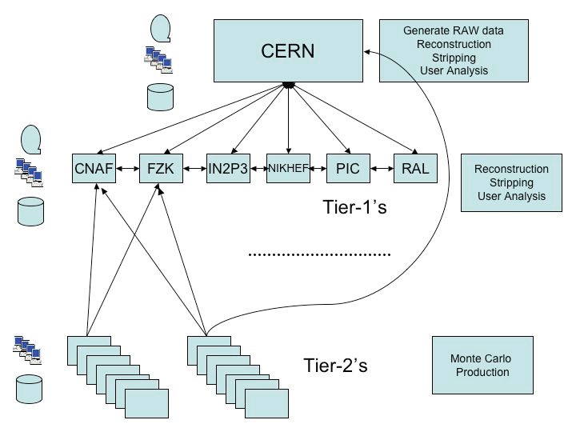
The LHCb Computing Model

Slide 4
LHCb real data in 2010
LHC started with very low luminosity
Very few colliding bunches
Not worth for rare b-physics decays
Minimum bias trigger for 2 months
Introduce tighter triggers when luminosity increases
LHC change of strategy for higher luminosity
Large number of protons per bunch
Small squeezing
Still low number of bunches (16, 25, 48, increasing since September, up to 400 bunches)
Consequence: larger number of collisions per crossing
µ=1 to 2.3 !!!
Much higher pile-up (1.6 to 2.3 collisions per trigger)
Effects on Computing
Larger events
More complex events to reconstruct
Larger pre-selection retention

Slide 5
Adaptability of the Computing Model
Needs to be reactive to continuously changing conditions
First months: minimum bias data
No preselection
Reconstruction creating DSTs for all events
As of July: large µ data
Event size
50 to 60 kB
Twice more than design
Reconstruction time
Quadratic with event size
4 times more than design
Stripping time and memory
Large combinatorics for pre-selection
Stripping time exponential with event size
Algorithms tuned for µ=0.4 were taking up to 60 HS06.s
Twice the reconstruction time!
Memory consumption up to 3 GB (nominally 1.5 GB)

Slide 6
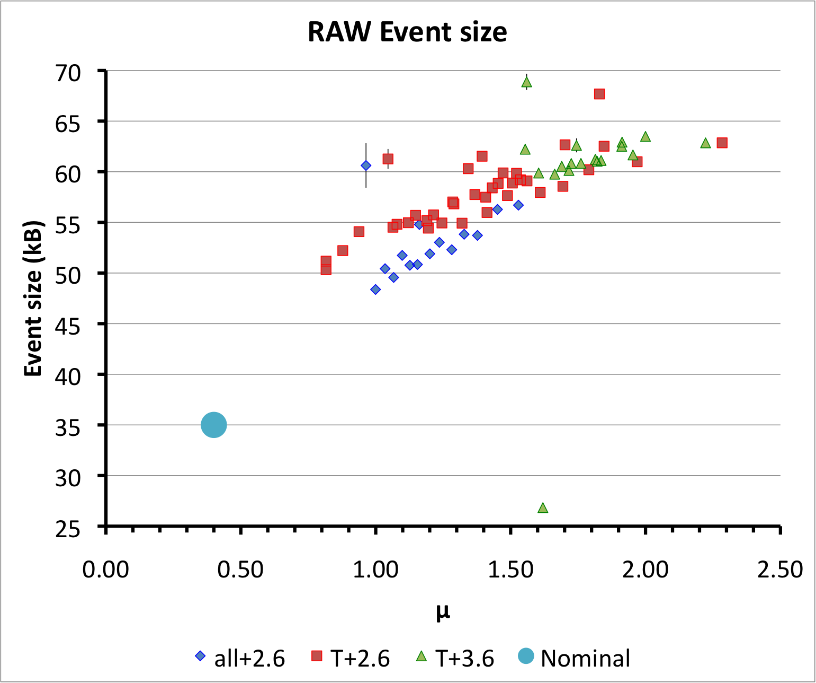
New Computing Conditions
Both event size and CPU time rise with µ
Compatible with expectations at µ=0.4
Notes:
Brighter colors
Put a reference

Slide 7
Adaptability (2)
Reconstruction / stripping jobs
Need to fit in Tier1 Grid queues
Reduce file size (nominally 3 GB) to 1 GB
Extensive work on reducing computing time
Reconstruction: factor 2 reduction
Stripping: factor 10 reduction in time, large increase in rejection
Nevertheless, this takes… time!
For optimisation, data is needed
Run with existing applications
High failure rate (CPU time limit, max memory exceeded)
Use a lot of space for storing too many (too large) events
Possible thanks to the available disk (foreseen for more data)
Continuous data management operations
Remove obsolete processings (keep only 2)
Reduce number of replicas (from 7 to 3 or 4)
Notes:
sAve tiem on that one

Slide 8
Weaknesses of the Grid
Workload Management System
Mitigated by usage of pilot jobs (DIRAC)
Workload optimisation using generic pilot jobs
Run multiple payloads (e.g. production + analysis)
Data Management System
Data access by protocol unreliable for long jobs
Errors when opening files (servers overloaded)
Connections broken when job lasts hours
Use as few files as possible, i.e. as large as possible
Requires merging of output files (DSTs)
Keep runs (1 hour data taking) as granularity of datasets
Mitigated by local copy of input data
Standard procedure for reconstruction-stripping jobs and merging
Not possible for analysis jobs though…
Notes:
Skip a bit

Slide 9
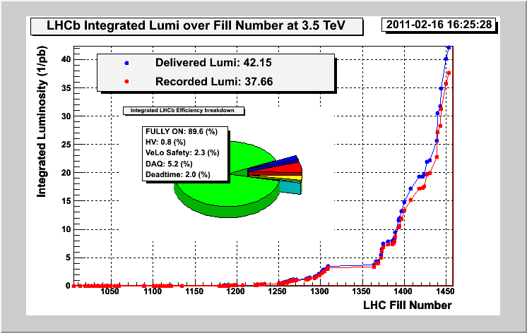
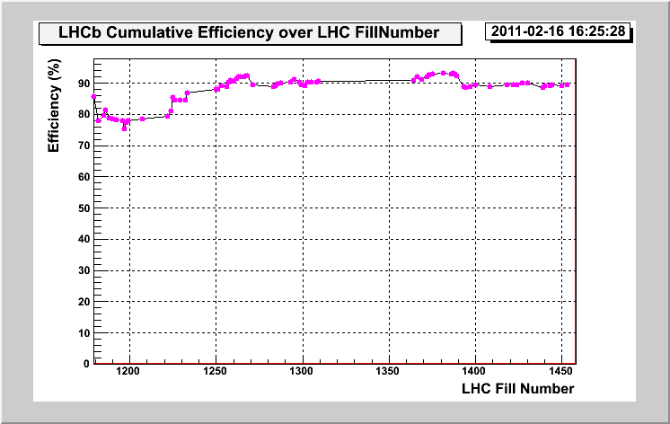
Data collection
42.2 pb⁻¹ delivered
37.7 pb⁻¹ recorded
89.3% data taking efficiency
Most data collected after 15 September

Slide 10
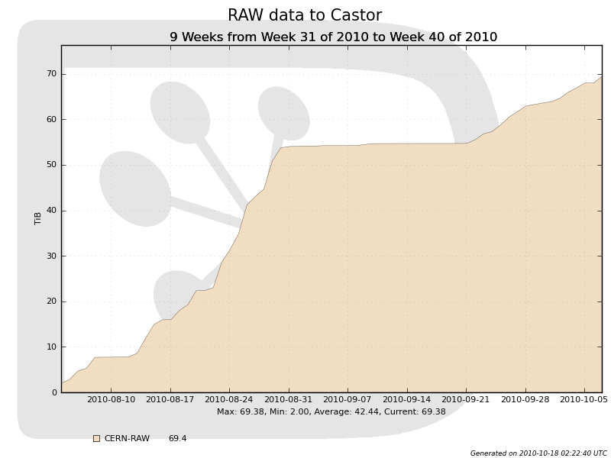
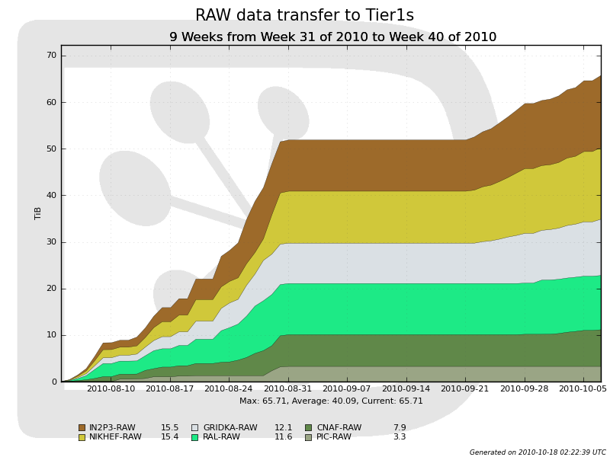
RAW data distribution
65.7 TB of physics RAW data collected
Slightly more transferred to Castor
Calibration and test data
Not distributed to Tier1s
Distributed immediately to Tier1s
A full run (1 hour) goes to a single Tier1
RAW data share according to CPU pledges of Tier1s
When a Tier1 is unavailable, share temporarily set to 0

Slide 11
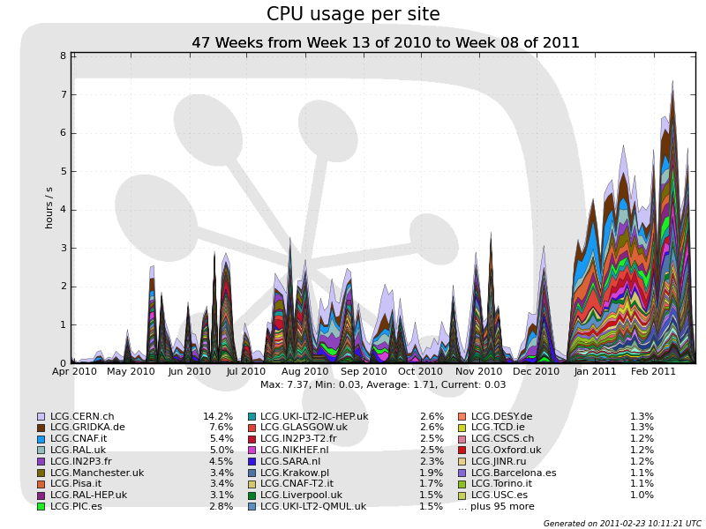
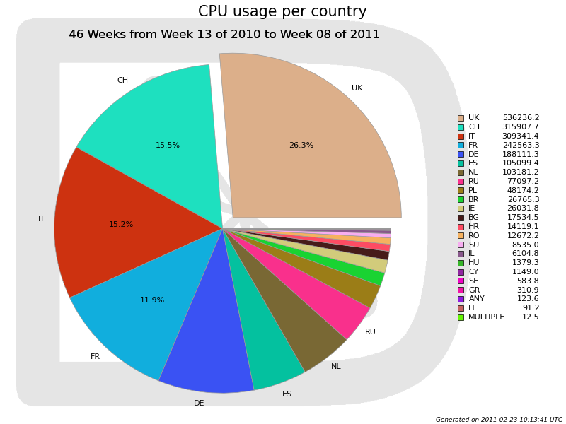
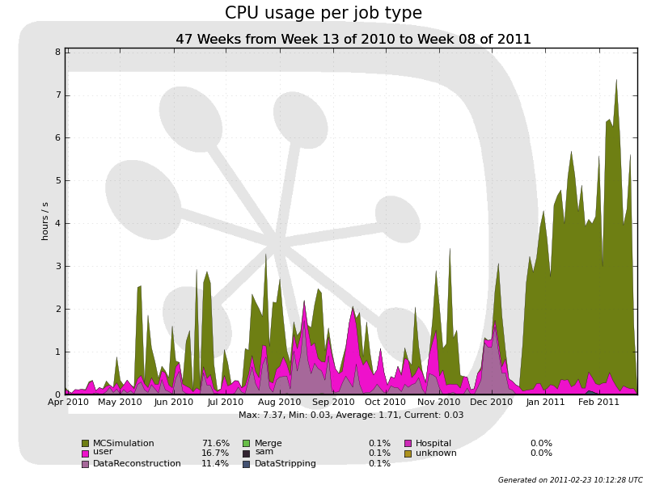
Global Grid usage
121 sites used
22 countries
Since April 2010:
Simulation: 72%
Mainly since December
Analysis: 17%
Reconstruction: 11%
Notes:
Put labels

Slide 12
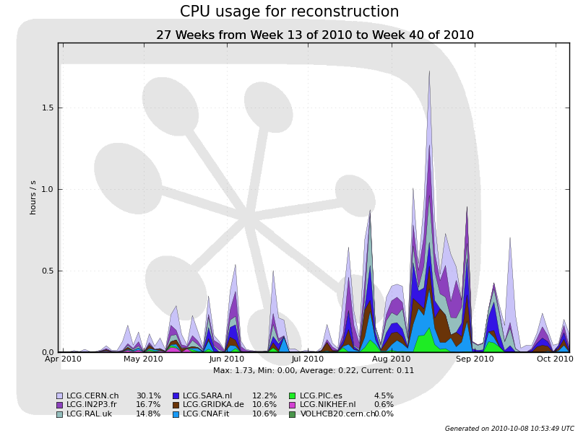
Reconstruction jobs
Continuous processing
From time to time reprocess all existing data when changes are worth it
Major one in August
Notes:
Remove prodsand enlarge plot

Slide 13
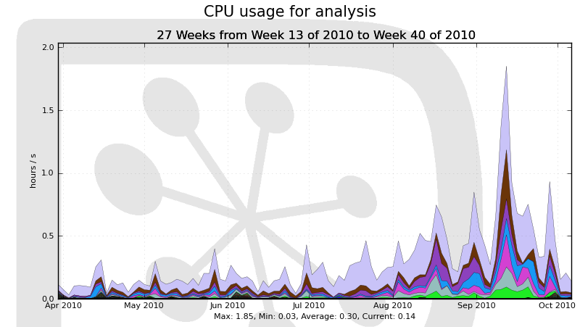
Analysis jobs
Over 250 users used the Grid for analysis
Only 2% of analysis at Tier2s (toy MC, private small simulations)
No a-priori assignment of site: share by availability of resources and data
Notes:
Enlarge plot, reduce text

Slide 14
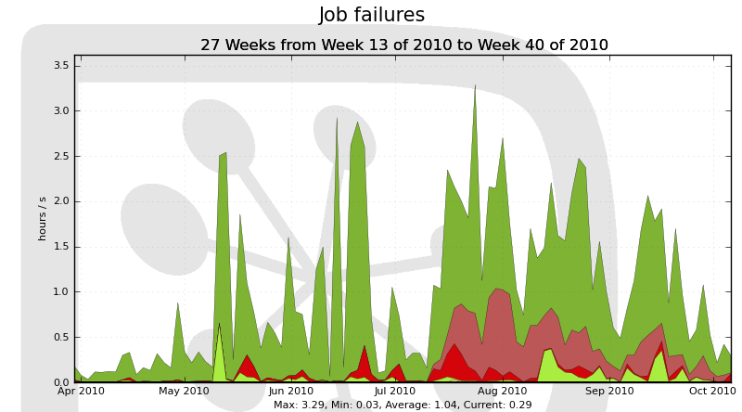
Job success
Overall 81% successful jobs
Main cause of failures (15%): job exceeding CPU time limit
Infinite loop in Geant4 on 64-bit
Large µ
Jobs eventually all completed after several retries!
Also few user jobs
4% data access problem in application
Notes:
Simulation CPU limit as well

Slide 15
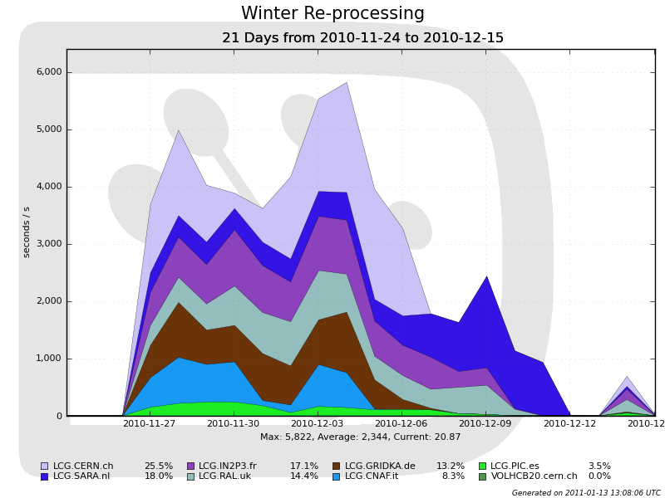
Winter re-processing
Re-processing of all 2010 data
New calibration
New pre-selection (stripping) algorithms

Slide 16
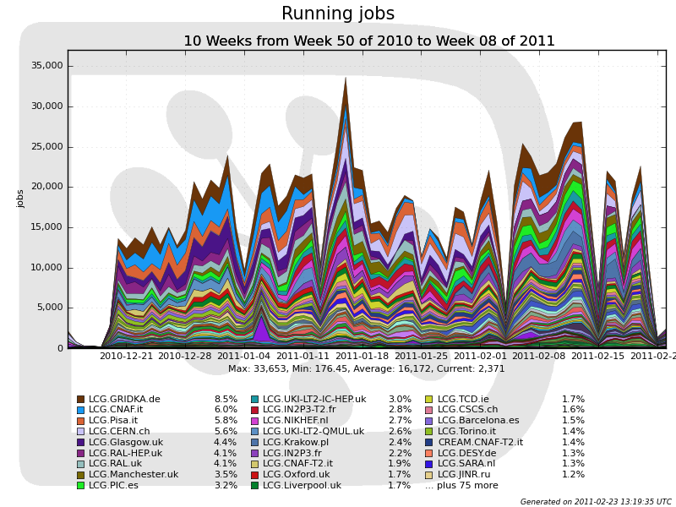
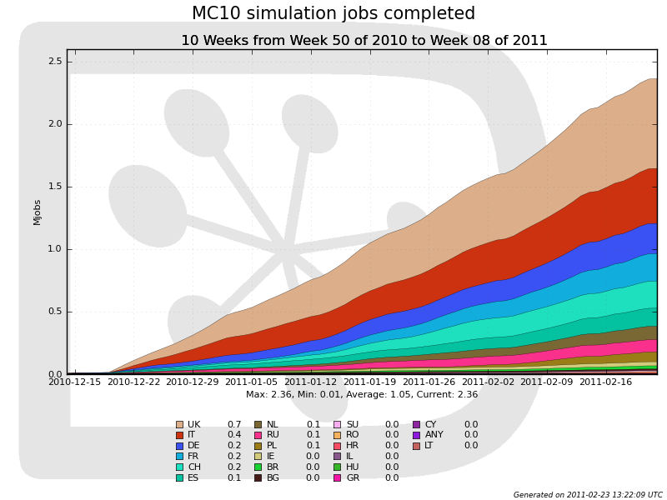
Winter Simulation Campaign
Large campaign of simulation for extracting physics from 2010 data
Uses the beam and detector conditions of 2010
Steady pace of 32,000 jobs per day (about 5 million events)
Already half of the highest priority events have been simulated

Slide 17
Conclusions
The LHCb Computing Model looks global sound
However the new LHC running conditions imply some changes to the offline reconstruction and analysis conditions
During 2010, several iterations were needed in order to adapt to these conditions
The full reprocessing of 2010 data will take place starting in November 2010
Increase in CPU requirements and disk space will have to be watched carefully in order to match the pledges
Usage or resources beyond Tier1s for reconstruction and analysis are being investigated

