Slide 1
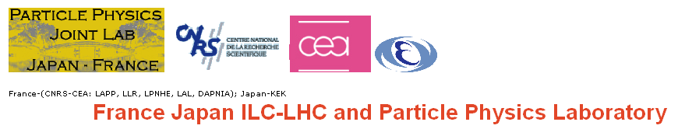
Bio1 : New developments of the Geant4 Monte Carlo simulation toolkit
Koichi MURAKAMI (KEK)
- on behalf of KEK, IN2P3 &colleagues -
15-17 May 2008
Paris, France

Slide 2
Contents
The Geant4 simulationtoolkit
FJPPL collaboration activities
  Educational tools and materials
  Extension of Geant4 for applications in medicine and biology
  Deployment on computing GRID for medical applications
KEK & IN2P3 & collaborating teams
2007-2008 Budget spending summary
2008-2009 Budget request

Slide 3

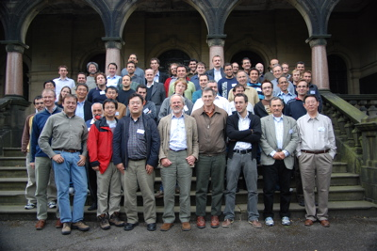
Geometry and tracking:
Geant4
Geant4 : a toolkit for the simulation of the passage of particles through matter
  Developed by an international collaboration for HEP, successor of Geant3 (20 years)
  Gather more than 160 collaborators today
  Most recent Monte Carlo code in HEP (1998)
  Consist of C++ libraries
  Regularly updated, entirely open and free
Geant4 is designed not only for HEP experiments, but also for other domains like bio-medical and space radiation modeling
  Flexible geometry and materials
  Physics processes modeling (electromagnetic, hadronic)
  Generate particles and track them inside the geometry
  Record physical quantities and analysis
Potentialities
  Visualization
  Interactivity
Necessity : education, new developments and validation

Slide 4
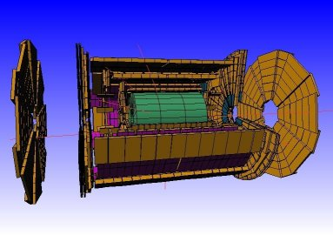
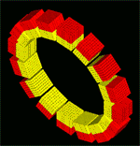
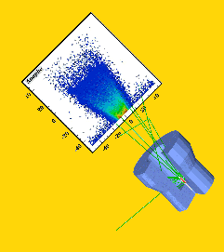
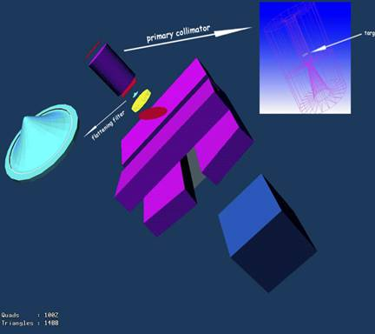
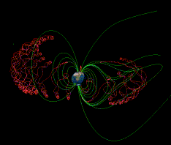

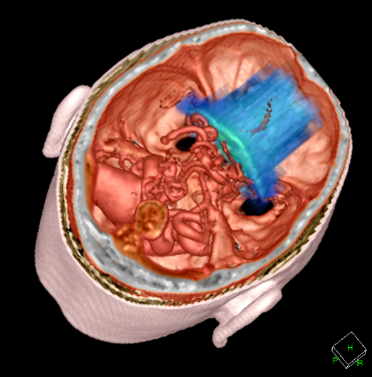
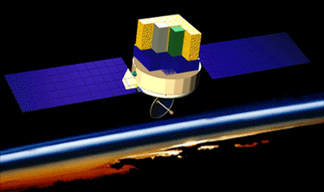
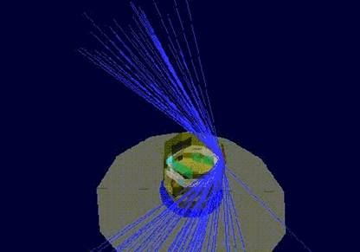
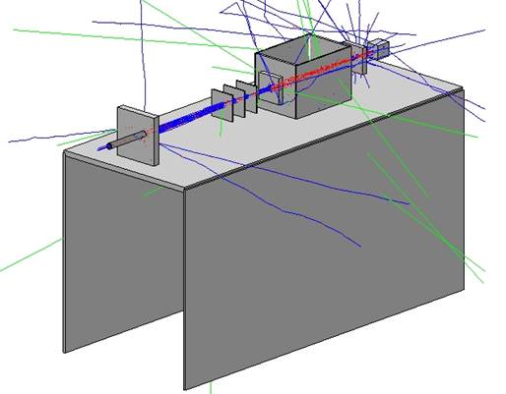
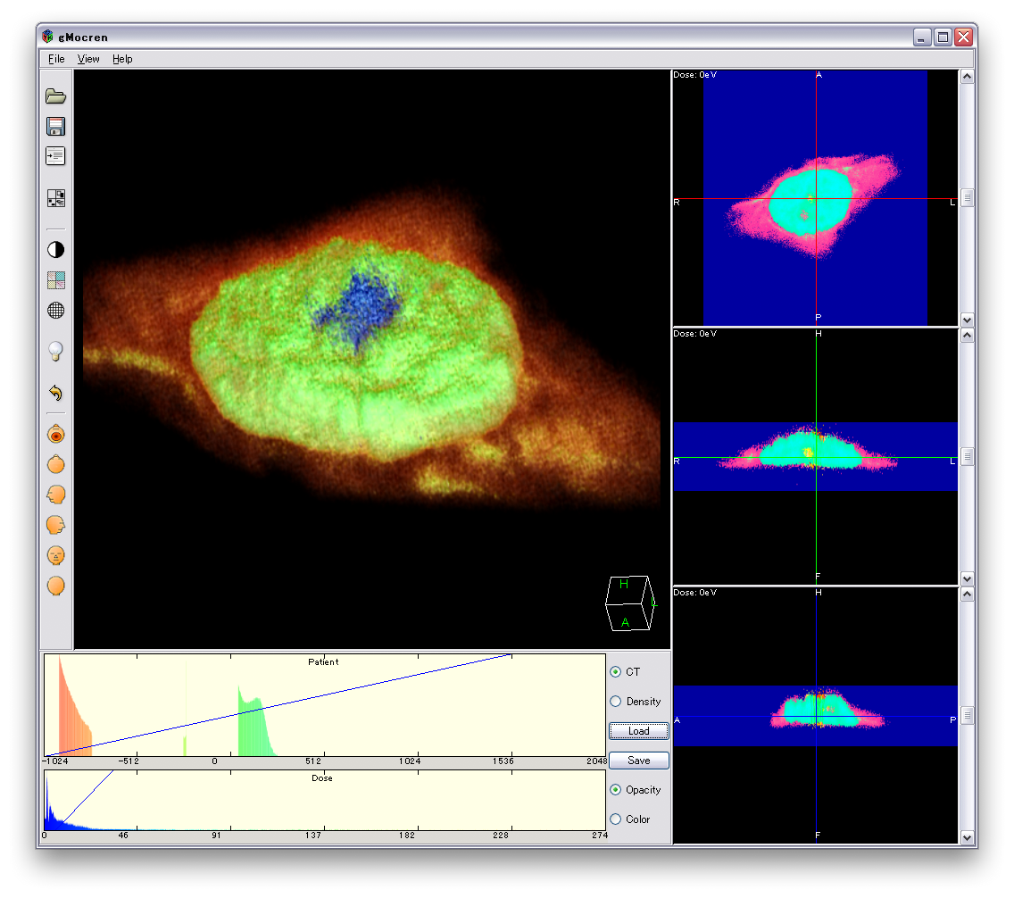
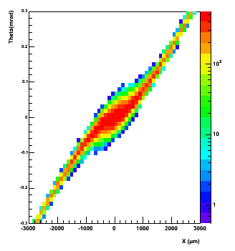
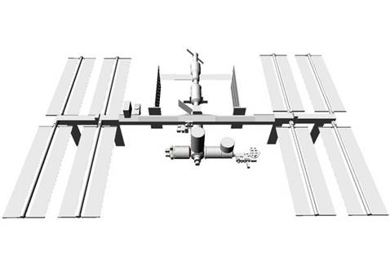
ATLAS, CMS, LHCb, ALICE
@ CERN
PET Scan
(GATE)
BaBar, ILC…
Brachytherapy
Medical linac
Planetology
GLAST (NASA)
http://cern.ch/geant4
Technology transfer from
HEP to space, medical, bio …
GAIA (ESA)
Dosimetry DICOM
Cellular irradiation
Nanobeam raytracing
ISS
Hadrontherapy

Slide 5
Activity #1
Educational tools and materials
  Geant4 for education
  Common development for Geant4 tutorials

Slide 6
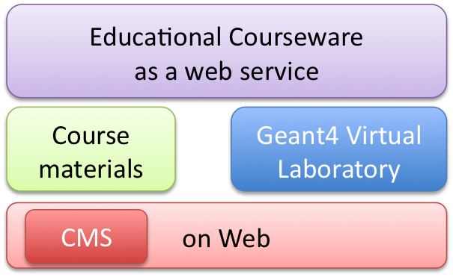
Geant4 for education
Not to teach Gaant4, but use Geant4 to teach Physics
  Geant4 contains a large phenomenological and empirical knowledge of interactions of particles with matter
  , also contains many realistic examples and test suites to start with
A framework for
  Educational courseware for leaning particle physics with Geant4
  Hybrid e-learning system of
    Course materials (online textbooks)
    Geant4 applications (virtual laboratory)
  Finally as web service
Collaboration
  Japan – framework development
  France – providing course materials

Slide 7
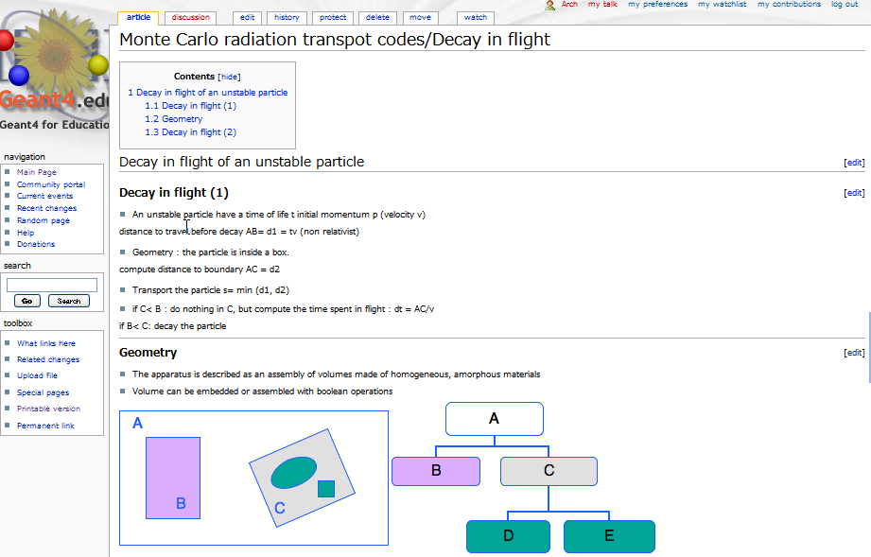
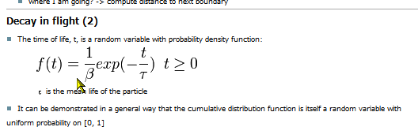

Course materials on web CMS
Math expressions can be handled
with Latex format
Images
(Contents Management System)

Slide 8
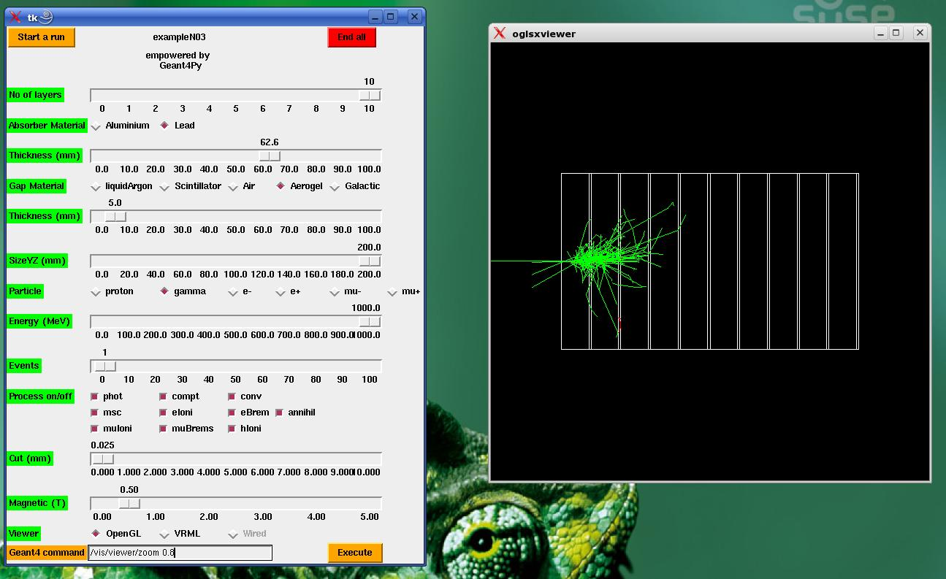
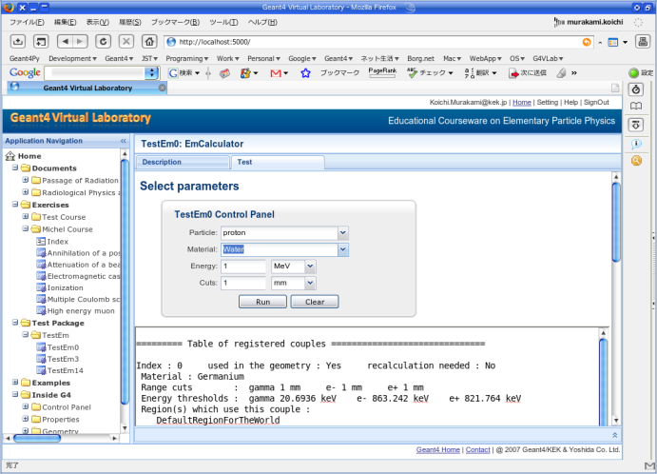


Local Application
Geant4 virtual laboratory on web
On Web
Client side (web browser)
Ajax-powered GUI
as Control Panel of G4 applications
XMLHTTP Request
XML/JSON
Job Dispatcher /
Load Balancer
G4 Application Modules
Python Software Bus
Server side
Web Framework
URL maper
Geant4 Educational Application
w/ GUI control panel
Educational courseware as web service

Slide 9
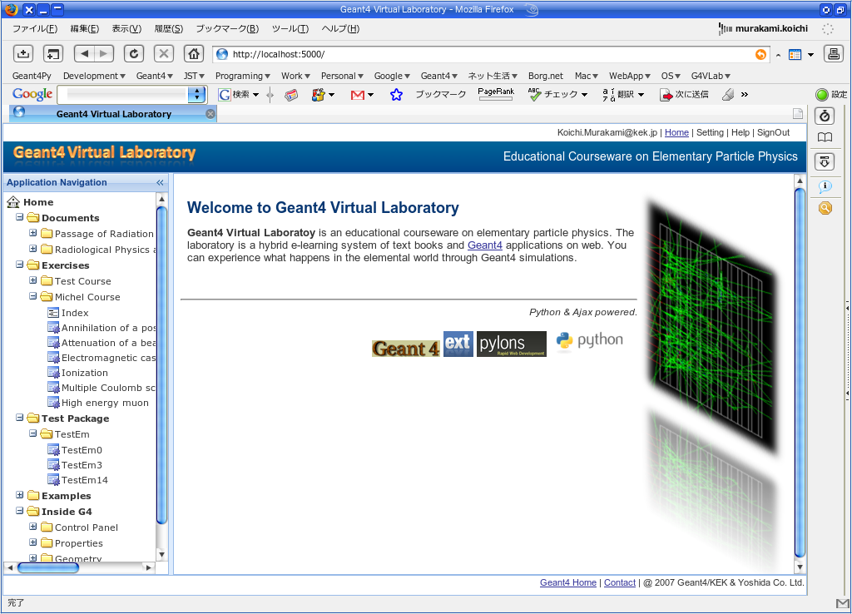
Educational courseware as web service

Slide 10
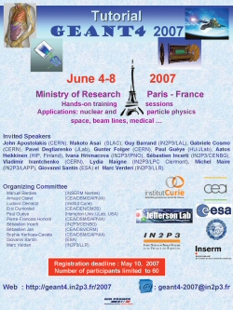
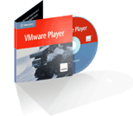
Common developments for Geant4 tutorials
Both KEK & IN2P3 have organized Geant4 tutorials :
Tsukuba (2006), Sendai (2007), Tokyo (2008), Tsukuba (scheduled 2008), Strasbourg (2007), Paris (2007), Annecy (2008)
Strong demand among young physicists
Common educational environment :
  Making the deployment of Geant4 easier for users
  VMWare virtualization environment
    Geant4 is pre-installed on a virtual machine
  Sharing tutorial materials
  Documentation management on Web technology

Slide 11
Activity #2
  Extension of Geant4 for applications in medicine and biology
    Simulation framework for radiotherapy (Japan)
    Modeling of biological effects of radiation (France)

Slide 12
Motivation
Geant4 is a well designed software for the simulation of interactions between particles and matter
Its flexibility and potentialities make Geant4 a good candidate for extensions towards emerging interdiciplinary fields
  Particle therapy in medicine
  Particle interactions in biological medium
  Space science
molecule
organs
planets

Slide 13
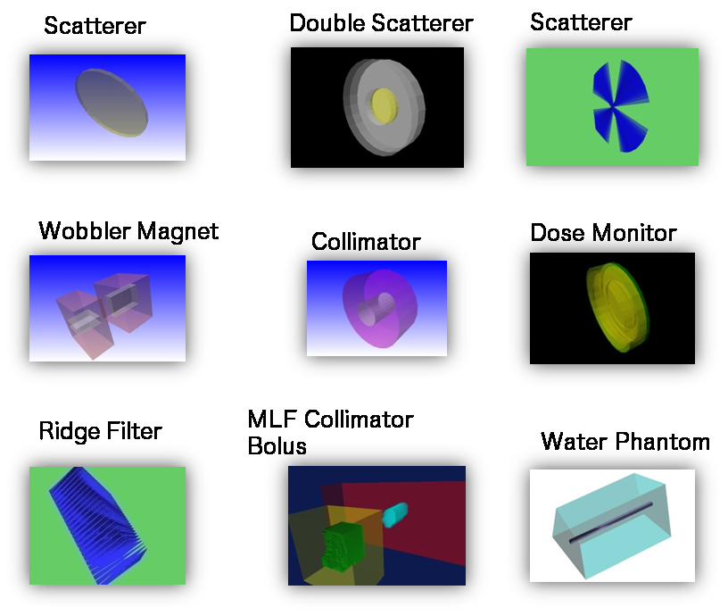
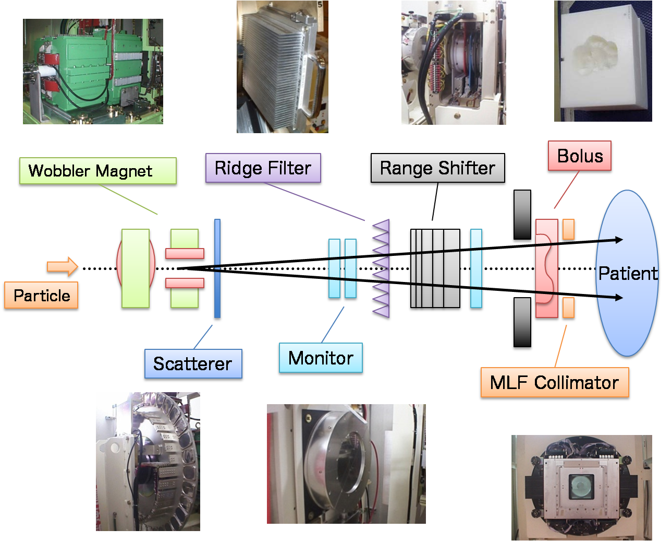
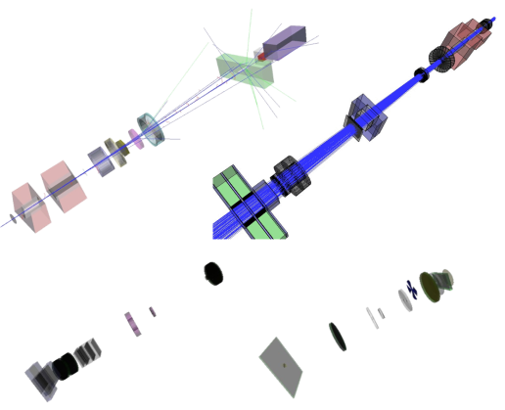
Software framework for particle therapy simulation
Irradiation Modules
Typical Beamline
Geant4 Simulation for various facilities

Slide 14
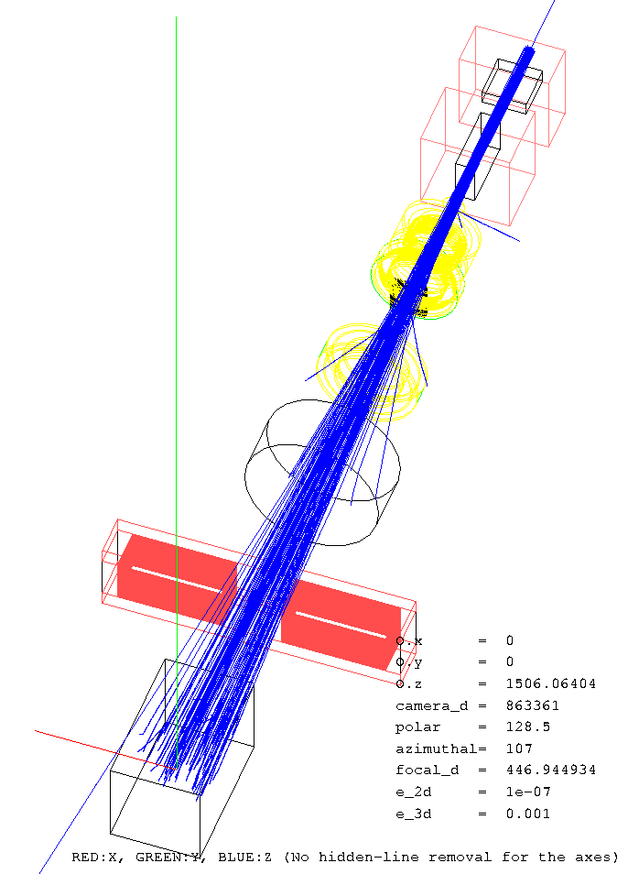
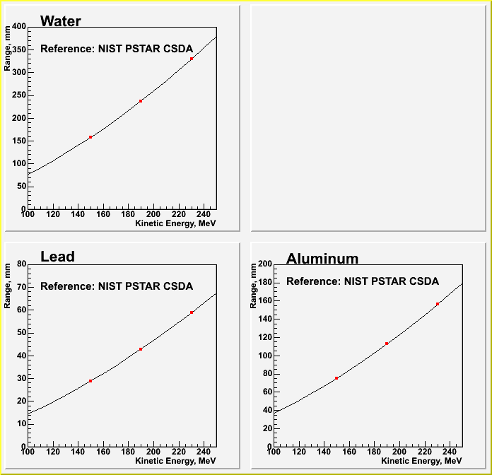
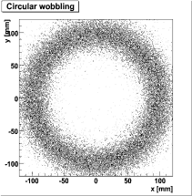
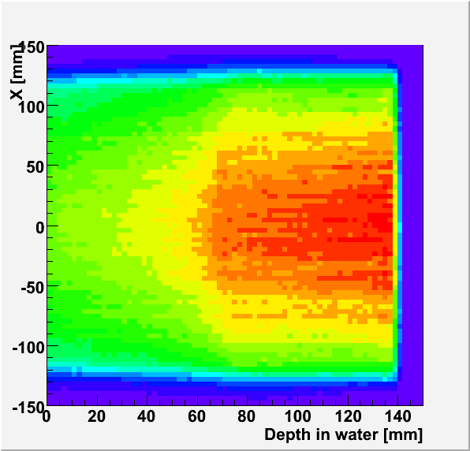
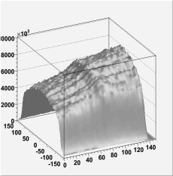
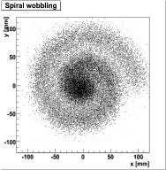
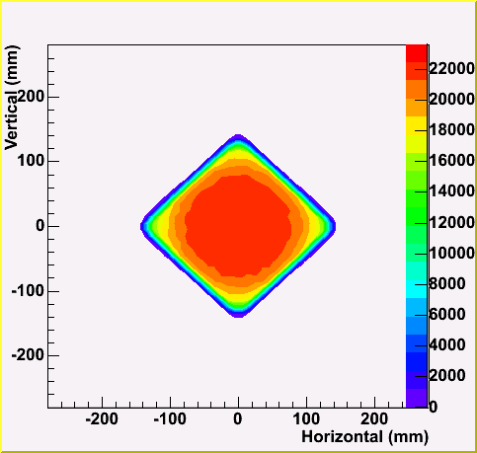
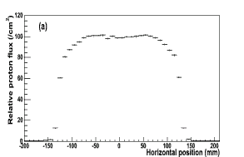
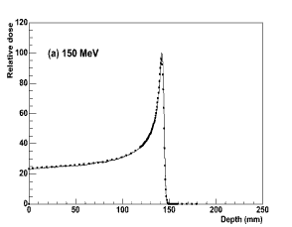
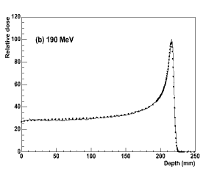
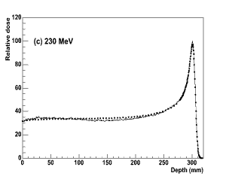
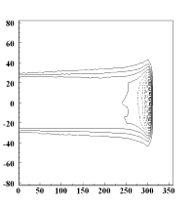
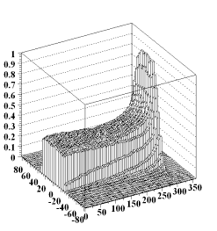
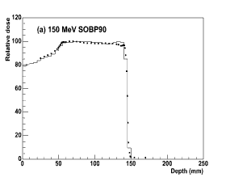
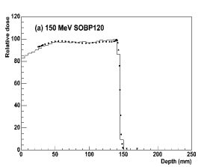
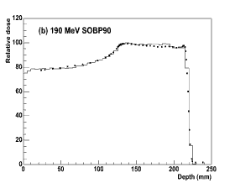
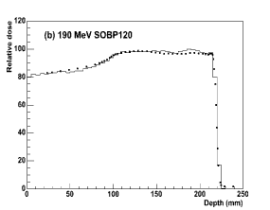
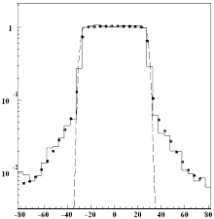
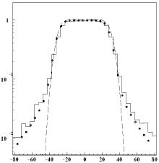
Validation activities
for Proton Therapy
Material Properties
Beam Delivery system validation
Proton range
Wobbler Magnet
Lead Scatterer
ーNIST PSTAR
●Simulation
Wobbler demonstration:
Spiral Wobbling
Uniform Irradiation Field
Edges of Multi-Leaf Collimator
Stopping Power/Range ,
checked with NIST data
Depth-Dose distribution
IEEE TNS V52,Issue4,(2005)pp.896-901
Nuclear Interaction Effect
Bragg Peak
( with Wobbler and Scatter )
by T.Akagi (HIBMC)
beam
MLC
Water phantom
― Simulation
■ Measurement
Spread Out Bragg Peak (SOBP)
(with Wobbler, Scatter, and Ridge filter)
50mm depth
250mm depth
● ： Measurements
－ ： TPS calculations
□ ： G4 (histograms)

Slide 15
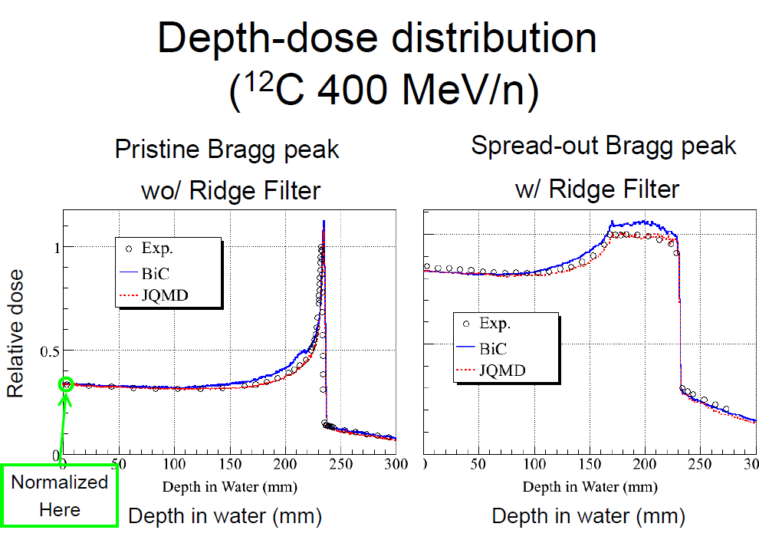
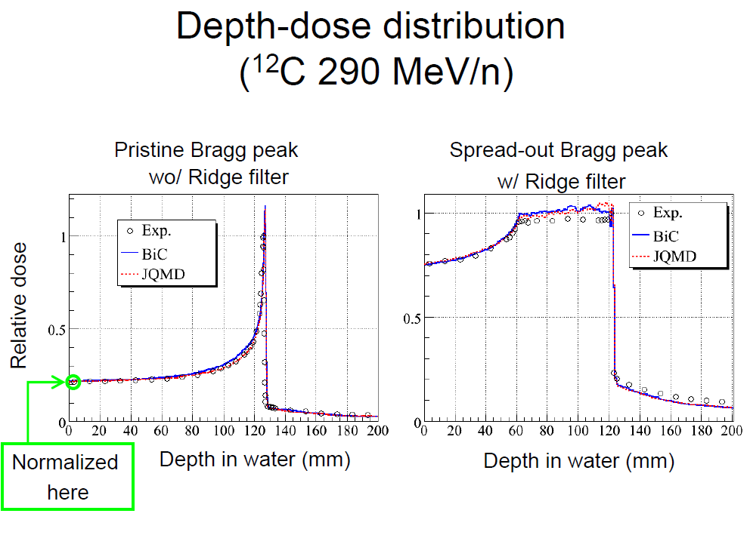
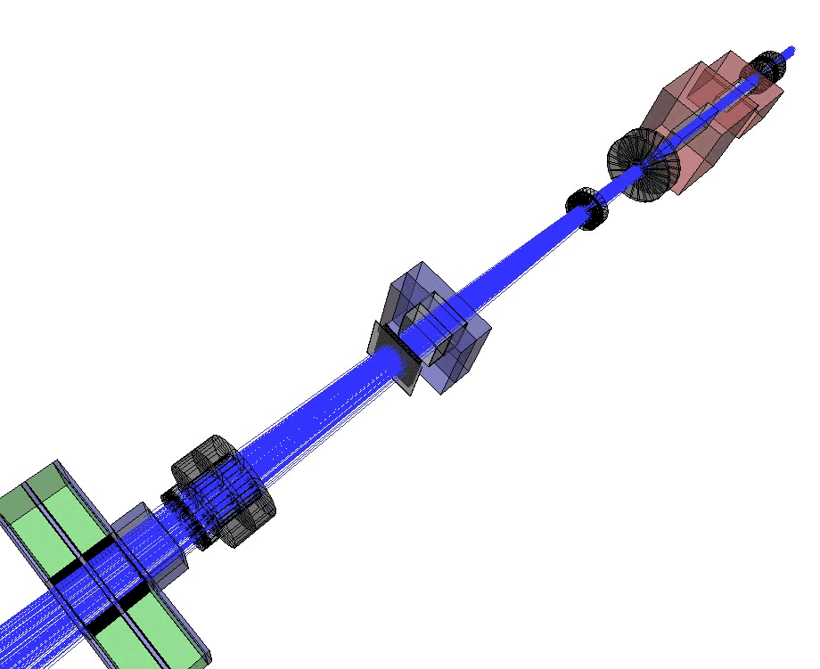
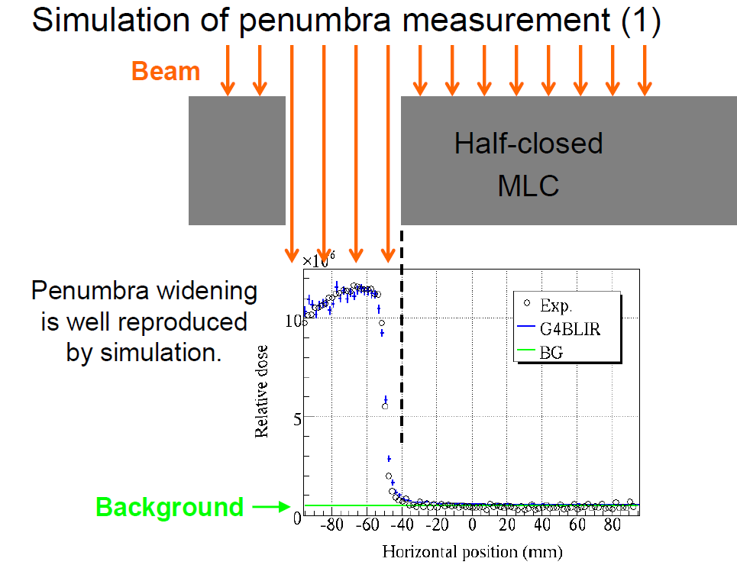
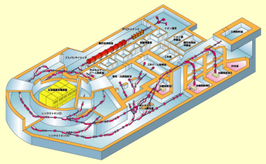
Validation activities
for Carbon Therapy
NIRS /
IHI experimental beam line

Slide 16
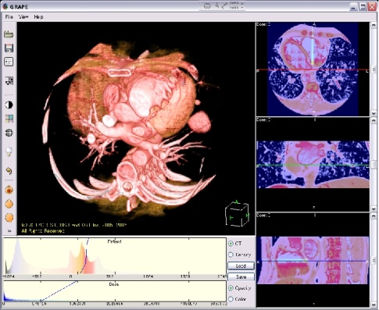











gMocren : A visualization tool
http://geant4.kek.jp/gMocren/
3D (ray casting)
2D (MPR)
Opacity curve and color map editor
gMocren and utility softwares are
freely available.
Supported system :
- Windows 2k/XP or PC Linux OS
- Pentium 4 or faster
- more than 1 GB (recommend)
free hand or templates with WW&WL editing
Calculated dose distribution
Particle trajectories
Opacity curve and color map editor
Functionality Requirements :
color mapping
To visualize
- the modality image used by the simulation,
- the calculated dose distribution and
- the particle trajectories
- in an agreeable speed
Transfer function editor
Multi-platform
Trajectory information in the simulation is available.
contour plot

Slide 17

Geant4 & Biology
Objective : detailed simulation of particle interactions with biological medium (DNA molecule) down to the eV scale in realistic cellular models
Using data from state-of-the art experimental techniques
  confocal imaging at the cellular scale (→ 3D cellular phantoms)
  ion beam analysis of cells (→ chemical composition of organities)
  cellular damages after microbeam irradiation

Slide 18
Work Plan
We have extended Geant4 EM Physics processes for electrons and light ions down to the eV scale in the framework of the Geant4 DNA project.
Work plan in 4 stages
  Physics stage (2007-2008) :
    propose additional/ complementary Physics models for elastic scattering, ionization… (in progress)
    propose new target materials (not only liquid water : DNA bases)
  Geometry stage (2007-2008) :
    implement realistic cellular phantoms (in progress)
    implement DNA molecular geometries
    use gMocren for visualization (in progress)
  Chemistry stage :
    implement chemistry reactions in Geant4 (production of radical oxidative species)
  Biology stage :
    modeling of DNA damages
Collaboration
  FJPPL
  in close contact with Geant4 collaboration (standard EM)
  C. Champion (Metz Univ.) : theoretician

Slide 19
Current eV scale physics models in Geant4
Liquid water only
 | e | p | H | α,He⁺,He
Elastic scattering | > 7.5 eV Screened Rutherford | - | - | -
Excitation A₁B₁, B₁A₁, Ryd A+B, Ryd C+D, diffuse bands | 7 eV – 10 keV Emfietzoglou | 10 eV – 500 keV Miller Green 500 keV – 10 MeV Born | - | Effective charge scaling from same models as for proton
Charge Change | - | 1 keV – 10 MeV Dingfelder | 1 keV – 10 MeV Dingfelder
Ionization 1b₁, 3a₁, 1b₂, 2a₁ + 1a₁ | 20 eV – 10 keV Born | 100 eV – 500 keV Rudd 500 keV – 10 MeV Born | 100 eV – 100 MeV Rudd

Slide 20



In liquid water
eV range

Slide 21
Realistic cellular geometries
directly implemented within Geant4
obtained from confocal microscopy of human cells (HaCat) and from ion beam analysis techniques (CENBG)
these geometries can be used with the eV scale extensions of Geant4 for track structure simulations in cells and microdosimetry

Slide 22


gMocren images
Confocal
microscopy
Geant4 + gMocren
cytoplasm
dose
nucleus
single HaCat (keratinocyte) cell
3 MeV He⁺ particles
512x512x60 phantom resolution 90x90x160 nm³ per voxel

Slide 23
Activity #3
Deployment on computing grids for medical applications

Slide 24

Motivation
Medical applications of Geant4
  large amount of computing power needed especially for
    Monte Carlo-based dose calculation in radiotherapy
    Systematic validation of physics (EM, hadronic)
Gridification is a solution to boost simulation speed
Both KEK & IN2P3 involved through LCG/gLite, EGEE

Slide 25


Easier GRID access needed
Development of web portals as an easy way to access GRID resources
  managing GRID jobs across firewalls
  intra-networks of universities/hospitals are closed under firewalls in most cases
  users applications are served as web applications
  ex. : fixed application in hadron therapy simulation changing different parameter sets
Provides a secure and efficient way of distributed analysis (job management)
Potentially, a toolkit for constructing GRID web applications
Activities on both Japanese and French sides
  Hadron Therapy Simulation (Japan) / GATE (France)
Japan
France

Slide 26


Grid Web Portal for
Medical Applications
Functional Components
Collaboration Matters
Grid computing
  Modality of submission
  Web portal interface for medical staff
  Medical imaging management
Visualization tool
  DICOM and DICOM RT images
  Output: Dosimetry, imaging using gMocren
Snapshot

Slide 27


Collaborating teams
16 collaborators (researchers + engineers)
Members of the Geant4 or GATE collaborations
Name | Affiliation | Name | Affiliation
Takashi Sasaki | KEK | Sébastien Incerti | IN2P3 - CENBG
Katsuya Amako | KEK | Vincent Breton | IN2P3 – LPC Clermont
Koichi Murakami | KEK | Lydia Maigne | IN2P3 – LPC Clermont
Go Iwai | KEK | Michel Maire | IN2P3 – LAPP
Hajime Yoshida | Shikoku Univ. | Jean Jacquemier | IN2P3 – LAPP
Tsukasa Aso | TNCMT | Sabine Elles | IN2P3 - LAPP
Akinori Kimura | AIT | Marc Verderi | IN2P3 - LLR
Satoshi Tanaka | Ritsumeikan Univ.
Toshiyuki Toshito | JST/KEK

Slide 28

Budget spending summary
 |  | Japan | France
2007-2008 | Requested | 1950 kYen | 21500 €
 | Allocated | 800 kYen | 5000 € + 10000 €
Two meetings
  Bordeaux (December 12-14, 2007)
    http://indico.in2p3.fr/conferenceDisplay.py?confId=442
  Tokushima (April 17-19, 2008)
    http://kds.kek.jp/conferenceDisplay.py?confId=891
One visit : K. Murakamiat to LAPP
(March 2008)

Slide 29
Budget request (2008-2009)
Budget Request | French Teams |  |  |  | Japanese Teams
 | Item |  | Euro | Supported by | Item |  | k Yen | Supported by
 | Nb of travels | 5 | 5×2500 | CNRS | Nb of travels | 8 | 8×200 | KEK
 | Workshop | 1 | 5000 | CNRS | Workshop | 1 | 350 | KEK
 | Other:computer | 2 | 2×2000 | CNRS
 | Total |  | 21500 | CNRS | Total |  | 1950 | KEK
Two meetings (Japan, France)
Visits to labs

Slide 30
Summary
Geant4 is designed not only for HEP experiments, but also for other domains like bio-medical and space radiation modeling.
FJPPL collaboration activities on new developments of Geant4:
  Educational tools and materials
  Extension of Geant4 for applications in medicine and biology
  Deployment on computing GRID for medical applications
Budget request
  Workshops both in Japan and France
  Visits to each laboratory

Slide 31
Thank you for your attention

