Slide 1




Max Baak (CERN),
on behalf of the Gfitter group (*)
Rencontres de Moriond ElectroWeak
La Thuile, 13th-20th March 2011
http://cern.ch/Gfitter
Global ElectroWeak fit
of Standard Model and Beyond
with Gfitter
(*) M. Baak, M. Goebel, J. Haller, A. Höcker, D. Ludwig, K. Mönig, M. Schott, J. Stelzer

Slide 2

The Gfitter Project – Introduction
A Generic Fitter Project
for HEP Model Testing
Gfitter = state-of-the-art HEP model testing tool for LHC era
Gfitter software and features:
  Modular, object-oriented C++, relying on ROOT, XML, python, RooWorkspaces.
  Core package with data-handling, fitting, and statistics tools
    Various fitting tools: Minuit (1/2), Genetic Algorithms, Simulated Annealing, etc.
    Consistent treatment of statistical, systematic, theoretical uncertainties (Rfit prescription), correlations, and inter‐parameter dependencies.
        Theoretical uncertainties included in χ² with flat likelihood in allowed ranges
    Full statistics analysis: goodness‐of‐fit, p-values, parameter scans, MC analyses.
  Independent physics “plug-in” libraries: SM, 2HDM, oblique parameters, SUSY, ...
Main publication: EPJ C60, 543-583, 2009 [arXiv:0811.0009]
  Updates and new results available at: www.cern.ch/Gfitter
Today: latest global electroweak fit, BSM constraints from oblique corrections
Notes:
HEP model testing tool …
The Gfitter software is … modular, etc

Slide 3
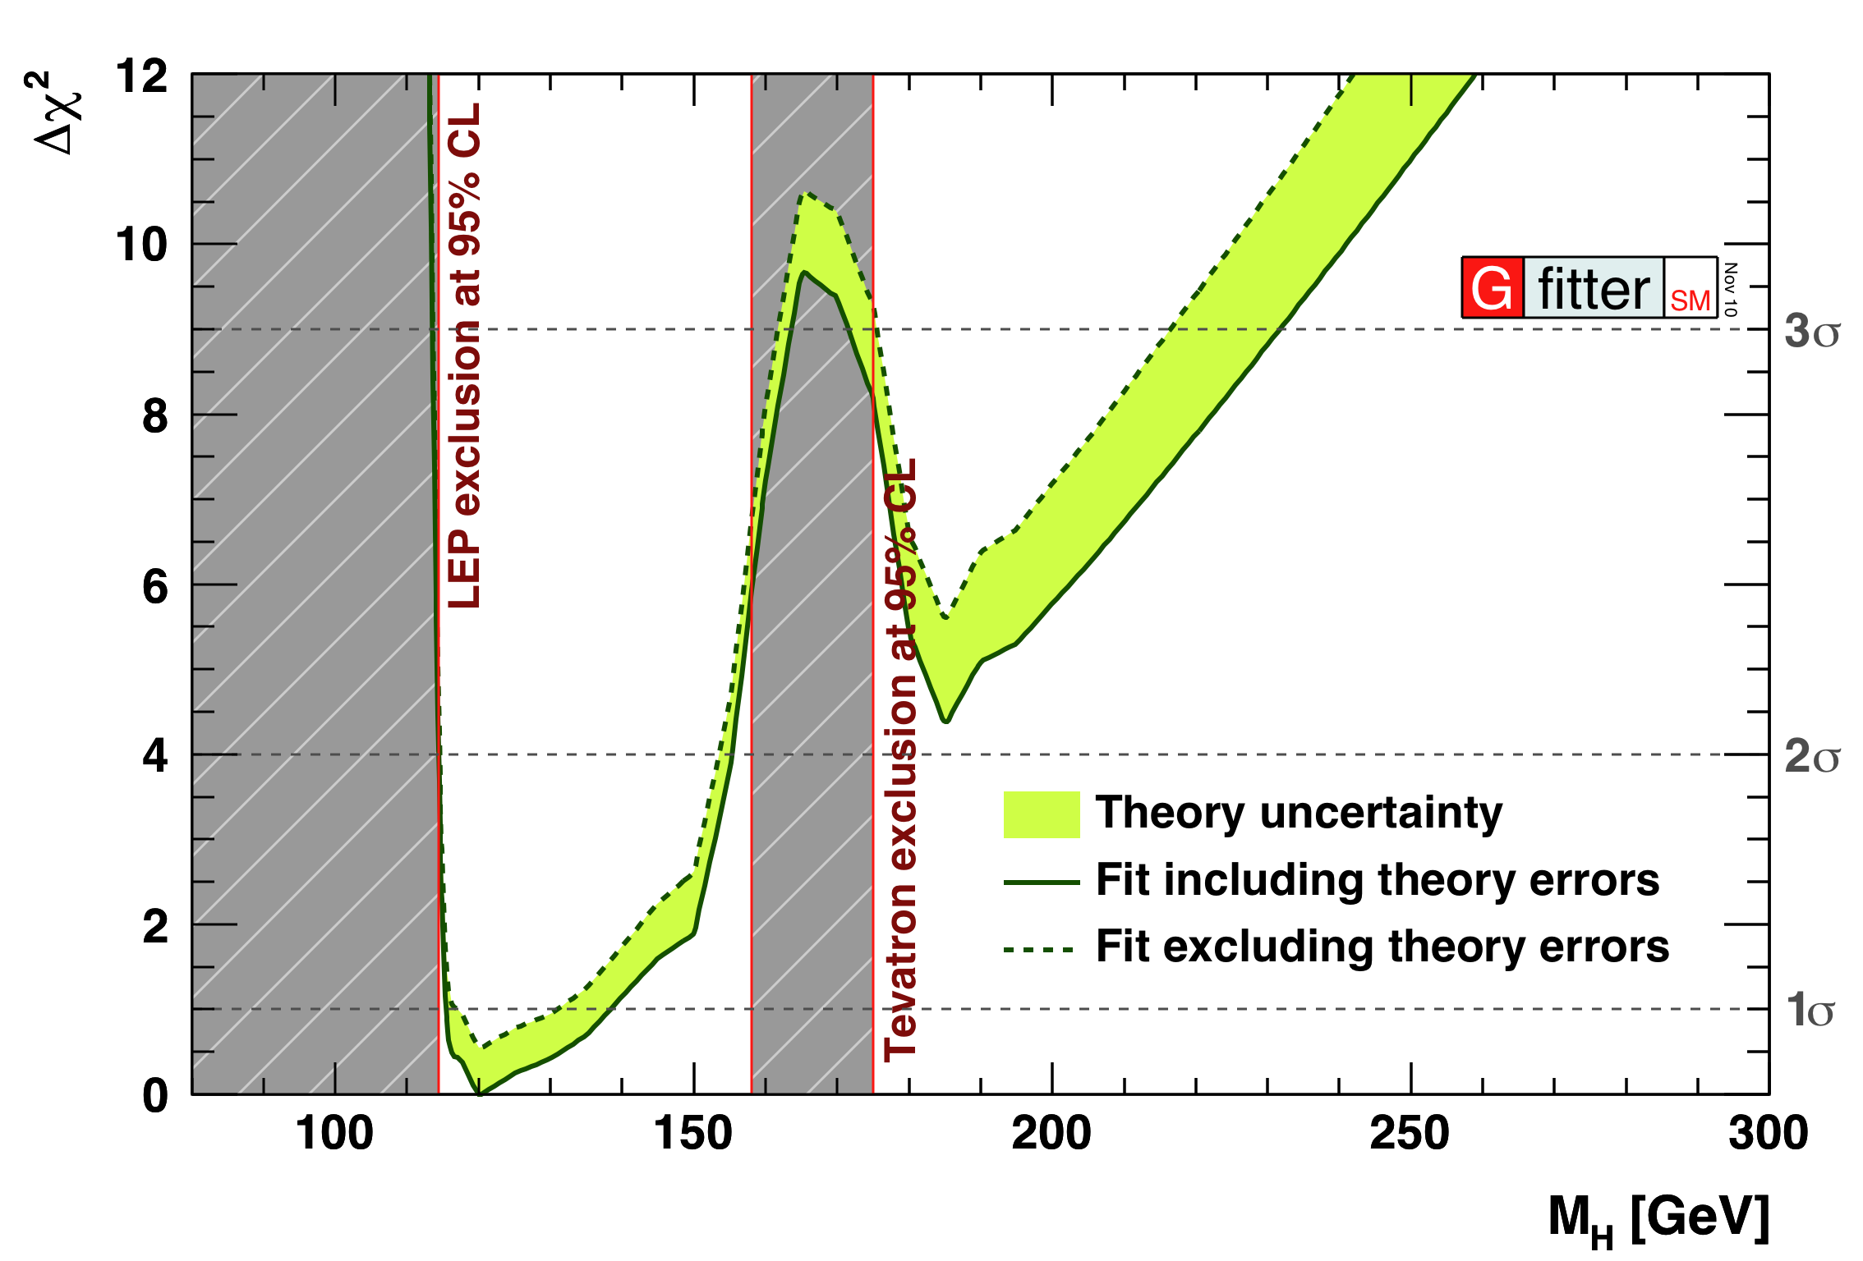
The global electroweak fit of the SM
Part 1/2

Slide 4

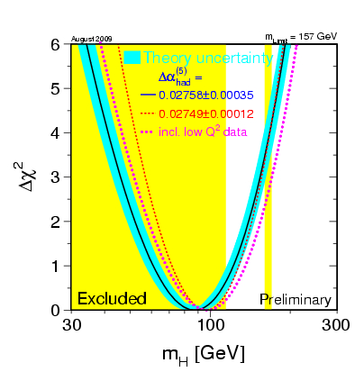
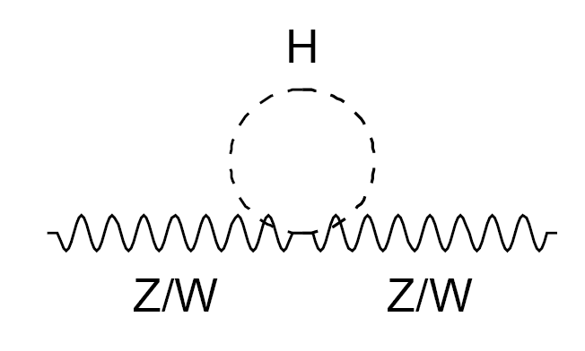
The global electroweak fit with Gfitter
A Gfitter package for the global EW fit of the SM
  New implementation of SM predictions of EW precision observables
  Based on huge amount of pioneering work by many people (ZFITTER)
  Radiative corrections are important
    Logarithmic dependence on M_{H} through virtual corrections
State-of-the art calculations; in particular:
  Radiator functions: N³LO of the massless QCD Adler function,
  used for Z and W hadronic decay widths
  [P.A. Baikov et al., Phys. Rev. Lett. 101 (2008) 012022]
  M_{W} and sin²θ^{f}_{eff} : full two-loop + leading beyond-two-loop correction
  [M. Awramik et al., Phys. Rev D69, 053006 (2004) and ref.] [M. Awramik et al., Nucl.Phys.B813:174-187 (2009) and refs.]
    Theoretical uncertainties: M_{W} (δM_{W}=4-6MeV), sin²θ^{l}_{eff} (δsin²θ^{l}_{eff} =4.7·10⁻⁵)
  2-loop EW form-factors: taken and adapted from ZFITTER
Wherever possible, calculations thoroughly cross-checked against ZFITTER
→ excellent agreement
[A.B. Abruzov et al., Comput. Phys. Commun. 174 (2006) 728-758]
Notes:
So first the global electroweak fit, which – a couple of years ago – we have completely reimplemented …

Slide 5
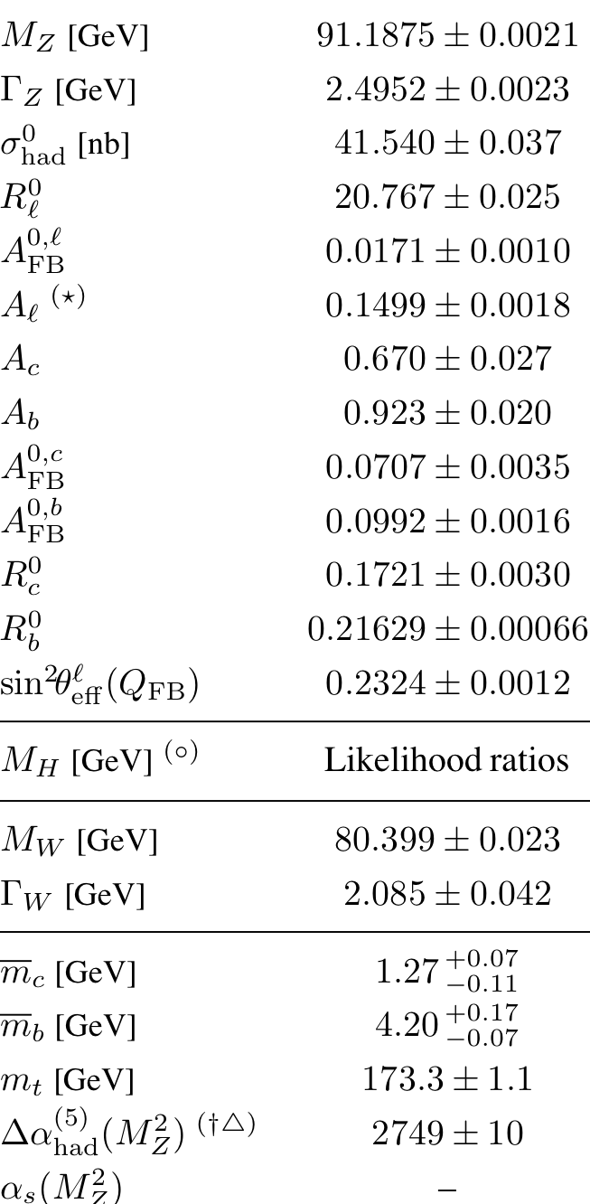
Electroweak fit – Experimental input
Free fit parameters:
  M_{Z}, M_{H}, m_{t}, Δα_{had}⁽⁵⁾(M_{Z}²), α_{S}(M_{Z}²), m_{c}, m_{b}
    Scale parameters for theoretical uncertainties
    on M_{W} , sin²θ ^{l}_{eff} (and the EW form factors ρ_{Z}^{f}, κ_{Z}^{f})
Latest experimental input:
  Z-pole observables: LEP / SLC results
  [ADLO+SLD, Phys. Rept. 427, 257 (2006)]
  M_{W} and Γ_{W} latest from LEP/Tevatron (03/2010)
  [ADLO,CFD+D0: arXiv:0908.1374v1]
  m_{top} : latest Tevatron average (07/2010)
  [CDF&D0: new combination ICHEP’10]
  m_{c}, m_{b} world averages
  [PDG, J. Phys. G33,1 (2006)]
  Δα_{had}⁽⁵⁾(M_{Z}²) including α_{S} dependency (10/2010)
  [Davier et al., arXiv:1010.4180]
  Direct Higgs searches from LEP/Tevatron/LHC
  (03/2011)
  [ADLO: Phys. Lett. B565, 61 (2003)], [CDF+D0: Moriond 2011][ATLAS+CMS: Moriond 2011]
& SLC
LEP
New!
LEP & Tevatron & LHC
Not considered: sin²θ_{eff} results from NuTeV (uncertainties from NLO and nucl. effects of bound nucleon PDF) and APV and polarized Möller scattering (exp. accuracy too low)
Tevatron
Notes:
… dalpha_had and Higgs searches I will discuss in a bit more detail
… in the fit we also allow for theoretical uncertainties on …

Slide 6
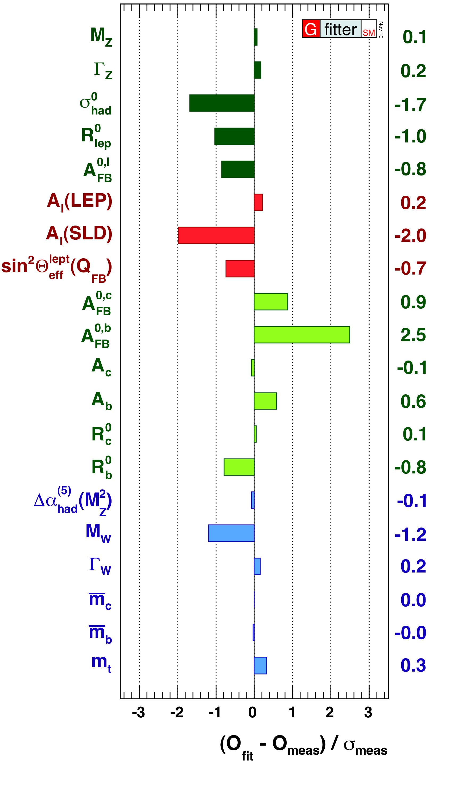
Electroweak Fit – SM Fit Results
Standard fit w/o direct Higgs searches
Pull values of complete fit
  No individual value exceeds 3σ
  FB asymmetry of bottom quarks
  → largest contribution to χ²
  Small contributions from M_{Z}, Δα_{had}⁽⁵⁾(M_{Z}²), m_{c}, m_{b}
    Input accuracies exceed fit requirements
Goodness of fit – naïve p-value:
  Excluding direct Higgs searches: χ²_{min}=16.6
  → Prob(χ²_{min}, 13) = 22 %
  Consistent when including direct Higgs searches:
  → p-value = 25 ± 1₋₂ % (as obtained from toys)
  No indication for new physics
N³LO α_{S} from fit:
  α_{s}(M_{Z}²) = 0.1193 ± 0.0028 ± 0.0001
  First error is experimental fit error
  Second error due to missing QCD orders:
    incl. variation of renorm. scale from M_{Z}/2 to 2M_{Z} and massless terms of order/beyond α_{S}⁵(M_{Z}) and massive terms of order/beyond α_{S}⁴(M_{Z})
  Excellent agreement with result N³LO from τ decays
[Davier et al., EPJ C56, 305 (2008), arXiv:0803.0979]

Slide 7
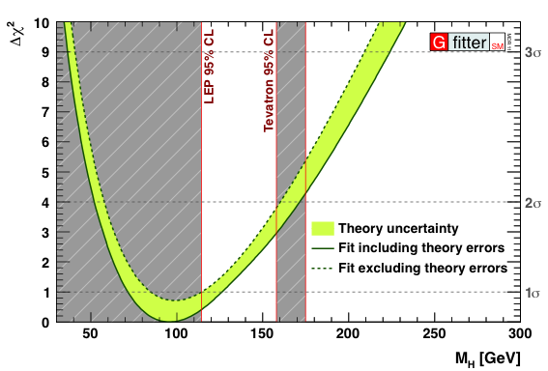
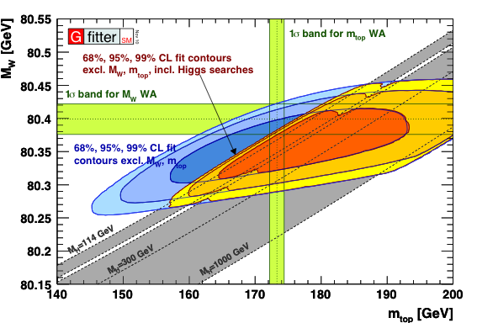
Electroweak Fit – w/o direct Higgs searches
M_{H} from fit w/o Higgs searches:
  Central value ±1σ:
  2σ interval:
m_{top} vs M_{W}
  Indirect results agree nicely with direct measurements.
  Results from Higgs searches significantly reduces allowed indirect parameter space.
  Illustrative probe of SM,
  if Higgs measured at LHC.
Green error band from including / excluding theoretical errors in fit
  Theoretical errors included in χ² with “flat likelihood term”
Notes:
No tension between the three
CL_s+b vs -2lnQ
Tevatron Lumi ?
For SM cross section limit-setting purposes, we use the Bayesian exclusion which excludesa tiny bit less than the CLs exclusion. If you need to draw exclusion bands on your plots,to be consistent with our plots, you can use the numbers: 157.64 - 172.97 observed, which we quote as 158-173 GeV 152.61 - 178.62 median expected, which we quote as 153-179 GeV

Slide 8
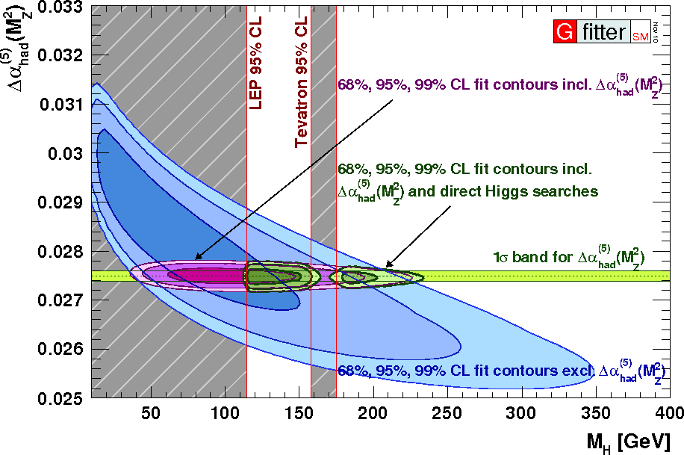
Electroweak fit – Impact of new Δα_{had}⁽⁵⁾(M_{Z}²)
We use latest value:
  Includes (among others) new π⁺π⁻ and multi-hadron x-sections from BABAR
  Value decreased compared with previous value:
[Davier et al., arXiv:1010.4180]
Increase of M_{H} by 12 GeV thanks to negative correlation (-39%)
[Hagiwara et al., PLB B649, 173 (2007)]
In comparison:
  Preliminary value (275.9±1.5)·10⁻⁴ (Teubner at Tau2010):
  LEP EW wg: (275.8±3.5)·10⁻⁴ (Burghardt & Pietrzyk, 2005):
Notes:
Hadronic correction to electromagnetic coupling constant

Slide 9
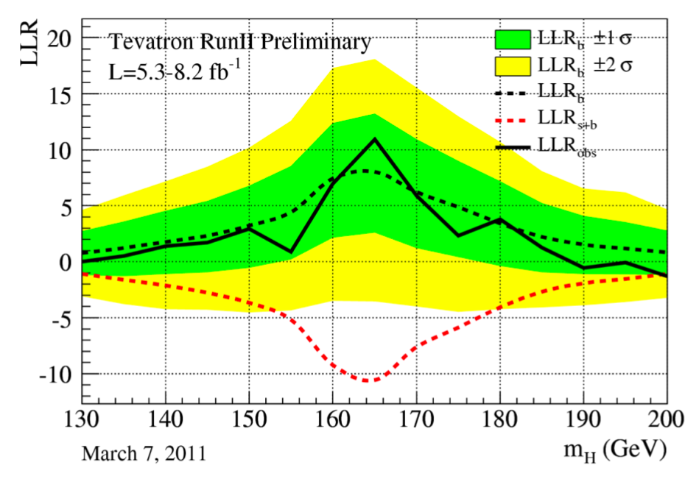
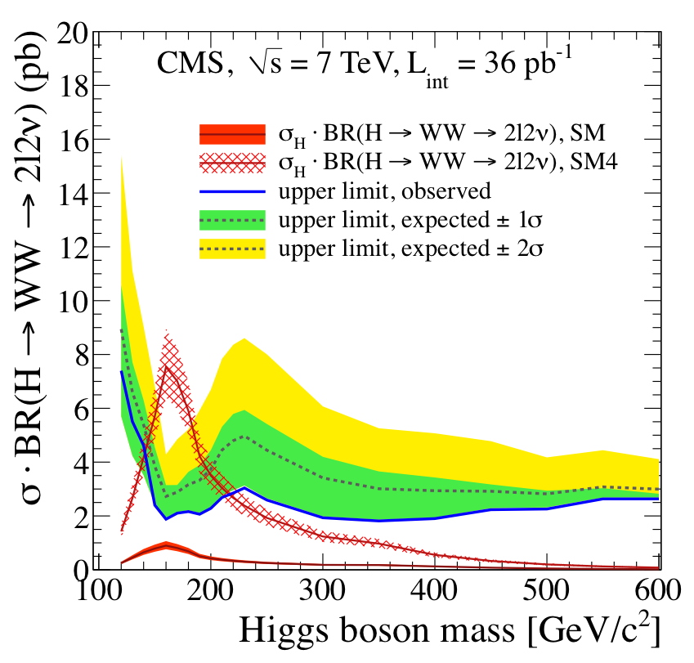
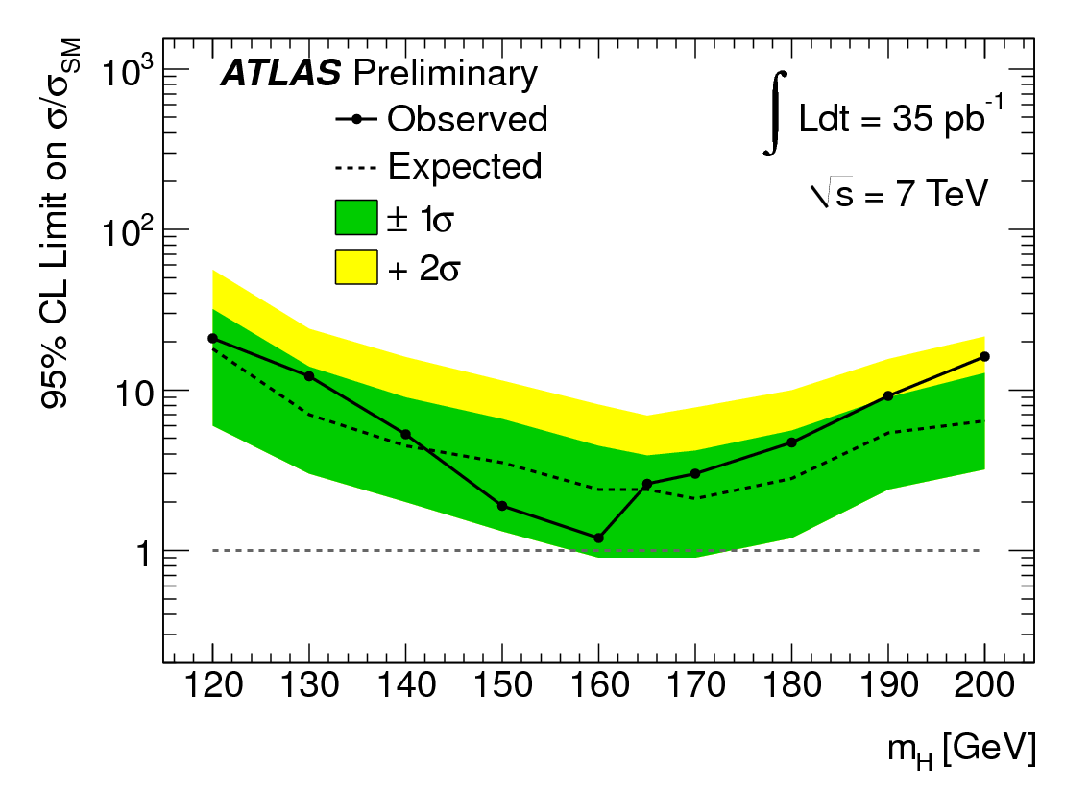
Electroweak fit – Experimental input
Direct Higgs searches
  LEP: Higgs-Strahlung
  [ADLO: Phys. Lett. B565, 61 (2003)]
    ee → ZH (H→bb, ττ)
  Tevatron: various channels
  gg fusion with H → WW,
  assoc. prod., VBF
    [FERMILAB-CONF-11-044-E]
  CMS & ATLAS: latest H→WW results, 35 and 36 /pb [CMS: arXiv:1102:5429] [ATLAS: ATLAS-CONF-2011-005]
Notes:
References
… it will become very clear how much CMS and ATLAS contribute …

Slide 10
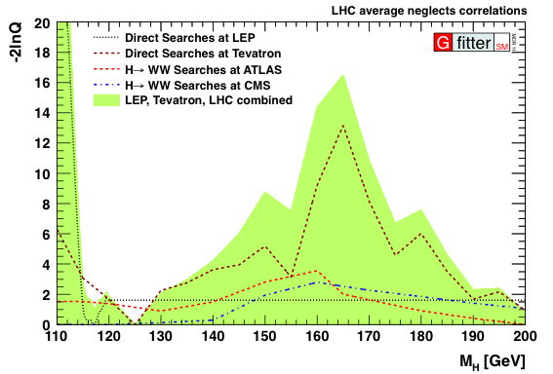
Statistical interpretation direct Higgs searches
Statistical interpretation
  Experiments measure test statistic:
  LLR = -2lnQ, where Q=L_{S+B}/L_{B}
  Transformed by experiments into
  1-sided upper limit (CL_{S}=CL_{S+B}/CL_{B})
  using pseudo experiments
  We transform 1-sided CL_{S+B}
  into 2-sided CL^{2s}_{S+B}
    SM is null hypothesis. We
    measure both down- and up-
    ward deviations from SM !
  χ² contribution calculated
  via inverse error function:
  dχ² = Erf⁻¹(1-CL^{2s}_{S+B})
Alternative treatment,
followed here:
  χ² contribution is: -2lnQ
  Lacks statistical information
  from experiments.
  No 2-sided interpretation
  ATLAS CL_{S+B} not public ☹
Note about combination of ATLAS and CMS H→WW results
  Ignores correlations between x-section
  theory and luminosity uncertainties !
  Tevatron/LHC combination procedure needed; ATLAS/CMS expected this summer.
Notes:
We have CL_s+b values available them available, but they are not all public

Slide 11
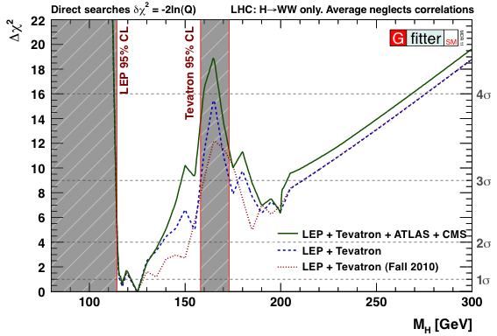
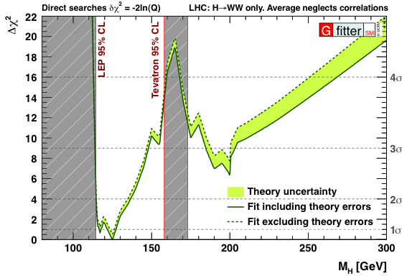
Electroweak Fit – with direct Higgs searches
LEP + Tevatron (Fall 2010) :
  CL_{s+b} central value ±1σ:
  2σ interval:
LEP + Tevatron (Moriond 2011) :
  CL_{s+b} central value ±1σ:
  2σ interval:
Fit with LEP + Tevatron + LHC (H➔WW) searches (Moriond 2011) :
  Central value unchanged
  2σ interval:
^{2s}
^{2s}
Notes:
Really starting to constrain SM Higgs!

Slide 12
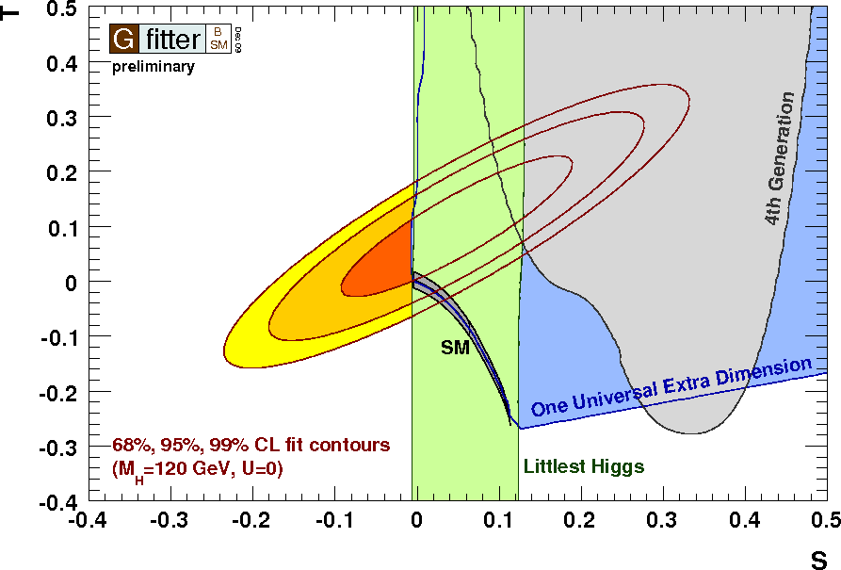
Constraints on New Physics Models through oblique corrections
Part 2/2

Slide 13

A Gfitter package for Oblique Corrections
Oblique corrections from New Physics
described through STU parametrization
[Peskin and Takeuchi, Phys. Rev. D46, 1 (1991)]
  O_{meas} = O_{SM,REF}(m_{H},m_{t}) + c_{S}S + c_{T}T +c_{U}U
  S : New Physics contributions
  to neutral currents
  T : Difference between neutral and
  charged current processes –
  sensitive to weak isospin violation
  U : (+S) New Physics contributions to
  charged currents. U only sensitive
  to W mass and width, usually
  very small in NP models
  (often: U=0)
  Also implemented: correction to Z→bb
  coupling, extended parameters (VWX)
  [Burgess et al., Phys. Lett. B326, 276 (1994)]
  [Burgess et al., Phys. Rev. D49, 6115 (1994)]
At low energies, BSM physics appears dominantly through vacuum polarization corrections
  Aka, “oblique corrections”
Oblique corrections reabsorbed into electroweak parameters
  Δρ, Δκ, Δr parameters, appearing in: M_{W}², sin²θ_{eff}, G_{F}, α, etc
Electroweak fit sensitive to BSM physics through oblique corrections
  In direct competition
  with sensitivity
  to Higgs loop
  corrections
X
X’

Slide 14
Fit to Oblique Parameters
Blue: U=0 , yellow: U=free
S,T,U obtained from fit to EW observables
Results for STU:
Dark grey area: SM prediction
  SM_{ref} chosen at: M_{H} = 120 GeV
  and m_{t} = 173.1 GeV
  This defines (S,T,U) = (0,0,0)
S, T: logarithmically dependent on M_{H}
Comparison of EW data w/ SM prediction:
  Preference for small M_{H}
  No indication for new physics
 | S | T | U
S | 1 | 0.879 | -0.469
T |  | 1 | -0.716
U |  |  | 1
S = 0.02 ± 0.11
T = 0.05 ± 0.12
U = 0.07 ± 0.12

Slide 15
Fit to Oblique Parameters
S,T,U obtained from fit to EW observables
Results for STU:
Dark grey area: SM prediction
  SM_{ref} chosen at: M_{H} = 120 GeV
  and m_{t} = 173.1 GeV
  This defines (S,T,U) = (0,0,0)
S, T: logarithmically dependent on M_{H}
Comparison of EW data w/ SM prediction:
  Preference for small M_{H}
  No indication for new physics
 | S | T | U
S | 1 | 0.879 | -0.469
T |  | 1 | -0.716
U |  |  | 1
S = 0.02 ± 0.11
T = 0.05 ± 0.12
U = 0.07 ± 0.12
Many new physics models also compatible with the EW data:
  Variation of model parameters often allows for large area in ST-plane.
  Tested: UED, 4th fermion generation, Littlest Higgs, SUSY, etc.

Slide 16
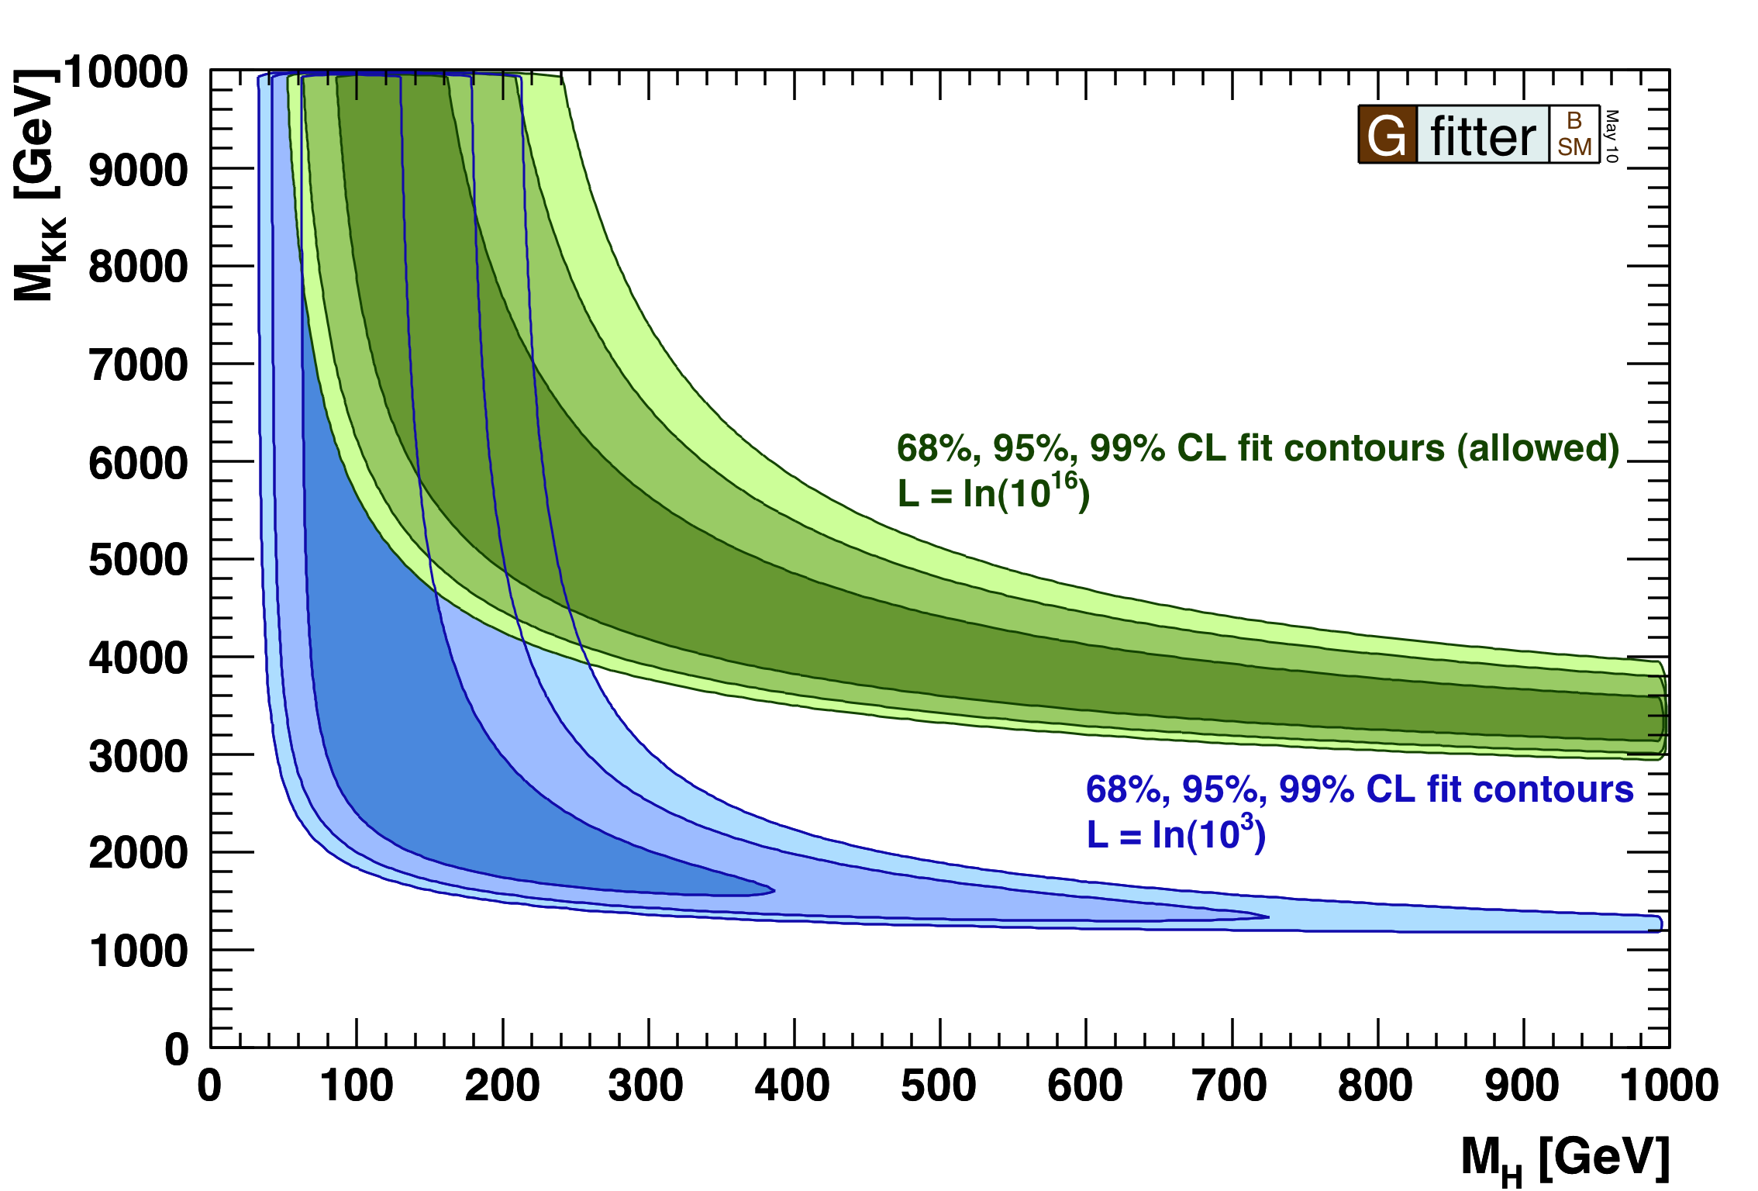
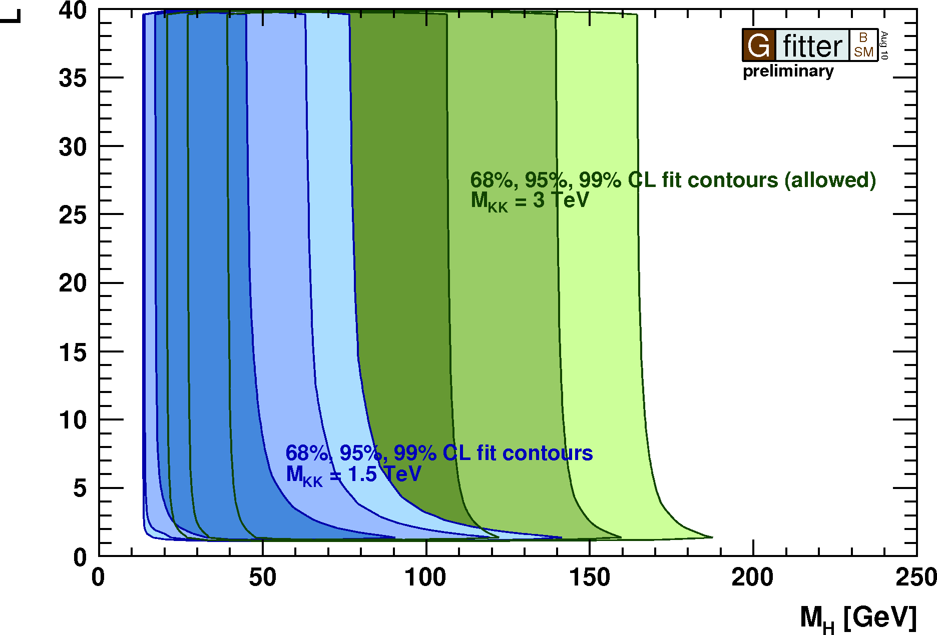
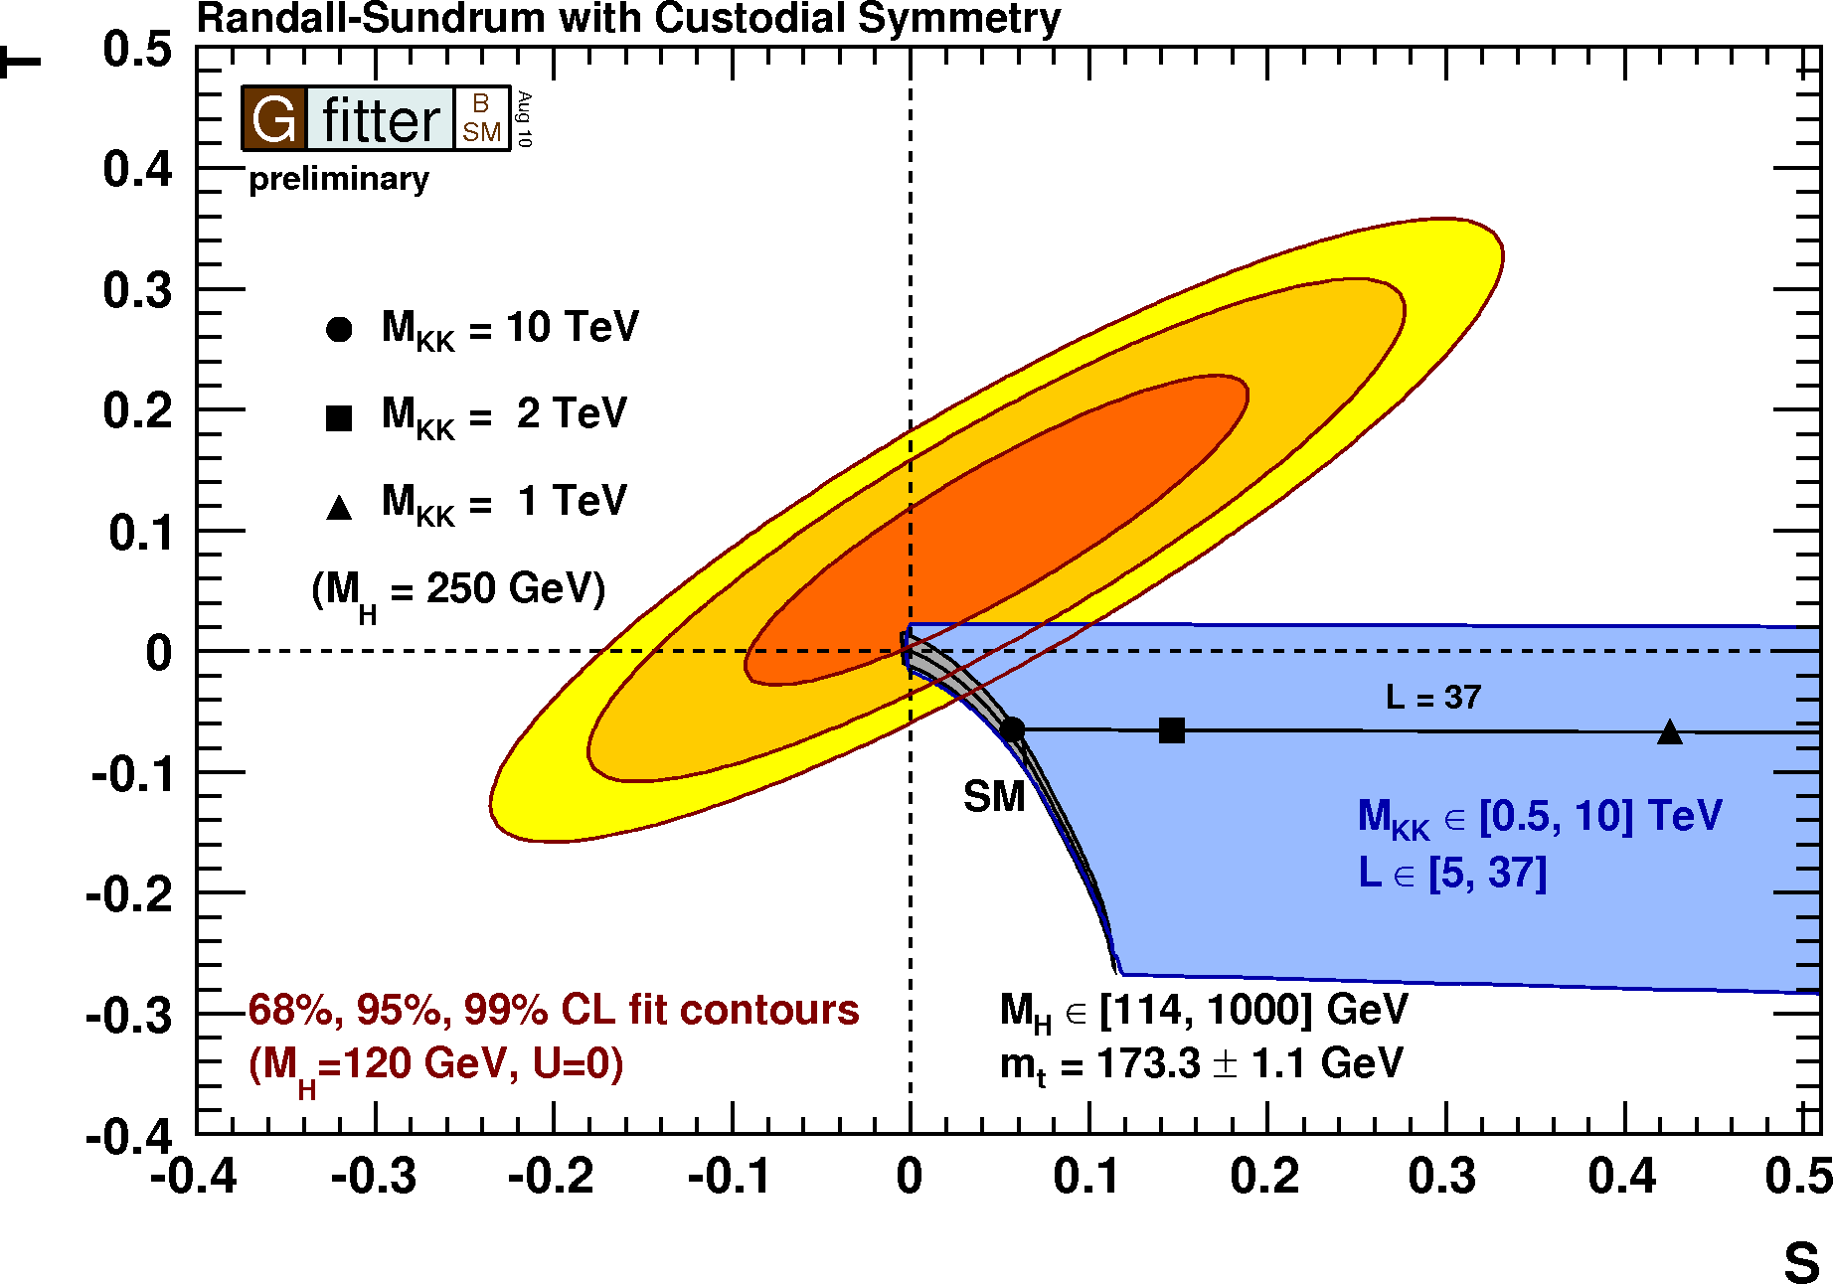
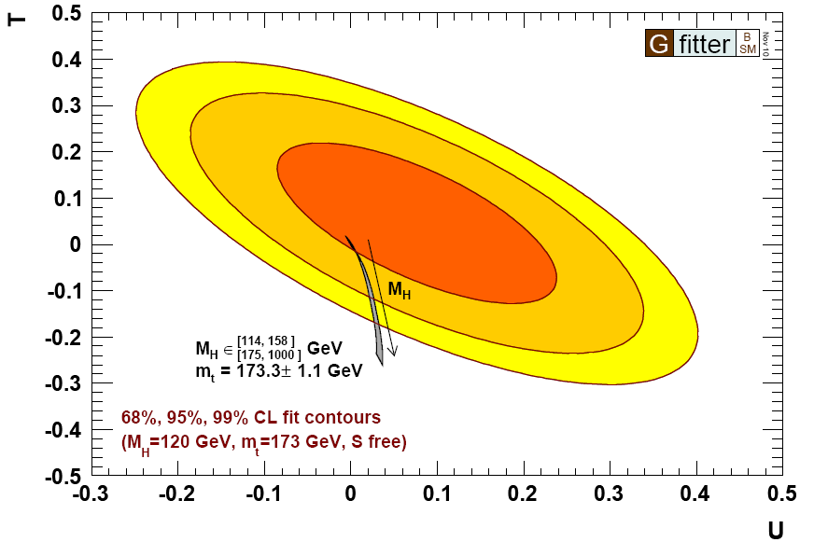
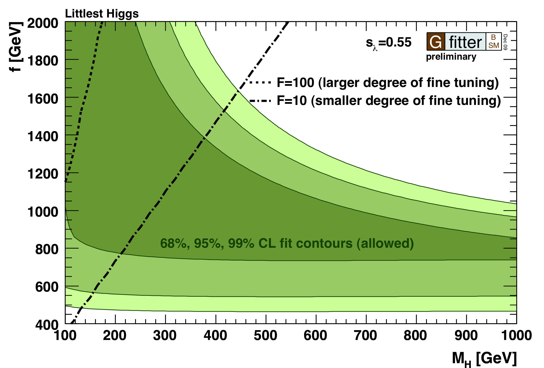
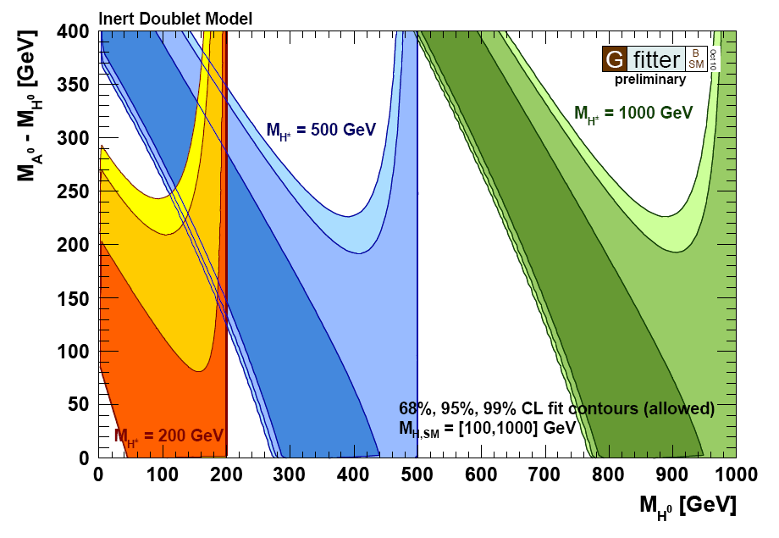
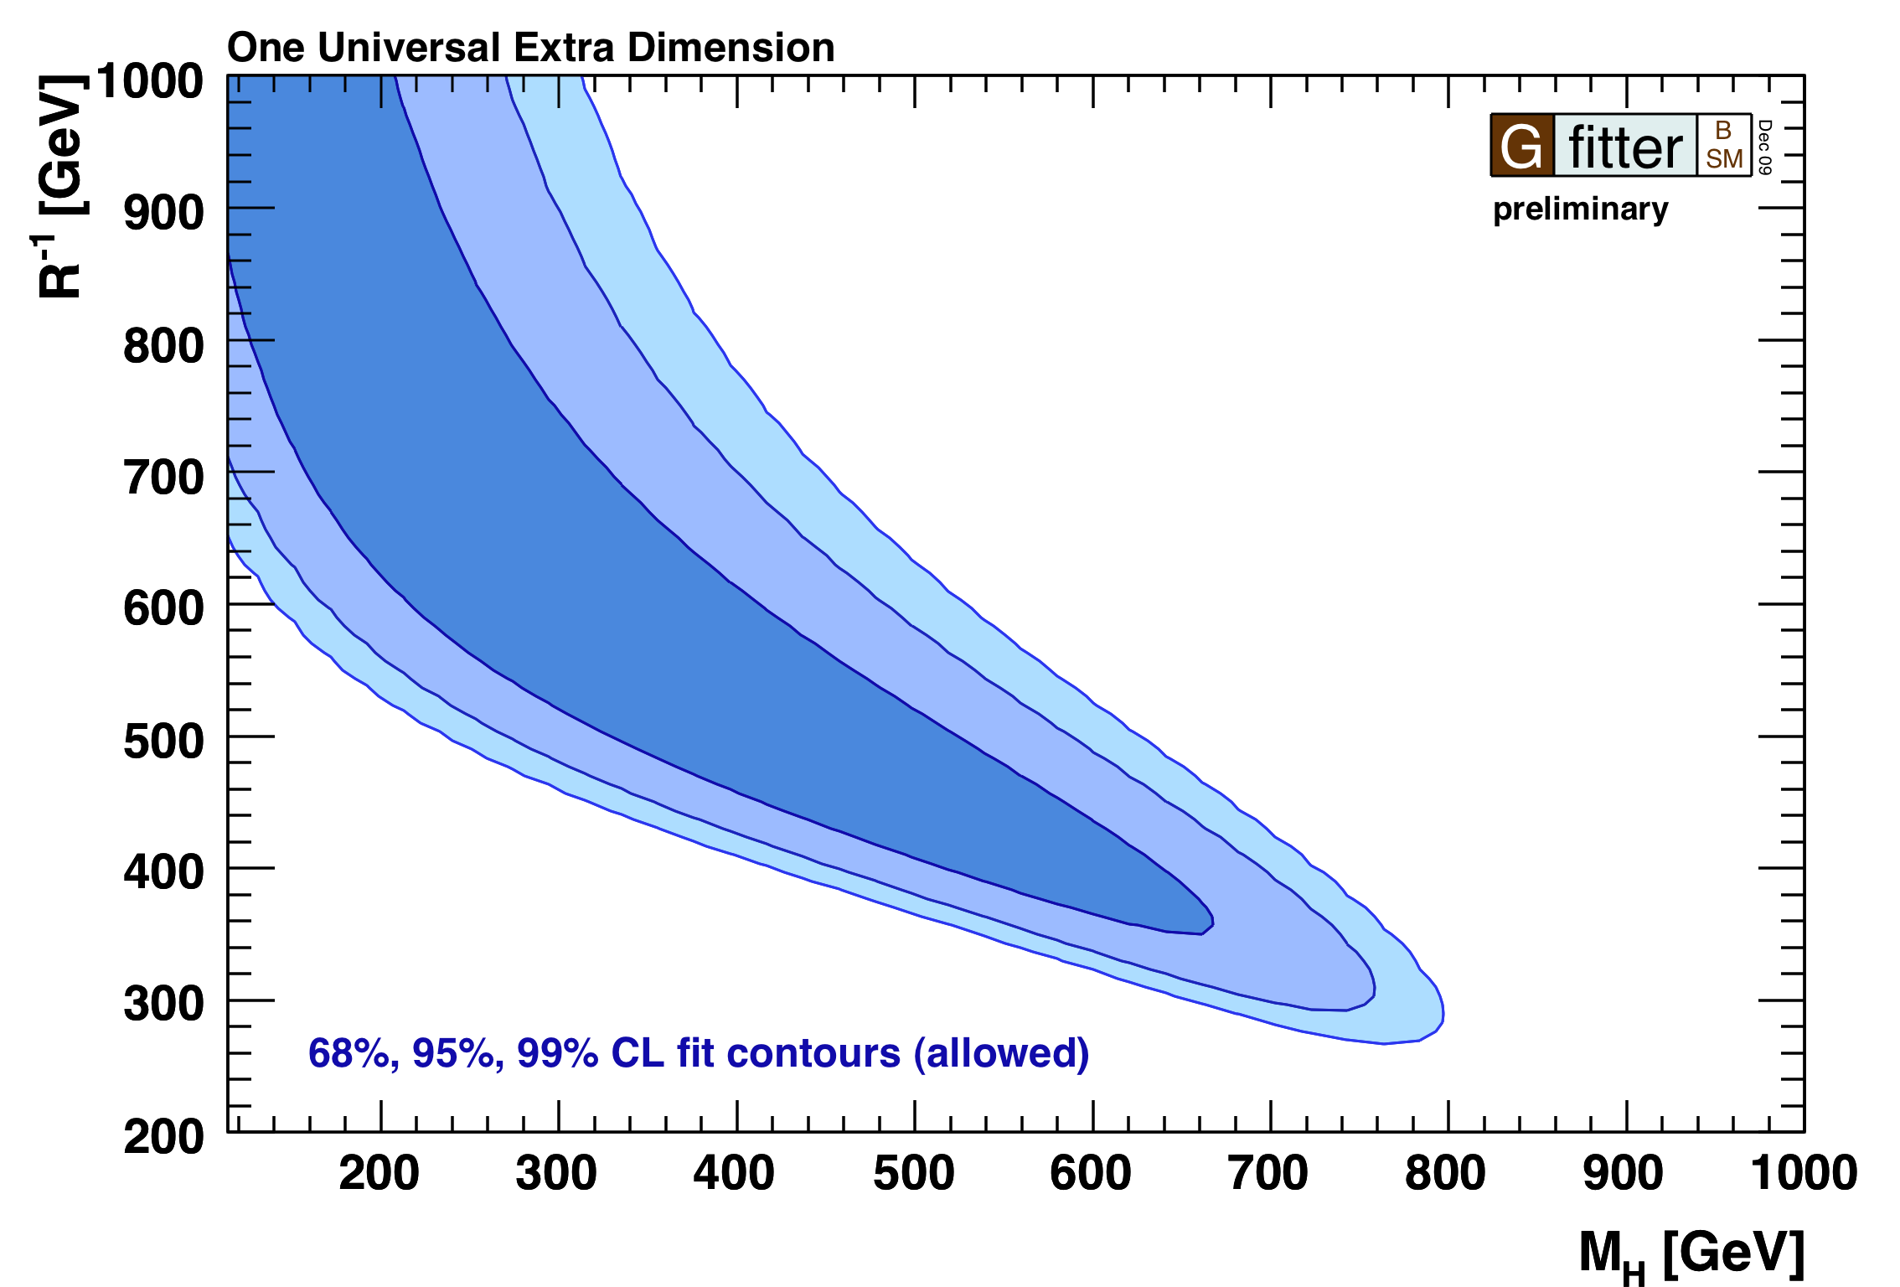
Many BSM theories can be tested …
Technicolor
Warped Extra Dimensions
STU results
WED with custodial symmetry
Inert Higgs Doublet Model
Littlest Higgs Model
Large Extra Dimensions
Universal Extra Dimensions
Notes:
Many bsm theories can be tested through STU formalism …

Slide 17
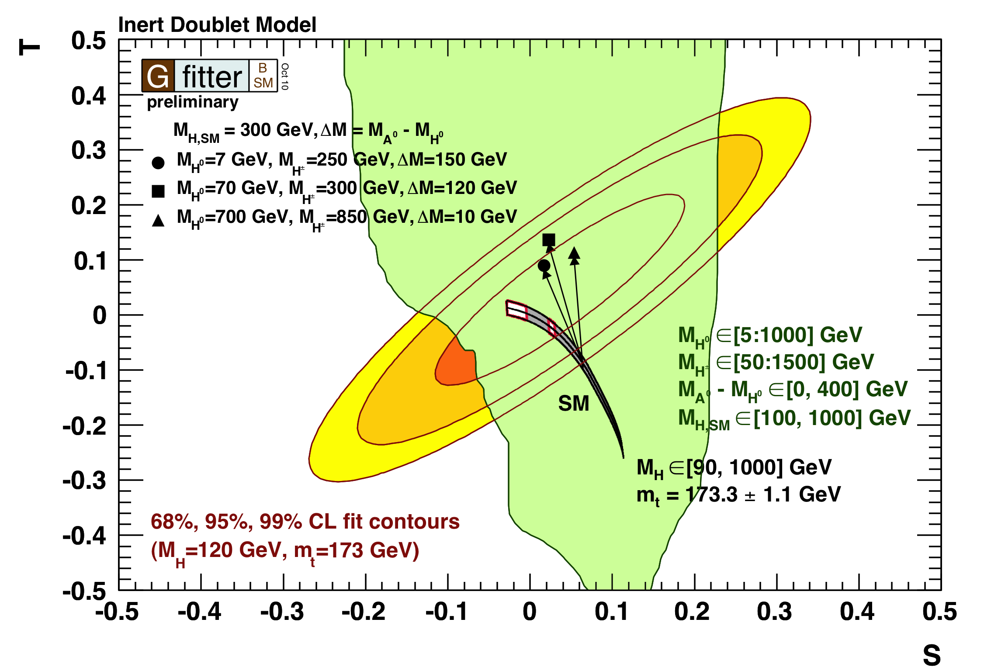
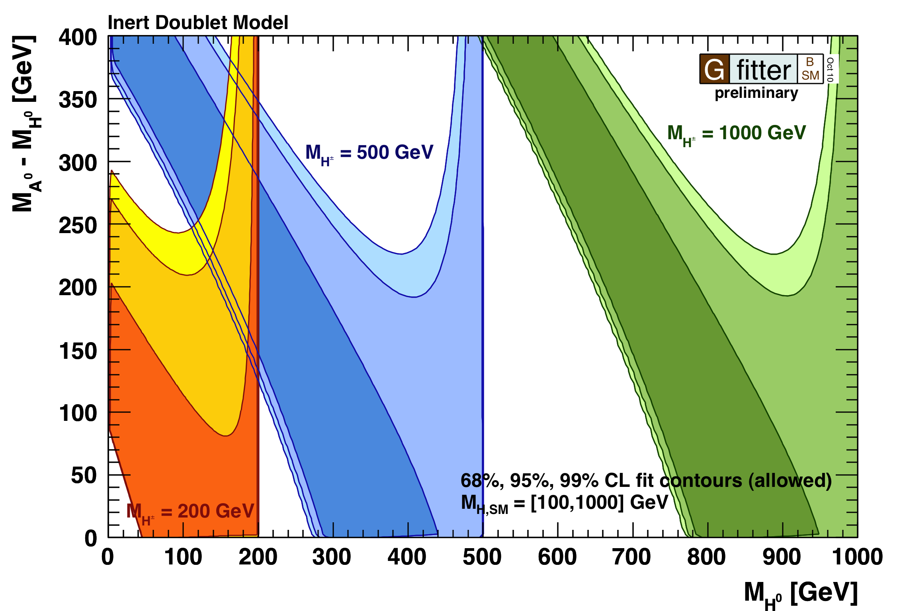
Inert Higgs Doublet Model
IDM: introduction of extra Higgs doublet to help solve hierarchy problem
  Doublet does not couple to fermions (“inert”). Does not acquire a VEV.
Three new Higgses
  Two neutral (M_{H}, M_{A}), one charged (M_{H+}).
Lightest inert particle (“LIP”) is stable (M_{L}), assumed neutral.
  Natural dark matter candidate
Contributions to:
  T: isospin violation between neutral and charged Higgses.
  S: H⁺H⁻ and HA loop corrections to self energy of Z-photon propagator
Results: large SM Higgs mass allowed.
[Barbieri et al., hep-ph/0603188v2 (2006)]
Notes:
So you see that you can allow for rather large Higgs masses,
Not only for the new Higgses, but for our original SM Higgs…
Dark matter: 60<mL<80 GeV
And mass splitting of 5-10 GeV between two neutral Higgses
IDM plot:First their is hard cut at MHch < MH0 which is assumed to be the lightest Higgs and therefore the dark matter candidate. If I remember correctly the STU corrections are quite symmetric in MH0 and MA. The corrections do not distinguish if MH0 or MA is the lightest Higgs particle.

Slide 18
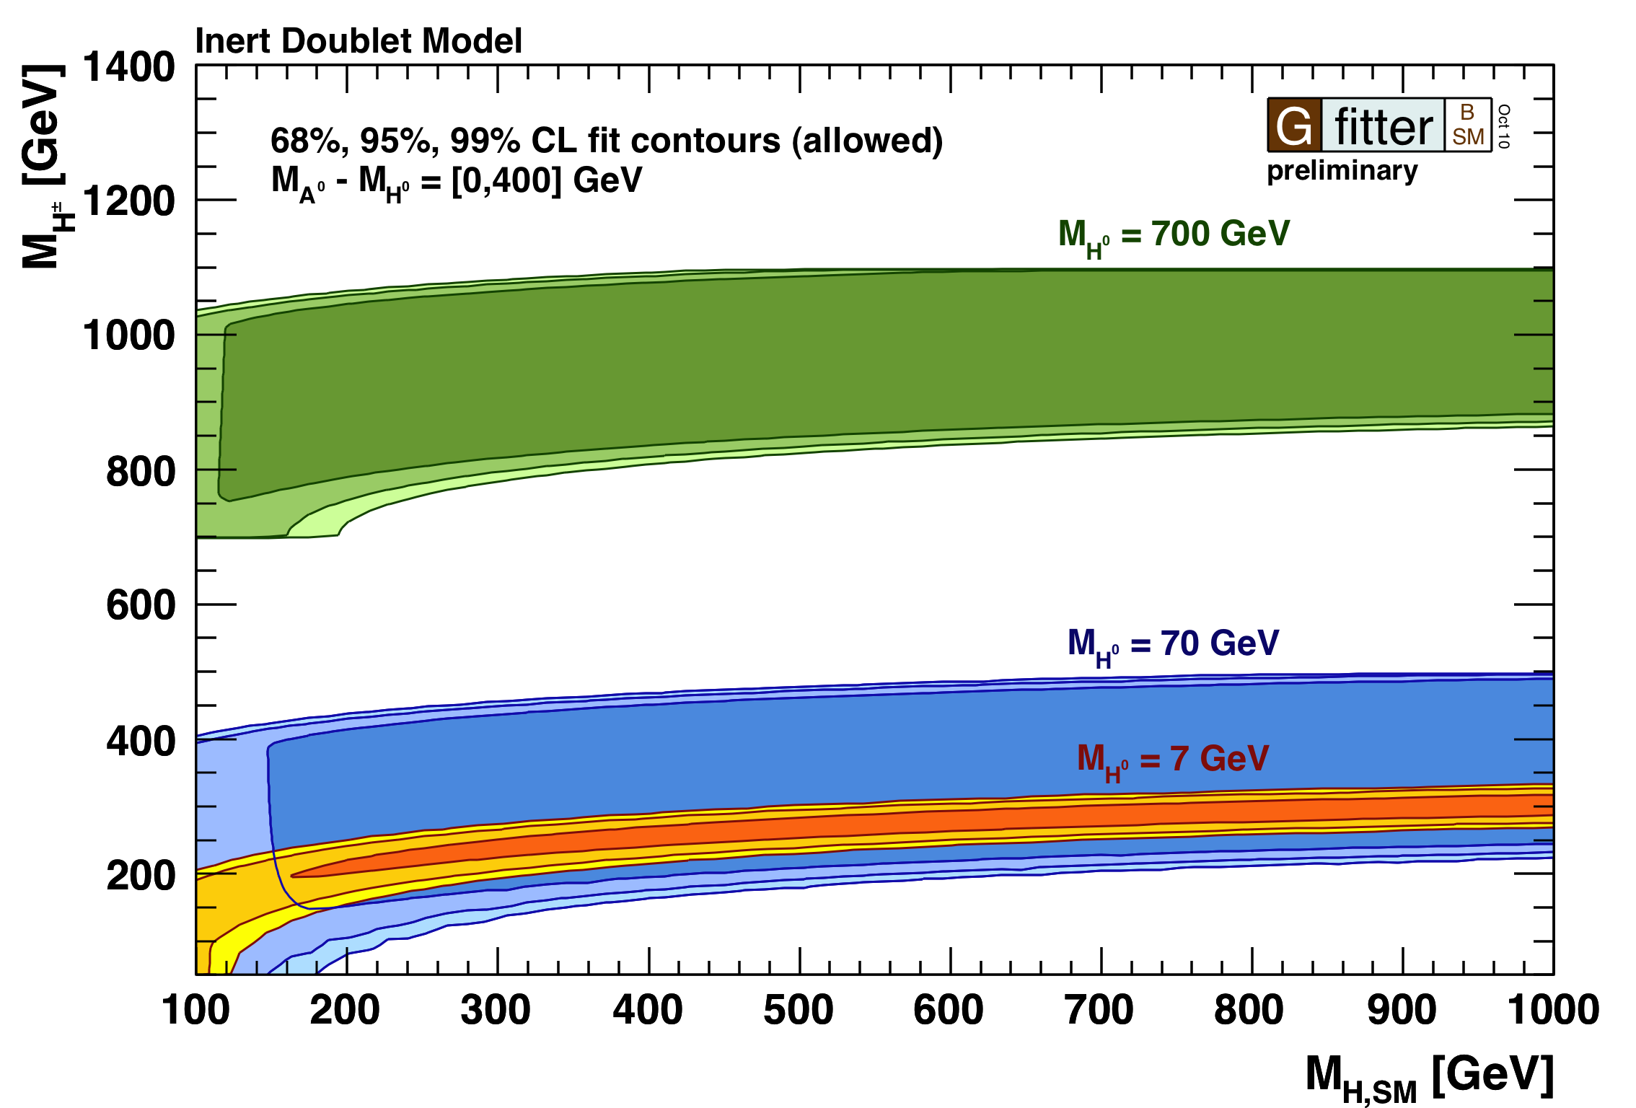
Inert Higgs Doublet Model
IDM: introduction of extra Higgs doublet to help solve hierarchy problem
  Does not couple to fermions (“inert”). Does not acquire a VEV.
Three new Higgses
  Two neutral (M_{H}, M_{A}), one charged (M_{H+}).
Lightest inert particle (“LIP”) is stable (M_{L}), assumed neutral.
  Natural dark matter candidate
Contributions to:
  T: isospin violation between neutral and charged Higgses.
  S: H⁺H⁻ and HA loop corrections to self energy of Z-photon propagator
Results: large SM Higgs mass allowed.
[Barbieri et al., hep-ph/0603188v2 (2006)]

Slide 19
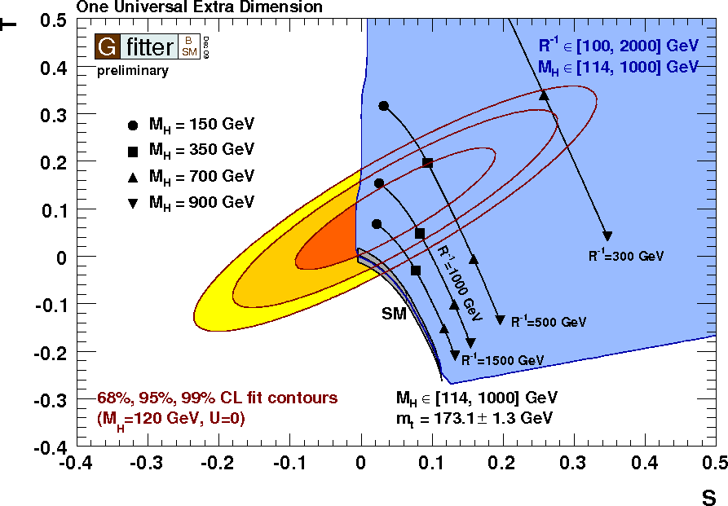
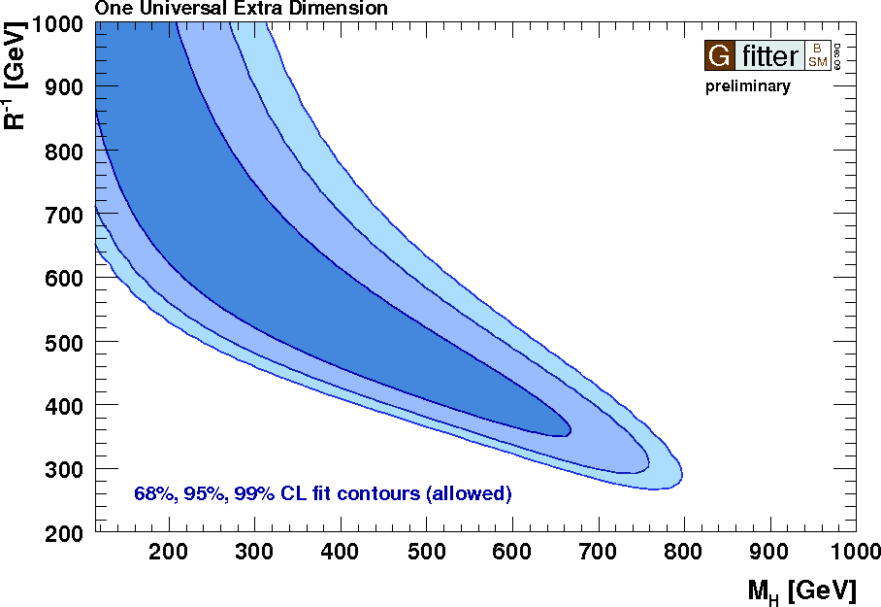
Universal Extra Dimensions
[Appelquist et al., Phys. Rev. D67 055002 (2003)] [Gogoladze et al., Phys. Rev. D74 093012 (2006)]
UED:
  All SM particles can propagate into ED
  Compactification → KK excitations
  Conservation of KK parity
    Phenomenology similar to SUSY
    Lightest stable KK state: DM candidate
  Model parameters:
    d_{ED}: number of ED (fixed to d_{ED}=1)
    R⁻¹: compactification scale (m_{KK}~n/R)
Contribution to vac. polarisation (STU):
  From KK-top/bottom and KK-Higgs loops
  Dependent on R⁻¹, M_{H} (and m_{t})
Results:
  Large R⁻¹: UED approaches SM (exp.)
    Only small M_{H} allowed
  Small R⁻¹: large UED contribution can be
  compensated by large M_{H}
  Excluded: R⁻¹< 300 GeV and M_{H} > 800 GeV
Notes:
Universal = all sm particles propagate into ED
KK parity = mom conservation in extra dimensions. KK particles produced in pairs

Slide 20
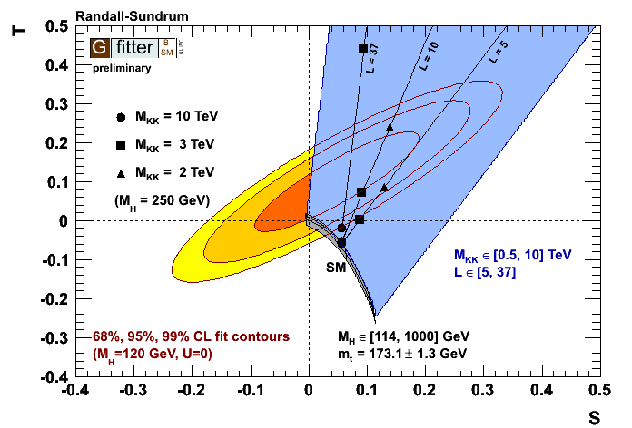
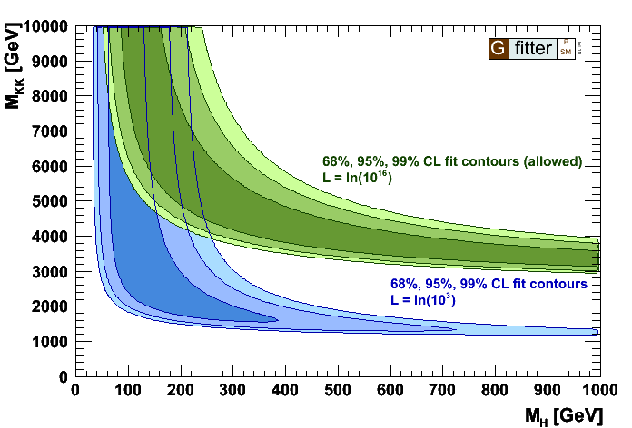
Warped Extra Dimensions (Randall-Sundrum)
[L. Randall, R. Sundrum, Phys. Rev. Lett. 83, 3370 (1999)] [M. Carena et al., Phys. Rev. D68, 035010 (2003)]
Introduction of one extra dimension (ED) to help solve the hierarchy problem
RS model characterized by one warped ED, confined by two three-branes
  Higgs localized on “IR” brane
  Gauge and matter fields allowed to propagate in bulk region
SM particles accompanied by towers of heavy KK modes.
Model parameters:
  L: inverse warp factor, function of compactification radius, explains hierarchy between EW an Pl scale
  M_{KK}: KK mass scale
Results:
  Large values of T possible
  Large L forces large M_{KK} (several TeVs)
  Some compensation if M_{H} is large

Slide 21
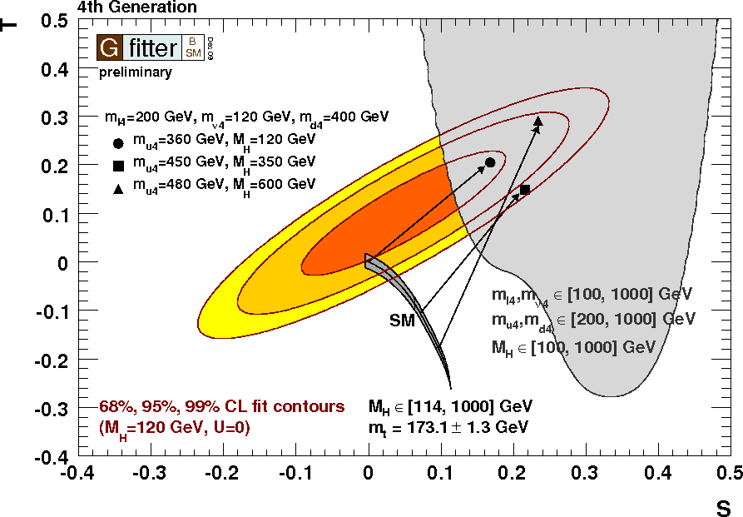
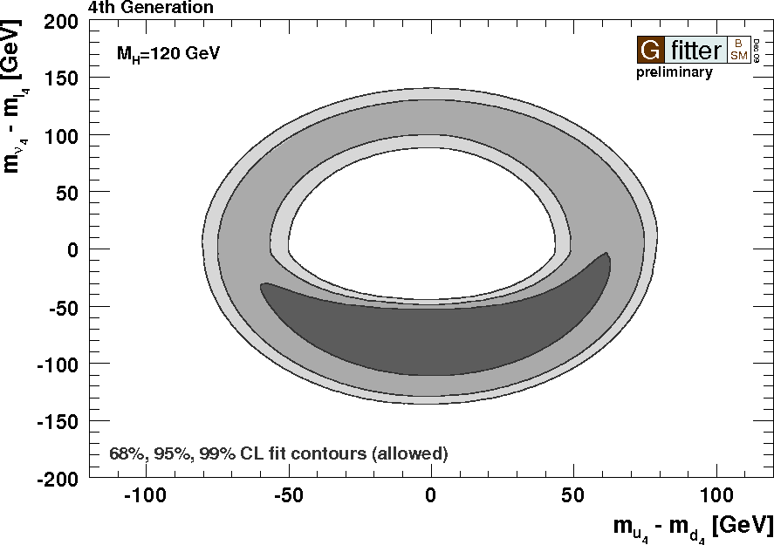
4th fermion generation
Models with a fourth generation
  No explanation for n=3 generations
  Intr. new states for leptons and quarks
  Free parameters:
    masses of new quarks and leptons
    assume: no mixing of extra fermions
Contrib. to STU from new fermions
  Discrete shift in S from extra generation
  Sensitive to mass difference between up- and down-type fields. (not to absolute mass scale)
CDF+D0 & CMS: SM4G Higgs partially excluded:
  CDF+D0: 131 > MH > 204 GeV @ 95% CL
  CMD: 144 > MH > 207 GeV @ 95% CL
Results:
  With appropriate mass differences: 4th fermion model consistent with EW data
    In particular, again a large M_{H} is allowed
  5+ generations disfavored
  Data prefer a heavier charged lepton / up-type quark (which both reduce size of S)
[H. He et al., Phys. Rev. D 64, 053004 (2001)]
M_{H} = 120 GeV
Notes:
… these are even more favored when you allow for heavy Higgs masses
CDF + D0 : MH between 131 and 204 GeV
CMS: 144 and 207 GeV is ruled out at 95% confidence level.
Hypercharge: quarks = 1/6, leptons = -1/2

Slide 22
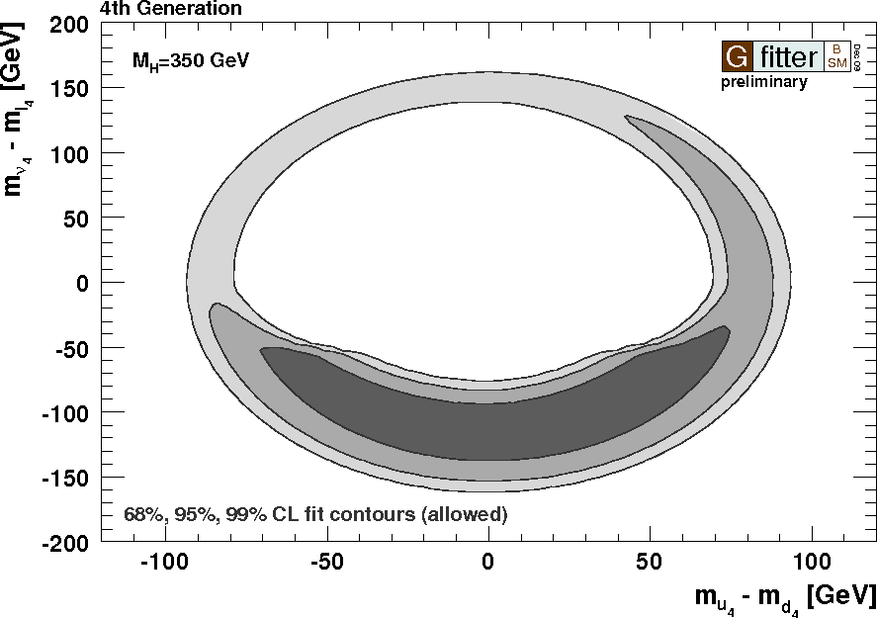
4th fermion generation
Models with a fourth generation
  No explanation for n=3 generations
  Intr. new states for leptons and quarks
  Free parameters:
    masses of new quarks and leptons
    assume: no mixing of extra fermions
Contrib. to STU from new fermions
  Discrete shift in S from extra generation
  Sensitive to mass difference between up- and down-type fields. (not to absolute mass scale)
CDF+D0 & CMS: SM4G Higgs partially excluded:
  CDF+D0: 131 > MH > 204 GeV @ 95% CL
  CMD: 144 > MH > 207 GeV @ 95% CL
Results:
  With appropriate mass differences: 4th fermion model consistent with EW data
    In particular, again a large M_{H} is allowed
  5+ generations disfavored
  Data prefer a heavier charged lepton / up-type quark (which both reduce size of S)
[H. He et al., Phys. Rev. D 64, 053004 (2001)]
M_{H} = 350 GeV

Slide 23
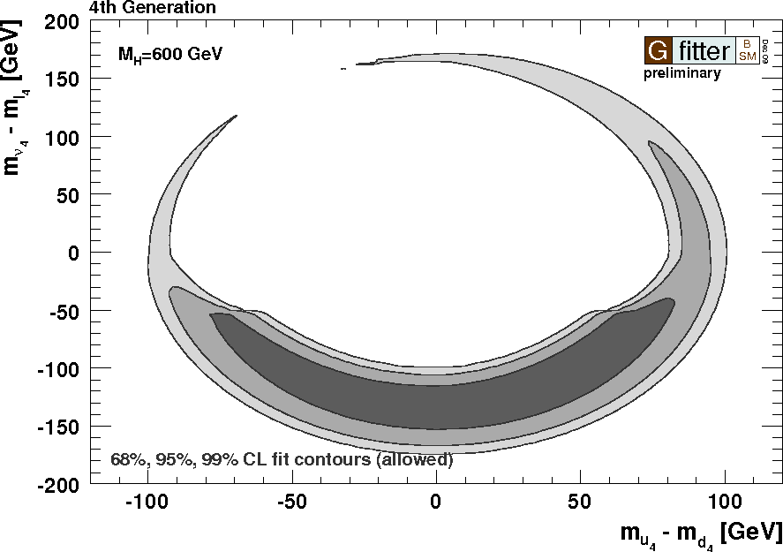
4th fermion generation
Models with a fourth generation
  No explanation for n=3 generations
  Intr. new states for leptons and quarks
  Free parameters:
    masses of new quarks and leptons
    assume: no mixing of extra fermions
Contrib. to STU from new fermions
  Discrete shift in S from extra generation
  Sensitive to mass difference between up- and down-type fields. (not to absolute mass scale)
CDF+D0 & CMS: SM4G Higgs partially excluded:
  CDF+D0: 131 > MH > 204 GeV @ 95% CL
  CMD: 144 > MH > 207 GeV @ 95% CL
Results:
  With appropriate mass differences: 4th fermion model consistent with EW data
    In particular, again a large M_{H} is allowed
  5+ generations disfavored
  Data prefer a heavier charged lepton / up-type quark (which both reduce size of S)
[H. He et al., Phys. Rev. D 64, 053004 (2001)]
M_{H} = 120 GeV
M_{H} = 600 GeV

Slide 24

Conclusion & Prospects
is a powerful framework for HEP model fits.
Results shown
  New and updated global fit of the electroweak SM
    Very happy to see first LHC Higgs results included in EW fit !
    SM Higgs mass strongly constrained. Light Higgs very much preferred by SM.
  Oblique parameters (still!) a powerful method to constrain BSM theories
    Presented constraints on various BSM theories (see more in models backup)
    Heavy Higgs boson perfectly allowed in many BSM models by EW fit !
The future
  Maintain and extend existing fits.
    Update with latest Tevatron and LHC results
  Publication for BSM constraints from oblique parameters coming soon!
  Emphasis this year: SUSY results
Latest results/updates and new results always available at:
  http://cern.ch/Gfitter

Slide 25
Backup
A Generic Fitter Project for HEP Model Testing
Backup

Slide 26
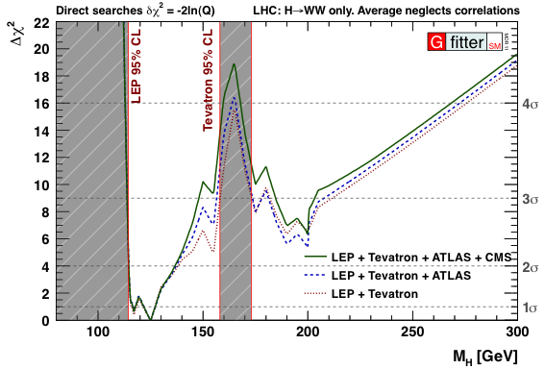

Comparison of ATLAS and CMS
Results used:
  Tevatron combination Moriond 2011, upto 8.2 /fb
  CMS & ATLAS: latest H→WW results, 35 and 36 /pb

Slide 27
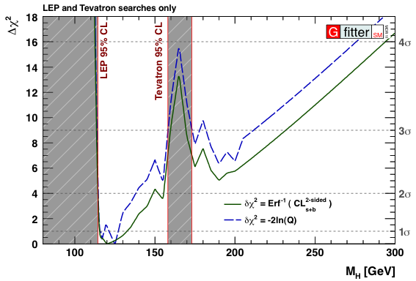
Electroweak Fit – Tevatron Higgs Constraints
M_{H} from fit w/o Higgs searches:
  Central value ±1σ:
  2σ interval:
Fit with LEP & latest Tevatron searches:
  CL_{s+b}^{2s} central value ±1σ:
  2σ interval:
LEP & Tevatron upto 8.2 fb⁻¹
Green error band from including / excluding theoretical errors in fit
  Theoretical errors included in χ² with “flat likelihood term”
Notes:
CL_s+b vs -2lnQ
Tevatron Lumi ?
For SM cross section limit-setting purposes, we use the Bayesian exclusion which excludesa tiny bit less than the CLs exclusion. If you need to draw exclusion bands on your plots,to be consistent with our plots, you can use the numbers: 157.64 - 172.97 observed, which we quote as 158-173 GeV 152.61 - 178.62 median expected, which we quote as 153-179 GeV

Slide 28
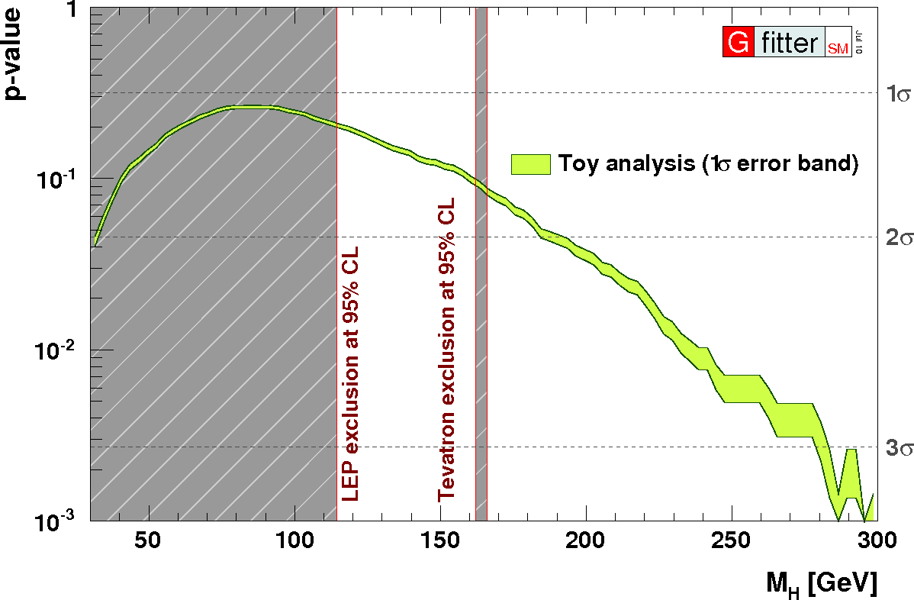
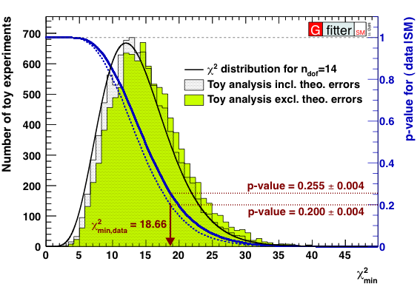
Goodness of Global Fit
determine p-value by using MC toy experiments
  p-value: probability for wrongly rejecting the SM
  p-value: probability for getting a χ²_{min,toy} larger than the χ²_{min,data} from data
for each toy complete fit is performed
p-value = (25±1₋₂)%
  no significant requirement for new physics
derivation of p-value for standard fit as function of M_{H}
small p-values for large Higgs masses (M_{H}~280 GeV)
usually unable to indicate signals for physics beyond SM
  sensitive observables mixed with insensitive ones

Slide 29
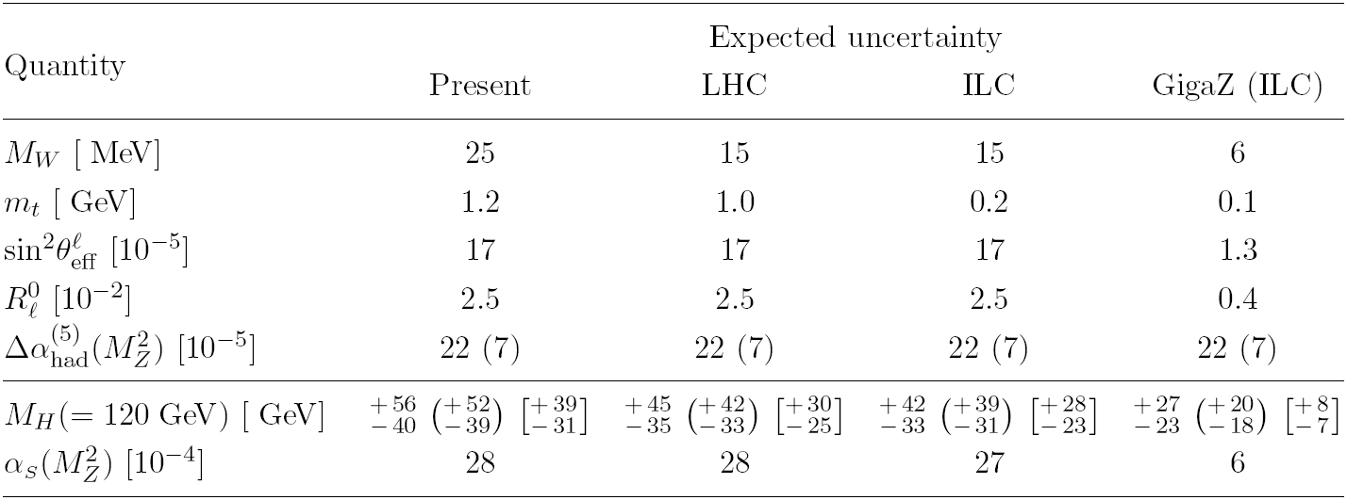
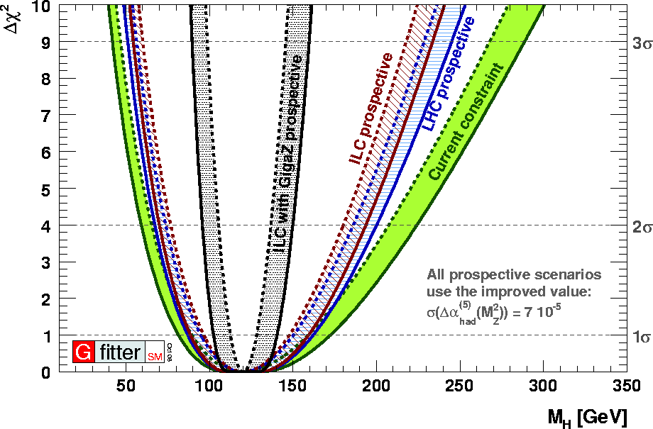
Prospects for LHC and ILC
LHC, ILC (+GigaZ)*
  exp. improvement on M_{W}, m_{t}, sin²θ^{l}_{eff},R_{l}⁰
  in addition improved Δα_{had}⁽⁵⁾(M_{Z}²) [F. Jegerlehner, hep-ph/0105283]
assume M_{H}=120 GeV by adjusting central values of observables
improvement of M_{H} prediction
  to be confronted with direct measurement → goodness-of-fit
  broad minima: Rfit treatment of theo. uncertainties
GigaZ: significant improvement for M_{H} and α_{S}(M_{Z}²)
*[ATLAS, Physics TDR (1999)][CMS, Physics TDR (2006)][A. Djouadi et al., arXiv:0709.1893][I. Borjanovic, EPJ C39S2, 63 (2005)][S. Haywood et al., hep-ph/0003275][R. Hawkings, K. Mönig, EPJ direct C1, 8 (1999)][A. H. Hoang et al., EPJ direct C2, 1 (2000)][M. Winter, LC-PHSM-2001-016]

Slide 30
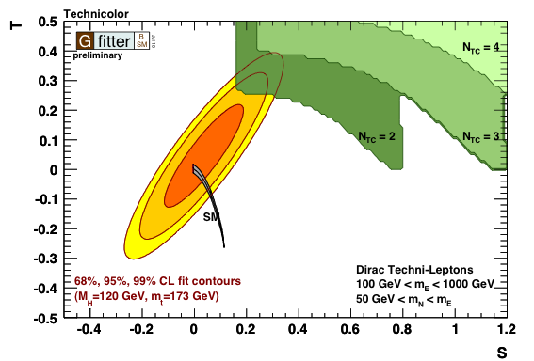
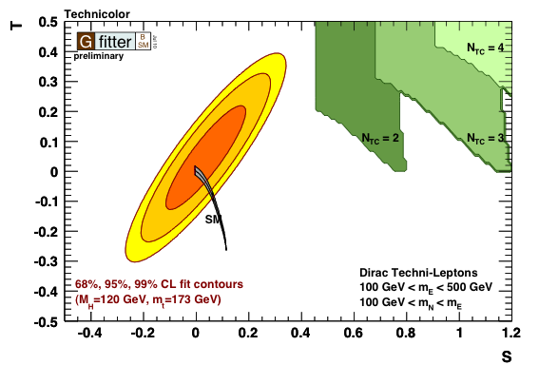
Minimal Extended Technicolor
Extended Technicolor (ETC)
  One of first explanations for EWSB and hierarchy problem.
Magnitude of rad. corrections scales with number of techni- colors and flavors.
Minimal ETC: with 1 TC quark/lepton generation, and 2 upto 4 TCs.
  One triplet of TC quarks, doublet of TC leptons.
  Techni-neutrino can be Dirac or Majorana.
  Parameters: N_{TC}, ratio neutrino/electrion masses.
Results:
  Ruled out: well-known incompatibility in S parameter.
  Large isospin violations in Dirac techni-doublet are disfavored
[M.E.Peskin and T. Tacheuchi. Phys Rev. D46 (1992) 381] [J. Ellis et al., Phys.Lett. B343, 282 (1995)]

Slide 31
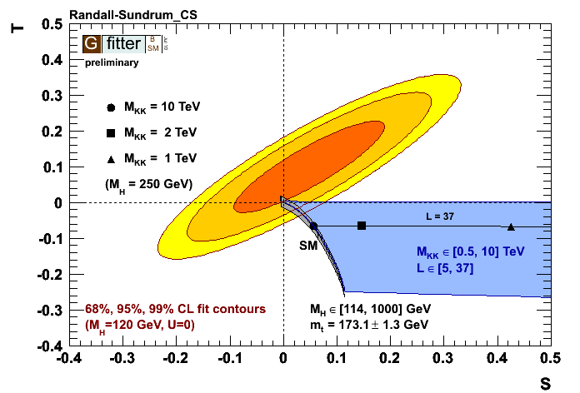
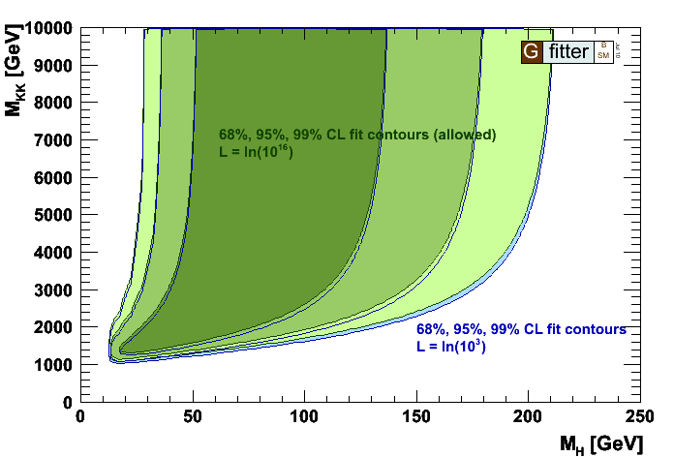
Warped Extra Dimensions w/ custodial symmetry
[K. Agashe, A. Delgado, M. May, R. Sundrum, hep-ph/0308036v2]
Goal: “cure” WED with too large T values
Introduction of so-called custodial isospin gauge symmetry in the bulk
Extension of hypercharge group to
SU(2)_{R} x U(1)_{X}
  Bulk symmetry group:
  SU(3)_{C} x SU(2)_{L} x SU(2)_{R} x U(1)_{X}
Broken to SM SU(3)_{C} x SU(2)_{L} x U(1)_{Y}
on “UV” brane
IR brane SU(2)_{R} symmetric
Right-handed fermionic fields occur in doublets
Results:
  Almost completely ruled out
  Only small M_{H} allowed

Slide 32
Littlest Higgs Model with T-Parity
LHM: solves hierarchy problem, possible explanation for EWSM
  SM contributions to Higgs mass cancelled by new particles
Non-linear sigma model, broken Global SU(5)/SO(5) symmetry
  Higgs = lightest pseudo-Nambu-Goldstone boson
  New SM-like fermions and gauge bosons at TeV scale
T-parity = symmetry like susy R-parity (not time-invariance)
  Symmetry forbids direct couplings of new gauge bosons (T-odd) to SM particles (T-even)
  LHM provides natural dark matter candidate
Two new top states: T-even m_{T+} and T-odd m_{T-}
Dominant oblique corrections from weak isospin violation:
t, T⁺
t, T⁺, t, T⁻
W
W
Z
Z
b
t, T⁺, T⁺, T⁻

Slide 33
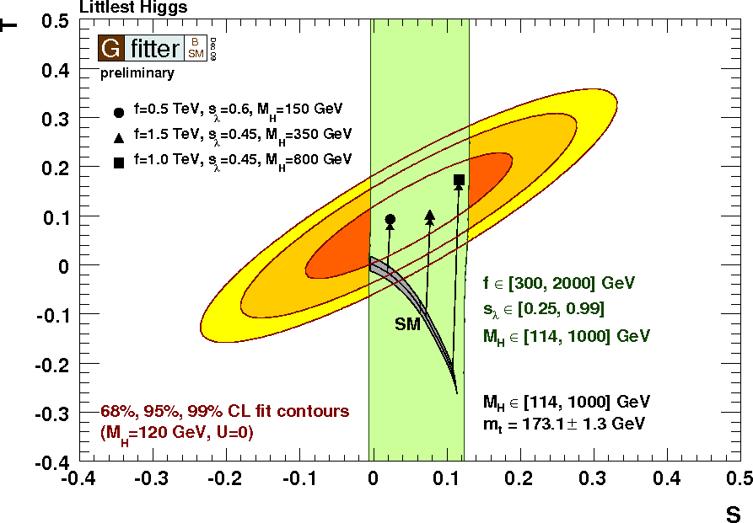
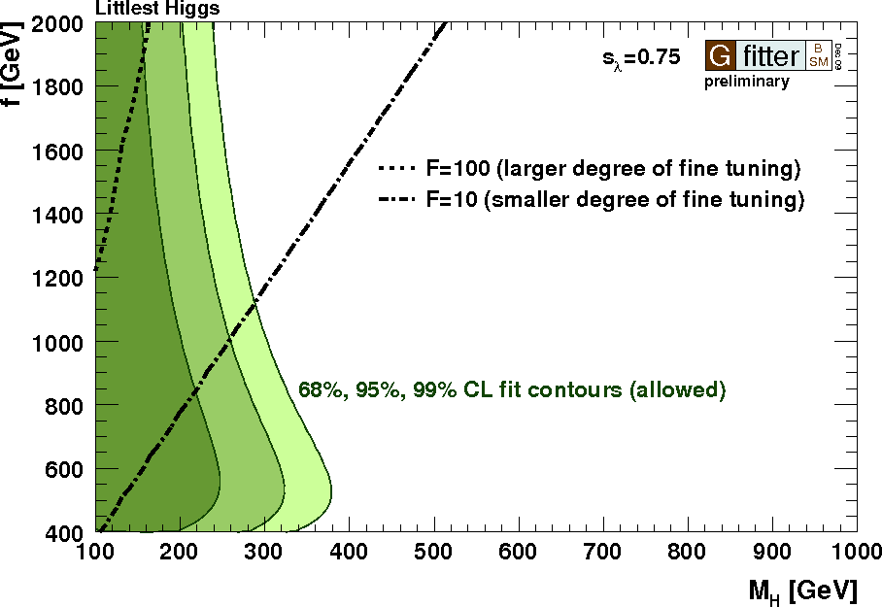
Littlest Higgs with T-Parity
STU predictions (oblique corrections) inserted for
Littlest Higgs model
[Hubisz et al., JHEP 0601:135 (2006)]
Parameters of LH model
  f : symmetry breaking scale
  (scale of new particles)
  s_{λ}≅m_{T-} /m_{T+} : ratio of T-odd/-even masses in top sector
  Order one-coefficient δ_{c} (value depends on detail of UV physics)
    Treated as theory uncertainty in fit (Rfit) : δ_{c}= [-5,5]
F: degree of fine-tuning
Results: LH model prefers large Higgs mass, with only small degree of fine-tuning

Slide 34
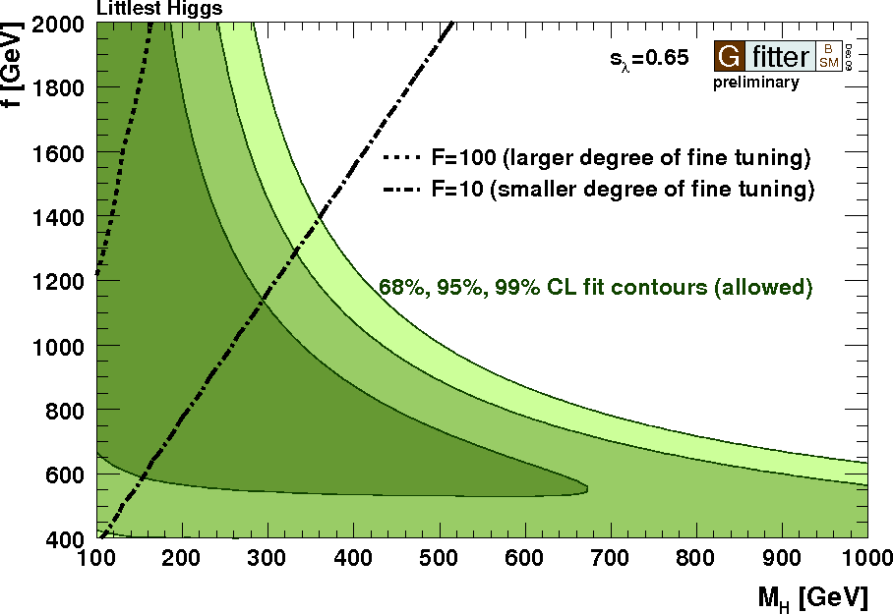
Littlest Higgs with T-Parity
STU predictions (oblique corrections) inserted for
Littlest Higgs model
[Hubisz et al., JHEP 0601:135 (2006)]
Parameters of LH model
  f : symmetry breaking scale
  (scale of new particles)
  s_{λ}≅m_{T-} /m_{T+} : ratio of T-odd/-even masses in top sector
  Order one-coefficient δ_{c} (value depends on detail of UV physics)
    Treated as theory uncertainty in fit (Rfit) : δ_{c}= [-5,5]
F: degree of fine-tuning
Results: LH model prefers large Higgs mass, with only small degree of fine-tuning

Slide 35
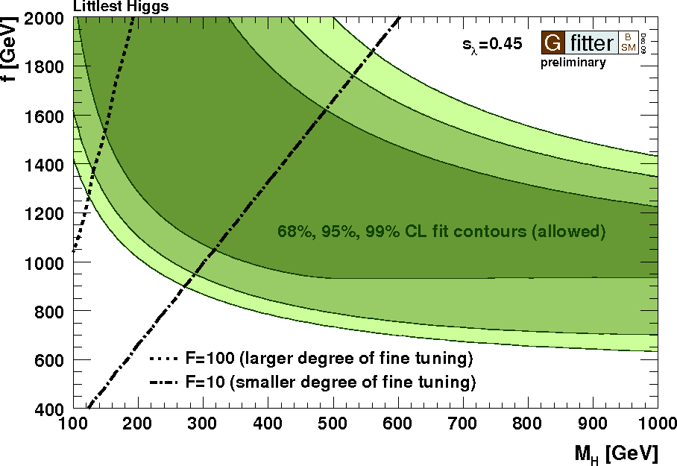
Littlest Higgs with T-Parity
STU predictions (oblique corrections) inserted for
Littlest Higgs model
[Hubisz et al., JHEP 0601:135 (2006)]
Parameters of LH model
  f : symmetry breaking scale
  (scale of new particles)
  s_{λ}≅m_{T-} /m_{T+} : ratio of T-odd/-even masses in top sector
  Order one-coefficient δ_{c} (value depends on detail of UV physics)
    Treated as theory uncertainty in fit (Rfit) : δ_{c}= [-5,5]
F: degree of fine-tuning
Results: LH model prefers large Higgs mass, with only small degree of fine-tuning

Slide 36
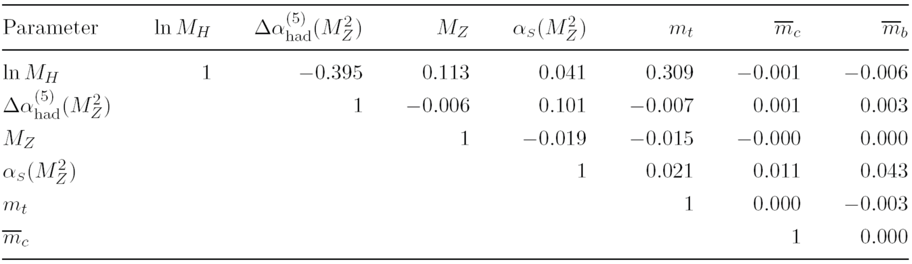
Fit correlations
correlation coefficients between free fit parameters

