Slide 1
Beam Window Studies for Superbeams
Matt Rooney, Tristan Davenne, Chris Densham
Krakow, October 2010

Slide 2
Window candidate materials
Others candidate: AlBeMet

Slide 3
Superbeam comparison
 | EUROnu SPL | LBNE (700 kW) | LBNE (2 MW) | T2K
Beam power | 1 | 0.7 | 2 | 0.75 | MW
Beam energy | 5 | 60 | 60 | 30 | GeV
Protons per pulse | 1.50e14 | 5.60e13 | 1.6e14 | 3.30e14
Beam sigma | 4 | 1.5 | 3.5 | 4.24 | mm
Peak energy dep. | ~ 80 | ~ 200 | ~ 128 | ~ 160 | J/cc/spill
Pulse length | 5 | 10 | 5 | 5 | μs
Frequency | 12 | 1.32 | 1.32 | 0.47 | Hz
NOTE: Energy deposition is for beryllium.

Slide 4
Stress analysis – variables studied
Beam parameters:
Power: 1 MW (4 MW divided between four targets/windows)
Energy: 5 GeV
1.5 x 10¹⁴ protons per pulse
Frequency: 12.5 Hz
Pulse length: 5 microseconds
Beam sigma: 4 mm
Design considerations:
Materials: Beryllium (S65C), AlBeMet
Cooling methods: direct forced convection helium and circumferential water
Beam parameters taken from EUROnu WP2 Note 09-11

Slide 5
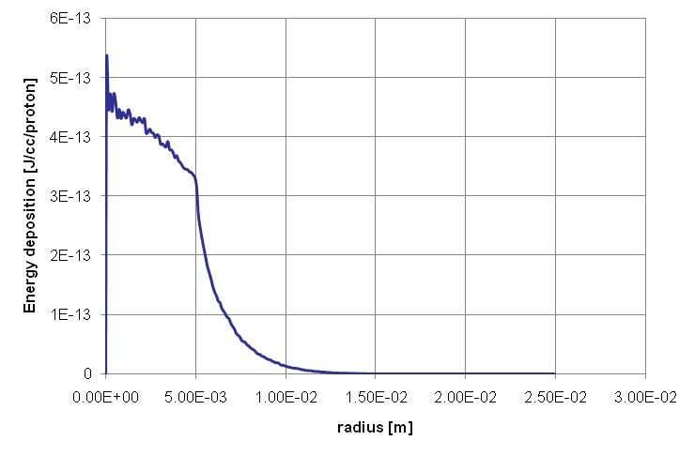
Energy deposition profile
NOTE: Data produced by Tristan Davenne (RAL) using Fluka.
A Gaussian approximation of this data has been used in ANSYS for simplicity.
Peak is around 80 J/cc/spill for beryllium window
A bug was found in FLUKA that means peak may be slightly lower. Needs to be checked.

Slide 6
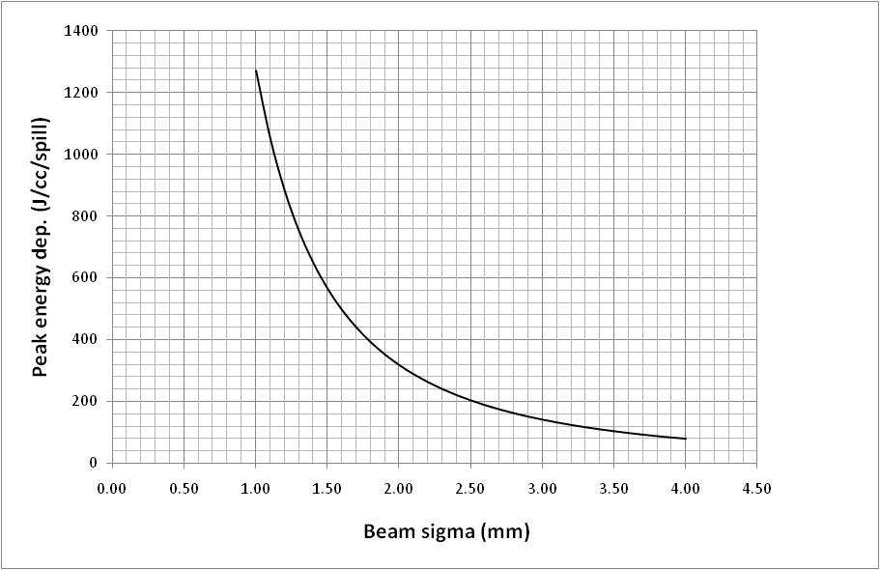
Window energy dep. as a function of beam sigma
LBNE 700 kW (1.5 mm)
T2K 700 kW (4.24 mm)
EUROnu 1 MW (4 mm)
For Gaussian profile beam: (peak energy dep.) x σ² = constant
(assumes constant total heat deposited, confirmed by FLUKA simulations)

Slide 7
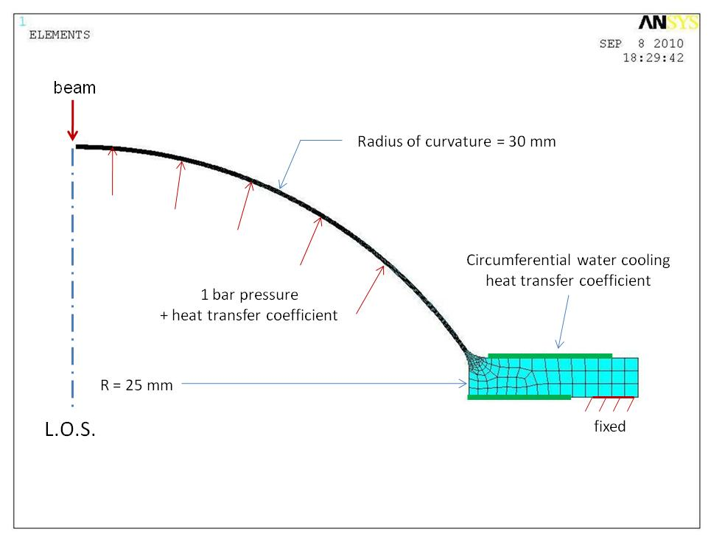
Typical ANSYS model showing cooling options
ANSYS Multiphysics v11 used with coupled field elements (axisymmetric model)
Window thickness is 0.25 mm.

Slide 8
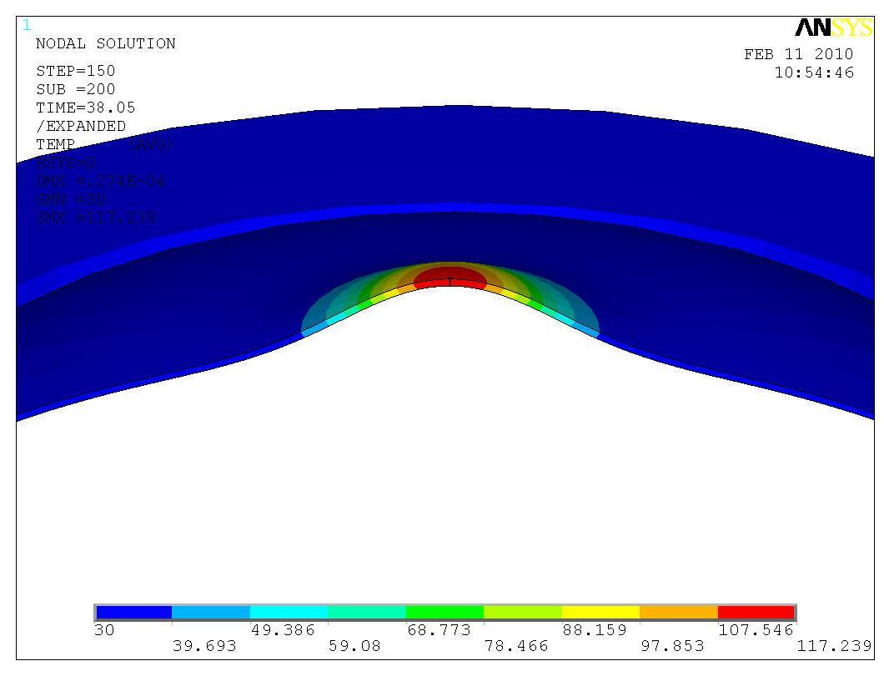
Thermal stress and strain
Stress components:
Quasi-static thermal stress
Stress waves
Background stress due to pressure

Slide 9
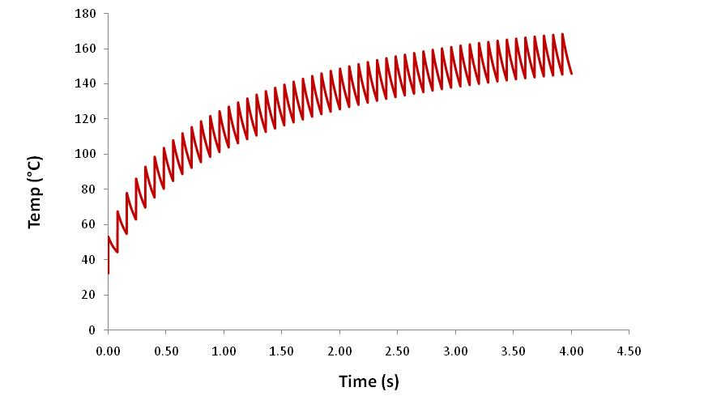
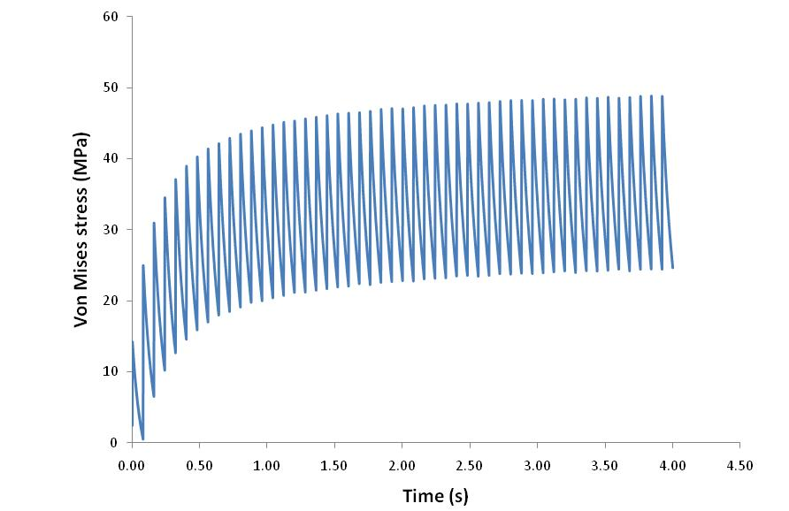
Circumferentially water cooled beryllium window
0.25 mm thick beryllium window
Circumferentially water cooled
(assumes 2000 W/m²K)
Max temp ~ 180 °C
Max stress ~ 50 MPa (yield ~ 270 MPa)

Slide 10
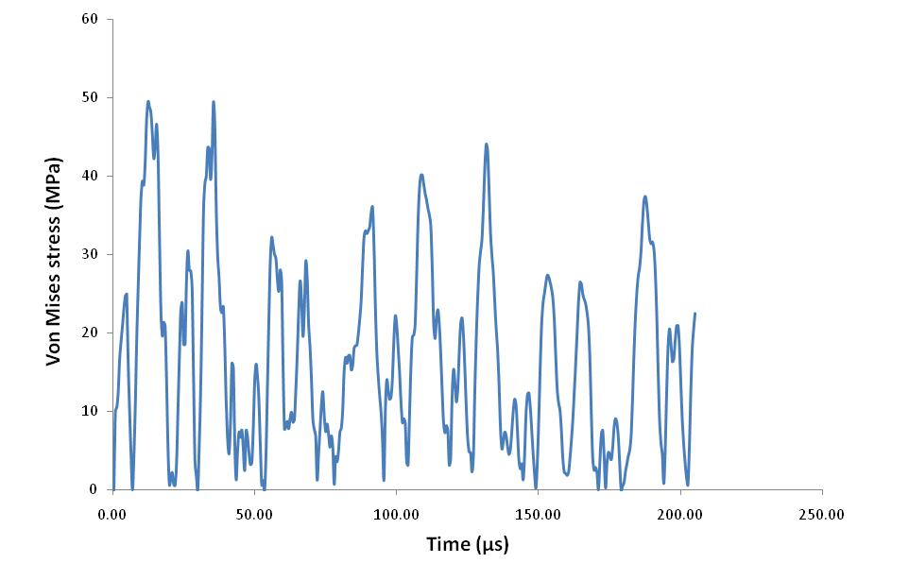
‘Shock’ stress due to single pulse in beryllium window
Temp jump of 22°C results in 50 MPa peak stress. When superimposed with other stresses the peak may be around 80 MPa, giving a SF of around 4 on the UTS.

Slide 11
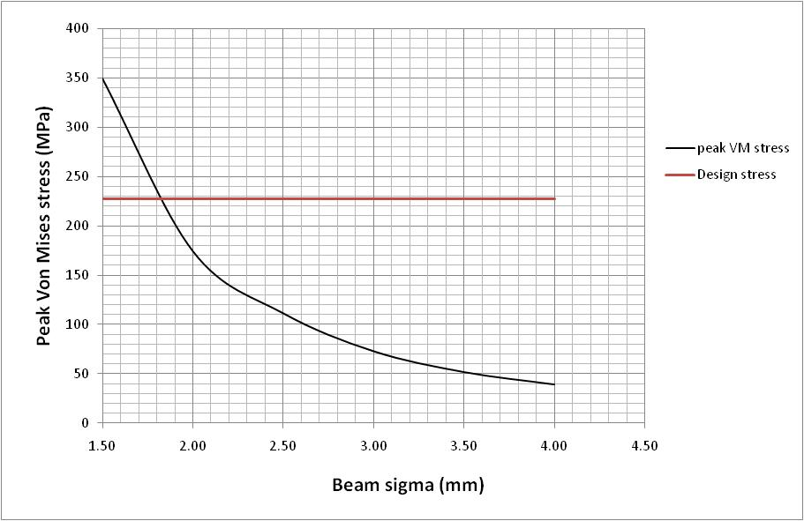
Minimum beam size for beryllium window
Design stress is assumed to be half ultimate tensile strength.

Slide 12
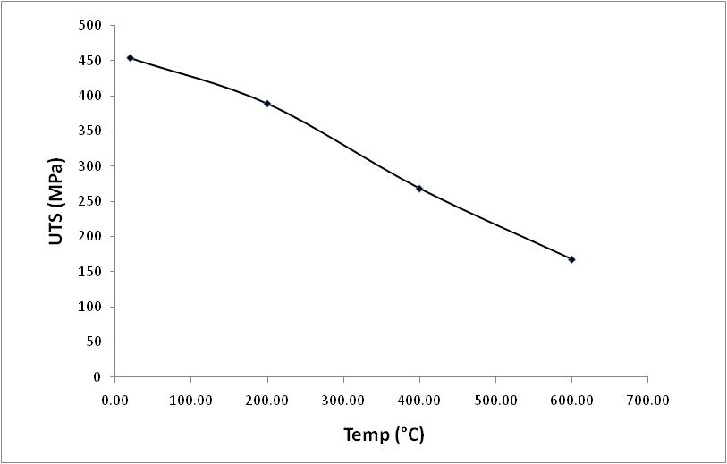
But UTS falls with temperature
ITER Material Properties Handbook

Slide 13
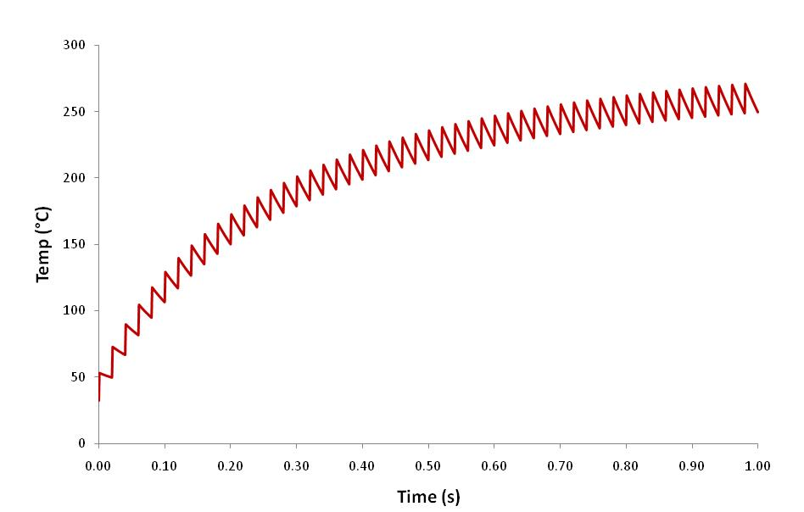
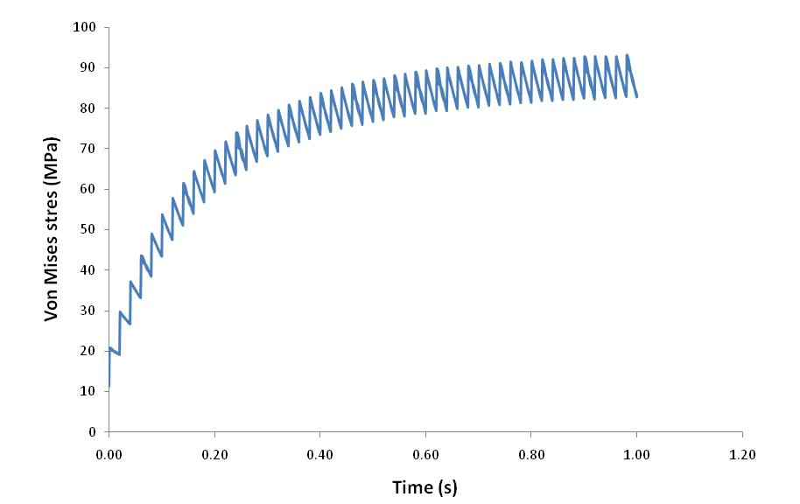
4 MW window
50 pulses (1 second)
Yield strength of beryllium @ 260°C
is around 200 MPa. This leaves a safety factor of about 2 for a beryllium neutrino factory window with these beam parameters.

Slide 14
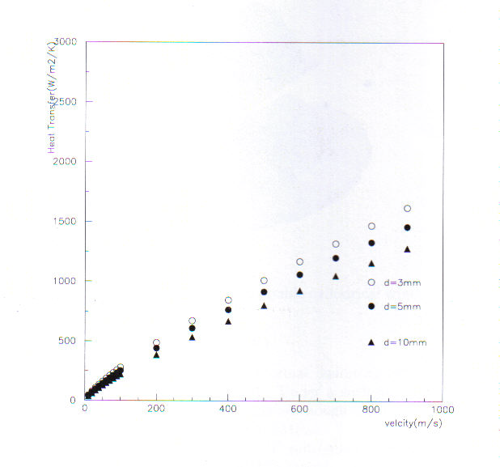
Empirical heat transfer coefficient of flowing gaseous helium
1000 W/m²K would require velocity of around 500 m/s. This is possible but may be very costly.
Dalle Donne formula for turbulent flow:
Nu = 0.019r^{-0.16}Re^{0.8}Pr^{0.5}
Ref: Y. Yamada. T2K Target Station Interim Design Report. 2005.

Slide 15
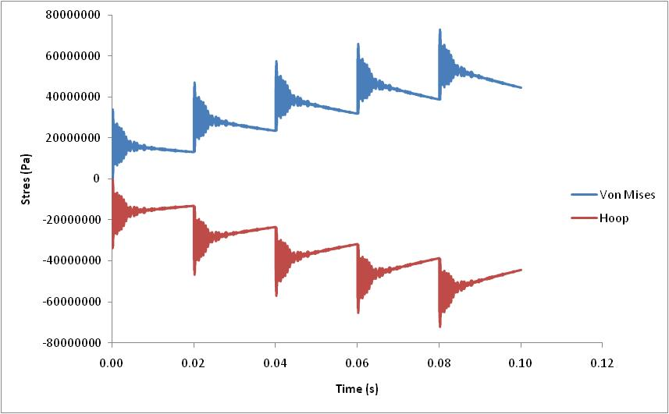
Stress wave interaction at 50 Hz?
Stress waves in window dissipate before arrival of next pulse. But this will depend heavily on the geometry. Needs to be studied for target.

Slide 16
LBNE Window Studies

Slide 17
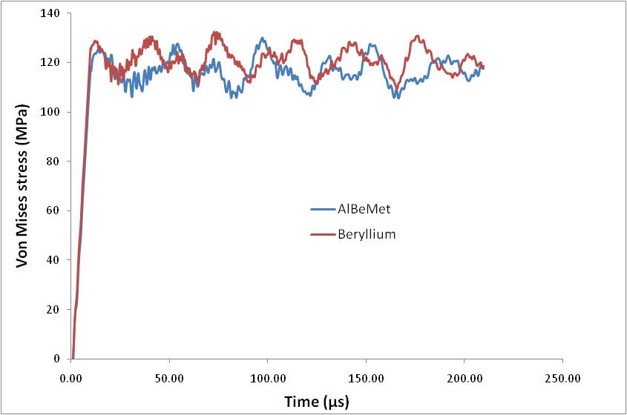
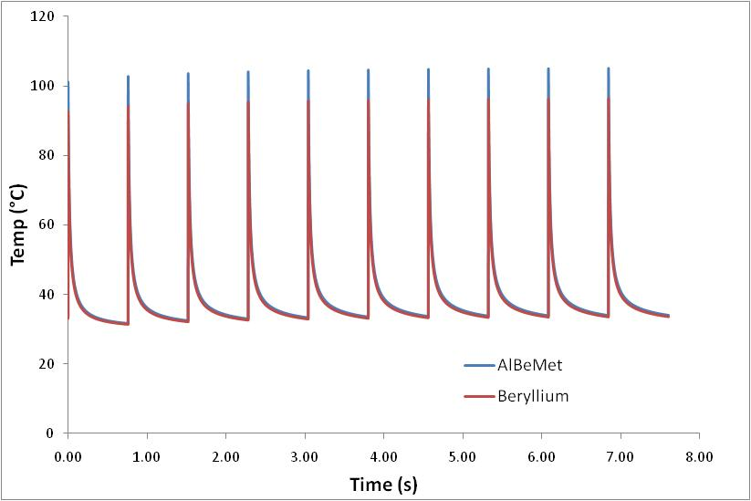
AlBeMet window as a window material
AlBeMet seems to offer little benefit over beryllium and is relative untested in radiation environment.

Slide 18
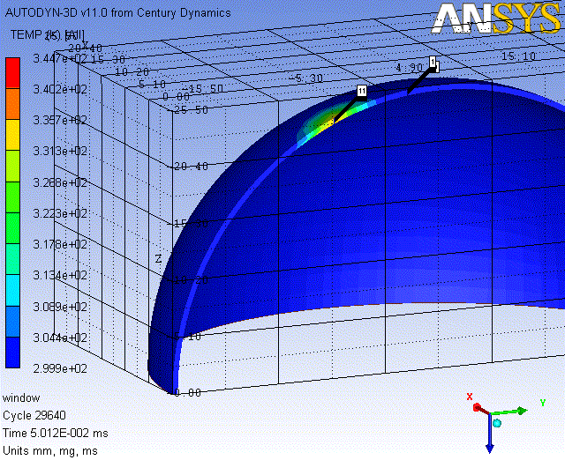
3D ANSYS Autodyne simulation of off-centre beam
Single pulse
on-centre
3mm off centre
10mm off centre
15mm off centre
Heat profile imported from FLUKA

Slide 19
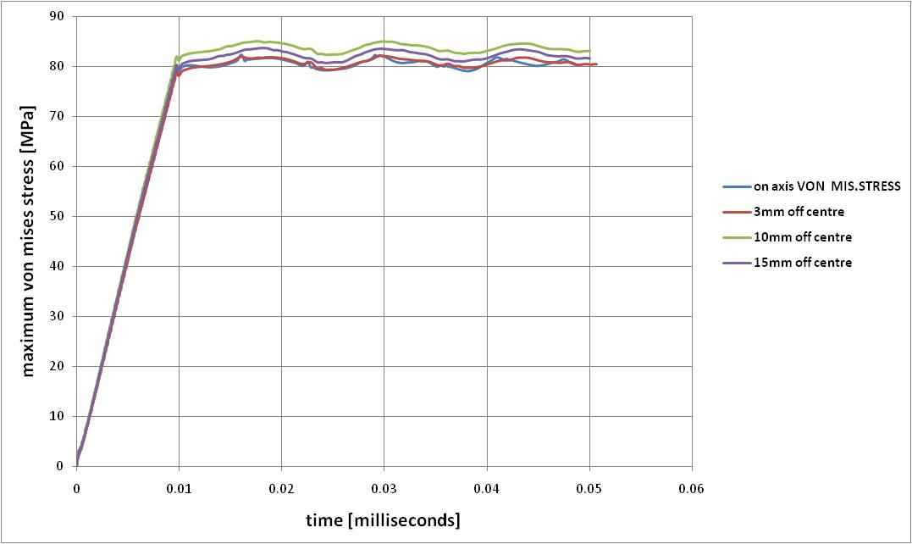
Off-centre beam results
Study by Tristan Davenne (RAL) seems to confirm that hemispherical shape is tolerant to off-centre beam pulses.
Similar results for multiple pulses, but depends on boundary conditions, i.e. how the window is fixed/welded/joined.

Slide 20
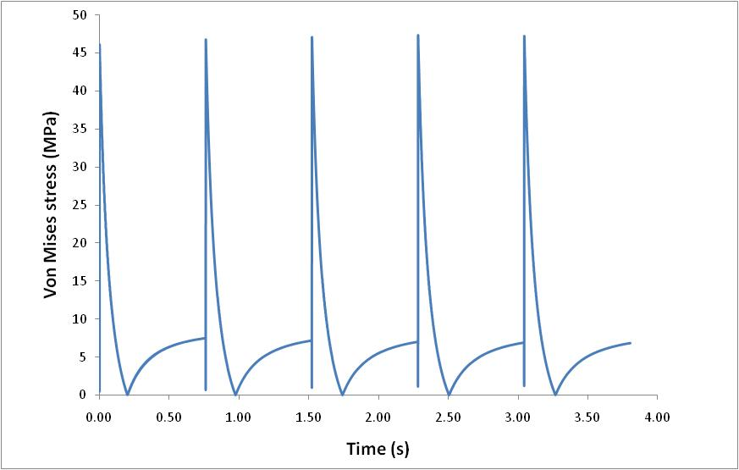
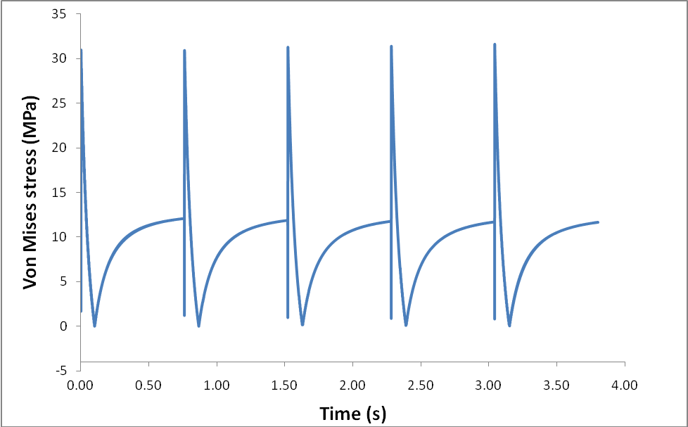
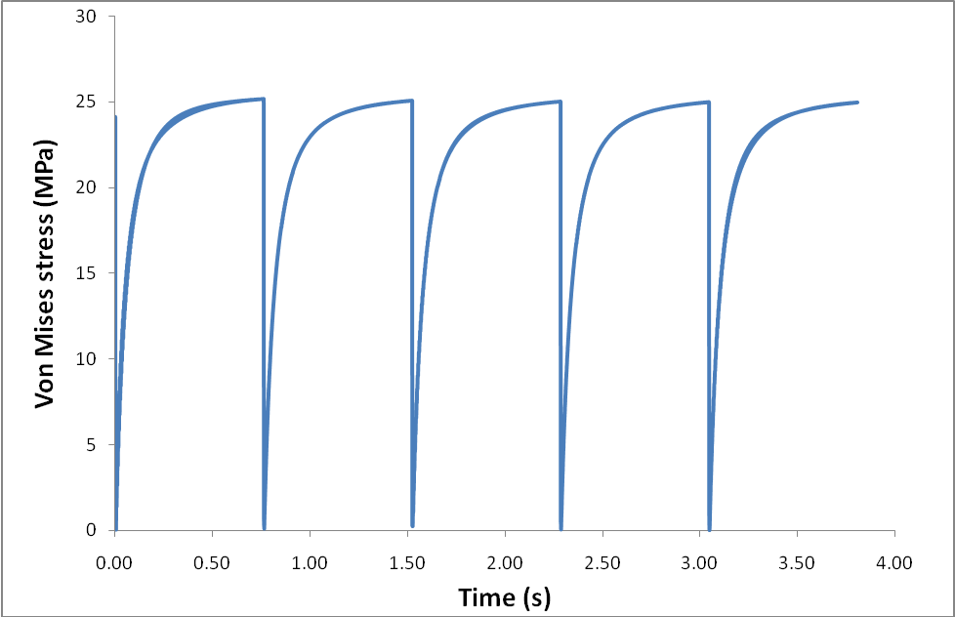
Significance of window thickness
0.3 mm thick
0.2 mm thick
0.1 mm thick

Slide 21
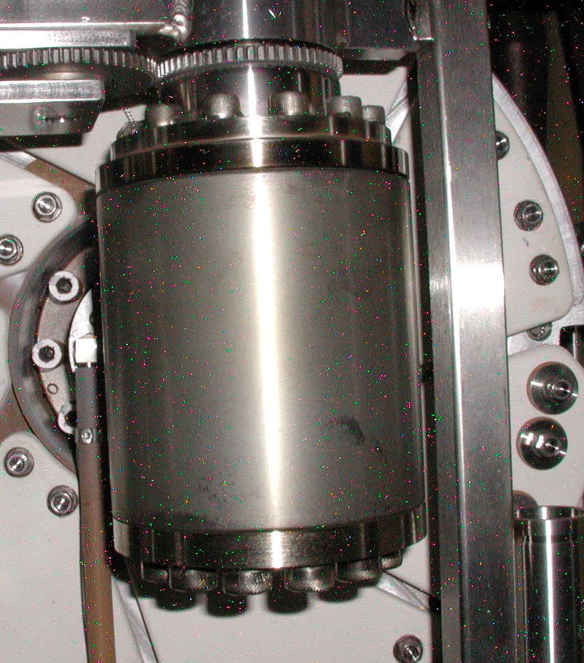
P-bar target at Fermilab (P. Hurh)
P-bar Target (FNAL) has a Beryllium cover that regularly sees 1000 J/cc and shows no evidence of damage
Possible explanations:
  1. Small areas of deformation not visible
    Analysis indicates about 0.05 mm of plastic deformation on surface in an outward “bump” with diameter of about 1 mm
  2. Beam profile is not gaussian
    At such small sigma, peak energy deposition would be reduced greatly if profile were flat in center of beam
  3. Fast energy deposition rate creates high strain rates
    Yield strength of metals increases for high strain rates

Slide 22
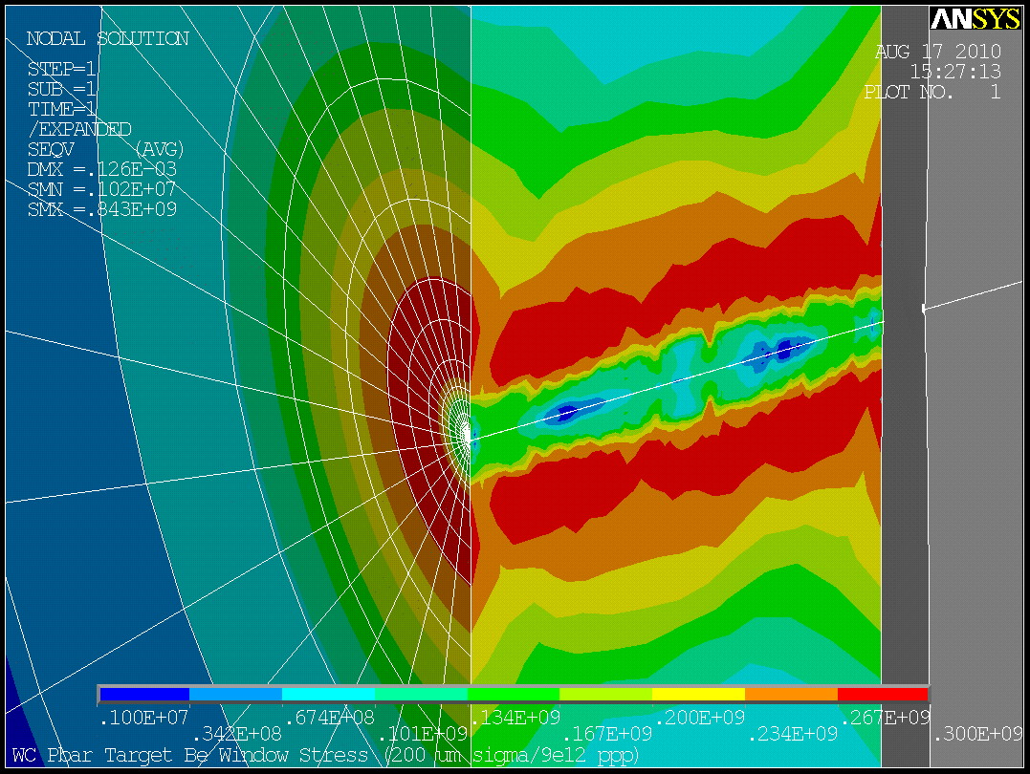
Beryllium P-bar target cover – surviving 1000 J/cc pulses?
(results presented by P. Hurh at NBI 2010)
120 GeV
0.2 mm sigma
Elastic/plastic
Temp Dependent Mat’l Properties
Peak Seqv is 300 MPa
Peak Temp is ~800 C
Be Melting Temp is 1278 C
Be UTS at 600 C is ~150 MPa

Slide 23
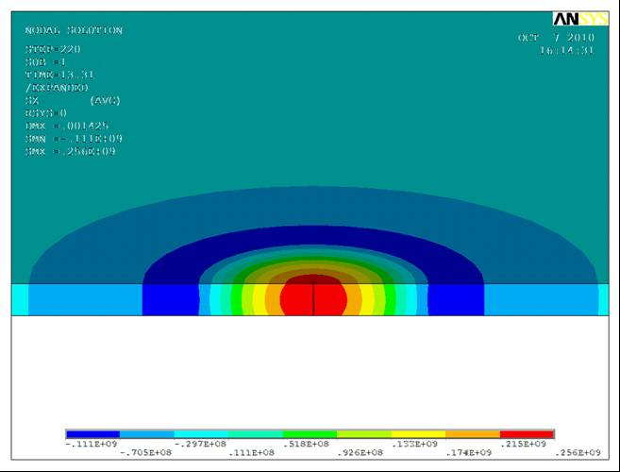
Elastic plastic simulation - High intensity beams
ANSYS elastic-plastic simulation using a bi-linear stress strain curve with yield strength 273 Mpa and UTS 453 Mpa (from ITER Material Properties Handbook)

Slide 24
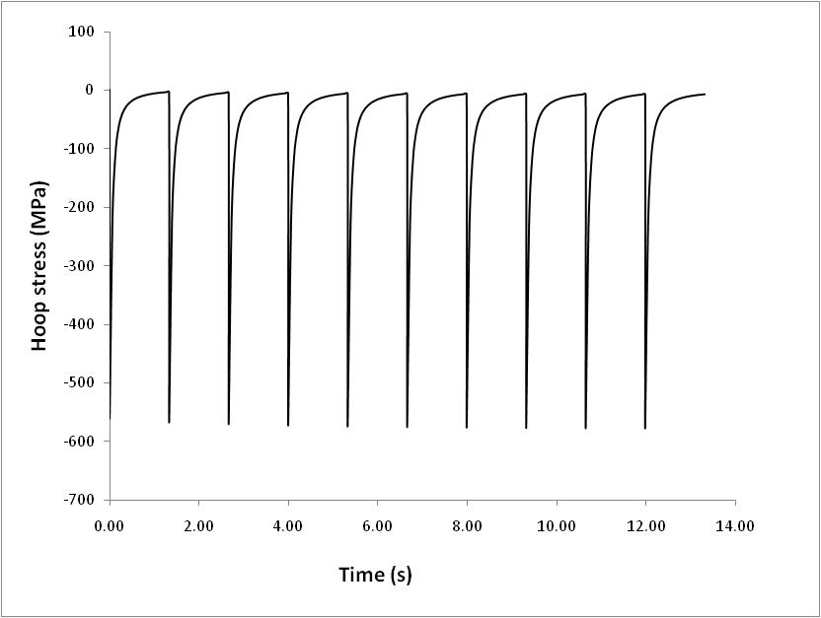
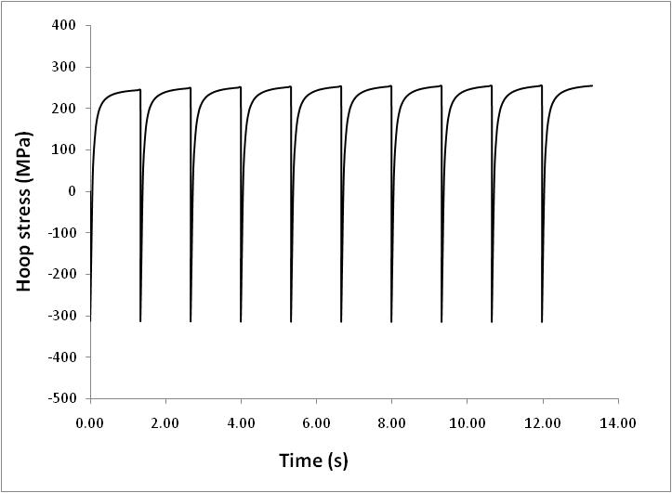
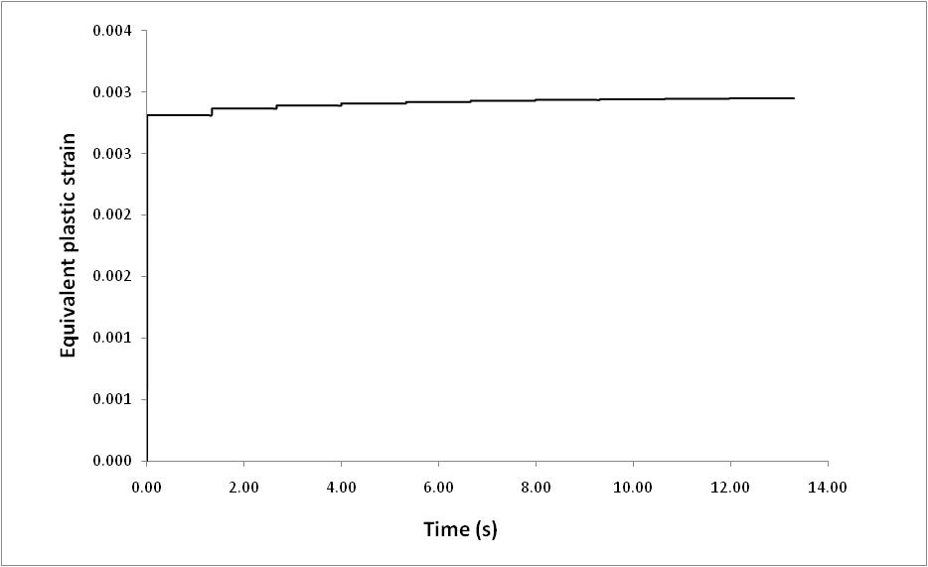
Elastic-plastic simulation results

