Slide 1
Looking for a non standard supersymmetric Higgs
Guillaume Drieu La Rochelle, LAPTH
Powerpoint Templates

Slide 2
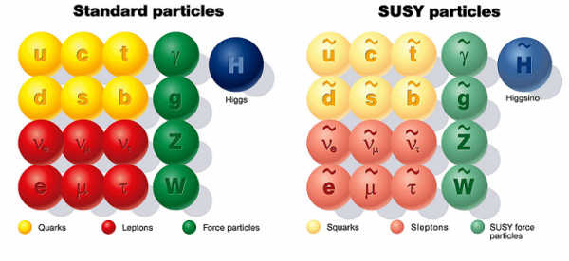
From simple susy…
Unique extension of the Poincaré group
WARNING :
No superparticles seen
Higgs too light
Theoretical issues :
mu problem

Slide 3
… to realistic susy
+
something else ...
MSSM
BMSSM

Slide 4
BMMSM Physics
Many different scenarios
NMSSM
U(1)’MSSM
MSSM with ED
...
Are there any susy general features?
How will susy show up in experiments?
How much freedom does it leave us with?
Different phenomenologies
Dedicated studies

Slide 5
Heavy BMSSM
Heavy extra (non standard) physics
Effective Field Theory
Integrating out extra particles
Theory with no extra particles
but extra vertices
Validity of the EFT
MSSM is renormalisable EFT is predictive
Standard = MSSM

Slide 6
Restriction of EFT framework
Generic Include all possible operators
Theoretical consistency
Gauge invariance
Lorentz invariance
Study preferences
Higgs sector only
Order 1 and 2 in
Antoniadis et al. arXiv:0910.1100
Carena et al. arXiv:0909.5434

Slide 7
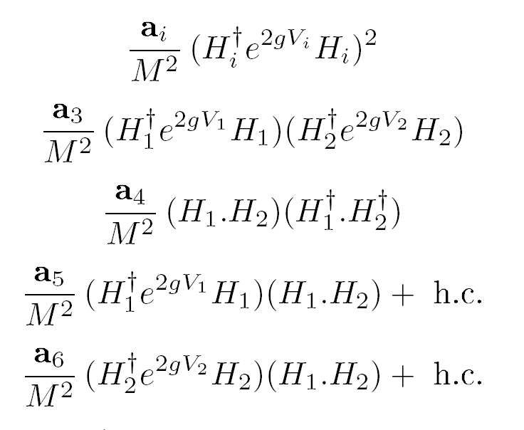
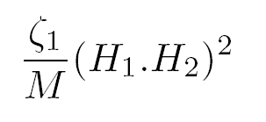
Base of Effective Operators
Dimension 5
Dimension 6
Effective Coefficients

Slide 8
Computation method
Feynman approach
Feynman expansion truncated
the truncation level depends on the observable
Regularisation scheme
Renormalisation scheme
Issue of (2 schemes : and )
Parameter extraction
SM canonical set ( ... )
MSSM masses ( ) and trilinear couplings
Extraction of via in the case of the scheme
For On-Shell observables, the extraction is done at tree-level
Dimensional Regularisation
On-Shell and MS

Slide 9
Computation Precision
EFT validity we should be able to reach any accuracy we want
Truncation on the loop expansion
Only standard particles contribute
usual MSSM radiative corrections
Masses, strong couplings : 2-loops via RGE
Higgs interactions : effective potentials (~loop)
b-quark, and self-interactions
Truncation on the expansion
Truncation at order 2
Loop expansion well under control (no need for high accuracy)
expansion much more likely to be wrong

Slide 10
TOOLS
Lagrangian
&
Parameter Space
I
Feynman
Rules
II
Observables
IV
III
Reference Data
Test Data
Predictions
I : LanHEP
II : CalcHEP/SuSpect
III : MicrOmegas/HiggsBound/Hdecay
IV : Mathematica

Slide 11
Basic Phenomenology
Interactions altered
Observables altered
W,Z masses
Scalar Higgs :
Masses
Couplings to matter
Neutralinos/charginos
Masses
Couplings to SM matter
But are taken as reference data
Hence stay fixed
But weak couplings change (while performing the extraction)
coupling change EW Precision Test

Slide 12
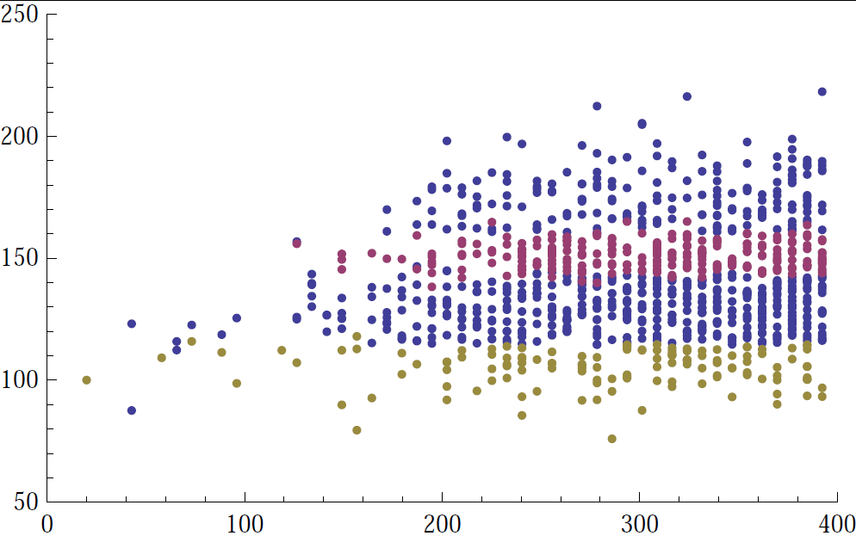
Colliders Constraints
LEP ElectroWeak Precision Data
Partly taken as input (masses, electromagnetic and strong couplings)
Partly as constraints from weak couplings
Precision observable
LEPEWWG hep-ex:0509008
Higgs exclusion bound
Tevatron searches
Constraints from Higgs searches
Implemented via HiggsBound
arXiv:0811.4169

Slide 13
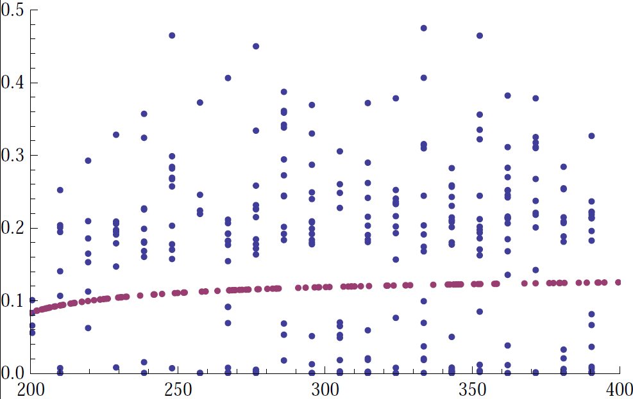
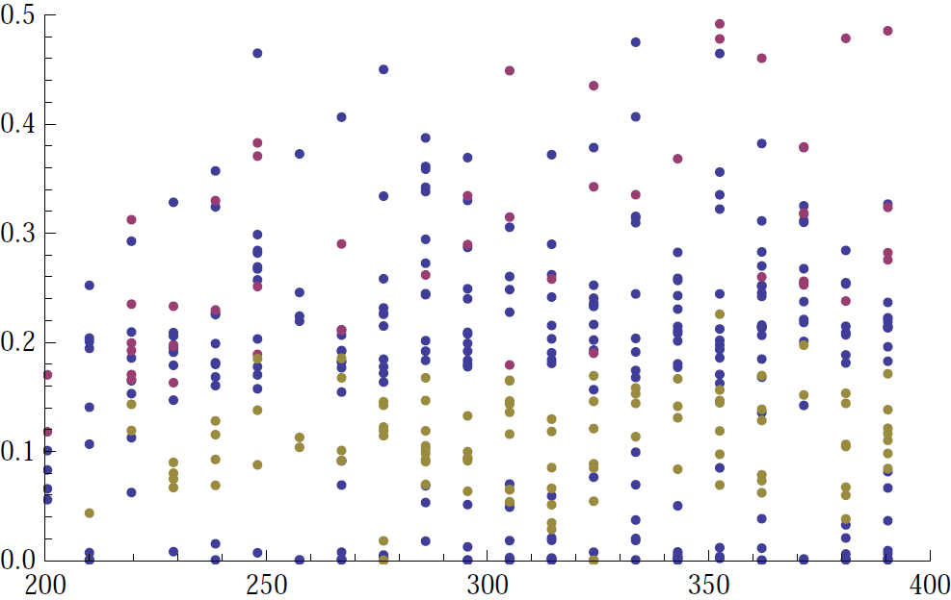
Astrophysics constraints
Relic density
WMAP bounds

Slide 14
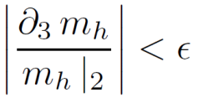
Theoretical validity
Effective expansion truncated at order 2 : is it enough?
Accidental cancelations at low orders
Singularities at low orders
degeneracies e.g.
Estimator :
Compute the relative size of 3rd order contribution for a given observable
Exclude point in non-perturbative regions
Not because they are not physical,
but the mathematical set-up is no more suitable

Slide 15
Scanning the SM-like Higgs
Observables
Masses :
Higgs production :
Higgs decay :
Parameter space
MSSM parameters
effective coefficients are of the order of unity
Soft masses, trilinear couplings are taken at SPS1a
Comparison with Standard Model :
Same observables, with Higgs mass as input

Slide 16
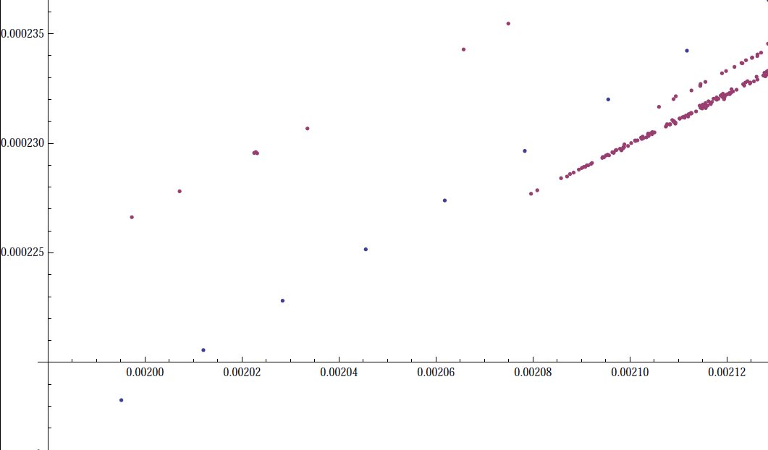
Discriminating SUSY from SM
Work in progress :
Most points get excluded
Regions favoured by constraints are NOT those resembling the Standard Model
Need for a slightly more involved study

Slide 17
Summary and Outlook
Summary
We can use the EFT formalism to encode any extra physics effect – provided extra physics is heavy -- in a finite set of effective coefficients.
From this formulation, it is possible to reduce the effective parameter space with experimental constraints (colliders measurements, searches, and astrophysics data).
For Higgs signature at LHC, extra physics in the Higgs sector change considerably the expectations from the MSSM.
Outlook
Use those effective operators, not as extra physics contribution, but as higher loop contribution Include loop computation in a intrinsically gauge invariant way.
Include more sectors.
Effective potential for relic density.

