Slide 1
INCL
The Liège Intra Nuclear Cascade, a versatile and long term developing tool.
A. Boudard (CEA-IRFU/SPhN-Saclay)

Slide 2
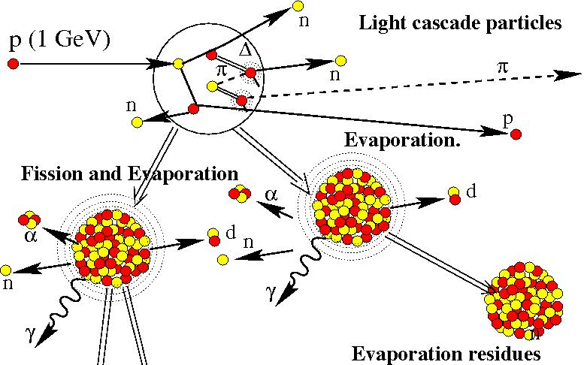
What is Intra Nuclear Cascade (in brief) ?

Slide 3
A bit of history
First age:
Basis of the cascade approach
1947: R. Serber main ideas: N induced reactions at ~100 MeV as
series of free NN interactions followed by an evaporation
1948: M.L. Goldberger (G.F.Chew) Hand calculation (n on “heavy nucleus”)
1958: N. Metropolis et al: Monte-Carlo with computer, calc up to 2 GeV, pions treated
1963: H. W. Bertini :The Bertini code, mean free path and approximate diffuseness
Second age:
Understanding of reaction mechanisms
Mainly Heavy ion collisions (also Nucleon, pion and anti-proton)
1979-1981: Y.Yariv and Z. Fraenkel : ISABEL code (time ordering of collisions for participants)
1980: J. Cugnon (J. Vandermeulen) INCL code
(time explicit for ALL nucleons and pions)
Third age (~1995):
… and also more precision for applications
Spallation source,
Accelerator driven systems (energy production, transmutation of nuclear waste),
Event generator in transport codes (simulation of experiments, medical applications…)

Slide 4
Ingredients of the INCL model
Target preparation
p (1 GeV)
N
Transmission
Wood-Saxon density,
Fermi momentum
N
Reflection
(Refraction)
b
N
Δ
Entering particles
Δ
π
(Coulomb deviation)
N
N
Propagation (t dependence)
Potential
Straight lines, constant velocity
Interactions
(NN,Δ,π)
p in
Realistic, minimal distance,
Pauli principle
Escaping particles
Quantum transmission
Formation of clusters (d, t, α…Be)
E=0
End of the cascade
Ef
(38 MeV)
h
(A,Z,E*,J) The starting state
for any de-excitation.
h
h
V0 (- 45 MeV)
Notes:
Les interactions: NN elast, NN-Delta, absorption by Ndeta-NN…

Slide 5
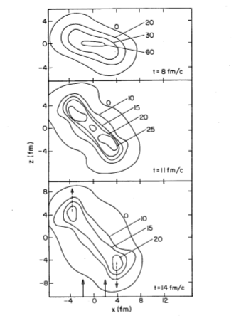
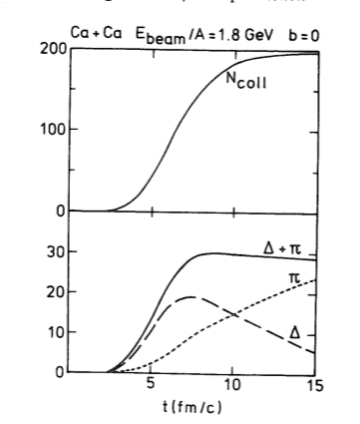
Relativistic Heavy Ion collisions
Goal: High nuclear densities, Nuclear equation of state studies.
Tool needed: to have a full picture of the “inside”, how it evolutes.
What is surviving in the detectors and how to select heads on collisions.
INCL ideal: Full picture, time evolution, realistic and giving the
“broadening” of any signal due to unavoidable fluctuations!
ρ=~3ρ0
(unit: ρ0/18)
Ca+Ca 1A GeV
b=3.83 f
J. Cugnon, T. Mitzutani, J. Vandermeulen Nucl. Phys. (1981) 505
Notes:
Time evolution illustrated.

Slide 6
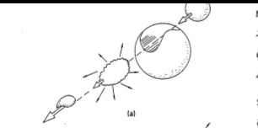
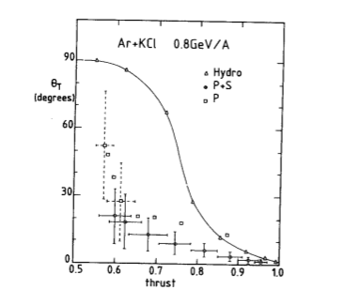
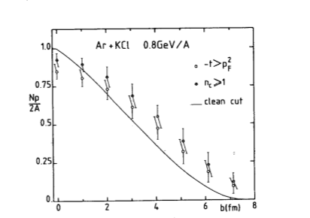
Participants function of impact
(more precise than a clean cut)
Contradiction with hydrodynamical
picture
Global variables introduced for analysis of exclusive measurements
J. Cugnon, D. L’Hote Nucl. Phys. A397 (1983) 519
Quest for “robust variables” signals of the early compression phase.
Notes:
Illustrate the use of global variables for the analysis of exclusive measurements
Trust: illustrate the fact that for the hydro picture the mean free path is small compare to the size of the nucleus leading to radial emission. In contradiction a nuclear transparency leads to more longitudinal production INCL.

Slide 7
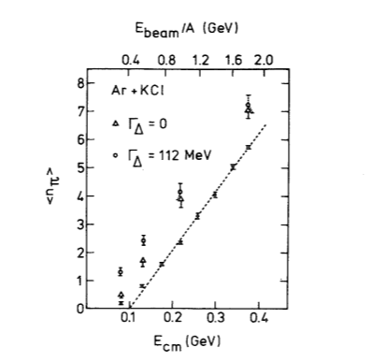
But pion production is too high!
J. Cugnon D. Kinet, J. Vandermeulen Nucl. Phys. A379 (1982) 553
Streamer chamber data
A. Sandoval et al. P.R.L. 45 (1980) 874
Δ- resonance however shown to be important for the thermalization
(efficient conversion of kinetic energy in mass)

Slide 8
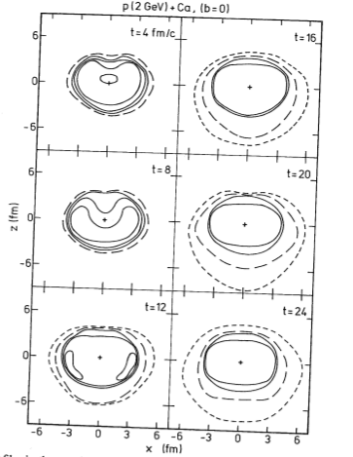
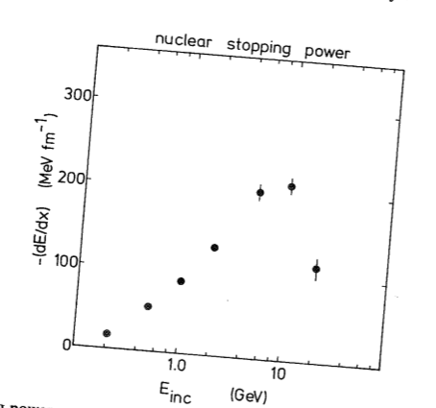
Proton induced reactions
J.Cugnon Nucl. Phys. A462 (1987) 751
Unit: ρ0/3
Nuclear stopping power (independent of target
size and impact parameter)
“wake” of the proton
Improvements of the model:
Nuclear potential, π absorption (πN→Δ) improved

Slide 9
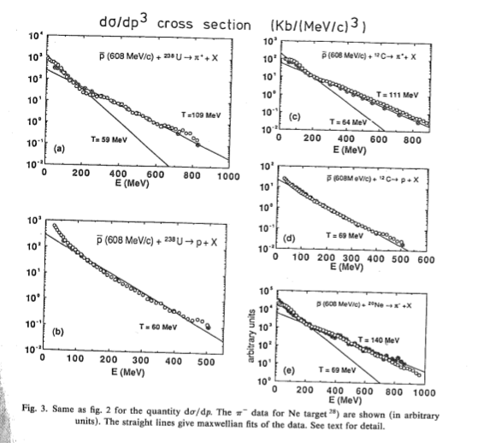
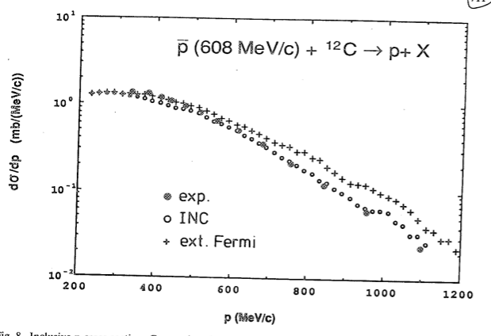
Anti-Proton induced reactions
High excitation energy deposited in one spot
(NN annihilation at the surface ) → multi-π source
Two pion populations
  -primordial
  -interacting
No unconventional momentum distribution
needed for the high momentum p tail

Slide 10
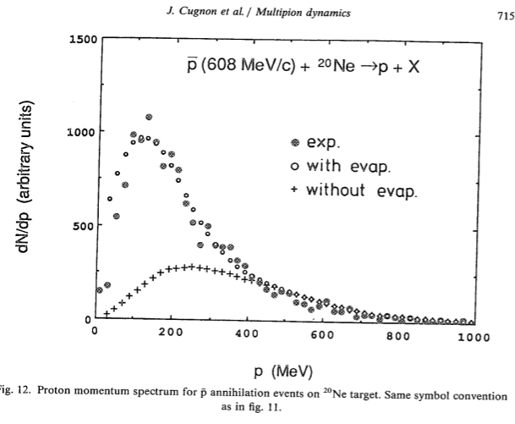
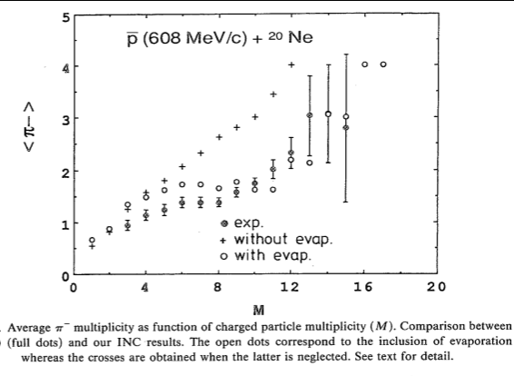
… and the evaporation is needed for a full picture
J.Cugnon P. Deneye J. Vandermeulen Nucl. Phys. A500 (1989) 701

Slide 11
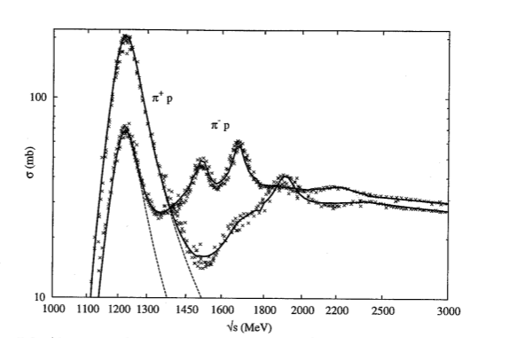
Constant improvements
Nuclear potential and local Pauli blocking
Interaction
NN elastic, inelastic and angular distributions
J.Cugnon, D. L’Hote J. Vandermeulen NIM B111 (1996) 215
Frequently quoted and used
π-N interaction:
Th. Aoust PhD 2006

Slide 12
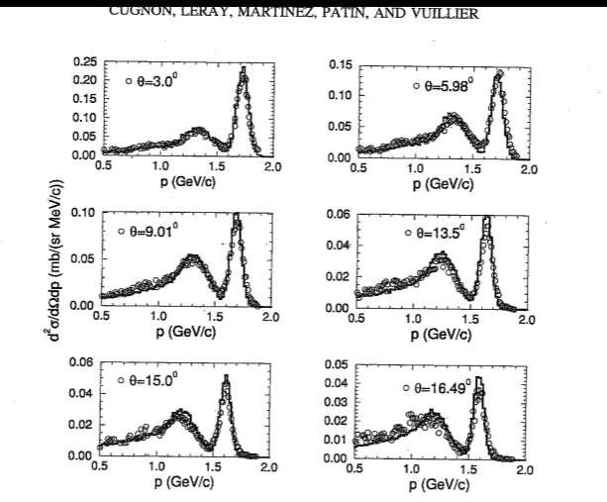
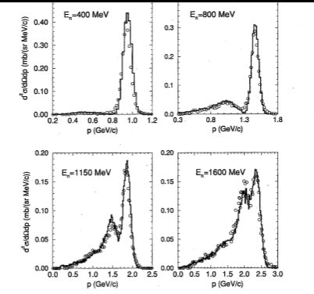
NN→NΔ cross sections
From np→pX experiments
(Lab. Nat. Saturne exp.)
J. Cugnon, S. Leray et al Phys. Rev. C56 (1997) 2431

Slide 13
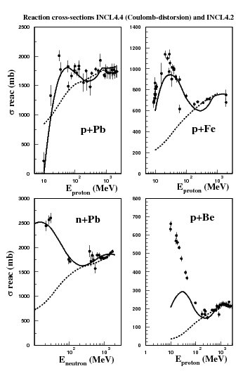
Flash of present INCL capabilities
(With the SAME version pointing out the importance of specific improvements)
Reaction cross section realistic
below 100 MeV
NN interaction at low energy
and coulomb deviation
Dashed INCL4.2 Must be renormalized!
Full line INCL4.5 Realistic
A.Boudard, J.Cugnon Workshop on Model Codes
for Spallation, IAEA Trieste 2008

Slide 14
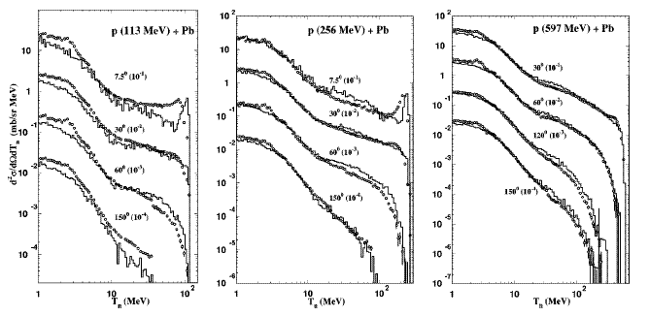
INCL4 + ABLA: Elementary production of neutrons
Modèle, voir:
A. Boudard et al, Phys. Rev.
C66 (2002) 44615
ABLA: Desexcitation
model GSI,
K.H. Schmidt,
J. Benlliure,
A. Kelic
W. Amian et al, Nucl. Sci. Eng 115 (1993) 1
S. Stamer et al, Phys. Rev. C47 (1993) 1647
W. Amian et al, Nucl. Sci. Eng 102 (1989) 310
p (3 GeV) + Pb
+p+Pb 3 GeV
S. Leray et al, Phys. Rev. C65 (2002) 044621
S. Meigo et al (KEK)

Slide 15
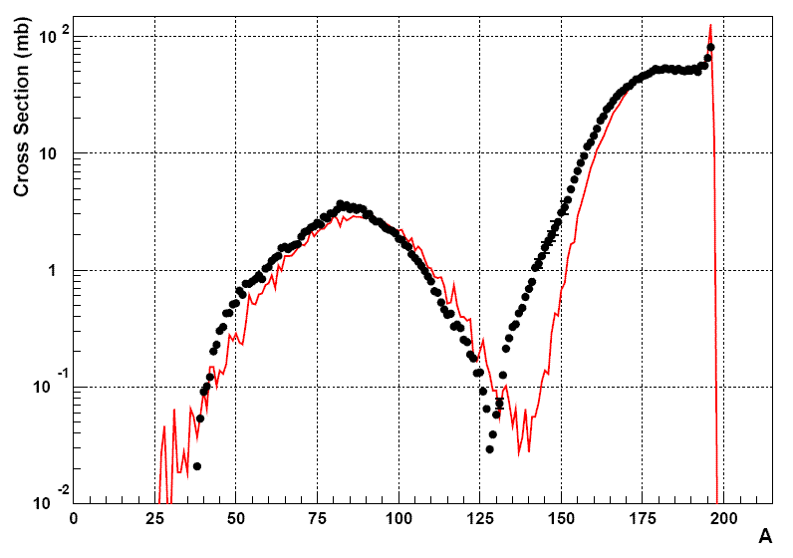
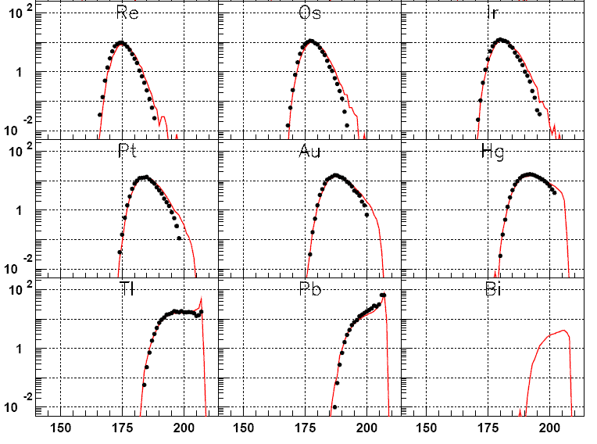
INCL4 + ABLA: Residual nucleus (GSI)
Pb (1 GeV/A) + p
Au (800 MeV/A) + p
Pb (500 MeV/A) + p
F. Rejmund et al,Nucl. Phys. A683 (2001) 540
L. Audouin et al, Nucl. Phys. A768 (2006) 1
B. Fernandez et al, Nucl. Phys. A 747 (2005) 227
Même caractéristique avec GEM
Realistic Wood-Saxon densities correlated with Fermi distribution

Slide 16
INCL4+ABLA: Residual Nucleus production
(from irradiation exp., after radioactive decays)
p (up to 2.6 GeV) + Pb -> Residuals
Problems in fission of light nuclei?
(blue curve is Bertini-Dresner)
M. Gloris et al, NIM A463 (2001) 593; Michel et al, Nucl. Sci. Tech. Supp 2 (2002) 242

Slide 17
Recoil velocities and energies
p (1 GeV) + Pb → Residu(A,Z)
INCL4 + ABLA
INCL4 + ABLA
208 198 188 178 A
208 198 188 178 A
INCL4 + ABLA
198 188 178 168 158 148 138
A
Data GSI: T. Enquist-W. Wlaslo et al.
Notes:
Average value and variance of the longitudinal velocity function of the mass loss.

Slide 18
INCL4.5: Pion production improved
p (730 MeV) + Pb -> π+ (or π-)
T. Aoust, J. Cugnon, Phys. Rev. C74 (2006) 064607
π+
V_{π}(t_{π},(N-Z)/A) introduced
Dashed: WITH Vπ (New)
Continuous: WITHOUT (Old)
π production significantly better
(also π induced reactions)
π-
π+
π-
D. Cochran et al, Phys. Rev. D6 (1972) 292

Slide 19
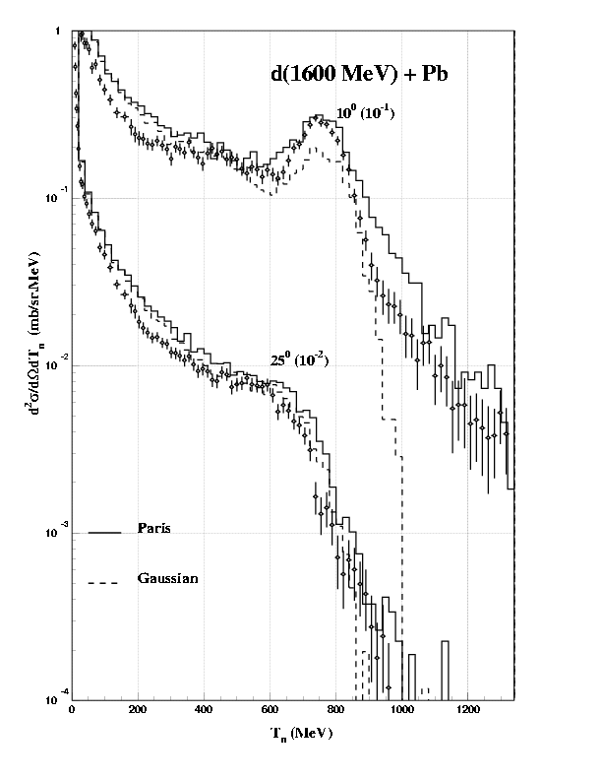
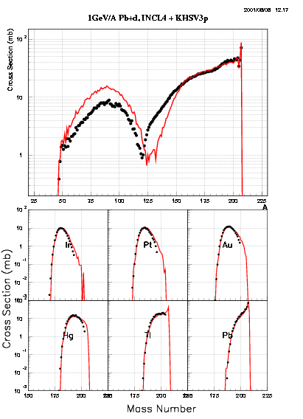
INCL4+ABLA: Composite projectiles (n cross sections)
(d beam already in)
Potentiality of extensions:
C12 beam
Y. Iwata et al., Phys. Rev. C64 (2001) 54609
Extension for fun: C12 as 12 nucleons in
realistic r-space and p-space distrib. + binding energy.

Slide 20
Light charged particle prediction with INCL4.5-ABLA07
p (1.2 GeV) +Ta
p (62 MeV) +Fe
C.M. Herbach et al. Nucl. Phys. A765 (2006) 426
F.E. Bertrand, R.W. Pelle Phys. Rev. C8 (1973) 1045
Cluster formation by coalescence (r,p) at the nucleus surface

Slide 21
Tritium production
ABLA07: New Desexcitation
model GSI (2007)
K.H. Schmidt, A. Kelic
ABLA07 now produces t and ³He
Cluster emission during the INC stage very important for t (NIMB 268 (2010) 581)
INCL4.5-ABLA07 gives a very good agreement with data all over the energy range, generally better than other models in MCNPX

Slide 22
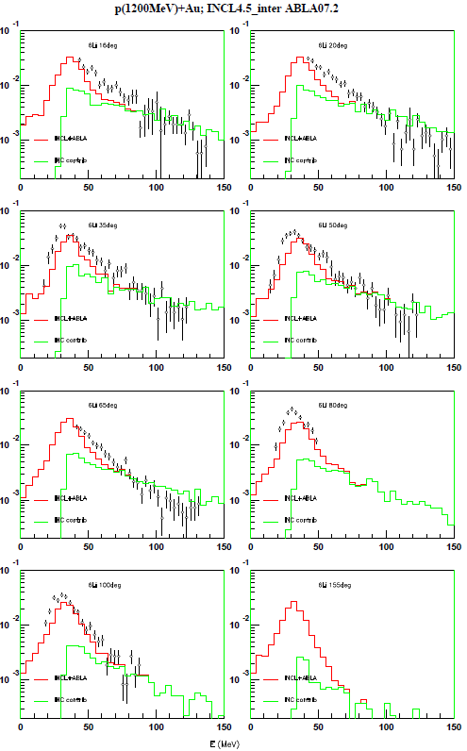
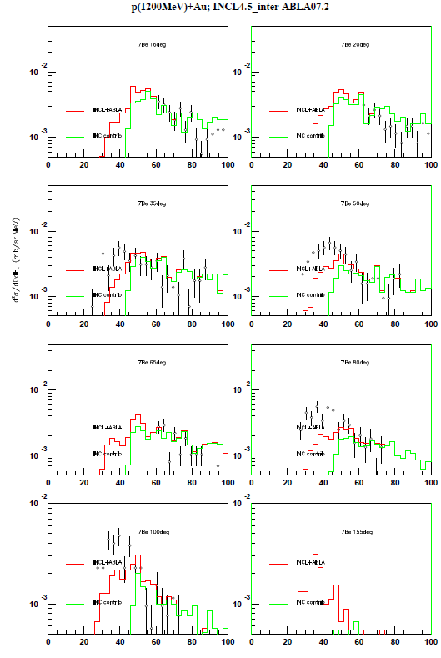
Emission of intermediate mass fragments
p+Au 1200 MeV
Total
INCL4
⁶Li
⁷Be
Data: Budzanowski et al., PRC 78, 024603 (2008)

Slide 23
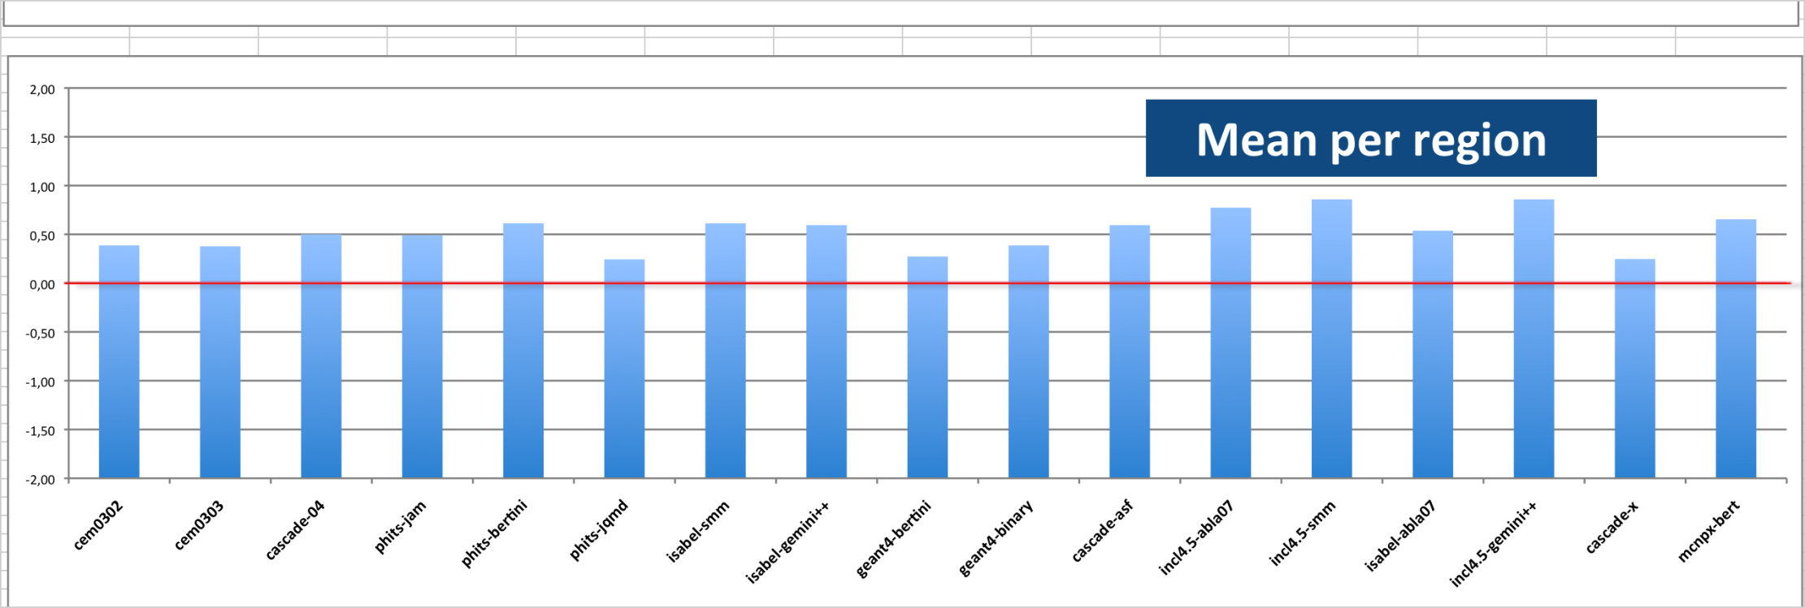
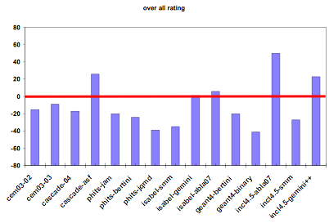
IAEA Intercomparison Vienna 2009
Neutron production
p(~40Mev-2.6GeV)
Targets: Fe and Pb
~12 cascades
~7 deexcitations
INCL4.5
Residus
(from J.C. David presentation)

Slide 24
INCL at threshold!
(Last improvement
unpublished)
α+Bi209→x.n+At
(Also right reaction cross-section at higher energy 100-200 MeV)
Coulomb deviation of 4He
Off-shell nucleons in 4He treated → Projectile spectators - Compound nucleus
Q-values from mass tables

Slide 25
INCL: Concluding Remarks
A broad range of physics studied (~100 MeV ~2GeV)
Heavy-Ion collisions, N-A, π-A, anti-p A….
More than 70 papers by J.Cugnon based on Monte-Carlo
More than 2200 quotations to them!
Evolution-improvements of the code 1980 → 2010…and more!
Nuclear potentials, Interactions, Coulomb distortions,
cluster emission, low energy…
Two complementary path
A lab for testing standard effects realistically treated
No (or minimal) adjusted parameters → prediction capability
Coupling with various deexcitation models (evaporation, fission, multifragmentation…)
Precise event generator for transport codes (MCNPX, GEANT4, PHITS…)
Ambitious at the beginning, a winning bet! (50 run of Ca-Ca in 1980, now ~106)
Applied physics (spallation source, medicine, radioprotection, irradiated materials…)
Exciting capabilities for the future (already going on)
High energy, multi pions, K-physics (Sophie Pedoux)
Back to heavy ion interactions (Davide Mancusi)
Specific target densities (n-p differentiate, core + major shell etc.)
Notes:
Potential introduced, more recently energy and isospin dependent, pi potential…

Slide 26
Thank you JOSEPH!
For this marvelous tool
For your smooth human contact
For the richness of your extensive culture
Alain Boudard, Spa 2011

Slide 27
INCL4.5: Cluster (A,Z) emission (A< 8…12)
h
π(A)
Criteria of coalescence:
ρ(r)
Leading nucleon
Δr.Δp < π(A)
(5 parameters)
R0
r
E
E*(A,Z)
Minimized quantity
(per nucleon)
Selection among clusters:
{√S – A*Mn –Binding(A,Z)} /A
0
Binding(A,Z)
Radial emission:
θ
P cluster(A,Z)
θ < 45°
(1 parameter)
Coulomb barrier at R0+r.m.s.(A,Z)
Coulomb asymptotic deviation
Target nucleus

