Slide 1
Lyon Tier-1 infrastructure & services : status and issues

Slide 2
Contents
Human resources status
New T1 representative
Manpower turnover
Infrastructure status
Local network
Storage
Issues
Concerns and perspectives
Conclusions
Questions & Comments

Slide 3
Human resources status

Slide 4
Human resources status
New T1 representative
Good connection with the LCG France technical manager (Frédérique)
Even though a 100 GB/s connection could not compete against connection between Fabio’s cerebral hemispheres
Must still improve communication from T1 representative to Technical Manager
Big progresses in understanding experiments’ computing/operating models
Thanks to problems to be dealt with
Thanks to experiment people
Big progresses in understanding T1 infrastructure
Thanks to problems to be dealt with
Thanks to CCIN2P3 experts
Mostly storage system/usage
Not yet available enough for LCG duties
French NGI involvement
Grid deployment tasks

Slide 5
Human resources status
(Grid) Manpower turnover
Dcache administrators
Entire team renewed in about one year
Smooth know-how transmission was operated
Grid administrators
Most of the team renewed in one year
CEs, WNs, UIs, VO Boxes, LFC
know-how transmission still to be operated
VO supporters
3 persons will leave soon (for very good reasons)
ATLAS, CMS, and LHCB
Is that a concern ?
Different reason for each case
Probably inevitable in a project mode
Must live with and adapt to

Slide 6
Infrastructure status

Slide 7
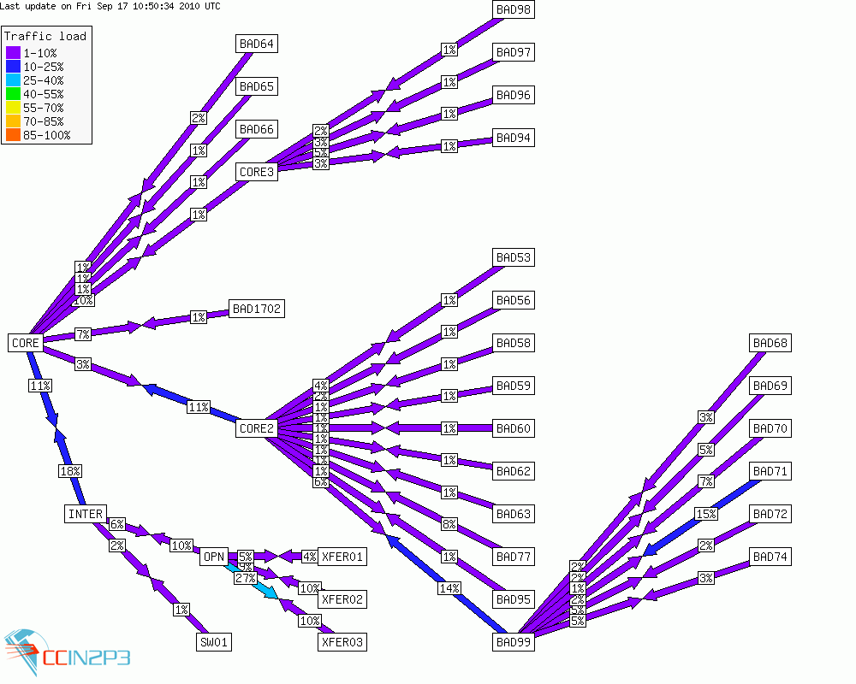
Local network Before sept. downtime
In august, network saturations were observed with Dcache, Xrootd, etc. We were about to reach the limits of this topology.
40Gb/s
80Gb/s

Slide 8
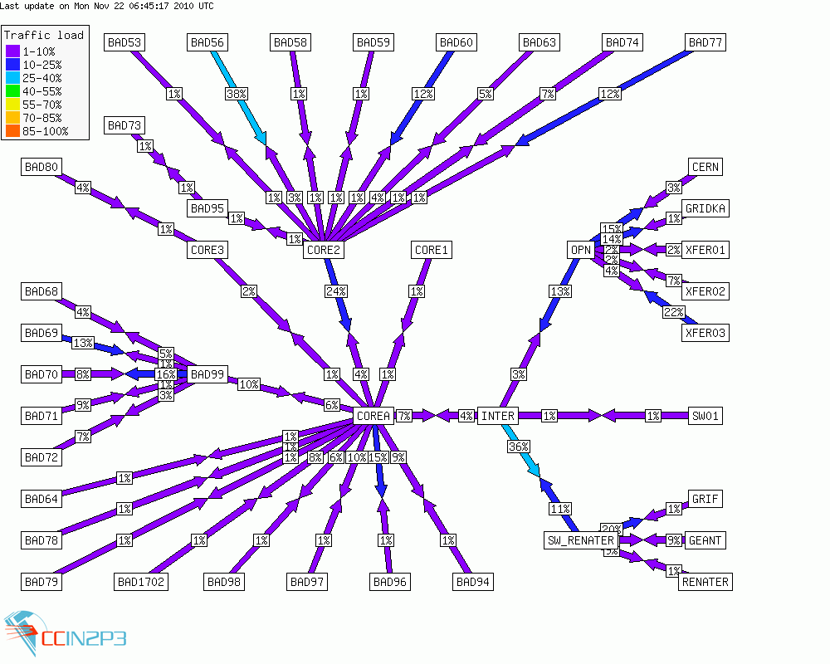
Local network After sept. downtime
A big router/switch (200 Kg) was added to reduce the network depth, to enhance the manageability, and increase the bandwith.

Slide 9
Storage / Dcache
Dcache disk includes all tiers disks. No easy way to distinguish a tier from each other.
2464TB
1209TB
728TB
Dcache disk for ALICE was decommissionned in september to be put in xrootd instead.

Slide 10
Storage / Xrootd
ALICE is now using only Xrootd
Xrootd-T1
HPSS backend
319TB of disk (SUN/Thor/Solaris)
Xrootd-T2
111TB of disk (SUN/Thor/Solaris)
ALICE authentication plugin not anymore supported on Solaris
No migration to Linux planned at short terms for our storage
Require a discussion with ALICE to go ahead

Slide 11
Issues

Slide 12
Problems solved since june
Transfer between CCIN2P3 and BNL
Low rate (4MB/s) for file transfer
Problem between Solaris and Linux
Put in evidence by introducing Linux GridFTP in Dcache
Solved by changing TCP configuration on Solaris
Local LFC instabilities solved by load-lbalancing several LFC servers
SL5 WN crashes due to I/O problem
Various tuning steps to get something satisfactory enough
Local network saturation

Slide 13
SW Area problems
Overload with Atlas SW area solved by RO AFS volume replications long time ago
But release installation requires some CC-specific adaptations to be achieved
Makes it not grid-aware anymore
Works better but human intervention still needed sometimes
LHCB SW Area
Installation jobs failed since august
We install manually missing LHCB modules on demand
Latencies in AFS read access can lead to 7% of failures
Due to a timeout (600s) in job setup (CMT)
No overload observed on AFS server
AFS client is suspected and different tunings are tested at the time being
ALAS suffered the same problem with their last release which introduced also a timeout on job setup (CMT)
Bypassed by deploying a new version with a longer timeout (6000s)
That might also explained low CMS job efficiency

Slide 14
ATLAS problems with Dcache
September downtime: security alert + many upgrades/updates at same time: network, solaris, dcache, etc.
Very chaotic Dcache restarting
3 disk servers with precious data were not working properly
Need to be reinstalled after long investigations
Data had to be migrated
Huge amount of files kept blocked in import buffer because of a unexplained dcache service crash
Released them took a long time because of a bug with a dcache command
Low throughputs on export pools were observed and unexplained during many days
The problem disappeared and came back later
Many other problems occurred during october reprocessing

Slide 15
ATLAS problems with Dcache
ATLAS very unhappy during the reprocessing
Is Dcache guilty or victim ?
But CMS seems happy

Slide 16
Concerns and perspectives

Slide 17
Problem solving vs operations
We are facing problems from both computing and storage sides
Each problem
is particularly tricky and time consuming
monopolizes CCIN2P3 staff in a transversal way
From VO support to system administrator
In the meantime, we must still operate the T1, even in a degraded mode
Be able to regulate the different activities to keep alive the T1
Communicate with the experiments
To define together with them the priorities in order to use in the best way our available resources
To provide them a clear status of the site
We must organize ourself better
To evacuate asap problem solving from operations
To gather together the required experts to start solving the problem
Creating a dedicated working group, as done with LHCB problem, seems a good way

Slide 18
Monitoring/Communication
There are evidences we miss well-adapted monitoring tools
To understand the load put by a VO, a VO activity, etc.
To speed-up problem detection and diagnostic
Too many human exchanges needed between VO supporters and service experts

Slide 19
Resources/Services sharing
We must check that Resources/Services sharing scales with
T1, T2 and T3 simultaneous activities
4 VOs using the same services at same time
Some configuration should be checked
CCIN2P3 is based on mutualization model
Manpower is sized for
Cannot provide dedicated infrastructure by VO

Slide 20
Conclusions
A staff turnover to deal with
Seems we are good trainers
Problems we must learn to live with
Separate problem solving from operations
Staff worked hard without complaining (too much)
Reconsider our resources/services sharing configuration
To be sure that experiment won’t impact the others
To check we’ll fill the future fullfilments

Slide 21
Questions & Comments
?

Slide 22
Backup slides

Slide 23
Computing trend

Slide 24
Storage service
Storage chain composed of 3 main components
dCache: disk-based system exposing gridified interfaces
One instance serving the 4 LHC experiments
HPSS: tape-based mass storage system, used as permanent storage back-end for dCache
One instance for all the experiments served by CCIN2P3
TReqS: mediator between dCache and HPSS for scheduling access to tapes, for optimization purposes
To minimize tape mounts/dismounts and to optimize the sequence of files read within a single tape

