Slide 1
LCG-France Tier-1 and Analysis Facility Overview
Fabio Hernandez
IN2P3/CNRS Computing Centre - Lyon
fabio@in2p3.fr
CMS Tier-1 tour
Lyon, November 30th 2007

Slide 2
Contents
Introduction to LCG-France
Introduction to CC-IN2P3
Resources for LHC experiments with focus on CMS
budget, plan and pledges
contribution
Current and future work
Conclusions
Questions

Slide 3
LCG-France project
Goals
Setup, develop and maintain a LCG Tier-1 and an Analysis Facility at CC-IN2P3
Promote the creation of Tier-2/Tier-3 french sites and coordinate their integration into the WLCG collaboration
Funding
national funding for Tier-1 and AF
Tier-2s and tier-3s are funded by universities, local/regional governments, hosting laboratories, …
Organization
Started in June 2004
Scientific and technical leaders appointed for a 4-year term, management board (executive) and overview boards in place since then
Leverage on EGEE operations organization
Co-location of the tier-1 and the EGEE regional operations centre
More information
Project web site: http://lcg.in2p3.fr
Project charter: https://edms.in2p3.fr/document/I-003682

Slide 4
LCG-France: sites
Tier-2: GRIF
CEA/DAPNIA
LAL
LLR
LPNHE
IPNO
Tier-3: IPHC
Strasbourg
Ile de France
Tier-3: IPNL
Nantes
Tier-2: Subatech
Tier-3: LAPP
Clermont-Ferrand
Tier-2: LPC
Annecy
Lyon
Tier-1: CC-IN2P3
AF: CC-IN2P3
Marseille
Tier-3: CPPM

Slide 5
Introduction to CC-IN2P3
Data repository and processing facility shared by several experiments
Operates a WLCG tier-1, a tier-2 and an Analysis Facility for the 4 LHC experiments
The main compute farm used by both grid and local users
Grid middleware is "just another" interface for using our services
Data storage infrastructure (disk and mass storage) accessible to all jobs running in the site
Although not all storage spaces have a gridified interface

Slide 6
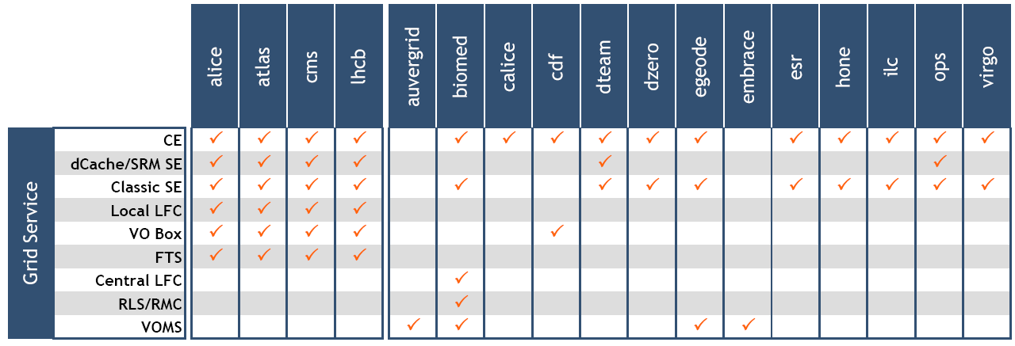
Introduction to CC-IN2P3 (cont.)
Also operating grid services for non-LHC VOs

Slide 7
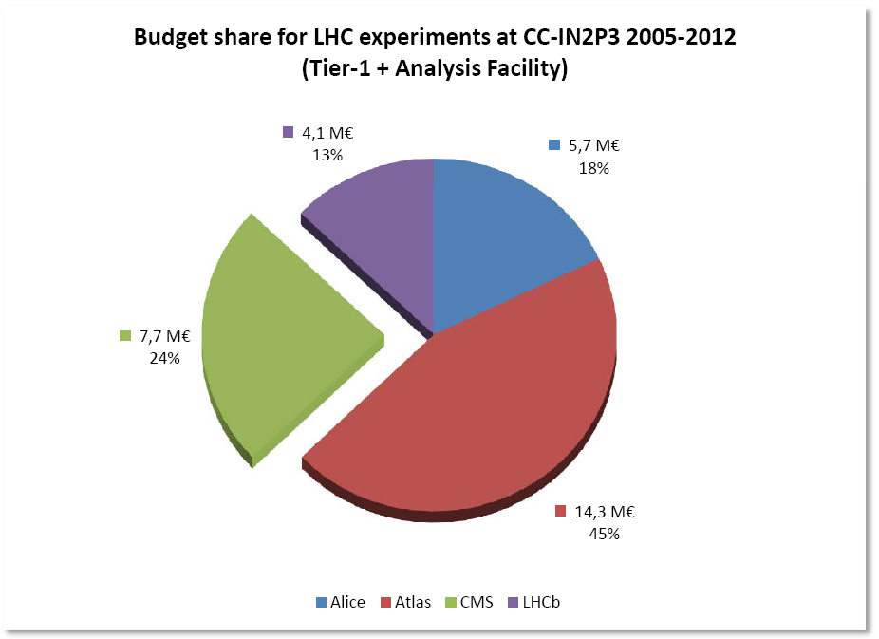
Budget: all LHC Experiments
Equipment and running costs for all LHC experiments at CC-IN2P3 (2005-2012)
Total required: 31,9 M€
the refurbishment of current machine room and the construction of a second one are NOT included
Budget requested on a pluriannual basis
Approval on a yearly basis
Impact on hardware procurement process

Slide 8
Budget: CMS
Equipment and running costs for CMS needs (2005-2012)
7,7 M€

Slide 9
Planned resource deployment

Slide 10
Planned resource deployment: CMS
A fraction of those resources are not pledged

Slide 11
Planned vs. Actual Contribution
Source: http://lcg.web.cern.ch/LCG/MB/accounting/accounting_summaries.pdf

Slide 12
Resources: CPU
Pledged CPU capacity equivalent to 588 job slots

Slide 13
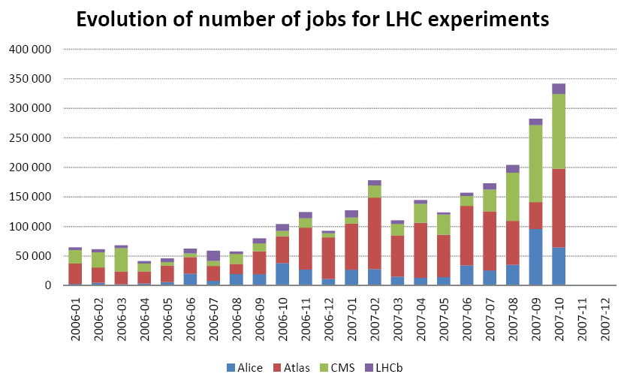
Resources: CPU
Daily throughput for CMS:
4000 jobs
Total throughput of the site:
28000 jobs/day

Slide 14
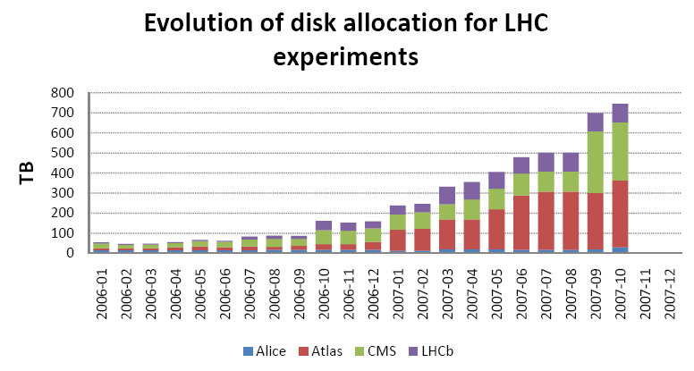
Resources: disk
Allocation: 292 TB
(pledged: 237 TB)
Total allocation (all supported experiments) : 1.2 PB

Slide 15
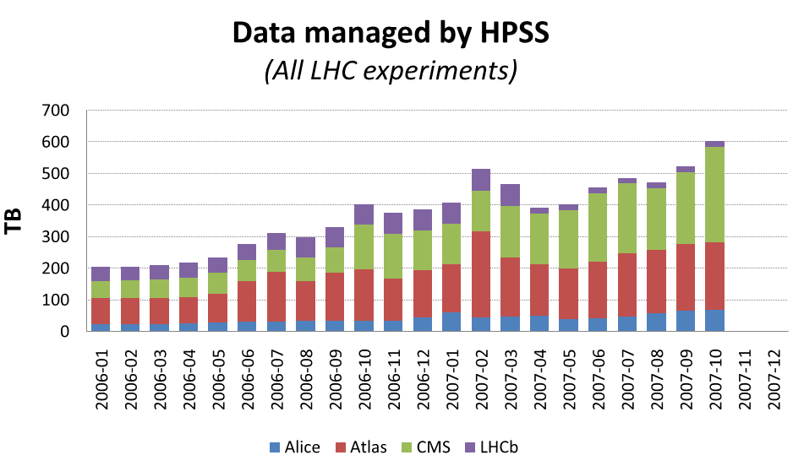
Resources: MSS
Utilization by CMS: 304 TB
(pledged: 292 TB)
Total amount of data managed by HPSS: 2.7 PB

Slide 16
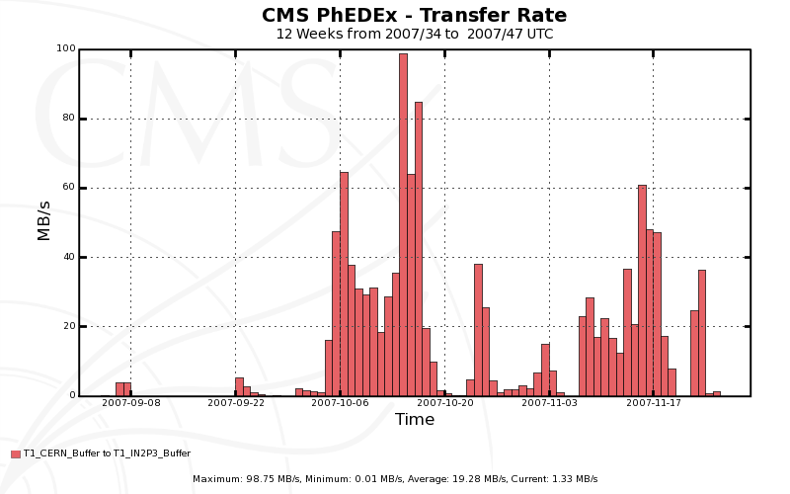
Data transfer: CERN→CCIN2P3
CERN → CCIN2P3 target rate for CMS:
32 MB/sec

Slide 17
WAN bandwidth requirements
The number of CMS sites we have to exchage data (and solve problems) with is worrying!!!
Source: Megatable http://lcg.web.cern.ch/LCG/documents/Megatable240107.xls

Slide 18
Procurement
We have to satisfy several constraints
Formal process is long
Call for tenders at the European level
Budget is approved on a yearly basis
« Final word » during last quarter each year
Limited machine room space available
Extensive in-situ tests to realistically identify the real characteristics of candidate hardware (when possible)
Optimize (computing power/m²) but also (computing power/€)
Forecast of running costs performed at this stage
Desired availability of computing equipment in operation by experiments
Delays in the deliveries of equipment

Slide 19
Procurement (cont.)
Starting in 2007, we modified our procurement plan for LHC experiments
With budget for year N, purchase at least 40% of the required equipment for year N+1
Procurement process for remaining fraction triggered as soon as next year budget is known
Our experience with this model for this year's procurement makes us confident that we will be in good shape to provide a significant amount of the pledged capacity by April 1st each year

Slide 20
2007: Capacity Increase
Compute nodes
479 worker nodes
DELL Intel Xeon 5345 @ 2.33 GHz, 8 cores, 2 CPUs, 16 GB RAM, 160 GB disk
6.2 MSI2000
New bid ongoing
Expected ~400 equivalent machines
Disk servers
1.2 PB
Sun X4500 (Thumpers)
Order placed for additional 0.6 PB
Mass storage
Cartridges for populating the SUN/STK SL8500 library
Both STK T10.000 and LTO4
Increase of the cartridge storage capacity: 2 PB

Slide 21
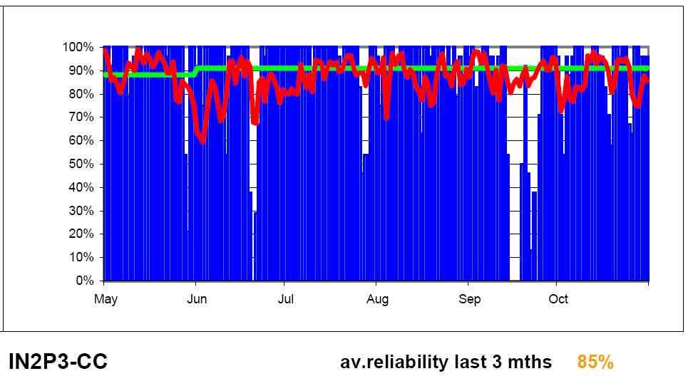
Site Availability
Site availability daily score: May – October 2007
Sources: http://lcg.web.cern.ch/LCG/MB/availability/site_reliability.pdf
Below the target

Slide 22
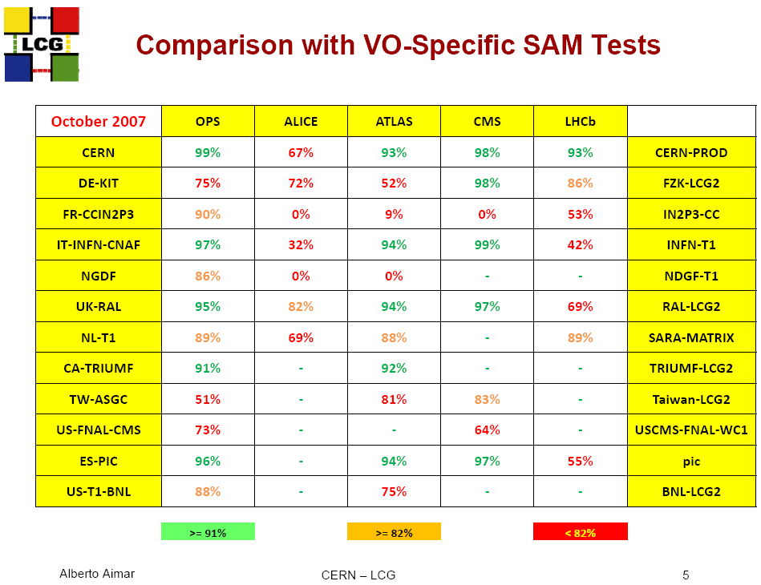
VO-specific tests
We need to understand why our site is not perceived available by CMS, in spite of the number of jobs and data being constantly transfered to and from the site
Source: Alberto Aimar, Management Board meeting, 20th Nov. 2007, :http://indico.cern.ch/conferenceDisplay.py?confId=22187

Slide 23
Current work
Top priority: stability!!!
Continue the integration of the grid services to the standard operations
Including on-call service
Monitoring & alerting, progressively documenting procedures, identifying roles and levels of service, etc.
Strong interaction with people developing the grid operations portal (CIC)
Consolidation of the services
Deploy for availability
Hardware redundancy
Usage of (real or virtual) stand-by machines
Including VO Boxes
Assigning job priorities based on VOMS roles & groups
Interim solution in place

Slide 24
Current work (cont.)
Continous development of BQS
for coping with the expected load in the years ahead
for making it more grid-aware
Keep grid attributes in the job records
Submitter identity, grid name, VO name, etc.
Scheduling based on grid-related attributes
VOMS roles/groups, grid identity, etc.
Allow/deny job execution based on grid identity
Development of gLiteCE and CREAM compatible BQS-backed computing element

Slide 25
Current work (cont.)
Storage services
Consolidating the AFS service
Continuous work for internal reconfiguration of HPSS according to the (known) needs of LHC experiments
Planned upgrade of the hardware for the core machines of dCache/SRM
Trying to understand how the data will be accessed
What are the required rates for data transfers between MSS→disk→worker nodes and backwards…
..for each one of the several kind of job (reconstruction, simulation, analysis, …)
Job profiling
Studying the observed usage of memory and CPU time for LHC jobs
Memory requirements have a significant impact on budget and on the capacity of our site to efficiently exploit the purchased hardware
Understanding how to build an Analysis Facility

Slide 26
Facility Upgrade
Last July, a major effort for upgrading the electric and cooling infrastructure of the site was finished
From 500 kW to 1000 kW of electrical power usable for computing equipment
+600 kW for cooling
Improvements include
New diesel generator (880 kW, 72h autonomy)
2 additional UPS (500 kW each)
Significant improvement of electrical distribution
1 additional liquid cooler, pipe network for cool water, 7 additional chilled water units (for the machine room and for the UPS)
Budget: more than 1,5 M€
2+ years-long project
People have done (almost heroic) efforts to maintain the site in (near normal) operating conditions

Slide 27
New building
Courtesy of Dominique Boutigny

Slide 28
New building (cont.)
On-going project for building an additional machine room
800 m² floor space
Electric power for computing equipment: 1 MW at the beginning, with capacity for increasing up to 2,5 MW
Offices: for around 30 additional people
Meeting rooms, 140+ seats amphitheatre
Encouraging signals recently received regarding funding, but the second machine room won’t be available before 2010 as needed
Currently evaluating temporary solutions (offsite hosting of the equipment, shorten renewal intervals by leasing the hardware, use of modular transportable machine rooms to be installed in the parking lot)

Slide 29
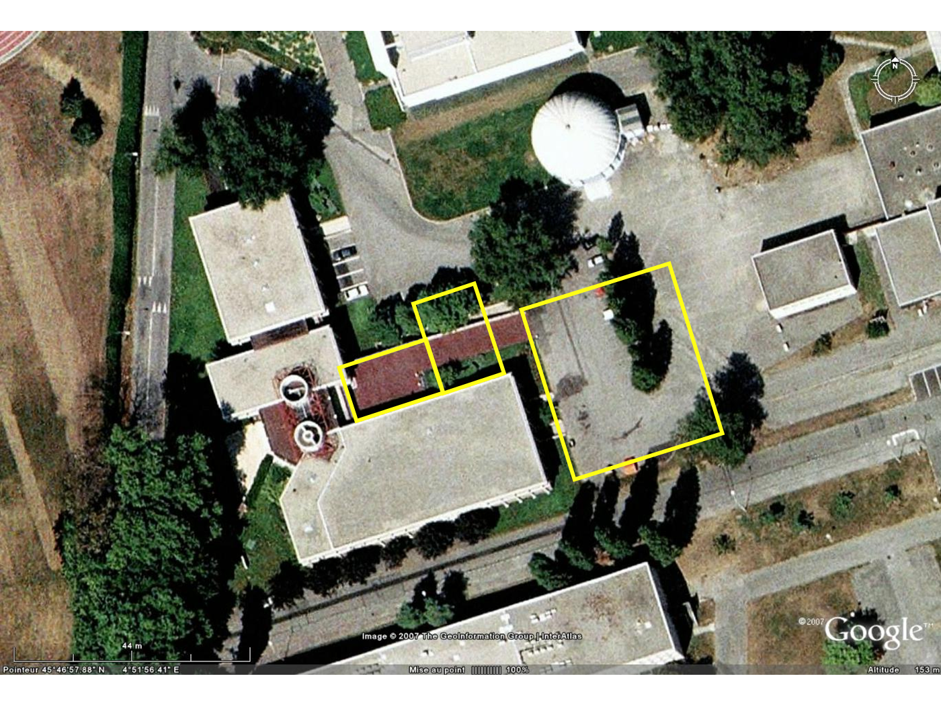
New building (cont.)
Courtesy of Dominique Boutigny

Slide 30
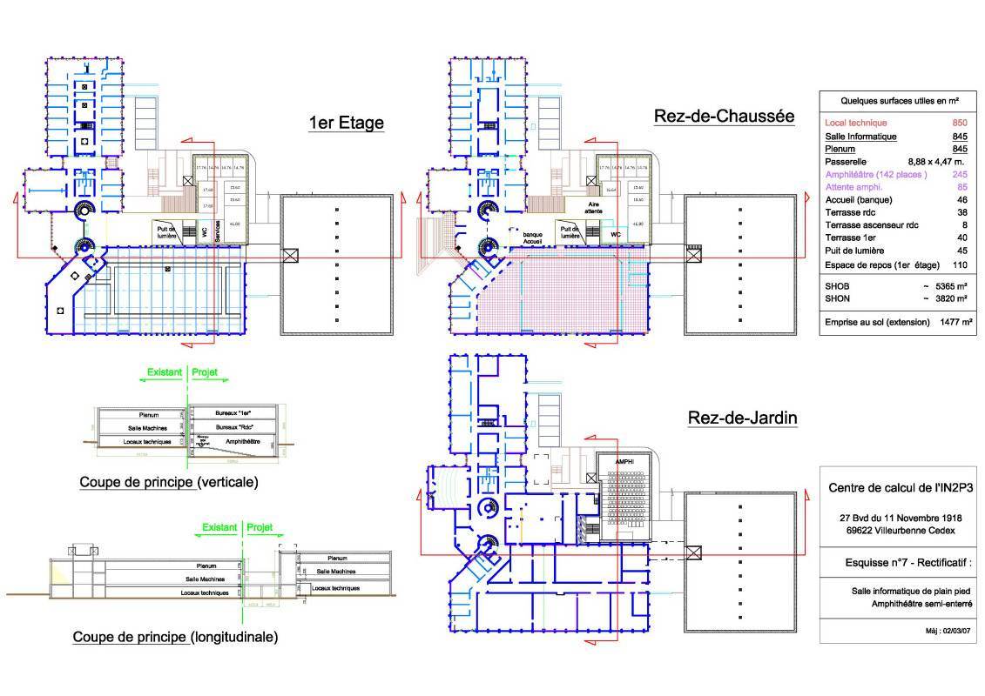

Slide 31
What’s next today
In the coming presentations you will find the detailed status and plans of the
Storage infrastructure and data transfers
Grid services
Site operations
Network infrastructure

Slide 32
Questions
?

Slide 33
Fabien Wernli, 2006

