Slide 1
Electron Reconstruction through OpEmuRec
Collaboration meeting 22/09/10
Florian Brunet

Slide 2
MC production
Reconstruction tool : OpEmuRec – Fedra
Outlook

Slide 3
MC production
Beamfiles from ccali (Lyon)
MC Production through OpRelease 3.2 software
  OpSim
  OpDigit : no microtrack efficiency, no disalignment between plates
  OpEmuIO : no scanning efficiency
Statistics : electron 1000 events

Slide 4
Reconstruction tool
OpEmuRec :
  Fedra linking
  Fedra alignment : not necessary but useful for software robustness
  Fedra tracking : nsegmin=2, ngap=3
  Fedra Vertexing : ProbMin=0.0001,dz=3000μm, IPmax=100μm
  Fedra showering : nplatemin=4, ngap=3, cone 0.020 mrd & 800 μm

Slide 5
Em Shower reconstruction algorithm
For each BT candidate, we look for any other corresponding BT according angular and spatial criteria :
  BT downstream wrt BT candidate
  δr < 150μm , δr = r(BT) – r(BT_{cand}) = distance in transverse plane
  δθ < 150 mrad, δθ_{3D} = θ_{3D}(BT) – θ_{3D}(BT_{cand})
  BT is inside a cone defined wrt BT candidate
  Showers propagate through at least 4 plates

Slide 6
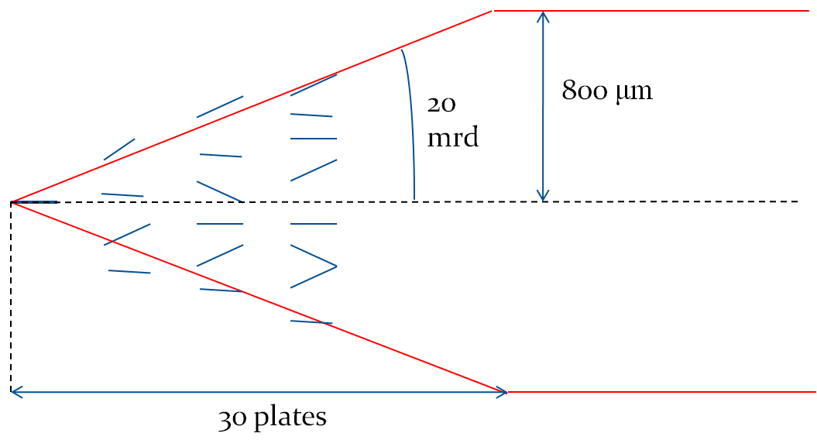

Slide 7
Simulation parameters
1000 electrons
10 GeV Energy
Interaction point : 1st plate in the middle of the brick
Propagation through the whole brick : 57 plates
No incident angle

Slide 8
Reconstruction & analysis parameters
We use as defaut setting a cone with radius of 800μm and then 1200μm.
All reconstructed showers wrt the most energetic shower per event and the shower which contains the largest amount of BT

Slide 9
Cone radius 800μm & 1200μm for all showers

Slide 10
Cone radius 800μm & 1200μm for all showers

Slide 11
Cone radius 800μm & 1200μm for the most energetic showers

Slide 12
Cone radius 800μm & 1200μm for the most energetic showers

Slide 13
Cone radius 800μm & 1200μm for the maximum BT number showers

Slide 14
Cone radius 800μm & 1200μm for the maximum BT number showers

Slide 15
All showers & selected showers wrt energy & number of BT

Slide 16
All showers & selected showers wrt energy & number of BT

