Slide 1
Signal Integrity

Slide 2
Modèles Quartus
IBIS
Fichier .ibs -> [IBIS Ver] 3.2
HSPICE
Modèles cryptés pour synopsys
Netliste hspice pour chaque I/O
Notes:
I/O Buffer Information Specification – Version 5.0
http://www.eda.org/ibis/

Slide 3
Systèmes et versions
WINDOWS XP 64 Bit
Core 2 Duo E8400 3G – 8 G de RAM (Optiplex 960)
SPB16.3
Hspui D-2010.03
Quartus II 64-Bit 9.1 SP2

Slide 4
Les outils
SYNOPSYS
Hspice
Cscope
CADENCE
SigXplorer

Slide 5
Simulation du transceiver
pulse
Simulation du receiver
pulse
wtlineb pinb vssn loadb vssn N=1 L=1 RLGCMODEL=tlinemodel
.MODEL tlinemodel W MODELTYPE=RLGC N=1 Lo=7.13n Co=2.85p * Trace model (transmission lines)

Slide 6
Hspice
Simulation directe avec la netliste hspice
Stimuli crée par pulse
Remplacez le modèle de piste inclus dans la netliste par le modèle de piste réel
Pas de netliste pour l’ensemble transmitter, pistes, receiver (existe pour les transceivers)
Permet de valider les résultats obtenus avec un autre flot de simulation

Slide 7
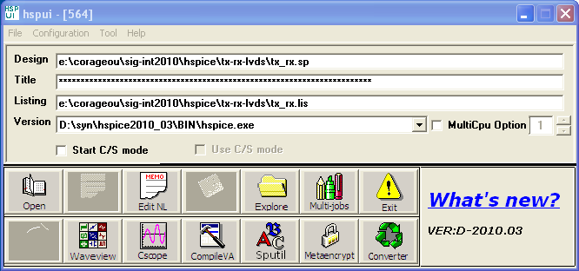
****** Circuit Statistics ******
# nodes = 11326 # elements = 14386
# resistors = 8915 # capacitors = 514 # inductors = 0
# mutual_inds = 0 # vccs = 0 # vcvs = 0
# cccs = 0 # ccvs = 0 # volt_srcs = 167
# curr_srcs = 0 # diodes = 0 # bjts = 0
# jfets = 0 # mosfets = 4790 # U elements = 0
# T elements = 0 # W elements = 6 # B elements = 0
# S elements = 0 # P elements = 0 # va device = 0
total memory used 48233 kbytes
total cpu time 85.94 seconds
total elapsed time 86.26 seconds
job started at 14:16:01 06/03/2010
job ended at 14:17:27 06/03/2010
1 mn 30 de simulation
20 Minutes de simulation pour liens optiques (KIT Altera)

Slide 8
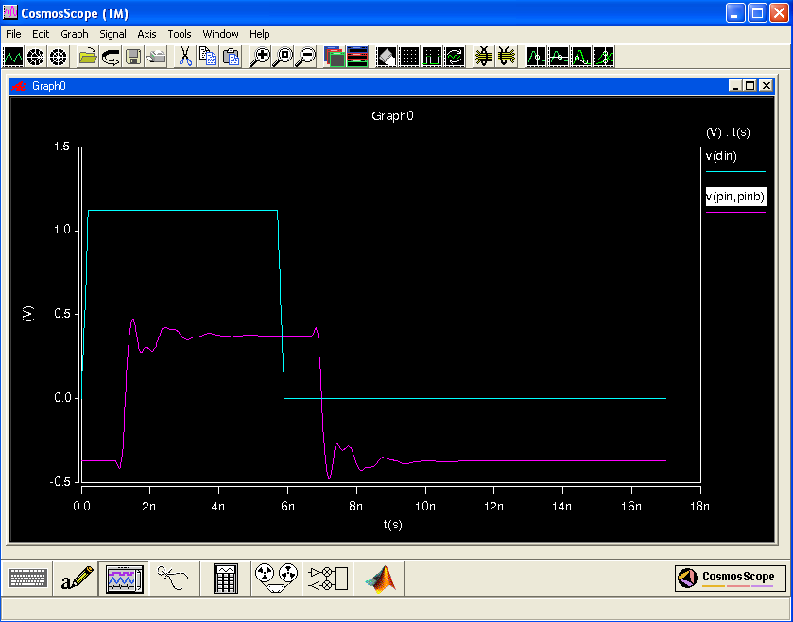
Pistes « bidons »

Slide 9
SigXplorer
Device Modeling Language .dml
Translation IBIS -> DML
Interconnect Description Language .idl
ESPICE spice de cadence (tlsim)
Interface avec HSPICE

Slide 10
SigXplorer
Stimuli crée par l’utilisateur avec l’interface graphique
Modèles des pistes héritées d’allegro
Simplicité d’emploi avec les modèles IBIS
Prise en charge du simulateur hspice
A la condition d’avoir les modèles sous forme de .subckt

Slide 11
.sp
Netliste hspice
Process Settings
Simulation Options
Instantiate I/O Buffer
Simulation Analysis Setup
.subckt
include -> Options du simulateur
Instantiate Power Supplies -> En double dans tx et rx

Slide 12
Modèles sous forme de .subckt
Validation modèle avec hspice
Convertion hspice en .dml avec translate spb163
Edition du fichier options hspice
Composant.dml -> DiffPair
Simulation avec sigXplorer

Slide 13
Sortie LVDS sous forme de .subckt
* Buffer lvds
.subckt ep2sgx_out din pin pinb
************************************************************************
* IO Buffer Netlist
************************************************************************
*.include 'cir/lvds_output.inc'
*.include 'cir/hio_buffer_load.inc'
************************************************************************
* Constant Definition
************************************************************************
vlvdsoe rlvdsoe 0 vc * Set to vc to enable buffer output
vrldt rldt 0 0 * 0 for LVDS, vc for HyperTransport
*vdin din 0 pulse(0 vc 0s 0.2ns 0.2ns 8.5ns 17.4ns)
* Supply Voltages Settings
.param vcn=2.325
.param vpd=2.92
.param vc=1.12
* Instantiate Power Supplies
vvcc vcc 0 vc * FPGA core voltage
vvss vss 0 0 * FPGA core ground
vvccn vccn 0 vcn * IO supply voltage
vvssn vssn 0 0 * IO ground
vvccpd vccpd 0 vpd * Pre-drive supply voltage

Slide 14
************************************************************************
* IO Buffer Netlist
************************************************************************
* Instantiate I/O Buffer
xlvds_buf din die dieb rldt rlvdsoe vccn vcpad0 vcpad1 lvds_out
* Internal Loading on Pad
* - These pads also have single-ended buffers connected to them. These
* buffers are disabled but add parasitic loads that are modeled below:
xhio_load die vccn vccpd vcpad0 hio_load
xhio_loadb dieb vccn vccpd vcpad1 hio_load
* I/O Buffer Package Model
* - Standard Stratix II GX package model
* Positive end
*.include 'lib/siigx_package_model.sp'
Wpkg die 0 pin 0 N=1 L=0.01 RLGCMODEL=GX_Pkg_model
* Negative end
Wpkgb dieb 0 pinb 0 N=1 L=0.01 RLGCMODEL=GX_Pkg_model
.ends ep2sgx_out

Slide 15
************************************************************************
* Quartus HSPICE Writer I/O Simulation Deck
*
* This spice simulation deck was automatically generated by Quartus for
* the following IO settings:
*
* Device: EP2SGX90FF1508C3
* Speed Grade: C3
* Pins: AD33 (dataout1)
* AE33 (dataout1(n))
* Bank: IO Bank 1 (Row I/O)
* I/O Standard: LVDS
* OCT: Off
************************************************************************
* Process Settings
************************************************************************
.options brief
.inc 'lib/sii_tt.inc' * TT process corner
************************************************************************
* Simulation Options
************************************************************************
.options brief=0
.options badchr co=132 scale=1e-6 acct ingold=2 nomod dv=1.0
+ dcstep=1 absv=1e-3 absi=1e-8 probe csdf=2 accurate=1
+ converge=1
.temp 85

Slide 16
************************************************************************
* Constant Definition
************************************************************************
vlvdsoe rlvdsoe 0 vc * Set to vc to enable buffer output
vrldt rldt 0 0 * 0 for LVDS, vc for HyperTransport
vdin din 0 pulse(0 vc 0s 0.2ns 0.2ns 8.5ns 17.4ns)
************************************************************************
* IO Buffer Netlist
************************************************************************
.include 'cir/lvds_output.inc'
.include 'cir/hio_buffer_load.inc'
************************************************************************
* I/O Buffer Instantiation
************************************************************************
* Supply Voltages Settings
.param vcn=2.325
.param vpd=2.92
.param vc=1.12
* Instantiate Power Supplies
vvcc vcc 0 vc * FPGA core voltage
vvss vss 0 0 * FPGA core ground
vvccn vccn 0 vcn * IO supply voltage
vvssn vssn 0 0 * IO ground
vvccpd vccpd 0 vpd * Pre-drive supply voltage

Slide 17
* Instantiate I/O Buffer
xlvds_buf din die dieb rldt rlvdsoe vccn vcpad0 vcpad1 lvds_out
* Internal Loading on Pad
* - These pads also have single-ended buffers connected to them. These
* buffers are disabled but add parasitic loads that are modeled below:
xhio_load die vccn vccpd vcpad0 hio_load
xhio_loadb dieb vccn vccpd vcpad1 hio_load
* I/O Buffer Package Model
* - Standard Stratix II GX package model
* Positive end
.include 'lib/siigx_package_model.sp'
Wpkg die 0 pin 0 N=1 L=0.01 RLGCMODEL=GX_Pkg_model
* Negative end
Wpkgb dieb 0 pinb 0 N=1 L=0.01 RLGCMODEL=GX_Pkg_model
* /////////////////////////////////////////////////////////////////// *
* I/O Board Trace And Termination Description *
* - Replace this with your board trace and termination description *
* /////////////////////////////////////////////////////////////////// *
* LVDS Termination
* (reference: Stratix II GX Handbook Volume 2, Selectable I/O Standards Chapter)
wtline pin vssn load vssn N=1 L=1 RLGCMODEL=tlinemodel
wtlineb pinb vssn loadb vssn N=1 L=1 RLGCMODEL=tlinemodel
.MODEL tlinemodel W MODELTYPE=RLGC N=1 Lo=7.13n Co=2.85p * Trace model (transmission lines)
rterm load loadb 100

Slide 18
************************************************************************
* Simulation Analysis Setup
************************************************************************
* Print out the voltage waveform at both the FPGA pin and far end load
.print tran v(pin) v(pinb) v(load) v(loadb)
.tran 0.020ns 17ns
* Measure the propagation delay to the load pin. This value will
* include some double counting with Quartus' Tco
.measure TRAN tpd_uncomp_rise TRIG v(din) val='vc*0.5' rise=1 TARG v(load,loadb) val='0' rise=1
.measure TRAN tpd_uncomp_fall TRIG v(din) val='vc*0.5' td=8.7ns fall=1 TARG v(load,loadb) val='0' td=8.7ns fall=1
* Use the test load driver to calculate the amount of double counting
.measure TRAN t_dblcnt_rise TRIG v(din) val='vc*0.5' rise=1 TARG v(pin_tl,pinb_tl) val='0' rise=1
.measure TRAN t_dblcnt_fall TRIG v(din) val='vc*0.5' td=8.7ns fall=1 TARG v(pin_tl,pinb_tl) val='0' td=8.7ns fall=1
* Calculate the true propagation delay by subtraction
.measure TRAN tpd_rise PARAM='tpd_uncomp_rise-t_dblcnt_rise'
.measure TRAN tpd_fall PARAM='tpd_uncomp_fall-t_dblcnt_fall'
.end

Slide 19
("ep2sgx90.dml"
(PackagedDevice
(EP2SGX90
(DiffPair
(AD33
(InversePin AE33 ) )
(AR39
(InversePin AT39 ) ) )
(IbisPinMap
(AD33
(WireNumber 102 )
(signal dataout1 )
(signal_model ep2sgx_out ) )
(AE33
(WireNumber 125 )
(signal "dataout1(n)" )
(signal_model ep2sgx_out ) )
(AR39
(WireNumber 347 )
(signal data1 )
(signal_model ep2sgx_in ) )
(AT39
(WireNumber 361 )
(signal "data1(n)" )
(signal_model ep2sgx_in ) ) ) )

Slide 20
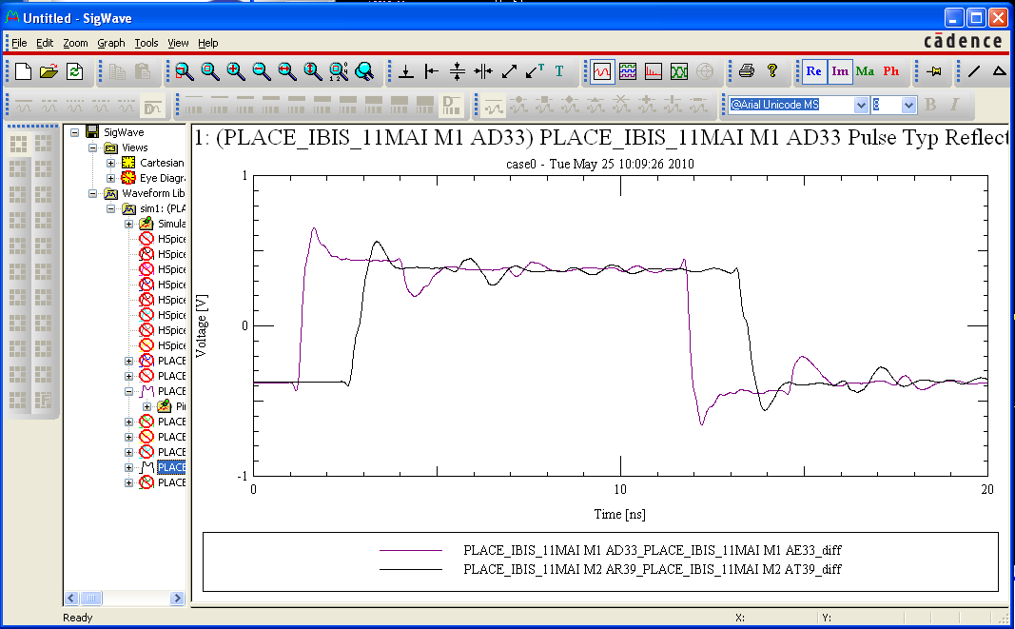

Slide 21
.options brief=0
.options badchr co=132 scale=1e-6 acct ingold=2 nomod dv=1.0
+ dcstep=1 absv=1e-3 absi=1e-8 probe accurate=1
+ converge=1
.temp 85
.param vcn=2.325
.param vpd=2.92
.param vc=1.12
.options brief
.inc '../../../hspice/lib/sii_tt.inc' * TT process corner
.include '../../../hspice/cir/lvds_output.inc'
.include '../../../hspice/cir/lvds_oct_load.inc'
.include '../../../hspice/cir/hio_buffer_load.inc'
.include '../../../hspice/lib/siigx_package_model.sp'
************************************************************************
* IO Buffer Netlist
************************************************************************
.include '../../../hspice/cir/lvds_input_load.inc'
*.include '../../../hspice/cir/hio_buffer_load.inc'
.include '../../../hspice/cir/lvds_oct_rd.inc'

Slide 22
Modélisation des pistes
subckt
Utilisation de W-élement pour modéliser les lignes de transmission couplées

Slide 23
\sigxp.run\case0\sim1
main_gen.spc
** Display all elements first
.subckt PLACE_IBIS_11MAI_icn_ckt 1 2 3 4
RPLACE_IBIS_11MAI.@@R1.1.2 5 6 1.000000e+002
WTLPLACE_IBIS_11MAI.XSTLX2207565Y2129485L1X2216968Y2120082L1 7 0 8 0 n=1
+ TABLEMODEL=stl_1s_1r_157 l=0.0013298
.include 'stl_1s_1r_157.rlc'
WTLPLACE_IBIS_11MAI.MTL_SX1854708_SY2482342_EX2216968_EY2120082_L1_P2 9 10 0 7
+ 11 0 n=2 TABLEMODEL=mtl_1s_6r_159 l=0.0491395
.include 'mtl_1s_6r_159.rlc’
…

Slide 24
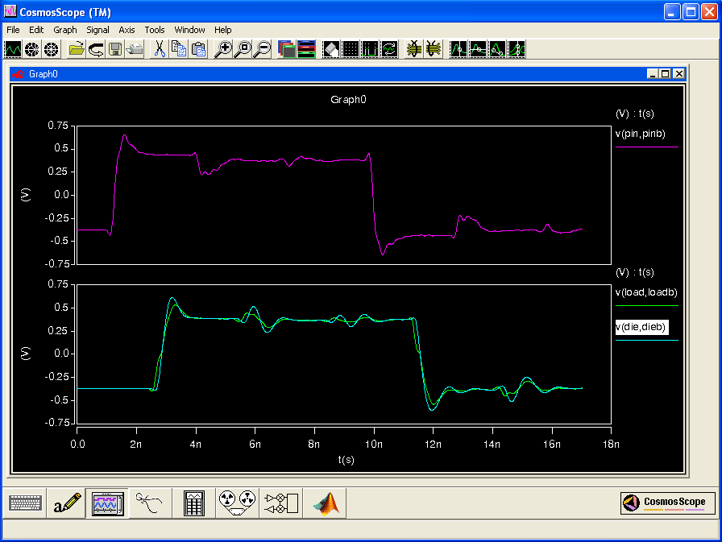

Slide 25
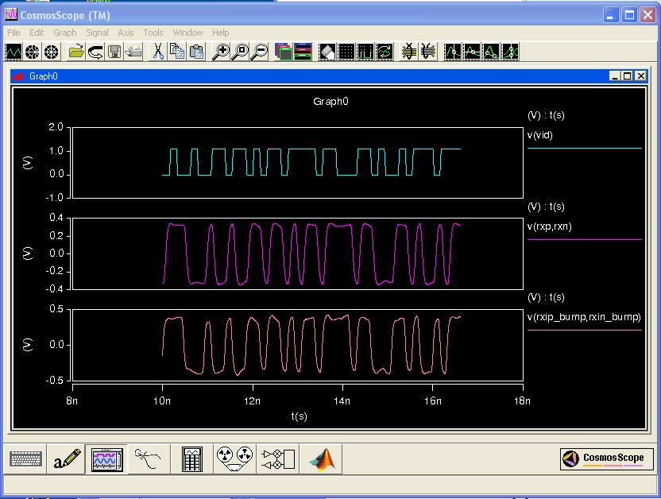
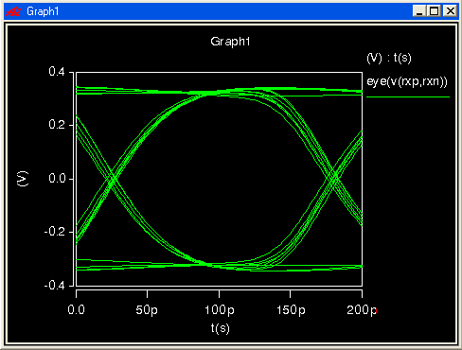
Simulation des liens optiques avec le KIT du site Altera

